Slide 1
Pixelated anode design induce charge simulations

Slide 2
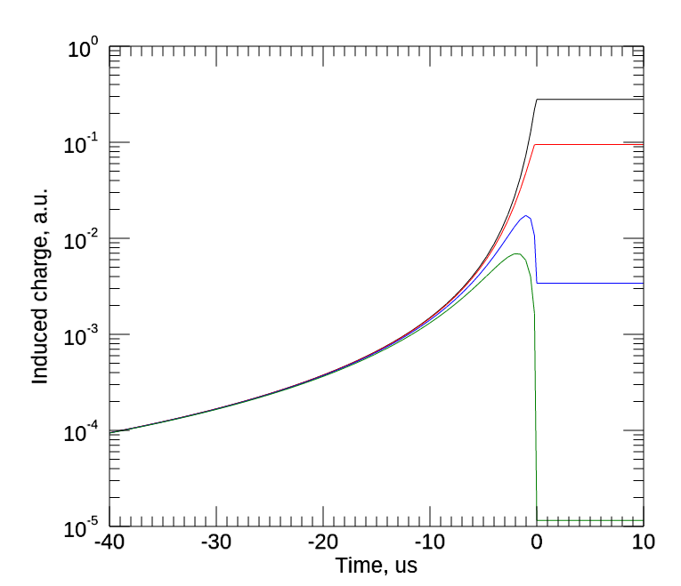
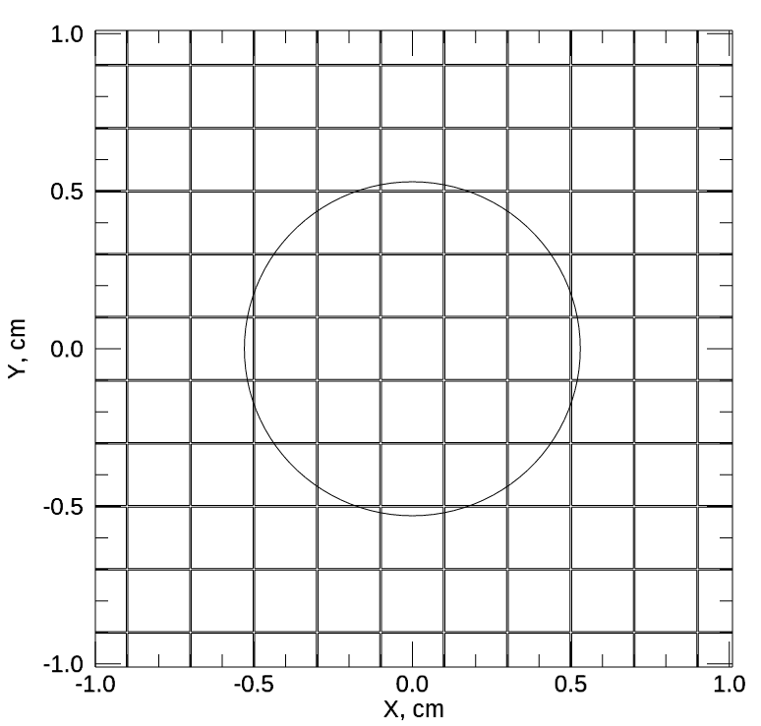
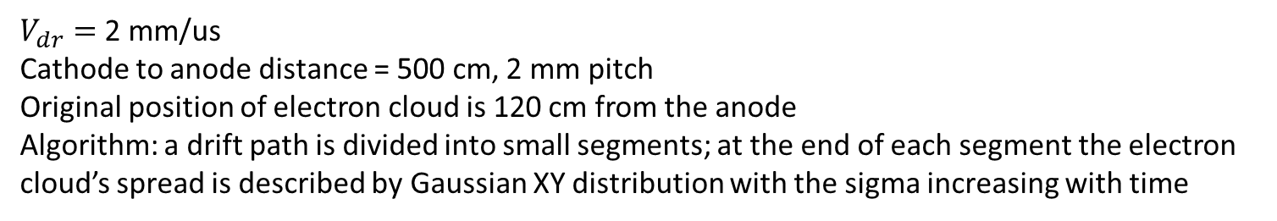
Induced charge vs. drift time, conventional pixel anode, 2 mm pitch, long drift like in DUNE
$V_{dr}=$2 mm/us
Cathode to anode distance = 500 cm, 2 mm pitch
Original position of electron cloud is 120 cm from the anode
Algorithm: a drift path is divided into small segments; at the end of each segment the electron cloud’s spread is described by Gaussian XY distribution with the sigma increasing with time
1
2
Charge sharing
Charge collected and induced signals
6 Sigma
3
1
2
3
4
4

Slide 3
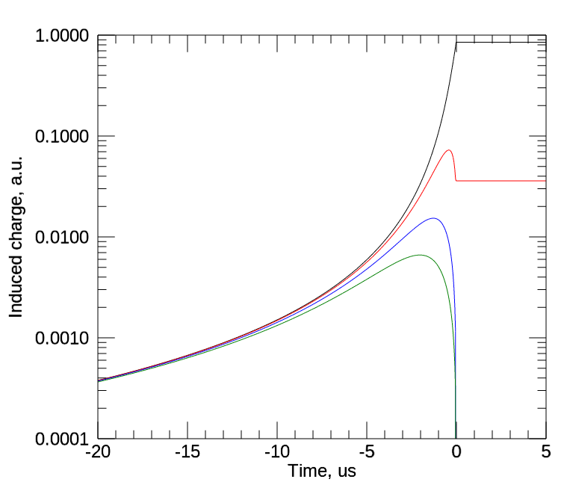
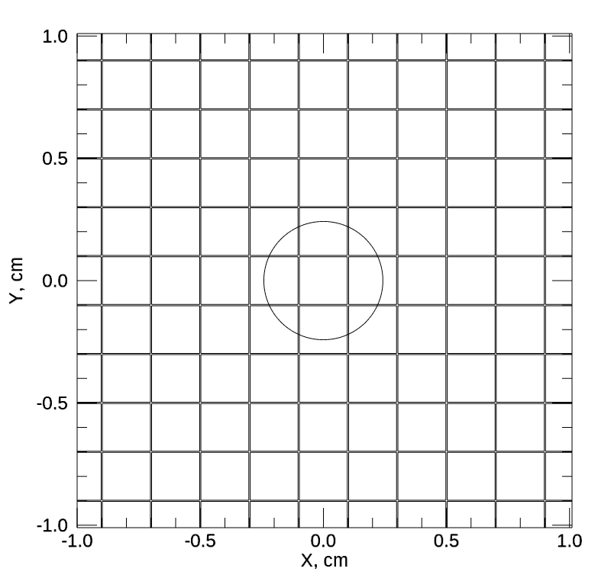
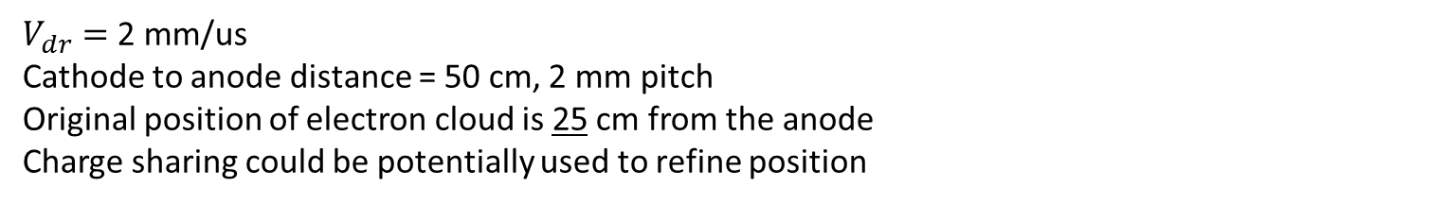
Induced charge vs. drift time, conventional pixel anode, 2 mm pitch
$V_{dr}=$2 mm/us
Cathode to anode distance = 50 cm, 2 mm pitch
Original position of electron cloud is 25 cm from the anode
Charge sharing could be potentially used to refine position
1
2
6 Sigma
3
1
2
3
4
4

Slide 4
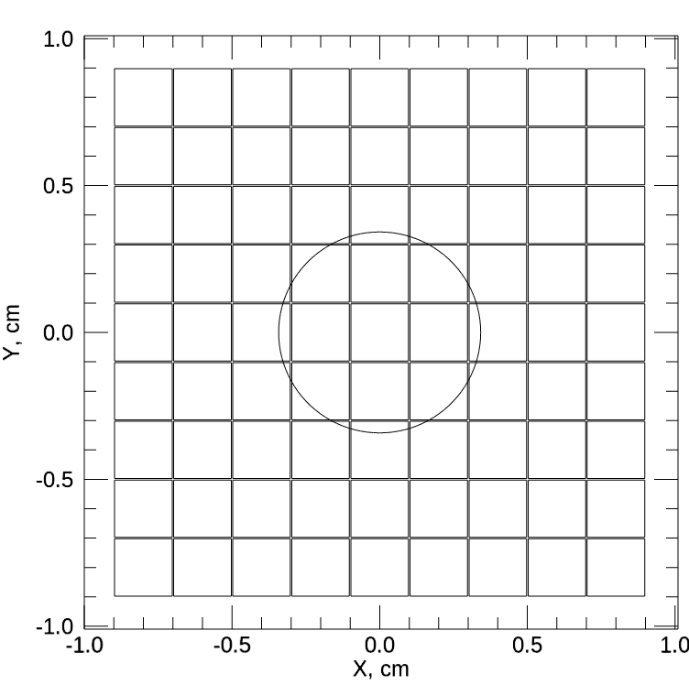
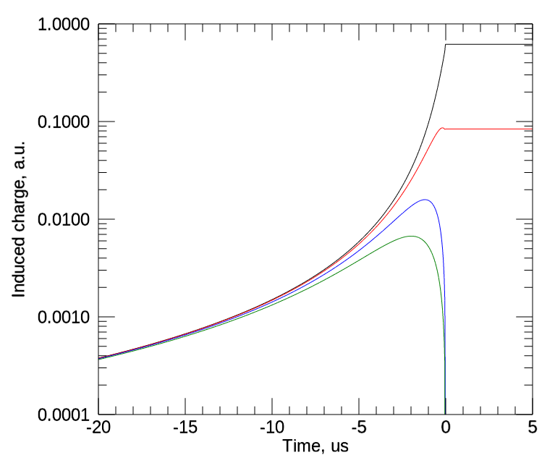
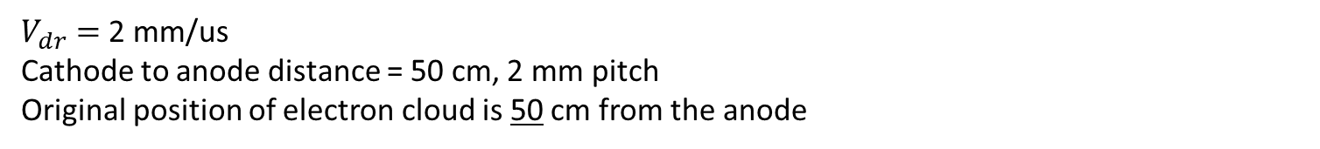
Induced charge vs. drift time, conventional pixel anode, 2 mm pitch
$V_{dr}=$2 mm/us
Cathode to anode distance = 50 cm, 2 mm pitch
Original position of electron cloud is 50 cm from the anode
1
2
6 Sigma
3
1
2
3
4
4

Slide 5
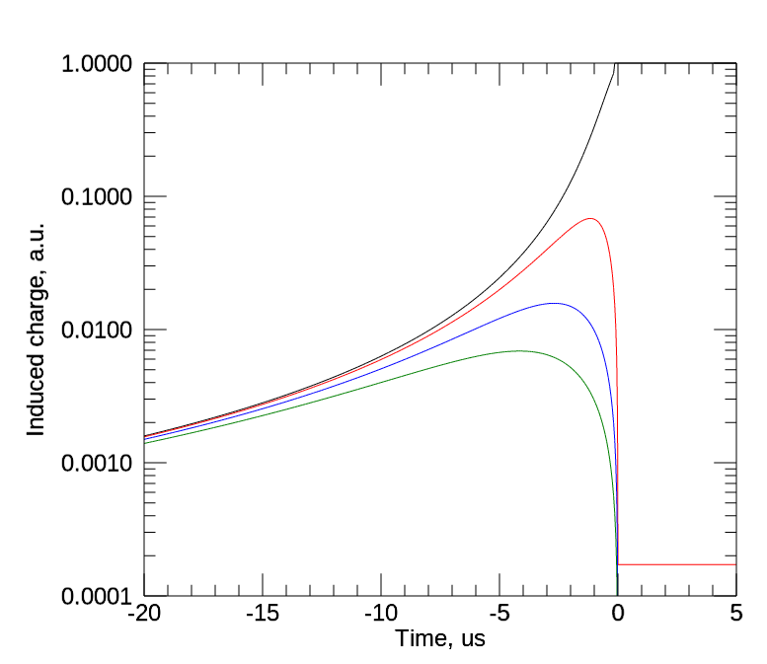
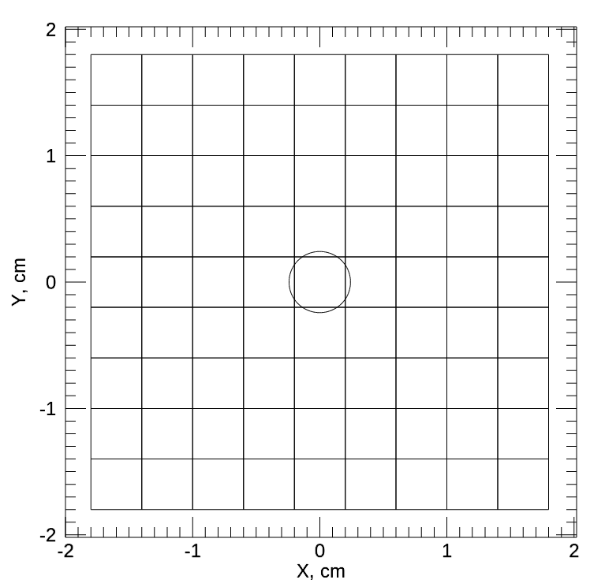
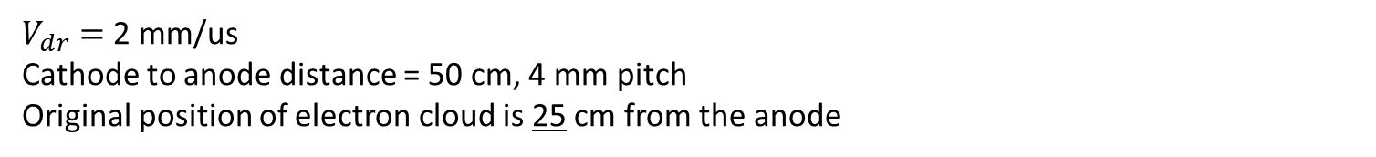
Induced charge vs. drift time, conventional pixel anode, 4 mm pitch
$V_{dr}=$2 mm/us
Cathode to anode distance = 50 cm, 4 mm pitch
Original position of electron cloud is 25 cm from the anode
1
2
6 Sigma
3
1
2
3
4
4

Slide 6
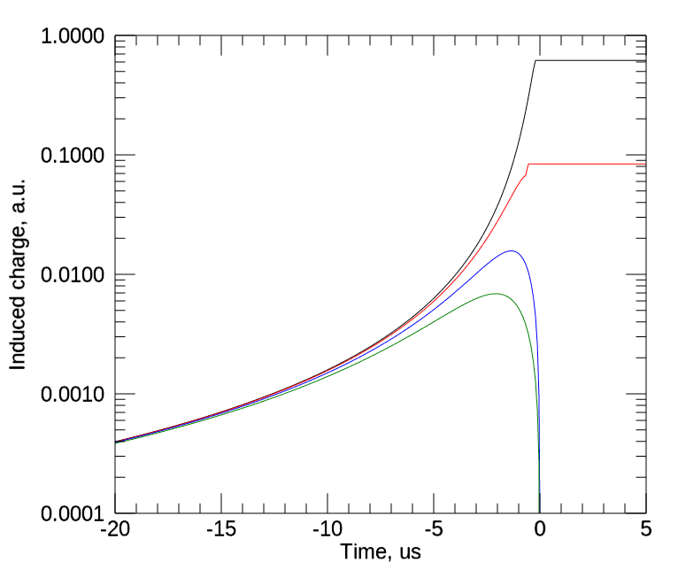
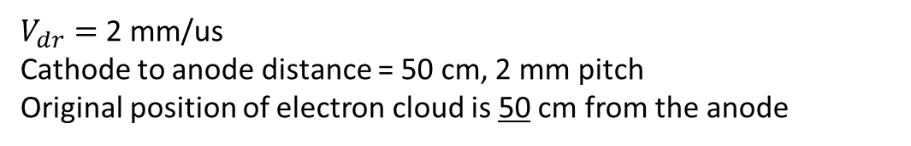
Comparison between the exact and simplified calculations transverse diffusion
$V_{dr}=$2 mm/us
Cathode to anode distance = 50 cm, 2 mm pitch
Original position of electron cloud is 50 cm from the anode
Exact calculation: A drift path is divided into small segments; at the end of each segment the electron cloud has a 2D Gaussian distribution with the sigma increased due to transverse diffusion (broadening)
Simplified calculation: The electron cloud broadening effect is included at the very end of the drift path (charge sharing at the anode)
1
2
3
4
Diffusion can be neglected when calculating the induced signal profiles
Signal amplitudes can be calculated based on the charge sharing at the anode

Slide 7

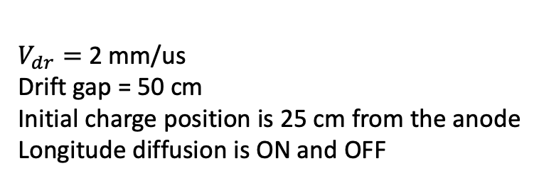
Comparison between induced charge dependence calculated with and without longitude diffusion, conventional pixel anode, 2 mm pitch
$V_{dr}=$2 mm/us
Drift gap = 50 cm
Initial charge position is 25 cm from the anode
Longitude diffusion is ON and OFF
Longitude diffusion can be neglected when calculating the signal profiles

Slide 8
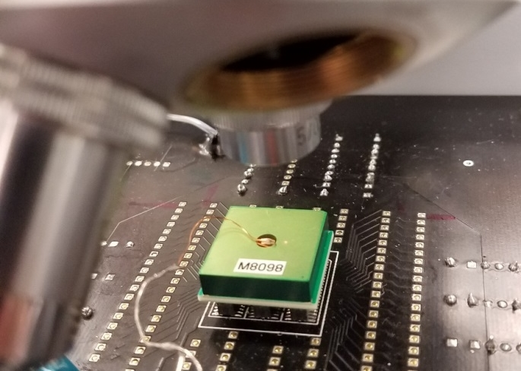
Using signals from neighboring pixels to get subpixel position resolution
15x15x5 mm3 CdZnTe pixel detector
Illuminated by a pulsed laser beam
Signal generated with fast laser pulses
Reconstructed positions of the laser beam during a “Cross” scan over 1.7x17 mm2 area with 250 keV (5x10⁴ electrons) and 1 MeV (~2x10⁵ electrons) pulses
Pixel size 1.7x1.7 mm2
Simulated amplitudes from neighboring pixels
250 um
50 um
Use synchronized samples

Slide 9
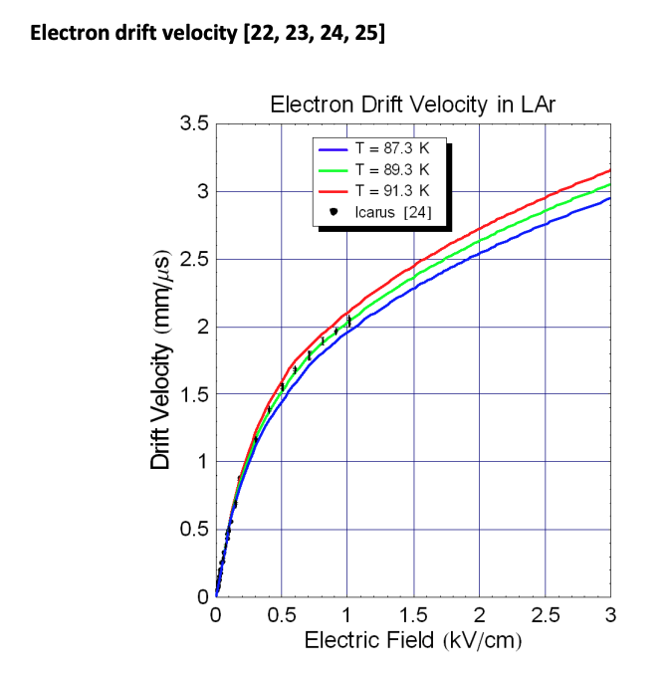
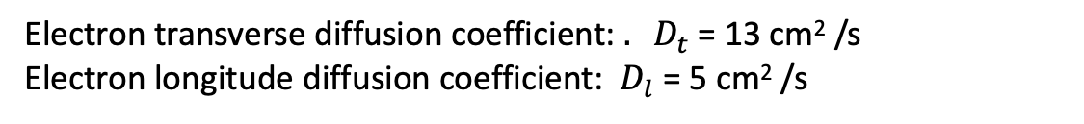
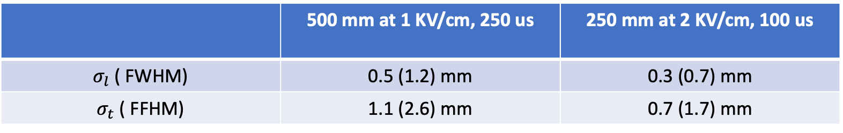
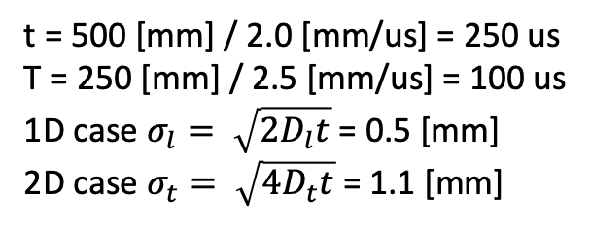
Drift velocity and diffusion
Electron transverse diffusion coefficient: ${. D}_{t}$ = 13 cm² /s
Electron longitude diffusion coefficient: $D_{l}$ = 5 cm² /s
t = 500 [mm] / 2.0 [mm/us] = 250 us
T = 250 [mm] / 2.5 [mm/us] = 100 us
1D case $σ_{l}= \sqrt{{2D}_{l}t}$ = 0.5 [mm]
2D case $σ_{t}= \sqrt{{4D}_{t}t}$ = 1.1 [mm]
 | 500 mm at 1 KV/cm, 250 us | 250 mm at 2 KV/cm, 100 us
$σ_{l}$ ( FWHM) | 0.5 (1.2) mm | 0.3 (0.7) mm
$σ_{t}$ ( FFHM) | 1.1 (2.6) mm | 0.7 (1.7) mm

Slide 10
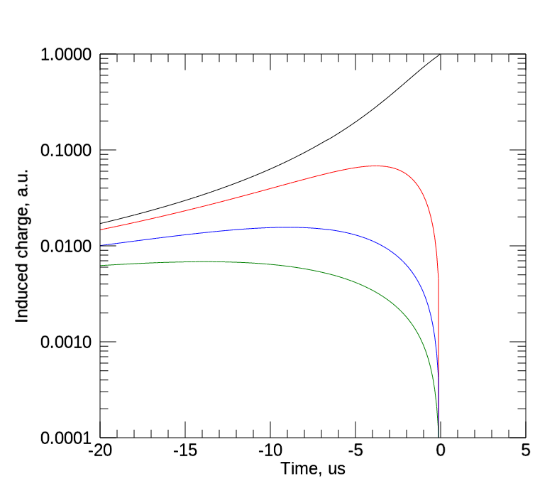
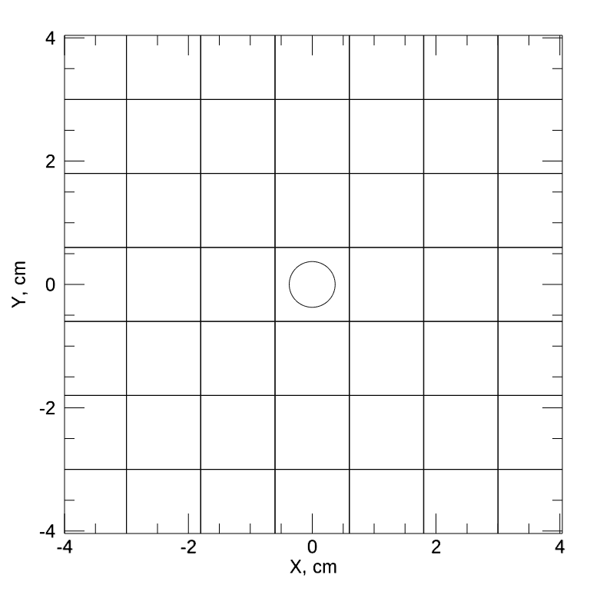
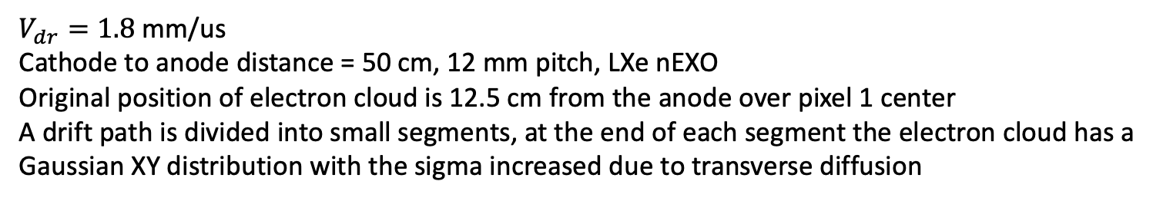
Induced charge vs. drift time, conventional pixel anode, 12 mm pitch, LXe
$V_{dr}=1.8$ mm/us
Cathode to anode distance = 50 cm, 12 mm pitch, LXe nEXO
Original position of electron cloud is 12.5 cm from the anode over pixel 1 center
A drift path is divided into small segments, at the end of each segment the electron cloud has a Gaussian XY distribution with the sigma increased due to transverse diffusion
1
2
6 Sigma
3
1
2
3
4
4

Slide 11
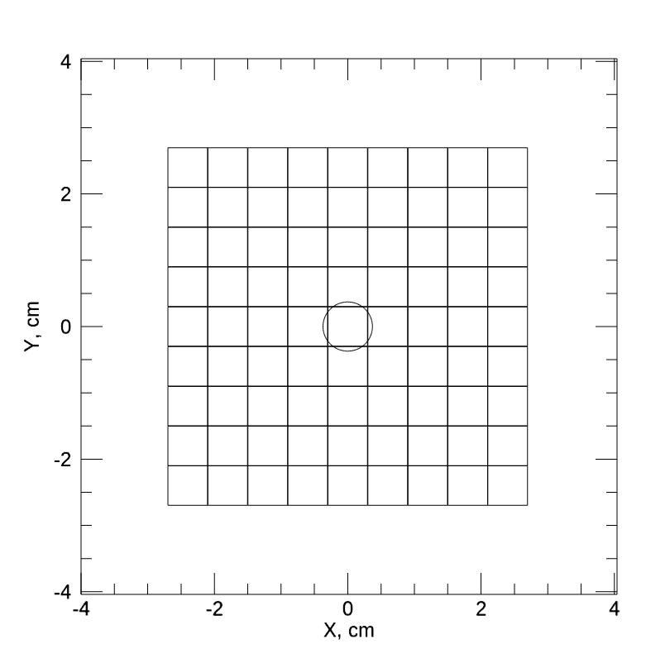
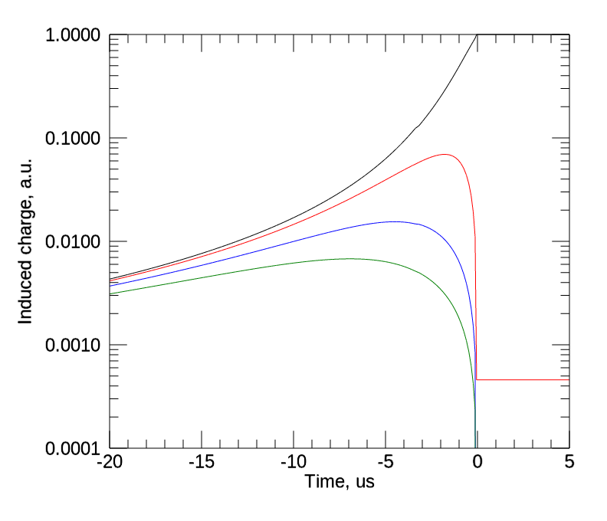
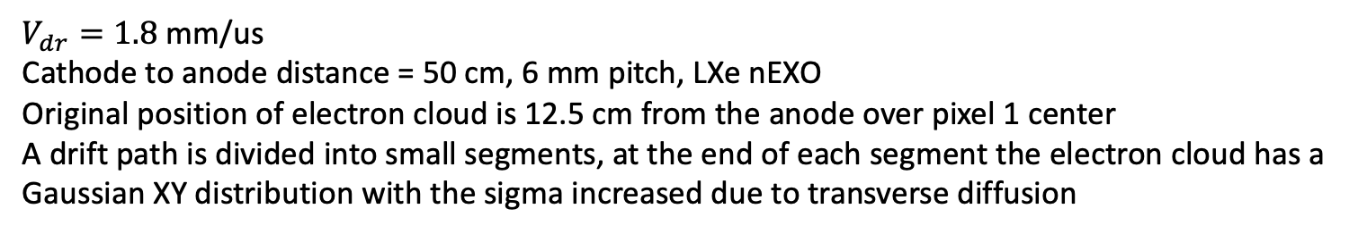
Induced charge vs. drift time, conventional pixel anode, 6 mm pitch, LXe
$V_{dr}=1.8$ mm/us
Cathode to anode distance = 50 cm, 6 mm pitch, LXe nEXO
Original position of electron cloud is 12.5 cm from the anode over pixel 1 center
A drift path is divided into small segments, at the end of each segment the electron cloud has a Gaussian XY distribution with the sigma increased due to transverse diffusion
1
2
6 Sigma
3
1
2
3
4
4

