Slide 1
Projeto Temático
2020/04867-2
V Reunião Geral - 22/02/2023
Working Group - 1
Marcelo Gameiro Munhoz
Instituto de Física
Universidade de São Paulo

Slide 2
Objetivos do Working Group 1
Strong Sector of the Standard Model
ALICE data analysis and detector upgrade
Experimental Study of the Quark-Gluon Plasma Properties
  Strangeness Production in Relativistic Heavy Ion Collisions
  Quark-Gluon Plasma Tomography with Hard Probes
The ALICE Experiment Upgrade
  ALICE-TPC Aging Studies
  ALICE Forward Calorimeter
  ALICE 3

Slide 3
Resultados Esperados
Análises realizadas (com notas e participação nos comitês de elaboração de artigos)
Apresentações em conferências representando as colaborações
Posições de liderança dentro das colaborações
Artigos fenomenológicos interpretando os dados

Slide 4
Cronograma WG-1
Activity | 1st Y | 2nd Y | 3rd Y | 4th Y | 5th Y
1. Experimental Study of the Quark-Gluon Plasma Properties
Strangeness Enhancement (Run 2 data) | X | X | X
Strangeness Enhancement (Run 3 data) |  | X | X | X | X
Heavy Quark Jet Inclusive Measurements (Run 2 data) | X | X
Heavy Quark Production Precision Measurements (Run 3 data) |  |  | X | X | X
Heavy Quark Jet Shape Studies (Run 3 data) |  |  | X | X | X
7. ALICE Upgrade Activities
Construction of a degradation chamber | X
Development of DRS as a tool for the ALICE TPC diagnostics |  | X | X | X
Studies of gaseous chemical reactions and outgassing |  |  | X | X | X
Studies of the HGCROC performance | X
Contribution to the design of PAD readout; validation of prototypes; TDR | X | X | X
Production and test of PAD readout front-end electronics |  |  | X | X
Contribution to FoCal construction |  |  |  | X | X

Slide 5
Resultados

Slide 6
Strangeness Production in Relativistic Heavy Ion Collisions
Reconstrução de hipernúcleos usando redes neurais no Alice
  Início da análise por Maria Paula Palhares (IFUSP) - estágio de 2 anos no CERN

Slide 7
Quark-Gluon Plasma Tomography with Hard Probes
Heavy quark jet inclusive measurements (Run 2)
  J/Ψ jet fragmentation function:
    Fase final da tese de Fábio Canedo (IFUSP)
    Apresentação da Cristiane Jahnke
  Identificação e tagging de jatos através de algoritmos de deep learning para imagens em colisões ultra-relativísticas
    Início da análise por Jhoão Gabriel (IFUSP)

Slide 8
Quark-Gluon Plasma Tomography with Hard Probes
Heavy quark jet inclusive measurements (Run 2)
  Subestrutura de jatos de quarks pesados usando elétrons como tagging
    Leonardo Barreto (IFUSP)
    Participará da finalização da análise dos dados do Run 2 durante estágio em Munster-Alemanha
    Visa apresentação na conferência Hard Probes no Japão em setembro e publicação de artigodo ALICE até o final do ano

Slide 9
Quark-Gluon Plasma Tomography with Hard Probes
Heavy quark jet inclusive measurements
  Estudo fenomenológico dos modelos JEWEL+vUSPhydro: Fabio Canedo, Leonardo Barreto e Monalisa Melo (IFUSP)
    Dissertação de mestrado da Monalisa defendida em outubro
    Um artigo submetido e outro em preparação
    Apresentação submetida para o SQM2024 em junho por Leonardo Barreto

Slide 10
ALICE-TPC Aging Studies
Construction of a degradation chamber (Ano 1)
Development of DRS as a tool for the ALICE TPC diagnostics
  Tiago Silva (IFUSP)
  Relato na apresentação do WG-5.1

Slide 11
ALICE Forward Calorimeter
Studies of the HGCROC performance (Ano 1)
Contribution to the design of PAD readout; validation of prototypes; TDR
  Marco Bregant (IFUSP), Cristiano Krug (UFRGS), Mauro Cosentino (UFABC) e Beatriz Gay (UFRGS)

Slide 12
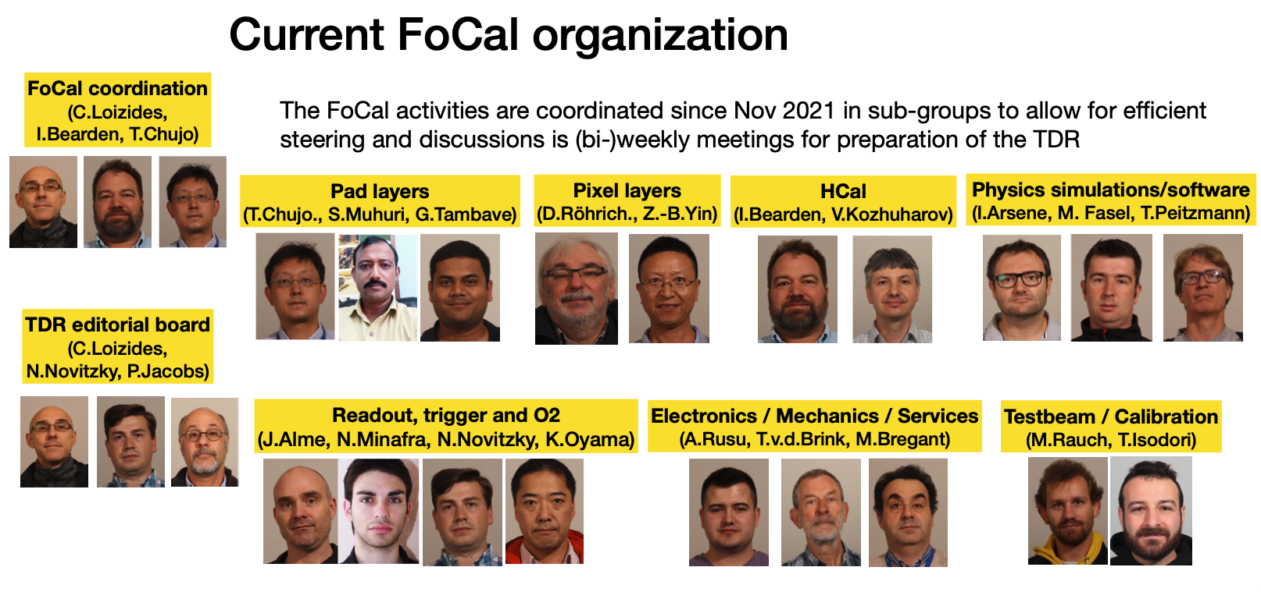
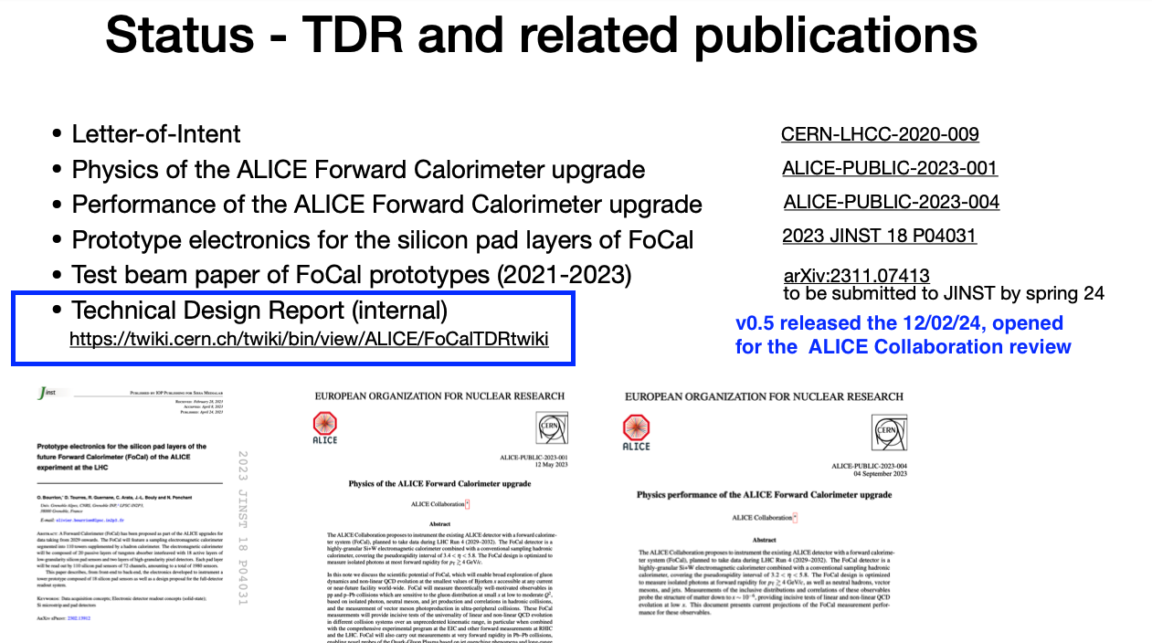
The Brazilian groups involved in several aspects of the FoCal project:
management
integration
Pad readout electronic studies
Physics simulations
next slides
TDR was an hectic activity in the last six months!
A researcher of the Temático was in charge of the “Integration” chapter redaction.

Slide 13
HGCROC caracterization (and configuration) studies
mainly C. Krug & students

Slide 14

FoCal heavy meson identification capabilities
Paulo Fetter Master’s work

Slide 15
ALICE 3
Detector configuration studies
  Dissertação de mestrado de Levi Stahl (IFUSP)
  Contribuição para a otimização sistema ToF do detetor ALICE3

Slide 16

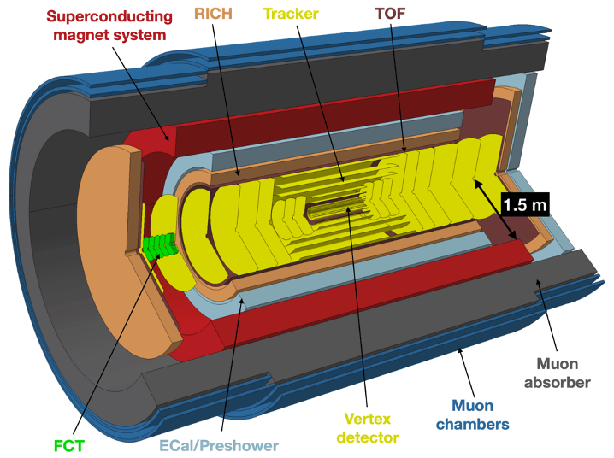
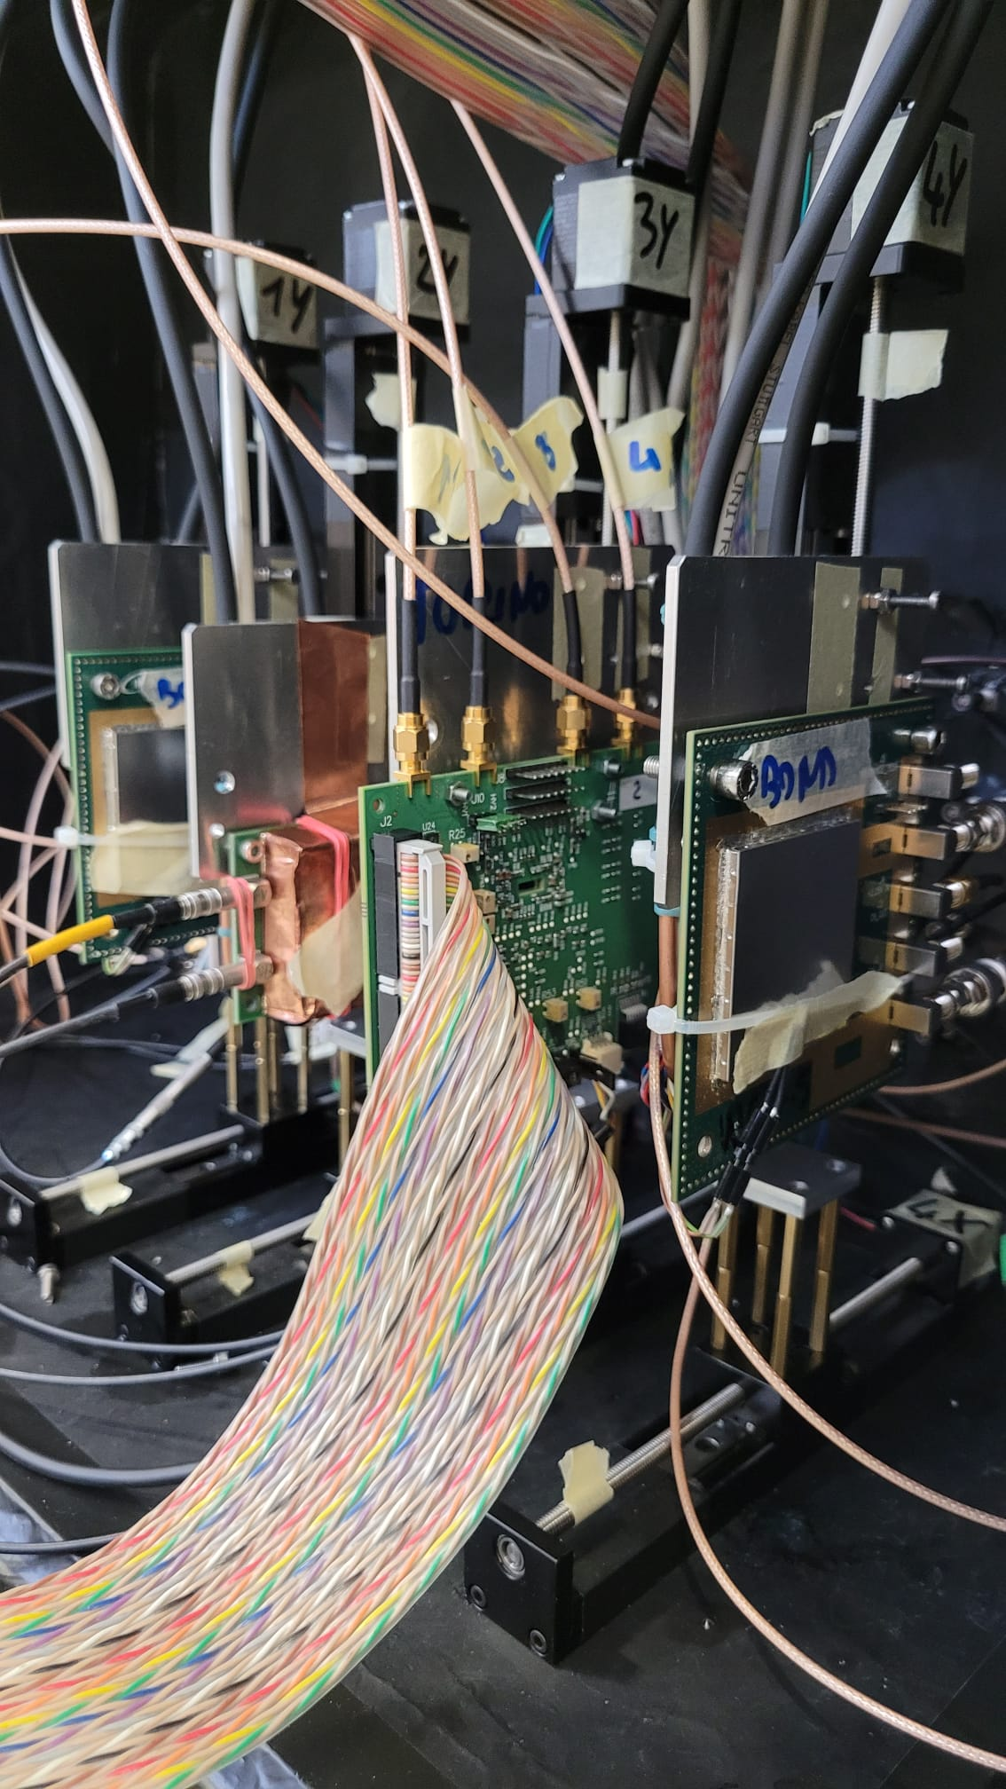
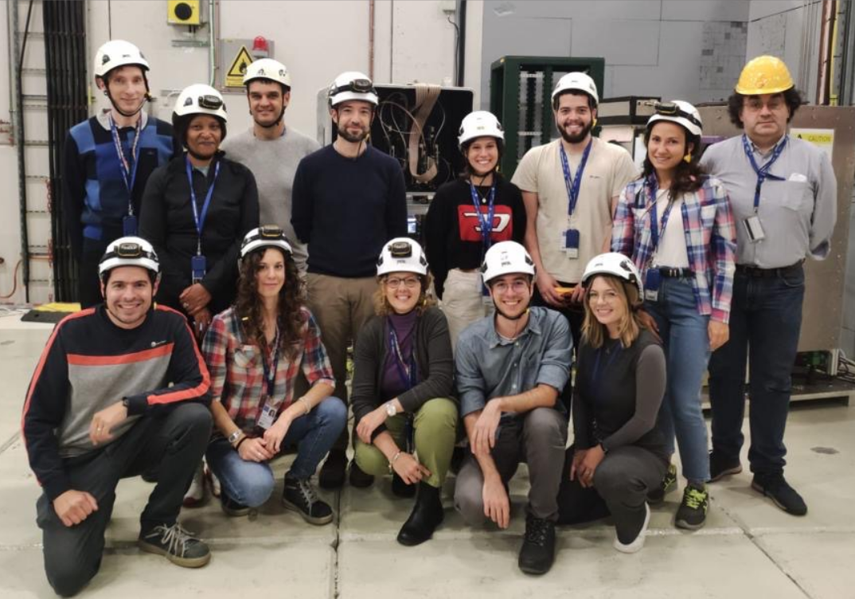
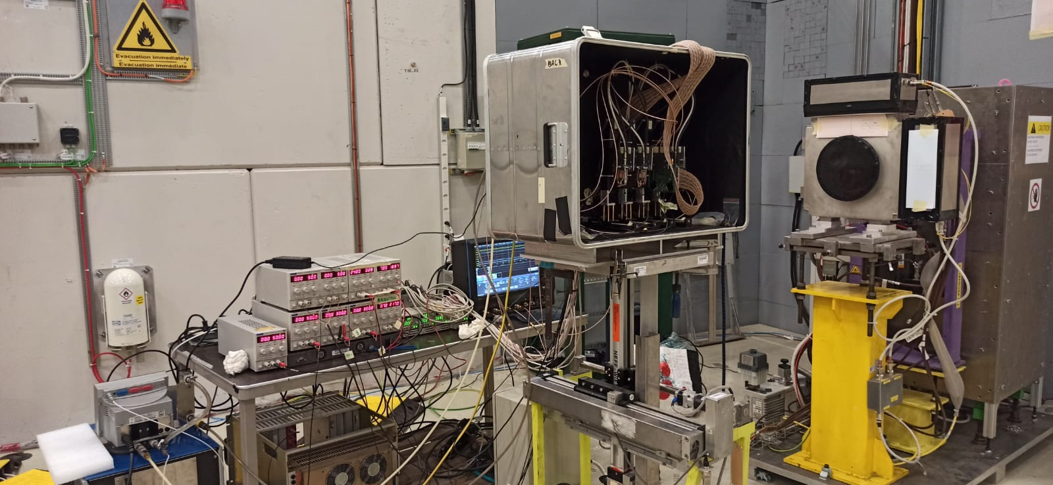
The HEPIC in the ALICE 3 TOF collaboration
Participation on the 10/2023 test beam
Measurements of time resolution at CERN’s PS (proton synchrotron) - 10 GeV/c
Results under analysis - paper on the way
ALICE 3 experiment layout. (Image: CERN)
MadPix - Monolithic CMOS Avalanche Detector PIXelated Prototype for ps Timing Application
First prototype with integrated electronics (LFoundry 110 nm) and sensor gain
Active thickness: 48µm
_{Collaboration Meeting}
G. Souza ₂₀₂₄

Slide 17
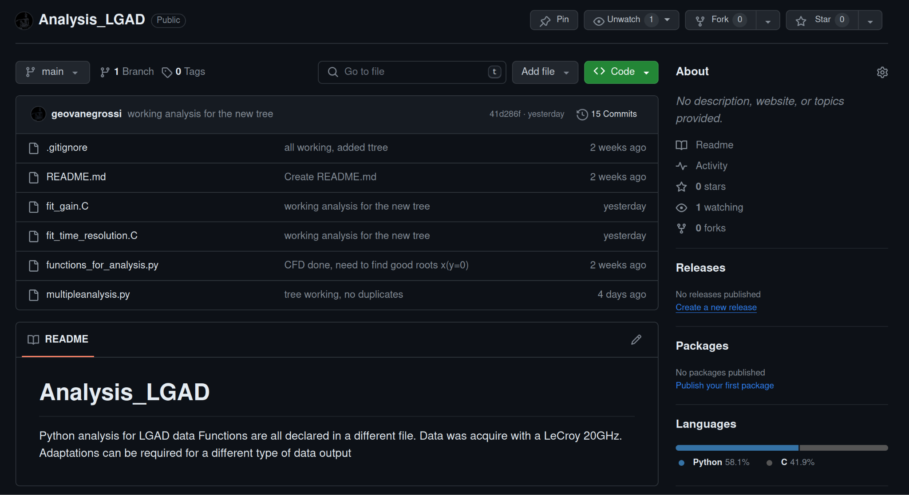
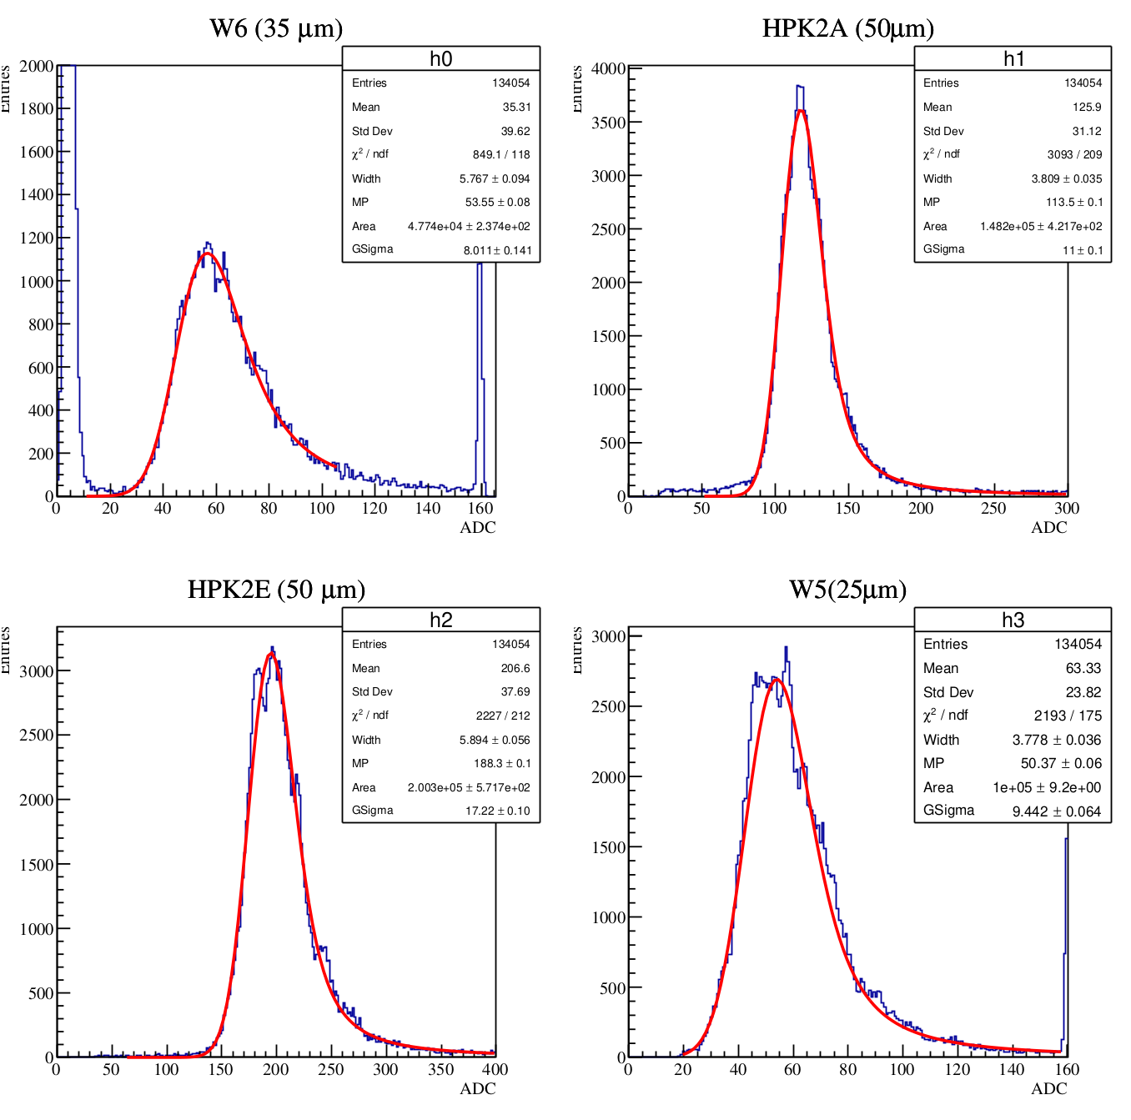
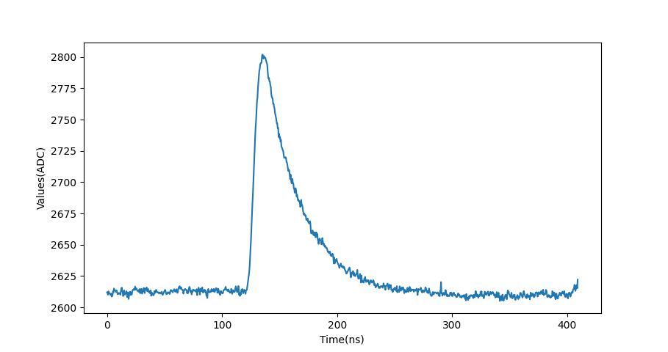
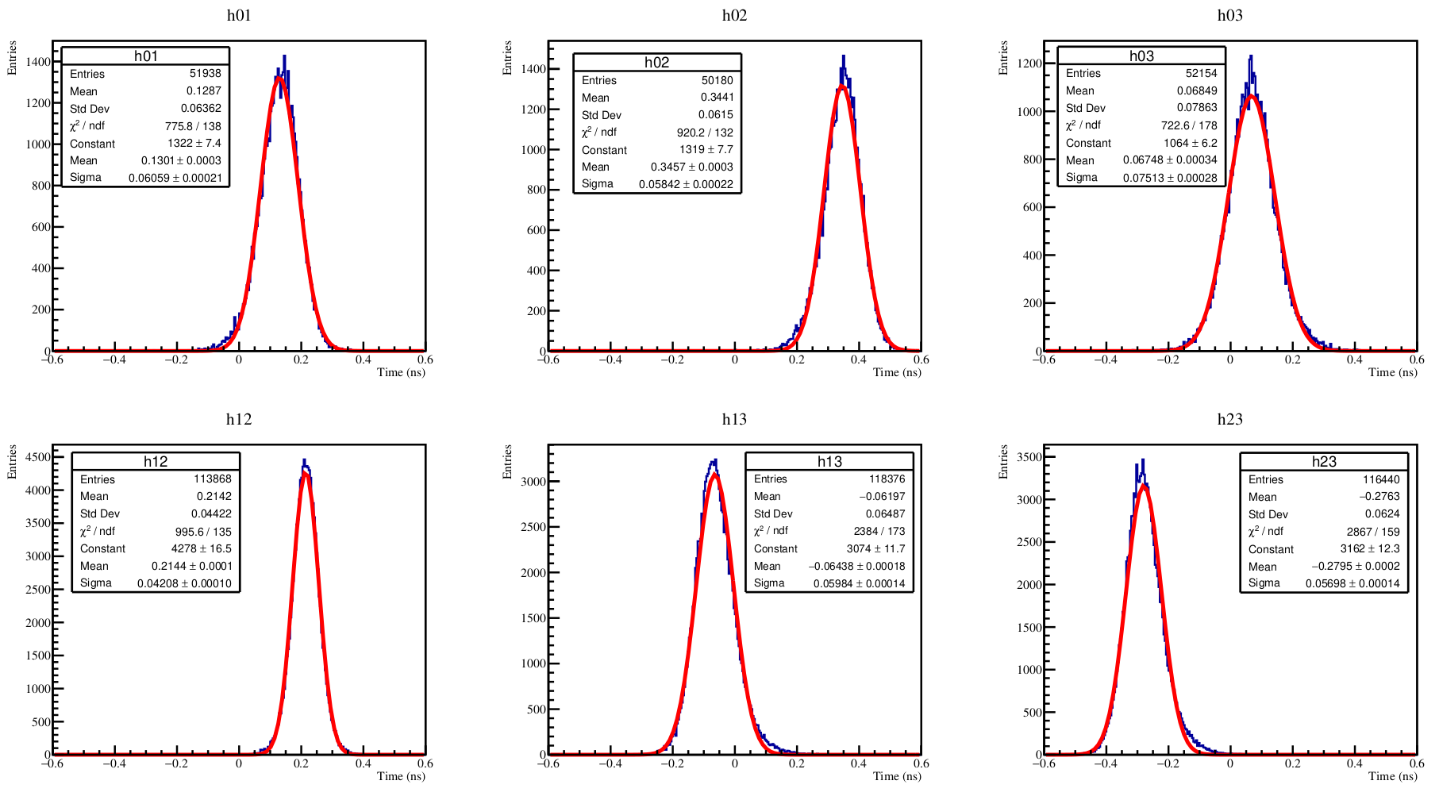
Other contributions: New analysis tools based on PyROOT
You will find:
Also new digitizer decoder:
Decoder for the new digitizer that will be used in the next TB - 07/2024 ~ 10/2024
Integrated with the old analysis tool
Energy spectrum and gain/MPV calculations macro
Available at: ALICE3 TOF gitlab repository
CFD/Time difference calculation and time resolution
_{Collaboration Meeting}
G. Souza ₂₀₂₄

