Slide 1
EFEITOS DA RADIAÇÃO IONIZANTE EM DISPOSITIVOS E COMPONENTES ELETRÔNICOS
High Energy Physics and Instrumentation with the LHC-CERN
Física e Instrumentação de Altas Energias com o LHC-CERN
Centro Universitário FEI, São Bernardo do Campo, Brasil

Slide 2

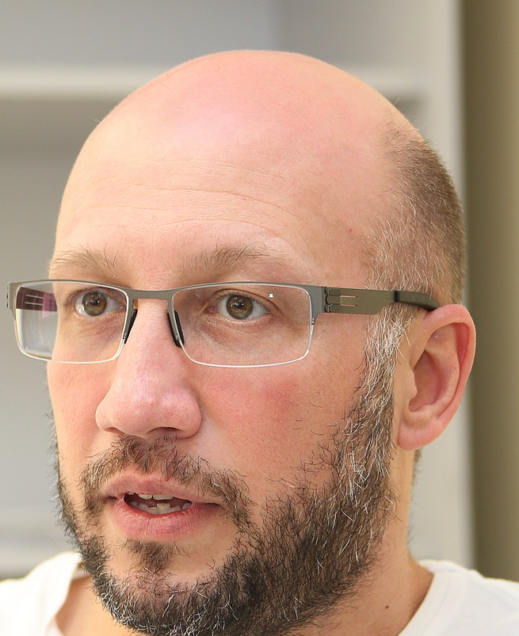
COLLABORATION TO SEARCH A SOLUTION
Knowledge
Creativity
Multidisciplinary
…..AND ALSO A LOT OF EFFORT

Slide 3
Objetivos específicos relacionados ao Estudo dos Efeitos da Radiação Ionizante em Dispositivos Eletrônicos
Compreender
os mecanismos físicos decorrentes da interação da radiação ionizante com os diferentes materiais, tecnologias e dispositivos eletrônicos
o comportamento de dispositivos / circuitos / sistemas eletrônicos em ambientes radioativos, por meio de testes EM LABORATÓRIO E SIMULAÇÕES.
Analisar
os diferentes dispositivos eletrônicos, caracterizando e testando através de uma plataforma específica – detectores de radiação.
os diferentes materiais que compõem os dispositivos.
Raio X
⁶⁰Co
Neutrons, prótons
Íons pesados, Laser

Slide 4
Total Ionizing Dose is a cumulative effect caused by trapped charges in the oxide. These trapped charges modify the transistor characteristics such as threshold voltage (V_{th}), mobility, leakage current, power dissipation, etc.
Atom Displacement Damage is provoked by protons, heavy ions, electron with high energy and neutrons, which change the arrangement of atoms in the lattice, modifying electrical properties of a device.
Single Event Effects are caused by particles of high LET (Linear Energy Transfer) due to, for example, the strike of a single ion. They can be non-destructive, causing current or voltage peaks, changing the state of a bit, or destructive, burning the device or destroying the gate oxide in a MOSFET.

Slide 5














INTEGRAÇÃO ENTRE PESQUISADORES DE INSTITUIÇÕES BRASILEIRAS E INTERNACIONAIS, COOPERAÇÃO INTERDISCIPLINAR
Capacitação de RH em Projeto e Qualificação de CIs Tolerantes à Radiação
Capacitação de Recursos Humanos e Criação de Infraestrutura para
Projeto, Teste e Qualificação de CIs Tolerantes à Radiação.
Temáticos FAPESP: Centro de Pesquisa e Análise de São Paulo; Física e Instrumentação de Altas Energias com o LHC-CERN; Reações nucleares com núcleos fracamente ligados ou com estrutura de cluster, radioativos e estáveis.
COLABORADORES INTERNACIONAIS
Nuclear matrix elements for neutrinoless double beta decay

Slide 6
High Energy Physics and Instrumentation with the LHC-CERN
Física e Instrumentação de Altas Energias com o LHC-CERN
Escola de Engenharia/EE/UFRGS | Brasil - Rio Grande do Sul - Porto Alegre
Escola Politécnica/EP/USP | Brasil - São Paulo - São Paulo
Instituto de Ciência e Tecnologia de Sorocaba/ICTS/UNESP | Brasil - São Paulo - Sorocaba
Instituto de Física Gleb Wataghin/IFGW/UNICAMP | Brasil - São Paulo - Campinas
Instituto de Física Armando Dias Tavares/IF/UERJ | Brasil - Rio de Janeiro - Rio de Janeiro
Câmpus Experimental de São João da Boa Vista/CESJBV/UNESP | Brasil - São Paulo - São João da Boa Vista
Escola de Engenharia/EE/UFMG | Brasil - Minas Gerais - Belo Horizonte
Instituto de Física/IF/UFRGS | Brasil - Rio Grande do Sul - Porto Alegre
Instituto de Física/IF/UFRJ | Brasil - Rio de Janeiro - Rio de Janeiro
Centro de Ciências Naturais e Humanas/CCNH/UFABC | Brasil - São Paulo - Santo André
Universidade Federal do Pampa/UNIPAMPA | Brasil - Rio Grande do Sul - Bagé
Instituto de Pesquisas Energéticas e Nucleares/IPEN/SDE | Brasil - São Paulo - São Paulo
Centro Universitário FEI | Brasil - São Paulo - São Bernardo do Campo
Czech Technical University in Prague/CTU | República Tcheca - Praga

Slide 7
GRUPO DE TRABALHO 5
Centro Universitário FEI
MARCILEI A. GUAZZELLI
ROBERTO S. S. BAGINSKI
RENATO GIACOMINI
RUDOLF THEODERICH BÜHLER
MARCO ANTONIO ASSIS DE MELO
ALEXIS CRISTIANO VILAS BÔAS
GUILHERME PARREIRA GOMES
Ana Laura Guidi
Paulo Garcia Junior
Isabel
Beatriz
NOVOS COLABORADORES SURGEM COM A DEMANDA

Slide 8
INFRAESTRUTURA
FEI
LABORATÓRIO DE EFEITOS DA RADIAÇÃO IONIZANTE – LERI
  RAIOS-X COM CALIBRAÇÃO EM DOSE
  DIFRATÔMETRO DE RAOS X
  PLATAFORMA DE CARACTERIZAÇÃO ELÉTRICA PXI NATIONAL
LABORATÓRIO DE FÍSICA DAS RADIAÇÕES – LAFIR
  ESPECTROMETRIA GAMA E FLUORESCÊNCIA DE RAIO X POR DISPERSÃO EM ENERGIA
LABORATÓRIO DE SIMULAÇÃO DE DISPOSITIVOS ELETRÔNICOS - TCAD
PROBE STATION
CARACTERIZAÇÃO SOB EFEITO DE BAIXA E ALTA TEMPERATURA
MICROSCÓPIO DE FORÇA ATÔMICA E MICROSCÓPIO ELETRÔNICO DE VARREDURA
LABORATÓRIO DE MATERIAIS E MECÂNICA – METALOGRAFIA

Slide 9
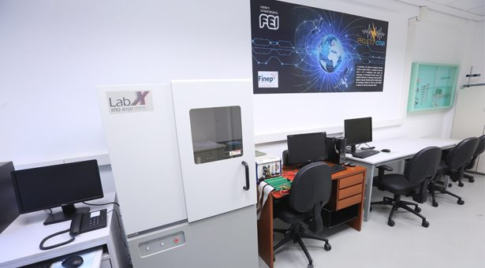
LERI
LERI – LABORATÓRIO DE EFEITOS DA
RADIAÇÃO IONIZANTE
X-ray source
60 kV, 50 mA

Slide 10
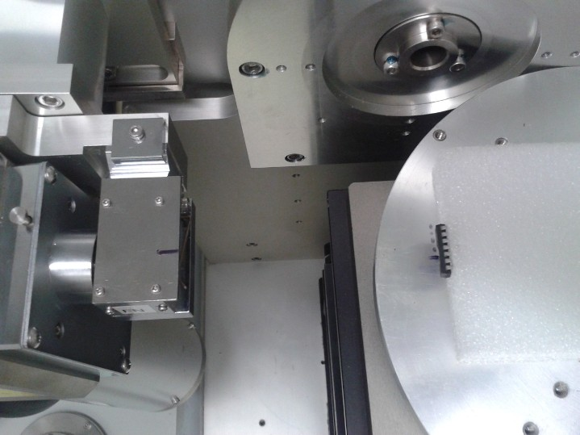
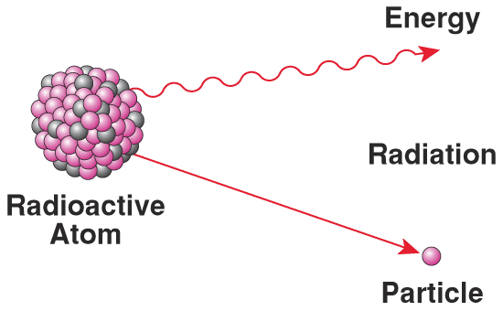
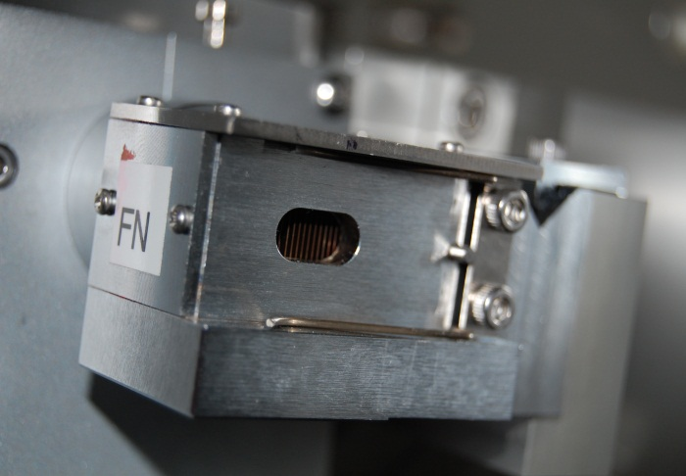
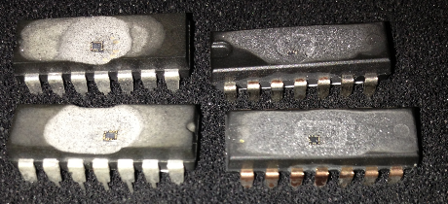
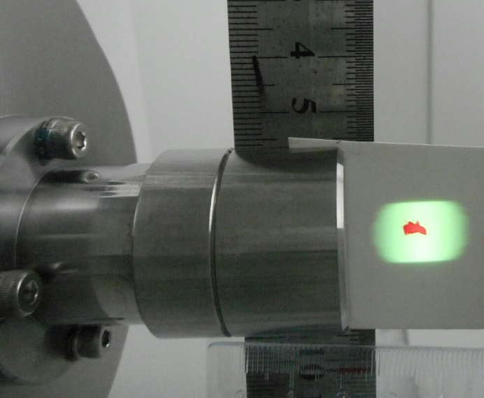
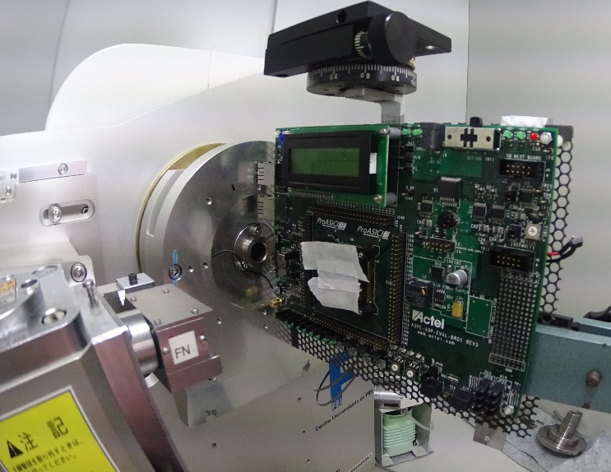
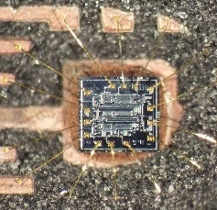
X-RAY SOURCE FACILITY
EXPERIMENTAL SETUP
We have performed several tests on different devices, exposed to different dose rates and total ionization doses.
The total ionizing dose of radiation accumulated in the device is a function of the exposure time.
DIE preparation
Homogeneity of the radiation field

Slide 11
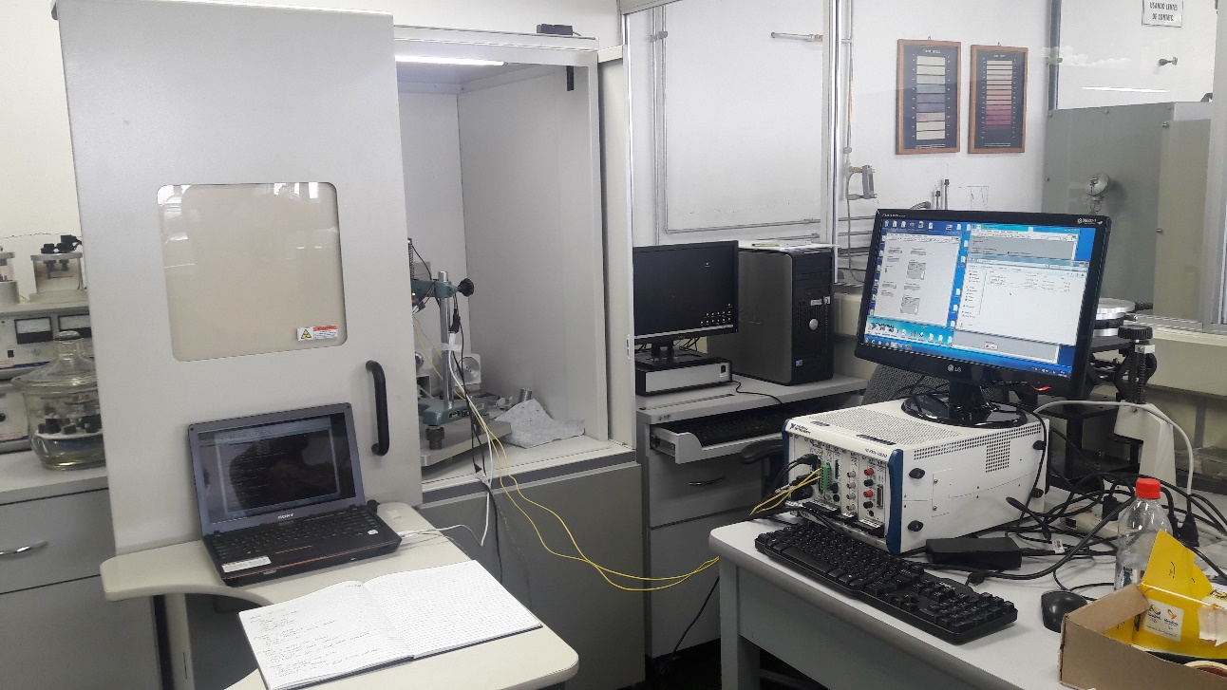
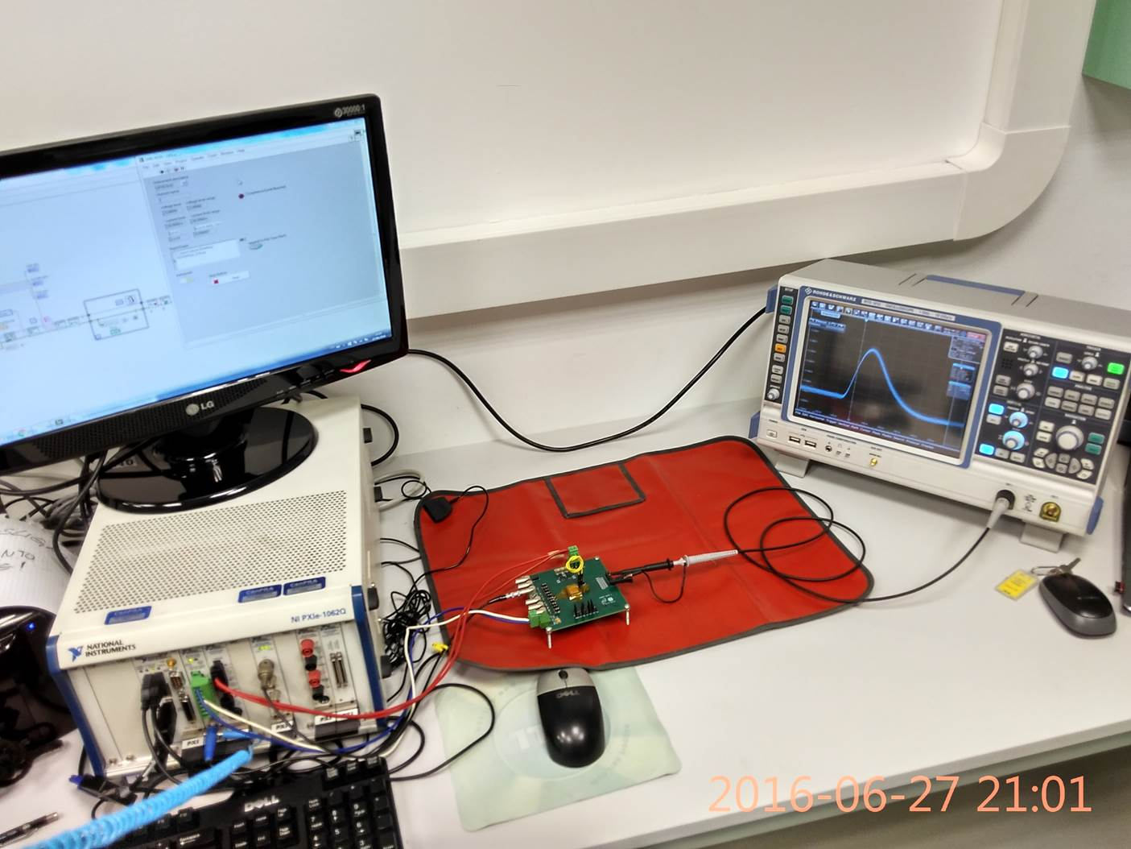
X-RAY SETUP
manipulador:
https://youtu.be/e90mlBE-n0c
medição de distância: https://youtu.be/WdfVwfKudqk
The sample support holds the electronic component or circuit board to be irradiated
https://youtu.be/qtmuD0lV2Ag

Slide 12
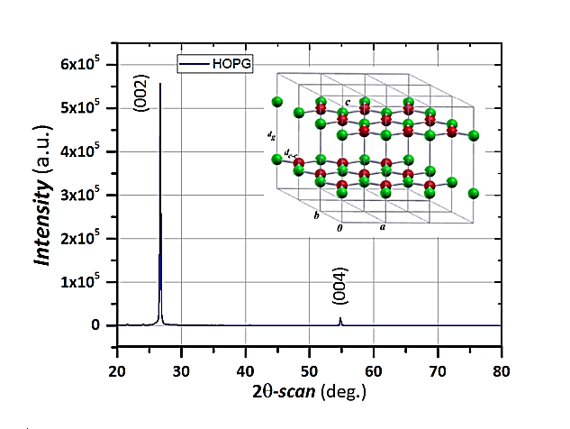
MEMECHANICAL AND THERMAL PROPERTIES THAT CAN MODIFY
A DEVICE'S FUNCTIONALITYCHANICAL and thermal properties hat X-ray θ-2θ Diffraction
crystallographic perfection
HOPG not irradiated and irradiated with nêutrons
Highly Ordered Pyrolytic Graphite
HOPG is a stacking of graphene sheets with a sligth disorientation between each other
For the HOPG to act with thermal energy dissipation functionality IT IS NECESSARY TO VERIFY WHETHER POSSIBLE CHANGES CAUSED BY EXPOSURE TO THE RADIATION BEAM HAVE A DIRECT OR INDIRECT INFLUENCE ON ITS THERMAL PROPERTIES.
θ−2θ scan (deg)
High degree of purity and high ordering of the atoms in the HOPG crystal lattice
0.25% concentration of defects in graphene result in significant reduction of termal conduction property of graphene by around 50%”

Slide 13
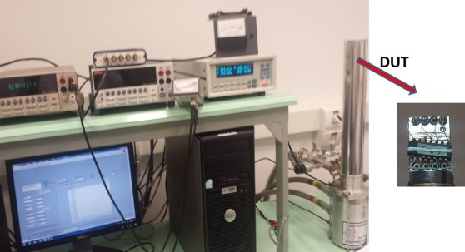
Characterization of devices under the influence of temperature before and after radiation.
ARS-2HW closed cycle cryocooler, equipped with a Lakeshore temperature controller.
Helium compressor and the refrigerator allow temperatures from -50 ⁰C to 70 ⁰C.

Slide 14
Laboratório de Microeletrônica
INFRAESTRUTURA:
  1x Keysight Semiconductor Characterization System B1500A;
  2x Keythley Semiconductor Characterization System 4200 SCS;
  1x Keithley CV Unit 4200 CVU;
  1x Keythley Pulse I-V System 4200 SCS;
  1x Keithley CV Analyzer 590;
  1x Agilent Semicondutor Parameter Analyzer 4156C;
  1x Agilent CV 4395A;
  1x K-20 da MMR Technologies form low and high temperature characterization from 80K to 730K;
  1x Cascade Microtech REL 3600;
  1x Signatone S1160B;
  1x vacum pumping system
Available Softwar
Synopsys TCAD;
  Silvaco TCAD;
  Cadence for layout design;
  Mentor Graphics for layout design.

Slide 15
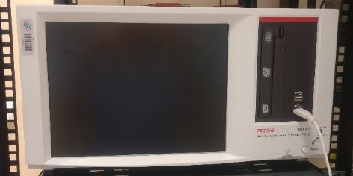
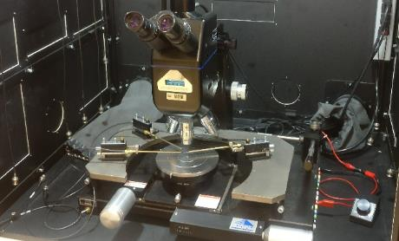
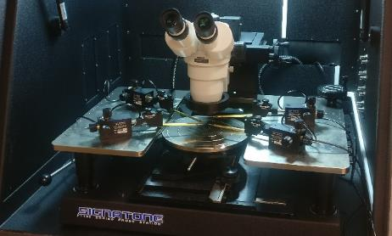
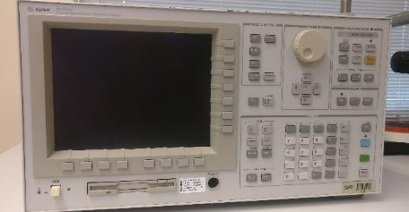
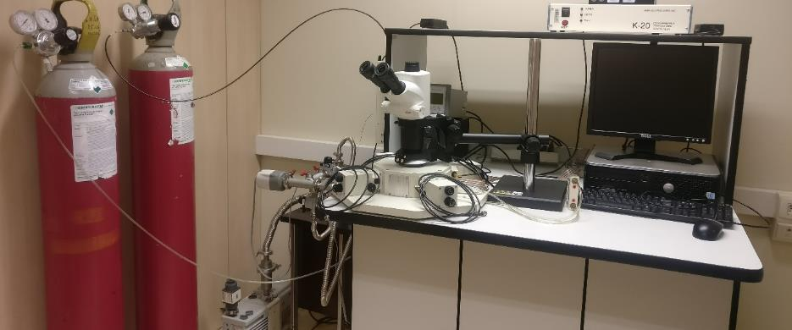
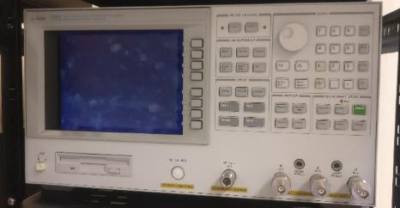
Laboratório de Microeletrônica

Slide 16
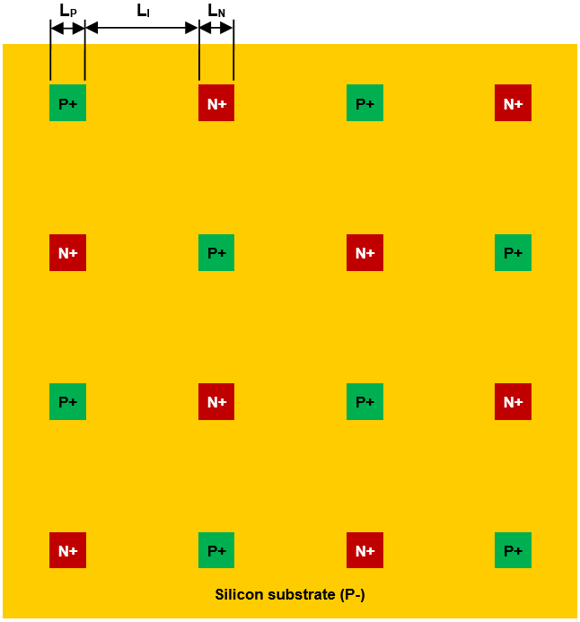
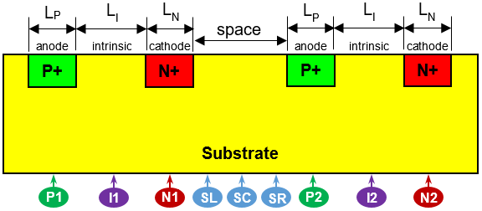
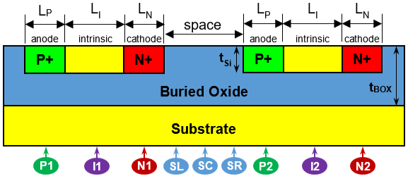
The Analyzed PIN Sensor Array
Simulações de efeitos da radiação
The Analyzed PIN Sensor Array
Developed in IBM BiCMOS 8HP 0.13 technology with MOSIS support
Wider Space Used for Study
Bulk Technology
6.5µm
10µm
6.5µm
6.5µm
10µm
6.5µm
20µm
SOI Technology
6.5µm
10µm
6.5µm
6.5µm
10µm
6.5µm
20µm
150nm →
390nm →
Proposed Array
V_{cat} = 0.5 V (reversely polarized)
Anode & Substrate → GND
Numerical Simulation’s
Comparison Study

Slide 17
The Analyzed PIN Sensor Array
Simulações de efeitos da radiação
Developed in IBM BiCMOS 8HP 0.13 technology with MOSIS support
Bulk Technology
Pre-radiation model’s characteristics:
PIN dimensions match experimental devices
Mobility and carrier’s lifetime parameters
adjusted with experimental data
6.5µm
10µm
6.5µm
6.5µm
10µm
6.5µm
20µm
SOI Technology
6.5µm
10µm
6.5µm
6.5µm
10µm
6.5µm
SEE Parameters:
Heavy-Ion LET = 1 and 10 MeV.cm²/mg
Strikes vertically at specified positions
Strike time: t* = 1.0 ns
Total transient time: 2.0 µs
20µm
150nm →
390nm →
Numerical Simulation’s
Comparison Study

Slide 18
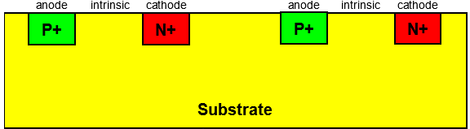
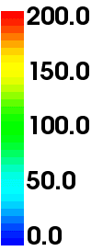


Bulk Technology
Abs Total
Current Density
[A/cm²]|
Sodium Particle Incidence – 1 MeV.cm²/mg
P1
I1
N1
SL
SC
SR
P2
I2
N2
P1
I1
N1
SL
SC
SR
P2
I2
N2
P1
I1
N1
SL
SC
SR
P2
I2
N2
P1
I1
N1
SL
SC
SR
P2
I2
N2
P1
I1
N1
SL
SC
SR
P2
I2
N2
P1
I1
N1
SL
SC
SR
P2
I2
N2
P1
I1
N1
SL
SC
SR
P2
I2
N2
P1
I1
N1
SL
SC
SR
P2
I2
N2
P1
I1
N1
SL
SC
SR
P2
I2
N2
LET: 1 MeV.cm²/mg
Time:

Slide 19
Bulk Technology
Abs Total
Current Density
[A/cm²]|
Sodium Particle Incidence – 10 MeV.cm²/mg
P1
I1
N1
SL
SC
SR
P2
I2
N2
P1
I1
N1
SL
SC
SR
P2
I2
N2
P1
I1
N1
SL
SC
SR
P2
I2
N2
P1
I1
N1
SL
SC
SR
P2
I2
N2
P1
I1
N1
SL
SC
SR
P2
I2
N2
P1
I1
N1
SL
SC
SR
P2
I2
N2
P1
I1
N1
SL
SC
SR
P2
I2
N2
P1
I1
N1
SL
SC
SR
P2
I2
N2
P1
I1
N1
SL
SC
SR
P2
I2
N2
LET: 10 MeV.cm²/mg
Time:

Slide 20
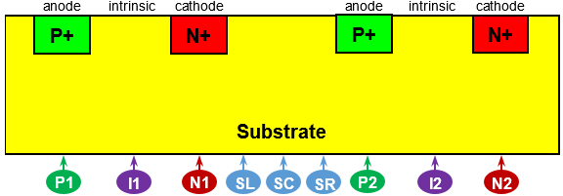

Transient Current Simulated – Bulk Technology
Simulações de efeitos da radiação
Cathode’s Current
Generated e-h pairs forms a “funnel” that distorts the depletion layer;
Prompt current component (drift) produces the peak;
Remaining e-h creates the delayed current component (diffuse).
PIN 1 Cathodes’ Current
PIN 1 Cathodes’ Peak Current

Slide 21
Simulações de efeitos da radiação
PIN 1 Time for Peak Current
Charge Collected at PIN 1’ Cathode

Slide 22
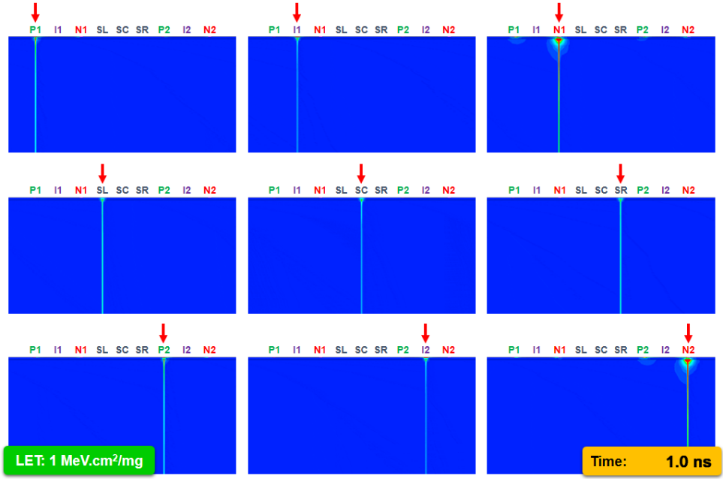
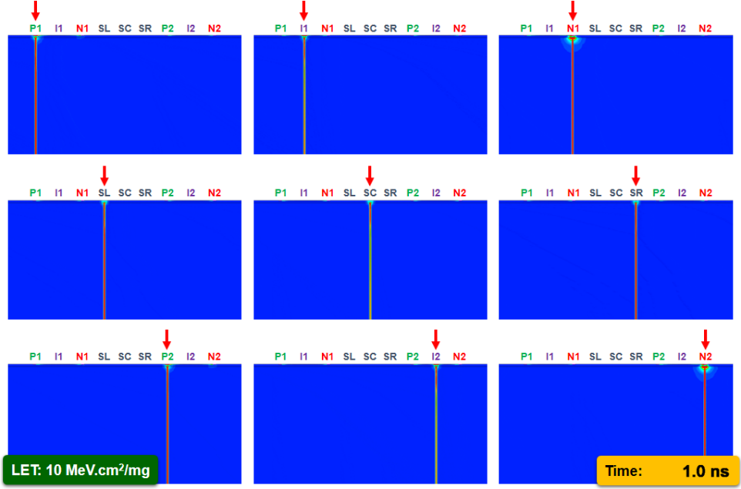
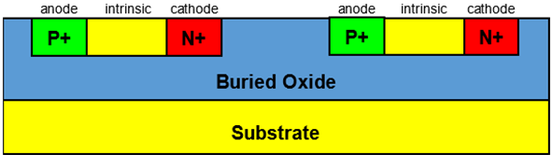
SOI Technology
Abs Total
Current Density
[A/cm²]|

Slide 23
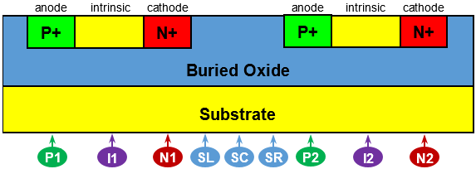
Transient Current Simulated – SOI Technology
SOI Technology
Cathode’s Current
2 peaks: 1st about 1 ns wide;
2nd when the particle hits I1 and I2.
PIN 1 Cathodes’ Current
PIN 2 Cathodes’ Current

Slide 24
Peak Current Simulated – SOI Technology
SOI Technology
For I1 and I2, 2nd peak was considered;
The radius of detection is limited to its own active region*;
Small current can be detected in the nearby diodes (generated substrate charges).
PIN 1 Cathodes’ Peak Current
PIN 2 Cathodes’ Peak Current

Slide 25
Peak Current Simulated – SOI Technology
SOI Technology
Time for Peak Current Detection
The delay is virtually the same in nearby PINs;
1st peak has the same delay as others (another reason for choosing second peak).
PIN 1 Time for Peak Current
PIN 2 Time for Peak Current

Slide 26
Total Charge Collected – SOI Technology
SOI Technology
~ 5 x lower than bulk in the I1 and I2 regions;
Remaining regions return almost constant values, near tens of zC (10⁻²¹C);
Impractical to be read by standard equipment.
Charge Collected at PIN 1’ Cathode
Charge Collected at PIN 2’ Cathode

Slide 27
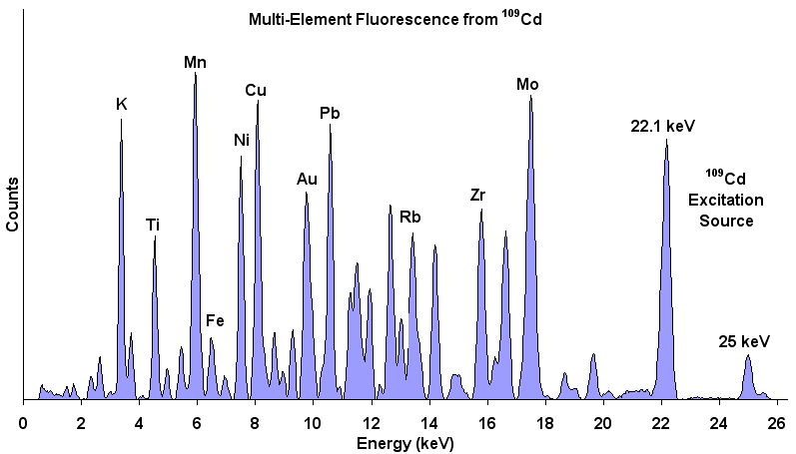
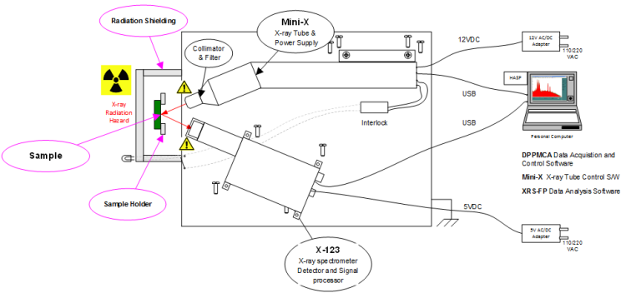
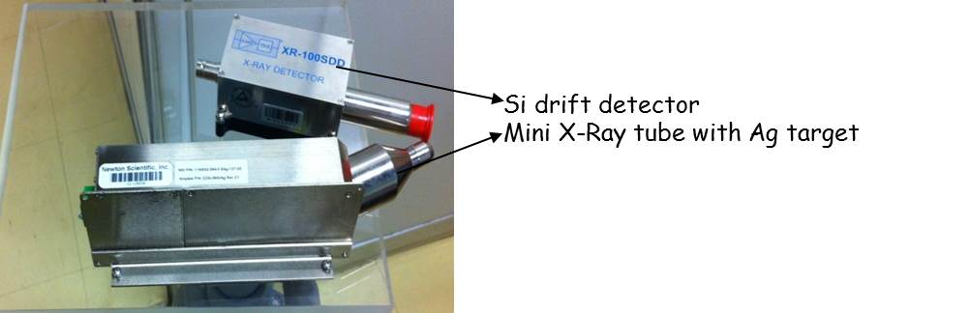
LAFIR – LABORATÓRIO FÍSICA DAS RADIAÇÕES
Energy Dispersive X-ray Fluorescence (EDXRF)
X-ray Fluorescence techniques used for elemental analysis applications.

Slide 28
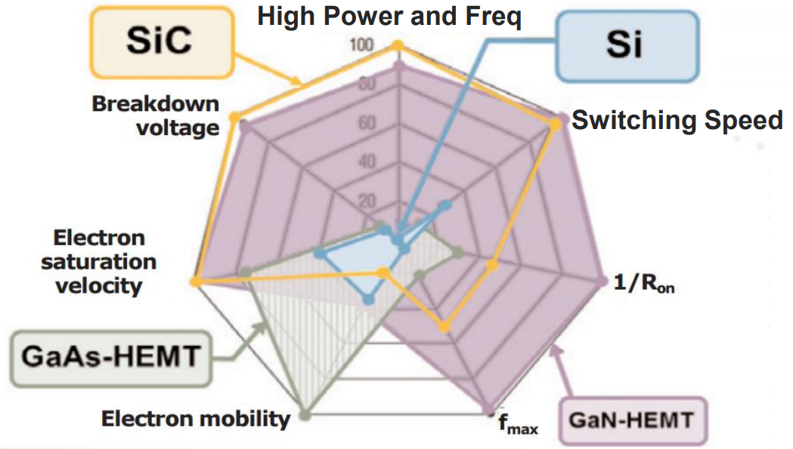
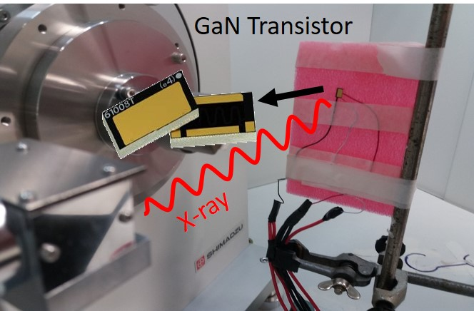
DEVICES AND NEW TECHNOLOGIES
TECHNOLOGY COMPARISON: SI (MORE TRADITIONAL), SiC, GaAs, GaN
THE NEWEST TECHNOLOGY IN THIS AREA!

Slide 29
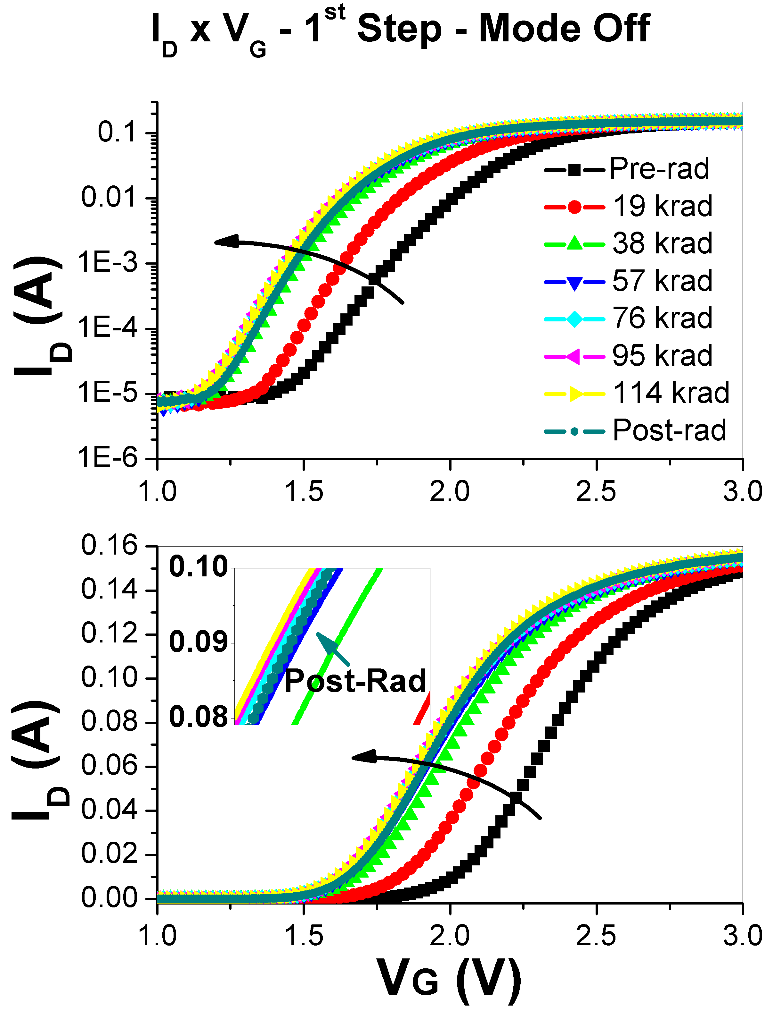
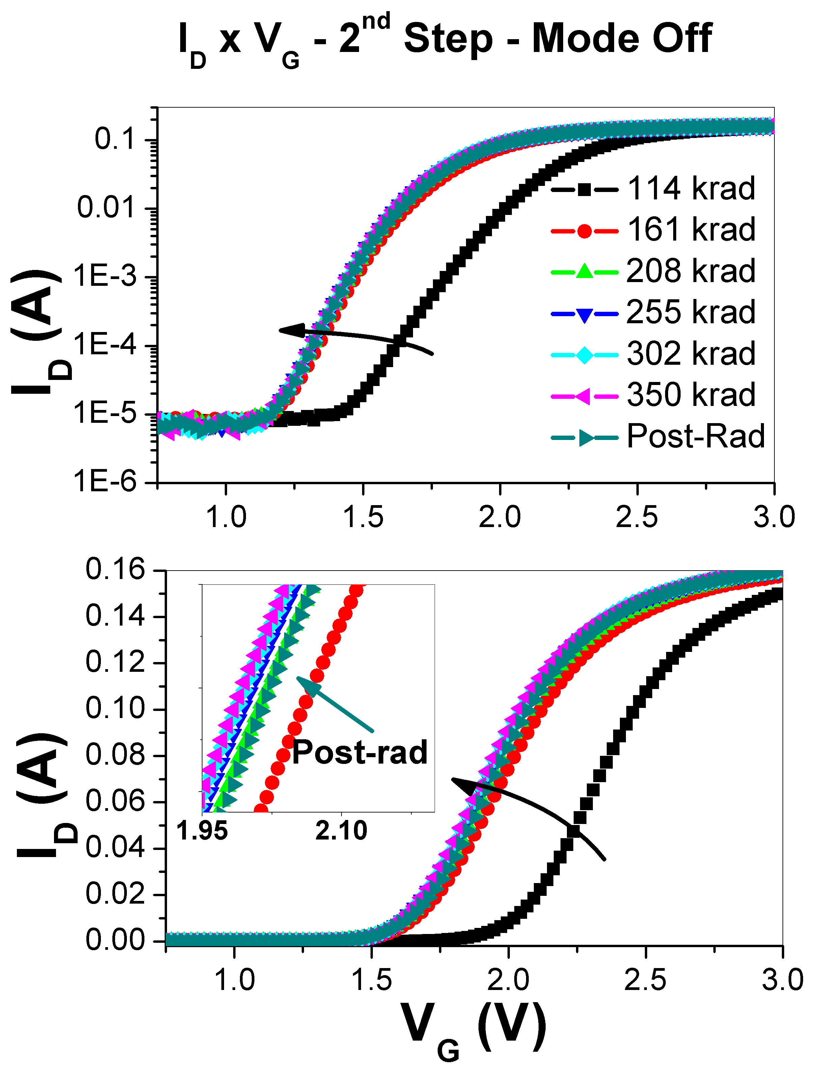
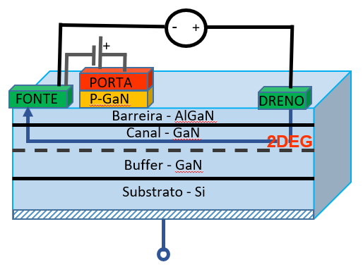
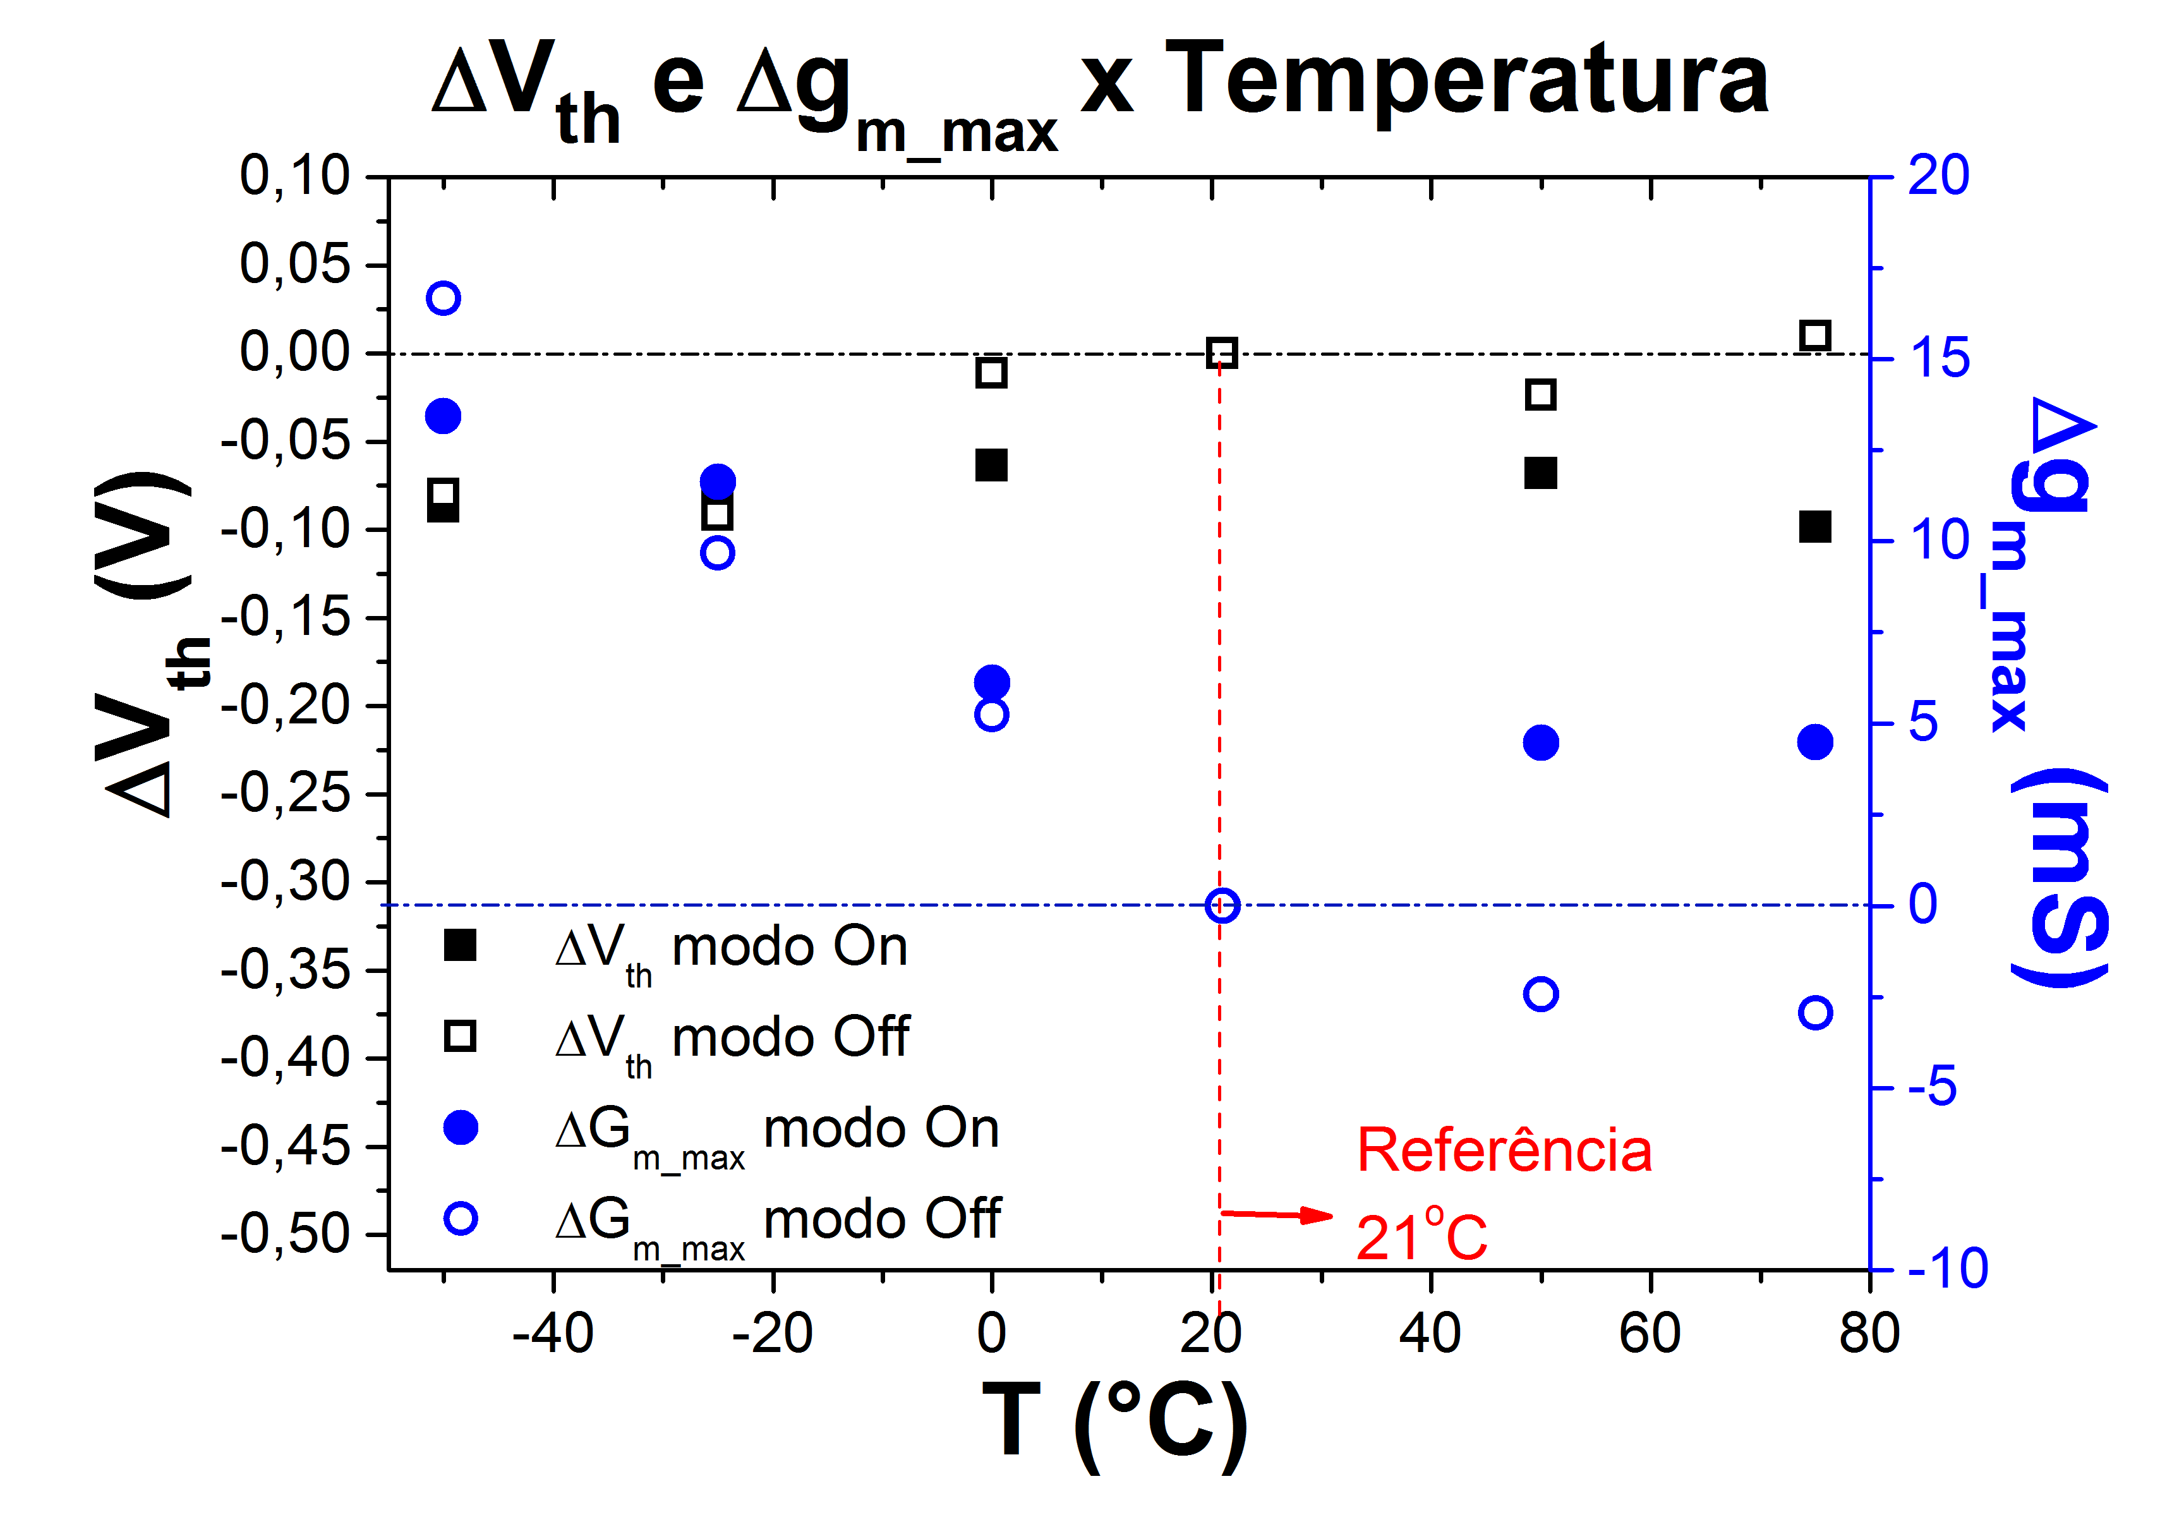
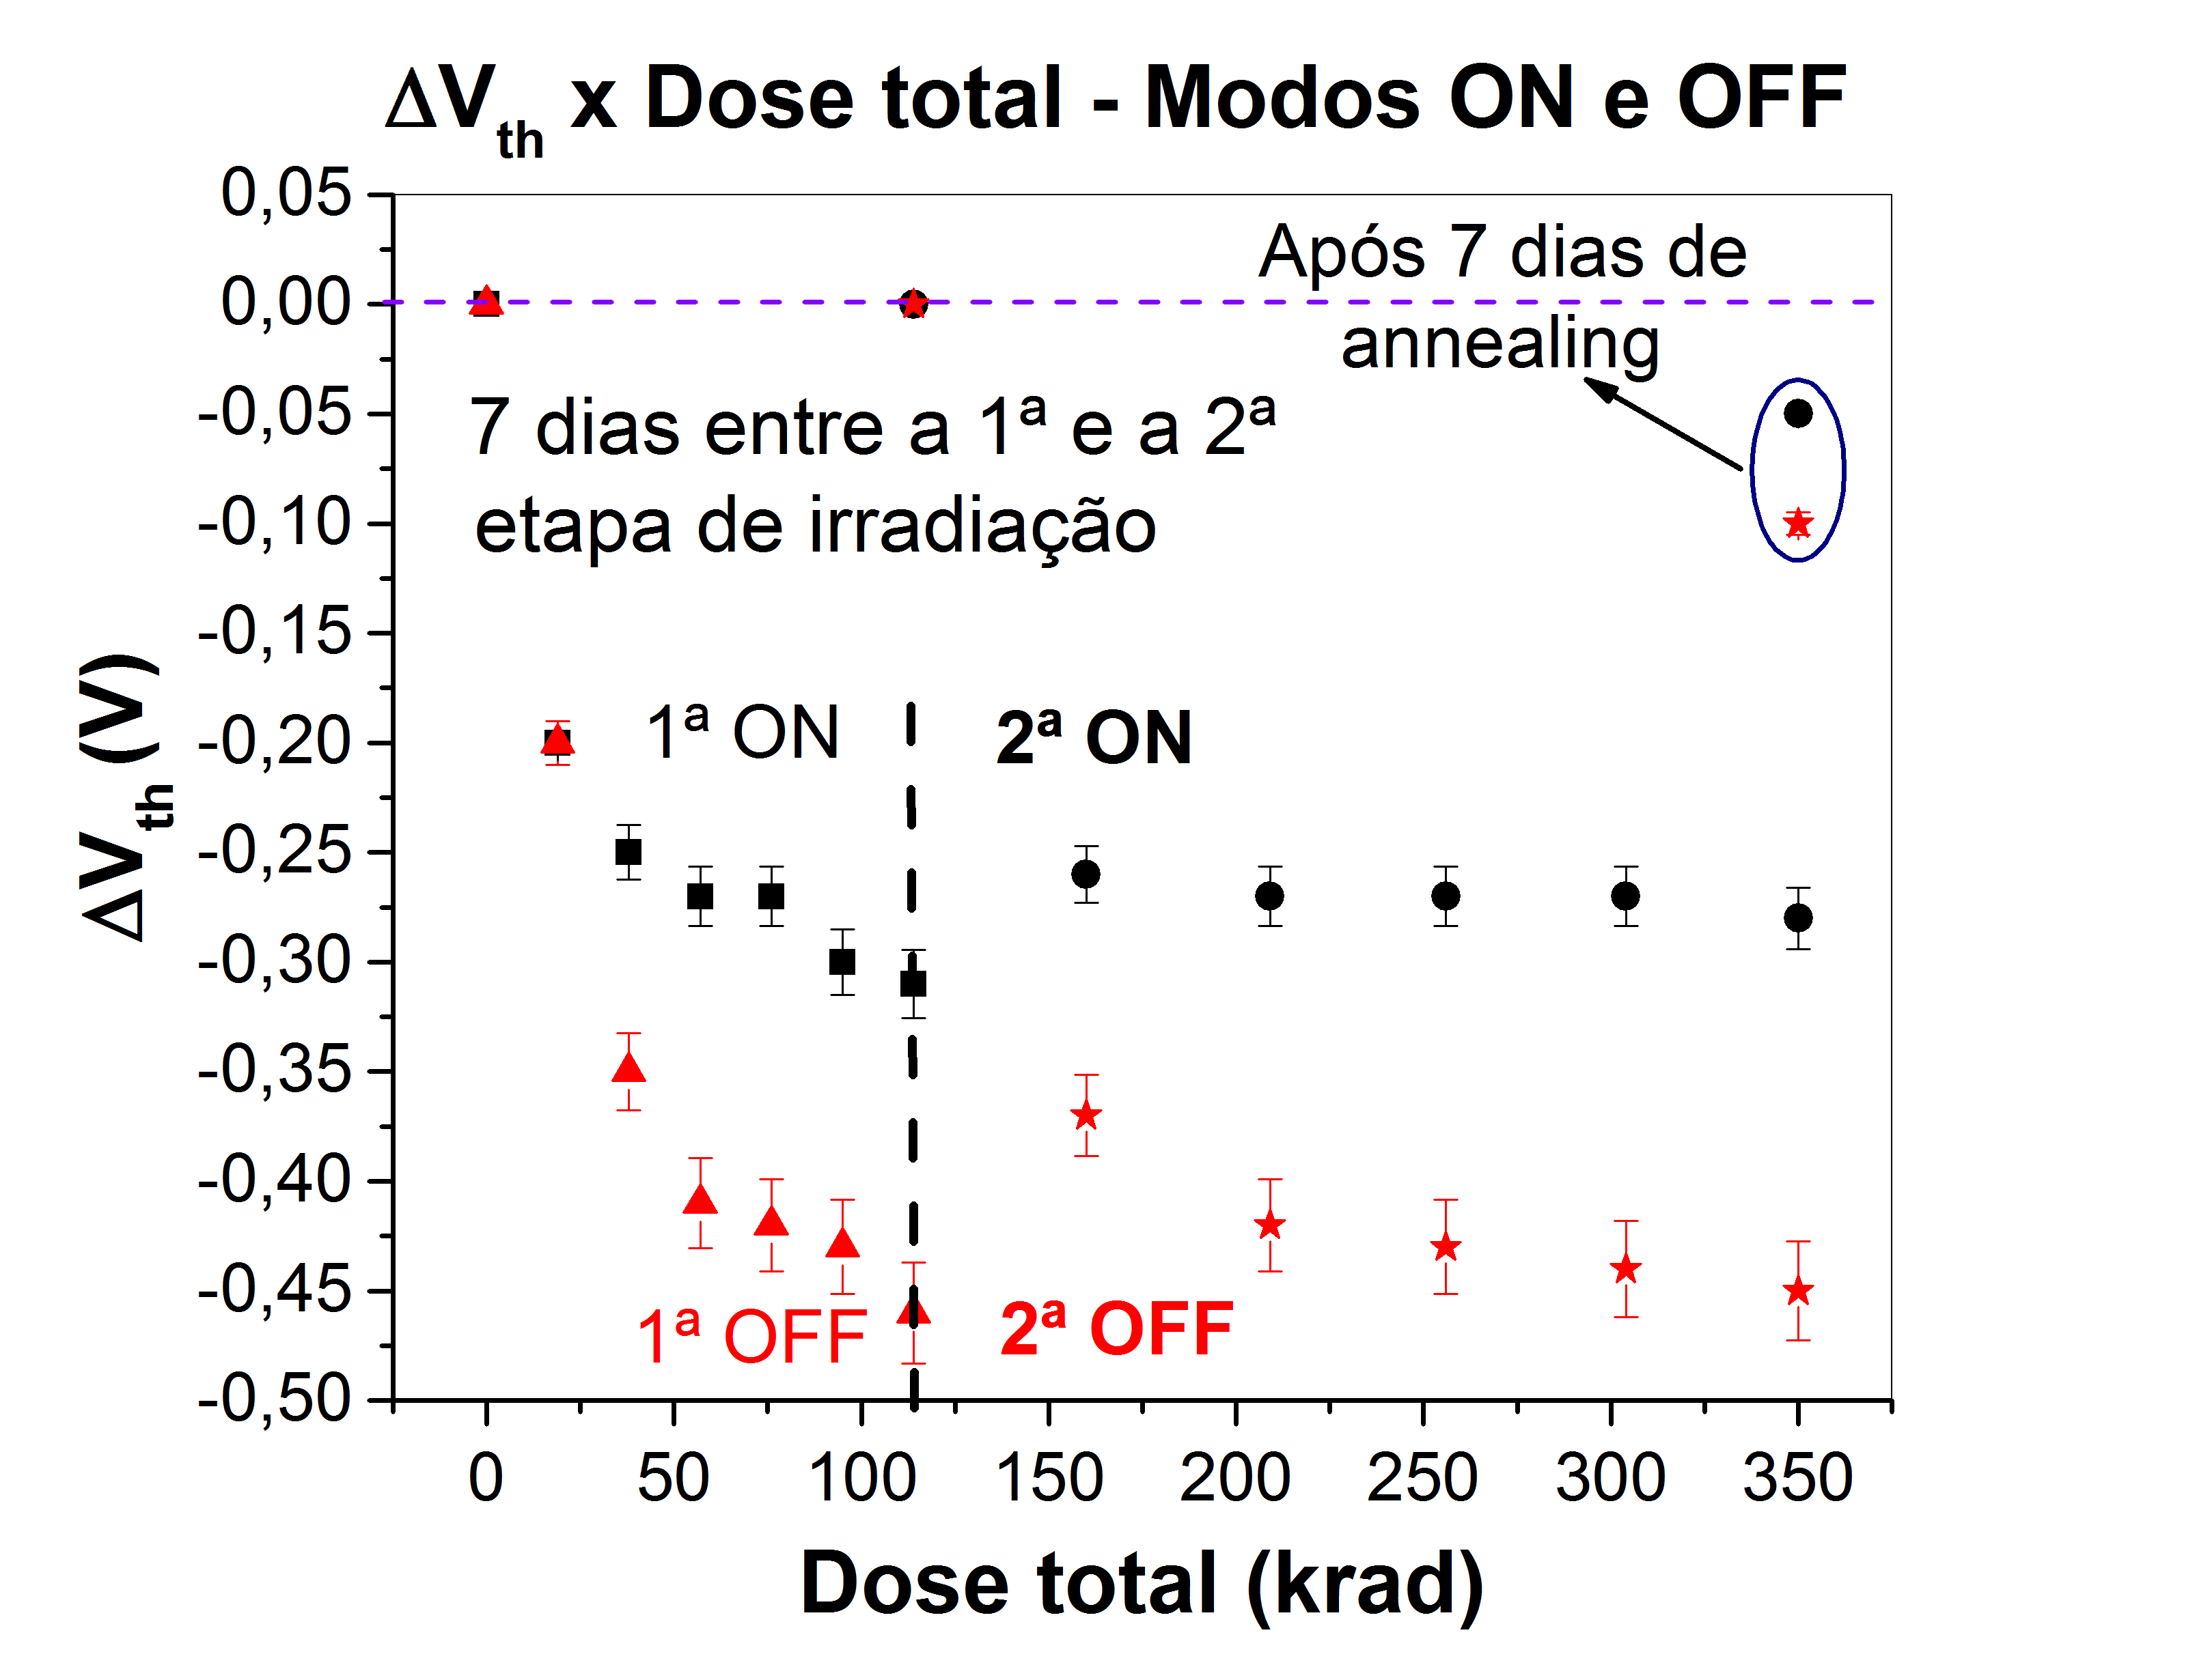
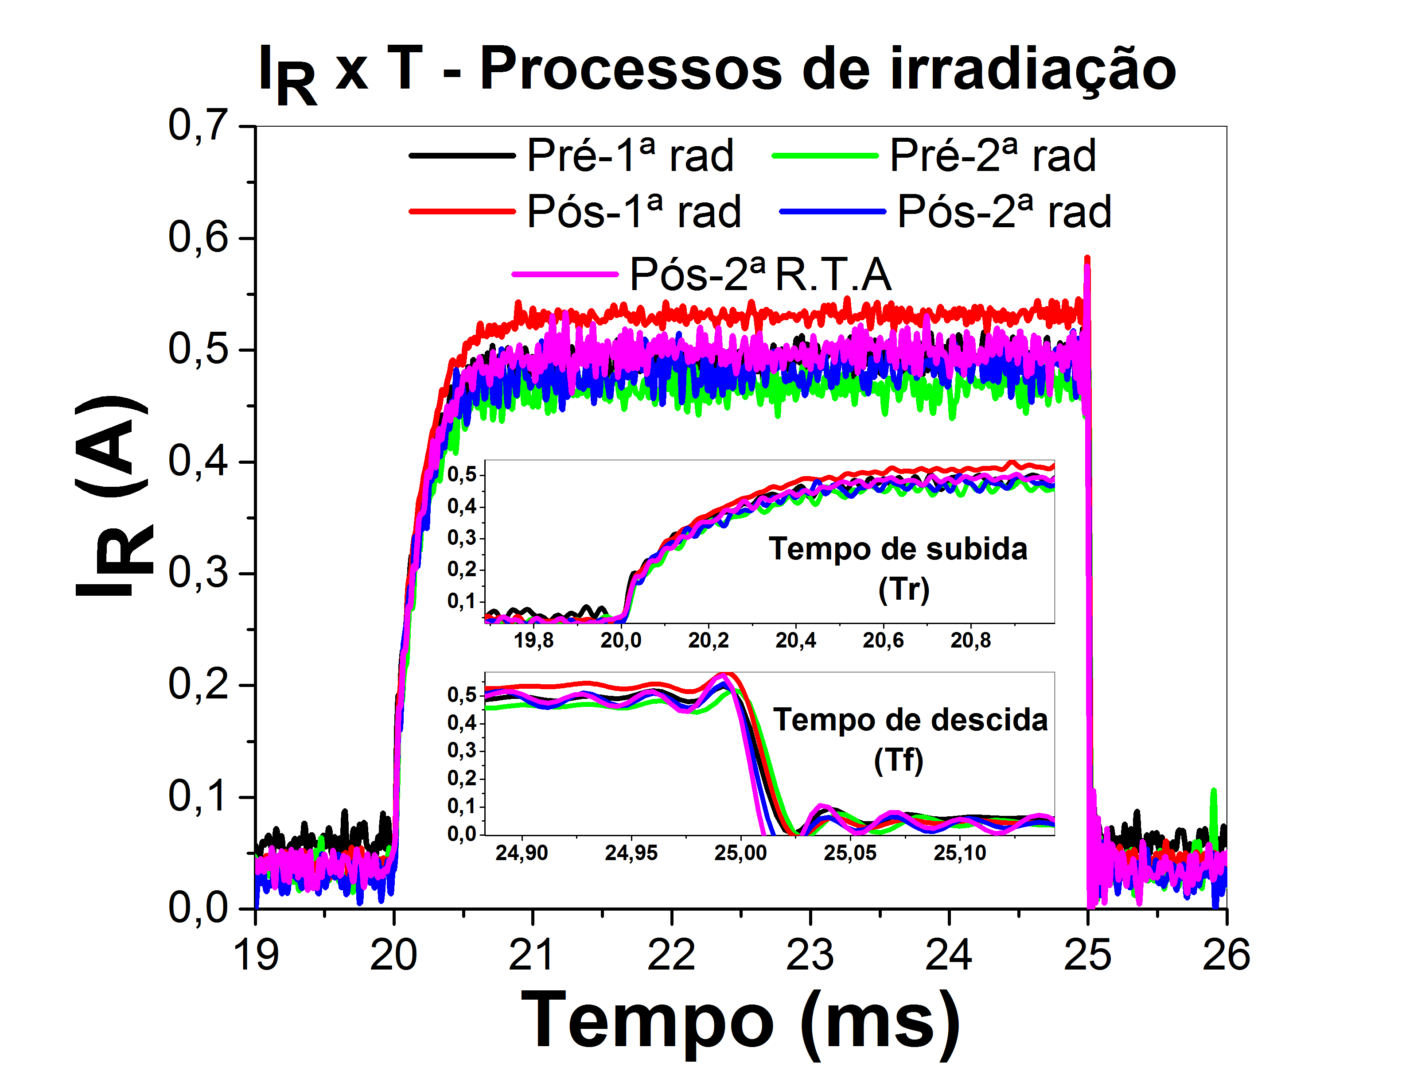

Slide 30
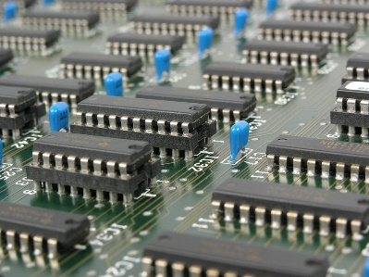
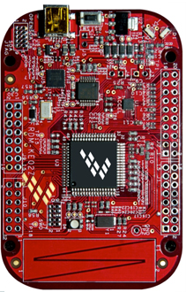
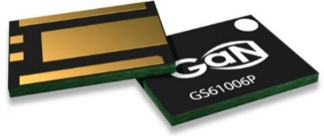
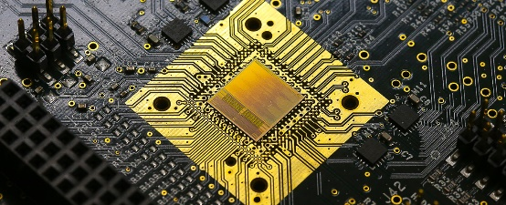
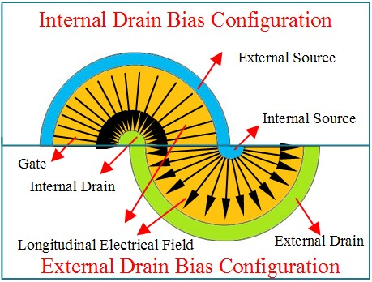
RESEARCHES
COTS: Commercial off-the-shelf devices on reliable designs for space, medical and high energy physics applications. Usually a COTS have a lower cost, easy acquisition and more technical resources than radiation-hardened devices.
ASICs: Application-specific integrated circuits. It is an integrated circuit (IC) customized for a particular use, rather than intended for general-purpose use.
RAD-HARD DEVICES

Slide 31
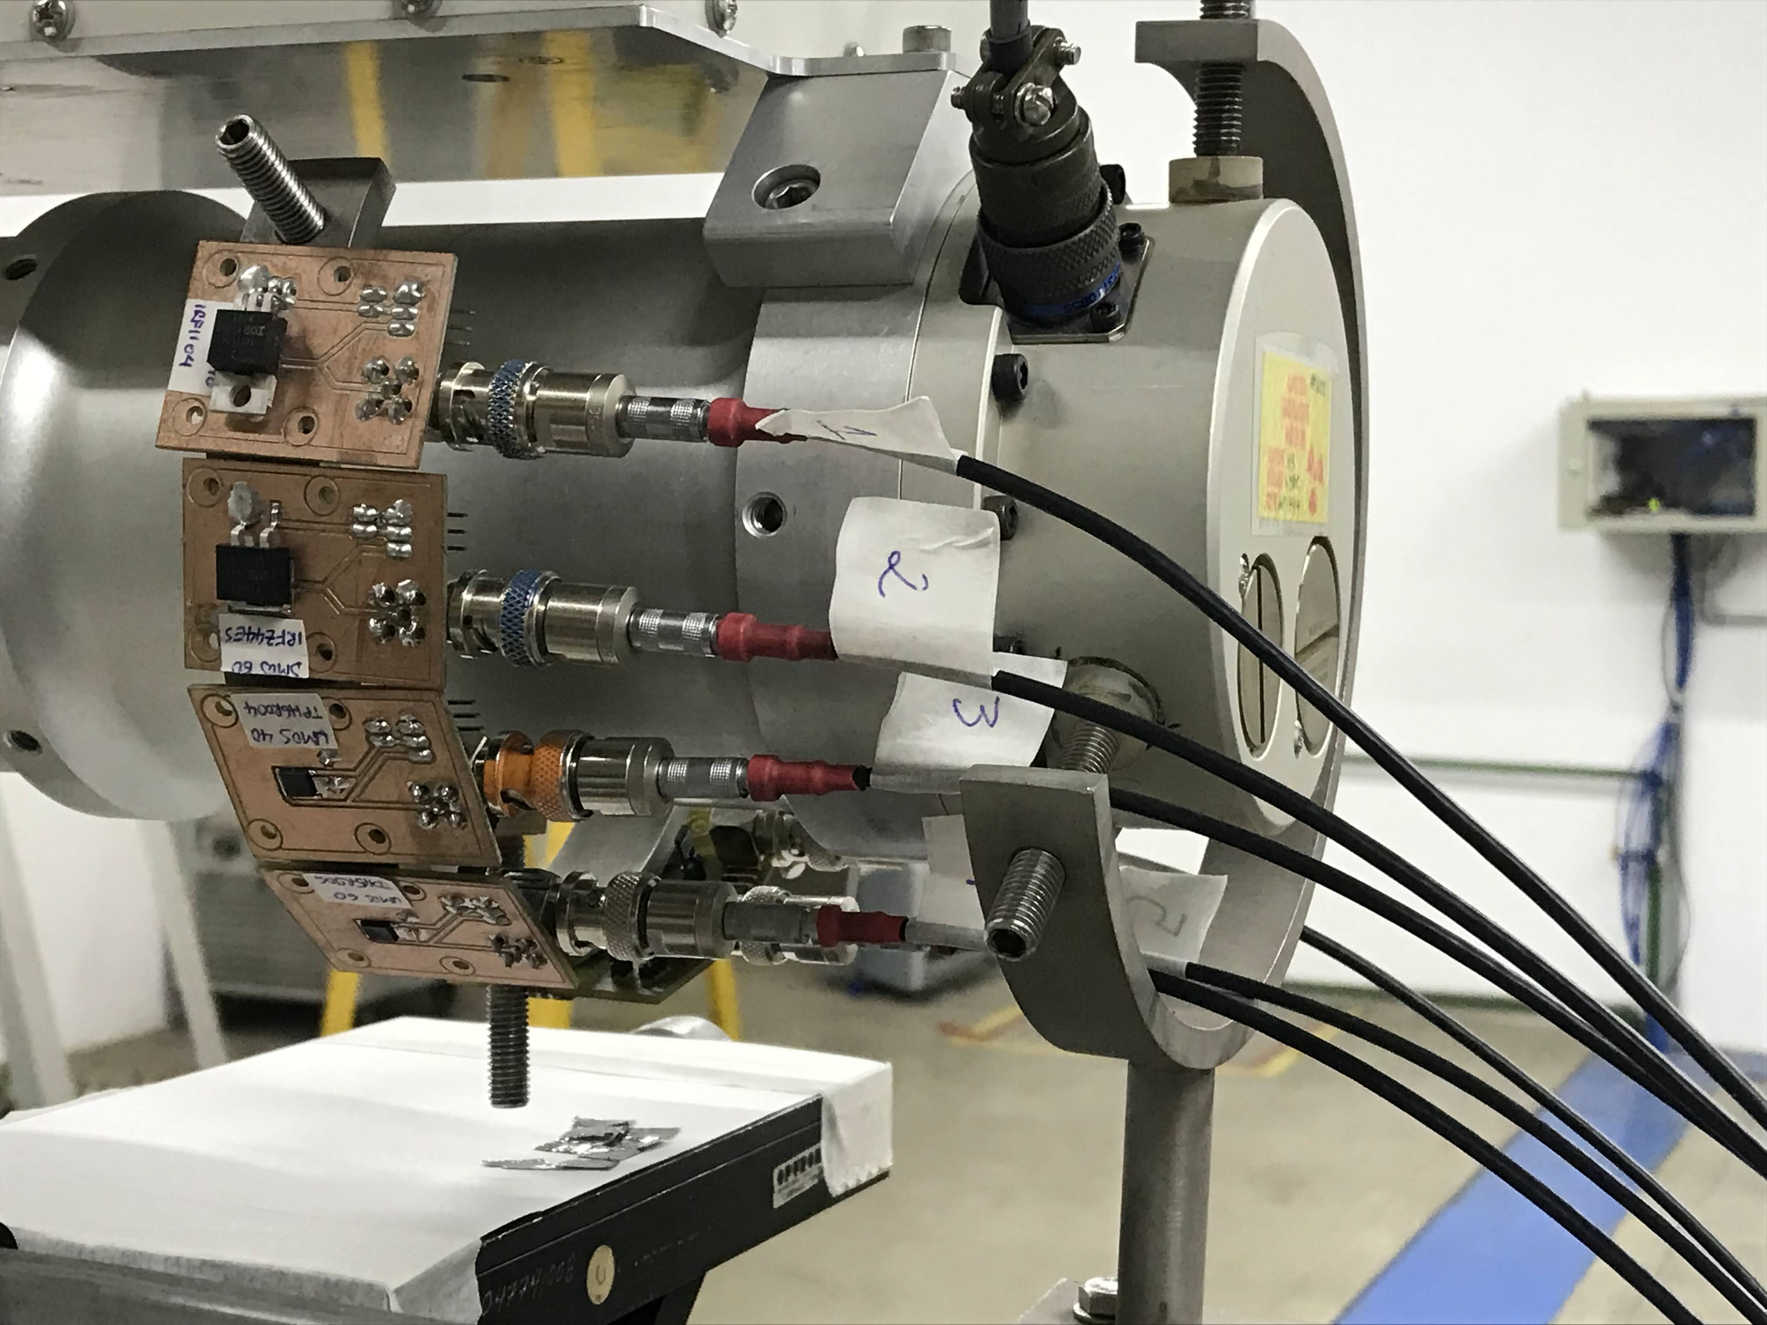
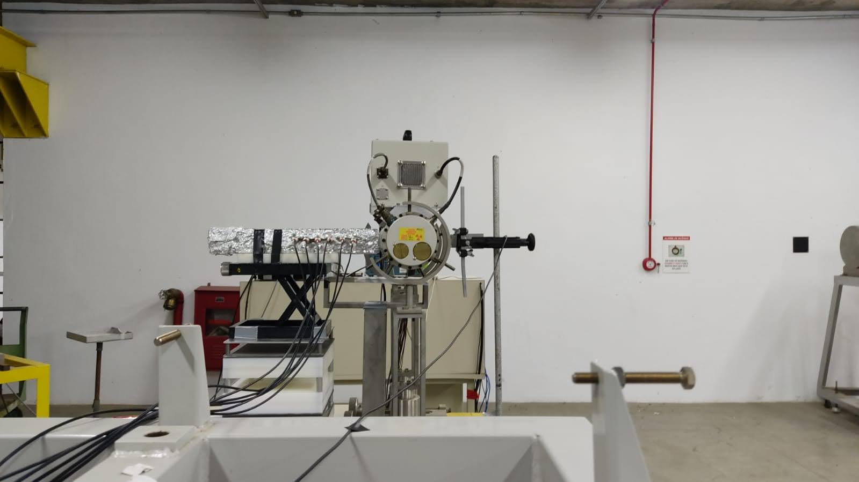
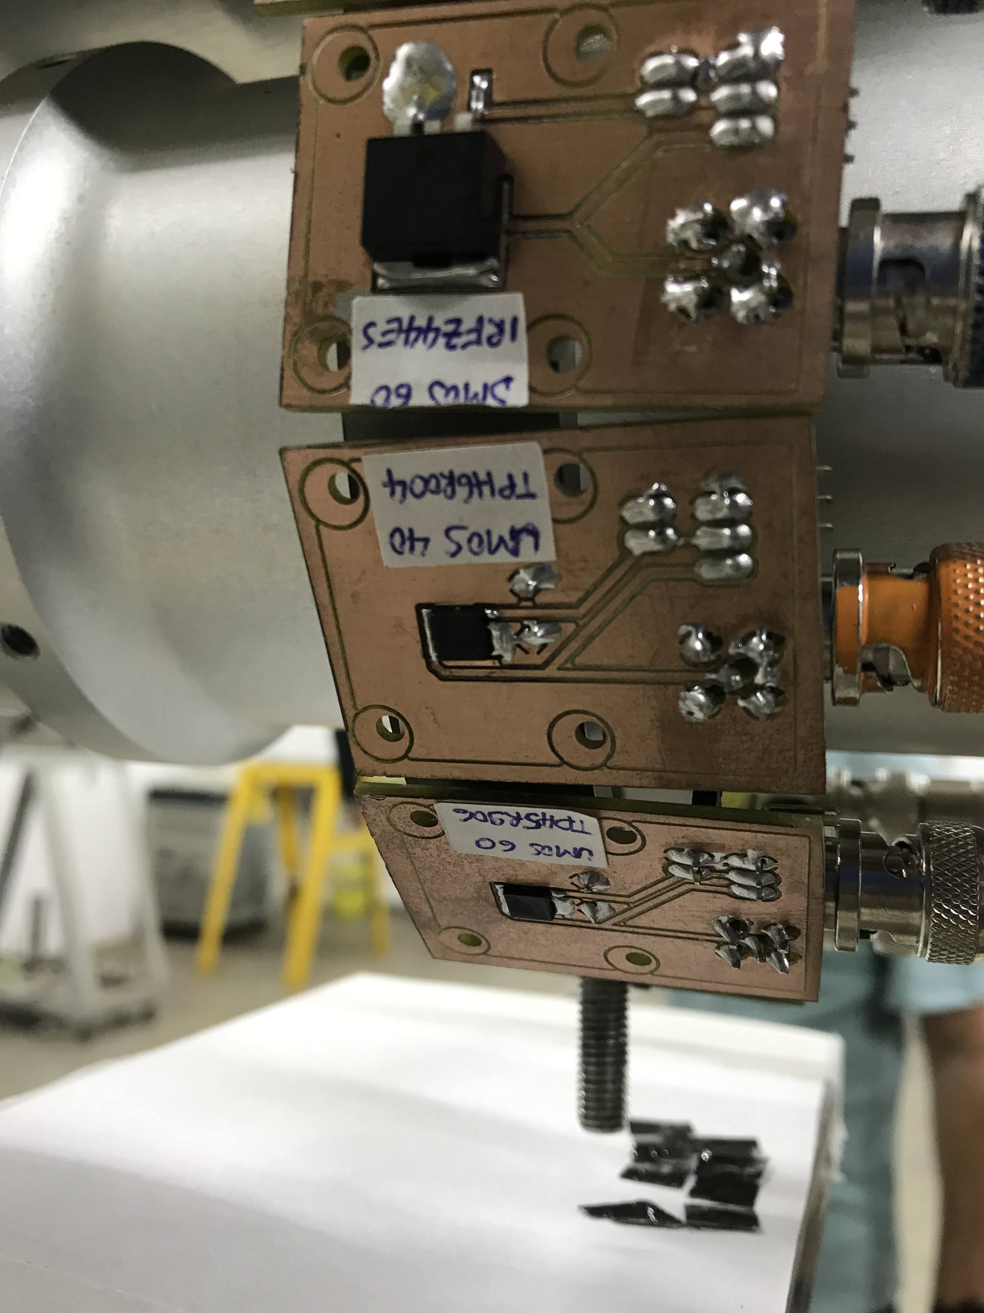
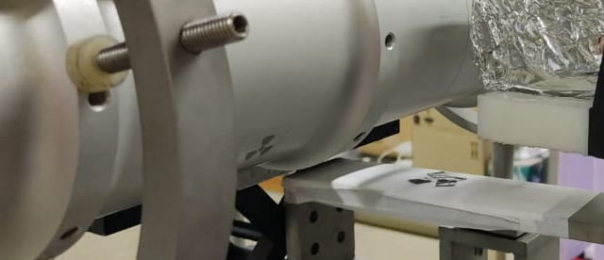
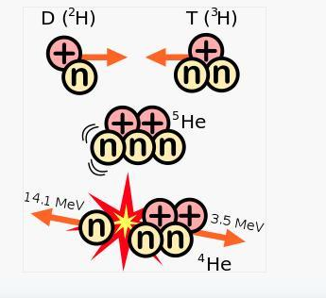
Integrity of HOPG sheets used as heat sink in nuclear reaction
Rqdiation effects on electronic devices
NEUTRON 14 MeV
THE EXPERIMENT
Neutron generator: accelerated deuterons collide with Tritium-enriched titanium target
14.1 MeV

Slide 32





EXPERIMENTOS
Co-60
Pelletron
Beam line
LAMFI

Slide 33

OBRIGADA
Centro Universitário FEI, São Bernardo do Campo, Brasil

