Slide 1
Projeto Temático
2020/04867-2
Kick-off Meeting
Marcelo Gameiro Munhoz
Instituto de Física
Universidade de São Paulo

Slide 2
Kick-off Meeting
Objetivos
Início “oficial” do projeto!
Apresentar todo o escopo do projeto aos participantes
  Bastante diverso e abrangente
Apresentar a proposta de organização e gerenciamento do projeto
  Working Groups e ferramentas
Discutir as atividades iniciais nas várias vertentes do projeto
  Dúvidas, sugestões e comentários

Slide 3
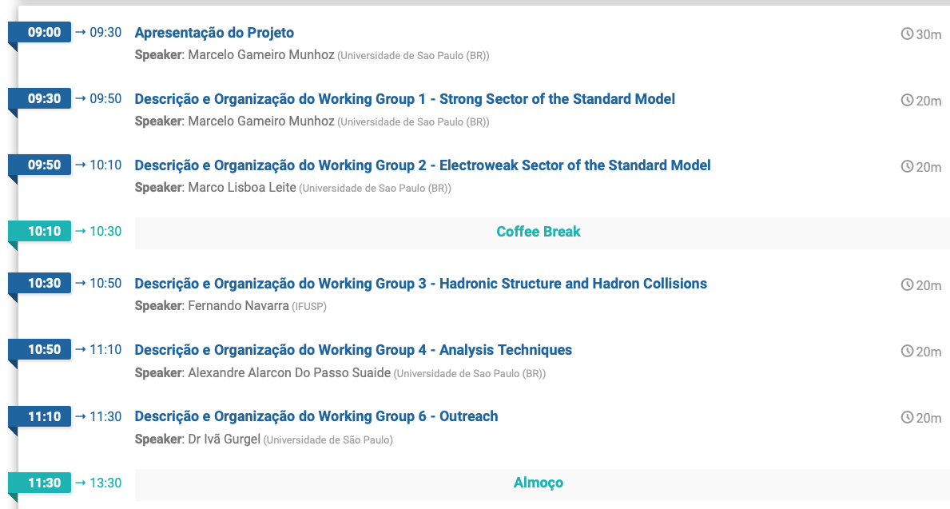
Kick-off Meeting
Programa

Slide 4
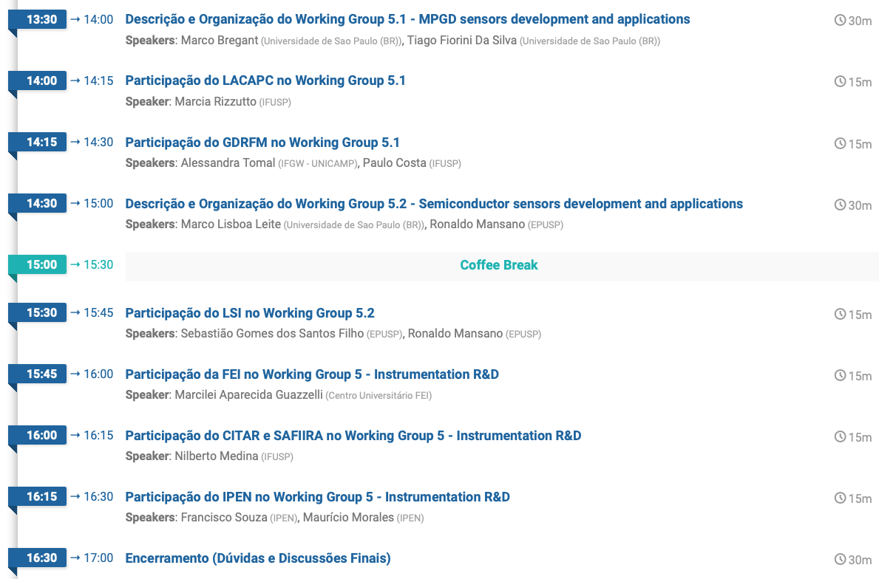
Kick-off Meeting
Programa

Slide 5
Kick-off Meeting
Abertura
Apresentação do escopo do projeto
  Objetivos e ligações entre as várias vertentes do projeto
Participantes
Organização
Gerenciamento
Orçamento

Slide 6

CERN
International facility dealing with knowledge and technological frontiers
  Maintained by 23 member states and 10 Associated Members
  Brazil is in the process of becoming the next Associated Member
Knowledge Transfer Group

Slide 7
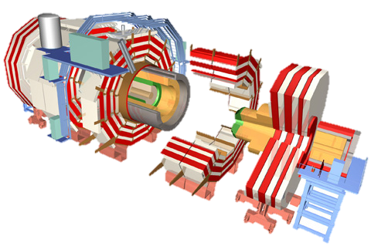

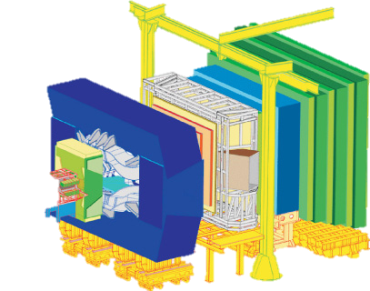
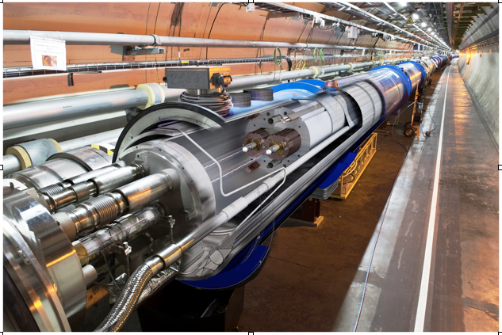
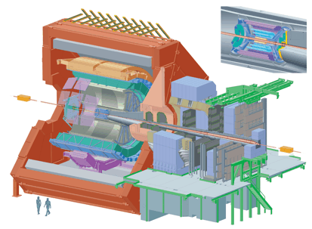
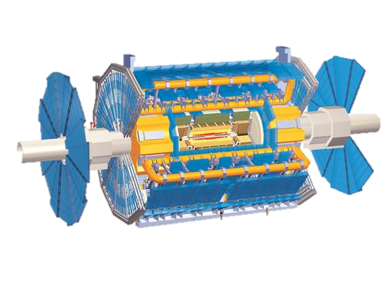
Large Hadron Collider

Slide 8
Goals of the Project
Scientific Goals
Significantly contribute to the understanding of fundamental aspects of matter through theoretical and experimental studies inserted in the ATLAS and ALICE experiments of the Large Hadron Collider (LHC),
Instrumentation
including state-of-the-art instrumentation development
Applications
and spin-offs

Slide 9
Main Challenges
Achieve a significant contribution in these large and competitive experiments
  Data Analysis and interpretation through theoretical models
  Major contribution to instrumentation development for the experiments upgrades
Share the acquired technology and expertise developing collaboratively local applications

Slide 10
Scientific Goals

Slide 11


STANDARD MODEL
Strong
Interaction
(WG-1)
Theoretical
Program
Electroweak
Physics
(WG-2)
Hadronic Collisions
(WG-3)
QGP
Vector
Bosons
Higgs Pair
Production
Hadronic
Structure
(WG-3)
Experimental Program
ALICE
Analysis Techniques
(WG-4)
ATLAS

Slide 12
Main Expected Results
What are the results that indicate a significant contribution to these experiments?
  Analysis produced (with notes and main participation in papers)
  Presentations in conferences representing the collaborations
  Leadership positions within the collaborations
  Theoretical papers interpreting the data

Slide 13
Instrumentation

Slide 14
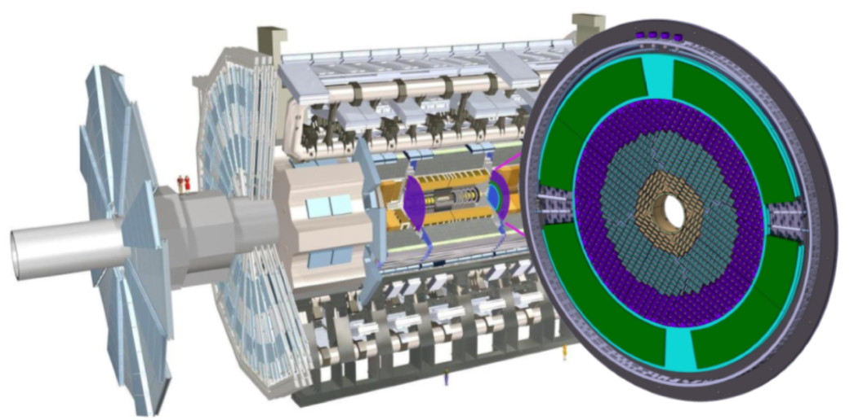
ALICE and ATLAS Upgrades
ALICE TPC: installed during 2020-2021 (LS2)
ALICE FoCal: installation planned for 2026-2028 (LS3)
ATLAS HGTD: installation planned for 2026-2028 (LS3)
ALICE 3: planned for 2033 (LS4)

Slide 15
ALICE
Experimental Program
ATLAS
Instrumentation Program
FoCal
HGTD
RD51
MPGD R&D
(WG-5)
LGAD
TPC
Semiconductor
Detectors R&D
(WG-5)
ALICE 3
ToF

Slide 16
ALICE
Experimental Program
ATLAS
Instrumentation Program
TPC
RD51
MPGD R&D
(WG-5)

Slide 17
Main Expected Results
New method to test MPGD degradation
  Ensure a good performance of the TPC during its lifetime in ALICE
  Build more resistant detectors for different applications (spin-offs discussed later)

Slide 18
ALICE
Experimental Program
ATLAS
Instrumentation Program
FoCal
HGTD
LGAD
Semiconductor
Detectors R&D
(WG-5)
ALICE 3
ToF

Slide 19
Main Expected Results
Unique facility for development and characterization of ionizing radiation semiconductor sensors
  Plans to include the facility in the USP program Multi
Development of a new UFSD prototype
Foreseen several applications of these sensors (discussed later)

Slide 20
Main Expected Results
Contribution to the FoCal Electronics
  Further development of know-how on front end ASICs, this time concerning semiconductor devices
Contribution to the HGTD project
  Further development of know-how on ionizing radiation semiconductor sensors and associated electronics
Development of a proposal to equip the ALICE 3 ToF detector
  Prominent contribution to a new LHC detector

Slide 21
Applications

Slide 22






ALICE
Experimental Program
ATLAS
Instrumentation Program
RD51
MPGD R&D
(WG-5)
Semiconductor
Detectors R&D
(WG-5)
Simulations
Applications
Electronics
UFSD
Radiation
Hardness
Neutron
Detection
Fusion Reactors
Diagnosis
X-ray Imaging
RMB
Sirius
Medical Imaging

Slide 23
Main Expected Results
Several spin-offs
  Neutron detector based on MPGD
  Fusion reactors diagnosis technique with MPGD detectors
  X-ray imaging detector based on MPGD and semiconductor
  Medical physics applications
  Radiation hard sensors and electronics

Slide 24


Participantes
12 Universidades
48 pesquisadores
47 alunos de pós-graduação

Slide 25
Organização
WG-1 Strong Sector of the Standard Model
  ALICE data analysis and detector upgrade
  Coordenação: Marcelo Munhoz
WG-2 Electroweak Sector of the Standard Model
  ATLAS data analysis and detector upgrade
  Coordenação: Marco Leite
WG-3 Hadronic Structure and Hadron Collisions
  Phenomenology and applications to the ALICE and ATLAS experiments
  Coordenação: Fernando Navarra
WG-4 Analysis Techniques
  Machine Learning applied to ALICE and ATLAS data analysis
  Coordenação: Alexandre Suaide
WG-5 Instrumentation R&D
  WG-5.1 MPGD development and applications, Coordenação: Marco Bregant e Tiago Silva
  WG-5.2 Semiconductor sensors development and applications, Coordenação: Marco Leite e Ronaldo Mansano
WG-6 Outreach
  Coordenação: Ivã Gurgel

Slide 26
Gerenciamento
Plataforma Teams
  Convites para participação serão enviados por e-mail
  A proposta é que toda a interação seja através desta plataforma (sites, e-mails, chats, documentos, tarefas, resultados, cronogramas, etc.)
Reuniões periódicas (semanais ou quinzenais) de cada WG
Reunião Geral mensal ou bimensal
  Apresentações (15 min) de cada WG, mostrando andamento do cronograma
Workshop anual com todos os participantes
  Apresentações de trabalhos
  Aproximadamente dois meses antes da entrega do relatório anual

Slide 27
Orçamento
Valor
Cluster de Computadores (GRID-LHC) | R$ 1.182.015,00
Passagens aéreas para missões científicas ao CERN | R$ 250.000,00
Diárias para missões científicas ao CERN | R$ 672.000,00
Benefícios Complementares | R$ 600.000,00
Reserva Técnica | R$ 1.146.930,68
TOTAL em Reais | R$ 3.850.945,68
Material Permanente Importado | $ 108.817,81
Material de Consumo Importado | $ 450.992,17
Serviços de Terceiro no Exterior | $ 88.518,31
TOTAL em Dólares | $ 648.328,29
Bolsas | R$ 2.821.286,88
TOTAL do Projeto em Reais | R$ 11.995.338,54

Slide 28
Orçamento
Gerenciamento
Planilha pública (Teams) com orçamento enviado para a FAPESP
Planilha pública (Teams) com desembolsos
Reserva Técnica:
  Gastos já previstos: 54%
  Gastos maiores serão discutidos entre PP
Viagens (passagens e diárias)
  Missões científicas ao CERN (ALICE, ATLAS e RD51)
  Participações em eventos estritamente ligados ao projeto financiadas pela RT

Slide 29
Considerações Finais
Projeto bastante desafiador!
  Visa uma contribuição significativa para projetos internacionais muito competitivos na fronteira do conhecimento
  Gerar desenvolvimento tecnológico
Ao nosso favor:
  Equipe grande, experiente e bem estabelecida tanto nas colaborações do LHC como em áreas tecnológicas
  Boa infraestrutura já disponível
Resultados esperados de alto impacto
  Combinação única de ciência fundamental com desenvolvimentos e aplicações tecnológicas

