Slide 1



Charged polaron at finite momentum
Grover D. Andrade Sánchez
-o-
Dr. Arturo Camacho Guardian
September 5, 2025

Slide 2

System of study

Slide 3
Gas in a BEC state
Described by Bogoliubov theory
Ion of the same gas
A. Camacho-Guardian. ((Polaritons for testing the universality of an impurity in a Bose-Einstein conden-sate)). En: Phys. Rev. A 108 (2 ago. de 2023)
Steffen Patrick Rath y Richard Schmidt. ((Field-theoretical study of the Bose polaron)). En: Phys. Rev. A88 (5 nov. de 2013)

Slide 4
Gas in a BEC state
Described by Bogoliubov theory
Ion of the same gas
Rasmus Søgaard Christensen, Jesper Levinsen y Georg M. Bruun. ((Quasiparticle Properties of a MobileImpurity in a Bose-Einstein Condensate)). En: Phys. Rev. Lett. 115 (16 oct. de 2015

Slide 5
Gas in a BEC state
Described by Bogoliubov theory
Ion of the same gas

Slide 6
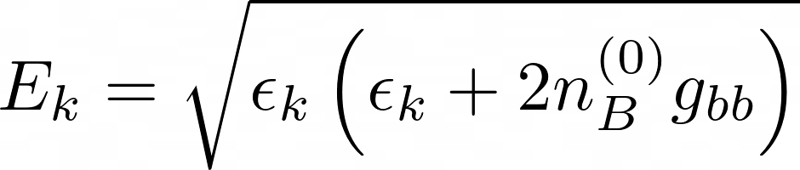
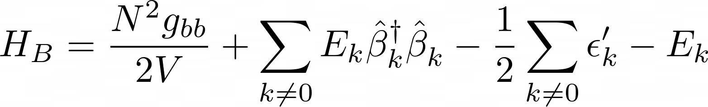
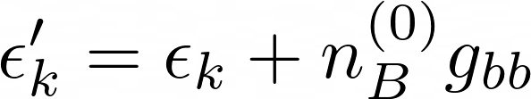
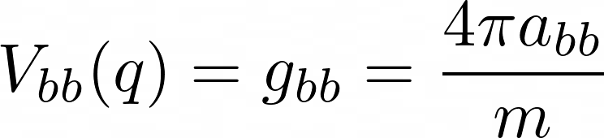
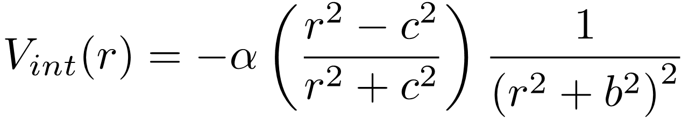
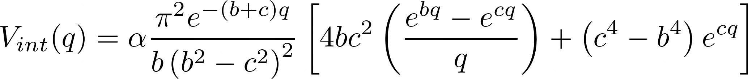

Hamiltonian of the system $\hat{H}$
BEC: Bogoliubov theory
Ion-Atom interaction: Ion-Dipolar interaction

Slide 7
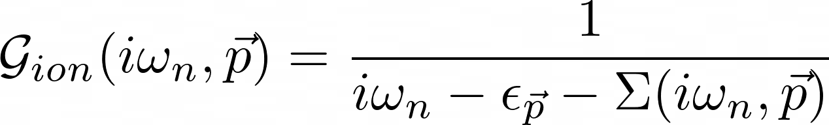
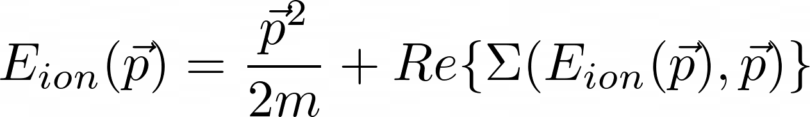
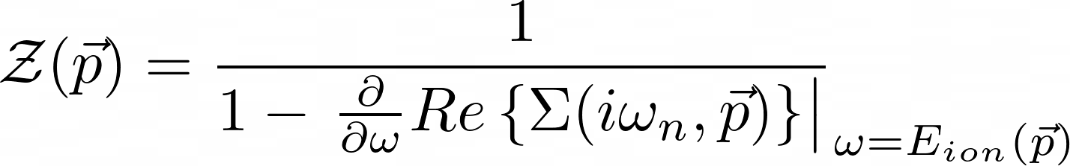
Quasiparticle Properties
Dyson equation
Energy:
Residue:
Decay rate:

Slide 8

Hamiltonian of the system $\hat{H}$
BEC: Bogoliubov theory
Ion-Atom interaction: Ion-Dipolar Interaction

Slide 9
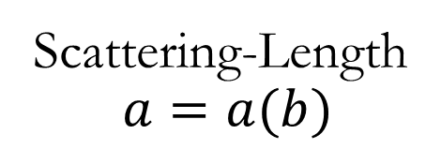
Scattering-Length
$$a=a(b)$$
The Lippmann-Schwinger equation

Slide 10
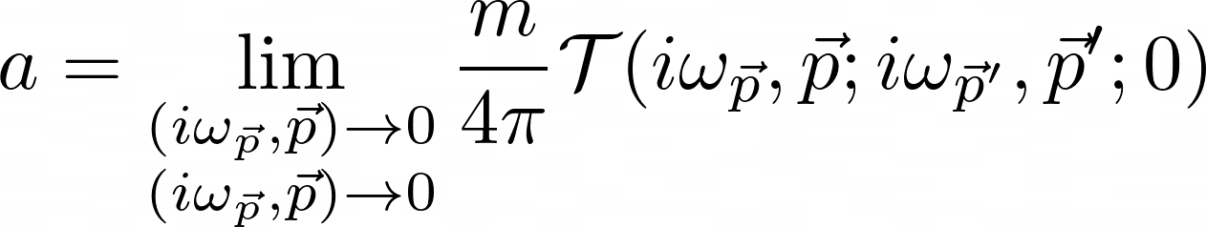
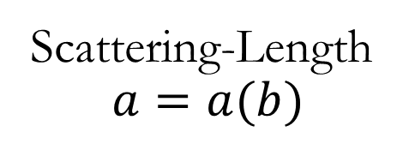
Scattering-Length
$$a=a(b)$$
Definition of the Scattering-Length
By solving the Lippmann-Schwinger equation

Slide 11
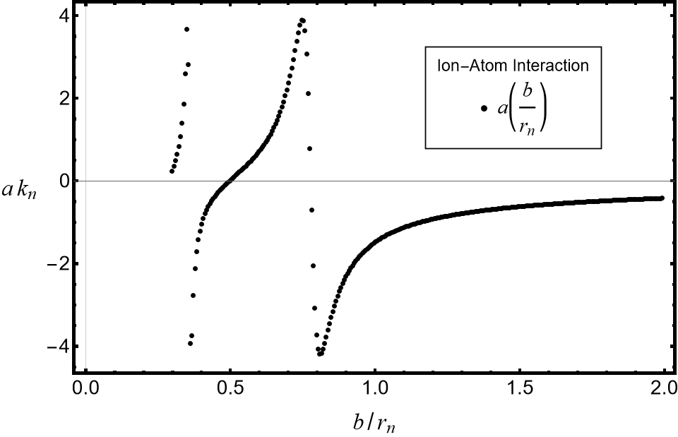
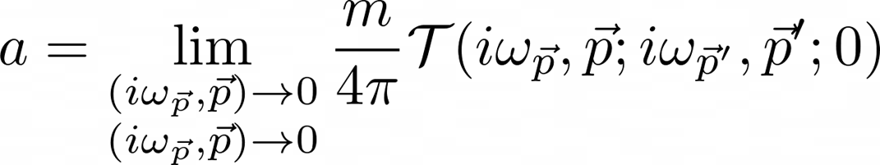
Scattering-Length
$$a=a(b)$$
By solving the Lippmann-Schwinger equation
Definition
Perturbative region
(Contact Interaction)
Perturbative region
(Ion-Dipole)

Slide 12

Calculation of self-energy

Slide 13
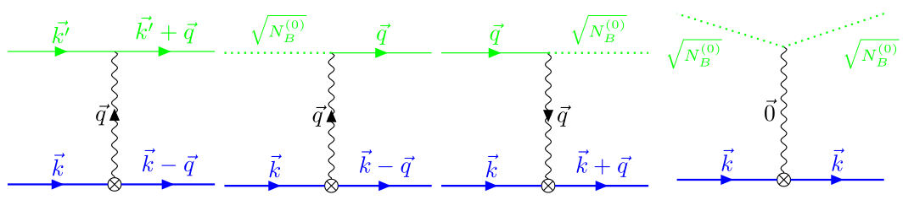
General Interaction

Slide 14


General Interaction

Slide 15
General Interaction

Slide 16
First Order
Interaction

Slide 17
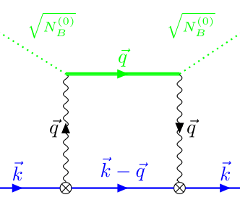
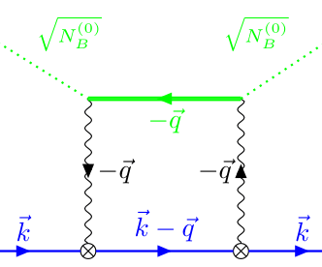
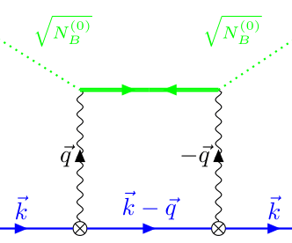
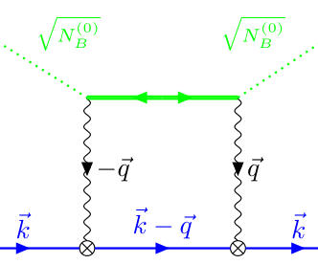
Second Order
Interaction

Slide 18
quasiparticle properties

Slide 19


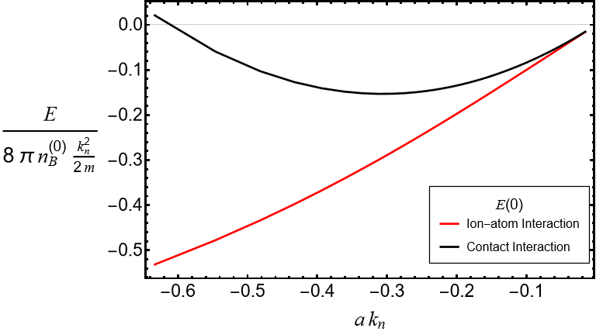


Energy

Slide 20
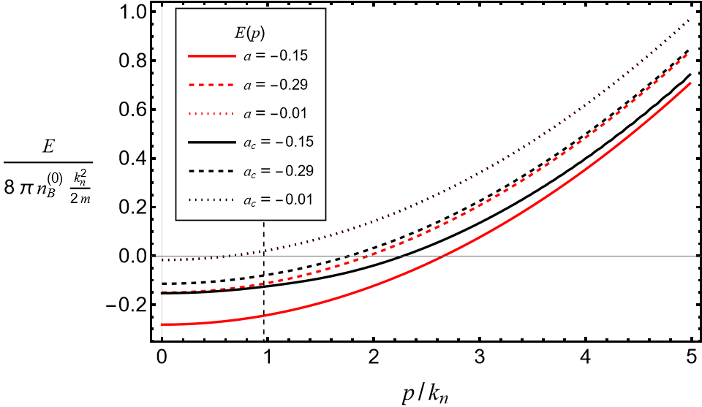
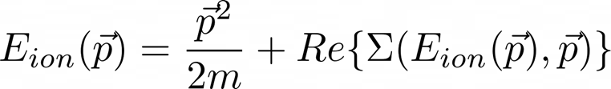
Energy

Slide 21
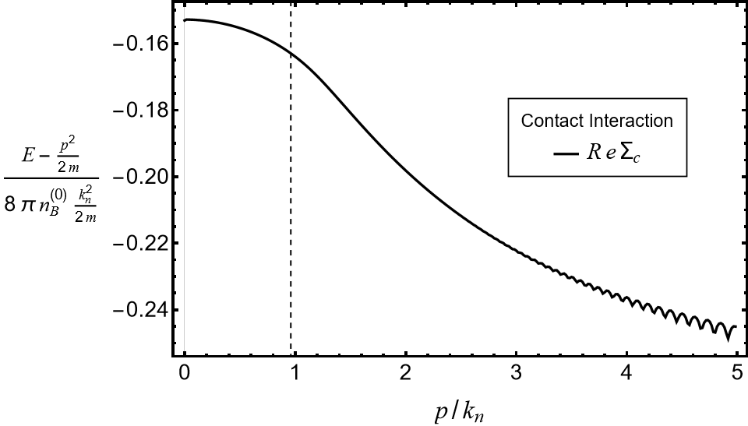
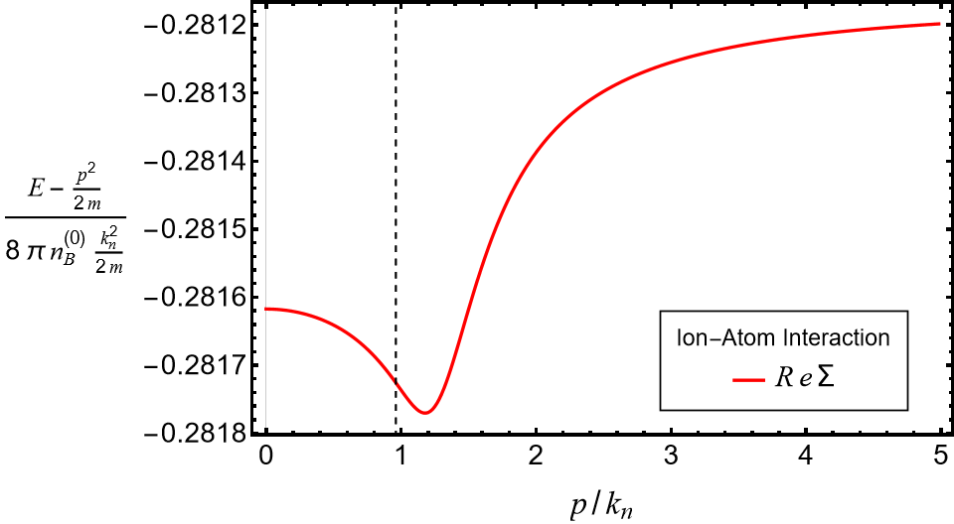
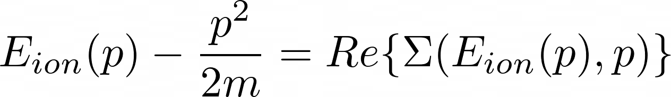
Difference to free particle

Slide 22
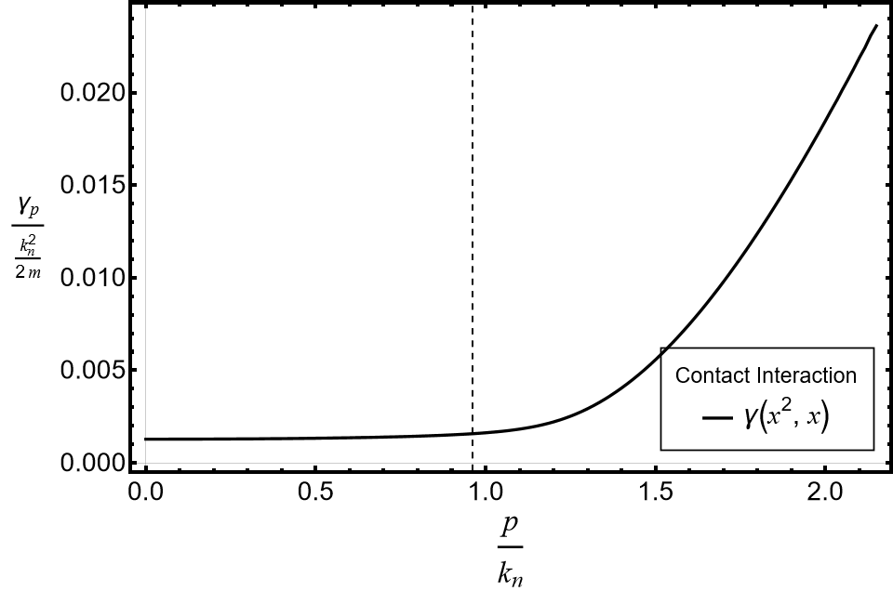
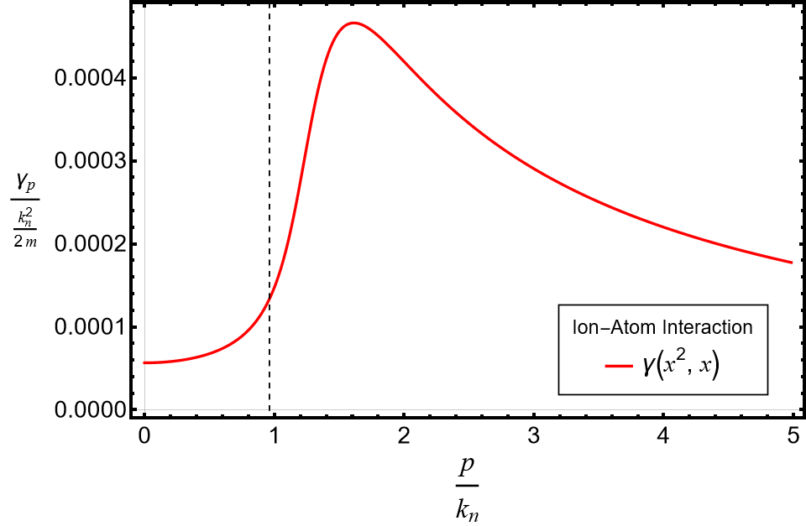
Decay rate

Slide 23
Conclusions
Contact Interaction as a function of the momentum has a nonstop growing of the decay rate and real part of the self-energy, which is not physical.
Description of a charged polaron requires to go beyond the Contact Interaction when studying its dynamical properties.
The Ion-Dipolar interaction recovers the known physics for zero momentum experiments.
Contact Interaction as a function of the scattering length has a short range of validity on second order corrections.

Slide 24
Backup

Slide 25
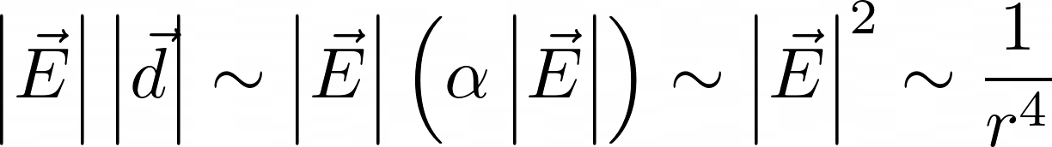
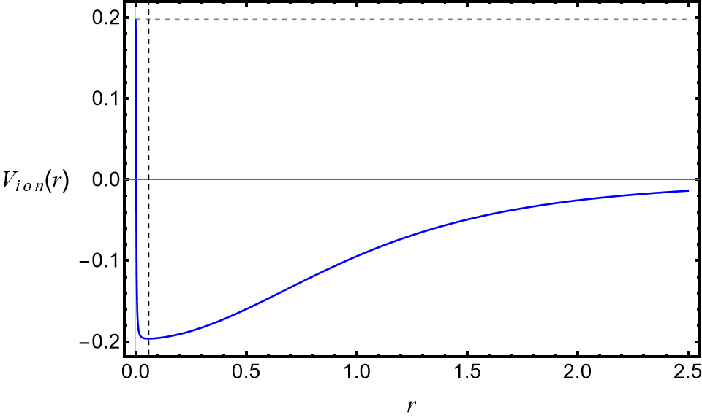

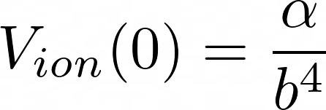
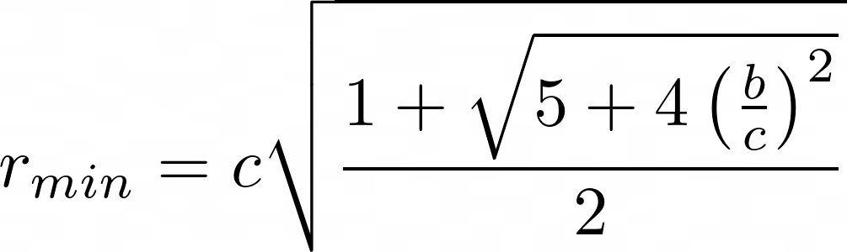
Ion-Dipole Interaction

Slide 26
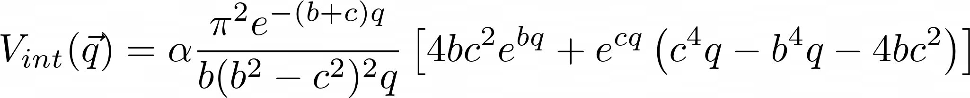
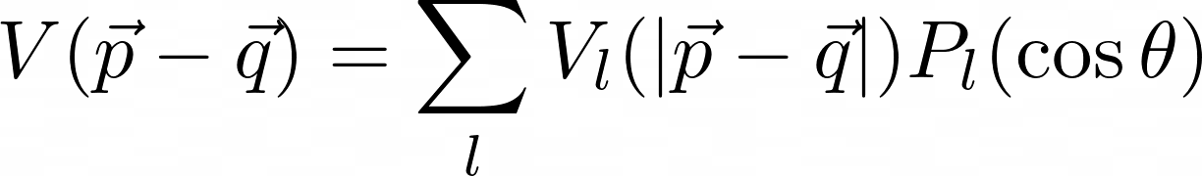
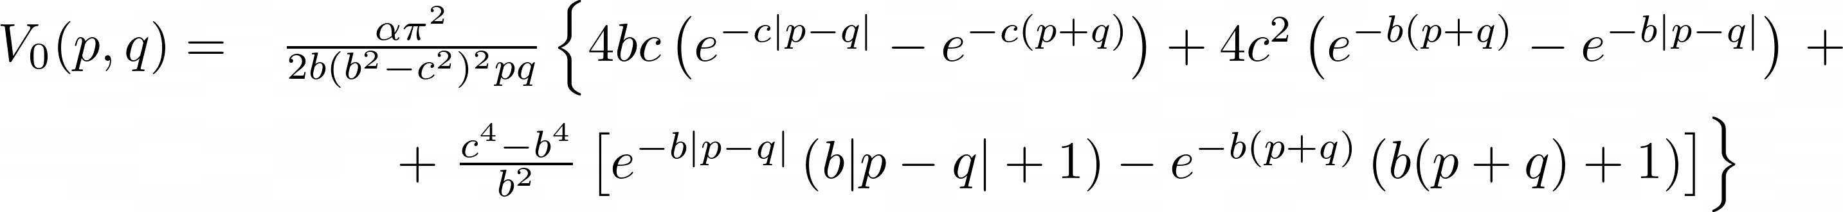

Solution to -Matrix
Partial wave expansion of the potential to $s$-wave order

Slide 27
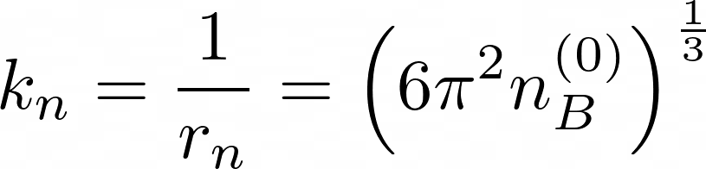
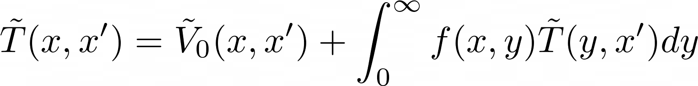
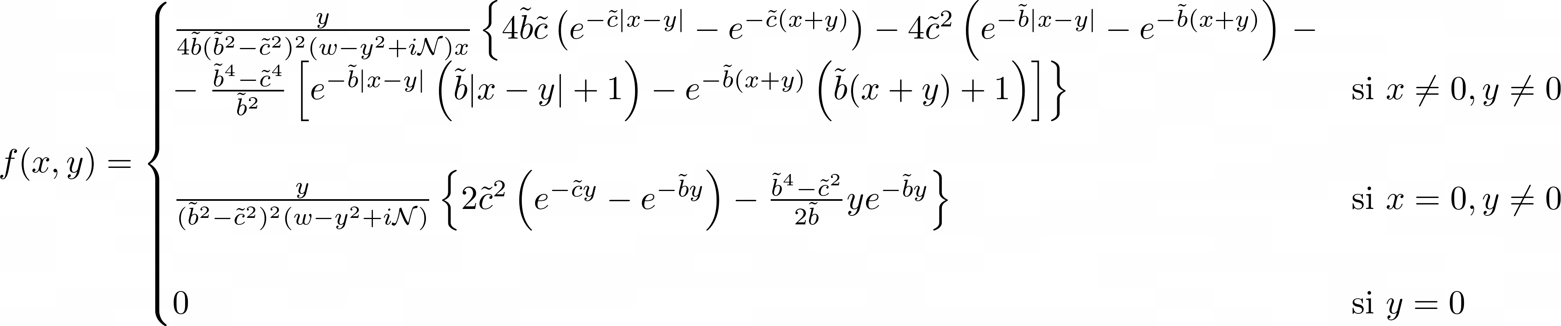
Autoconsistent integral to Lippmann-Schwinger equation

Slide 28

