Slide 1
FAKT matters
February 24th, 2021
R. Schöfbeck, M. Procura

Slide 2
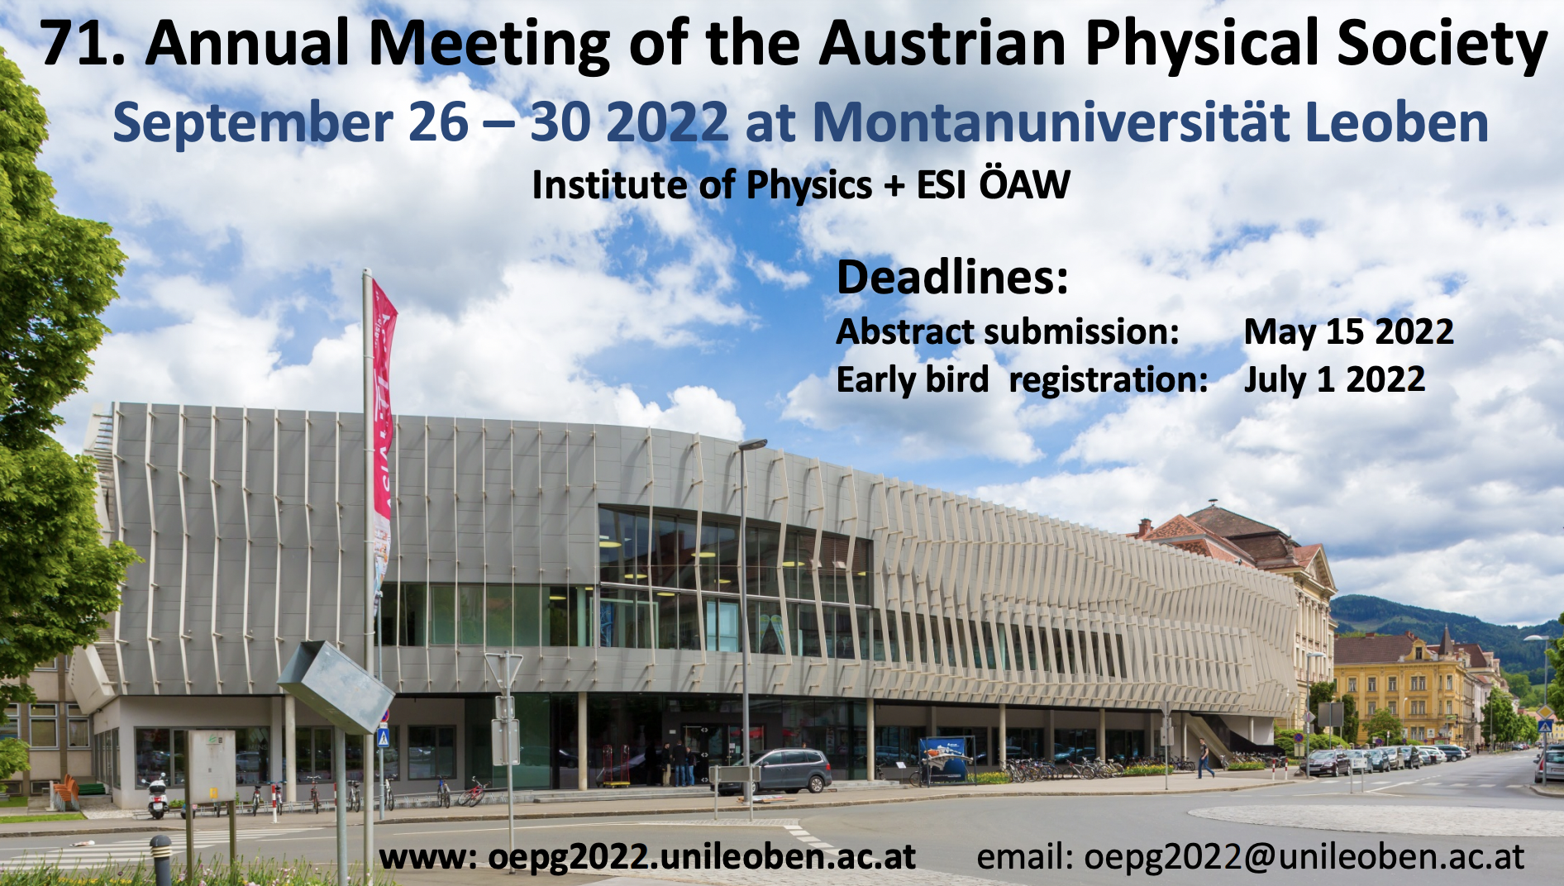
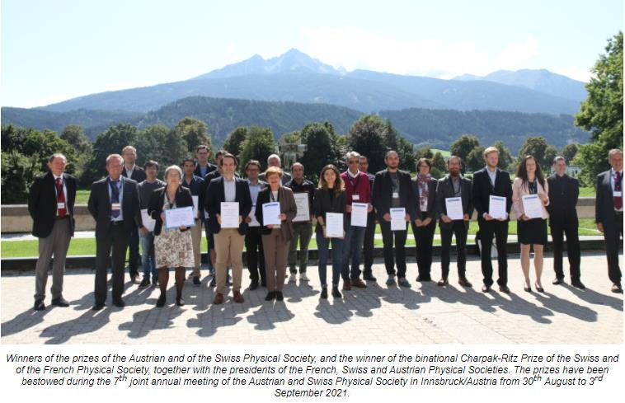
ÖPG
ÖPG Präsident: Gottfried Strasser
  Vizepräsident: Maurizio Musso
  Geschäftsführer: Hermann Detz
Annual meeting of the ÖPG/SPG 2021
  Aug. 30th – Sept. 3rd 2021 in Innsbruck
Annual meeting of the ÖPG 2022
  Sept. 26th – Sept. 30th 2022 in Leoben
ÖPG-SPG Tagung 2023 in Basel,
2024 Linz (A. Bonnani, JKU)

Slide 3
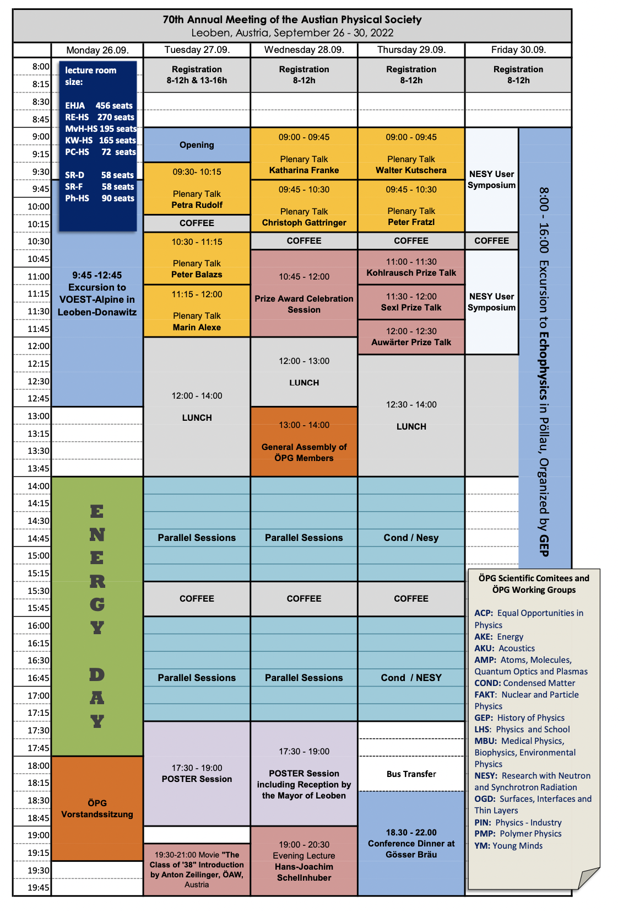
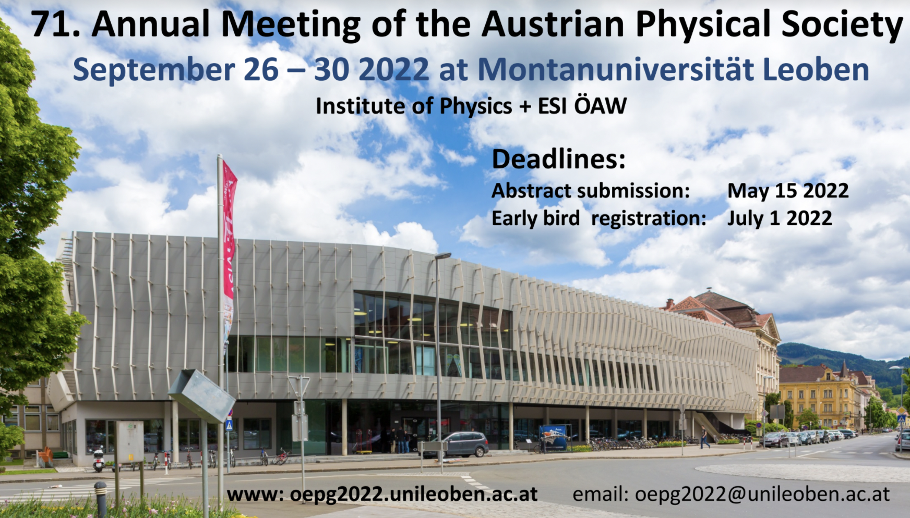
ÖPG
Annual meeting of the ÖPG 2022
  Sept. 26th – Sept. 30th 2022 in Leoben
Hint: reserve hotel room early

Slide 4
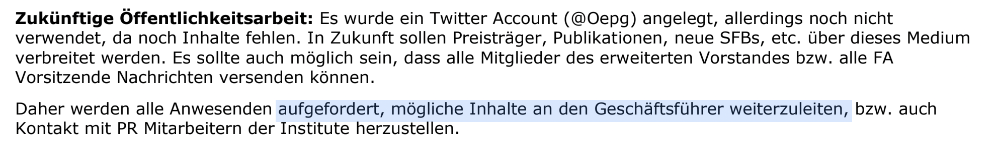
Outreach activity OePG
Contact: Herman Detz email

Slide 5
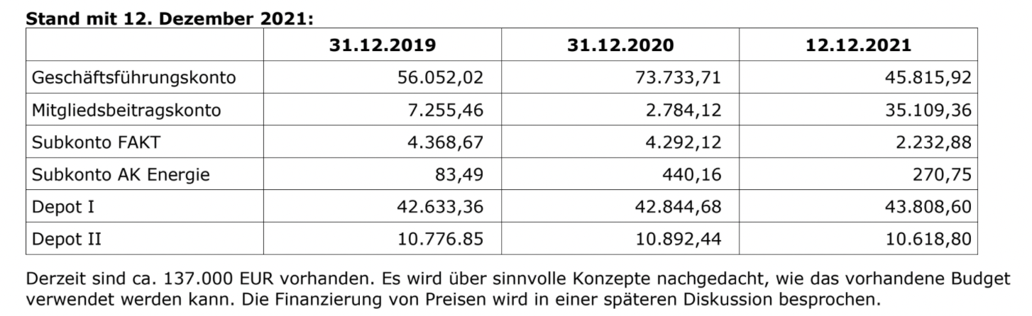
FAKT – viktor Franz Hess Preis
New procedure: OePG awards 3-5 prizes
  Subcommittees (e.g. FAKT) short-lists up to two candidates
  OePG management board makes final decision
Current suggestion for text : “Die ÖPG vergibt den Victor Franz Hess des Fachauschusses für …”

Slide 6
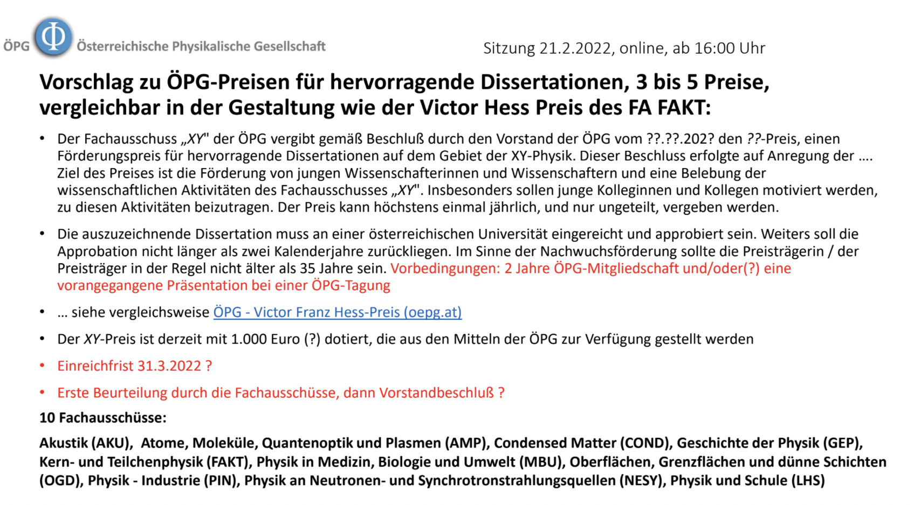

Slide 7
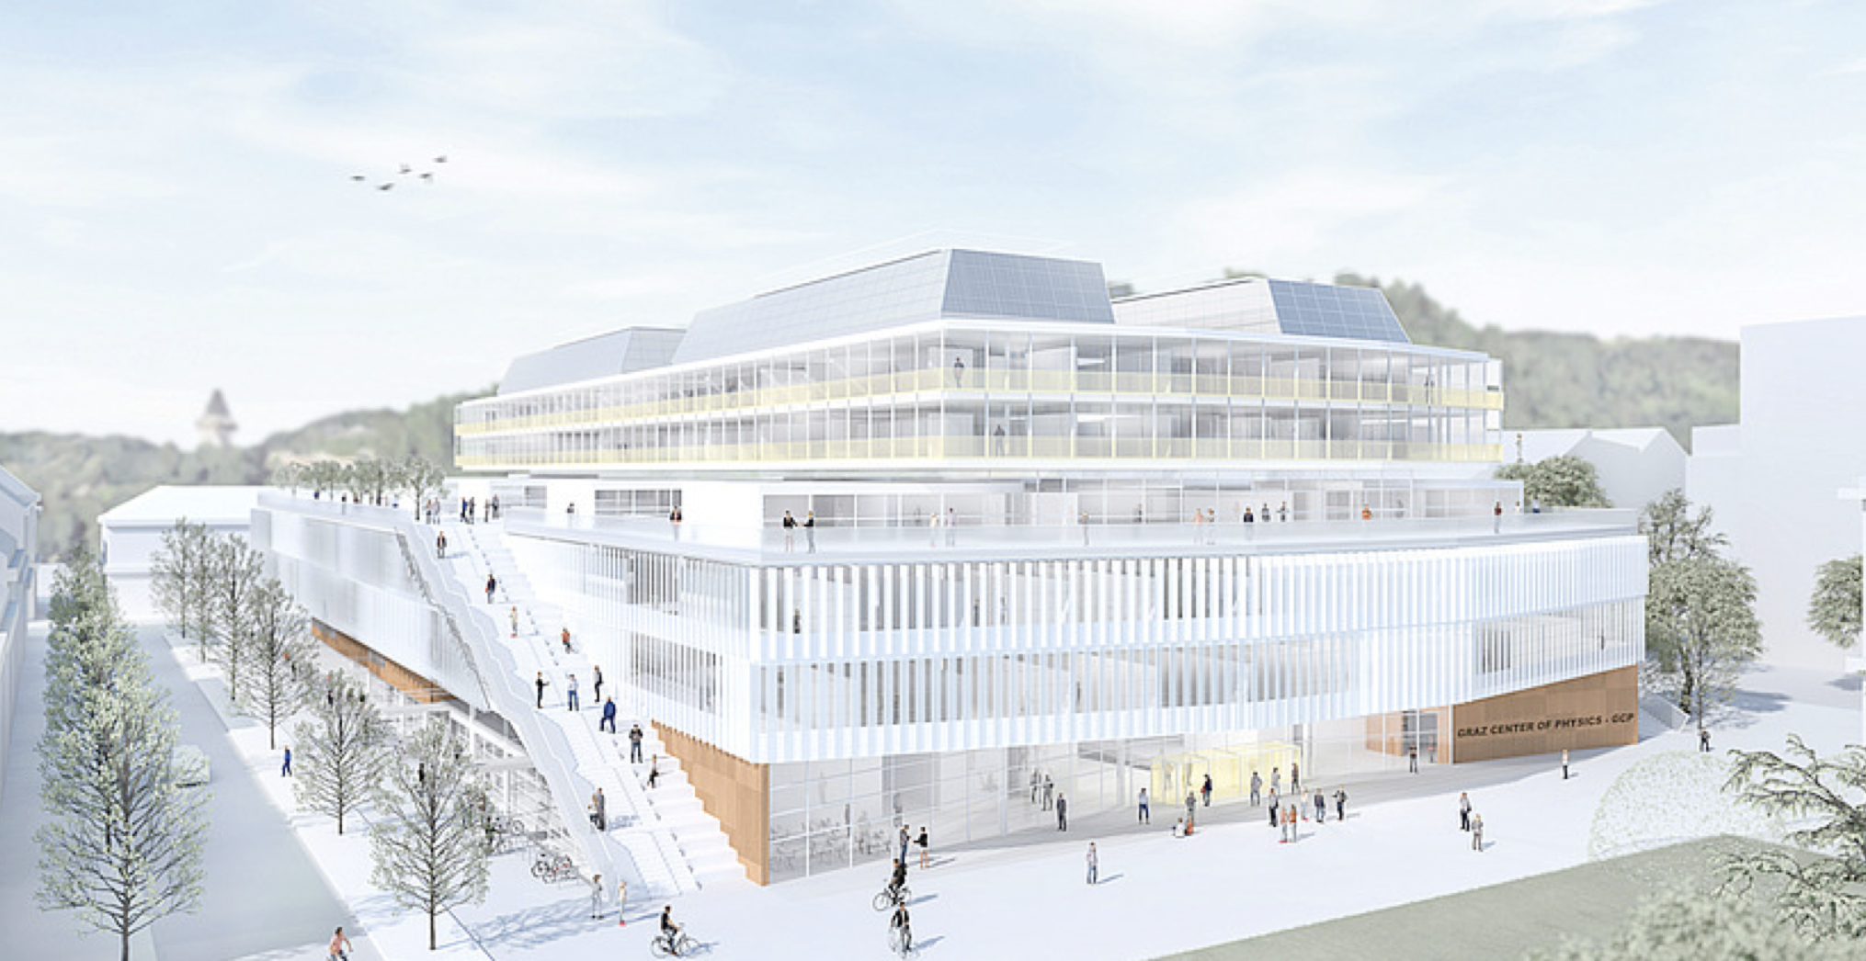
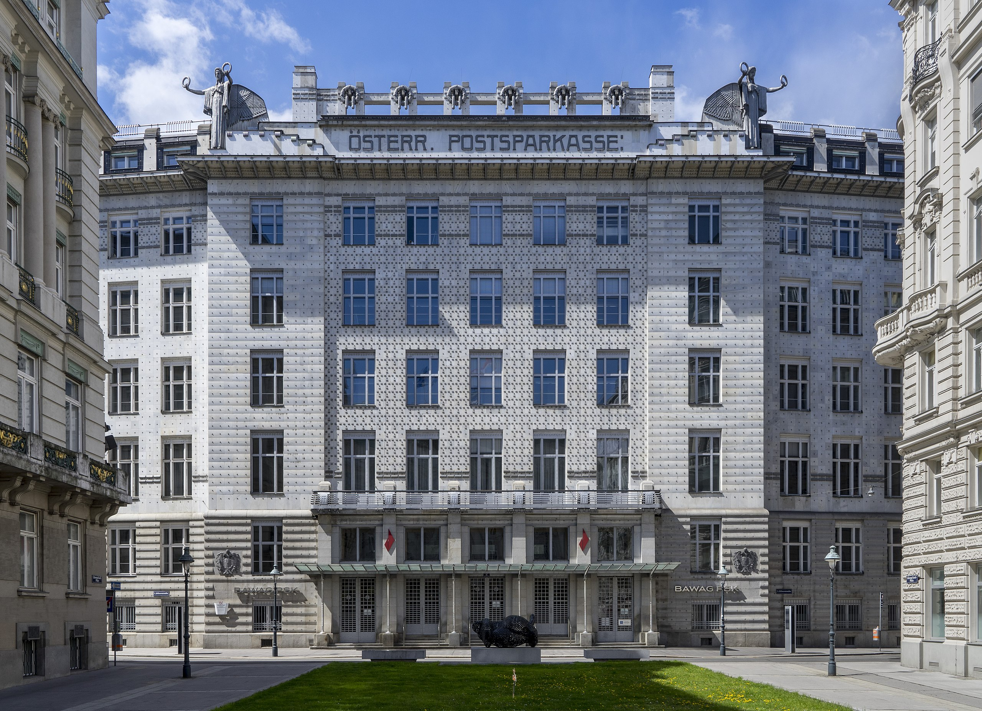
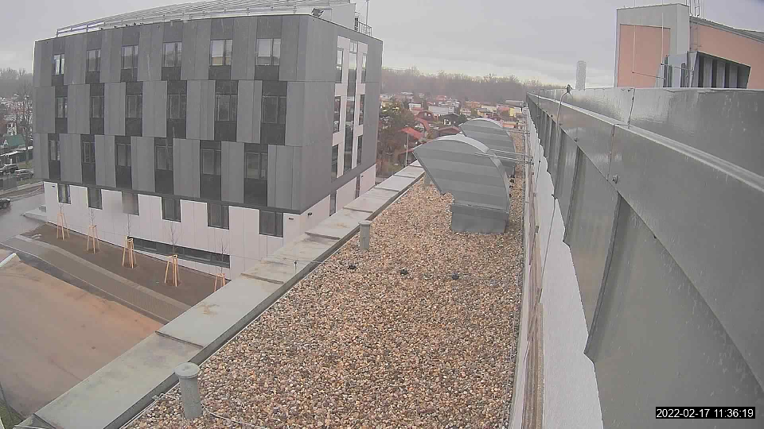
Buildingsew buildings
GCP Graz
HEPHY, SMI, (FWF, ISF, …) → PSK
ATI new building
GCP
SMI, HEPHY → PSK
Postsparkasse
ATI Screenshot (Tue)

Slide 8
Homepagesomepage(s) / emails
Current FAKT homepage:
  https://www.oeaw.ac.at/hephy/kerne-teilchen-fakt
link from ÖPG homepage is [fixed]:
  Virtual machine for VCI2022, can clone
  www.teilchen.at is registered (TU Wien) and redirects to OePG / teilchenphysik.at
Webpage for the general public for HEPHY topics:
  http://www.teilchenphysik.at/
219 paying OePG members in FAKT
  New OePG webpage will offer possibility to send emails to the sub-list
  FAKT mailing lists: austria-oepg-fakt (CERN egroup)

Slide 9
Beyond Vienna particle physics
Formally known as the (mostly) theory seminar series ”Vienna collider cross talk”
  Originally organized by Suchita Kulkarni, Simon Plätzer, Jochen Schieck
  S. Plätzer: Reactivate this series and go beyond colliders
    ‘Vienna particle physics’
    Using existing indico category: https://indico.cern.ch/category/11313/

Slide 10
FAKT related Conferences in AUSTRIA
  Identification of Dark Matter [IDM2022], 18-22 Juli 2022
  Strings2022 18-22 Juli, 2022
  IPA Sept. 2022: https://indico.cern.ch/event/837621/overview
  ESI Programme: https://www.esi.ac.at/events/e393/

Slide 11
Other items
Role of FAKT: Facilitate discussions & collaborations in Austria
Next FAKT meeting
  Default date: Last week of February 2022
Legal matters:
  Online tool for secrete election

