Slide 1


TU Wien Contribution during
FCC Study (2016-2021)
Low Temperature Physics and Superconductivity

Slide 2
Research Projects
Nb₃Sn Conductor R&D
Beam Screen Development (HTS)
Marie Skodowska-Curie
ITN EASITrain

Slide 3


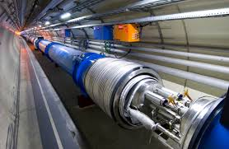
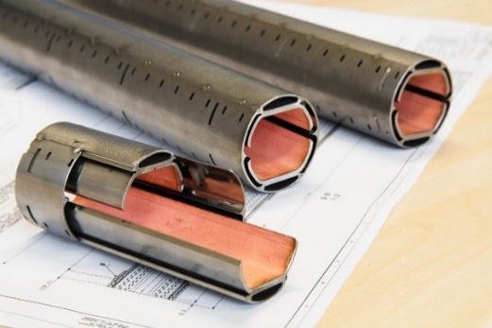
Nb₃Sn Conductor R&D
16 T dipole magnets
1500 A/mm²
4.2 K
Beam Screen Development (HTS)
Low impedance coating for reduction of beam-induced RF image currents
Operation at 50 K for
reduced cryogenic power consumption

Slide 4


Goal of the investigation
Microstructure
Local super-conducting properties
Macroscopic performance of super-conductors
SEM, TEM
EDX
SHPM, SQUID- magnetometry
Irradiation

Slide 5
Investigations at ATI
Low Temperature Physics and Superconductivity
Measurements of the critical currents
Irradiation experiments of superconducting materials
Magnetic field mapping
Search for material inhomogeneities
Finding the relationship between microstructure and superconducting properties

Slide 6
How to achieve J_{c}=1500 A/mm²?
Nb₃Sn Conductor R&D
16 T dipole magnets
1500 A/mm²
4.2 K
Two main concepts:
Artificial pinning
Reduction of inhomogeneities

Slide 7
Introduction
Superconducting properties (e.g. T_{C}, B_{C2}, J_{C}) in Nb₃Sn wires are influenced by:
Composition
Morphology
Composition gradients
Sn: Nb_{1−β} Sn_{β}
Additives: Ti, Ta
grain size
(grain boundaries)
→ J_{C}
→ T_{C}, B_{C2}
→ spatial T_{C} distribution
Defects (APC)

Slide 8
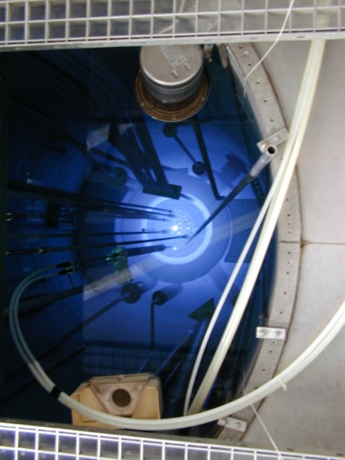
Irradiation experiments
Irradiation of short wire samples in the TRIGA Mark-II reactor at Atominstitut
Sequential irradiation in relatively small steps in order to assess fluence dependence of superconducting properties
Very important also for nuclear fusion

Slide 9
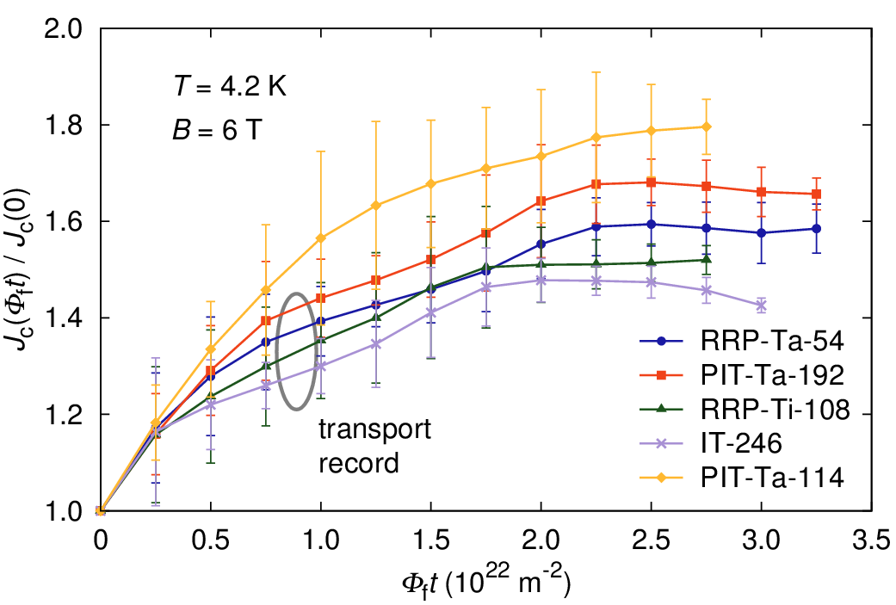
Irradiation experiments
Critical current density increases significantly in irradiated wires because of nano-sized defects.
FCC target was obtained in industrial Nb₃Sn wire!
Only model system. Later realized by oxide nano-particles in prototype wires.
Baumgartner, T. et al., Sci. Rep. 5, 10236;
doi: 10.1038/srep10236 (2015).

Slide 10
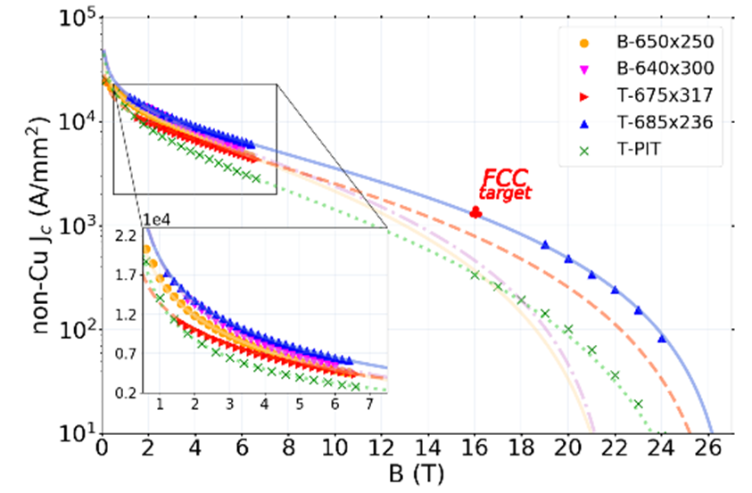
Artificial pinning centers
“Addition” of Zr-O nanoparticles
Collaboration with USA: Ohio State University, Hypertech, Fermilab
Ortino, M. et al., Supercond. Sci. Technol. 34, 035028;
doi: 10.1088/1361-6668/abd5f4 (2015).

Slide 11
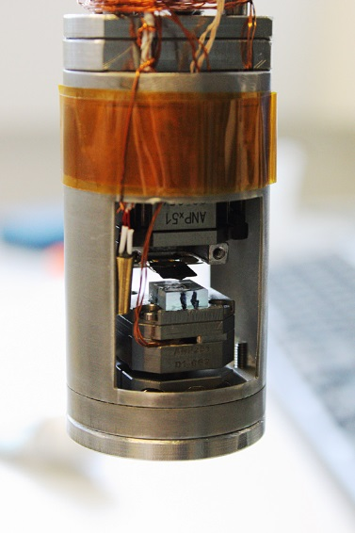
Magnetometry - SHPM
Micro Hall Scanner
Principle:
  Measurement of local magnetic field,
  either in applied magnetic field or with
  remnant magnetization
Experiment
  Field up to 8 T, range: 3 x 3 mm² @ 1 µm
Goal
  Evaluating T_{C} gradients by scanning in the Meißner state at different temperatures
  Assessing inhomogeneities in J_{c} by inversion of the Biot-Savart law
Scanner head with mounted sample

Slide 12
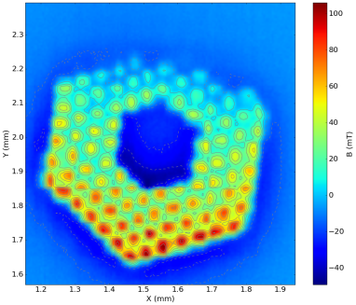
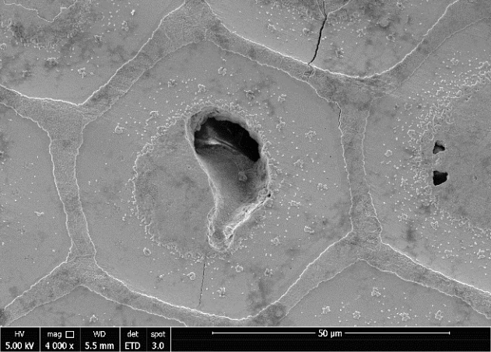
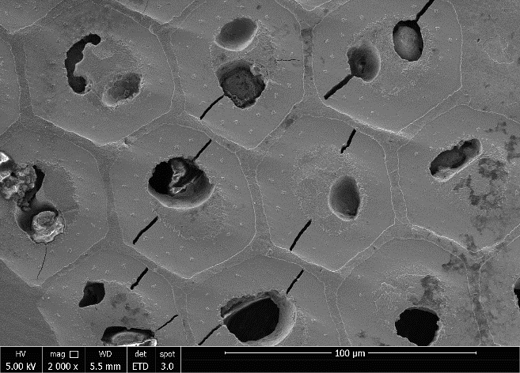
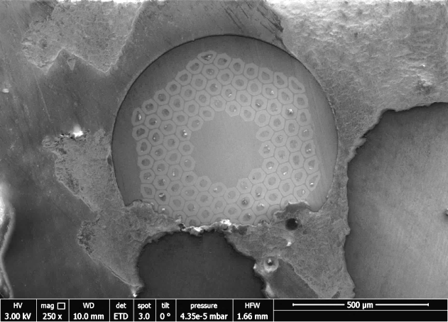
Sample preparation for Micro Hall Scanner
Thin slice of less than 10 µm prepared by mechanical polishing with diamond disks
Parallel and even surfaces essential
Polishing induces damage on the sample
4 K @ 1 T

Slide 13
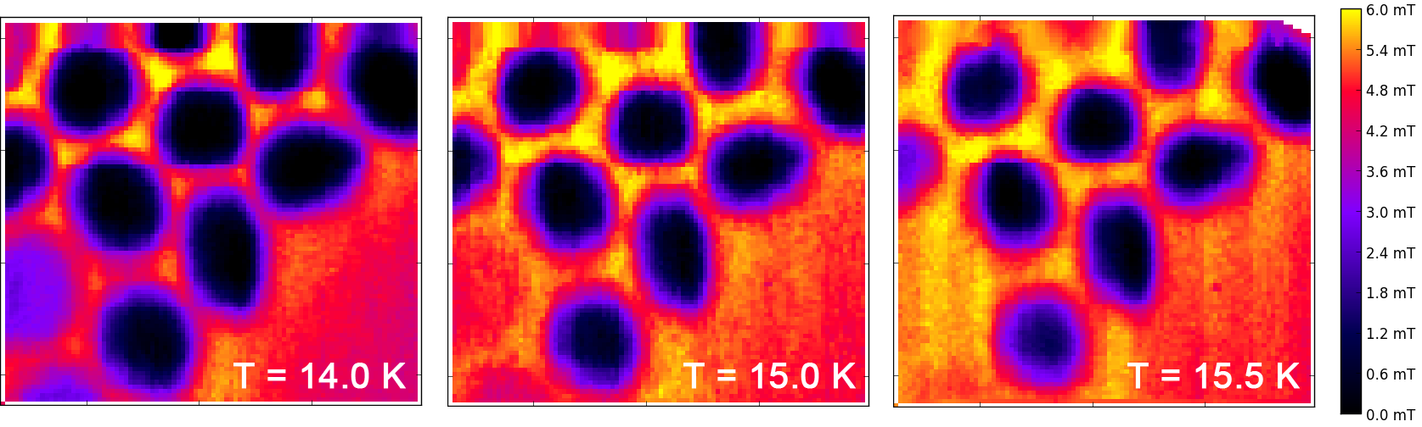
Magnetic Inhomogeneities
RRP-Ti wire
RRP-Ti wire @ 10 K / 100 mT
RRP-Ti wire, scanned in the Meißner state at different temperatures
Change in screened area reveals T_{C} gradient in the sub-elements
For finding inhomogeneities in J_{C}, scans at fields of several Tesla will be performed

Slide 14
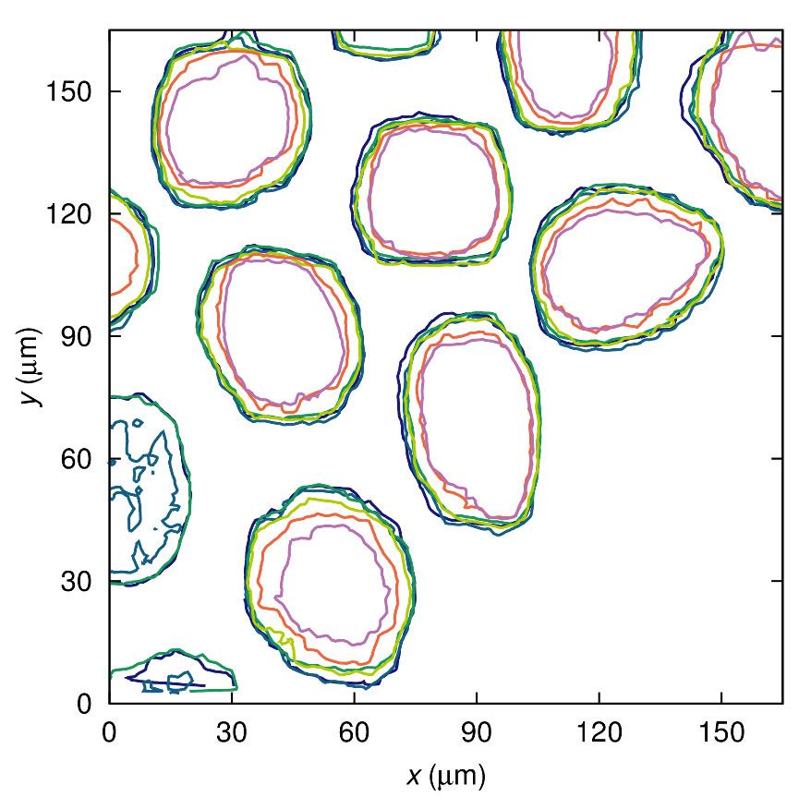
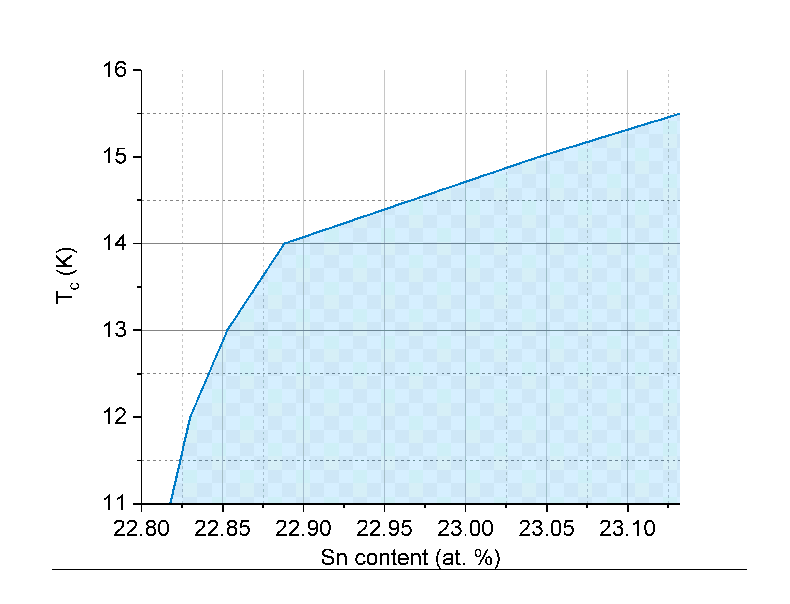
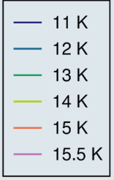
Meißner scans of RRP-Ti wire
Meißner Scans on 10 µm thin slice of RRP-Ti wire
Screening radius depends on temperature due to gradient in Sn content
Dependency of T_{C} from the Sn content
Small change in Sn content heavily impacts T_{C}

Slide 15
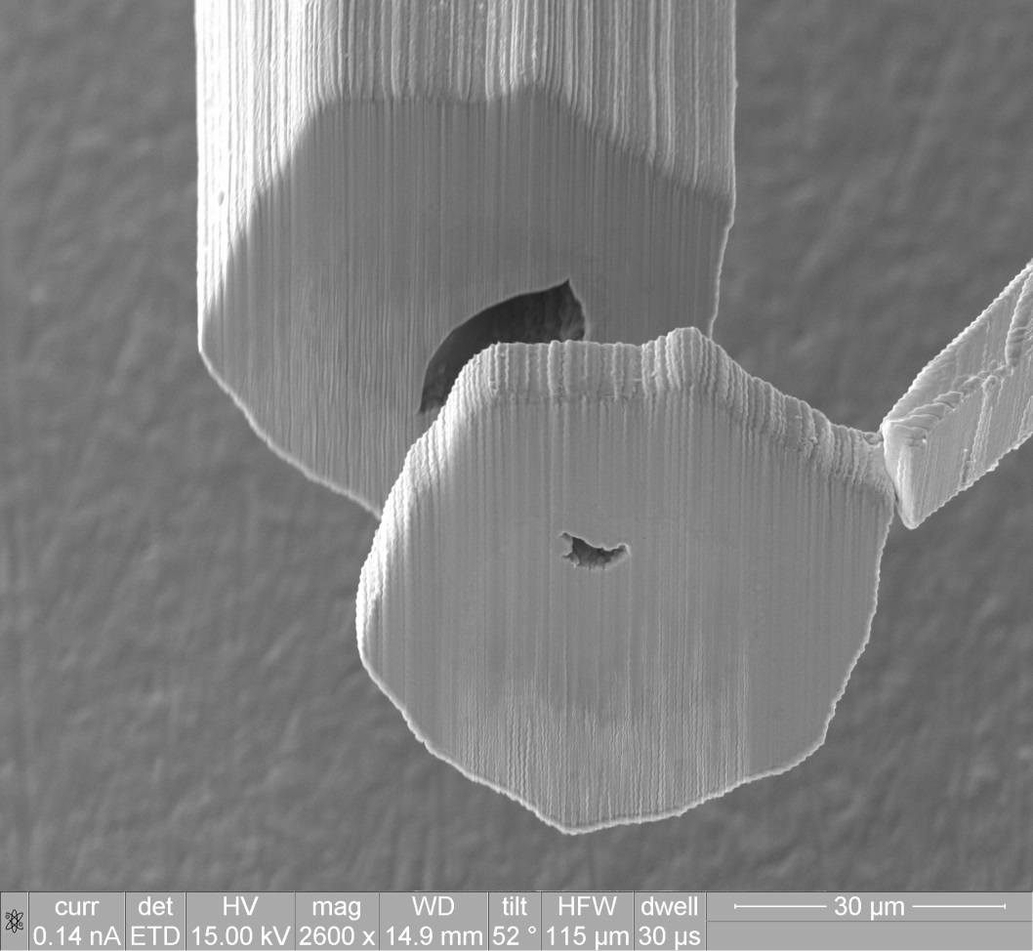
Sample Preparation of subelement
Preparing thin slices of etched subelements using FIB for SHPM measurements

Slide 16
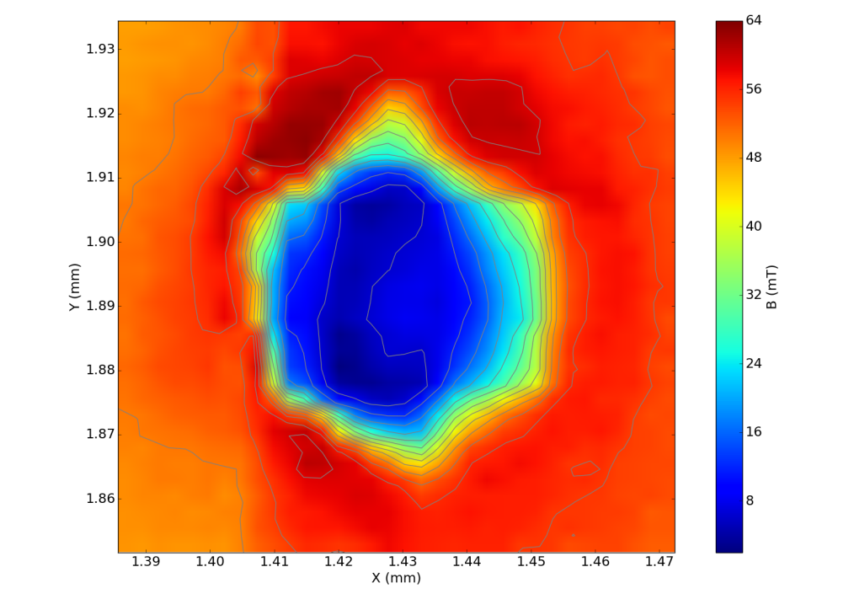
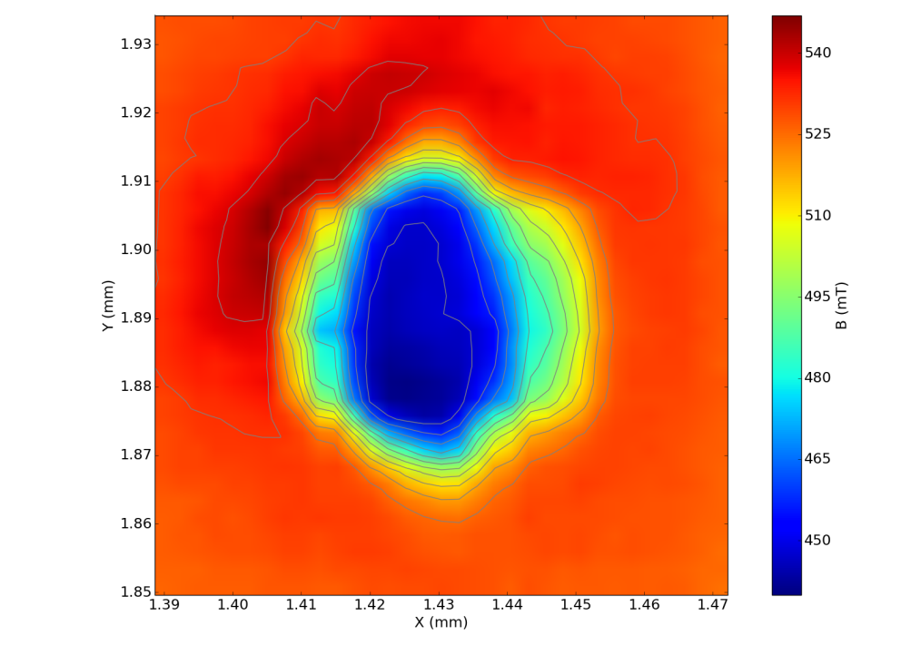
Magnetic Inhomogeneities
Hall scans of subelement at 5 K
50 mT
500 mT
FIB preparation of individual single subelements is feasible
For detection of inhomogeneities of J_{C} Hall scans at higher applied fields will be performed

Slide 17
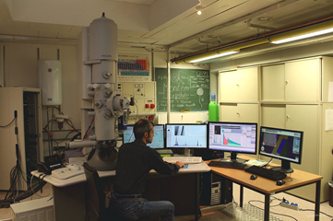
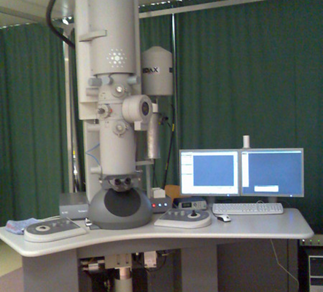
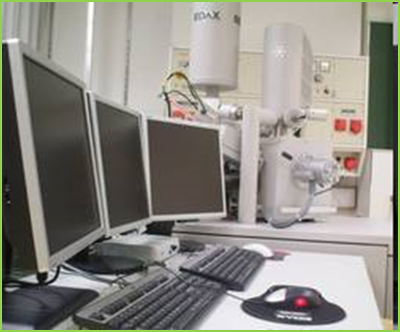
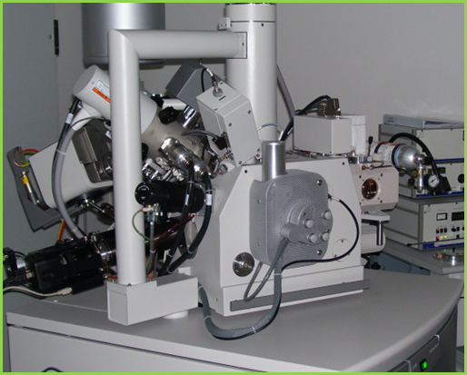
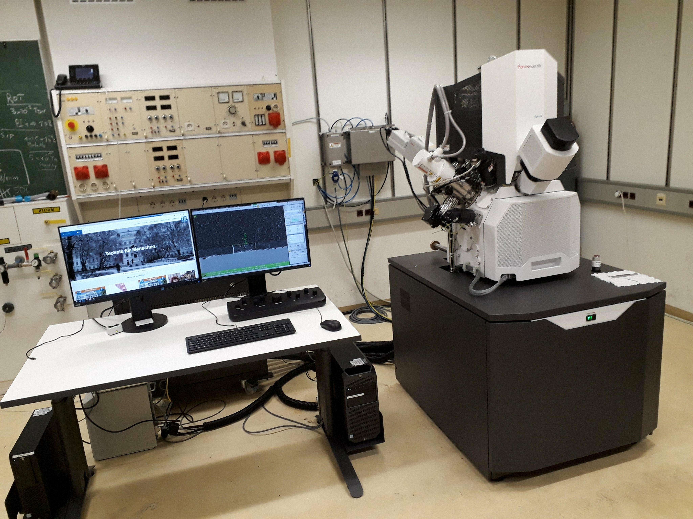
Investigations at USTEM
Composition gradients in Nb₃Sn wires
Irradiation Effects
Tl1223 for beam screens
Artificial pinning centers (APC)
Carbon-Cluster in MgB₂
Coated conductors YBCO
FEGTEM
TEM
FEGSEM
DBFIB
DBFIB

Slide 18
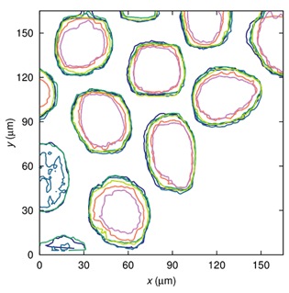
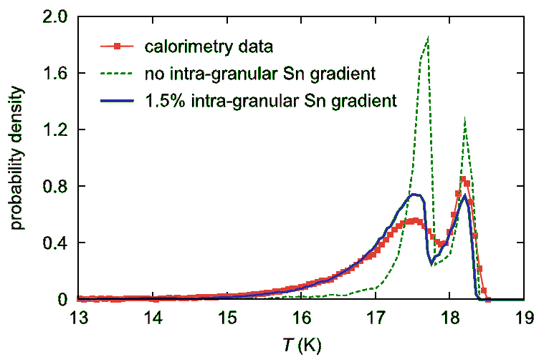
Composition Gradients
Thomas Baumgartner et al, SUST 30, (2017)
Magnetometry and calorimetry
lead to different distribution functions
Caused by Sn distribution within individual grains

Slide 19
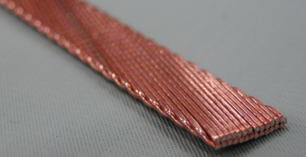
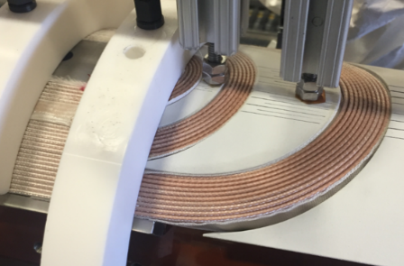
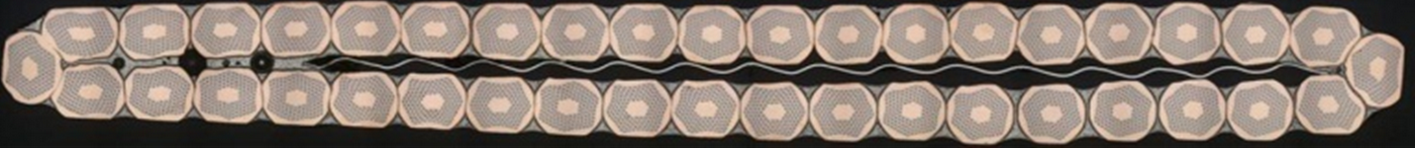
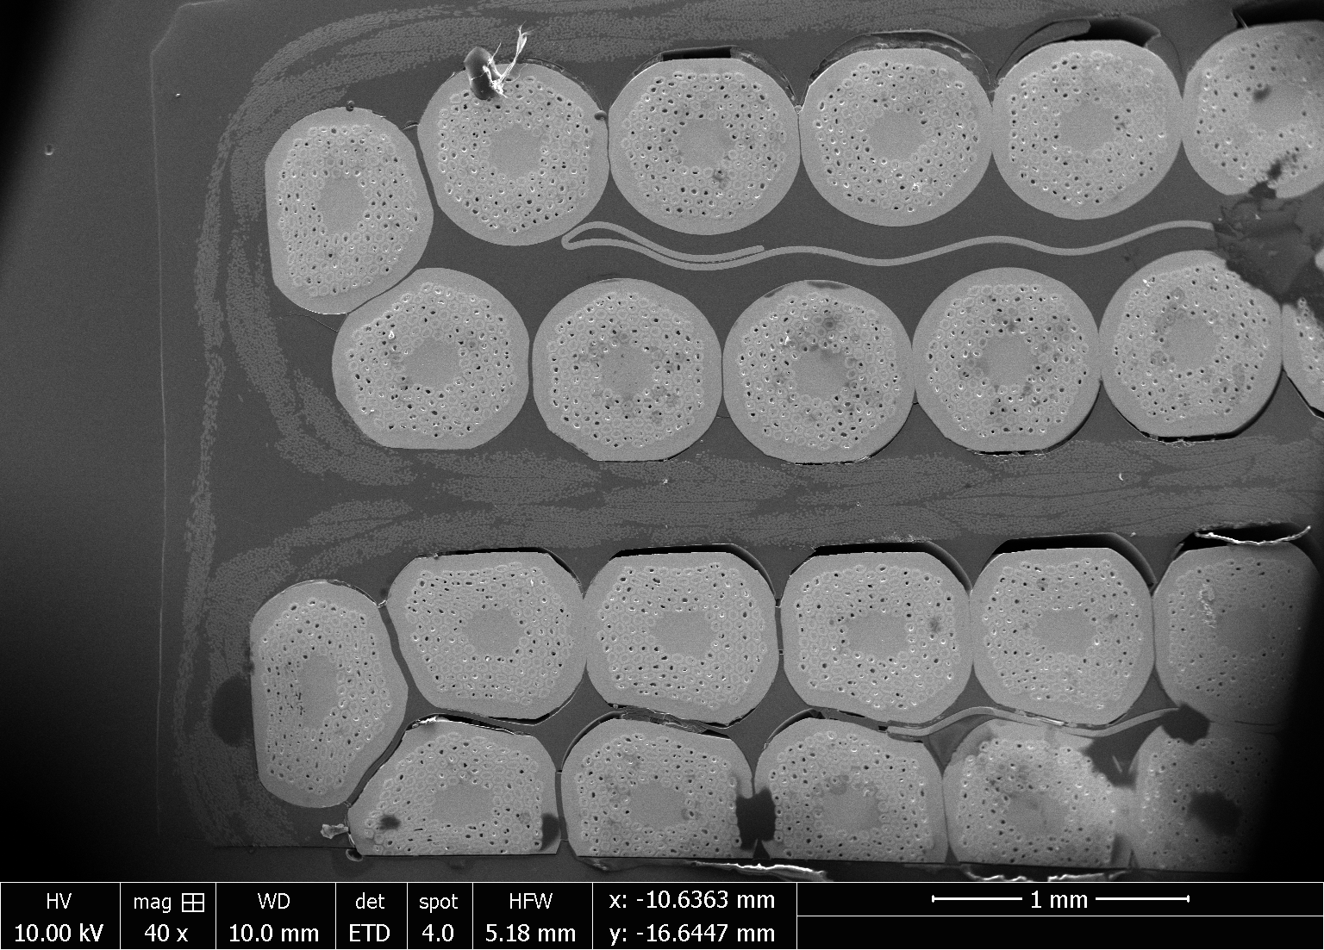
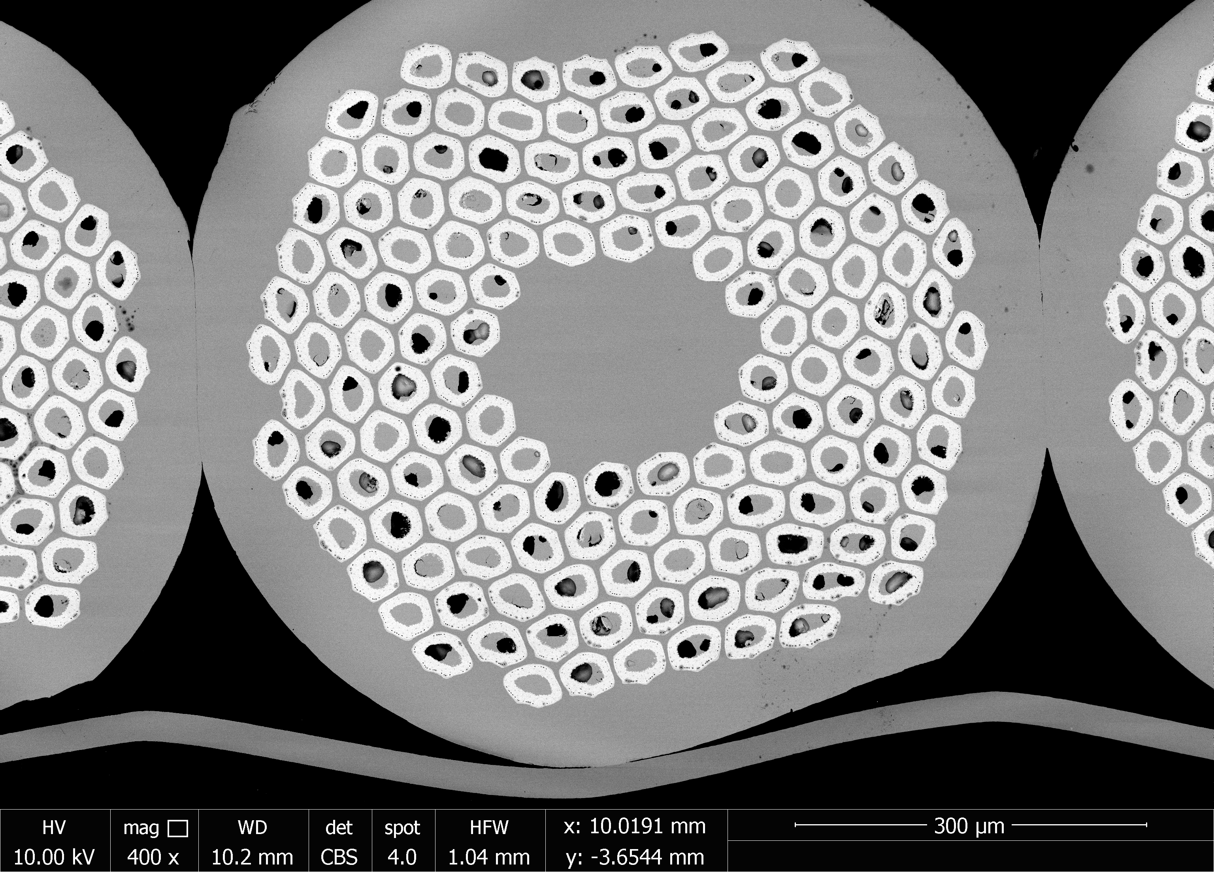
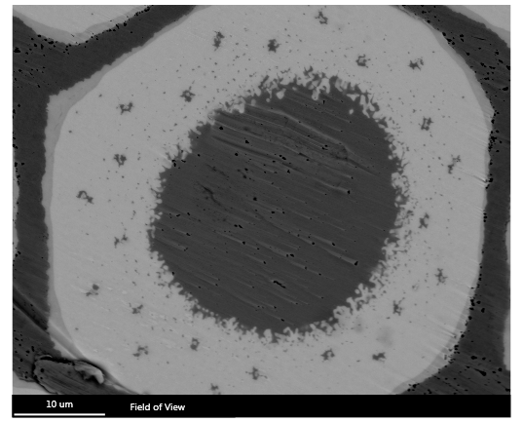
Nb₃Sn Conductor R&D
Rutherford cable
Fermilab
Strands
Subelements
(Filaments)

Slide 20
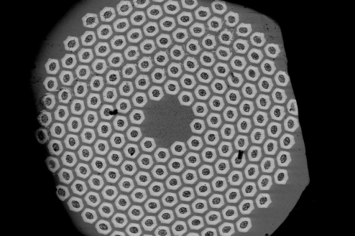
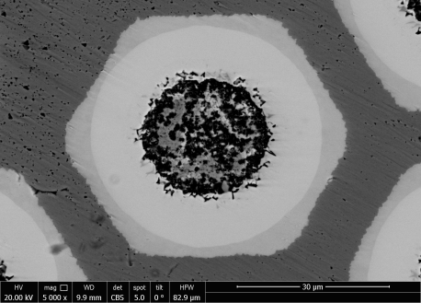
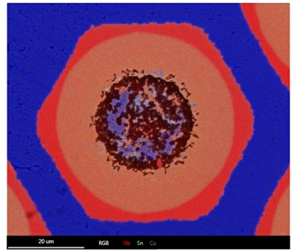
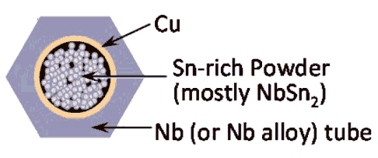
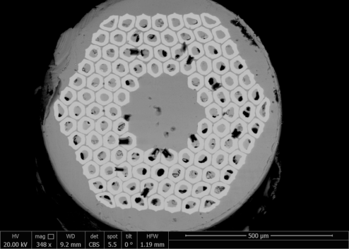
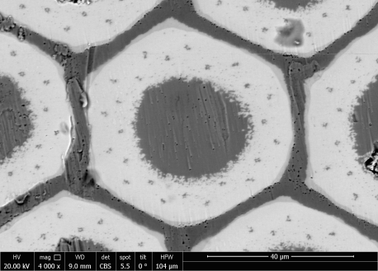
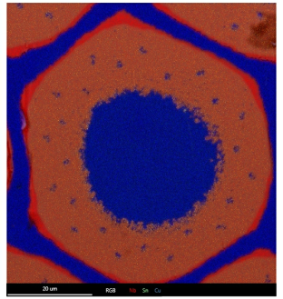
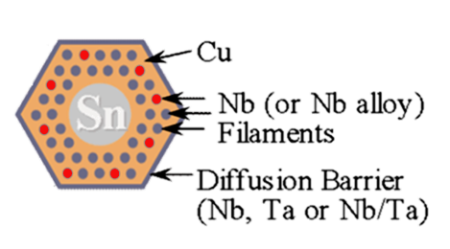
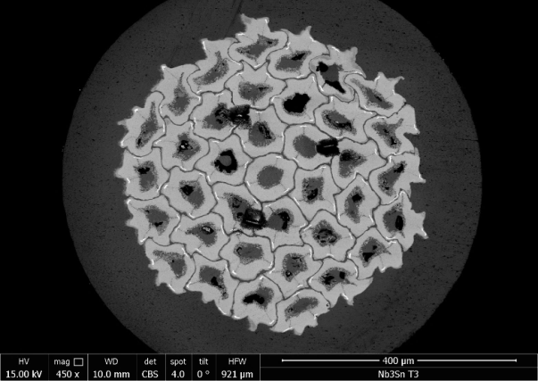
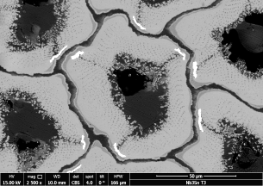
Investigated Nb₃Sn wires
FEGSEM
Subelement
EDX map
PIT-Ta
500 µm
Internal Sn–Ti RRP
Ti
Nb₃Sn
Cu
Nb
1
2
3
Distributed Nb + Ta
Clustered layout
Diagrams redrawn from: M.Jewell, Thesis, (2008), UW-Madison

Slide 21
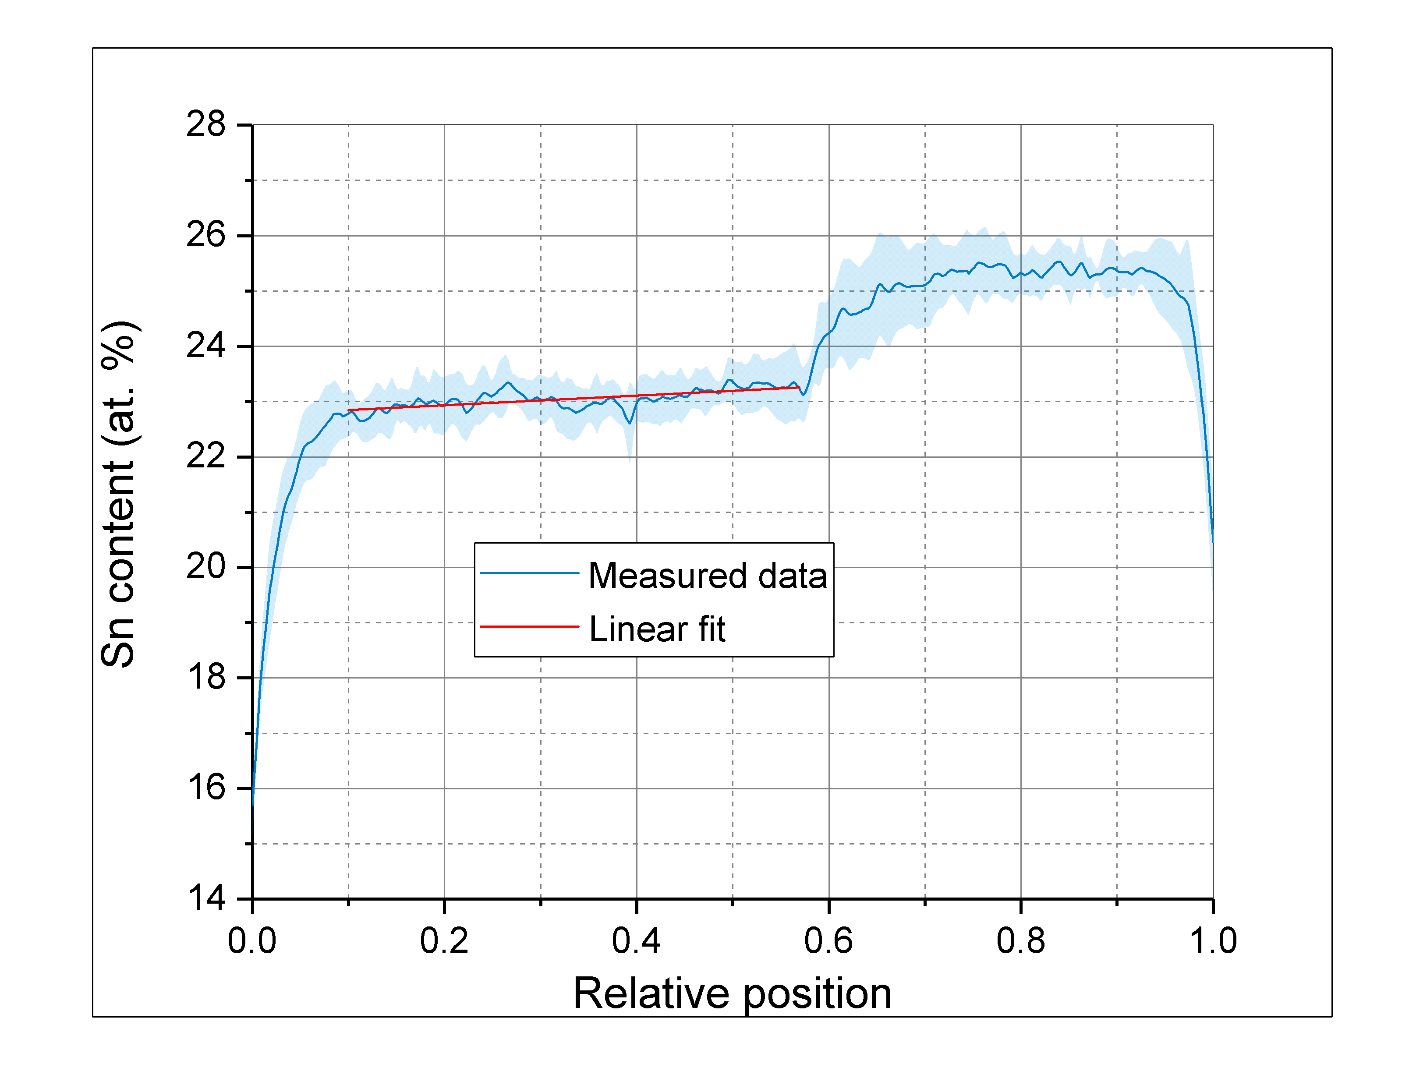
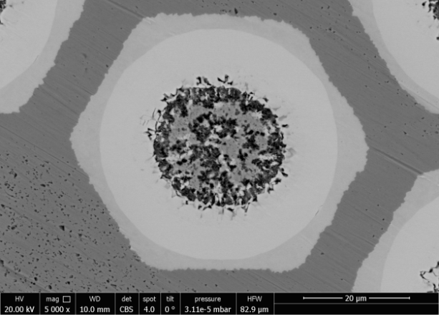
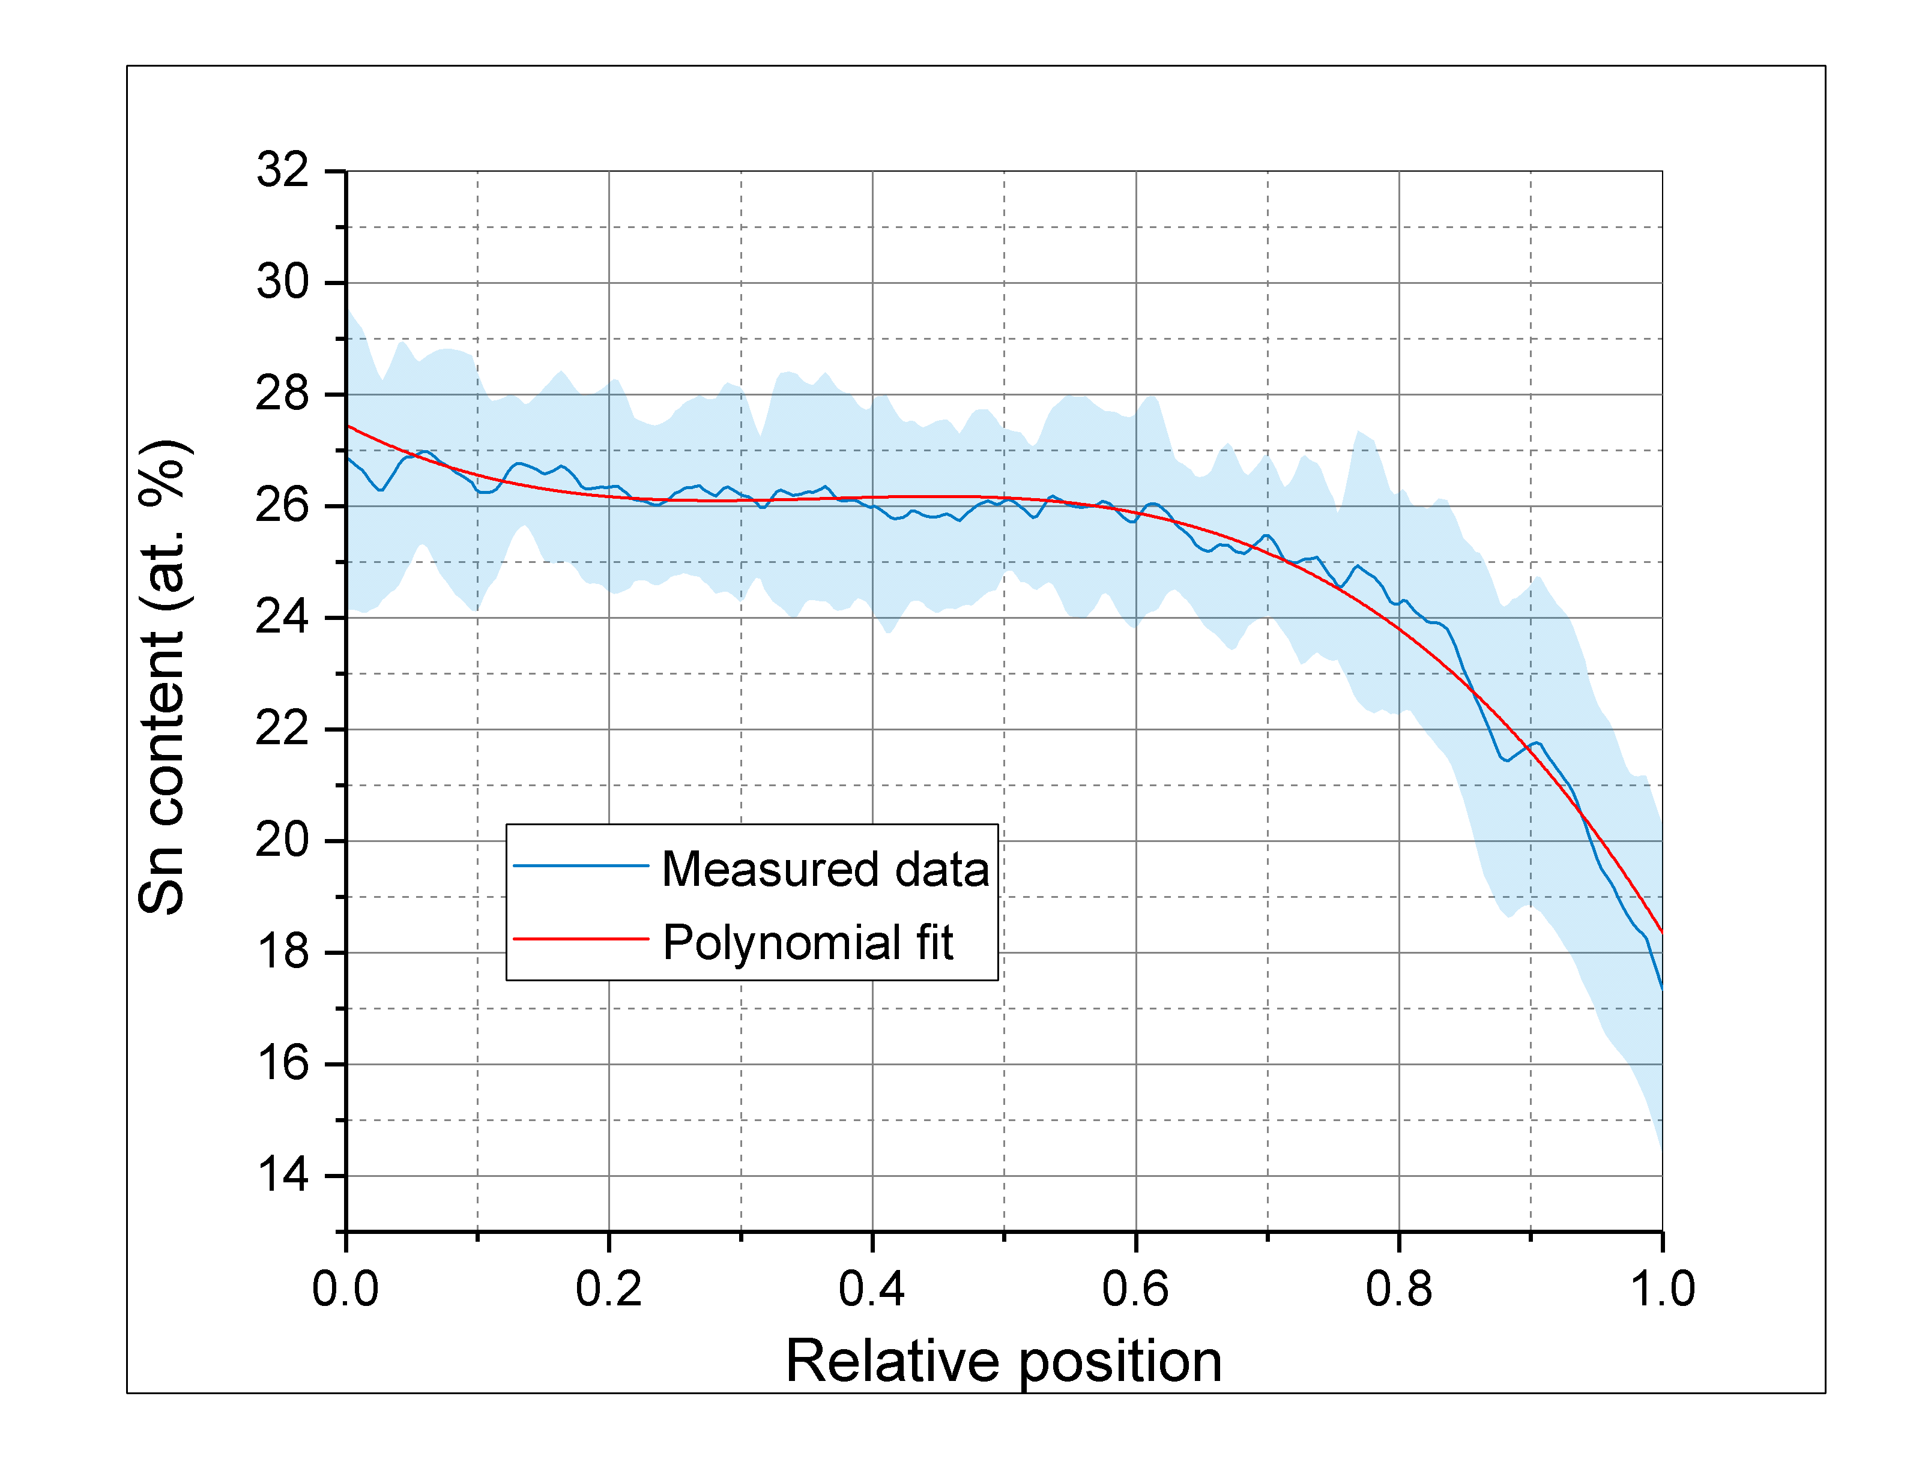
Sn distribution within PIT-Ta
ΔSn: 0.08 %/µm
Barrier
Center
GB
Center

Slide 22
Irradiated RRP-Ti wire

Slide 23
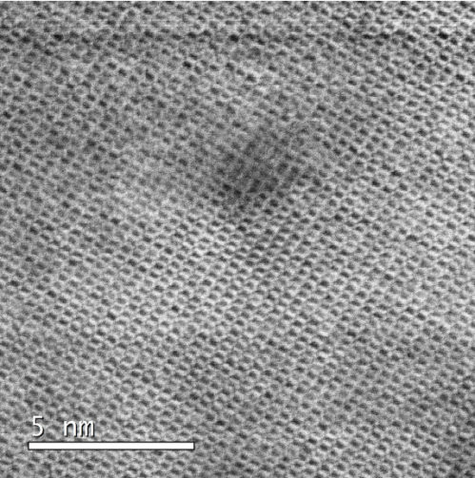
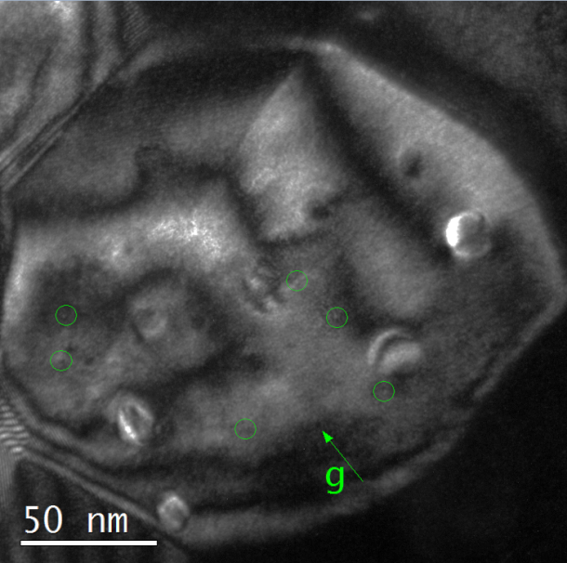
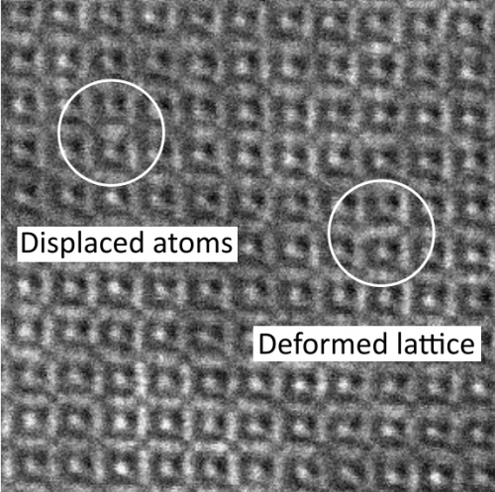
Irradiation experiments
DF
BF
Formation of nanosized defects

Slide 24
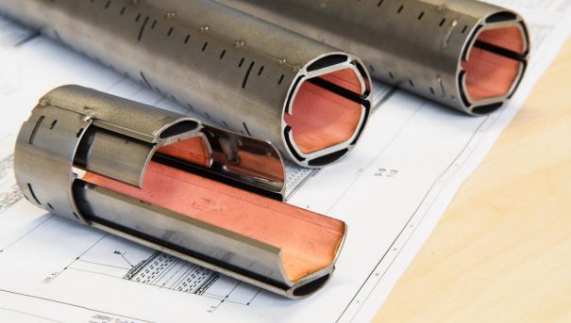

Tl1223 for Beam Screens
Synchrotron radiation must be absorbed at 50 K
Vacuum requirements
Cryogenic efficiency
Power consumption
Cu is not sufficient
YBCo or Tl based HTS are an option
Tl-HTS produced at CNR Spin / Genova

Slide 25
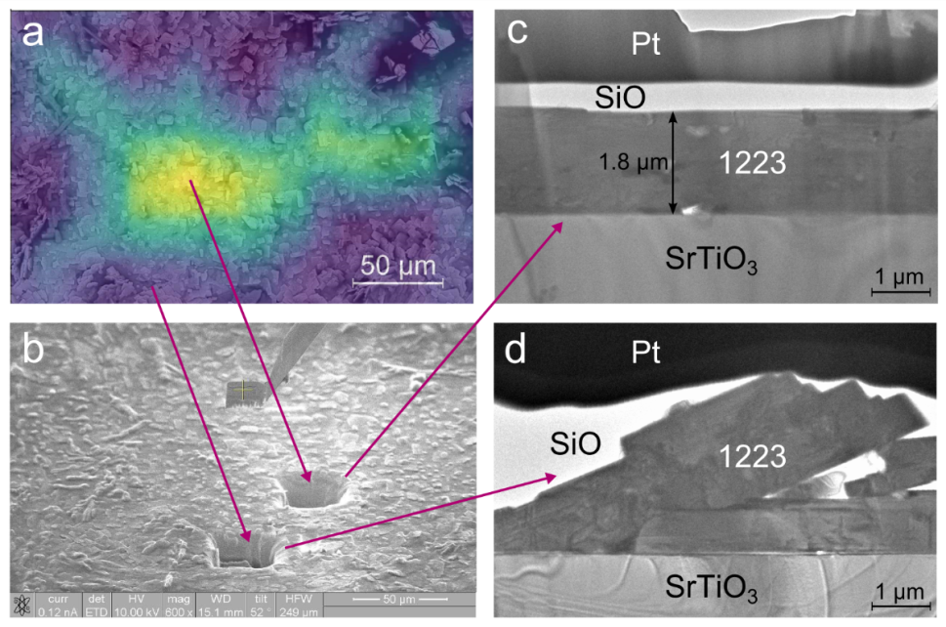
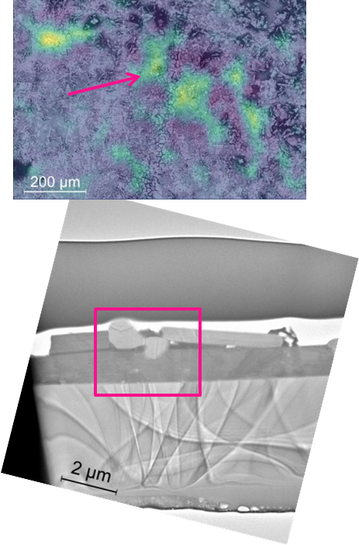
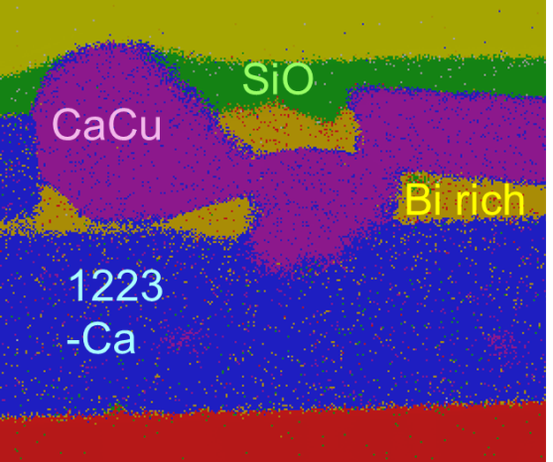
What influences sc properties
Misagligned 1223 grains
Impurities

Slide 26




Beam Screen Development (HTS)
Ag
Tl-1223
Tl-1212
O, Ca rich
O, Ca, Sr rich
Ag
Tl-1223
O, Ca,
Pb rich
Tl-1212
Notes:
The first samples produced typically show plate-like big grains (approx. 200 µm) spread out all over the Ag substrate. In particular, it was observed that the surface is mostly characterized by Tl-1212 grains (whose formation is energetically more favourable) covering the Tl-1223 ones and by O, Ca and Sr rich areas.

Slide 27







Beam Screen Development (HTS)
1223
Correlation of sc properties with microstructural features
1234?
1223
1223
Cu
1223
1223
1234?
Notes:
The first samples produced typically show plate-like big grains (approx. 200 µm) spread out all over the Ag substrate. In particular, it was observed that the surface is mostly characterized by Tl-1212 grains (whose formation is energetically more favourable) covering the Tl-1223 ones and by O, Ca and Sr rich areas.

Slide 28

µHall: Magnetic field mapping
Comparison between remnant magnetic field and local composition of the superconductor
Notes:
The first samples produced typically show plate-like big grains (approx. 200 µm) spread out all over the Ag substrate. In particular, it was observed that the surface is mostly characterized by Tl-1212 grains (whose formation is energetically more favourable) covering the Tl-1223 ones and by O, Ca and Sr rich areas.

Slide 29
Nb₃Sn with artificial pinning
Formation of ZrO₂ or HfO₂ precipitates
Grain size refinement (more grain boundaries)
Additional pinning centers

Slide 30




Nb₃Sn with APC
TEM
TKD
Grain refinement determined by TKD

Slide 31


Nb₃Sn with APC
5900–6400 precipitates/µm³
Sample thickness determined by EELS
Estimation of APC density

Slide 32
Scientific Output FCC related
2016 – 2021
14 Publications in Journals
11 Poster Presentations
20 Talks
3 PhD and 2 PhD

