Slide 1
Hardware Activities at HEPHY
Austrian FCC Meeting

Slide 2
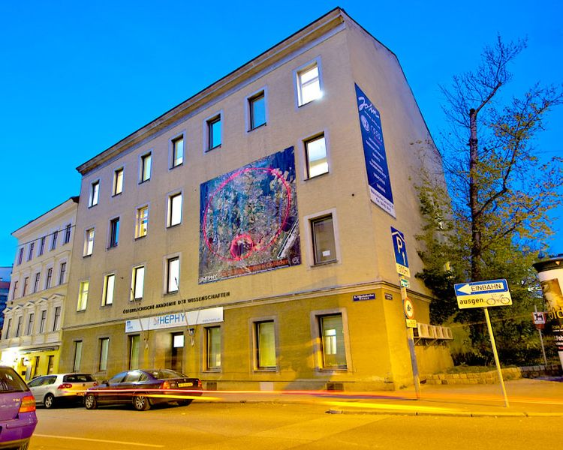
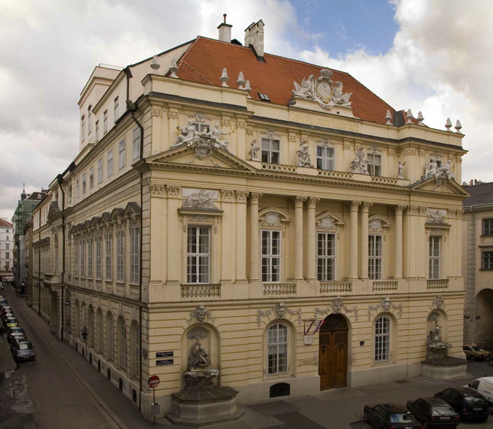

HEPHY
Institut für Hochenergiephysik
Nikolsdoerfer Gasse 18
Institute for High Energy Physics (HEPHY)
  Founded 1966 to take advantage of Austria’s CERN membership (1959)
  Situated in Vienna, two locations
  Staff: ~80 people
Belongs to
Austrian Academy of Sciences (ÖAW/OEAW)
  Founded 1847 as “scientific club”
  Nowadays the largest non-university institution for basic research in Austria
  28 Institutes with around 1450 staff
    Humanities
    Natural sciences
Österreichische Akademie der Wissenschaften
Hauptgebäude, Ignatz Seipel Platz

Slide 3

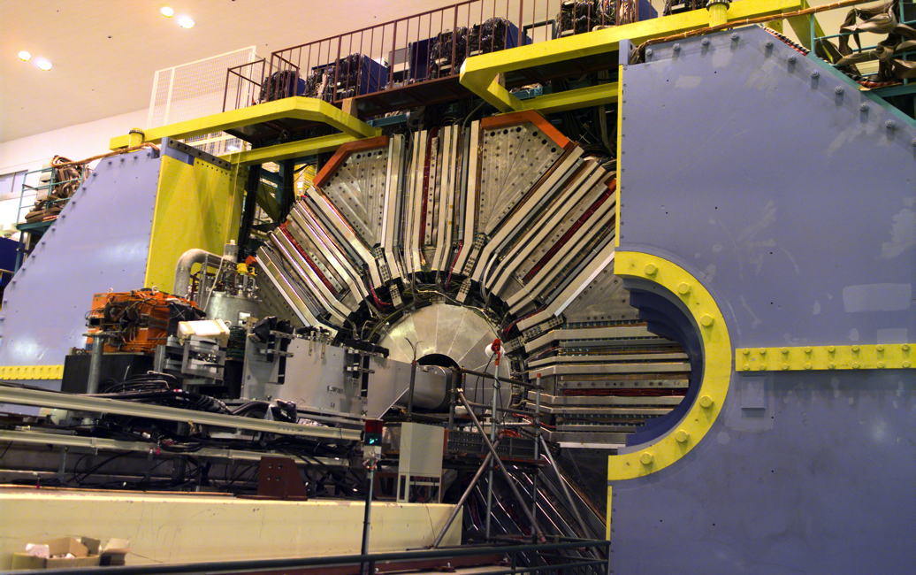
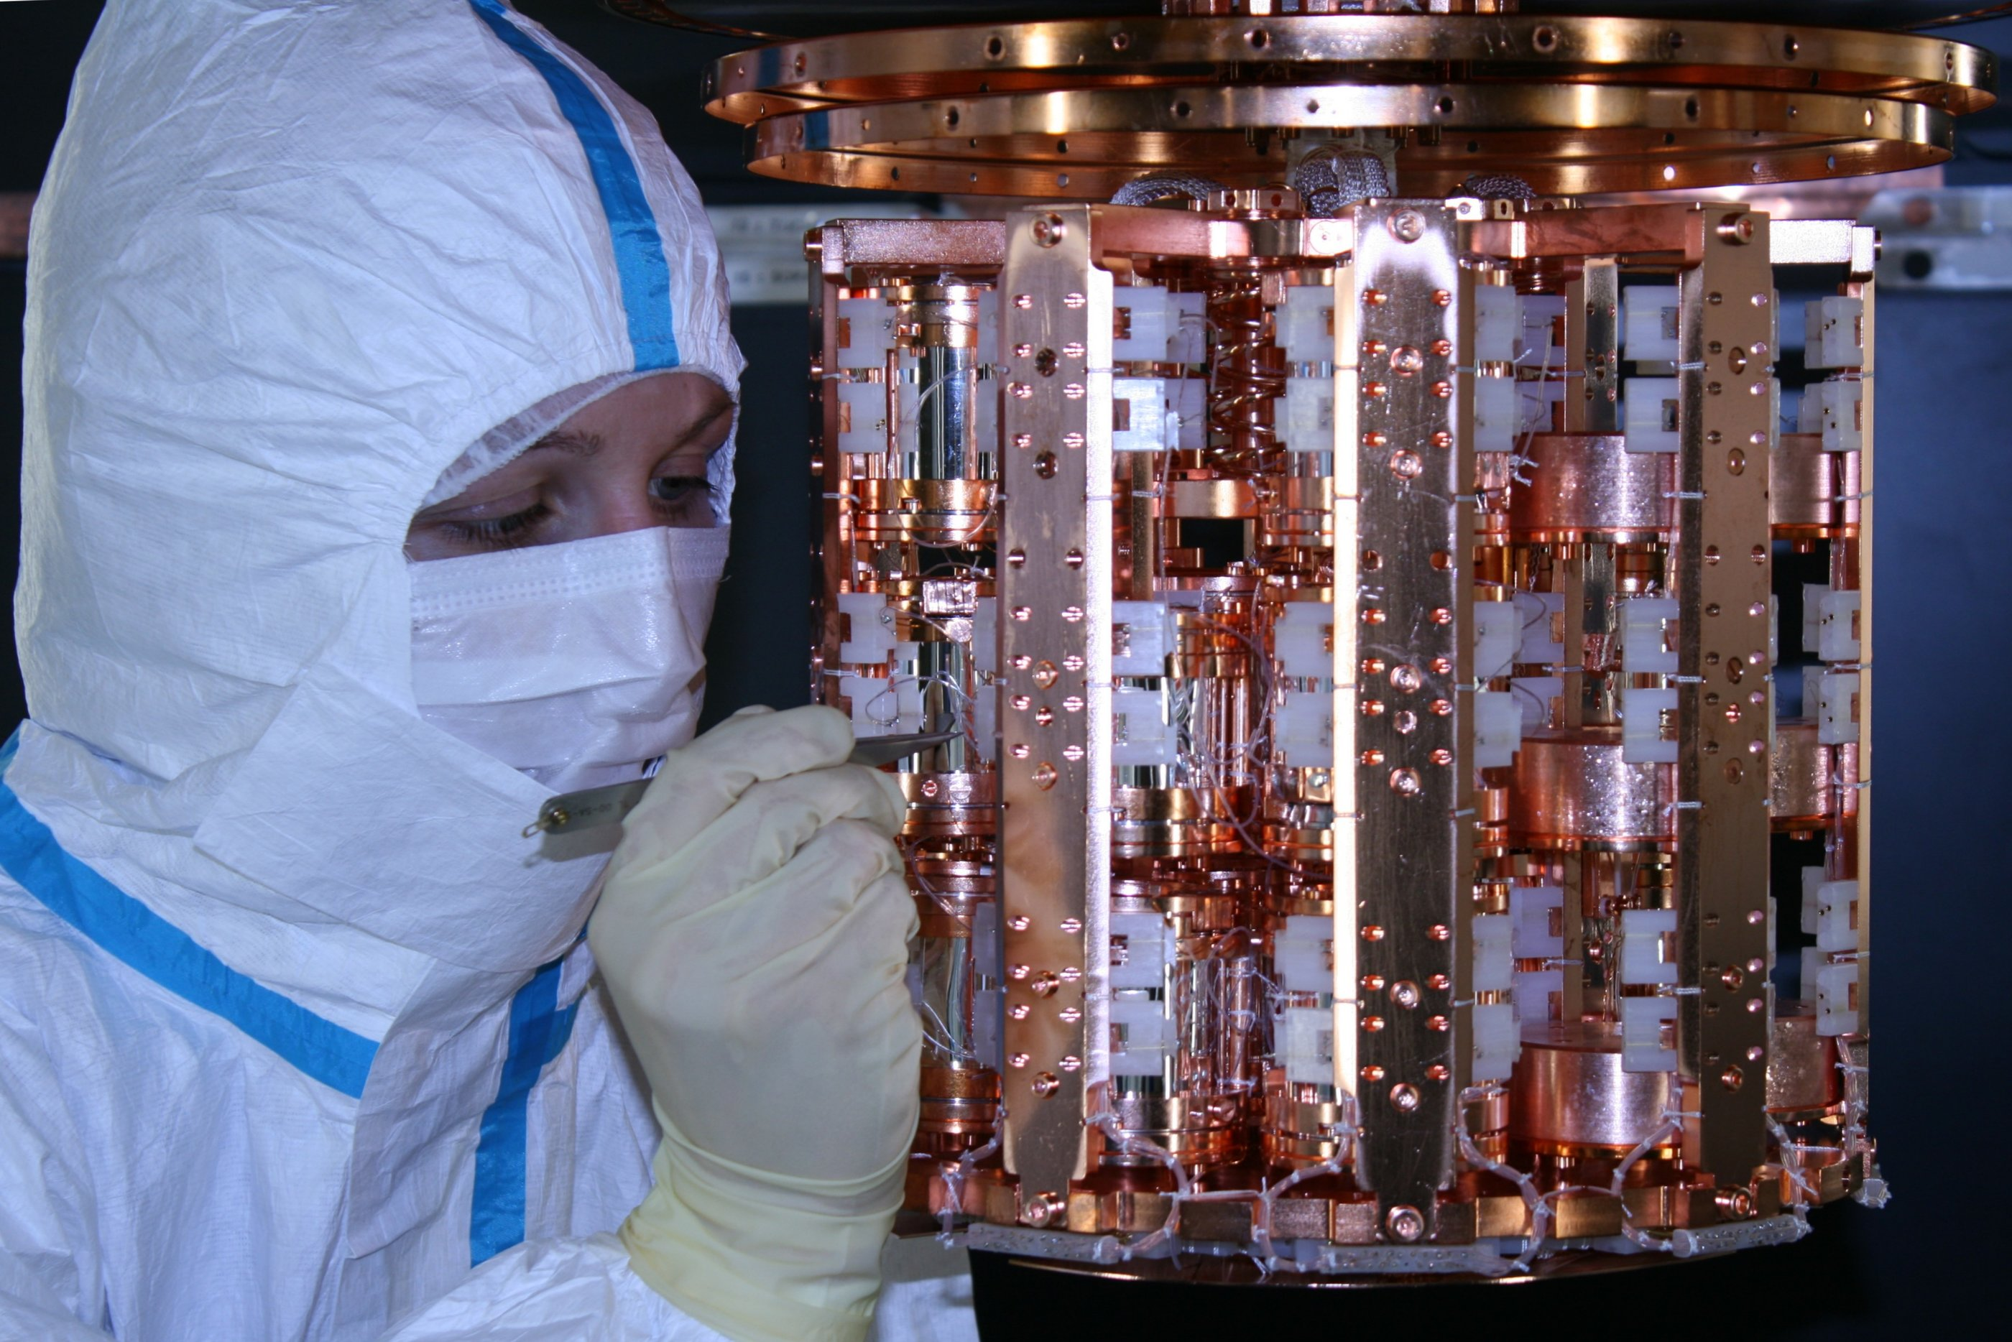
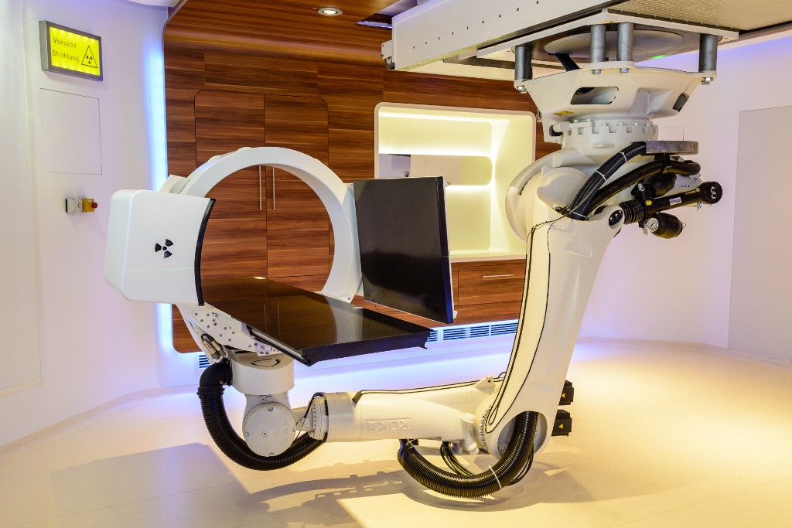
Frontiers in HEP @ HEPHY
CMS @ CERN
Belle @ KEK
Energy Frontier
Intensity Frontier
Astroparticle
(non-accelerator)
Frontier
CRESST @ LNGS
Medical Imaging @ MedAustron

Slide 4
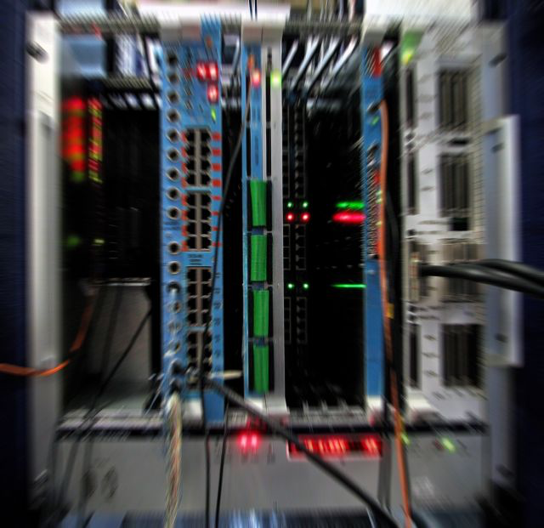
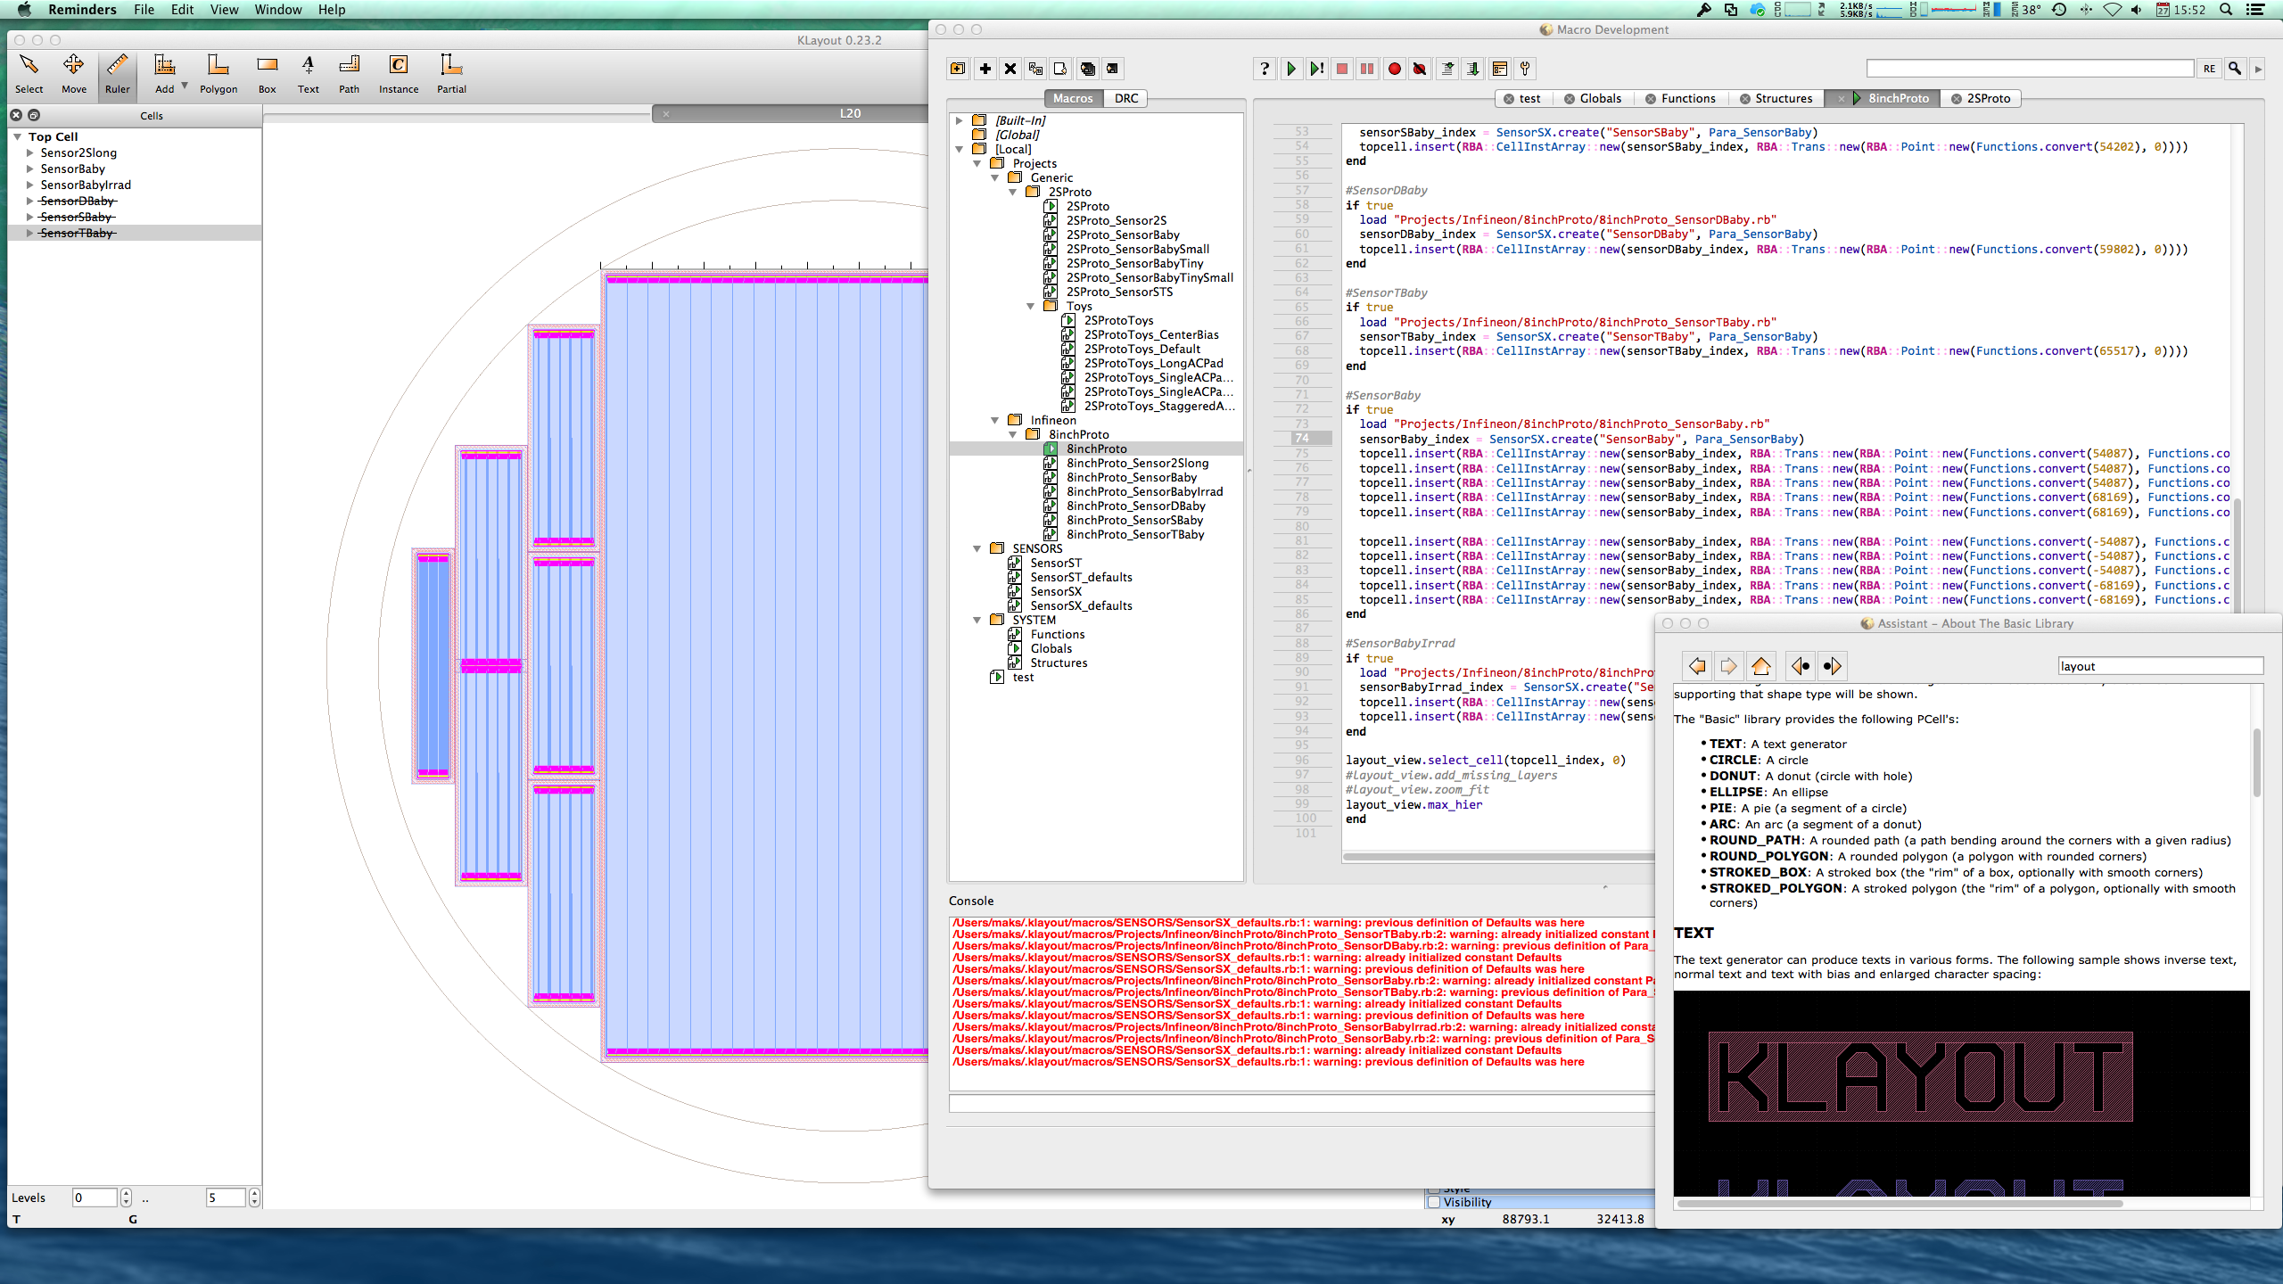
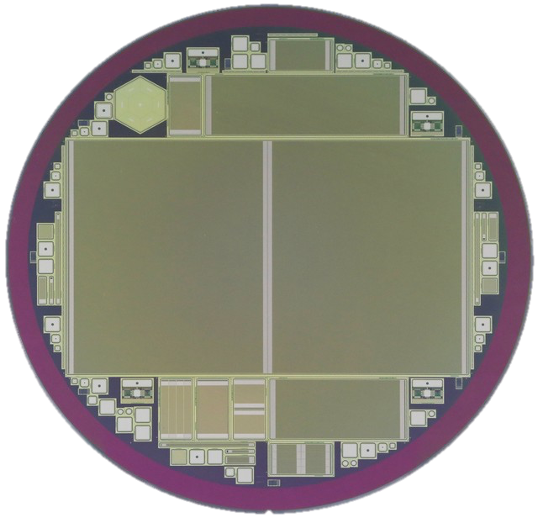
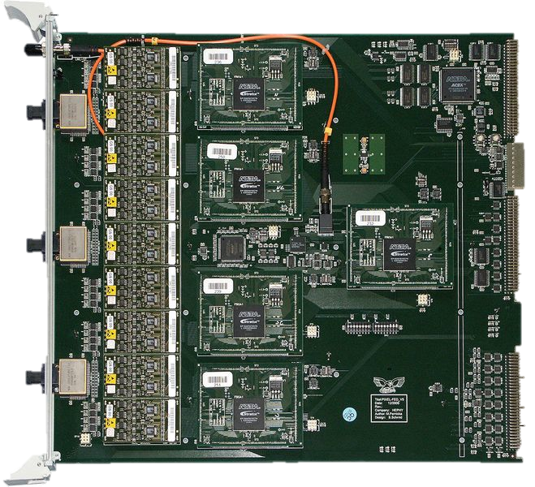
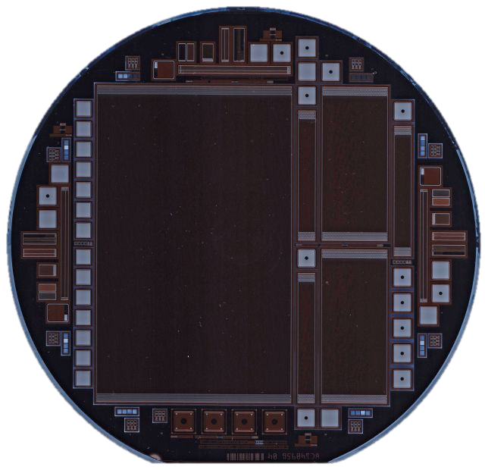
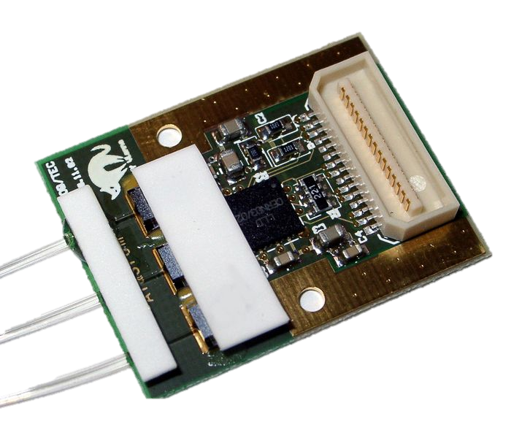
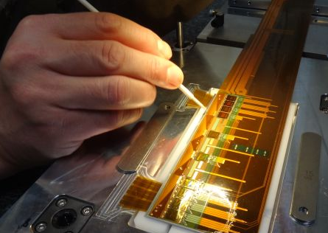
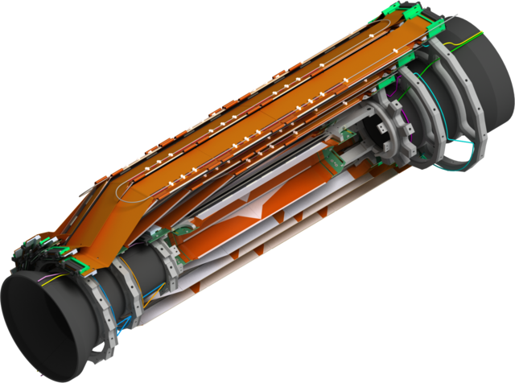
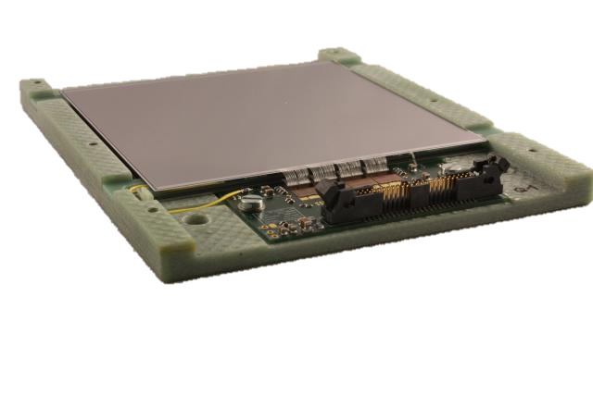
Experimental Expertise @ HEPHY
Electronics
Semiconductor
Sensors
Detector Modules

Slide 5
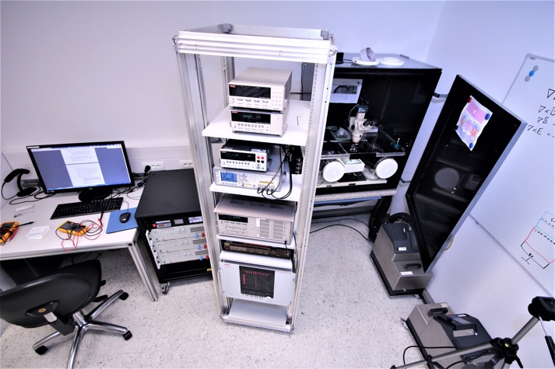
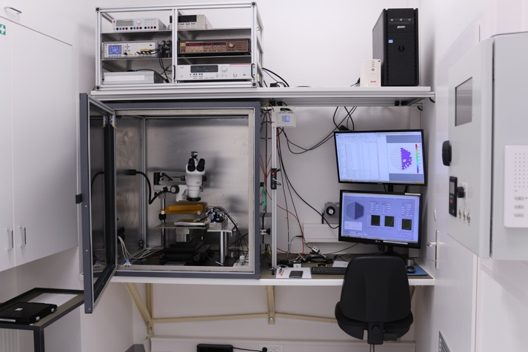
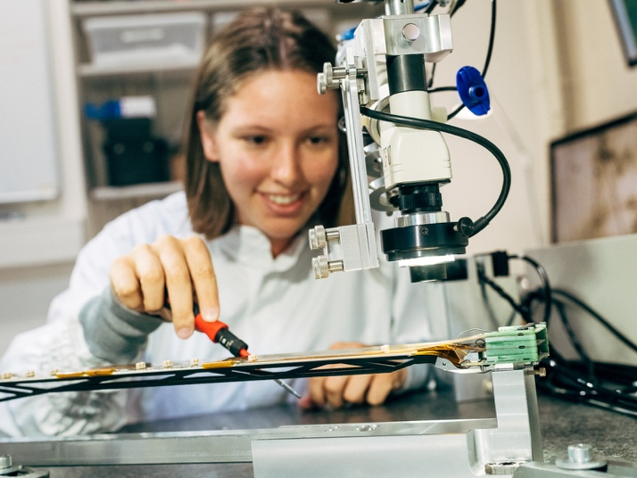
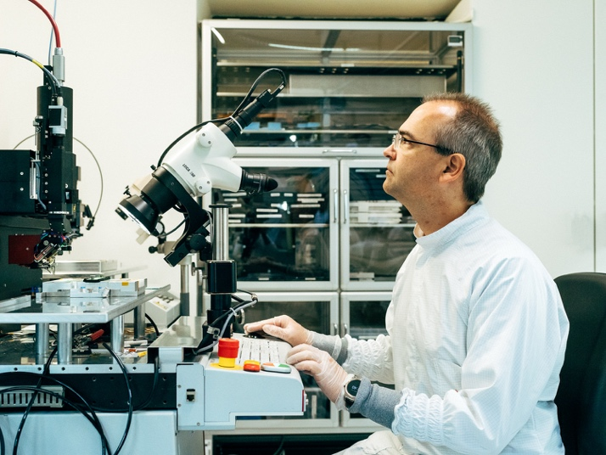
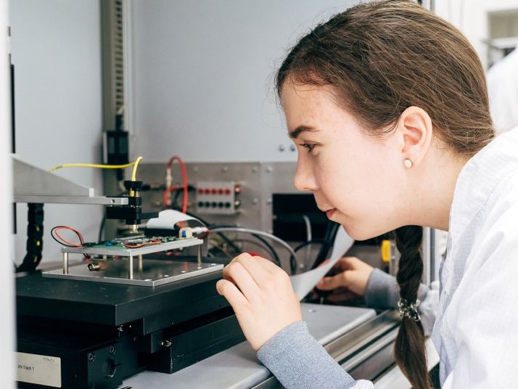
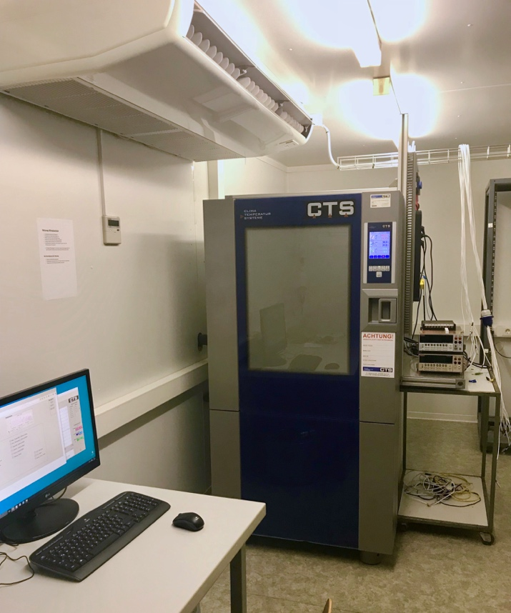
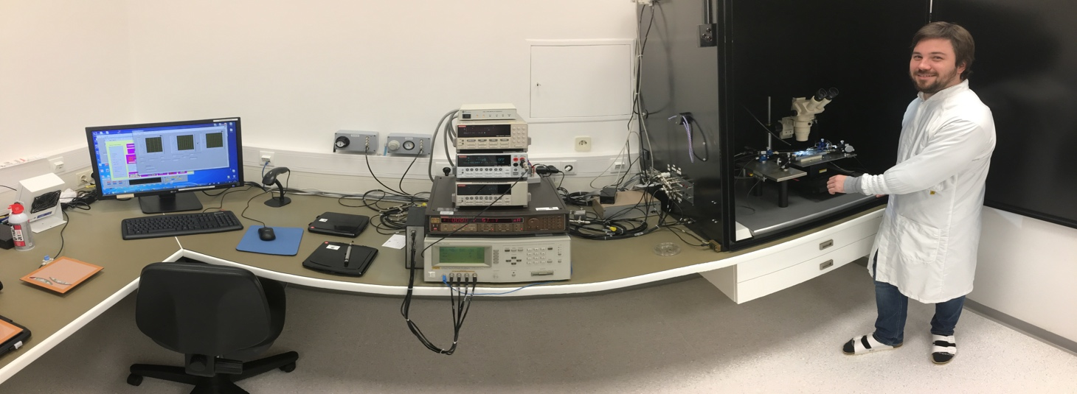
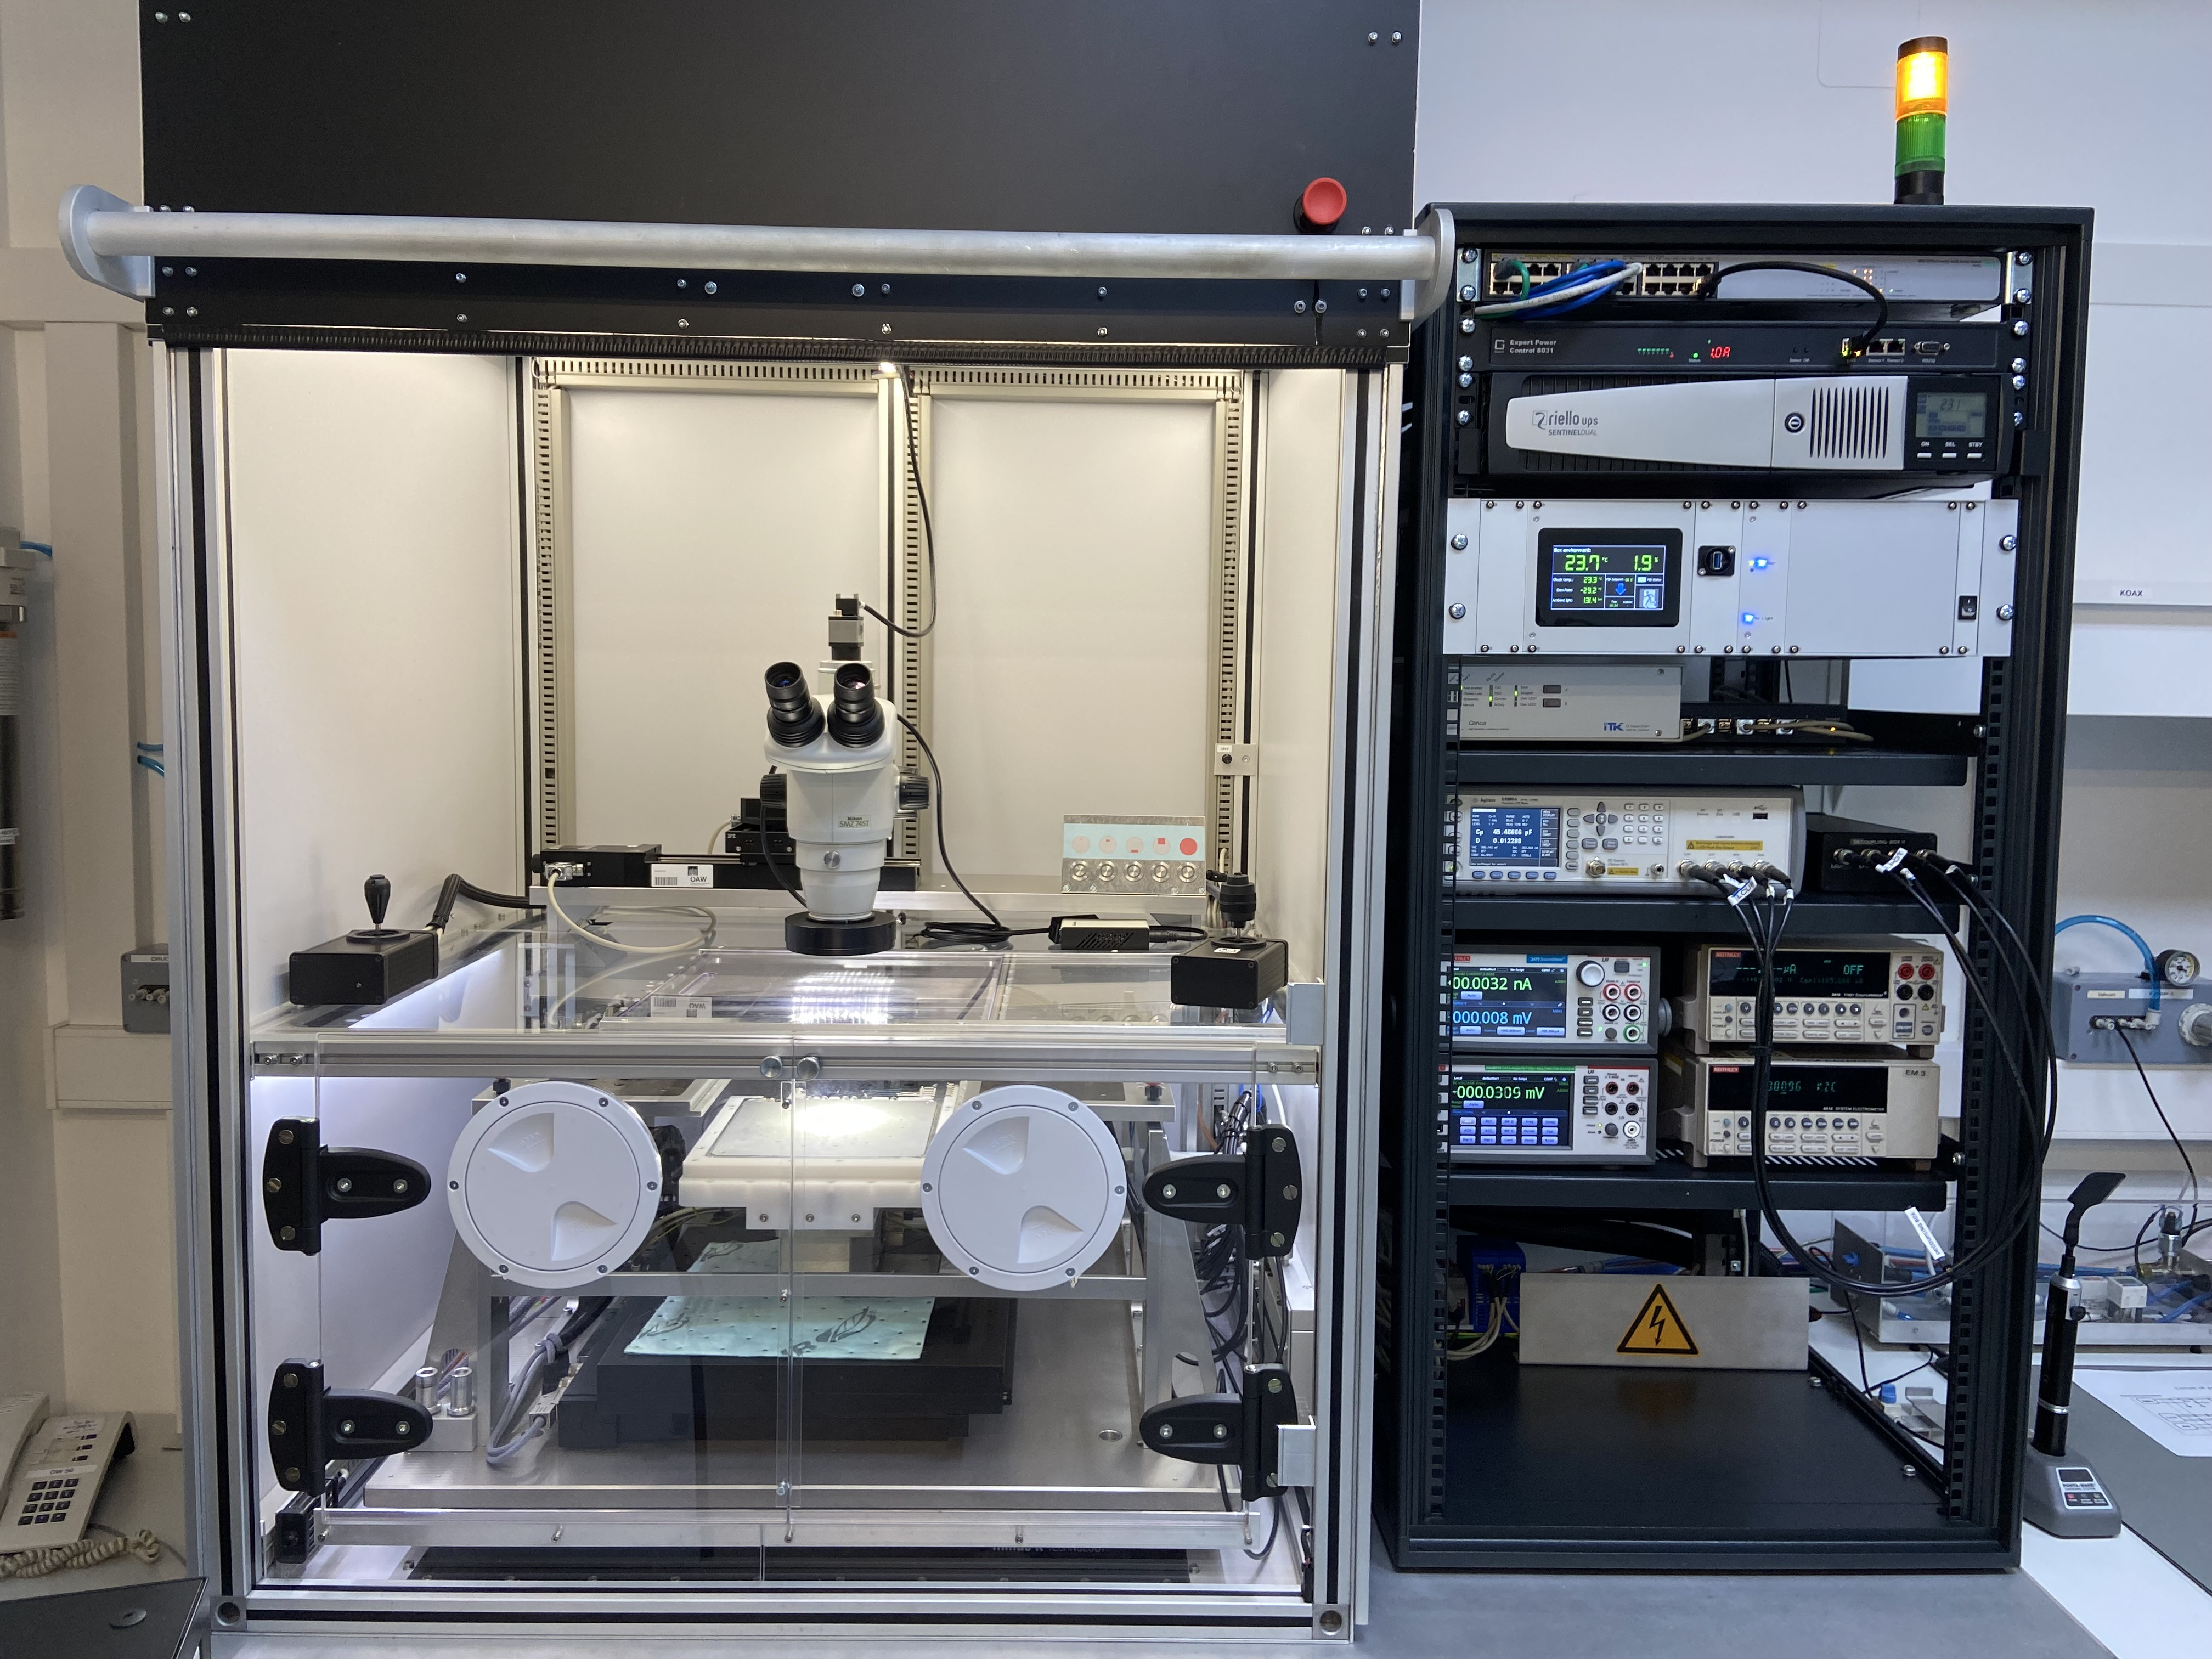
Infrastructure at HEPHY
We are operating high level equipment for sensor characterization and module construction
  Several probe stations for sensor tests (own developments)
  Semi-automatized module assembly (CMM, glue robot)
  Fully automatic thin-wire bonding machine
  Microscopes for optical measurements
  Radioactive sources and Lasers for signal stimulation (TCT)
  Software frameworks for sensor design and simulation (TCAD)
  Chip design Workflow (Cadence, Mentor, SOS,….)
PQC Setup
Probe station 3
Climatic Chamber
Coordinate Measurements
Thin-wire bonding machine
Laser Setup
QTC/SQC Setup
HGCCal Setup

Slide 6
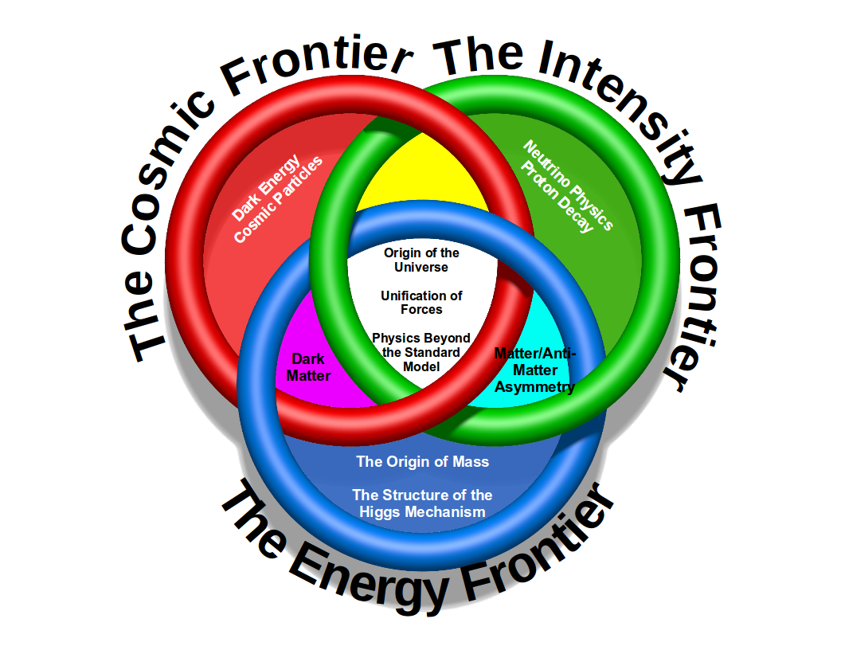
CMS @ CERN
The Energy Frontier

Slide 7
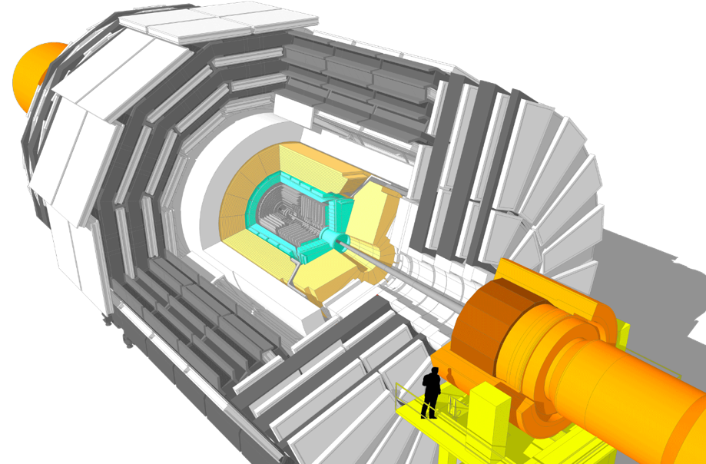
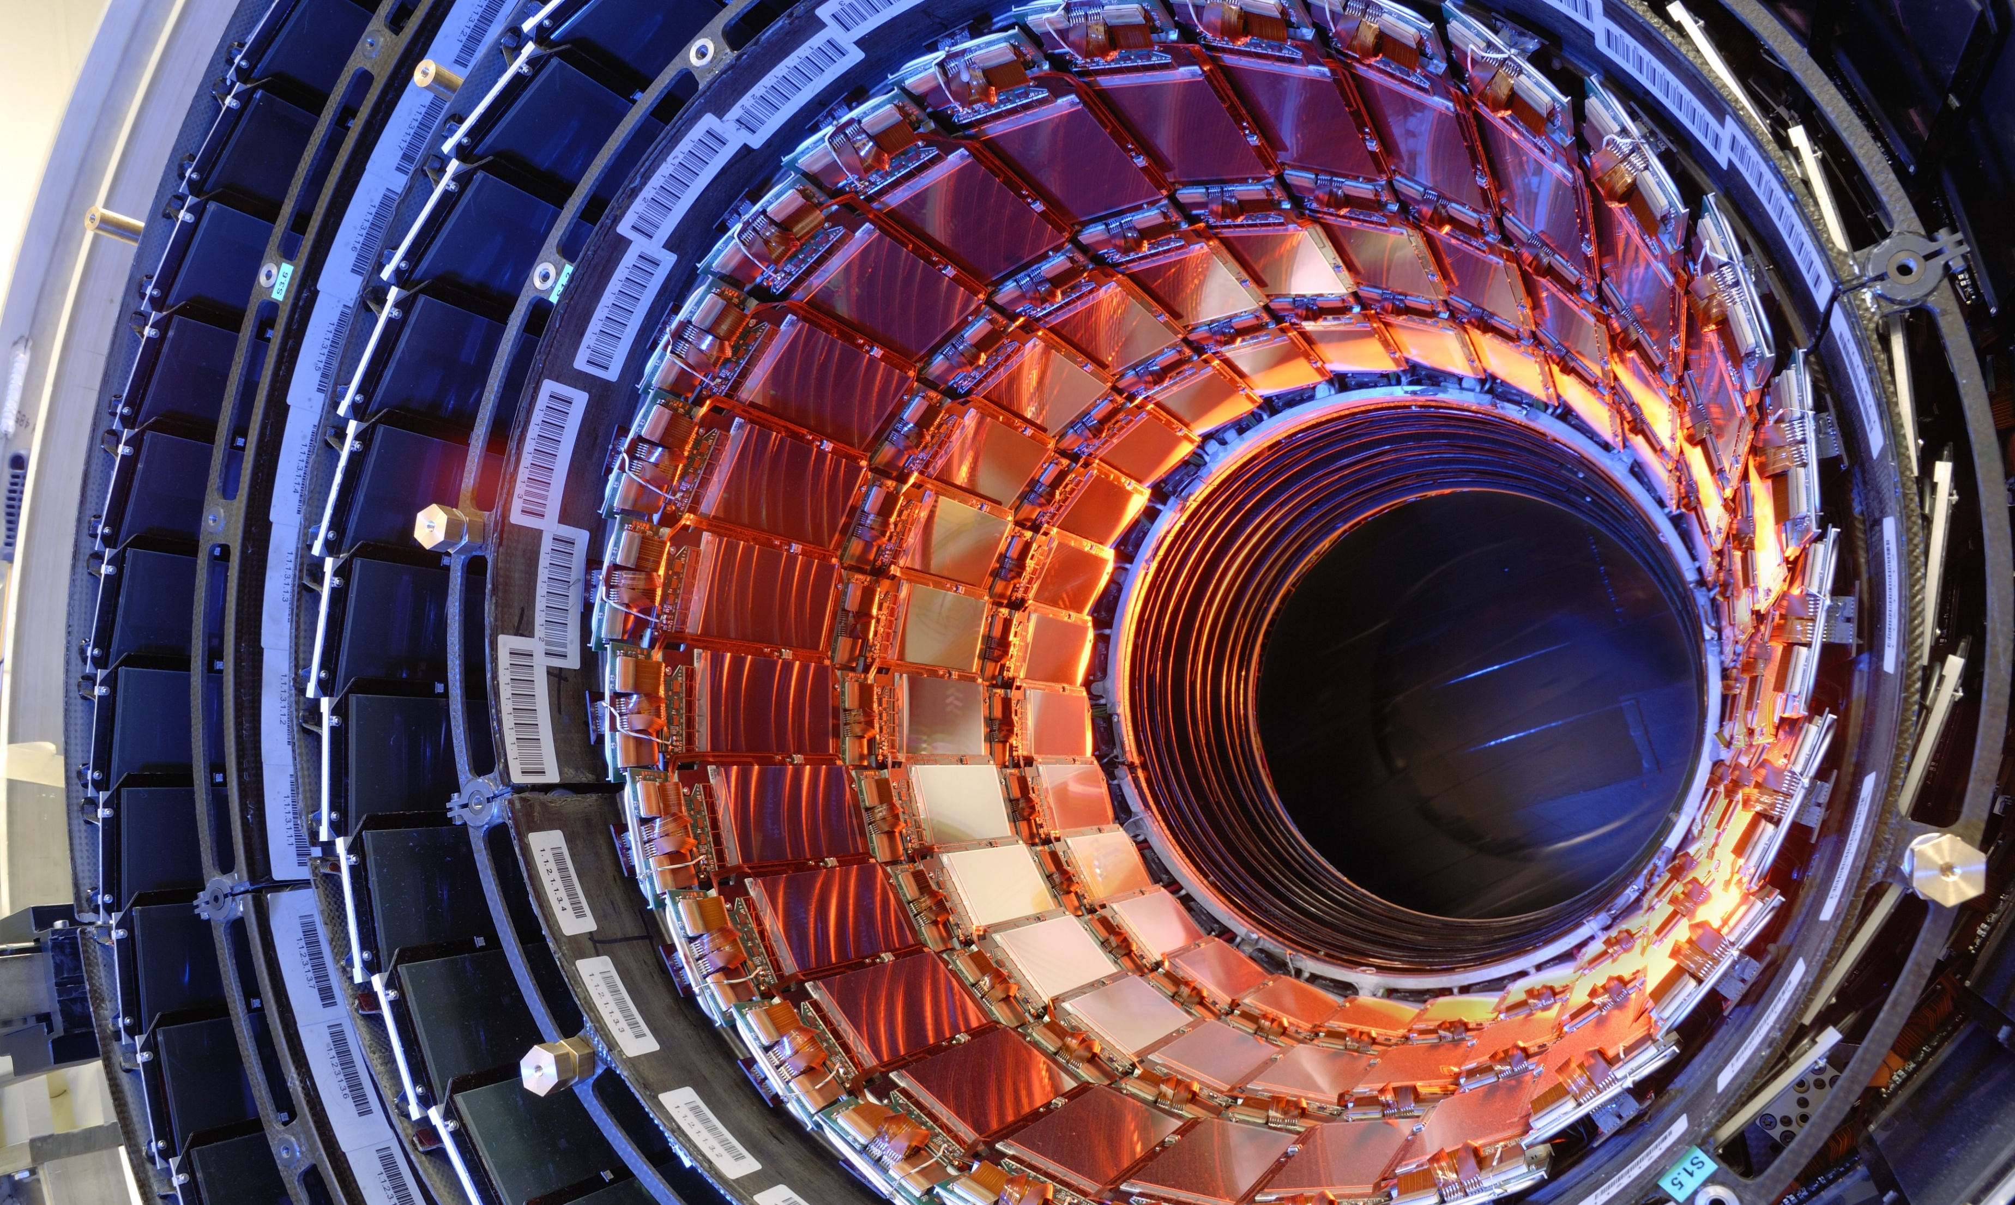
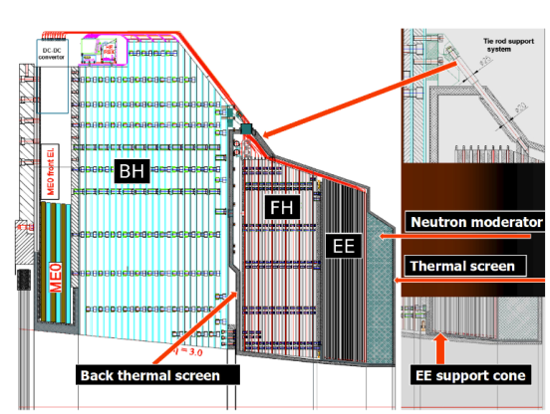
CMS Phase-II Upgrades
LHC Long Shutdown 3 (LS3) in 2025-2027
Accelerator upgrade to High-Luminosity (HL)-LHC
Upgrade of experiments necessary
  Existing systems reach end of life (radiation damage)
  Increase in luminosity at HL-LHC: 300 → 3000 fb⁻¹ → More radiation hard material necessary
  Increase in pile-ups → new techniques necessary
    “Track trigger” in Tracker
    Timing layer as complete new subdetector of CMS
Phase-II Upgrade of CMS:
Complete exchange of Outer Tracker
→ 200 m² Si Sensors needed
New Highly Granularity Calorimeter (HGCal)
→ 600 m² Si Sensors (8 inch)
New Timing Layer
→ Ultra-Fast detectors to enable “4D” tracking”
Big responsibility and commitments in both projects as institute members are convenors of working groups for sensor development in both subdetectors
Layout of HGCal

Slide 8
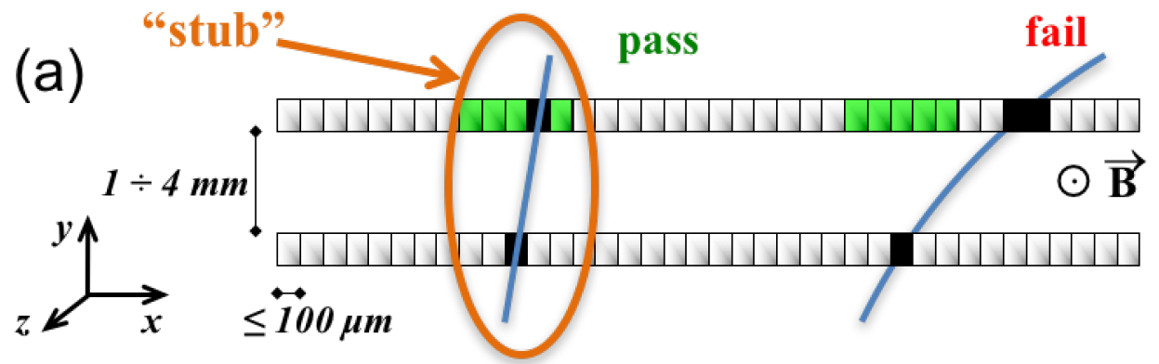
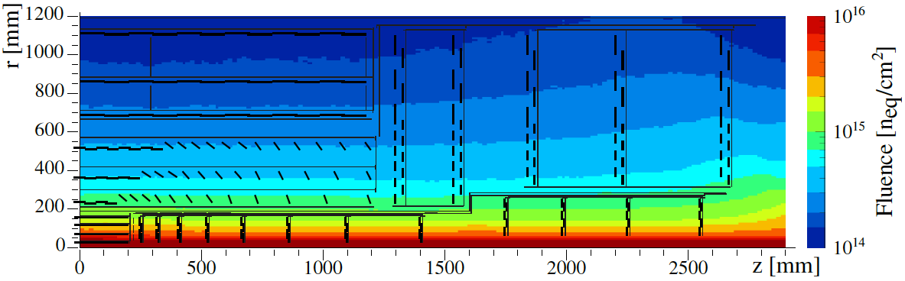
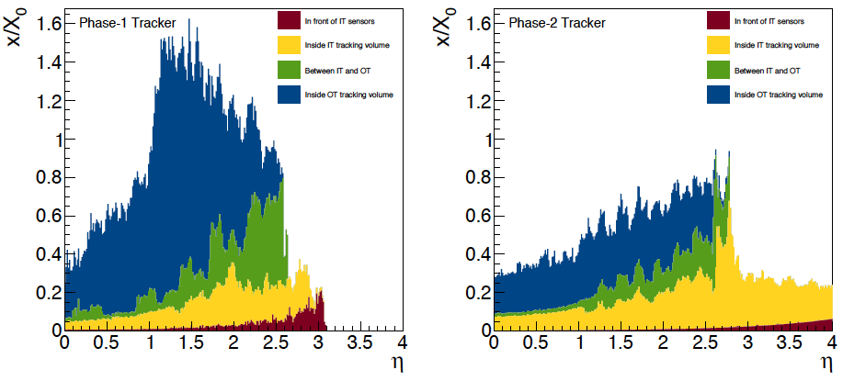
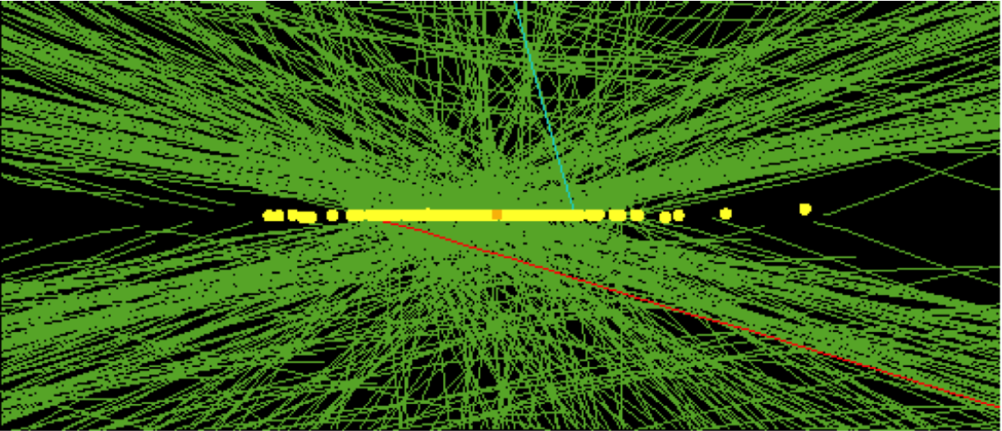
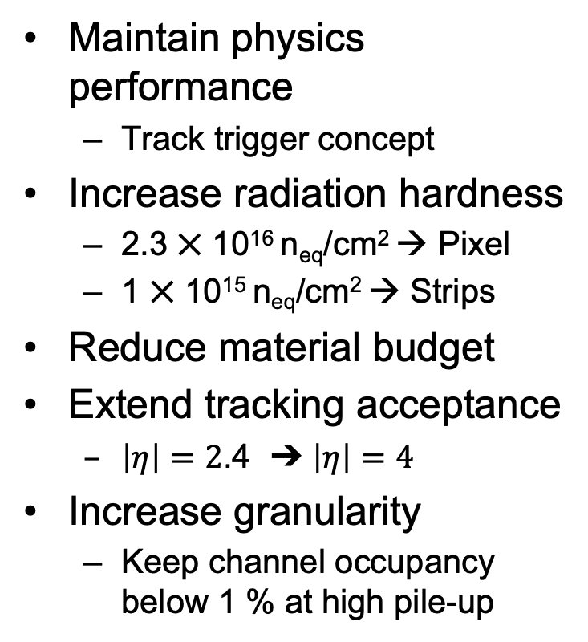
Completely replace Outer tracker for Phase II
CMS Tracker Upgrade
Maintain physics performance
  Track trigger concept
Increase radiation hardness
  2.3 ⨉ 10¹⁶ n_{eq}/cm² → Pixel
  1 ⨉ 10¹⁵ n_{eq}/cm² → Strips
Reduce material budget
Extend tracking acceptance
  $\left|η\right|=2$.4 ➔ $\left|η\right|=4$
Increase granularity
  Keep channel occupancy below 1 % at high pile-up
Notes:
Low material budget is essential for precise track reconstruction, Coulomb scattering deflects path

Slide 9
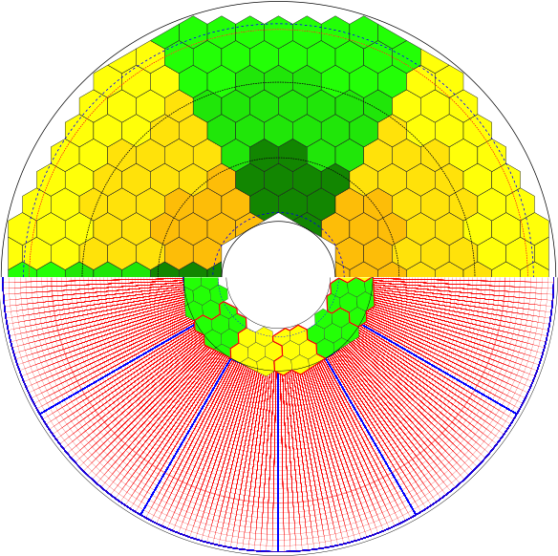
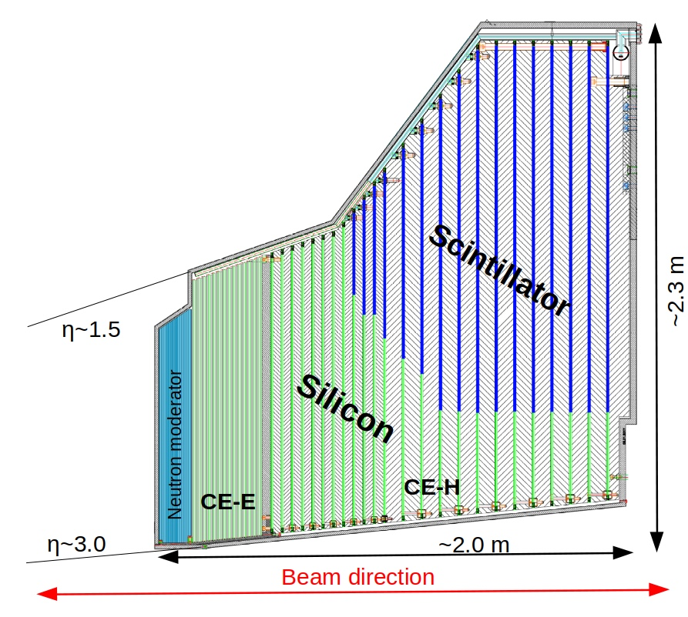
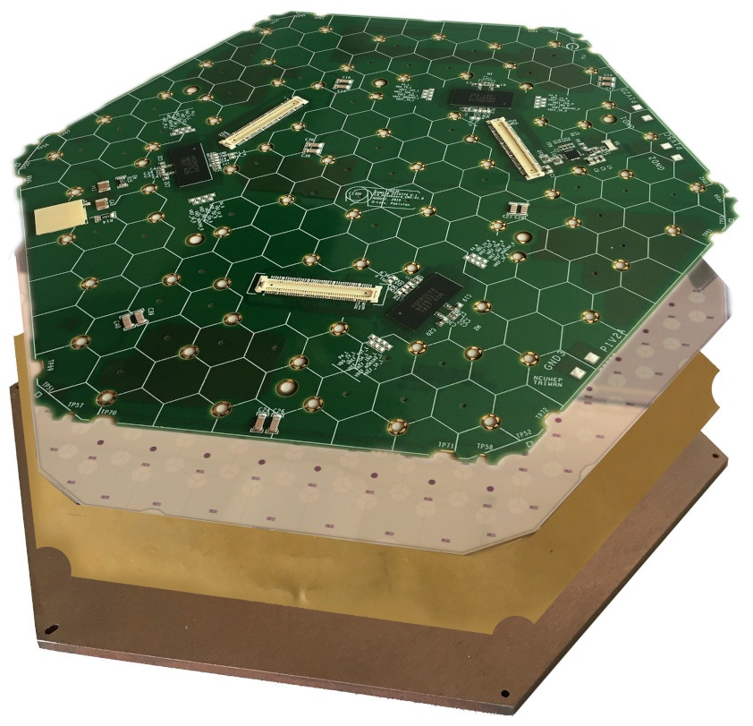
High Granularity Calorimeter
Calorimeter Endcap or High Granularity CALorimeter
CALICE-inspired imaging calorimeter optimized for particle ﬂow analysis
Covers 1.5 < η < 3.0
215 tons per endcap, full system at -35°C
Silicon part:
∼620 m² of silicon sensors, 8” (200mm wafers)
∼6M channels in
~30k modules, two cell sizes 0.5 and 1.1 cm²
Scintillator part:
∼400 m² of scintillator,
∼240k tiles + SiPMs in ∼4000 boards,
two tile size 4–30 cm
El.-mag. section CE-E: Si, Cu, CuW, Pb absorbers, 28 layers, 25X₀ & ∼1.3λ
Hadronic section CE-H: Si+scintillator/SiPM, steel absorbers, 22 layers, ∼ 8.5λ
“disc”
“Si module”

Slide 10
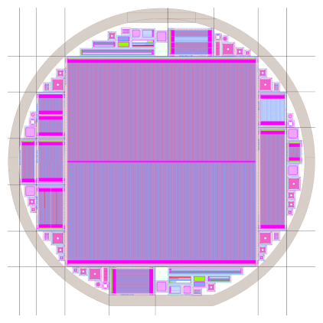
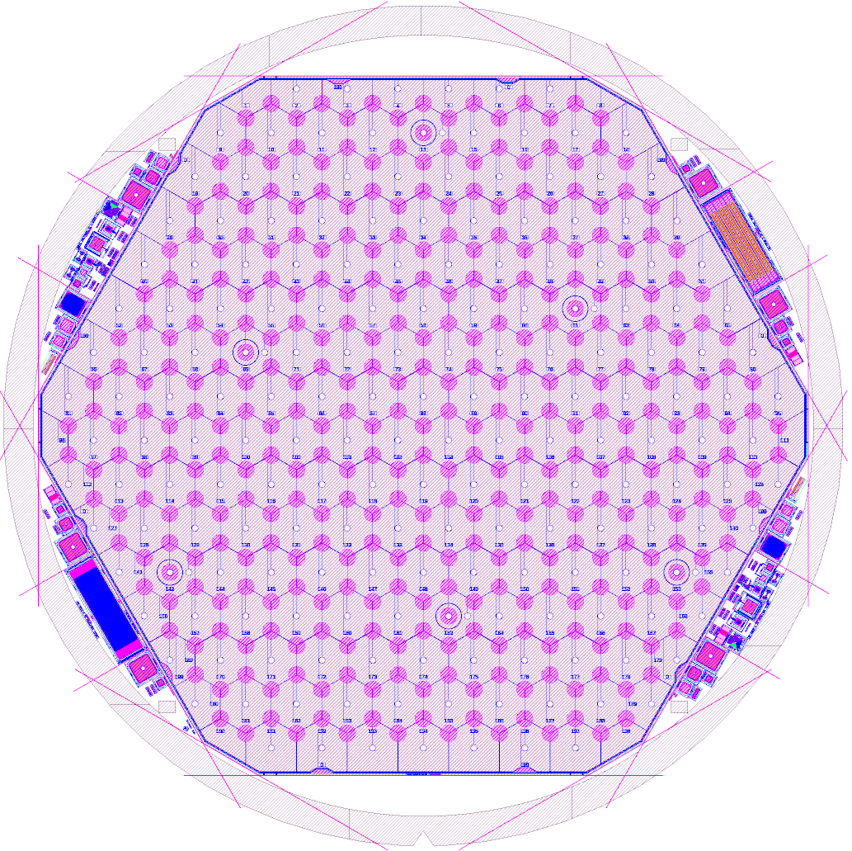
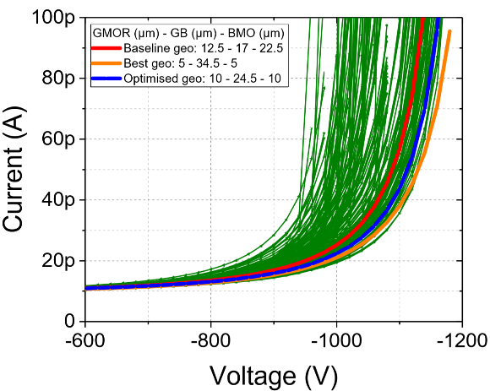
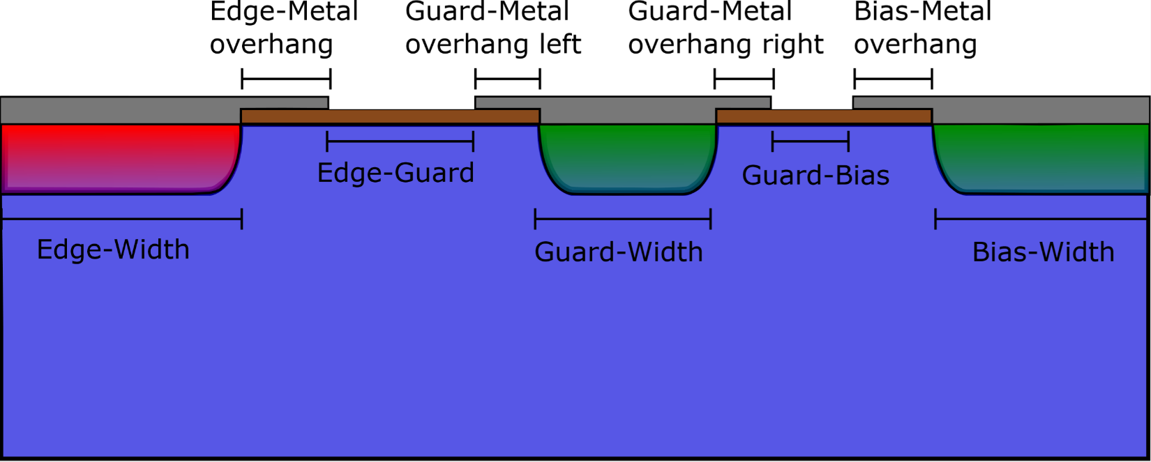
Sensor Design
Wafer layouts for both strip sensors of Tracker and HGCal sensors is fully driven by us at HEPHY
  Main sensor, test structures
Using self-developed framework based on open source tools
Needs negotiations with vendors on details (e.g. design rules, dicing precision,..)
Supported by TCAD simulations for optimizing different aspects
  E.g. periphery simulation
2S Wafer layout
HGCal full wafer LD layout

Slide 11
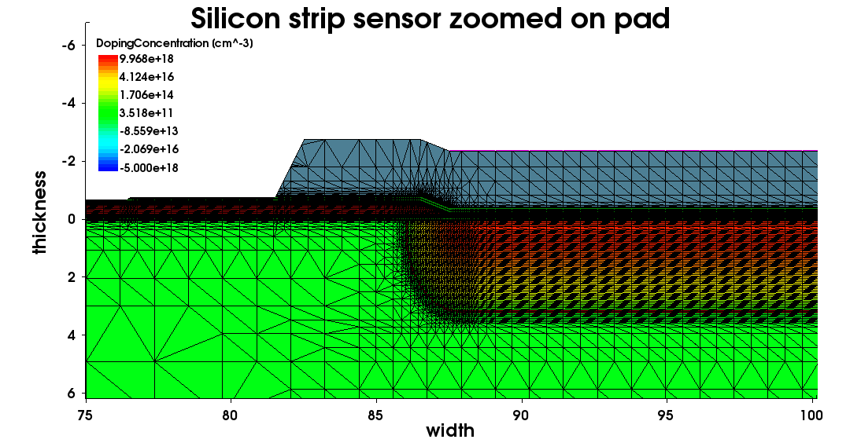
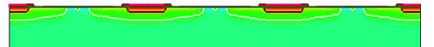
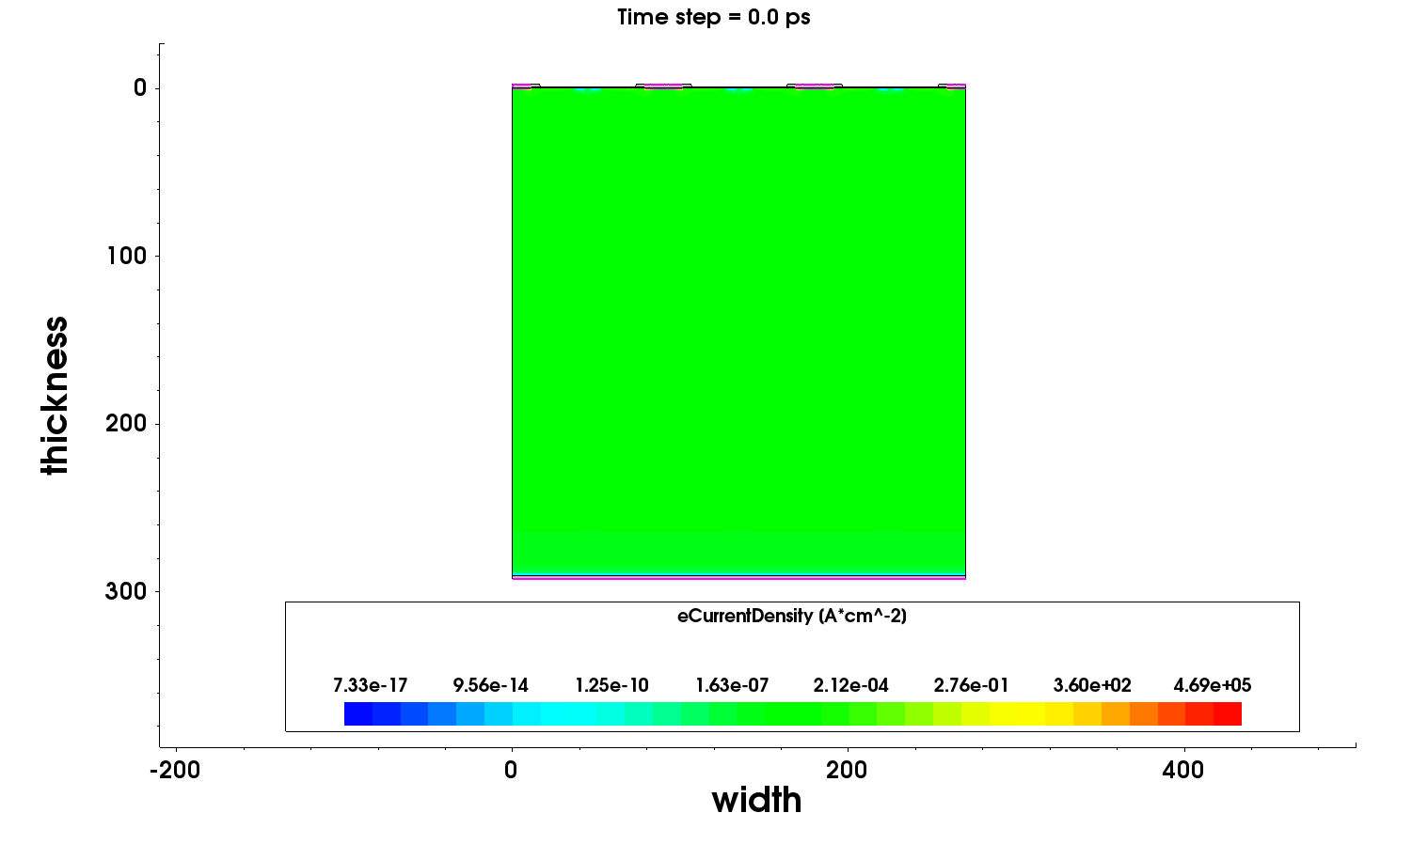
Sensor Simulation
Goal: fully reproduce strip-sensor measurements
Better understanding on Electric field, currents, breakdown behavior, interstrip characteristics,..
Performed tasks at HEPHY:
Improved/tuned sensor mesh and design
Improved physics models
Includes “real” doping profiles as result of scanning resistance profiling (SRP)
Added additional traps, revealed by DLTS (deep level transient spectroscopy) in unirradiated sensors
Further improvements by determining the correct charge carrier lifetime through GCD measurements

Slide 12
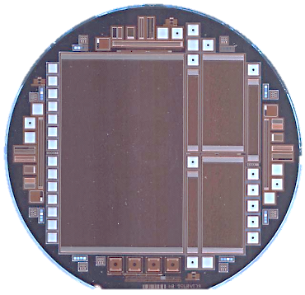
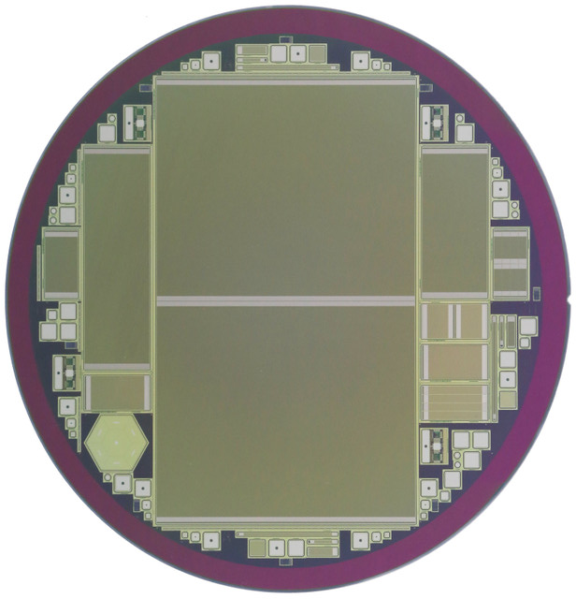
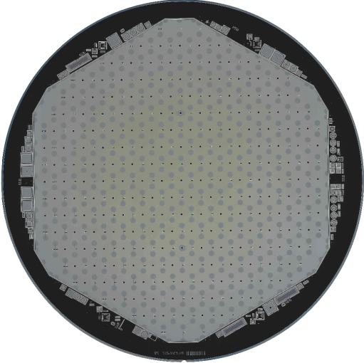
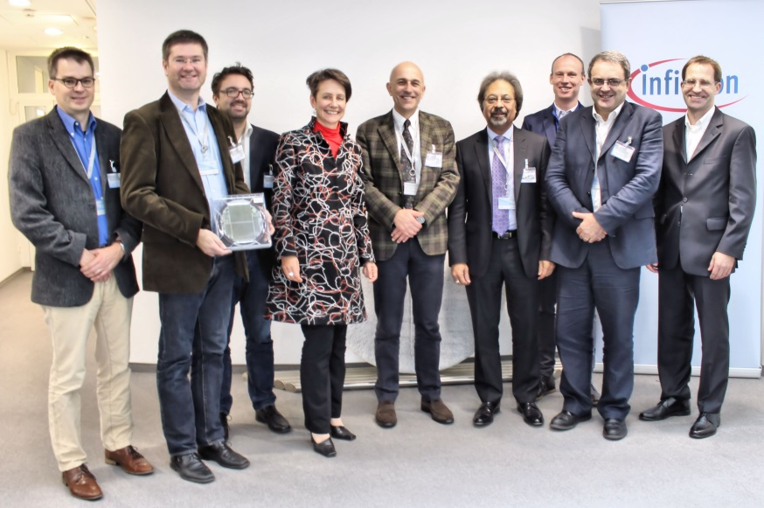
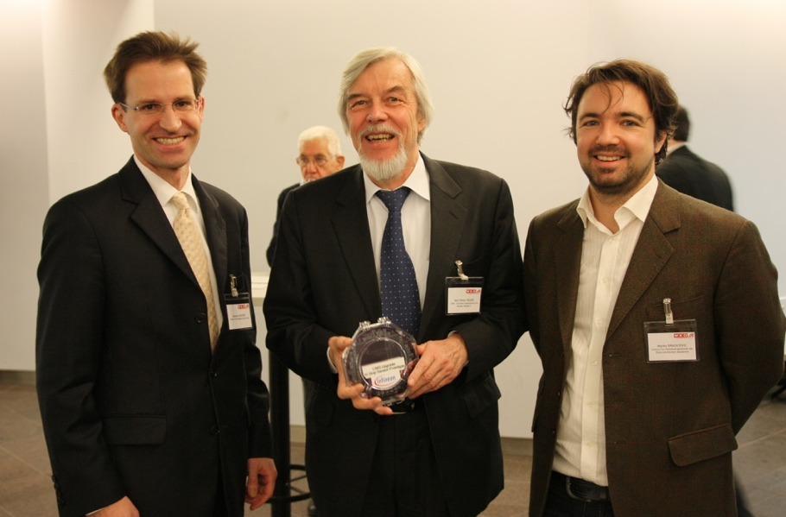
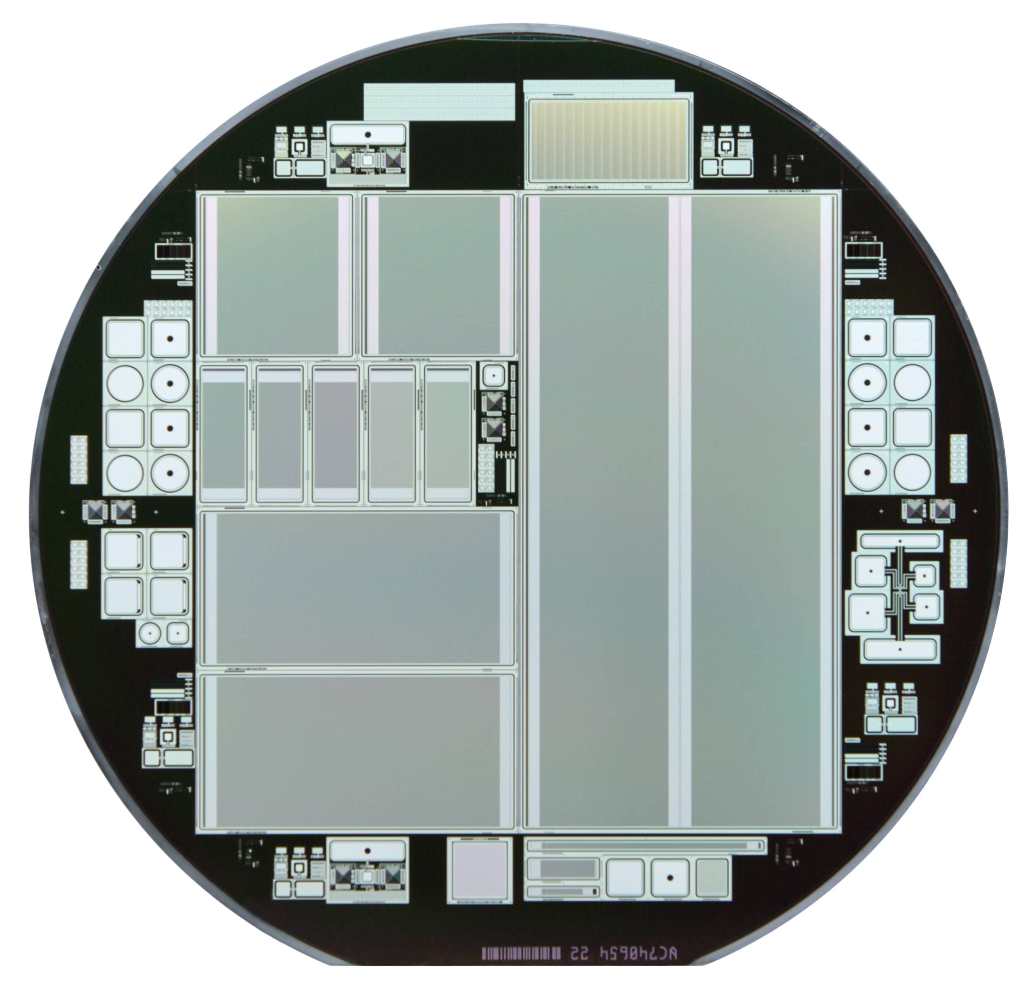
Sensor Production
We worked with Infineon to find a “second source” for large-area planar Si sensors
2009: Project started by private contacts as a bottom-up approach
2012-2014: production of 6” p-on-n sensors
  Goal: re-produce the current CMS tracker sensors
  Production workflow: design by HEPHY, production at IFX, characterization (lab, beam tests,…) by HEPHY (mostly done in the framework of Bachelor’s and Masters’ theses)
2015: First AC-coupled sensor on 8” wafer
2015-2017: production of first Si strip sensors on 8-inch FZ p-type wafers
2016/17: production of pad sensors for HGCal and 6-inch p-type sensors for CMS Tracker
2018 program stopped due to economic reasons
6“ p-on-n
Wafer:
8” p-type
strips
8” CMS HGCal
prototypes
6” CMS PS-S
prototypes
Former CERN DG Heuer with Infineon manager and M. Dragicevic
Infineon CEO together with HEPHY and CERN representatives
12

Slide 13
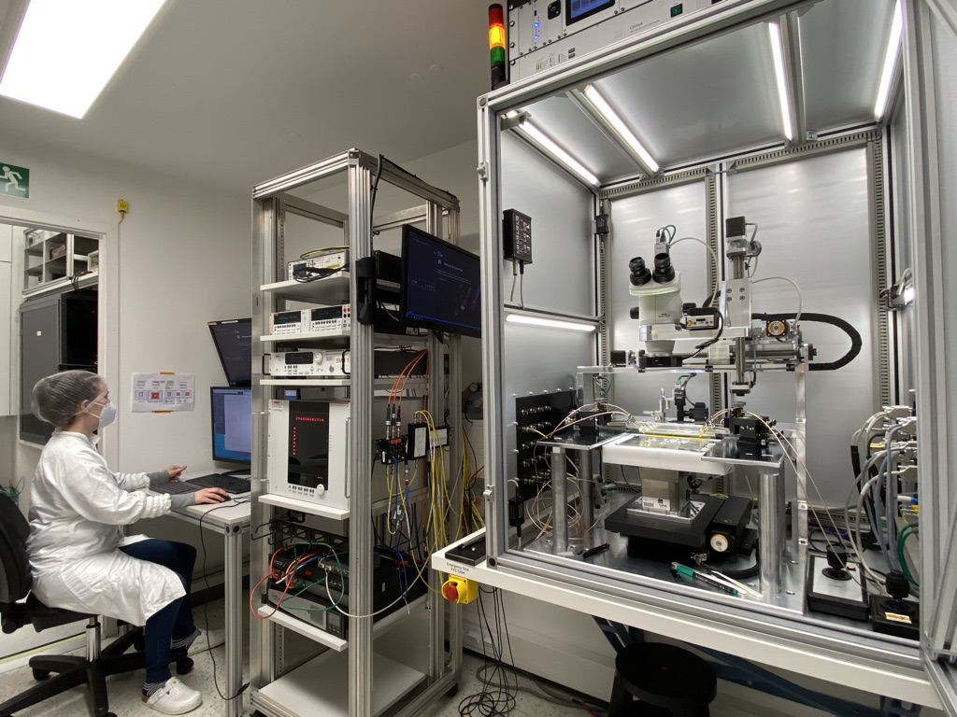

Sensor Testing
Characterizing sensors with several custom probe stations in our clean rooms
  ”custom” refers to develop both hardware and software to our own needs by help of our large electronics and mechanics groups
Tracker and HGCal in different status at the moment:
  “Series production” of Tracker sensors require quality control of tracker sensors using full sensors and process control on dedicated test structures (PQC)
  R&D of HGCal sensors to qualify 8” process of HPK
    Bulk irradiation tests (neutrons)
    Gamma/X-Ray irradiations for Oxide studies
    Full wafer characterization
    Backside fragility
PQC Setup
HGCal Setup

Slide 14
Medaustron
Medical Imaging at

Slide 15
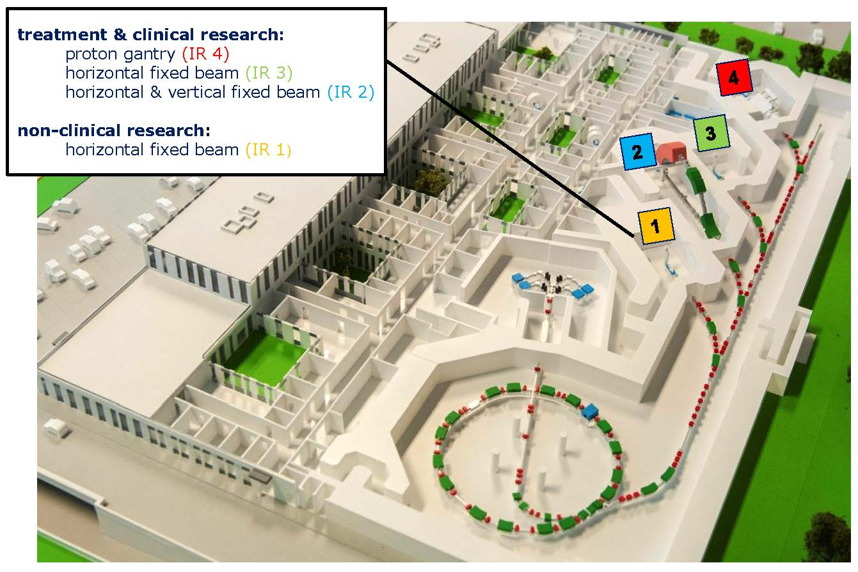
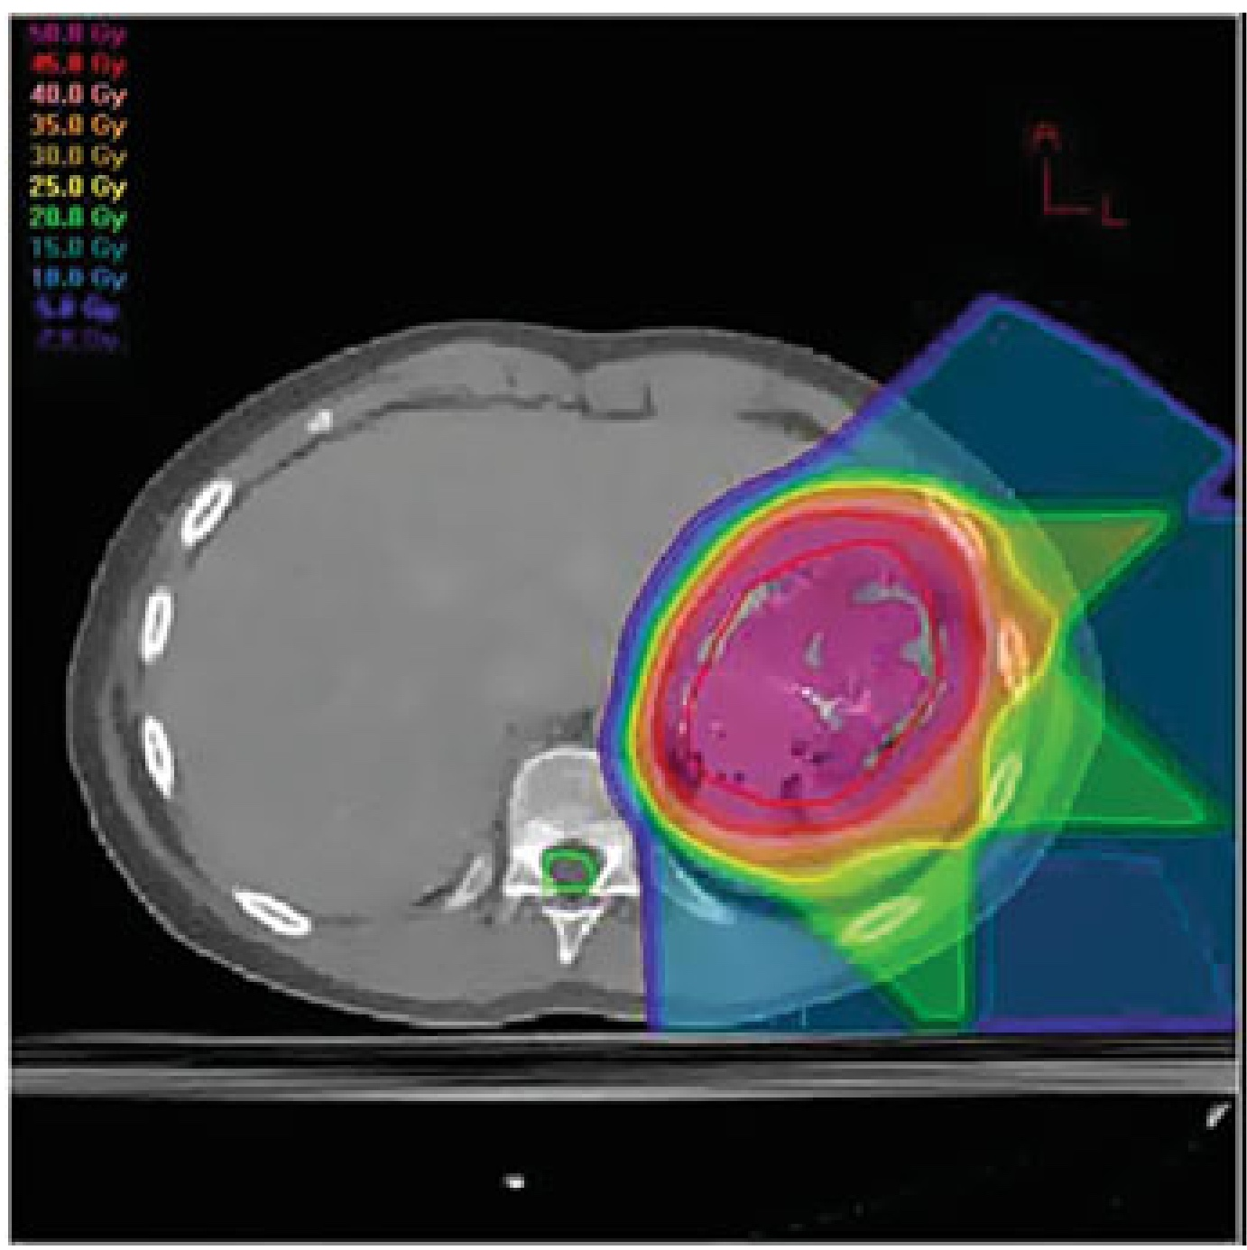

medAustron
MedAustron: Austrian hadron cancer therapy center
Based on CERN PIMMS study
Became operational end of 2016
Patient treatment using proton and carbon beams utilizing Bragg peak
  Protons: 60 MeV to 800 MeV, Clinical energies ≤ 250 MeV
  Carbon ions: 120 MeV/u to 400 MeV/u
Dedicated non-clinical irradiation room (IR1) for research
We perform regular beam tests there and collaborating with a group of TU Wien to establish an Ion-CT system

Slide 16





Ion Imaging
“Ion CT” by measuring stopping power in object per voxel needs
Tracker (similar beam telescope)
  Currently DSSDs
Calorimeter to measure residual energy
  Sandwich calo using scintillator planes and SiPM readout
Image Reconstruction
Phantom
Reconstructed image

Slide 17



pCT Tracker Upgrade: Monolithic
Depleted Monolithic Active Pixel Sensor combines both active sensing element and readout electronics into one device
  Sensor development becomes chip development
  Generally agreed that this technology will be the future of Si sensors in HEP
  Deep wells fully shield CMOS electronics from active volume and allows full CMOS electronics
DMAPS (a.k.a. HV-CMOS)

Slide 18



Ion Imaging Tracker Upgrade
MALTA HV CMOS
TowerJazz 180nm
512×512 square pixels, pitch 36.4 µm -> 1.8² cm²
asynchronous readout
Tested in beam time at MedAustron in summer 2019:
4 sensor planes of MALTA-C with Epi substrate used as „proof of principle“ as high-rate replacement
Due to small chip size no “phantom”
Plot below shows hitmap of not fully centered beam

Slide 19


DMAPS/CMOS at HEPHY
Current Projects:
  RD50-MPW (2|3)
  OBELIX (Belle-II Upgrade)
  HiBPM Readout chip
Available foundries/processes
  Lfoundry 150nm (LF15A)
  Towerjazz 180 nm CMOS Imaging Process (TS18IS)
  STM BiCMOS Bipolar/CMOS combination
Setups/Readout systems
  Chip design Software infrastructure (Cadence, Mentor,… tools)
  FPGA design (Xilinx, Altera) and test stands
RD50-MPW2 as seen
through confocal 3D microscope
Current periphery of RD50-MPW3

Slide 20




pCT calorimeter upgrade
Use Time-of-flight (ToF) concept to reconstruct residual energy
Precision timing based on Low Gain Avalanche Detectors (LGAD) a.k.a. UFSD needed
  LGAD have an additional deep implant layer to create locally a high electric field to initiate an avalanche
First tests performed successfully at MedAustron reaching 40ps
  System concept currently studied
  Taking advantage of developments of MTD layer of CMS Upgrade (and FCC later)

Slide 21
Conclusion
HEPHY is very active detector development and well prepared for future detectors at FCC
Current projects:
  CMS Phase-II Upgrades: Tracker and HGCal
  Belle II:
    Silicon Vertex Detector (installed 2019) with key contributions to electronics, mechanics, readout
    Belle-II Upgrade (DMAPS-based currently starting)
  Dark Matter
    CRESST (with COSINUS, NUCLEUS)
    DANAE: DEPFET Silicon sensor based
  Medical application
    Ion Imaging: Hardware setup and image reconstruction
    Ideal test bed for new concepts (DMAPS, LGAD sensors,…)
Rich expertise in all aspects of detector development
  Sensor Design, Simulation, Implementation
  Detector Module design, assembly
  Electronics & FPGA design, hardware and firmware
  Cleanroom laboratories with several test stands
  Most recently: ASIC and DMAPS Sensor Design, Precision Timing

Slide 22
The End.

Slide 23



LHC Roadmap
Most of our work is now for Phase-II Upgrades (LS3)
What is the next European project after HL-LHC?
  HE-LHC, FCC, CLIC, ILC,…
  Development for detector technologies need to start well in advance
European Strategy for Particle Physics Update 2020~2030
  Scheduled for approval in 2020
    Open Symposium May 2019 Granada (Spain)
FCC

Slide 24



CERN RD50 collaboration
is a CERN R&D collaboration with currently
63 institutes (370 authors)
Initially focused on radiation hardness of silicon
  widened its scope, e.g. towards timing detectors (LGADs)
  Recently started also HV-CMOS developments
Covers now all Si development paths we see important for future HEP detectors
  Thus we joined RD50 in Dec 2017
Weightfield2 (1st version created at
HEPHY):

Slide 25




CMS High Granularity Calorimeter
CMS is planning to build a High Granularity Calorimeter for Phase-II at HL-LHC
Covering 1.5 < η < 3.0
Features unprecedented transverse and longitudinal segmentation
  Silicon in high radiation areas
  Scintillating tiles in the low-radiation region of CE-H (Mixed Silicon-Scintillator cassettes)
Scintillator
Silicon
Silicon
Cassettes
Scintillators

Slide 26


Radiation Hardness
Fluence is n-dominated w.r.t. charged hadrons (90%/10%)
  No validated irradiation model in TCAD up to fluence of 10¹⁶ n_{eq}
Deployment of thinner sensors in the higher ﬂuence regions of the calorimeter
  improved charge collection
  reduced leakage current
Typical signals in calorimeter much higher than MIPs
  MIP sensitivity needed for energy calibration (e.g. isolated muons)
300 μm
200 μm
120 μm

Slide 27




Sensor Irradiation
Access to Triga Mark II nuclear reactor at TU Vienna
  Similar to JSI Ljubljana, but only 2x10 cm wide samples possible (no larger irradiation channel
  Distance to HEPHY 30 minutes by car or public transport
Cold Chuck available at HEPHY for characterization of irradiated sensors
  Self-made Peltier-based system
  6”, to be upgraded to 8” for HGCal
  Used for irradiation studies of Infineon sensors
  Study to understand E_{eff} as current has to be scaled to +20°

Slide 28






PQC: Tracker & HGCal
2S
HGC HD
PQC - Process Quality Control: Use test structures to asses the quality (stability) of the production process
  6” AC coupled (Tracker 2S and PS-s)
  6” DC coupled (Tracker PS-p)
  8” DC coupled (HGCal)
Same set of test structures on all wafers
Use standardised pattern of 20 connection pads: flute
  Connect using standardised probe cards
  Use switching to access all structures on one flute
  Automatic movement to next flute
PS-s
PQC Flutes

Slide 29


DD with Industry
Silicon is a key detector technology for future HEP experiments
All LHC experiment upgrades will use Silicon detectors
But Silicon detectors are a major cost driver
Silicon detector areas used in HEP
From a few cm² at NA11 up to 200 m² (CMS)
Tracker Upgrades of CMS and ATLAS (~200 m² each)
Significant increase for CMS Highly Granular Calorimeter (HGCal) by ~ 600 m²
Wafer Sizes used for HEP detectors
NA11 started with 2-3 inches (1980)
Today 6 inch (150 mm) is standard
(used by LHC Experiments)
→ Introduced in the industry in the 80ies
Producers
Only one high-quality high-volume producer available during LHC construction

Slide 30
Ion Imaging Tracker
Currently using Double-sided strip sensors and FADC readout very similar to Belle-II SVD
Sensors:
  Size: (2.56 × 5.12) cm²
  Thickness: 300 µm
  Pitch 50 / 100 µm (Strips: 512)
DAQ:
  Readout chain APV → FADC → VME
  Max. event rate: 500Hz
  → 90 minutes to record one image with 1E6 tracks
  → 11 days for full iCT 3D reconstruction (many images under different angles)
  Planned short-term upgrade: Gbit Ethernet instead of VME readout to increase speed (will also implemented into SVD for speeding up local runs)
Particle rates for clinical use (10⁹ particles/s) are too high for both
  detectors (ghost, pile-up) and
  readout (trigger rate max 100kHz)

Slide 31


Tracking in 4D
CMS currently sees 32 pp collisions per event (pile-up) in average
CMS will suffer from a pile-up of ~200 collisions per event at HL-LHC
  Too many ambiguities for vertexing and track reconstruction
Real event with pile-up of 78 in CMS

Slide 32

Tracking in 4D
„Tracking in 4D“ allows to reduce pile-up of HL-LHC area to current levels
Simulation of pile-up of 200 and 30ps timing resolution of MTD:

Slide 33

Tracking in 4D

Slide 34


Future Circular Collider
Circular collider with 80-100 km circumference
  Different flavors: FCC-ee, FCC-eh, FCC-hh
Detector concepts: scaled versions of ATLAS and CMS
  Forward detectors up to η<6
  Tremendous particle fluence of ~6x10¹⁷ n_{eq} cm⁻² & TID ~0.4GGy → ultra-high radiation tolerant detectors
  Pile up of 1000 mitigated by timing → ultra-fast detectors
Z.Drásal, Vertex 2017 Asturias Spain
Z.Drásal, Vertex 2017 Asturias Spain

Slide 35




DMAPS (HV/HR-CMOS)
Depleted Monolithic Active Pixel Sensors became available due to availability of:
HV processes in CMOS foundries
high resistivity bulk material
At a couple of foundries
Examples:
MAPS: Mimosa Series
  Quite old, charge collection due diffusion only
  Different foundries and processes
DMAPS: ALPIDE, MALTA and Monopix
  TowerJazz Imaging process, 6 metal layers, small (180 nm) feature size, deep p-well
  Process modified to optimize charge collection
  RD50 Lfoundry and others
Still R&D issues to solve. E.g.:
Backplane metallization, biasing
Radiation hardness
Large sensors (stitching)
Thin, flexible silicon
RD50-MPW1
Malta test at MedAustron
Modified Towerjazz process:

Slide 36


Access to Foundries and Tools
Demand of detectors/chips for HEP still vanishingly small compared to big industry
Access through and help by proxies (Europratice, CERN,..) mandatory
Europractice IC initiative:
Software services
  Provides all necessary software tools for ASIC / FPGA development, chip simulation, verification, versioning (Cadence,…)
  http://www.europractice.stfc.ac.uk/
Foundry access
  Multi-project wafer runs organized by Europractice: cost-effective way for prototyping
  https://europractice-ic.com/
Different other foundry/process options:
TSMC 65nm via CERN frame contract
STM, ONSemi, AMS,.. via CMP https://mycmp.fr/

Slide 37


Hardware for Prototype tests
Typical setup consists of:
FPGA Evaluation board
  Xilinx, Trenz, Enclustra
ASIC-specific chip board
Custom FPGA firmware written in VHDL/Verilog
SoC-Mini Linux distribution
Typically an ethernet connection to PC
Setup used for
  R&D, debugging
  lab measurements
  beam tests at testbeam facilities, e.g. CERN, MedAustron
FPGA evaluation board
Caribou System
RD50 MPW2
chipboard
Main board
BDAQ readout board
Monopix2 chipboard

Slide 38
Belle @ KEK
The Intensity Frontier

Slide 39


SuperKEKB / Belle II
SuperKEKB: e⁻/e⁺ collider at KEK, Tsukuba, Japan → B factory
40-fold increase in peak luminosity to 8×10³⁵ cm⁻²s⁻¹ → 1×10¹⁰ BB / year
50-fold increase in integrated luminosity until 2023 w.r.t. Belle
Refurbishment of accelerator and detector required
  Nano-beams with cross-sections of ~10 µm x 60 nm
  10 mm radius beam pipe at interaction region
e⁺ 4GeV 3.6 A
Belle II
e⁻ 7GeV 2.6 A
Target of SuperKEKB / Belle II
Integrated luminosity
[ab⁻¹]
Peak luminosity
[cm⁻²s⁻¹]
Calendar year

Slide 40
Belle II Detector
Belle II Experiment @ KEK
K_{L} and muon detector:
Resistive Plate Counter (barrel outer layers)
Scintillator + WLSF + MPPC (end-caps, inner 2 barrel layers)
EM Calorimeter:
CsI(Tl), waveform sampling (baseline)
(opt.) Pure CsI for end-caps
Particle Identification
Time-of-Propagation counter (barrel)
Prox. focusing Aerogel RICH (fwd)
electron (7GeV)
Beryllium beam pipe
2cm diameter
Vertex Detector
2 layers DEPFET + 4 layers DSSD
positron (4GeV)
Central Drift Chamber
He(50%):C2H6(50%), Small cells, long lever arm, fast electronics

Slide 41

Belle II Silicon Vertex Detector
Carbon fiber
(CF) cone
Outer CF shell
End flange
End rings
Ladders
Beam pipe
Pixel Detector (PXD)
(inside SVD → individual sub-detector)
Four layers of double sided silicon strip detectors (made from 6” wafers)
Radii of SVD layers: 38 / 80 / 115 / 140 mm
2,3,4 or 5 sensors per ladder
Belle II Vertex Detector (VXD) = SVD + PXD

Slide 42






SVD Ladder Design
L6 Ladder
FWD module
FWD
Origami +z
L5 Ladder
Origami ce
BWD
Origami -z
L4 Ladder
BWD module
L3 Ladder
Cooling pipe
FWD module
Cooling pipe
BWD module
Cooling pipe

Slide 43

Double-sided strip sensors
Sensor Properties:
Double-sided with perpendicular strips
AC-coupled readout with poly-silicon resistor
N-bulk, 300/320 micron thickness
Three layouts only:
  Rectangular small for layer 3 (HPK)
  Rectangular large for layers 4-6 (HPK)
  Trapezoidal for forward layers 4-6 (Micron)
 | Readout strips(p/Rφ) | Readout strips(n/z) | Readout pitch (p/Rφ) | Readout pitch(n/z) | Sensors # (+ spares) | Active area (mm²)
Large | 768 | 512 | 75 μm | 240 μm | 120+18 | 122.90x57.72 =7029.88
Trapezoidal | 768 | 512 | 50-75 μm | 240 μm | 38+6 | 122.76x(57.59+38.42)/2=5893.09
Small | 768 | 768 | 50 μm | 160 μm | 14+4 | 122.90x38.55 =4737.80

Slide 44


Sensors for Forward Region
Trapezoidal sensor for forward region
Designed completely in-house
  Production at Micron Inc.
  Testing again in-house
Double sided with orthogonal strips
  Special isolation measure necessary on ohmic side (p-stop)
  Different p-stop layouts on test sensors
  Testbeam and irradiation study to determine best structure
Sensor thickness
= 300-320μm
Atoll
Common
Combined

Slide 45

Detector Module Assembly
Design and construction of the Belle II Silicon Vertex Detector
  “Origami Module”: Highly integrated and lightweight module
    Carbon-fibre reinforced ribs
    6” DSSD, Kapton flex PCB
    CO₂ cooling
    Material budget 0.55 X₀ (averaged)
  Design developed at HEPHY starting in 2008
  Ladder assembly in-house finished 2017

Slide 46




Half-Ladder Assembly
2015: Assembly process at HEPHY Clean room:
Sub Process
RS5 on assembly base
FW sub-assembly gluing
BW sub-assembly gluing
Completed half-ladder

Slide 47
Belle II SVD Electronics
Belle II Electronics Chain:
8
48

Slide 48



Belle II SVD – Activities and Status
October 2018
  Marriage of PXD+SVD = VXD
  Commissioning of VXD
  Outer cabling from dock boxes to FADC crates
November 2018
  Installation of VXD
  Inner cabling between detector and dock boxes
December 2018
  Completion of cabling and services
  Commissioning of installed Vertex Detector (VXD)
PXD + SVD marriage (+X)
installed
FADC boards
VXD installation

Slide 49
The Cosmic Frontier
CRESST @ LNGS

Slide 50


Rare Event Searches
Working group on “Rare Event Searches” is synergetically working on these projects:
DANAE: Search for very low-mass dark matter particles interacting with electrons
CRESST III: Search for low-mass dark matter particles interacting with atomic nuclei
COSINUS: Clarify the long-standing dark matter claim from DAMA
NUCLEUS: Precisely measure coherent, elastic neutrino nucleus scattering (CEvNS)

Slide 51
Synergy, more than a buzzword:
Rare Event Searches
Experiment | Aim | Technology | Signal | Physics Case
DANAE | Search for very low-mass dark matter particles interacting with electrons | Silicon (DEPFET) | Electron recoil | Dark Matter
CRESST III | Search for low-mass dark matter particles interacting with atomic nuclei | Cryogenic | Nuclear recoil
COSINUS | Clarify the long-standing dark matter claim from DAMA
NUCLEUS | Precisely measure coherent, elastic neutrino nucleus scattering (CEvNS) |  |  | CEvNS

Slide 52


DANAE – Dark Matter Detection
Nothing found in classic WIMP windows
  Also no candidate by SUSY
dark matter detection using ionization signal from Dark Matter- electron scattering
  inelastic nature of scattering and increased energy transfer possible due to lightness of electron

Slide 53


DANAE – Key Principle
DEPFET: DEPleted Field Effect Transistor
  Charges are collected at internal gate → modulation of current in FET
  Well-established concept (e.g. BELLE-II)
RNDR-DEPFET
  Modified to host two internal gates
  Charge transfer between gates 1 & 2 with n transfers
  Noise scales with 1/sqrt(n)
  Minimum noise levels defined by leakage current

Slide 54


DANAE Implementation
DANAE Test setup available at HLL Munich
  Stirling cooler & vacuum chamber
  To be transferred to Vienna
DEPFET Sensor prototype detector matrix
  64x64 pixels á 75x75x450µm
  Sensitive volume: 24mg

Slide 55

CRESST at LNGS Gran Sasso
Cryogenic Rare Event Search with Superconducting Thermometers
  Direct detection of dark matter particles via their scattering off target nuclei
Scintillating CaWO₄ crystals as target operated as
  Cryogenic calorimeter
  Cryogenic light detector to detect scintillation light

Slide 56




CRESST Detectors
Cryogenic Detector with Phonons (>90%)
  Transition Edge Sensor (SQUID-type)
  Ultimate energy resolution is determined by how well you can measure T against thermodynamic fluctuations
Scintillation
light (few %)
  Particle type
  dependent

Slide 57
CRRESST-III Timeline
CRESST-III
Run 1: 07/2016 – 02/2018
  30eV threshold reached
  Leading sensitivity over one order of magnitude: 160MeV/c² – 1.8GeV/c²
Run 2: 12/2018 – 10/2019
  Upgraded detector modules with dedicated hardware changes to understand unexplained rise
Run 3: >01/2020
  2nd round with additional modifications

Slide 58


COSINUS
COSINUS: Testing the DAMA signal with cryogenic NaI detectors
  Re-use technology of CRESST
  First data taking planned 2022
DAMA/LIBRA claimed DM signal with statistical significance of 11.9σ

Slide 59


Nucleus
Study neutrino-induced nuclei recoil
  Using reactor neutrinos at high flux
  Challenges: recoil energies below 100eV → ultra-low thresholds required
Nucleus collaboration: 5 institutes with ~40 members
Scientific Goals:
  Measurement of weak mixing angle
  Approach neutrino floor

