Slide 1








The Future Circular Collider Feasibility Study
Michael Benedikt, CERN
Austrian FCC Meeting,
11 October 2021
LHC
PS
SPS
FCC
photo: J. Wenninger
http://cern.ch/fcc
Work supported by the European Commission under the HORIZON 2020 projects EuroCirCol, grant agreement 654305; EASITrain, grant agreement no. 764879; ARIES, grant agreement 730871, FCCIS, grant agreement 951754, and E-JADE, contract no. 645479

Slide 2

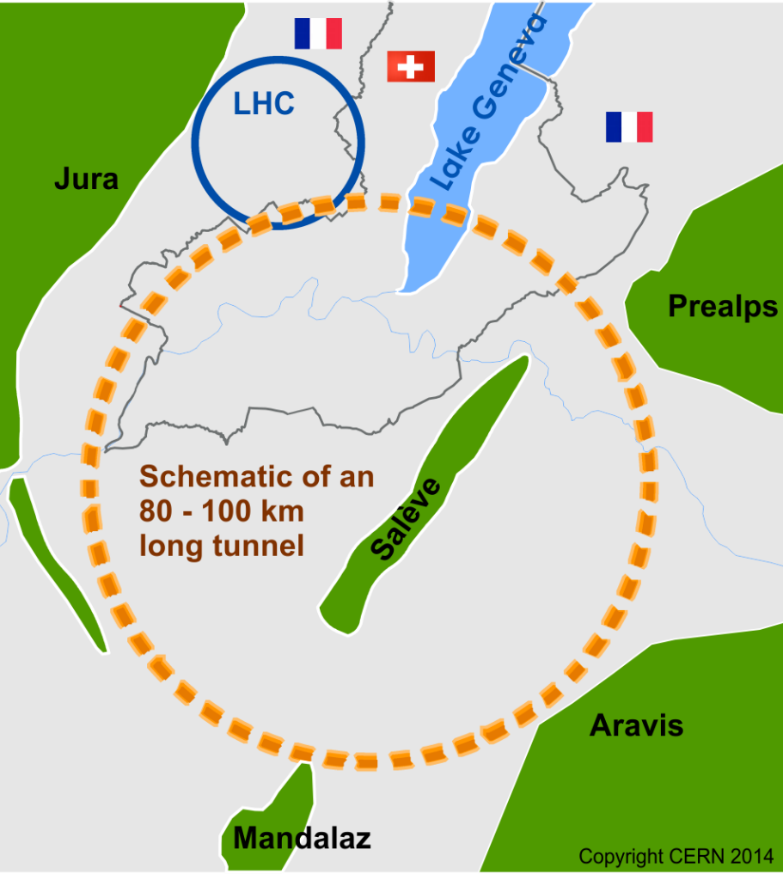
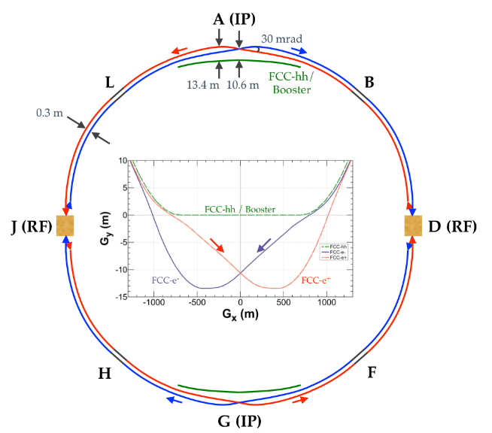
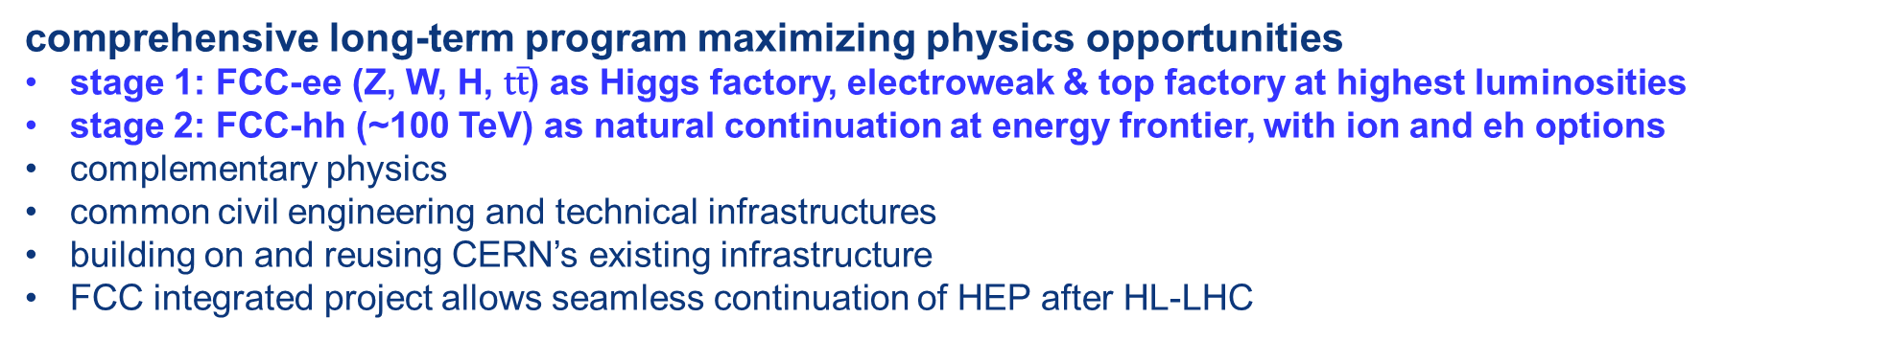
The FCC integrated program
inspired by successful LEP – LHC programs at CERN
comprehensive long-term program maximizing physics opportunities
stage 1: FCC-ee (Z, W, H, $\text{t}\overline{\text{t}}$) as Higgs factory, electroweak & top factory at highest luminosities
stage 2: FCC-hh (~100 TeV) as natural continuation at energy frontier, with ion and eh options
complementary physics
common civil engineering and technical infrastructures
building on and reusing CERN’s existing infrastructure
FCC integrated project allows seamless continuation of HEP after HL-LHC
FCC-ee
FCC-hh

Slide 3
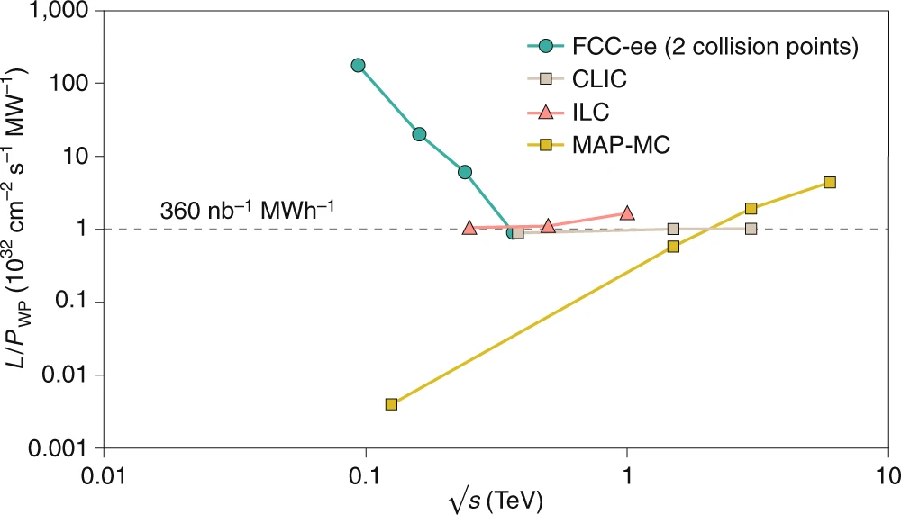
FCC-ee figures of merit
Luminosity vs. capital cost
for the H running, with 5 ab⁻¹ accumulated over 3 years and 10⁶ H produced, the total investment cost (~10 BCHF) corresponds to → 10 kCHF per produced Higgs boson
for the Z running with 150 ab⁻¹ accumulated over 4 years and 5x10¹² Z produced, the total investment cost corresponds to → 10 kCHF per 5×10⁶ Z bosons
This is the number of Z bosons collected by each experiment during the entire LEP programme !
Luminosity vs. electricity consumption
Due to twin-aperture magnets,
thin-film SRF, efficient RF power
sources, top-up injection
Capital cost per luminosity dramatically
decreased compared with LEP !
Highest lumi/power of all H fact proposals
Electricity cost ~200 CHF per Higgs boson

Slide 4
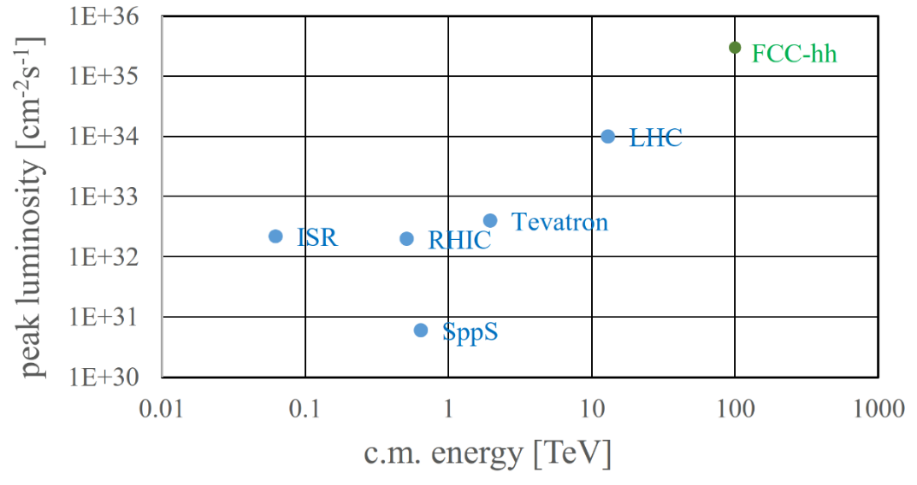
FCC-hh: performance
order of magnitude performance increase in energy & luminosity
100 TeV cm collision energy (vs 14 TeV for LHC)
20 ab⁻¹ per experiment collected over 25 years of operation (vs 3 ab⁻¹ for LHC)
similar performance increase as from Tevatron to LHC
key technology: high-field magnets

Slide 5
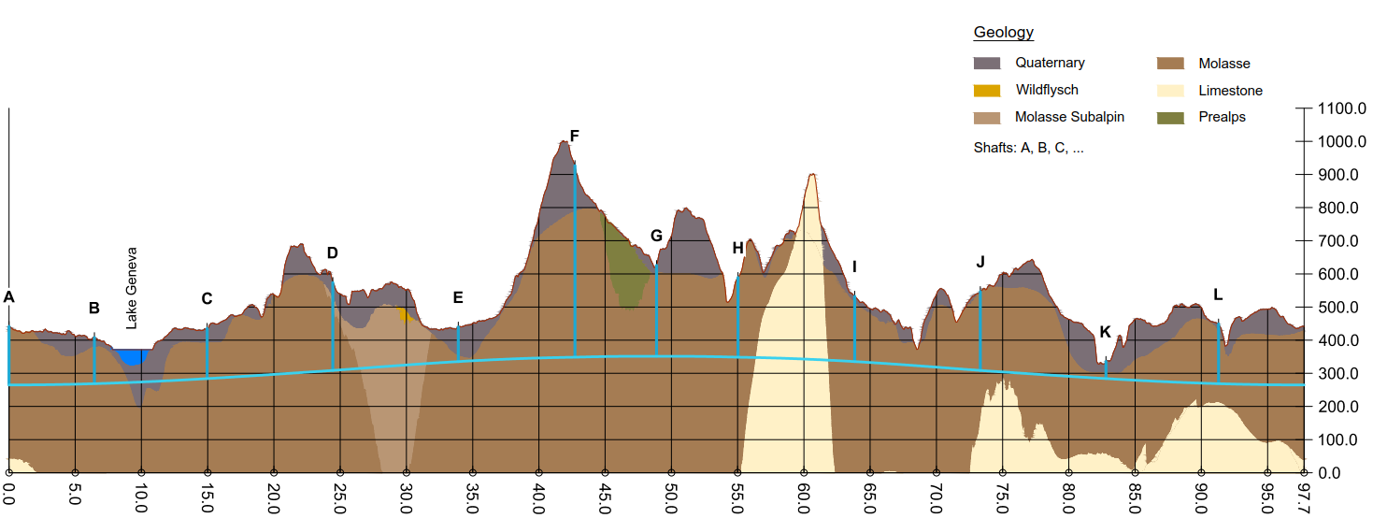
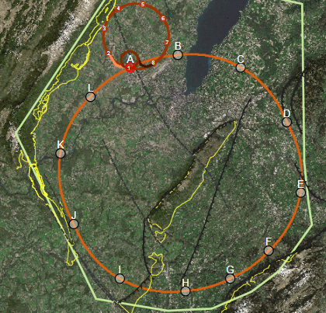
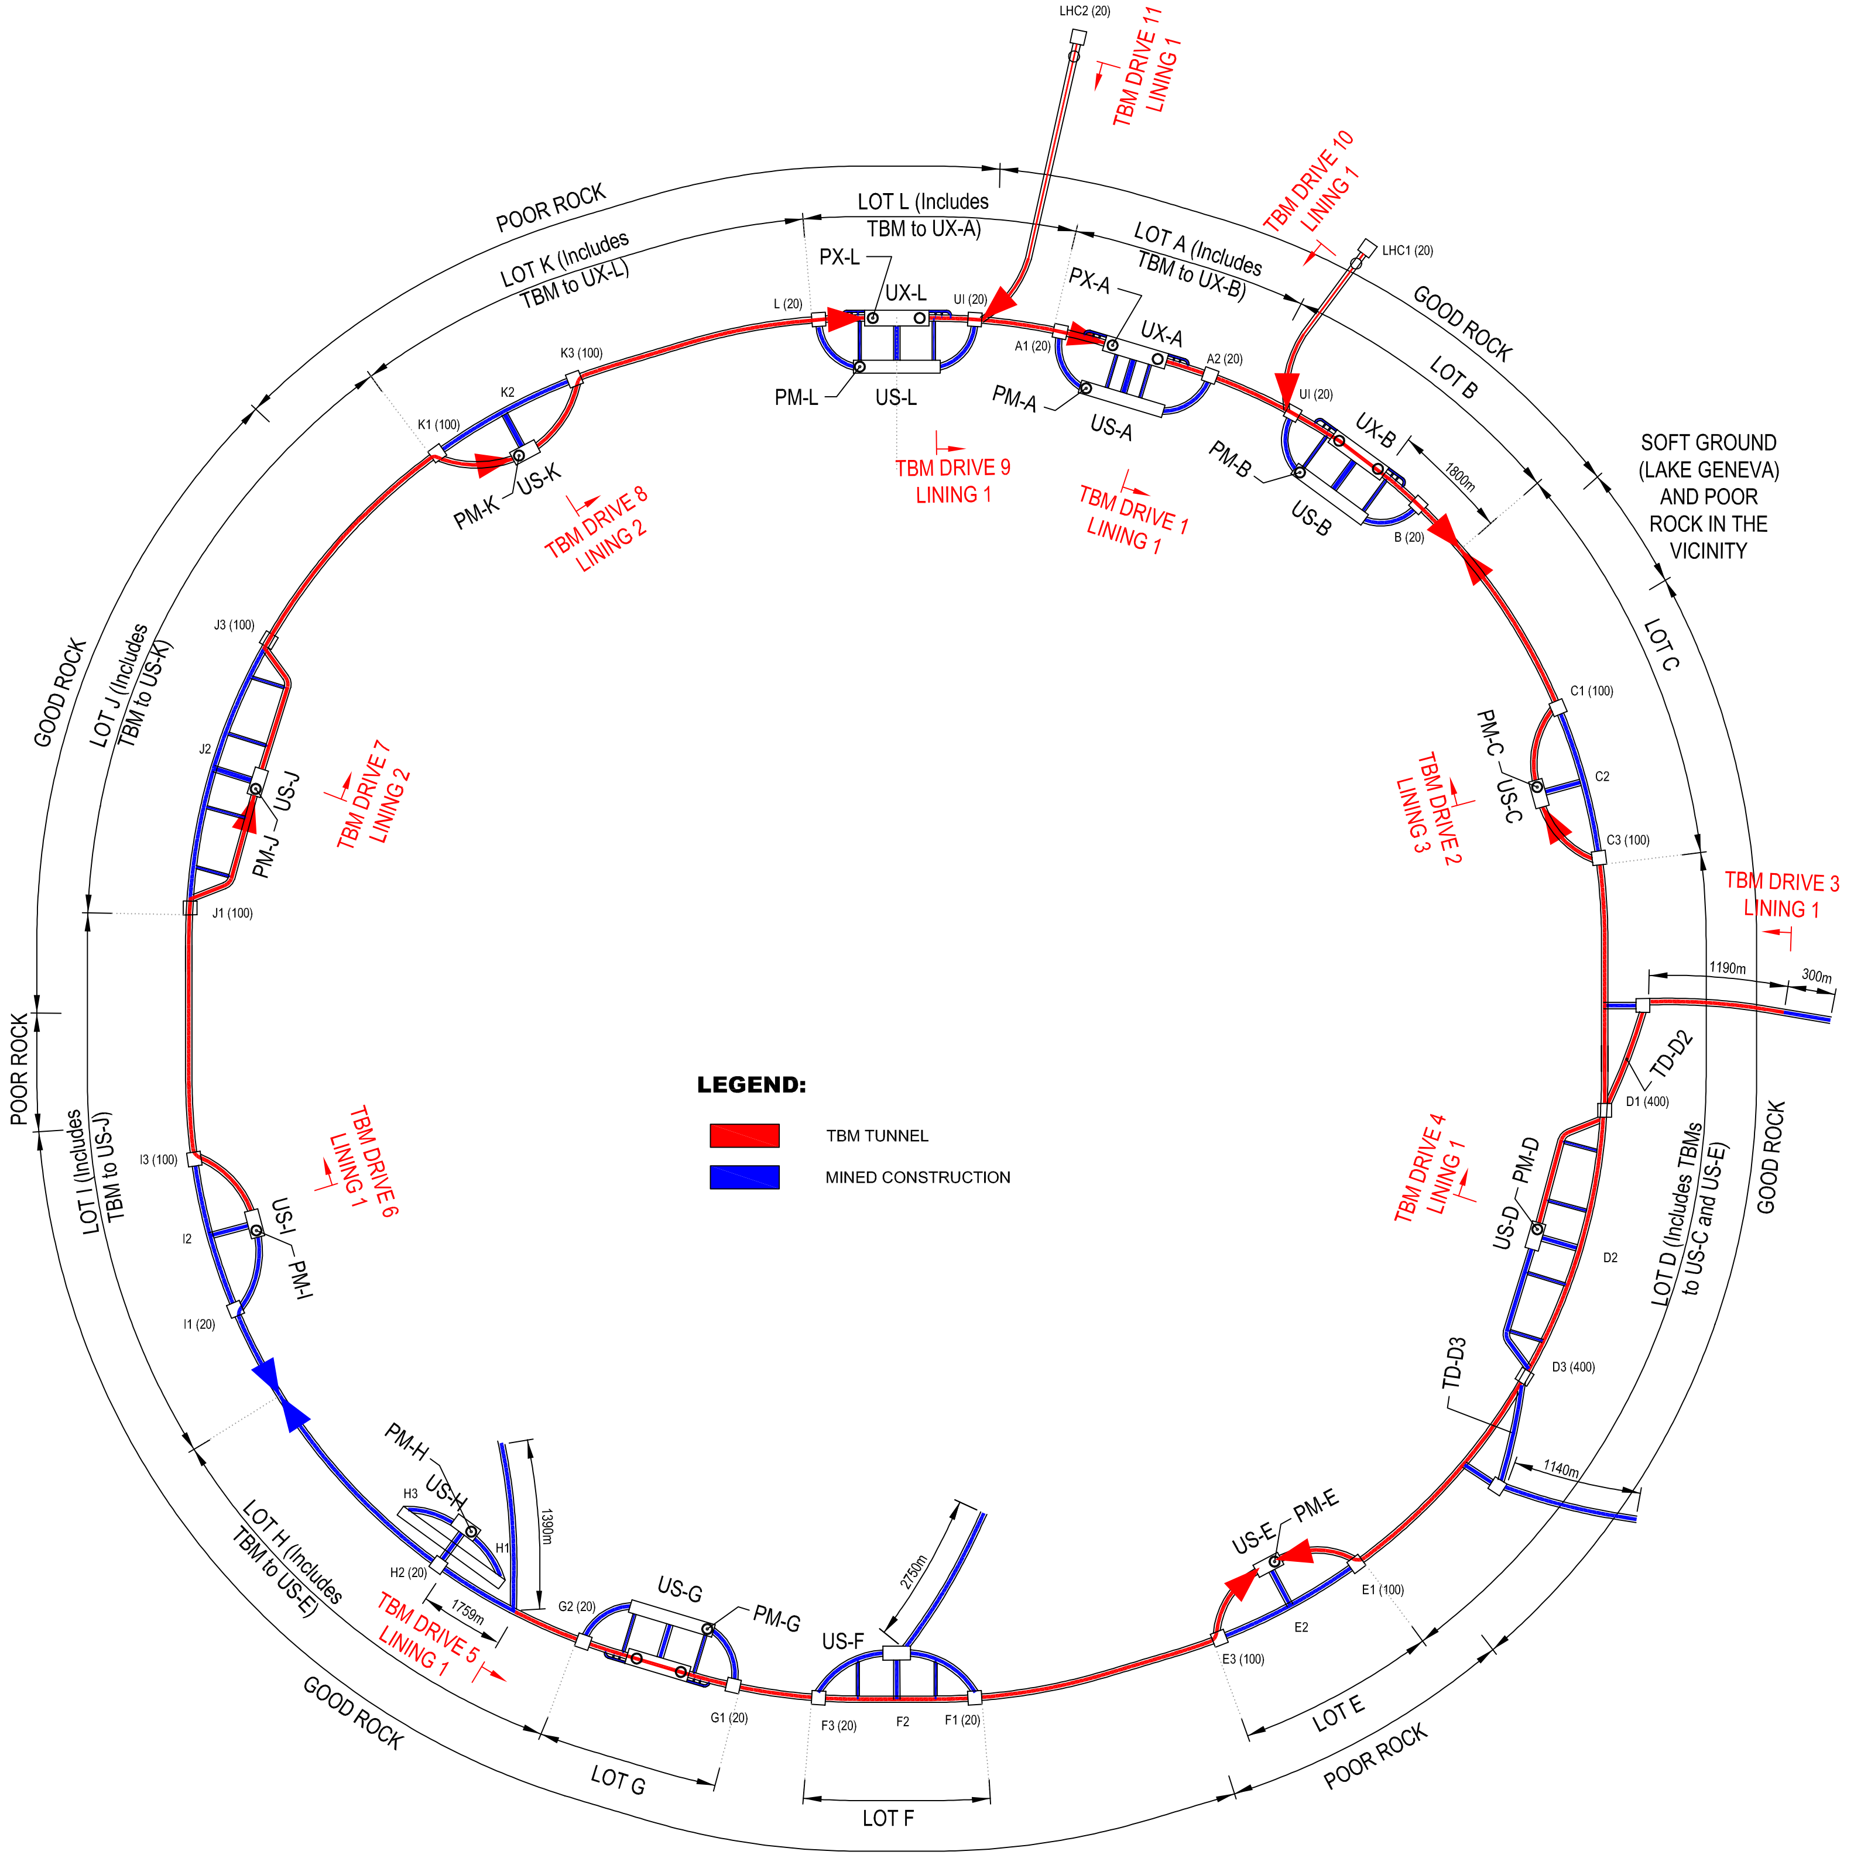
FCC implementation - footprint baseline
present baseline position was established considering:
lowest risk for construction, fastest and cheapest construction
feasible positions for large span caverns (most challenging structures)
90 – 100 km circumference
12 surface sites with ~5 ha area each → recent studies on 8 surface s.

Slide 6
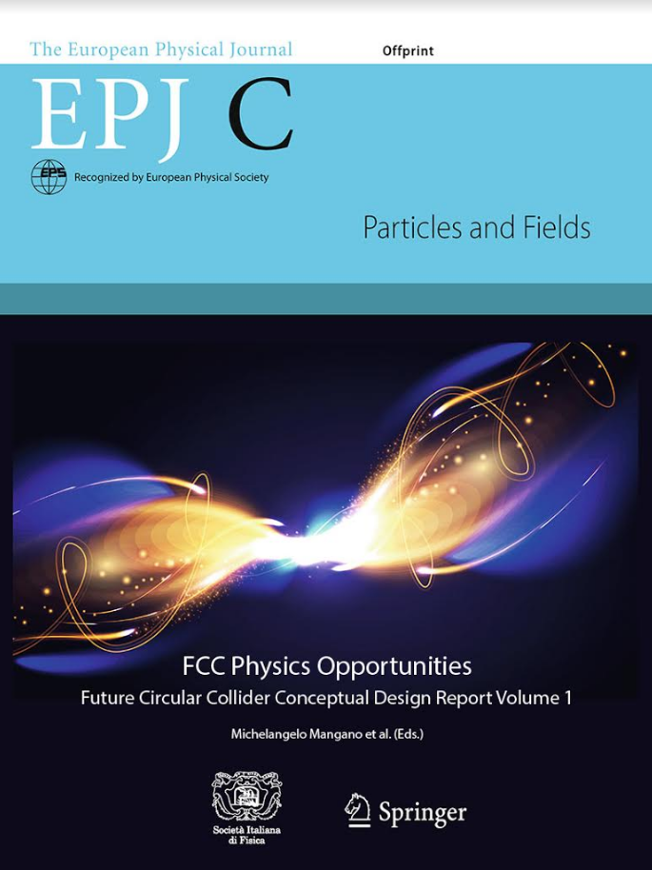
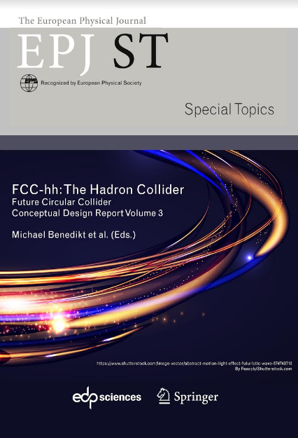
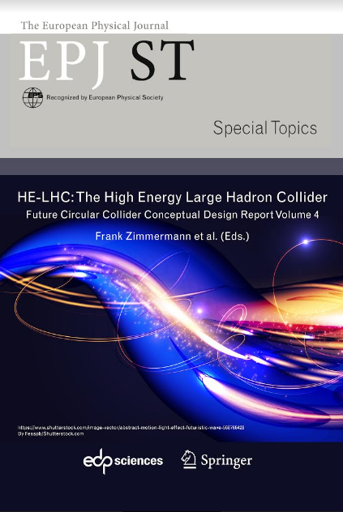
FCC CDR & Study Documentation
FCC-Conceptual Design Reports:
  Vol 1 Physics, Vol 2 FCC-ee, Vol 3 FCC-hh, Vol 4 HE-LHC
  CDRs published in European Physical Journal C (Vol 1) and ST (Vol 2 – 4) [Springer]
  EPJ C 79, 6 (2019) 474 , EPJ ST 228, 2 (2019) 261-623 ,
  EPJ ST 228, 4 (2019) 755-1107 , EPJ ST 228, 5 (2019) 1109-1382
EPJ is a merger and continuation of Acta Physica Hungarica, Anales de Fisica, Czechoslovak Journal of Physics, Fizika A, Il Nuovo Cimento, Journal de Physique, Portugaliae Physica and Zeitschrift für Physik. 25 European Physical Societies are represented in EPJ, including the DPG.
Summary documents provided to EPPSU 2019/20
  FCC-integral, FCC-ee, FCC-hh, HE-LHC
  Accessible on http://fcc-cdr.web.cern.ch/
>1350 contributors from > 350 institutes,
a truly global effort as suggested by EPPSU 2013

Slide 7
from ESPP Update 2020
      High-priority future initiatives:
      An electron-positron Higgs factory is the highest-priority next collider. For the longer term, the European particle physics community has the ambition to operate a proton-proton collider at the highest achievable energy.
      “Europe, together with its international partners, should investigate the technical and financial feasibility of a future hadron collider at CERN with a centre-of-mass energy of at least 100 TeV and with an electron-positron Higgs and electroweak factory as a possible first stage.
      Such a feasibility study of the colliders and related infrastructure should be established as a global endeavour and be completed on the timescale of the next Strategy update..”

Slide 8
FCC feasibility study 2021 – 25 & roadmap
Highest priority goals:
Financial feasibility
Technical and administrative feasibility of tunnel: no show-stopper for ~100 km tunnel
\
Technologies of machine and experiments: magnets; minimised environmental impact; energy efficiency & recovery
Gathering scientific, political, societal and other support
>2040 first
ee collisions
Fabiola Gianotti: “CERN vision and goals until next strategy update” FCCIS Kick-Off, 9 Nov. 2020
>2030
start tunnel
construction
>2036
machine
installation
2028 approval
2026/7
ESPPU
>2030 - 37
element production
2025/26
Feasibility proof
>2026 - 30 full
technical design
2014 FCC
study kickoff
2020
ESPPU
2020 FCCIS
kickoff
2025/26
Financing model
Operation concept
2013
ESPPU
2018 FCC CDR
2020-25
FCC Feasibility Study
FCCIS H2020 DS
today
2012 Higgs discovery announced
2011 circular Higgs factory proposal

Slide 9
FCC integrated project technical schedule
1
2
3
4
5
6
7
8
9
10
11
………………..
19
20
~ 15 years operation
7 – 10 years
~ 25 years operation
70
Feasibility Study
EPPSU
Project preparation &
administrative processes
Permis-sions
Update
Permissions
Funding strategy
Funding and
in-kind contribution agreements
Funding and
in-kind contribution agreements
Geological investigations, infrastructure detailed design and tendering preparation
Tunnel, site and technical infrastructure construction
FCC-ee dismantling, CE & infrastructure adaptations FCC-hh
FCC-ee accelerator R&D and technical design
FCC-ee accelerator construction, installation, commissioning
FCC-hh accelerator R&D and technical design
FCC-hh accelerator construction, installation, commissioning
Set up of international experiment collaborations, detector R&D and concept development
FCC-ee detector technical design
FCC-ee detector
construction, installation, commissioning
FCC-hh detector R&D,
technical design
FCC-hh detector
construction, installation, commissioning
Superconducting wire and magnet R&D, short models
Long model magnets, prototypes, preseries
High-field magnet
industrialization and
series production

Slide 10
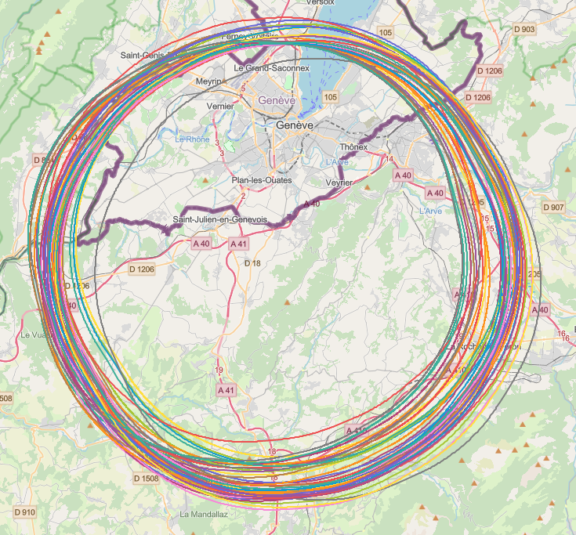
Implementation studies with host states
layout & placement optimisation across both host states, Switzerland and France;
following "avoid-reduce-compensate" directive of European & French regulatory frameworks;
diverse requirements and constraints:
  technical feasibility of civil engineering and subsurface geological constraints
  territorial constraints on surface and subsurface
  nature, accessibility, technical infrastructure, resource needs & constraints
  optimum machine performance and efficiency
  economic factors including benefits for, and synergies, with the regional developments
  …
collaborative effort: FCC technical experts, consulting companies, government-notified bodies

Slide 11

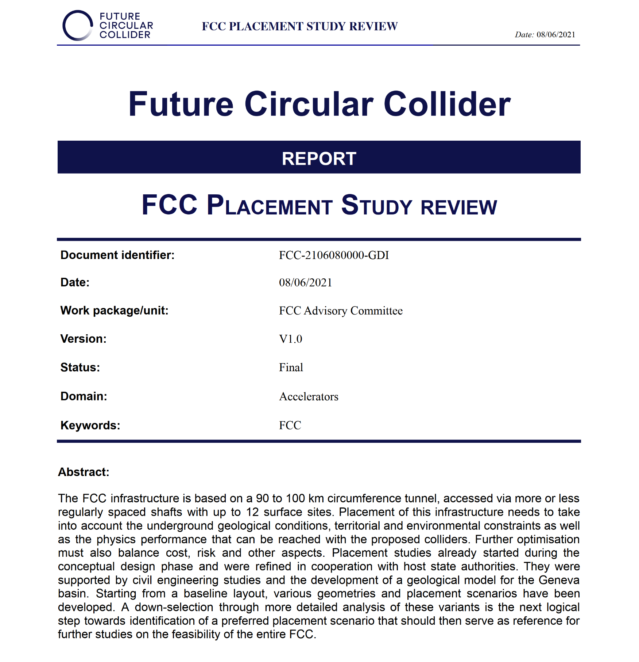
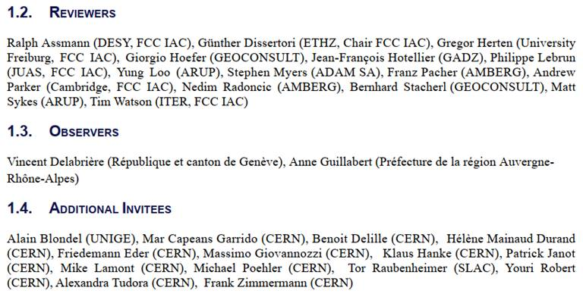
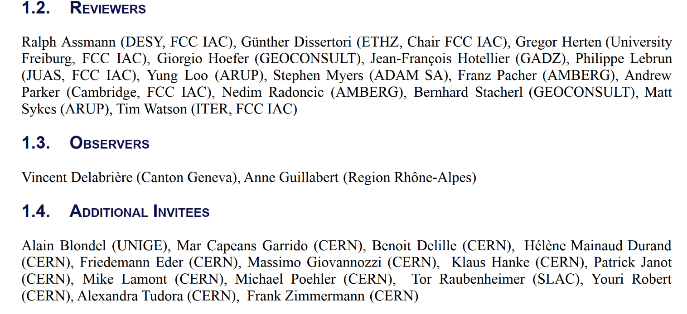
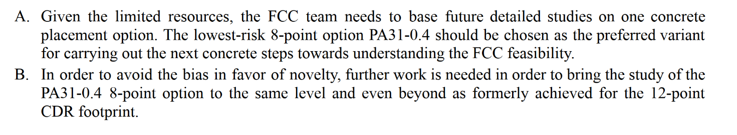
FCC FS Placement Review - Conclusion
Main recommendations:

Slide 12
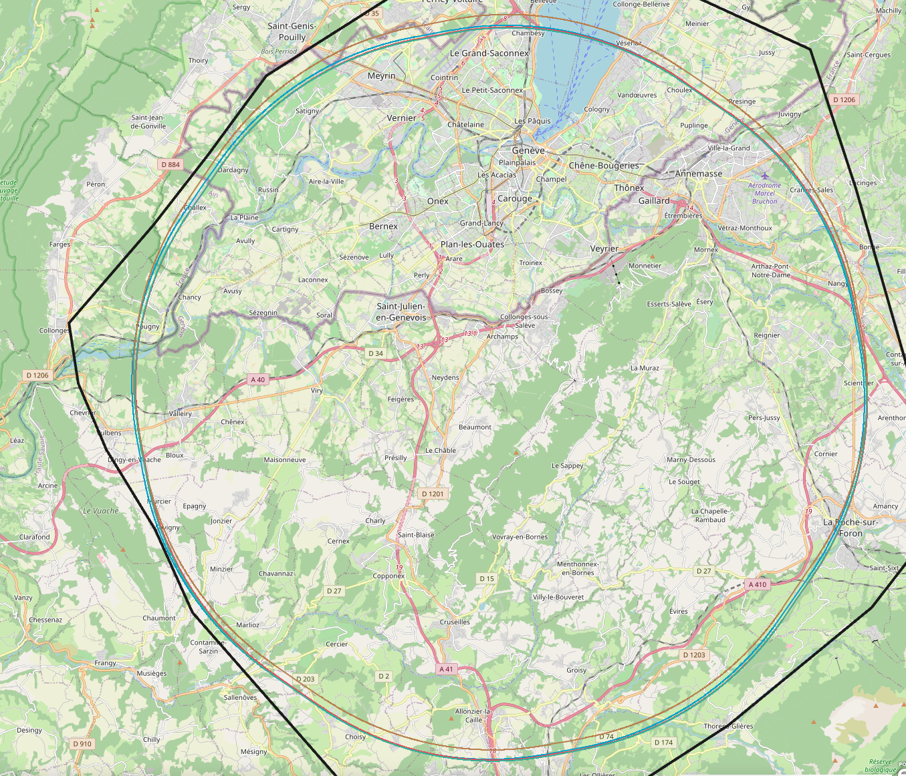
Detailed implementation studies
Analysis of baseline scenario from review PA31-1.0 with automated search tool with enlarged perimeters around target areas for surface sites.
More than 3’000’000 iterations on PA31-1.0 with different starting conditions revealed no better ranked scenarios in geological boundary area.
Presently three scenarios maintained, optimised fallback scenarios 1.1 and 1.6 in addition to a baseline 1.0 scenario that will only be considered if 1.0 turns out to be incompatible from a territorial point of view.

Slide 13

Status of Global FCC Collaboration
increasing international collaboration as a prerequisite for success
34
Countries
EC
H2020
30
Companies
147
Institutes
93 member states
16 associate member states
21 non-member states with observer status
17 other non-member states

Slide 14
Summary
The European Strategy Update 2019/20 issued the request for a feasibility study of the FCC integrated programme to be delivered by end 2025.
The main activities of the FCC Feasibility Study are:
  concrete local/regional implementation scenario in collaboration with host state authorities,
  accompanied by machine optimization, physics studies and technology R&D,
  performed via global collaboration and supported by EC H2020 Design Study FCCIS,
  in parallel High Field Magnet R&D program as separate line, to prepare for FCC-hh.
Long term goal: world-leading HEP infrastructure for 21st century to push the particle-physics precision and energy frontiers far beyond present limits.
Success of FCC relies on strong global participation. Everybody interested is warmly welcome to join the effort!

