Slide 1


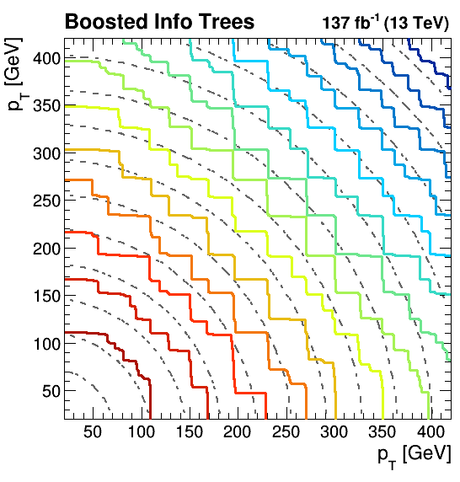

Learning the EFT likelihood from tree boosting
L. Lechner, S. Chatterjee, D. Schwarz, R. Schöfbeck (HEPHY), N. Frohner (TU Vienna)

Slide 2
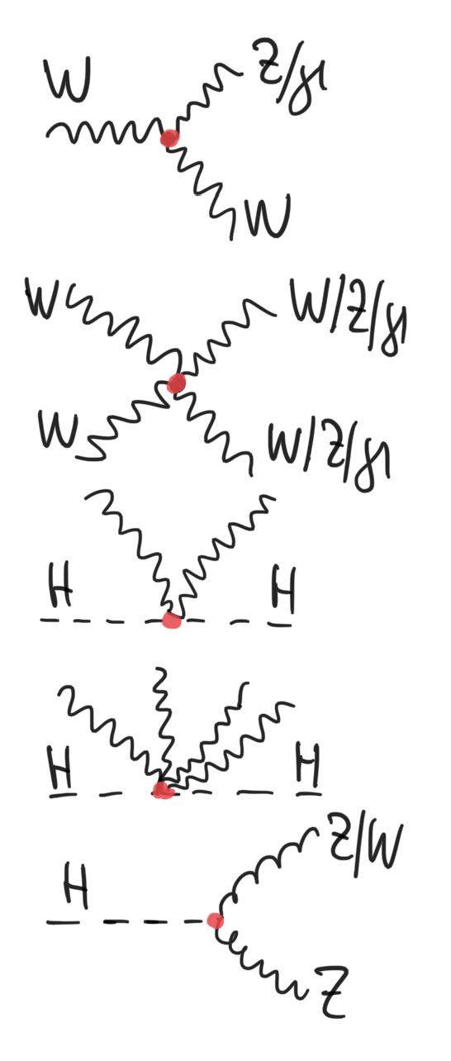
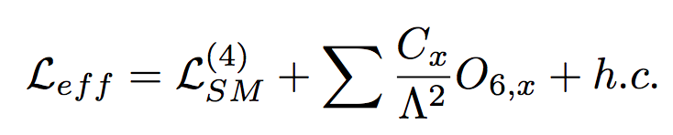

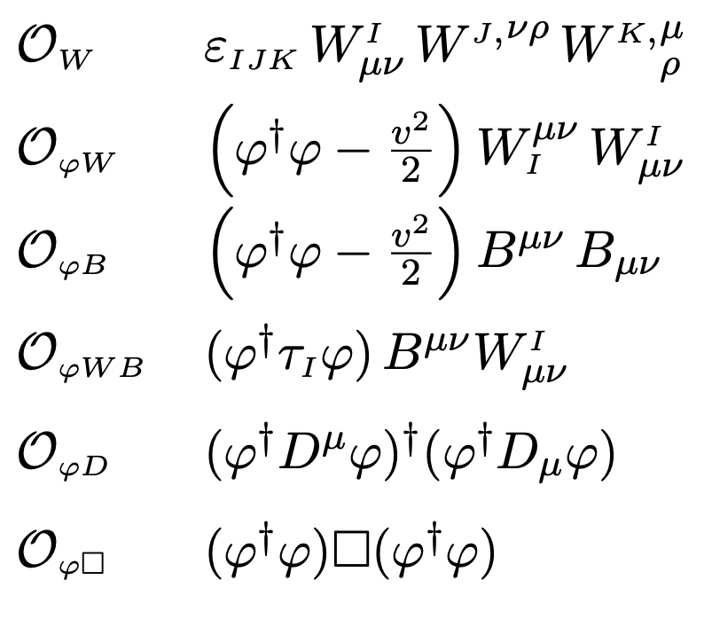
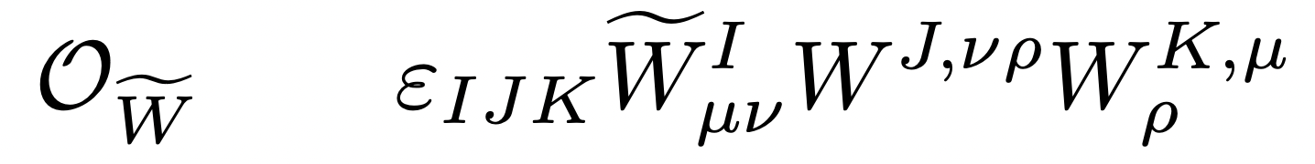
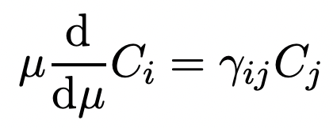
effective field theories in HEP
Instead of complete UV models, organized all symmetry-respecting BSM extensions in the operators’ mass dimension:
For example, in the SM:
  SU(3)_{c} ⨂ SU(2)_{L}⨂U(1) 59 operators at d=6 [JHEP10(2010)085 ]
  Describes BSM LHC physics from the weak scale up to 𝛬
flavor physics at lower scales: SU(3)_{c} ⨂U(1) :
“Weak effective theory”, e.g. [JHEP 1801 (2018) 084]
Connecting scales with RGEs: [JHEP 10 (2013) 087]
matching
WET
SM-EFT
𝚲
UV models
0.01TeV
0.1 TeV
1 TeV
E [ TEV ]

Slide 3
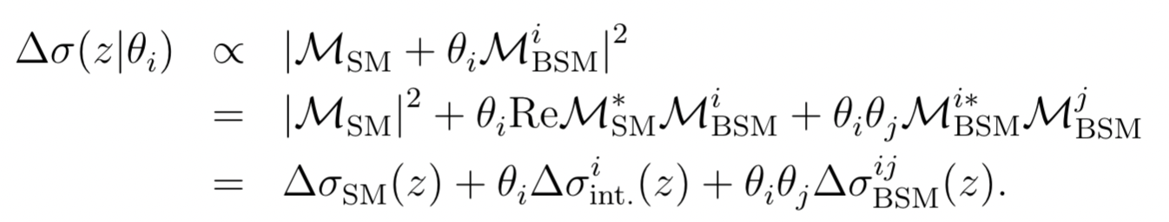
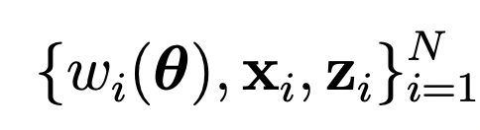
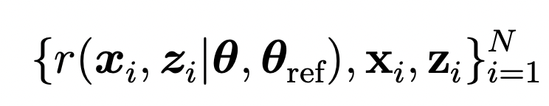
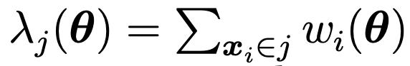

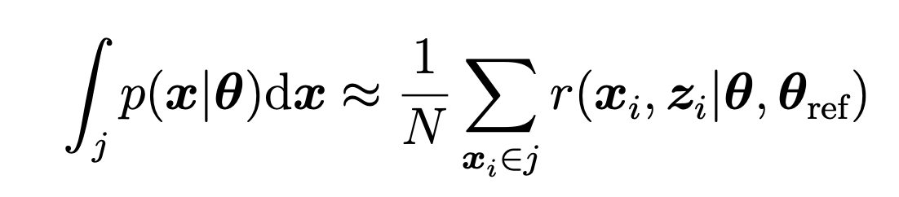
The EFT measurement problem
Simple dependence of cross sections on Wilson coefficients differentially
  Can truncate the few non-polynomial cases (supported e.g. in [SMEFTsim] )
Can re-evaluated ME at parameter points θ ≠ θ _{SM}=0 at the generator phase-space point z.
  This extra information (‘augmented’ data) allows (polynomially) parametrized EFT predictions
  Detector simulation provides the ”reconstruction level” features x.
  Can compute (event-wise) “joint” LL ratio r(x,z|θ₂, θ₁), the score vector t(x,z|θ) and other quantities.
Curse of dimensionality is lifted!!
15 operators → 136 functions
→ linear or quadratic effects
“cross section normalization”
“probability normalization"
Divide out
total cross section
“weights (quadratic)”
“Event-wise (joint)
likelihood ratios”
“yields”
”probabilities”

Slide 4
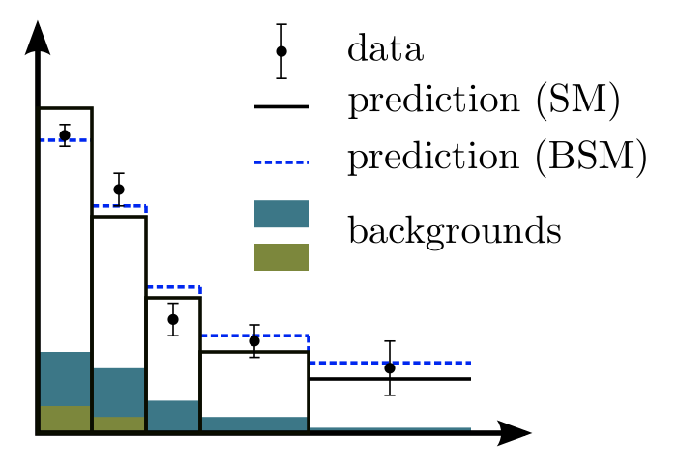
The EFT measurement problem
Conventional strategy for constraining parameters
  Choose sensitive distribution(s)
  Subtract the background
  Fit (e.g. a signal template for an x-sec measurement)
  Compare measured diff. x-sec with a parametrized prediction
Classification MVAs in parameter measurements
  Use an MVA to separate signal (=1) and background (=0)
    Discrete labels
  Choose sensitive distribution(s) after MVA cut or MVA discriminator
  Continue as before
Optimal classification provides an optimal cross-section measurement … but that’s just not what we’re doing
Can we modify the MVA training such that it results in an optimized (EFT-) estimator?
The quadratic dependence lifts the curse of dimensionality in EFT. Can it be exploited in ML?
Recent ML developments focus on ANNs, but in practice, (lightweight) BDTs are sometimes preferred over (extrapolating) ANNs. Can we bring the simplicity of BDTs to the EFT measurement problem?
n
𝛌
i = 1…N

Slide 5
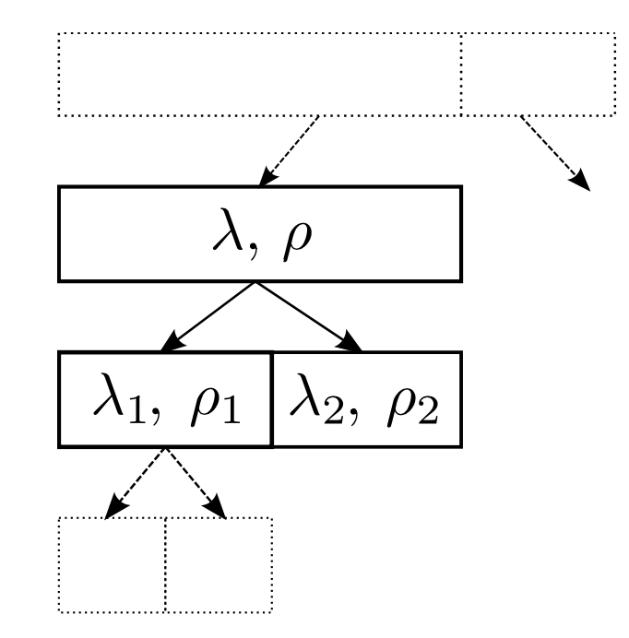





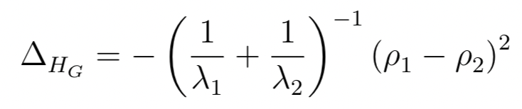
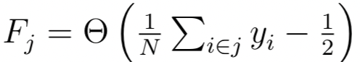
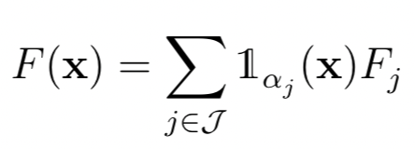
Fisher information in traditional classification
Let’s look at a weak learner in classification (CART) aiming to separate binary hypothesis (supervised training).
Data: with
Find the next cut in feature j at position
where the loss is
Purity ρ = S/(S+B), total yield 𝛌 = S+B
Let’s chose the Gini impurity
and we find
The weak learner returns the majority label of the training data
somewhere in the tree
Fancy way to write the weak learner’s majority output:
Penalty for
small yields
Maximally
different purities

Slide 6

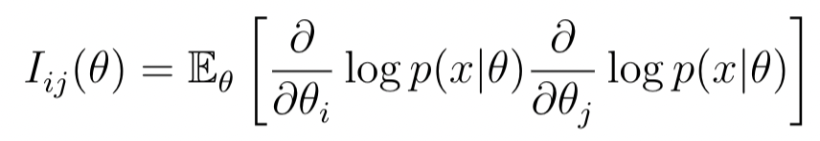
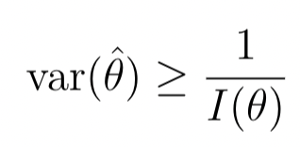
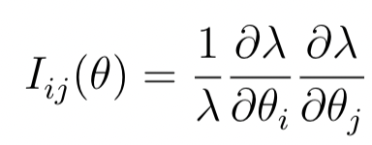
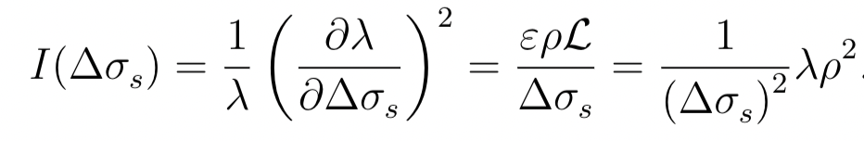
Fisher information in traditional classification
1 step back: Take pdf p(x|𝛉) and score
The Fisher information is defined as
The Cramér-Rao bound states that,
for an (unbiased) estimator of θ, we have
Now let’s do a Poisson counting experiment:
and measure a cross section Δσ_{s} of a signal process
The Fisher information in the x-sec from a Poisson count is
Gini impurity is the Fisher optimum of xsec measurement!
[A. Valassi, 2019,, 2020]
somewhere in the tree
Fancy way to write the weak learner’s majority output:
⟷ equivalent to H_{G}!
Constants and ∝ ρ drop out.

Slide 7
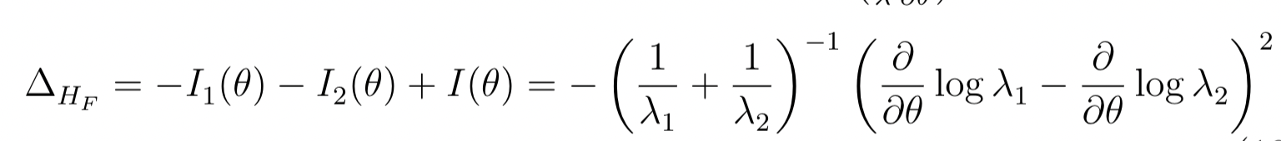
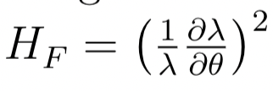

Ingredient 1: The weak learner
Generalize this interpretation to general parametrized predictions.
Use Fisher Information in Poisson EFT yield 𝛌(𝛉) to define node split in the CART¹ algorithm
Think of it as training to separate 𝛉_{ref} from 𝛉 _{ref} + d𝛉 at a reference point 𝛉_{ref}. For now, scalar 𝛉.
  The impurity H_{G} is replaced by the 𝛉-dependent general function:
  ρ is replaced by the Poisson score function ⟷
  Same penalty term as for the Gini impurity
  There are no backgrounds! Only events with w’=0 that reduce the Poisson score ⟷ the classifier can learn that.
ΔH_{F} defines only the node split. But what shall the weak learner learn? And how does it learn?
Here are the Poisson I_{F} for general 𝛌(𝛉)
¹Classification And Regression Trees

Slide 8
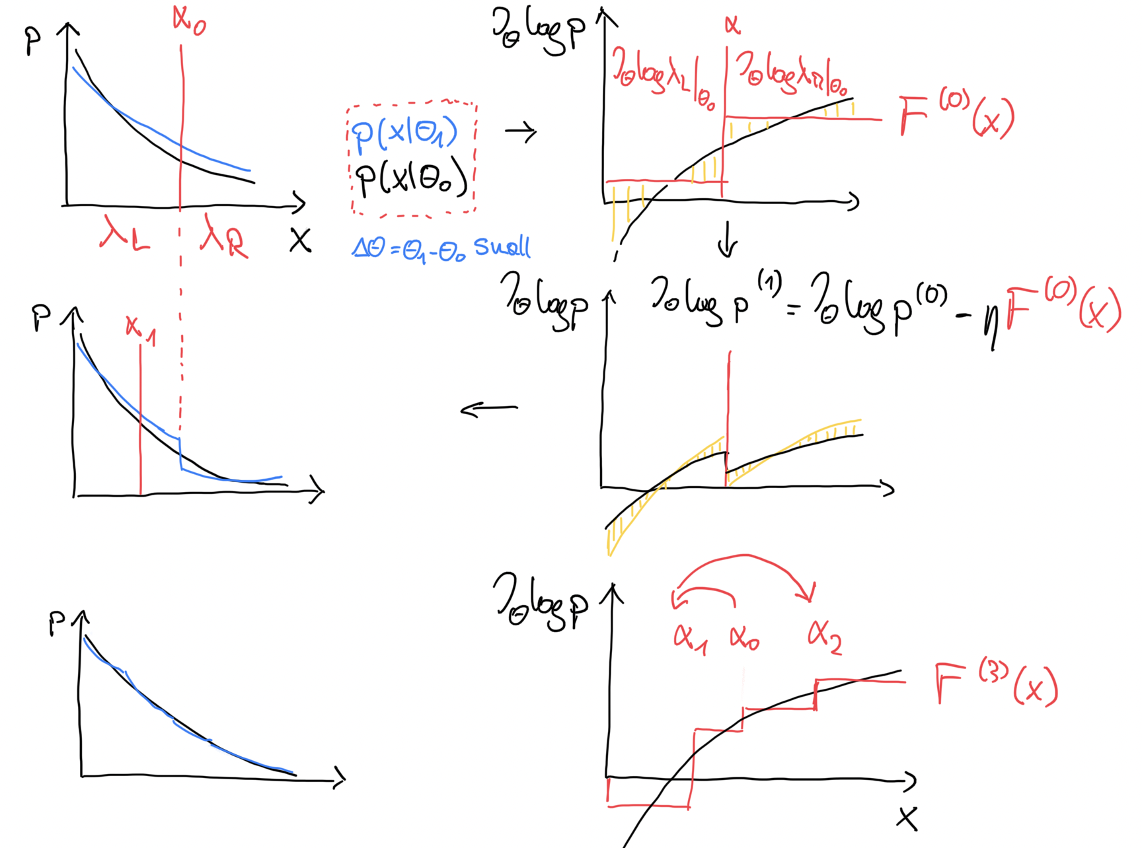





How does the weak learner learn? (What is boosting?)
Approximate a function by a linear sum of weak learner’s that are iteratively fit to the residuals of the previous iteration
  Start with F⁽⁰⁾ (x) = 0
  While you’re not happy with convergence:
    Fit simple function → F⁽¹⁾ (x)
    “Subtract” a fraction η F⁽¹⁾(x) from the input data (η=0.1 - 0.3, learning rate)
      Implemented as reweighting: Input data is scaled to a bit closer to f(x). This increases the relative importance of x values where we’ve done a bad job.
    Repeat with residuals [ will give you → F⁽²⁾(x) ]
  Your final estimator is F(x) = η Σ_{b} F^{(b)}(x)
This answers how we learn, but not what he target should be.
    f(x)
    F⁽¹⁾ (x)
𝛼₂
    f(x) – ηF⁽¹⁾(x)
F(x) = η Σ_{b} F^{(b)}(x)

Slide 9

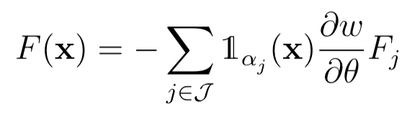
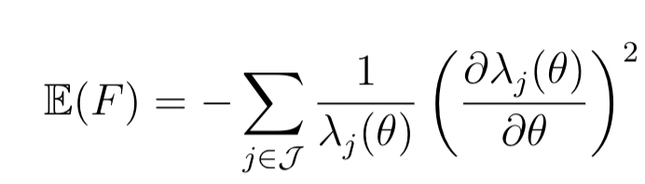
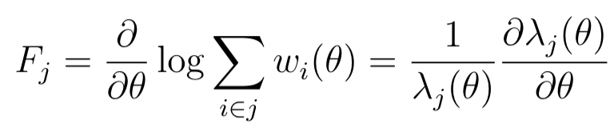
Ingredient 2: BOOSTING (or what the learner learns)
Traditionally loss functions have the form L( ), i.e. sum products of prediction x truth.
We classify 𝛉 and 𝛉 + d 𝛉 → each augmented event enters with +w(𝛉) and –w(𝛉+d𝛉)
Hence, the general form of the loss is the weight differentiated x (whatever we decide to predict)
Boosting: a linear sum of greedy weak learners is fit iteratively to the residuals of the preceding iteration.
It’s important to have the boosting loss consistent with the I_{F} criterion (otherwise will just learn this loss)
Choosing
The weak learner shall return (predict) the Poisson score from all events in the node!
F_{j} … What the weak learner shall learn (our choice)
𝜕w(𝛉)/𝜕𝛉 … Because each event enters twice in the classification loss
leads to
= -∑ I_{F}

Slide 10
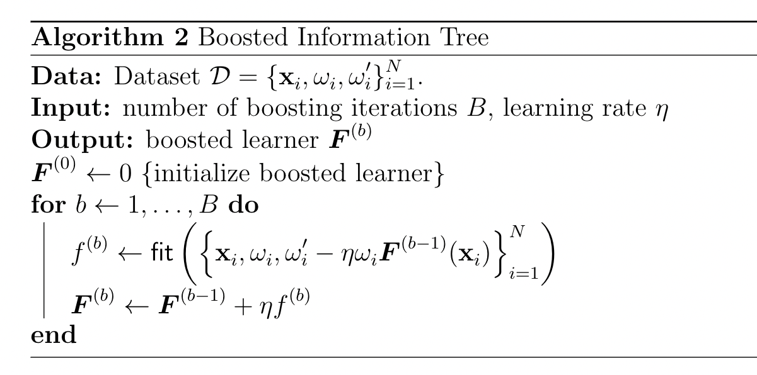
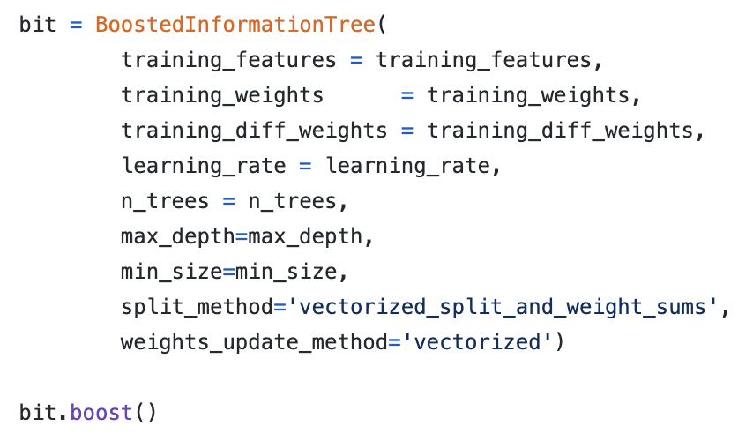
Boosted information trees
Result is a CART algorithm with dedicated node-split criterion and consistent boosting loss.
Boosting Algorithm: 1) Fit a weak learner using I_{F} node-split; 2) return the score. 3) Take only a fraction η·F (η = learning rate), 4) remove η·F from the events’ score, and 5) repeat!
  Pseudo-code of weak learner in backup
  Dressed up with overtraining protection
Python2/3 code on GitHub
Main aim: Minimal dependencies, very very short get-go time for the users

Slide 11
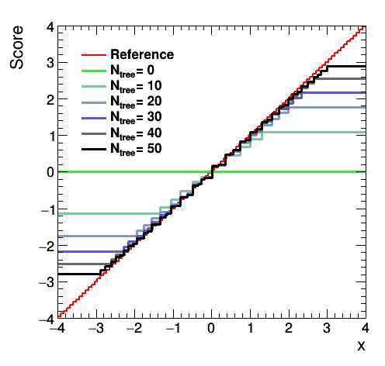
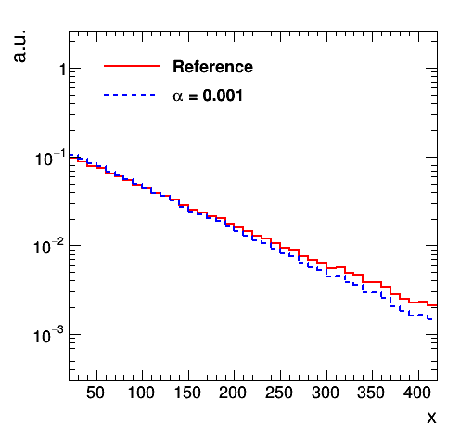
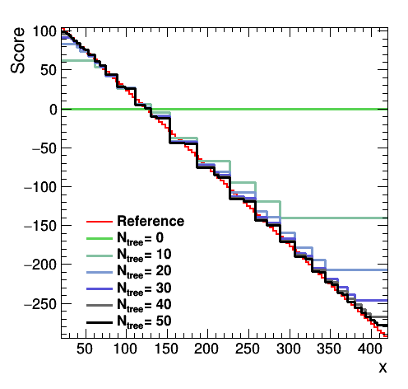
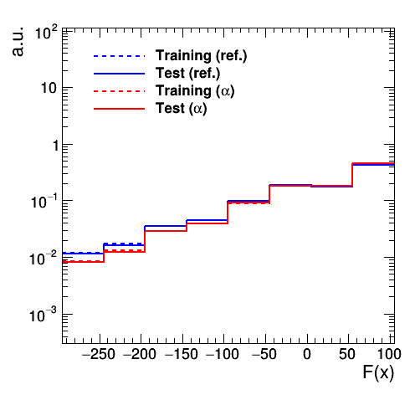
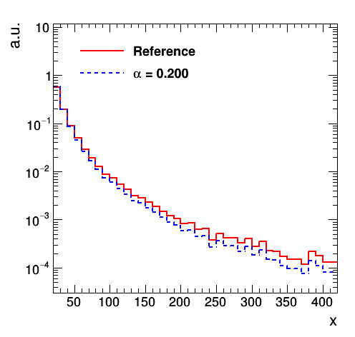
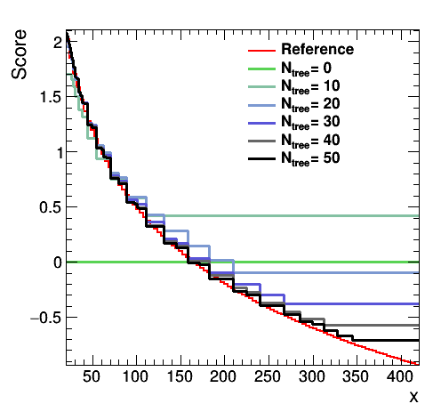
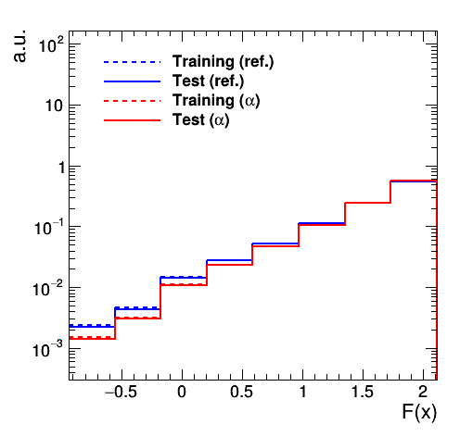
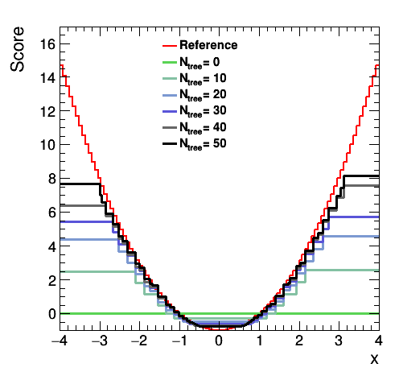
Boosted information trees: TOY models
Let’s fit to analytically tractable models!
“Gaussian mean”
x ~ p(x|𝛉)
Learnt score vs. theory (red)
Train/test for classifier
t(x|𝛉) ∝ -x
Exponential model
p(x|𝛉) ∝ e^{-𝛉x}
p(x|𝛉) ∝ e^{-𝛉x}
“Gaussian width”
Power-law model
p(x|𝛉) ∝ x^{-𝛉}
t(x|𝛉) ∝ -log(x)
p(x|𝛉) ∝ x^{-𝛉}

Slide 12
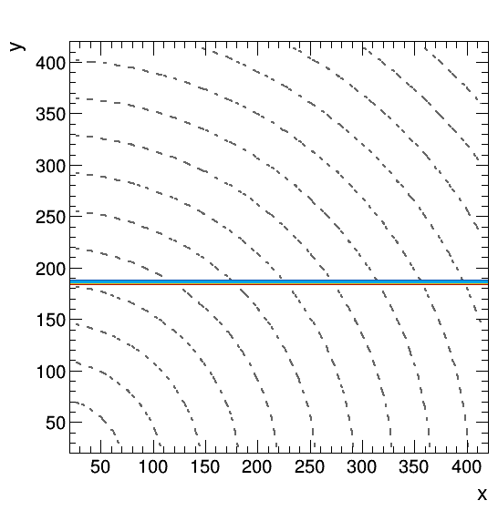
2D exponential toy
[Link] to animated gif

Slide 13
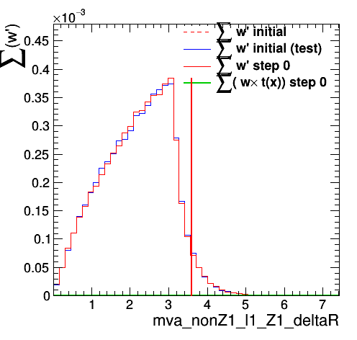
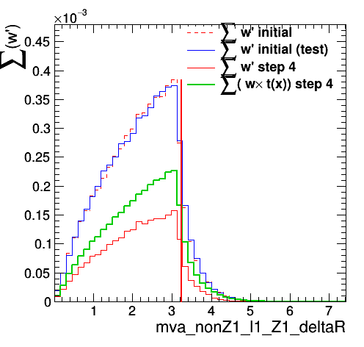
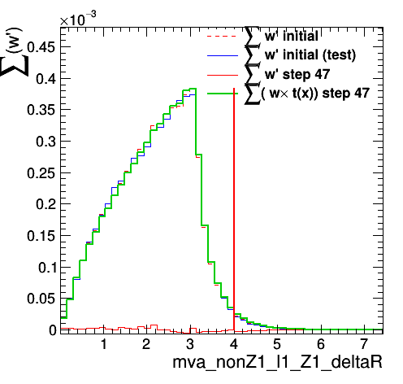
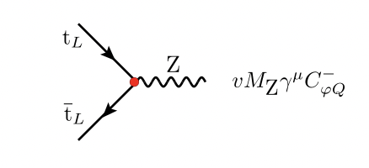
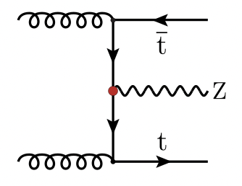
Boosting a simple Real problem
At the beginning of training:
Starting point
Test dataset
“Remaining” score in the dataset during boosting
“what we already learnt”, i.e. current BIT prediction
Expected score
Cut with optimal
Information gain
“Remaining” score in the dataset
f(x)
“what we already learnt”
During the boosting phase, the
BIT-predicted score approaches the training score
while the remainder in the
F⁽⁰⁾
ηΣ_{b=1…4}F(b)(x)
f(x) – ηΣ_{b=1…4}F^{(b)}(x)
In the end, the BIT correctly predicts
the training score and the score in the weighted data
set is zero.
EFT modification:
Training process
(representative)
ηΣ_{b=1…47}F(b)(x)
f(x) – ηΣ_{b=1…47}F^{(b)}(x)

Slide 14
Boosting a simple Real problem

Slide 15
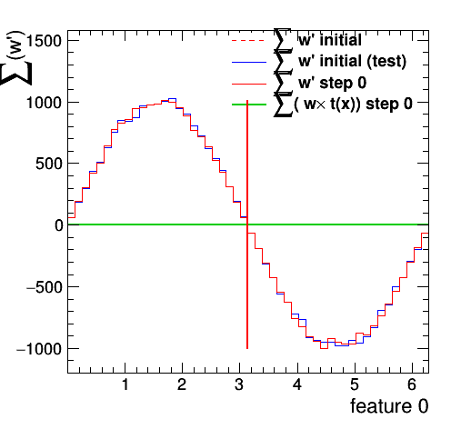
Learning the sine
pdf(x|𝛉) = 1/(2𝛑) + 𝛉 Sin(x)

Slide 16
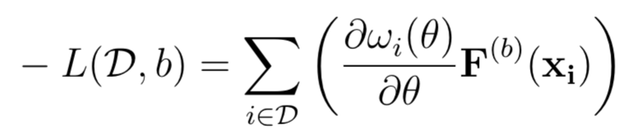
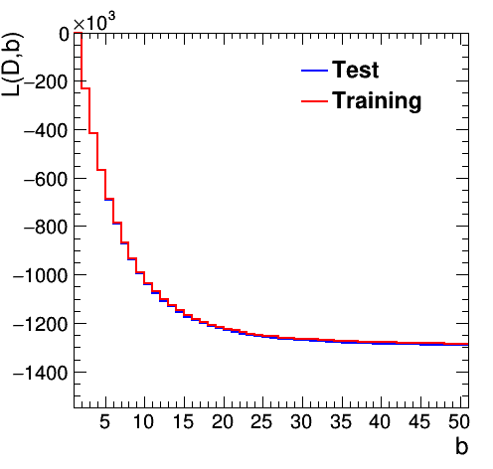
Overtraining & further tests
If all weights (per-event scores) similar → overtraining mitigated, because there is no sampling stochastics in the weight-derivative computation; each event enters with both hypothesis
If weight variance is large, overtraining situation
is similar to BDT case
Realistic SM-EFT examples show some weight variance,
i.e., the discriminating information is in a subset
Currently regularize with N_{node,min}, but look at
options involving the distribution of weights/derivatives
Training or test
loss for validation
Training or test
dataset
prediction
up to tree b
Negative loss (train/test)
No overtraining
for small weight
variance
b =

Slide 17
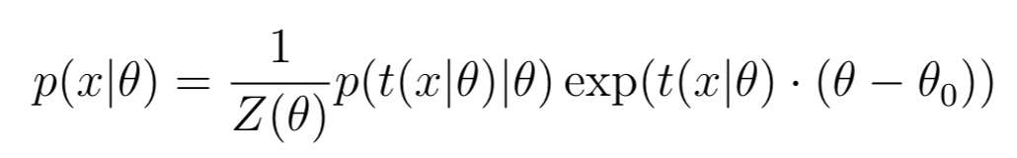
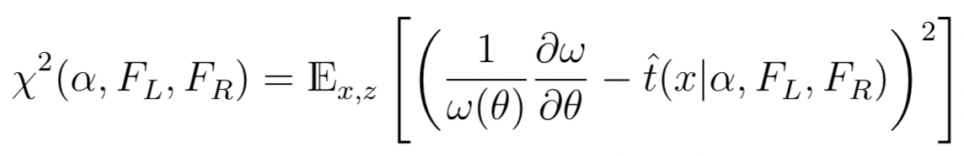
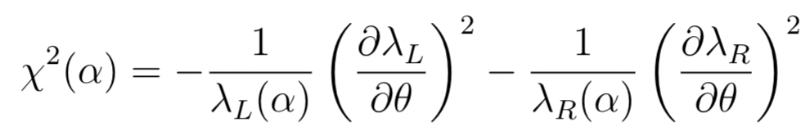
Classification with I_{F} = learning the score
We’ve started with classification, yet, the discriminator returns an estimate of the score.
  How so? The algorithm has the computational complexity of classification, not regression!
  Answer: linear approximation: Write likelihood as
  In the exponential family! The score is a sufficient statistic for p(x|𝛉) [1805.00020]
Clear in hindsight! Knowing the score is having the Fisher information.
Let’s see this: Fit a 2-node weak learner to regress to the score
  3-parameter estimator
Use a MSE loss :
Eliminate the two equations for the regression predictions F_{L}/F_{R}, keep the one for the cut value:
This loss is of the general form of
Eq. 27 in [1805.00020].
On the same footing as SALLINO (TBC.)
→ Boosted Information Trees
regress in score by means of I_{F} classification

Slide 18
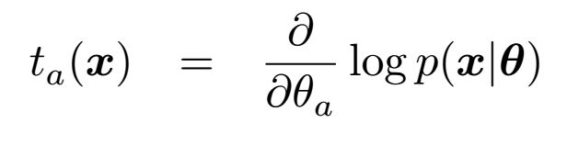
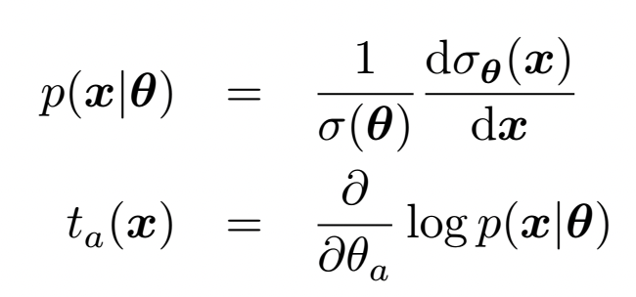


Learning the likelihood oRder by order
The linear BIT lears which allows us to compute the LL ratio to linear order in 𝛉.
The differential cross section is quadratic in 𝛉 → not much is missing
Consider the extended likelihood function in binned Poisson counting experiments:
The Neyman-Pearson Lemma states that the likelihood
ratio is the most powerful test statistic
The total x-sec σ(𝛉) is a known polynomial.
Knowing the cross section ratio R, we can compute the likelihood function.
R is a 2nd order polynomial in 𝛉 at each x.
t_{a} [x-sec. norm] = t_{a} [prob. norm] + 𝜕_{a}log σ(𝛉)
The BIT estimates t_{a}, but we calculated it
as an integral over x⊗z space ?! We need R(x)!

Slide 19






Intractable factors in the likelihood cancel
pioneering series of work by K. Cranmer et al. [1506.02169, 1805.00013, 1805.00020, 1805.12244]
If the EFT doesn’t change, e.g., the shower, we can obtain the joint quantities from simulation as:
  r(x,z|𝛉₁, 𝛉₀) = p(x|z) p(z| 𝛉₁) / p(x|z) p(z| 𝛉₀) = p(z| 𝛉₁) / p(z| 𝛉₀) where intractable parts cancel.
  How do we get from the an event-wise estimate of r (conditional on z) to the ratio of the differential cross sections? After all: “The average of the ratio is not the ratio of the average”
intractable
tractable
intractable
⟷ Estimate some joint quantity with an estimator w/o z-dependence.
Minimize:
Specify g(x,z) = r(x,z|𝛉₀,𝛉₁) [or 1/p 𝜕_{a} p(x|𝛉), 1/p 𝜕_{a} 𝜕_{b} p(x|𝛉) ]

Slide 20


Learning the likelihood order by order
Let’s write the theoretical cross section ratio as 2nd order polynomial
whose coefficients we learn from the augmented data by minimizing the MSE losses:

Slide 21








Learning the likelihood order by order
For each fixed a (linear order) or ab (quadratic order) we make a tree-ansatz for a weak learner:
Now we try to find the optimal partitioning of phase space J and the optimal values T_{j} and S_{j}:
We can solve for T_{j} and S_{j} for any given phase space partitioning J
… and insert back. We still have to find the optimal cuts (partitioning) by minimizing wrt 𝛼 → CART
Because all derivatives are evaluated at the same 𝛉₀, we can learn each derivative separately.

Slide 22


Learning the likelihood order by order
The boosting alrgorithm is not changed except for the inputs
Combining the individual BITs, we obtain an estimate of the unbinned likelihood:
⟷ feed it with 1st
or 2nd derivatives

Slide 23







First Toy at the quadratic order!
Mixture model of power law distributions
Same as in the real world, the yield of ANY phase space point is quadratic in 𝛉
For each bin, compare predicted and true coefficients and the LL
N(𝛉) - N(0)
truth
Predicting yields:
𝛌_{i} = 𝛌_{i,0} (1 + a_{i} 𝛉 + b_{i} 𝛉²)
b
Truth = prediction
a
Convergence of s

Slide 24









A quadratic 2-parameter 6-variable model of WZ
Boosted WZ with
interference resurrection
2 EFT parameters, quadratic
Fully described by 6 observables
Extended LLR as a function of G_{𝜙q}⁽³⁾
G_{𝜙q}⁽³⁾

Slide 25
Summary + outlook
Developed ”Boosted Information Trees” that learn the score function or the likelihood
  Linear order: Optimizes Fisher information in a (EFT or other) parameter measurement
  Quadratic order: Fully capitalize on the polynomial structure of EFT predictions
    Separately learns each linear (1st derivatives) and quadratic (2nd derivatives) in the expansion of the diff x-sec
    Regress in the true likelihood p(x|𝛉) via augmented data sampling the joint pdf(x,z| 𝛉).
  Computational complexity of classification for each of the N first-rder and 1/2N (N+1) second-order functions
  Training data is needed only for a single reference point (+ 𝛉 derivatives of weight functions)
Can predict,e.g., the unbinned likelihood function for new data, order by order in 𝛉
Further developments:
  Conjecture: Profiling nuisances can be built into the minimization!
  Can we construct a classifier that learns to optimize the profiled likelihood?
Problems:
  Need to tackle overtraining situations and highly uneven training weight distributions.

Slide 26


Slide 27
The EFT measurement problem
Conventional strategy for fitting a parameterized
prediction to the observed data.
  Choose sensitive distribution
  Subtract the background
  Fit
EFT modifies each coupling at production and decay
  Notion of signal and background blurs
  Real problem in “global fits” that combine background-subtracted
  differential cross sections; experimental correlations are neglected
A better approach is to define a measurement (an MVA discriminator)
n
𝛌
i = 1…N

Slide 28
Boosted score approximation
…

