Slide 1



HEPHY seminar
Vienna, 04.06.2024
A design overview of future muon colliders
Bernd Stechauner^{1,2}, Daniel Schulte¹, Jochen Schieck^{1,3}
¹TU Wien, Vienna, Austria
²CERN, Geneva, Switzerland
³HEPHY, Vienna, Austria
Funded by the European Union (EU). Views and opinions expressed are however those of the author(s) only and do not necessarily reflect those of the EU or European Research Executive Agency (REA). Neither the EU nor the REA can be held responsible for them.

Slide 2
Overview
Advantages and physics motivations
Current design focused on muon cooling
Summary

Slide 3


Past and present colliders
e⁻e⁺ circular colliders
p⁺p⁺ circular colliders
Multi-pass colliders
Energy limited due to synchrotron radiation.
LEP2 (105GeV) : 2.75GeV/turn.
e⁻e⁺ linear colliders
The full cms energy is not available at hadronic collisions.
Bunches collide only one time.
Power proportional to luminosity.
Energy proportional to costs.

Slide 4



The ideal collider recipe
Heavy in mass (avoid radiation)
Periodic collision structure (ring)
Fundamental particle (no hadrons)

Slide 5
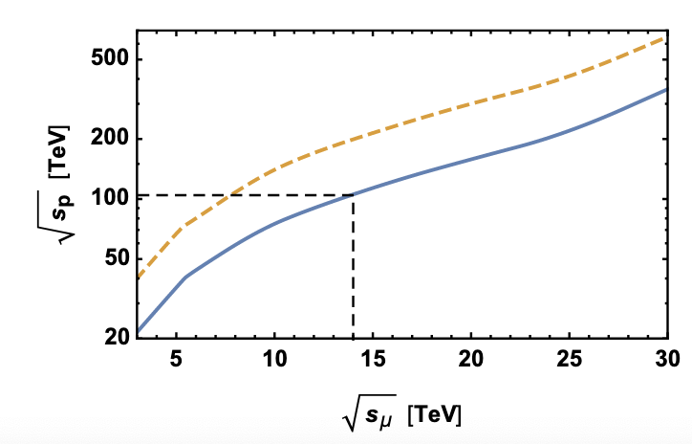

What about muons?
14 TeV muon collider = 100 TeV pp collider
1.6 x 10⁹ less synchrotron radiation compared to electron collider rings.
Fast & novel acceleration techniques must be studied.
BUT:
Lifetime 2.2$μs$
A. Wulzer al.

Slide 6
A brief history of muon colliders
1968, G. Budker first mentioned the idea of a muon collider.
1983, D. Neuffer published the idea of ionization cooling for muons.
1990-2010, first muon collider design studies by US institutes.
2011-2016, the US started the Muon Accelerator Program (MAP)
  Focused on feasibility issues of a muon collider
  Studies on a Neutrino factory and the design of [0.125, 1.5, 3, 6]TeV collider
2021: Creation of the International Muon Collider Collaboration (IMCC) led by CERN.
2022: The US shows profound interest in a muon collider at the Snowmass meeting.
2023: Co-funding from the European Union (MuCol).
2023: US P5: “This is our muon shot”:
  The US expresses strong interest in a multi-TeV parton collider with muons as the preferred option.

Slide 7
MoC and design study partners
UK | RAL
 | UK Research and Innovation
 | University of Lancaster
 | University of Southampton
 | University of Strathclyde
 | University of Sussex
 | Imperial College London
 | Royal Holloway
 | University of Huddersfield
 | University of Oxford
 | University of Warwick
 | University of Durham
US | Iowa State University
 | Wisconsin-Madison
 | Pittsburg University
 | Old Dominion
 | BNL
 | Florida State University
 | RICE University
 | Tennessee University
IT | INFN
 | INFN, Univ., Polit. Torino
 | INFN, Univ. Milano
 | INFN, Univ. Padova
 | INFN, Univ. Pavia
 | INFN, Univ. Bologna
 | INFN Trieste
 | INFN, Univ. Bari
 | INFN, Univ. Roma 1
 | ENEA
 | INFN Frascati
 | INFN, Univ. Ferrara
 | INFN, Univ. Roma 3
 | INFN Legnaro
 | INFN, Univ. Milano Bicocca
 | INFN Genova
 | INFN Laboratori del Sud
 | INFN Napoli
Mal | Univ. of Malta
China | Sun Yat-sen University
 | IHEP
 | Peking University
AU | HEPHY
 | TU Wien
ES | I3M
 | CIEMAT
 | ICMAB
KO | KEU
 | Yonsei University
India | CHEP
IEIO | CERN
FR | CEA-IRFU
 | CNRS-LNCMI
DE | DESY
 | Technical University of Darmstadt
 | University of Rostock
 | KIT
SE | ESS
 | University of Uppsala
PT | LIP
NL | University of Twente
FI | Tampere University
LAT | Riga Technical Univers.
CH | PSI
 | University of Geneva
 | EPFL
EST | Tartu University
BE | Univ. Louvain
US | FNAL
 | LBL
 | JLAB
 | Chicago
Study leader: Daniel Schulte
7

Slide 8
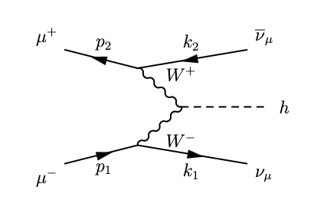
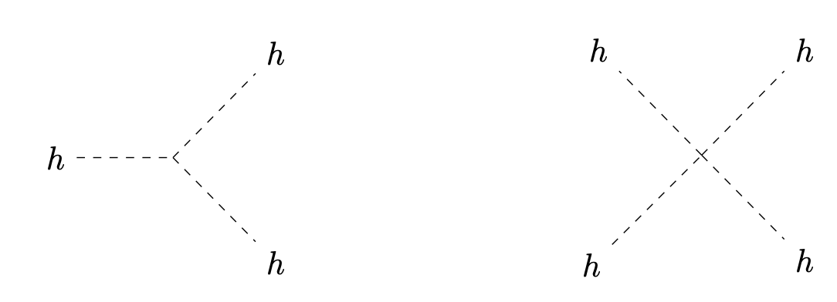
Physics motivations behind muon colliders I
Vector boson fusions
Lepton PDF
3TeV
10TeV
High energy fundamental particles can split themselves in other particles.
Derived from first principles.
Can be tested in multi-TeV colliders.
Study of the Higgs self interaction.
Many other SM couplings are measurable.
L. Bellinato, H. Eberl, B. Stechauner
D. Marzocca, F. Garosi et al.

Slide 9
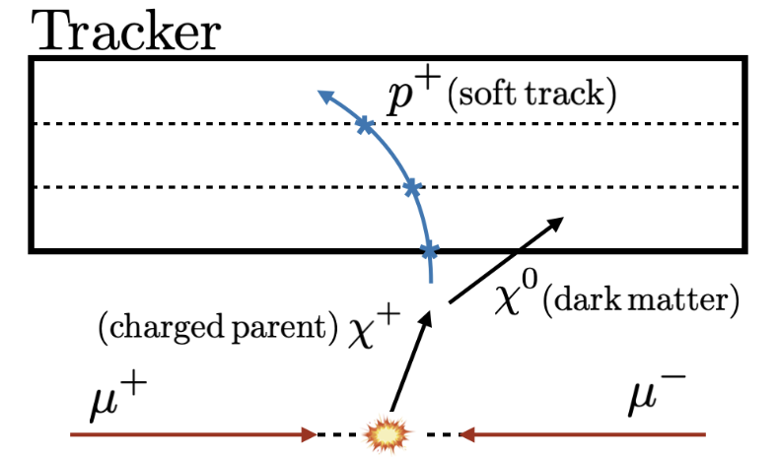
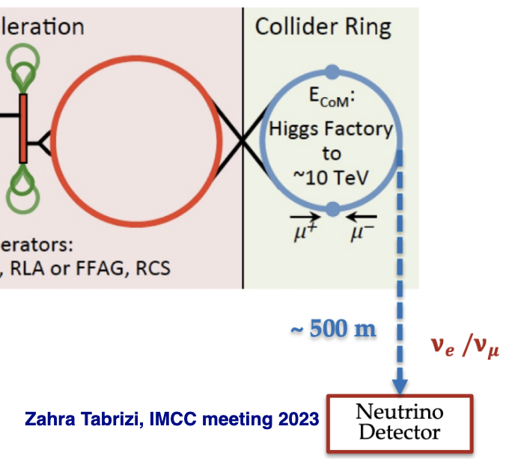
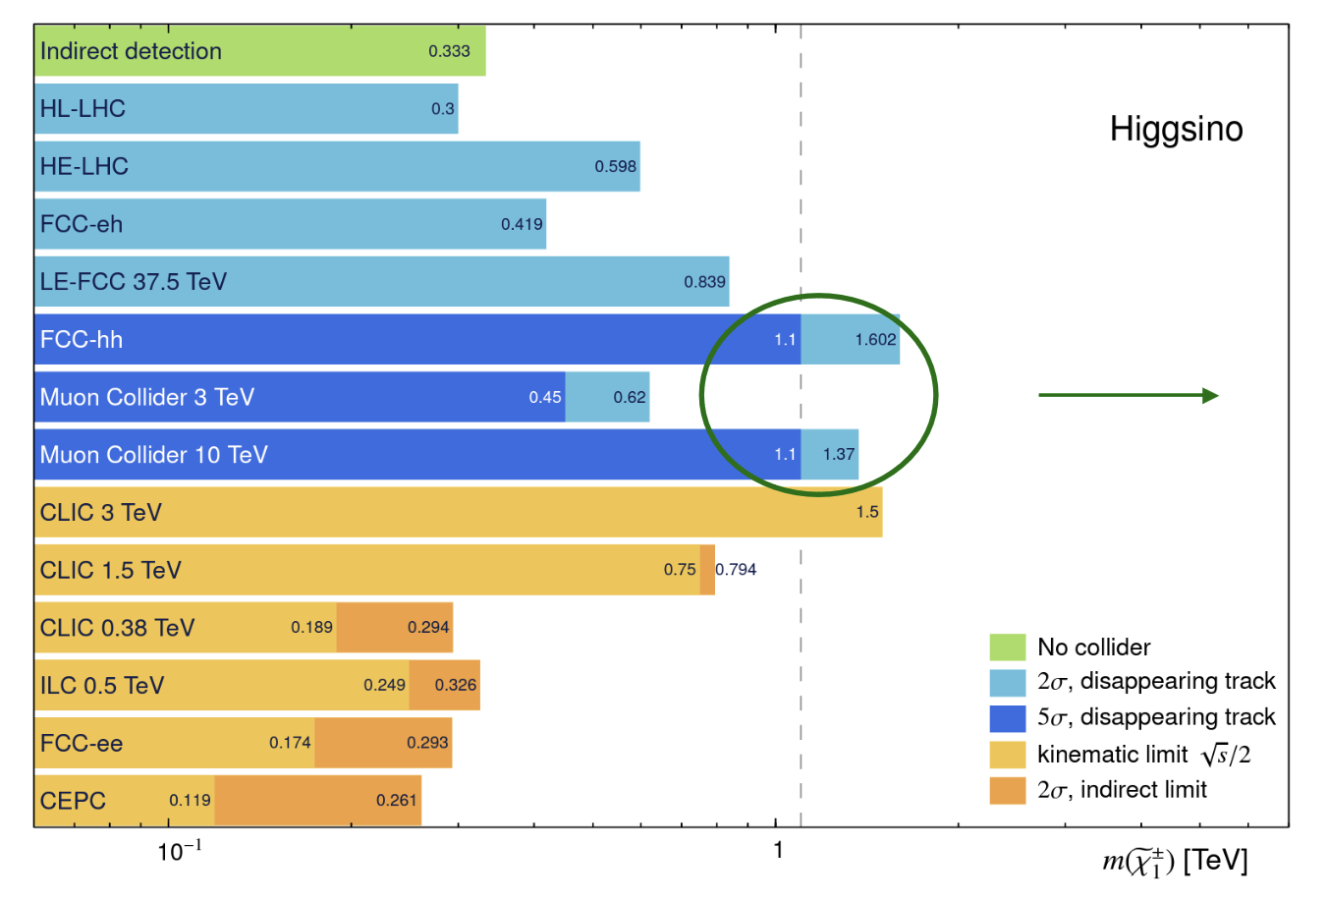
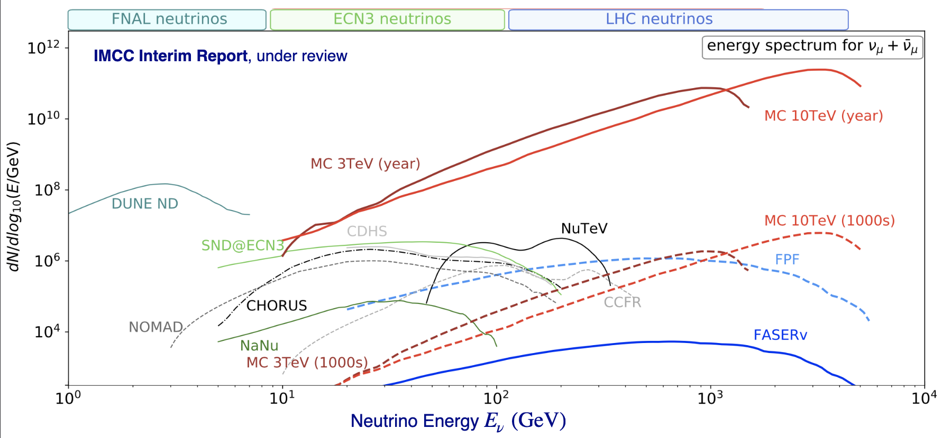
Physics motivations behind muon colliders II
R. Capdevilla et al.
Neutrino beam physics
10 TeV collider: 10¹⁷ neutrinos/year
10⁷ detector events
R. Capdevilla
Juan Rojo et al.
New: https://arxiv.org/pdf/2405.08858

Slide 10
Luminosity and tentative parameters
Accelerator physics
Parameter | Unit | 3 TeV | 10 TeV
L | 10³⁴ cm⁻²s⁻¹ | 1.8 | 20
N | 10¹² | 2.2 | 1.8
f_{r} | Hz | 5 | 5
P_{beam} | MW | 5.3 | 14.4
C | km | 4.5 | 10
<B> | T | 7 | 10.5
ε_{L} | MeV m | 7.5 | 7.5
σ_{E} / E | % | 0.1 | 0.1
σ_{z} | mm | 5 | 1.5
β | mm | 5 | 1.5
ε | μm | 25 | 25
σ_{x,y} | μm | 3.0 | 0.9
Theoretical/Experimental physics
IP
MC luminosity equation
Fresh bunch insertion every 200 ms
IP

Slide 11
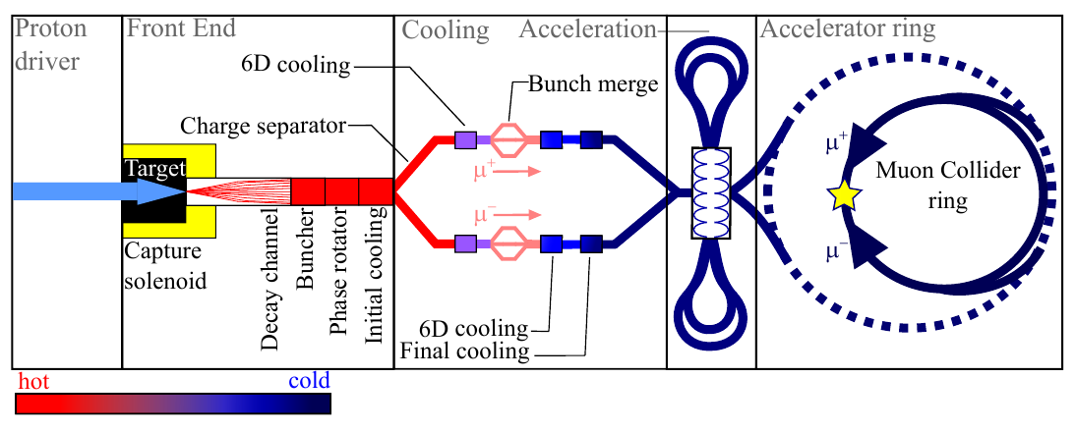
Muon collider design
p produce π⁺π⁻ which decay into µ⁺µ⁻ and get captured
Rapid acceleration and collision
Short, intense p⁺ bunch
Ionization cooling of muons in matter

Slide 12
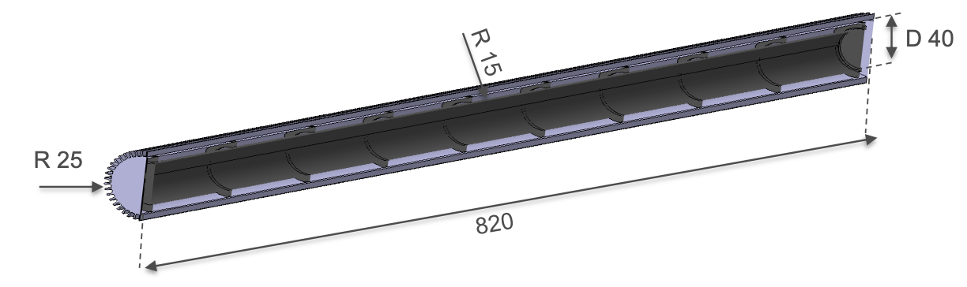
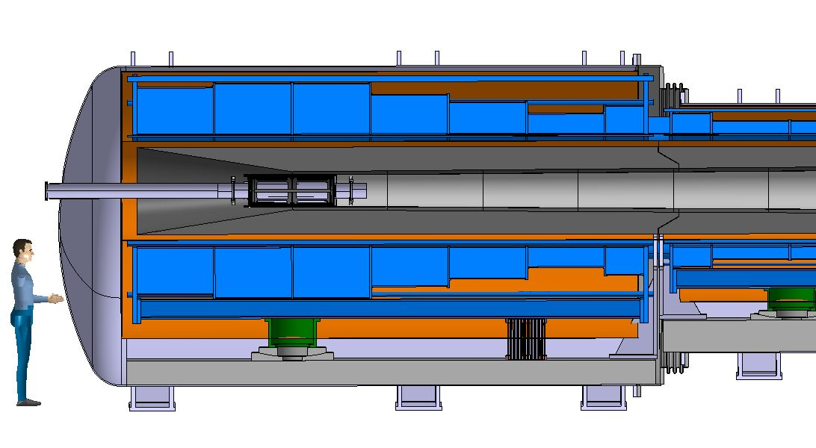
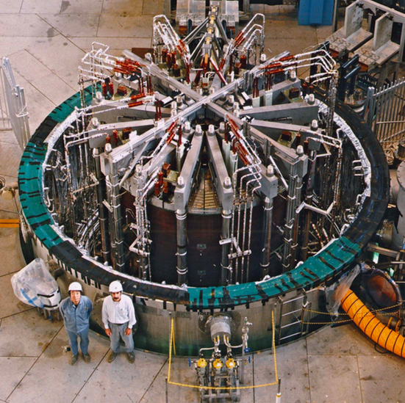
Muon production, target area
Graphite rod
Our work is relevant for fusion
A. Lechner, D. Calzolari, R. Ximenes, F. Saura, et al.
Tunsten shielding
To protect magnet
ITER Central Solenoid Model Coil
13 T in 1.7 m (LTS)
Graphite Target
20 T solenoid
to guide pions and muons

Slide 13
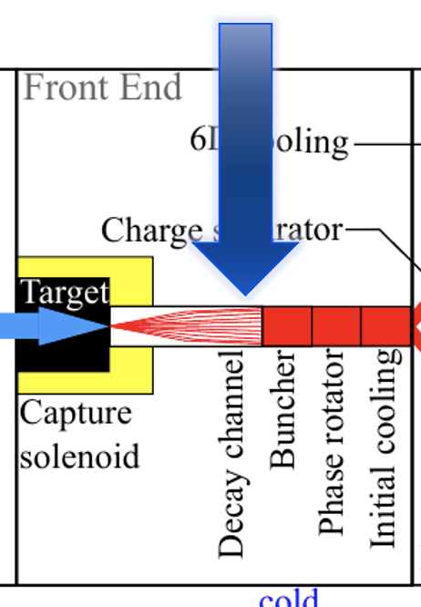
Post-decay channel
Fast
Slow

Slide 14
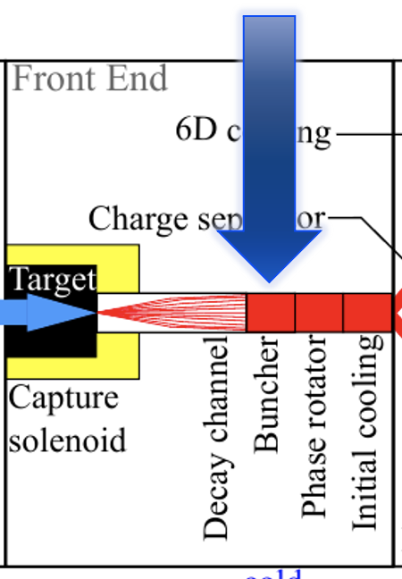
Bunch splitting
21 & 21 Bunches
Bunch split

Slide 15
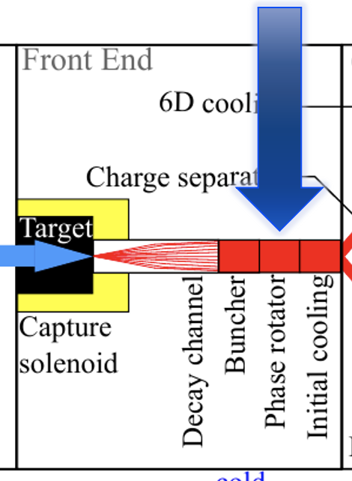
Phase rotation
Series of cavities with constant voltage

Slide 16
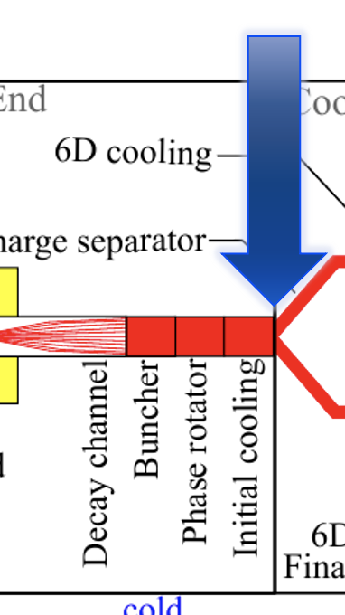
Charge separation
21 bunches
42 / bunches
21 bunches

Slide 17
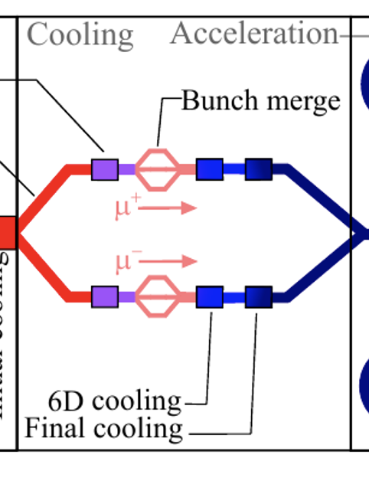
Muon phase space reductions/cooling
HOT
COLD

Slide 18
Ionization cooling: transverse momentum reduction
Transverse momentum reduction:

Slide 19
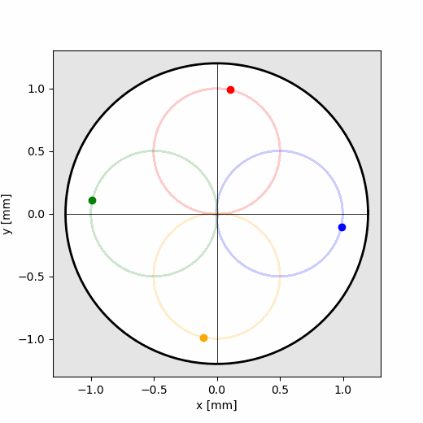
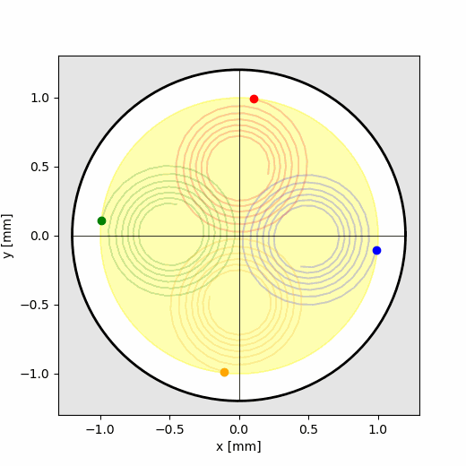

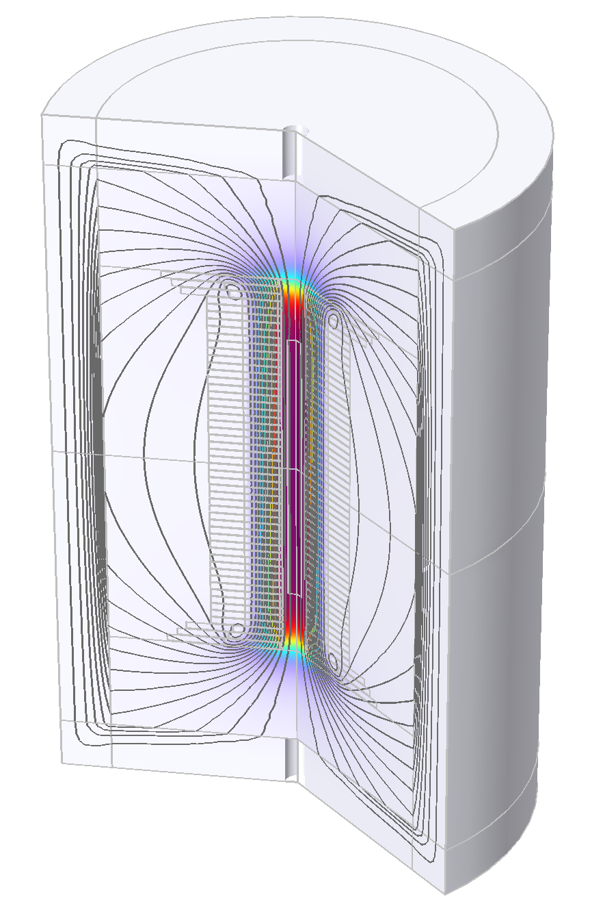
Transverse solenoidal focusing
Transverse offset reduction:
A. Dudarev, B. Bordini, T. Mulder, S. Fabbri

Slide 20
Description of ionization cooling
Scattering mitigation with hydrogen absorbers.
Heating due to scattering
Cooling due to energy deposition
D. Neuffer

Slide 21
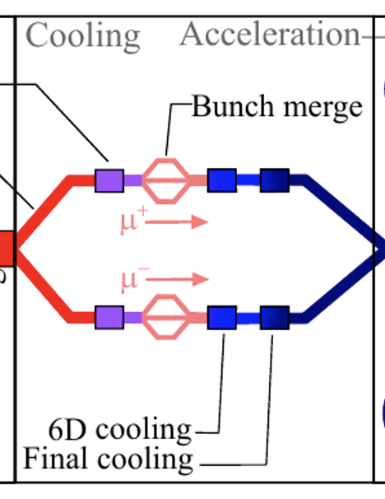
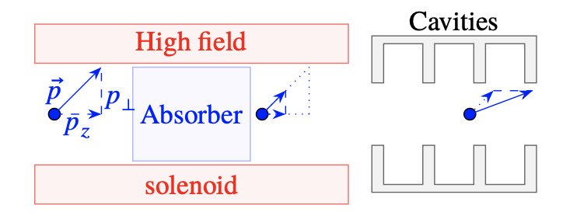
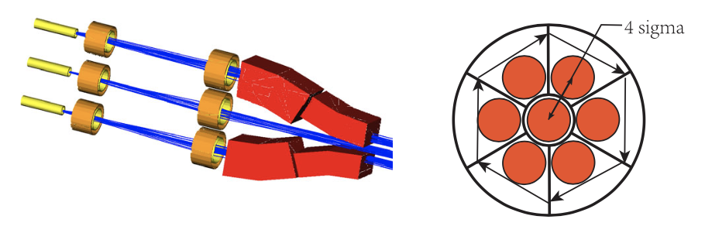
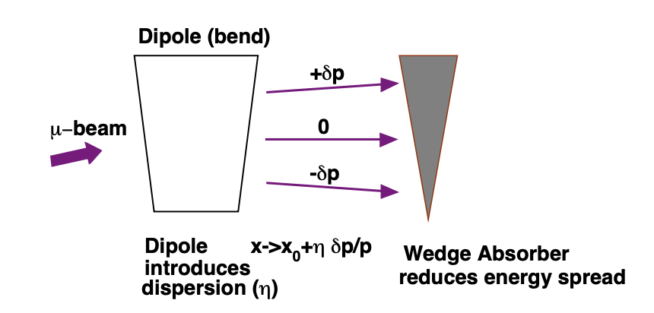
Final cooling
Bunch merge
6D cooling
D. Stratakis et al.

Slide 22
Improved analytical cooling description
Wentzel approach:

Slide 23
Simulation tool for ionization cooling
ICOOL
G4Beamline
RF-Track
NEW
ICOOL & G4Bl were used in the past.
RF-Tack written by A. Latina, CERN.
The simulation benefits from space charge and other collective effects in RF-Track.

Slide 24
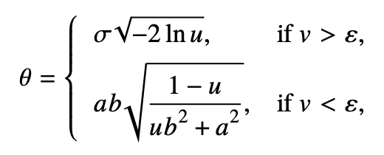
A semi-Gaussian scattering model in RF-Track
Scattering codes usually use Molière theory.
In principle, scattering distribution can be described by a Gaussian core and long-range tails.
Semi-Gaussian mixture model form R. Frühwirth
core
tails

Slide 25
Hydrogen absorbers
Low energy beam and low beam size causes extreme energy deposition in small volumes.
Pressure increase of several 100bar.
Damages absorber confinement!
Solution: hydrogen gas.
Absorber heatmap
s [m]

Slide 26
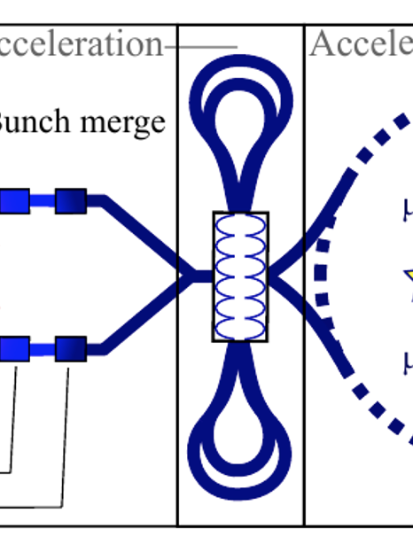
Fast acceleration of low energy muons
injection
extraction
Not efficient
Acceleration form 250MeV -> 63GeV
Synchrotrons are time consuming
Muons need an efficient concept

Slide 27
Racetrack LINAC
injection
extraction
Not used for MC

Slide 28
Recirculating LINAC (RLA)
injection
extraction
Acceleration is highly efficient at low costs for low energy muons.
Also known as ‘Dogbone’ LINAC.
One LINAC accelerates both bunches of µ⁺ and µ⁻.
A. Bogacz

Slide 29
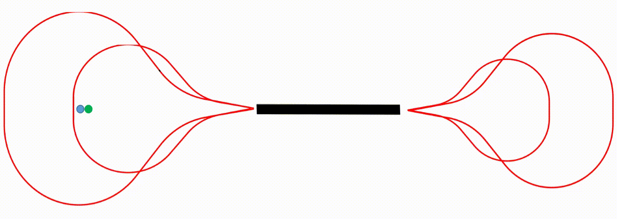
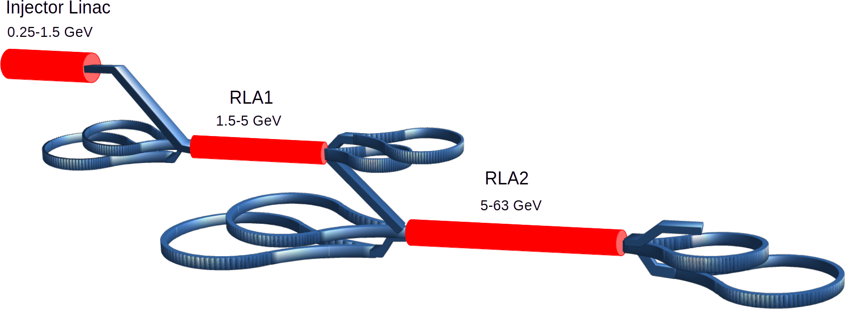
Recirculating LINAC
Each arc has different magnetic fields due to energy gain after each bunch passes through the LINAC.
51.4 GeV
28.2 GeV
16.6 GeV
39.8 GeV
Energy gain: 11.6GeV/pass
Total acceleration time: 25µs
A. Aksoy, P. Desiré

Slide 30
Rapid cycling synchrotron (RCS)
D. Amorim, F. Batsch, L. Thiele, H. Damerau, A. Chance, M. Gast
After the RLA, the muons are accelerated in a hybrid magnet synchrotron.
Normal conducted magnets have to ramp up very fast.
Super conducting magnets ramp up very slowly!
Optimization of the circumferences to use existing CERN infrastructure
55 turns
RCS 4
1.5 -5.0 TeV
35 km
17 turns
55 turns
66 turns
RCS 3
750 -1500 GeV
10 km
RCS 1
63 – 313 GeV
6 km
RCS 2
313 - 750 GeV
6 km

Slide 31
Hybrid RCS concept I
Super conducting
Normal conducting
2T
ramp
current
-2T

Slide 32
Hybrid RCS concept II
2T
current
-2T
Consumes a high degree of energy!
Current investigations are ongoing for novel power converter concepts.

Slide 33
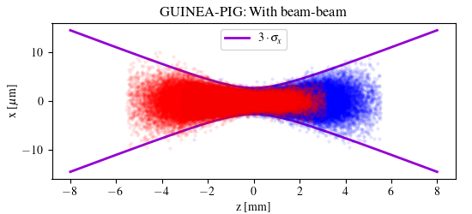
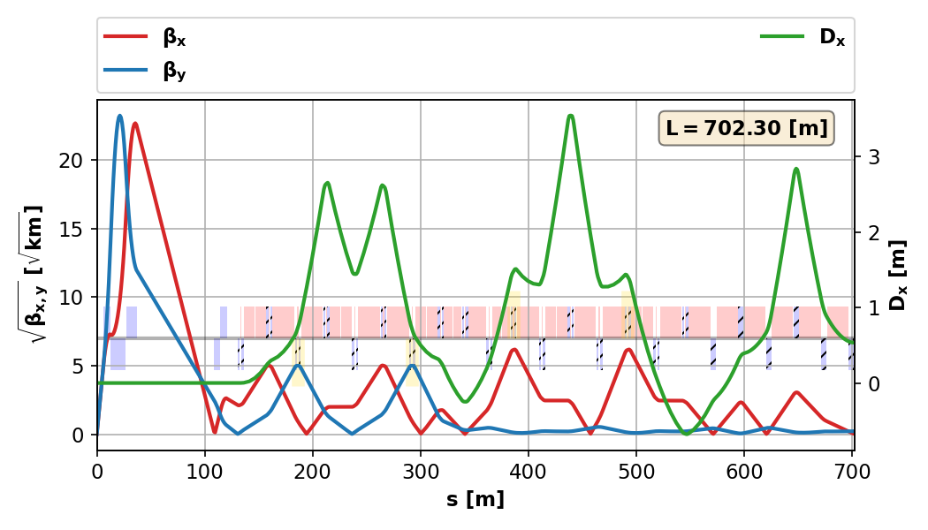
Collider ring
Hourglass effect reduces the luminosity 25% down.
Challenging
1% energy spread
Large beam size
Magnets
K. Skoufaris, C. Carli

Slide 34
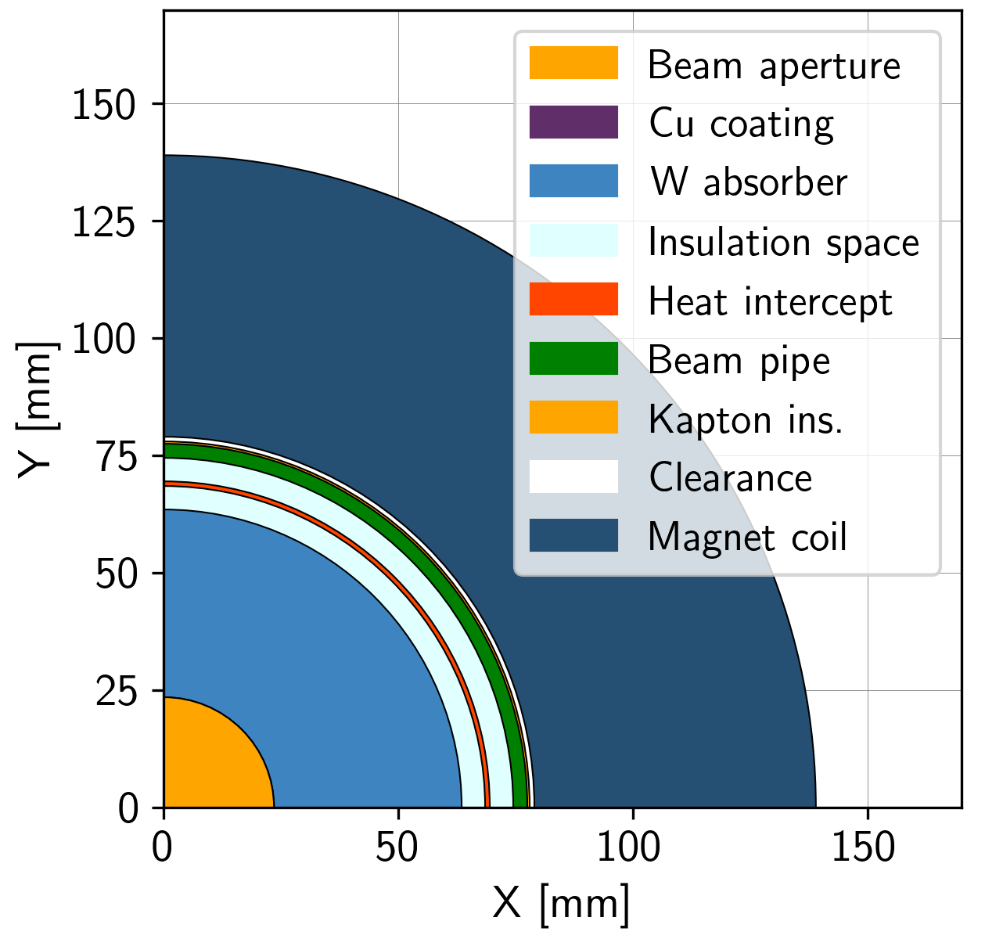

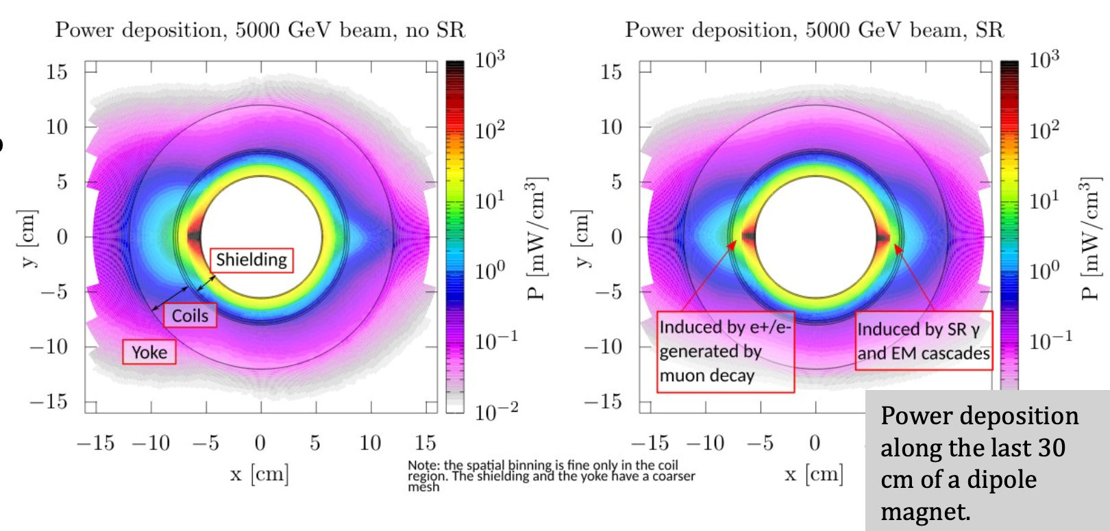
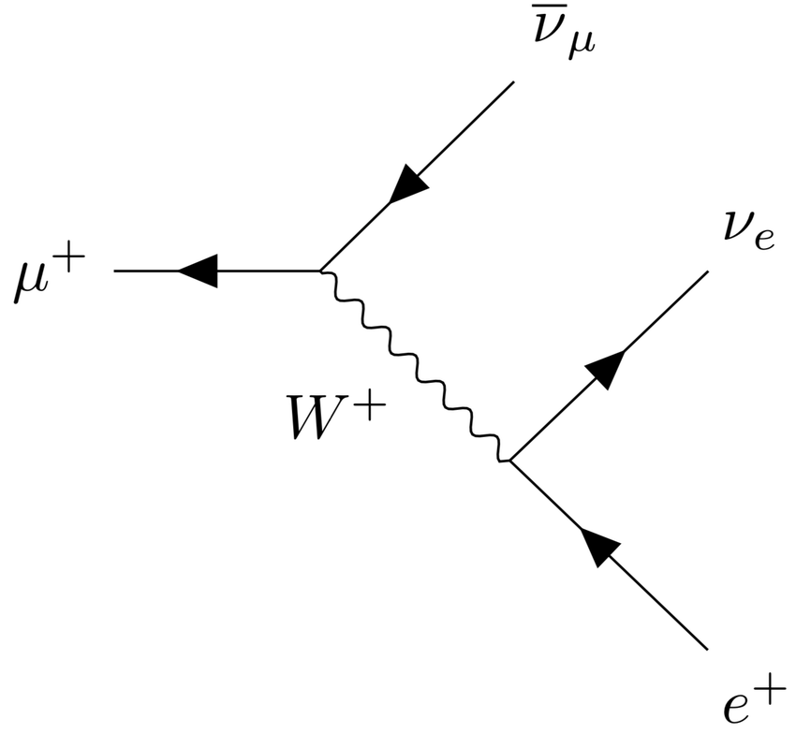
Collider ring technologies
P. T. Coujnho et al.
Coil
Power loss appears due to muon decay
Electron causes synch. radiation
Magnets have to be shielded
Shielding
D. Calzolari, A. Lechner

Slide 35
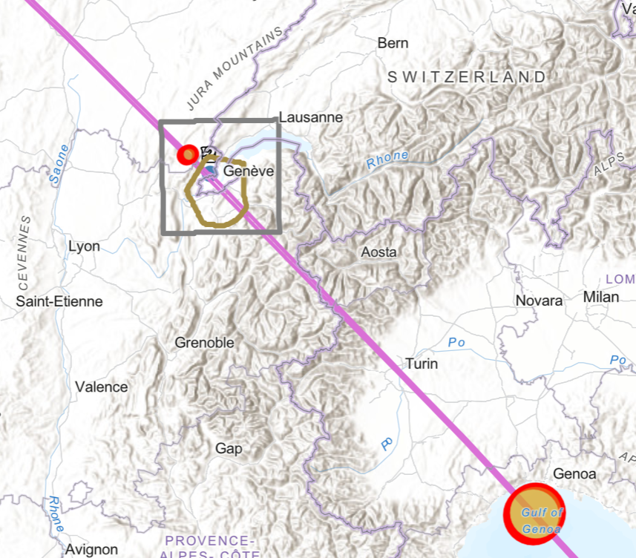


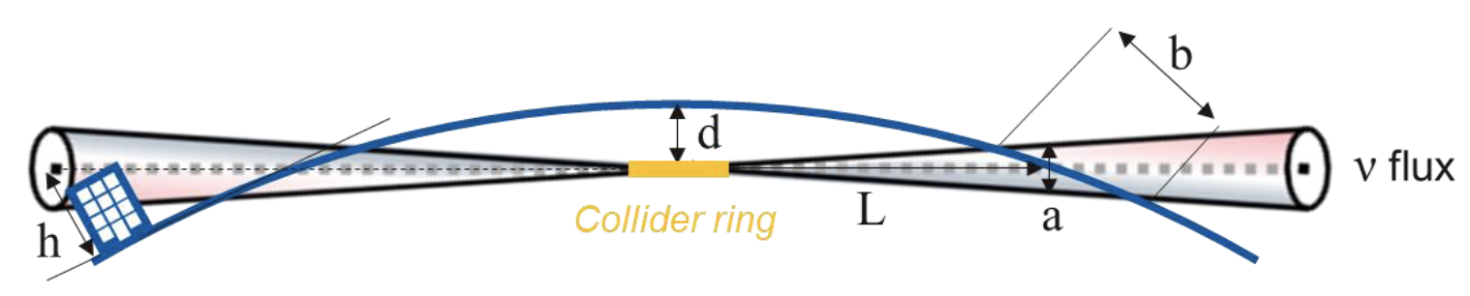
Muon decay & neutrino flux
Possible exit points
Rare single events create secondary particle showers.
The effective dose in public has to be minimized to a negligible value (~10µSv/a).
Most intense neutrinos beam from straight sections (Injection, Extraction, IP areas).
Collider tunnel depth deeper than LHC (~280m).
Beam wobbling concept for neutrino rad. mitigations.
C. Despond
Y. Robert
C. Ahdida
https://indico.cern.ch/event/1325963/contributions/5837736/
https://indico.cern.ch/event/1325963/contributions/5837738/

Slide 36
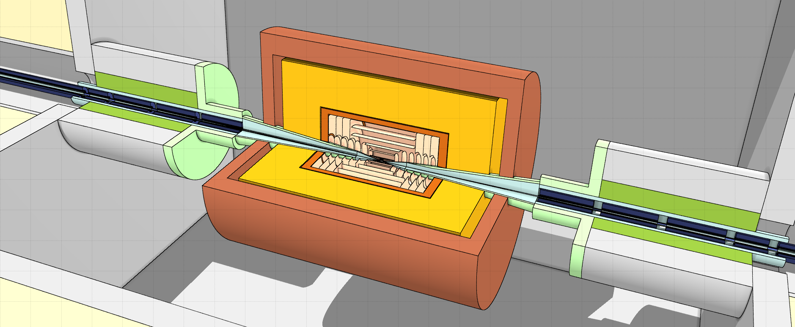
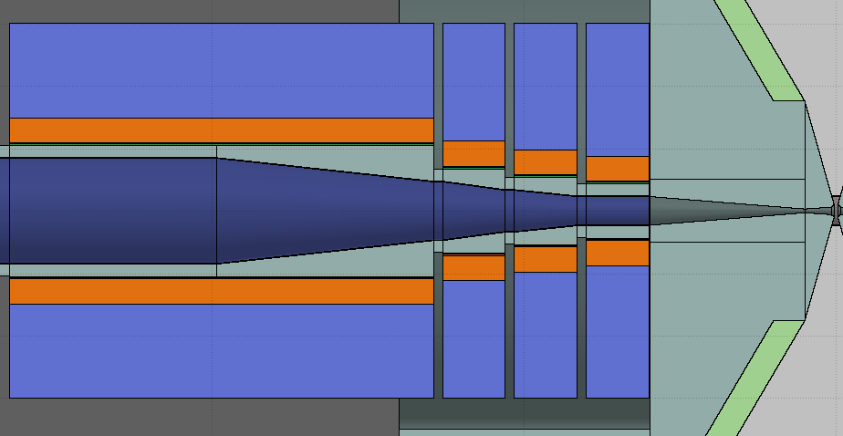
Beam induced background in the detector?
D. Calzolari, A. Lechner
Conical absorber inside detector (nozzle)
Shield the detector from high-energy decay products and halo losses (requires also an optimization of the beam aperture)
Detector
Handle background by suitable choice of detector technologies and reconstruction techniques (time gates, directional suppression, etc.)
Many concepts
from MAP!
Interaction region (IR) lattice
Customized IR lattice to reduce the loss of decay products near the IP
IR masks/liners and shielding
Shield the detector from particles lost in final focus region (requires also an optimization of the beam aperture)
Transverse halo cleaning
Clean the transverse beam halo far from the IP to avoid halo losses on the aperture near the detector (IR is an aperture bottleneck)
Conical liners inside FF magnets
Solenoid
Capture secondaries produced near the IP (e.g. incoherent e-e+ pairs)
Follow 5σ beam envelope

Slide 37
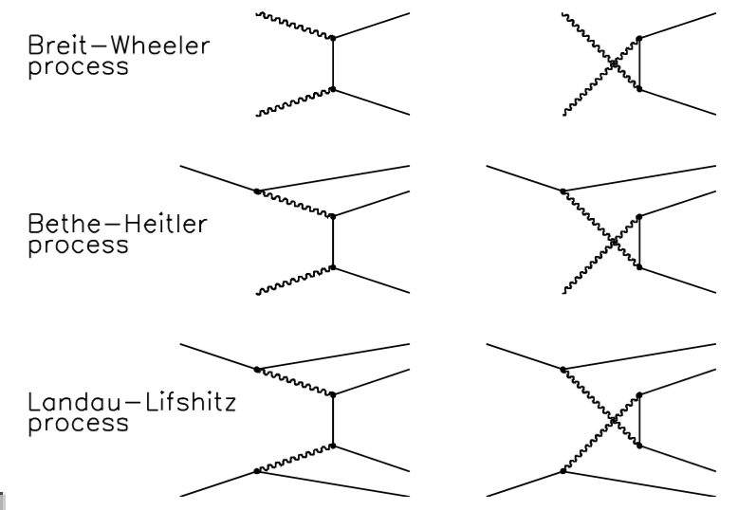
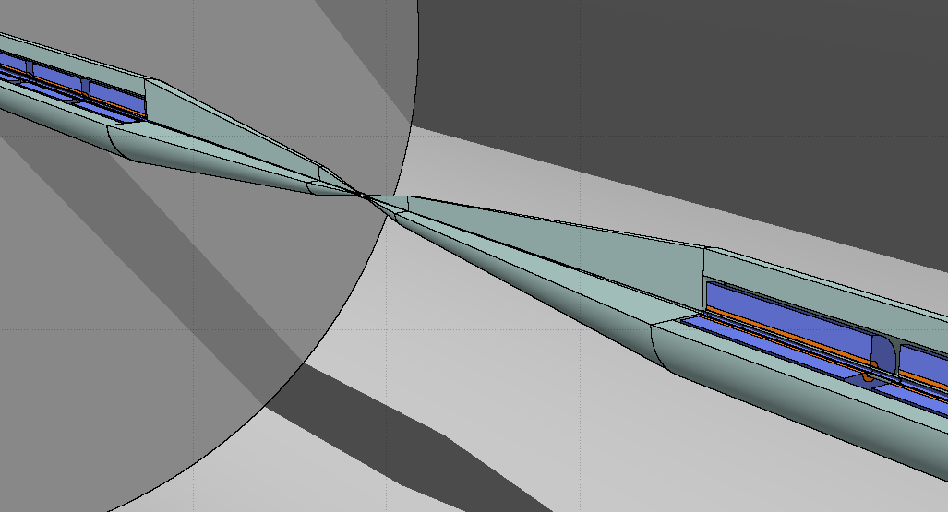
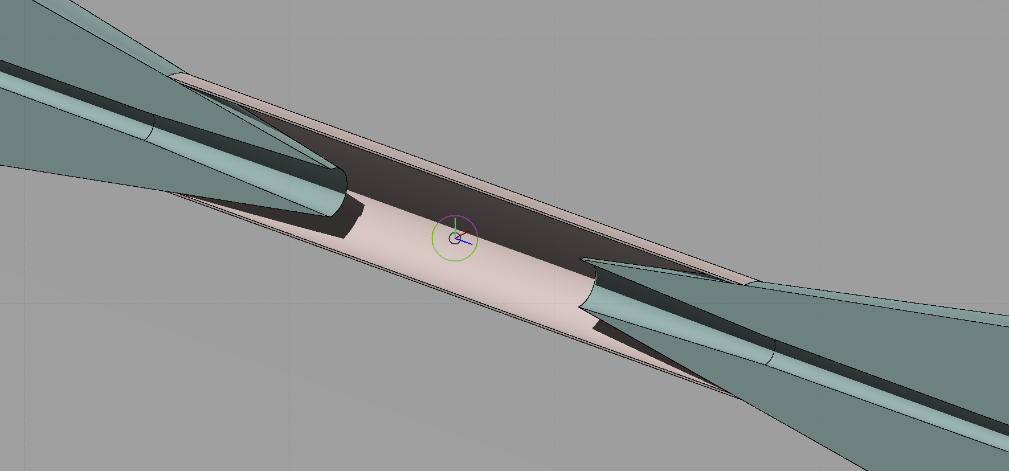
Muon collider MDI challenges
 | Description | Relevance as background
Muon decay | Decay of stored muons around the collider ring | Dominating source
Incoherent e⁻e⁺ pair production | Pair creation through the collision of two real* or virtual photons emitted by muons of counter-rotating bunches | Significant
~30 cm
12 cm
D. Calzolari, A. Lechner, D. Schulte

Slide 38
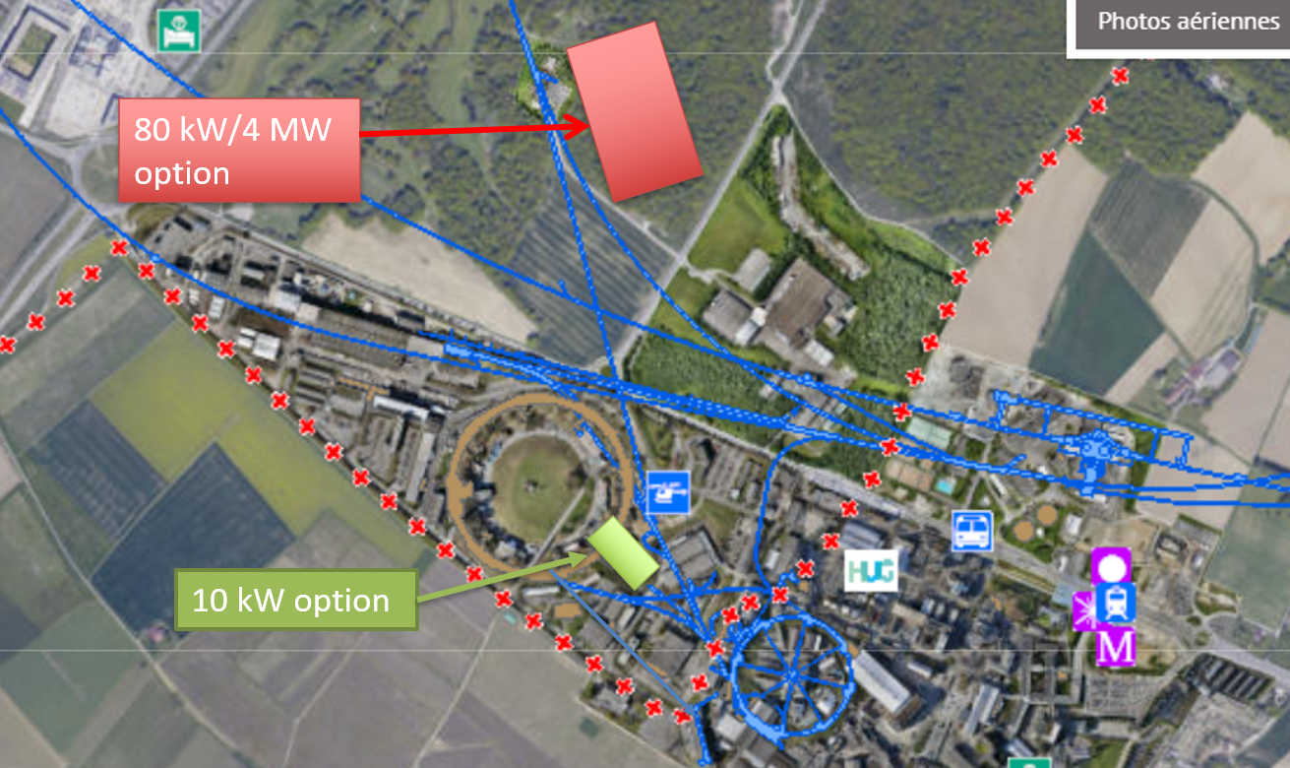
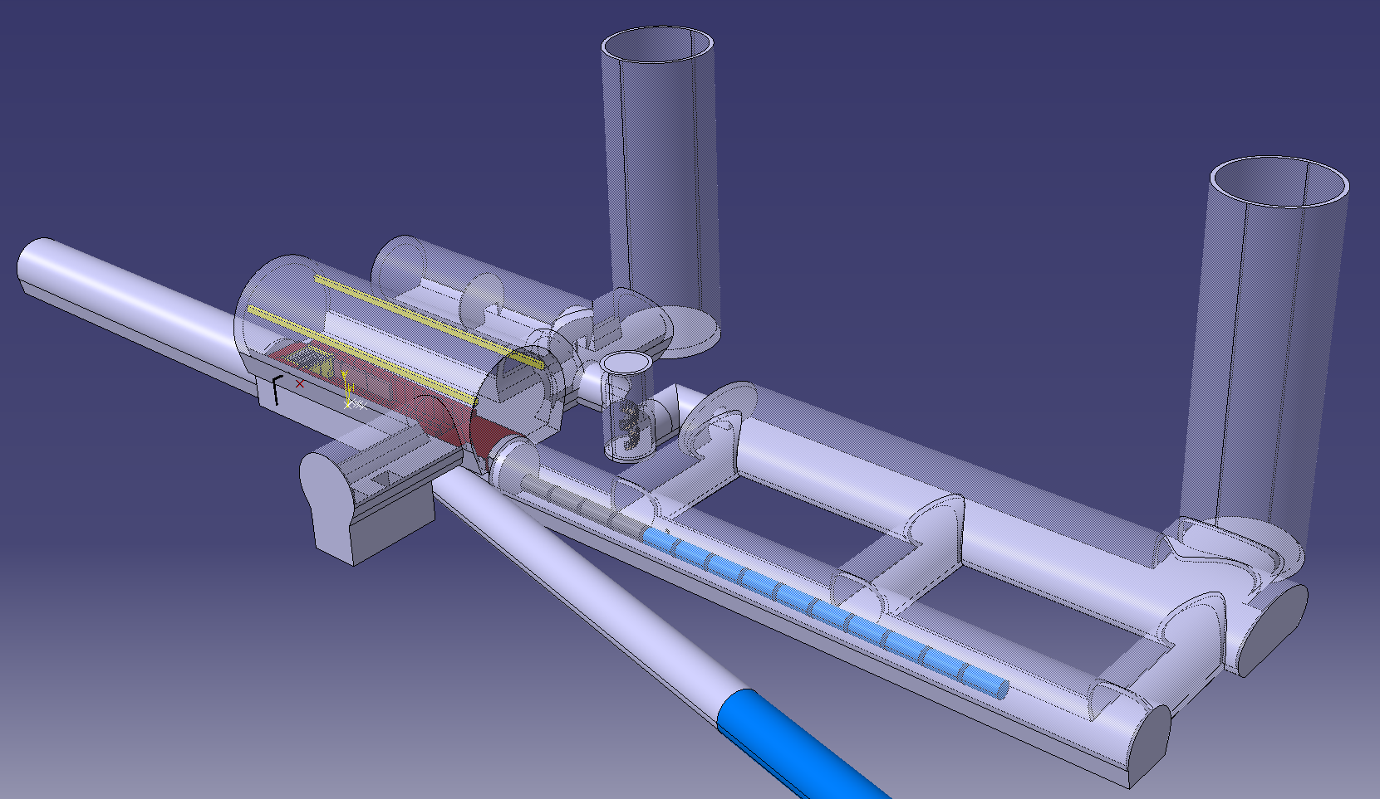
CDR Phase, R&D and Demonstrator Facility
M. Calviani, R. Losito, J. Osborn et al.
Broad R&D programme can be distributed world-wide
Models and prototypes
  Magnets, Target, RF systems, Absorbers, …
CDR development
Integrated tests, also with beam
Cooling demonstrator is a key facility
look for an existing proton beam with significant power
Different sites are being considered
CERN, FNAL, ESS …
Two site options at CERN
Muon cooling module test is important
INFN is driving the work
Could test it at CERN with proton beam

Slide 39
Summary
Muon colliders bring many potential explorations and discoveries in particle physics.
They are more efficient than current collider schemes.
Key technologies: Muon cooling, fast ramping magnets, muon production.
The neutrino flux mitigations is essential to protect the environment.
The main goal is to build a demonstrator to test the novel technologies.
More information: https://muoncollider.web.cern.ch/

Slide 40

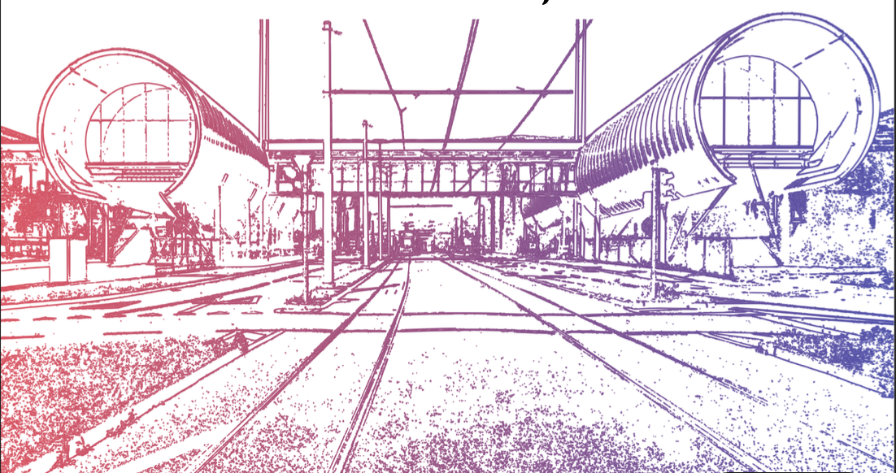
Thank you for your attention

Slide 41
Technically Limited Timeline
To be reviewed considering progress, funding and decisions
Muon collider important in the long term
Prudently explore if MuC can be option as next project
e.g. in Europe if higgs factory built elsewhere
sufficient funding required now
very strong ramp-up required after 2026
might require compromises on initial scope and performance
  3 TeV
Evaluation+decision
Evaluation+decision
41

