Slide 1
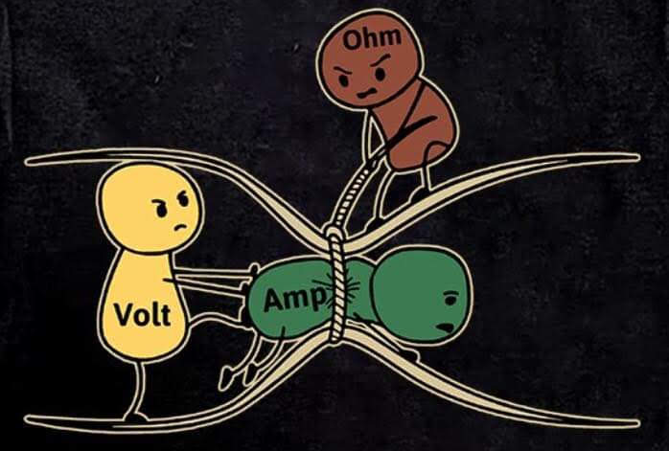
ELECTRONICS
2 Feb 2024
M.Friedl

Slide 2
Mission Statement
Provide electronics services to support the scientific projects
  Manpower (skills)
  Tools (devices, software)
Education
  Apprenticeship training (since September 2021)
  Teaching
  Pupils on summer internship

Slide 3
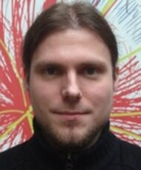
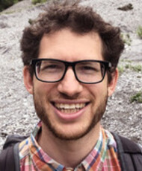
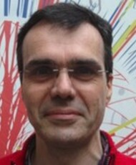
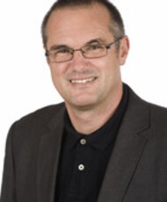

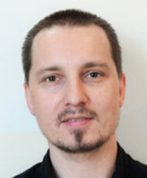
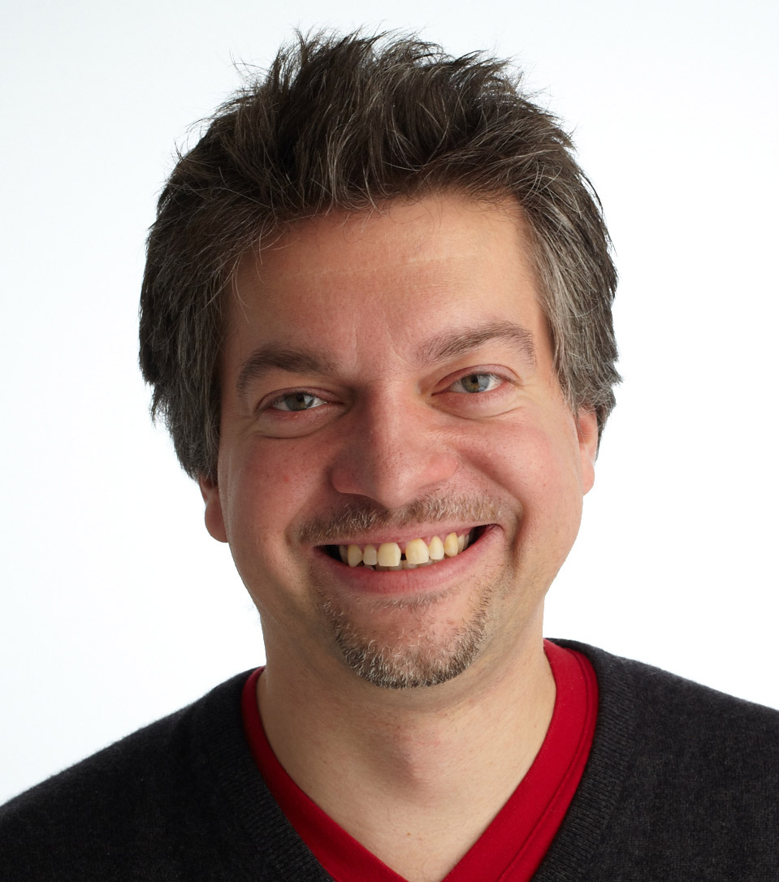
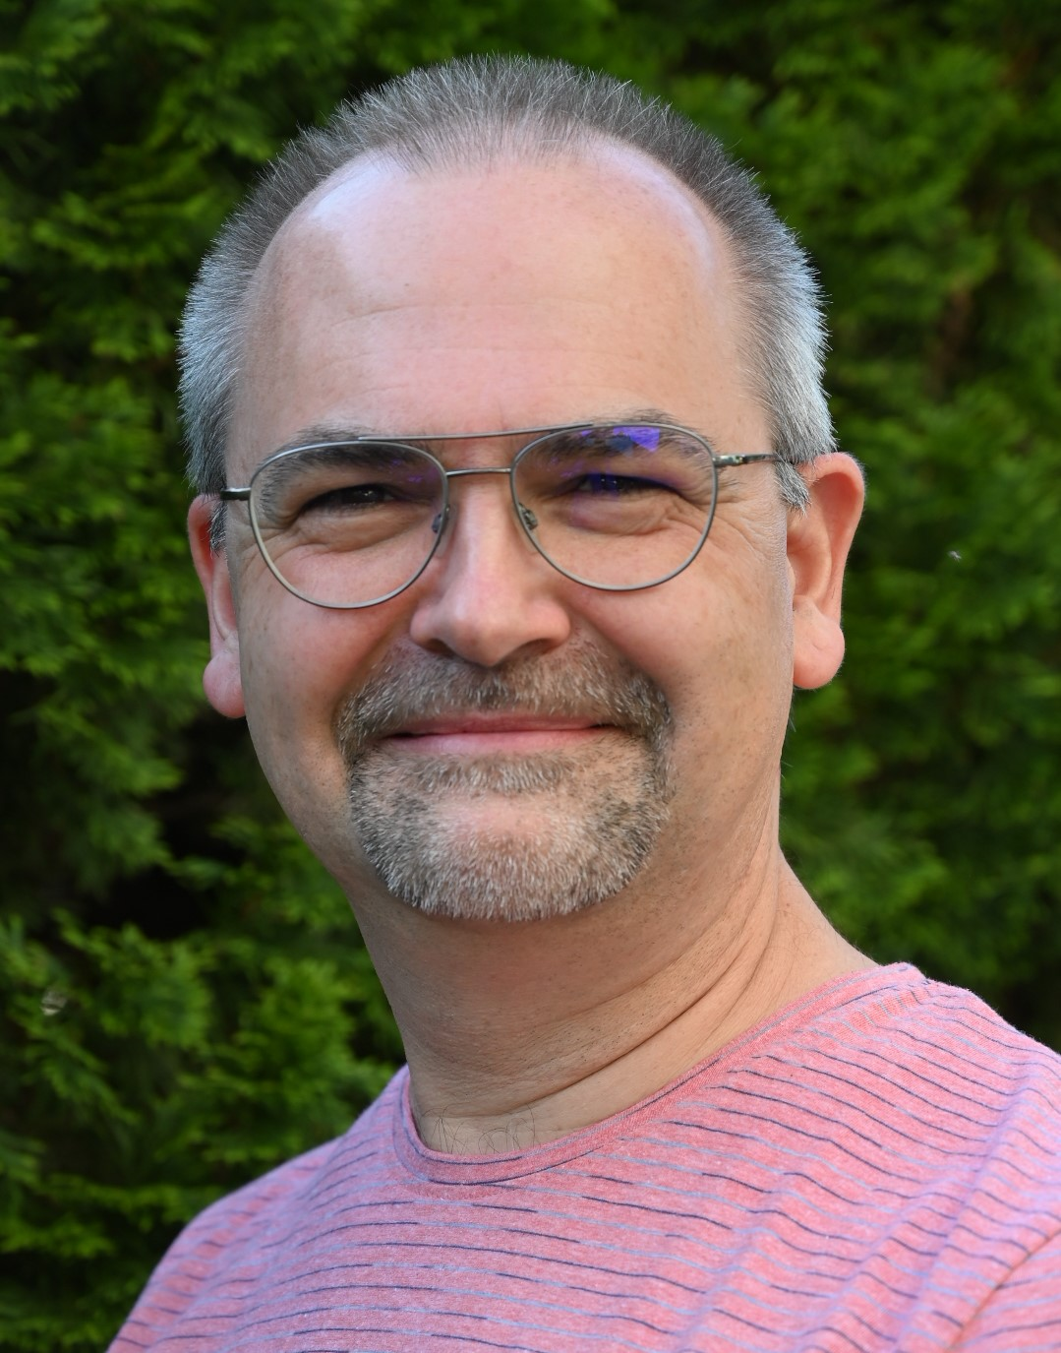
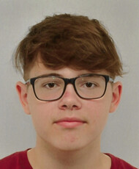
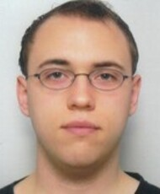
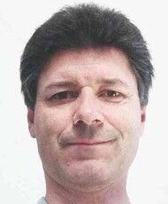
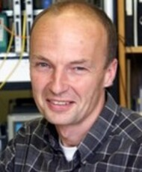
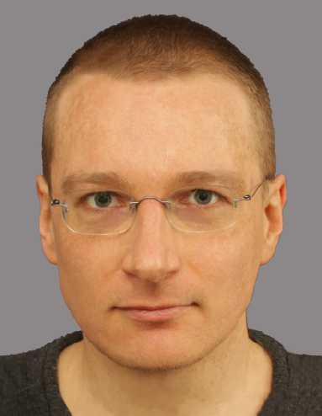
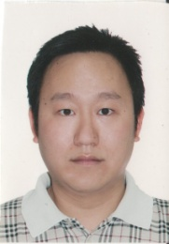
Staff
B.Arnold
A.Bauer
H.Bergauer
W.Brandner
S.Fichtinger
K.D.Fischer
M.Friedl
C.Irmler
N.Kumerer
M.Oberegger
S.Schultschik
C.Schwertner
H.Steininger
R.Thalmeier
H.Yin

Slide 4
Staff
Name | FTE | Skills | Comments
Bernhard ARNOLD | 1 | Software
Andreas BAUER | 0.6 | Wire bonding, measurements, circuits
Herbert BERGAUER | 0.48 | Firmware | Retiring July 2025
Wolfgang BRANDNER | 1 | Infrastructure, clean rooms, circuits | In administration, retiring end 2024
Stephan FICHTINGER | 1 | Software
Klaus-Dieter FISCHER | 1 | Soldering, assembly, PCB design
Markus FRIEDL | 1 | System design, circuits, mechanics | Leader
Christian IRMLER | 1 | System design, wire bonding | Deputy leader
Niklas KUMERER | 1 | PCB design, soldering | Apprentice
Margit OBEREGGER | 0.5 | Measurements, packing
Stefan SCHULTSCHIK | 0.875 | Mechanics, measurements
Christoph SCHWERTNER | 1 | Circuits, firmware | TU funded
Helmut STEININGER | 1 | Firmware
Richard THALMEIER | 1 | Circuits, PCB design, tests
Hao YIN | 1 | Software

Slide 5
Staff and Projects

Slide 6







Projects
Belle
  Operation, software, VXD 2023, VTX upgrade 2026+
CMS Tracker
  Sensor measurements
CMS Trigger
  Operation
Rare Event Searches
  Readout electronics, software, clean room
R&D
  ASIC design (RD50), beam monitoring (MedAustron), protonCT
Conferences, Outreach
  Collaboration meetings, VCI2025, outreach activities

Slide 7
Competences
System design
Schematics development
(Small-scale) PCB layout
Assembly, debugging, testing
Firmware and software development
Interweaved with detector development and clean rooms (module assembly, sensor testing etc.)
ASIC design (mainly by students)
Wire bonding

Slide 8
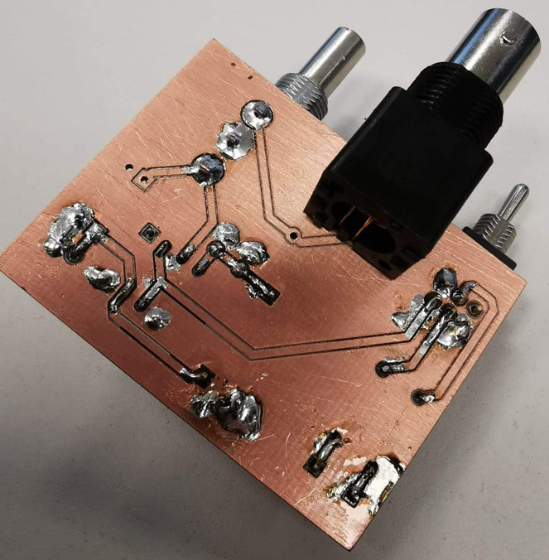
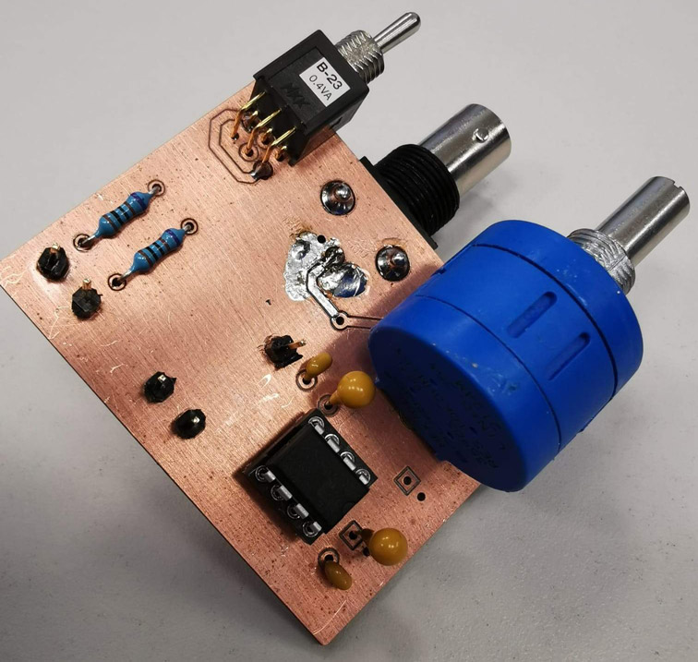
(Currently) Not Covered
Large scale PCB layout → outsourced to industry
  Sigi SCHMID retired in 2016, not replaced
  Currently no need to change that
  Good experience with Belle II FADC and VDAQ3
PCB manufacturing
  In-house wet chemistry stopped >10 years ago
  Done in industry (cheap, especially in China)
  Can do FR4 milling for very simple PCBs

Slide 9
Organization
“Technik-Retreat” in October 2023
  Long-term direction/involvements
  Including SMI because we will be neighbors in PSK and a future merger is anticipated
“Technik-Beirat” meetings
  Once every quarter (March, June, September, December)
  Discussing assignments for the next months (“big picture”)
Weekly meeting
  Jour fixe every Monday at 09:00
  Discussing assignments for coming week (“small picture”)

Slide 10
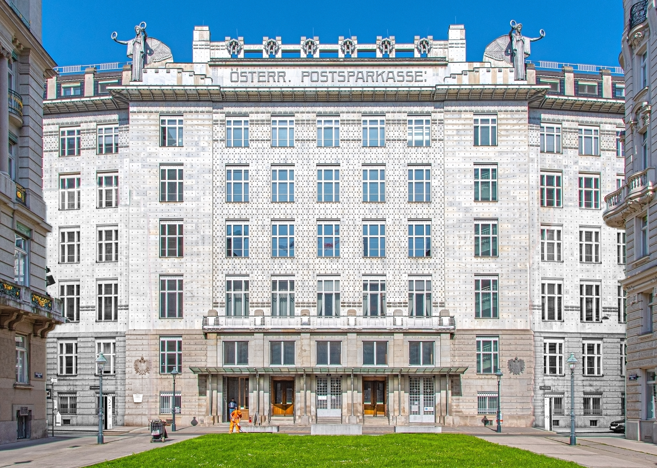
The Future

Slide 11
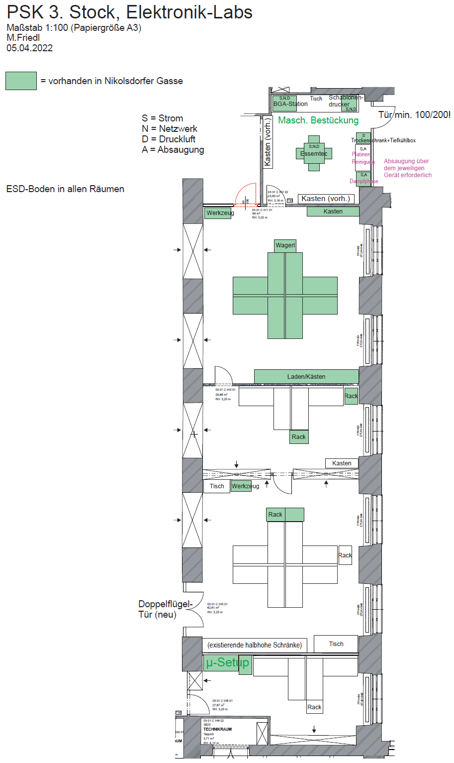
Electronics @ PSK
Location of work places, devices, furniture and technical requirements defined in 2022
For unknown reasons not everything was implemented
Several things need to be fixed before we can move in (needs time and money)
Presently occupied (“temporarily”) by other institutes
Preparation/moving/installation will take several months during which the electronics group will not be productive

Slide 12
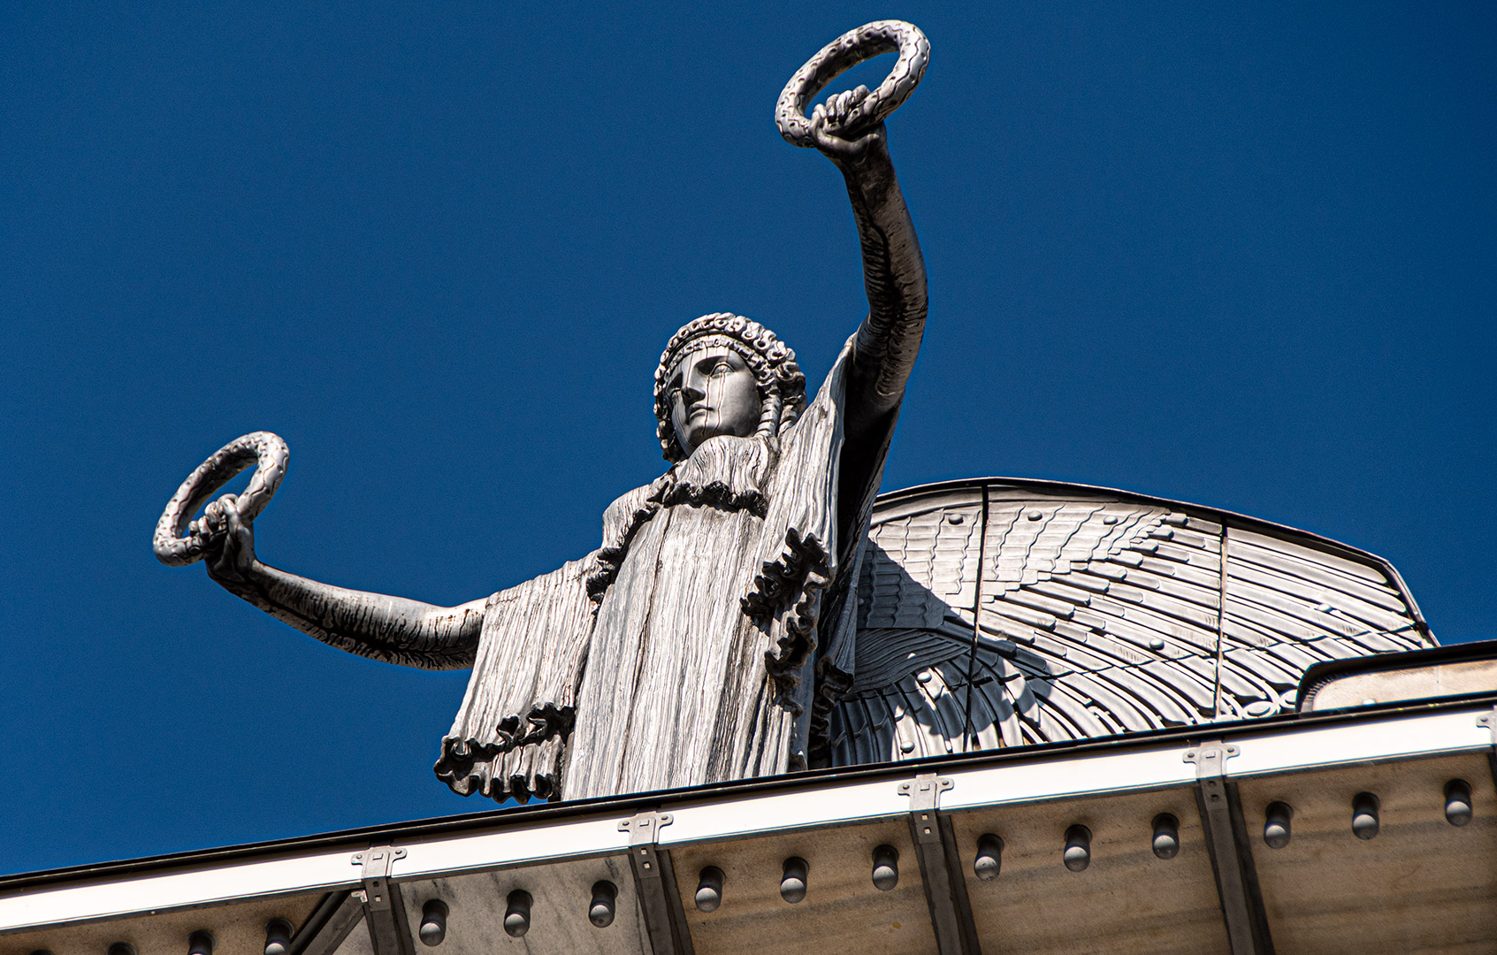
Thank you for your attention!

