Slide 1
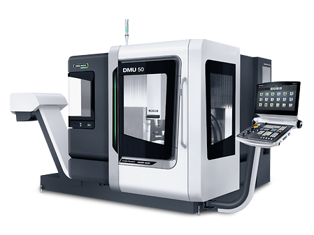
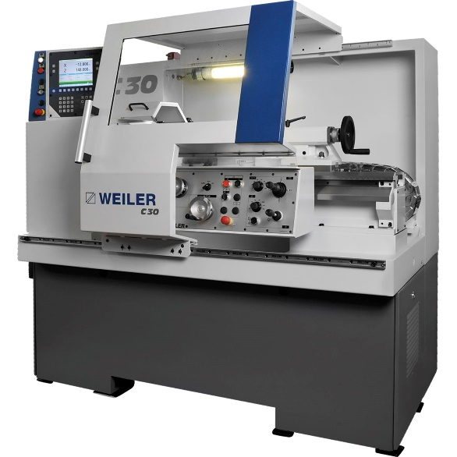
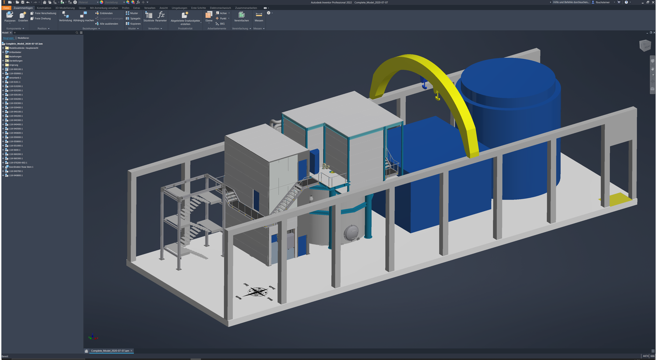
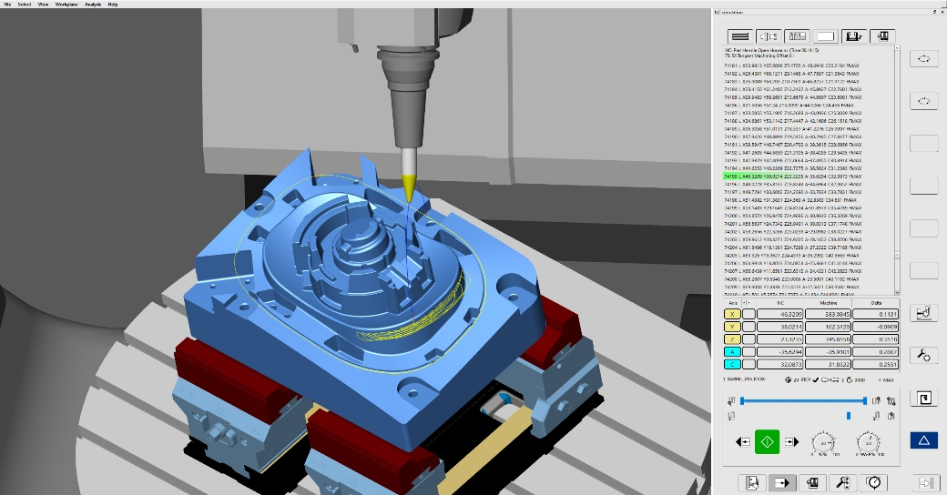
Machine Shop and Design Engineering

Slide 2
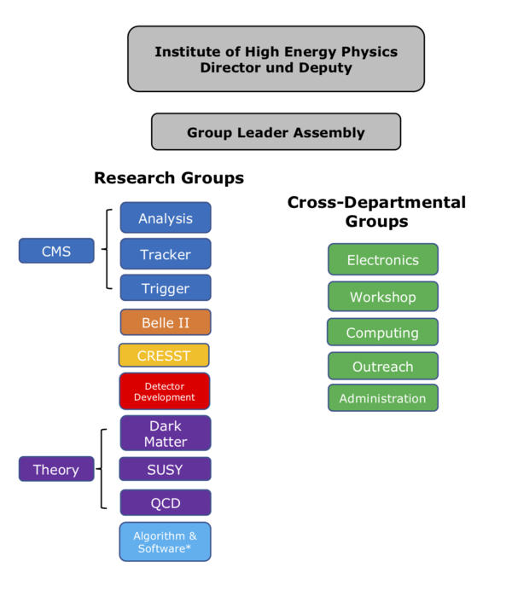
HEPHY Structure
2 columns:
  Projects
  Service groups
Projects are scientific, service groups are supporting
In the past, assignment of technicians was strict and inflexible
Projects
Service Groups

Slide 3
How Are The Resources Allocated
For electronics/machine shop and design engineering:
  Meeting (Technik-Beirat) every 3 months
  Project group leaders present their tasks and ask for support
  Distribution of manpower and service
Weekly jour fixe every Monday morning
For IT:
  Ticket system (hephy-it@oeaw.ac.at)
  IT User Meetings

Slide 4
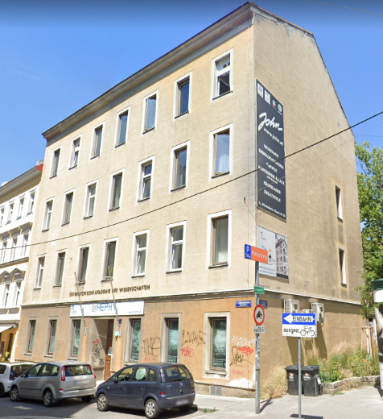
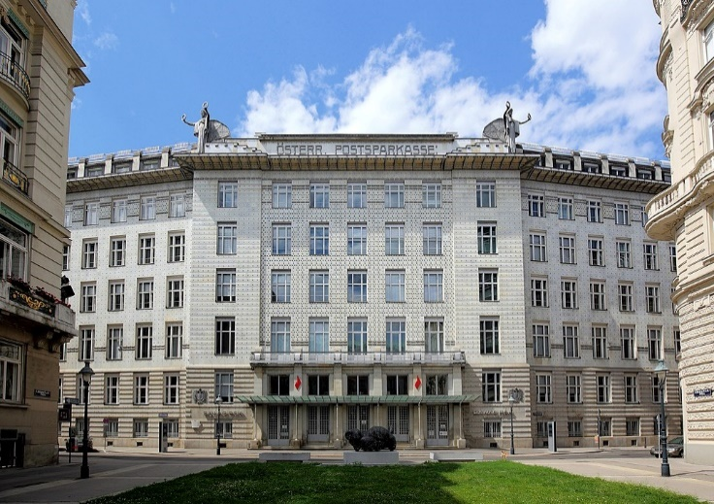


PSK
We are allowed (by Arbeitsinspektorat)
  to work in the room of the CNC milling machine for more than 2 hours/day
Relocation currently planned for spring/summer 2024

Slide 5
Tasks / Group Members
The machine shop and design engineering helps with the development, construction and manufacture of mechanical components/assemblies, prototypes and small series of experiments, test stands, tools for detector construction and special equipment.
Group Members:
Florian Buchsteiner (Group Leader)
Roland Stark

Slide 6
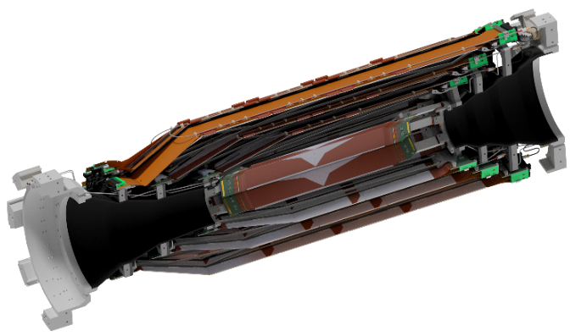
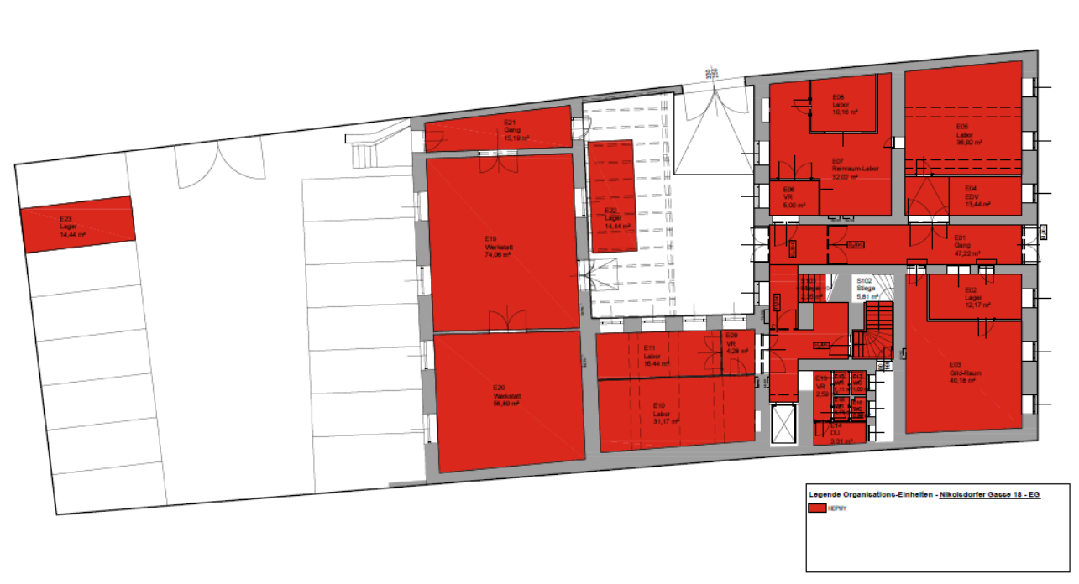
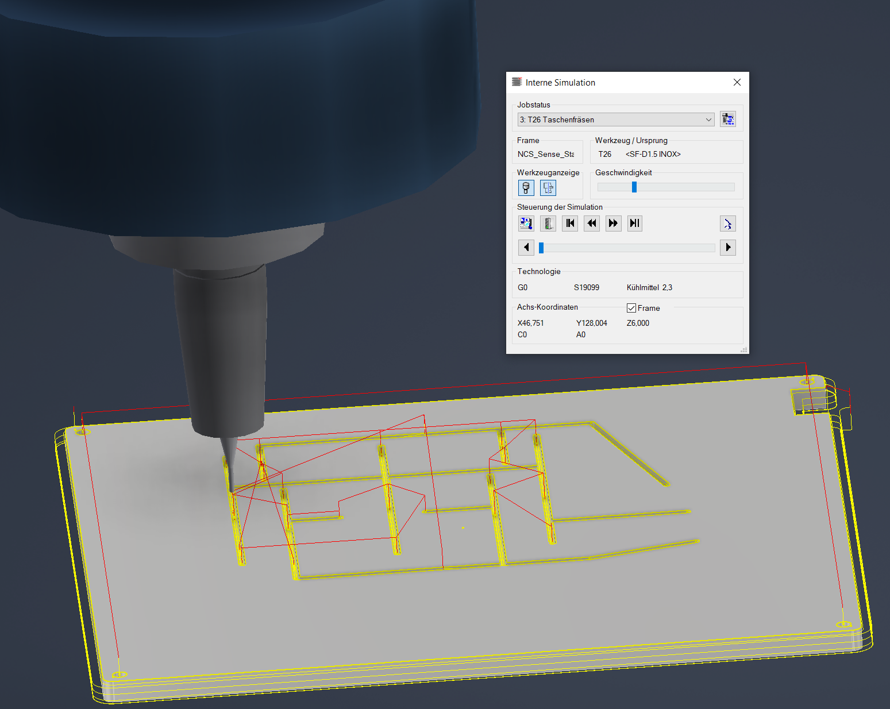
Design Engineering
3D CAD (computer-aided design)
  Program: Inventor 2023 (current)
  Operators: F. Buchsteiner (A. Bauer, S. Schultschik)
2D CAD (computer-aided design)
  Program: AutoCAD 2023 (current)
  Operator: F. Buchsteiner
CAM (computer-aided manufacturing)
  Program: HyperMill in Inventor
  Operator: F. Buchsteiner

Slide 7
Machine Shop
5-axis CNC milling machine
  Machine: DMU 50
  Working space: X=650mm, Y=520mm, Z=475mm, B=-5/+110°, C=360°,
  Workpiece mass: 300kg
  Materials: steel, stainless steel, aluminum, brass, copper, plastics (which do not generate dust during processing e.g. Delrin, PEEK, PA, ...), other metals such as titanium are possible
  Operators: F. Buchsteiner, R. Stark

Slide 8
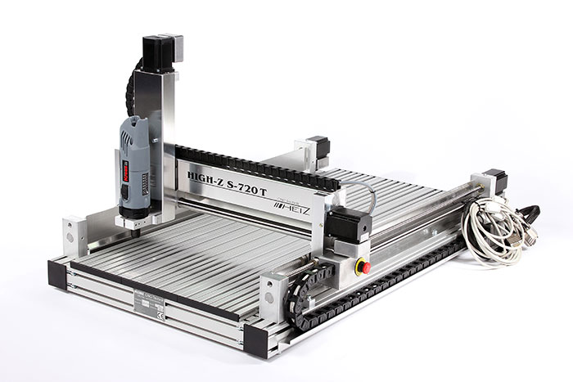
Machine Shop
FR4 CNC milling machine
  Machine: High-Z S-720
  Working space: X=720mm, Y=420mm, Z=103mm
  Materials: aluminum, all plastics, composite materials (GFK, FR4, carbon, ...), wood
  Operators: F. Buchsteiner, R. Stark
  Located in the basement (for reasons of space)

Slide 9
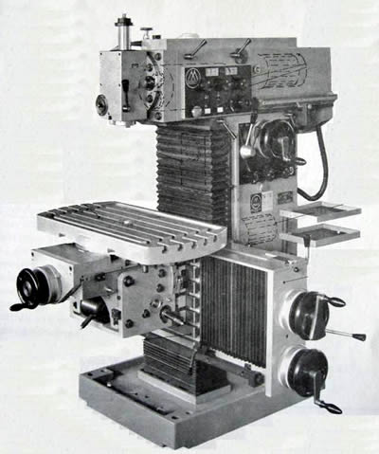
Machine Shop
Conventional milling machine
  Machine: Maho MH700
  Working space: X=500mm, Y=300mm, Z=400mm
  Materials: steel, stainless steel, aluminum, brass, copper, plastics
  Operators: F. Buchsteiner, R. Stark

Slide 10
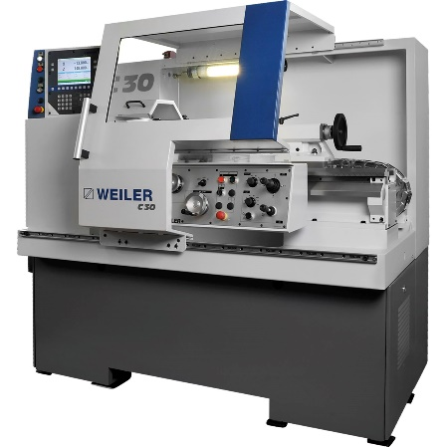
Machine Shop
Servo-conventional lathe
  Machine: Weiler C30
  Working space: turning length (Z) = 750mm, diameter (X) = 300mm, long workpieces only possible up to a diameter of 40mm!
  Materials: steel, stainless steel, aluminum, brass, copper, plastics (which do not generate dust during processing e.g. Delrin, PEEK, PA, ...), other metals such as titanium are possible Operators: F. Buchsteiner, R. Stark

Slide 11
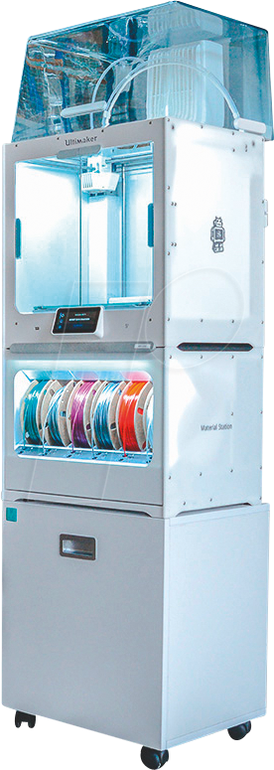
Machine Shop
3D-printer
  Machine: Ultimaker S5 Pro
  Working space: 330 x 240 x 300 mm³
  Materials: PLA (polylactic acid),
    Tough PLA, TPU (thermoplastic polyurethane), PC (Polycarbonate), PP (Polypropylen) → in stock
    Compatible with over 200 materials
    (https://ultimaker.com/de/materials)
  Operators: F. Buchsteiner, R. Stark, A. Bauer, S. Schultschik, K-D. Fischer

Slide 12
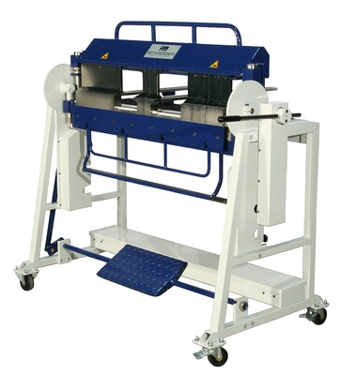
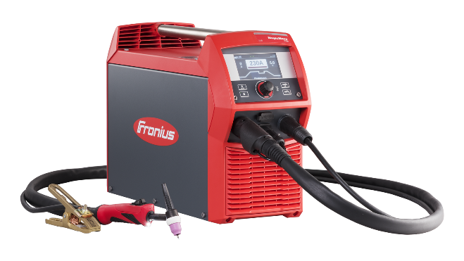
Machine Shop
Sheet metal processing
  Materials: aluminum, steel, stainless steel, brass, copper
    aluminum up to 3mm thickness
    steel up to 2mm thick
    stainless steel up to 1.5mm thickness
    brass/copper up to 2mm thickness
  Operators: F. Buchsteiner, R. Stark
Machining operations
  drilling, thread cutting, cutting, ...
  Operators: F. Buchsteiner, R. Stark
Welding: MIG/MAG, TIG, gas fusion welding and brazing
  Materials: aluminum, steel, stainless steel
  Operators: F. Buchsteiner, R. Stark

Slide 13
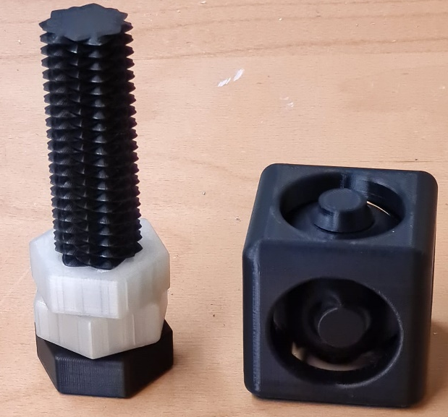
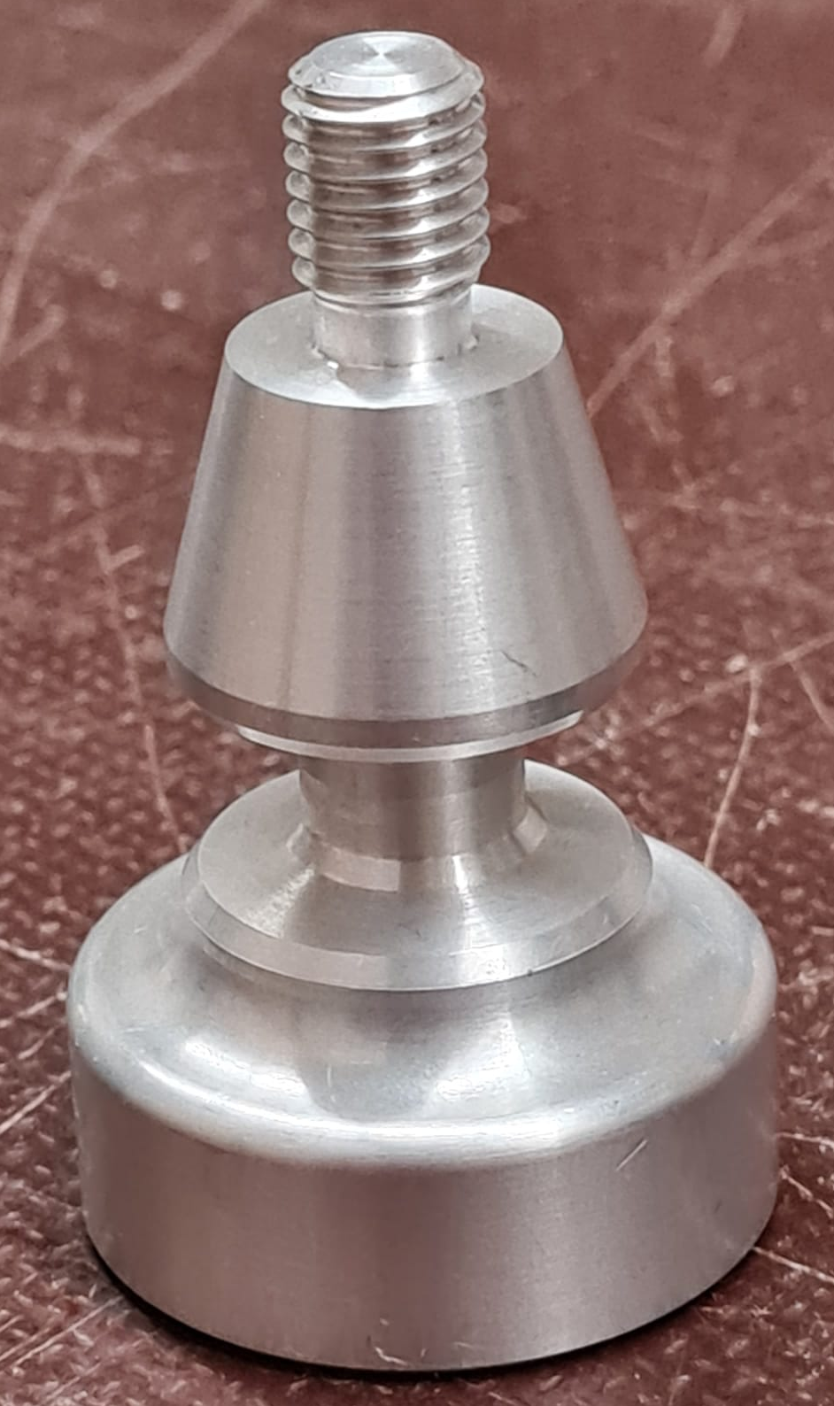
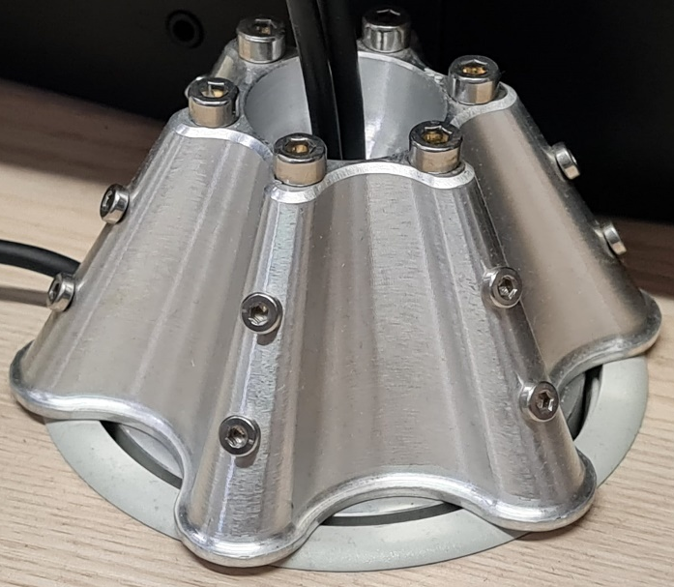
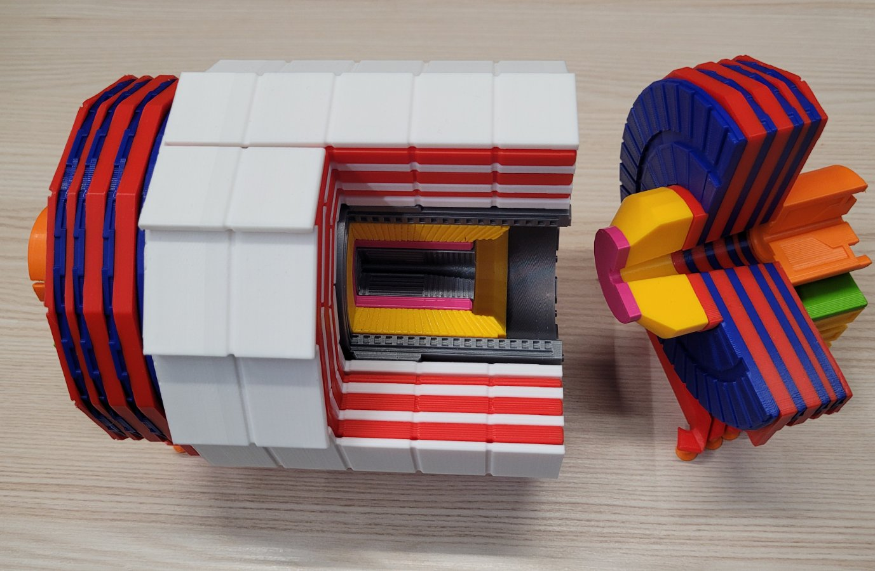
Machine Shop
3D printed parts
Lathed part
5-axis CNC milling part

Slide 14
Current and Future Projects
COSINUS experiment installation (2023)
Belle PXD upgrade (2023)
  There is a detailed plan but no start date yet
Belle 2026+ upgrade
  No concrete participation planned yet, surveying possible involvement → no commitments without consultation of the Technik-Beirat

