Slide 1

ELECTRONICS
13 Jan 2023
M.Friedl

Slide 2
Mission Statement
Provide electronics services to support the scientific projects
  Manpower (skills)
  Tools (devices, software)
Education
  Apprenticeship training (since September 2021)
  Teaching
  Pupils on summer internship

Slide 3
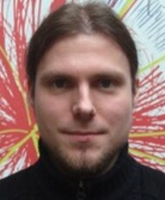
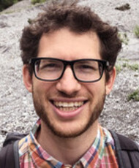
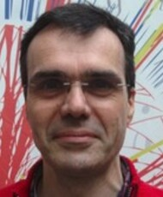
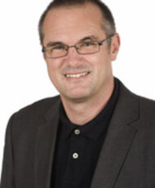

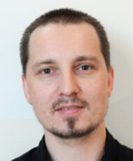
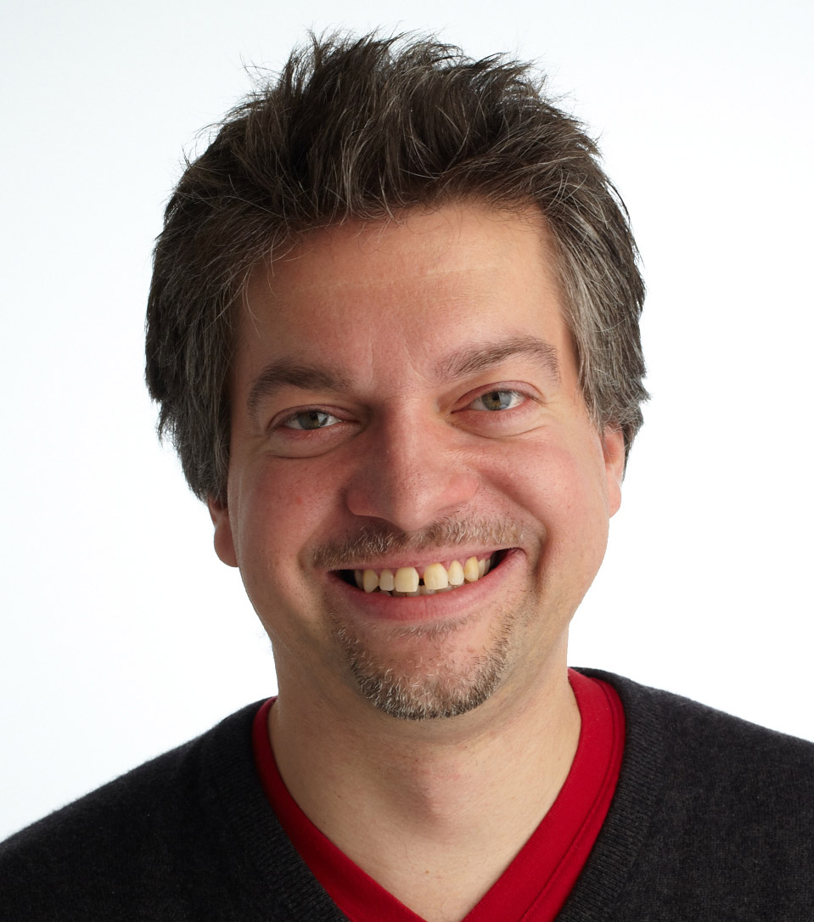
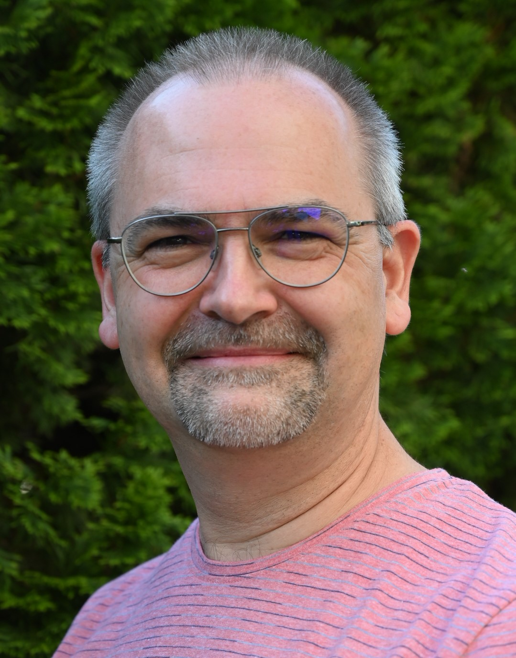
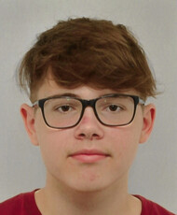
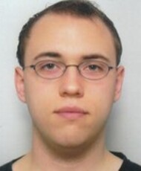
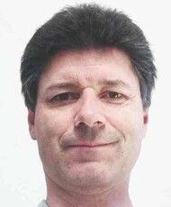
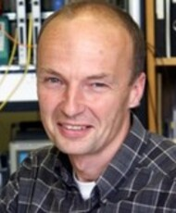
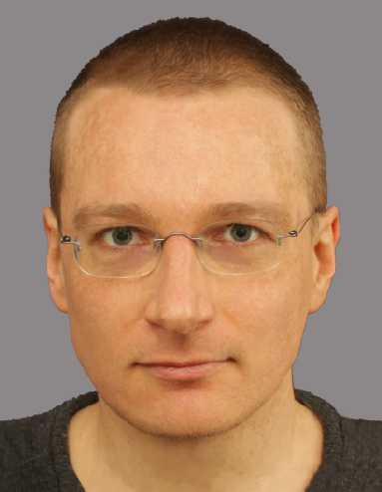
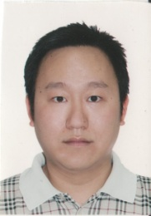
Staff
B.Arnold
A.Bauer
H.Bergauer
W.Brandner
S.Fichtinger
K.D.Fischer
M.Friedl
C.Irmler
N.Kumerer
M.Oberegger
S.Schultschik
C.Schwertner
H.Steininger
R.Thalmeier
H.Yin

Slide 4
Staff
Name | FTE | Skills | Comments
Bernhard ARNOLD | 1 | Software
Andreas BAUER | 0.6 | Wire bonding, measurements, circuits
Herbert BERGAUER | 0.48 | Firmware | Retiring July 2025
Wolfgang BRANDNER | 1 | Infrastructure, clean rooms, circuits | In administration, retiring "ca. end 2024"
Stephan FICHTINGER | 1 | Software
Klaus-Dieter FISCHER | 1 | Soldering, assembly, PCB design
Markus FRIEDL | 1 | System design, circuits, mechanics | Leader
Christian IRMLER | 1 | System design, wire bonding | Deputy leader
Niklas KUMERER | 1 | PCB design, soldering | Apprentice
Margit OBEREGGER | 0.5 | Measurements, packing
Stefan SCHULTSCHIK | 0.875 | Mechanics, measurements
Christoph SCHWERTNER | 1 | Circuits, firmware | TU funded
Helmut STEININGER | 1 | Firmware
Richard THALMEIER | 1 | Circuits, PCB design, tests
Hao YIN | 1 | Software

Slide 5
Staff and Projects

Slide 6







Projects
Belle
  Operation, software, PXD 2023, VTX upgrade 2026+
CMS Tracker
  Sensor measurements
CMS Trigger
  Operation
Rare Event Searches
  Readout electronics, software, clean room
R&D
  ASIC design (RD50), beam monitoring (MedAustron), protonCT
Conferences, Outreach
  VCI2022, occasional outreach activities

Slide 7
Competences
System design
Schematics development
(Small-scale) PCB layout
Assembly, debugging, testing
Firmware and software development
Interweaved with detector development and clean rooms (module assembly, sensor testing etc.)
ASIC design (mainly by students)
Wire bonding

Slide 8
Organization
“Technik-Beirat” meetings
  Once every quarter (March, June, September, December)
  Discussing assignments for the next months (“big picture”)
Weekly meeting
  Jour fixe every Monday at 09:00
  Discussing assignments for coming week (“small picture”)

Slide 9
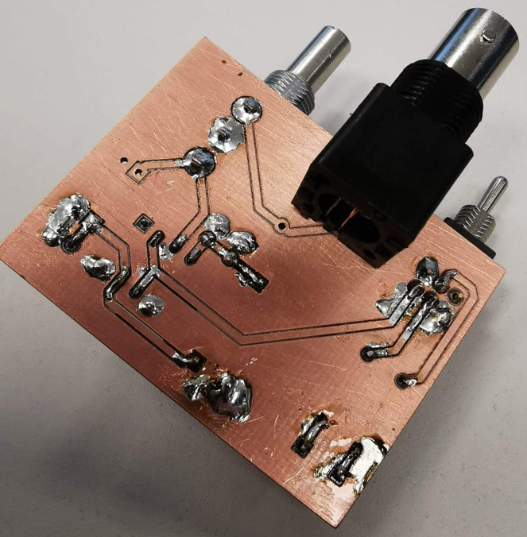
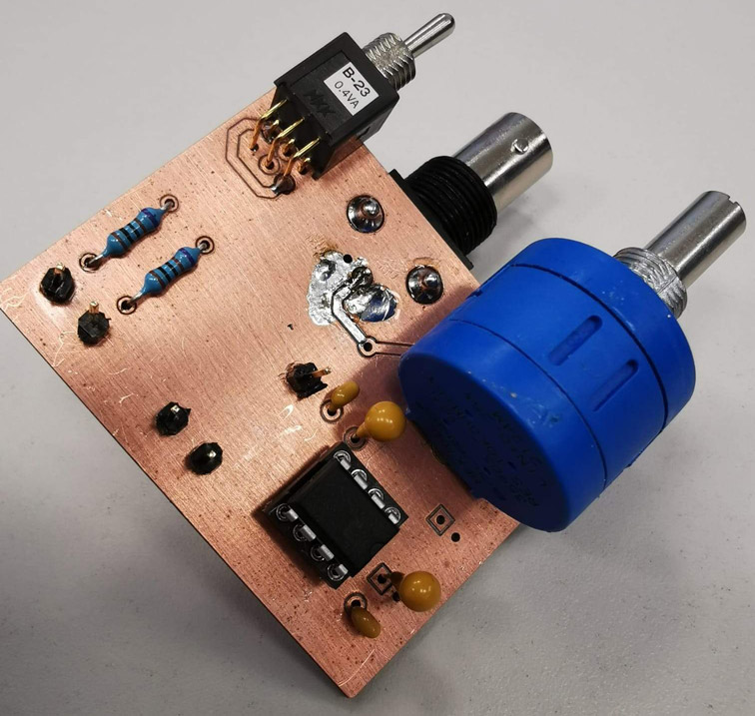
(Currently) Not Covered
Large scale PCB layout → outsourced to industry
  Sigi SCHMID retired in 2016, not replaced
  Currently no need to change that
  Good experience with Belle II FADC and VDAQ3
PCB manufacturing
  In-house wet chemistry stopped >10 years ago
  Done in industry (cheap, especially in China)
  Can do FR4 milling for very simple PCBs

Slide 10
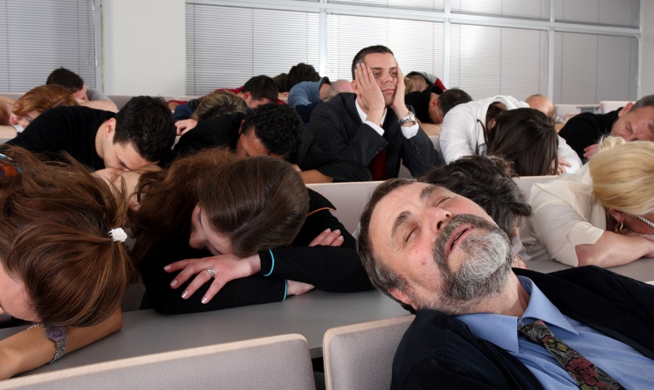
Thank you for your attention!

Slide 11
Backup Slides

Slide 12
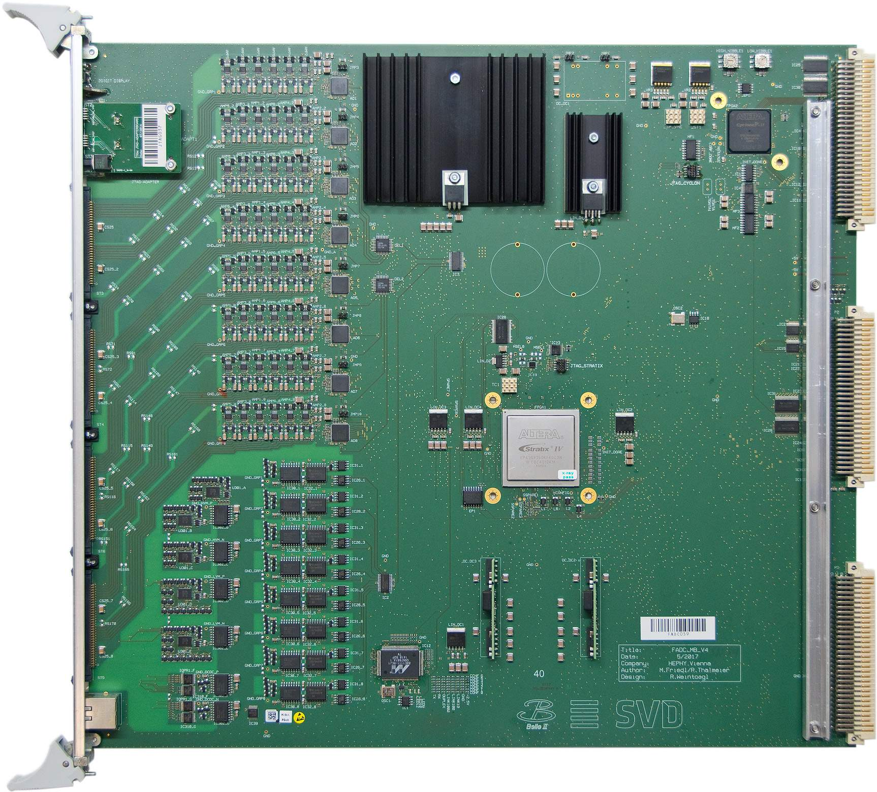
Example: Belle II FADC
9U VME readout module for Belle II SVD

Slide 13
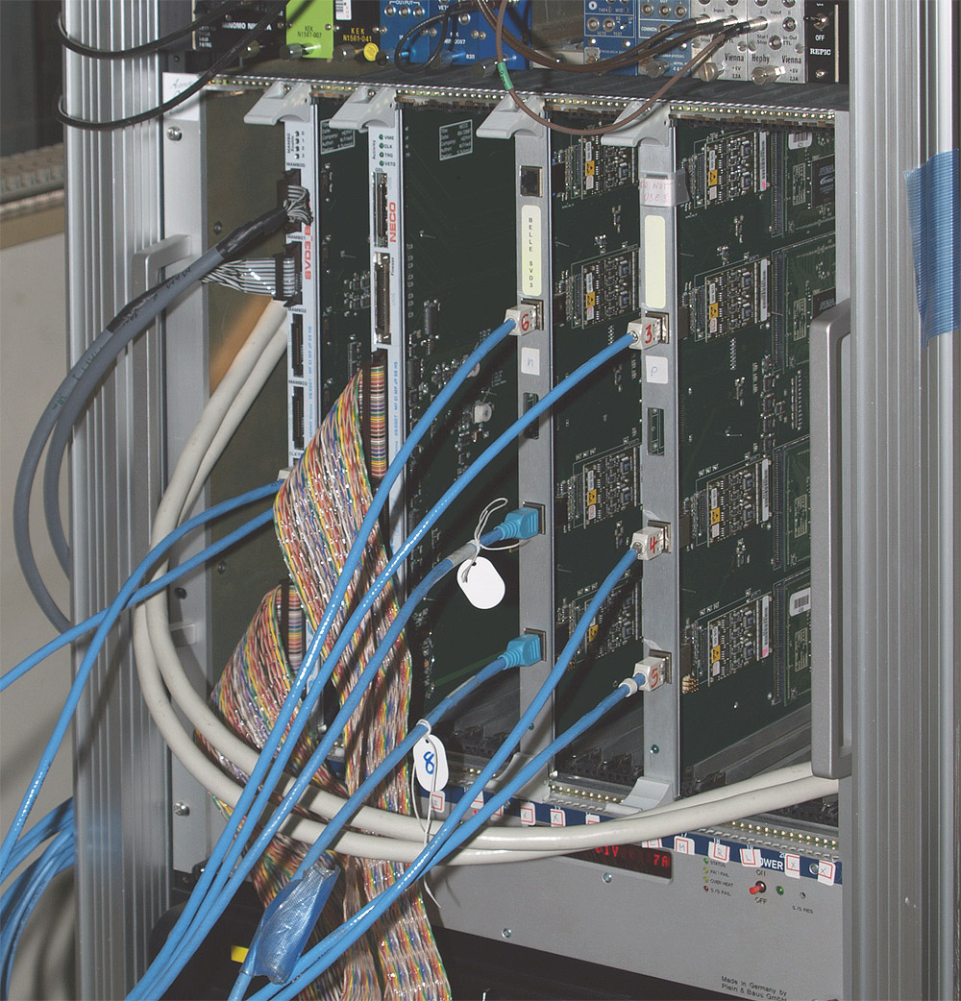
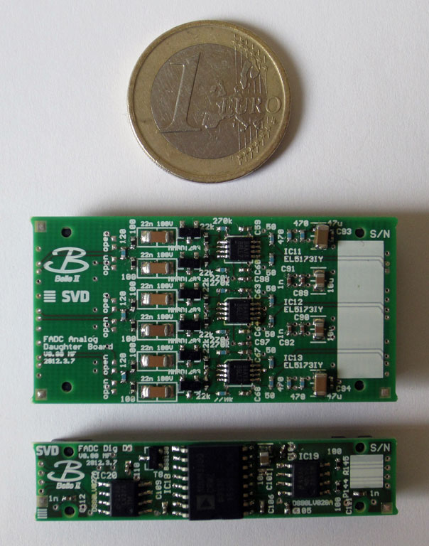
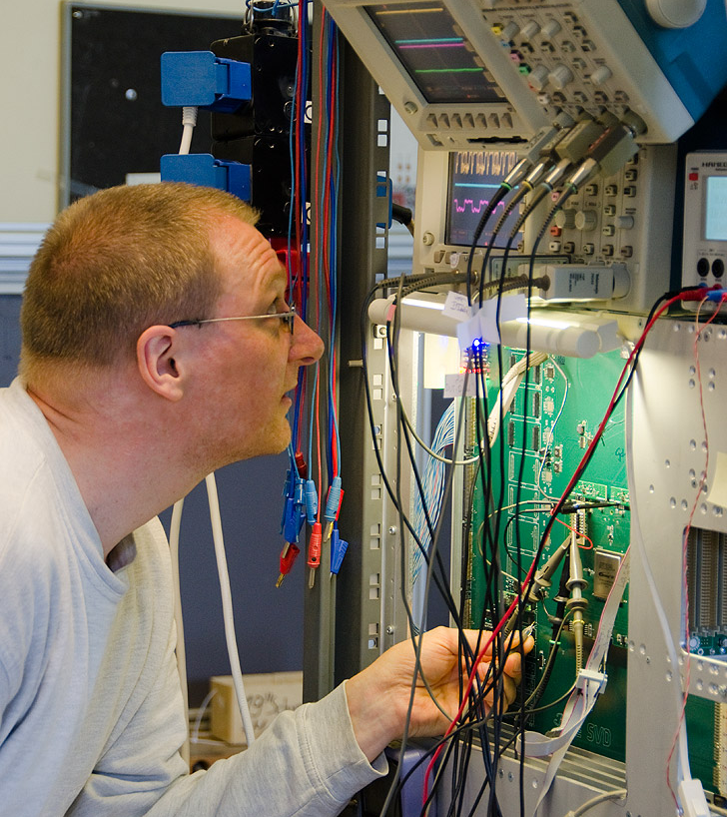
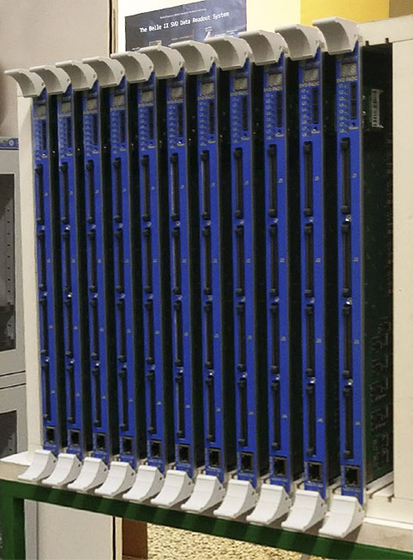
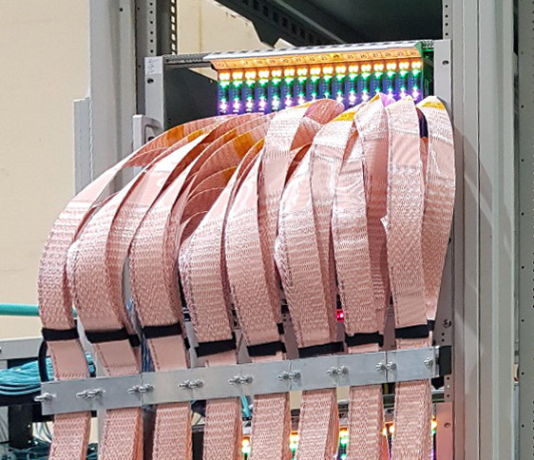
Example: Belle II FADC
Timeline:
  2008: prototype system based on SVD2 concept
  2013: first design of final FADC (V1)
  2014: bug fixes, redesign (V2)
  2016: redesign (V3) without daughter boards
  2017: bug fixes, final version (V4)
  2018: serial production, tests, delivery to KEK

Slide 14
Example: Belle II FADC
Many people involved:
  Markus (concept, schematics, tests)
  Richard (schematics, firmware, tests)
  Hao (software, tests)
  Josef, Klaus-Dieter (assembly)
  Florian, Roland (panels, boxes, fixtures)
  Christian (tests)
  Sigi (V1, V2), company (V3, V4) (PCB layout)
  Helmut (firmware)
  and many others!
In operation since 2019 without any problem

