Slide 1
Outreach HEPHY
2 September 2022

Slide 2
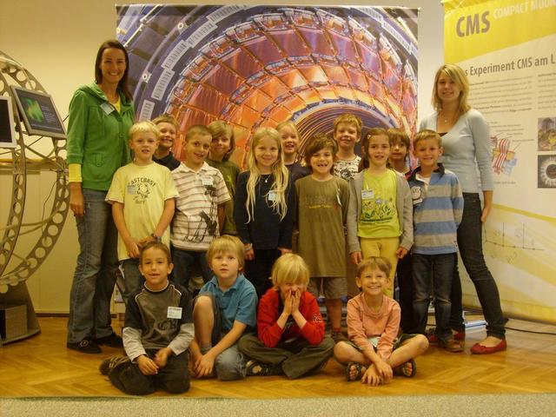
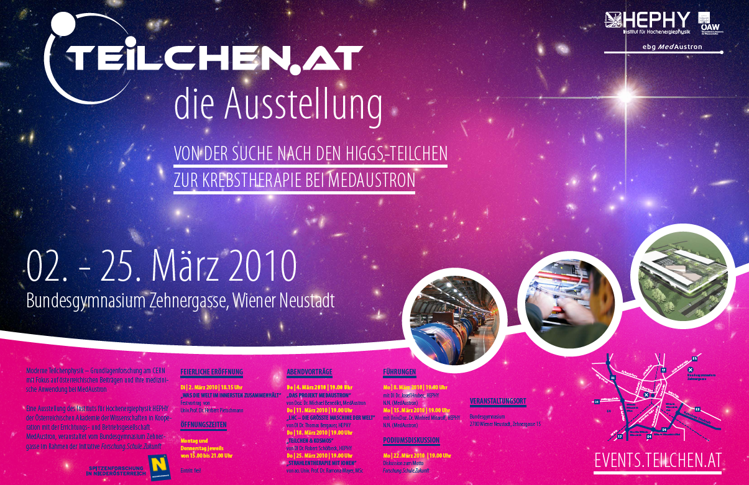
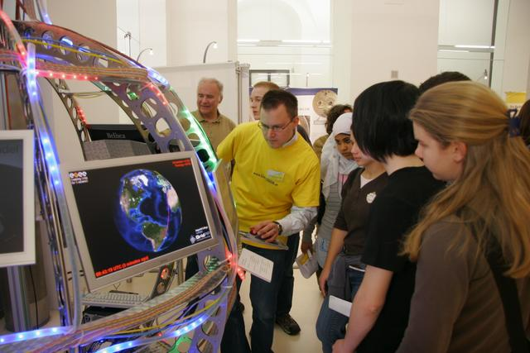
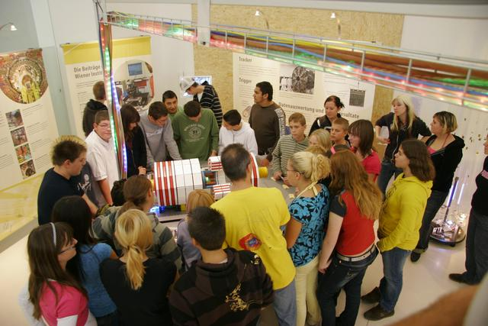

Long tradition
HEPHY has a long tradition of bringing particle physics to the public
First large event was: LHC Inauguration 2008 → Exhibition „LHC2008 – Die größte Maschine der Welt auf der Suche nach den kleinsten Teilchen des Universums“
  Guided tours for school classes (about 125 school classes)
This resulted in a travelling exhibition with the main focus on schools (about 70)

Slide 3
Overview – Recurring Activities
Workshops for children (from 7 year) and pupils (International Masterclasses – CMS and Belle, Physik zum Anfassen, Kinderuni, Cultural Collision Workshops, Perchtoldsdorfer Forschertage,…)
Participation in public events (e.g. Lange Nacht der Forschung, European Researcher´s Night, Wiener Forschungsfest, Dark Matter Day, Girls Day, …)
Public talks (e.g. Akademie im Klassenzimmer, adult education centers, public events, schools, …)
Educational material for teachers, blogs, broschures, videos, …
Networking with other institutions (e.g. ScienceCenter Network, …)
Cooperation with other organizations (e.g. University of Applied Arts Vienna, NHM Vienna, … )

Slide 4
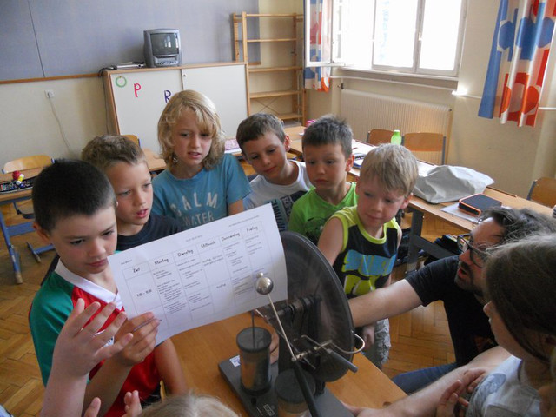
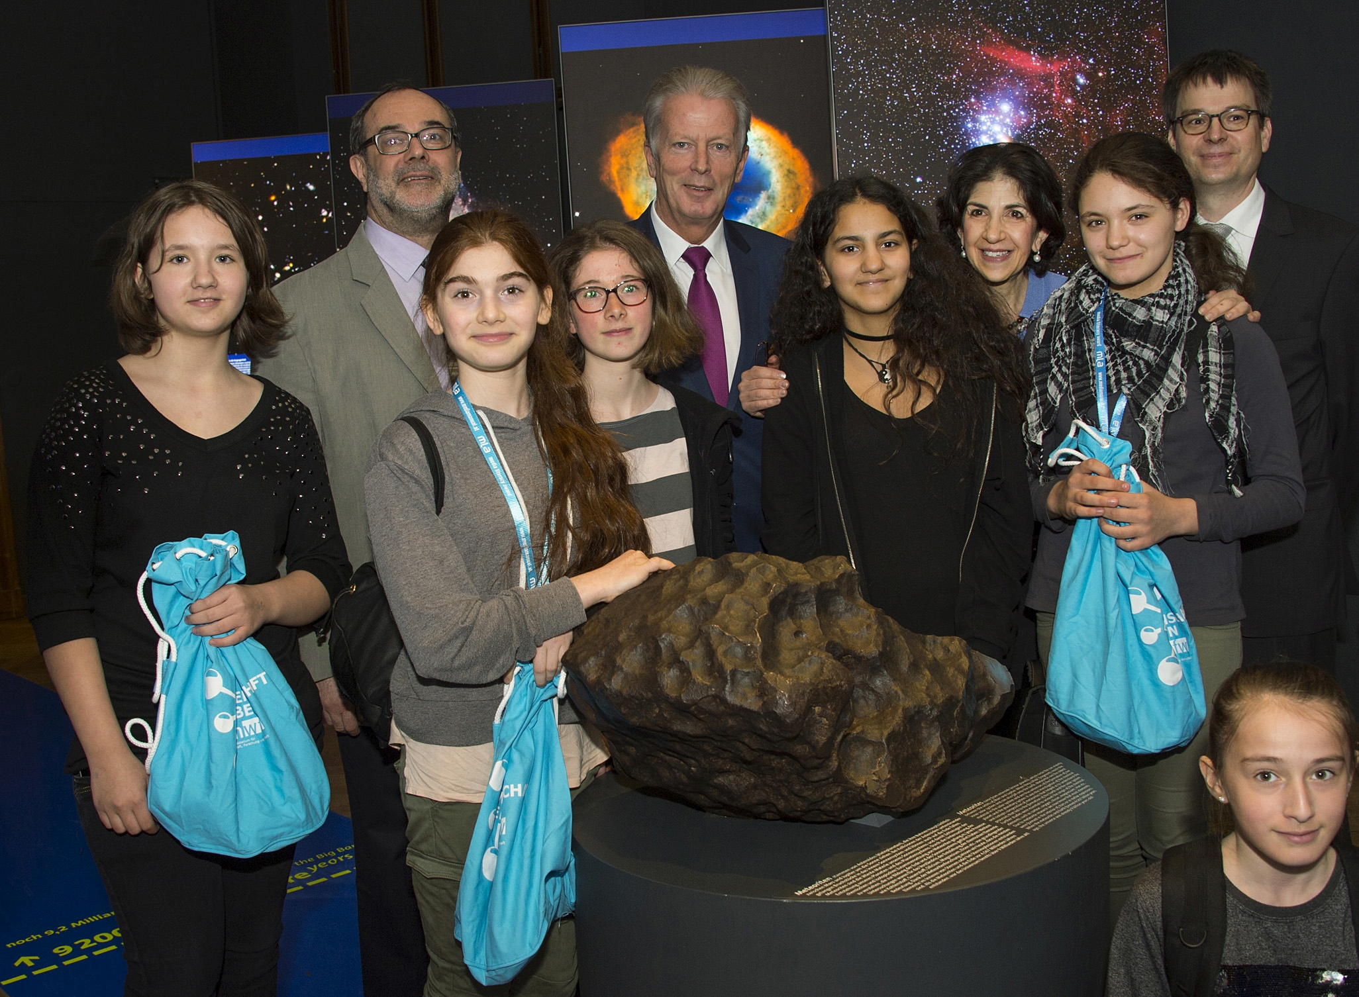
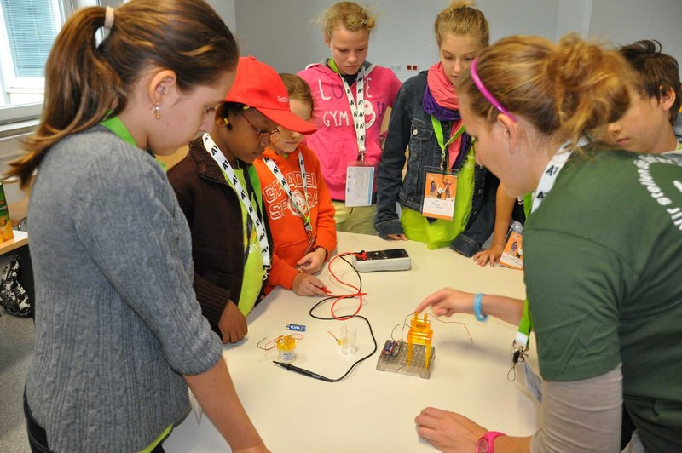
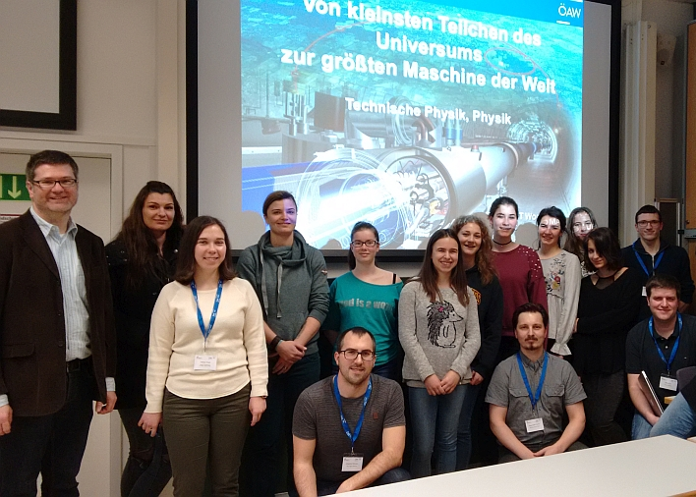
Particle Physics for students and kids
Perchtoldsdorfer Forschertage
(5-12yr)(full day courses)
since 2009
Girls Day (10-15yr)
2017 at the NHM Vienna,
Kinder Uni (7-12yr)
FIT (Females into technics) days (16-18yr)
FIT-workshop at the HEPHY 2018

Slide 5
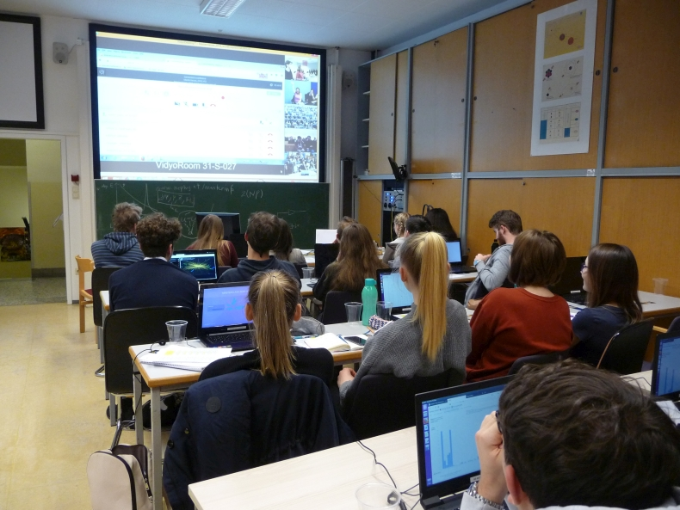
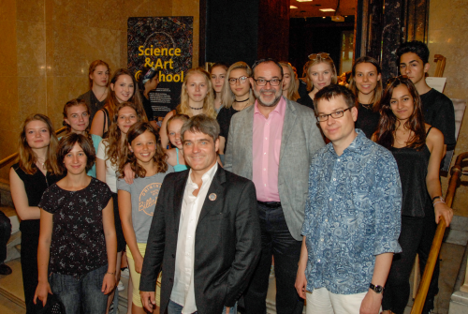
Workshops for students (15-18)
International Masterclasses
– a project of IPPOG
– 120 participating institutes worldwide (4 in Austria: Vienna, Graz, Innsbruck)
Workshop “Cultural Collisions”
– cooperation of art@CMS and HEPHY
- Cooperation with mumok (Museum Moderner Kunst Stiftung Ludwig Wien)
– Highlight: exhibition of the art work of the students at the Natural History Museum Vienna and Universalmuseum Joanneum Graz

Slide 6
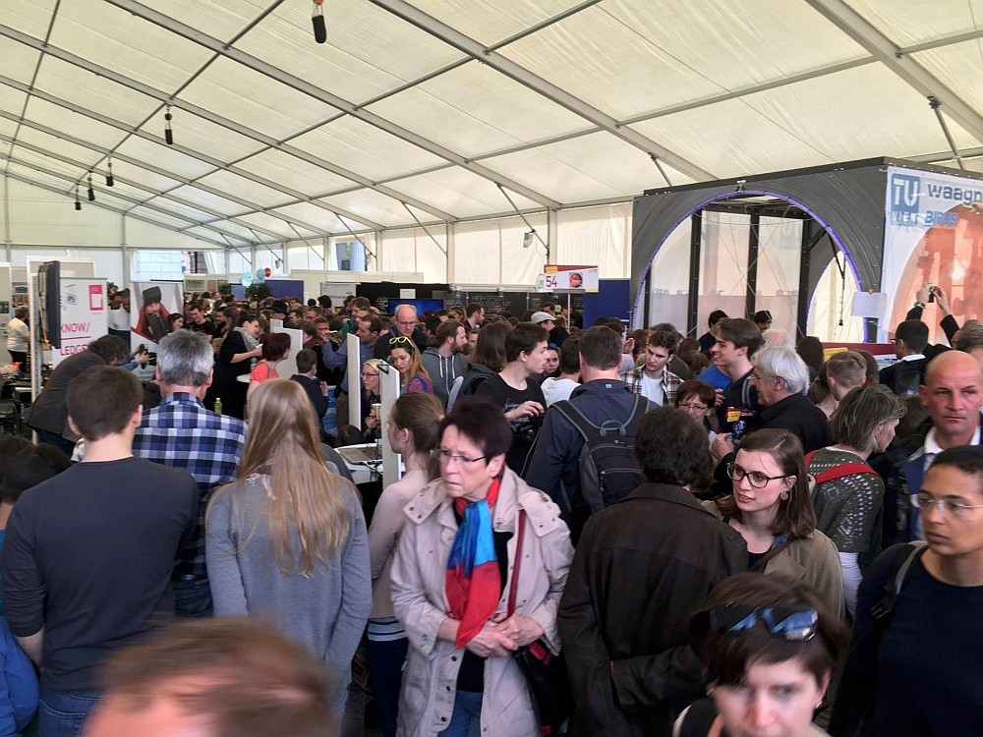
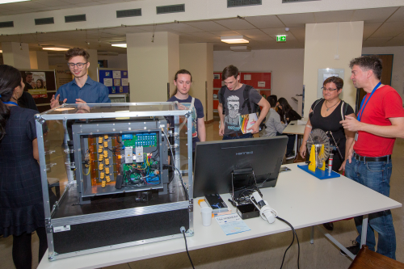
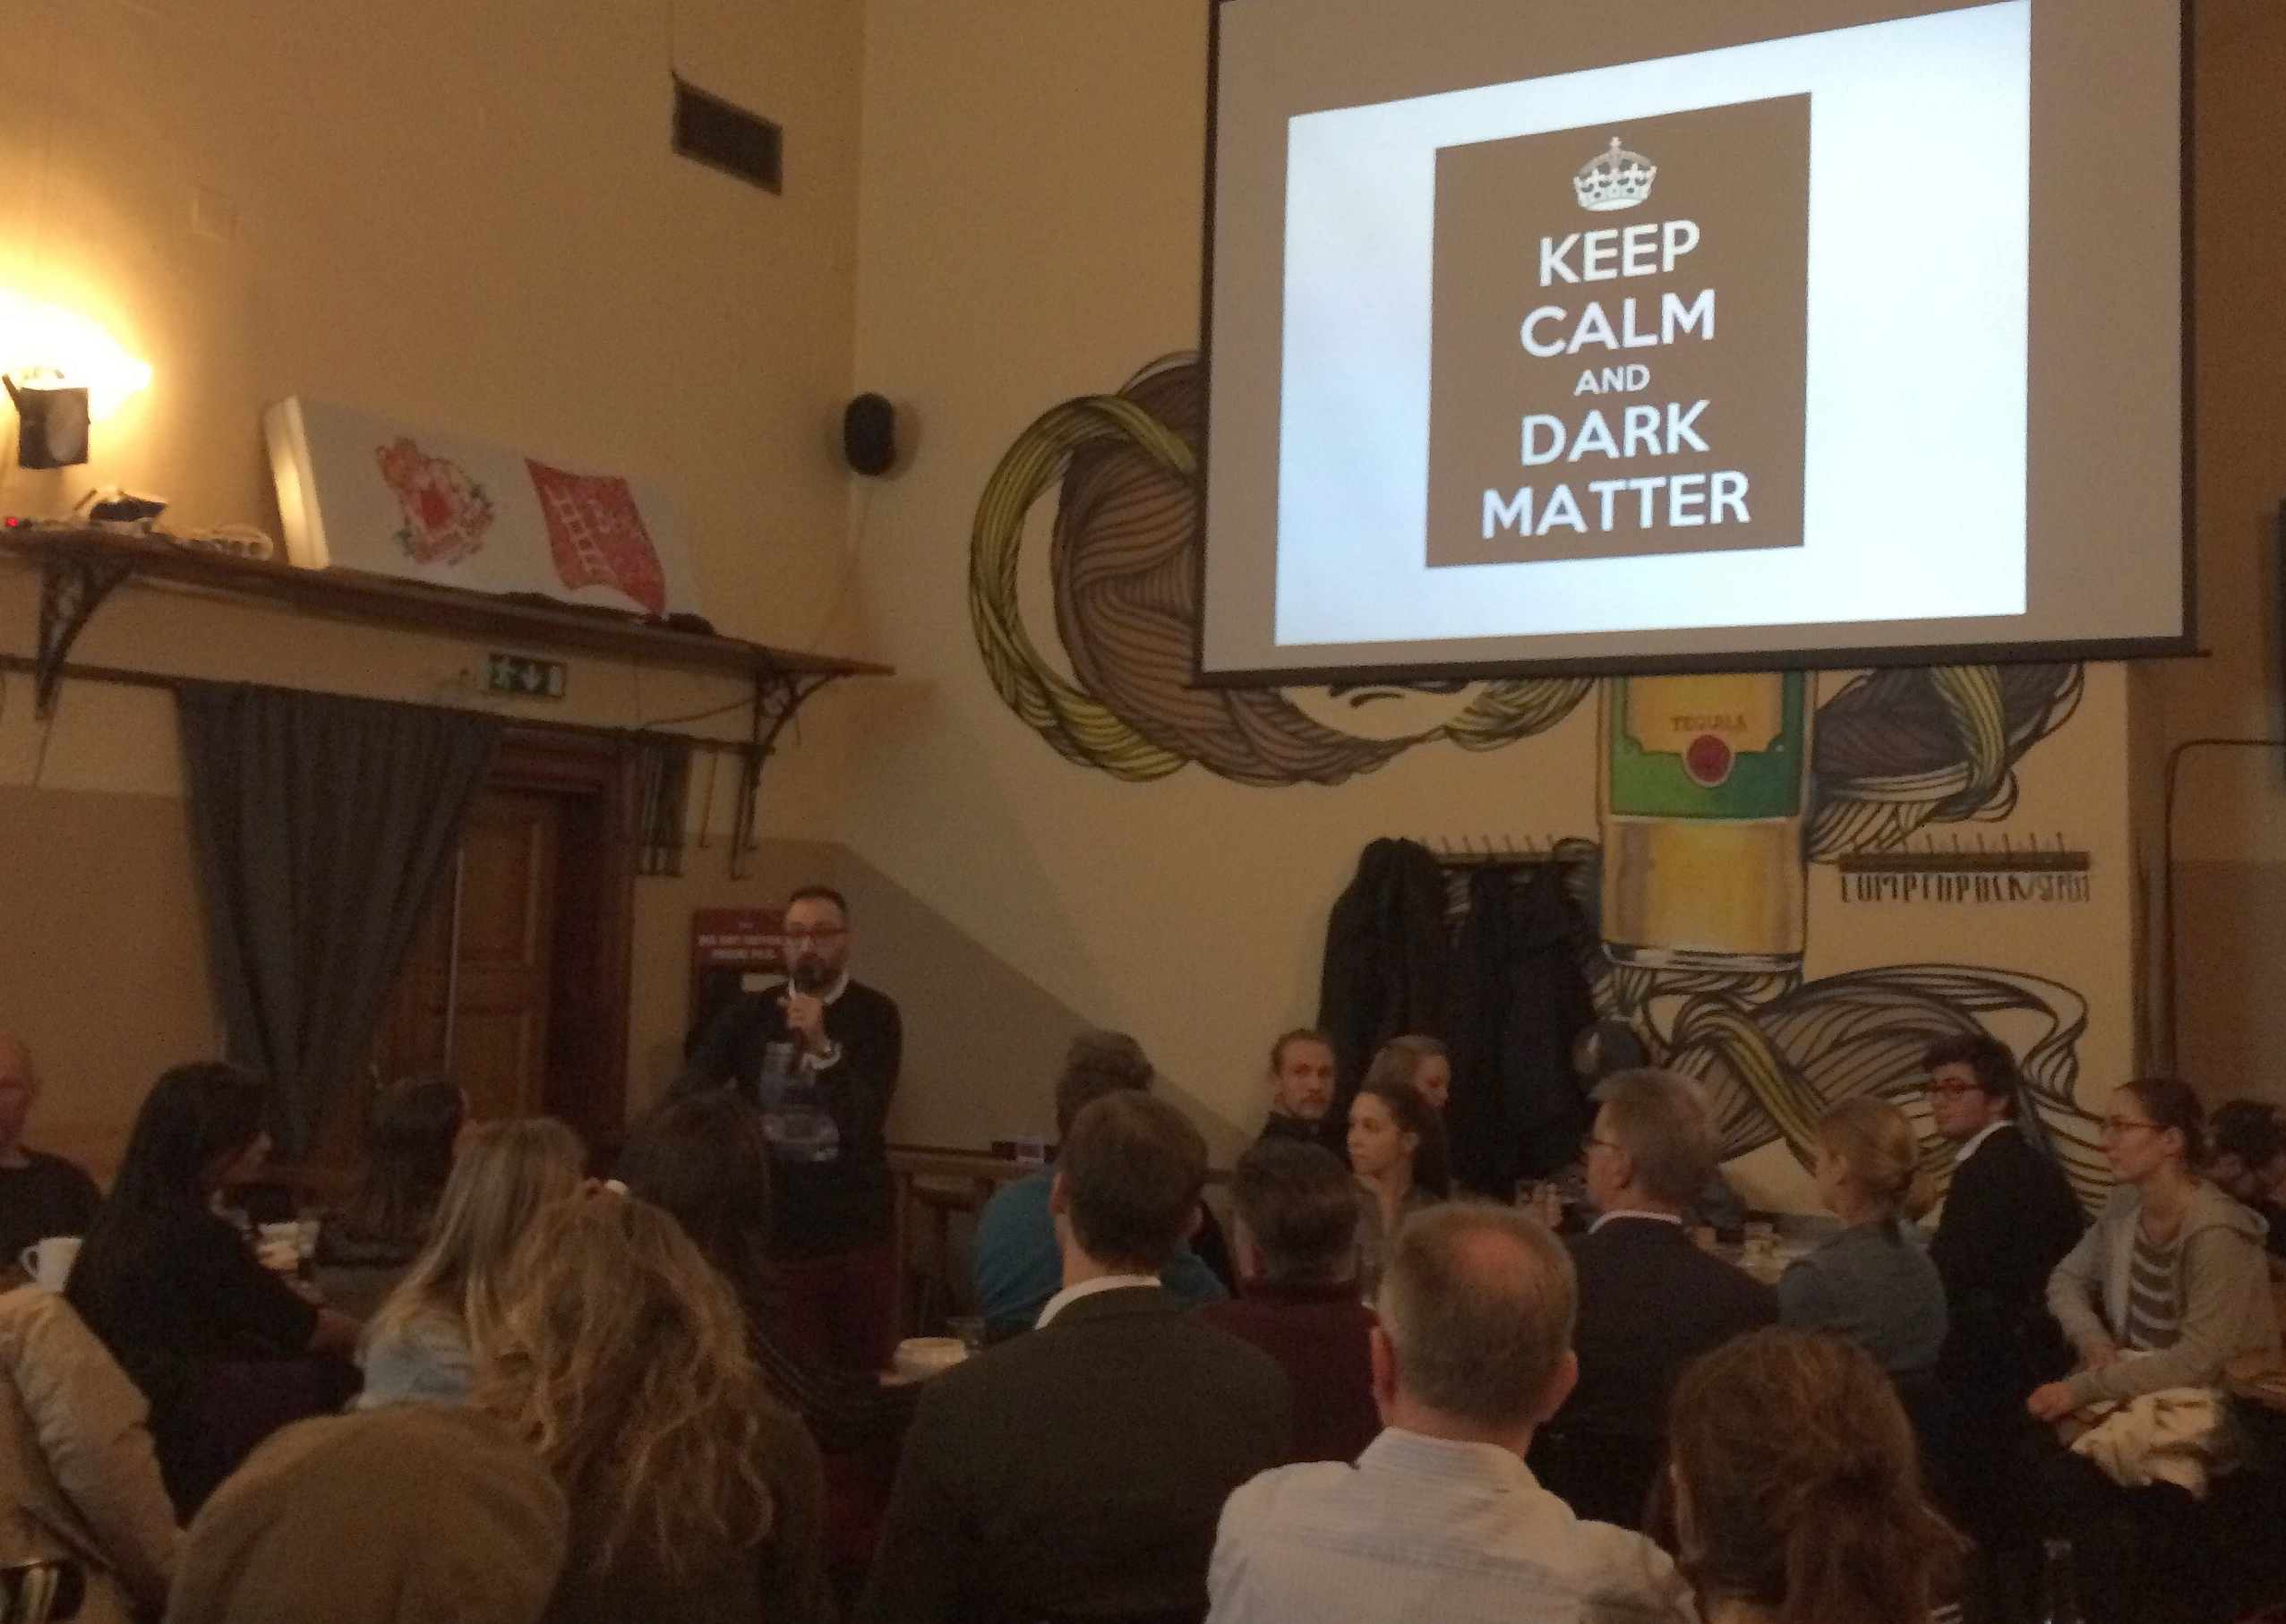
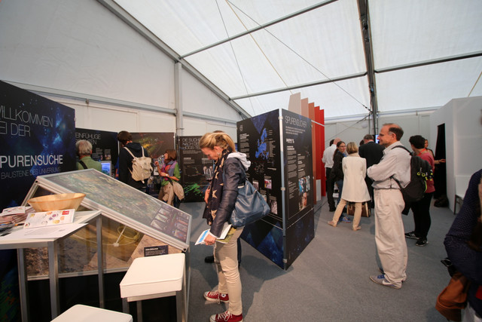
Public events
Lange Nacht der Forschung
European Researchers` Night
Dark Matter Day
Wiener Forschungsfest

Slide 7
Large Exhibitions

Slide 8

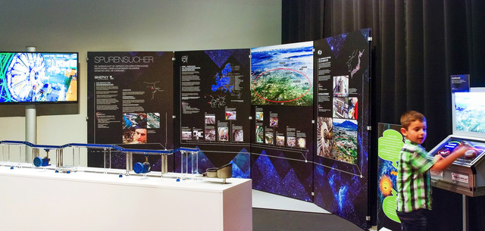
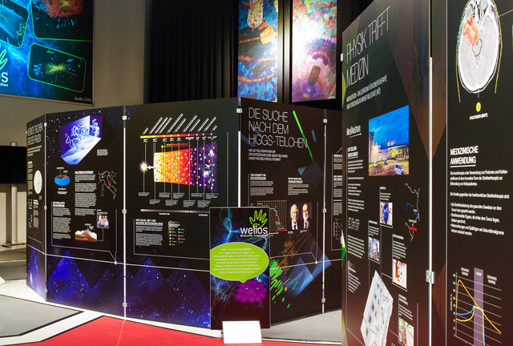
HEPHY traveling exhibition
“Spurensuche – Die Bausteine des Universums”
Information boards and exhibits explain the basic of particle physics and confronts visitors with the great questions of contemporary physics
Created with and for Welios in 2014, then updated and shown at various places
Welios Science Center Wels (2014), Austria
EXPI Gotschuchen (2015), Austria
Altes AKH Vienna (in the course of the EPS-HEP 2015), Kitzbühel, …
Aula der Wissenschaften (Science Week 2019)

Slide 9
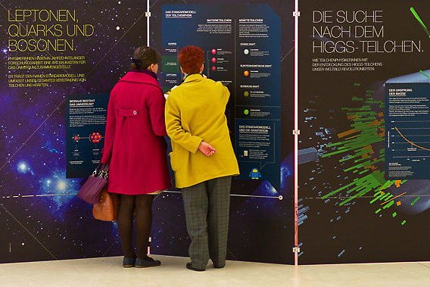
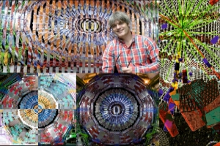
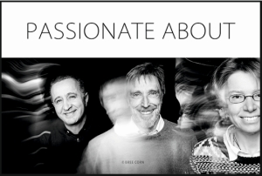
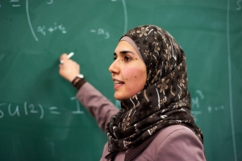
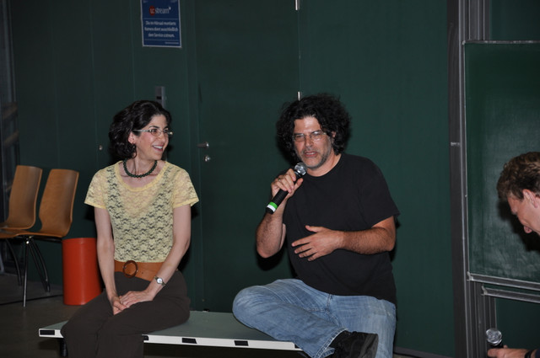
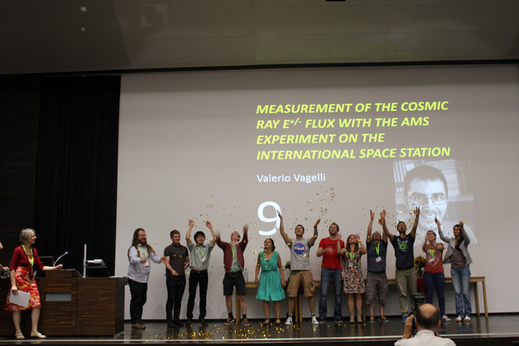
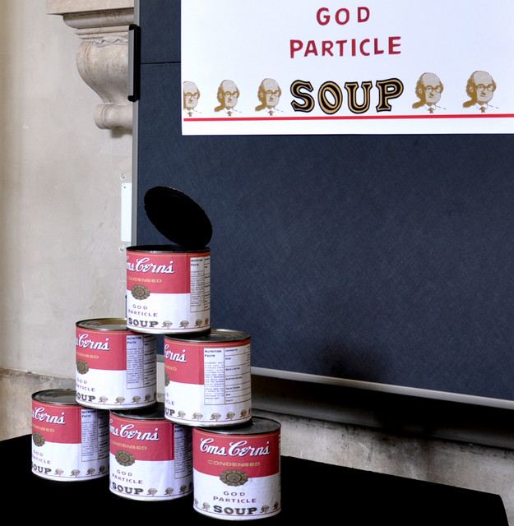
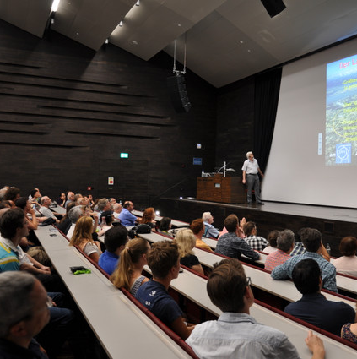
Outreach @ EPS-HEP2015 conference
Exhibition “Spurensuche”
Exhibition “Art&CMS”
Exhibition “passionate about”
Women in Physics in the Palestinian Territories
Movie screening “Particle Fever”
Public lectures
Panel discussion “Beauty in creation”
Physics Slam

Slide 10
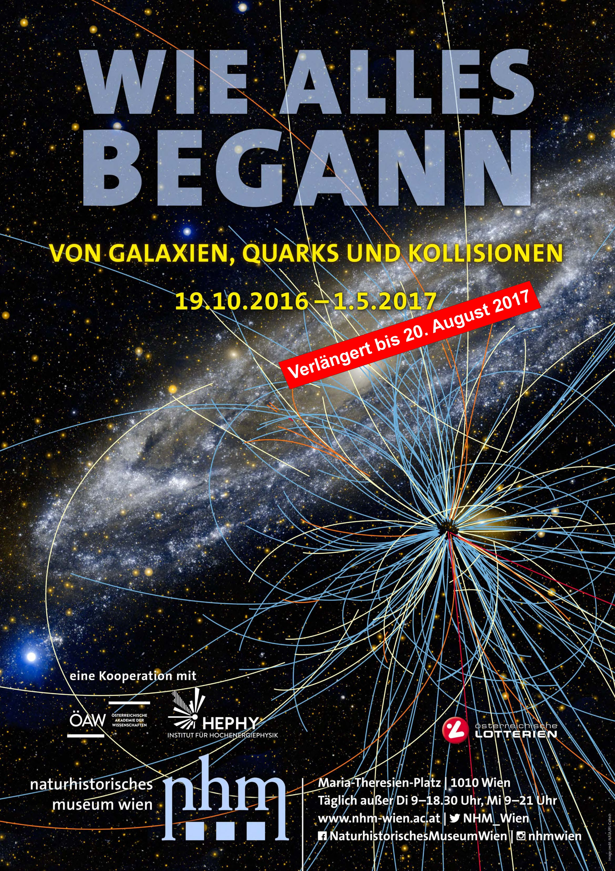
The Highlight!
Exhibition “The beginning of everything. From galaxies, quarks and collisions”
Natural History Museum Vienna (NHM Vienna)
19th October 2016 - 20th August 2017
Cooperation between the NHM Vienna and
the Institute of High Energy Physics (HEPHY)
of the Austrian Academy of Sciences
Exhibition space: about 550 m²
About 600 000 museum visitors
Guest of honour at the grand opening:
    Peter W. Higgs, George F. Smoot, Federal Minister Thomas Drozda, video greetings by Fabiola Gianotti

Slide 11
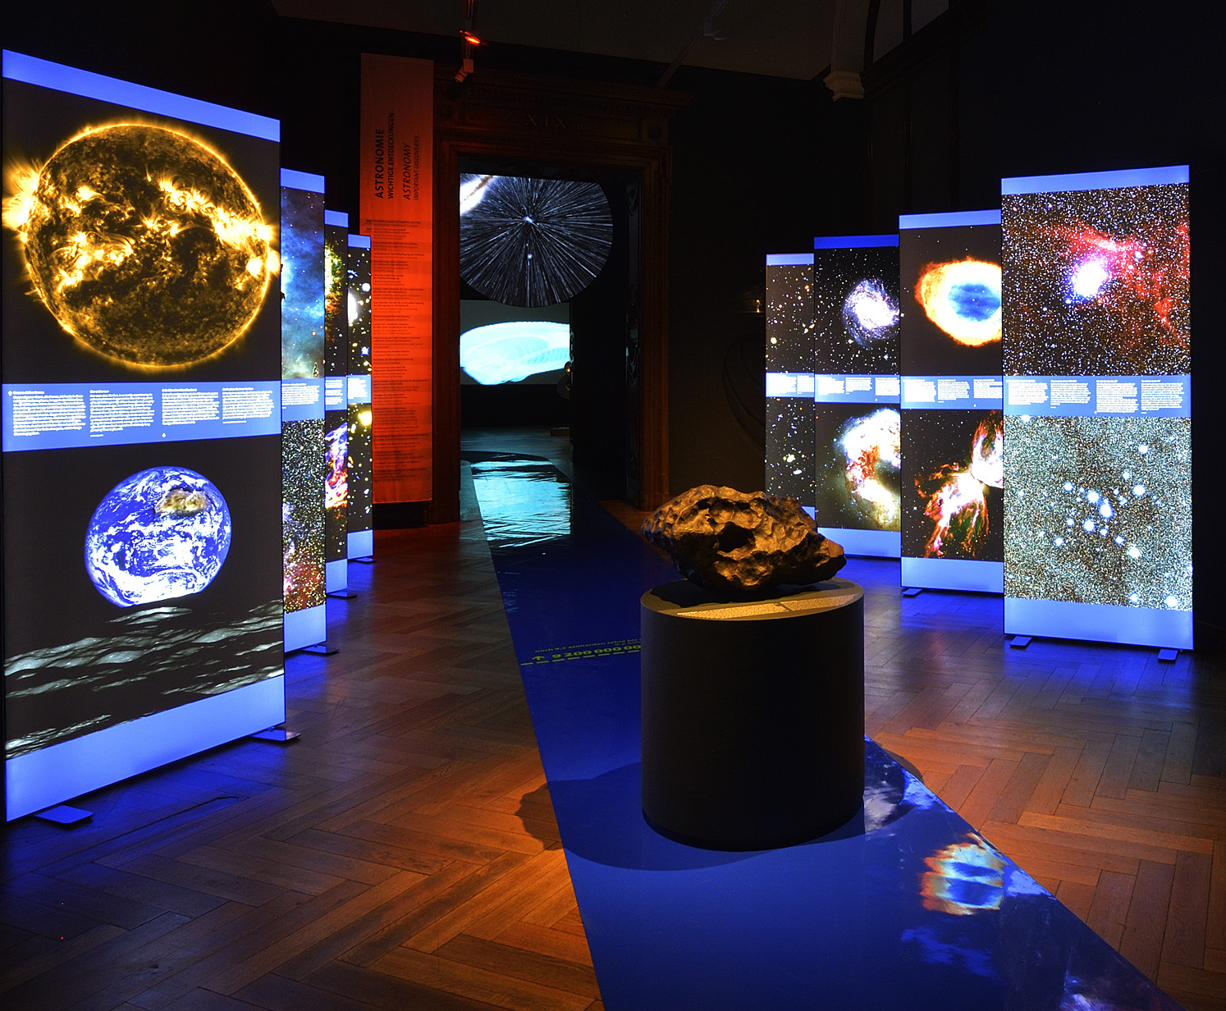
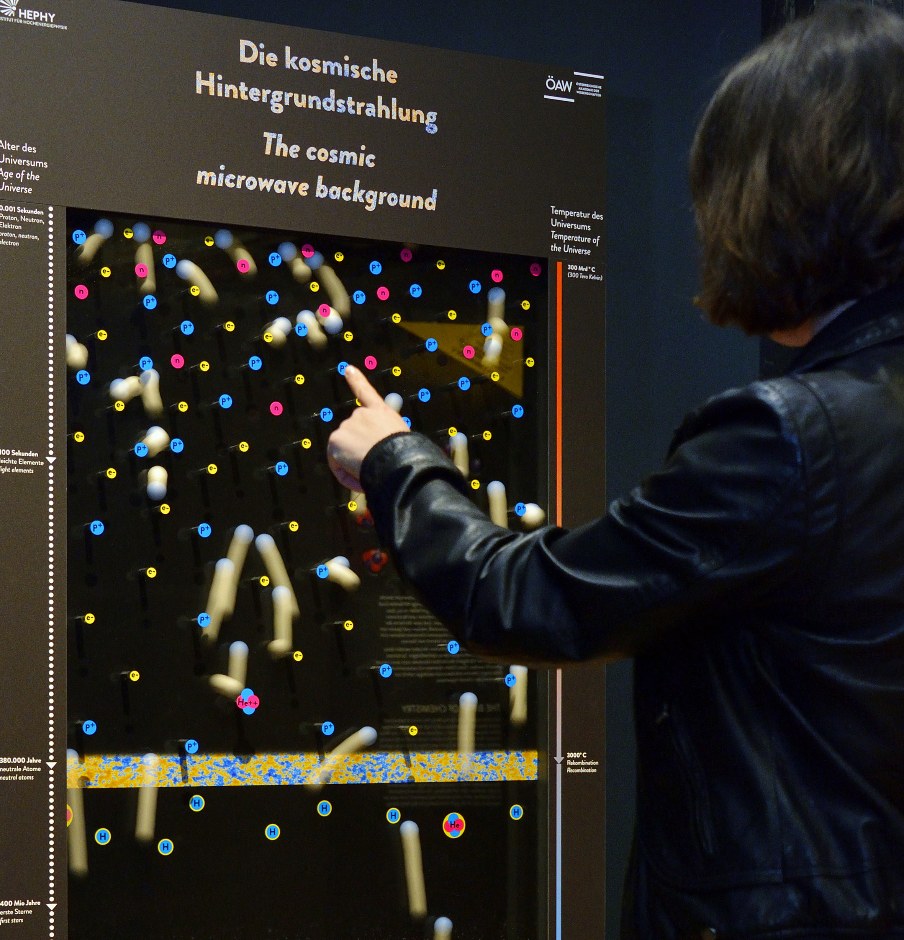
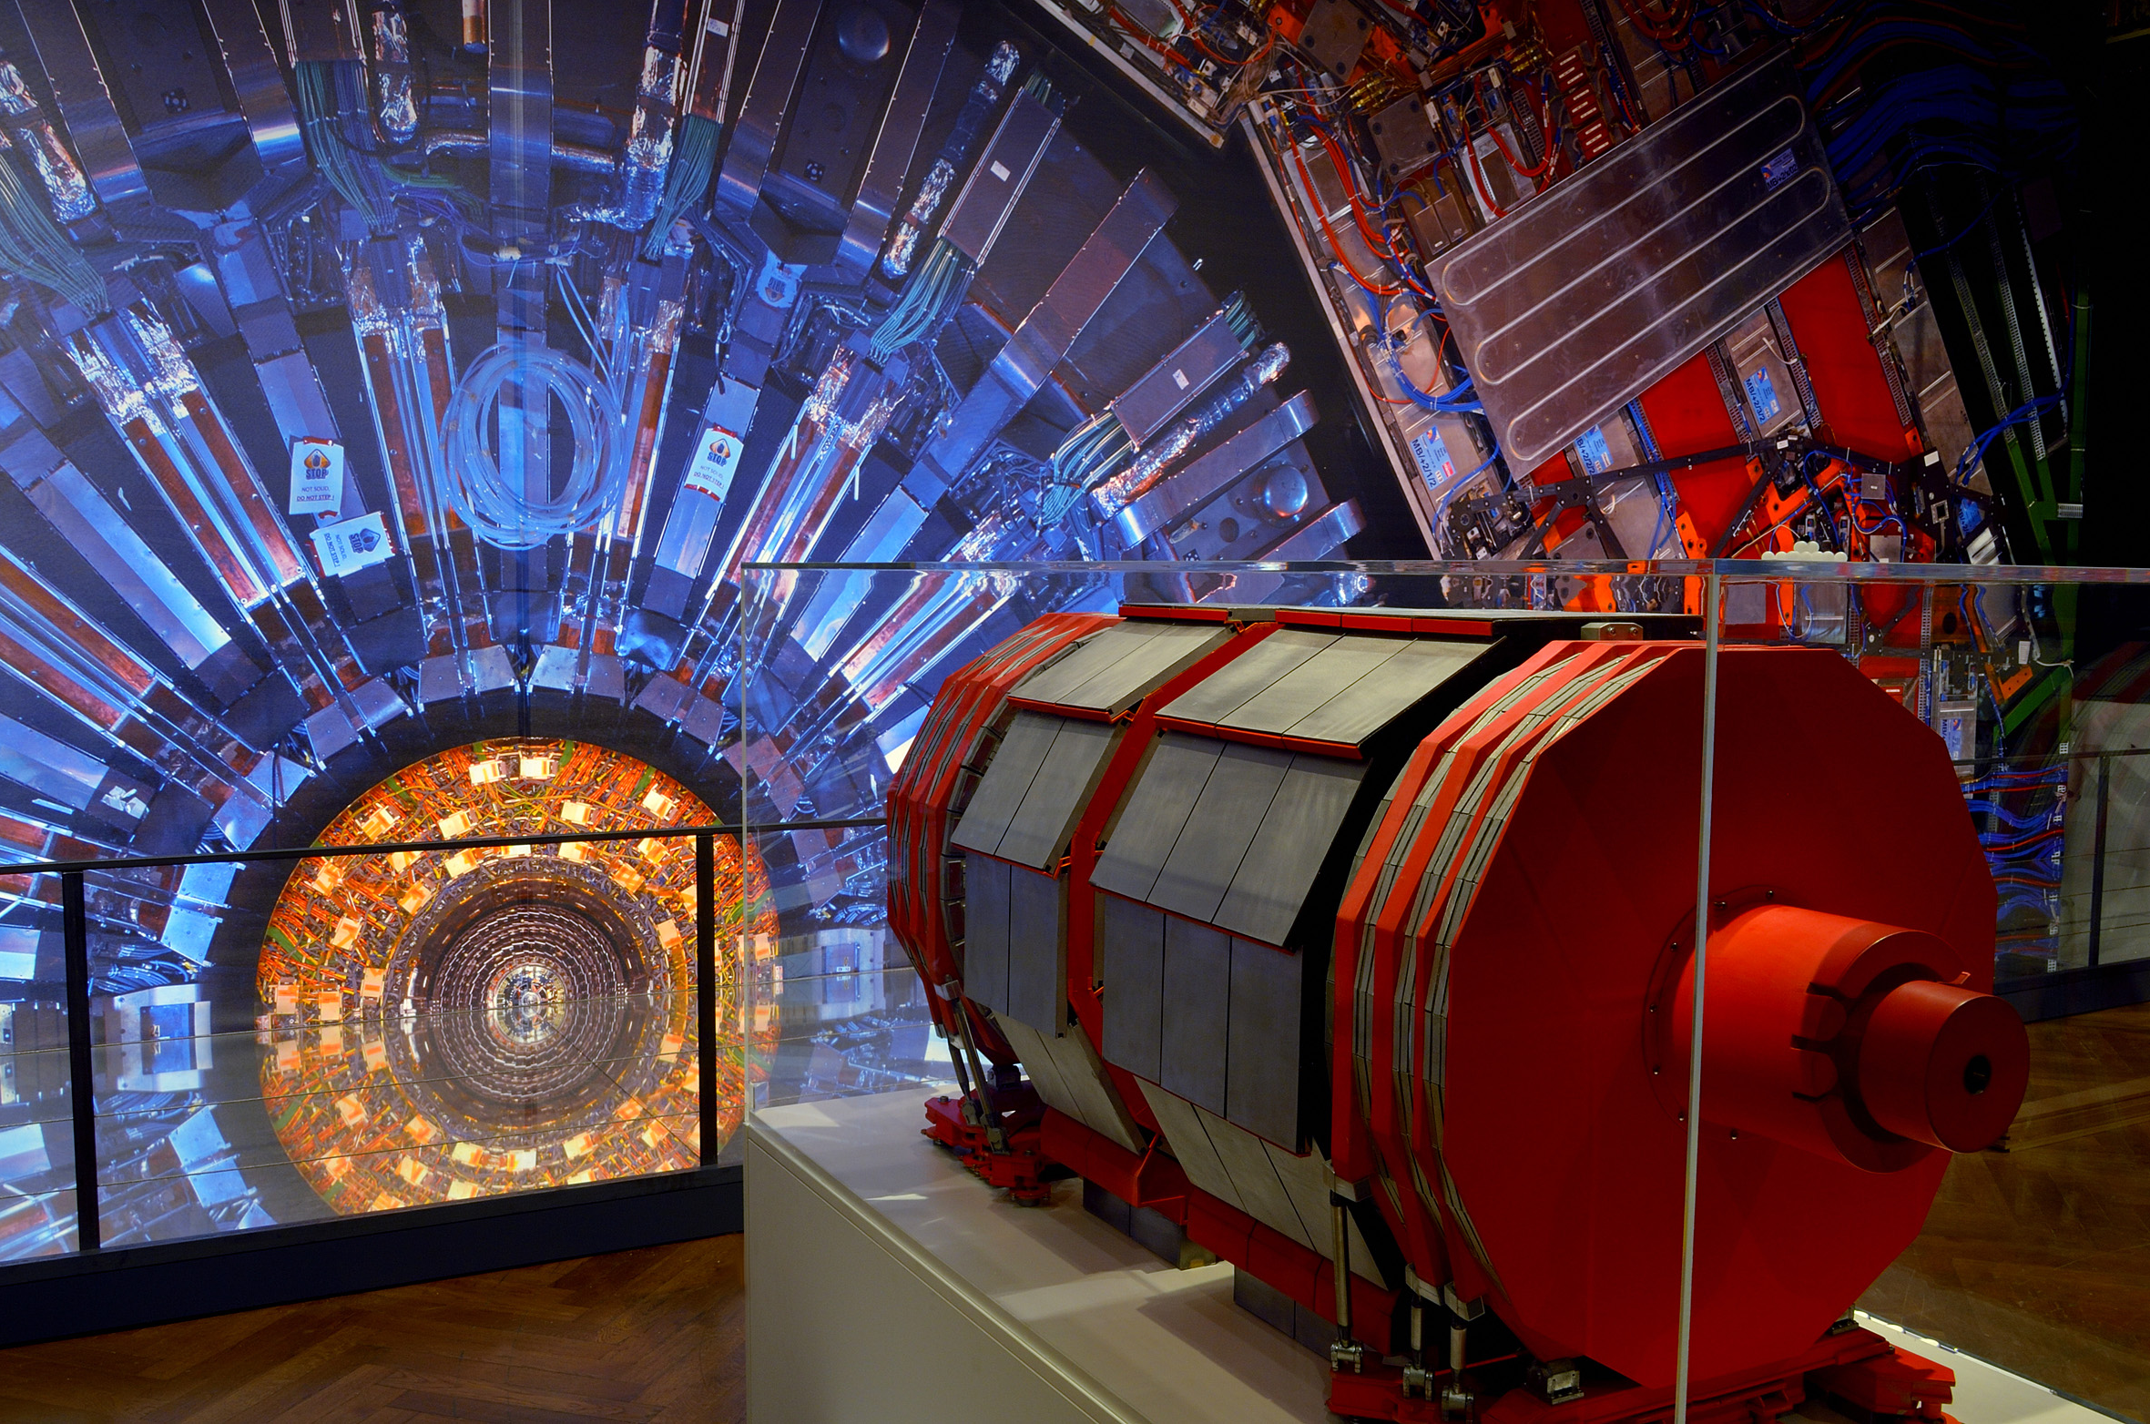
Story of „The beginning of everything“
The exhibition "The beginning of everything" taking visitors on a journey more than 13 billion years back into the past, to the start of the universe, and communicate the most recent scientific knowledge of particle physics and cosmology in a readily comprehensible manner.
„galaxies“
„quarks“
„collisions“

Slide 12
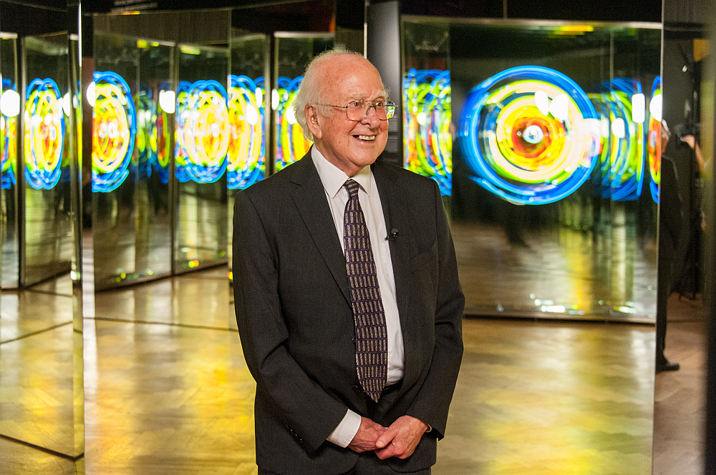
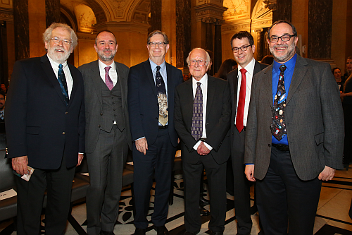
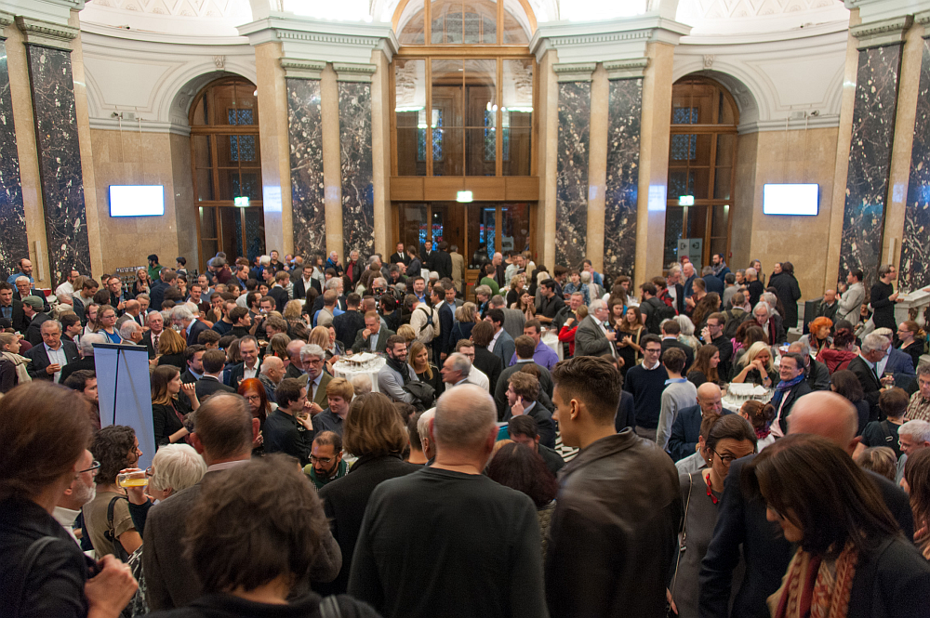
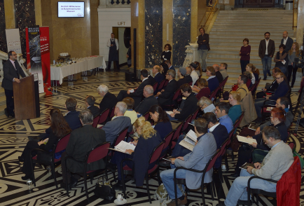
Peter Higgs in front of the art work of Brigitte Kowanz: „Dateline zero for space and time“
Grand opening: Anton Zeilinger,
Thomas Drozda, George Smoot,
Peter Higgs, Jochen Schieck , Christian Köberl
Grand opening
with ~ 700 guests
Press conference on 18th October 2016
at the NHM Vienna

Slide 13
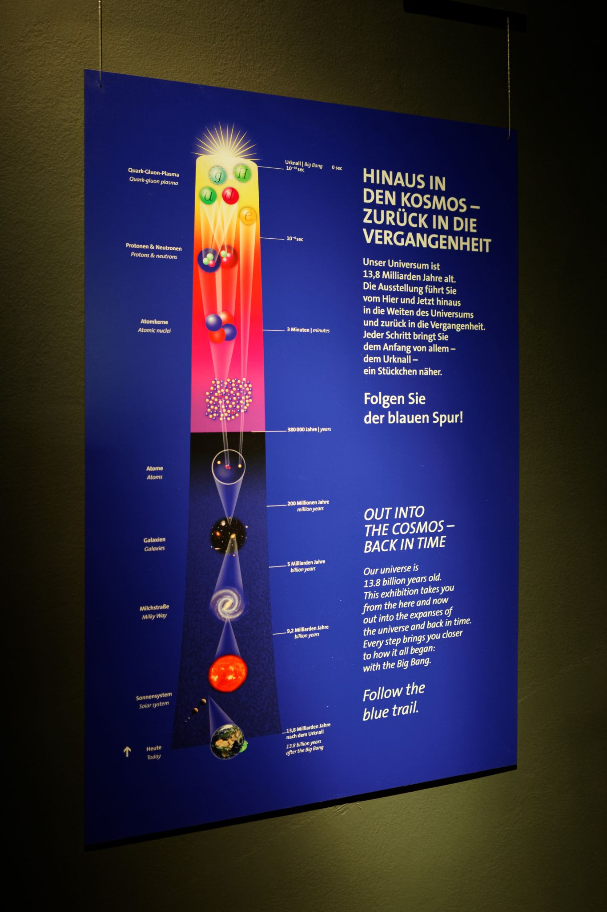
Accompanying program of the „beginning of everything“
The fulldome movie „Phantom of the Universe“
Girls Day 2017 (with Fabiola Gianotti and the federal minister Reinhold Mitterlehner)
Guided tours by experts
Matinees with artists and physicists
Readings by renowned writers
Concerts and visuales
Book presentation „CMS – the Art of Science“
Virtual CMS visit
International Masterclass
TEDXCERN
Workshop „Sciences&Art@School“
Opening sound installation „Expansion of the Universe“ (with Cardinal Schönborn)
Workshops for students and kids
Public lectures (Austrian and international physicists)

Slide 14
„Wie alles begann“ – in Hamburg
The exhibition „Wie alles begann“ will be shown in Hamburg at the „Museum für Arbeit“ from 25 October 2022 to April 2023.

Slide 15
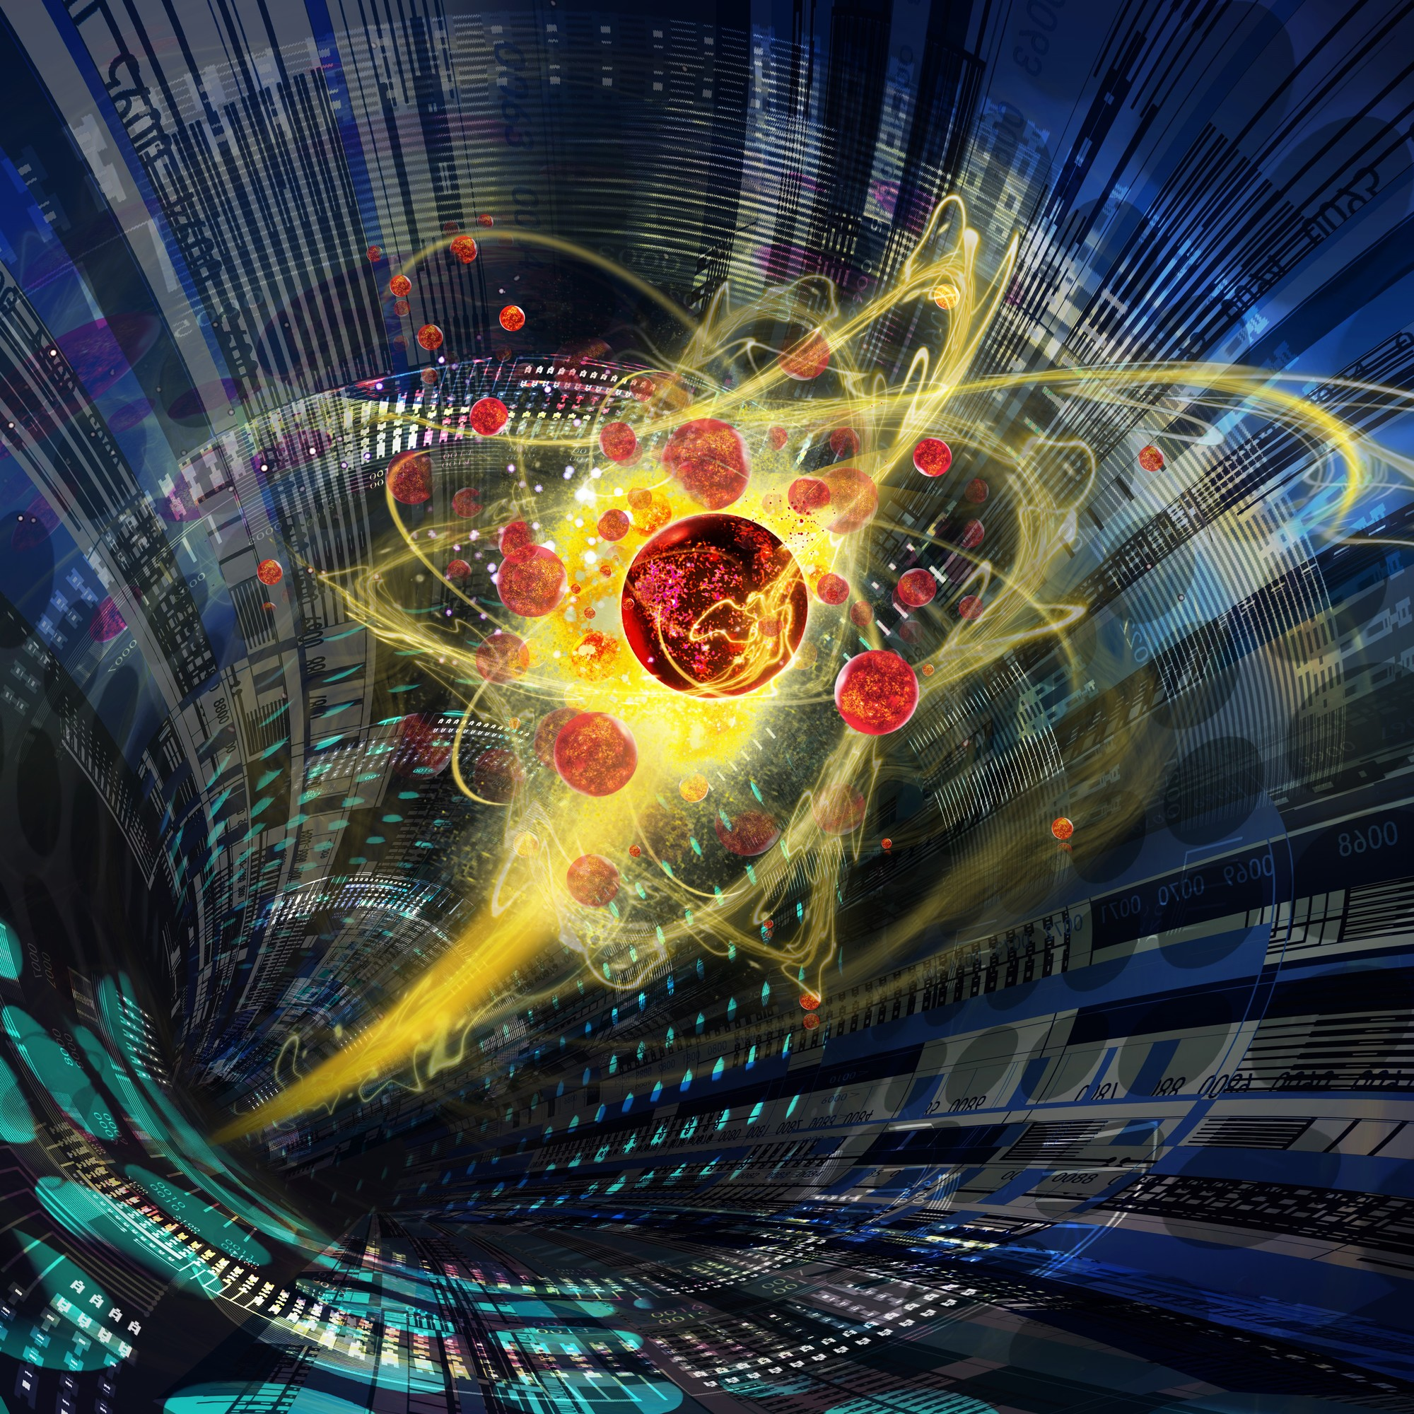
Our last big event
“Science Week: Meet the Universe”
5 – 12 September 2019
Aula der Wissenschaften
Exhibition „Spurensuche – Die Bausteine des Universums“
Exhibition „Origin“ (with Austrian and international Artists of the Art&CMS project)
Art exhibition of students of the Art&Science class of the University of Applied Art Vienna

Slide 16
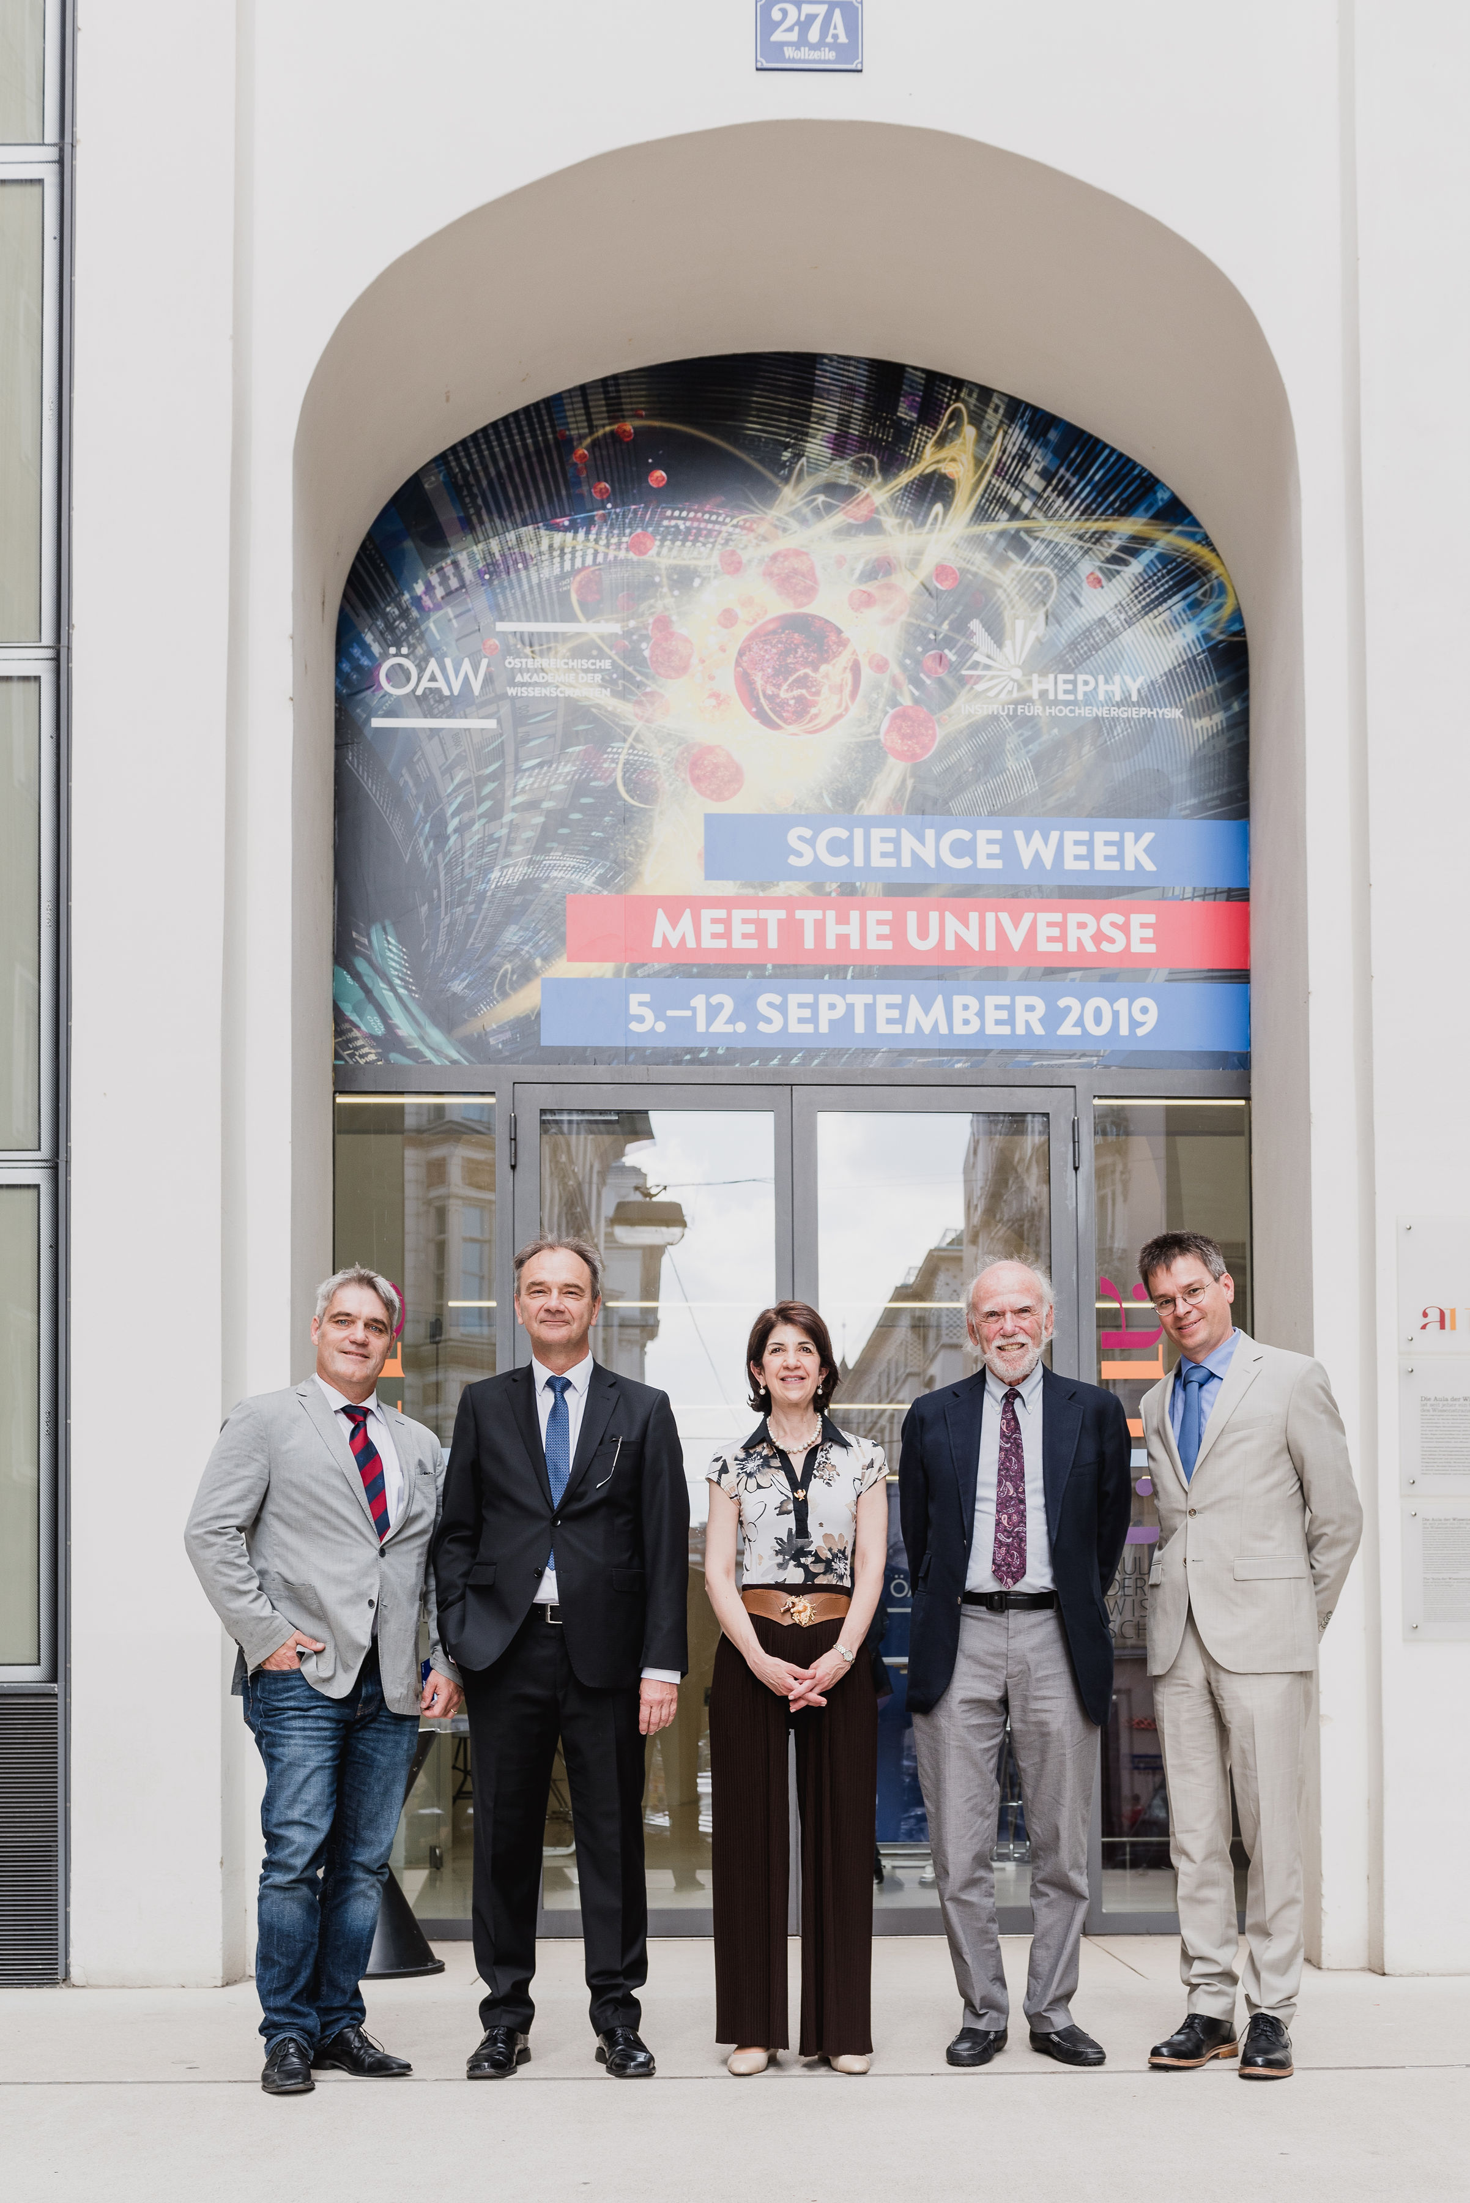
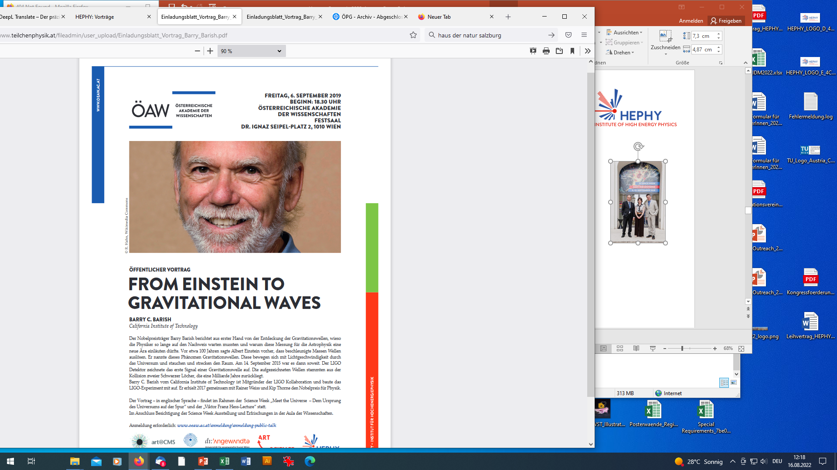
Program
Opening with Fabiola Gianotti
Workshops „Science&Art@School“
Workshop „Physik zum Anfassen“
Guided tours by experts for school classes and other groups
Science Cafes
Public lecture with Barry Barish at the Festsaal of the Austrian Academy of Sciences
Public lectures with Jon Butterworth and Christoph Schwanda
Symposium: Art&Science Collaborations around the Globe

Slide 17
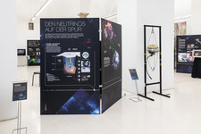
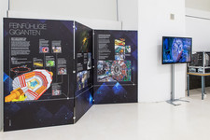
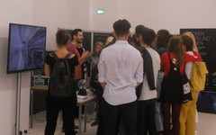
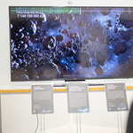
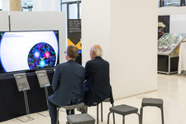
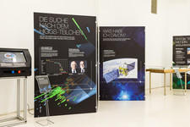
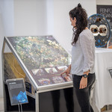
Impressions

Slide 18
Available Exhibits and Materials

Slide 19
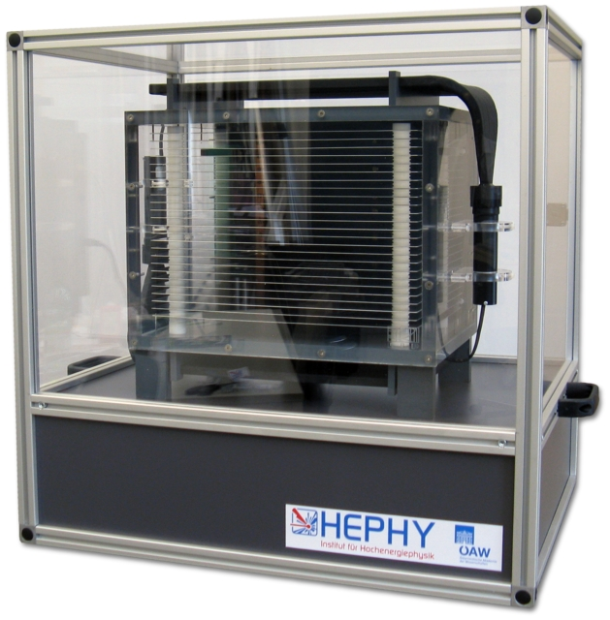
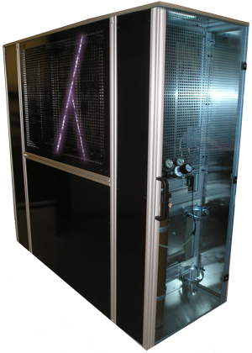
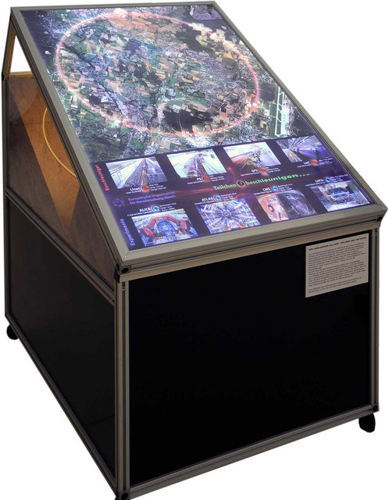
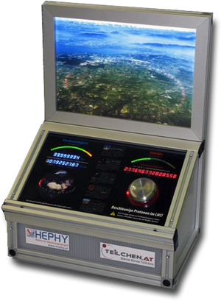
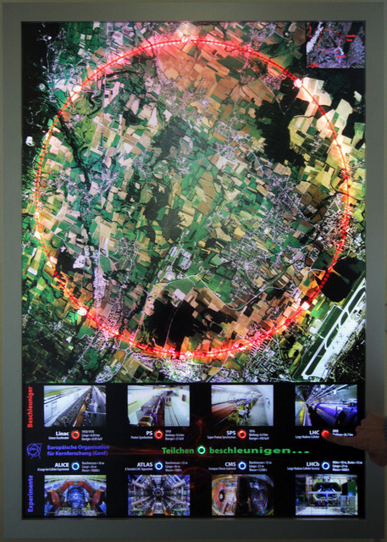
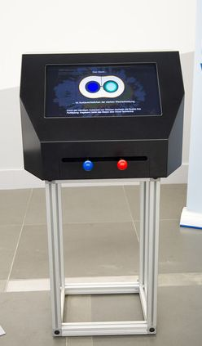
HEPHY Exhibits
Spark chambers (big and small)
Interactive, animated LHC model
Animated LHC wall
Hands-on LHC simulator
(adjustable beam energy, currectly scaled speed of animated particles)
Starke Paare

Slide 20
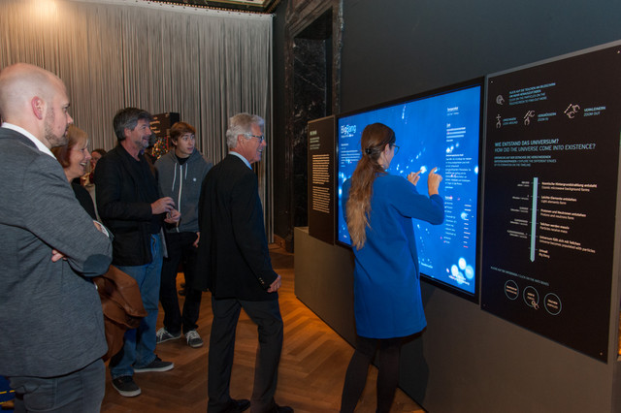


More recent exhibits
Interactiv journey back to the „Big Bang“
Discover the early stage of the Universe and navigate through the era of elementary particles.
„Cosmic macrowave background machine“
This exhibit demonstrates early stage of the Universe as 380 000 after the Big Bang the matter in the universe suddenly became neutral and the hence the universe transparent to photons.
Belle II in Virtual Reality
This virtual reality model of the Belle II experiment at the KEK laboratory in Japan shows the marvel of the subatomic world, where matter and antimatter collide at nearly the speed of light. You can watch and controll the simulation of each collision.
*licensed under Creative Commons Attribution-NonCommercial-ShareAlike 4.0 International

Slide 21






Boards: „Spurensuche“
High quality prints on large 2 x 1.25 m² aluminium dibond boards
More than 30 boards on different subtopics
In professional cases for safe transport
Find a (non-complete) collection of boards at:
https://www.teilchenphysik.at/veranstaltungen/ausstellungen/ausstellung-spurensuche/infotafeln/

Slide 22






PR, webpages, broschures, videos, …
Brochures (institute, Spurensuche, Wie alles begann)
Bookmarks, buttons, t-shirts, …
www.teilchenphysik.at
Special stamps: 60 years CERN, 50 year HEPHY
Science blogs
Videos e.g. From the big bang to now, Wie findet man Dunkle Materie, Was macht eigentlich …, manufacturing of detector components, what are quarks, …
Facebook, twitter, youtube, …

Slide 23
And more …

Slide 24
What else
Permanent exhibition „Strahlung in der Umwelt“ at the NHM Wien
Movie screening
Pop-up Science Center (eg. Wissens°raum)
HEPHY Open days
„Auf ins All“
Kindertag der Industrie

Slide 25




Pop-up Science Center
Auf ins All - 2012
(100th anniversary of the discovery of
the cosmic radiation), Kasematten, Graz
HEPHY Open Day – 04.07.2012 -
several journalists from major newspapers
and TV teams were present
Kindertag der Industrie

Slide 26



Travelling exhibition “Wirkungswechsel”
a collaboration with the Science Center Netzwerk
HEPHY Exhibit „Starke Paare“
Vienna, Wr. Neustadt, Graz, Dornbirn, Hartberg,...
Opening 2014
about 50 000 vistitors

Slide 27



“Circuit Training – A foray into the world of the Large Hadron Collider”
an exhibition of the University of Applied Art Vienna (Art&Science and Site-Spezific Art) in cooperation with art@CMS and the Institute of High Energy Physics (HEPHY) of the Austrian Academy of Sciences.
June 2017
Location: “das weisse haus”, Vienna

Slide 28



Movie screening
World premiere of the full dome movie “Phantom of the Universe” in German and English; 18 October 2016 at the Planetarium of the Natural History Museum Vienna in the presence of Michael Barnett (producer).
Austrian premiere of the movie „Particle Fever“; 24 November 2014 at the CineCenter Cinema; Premiere of the german version on 25 July 2015 in the presence of David Kaplan, producer and physicist and Fabiola Gianotti.

Slide 29

Akademie im Klassenzimmer
– a Young-Science-Initiative
– with lectures by researchers directly at the school, the academy arouses interest in scientific topics.
– lectures 2022: https://www.oeaw.ac.at/veranstaltungen/veranstaltungsreihen/akademie-im-klassenzimmer

Slide 30
The Future …

Slide 31
Outlook
Event series at a high school (GRG23) – to arouse the interest in particle physics and evaluate, if there is an impulse in the further education path of the pupils.
- Physik zum Anfassen and Cultural Collision Workshop (once a semester)
- public lectures (Akademie im Klassenzimmer)
- exhibition (roll-ups, videos, …)
Expansion of our „Spurensuche“ with information boards and exhibits on Dark Matter (Cosinus, …)
3-D Video Mapping (Museumsquartier, Campus Akademie, Karlskirche, …)
New animations, videos, and interactive as well as virtuell reality models
Anniversaries
  - 2024 → 70 years CERN
  - …..
2026 - Ausstellung zum Thema "Zeit" im Museum Niederösterreich in St. Pölten in Kooperation mit HEPHY

Slide 32
e.g. Show – Sound of particle physics
Combination of science, performance and music
- short particle physics presentations/demonstrations
- videos/animationen /3D graphics on a big screen
- live music
- target audience: children (with parents)
FURTHER IDEAS WELCOME!!!

Slide 33
Marko‘s Personal Remarks
Outreach is …
  … a responsibility of every scientist!
  … fun when developing new exhibits and concepts for events!
  … even more fun when discussing, explaining or dreaming about scientific discoveries with visitors!
  … rewarding as you are directly interacting with people and get immediate feedback!
You can help …
  … as an important part of your work for the institute!
  … as an essential part of being a good scientist!
  … in participating in recurring activities!
  … in updating or developing new exhibits and content!
  … in bringing in fresh ideas!
Brigitte is your main contact!

Slide 34


Thanks for your attention!

