Slide 1
CMS Tracker & HGCal
Phase II Construction
Project Report

Slide 2
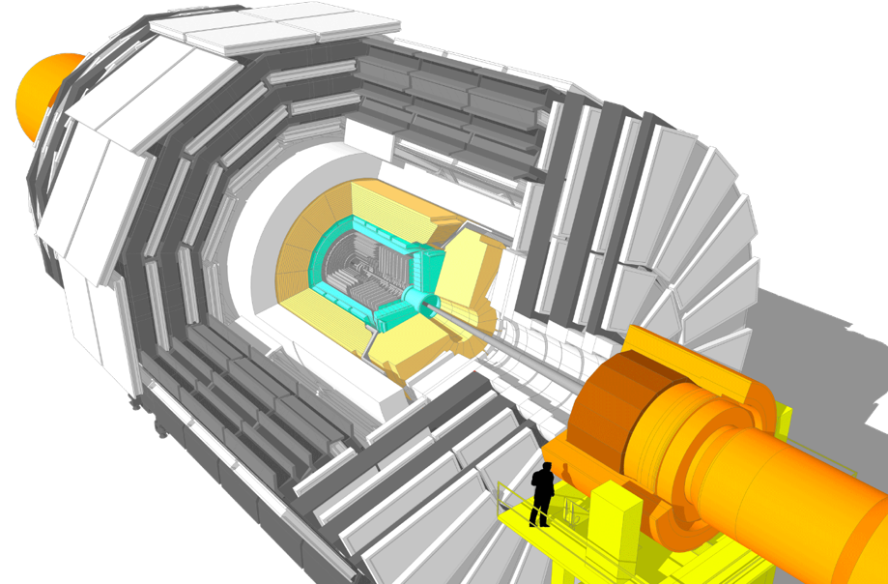
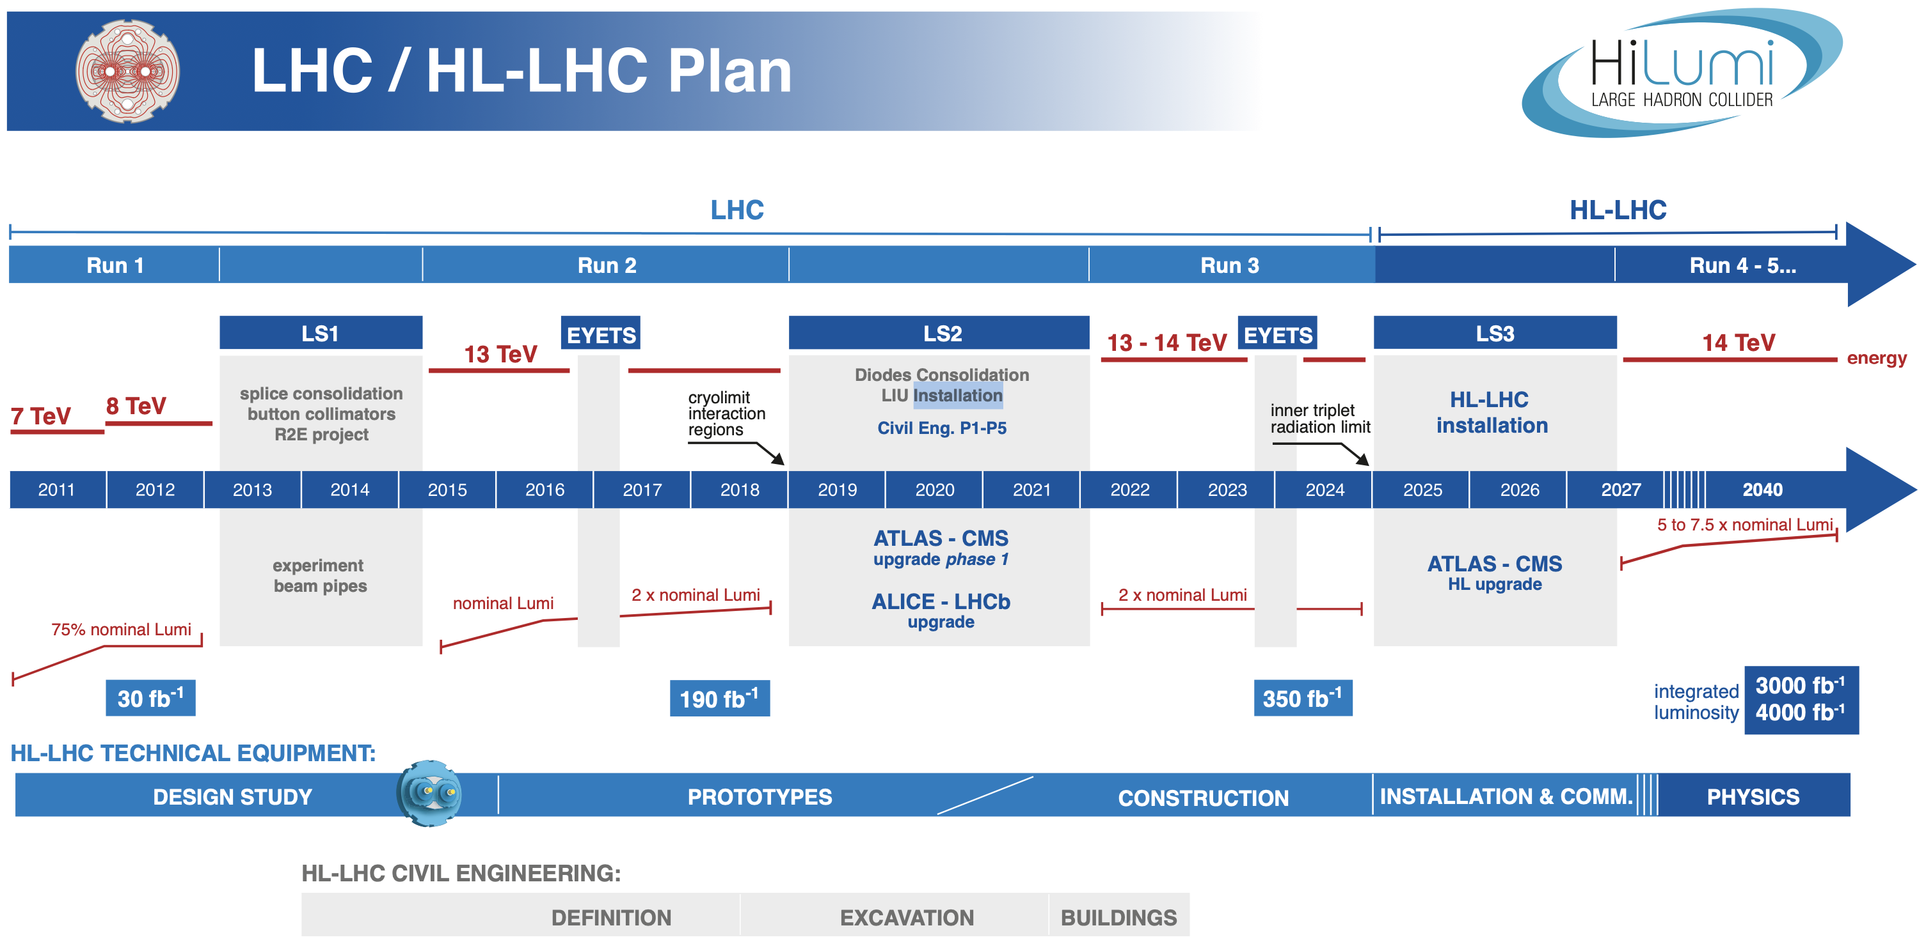
CMS Phase-II Upgrades
Long Shutdown 3 (LS3) scheduled for 2025-2027?!?
LHC accelerator upgrade to
High-Luminosity (HL)-LHC
Upgrade of detectors necessary
  Existing systems reach end of life (radiation damage)
  Increase in luminosity at HL-LHC: 300 → 3000 fb⁻¹
Latest schedule with no COVID related delays
  And experiments will not be ready by 2027 …

Slide 3
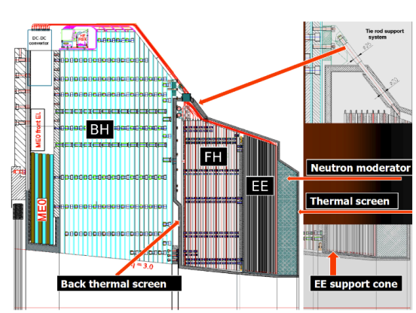
CMS Phase-II Upgrades
Long Shutdown 3 (LS3) scheduled for 2025-2027?!?
LHC accelerator upgrade to
High-Luminosity (HL)-LHC
Upgrade of detectors necessary
  Existing systems reach end of life (radiation damage)
  Increase in luminosity at HL-LHC: 300 → 3000 fb⁻¹
Latest schedule with no COVID related delays
  And experiments will not be ready by 2027 …
Phase-II Upgrade of CMS (with HEPHY involvement):
CMS Tracker
→ 200 m² Si Sensors needed
High Granularity Calorimeter
→ 600 m² Si Sensors (8 inch)
With our expertise in silicon sensors HEPHY plays a key role in both projects
Simulations and design of sensors and test structures
Electrical characterization of sensors and test structures
Preparation, negotiations and QA of series production
→ Co-Convenors of both sensor development working groups
Layout of Phase II Tracker
Layout of Endcap Calorimeter

Slide 4
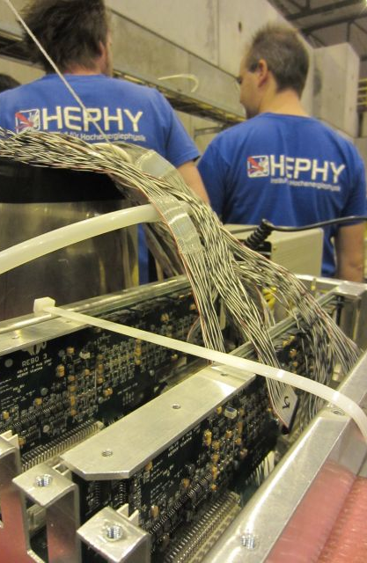
Staff
Active contributors today
Staff Scientists
  Marko Dragicevic
    Convener: Outer Tracker Sensors WG
    Tracker Resource Manager
  Thomas Bergauer
    Convener: HGCal Sensors WG
    Also: Group Leader Detector Development
    (non-CMS)
PhDs
  Dominic Blöch: Tracker SQC
  (ÖAW funded until Oct 2020)
  Viktoria Hinger: Tracker & HGCal PQC
  (FFG funded until Oct 2020)
  Peter Paulitsch: HGCal
  (FFG funded until mid 2021)
  Konstantinos Damanakis: Sensor QA
  (ÖAW funded since Oct. 2020)
PostDocs
  Florian Pitters: HGCal & Detector Development
  Left for paternity leave and to industry
  Moritz Wiehe: HGCal
  Since mid August 2021
Sensor QA team
  Margit Oberegger
  Andreas Bauer
  Stefan Schultschik
  Doris Wohlmuth
  July – October 2021
Additional support
  Wolfgang Brandner
  Florian Buchsteiner

Slide 5

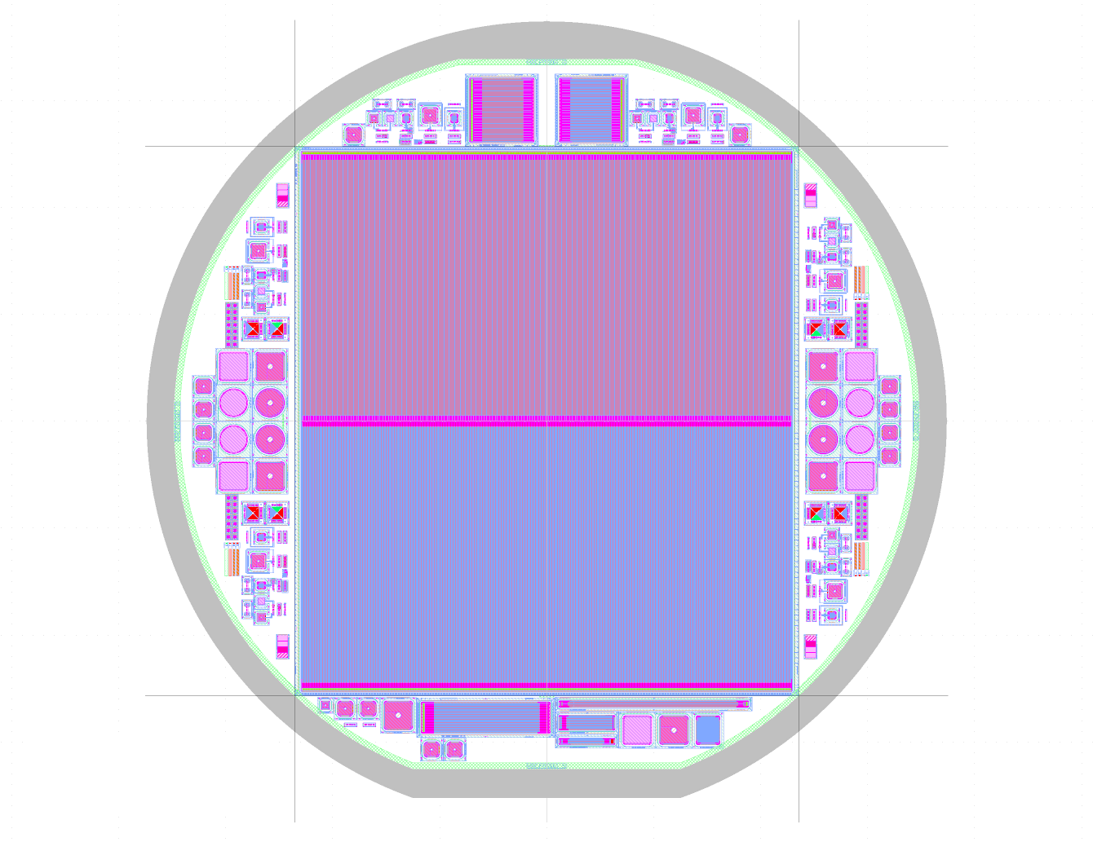
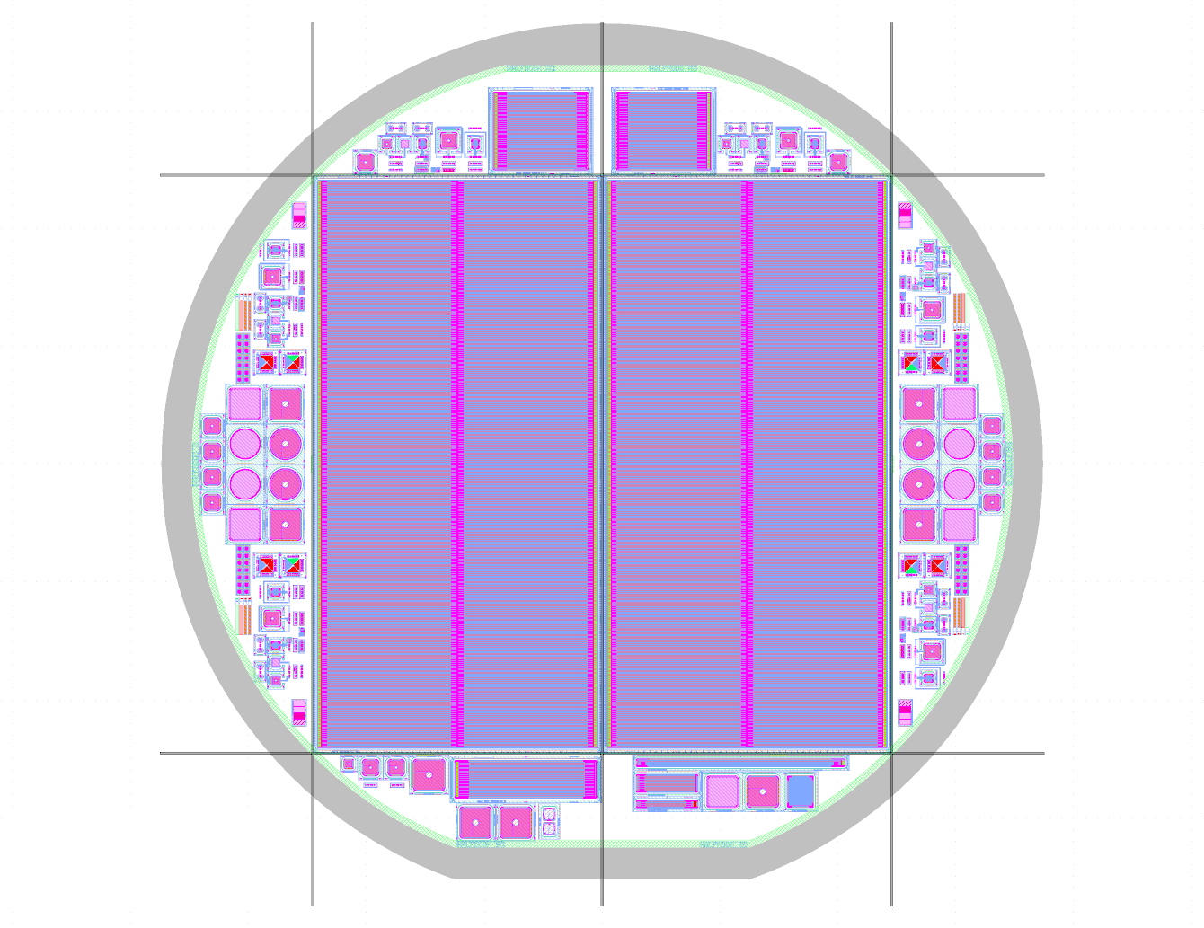
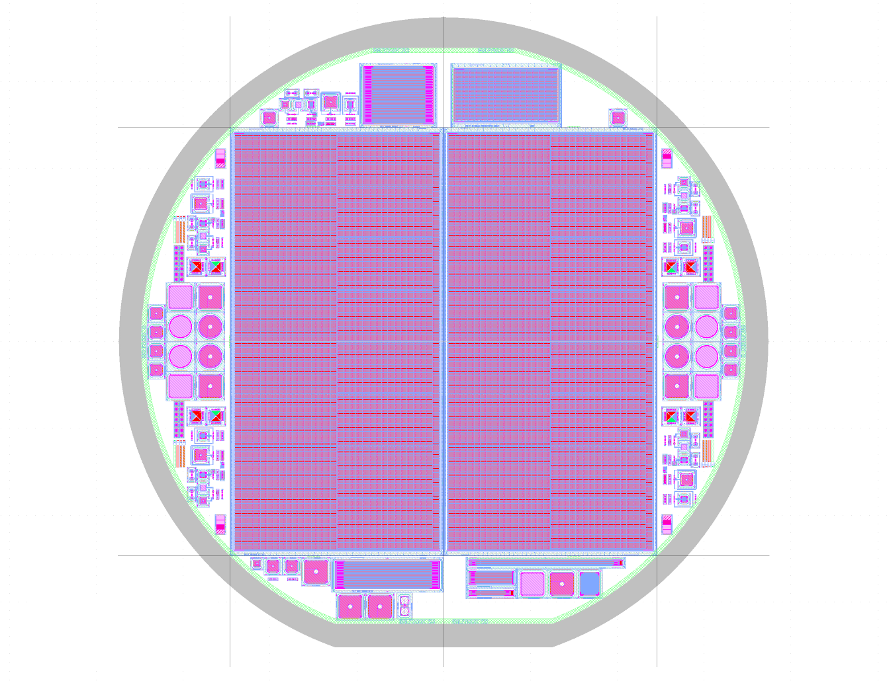
HEPHY in CMS Phase II
Note: In 2015, after long internal discussions and with the SAB, we decided to contribute to sensors only!
HEPHY responsibilities in CMS Outer Tracker
  2010 – 2019: Participation in all development studies of the sensors
  (Materials, thickness, radiation hardness, simulations, production process, design choices, etc.)
  2008 – 2018: Establishing alternative European sensor producer (Infineon)
    Stopped by Infineon in 2018 due to commercial reasons
  2019: Final design and wafer layout for all three sensor types
  (PS-p pixel design from KIT)
  2014 – 2019: Conduction of the procurement process (~18 MCHF)
  2019 – 2024: Definition and supervision of the Quality Assurance Campaign to produce ~ 29.000 sensors
    Process Quality Control (PQC) as major contribution from HEPHY
    (Viktoria Hingers PhD Thesis)
HEPHY responsibilities in CMS HGCal
  2015 – 2018: Establishing alternative European sensor producer (Infineon)
    Initially our main interest to join HGCal
    Infineon’s 8” sensor technology was highly attractive for HGCal
    Pushed HPK into developing 8” process for HGCal in parallel
  2018 – 2022: Development of radiation hard HGCal sensors with HPK
  (Materials, thickness, radiation hardness, simulations, production process, design choices, etc.)
  2022 – 2024: Participate in Quality Assurance campaign
    Process Quality Control (PQC) as major contribution from HEPHY
    (Viktoria Hingers PhD Thesis)
Managerial responsibilities
  Thomas Bergauer
    since 2016: Co-Convener of the HGCal Sensor WG
  Marko Dragicevic
    Since 2014: Co-Convener of the Tracker Sensor WG
    Since 2017: Tracker Resource Manager
2S
PS-s
PS-p

Slide 6
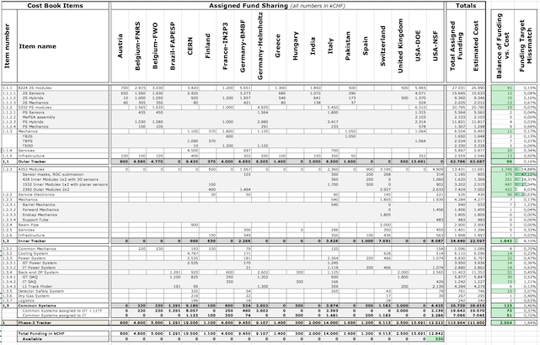
CMS Phase II Upgrade
Status

Slide 7






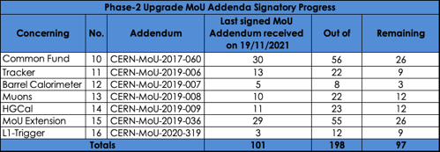
TDRs¹ for all major Phase 2 upgrades completed and reviewed by LHCC
  Tracker since 2017
  HGCal since 2018
MoUs² defined and signatures still in progress
  MTD, BRIL and DAQ/HLT outstanding
Tracker has recently passed the EDR³ for the Outer Tracker
¹ Technical Design Report – Comprehensive description and motivation of the detector design with some details not yet fixed
² Memorandum of Understanding - defining technical and financial responsibilities of each Funding Agency in the construction of a subdetector
3 Engineering Design Review - CMS internal review to authorise the construction of significant parts of the detector

Slide 8

Outer Tracker

Slide 9
Reminder HL-LHC tracking
Challenges for HL-LHC tracking
  Harsh radiation environment up to
    IT max.: 3.5 x 10¹⁶ n_{eq}/cm⁻², 1.9 Grad
    OT max.: 1.1 x 10¹⁵ n_{eq}/cm⁻², 77 Mrad
  High pileup
    Increase granularity for sufficient two track separation
  L1 Trigger needs tracking information
    Tracker needs to provide data to L1 Trigger at every BX
    Transmitting full information at every BX not possible, data reduction is required
Goal: Keep performance of existing system in HL-LHC environment for 3000 fb⁻¹ (ultimate 4000 fb⁻¹)

Slide 10
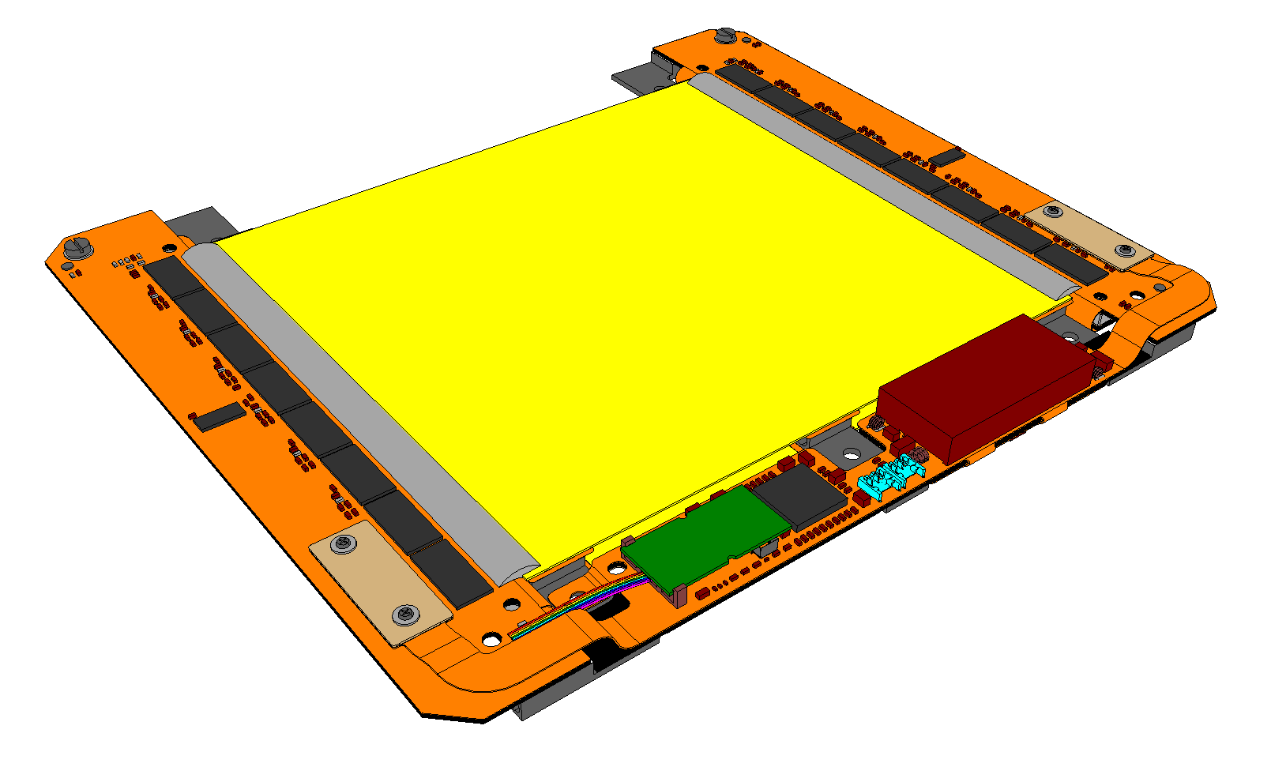
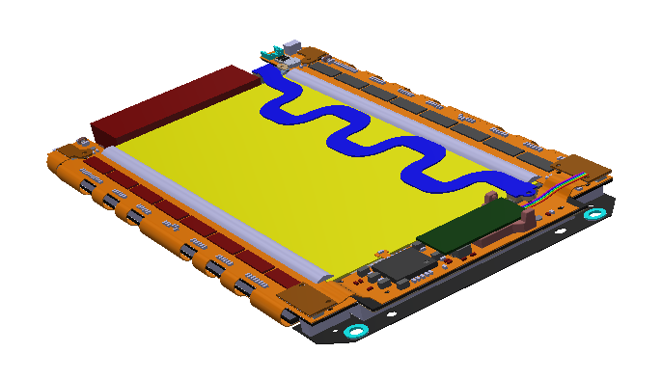
CMS Tracker Solution
Fully integrated modules
  Just add services
  (HV, LV, CO₂ cooling, readout and control links, mechanical mounting)
  Filtering on high p_{t} tracks on module
Just two types of modules used everywhere
  Barrel and endcaps!
  2 and 3 different flavours (sensor spacing)

Slide 11
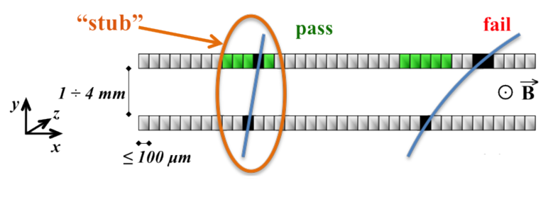
Detector modules with data filtering
Data filtering
On-module data reduction by only sending hits from particles with a transverse momentum p_{t} of > a few GeV/c
At given magnetic field the track curvature depends on the particle’s p_{t}
Different curvature results in different incident angles at a given radius
Estimate incident angle from hit displacement over a short distance
→ two parallel sensor planes

Slide 12
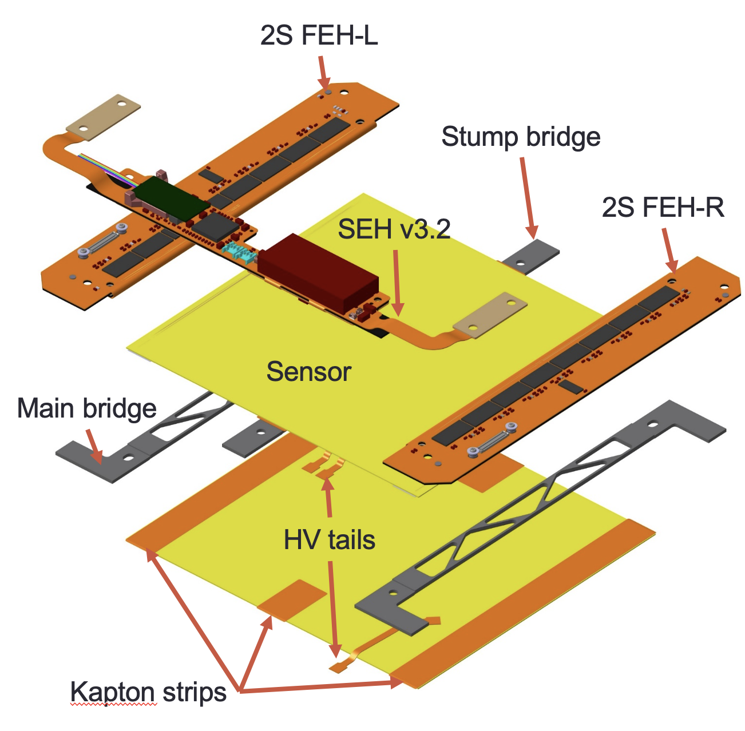
The p_{t} Module Concepts
The 2S Module
2 x Strip sensors: 2S sensor
  Size: 10 x 10 cm²
  Pitch: 90 µm
  Length: 5 cm
  No. of strips per sensor: 2x1016
2 x 8 CMS Binary Chips: CBC
  2x127 channels per chip
  Bump bonded to flexible hybrid
  Connects to top and bottom sensors
  Interchip communication via hybrid
Concentrator ASIC: CIC
  collects data from 8 CBCs (half module)
Low Power GigaBit Transceiver lpGBT + VTRx+
  Bandwidth: 5 Gb/s
2-stage DCDC powering
  12 V to
    2.5 V (opto)
    1.25 V (ASICS)

Slide 13
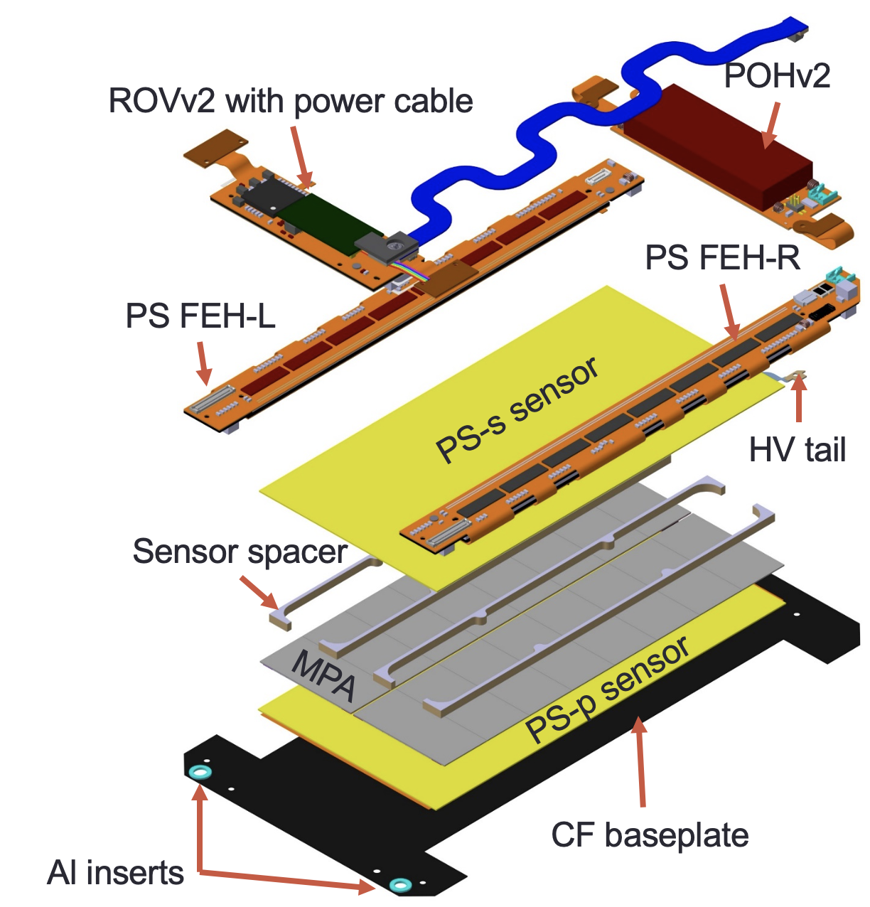
The p_{t} Module Concepts
The PS Module
MacroPixel sensor: PS-p sensor
  Size: 5 x 10 cm²
  Pitch: 100 µm
  Length: 1.5 mm
  No. of pixels: 32x960
Strip sensors: PS-s sensor
  Size: 5 x 10 cm²
  Pitch: 100 µm
  Length: 2.5 cm
  No. of strips: 2x960
2 x 8 Short Strip ASIC: SSA
  120 channels per chip
  Sends hits to MPA
  Bump bonded to flexible hybrid
16 MacroPixel ASIC: MPA
  120 x 16 pixels per chip
  Bump bonded to MacroPixel sensor
  Includes correlation logic
Concentrator ASIC: CIC
  collects data from 8 MPAs
Low Power GigaBit Transceiver
lpGBT + VTRx+
  Bandwidth: 5 or 10 Gb/s
2 stage DCDC powering
  12 V to
    2.5 V (opto)
    1.25 V (ASICS)
    1.05 V (MPA digital)

Slide 14
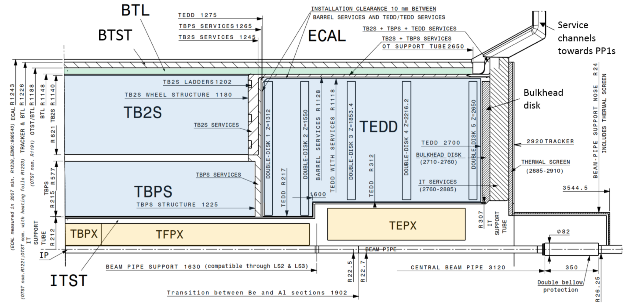
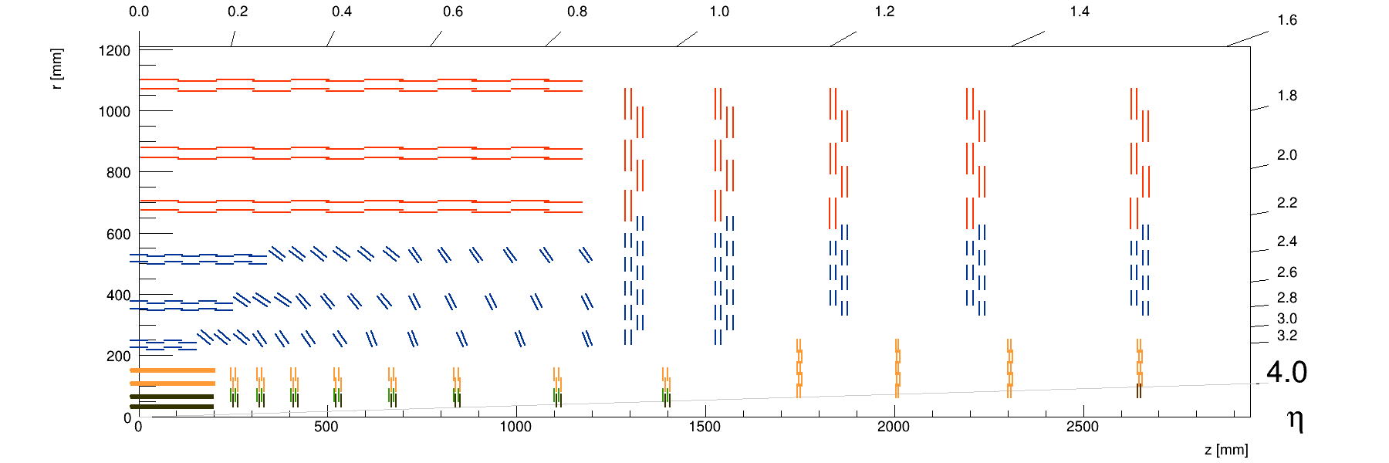
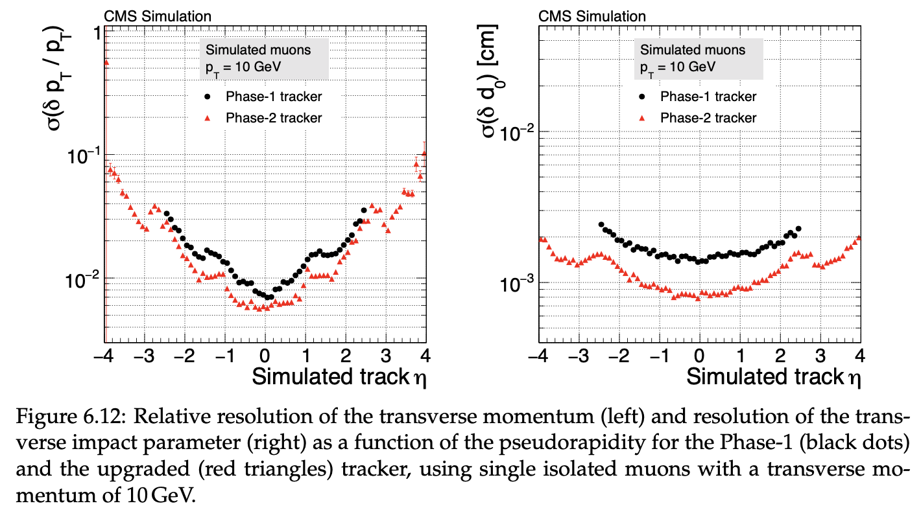
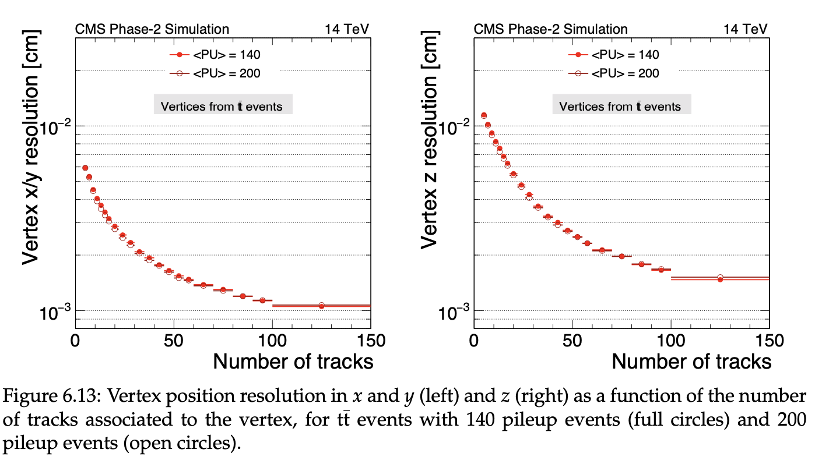
Tracker Layout
TB2S
TEDD
Flat TBPS
Tilted TBPS
TEPX
TBPX
TFPX

Slide 15
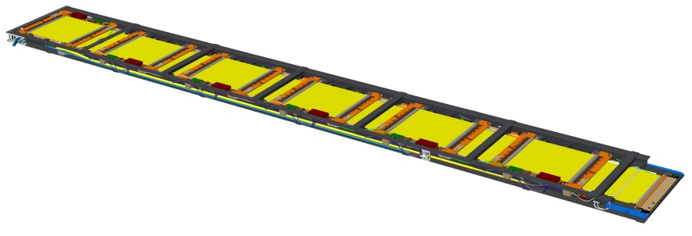
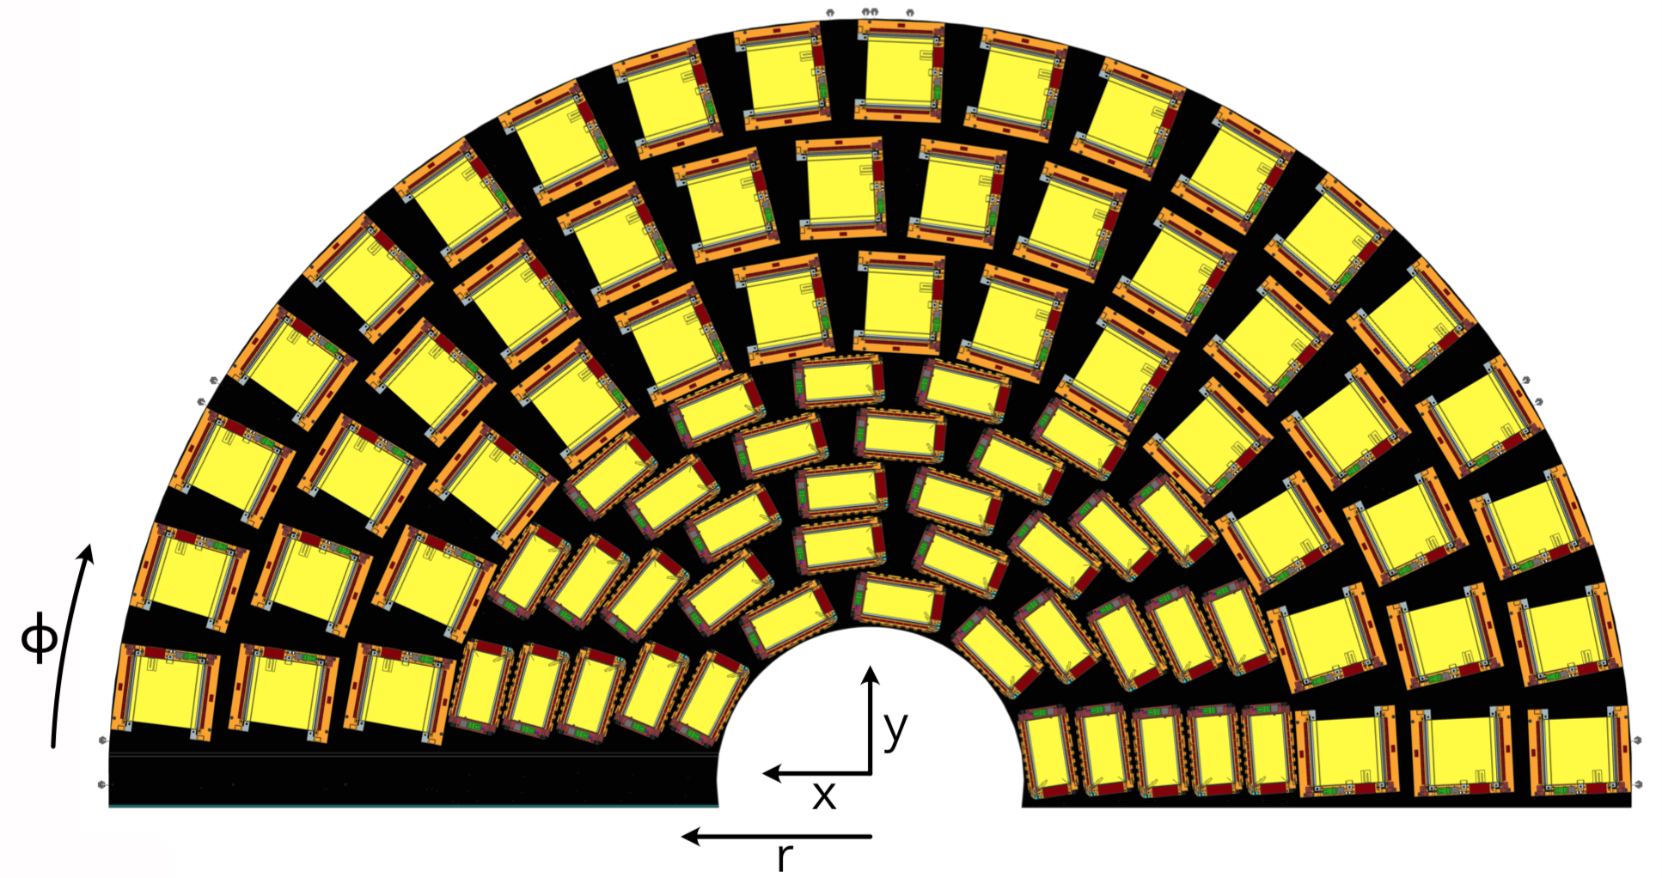
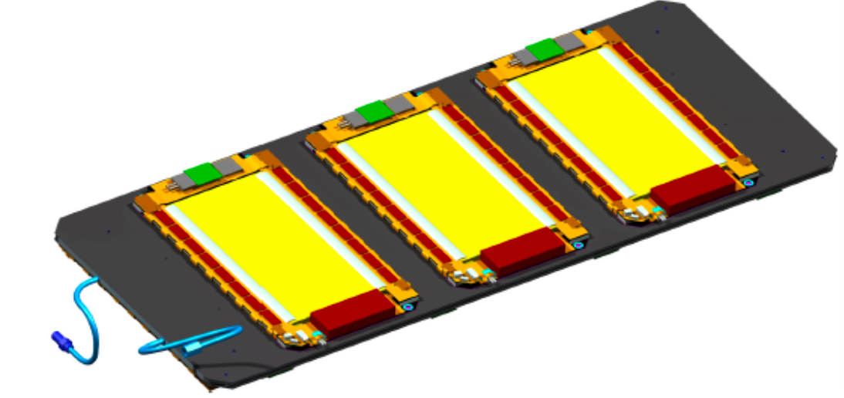
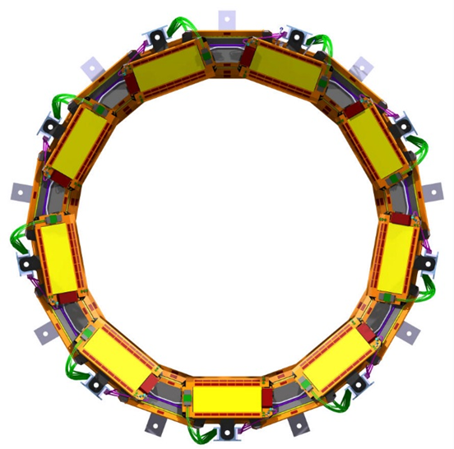
Mechanics
TB2S ladder
TEDD dee
TBPS plank
TBPS ring

Slide 16
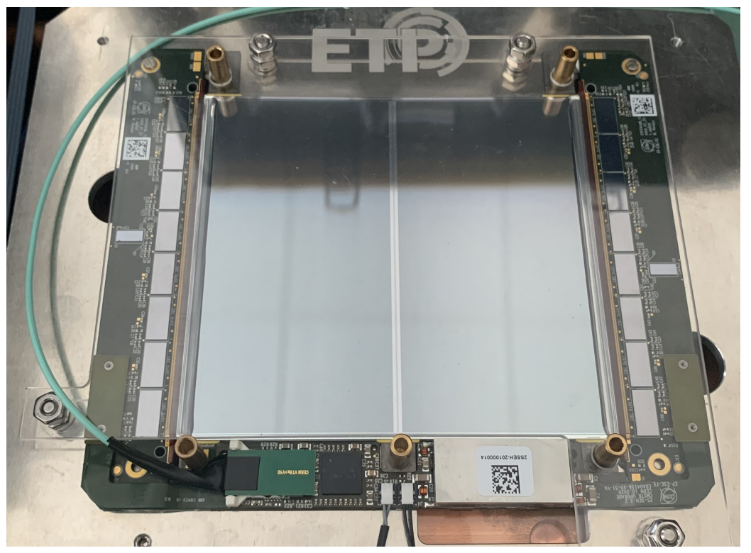
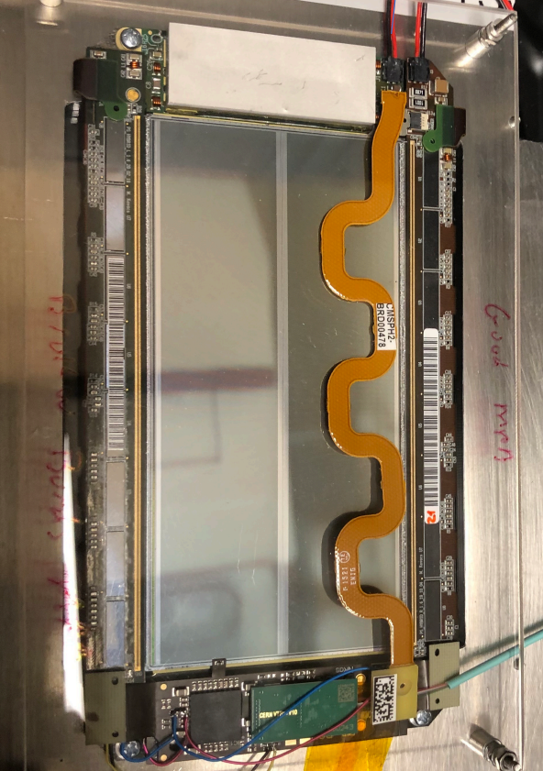
Modules
2S Module
2S-FEH-Right
2S-FEH-Right
2S-FEH-Left
2S-FEH-Left
2S-SEH
2S-SEH
PS Module
PS-POH
PS-POH
PS-FEH-Right
PS-FEH-Left
PS-FEH-Right
PS-FEH-Left
PS-ROH
PS-ROH

Slide 17
Construction Status
Outer Tracker in transition to construction
  Engineering Design Review (EDR) held on 14 – 15 October
  https://indico.cern.ch/event/1064838
    Authorised global production start for Outer Tracker
      Specifically Hybrids, MaPSA and mechanics
  Procurement Readiness Reviews (PRRs) already done for
      Sensors (2019/20)
      Raw composite materials CFRP, CF-foam, AlCF (2020)
      CBC production (2020)
      MPA, SSA and CIC design and engineering run (2021)
  Some components already in production since 2020
    Sensors and CBC
Production of modules will start next year

Slide 18
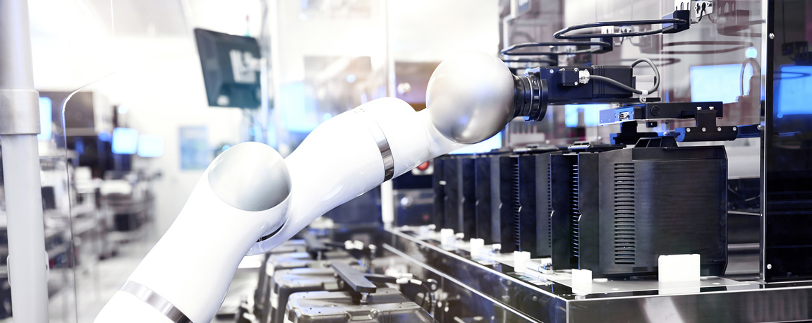
Sensor Production
(at HEPHY)

Slide 19
Production Status
Sensor production (deliveries) started summer 2020
  Campaign started within COVID-19 pandemic
  Lockdowns had significant effects on all centres
  But all institutes pulled through
  Several problems identified during pre-production and now corrected
Projected end date for production is mid 2024
  Almost 24.000 x 6” wafers
  16900 x 2S + 3100 x PS-s + 3750 x PS-p
Today:
  > 5000 wafers (> 20%) delivered
  > 1200 sensors IV tested
  > 500 sensors fully tested
  > 3000 halfmoons tested

Slide 20
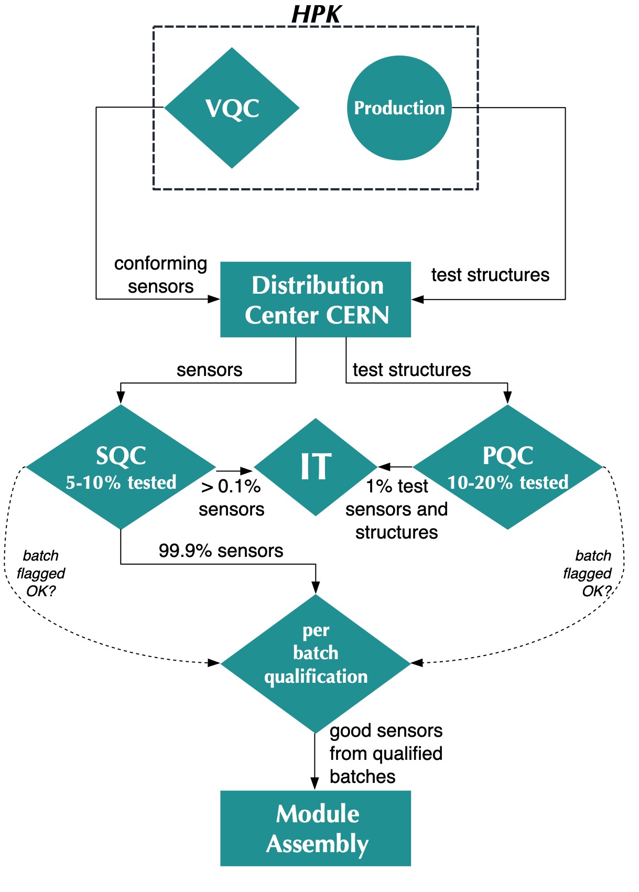
Quality Control
Quality Assurance
Four tier quality control system
  VQC - Vendor Quality Control
  SQC - Sensor Quality Control
  PQC - Process Quality Control
  IT - Irradiation Tests
All sensors characterised by producer
  Results recorded in DB for each sensor
  Only conforming sensors are sent to CERN
Acceptance using sample measurements at SQC, PQC and IT
Production and QA monitored by expert panel
Effort lead by HEPHY and KIT
Participants
  Europe: Demokritos, Perugia,
  US: Brown, Rochester
  Asia: Delhi, NCP Pakistan

Slide 21
Quality Assurance
HEPHY’s responsibilities
Managerial tasks
  Overall planning
  Co-convener of weekly acceptance meetings (OTSEPP)
  Contact to Tracker and CMS
  Contact to Vendor (HPK)
Sensor Quality Control (SQC)
  Responsible for testing 25% of the production
Process Quality Control (PQC)
  Test structures, characterisation methods and setups developed at HEPHY
  Responsible for testing 25% of the production

Slide 22
Sensor Quality Control SQC at HEPHY

Slide 23
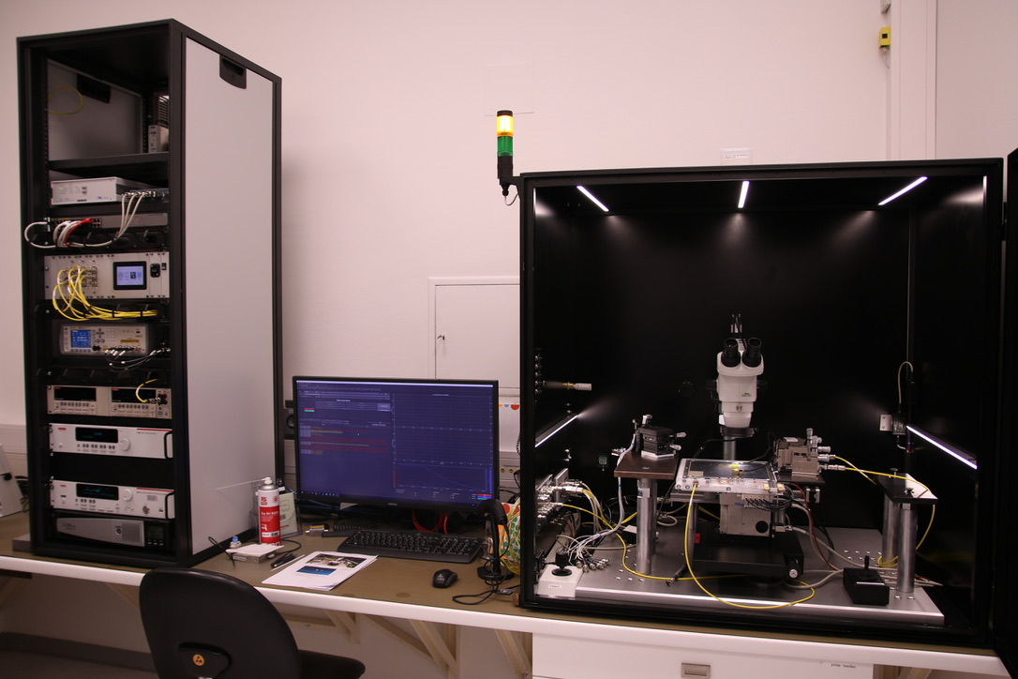
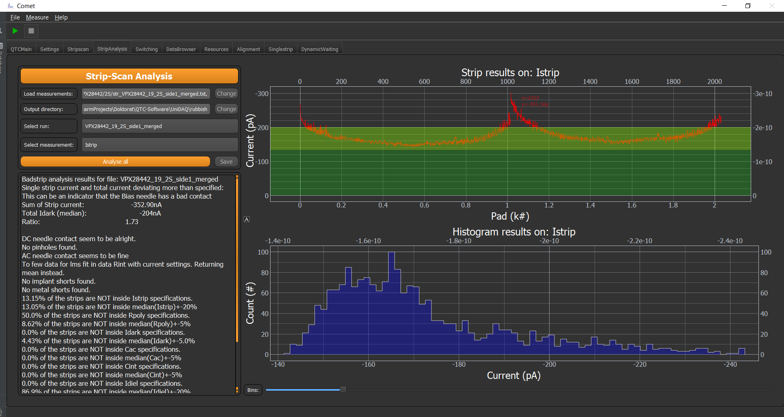
SQC: Tracker
SQC – Sensor Quality Control:
fully characterise strip sensors
Existing semiautomatic probe station completely refurbished
  Fully custom made at HEPHY
  Complex mechanical and electrical setup with precise environmental control and monitoring
  Can automatically characterise ~2000 strips in 4-8 hours
Custom software to control setup implemented in Python
  Written by PhD Student (D. Blöch)
  Important first step to phase out proprietary LabVIEW control
  Plan to be replaced by more reliable Python tool implemented and maintained by Bernhard Arnold
    Based on existing software tools by Bernhard for other setups like PQC
Setup in operation every day to test one or two sensors
  Mainly operated and maintained by Kostas and Stephan
  Fully characterize at least 3 sensors per batch of ~40, one batch per week
In addition, longterm tests are performed in our climate chamber
  Including more detailed studies on humidity and temperature behaviour
After initial difficulties, HEPHY SQC is now among the fastest and most reliable!

Slide 24
Process Quality Control PQC at HEPHY

Slide 25
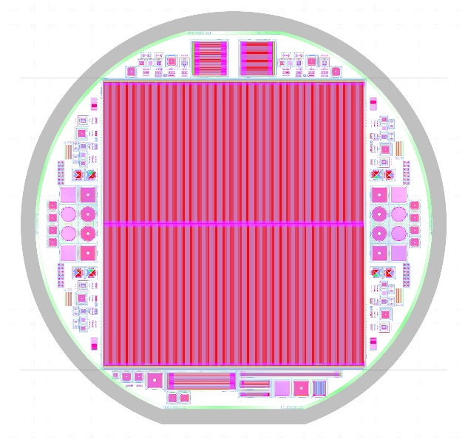
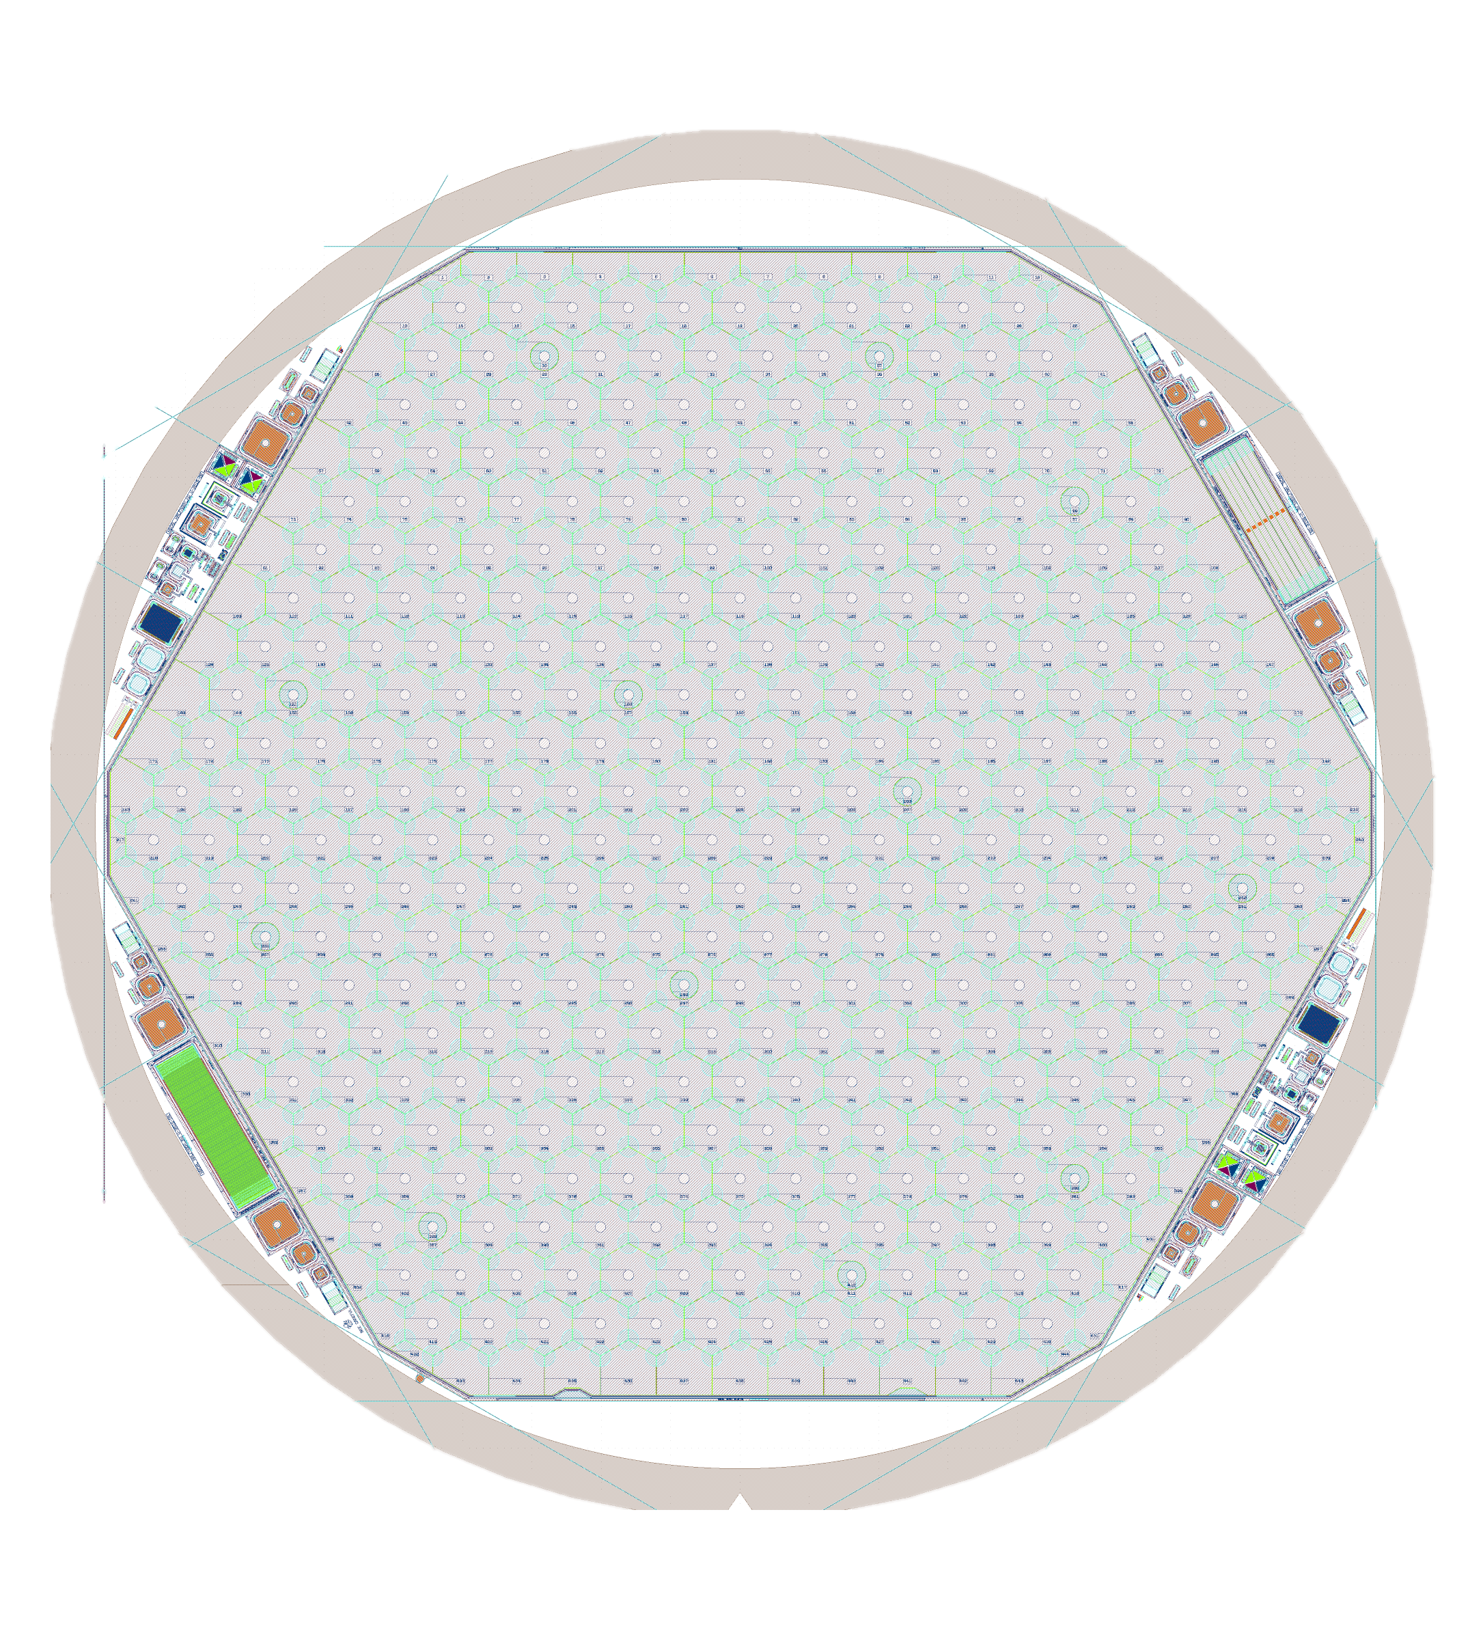
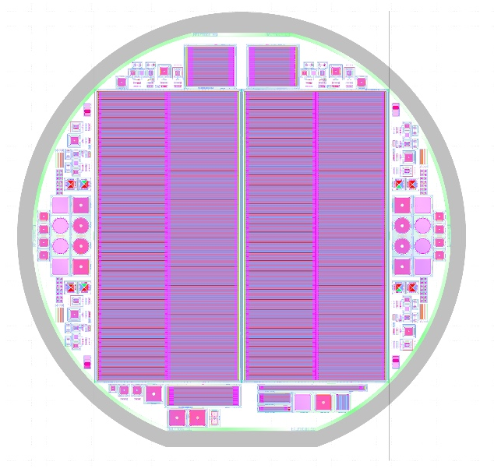
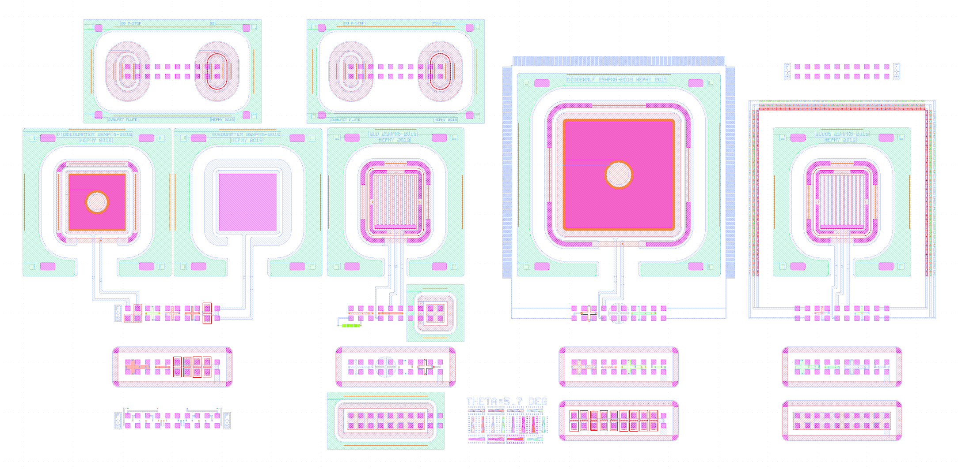
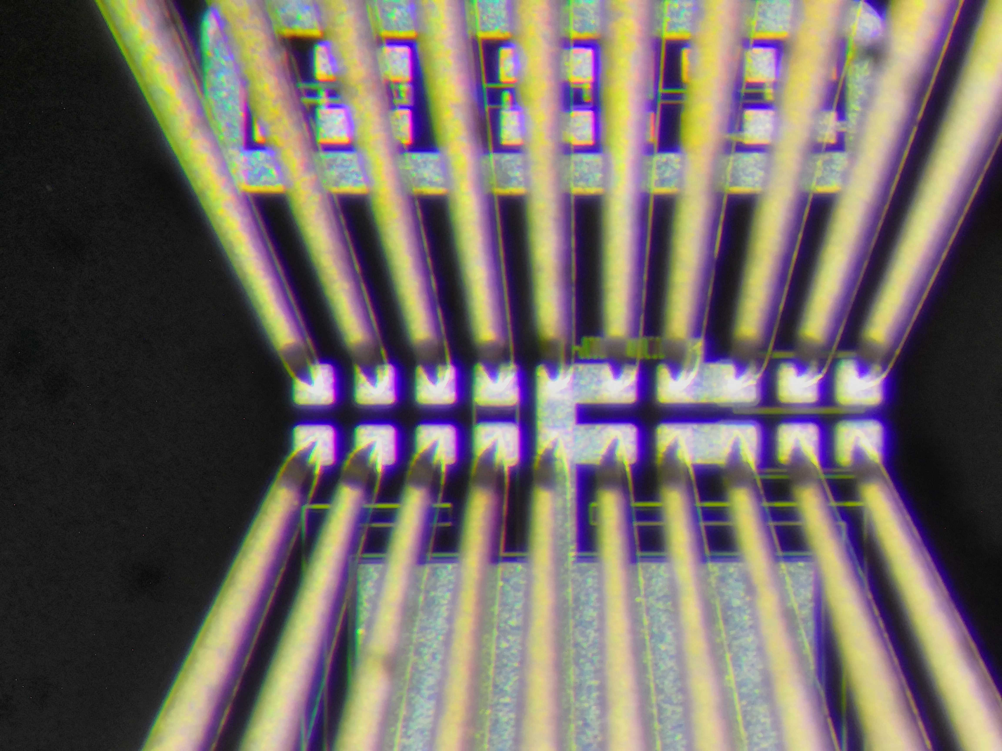
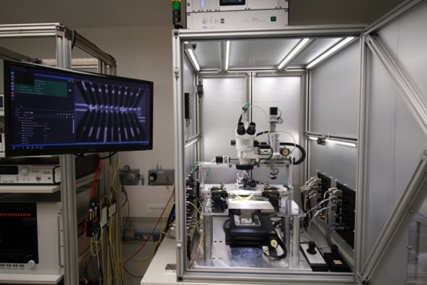
PQC: Tracker & HGCal
2S
HGC HD
PQC - Process Quality Control: Use test structures to asses the quality and stability of the production process
  6” AC coupled (Tracker 2S and PS-s)
  6” DC coupled (Tracker PS-p)
  8” DC coupled (HGCal)
Identical set of test structures on all wafers
Use standardised pattern of 20 connection pads: flute
  Connect using standardised probe cards
  Use switching to access all structures on one flute
  Automatic movement to next flute
PS
PQC Flutes

Slide 26
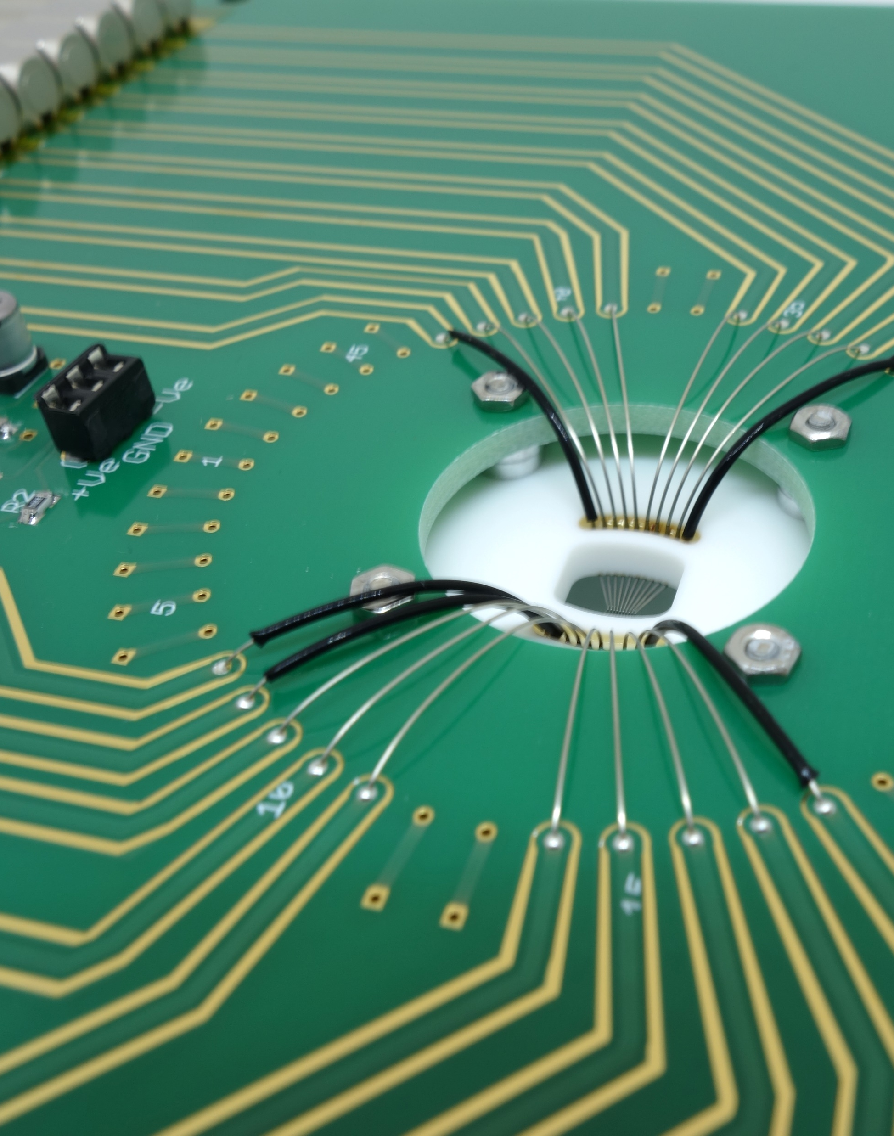
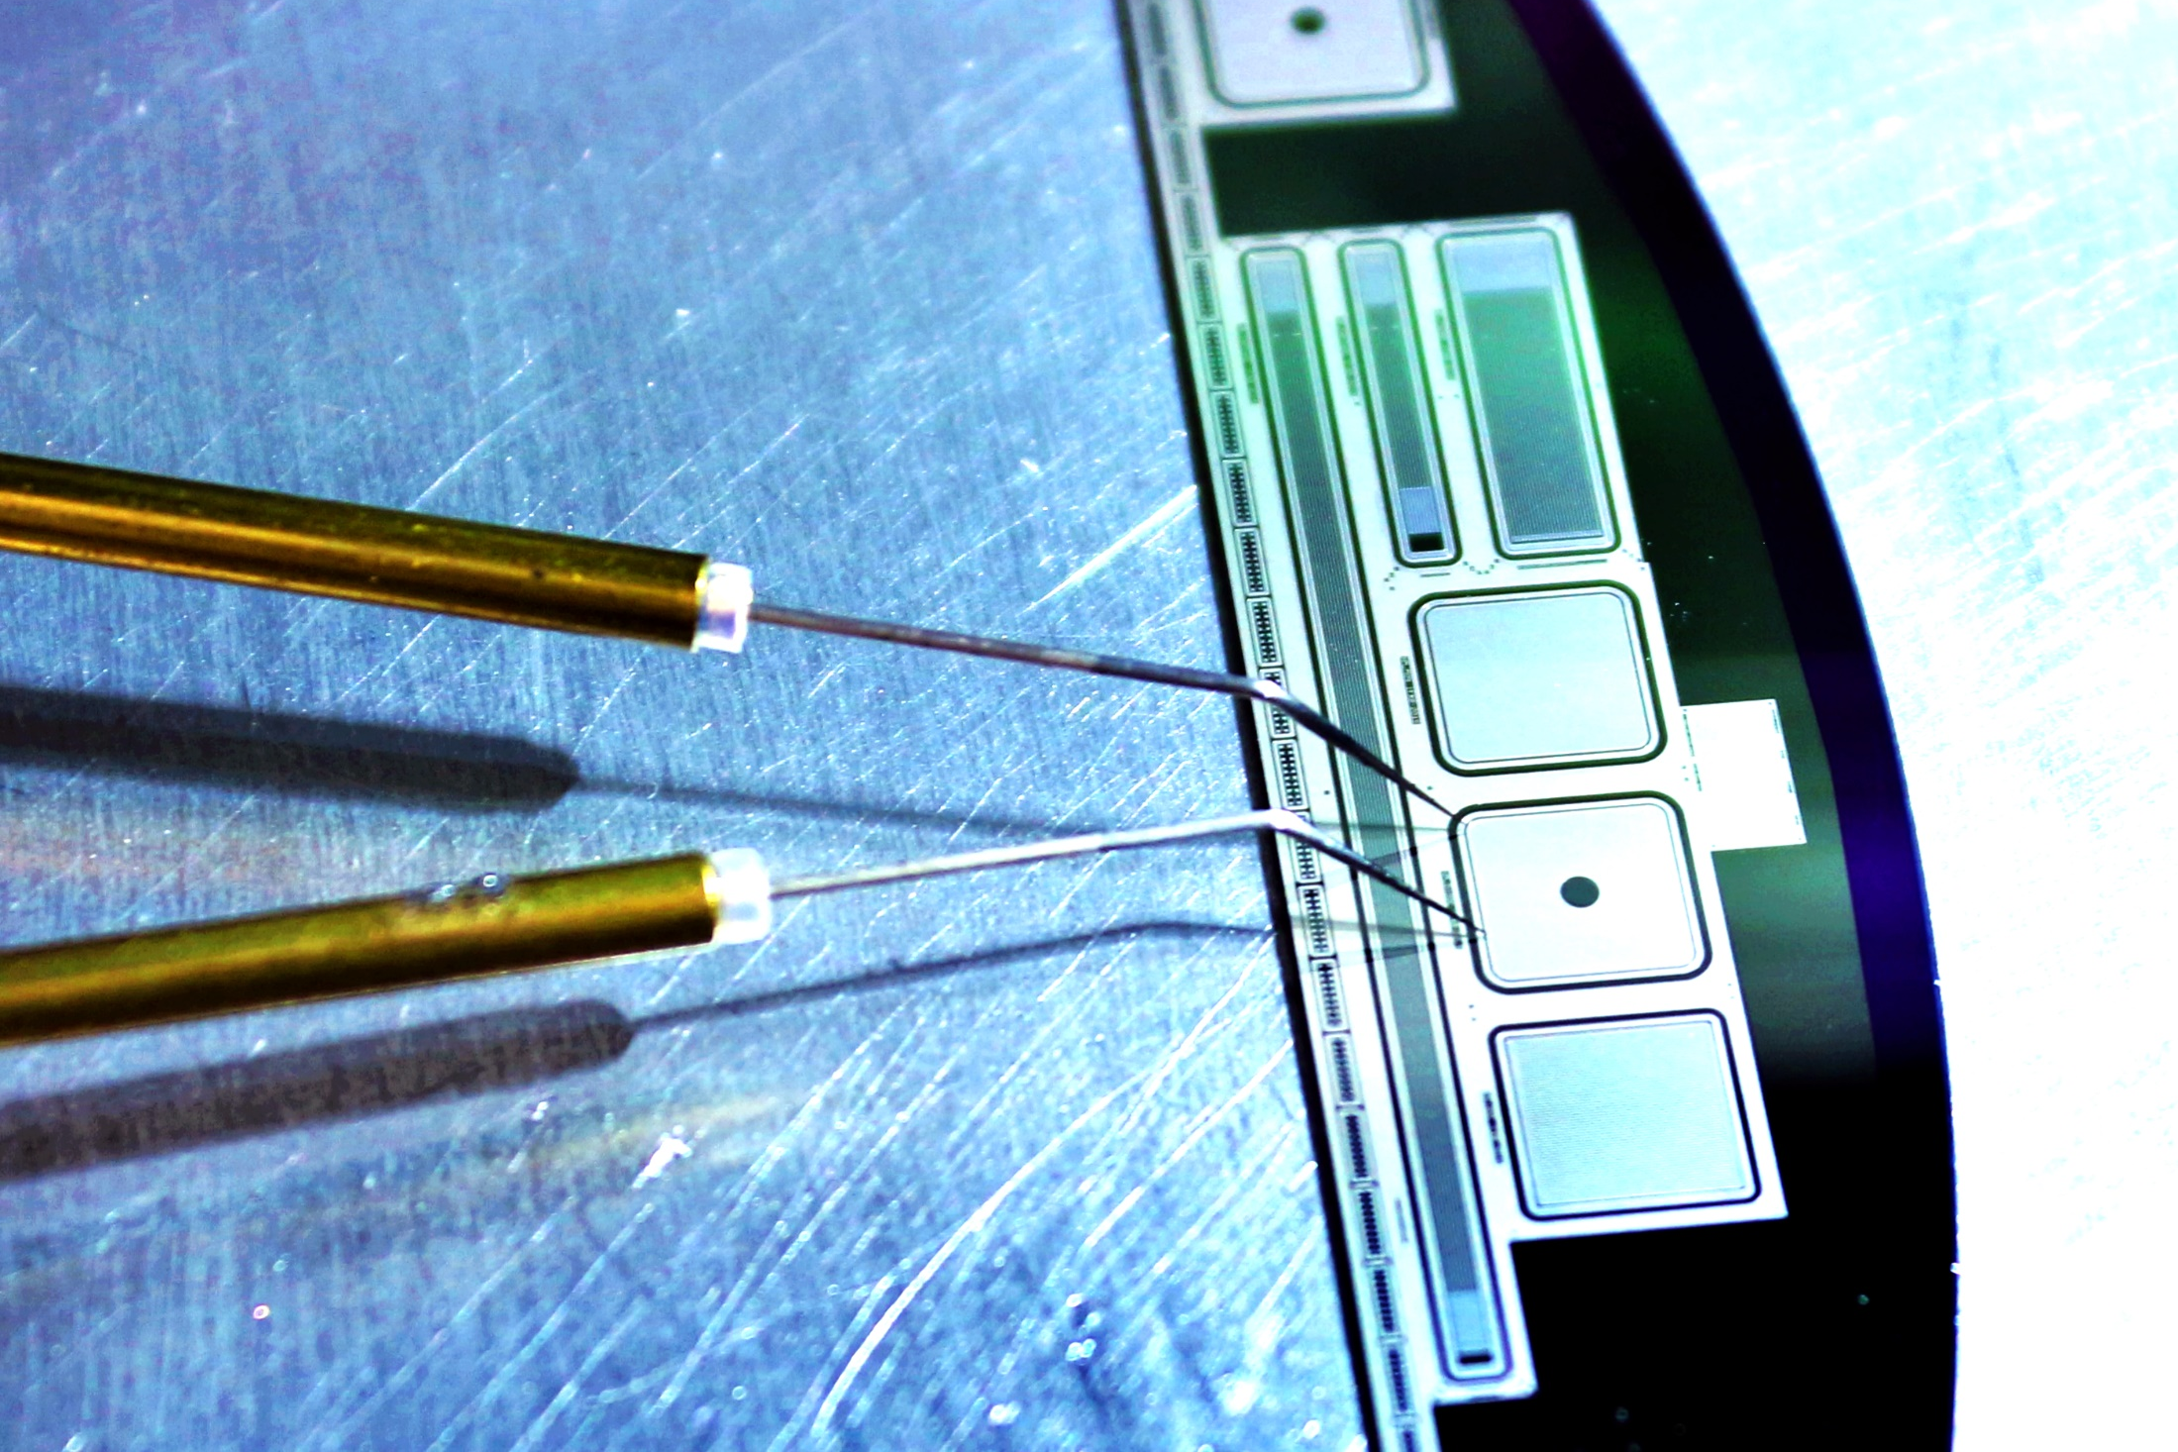
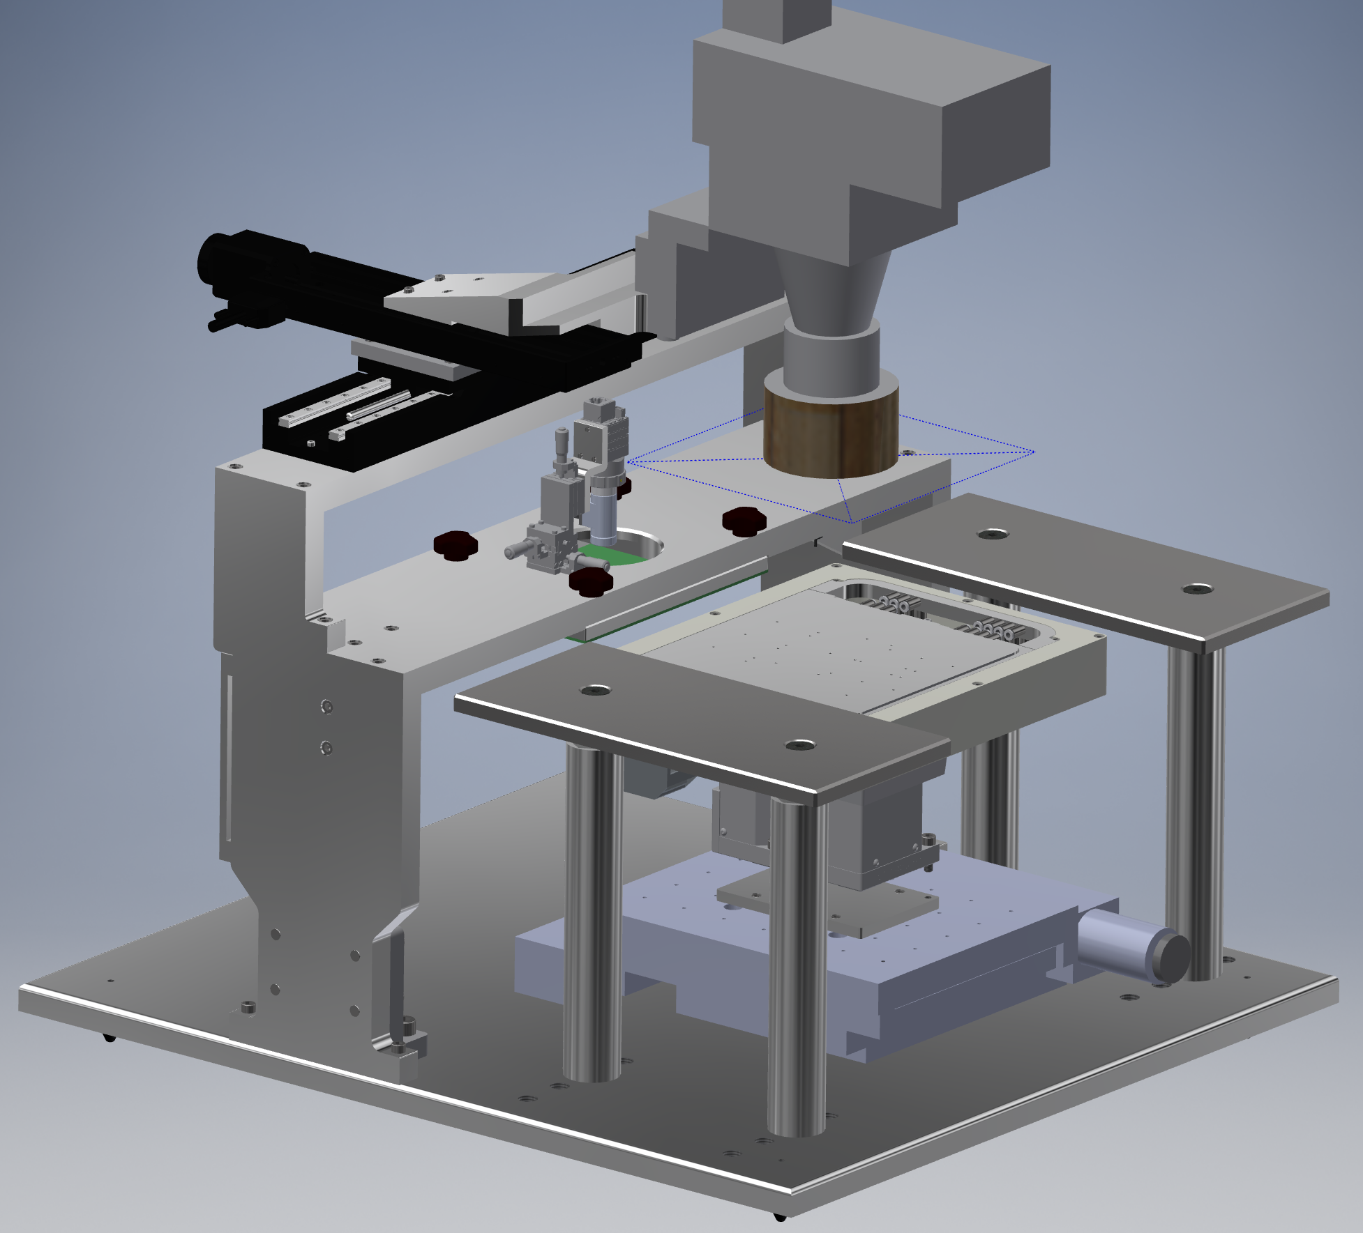
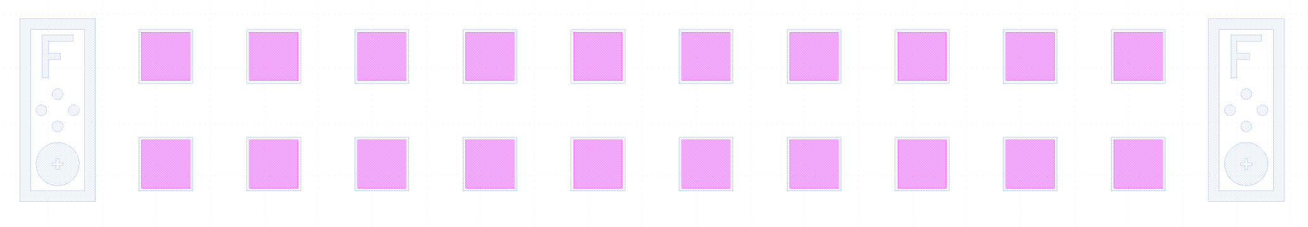
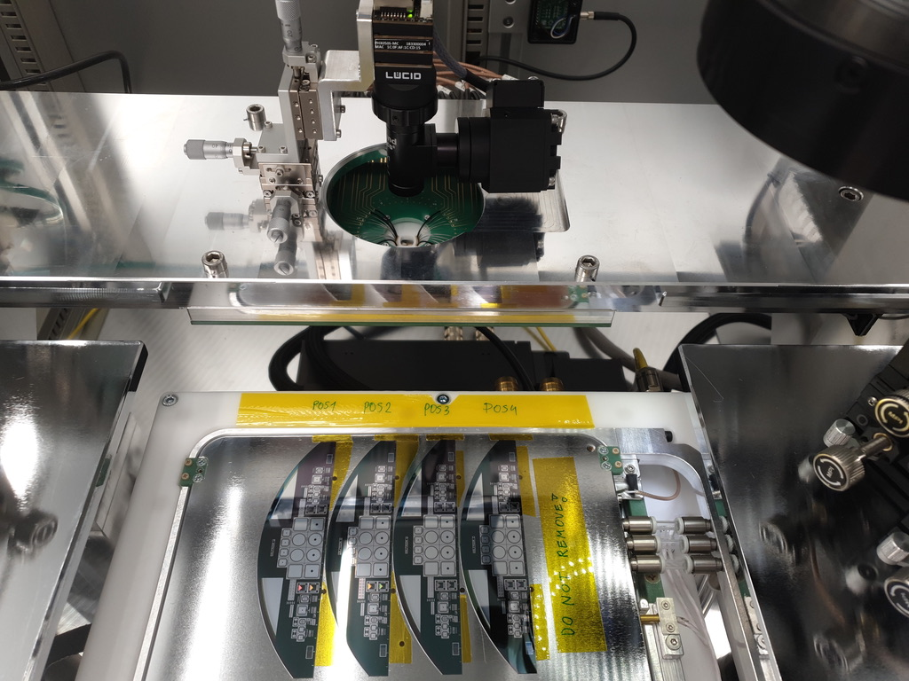
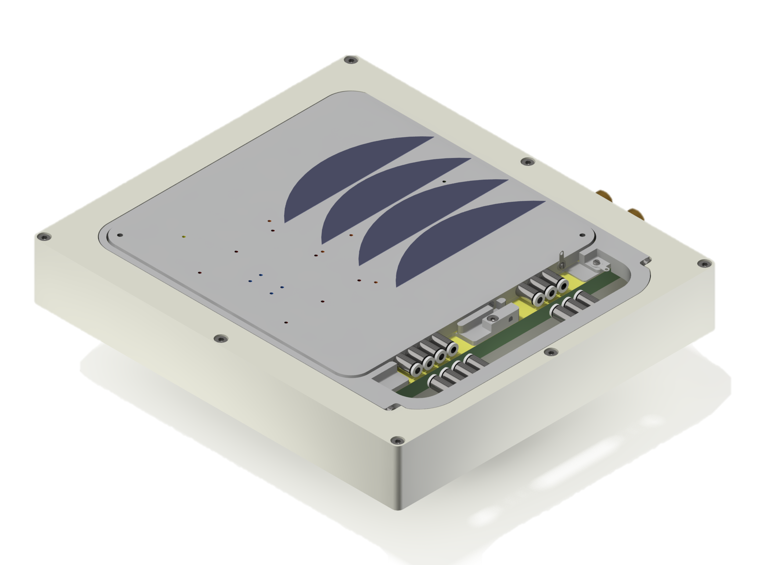
PQC: Tracker & HGCal
New versatile semiautomatic probe station
  Built from scratch in 2019
  Excellent support for design and manufacturing from HEPHY machine shop
  Commissioning in 2020 difficult due to lockdowns
  Now reliable working thanks a lot of effort:
  Doris Wohlmuth, Maximilian Babeluk, Andi Bauer
Will allow unattended characterization of several wafers
  Motorized chuck holds several “halfmoons” with test structures
  Moves to probe card in the back for automatised measurement
Custom measurements using needles still possible
  Probe needles in front part
2.
3.
1.

Slide 27
PQC: Tracker & HGCal
PQC is providing quick and detailed check of process stability
  First batches of sensor characterized within a week of delivery
  Completed within a month
  SQC usually lags behind a few weeks
For each batch of ~40 wafers we perform several 100 of measurements
All four Tracker PQC centers produce consistent results, reliably and quickly
Also used to understand and qualify the process used for the future HGCal production
Summary data produced from standard characterisation of a single batch

Slide 28
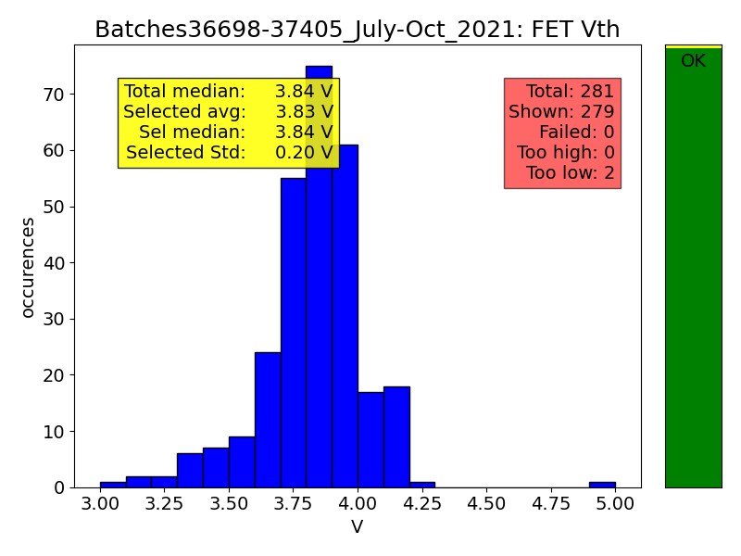
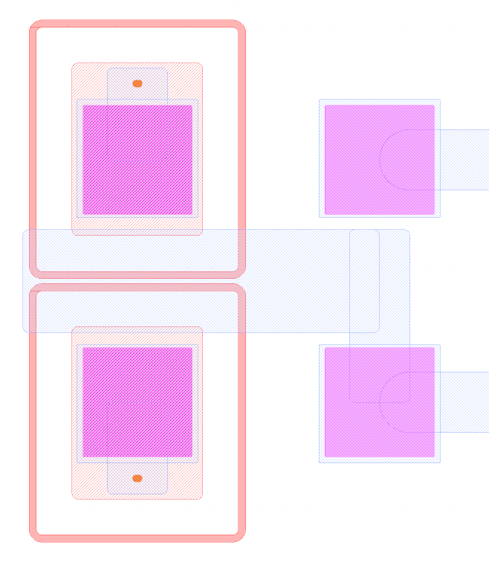
PQC: Example
Some exemplary results from
http://heros.local.hephy.at/pqc-results/INCOMING/analysis_Batches36698-37405_July-Oct_2021/results.html
Doris analysed all measurements she performed between July to October
  281 Halfmoons characterised
  Analysis done by script developed by Maximilian
Example: Threshold voltage of a FET using inter-strip geometry inside channel
  Representative and sensitive to strip isolation
Perfect batches show values around 3.8 V with a healthy ~gaussian distribution
Some weak batches (not shown here) have < 2 V
  But do not yet compromise strip isolation
  → FET threshold V is more sensitive
  HPK informed and can take countermeasures
Drain
Same geometry as between strips
Gate
Source

Slide 29
Summary for Tracker
Outer Tracker construction started and will be in full swing (module production) by end of 2022
Sensor production ongoing since 2020 with HEPHY leading the QA effort
High quality of sensors delivered by HPK as demonstrated and assured by our measurements
More detailed - and scientificly interesting - investigations starting now (not shown here)
→ Now to Moritz with an update on HGCal

Slide 30
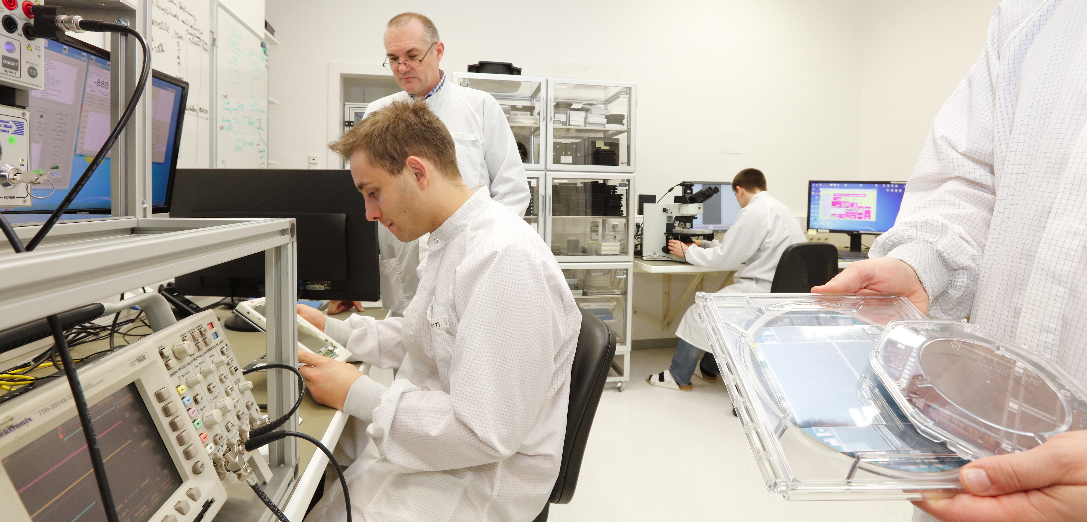
Thanks for your attention!

