Slide 1

Comparison and Validation of Background Subtraction Strategies for the $B^{+}→K^{+}π^{−}π^{+}γ$ Analysis at the LHCb Experiment
Felix Russo, 04.03.2021, Belle group meeting

Slide 2
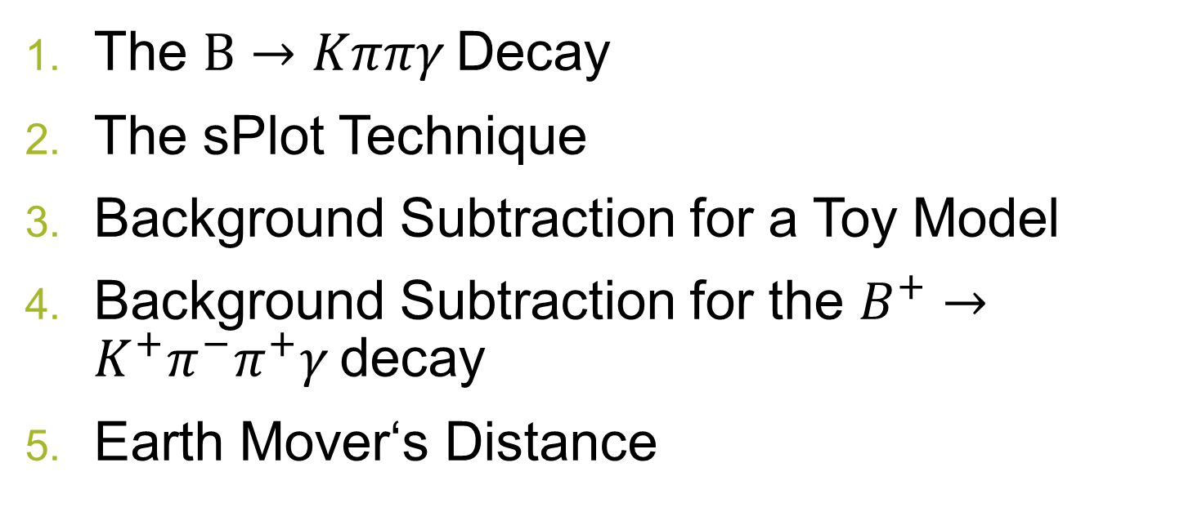
Contents
The $B→Kππγ$ Decay
The sPlot Technique
Background Subtraction for a Toy Model
Background Subtraction for the $B^{+}→K^{+}π^{−}π^{+}γ$ decay
Earth Mover‘s Distance

Slide 3
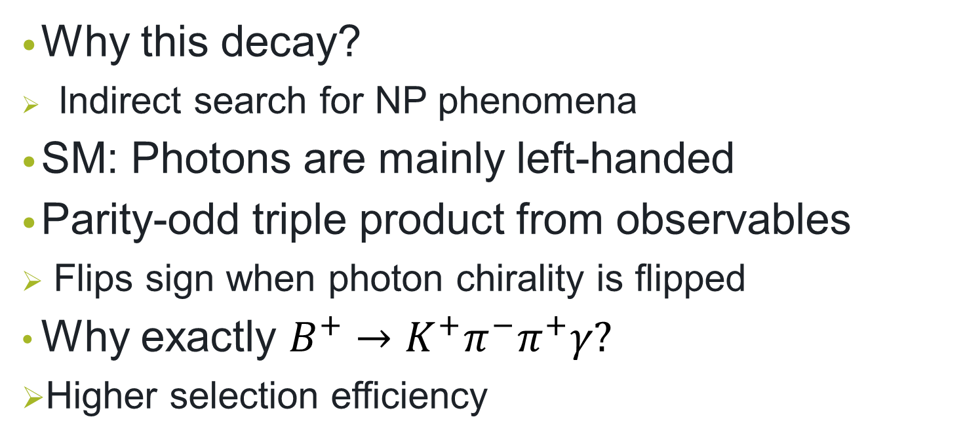

The $B→Kππγ$ Decay
Why this decay?
Indirect search for NP phenomena
SM: Photons are mainly left-handed
Parity-odd triple product from observables
Flips sign when photon chirality is flipped
Why exactly $B^{+}→K^{+}π^{−}π^{+}γ?$
Higher selection efficiency

Slide 4
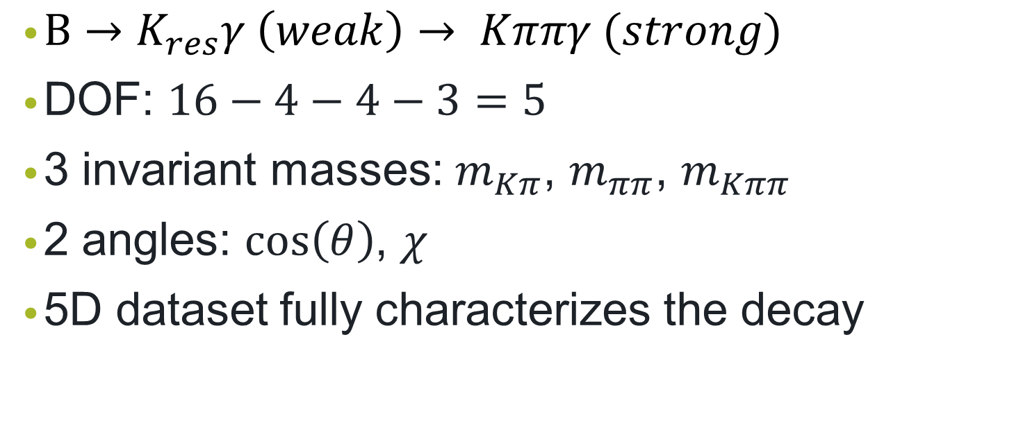
The $B→Kππγ$ Decay
$B→K_{res}γ \left(weak\right)→ Kππγ (strong)$
DOF: $16−4−4−3=5$
3 invariant masses: $m_{Kπ}$, $m_{ππ}$, $m_{Kππ}$
2 angles: $cos\left(θ\right)$, $χ$
5D dataset fully characterizes the decay

Slide 5
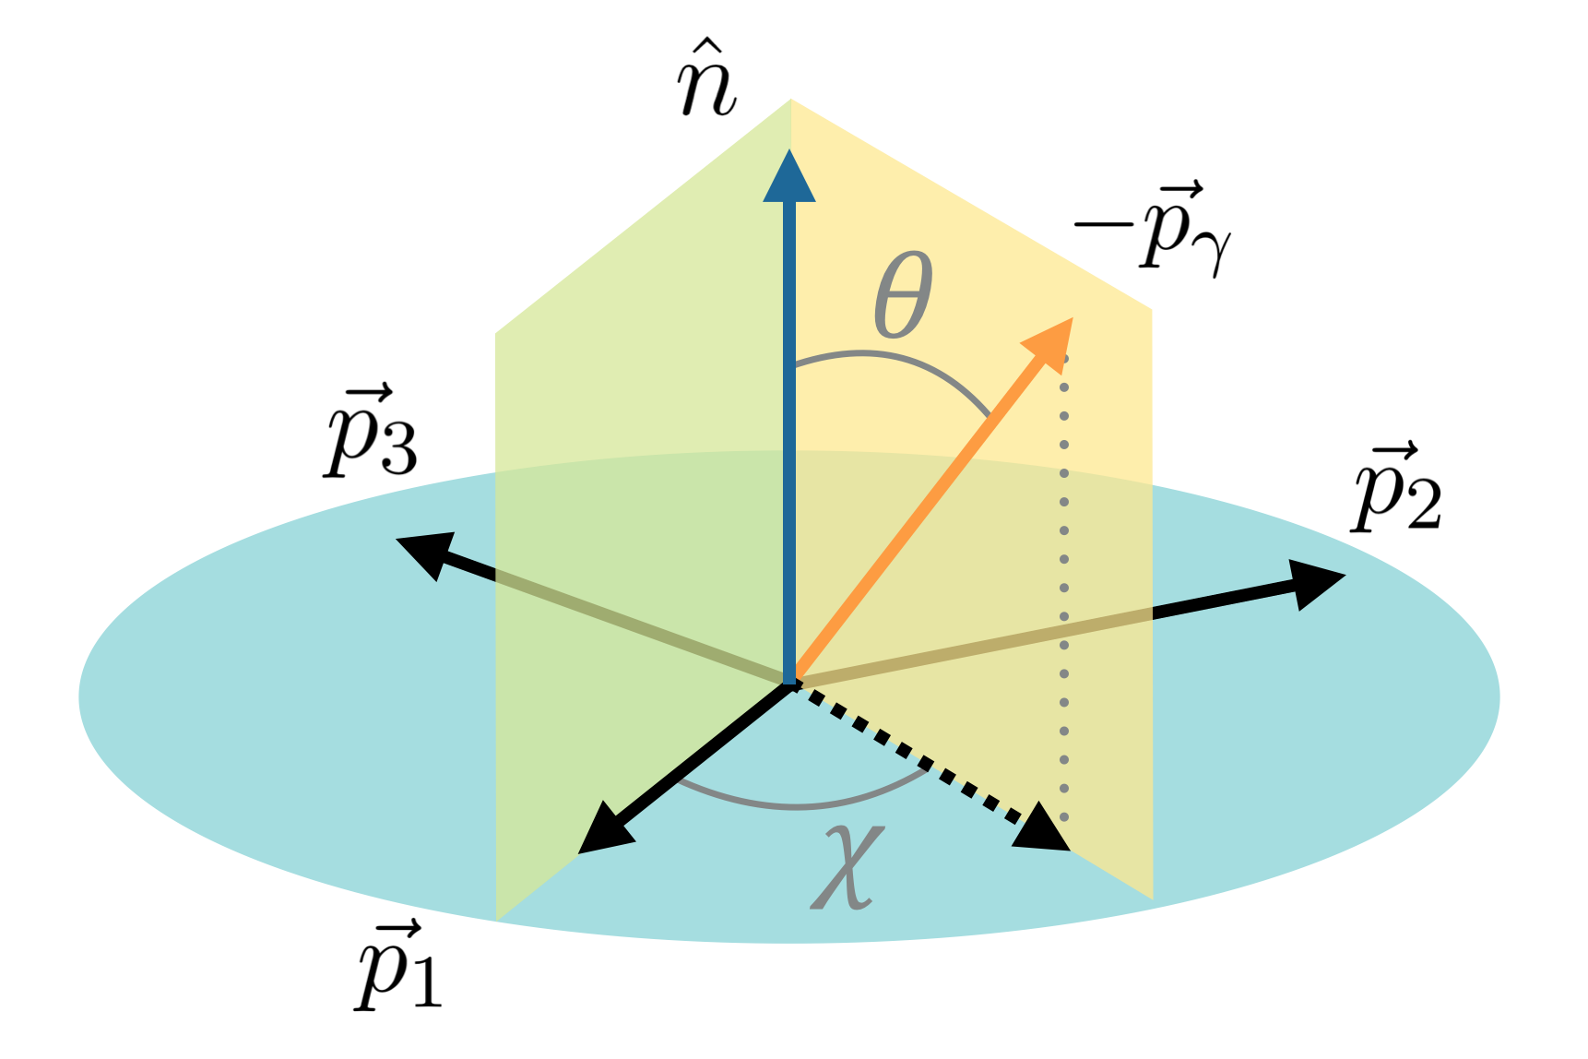

Slide 6
The sPlot Technique
Statistical background subtraction tool provided by ROOT
Separates 2+ species within a dataset ← weights
Needs: discriminating variable(s) (=known probability distributions)
Invariant mass
Need to be uncorrelated to other variables

Slide 7
Workflow sPlot technique
Define probability distributions for all background types in invariant mass (known from MC simulations)
Perform a fit to fix the yields using RooFit
Calculate sWeights
Fill histograms using those weights to obtain the distributions of the species (signal/ various background types)
This only works if variables uncorrelated to inv. mass

Slide 8
Why do we investigate this technique?
Well-tested algorithm
But: Form of the background distributions could greatly deteriorate its performance
Some background distributions are entirely hidden under the signal peak in the invariant mass spectrum

Slide 9
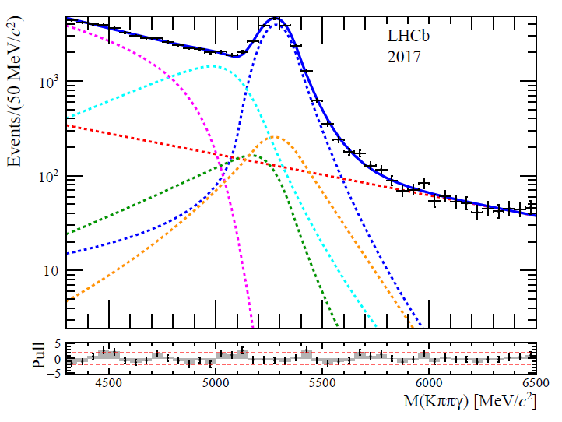
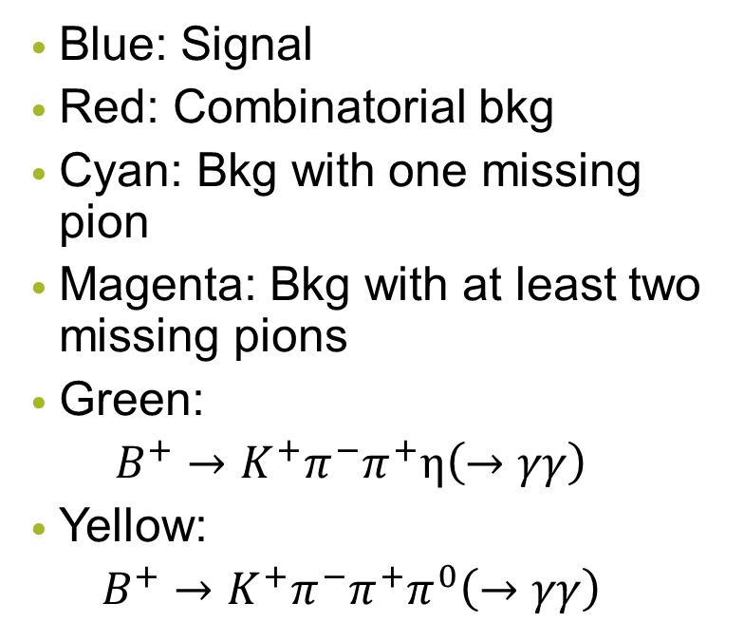
Background Types
Blue: Signal
Red: Combinatorial bkg
Cyan: Bkg with one missing pion
Magenta: Bkg with at least two missing pions
Green:
$$B^{+}→K^{+}π^{−}π^{+}η\left(→γγ\right)$$
Yellow:
$$B^{+}→K^{+}π^{−}π^{+}π^{0}\left(→γγ\right)$$

Slide 10
Background Subtraction - Toy Example
To test the method under well-defined conditions
No correlations between variables
Discrete control variable allows better assessment of the performance

Slide 11
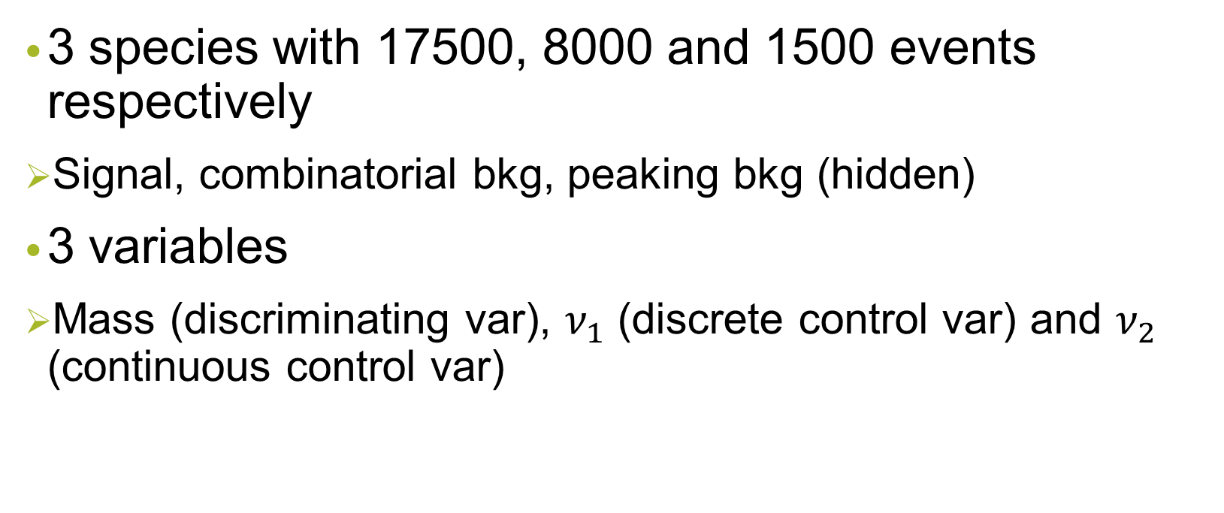
The Dataset
3 species with 17500, 8000 and 1500 events respectively
Signal, combinatorial bkg, peaking bkg (hidden)
3 variables
Mass (discriminating var), $ν_{1}$ (discrete control var) and $ν_{2}$ (continuous control var)

Slide 12
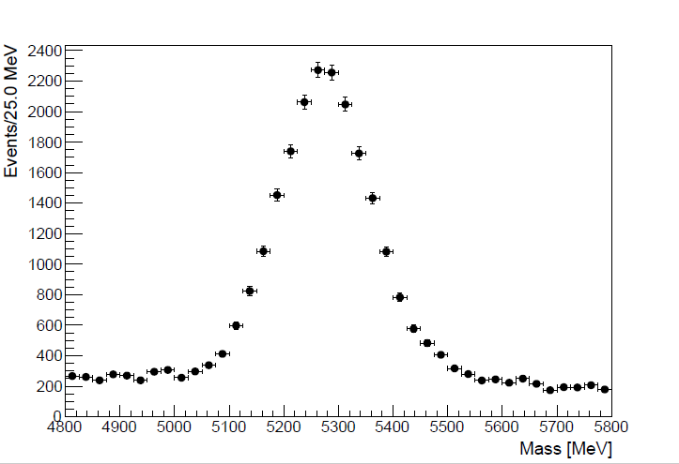

The Mass Variable
Signal: Bifurcated Crystal Ball PDF
Peaking Background: BCB PDF (~yellow bkg)
Combinatorial Background: Exponential PDF
Values of parameters from MC simulations

Slide 13
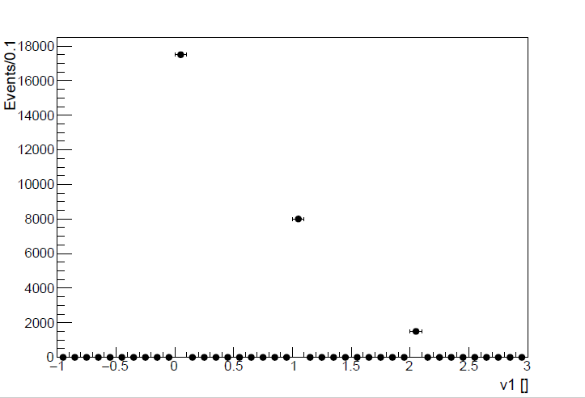
The discrete control variable
For backtracking the source of each event (=label)
Signal: 0
Combinatorial bkg: 1
Peaking bkg: 2

Slide 14
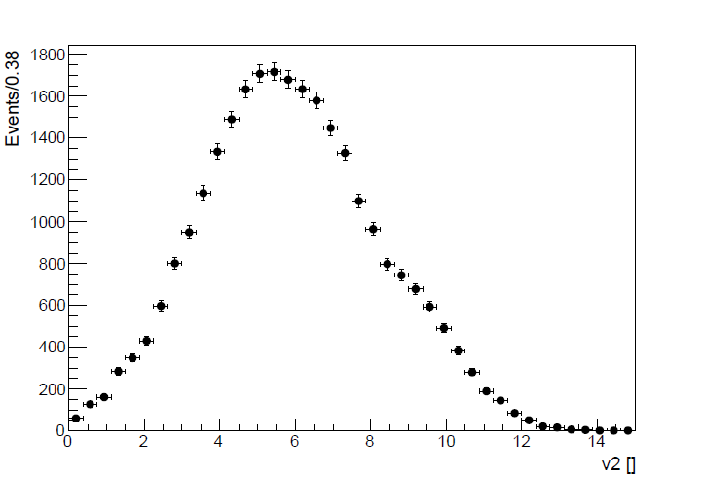
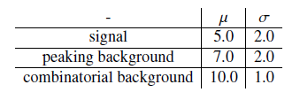
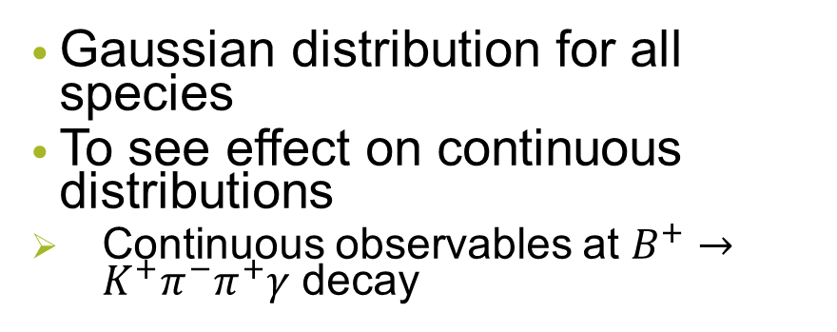
The continuous control variable
Gaussian distribution for all species
To see effect on continuous distributions
Continuous observables at $B^{+}→K^{+}π^{−}π^{+}γ$ decay

Slide 15
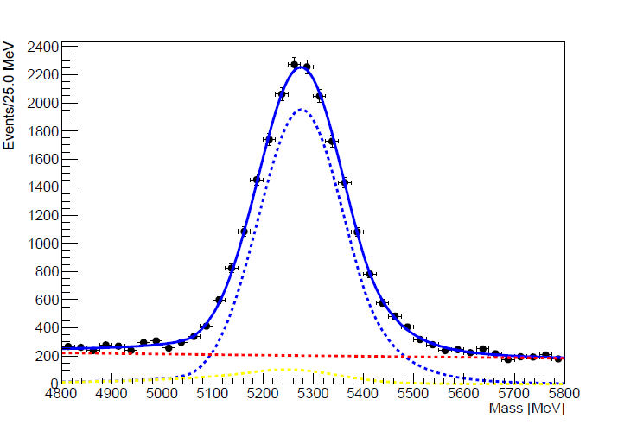
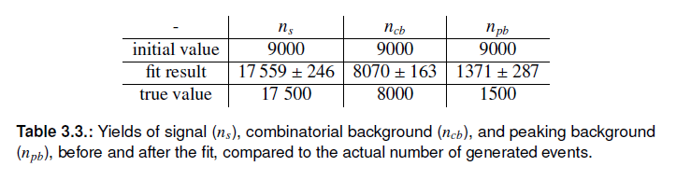
Mass Fit

Slide 16
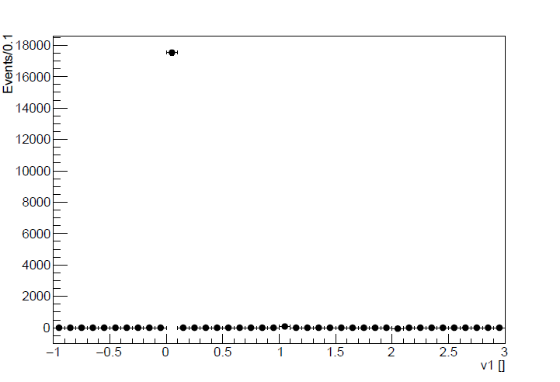
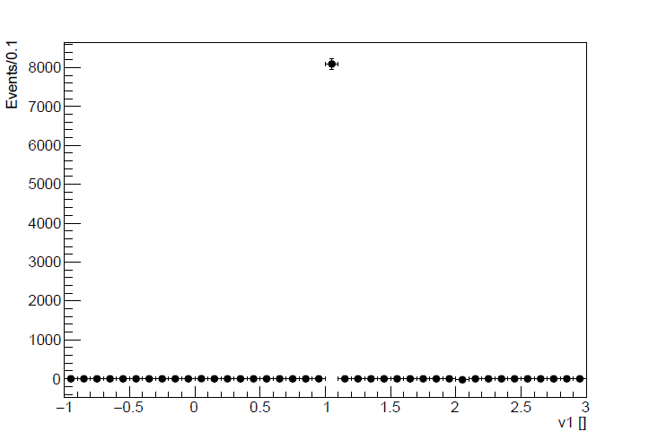
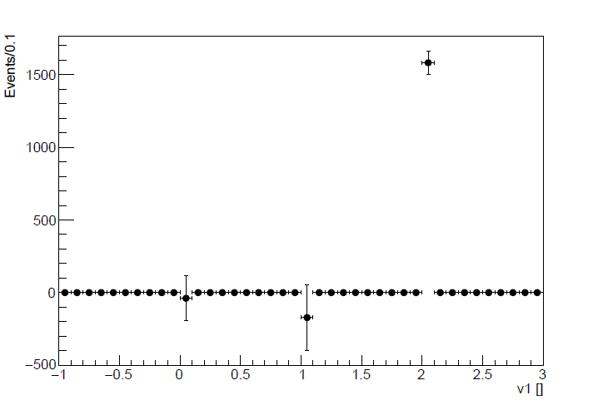

Separated Data - $ν_{1}$

Slide 17
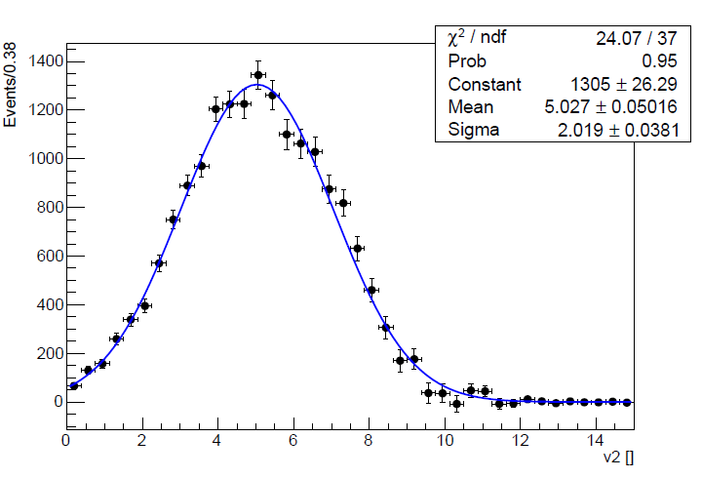
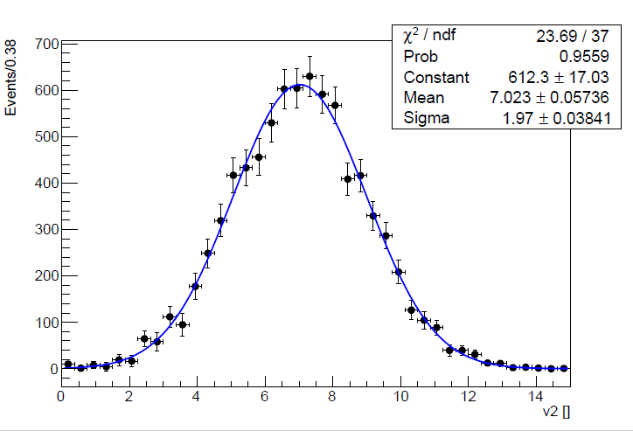
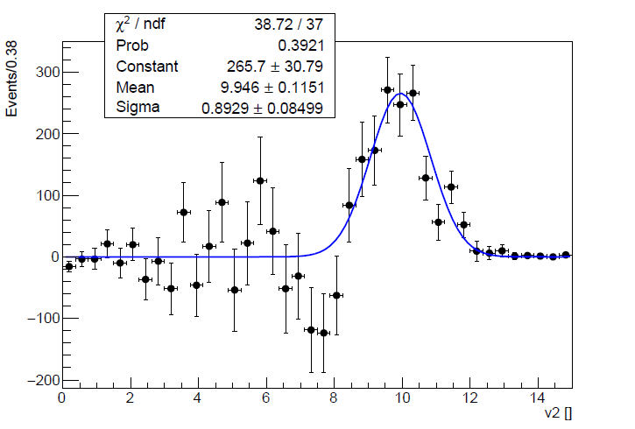

Separated Data - $ν_{2}$

Slide 18
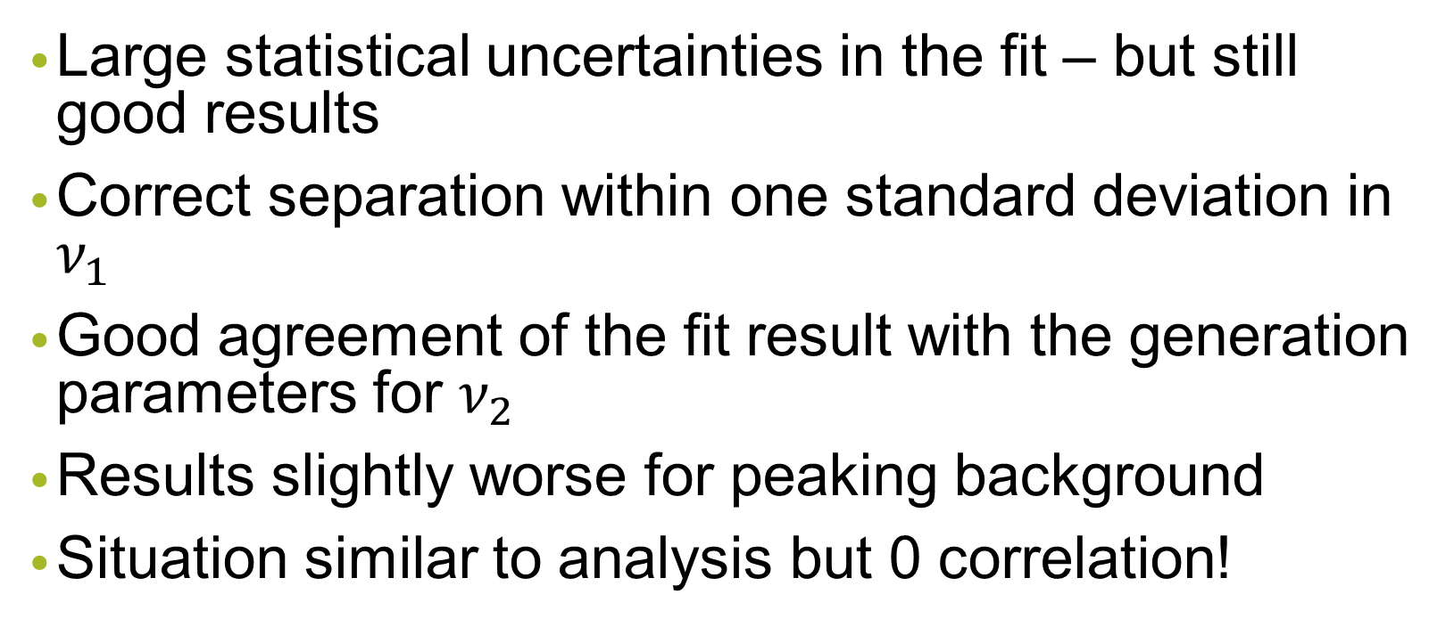
Toy Dataset - Conclusion
Large statistical uncertainties in the fit – but still good results
Correct separation within one standard deviation in $ν_{1}$
Good agreement of the fit result with the generation parameters for $ν_{2}$
Results slightly worse for peaking background
Situation similar to analysis but 0 correlation!

Slide 19
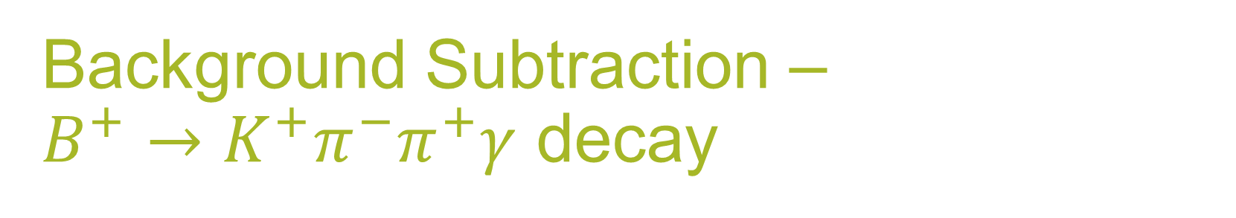
Background Subtraction –
$B^{+}→K^{+}π^{−}π^{+}γ$ decay
2 control variables → 5 analysis variables
Constructed to be uncorrelated with invariant B mass
However: Also uncorrelated for various bkg types?
How to assess the method‘s performance?
Comparison of sWeighted dataset to dataset that consists mainly of signal events

Slide 20
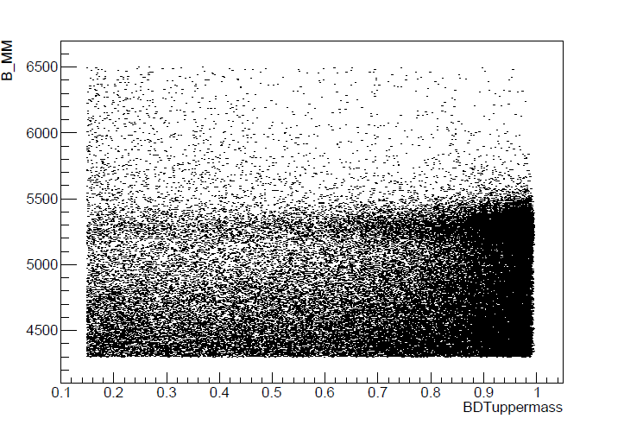
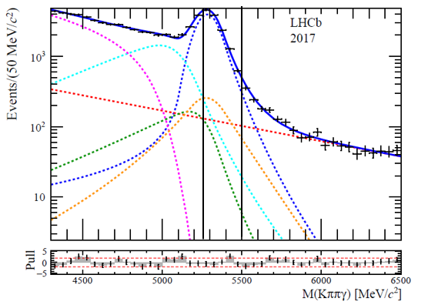
Finding a Mainly-Signal Dataset

Slide 21
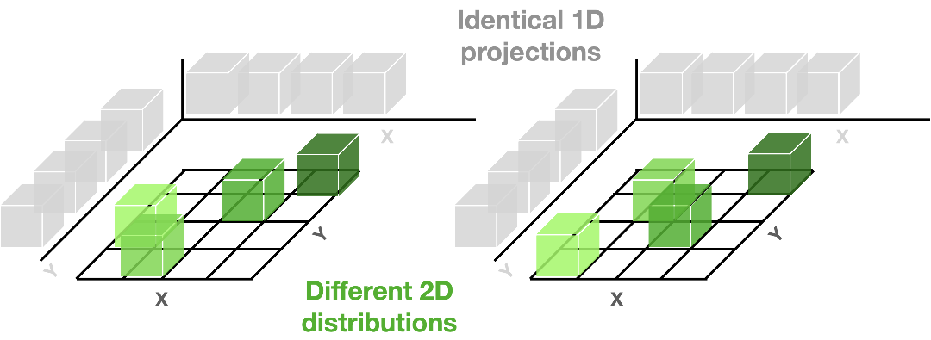
Comparison
How to compare two 5D datasets?
First: Check their 1D projections
Then: Check for correlations in higher dimensions

Slide 22
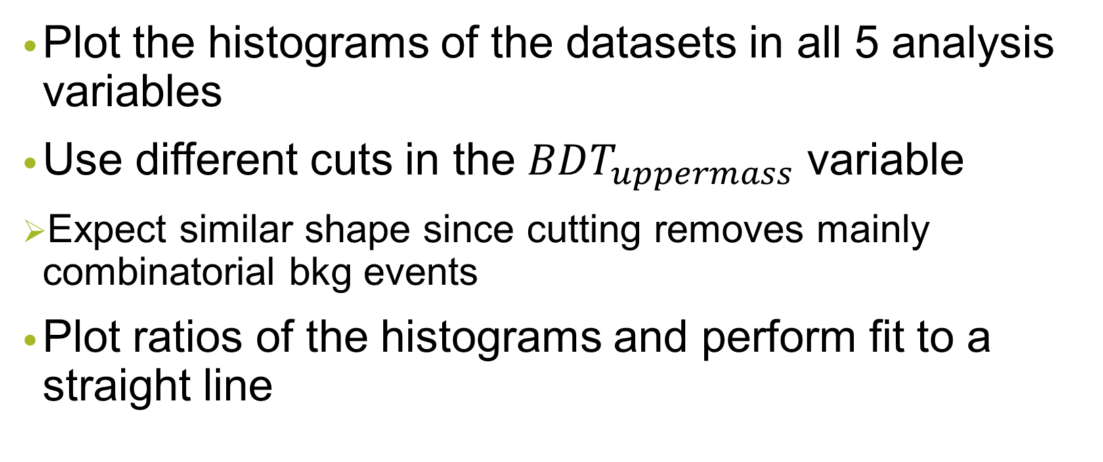
1D Projections
Plot the histograms of the datasets in all 5 analysis variables
Use different cuts in the $BDT_{uppermass}$ variable
Expect similar shape since cutting removes mainly combinatorial bkg events
Plot ratios of the histograms and perform fit to a straight line

Slide 23
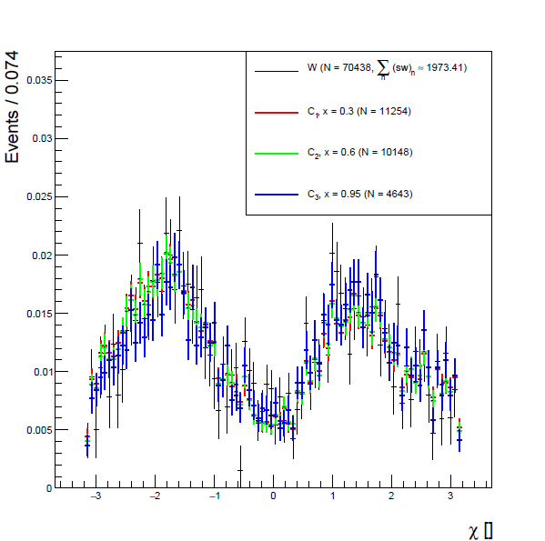
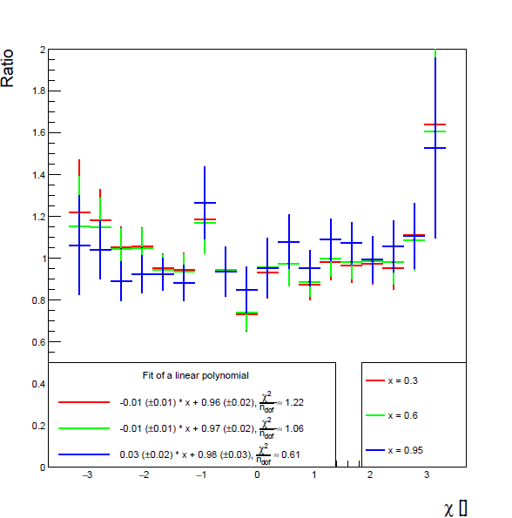

$$χ$$

Slide 24
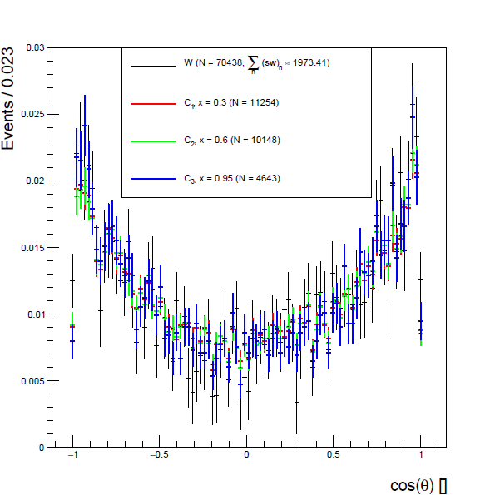
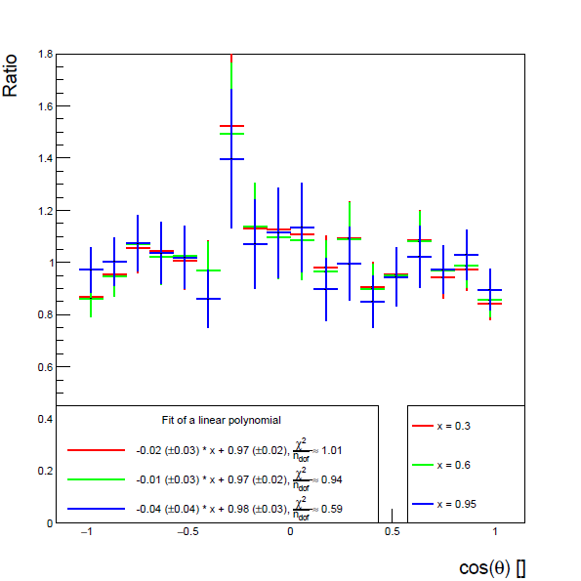

$$cos(θ)$$

Slide 25
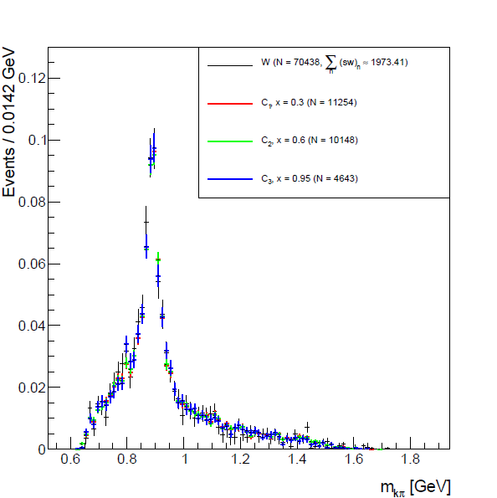
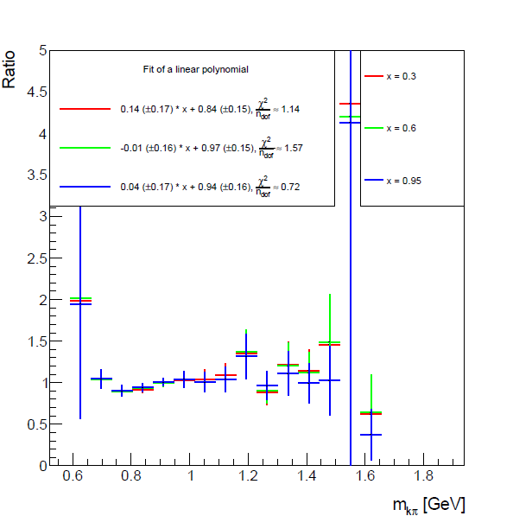

$m_{Kπ}$

Slide 26
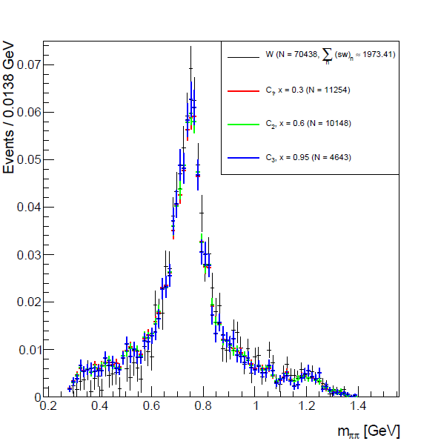
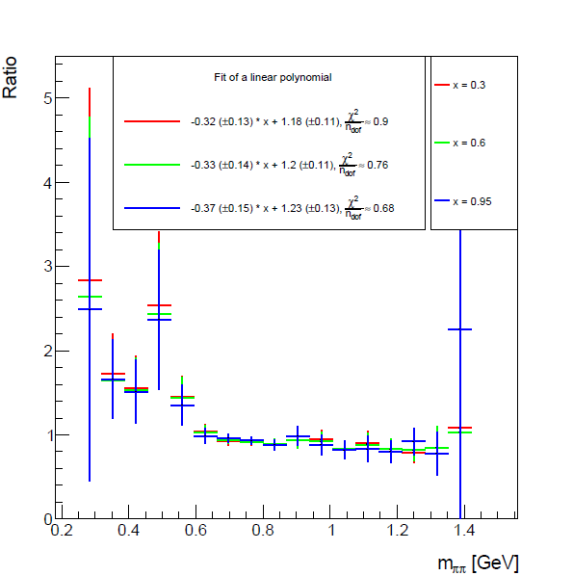

$$m_{ππ}$$

Slide 27
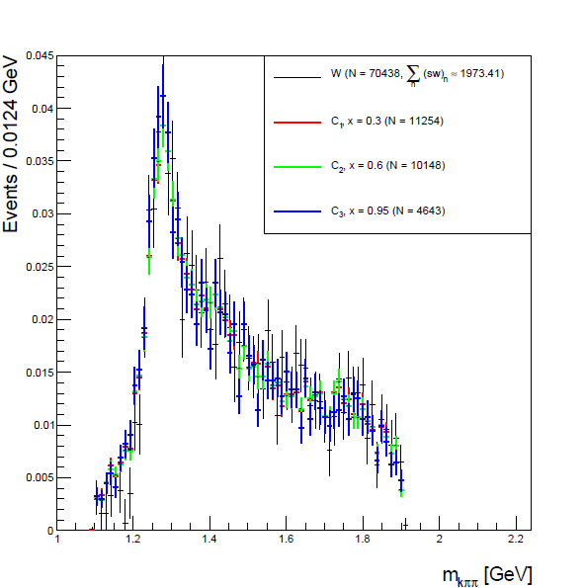
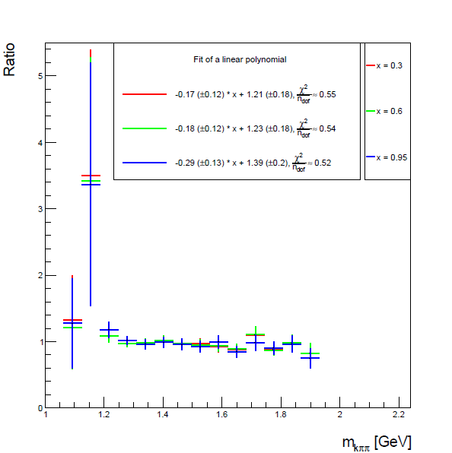

$$m_{Kππ}$$

Slide 28
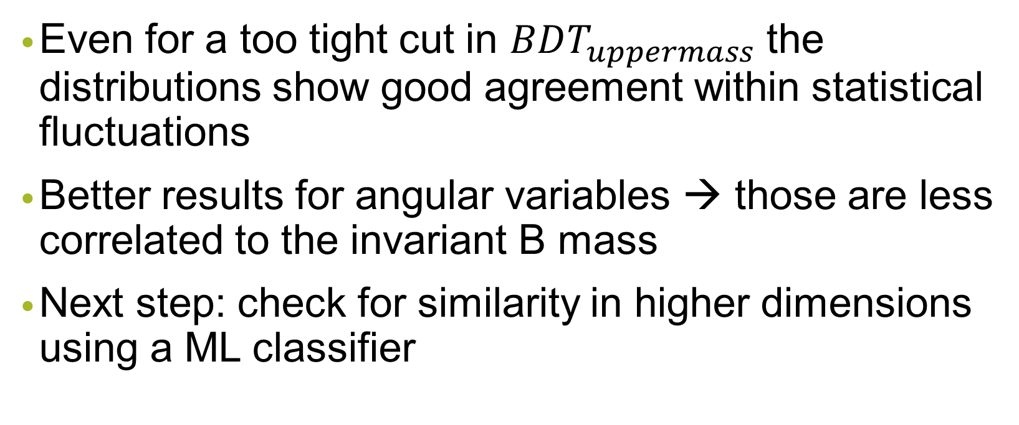
1D Projections - Conclusion
Even for a too tight cut in $BDT_{uppermass}$ the distributions show good agreement within statistical fluctuations
Better results for angular variables → those are less correlated to the invariant B mass
Next step: check for similarity in higher dimensions using a ML classifier

Slide 29

Check of the Background Distributions
Traces of their shapes in 1D projections?
Another check for correlations
→ Compare both sides of non-signal region (x = 0.6):

Slide 30
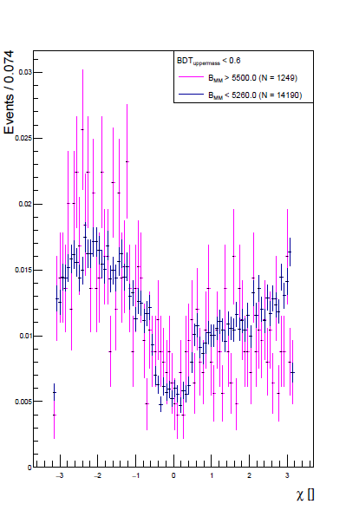

$$χ$$
No sharp peaks
No resemblance to signal distribution
Not flat as we would expect for combinatorial bkg

Slide 31
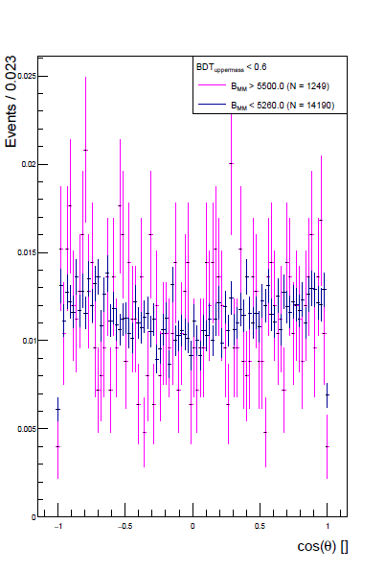

$$cos(θ)$$
Flat
No signal-like shapes

Slide 32
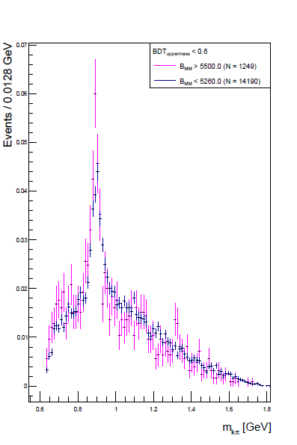


$$m_{Kπ}$$
Sharp peak at 892 MeV
Comes from the following decay chain:
But Kaon and Pion of the last line are not combined with the right pion → combinatorial bkg

Slide 33
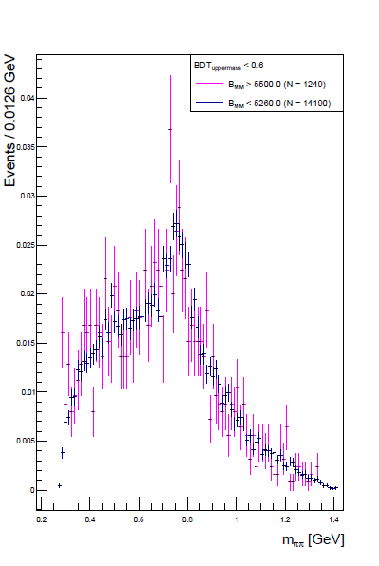


$$m_{ππ}$$
Peak at 795 MeV
Comes from the following decay chain:
Again, the Pions of the last line are not combined with the right Kaon → combinatorial bkg

Slide 34
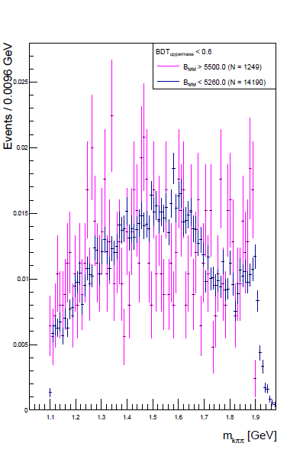

$$m_{Kππ}$$
No peak at 1270 MeV → More evidence of the only partially correct reconstruction of signal events

Slide 35
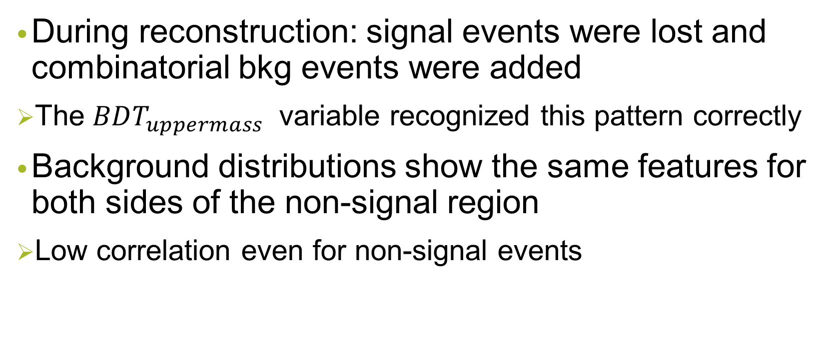
Background Distributions - Conclusion
During reconstruction: signal events were lost and combinatorial bkg events were added
The $BDT_{uppermass}$ variable recognized this pattern correctly
Background distributions show the same features for both sides of the non-signal region
Low correlation even for non-signal events

Slide 36
Machine Learning Classifier - BDT
To compare the 5D distributions
Boosted decision tree
Decision tree which is trained several times
Higher importance weights to wrongly classified events
No splitting into testing/training data
sWeights only work when applied to the whole dataset
We need to be careful about overfitting

Slide 37
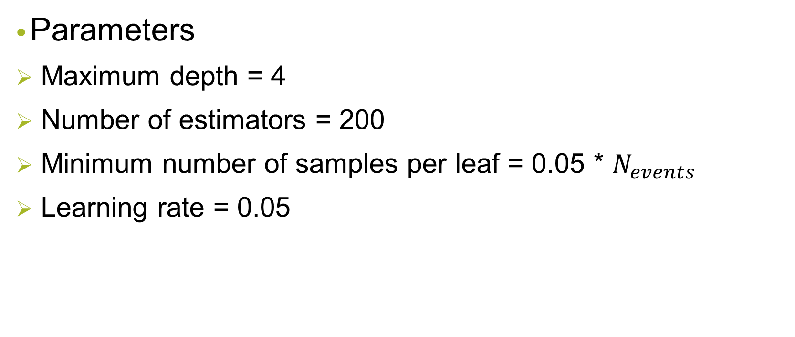
BDT Parameters
Parameters
Maximum depth = 4
Number of estimators = 200
Minimum number of samples per leaf = 0.05 * $N_{events}$
Learning rate = 0.05

Slide 38
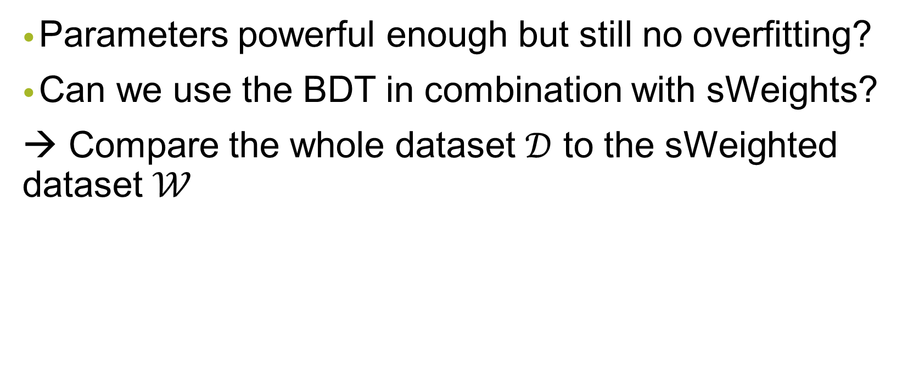
BDT Test
Parameters powerful enough but still no overfitting?
Can we use the BDT in combination with sWeights?
→ Compare the whole dataset $𝒟$ to the sWeighted dataset $𝒲$

Slide 39
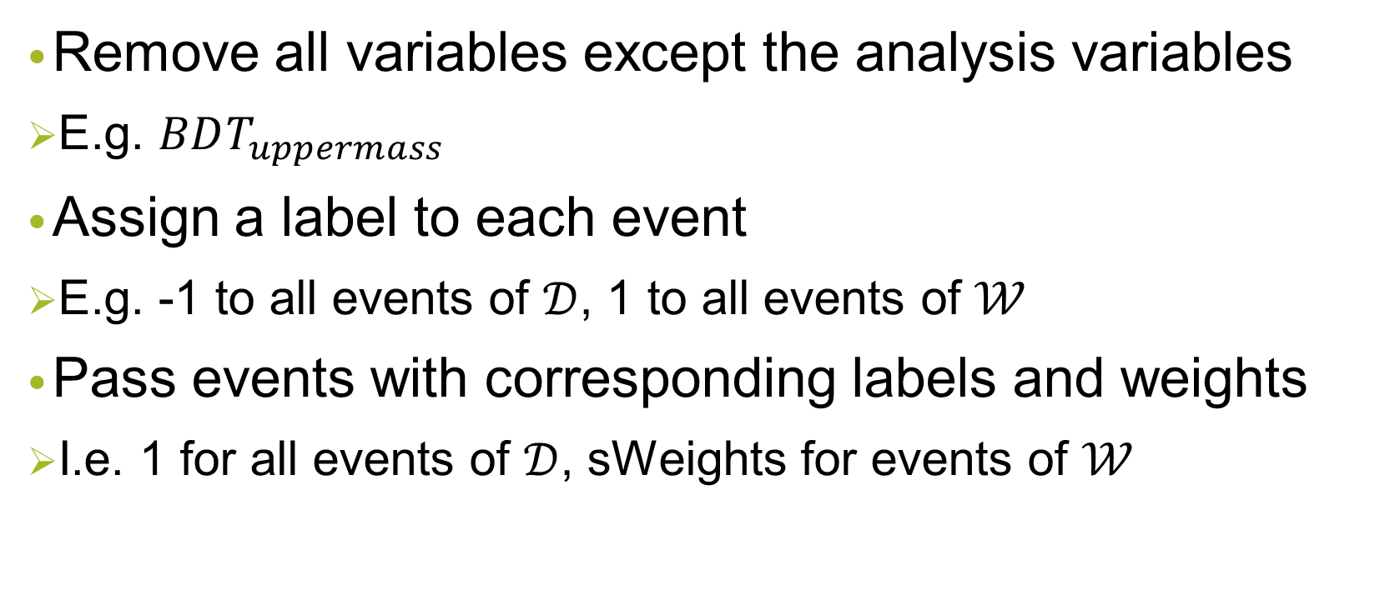

BDT Workflow: Example $𝒟$ vs. $𝒲$
Remove all variables except the analysis variables
E.g. $BDT_{uppermass}$
Assign a label to each event
E.g. -1 to all events of $𝒟$, 1 to all events of $𝒲$
Pass events with corresponding labels and weights
I.e. 1 for all events of $𝒟$, sWeights for events of $𝒲$

Slide 40
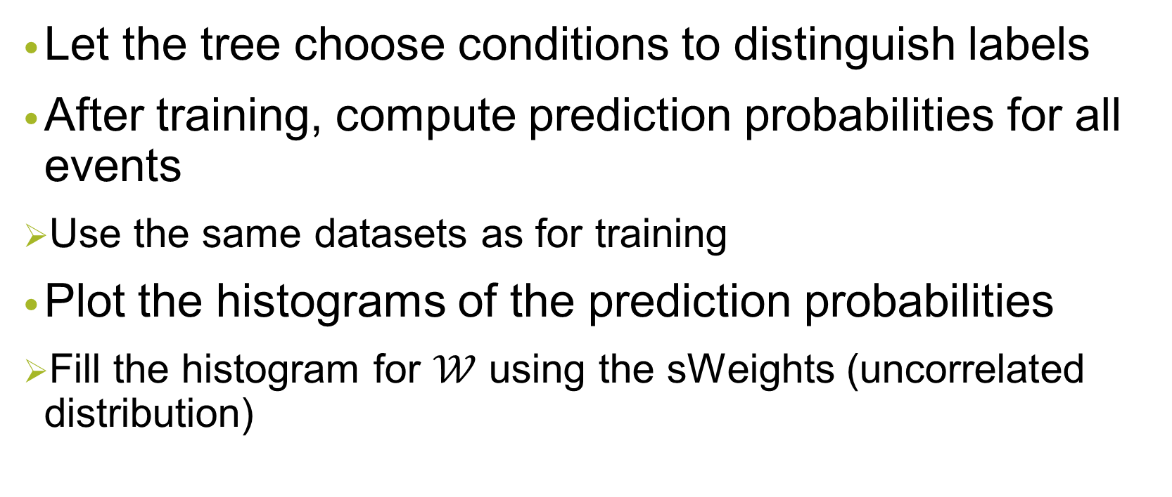

BDT Workflow: Example $𝒟$ vs. $𝒲$ (2)
Let the tree choose conditions to distinguish labels
After training, compute prediction probabilities for all events
Use the same datasets as for training
Plot the histograms of the prediction probabilities
Fill the histogram for $𝒲$ using the sWeights (uncorrelated distribution)

Slide 41
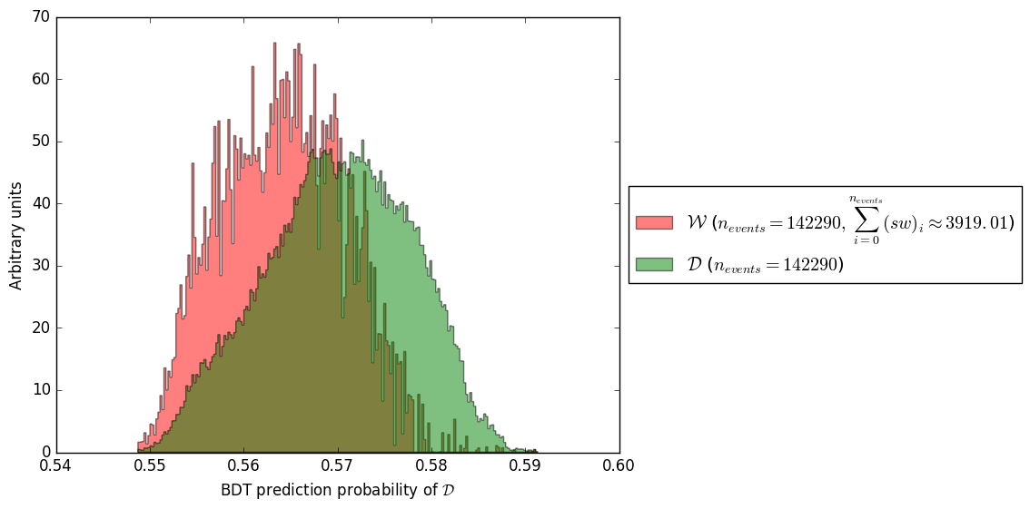

$$𝒟 \text{vs}\text{. }𝒲$$
The shapes of the histograms differ
The BDT was able to find differences between datasets
The parameters we chose are sufficiently powerful

Slide 42

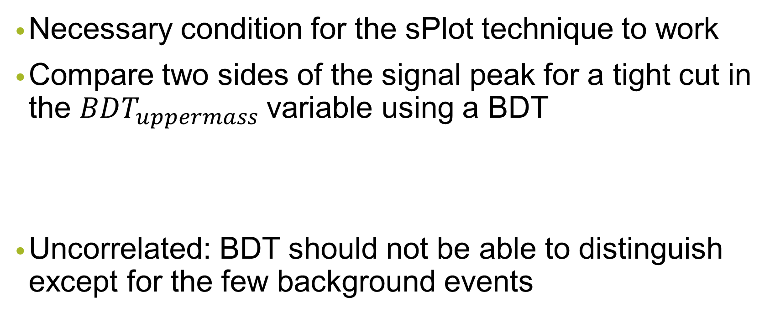
(Another) Check for Correlations
Necessary condition for the sPlot technique to work
Compare two sides of the signal peak for a tight cut in the $BDT_{uppermass}$ variable using a BDT
Uncorrelated: BDT should not be able to distinguish except for the few background events

Slide 43
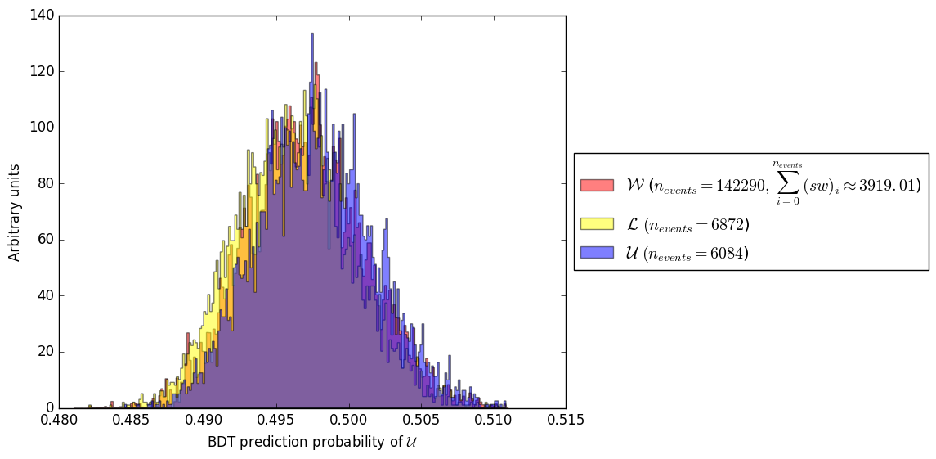

$$ℒ \text{vs}\text{. }𝒰$$
Histograms slightly shifted agains each other
Either: small correlations
Or: BDT is able to tell that the relative background contents are different

Slide 44


Finally: Compare $𝒞$ and $𝒲$ in 5D
Recall: We showed that the 1D projections of the datasets agree (visually)
Now: Account for correlations in higher dimensions
Interested in effect of the cut in the $BDT_{uppermass}$ variable
Train two trees: One to distinguish $𝒞$ and $𝒲$with and one without a cut in $BDT_{uppermass}$

Slide 45



$𝒞 \text{vs}\text{. }𝒲$ (x = 0.0)
BDT could not achieve a separation
5D distributions are very similar
Prediction probability for $𝒟$ is also plotted

Slide 46



$𝒞 \text{vs}\text{. }𝒲$ (x = 0.6)
BDT could not achieve a separation
5D distributions are very similar
Expected: More similar for $x ≠0.0$
Not the case

Slide 47


$𝒞$ vs. $𝒲:Conclusion$
BDT: No separation with and without the cut in the $BDT_{uppermass}$ variable
We observe distributions with one big and one or two small peaks
More events of $𝒟$ in the small peaks
Background events are more likely to be found in small peaks?
Indeed: some separation of signal/bkg (next slide)

Slide 48


Mass Variable for the Peaks

Slide 49
Earth Mover‘s Distance (Outlook)
Measure of distance between two probabilty distributions
Histograms = Piles of Dirt
Define a cost:
EMD = Minimal cost to turn one pile of dirt into the other

Slide 50

EMD Visualization 1
Example of the computation of the EMD
Algorithm tries to reconstruct the histogram Q from the histogram P by moving the minimal amount of dirt

Slide 51


EMD Visualization 2
Why is this better than $χ^{2}$ value for example?
Curse of dimensionality
100 bins/dimension, for 5 dimensions: ${10}^{10}$ bins

Slide 52

EMD – Preprocessing & Issues
Normalize histograms
Rescale every dimension → values within [0, 1]
Promising implementation was found
But: Distance matrix, $𝒪\left(N_{events}^{2}\right)=𝒪({10}^{8})$ entries
Memory error
Possible solution: Compute histograms beforehand and pass bin centers as datapoints and counts as weights

Slide 53

Conclusion and Summary 1
Measurement of the photon polarization in the $B^{+}→K^{+}π^{−}π^{+}γ$decay
Promising approach to search for NP
Important tool for background subtraction: the sPlot technique
Due to hidden background contributions: difficult to assess performance in the past

Slide 54
Conclusion and Summary 2
First: Toy Dataset
Discrete control variable → backtracking of events
sPlot technique works well for similar situations, where correlation is 0
Then: Dataset from decay
Visual comparison of 1D projections: No significant difference
Correlations in higher dimensions with ML: Again no significant difference

Slide 55

Conclusion and Summary 3
→ The sPlot technique can be used for the $B^{+}→K^{+}π^{−}π^{+}γ$ analysis
Further check of the method‘s performance using a measure of distance between distributions
EMD

Slide 56
Thanks a lot
Questions?
Topics that were not discussed
1D projections for other vars, check of the 1D background distributions, check for correlations with the BDT, EMD

