Slide 1
Overview of the Flavour Anomalies
Andreas Crivellin
Theory Group of the Laboratory for Particle Physics
Vienna, 08.01.2020

Slide 2
Outline
Introduction
Status of the Flavour anomalies
  b→sµµ
  b→cτν
  a_{µ} & a_{e}
Explanations of the Flavour anomalies
Common Explanations
  Vector Leptoquark
  Scalar Leptoquarks
  Z´ models
Conclusions
Andreas Crivellin

Slide 3
Physics Beyond the Standard Model
New particles and interactions exist!
Dark Matter existence established at cosmological scales
  New weakly interacting particles
Neutrinos not exactly massless
  Right-handed (sterile) neutrinos
Matter anti-matter asymmetry
  Additional CP violating interactions
writescience.wordpress.com
The SM must be extended!
What is the underlying fundamental theory?
Andreas Crivellin

Slide 4
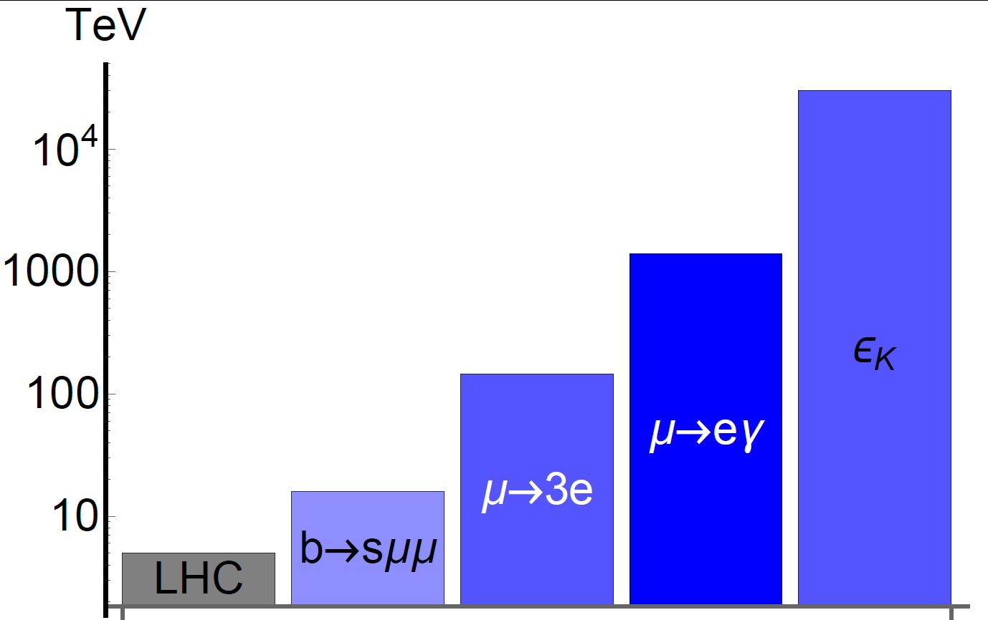
Finding New Physics with Flavour
At colliders one produces many (up to 10¹⁴) heavy quarks or leptons and measures their decays into light flavours
Experiment
Flavour observables
Standard Model
Direct searches
New Physics
PSI
PSI
Flavour observables are sensitive to higher energy scales than collider searches
Andreas Crivellin

Slide 5
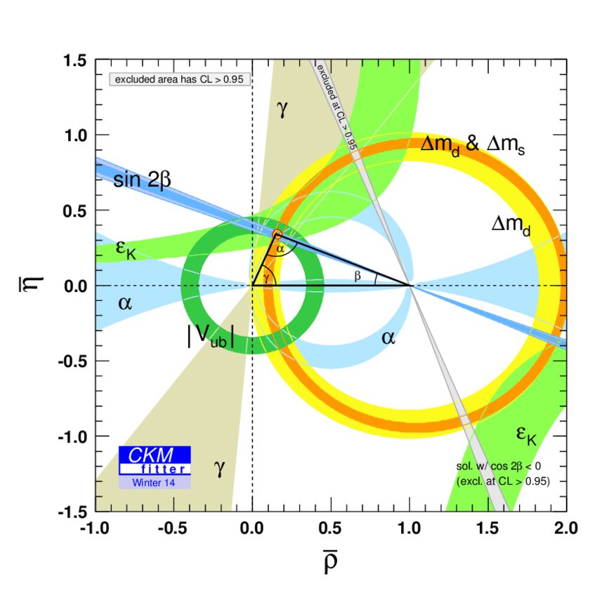
Global Fit to the CKM Matrix
Picture of CKM Flavour violation established
Andreas Crivellin

Slide 6
Overview on the Flavour anomalies

Slide 7
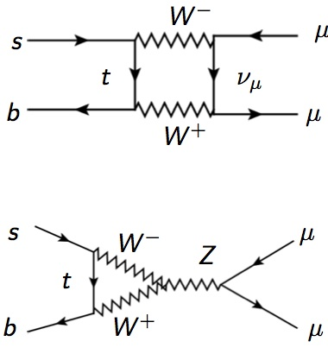
b→sμ⁺μ⁻ Processes
Flavour Changing Neutral Current (FCNC)
In the SM it is suppressed by
  The CKM elements V_{cb} ≈ 0.04
  Electroweak scale
  Loop-factor
Suppressed and very sensitive to New Physics
4

Slide 8
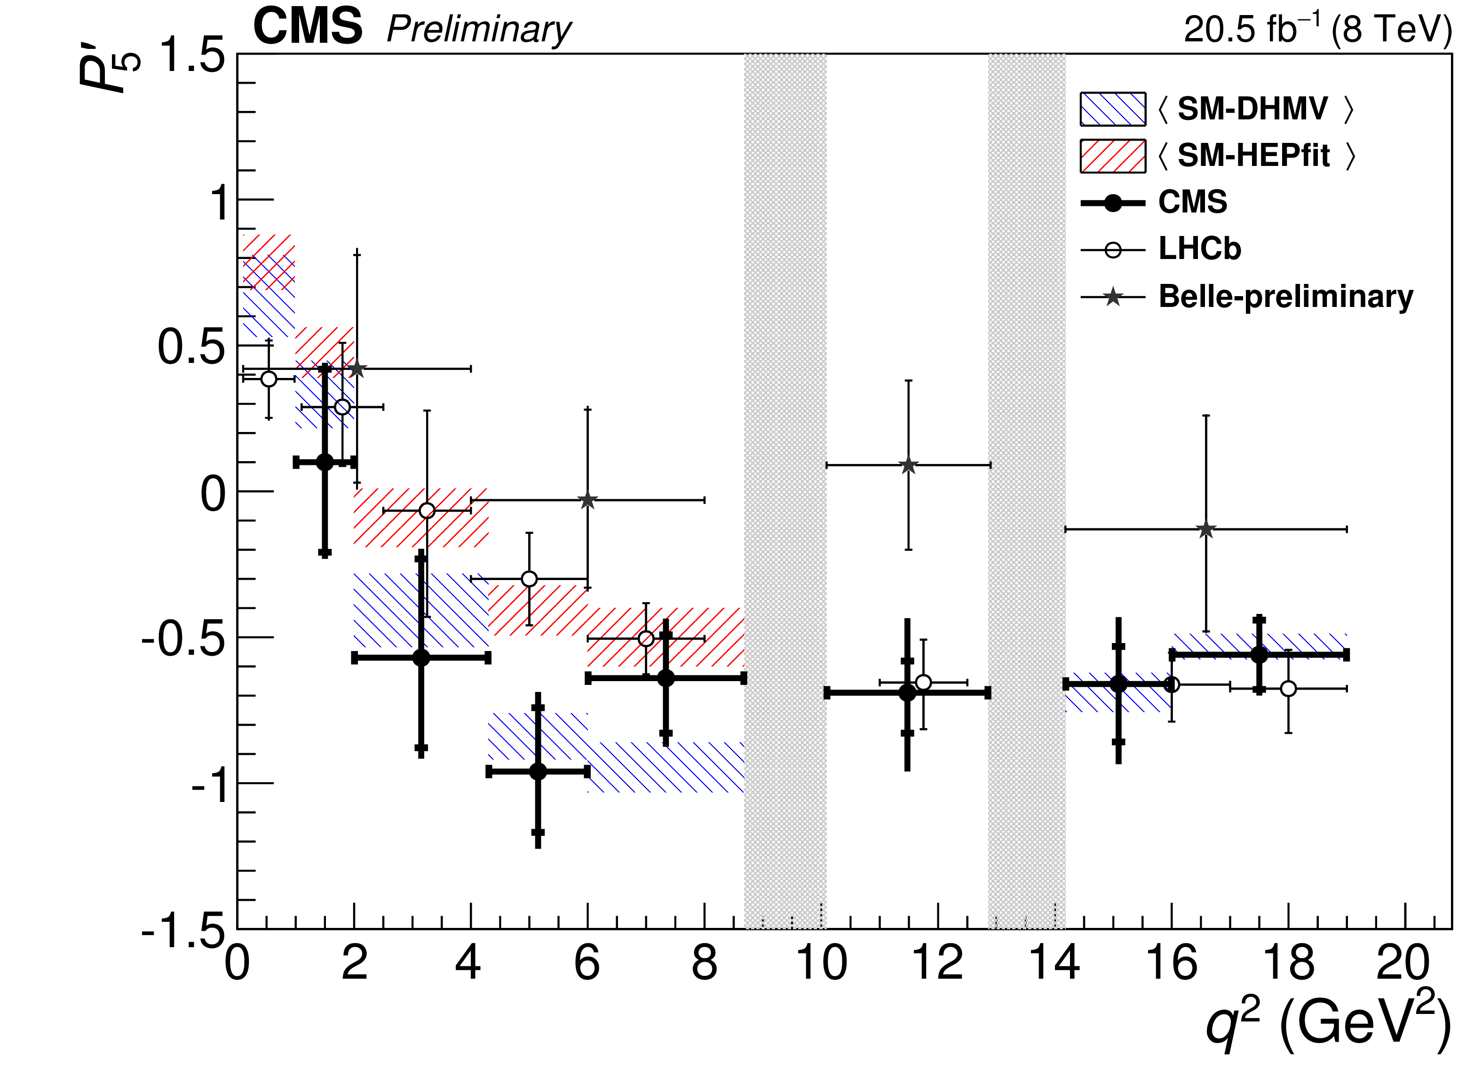
P₅’, B_{s}→μμ and B_{s}→ϕμμ
P₅´: angular observables in B→K*µµ ≈ 3σ
B_{s}→μμ and B_{s}→ϕμμ Br 20% to low; ≈ 2σ each
New particles and interactions exist!
writescience.wordpress.com
Hadronic uncertainties or NP?
Andreas Crivellin

Slide 9

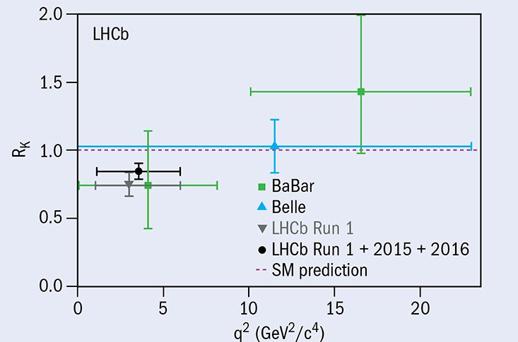
R(K⁽*⁾) = B→K⁽*⁾μ⁺μ⁻/B→K⁽*⁾e⁺e⁻
Lepton Flavour Violation in B decays?

Slide 10
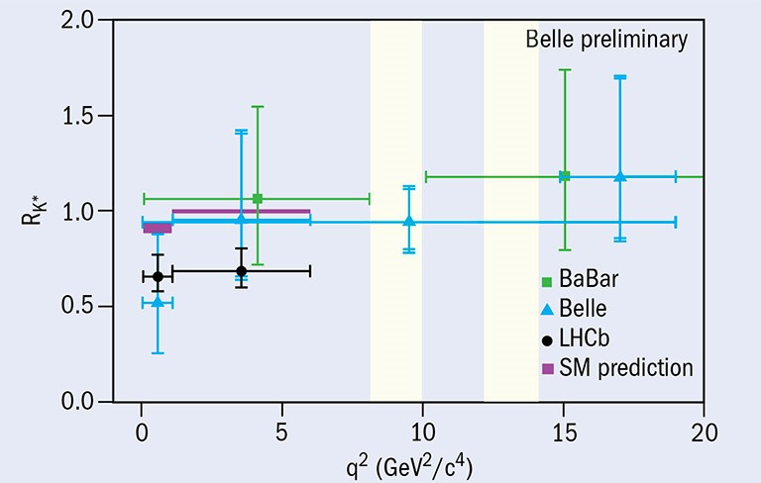
R(K⁽*⁾) = B→K⁽*⁾μ⁺μ⁻/B→K⁽*⁾e⁺e⁻
Lepton Flavour Violation in B decays?

Slide 11
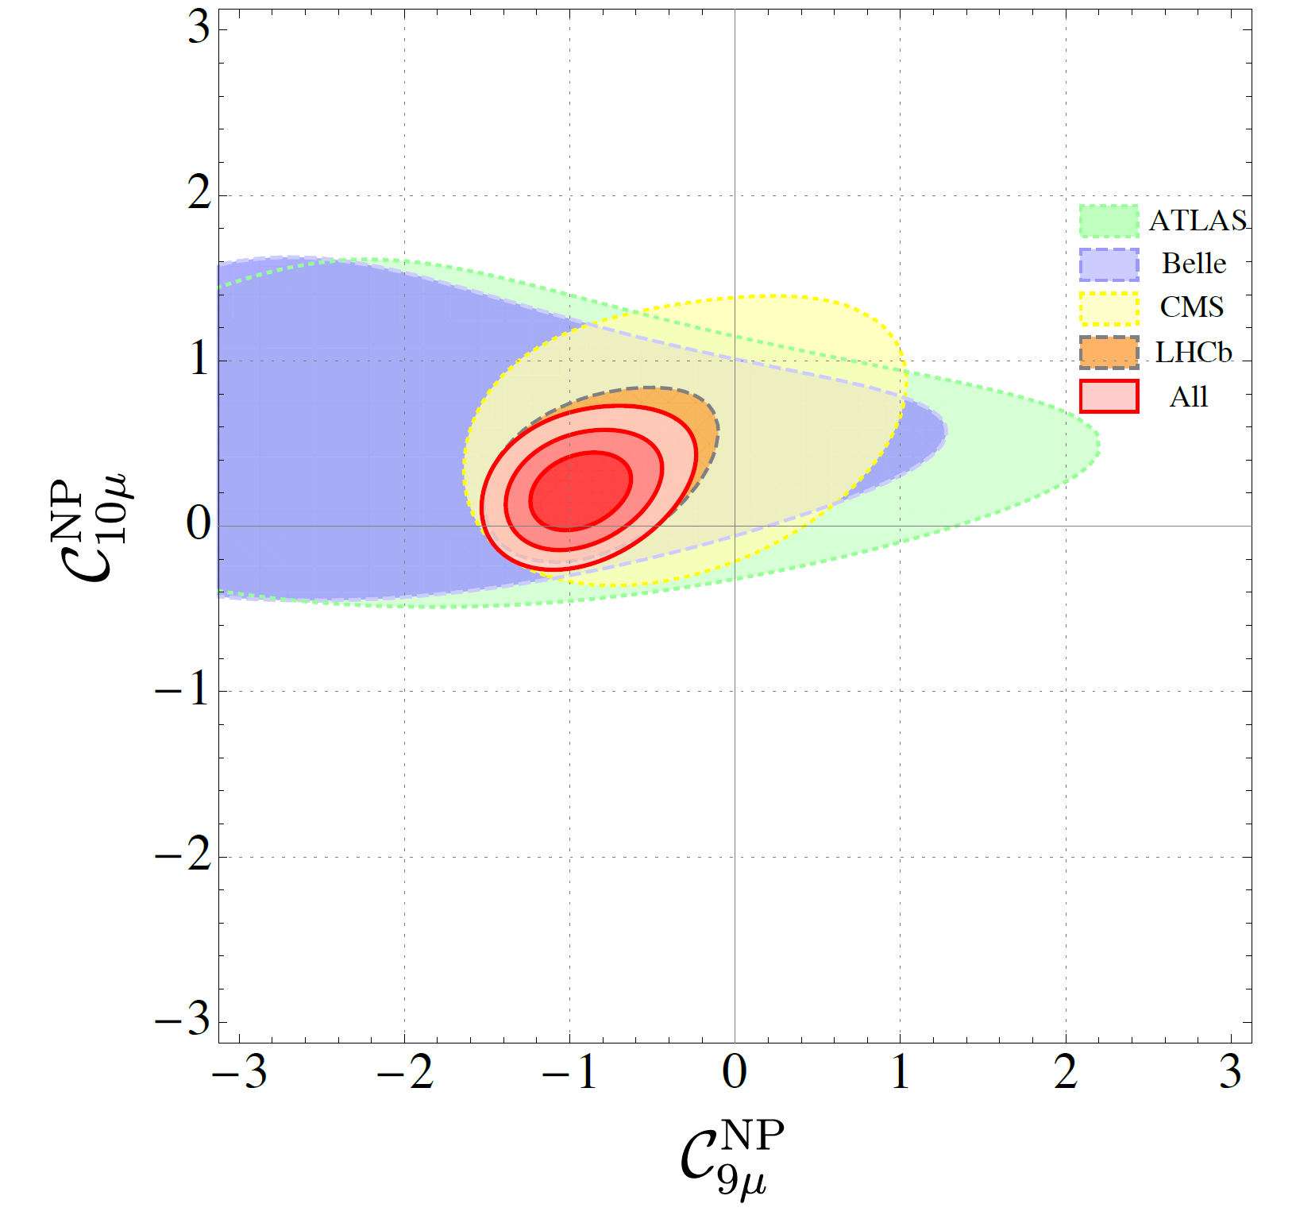
Global fit to b→sμ⁺μ⁻ data
Global analyses give a very good fit to data
Good fit to data:
1501.04239
M. Alguero, B. Capdevila, AC, S. Descotes-Genon, P. Masjuan J. Matias and J. Virto, arXiv:1903.09578 [hep-ph].
Fit is 5-6 σ better than the SM

Slide 12
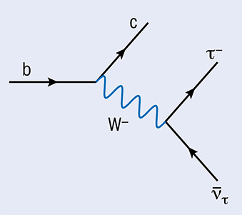
b→clν Transistions
B→Dlν, B →D*lnu, Λ_{b}→Λ_{c}lν
Tree-level decays
in the SM
Form factors
needed
With light leptons
(l=μ, e) used to determine the CKM elements
CKM fit works very well, i.e. tree-level in
agreement with ΔF=2 processes
Largest B branching ratios, used to determine the
CKM elements, usually assumed to be free of NP

Slide 13
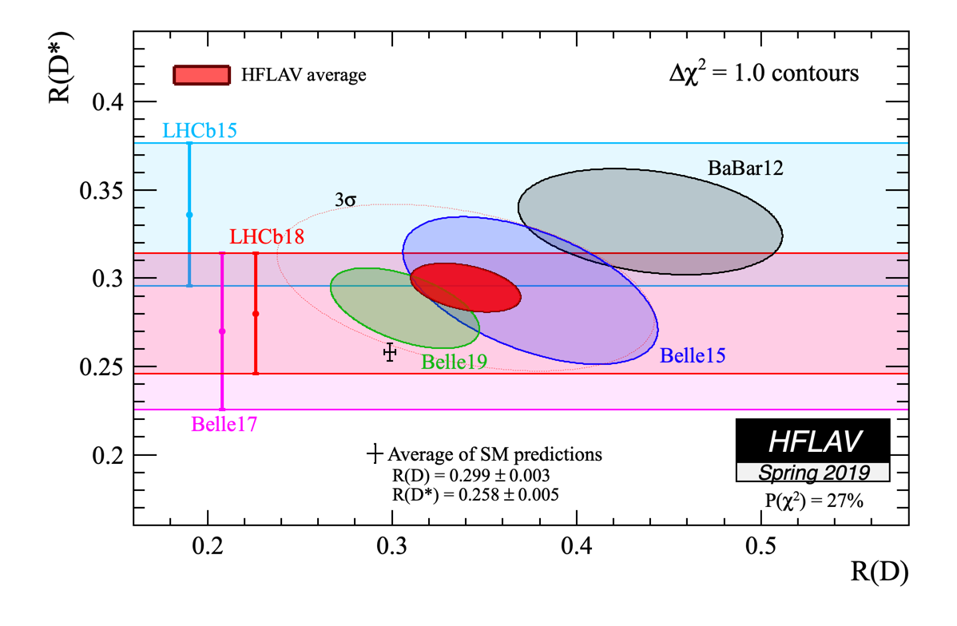
b→cτν Measurements
All measurements above the SM prediction
>3σ deviation

Slide 14
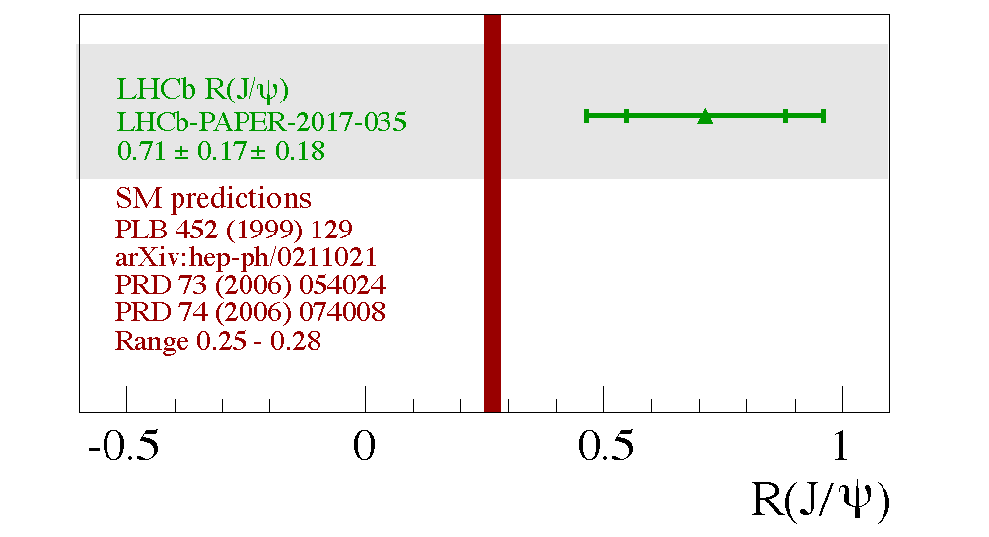
b→cτν Measurements
Supports R(D) & R(D*)

Slide 15
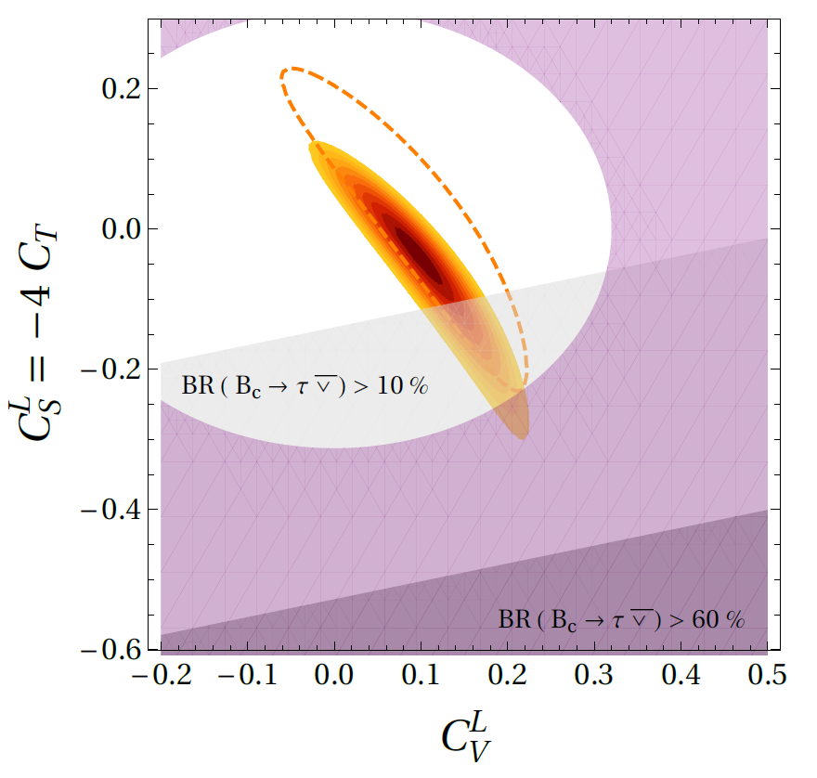
b→cτν Global Fit
1905.08253
Left-handed vector current needed
M. Blanke, A.C.,
T. Kitahara,
M. Moscati,
U. Nierste,
I. Nišandžić, 1905.08253

Slide 16
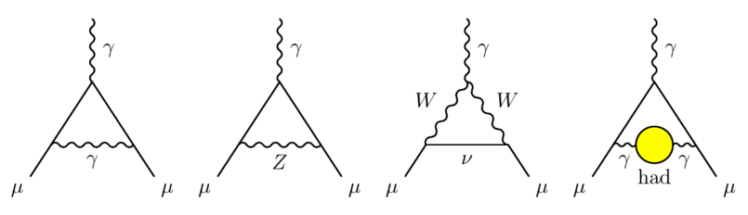
Muon Anomalous Magnetic Moment
Single measurement from BNL
Theory prediction sound but challenging because of hadronic effects.
Soon new experimental results
Small tension in with opposite sign
3σ deviation (order of SM-EW contribution)

Slide 17
Hints for New Physics
Lepton Flavour Universality Violation
(LFUV)
a_{e}
>2σ
b→sµµ
>5σ
b→cτν
>3σ
a_{µ}
>3σ
τ→Kν
>2σ
b→dµµ
b→uτν
1-2σ
V_{us}
>4σ
Andreas Crivellin

Slide 18
Extensions of the
Standard Model
to account for
the flavour anomalies

Slide 19
R(D) & R(D*)
Charged scalars: Problems with distributions and B_{c} lifetime
W’: Strong constraints from direct LHC searches
Leptoquark: Strong signals in qq→ττ searches
Explanation difficult but possible with Leptoquarks
8

Slide 20
b→sµ⁺µ⁻ explanations
W. Altmannshofer, S. Gori, M. Pospelov
and I. Yavin 1403.1269, ….
Z’
  Necessary effects in B_{s} mixing
  Collider constraints
Loop contributions
  Scalars and vector-like ferions
  2HDM
  R₂ Leptoquark
  Z’ coupling to tops
Leptoquarks
A.C., D. Müller and C. Wiegand, 1903.10440
D. Bečirević and O. Sumensari, 1704.05835
J. Kamenik, Y. Soreq and J. Zupan, 1704.06005
G. Hiller and M. Schmaltz arXiv:1408.1627
D. Bečirević, S. Fajfer and N. Košnik,1503.09024, ….
Small effect needed; many possibilities

Slide 21
a_{μ} explanations
MSSM
  tan(ß) enhanced slepton loops
Scalars
  Light scalars with enhanced muon couplings
Z’
  Very light with τμ couplings (m_{τ} enhancement)
Leptoquarks
  m_{t} enhaned effects
Chiral enhancement or very light particles
8

Slide 22
Simultaneous Explanation with the Pati-Salam
Leptoquark

Slide 23
Vector Leptoquark SU(2) Singlet
Left-handed effect in b→sμμ
Left-handed vector current in R(D) and R(D*)
No effect in b→sνν
No proton decay
Contained within the Pati-Salam model
Massive vector bosons
  Non-renormalizable without Higgs mechanism
  Pati Salam not possible at the Tev scale because of K_{L}→μe and K→πμe
Good solution, but difficult UV completion

Slide 24
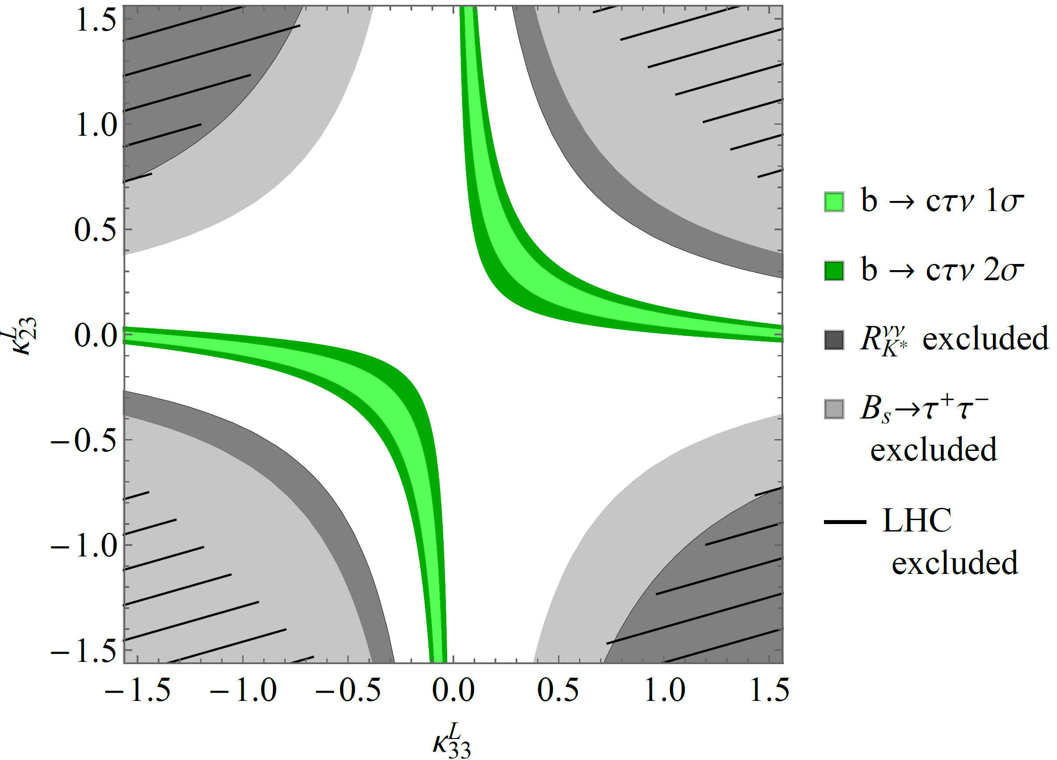
Vector LQ Phenomenology
Compatible with constraints for generic couplings

Slide 25
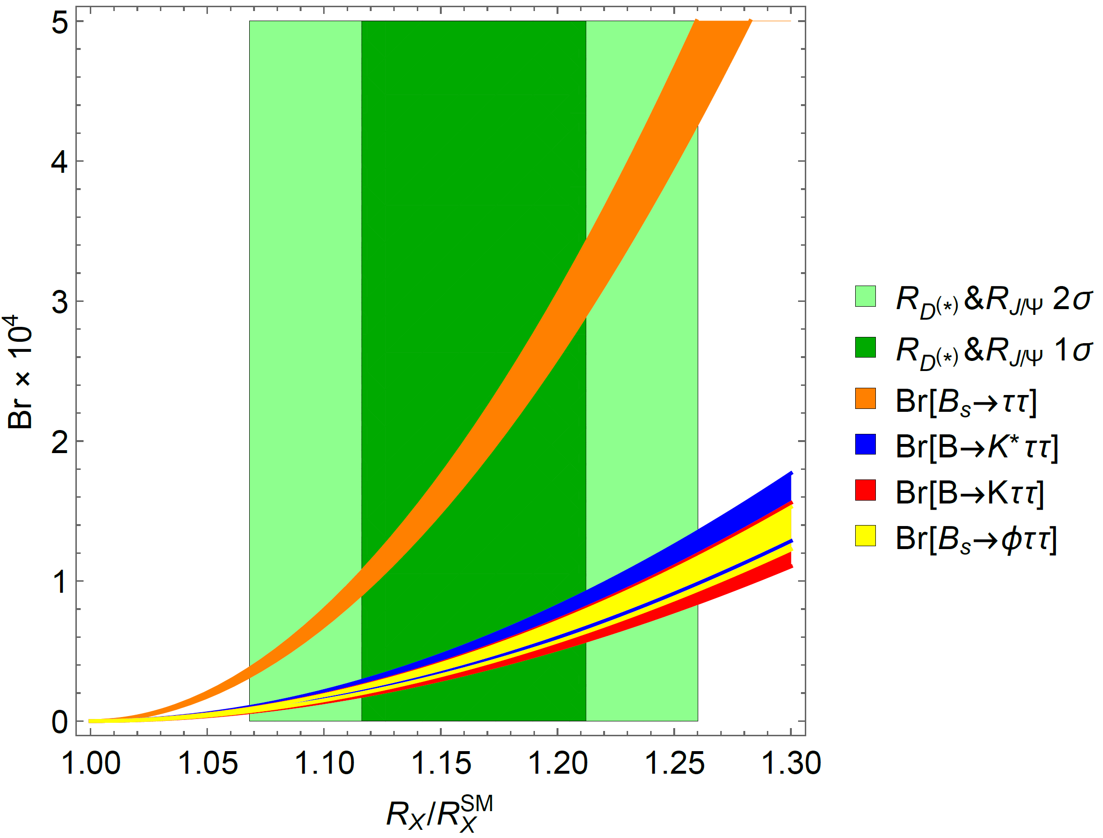
R(D⁽*⁾) and b→sττ
Large couplings to the second generation
b→sττ
very strongly enhanced
B. Capdevila, AC, S. Descotes-Genon, L. Hofer and J. Matias, PRL.120.181802

Slide 26
Important Loop-Effects
Explanation of b→cτν requires large bτ and sτ couplings (follows from SU(2) invariance)
AC, C. Greub, D. Müller,
F. Saturnino, PRL 2018
Large loop effects in b→sμμ

Slide 27
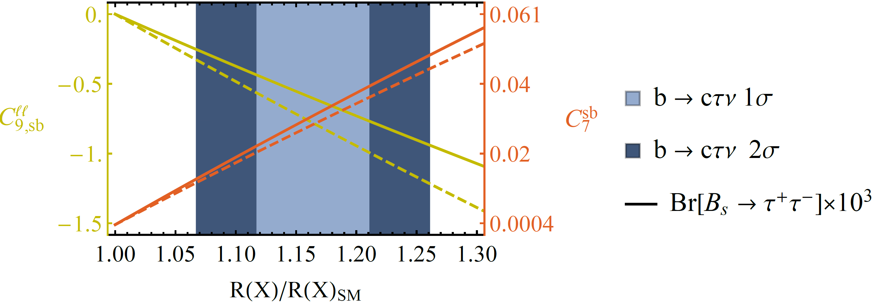
Important Loop-Effects
Explanation of b→cτν requires large bτ and sτ couplings (follows from SU(2) invariance)
AC, C. Greub, D. Müller,
F. Saturnino, PRL 2018
Large loop effects in b→sμμ

Slide 28
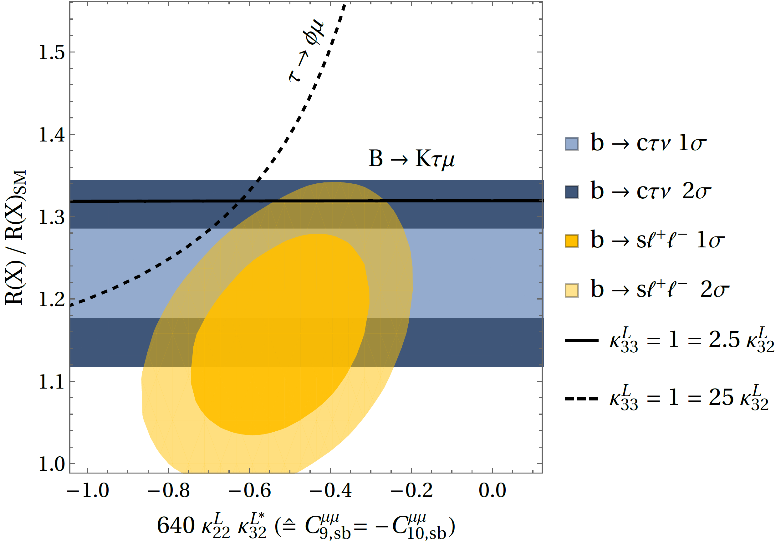
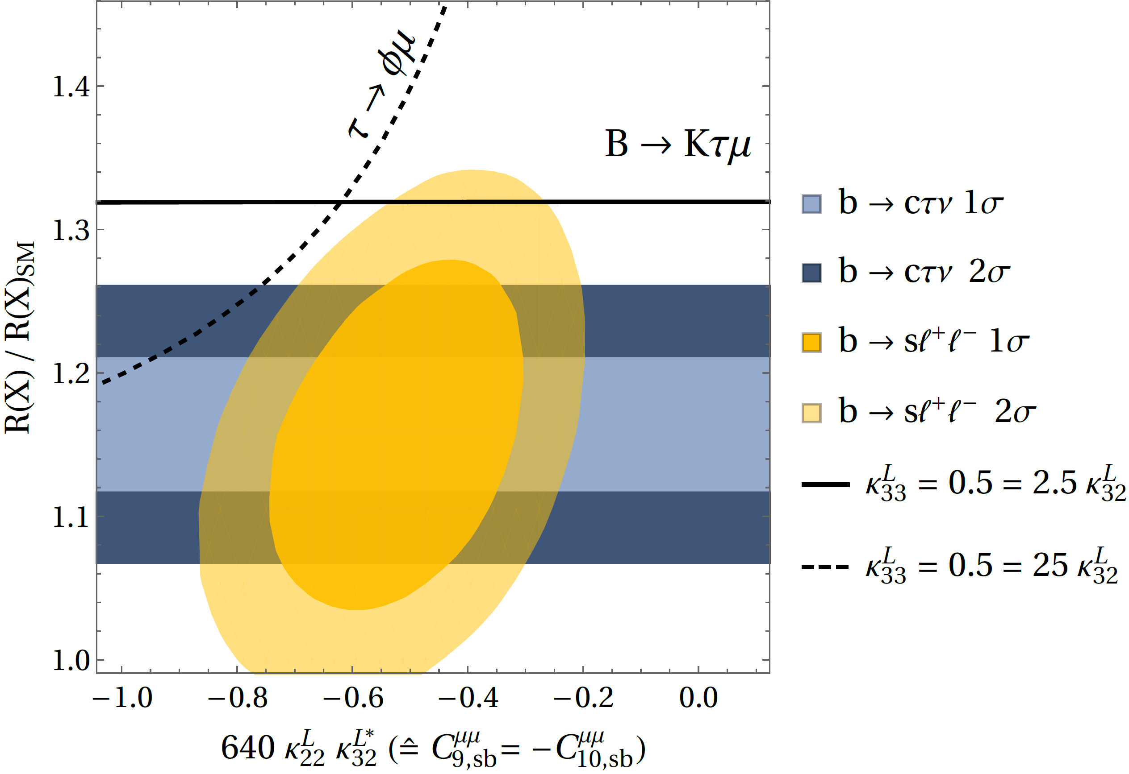
Perfect agreement with data
Pati-Salam LQ can explain the flavour anomalies

Slide 29
Possible UV completions
SU(4)×SU(3)’×SU(2)_{L}×U(1)_{Y} + Vector-like fermions
L. Di Luzio, A. Greljo, M. Nardecchia, arXiv:1708.08450
SU(4)×U(2)_{L}×SU(2)_{R} + Vector-like fermions
L. Calibbi, AC, T. Li, arXiv:1709.00692
SU(4)× SU(4)× SU(4)
M. Bordone, C. Cornella, J. Fuentes-Martin, G. Isidori, arXiv:1712.01368
SU(4) ×U(2)_{L}×SU(2)_{R} including scalar LQs and
light right-handed neutrinos
J. Heeck, D. Teresi, arXiv:1808.07492
SU(8) might even explain ɛ’/ɛ
S. Matsuzaki, K. Nishiwaki and K. Yamamoto, arXiv:1806.02312
SU(4)×U(2)×SU(2)_{R} in RS background
M. Blanke, AC, arXiv:1801.07256
Good solution, but challenging UV completion

Slide 30
Pati-Salam RS Phenomenology
M. Blanke, AC, PRL 2018
Modell well motivated + limited but sizable effect

Slide 31
Scalar
Leptoquarks

Slide 32
Leptoquarks in a_{μ}
Chirally enhanced effects via top-loops
Left-, right- handed muons-top
coupling
E. Leskow, A.C., G. D'Ambrosio, D. Müller
arXiv:1612.06858
P. Arnan, D. Becirevic, F. Mescia, O. Sumensari,
arXiv:1901.06315 [hep-ph]
Z→μμ at future colliders
8

Slide 33
Two Scalar Leptoquarks
AC, D. Mueller, T. Ota
arxiv:1703.09226
scalar leptoquark singlet with Y=-2/3
scalar leptoquark triplet with Y=-2/3
Constructive in R(D⁽*⁾)
Destructive in b→sμμ

Slide 34
R(D⁽*⁾), b→sνν with 2 Scalar LQs

Slide 35
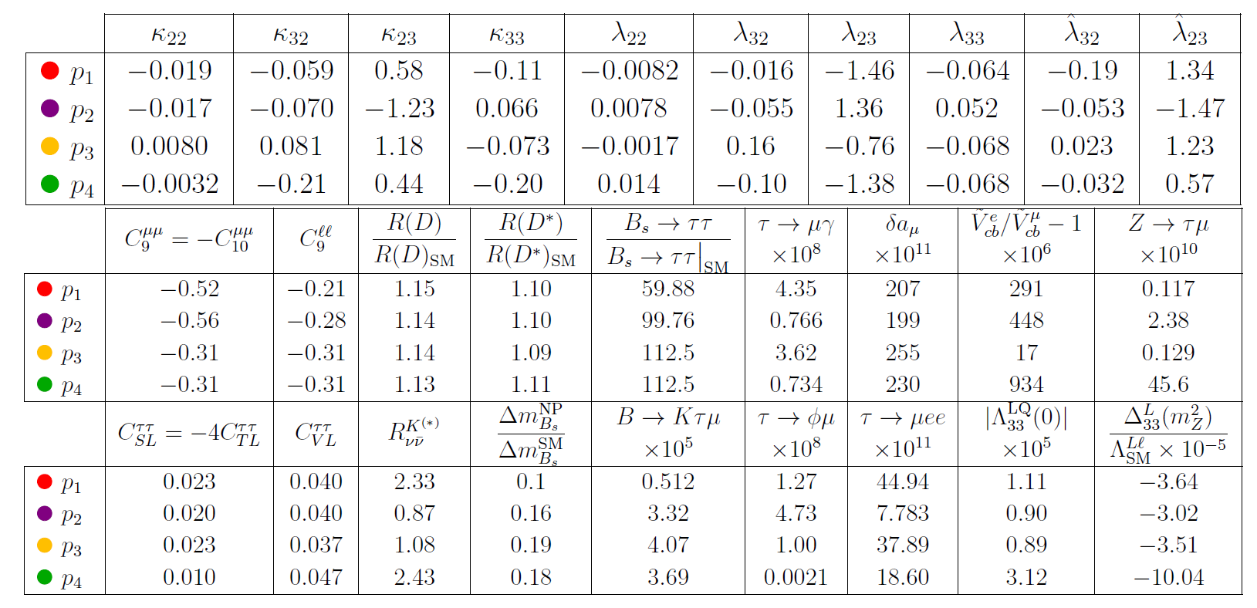
R(D⁽*⁾), b→sll and a_{µ}
4 benchmark points
AC, D. Mueller, F. Saturnino
arxiv:1912.04224
Common explanation possible

Slide 36
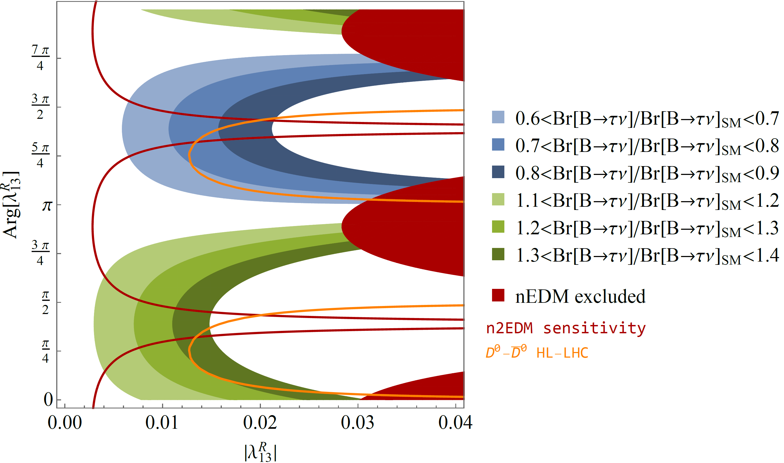
Correlations the neutron EDM with S1
W. Dekens, J. de Vries, M. Jung,
K. K. Vos, arXiv:1809.09114
AC, F. Saturnino
arxiv:1905:08257
1905:08257
J. Aebischer, AC, F. Saturnino, 1905.xxx
Effect in B predicts measurable nEDM effect

Slide 37
QCD corrections to the Matching
Perform matching
Correct for 4-dimensional Fierz identities

Slide 38
Results
J. Aebischer, AC, C. Greub, 1811.08907
Slightly weaker LHC constraints

Slide 39
Conclusions
R(D⁽*⁾)
a_{μ}
(PRV)
MSSM
Lepto-quarks
b→sμμ
ε'/ε
scalars and fermions
B→Kπ
Z’ gauge boson
Andreas Crivellin

Slide 40
Outlook
P5’ b→dμμ
R(D) & R(D*) b→sττ
R(K) & R(K*) μ→eγ, μ→eee
a_{μ} Z→μμ, d_{μ,} μ→eγ
R(D), R(D*) & a_{μ} τ →μγ, τ →μμμ
R(D), R(D*) & b → sμμ b →sτμ, τ →φμ
NP
Interesting experimental prospects

Slide 41
Z’ in b→sµµ, ɛ’/ɛ and hadronic B decays

Slide 42
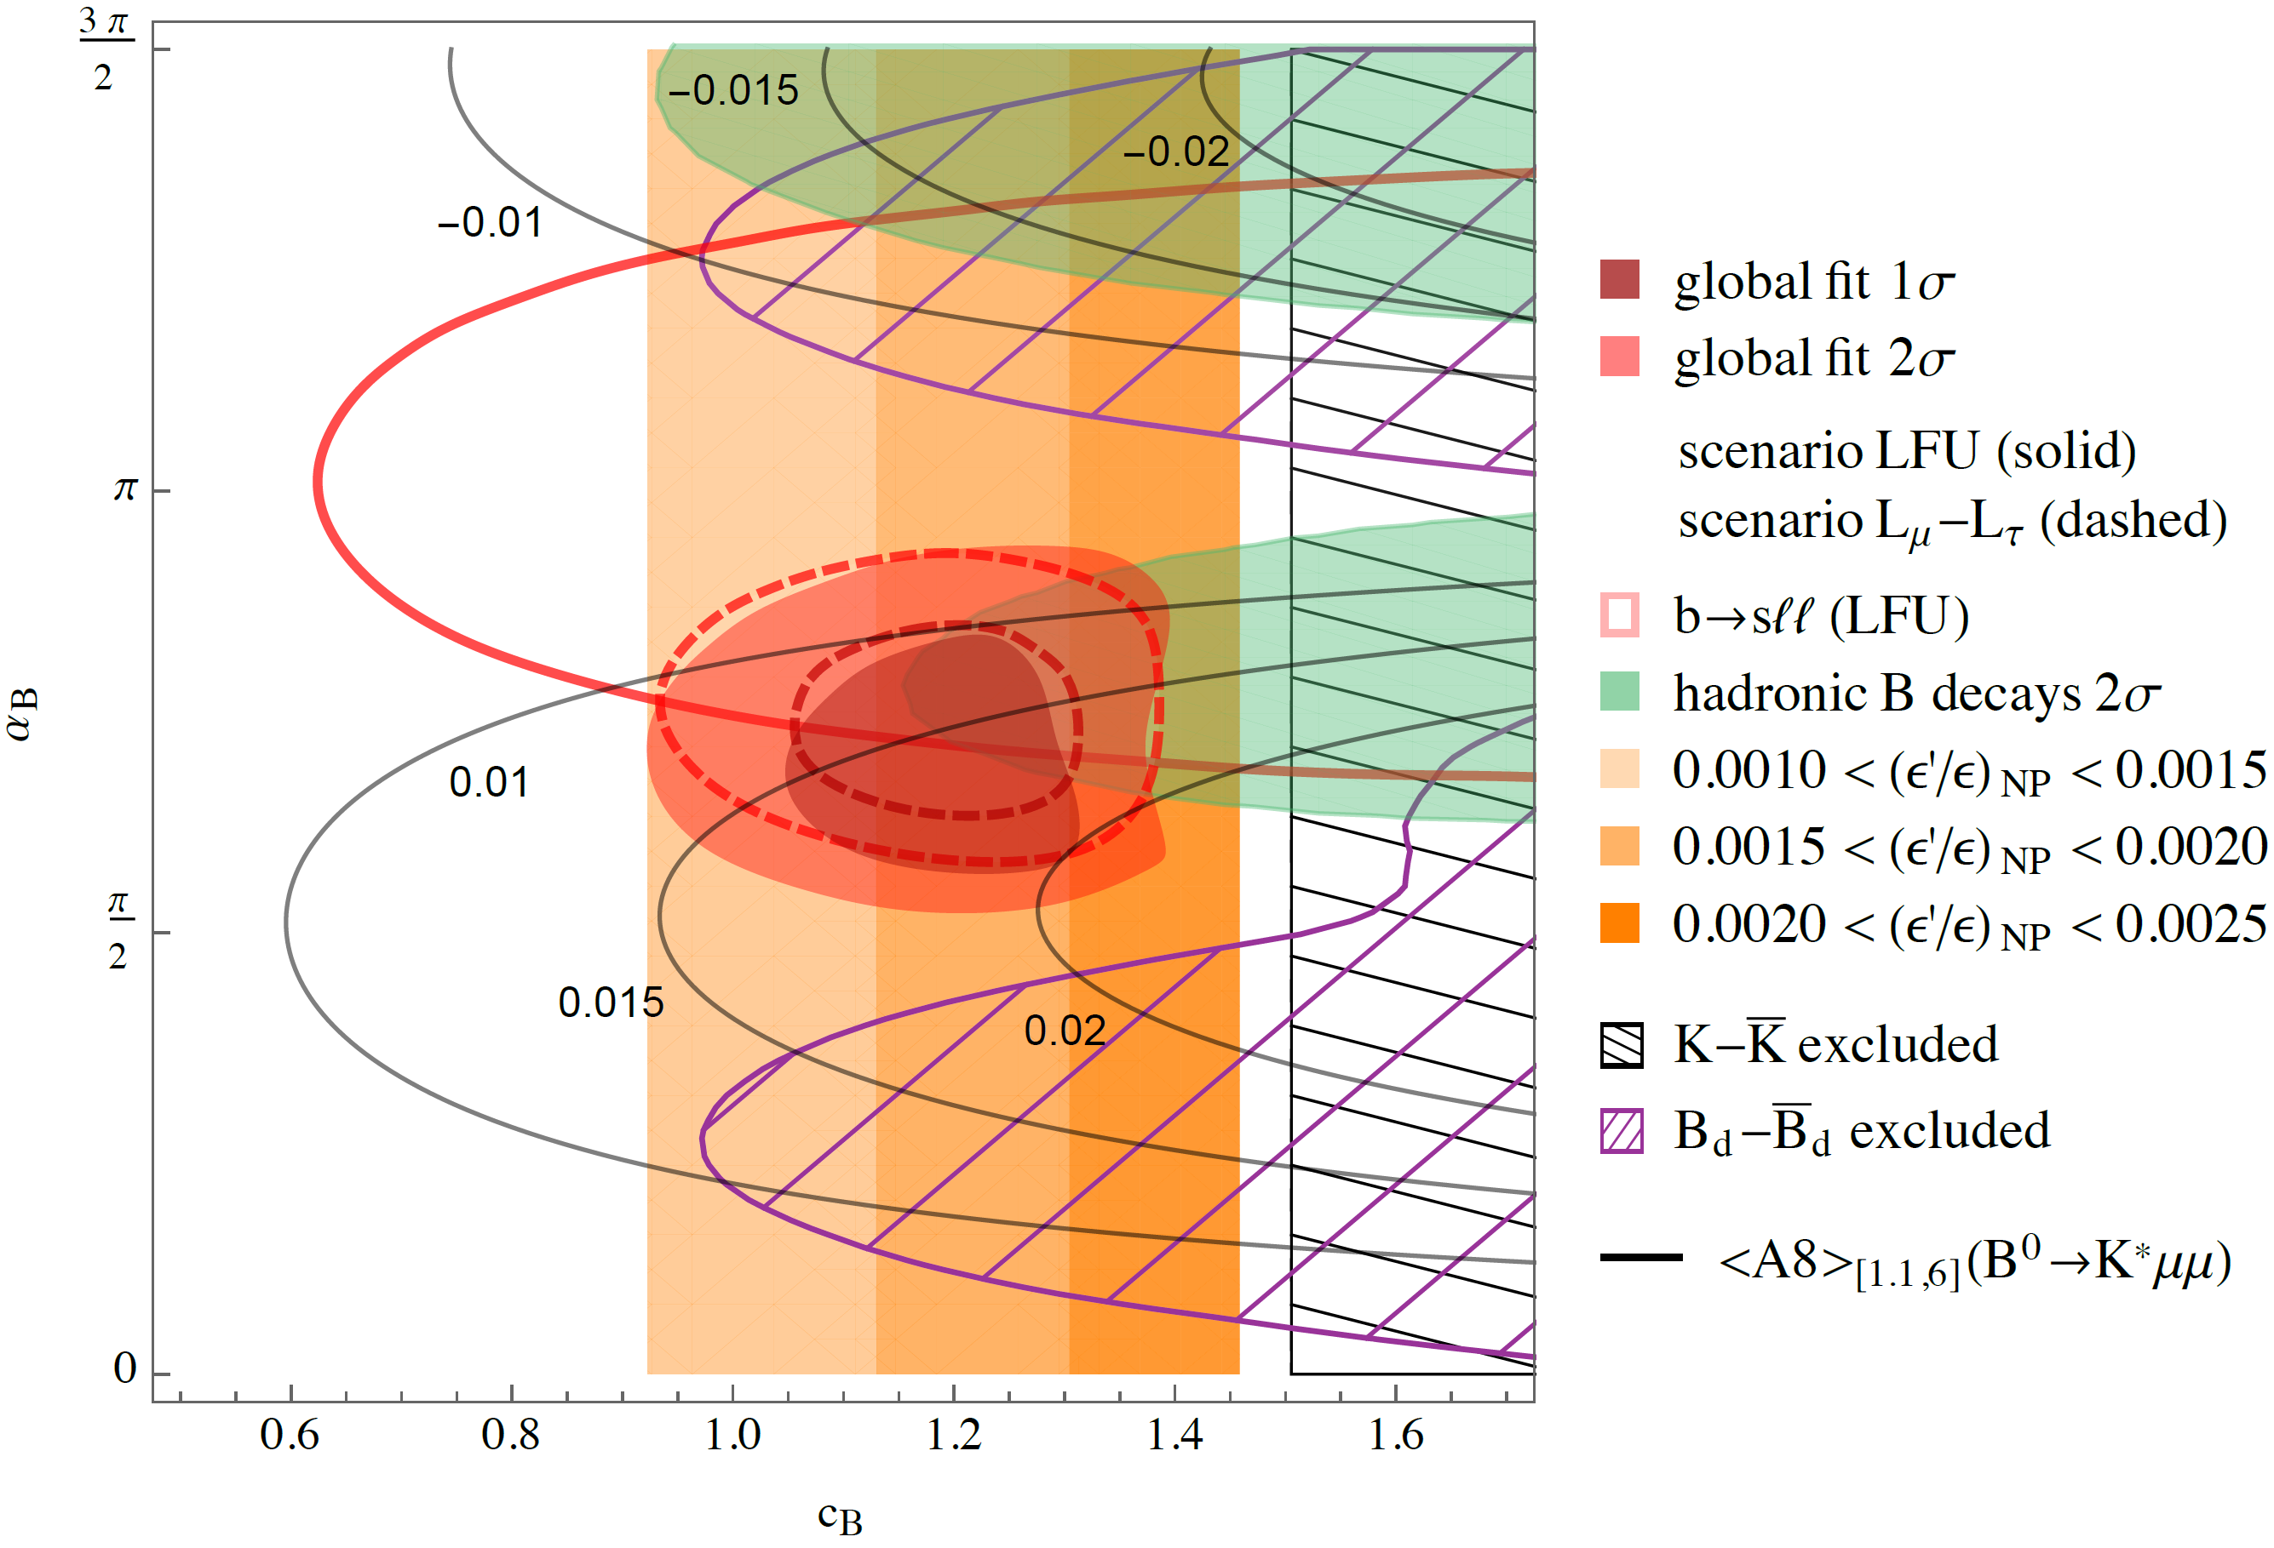
Z’ model with U(2) flavour
L. Calibbi, AC, F. Kirk, C. A. Manzari, L. Vernazza.
arXiv:1910.00014
Common explanation possible

Slide 43
CP violation in Kaon decays: ε‘/ ε
ε: indirect CP violation in Kaon decays
  K_{L} and K_{S} are not CP eigenstates due to mixing
ε': direct CP violation in Kaon decays
Buras et al.
Measurement ≈3σ above the SM prediction

Slide 44
Hadronic B decays
L. Hofer, D. Scherer, L. Vernazza, arXiv:1011.6319 [hep-ph]
Longstanding B→πK Puzzle
More observables like
CP and
isospin
violation
needed
Similar
picture
in D decays
Global fit to data: 2-3σ

Slide 45
ε‘/ ε explanations
W_{R} coupling
Z’ (also for ΔA_{CP})
MSSM
V. Cirigliano, et al. arXiv:1612.03914
A. Buras, et al.
arXiv:1507.08672
A. Buras and F. De Fazio,
arXiv:1512.02869
T. Kitahara, U. Nierste,
P. Tremper, arXiv:1604.07400
M. Endo, et al. arXiv:1608.01444
A. Crivellin, G. D'Ambrosio,
T. Kitahara and U. Nierste,
arXiv:1703.05786

