Slide 1
Status and Updates on Protomodels v2
Sahana Narasimha

Slide 2
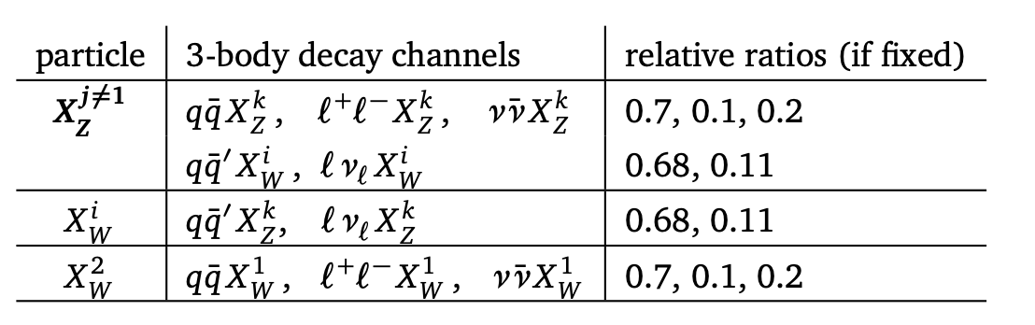
Feb – Mar
Started familiarizing with the the previous version of the code
Transitioning from smodels v2-> v3
Included offshell decays
Running multiple walks , understanding how walks work got initial protomodels with SmodelS v3 (software)
Trying to understand the ideas for test statistic

Slide 3
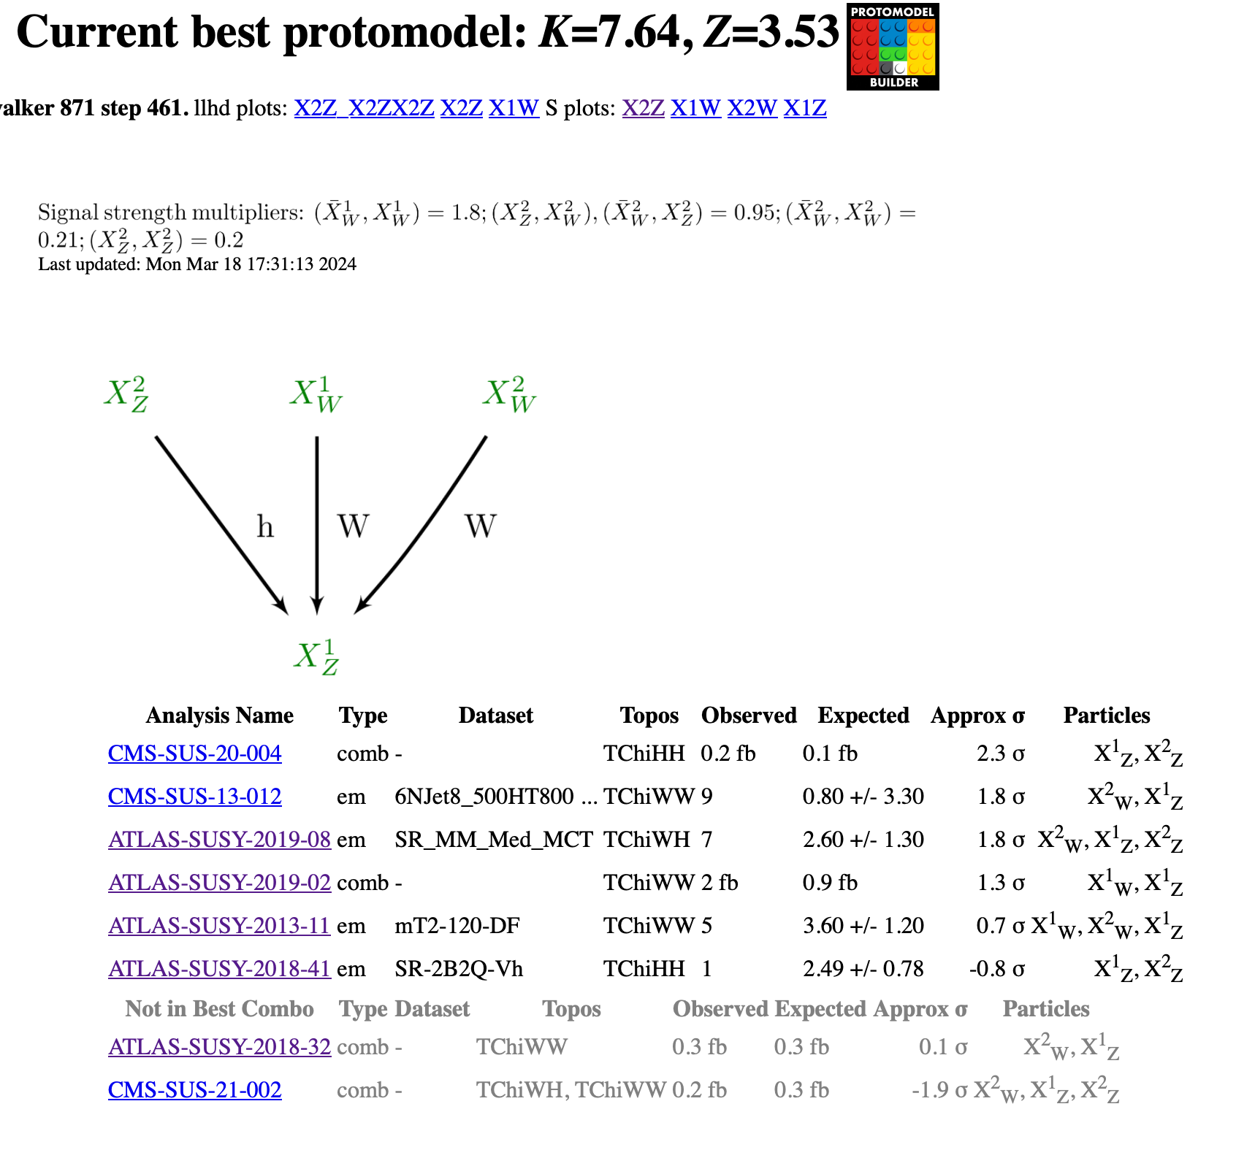
Initial run in Mar, with SModelS v3 (software)

Slide 4
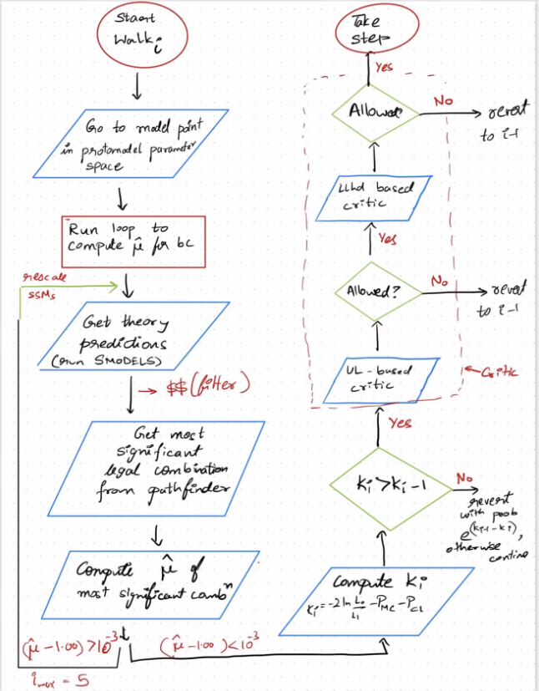
Apr - July
Jamie & Timothée
  Discussion on penalizing for combination length
  Integration of pathfinder in protomodel
Changed the flow of the decision making process
With Timothée
  write and update combination matrix in YAML format Upgrade Critics with Timothee – UL critic decision
  Upgrading critics -> worked on mostly the UL critic

Slide 5
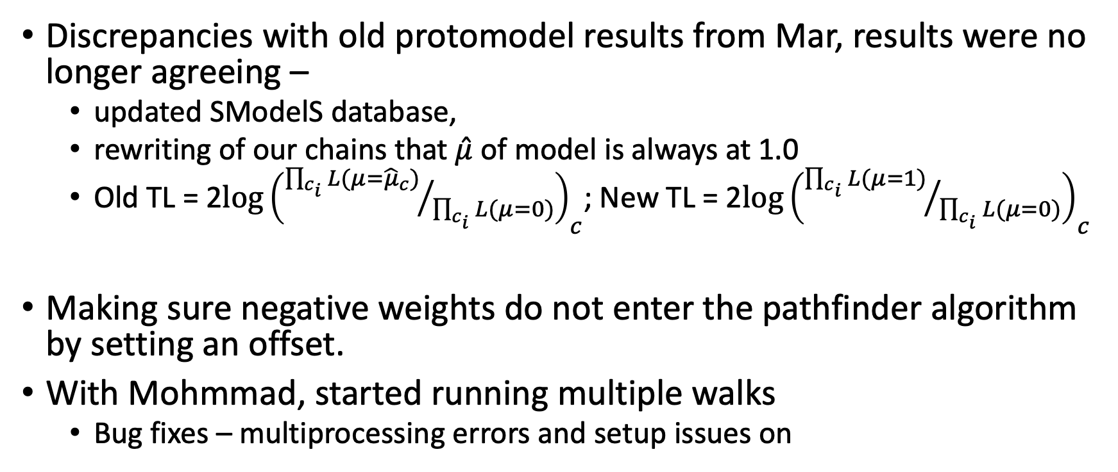
Sep - Oct
Discrepancies with old protomodel results from Mar, results were no longer agreeing –
  updated SModelS database,
  rewriting of our chains that $\hat{μ}$ of model is always at 1.0
  Old TL = 2$log{\left({\prod_{c_{i}}{L({μ=\hat{μ}}_{c})}}/{\prod_{c_{i}}{L(μ=0)}}\right)}_{c}$; New TL = 2$log{\left({\prod_{c_{i}}{L(μ=1)}}/{\prod_{c_{i}}{L(μ=0)}}\right)}_{c}$
Making sure negative weights do not enter the pathfinder algorithm by setting an offset.
With Mohmmad, started running multiple walks
  Bug fixes – multiprocessing errors and setup issues on

Slide 6
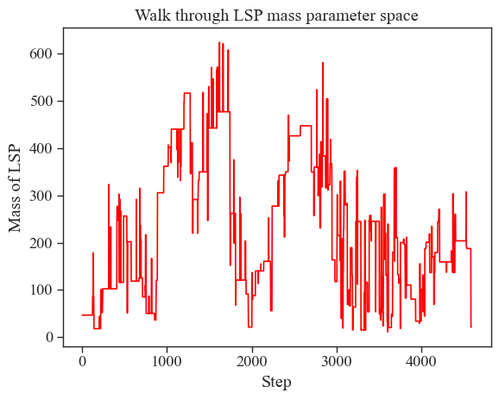
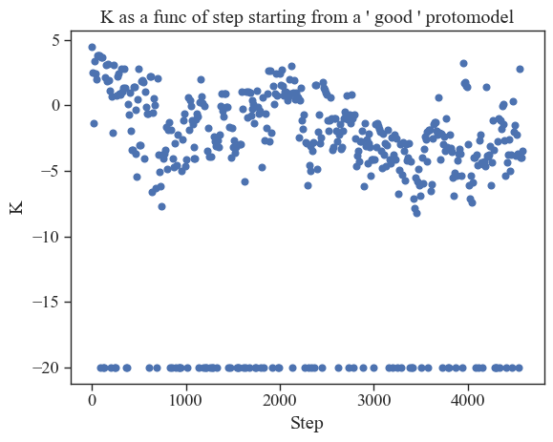
How is it walking?
With Mohammad – is entire parameter space covered if we don’t take into account K and TL?

Slide 7
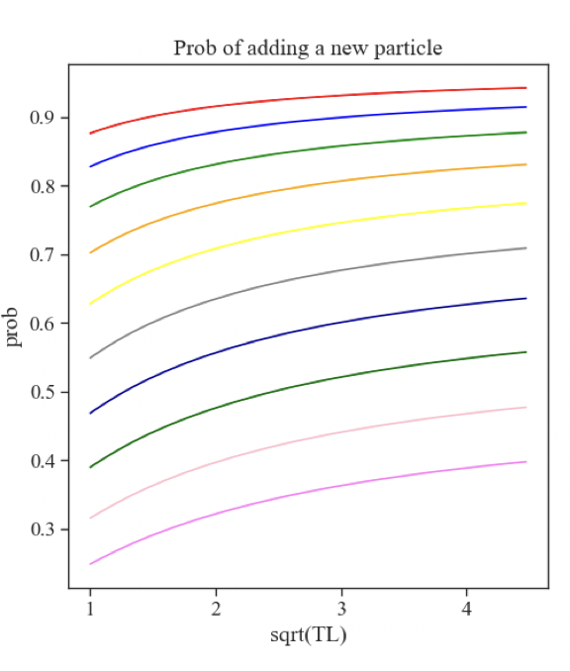
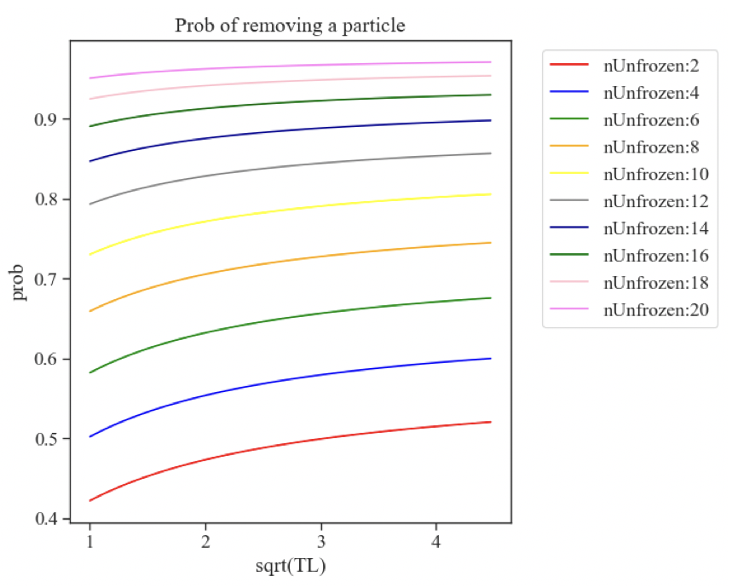
Proposal Density
old

Slide 8
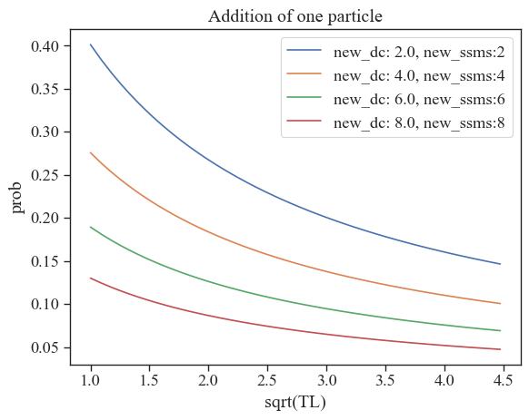
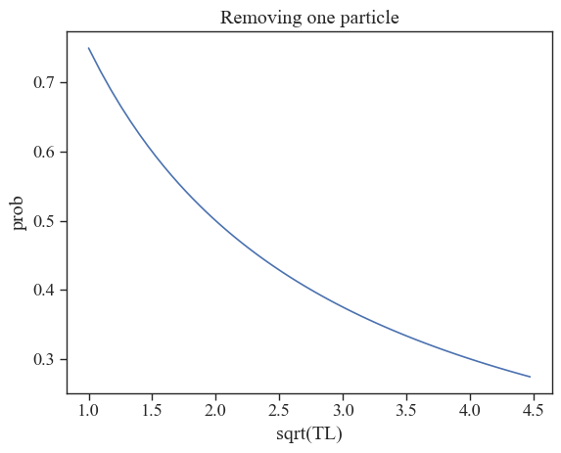
Current

Slide 9
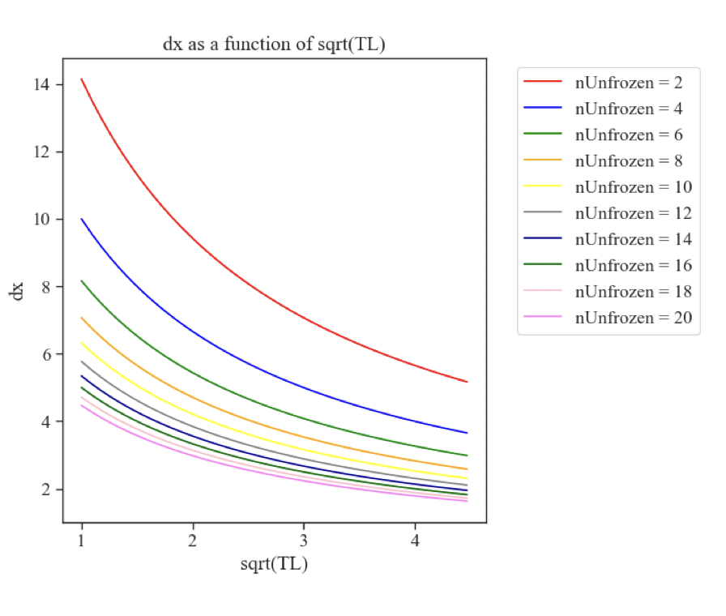
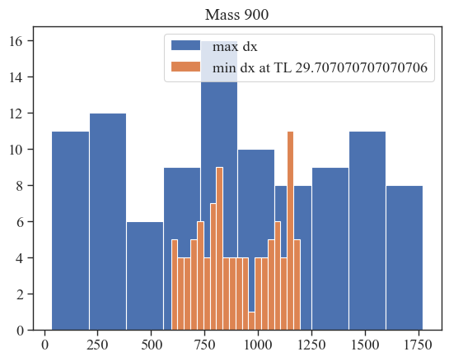
Old
Current

Slide 10
In Progress…
With Humberto, convergence tests
With Mohmmad, looking at the proposal and posterior distribution from fake SM and real data
With Wolfgang, looking at the penalty term for signal regions

