Slide 1


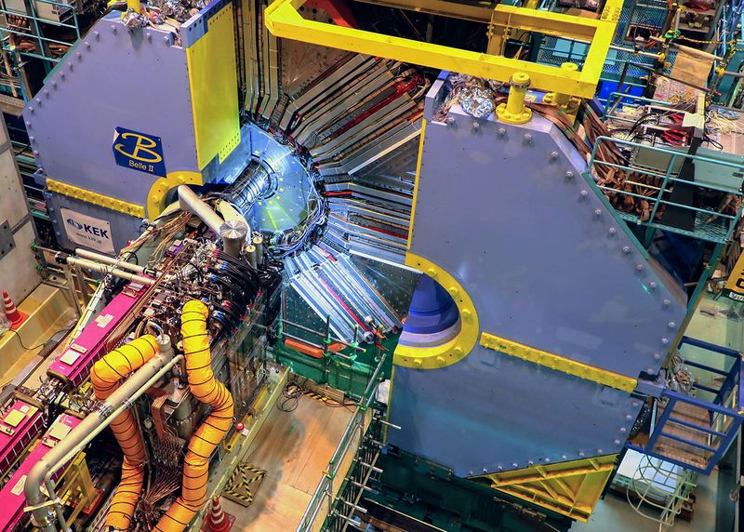
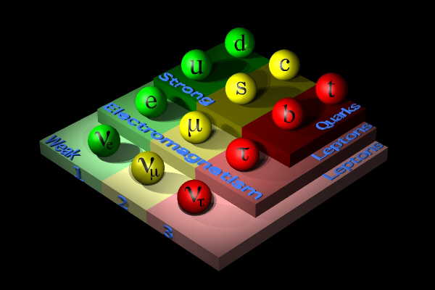
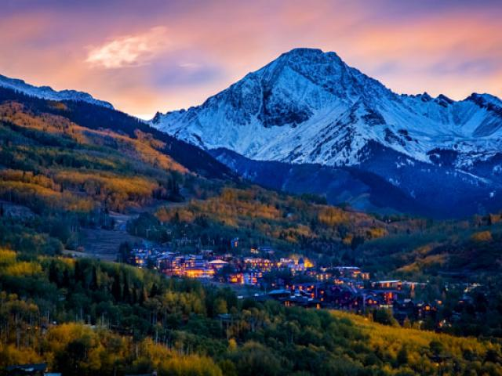
From Belle to Belle II and Beyond:
(Challenges for Belle II in the “Anomaly Era”)
Tom Browder (University of Hawai’i)
Some historical perspective:
(Belle, BaBar, HERA-B ?)
Belle II/SuperKEKB startup
https://cerncourier.com/a/superkekb-raises-the-bar/
SuperKEKB Challenges
Belle II/SuperKEKB@Snowmass: the Belle II Physics Mind Map, SuperKEKB upgrades and Belle II upgrades
Belle II Social Media (did not have this kind of outreach in Belle)
https://www.facebook.com/belle2collab/
https://twitter.com/belle2collab?lang=en
https://www.instagram.com/belle2collab/?hl=en
Notes:
Thanks to Gianluca for the invitation. I hope I can make some stimulating remarks. Note the figure showing QM billiards, the Belle II detector with the superconducting final focus visible and a snowmy mountain scenery (not in the European Alps !)

Slide 2
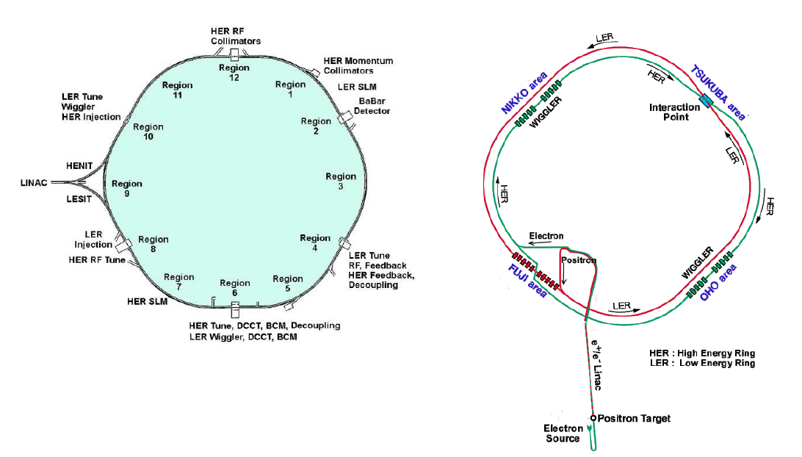
Brief History of the sin(2ϕ₁)/sin(2β) discovery
Two major facilities: Rather significant investments with a clear and straightforward physics goal to observe the expected large CPV in the B sector e.g. over ten years ~$1 billion dollars for KEKB.
c.f. LCLS-II (X ray FEL) will cost about $2 billion dollars; a typical new storage ring light source is $1 billion dollars. The DESY X-FEL will be a factor of a few more.
The US EIC (Electron Ion Collider) project is about 3 billion dollars.
PEP-II
KEKB

Slide 3
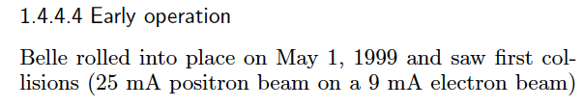
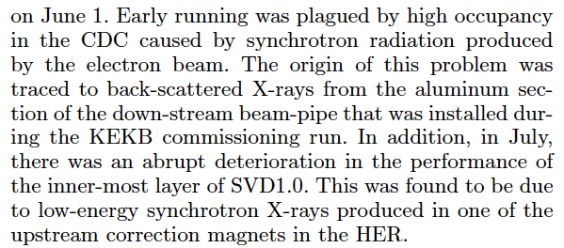
1999
From the B Factory Physics Book, p.34, arXiv: 1406.6311
A recap of some the technical problems.
SVD 1.0 was replaced by the spare SVD1.1 during the two-month summer shutdown. Added gold shielding on the beampipe. Fixed CDC grounding, added masks.
Notes:
BaBar had sparking and difficulties operating their CDC, huge backgrounds from the final dipole magnet, problems with extracting and using data from the OBJECTIVITY database, issues with VXD alignment. These problems were all overcome quite rapidly.

Slide 4
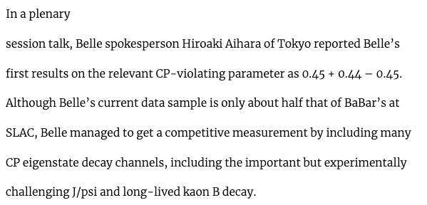
History: Summer 2000, Osaka ICHEP Conference
CERN Courier Report
BaBar had integrated a substanstial sample: 9 fb⁻¹ and reported
Notes:
Most people remember that the conference banquet ran out of food after 15 minutes and the weather in Osaka was extremely hot and humid but not the CP violation results. Some theorists over-interpreted the BaBar central value as a breakdown of the SM.

Slide 5
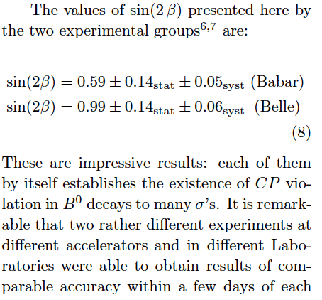
History:
July 23, 2001, Rome
J. Dorfan (SLAC)
S. Olsen (Hawaii)
Summary talk by Nicola Cabibbo at the 2001 Lepton Physics Symposium in Rome, Italy. (July 28, 2001)

Slide 6

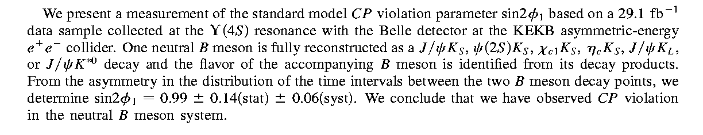
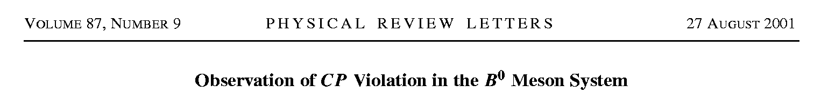
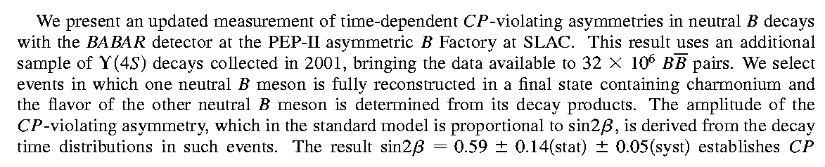
History: Summer of 2001
KEK
Belle:
SLAC
BaBar:
The first example of CP Violation outside of the kaon system.
CP Violating Effects of O(1) rather than O(10⁻³)
Notes:
Frantic Preparations; Graduate students at U Tokyo sleeping on their desks. PRL’s submitted during the conference.

Slide 7
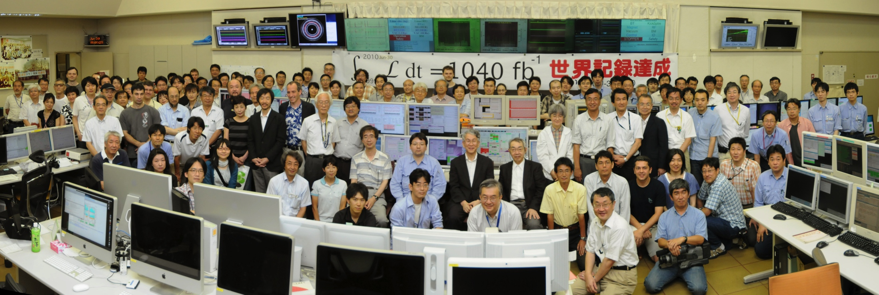
The conclusion of KEKB+Belle running in 2010
Belle実験グループ代表の一人、ハワイ大学のトム・ブラウダー教授は「11年前にKEKBとBelleが実験を開始したとき、世界最高のルミノシティを達成すると外部の人は予想していなかった。ここに至るまでの道のりは平坦ではなかったが、小林・益川両博士にノーベル賞をもたらしたＢ中間子のCP対称性の破れの確認など、世界各地の大学院生や研究者が数多くの論文を執筆するための重要なデータを得ることができた。これらのデータで得られた科学上の知見の大きさははかりしれない。」と述べます
I also explained that nano-beams would be so hard that KEKB would have to become an international collaboration to solve the associated technical problems.
I was very happy that my speech at this event was translated into Japanese.
http://www.kek.jp/ja/news/topics/2010/KEKBfactory.html
SuperKEKB was approved. Time to change focus.
Notes:
9 years later it was all over. We integrated 1 ab-1 and demonstrated through a large number of measurements that the KM theory is correct (at the 10% level) and enabled the 2008 Nobel Prize for Kobayashi and Maskawa.

Slide 8
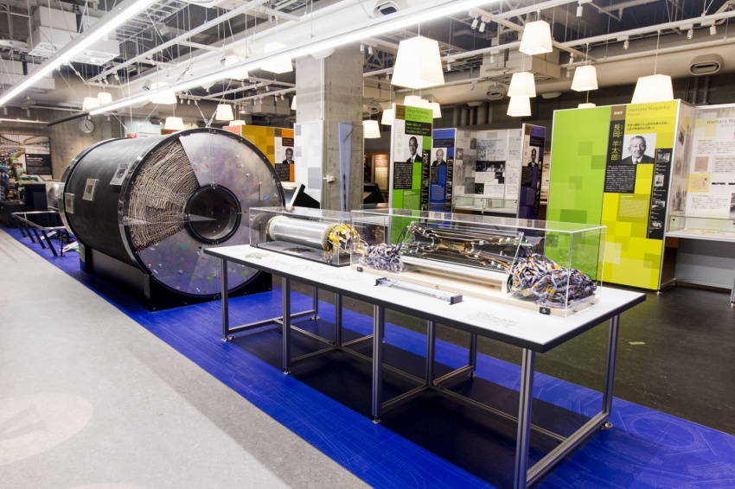
Belle Central Drift Chamber (CDC) and Silicon Vertex Detector (SVD2.0) in the Ueno Science Museum in Tokyo
Also an exhibit on Japanese Nobel Prize Winners (including Kobayashi and Maskawa)
We went through many SVD’s. Usually a summer shutdown was sufficient to install a new SVD.
Exhibit Opened in July 2015
Notes:
Central drift chamber, small-cell chamber and SVD 2.0 detector. Notice the large volume of cables coming out of SVD2.0. These are now museum pieces.

Slide 9
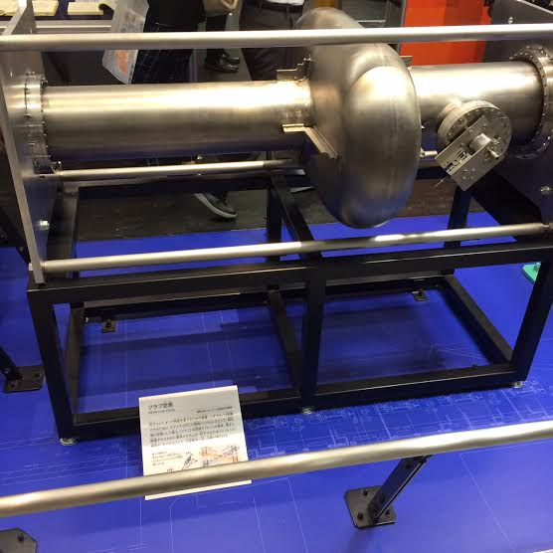
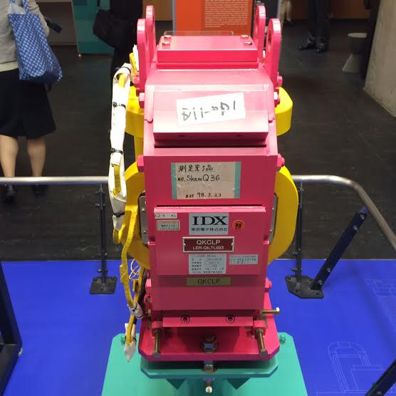
Crab cavity (superconducting) and a skew sextupole from KEKB in the Ueno Science Museum in Tokyo
Not to be confused with the “crab waist”
On the left is a superconducting crab cavity used to rotate the beams in the crossing-angle scheme so that they achieve head-on collisions. The crab cavities were not effective until skew sextupoles were added to correct optical defects. Combining these two elements, a peak of luminosity of 2.1 x 10³⁴ /cm^2/sec was achieved.
Notes:
On the left is a superconducting crab cavity used to rotate the beams in the crossing-angle scheme so that they achieve head-on collisions. The crab cavities were not effective until skew sextupoles were added to correct optical defects. Combining these two elements, a peak of luminosity of 2.1 x 10^34/cm^2/sec was achieved. Only KEK was crazy enough to try crab cavities.

Slide 10
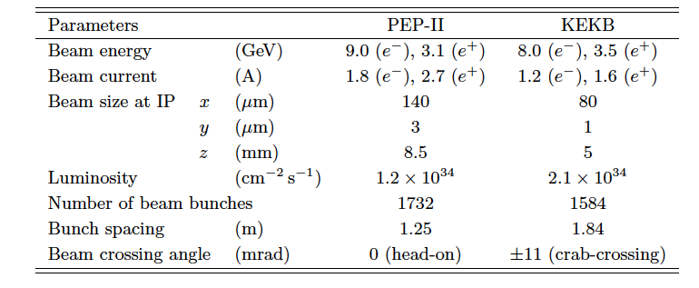
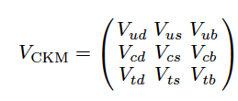
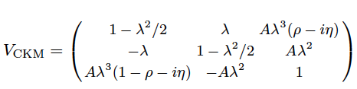
The B Factories focused on establishing large CP violation in the B Meson System in the SM and constraints on the CKM matrix. PEP II/BaBar stopped in 2008 while KEKB/Belle completed operations in 2010.
A single irreducible complex phase explains all CPV

Slide 11

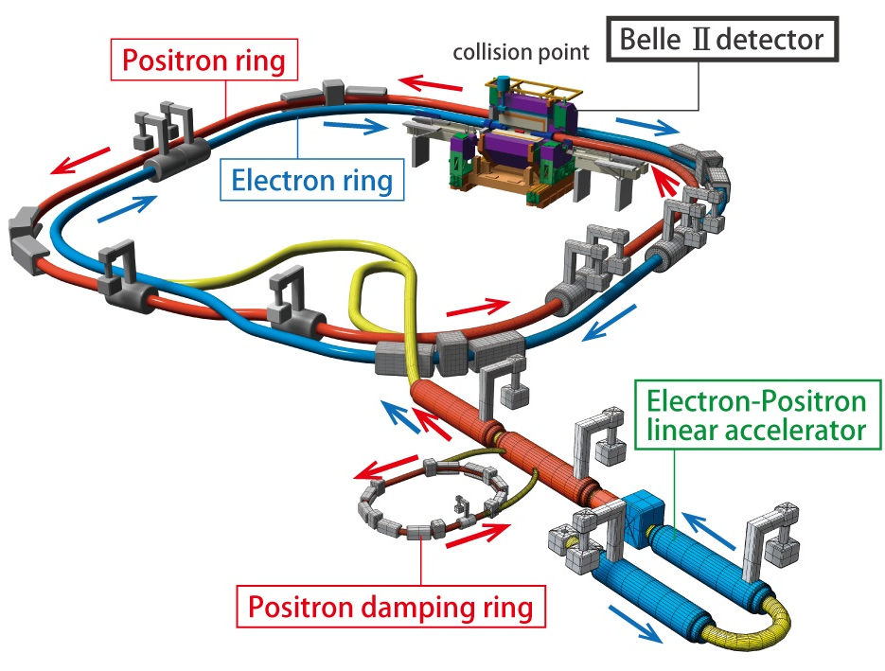
SuperKEKB, the first new collider in particle physics since the LHC in 2008 (electron-positron (e⁺e⁻) rather than proton-proton (pp)). Operates on the Upsilon(4S) resonance with 7 GeV(e-) on 4 GeV(e+) beams.
L(design,2020) = 6.5 x 10³⁵/cm²/sec
Phase 1:
Background, Optics
Commissioning
Feb-June 2016.
Brand new
3 km positron ring.
Phase 2: Pilot run without VXD
Superconducting Final Focus, add positron damping ring,
First Collisions (0.5 fb⁻¹).
April 27-July 17, 2018
Phase 3: → Physics running (spring 2019-spring 2021).
Have integrated 213 fb⁻¹ so far.
Accelerator innovations: nano-beams and crab waist optics (rather than large beam currents). Aim to reach 50 nm beam size in y.

Slide 12
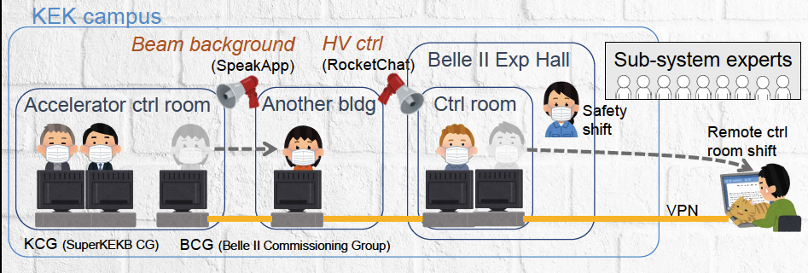
FAQ: How can an international experiment and
accelerator operate during a global pandemic ?
SuperKEKB/Belle II was and is operating during the COVID-19 pandemic with protocols in place to maximize safety and minimize the risk of infection. Difficult with travel restrictions and a very heavy load on a skeleton crew at KEK (~40 people). E.g. this included ~5-10 people onsite from the US.
Developed a “social distancing” scheme for on-site shifts in the Belle II and SuperKEKB control rooms. Mobilized remote shifters around the world – depended heavily on internet chat utilities for communication and monitoring.
Figure credit: K. Matsuoka
Notes:
I was at KEK during the entire “spring 2020” run. Only read the red text to save time.

Slide 13
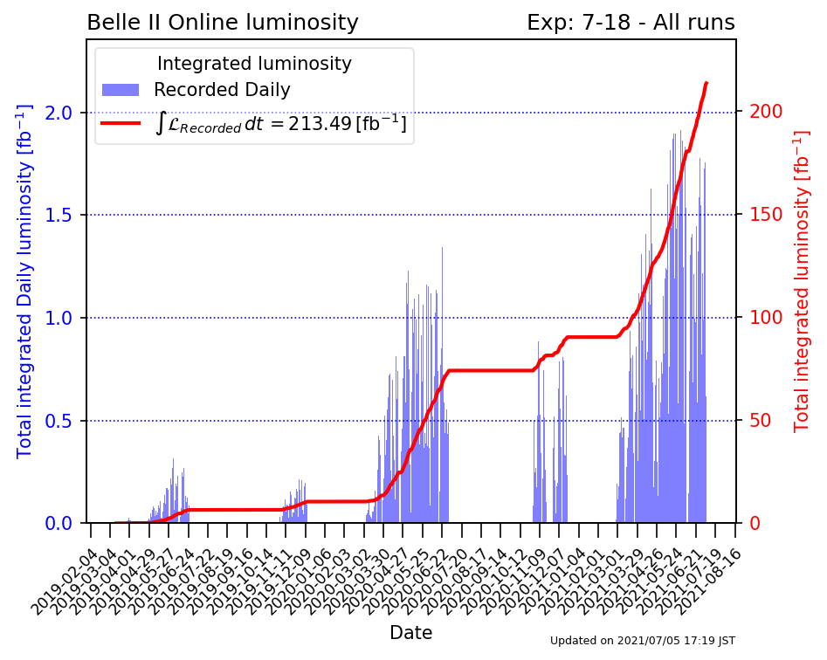
Belle II Integrated Luminosity
Here is where we are in
Fall 2021
New world record, above the B factories (3 X PEP-II) and LHC, with a product of beam currents 3.5 times lower than KEKB.
L_{peak}~3.1 x 10³⁴/cm²/sec
World records: 1.96 fb⁻¹/day,
12 fb⁻¹/week,
40 fb⁻¹/month
Notes:
Running and operation was difficult during the global pandemic. Now have about ½ of the BaBar data sample. Note the problems in Fall 2020 due to TMCI instability from the carbon collimator.

Slide 14
New and recent SuperKEKB World Records
https://cerncourier.com/a/superkekb-raises-the-bar/
L_{peak} =3.1 x 10³⁴/cm²/sec (0.8 A LER, 0.7 A HER)
c.f. L(KEKB)=2.1 x 10³⁴/cm²/sec (1.6 A LER, 1.2 A HER)
L(PEP-II)=1.2 x 10³⁴/cm²/sec (2.9 A LER, 1.9 A HER)
Starting to achieve Super B-factory performance levels.
Int(L dt)/day =1.96 fb⁻¹/day (May 18, 2020)
Int(L dt)/week = 12 fb⁻¹/week
Int(L dt)/month = 40 fb⁻¹/month (May 2020)
B factory reference values:
KEKB (1.48 fb⁻¹/day); PEP-II (0.911 fb⁻¹/day);
KEKB (8 fb⁻¹ /week); PEP-II (5 fb⁻¹/week);
KEKB ( 29.4 fb⁻¹/month); PEP-II (19.7 fb⁻¹/month);
Impressive work during the pandemic.
But these records were achieved years late compared to the original plan….Are we stuck ?
Ans: No, as I will explain

Slide 15
Besides delays in hardware construction and limited operations funding (initially only 4 months/year), some major technical problems so far:
Beam-related backgrounds were O(10) times higher than in the design report (beam tails, bad LER vacuum, oversimplified simulations etc). Outer Belle II detectors and parts of the DAQ/readout were not robust against large backgrounds. Injection backgrounds are dangerous and often out of control. Collimator optimization/installations and vacuum scrubbing are now reducing the storage backgrounds to a manageable level (which do NOT currently limit SuperKEKB)
2. Could not find a good operation point in tune space, which was infested with closely-spaced beam-beam resonances. Although it was initially thought to be impossible for SuperKEKB, a “crab-waist” (not to be confused with SC crab cavities used in KEKB) was implemented and worked well to stabilize the machine and increase the luminosity. This was an amazing outcome of international collaboration and input, combined with local SuperKEKB technical ingenuity.
BTW The SC crab cavities for KEKB did not work right away. Needed to add skew sextupoles.
Increasing luminosity by two orders of magnitude with nano-beams was never expected to be straightforward.
Notes:
Also poor injection quality and blowup of HER emittance from the injector have been a major problem.

Slide 16
Idea: Most current performance limitations are due to instabilities (various kinds of non-linear oscillations of the beam) such as TMCI (Transverse Mode Coupling Instability), Fast Ion (HER), PEI (LER), Resistive Wall Instability (HER, LER), synchro-betatron, BBHT(Beam-Beam Head Tail) and maybe a few others without familiar names.
The instabilities have some threshold(s) and lead to the unexplained
beam-beam blowup and poor luminosity performance at the highest
beam currents.
The instabilities keep us from increasing beam current. Since we are usually close to the threshold(s), we just lose or abort the beam when we increase currents.
The instabilities lead to bad injection bkgs but do NOT have much direct impact on storage backgrounds. However, TMCI mitigation requires opening collimators and increasing Belle II bkgs.
The instabilities are only partially suppressed by the feedback system(s).
Since they depend on beam current, the feedback system(s), which has noise
problems, needs to be constantly adjusted to keep them at bay. [N.B. feedback noise problem fixed at the end of 2021b]

Slide 17
Instability glossary (skip if time is short)
TMCI = Transverse Mode Coupled Instability
TMCI was induced by the carbon collimator in the Fall 2020 run and limited operation to low currents (and low luminosity). May also limit current operations.
Ref: https://journals.aps.org/prab/pdf/10.1103/PhysRevAccelBeams.23.053501
Fast Ion Instability (FII): Ions interact with the electrons in the HER and can cause beam-blowup and loss. Should be tamed by the feedback systems.
Ref: https://accelconf.web.cern.ch/ipac2017/papers/thpab022.pdf
PEI (Photo-Electron-Instability a.k.a. Electron Cloud): SR photon fan from the LER knocks out photo-electrons from the walls; these electrons interact with the positrons and blow-up and destabilize the LER beam. Antechamber, TiN coating and permanent magnets on the vacuum chamber of the LER mitigate this problem.
A curse for KEK-B and PEP-II.
Ref: https://journals.aps.org/prab/abstract/10.1103/PhysRevAccelBeams.22.023201
Resistive Wall Instability: Coupled bunch instability induced by wakefields in a vacuum chamber or RF cavity). With small bunch spacing and small beampipe radius can occur. Problem in ILC damping rings. A candidate for the HER instability.
Ref: https://uspas.fnal.gov/materials/12MSU/DampingRings-Lecture7.pdf

Slide 18
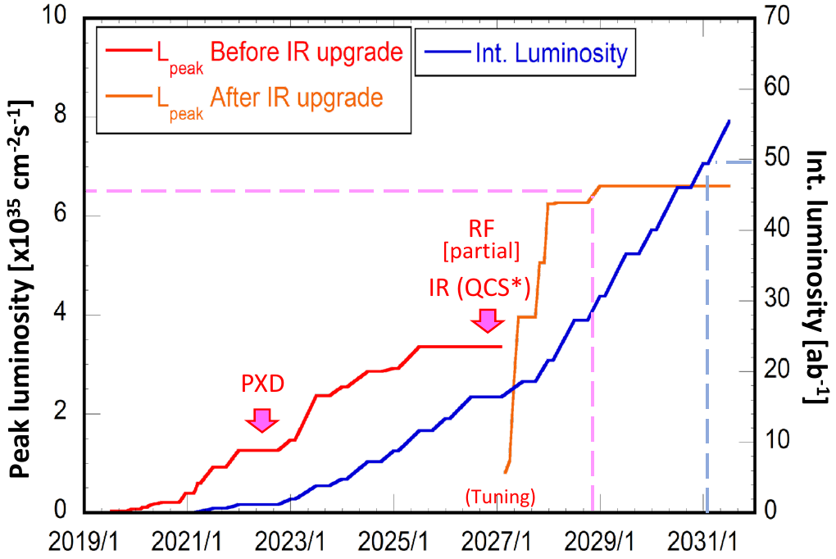
Plan for SuperKEKB and Belle II (needs to be updated)
Original plan: a simple QCS (enlargement) upgrade does not work.
Upgrade schedule delayed due to COVID-19.
Now, preparing a new upgrade plan with an International Task Force of the world’s accelerator physicists.
ALD replacement
Four steps: Intermediate luminosity (1-2 x 10³⁵ /cm²/sec, 5ab⁻¹);
High Luminosity (6.5 x 10³⁵/cm²/sec, 50 ab⁻¹) with a detector upgrade
Polarization Upgrade, Advanced R&D
Ultra high luminosity (4 x 10³⁶/cm²/sec, 250 ab⁻¹), R&D Project
Notes:
To be discussed at Snowmass 2021

Slide 19

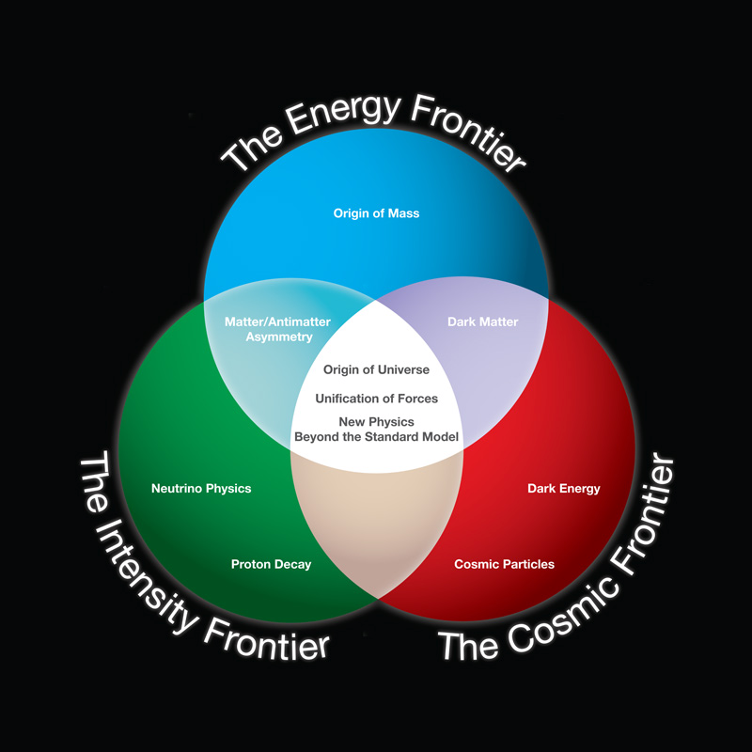

Disappointment at the energy frontier: no SUSY or new particles.
Stay calm. Don’t panic !!
The intensity frontier will save you (again) as it has done many times in the past. (K_{L}→μμ, B mixing, A_{FB}(e⁺e⁻→μ⁺ μ⁻), Electroweak corrections etc…).
This time lepton flavor violation ??
Beauty and the Beast
The legend is reborn
Notes:
Stay Calm. Don’t Panic. History will repeat itself.

Slide 20
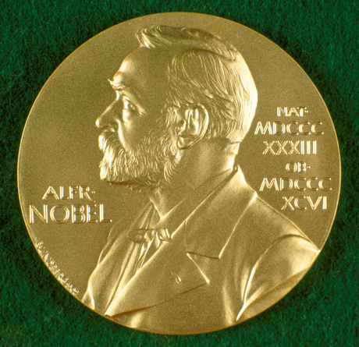
Revisionist History and Paradigm Shift in HEP
The B factory experiments, Belle and BaBar, discovered large CP violation in the B system in 2001, compatible with the SM and provided a large range of CKM measurements. These provided the experimental foundation for the 2008 Nobel Prize to Kobayashi and Maskawa.
This revisionist history ignores all the technical struggles and many unexpected twists and turns.
In the meantime, the LHC was constructed in 2008, ATLAS and CMS completely changed the nature of high energy physics. Of particular importance was the landmark discovery in 2012 of the Higgs boson.
This discovery was recognized by the 2013 Physics Nobel Prize to Englert and Higgs.
In addition, the high pT experiments, established tight constraints on direct production of high mass particles (e.g. M(Z’), M(W’)>3 TeV, vector-like fermions > 800 GeV) and limits on SUSY. This noble search continues with the high luminosity LHC.
Younger theorists:
Dark Sector may be another path.
Paradigm shift: inspired by intriguing results from LHCb and the potential of Belle II, the possibility of finding new physics in flavor has emerged as a complementary route to the LHC.

Slide 21
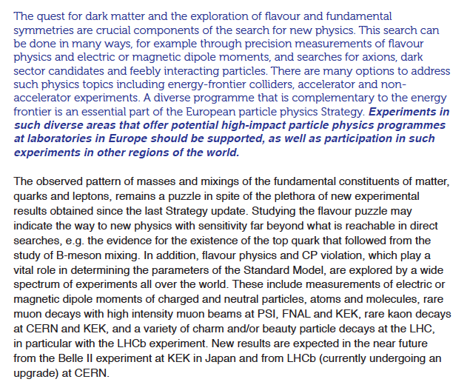
ESG report
ESG =
European Strategy Group
Notes:
European strategy group (ESG) report

Slide 22
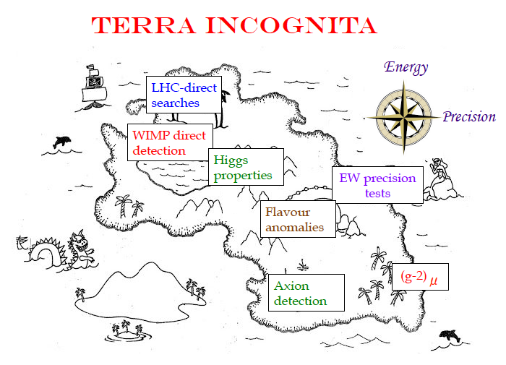
Can we map out our plan for exploring “Terra Incognita” in HEP ?
2017 Moriond Theory summary (slide is still useful)

Slide 23
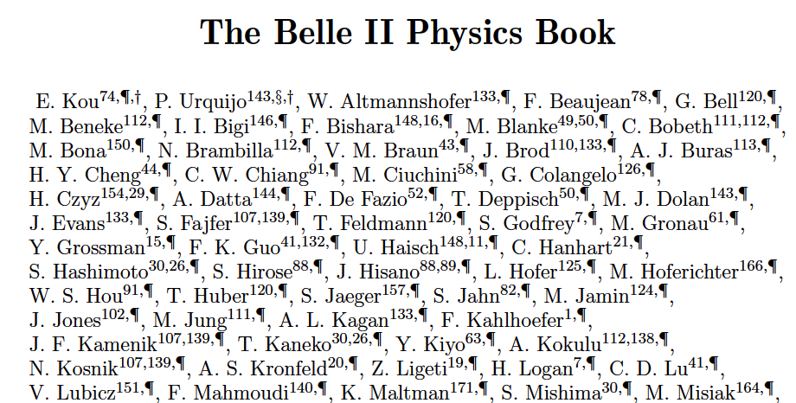
https://arxiv.org/abs/1808.10567
Outcome of the B2TIP (Belle II Theory Interface) Workshops (2014-2018)
Emphasis is on New Physics (NP) reach.
Strong participation from theory community,
lattice QCD community and Belle II experimenters.
689 pages, published by Oxford University Press
First steps toward realizing this program are now taking place.

Slide 24

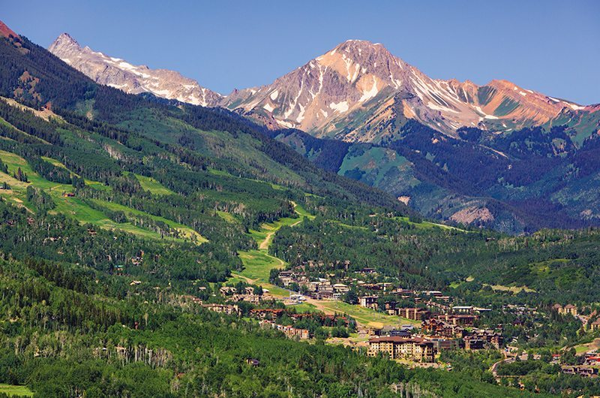
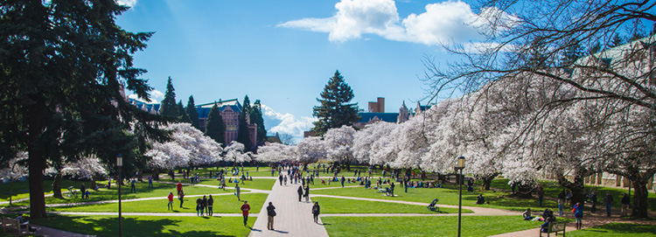
Your mission for the coming 9 months:
Another map of “Terra Incognita”
Belle II/SuperKEKB
Snowmass White Papers
Goal: Bring the Belle II/SuperKEKB physics program to the attention of the HEP community and make sure that is recognized as one of the critical and highest priority efforts in the search for new physics.
Snowmass Village, Colorado
Jargon check: “One Snowmass Year” = 10⁷ seconds, typical operation time of an accelerator facility.
University of Washington, Seattle
https://indico.fnal.gov/event/22303/

Slide 25
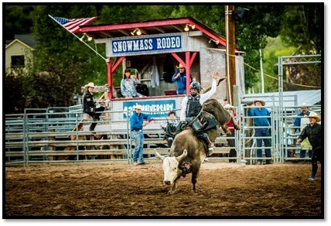
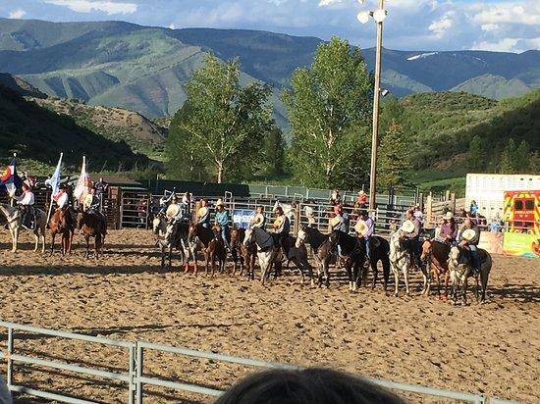
Preparing for Snowmass 2022 (International Physics Rodeo)
Scenes from the actual Snowmass Rodeo in Colorado
N.B. Snowmass 2022 to be held in Seattle, Washington in summer of 2022. The last one was held in Minneapolis, Minnesota in 2013. It is unlikely that there will ever be another month-long planning meeting in Snowmass, CO.
Historical note: Young(ish) Scientist Pier Oddone (originally from Peru/Italy) introduced the concept and first proposal for an asymmetric energy B-factory to the broad HEP community at a Snowmass in 1988.
Notes:
“This ain’t my first rodeo”

Slide 26
Details about Snowmass 2022 can be found on the official page: https://snowmass21.org/
The European Strategy Group (ESG) process has completed. The next major decadal strategy effort is the US Snowmass process, which will be followed by P5 panel recommendations, which in turn will guide funding and resource decisions.
The first milestone for the Snowmass process was the submission of short 2-page LOI’s (Belle II already submitted 9 LOIs). Longer “White-Paper" documents are due before the end of summer next year (2022). These White-Papers may update or go beyond the content of the Belle II Physics Book https://arxiv.org/abs/1808.10567 and/or may also discuss technical aspects of SuperKEKB accelerator and Belle II detector upgrades.
Detailed scientific discussions will take place during the next year and a large close-out meeting is planned in Seattle, WA in July 2022. Participation of all international Belle II colleagues and especially junior colleagues is needed in this high energy physics community planning process. Contributions from and collaboration with theoretical colleagues is especially welcome.

Slide 27
Update on the Snowmass process
9 Belle II/SuperKEKB LOIs were submitted by the Aug 31st , 2020 deadline. These 2-page LOIs are now linked from the Belle II home page
https://confluence.desy.de/display/BI/Snowmass+2021
Phase II: “Let a thousand flowers bloom”, collaborate, make plans, find innovations and synergies, write White Papers and post to the Arxiv
Phase III: Summer 2022 in Seattle, WA: Snowmass closeout workshop (delayed 1 year due to COVID-19)
This will be followed by the P5 Panel will decide on priorities in the field of high energy physics. Their recommendations and downselects guide long term decisions of the US DOE on funding and resource allocations (and perhaps influence those of other countries).

Slide 28
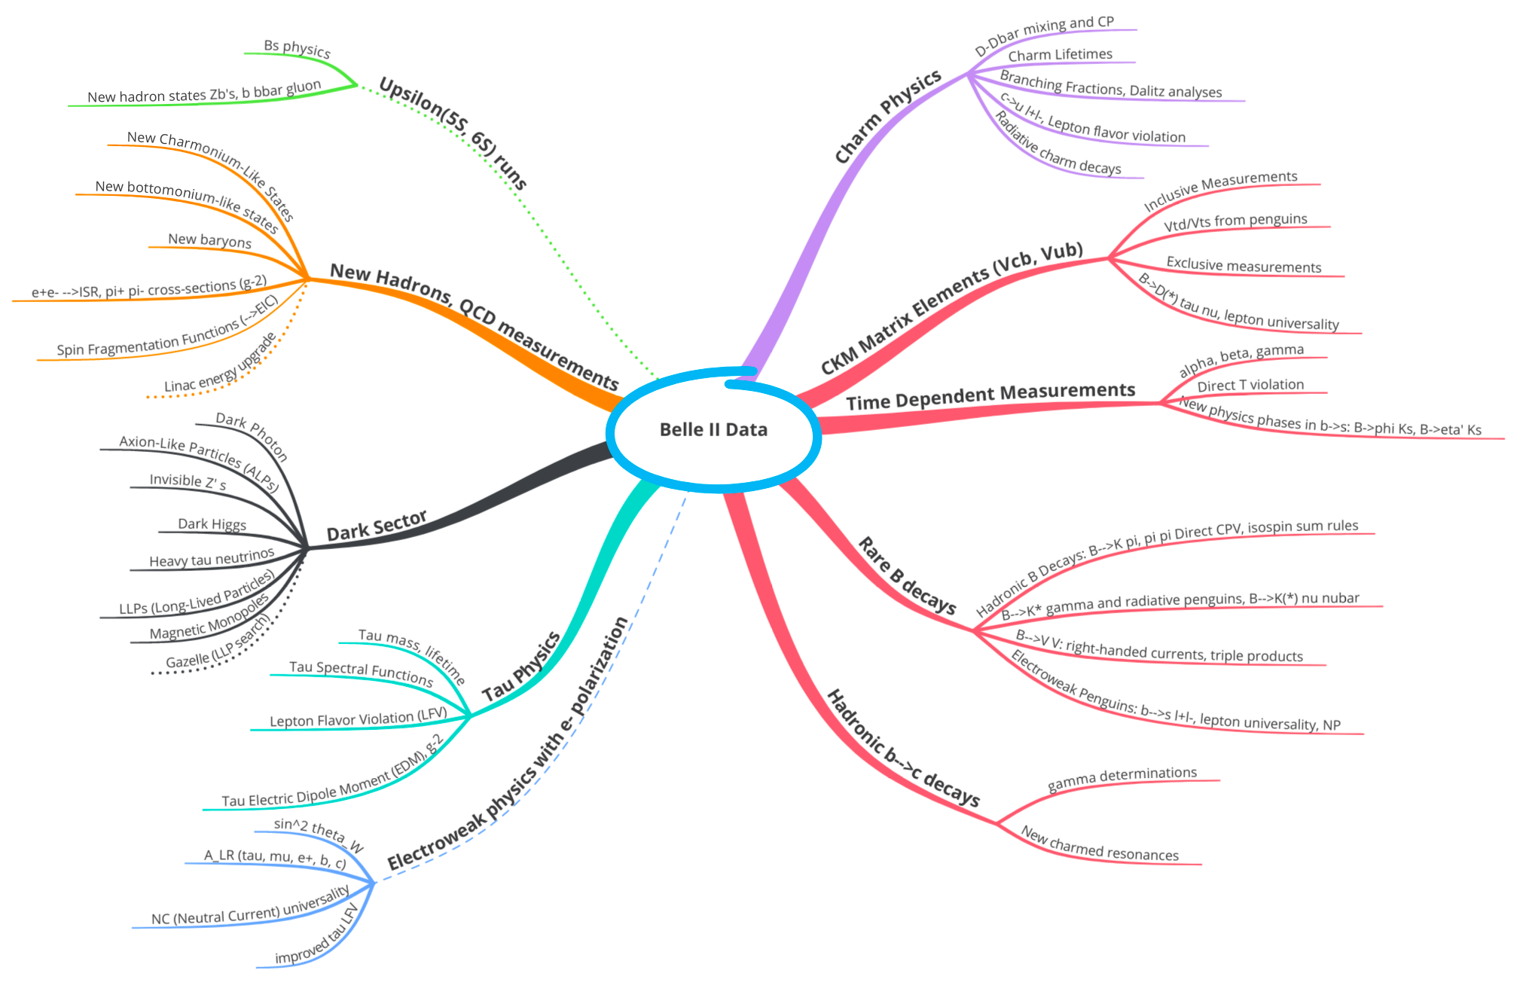
Belle II Physics “Mind Map” for Snowmass 2022
Wealth of new physics possibilities in different domains of HEP (weak, strong, electroweak interactions). Many opportunities for initiatives by young scientists.
Dashed lines indicate extensions to SuperKEKB/Belle II that can enhance
the physics reach of the facility. LOIs:
https://confluence.desy.de/display/BI/Snowmass+2021

Slide 29
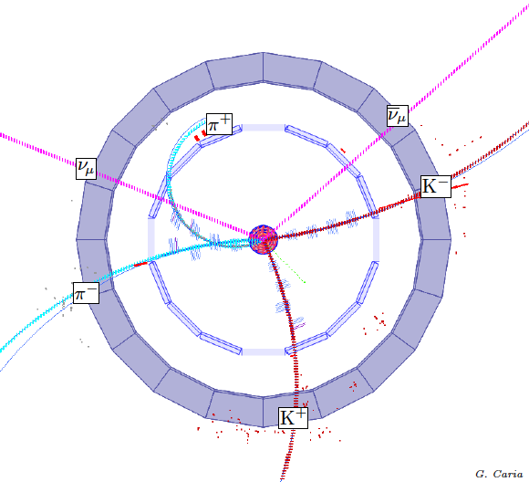
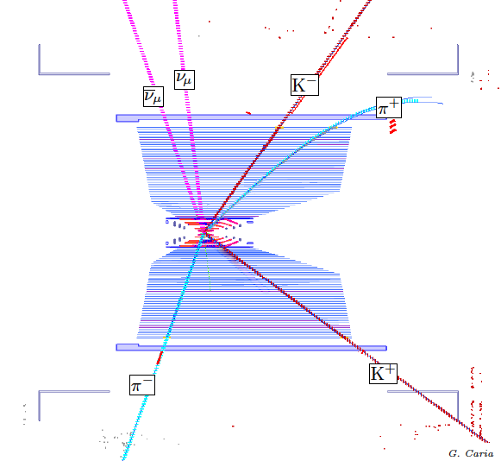
One example of a new idea.
What’s Ahead ?
“Missing Energy Decay” in a Belle II GEANT4 MC simulation
Signal: B→K ν ν tag mode: B→Dπ; D→Kπ
Zoomed view of the vertex region in r--phi
View in r-z
Notes:
Let’s talk some more about physics.

Slide 30
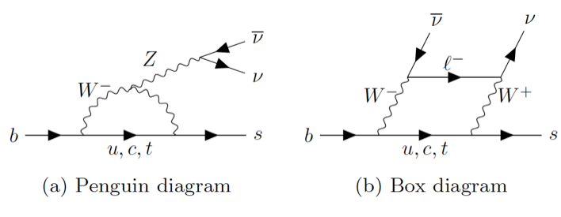
One example of a new idea (or maybe it was an old idea from Buras ?)
B→K ν νbar: NP without hadronic uncertainties
Note that in contrast to B→K^{(*)} l⁺ l⁻ angular asymmetries, there are NO long distance (charm annihilation) contributions from B→J/ψ K^{(*)} and B→ψ(2S) K^{(*)}

Slide 31
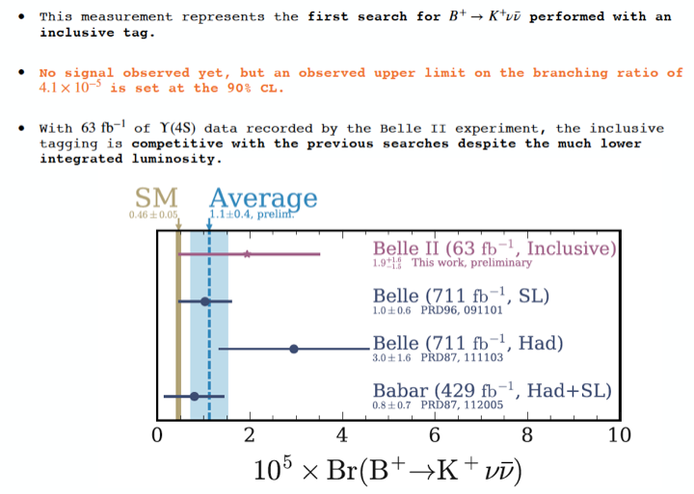
B→K ν νbar: NP without hadronic uncertainties
Moriond Plot in https://arxiv.org/abs/2105.05754
Belle II PRL submission
https://arxiv.org/abs/2104.12624
This is the most likely way that Belle II could discover NP. (see talk by Rusa Mandal)
More details in this theory paper, https://arxiv.org/abs/2107.01080 , to appear in PRD.

Slide 32
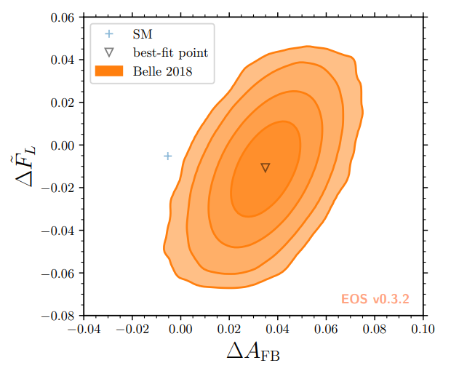
Hot and New Example: ΔA_{FB} in b→c l ν
Slide from A. Crivellin, Belle II summer school, Virginia Tech
4σ deviation found
by 2104.02094
based on Belle
data 1809.03290
Scalar and/or
tensor operators
required for an
angular asymmetry
g-2 and b→s µ⁺ µ⁼
motivate new physics
related to muons
See talk by Manca Marvar at this workshop.
Direct experimental measurements would be better.
2104.02094
Hint for scalar/tensor NP in b→cµν

Slide 33
Conclusions
SuperKEKB/Belle II is breaking world luminosity records (L=3.1 x 10³⁴ /cm²/sec) while learning about difficult but solvable accelerator physics problems.
The leading international accelerator physicists are now collaborating with KEK (formation of an International Task Force) to design a SuperKEKB/Belle II upgrade to reach a target luminosity of ~6 x 10³⁵/cm²/sec and to integrate 50 ab⁻¹
The Snowmass White Papers will make the case for the priority and importance of Belle II/SuperKEKB in the field of high energy physics. Lots of space for small group and individual initiatives (e.g. New Physics MC Generators).
I apologize for any omissions and will update the slides with corrections to the author lists etc.

Slide 34
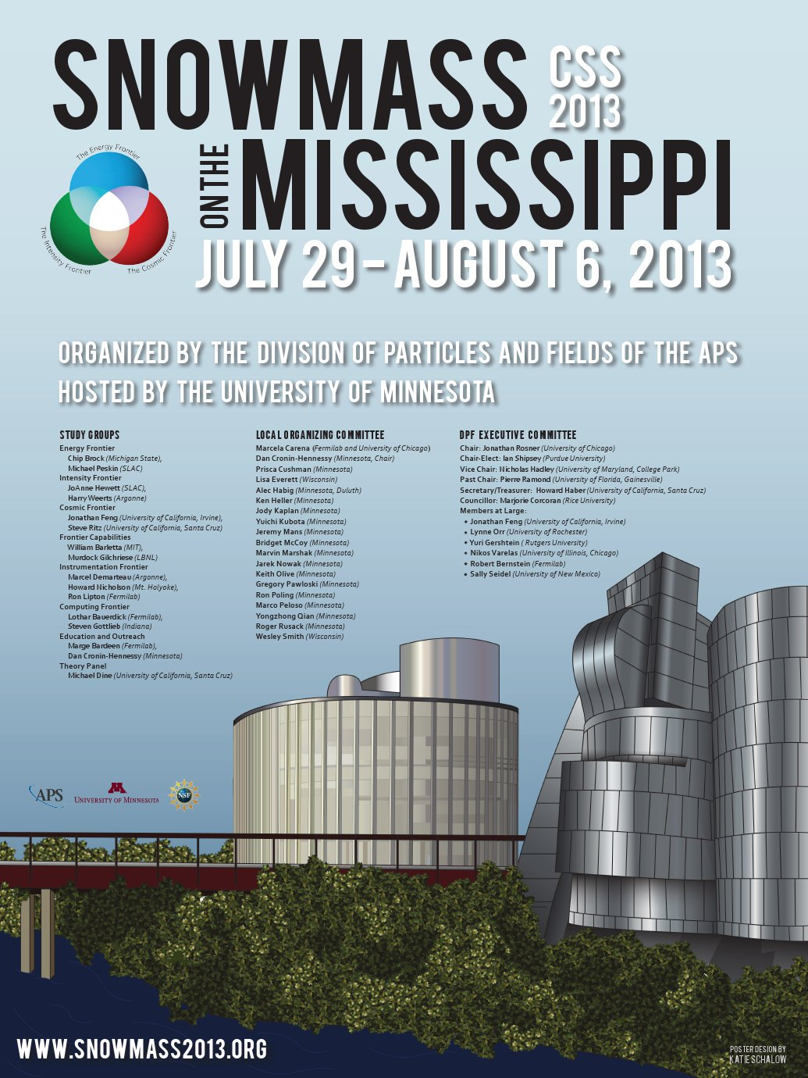
Backup slides
Snowmass, CO
Minneapolis, Minnesota

Slide 35

2008:
Critical Role of the B factories in Japan and the US in the verification of the Kobayashi-Maskawa hypothesis was recognized and cited by the Nobel Foundation
A single irreducible phase accounts for all the matter-antimatter asymmetries in particle physics.
CP violating effects in the B sector are O(1) rather than O(10⁻³) as in the kaon system.
Notes:
The Glory of the Past.

Slide 36
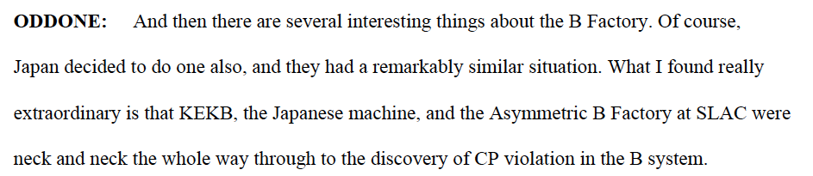
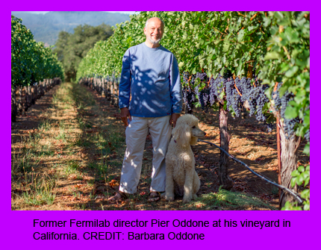
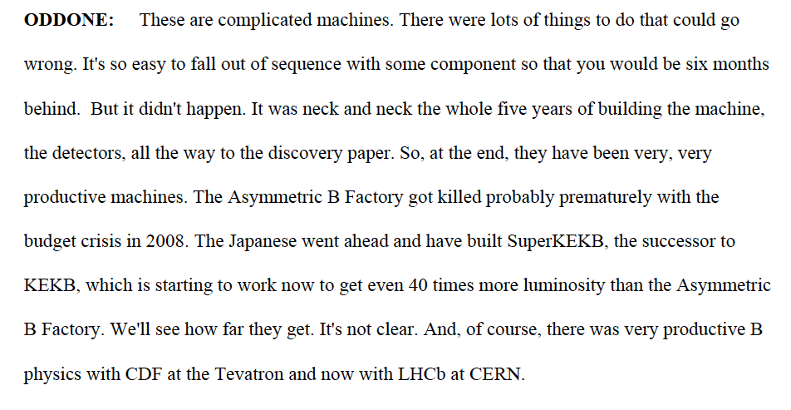
Interview May 2020

Slide 37
Whitepapers on New Physics MC generators and Improved Analyses
B→D^{(*)} τυ study group:
Alexei Sibidanov (Hawaii), Bhubanjyoti Bhattacharya (LTU), Quinn Campagna, Alakabha Datta (U Miss), Shawn Dubey, Sven Vahsen (Hawaii), and TEB.
First task: implement various couplings from NP.
B→K* l⁺ l⁻ , b→s l⁺ l⁻ group:
Alexei Sibidanov and Shahab Kohani (Hawaii), Rahul Sinha (IMSc), Rusa Mandal (Siegen), Saurabh Sandilya (Hyderabad), K. Nishimura, S. Vahsen and TEB (Hawaii).
More are welcome, including users to test as well as experts on EVTGEN or HAMMER MC packages etc.

Slide 38
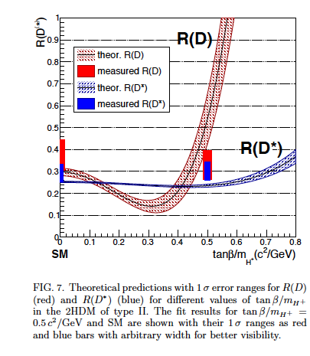
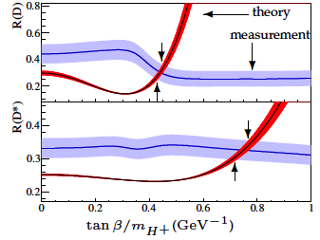
More examples of why we need new physics MC generators
Belle
BaBar
N.B. Change in R(D) and R(D*) as a function of NP, due to efficiency, phase space changes.
The world average has fluctuated down from the BaBar result in 2012. Type II HDM tightly constrained, Leptoquarks are now in fashion……
Also note that q^2 dependence, D* angular dependence not used, just BFs. Again lack of MC generators is the issue.
The problem is more severe for B→K* l⁺l⁻, b→s l⁺ l⁻

Slide 39
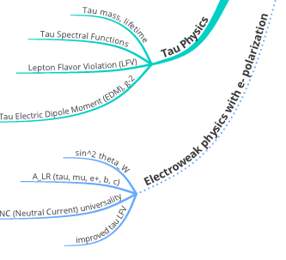
Gianluca Inuglia et al. (White Paper on the Interleptons Project)
Innovative studies of lepton flavor universality breakdown in a variety of Belle II physics domains
(tau physics, Upsilon decays, semi-leptonic B decays) making full use of machine learning techniques.
Swagato Bannerjee et al (White Paper on Belle II Tau Physics).

Slide 40
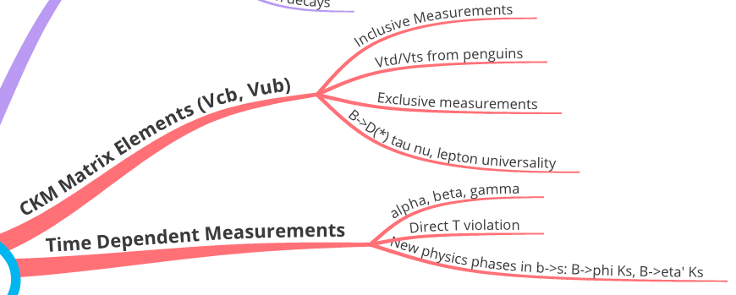
Racha Cheaib et al will write a Belle II White Paper on prospects for missing energy semileptonic decays.
Question: Will E_{ECL} still work well at high luminosity and backgrounds ?
Question: Is FEI always required or can more efficient ROE analyses work ?

Slide 41
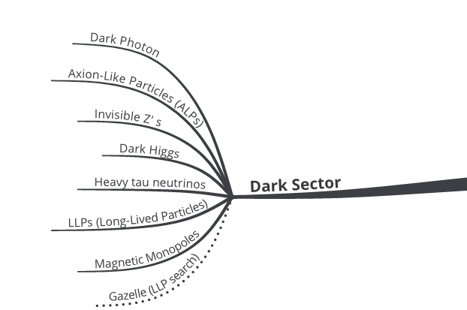
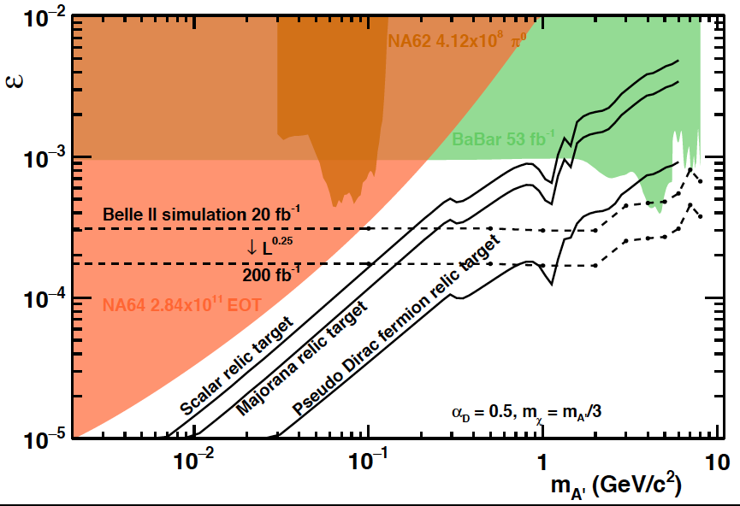
Zoom in on the Dark Sector
LLP White Paper (including the Gazelle proposal): Torben Ferber, Suzanne Westhof et al
Updated dark photon sensitivity plot
Dark Sector Capabilities of Belle II White Paper,
Chris Hearty, Kevin Flood et al.

Slide 42
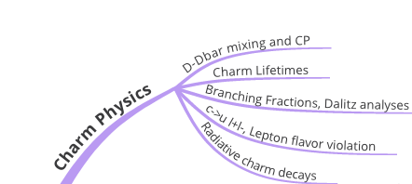
Zoom in to the Charm Physics Branch
Belle II Charm Physics Capabilities White Paper being organized by Alan Schwartz et al.

Slide 43
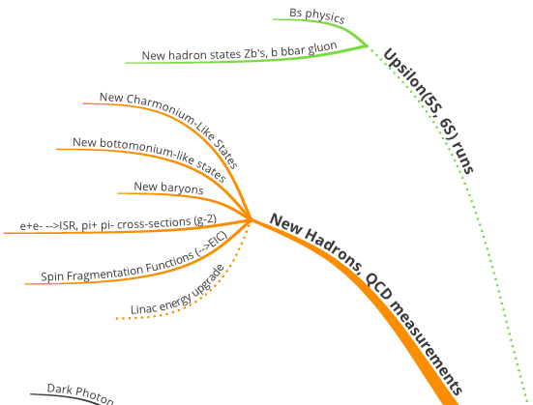
Zoom in on QCD and New Hadrons
Bryan Fulsom et al, together with LHCb, theorists is writing a White Paper on hadron spectroscopy prospects.
Anselm Vossen et al. is writing a White Paper on QCD measurements.
Here note the synergies with the EIC (Electron Ion Collider) and g-2 experiment(s).

Slide 44
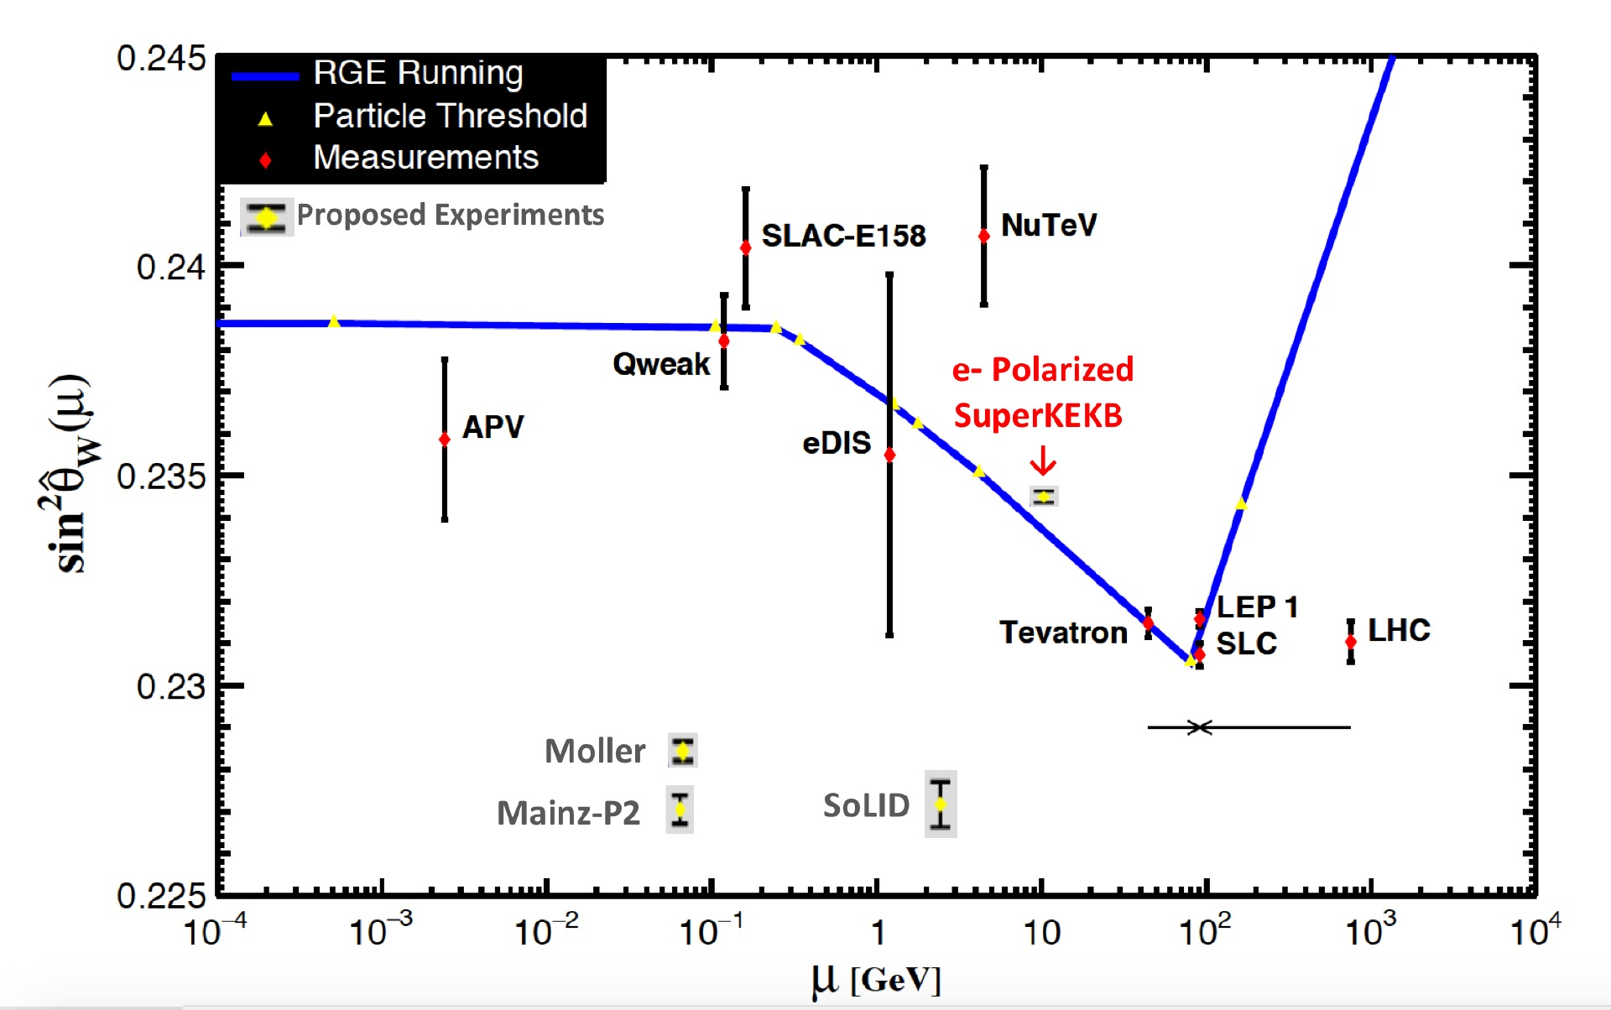

Upgrading SuperKEKB with Polarized e- Beams
Physics case: precision sin² θ_{W} measurements from
b, c, e, μ & τ, probing its running and universality
(White Paper in Preparation by M. Roney).
Planning 70% polarization with 80% polarized source.
NEW HARDWARE FOR POLARIZATION UPGRADE:
Low emittance polarized Source: electron helicity can be flipped bunch-to-bunch by controlling circular polarization of source laser illuminating a GaAs photocathode (à la SLC). Inject vertically polarized electrons into the 7 GeV e- Ring, needs low enough emittance source to be able to inject.
Spin rotators: Rotate spin to longitudinal before Interaction Point (IP) in Belle II, and then back to vertical after IP using solenoidal and dipole fields
Compton polarimeter: monitors longitudinal polarization with <1% absolute precision, higher for relative measurements (arXiv:1009.6178) - provides real time polarimetry. → Use tau decays from e⁺e⁻→ τ ⁺ τ⁻ measured in Belle II to provide high precision absolute average polarization at IP.
Belle II
Planning for implementation ~2026 in mid-decade upgrade window for new final focus; This upgrade proposal to be included in KEK Roadmap for MEXT to be submitted 2021
e- spin vector around ring

Slide 45

Known short and medium term Belle II detector upgrades (from the Belle II LOI on the Instrumentation Frontier)

Slide 46

A Snowmass White Paper is planned on the Belle II backgrounds for future SuperKEKB machine configurations.
The optics and background calculations for the final SuperKEKB configuration are now obsolete for a variety of reasons (e.g. crab waist, improvements in bkg simulation, new collimators, inj bkgs, vacuum scrubbing scenarios). It is clear that we need new estimates and a new realistic long-term plan.
Andrii Natochi, Hiro Nakayama, Sven Vahsen et al will write a Snowmass White Paper for the accelerator frontier.

Slide 47
Some general comments about Snowmass White Papers
(a.k.a “Contributed Papers”)
White Papers should be posted on the ArXiv
and to https://snowmass21.org/submissions/start before July 31, 2021.
The White Papers should refer to the appropriate Belle II LOI(s) (if it exists) and frontier, the Belle II/SuperKEKB facility, and where appropriate, to the Belle II Physics Book. The White Papers may have short author lists and include theorists (strongly encouraged) and members of other experiments or technical experts.
Physics White Papers should be refereed inside Belle II (we suggest that two reviewers be picked by the relevant physics convener.)
Instrumentation Frontier and Computing Frontier White Papers follow the same general procedures and should be reviewed by the Upgrade Working Group or by members of the Belle II computing team.

Slide 48

Some of the Snowmass talks given so far by Belle II members in 2020 at workshops and “kick-off” meetings.

Slide 49
Two more comments:
Many studies in the Belle II Physics Book did not have a state-of-the-art MC or reconstruction or beam background. These could be out of date or not realistic. Doing MC studies may be required for physics papers on the large Belle II dataset taken before the PXD shutdown (so you may be doing the work for Snowmass Papers at the same time).
A. Gaz: Need to use a consistent model of detector performance: (2 PXD layers ? Use software release-05 ?)
2) Many detector proposals and accelerator upgrade proposals need advanced CDRs or TDRs very soon (again you may already be doing the necessary work for Snowmass at the same time).

Slide 50


Slide 51


Slide 52


Slide 53


Slide 54


Slide 55


Slide 56


Slide 57


Slide 58


Slide 59

“But if you’re an instant-gratification kind of person, particle physics is not for you, since the most important discoveries took years.
New dimensions or underlying structures might exist, but we won’t know unless we explore.
Colliders are expensive, but so was the government shutdown. Only one of these will yield lasting insights into the nature of matter.”
Professor Lisa Randall
https://www.nytimes.com/2019/02/01/opinion/letters/physics-research-collider-cern.html

Slide 60

Slide from J. Hewett/HEPAP DOE

Slide 61

“Let a thousand flowers bloom”
In English this is taken to mean: Do not interfere with promising developments in their early stages.

Slide 62

FAQ: How do Belle II at KEK and LHCb at CERN capabilities compare ?
Figure credit:
G. Ciezarak et al,
Nature
546, 227 (2017)
++Belle II can do the dark sector
LHCB has a large b bbar cross-section (hundreds of microbarns versus nanobarns) and good sensitivity, signal to background, for modes with dimuons, and all charged final states using vertexing. Triggering and flavor tagging effs. are much lower than in e+e-.
Rule of thumb for statistics in this case:
1 fb⁻¹ at LHCb is 1 ab⁻¹ at Belle II.
(➔Need very good SuperKEKB performance)
2. Belle II has a simple event environment with B-anti B pairs produced in a coherent QM state with no additional particles.
3. Belle II can measure inclusive processes
4. Belle II can measure electrons as well as
muons. (important for lepton universality checks).
5. Belle II can measure final states with γ’s, Kshorts and missing neutrinos well.
Notes:
And Belle II can do dark sector physics.

Slide 63
Updated Dark Photon Sensitivity Plot, C. Hearty

