Slide 1

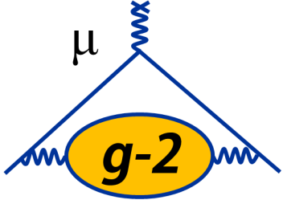


The muon g-2 Experiment
Carlo Ferrari
CNR-INO & INFN Italy & CERN
on behalf of the g-2 collaboration
IPA2022, Vienna
8 September 2022

Slide 2
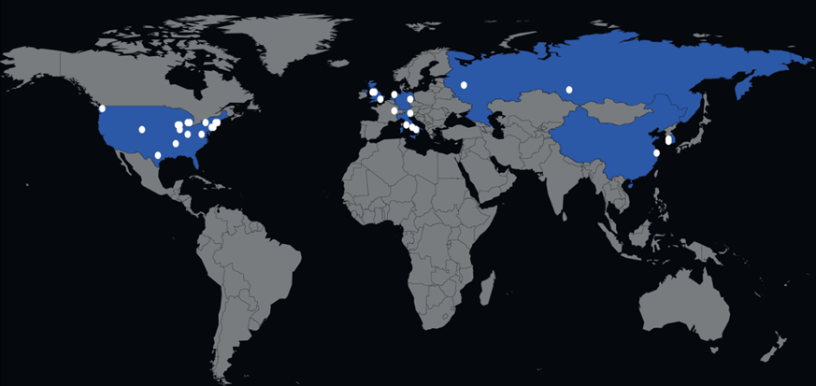
The muon g-2 Experiment at Fermilab
8 Countries, 35 Institutions, 190 Collaborators
Low energy, high Intensity experiment
Small scale detectors and collaborations, very high statistics
Precision measurements, looking for deviations from theory
Outline:
Brief introduction to a_{μ}
Experiment description
Calculating the a_{μ}
Status and outlook

Slide 3
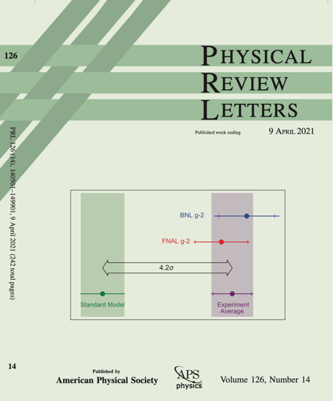
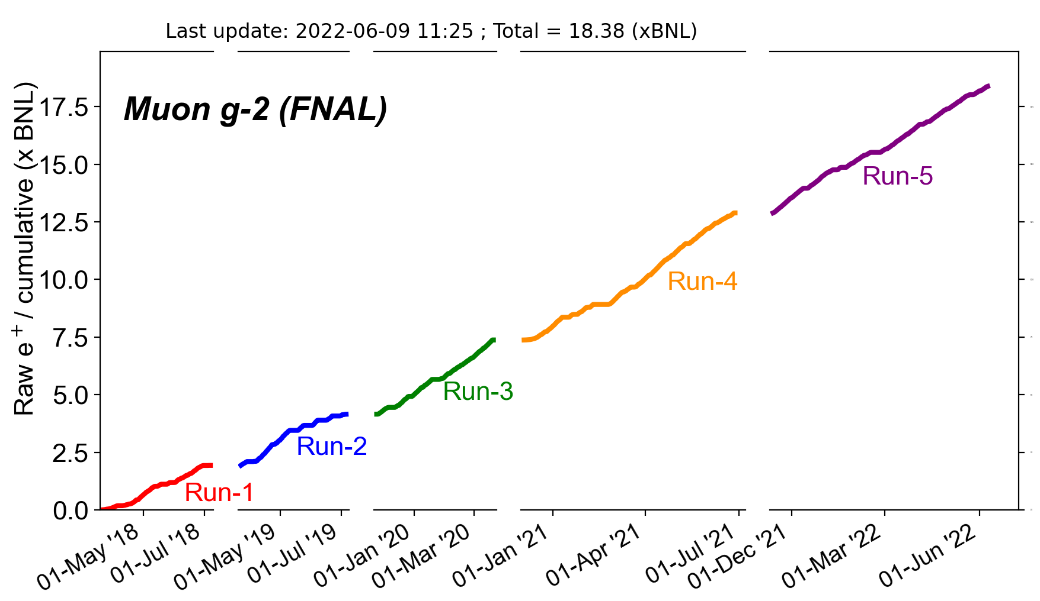
The data

Slide 4
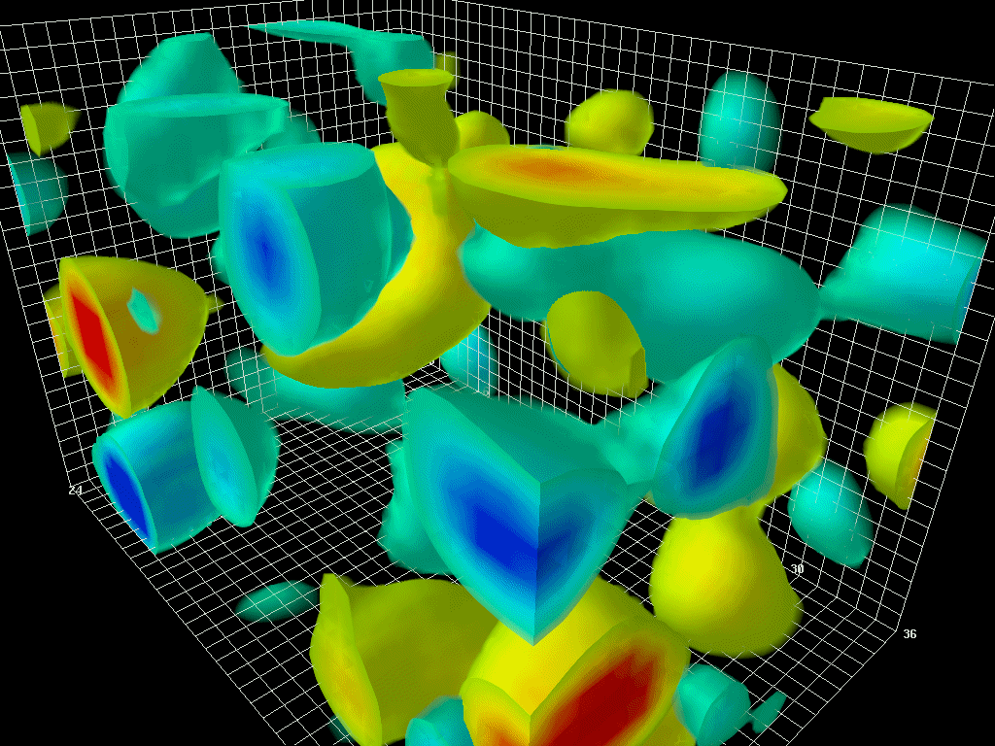
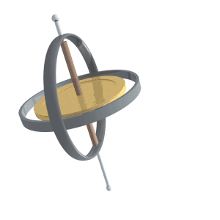
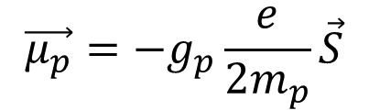
1948: Triumph of QED
g is the proportionality factor between spin and magnetic moment for particle p:
$$\vec{μ_{p}}=−g_{p}\frac{e}{2m_{p}}\vec{S}$$
Image Credits: Derek Leinweber
B
Classical physics: g = 1
Relativistic quantum mechanics prediction for a point-like particle (Dirac, 1928): g = 2
For electron, experimentally found to be
(Foley & Kush, 1948): g_{e} = 2.00119(5)
Schwinger figured out why: QED

Slide 5
1948: Triumph of Quantum Field Theory
g_{e,meas} = 2.00231930436182(52) [0.25 ppt]
The most precise prediction ever confirmed by experiment [Rev.Mod. Phys. 88, 035009]
Weak and hadronic interaction have small impact on the g_{e} result
Muons: most interactions are proportional to (m_{μ} / m_{e})² ≈ 43.000
a_{μ} is a better probe for new physics
QED
Weak
Hadronic contribution
HLbL
HLO
Precisely known
Large uncertainty

Slide 6
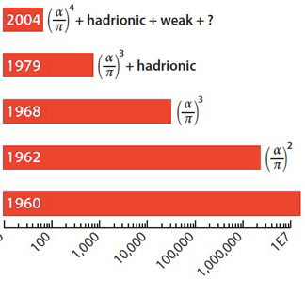
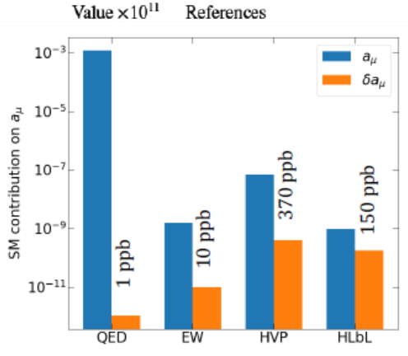


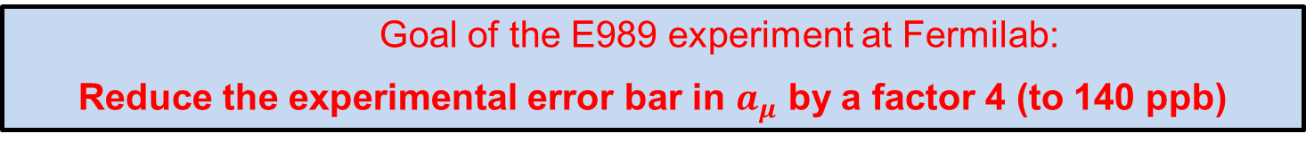

Muon g-2 experiments
$a_{μ}^{BNL}=116 592 089 {(54)}_{stat}{(33)}_{syst}{(63)}_{Tot}×{10}^{−11}$ (2001)
540 ppb
3.7 σ
$${\left(\frac{α}{π}\right)}^{4}+hadronic+weak+ ?$$
BNL
CERN III
7.3 ppm
CERN II
σ_{aμ}/a_{μ} =265 ppm
$${\left(\frac{α}{π}\right)}^{2}$$
CERN I
σ_{aμ}/a_{μ} =4300 ppm
$$\frac{α}{π}$$
Nevis
σ_{aμ}/a_{μ}=12.4%
Muon g-2 Theory Initiative
Phys. Rep. 887, 1-166 (2020)
(data-driven, dipersive approach)
Goal of the E989 experiment at Fermilab:
Reduce the experimental error bar in $a_{μ}$ by a factor 4 (to 140 ppb)
$$Uncertainty on a_{μ} × {10}^{−11}$$
6

Slide 7
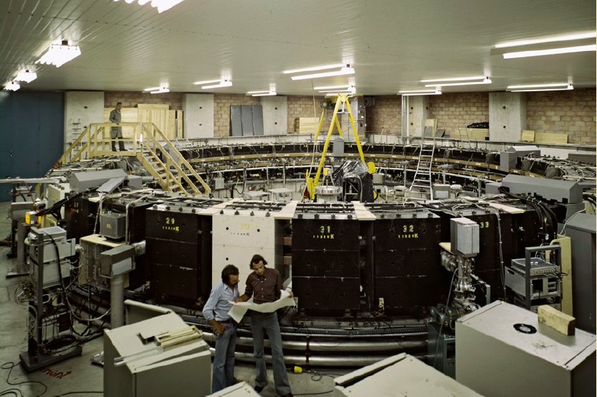
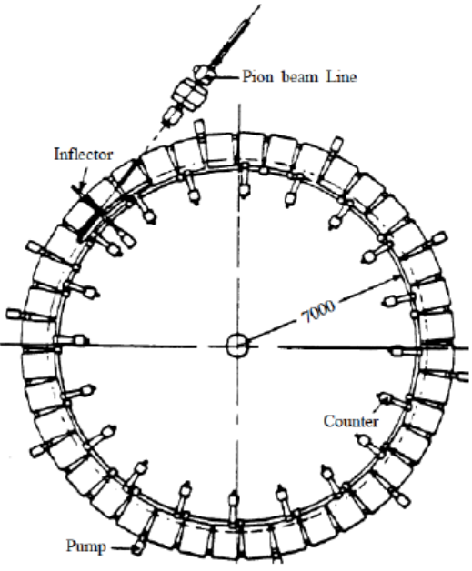

g-2 muon experiment at CERN (CERN III)
Pions injection, magic momentum, vertical confinement with E field
7

Slide 8
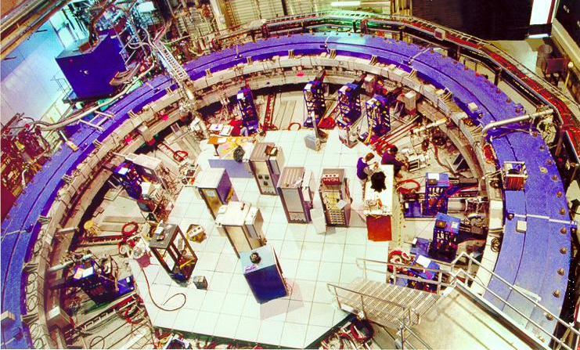
g-2 muon experiment at Brookhaven (2000’s)
Muons injection, magic momentum, vertical confinement with E field
$$a_{μ}^{BNL}=116 592 089 {(54)}_{stat}{(33)}_{syst}{(63)}_{Tot}×{10}^{−11}$$
8

Slide 9
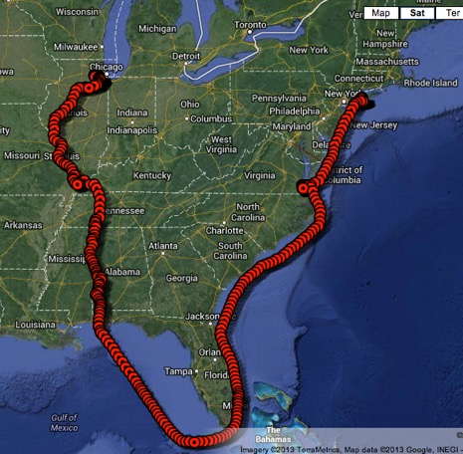
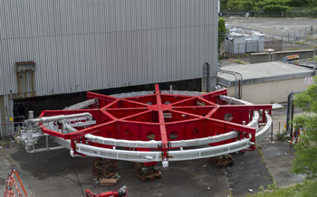
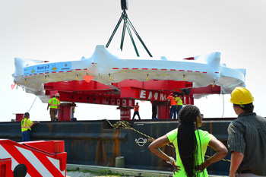
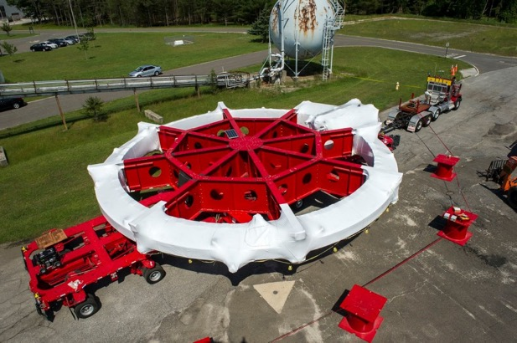
The Big Move of the Ring (2013)

Slide 10
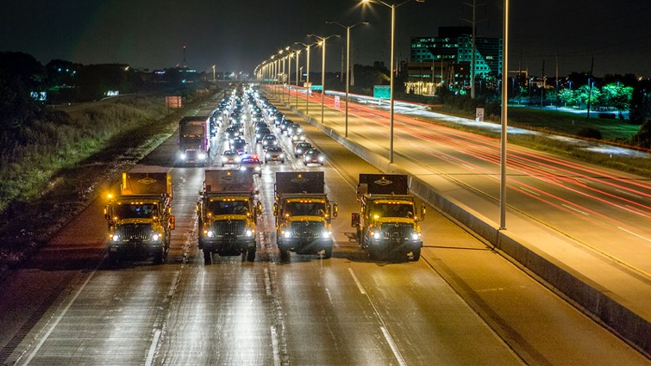
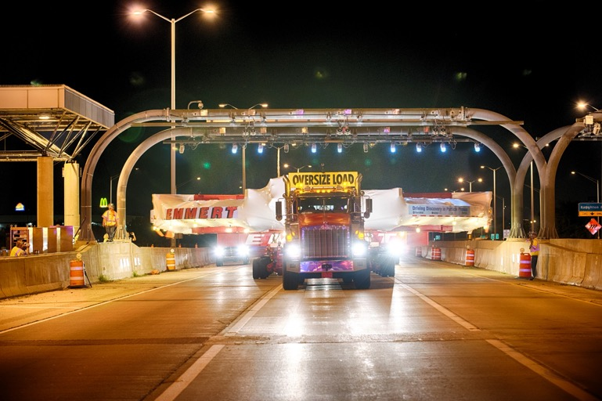
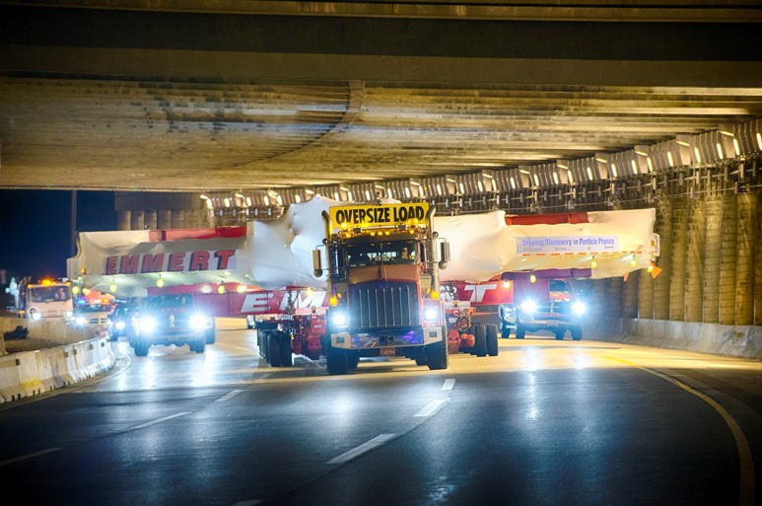
Including 30 miles of Chicago suburbs

Slide 11
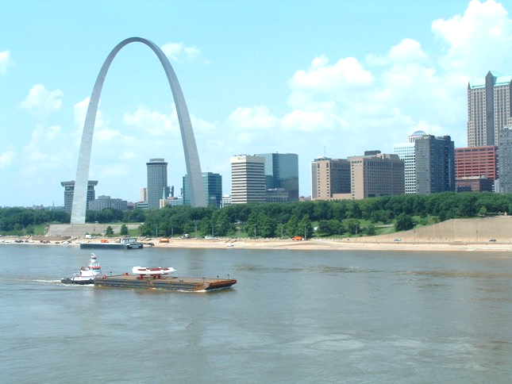
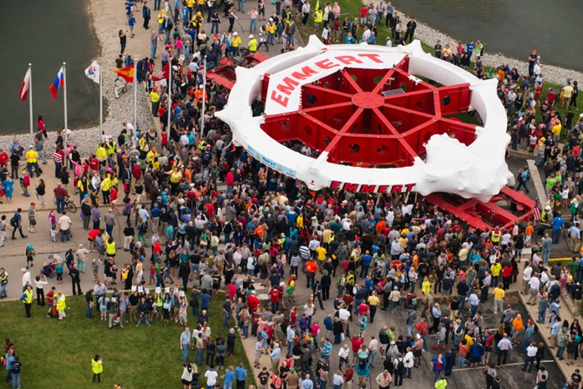
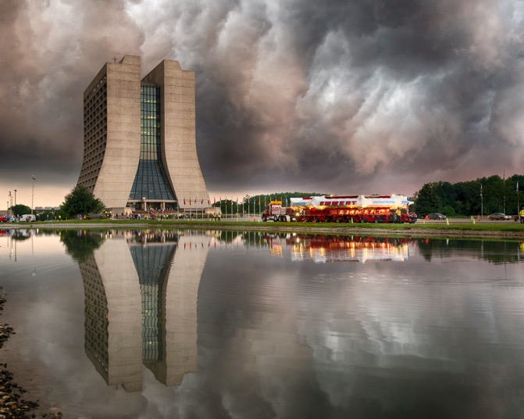
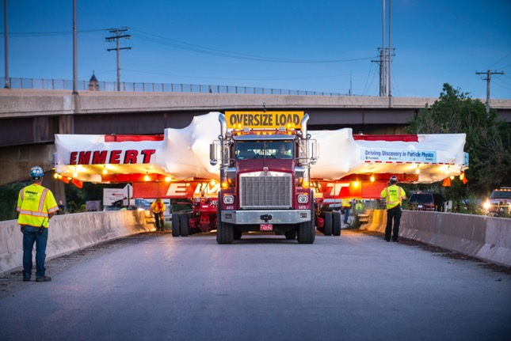
Photos

Slide 12
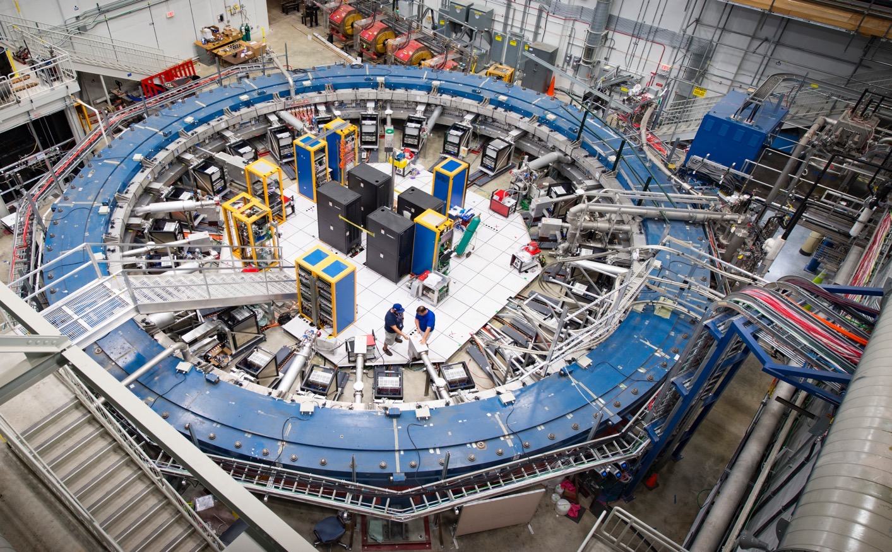
Muon g-2 Storage Ring at Fermilab

Slide 13
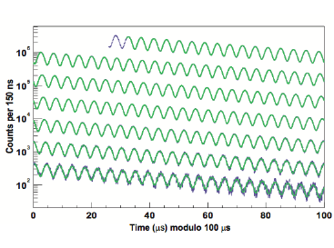
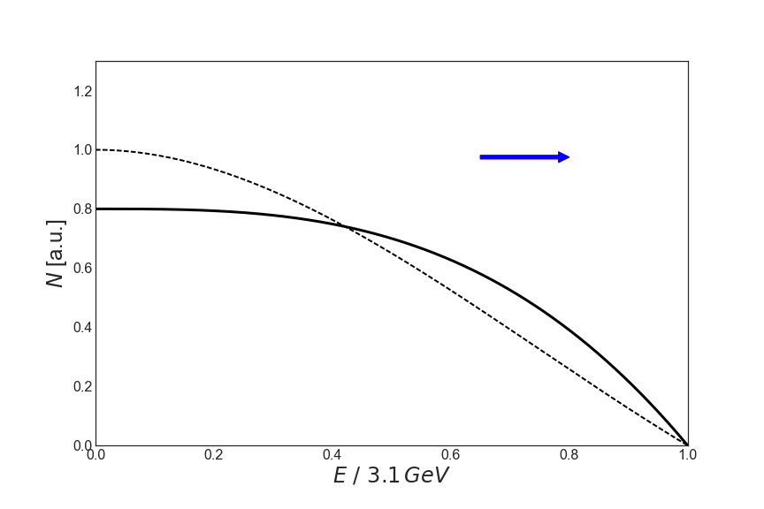


Key ingredients
1) Polarized muons (parity violation in weak decays)
Anomalous precession in a B field, proportional to (g-2)
P_{m} magic momentum = 3.09 GeV/c
High energy decay e⁺ are emitted preferably
in spin direction of the muon
ν π⁺ μ⁺
~97% polarized for forward decay
$$\vec{S}$$
µ
B
Measure 2 quantities
$$a_{µ}=\left(\frac{m}{e}\right)\frac{ω_{a}}{B}$$
E field doesn’t affect muon spin when γ = 29.3
Spin
Momentum

Slide 14


Towards Fermilab
E821 at Brookhaven
σ_{stat} = ± 460 ppb
σ_{syst} = ± 280 ppb
E989 at Fermilab
σ_{stat} = ± 100 ppb
σ_{syst} = ± 100 ppb
σ = ± 540 ppb
σ = ± 140 ppb
Improvements
More statistic (positrons x21)
Improved beam (much less hadronic contamination)
Improved detectors (segmented calorimeters, SiPM, trackers)
Laser calibration system (SiPMs gain changes at 1 part in 10⁴)
800 MHz waveform digitizers sample (twice the rate BNL)
Simulation tools (Ringsim, GEANT4, COSY, BMAD)
Magnetic field measurement

Slide 15
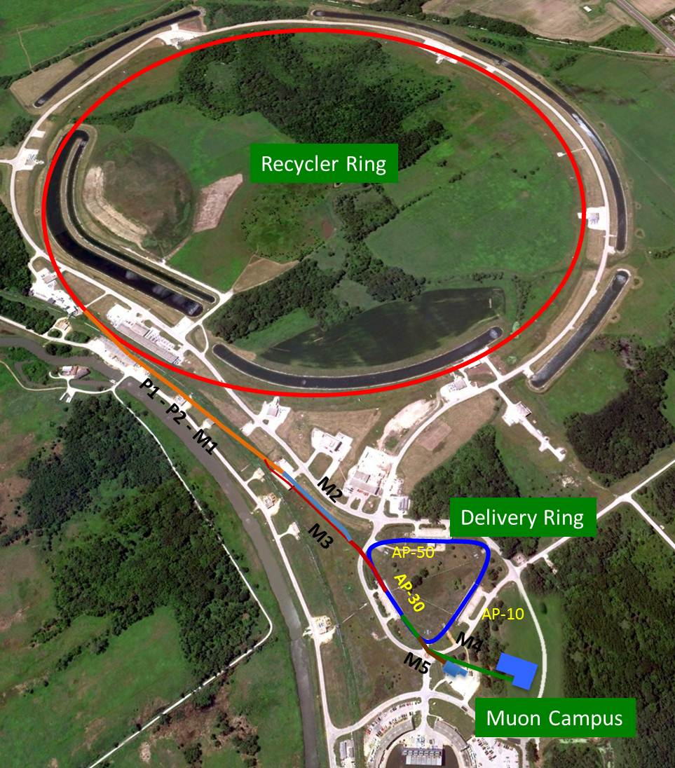
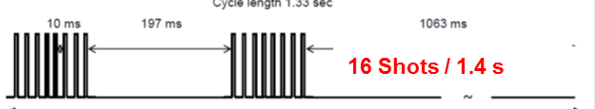
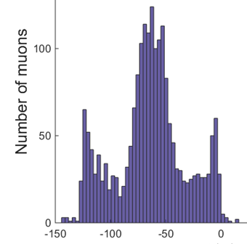
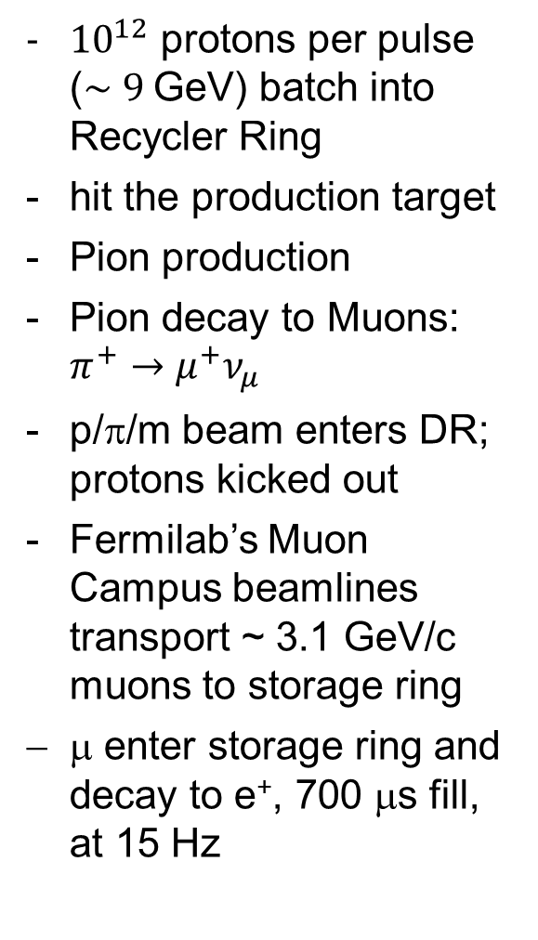
Muon beam production
${10}^{12}$ protons per pulse ($\sim 9$GeV) batch into Recycler Ring
hit the production target
Pion production
Pion decay to Muons: $π^{+}→μ^{+}ν_{μ}$
p/π/m beam enters DR; protons kicked out
Fermilab’s Muon Campus beamlines transport ~ 3.1 GeV/c muons to storage ring
μ enter storage ring and decay to e⁺, 700 μs fill, at 15 Hz
Intensity profile is 120 ns wide

Slide 16
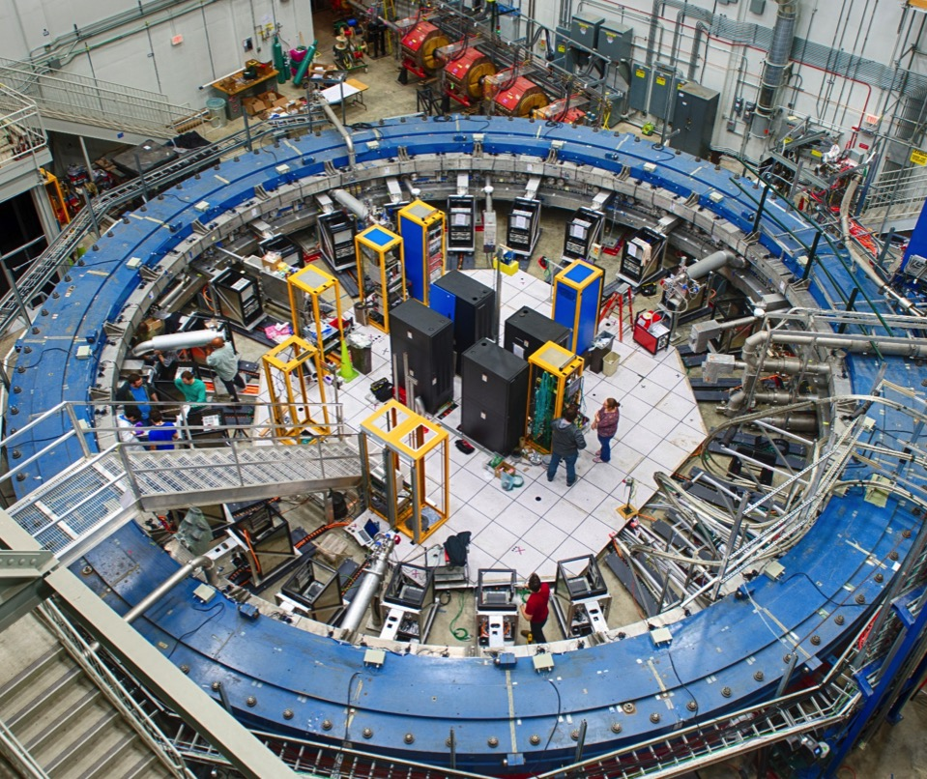
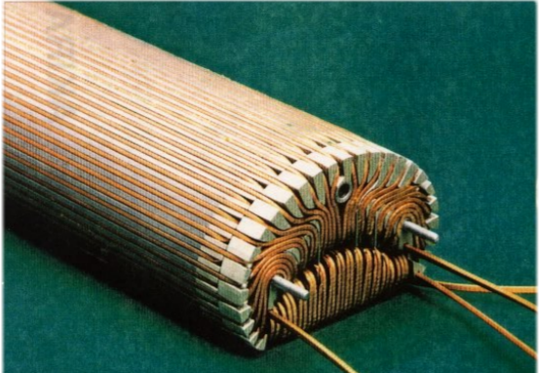
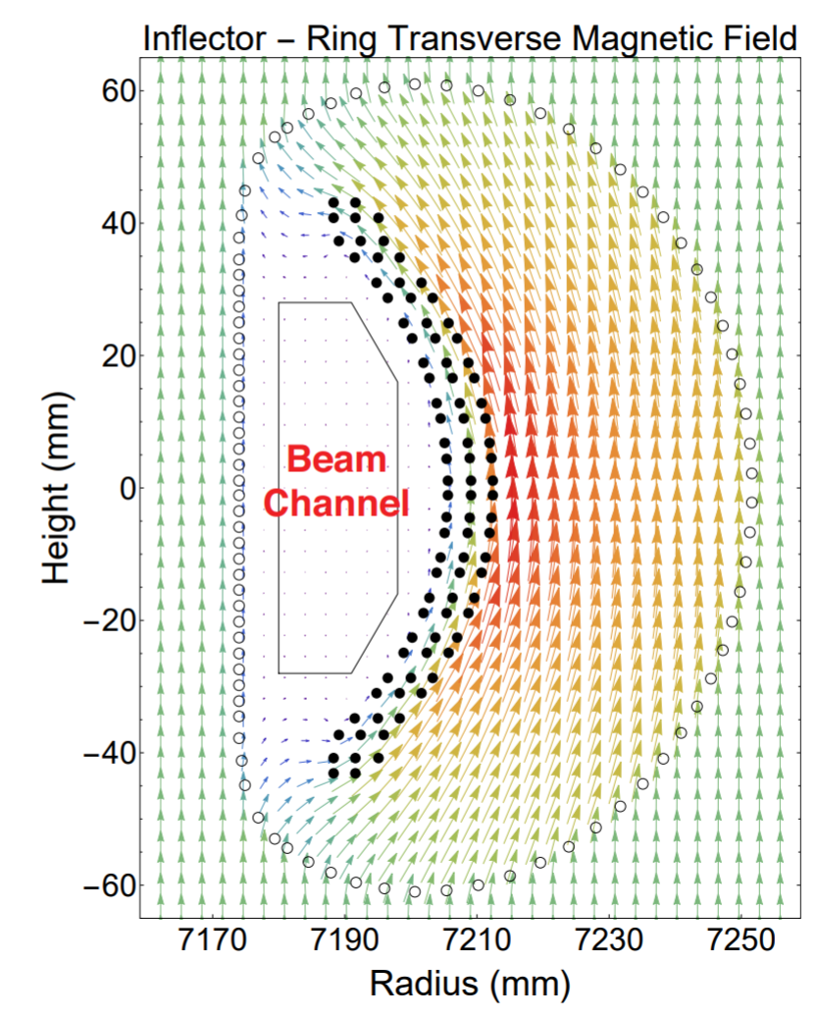
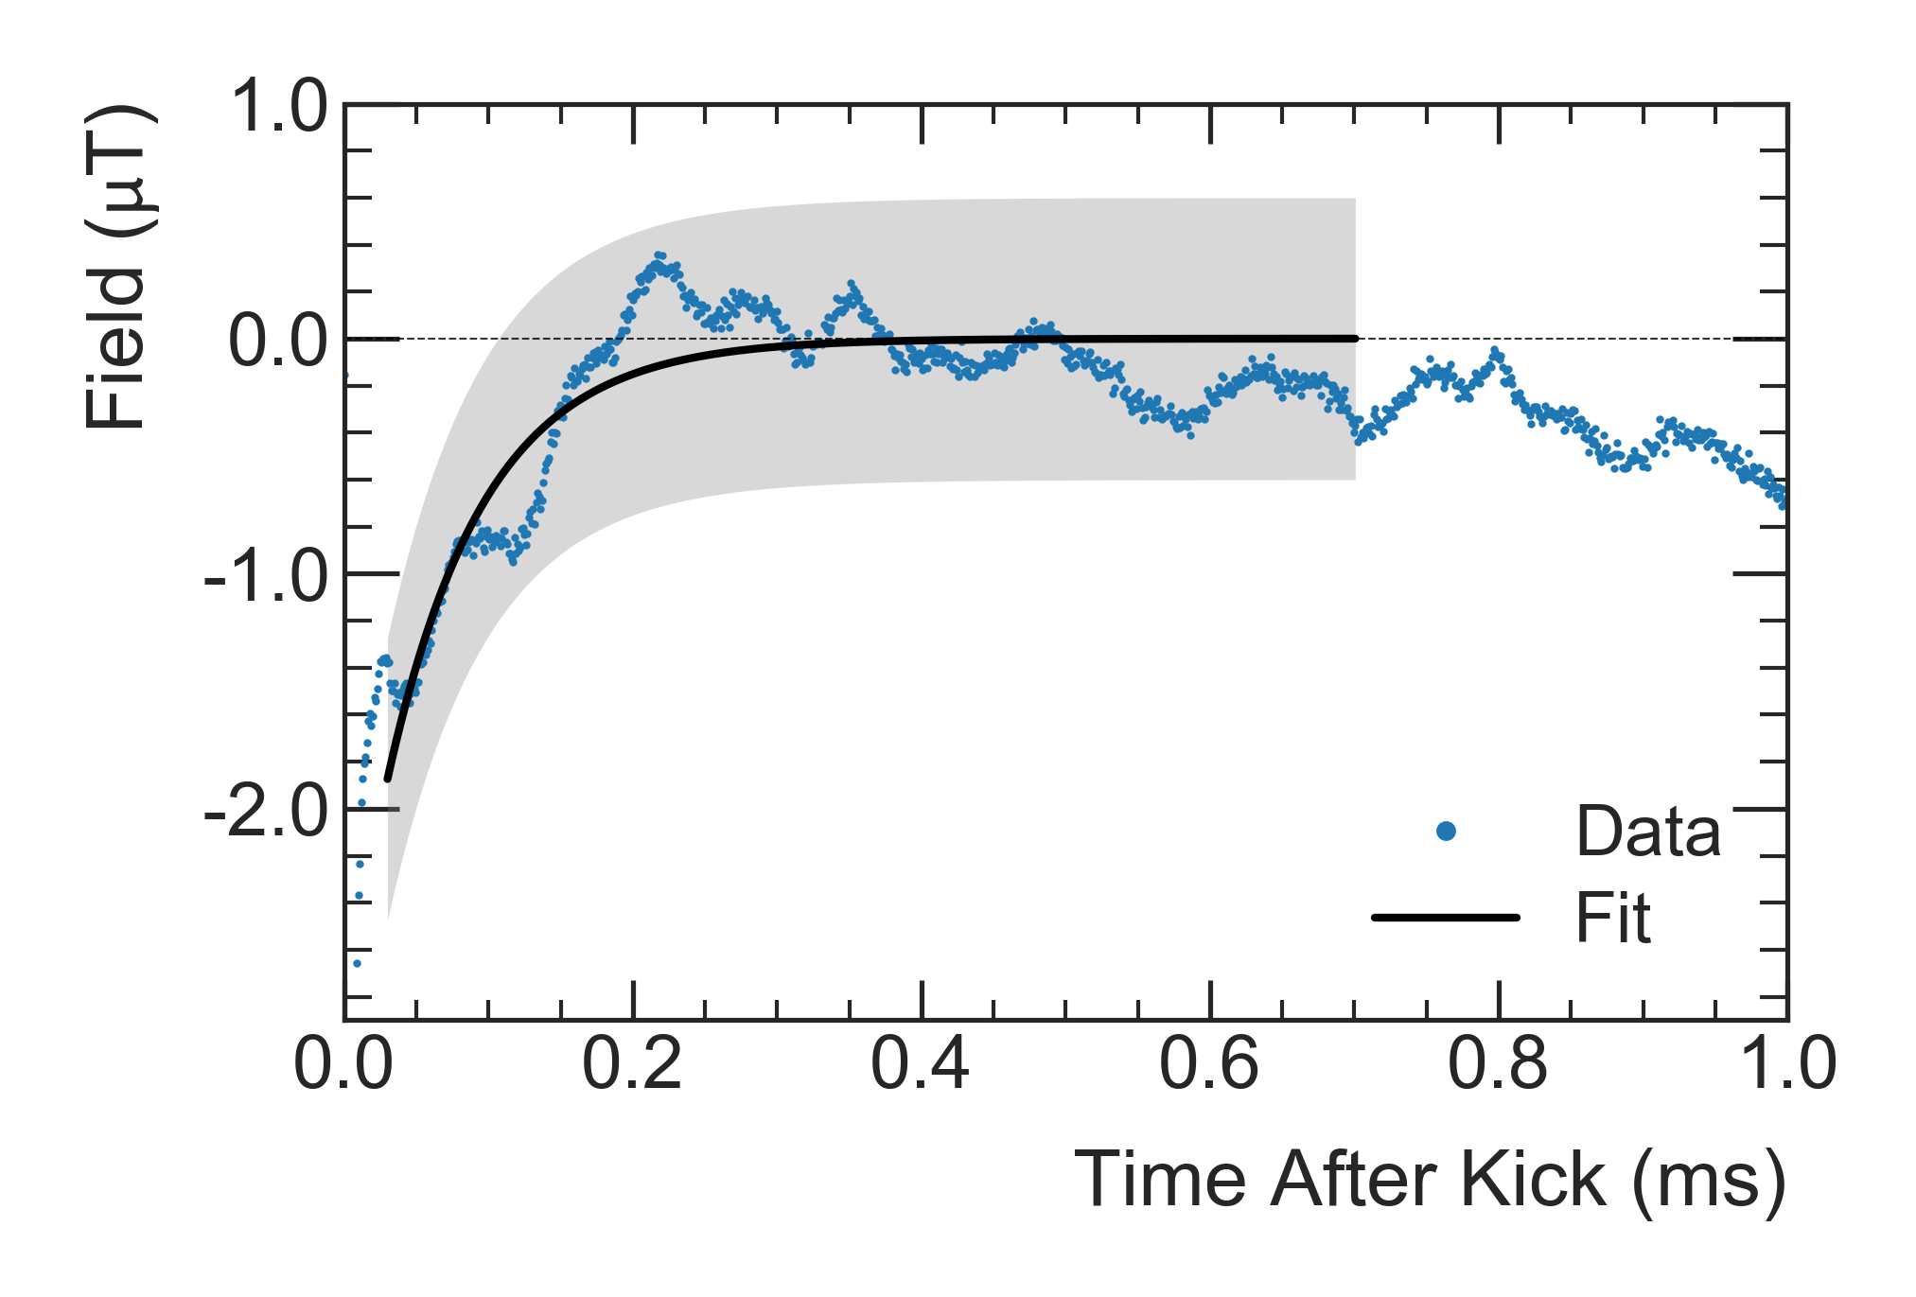

The ring
Muons
3 Magnetic kickers
Kicker transient field
Fast kicker pulses impedance mismatch induces Eddy currents.
Faraday magnetometer using fibers measured the kicker transient field (laser polarization rotates in TGG crystal in presence of the magnetic field).
Inflector magnet
Kickers aim to align muons with storage region (11 mrad deflection)
Off after the first turn (< 149 ns)
Run1 = 125-142 kV, 220 G (-> 165 kV)
Inflector magnet cancels the main B field to inject the muon beam
$B_{k}=−27\left(37\right) ppb$ for Run-1

Slide 17
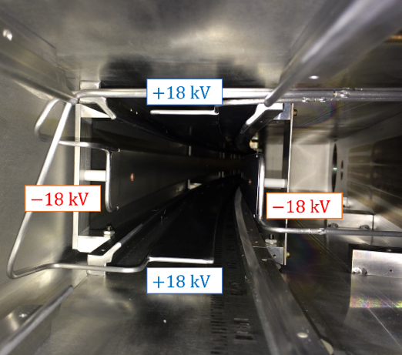
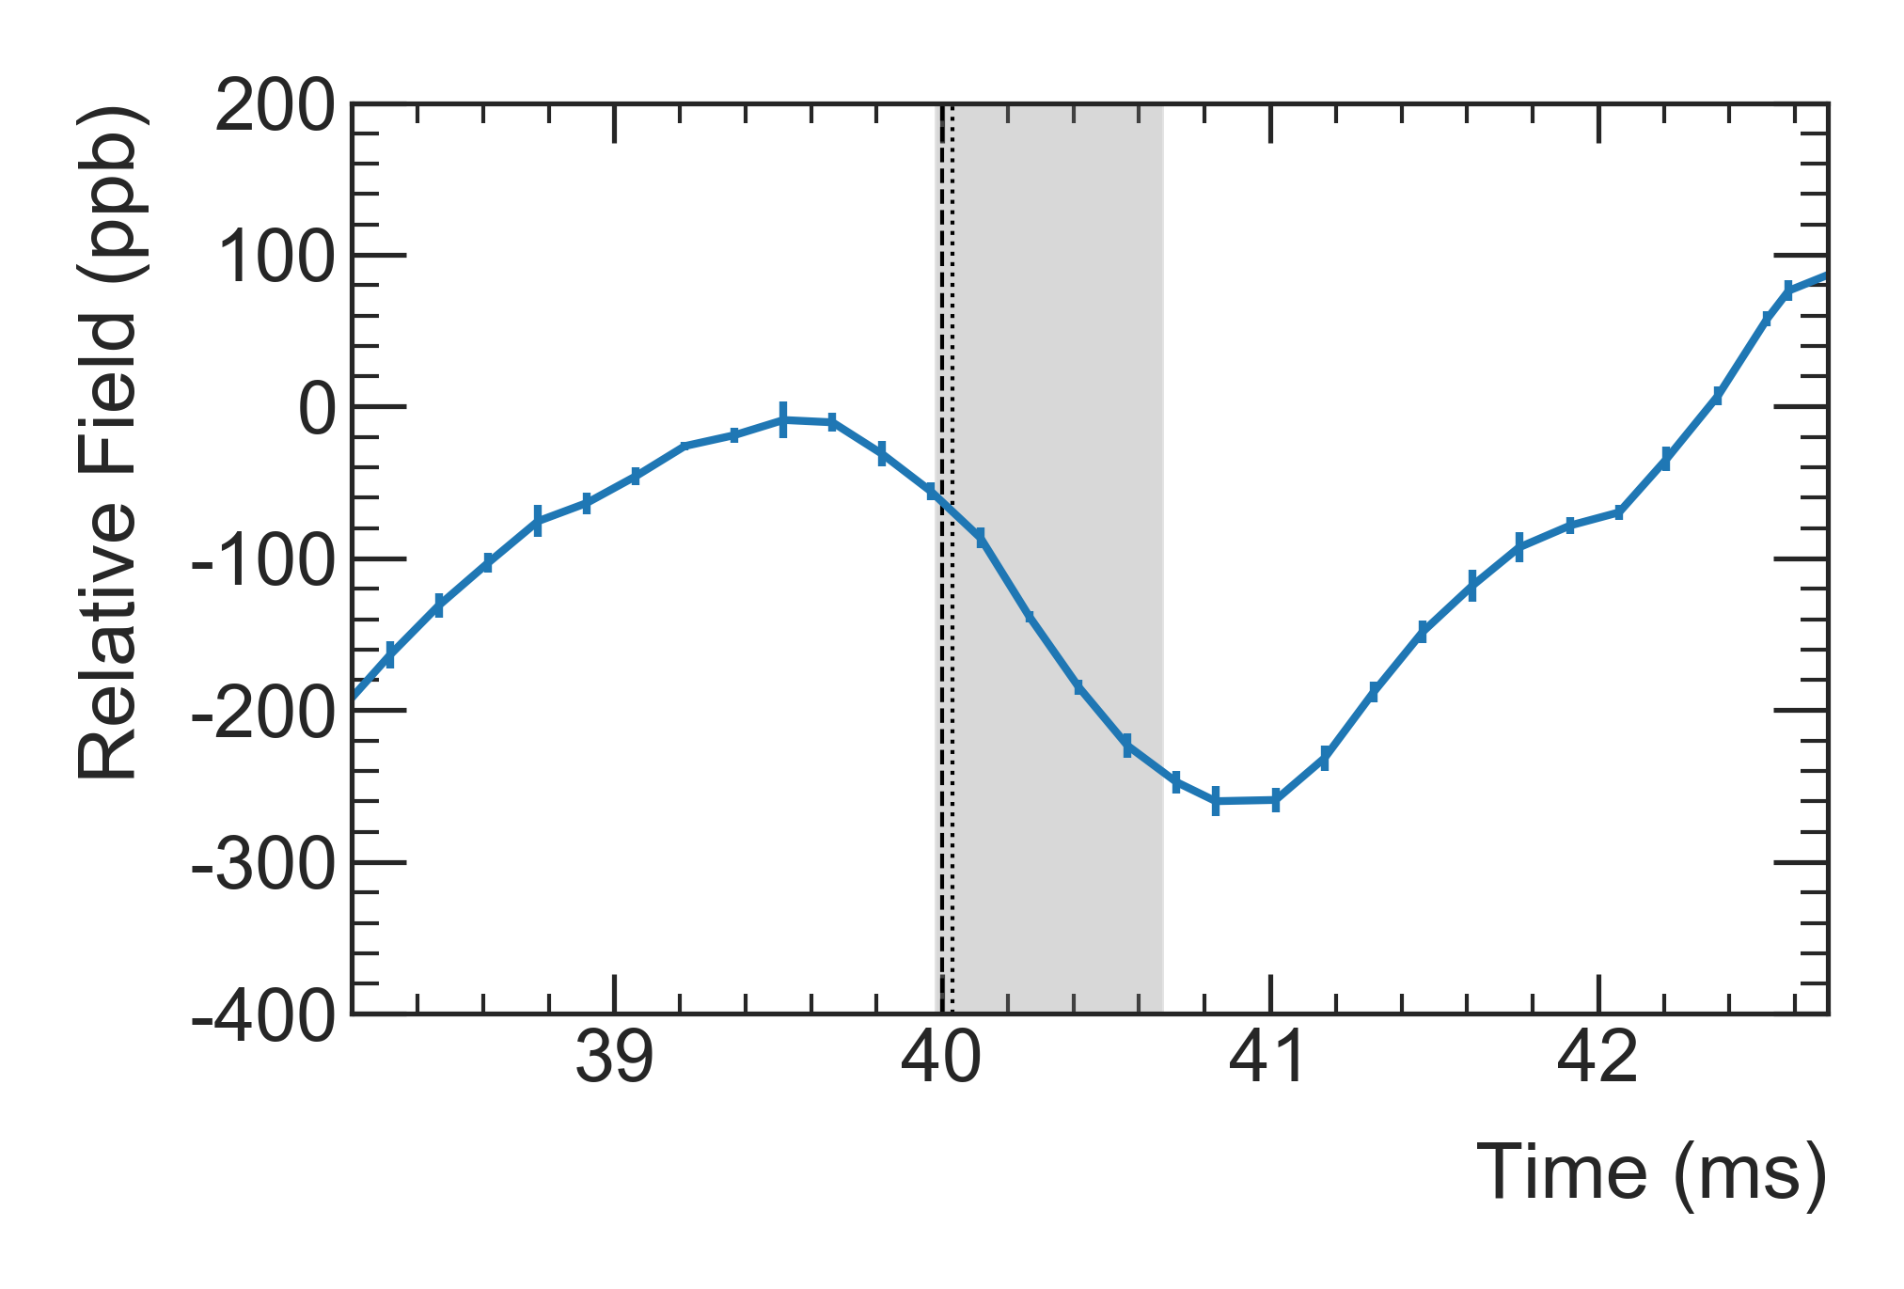

The ring
Muons
8 Quadrupoles
Quad plates mechanical vibration
The ESQ plates are pulsed at 100 Hz.
Mechanical vibrations induce a magnetic field transient in the storage region.
Quadrupole E-field to keep muon vertically confined
$B_{q}=−17\left(92\right) ppb$ for Run-1

Slide 18
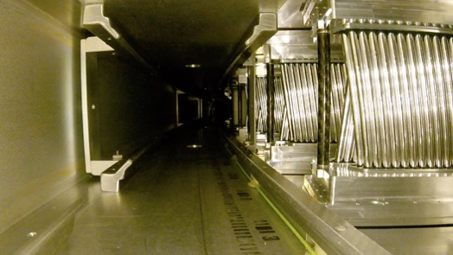
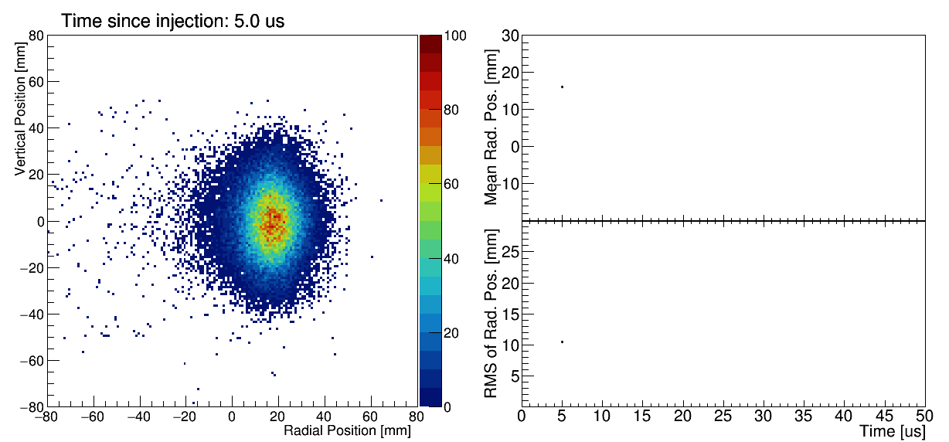
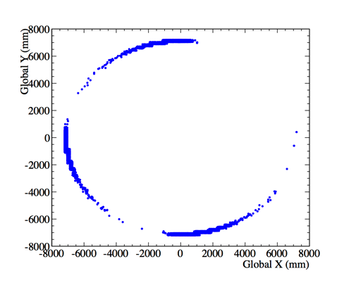
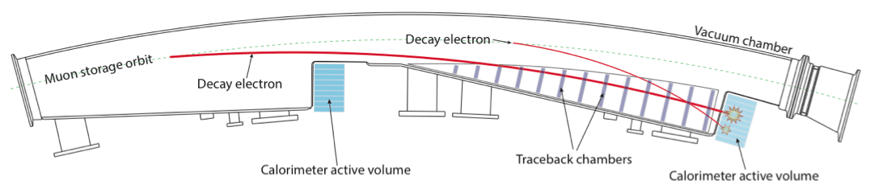
The ring
Muons
2 Trackers
Resolution 1 mm

Slide 19
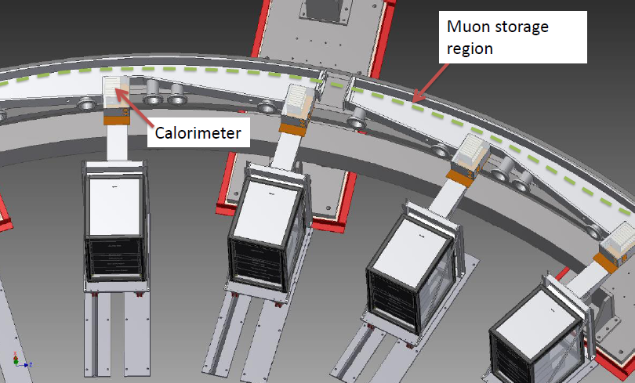
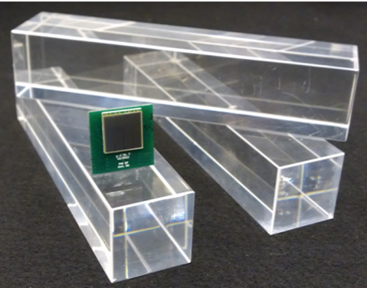
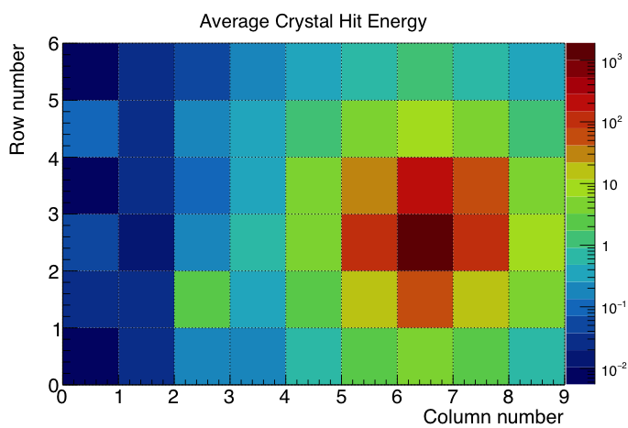
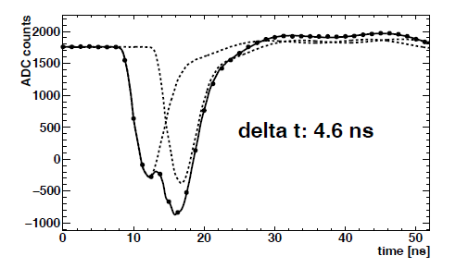
The ring
Muons
24 calorimeters
PbF₂

Slide 20
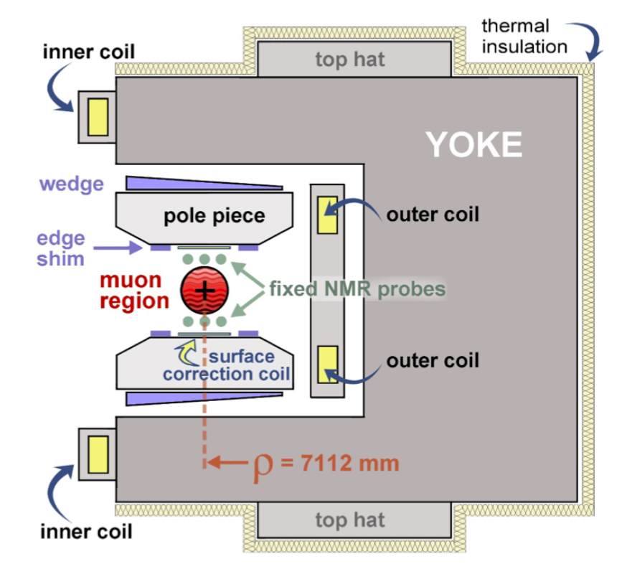
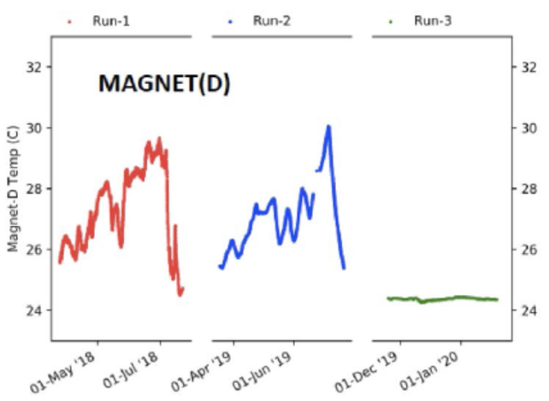
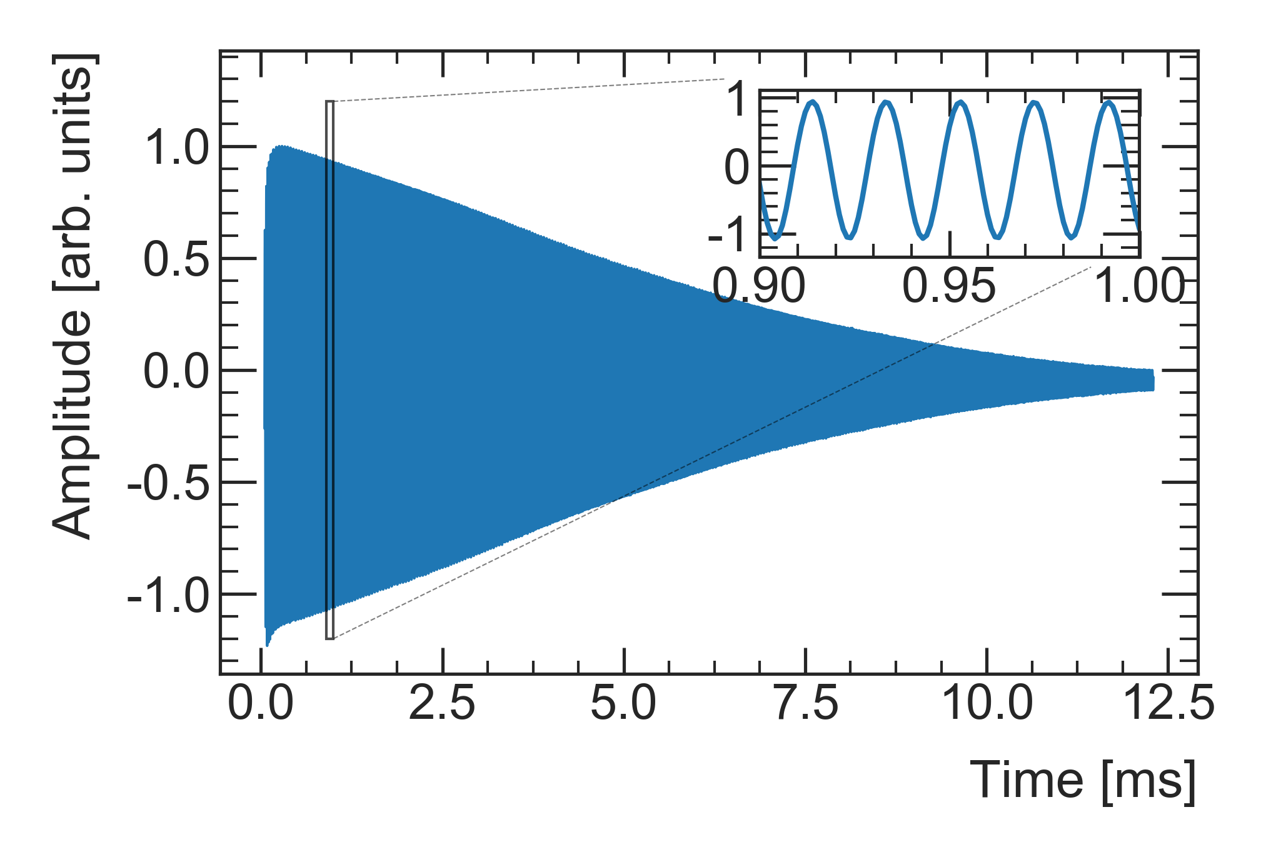
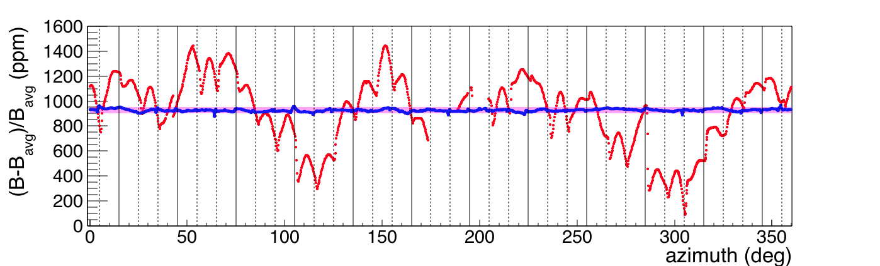
The magnet
Muons
FID signals from 378 NMR probes
B = 1.45 T
Oct 2015 Aug 2016
50 ppm
3X BNL

Slide 21







The NMR probes calibration
NMR trolley maps field every 3 days
Trolley absolute calibration:
plunging probe with water sample
17 NMR probes
Absolute probes all cross-calibrated at the ANL test magnet
9000 locations over the entire azimuth every 3 days
Consistent with BNL probe to 6 ppb
and with new ³He probe to 38 ppb

Slide 22




The magnetic anomaly a_{μ}= (g - 2)/2
Measured quantities
External data, total uncertainties: 25 ppb
$$ω_{a}$$
Precession of muons and protons in the same B field
$R_{μ}^{′}=\frac{ω_{a}}{{\tilde{ω}′}_{p}}$ ≈
ω_{p}= Larmor precession frequency of protons in water (mapping B)
from proton NMR
22

Slide 23



The magnetic anomaly a_{μ}= (g - 2)/2
Measured quantities
External data, total uncertainties: 25 ppb
$$ω_{a}$$
$R_{μ}^{′}=\frac{ω_{a}}{{\tilde{ω}′}_{p}}$ ≈
M = Muon distribution in the storage ring
ω_{p}= Larmor precession frequency of protons in water (mapping B)
⊗
${{\tilde{ω}}_{p}=ω}_{p}\left(x,y,φ\right) ⊗ M(x,y,φ$)

Slide 24








The master formula
Measured $g−2$ frequency
Corrections from
the beam dynamics systematic effects
Unblinding conversion factor
Magnetic field weighted over
the muon distribution and
azimuthally averaged
Corrections from
the transient magnetic field
NMR probe calibration factor
$δ \sim 38 ppb$
$δ_{ω_{p}^{}}\sim 48 ppb$
$δ_{Bk}\sim 37ppb$
Both $ω_{a}^{m}$ and $ω_{p}$ frequencies are measured by a single 10 MHz, GPS master clock.
A ($40−ε$) MHz blinded frequency ($±25 ppm$) is used for $ω_{a}^{m}$.
Uncertainty due to:
Temperature Corrections
Configuration Corrections
Trolley Map Systematics
Fixed Probe Systematics
Tracking Drift Uncertainty
$δ_{Bq}\sim 92 ppb$

Slide 25
The $ω_{a}^{m}$ analysis strategy
6 independent analysis groups using different Reconstruction algorithms and different Fit methods
Q-method is completely different from all others: it has a larger error
→ used as crosscheck
2 Independent Reconstruction algorithms developed (East, West)
Team | Reconstruction | Analysis
CU (Cornell) | East | T, E
UW (Washington) | West | T, A
Europa (INFN+UK) | West/Europa | T, A
SJTU (Shangai) | West | T, E
BU (Boston) | West | T, R
Uky (Kentucky) | Q | Q
T-method: count all positrons with E>1.7GeV and plot them vs time to get the «Wiggle plot» ; reference method
E-method (Energy binned): fit each energy slice, combine the resulting values for ω_{a}
A-method (Asimmetry weighted): weight each event with its own contribution to asimmetry A(E). From the statistical point of view, this method uses most information.
Ratio method: randomly split dataset in 2 subsets shifted by ±half a g-2 period, build combinations of the 2 subsets which eliminates the exponential behavior and leaves just a sinusoidal term
Q method No clustering: just integrate energy above threshold. The total energy per event fluctuates with ω_{a} frequency

Slide 26

The $ω_{a}^{m}$ fit equation (22 parameters)
Red = free parameters
Blue= fixed parameters
Muon Loss term
ω_{y}, ω_{vw} vertical oscillations
ω_{CBO,} ω_{2CBO,} radial oscillation

Slide 27

The $ω_{a}^{m}$ fit equation: residuals

Slide 28

The $ω_{a}^{m}$ Run 1 results
First beam injected into ring on May 31, 2017
Run 1 (FY18): Total statistics = 8.2B e⁺ ~ 1.2 x BNL
Conditions not stable, fragmented data sets taken in different Quad and Kicker conditions, while optimizing Storage Ring operations
434 ppb statistical uncertainty
(compare to 460 ppb for BNL)
56 ppb systematic uncertainty

Slide 29

The a_{μ} Run 1 results
Taking into account the other corrections:
E-field correction
Pitch correction
Muon loss
Phase-Acceptance
Enhanced by the
Run 1 conditions
434 ppb stat ⨁ 157 ppb syst error

Slide 30




References
PRAB
Beam dynamics
Phys. Rev. Accel. Beams 24, 044002
PRA
B field determination
Phys. Rev. A 103, 042208
PRD
Muon precession
Phys. Rev.D 103, 072002
PRL
Phys. Rev. Lett. 126, 141801

Slide 31


Comparison with theory
Combining BNL/FNAL and comparing to e+e- based theory by the Theory Initiative → 4.2σ tension with the SM
Lattice QCD (blue band) are becoming competitive
3.7 σ
Recent evaluation(s) of HVP from lattice (BMW20) in tension with the e⁺e⁻ evaluation (WP20), at 2σ
Data-driven evaluation (R-ratio) on firm ground. Unlikely to be wrong…
New experiment: MUonE
3.3 σ

Slide 32
Conclusion
We have determined a_{μ} to an unprecedented 460 ppb precision
The Run 1 result
  6% of ultimate data sample
  confirm the BNL experimental results
  15% smaller error than BNL
  3.3σ tension with e+e- SM
Next year release of Run 2&3
Analysis of Run 4&5 ongoing
Run 6 (opportunistic) approved
New experiment: J-PARC
We have collected ~19 x BNL
over the last 5 years

Slide 33


The g-2 Collaboration (experiment E989)
Thank you for your attention

Slide 34
Backup slides
Backup

Slide 35

Laser calibration system
35

Slide 36
Notes:
J-PARC E34 will employ a novel approach based on injection of an ultra-cold, low-energy, muon beam injected into a small, but highly uniform Magnet.
Only a small magnetic focusing field is needed to maintain storage emittance, no electri field. This can
be realized with a source of positive muons with thermal energy followed by reacceleration,
without increasing the transverse momentum spread. with a factor of 10 lower muon momentum, and a factor of 20 smaller diameter storage-ring solenoid

Slide 38

A third way for HVP…MUonE at CERN
Test RUN 2022/23
Alternative measurement of HVP for a_{μ}
-C. M. Carloni Calame et al PLB 746 (2015) 325
-G. Abbiendi et al Eur.Phys.J.C 77 (2017) 3, 139
-LoI https://cds.cern.ch/record/2677471/files/SPSC-I-252.pdf

