Slide 1




Muon Collider
D. Schulte for the International Muon Collider Collaboration
IPA
September 2022

Slide 2
High-energy Colliders
accelerating cavities
Electron-positron rings are multi-pass colliders limited by synchrotron radiation: LEP, FCC-ee, CEPC
Hence proton rings are energy frontier: LHC, FCC-hh, SppC
N
N
S
S
Electron-positron linear colliders avoid synchrotron radiation, but single pass: SLC, ILC, CLIC
Typically cost proportional to energy and power proportional to luminosity,
Novel approach: muon collider (the first of its kind)
Large mass suppresses synchrotron radiation => multi-pass
Fundamental particle requires less energy than protons
But lifetime at rest only 2.2 μs
Proportional to energy

Slide 3
Motivation and Goal
Previous studies in US (now very strong interest again), experimental programme in UK and alternatives studies by INFN
New strong interest:
Focus on high energy with high luminosity
  10+ TeV
  potential initial energy stage (e.g. 3 TeV)
Technology and design advances
Combines precision physics and discovery reach
Discovery reach
14 TeV lepton collisions are comparable to 100-200 TeV proton collisions for production of heavy particle pairs
Luminosity goal
(Similar to L(E_{CM} > 0.99 E_{CM,0}) CLIC at 3 TeV)
4x10³⁵ cm⁻²s⁻¹ at 14 TeV
3

Slide 4
Collider Concept
Fuly driven by muon lifetime, otherwise would be easy
Short, intense proton bunch
Ionisation cooling of muon in matter
Acceleration to collision energy
Collision
Protons produce pions which decay into muons
muons are captured
4

Slide 5
Sustainability
CLIC is highest energy proposal with CDR
No obvious way to further improve linear colliders (decades of R&D)
Cost 18 GCHF, power 590 MW
Rough rule of thumb:
cost proportional to energy
power proportional to luminosity
Muon Collider goals (10 TeV), challenging but reasonable:
Much more luminosity than CLIC at 3 TeV (L=20x10³⁴, CLIC: L=2x10³⁴/6x10³⁴)
Lower power consumption than CLIC at 3 TeV (P_{beam,MC}=0.5P_{beam,CLIC})
Lower cost
Staging is possible
Synergies exist (neutrino/higgs)
Unique opportunity for a high-energy, high-luminosity lepton collider
5

Slide 6
Initial Target Parameters
Target integrated luminosities
Note: currently focus on 10 TeV, also explore 3 TeV
Tentative parameters based on MAP study, might add margins
Achieve goal in 5 years
FCC-hh to operate for 25 years
Aim to have two detectors
Parameter | Unit | 3 TeV | 10 TeV | 14 TeV
L | 10³⁴ cm⁻²s⁻¹ | 1.8 | 20 | 40
N | 10¹² | 2.2 | 1.8 | 1.8
f_{r} | Hz | 5 | 5 | 5
P_{beam} | MW | 5.3 | 14.4 | 20
C | km | 4.5 | 10 | 14
<B> | T | 7 | 10.5 | 10.5
ε_{L} | MeV m | 7.5 | 7.5 | 7.5
σ_{E} / E | % | 0.1 | 0.1 | 0.1
σ_{z} | mm | 5 | 1.5 | 1.07
β | mm | 5 | 1.5 | 1.07
ε | μm | 25 | 25 | 25
σ_{x,y} | μm | 3.0 | 0.9 | 0.63
CLIC at 3 TeV
2 (6)
28
6

Slide 7
Accelerator R&D Roadmap
On CERN Council request Laboratory Directors Group developed Accelerator R&D Roadmap
global community participated, a global roadmap
No insurmountable obstacle found for the muon collider
but important need for R&D
developed two funding scenarios
Full scenario deliverables by next ESPPU/other processes
Project Evaluation Report
R&D Plan that describes a path towards the collider;
Allows to make informed decisions
Council asked for implementation plan
do not yet have the resources of the reduced scenario
Scenario | FTEy | M MCHF
Full scenario | 445.9 | 11.9
Reduced scenario | 193 | 2.45
http://arxiv.org/abs/2201.07895
7

Slide 8
Timeline
Muon collider important in the long term
Prudently explore if MuC can be option as next project
e.g. in Europe if higgs factory built elsewhere
sufficient funding required now
very strong ramp-up required after 2026
fast-track project might require some compromises on initial scope and performance
  3 TeV?
8

Slide 9
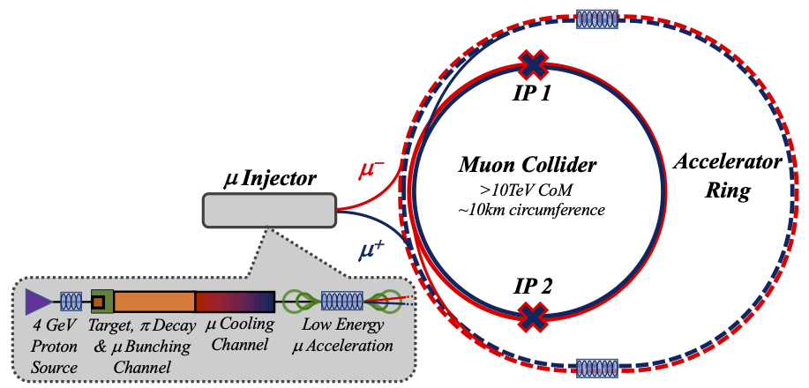
Key Challenges
0) Physics case
4) Drives the beam quality
MAP put much effort in design
optimise as much as possible
2) Beam-induced background
1) Dense neutrino flux
mitigated by mover system and site selection
3) Cost and power consumption limit energy reach
e.g. 35 km accelerator for 10 TeV, 10 km collider ring
Also impacts beam quality
9

Slide 10
Physics Studies
Details on physics case, detector and accelerator can be found in
Snowmass white papers https://indico.cern.ch/event/1130036/
EPJC report in preparation
Used tentative detector performance specifications in form of DELPHES card
based on FCC-hh and CLIC performances, including masks against beam induced background (BIB)
Please find the card here: https://muoncollider.web.cern.ch/node/14
M. Selvaggi, W. Riegler, U. Schnoor, A. Sailer, D. Lucchesi, N. Pastrone, M. Pierini, F. Maltoni, A. Wulzer et al.
Initial detector simulation studies at 1.5 and 3 TeV indicate that this is a good model
Now moving to 10 TeV
If you are interested to contribute please contact me or the responsible deputies:
Andrea Wulzer (physics) and Donatella Lucchesi (Detector and MDI)
D. Lucchesi et al.
10

Slide 11
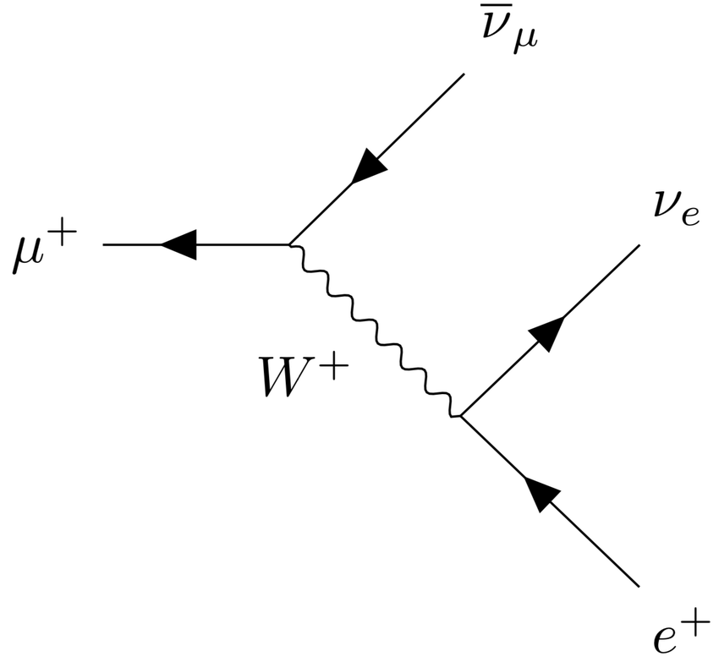
Muon Decay and Detector Background
At 10 TeV O(40 000 muons/m bunch crossing decay)
About 1/3 of energy in electrons and positrons:
Masks protect detectors from background
optimising 10 TeV design
Other mitigation
Timing (background mostly out of time
Track direction (most background from mask)
Detector design
…
Other background from incoherent pairs is also studied (addition in GUINEA-PIG)
Detailed simulation studies at 1.5/3 TeV indicate DELPHES card is realistic
studies indicate background does not increase significantly at 10 TeV (fewer decays/m)
D. Lucchesi, A. Lechner, C Carli et al.
11

Slide 12
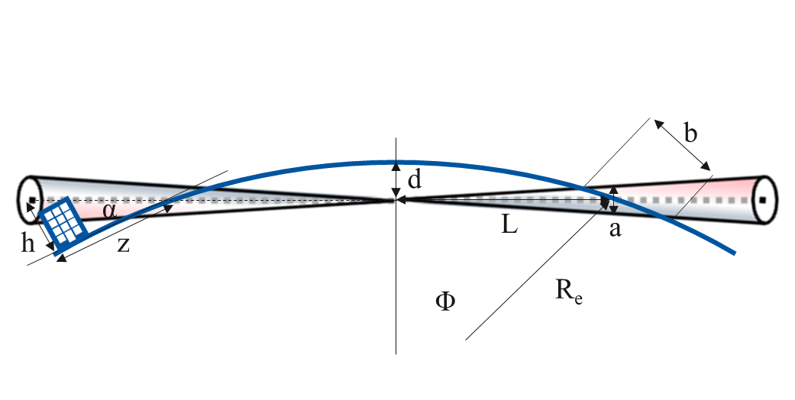
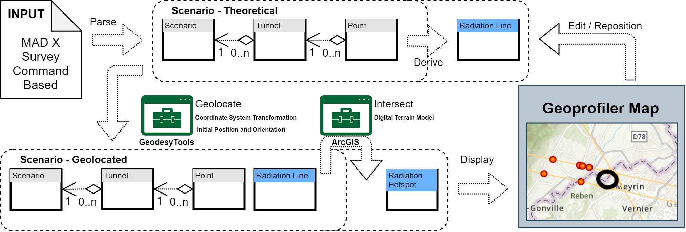
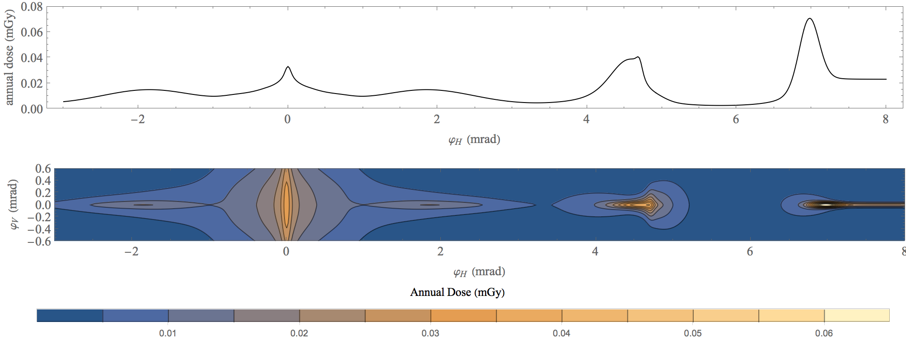
Neutrino Flux
Goal: similar to LHC: limit neutrino flux to have negligible impact, “fully optimised” (10% of MAP goal)
likely OK for 14 TeV
Mover and support system
FLUKA dose studies
Conformity Verification Scheme
F. Bertinelli et al. (CERN, Riga)
G. Lerner, D. Calzolari, A. Lechner, C. Ahdida
G. Lacerda, Y. Robert, N. Guilhaudin (CERN)
C. Ahdida, P. Vojtyla, M. Widorski, H. Vincke
Flux direction map / lattice design / mover impact on beam
Mitigation:
Site choice tool
C. Carli, K. Skoufaris (CERN)
12

Slide 13
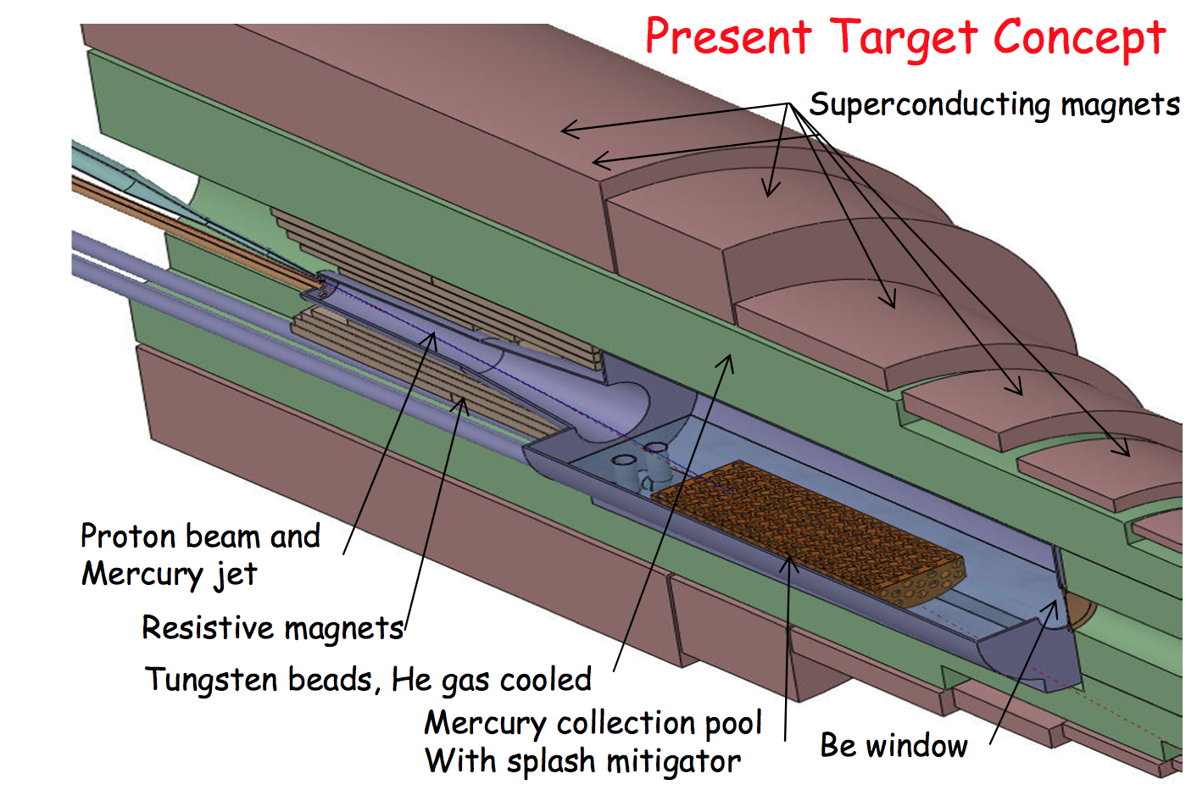
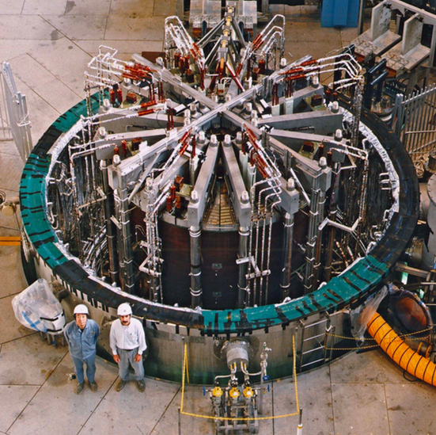
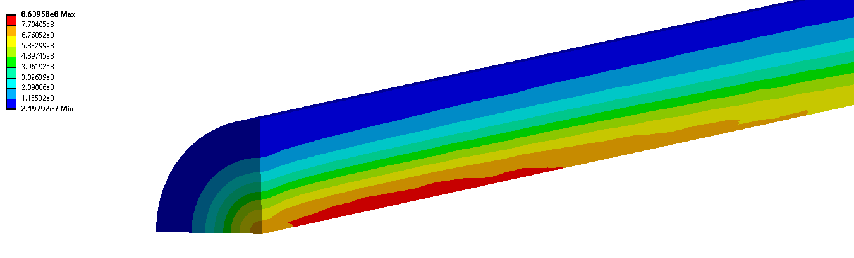
Target
MAP target design, K. McDonald, et al.
Two approaches:
15 T outer superconducting + 5 T inner resistive solenoid
O(20 T) HTS solenoid
Shield superconducting solenoid
larger aperture
Synergy with ITER
12…15 T
20 T
A. Lechner et al.
L. Bottura et al.
Rui Franqueira Ximenes et al.
ITER Central Solenoid Model Coil
13 T in 1.7 m (LTS)
2 MW proton beam is OK
bunching challenge will be addressed by ESS experts
Shock in target: Simulations of graphite target indicate 2 MW could be acceptable
STFC will also study alternatives
N. Milas et al. (ESS, Uppsala)
Proton beam
Operation at 2000 °C to maximise stress resistance
13

Slide 14
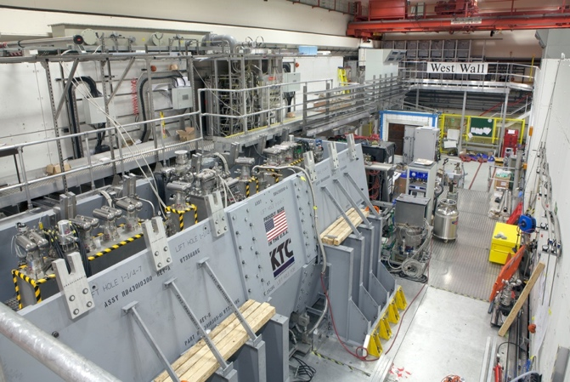
Muon Cooling
MAP designs almost achieve 10 TeV goal
miss factor two for final cooling
C. Rogers, B. Stechauner, E. Fol et al.
MICE Collaboration
Nature vol. 578, p. 53-59 (2020)
Integration/optimisation of overall cooling design
Integrating improved technology
Principle of ionisation cooling with no RF has been demonstrated in MICE at RAL
Use of data for benchmarking is still ongoing
C. Rogers et al.

Slide 15
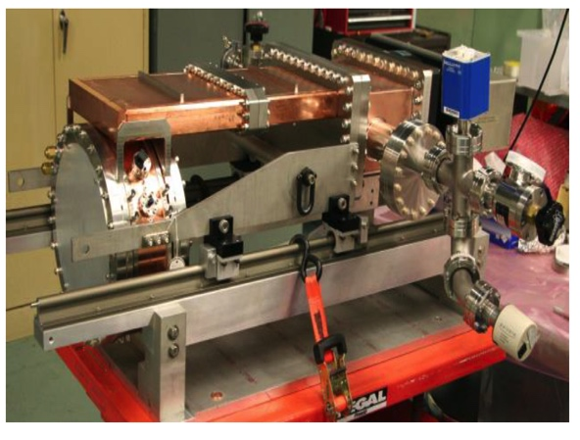
Cooling Cell Technology
C. Marchand, Alexej Grudiev et al. (CEA, Milano, CERN, Tartu)
RF cavities
MAP demonstrated higher than goal gradient
Improve design based on theoretical understanding
Preparation of new experiments
Test stand at CEA (700 MHz, need funding)
Test at other frequencies in the UK considered
Use of CLIC breakdown experiment considered
MuCool demonstrated >50 MV/m in 5 T
H2-filled copper
Be end caps
MAP demonstrated 30 T solenoid
now magnets aim for 40+ T
even more can be possible
synergy with high-field research
L. Bottura et al.
INFN (Task Leader), CEA, CERN, LNCMI, PSI, SOTON, UNIGE and TWENTE, in collaboration with KEK and US-MDP
Will develop cooling cell integration
tight constraints
additional technologies (absorbers, instrumentation,…)
early preparation of demonstrator facility
L. Rossi et al. (INFN, Milano, STFC, CERN),
J. Ferreira Somoza et al.
15

Slide 16
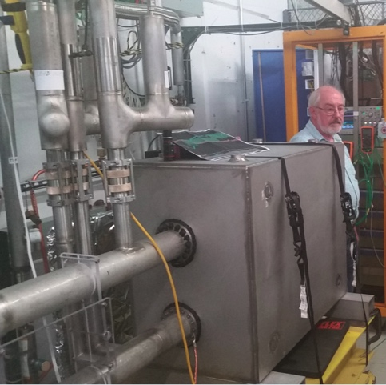
Acceleration Complex
Baseline is sequence of pulsed synchrotron (0.4-11 ms)
Important cost and power consumption
started to develop integrated design
Lattice design for larger energy bandwidth
Fast-ramping normal magnets
  HTS starts to look interesting
  profit from MAP study and US
Power converter with energy recovery
RF with high transient beam loading
A. Chance et al. (CEA)
L. Bottura et al. (LNCMI, Darmstadt, Bologna, Twente)
Alternative FFA
EMMA proof of FFA principle
Nature Physics 8, 243–247 (2012)
F. Boattini et al.
H. Damerell, F. Batsch, U. van Rienen, A. Grudiev et al. (Rostock, Milano, CERN)
FNAL 1 kT/s HTS magnet

Slide 17
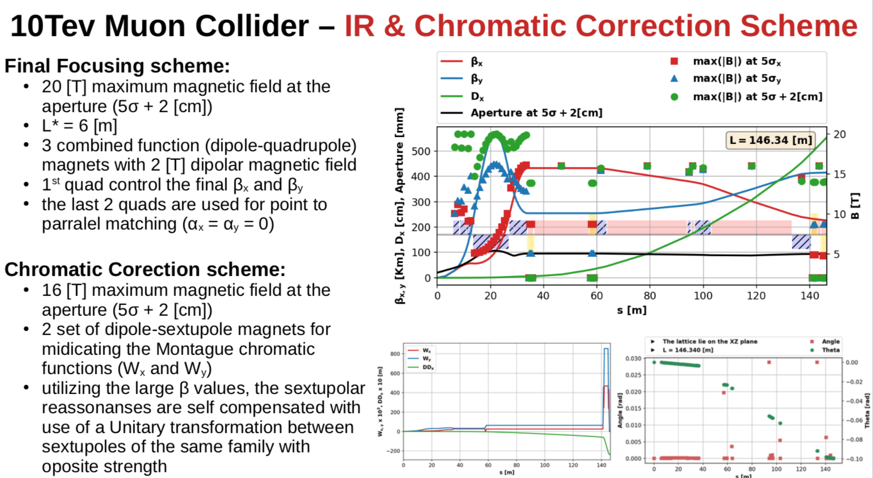
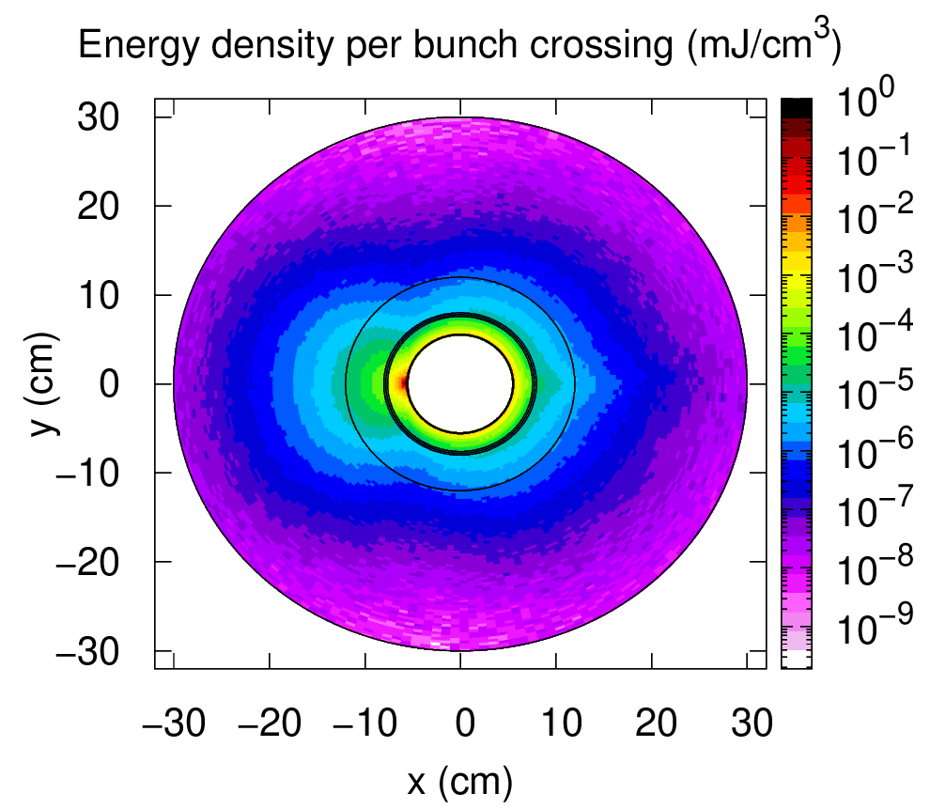
Collider Ring
MAP developed 4.5 km ring for 3 TeV with Nb₃Sn
magnet specifications in the HL-LHC range
5 mm beta-function at IP
Work on 10 km ring for 10 TeV collider ring
around 16 T Nb₃Sn or HTS dipole field around 15 cm
final focus based on HTS
1.5 mm beta-function at IP
15 cm aperture for shielding to ensure magnet lifetime
C. Carli, K. Skoufaris (CERN)
Shielding
A. Lechner
D. Calzolari (CERN)
Field choice will be reviewed for cost
Example alternatives:
a 6 km 3 TeV ring with NbTi at 8 T in arcs
a 15 km 10 TeV ring with HL-LHC performances
slight reduction in luminosity
Need stress managed magnet designs
Coil
INFN, Milano, Kyoto, CERN, profit from US
17

Slide 18
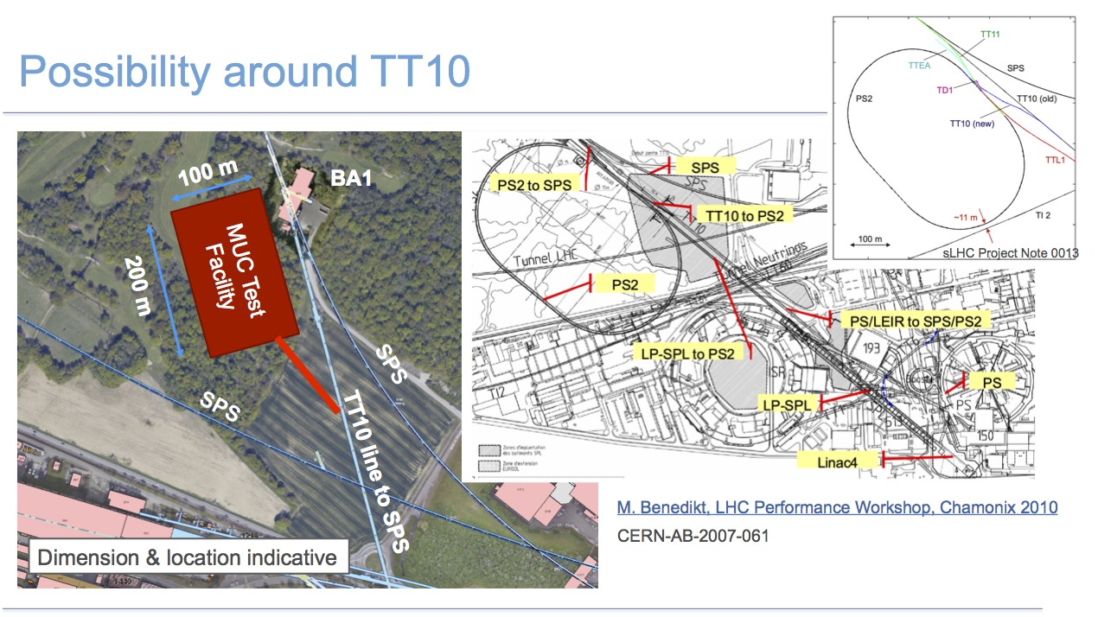
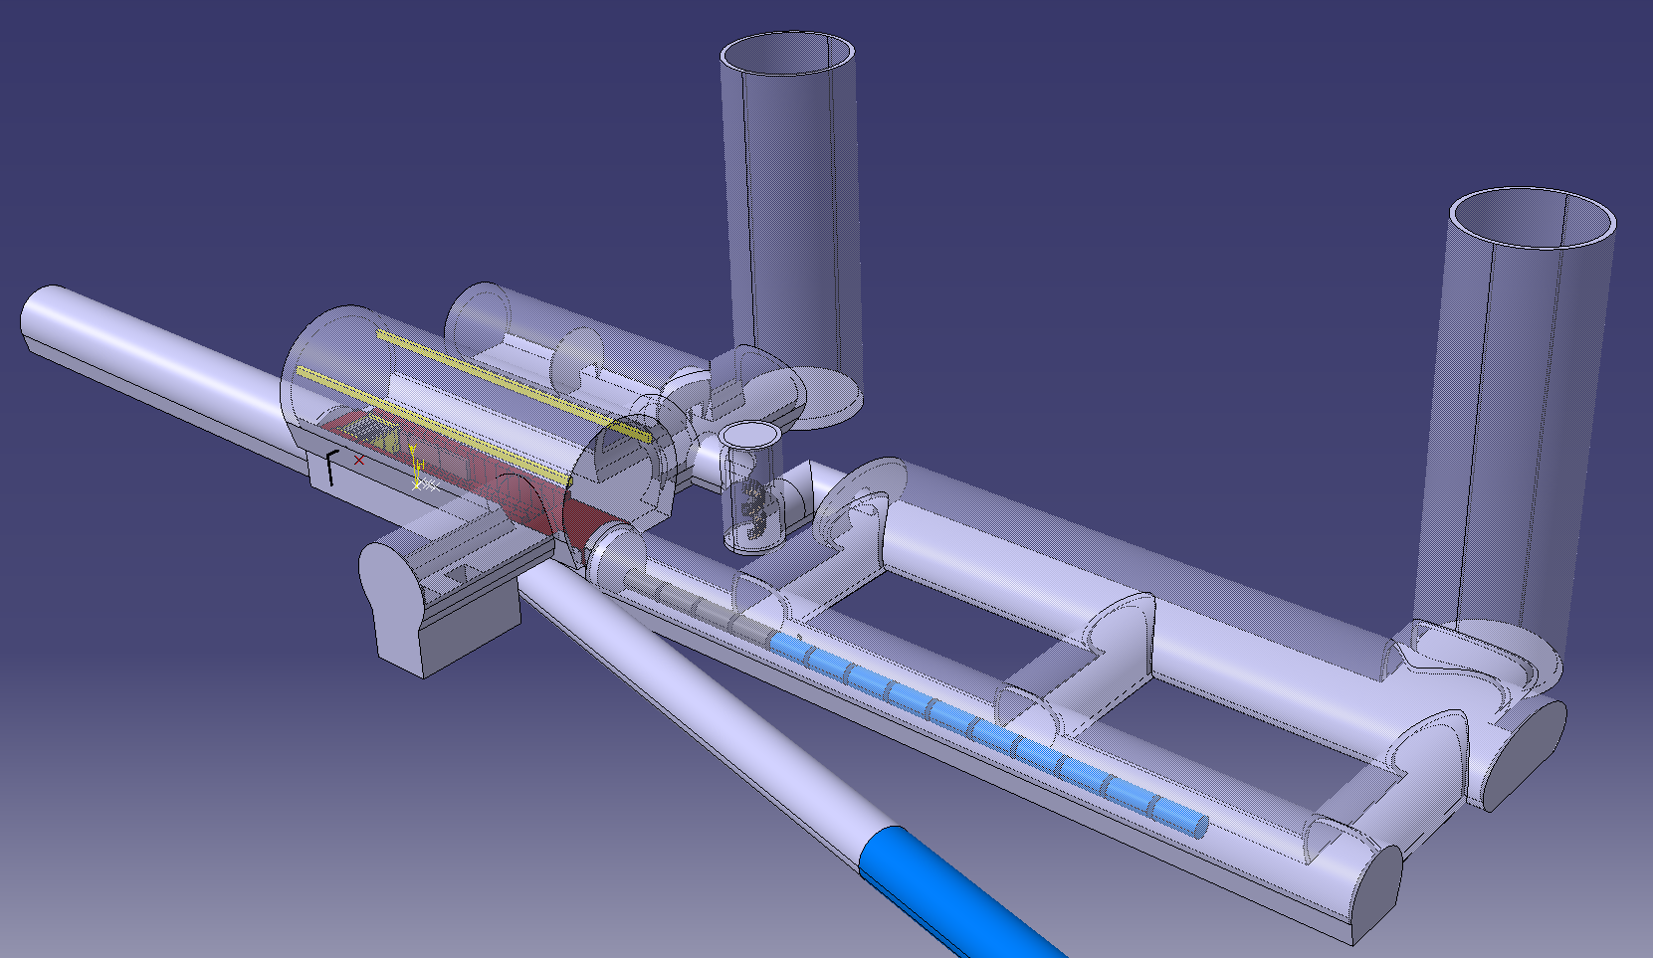
Demonstrator Facility Consideration
Target
+ horn (1st phase) /
+ superconducting solenoid (2nd phase)
Planning demonstrator facility with muon production target and cooling stations
Suitable site exists on CERN land and can use PS proton beam
could combine with NuStorm or other option
Other sites should be explored (FNAL?)
Collimation and upstream diagnostics area
Downstream diagnostics area
Cooling area
Momentum selection chicane
18
R. Losito et al.

Slide 19
Key Next Steps
Formal organisation
Collaboration Board
  Chair to be elected October 11
Steering Board (link to CERN Council, DoE?, …)
  Chair Steinar Stapnes
Coordination committee
  Study Leader Daniel Schulte, deputies: Andrea Wulzer, Donatella Lucchesi, Chris Rogers, to be endorsed by CB
  member are already working
Securing resources (not yet at reduced level)
Institutes, national funding, EU co-funding, US Snowmass/P5, …
your help needed
If you want to join and sign MoC please contact muon.collider.secretariat@cern.ch

Slide 20
EU Design Study
HORIZON-INFRA-2022-DEV-01-01: Research infrastructure concept development
January 2023 to December 2026
Approved late July, now preparing contract
EU contribution 3 MEUR, partners 4 MEUR, CERN
Workpackages
Coordination and Communication
Physics/Detector Performance Requirements
Proton Complex
Muon Production and Cooling
High-energy Complex
RF Systems
Magnetic Systems
Muon Cooling Module
Plan to also apply for next TECH call in 2024, to develop technologies
HORIZON-INFRA-2022-TECH-01-01:
Expected EU contribution: 5-10 MEUR
Total budget 110 MEUR
Type of Action: Research and Innovation Actions
20

Slide 21
Snowmass
Strong interest in the US community in muon collider
seen as an energy frontier machine
decoupled from LC
US community wants funding for R&D
Community interested in the US to host a muon collider
Meenakshi Narain: Energy Frontier / Large Experiments, Snowmass Community Summer Study July 17-26, 2022
21

Slide 22
MoC and Design Study Partners
IEIO | CERN
FR | CEA
 | CNRS-LNCMI
DE | DESY
 | Technical University of Darmstadt
 | University of Rostock
 | KIT
IT | INFN
 | University of Milano
 | University of Padova
 | University of Pavia
 | University of Bologna
 | ENEA
CH | PSI
 | University of Geneva
BE | Louvain
UK | STFC-RAL
 | UK Research and Innovation
 | University of Lancaster
 | University of Southampton
 | University of Strathclyde
 | University of Sussex
 | Imperial College
 | Royal Holloway
 | University of Huddersfield
 | University of Oxford
 | University of Warwick
 | University of Durham
SE | ESS
 | University of Uppsala
PT | LIP
NL | University of Twente
FI | Tampere University
US | Iowa State University
 | BNL
China | Sun Yat-sen University
 | IHEP
 | Peking University
EST | Tartu University
LAT | Riga Technical Univers.
AU | HEPHY
 | TU Wien
ES | I3M
CHART is contributing (and EPFL)
Informal contributions (US, Japan)
22
Note: some MoC still being prcessed

Slide 23
Test Facility, Staging and Physics Programme
Can envisage a staged approach to a muon collider
  Tentatively 3 TeV considered
    to be able to profit from CLIC detector work and to be able to compare to CLIC
    probably splits cost in half
  Need to refine choice
    In particular if no other collider is being built in the coming years
Can also provide non-collider physics
  test facility could be synergistic with neutrino user facility
Synergies on technology development exist (targets, …)
Plan a workshop on test facility, synergies and non-collider physics later this year
  please let me know if you want to contribute
23

Slide 24
Conclusion
Muon collider is unique opportunity for high-energy, high-luminosity lepton collider
Currently two different options considered
  goal of 10+ TeV
  potential 3 TeV intermediate stage explored
  will consider other options later
Started turning Roadmap into a workplan
First important results are being obtained
but still plenty of work remains
  increased R&D effort still required
  great opportunity to join, also for the physics and detector
Collaboration meeting October 11-14 at CERN
http://muoncollider.web.cern.ch
Many thanks to the Muon Beam Panel, the collaboration, the MAP study, the MICE collaboration, and many others
24

Slide 25
Reserve

Slide 26
Alternatives: The LEMMA Scheme
LEMMA scheme (INFN) P. Raimondi et al.
Note: New proposal by C. Curatolo and L. Serafini needs to be looked at
Uses Bethe-Heitler production with electrons
45 GeV positrons to produce muon pairs
Accumulate muons from several passages
Excellent idea, but nature is cruel
Detailed estimates of fundamental limits show that we require a very large positron bunch charge to reach the same luminosity as the proton-based scheme
Need same game changing invention

Slide 27
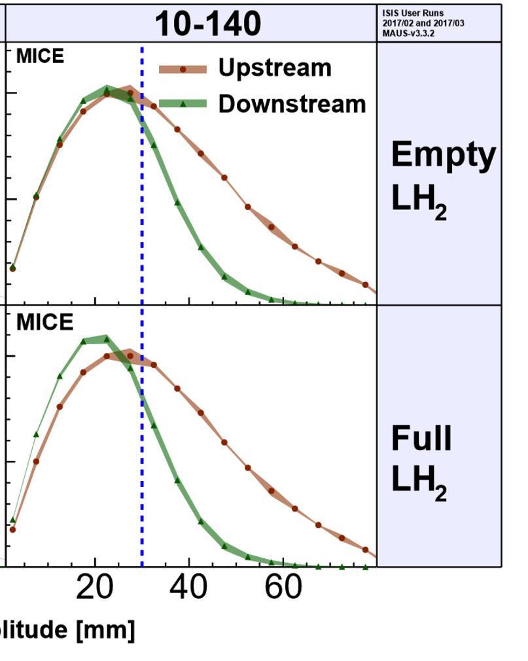
MICE: Cooling Demonstration
More particles at smaller amplitude after absorber is put in place
Nature vol. 578, p. 53-59 (2020)
More complete experiment with higher statistics, more than one stage required
Integration of magnets, RF, absorbers, vacuum is engineering challenge
Principle of ionisation cooling has been demonstrated
Use of data for benchmarking is still ongoing
WEPOPT053
27

Slide 28
Neutrino Flux
Dense neutrino flux cone can impact environment Challenge scales with E x L
Goal is to reduce to negligible level, similar to LHC
3 TeV, 200 m deep tunnel is about OK
Expand idea of Mokhov, Ginneken to move beam in aperture: move collider ring components, e.g. vertical bending with 1% of main field
14 TeV, in 200 m deep tunnel comparable to LHC case with +/- 1 mradian
scales with luminosity toward higher E
~2 x 600 m
Need to study mover system, magnet, connections and impact on beam
Working on different approaches for experimental insertion
Other optimisations are possible (magnetic field, emittance etc.)
28

Slide 29
Organisation
International Collaboration Board represents the partners
International Advisory Committee
Coordination Committee
executes the study
(only Study Leader in MoC)
Steering Board oversees study and links to regional supervision (addition to MoC)

Slide 30
Thanks
Muon Beam Panel: Daniel Schulte (CERN, chair), Mark Palmer (BNL, co-chair), Tabea Arndt (KIT), Antoine Chance (CEA/IRFU) Jean-Pierre Delahaye (retired), Angeles Faus-Golfe (IN2P3/IJClab), Simone Gilardoni (CERN), Philippe Lebrun (European Scientific Institute), Ken Long (Imperial College London), Elias Metral (CERN), Nadia Pastrone (INFN-Torino), Lionel Quettier (CEA/IRFU), Magnet Panel link, Tor Raubenheimer (SLAC), Chris Rogers (STFC-RAL), Mike Seidel (EPFL and PSI), Diktys Stratakis (FNAL), Akira Yamamoto (KEK and CERN) Contributors: Alexej Grudiev (CERN), Roberto Losito (CERN), Donatella Lucchesi (INFN)
Community conveners: Radio-Frequency (RF): Alexej Grudiev (CERN), Jean-Pierre Delahaye (CERN retiree), Derun Li (LBNL), Akira Yamamoto (KEK). Magnets: Lionel Quettier (CEA), Toru Ogitsu (KEK)‎, Soren Prestemon (LBNL), Sasha Zlobin (FNAL), Emanuela Barzi (FNAL). High-Energy Complex (HEC): Antoine Chance (CEA), J. Scott Berg (BNL), Alex Bogacz (JLAB), Christian Carli (CERN), Angeles Faus-Golfe (IJCLab), Eliana Gianfelice-Wendt (FNAL), Shinji Machida (RAL). Muon Production and Cooling (MPC): Chris Rogers (RAL), Marco Calviani (CERN), Chris Densham (RAL), Diktys Stratakis (FNAL), Akira Sato (Osaka University), Katsuya Yonehara (FNAL). Proton Complex (PC): Simone Gilardoni (CERN), Hannes Bartosik (CERN), Frank Gerigk (CERN), Natalia Milas (ESS). Beam Dynamics (BD): Elias Metral (CERN), Tor Raubenheimer (SLAC and Stanford University), Rob Ryne (LBNL). Radiation Protection (RP): Claudia Ahdida (CERN). Parameters, Power and Cost (PPC): Daniel Schulte (CERN), Mark Palmer (BNL), Jean-Pierre Delahaye (CERN retiree), Philippe Lebrun (CERN retiree and ESI), Mike Seidel (PSI), Vladimir Shiltsev (FNAL), Jingyu Tang (IHEP), Akira Yamamoto (KEK). Machine Detector Interface (MDI): Donatella Lucchesi (University of Padova), Christian Carli (CERN), Anton Lechner (CERN), Nicolai Mokhov (FNAL), Nadia Pastrone (INFN), Sergo R Jindariani (FNAL). Synergy: Kenneth Long (Imperial College), Roger Ruber (Uppsala University), Koichiro Shimomura (KEK). Test Facility (TF): Roberto Losito (CERN), Alan Bross (FNAL), Tord Ekelof (ESS,Uppsala University).
30
And the participants to the community meetings and the study

Slide 31
Other Key Studies
Review proton complex
average power of 2 MW is no problem
but merging into 5 pulses of 400 kJ per second needs to be verified
Collective effects across the whole complex to identify bottlenecks
review apertures, feedback and other specifications
  first results for aperture requirements
potential instability of interaction of muon beam with matter
Power and cost optimisation
Vacuum and absorber, instrumentation, cryogenics, …
Reuse of existing infrastructure, e.g. LHC tunnel to house accelerator
N. Milas et al. (ESS, Uppsala)
E. Metral et al. (CERN, EPFL/CHART)
J. Ferreira Somoza, M. Wendt, et al.
31

