Slide 1
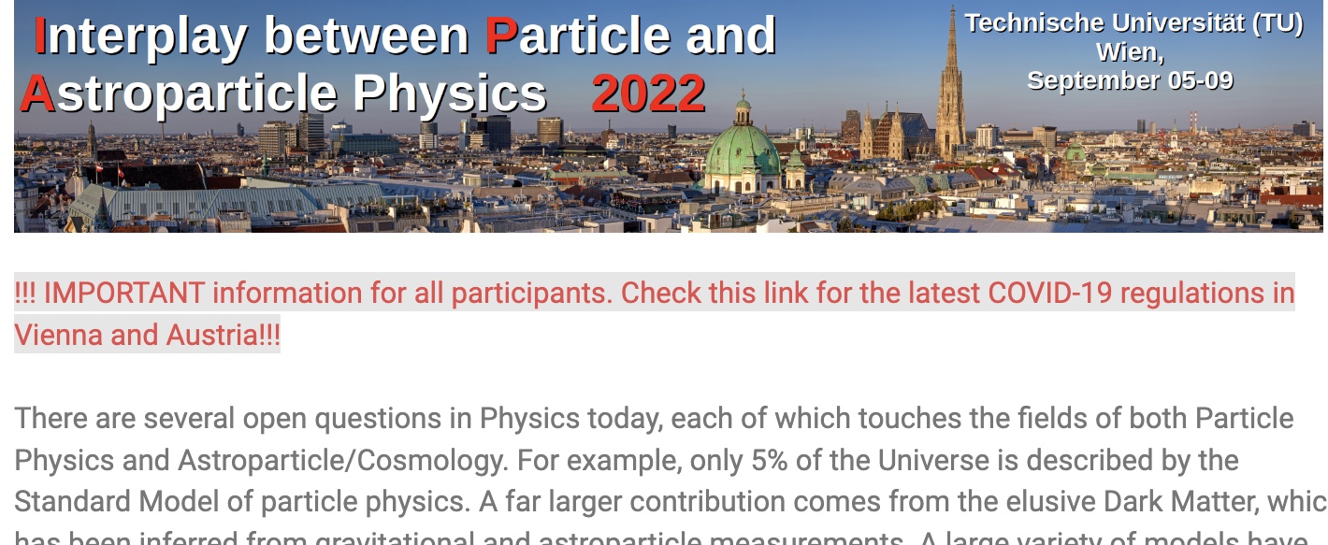

Multi-messenger astronomy and the extreme Universe
Andrii Neronov
APC Paris & EPFL Lausanne
– Dark matter
– Baryogenesis and Leptogenesis
– Matter at nuclear densities
– Relativistic gravity theory
– Lorentz invariance, weak equivalence principle
– ….
1
1e5
1e10
1e15
1e20
E, eV
1e15
$ν$, Hz
1e-5
1e15
1e-5
1
1
1e10
1e-10
1e10
1e-10
1e5
1e5
Ultra-light Dark Matter
Hidden sector Dark Matter
Pre-inflationary axion
Hidden thermal relics, WIMPless DM
Post-inflationary axion
Asymmetric DM
Primordial black holes
Freeze-in DM
QCD axion
SIMPs/ELDERs
Sterile neutrino
Superheavy DM
WIMPs
US Cosmic Visions 2017 report: arXiv:1707.04591

Slide 2
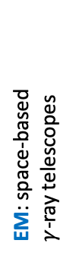
Multi-messenger astronomy and the extreme Universe
EM: electromagnetic
GW: gravitational wave
NU: neutrino
EM: microwave telescopes
EM: Cherenkov telescopes
EM: visible/UV telescopes
EM: space-based
$γ$-ray telescopes
EM: air shower arrays
EM: infrared telescopes
EM: X-ray telescopes
CR: cosmic ray
EM: radio telescopes
1
1e5
1e10
1e15
1e20
E, eV
1e-5
1
1e15
$ν$, Hz
1e-10
1e5
1e10
CR: direct detection
NU: 1e5 m³ scale water
Cherenkov detectors
NU: km³ scale water / ice
Cherenkov detectors
CR: air shower arrays
GW: pulsar timing arrays
GW: space-based
interferometers
GW: ground-based
interferometers
43 decades in energy / frequency

Slide 3
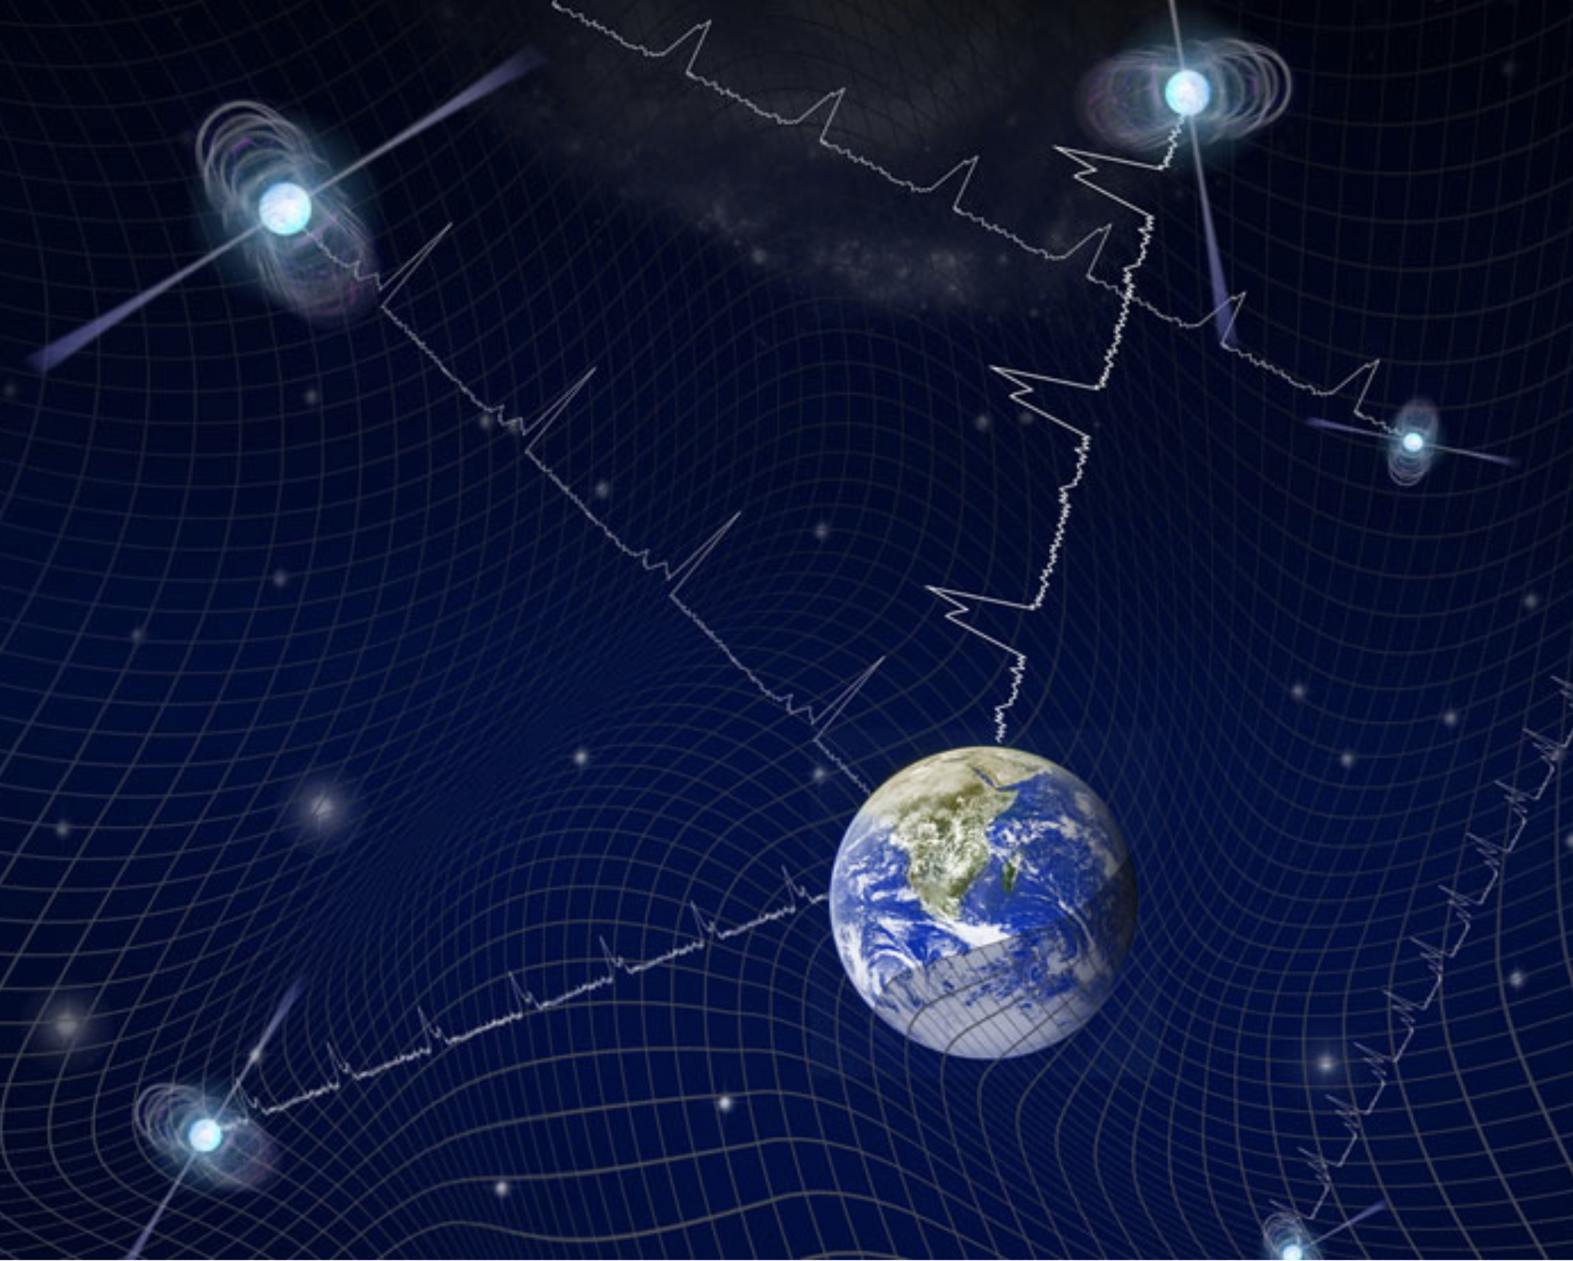
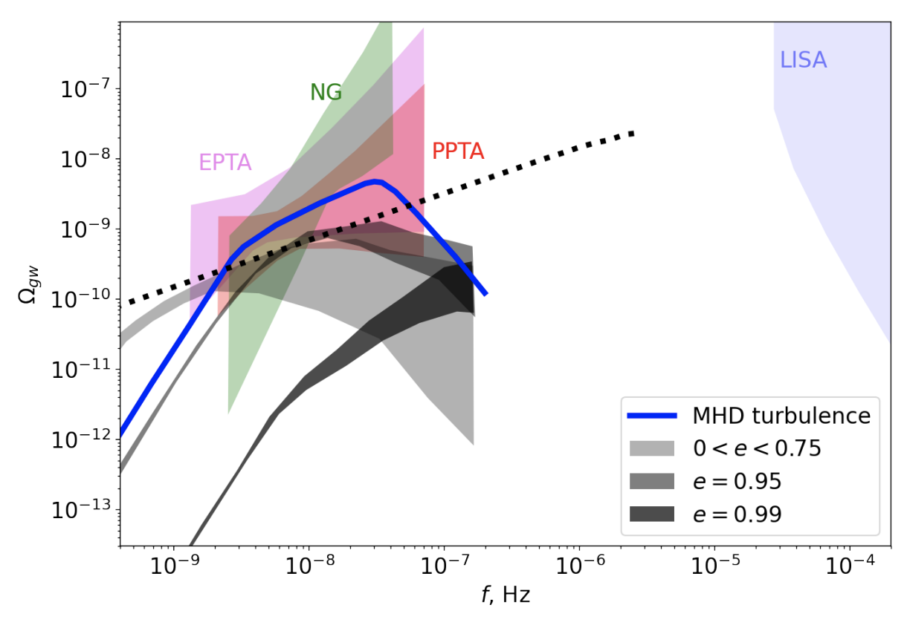
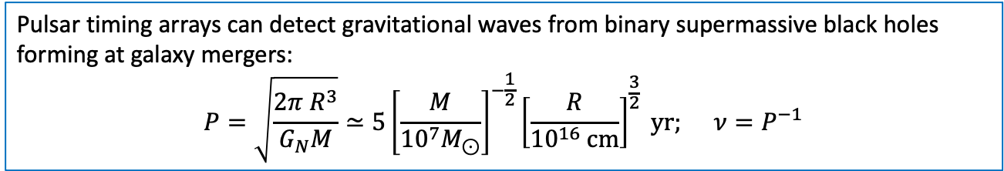
Nano-Hz gravitational waves with Pular Timing Arrays (PTA)
Passage of gravitational waves distorts the pattern of arrival time of pulsars by changing the distance to the sources. Measurement of timing residuals allows to detect gravitational waves with extremely low frequency, down to nHz (low frequency end is determined by the duration of timing monitoring, currently ~10 yr scale).
Pulsar timing arrays can detect gravitational waves from binary supermassive black holes forming at galaxy mergers:
$$P=\sqrt{\frac{2π R^{3}}{G_{N}M}}≃5{\left[\frac{M}{{{10}^{7}M}_{⊙}}\right]}^{−\frac{1}{2}}{\left[\frac{R}{{10}^{16} cm}\right]}^{\frac{3}{2}} yr; ν=P^{−1}$$
All PTA collaborations (NANOGrav, EPTA, PPTA, collaborating within “International” PTA, IPTA) have reported evidence for “common stochastic process” detectable in timing residuals of many pulsars. This is consistent with existence of stochastic gravitational wave background, but the definitive test, measurement of the angular dependence of cross-correlation power (Hellings-Downs) is not precise enough.
Roper Pol, Caprini, AN, Semikoz ‘22 (arXiv:2201.05630)
Model C: Unaccounted systematics
Model B: First-order cosmological QCD phase transition
Model A: mergers of supermassive black holes in galactic nuclei
… unresolved problem of “last parsec bottleneck”: black hole binaries with parsec separation loose energy on time scale longer than Hubble time
e.g. Sampson et al. arXiv:1503.02662
NANOGrav Collab. ‘20 (arXiv:2009.04496)
PPTA Collab. ’21 (arXiv:2107.12112)
EPTA Collab. ‘21 (arXiv:2110.13184)
IPTA Collab. ‘22 (arXiv:2201.03980

Slide 4
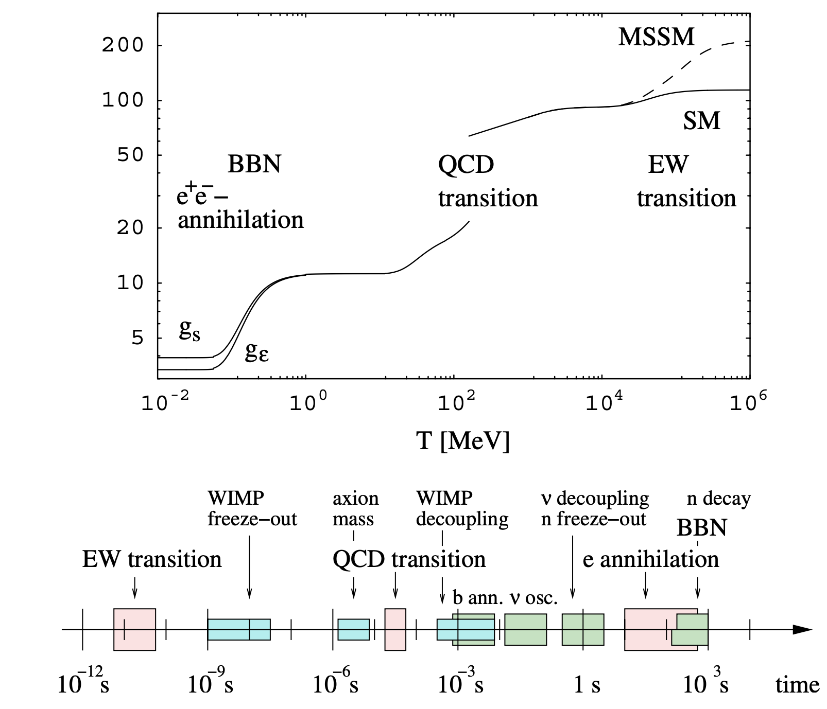
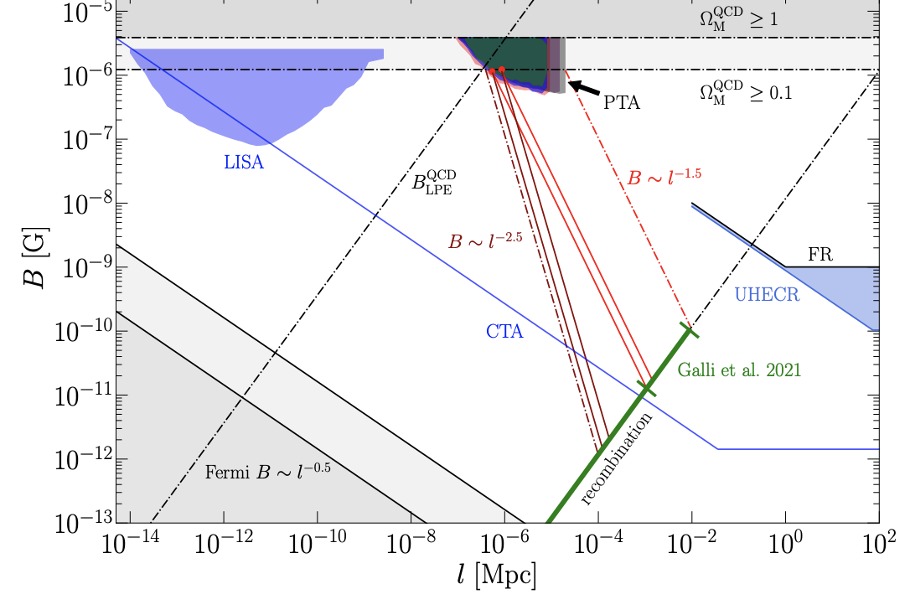
Fundamental physics with stochastic gravitational wave background(s)
… and cosmological magnetic fields
Within the Standard Model the Electroweak and QCD transitions are expected to cross-overs Detection of relic SGWB in nHz-mHz range would constitute an evidence for beyond-Standard-Model process(?).
1st-order phase transition also generates magnetic field that survives till present epoch as Intergalactic Magnetic Field (IGMF). This field can be measured in the near future via its effect on propagation of gamma-rays, and/or its effect on polarized radio signals and ultra-high-energy cosmic rays and/or its effect on Cosmic Microwave Background.
cosmological evolution
”preferred” field that would relax “Hubble tension” problem
Between CMB and present-day Hubble constant measurements.
From arXiv:2201.05630
CMS Physics TDR, (DOI: 10.1088/0954-3899/34/11/008)

Slide 5
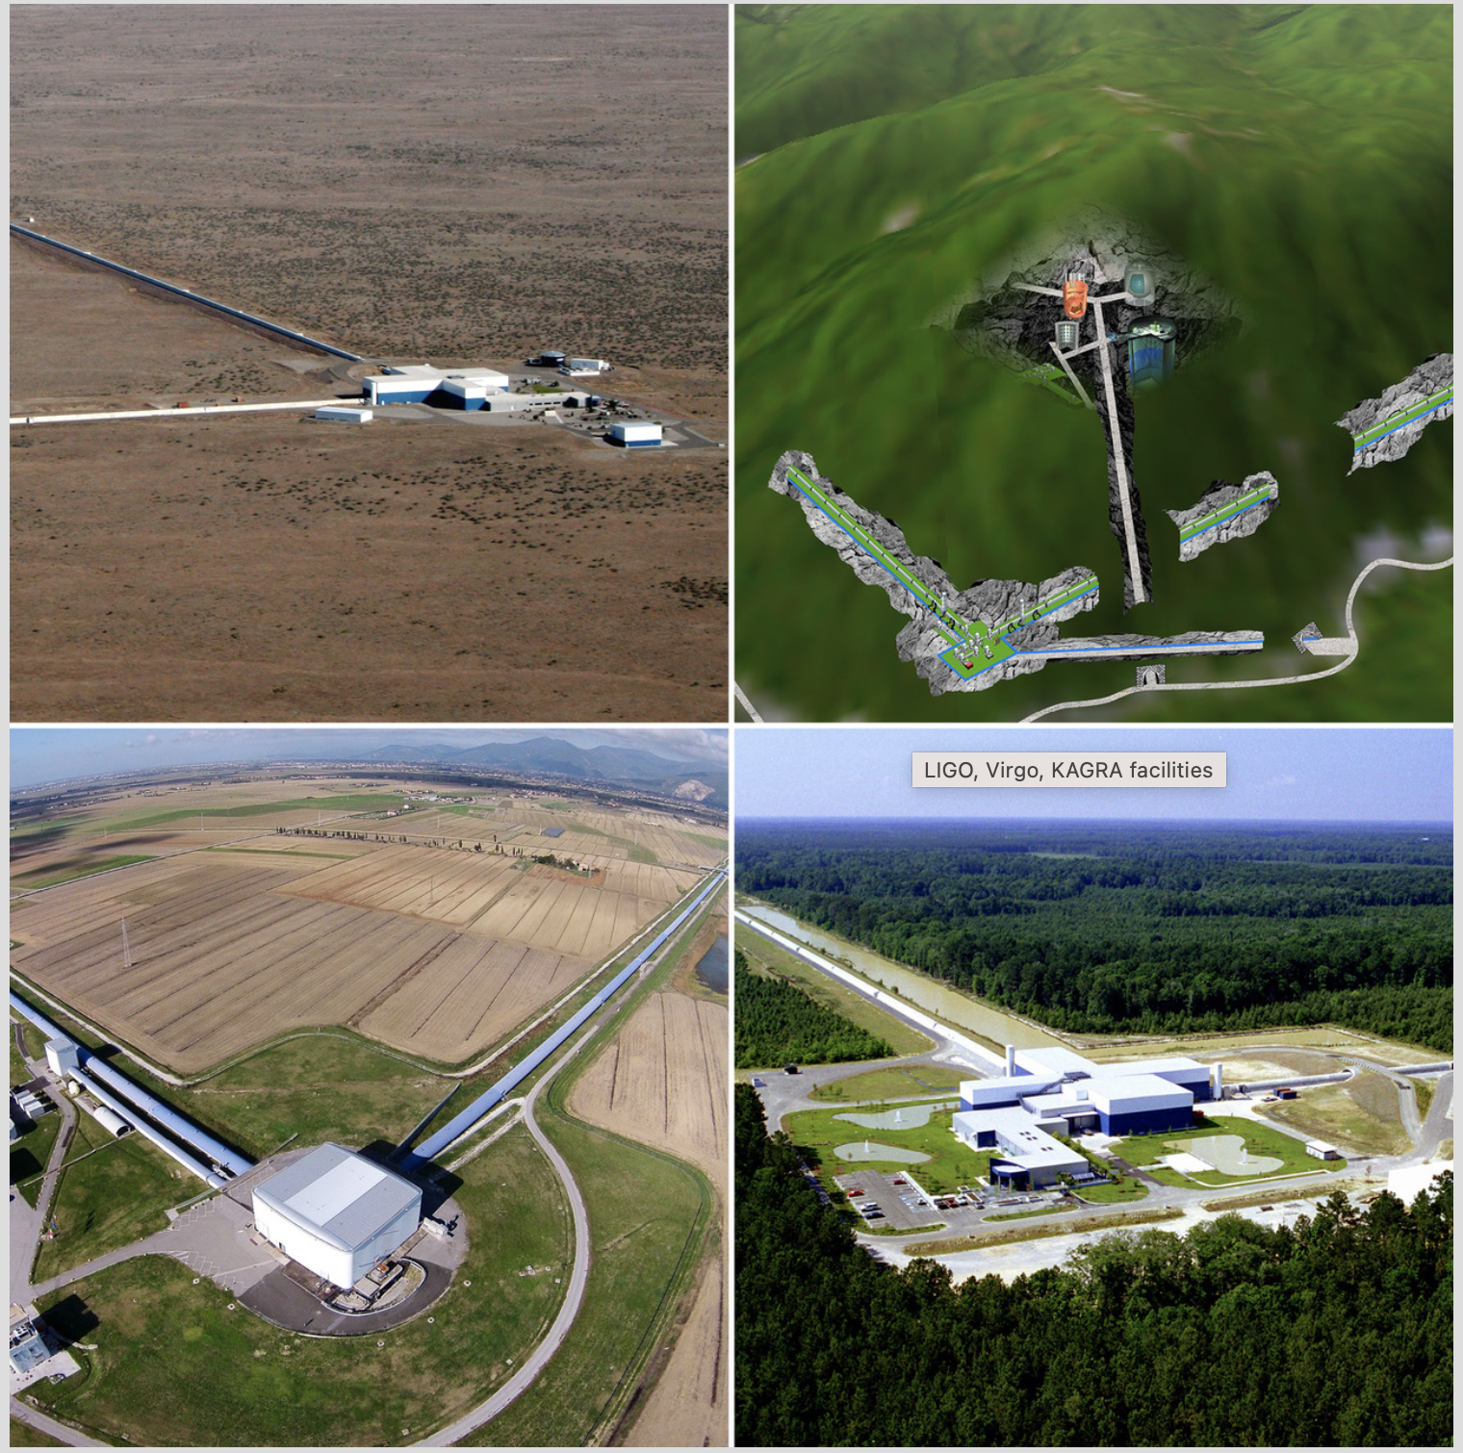
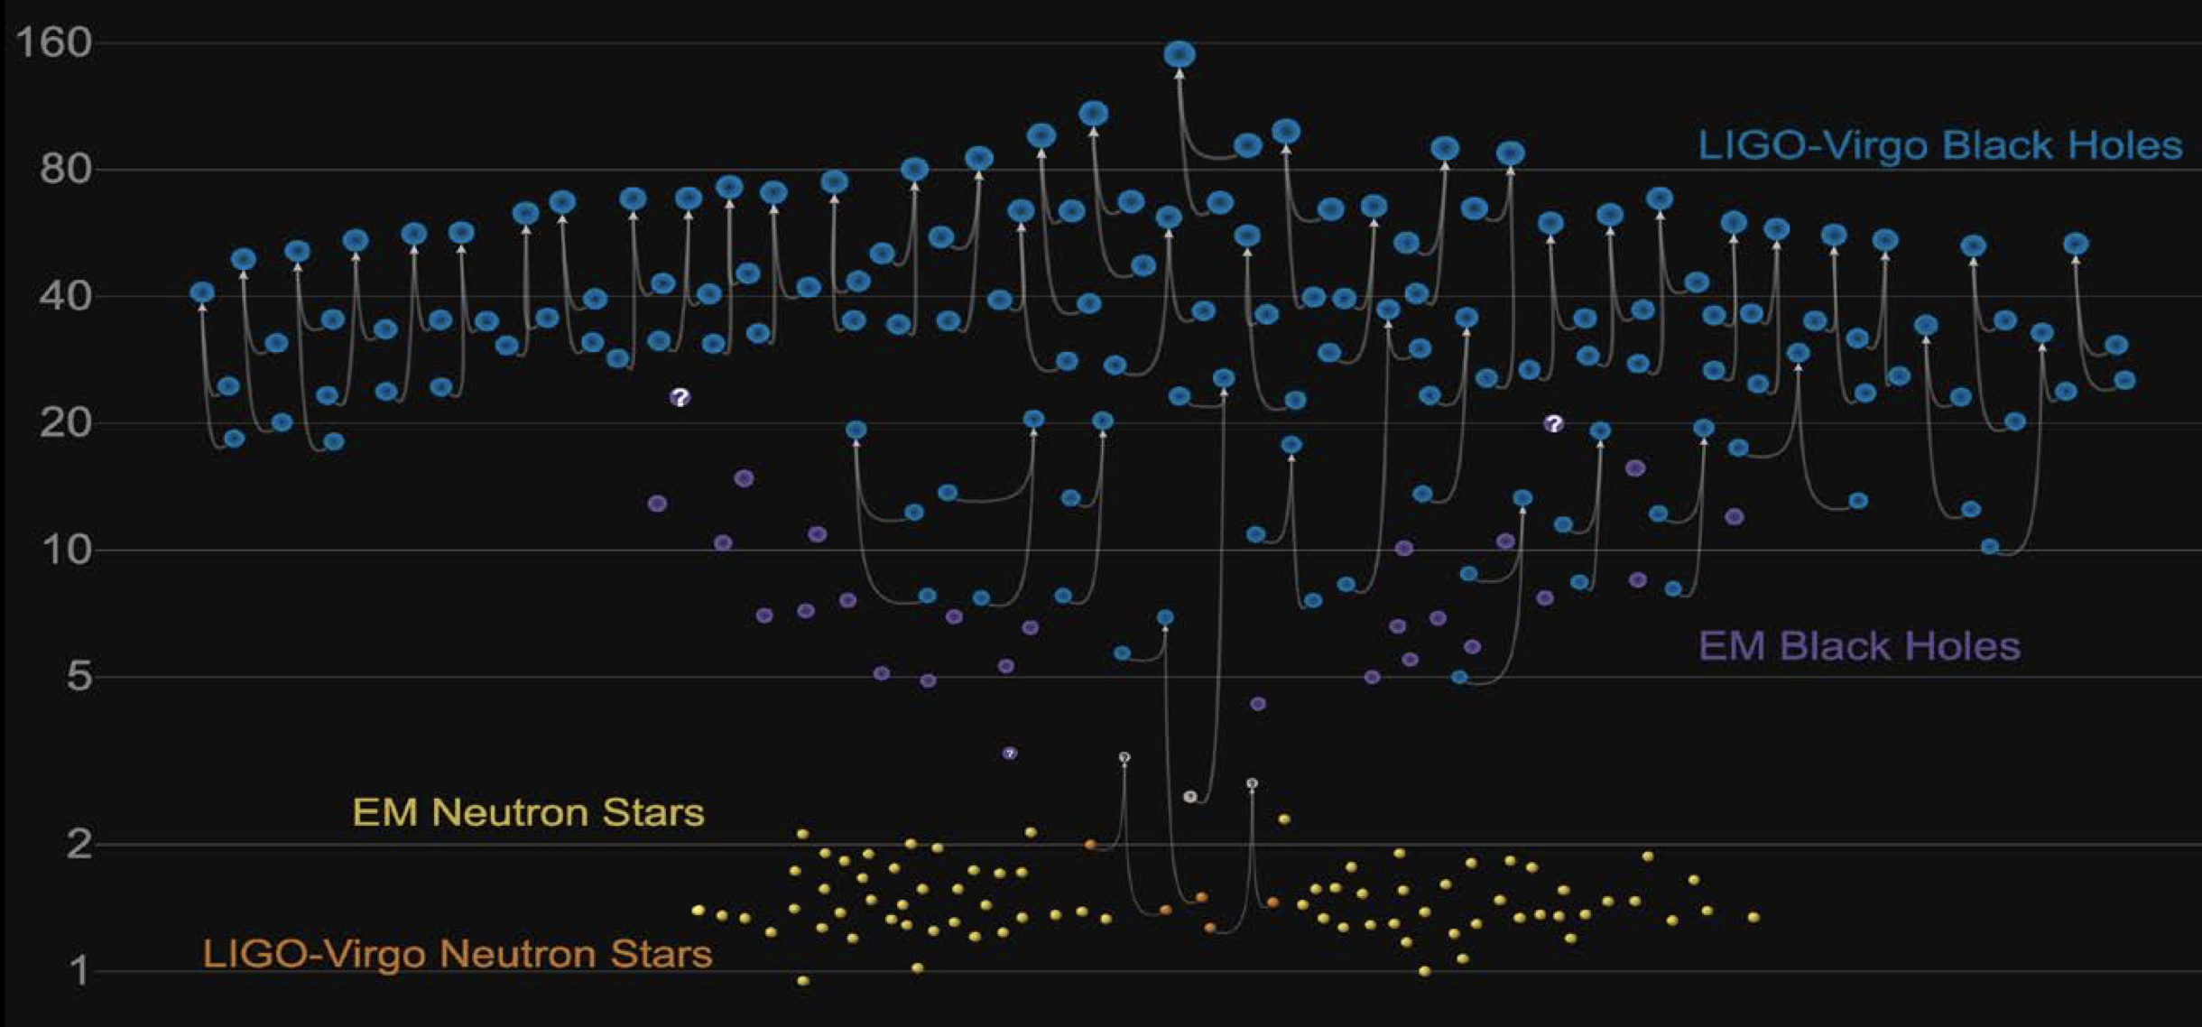
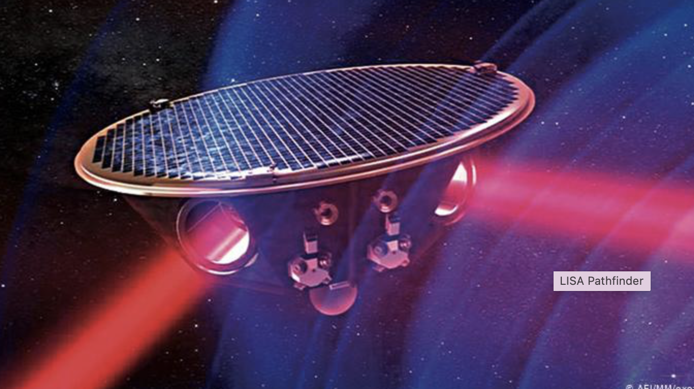
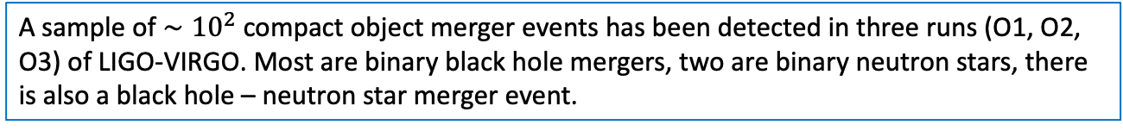
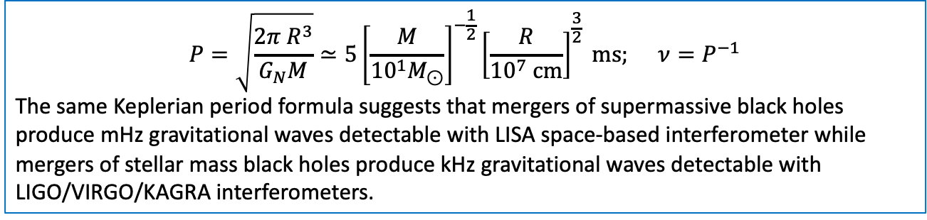
mHz to kHz gravitational waves with interferometers
Passage of gravitational waves affects the propagation time of laser beam in the arms of an interferometer. Measurement of interference pattern variability allows to detect gravitational waves in the kHz range with km-scale interferometers and down to mHz with 10⁹ cm long arms.
$$P=\sqrt{\frac{2π R^{3}}{G_{N}M}}≃5{\left[\frac{M}{{{10}^{1}M}_{⊙}}\right]}^{−\frac{1}{2}}{\left[\frac{R}{{10}^{7} cm}\right]}^{\frac{3}{2}} ms; ν=P^{−1}$$
The same Keplerian period formula suggests that mergers of supermassive black holes produce mHz gravitational waves detectable with LISA space-based interferometer while mergers of stellar mass black holes produce kHz gravitational waves detectable with LIGO/VIRGO/KAGRA interferometers.
LIGO Hanford
KAGRA
A sample of $∼{10}^{2}$ compact object merger events has been detected in three runs (O1, O2, O3) of LIGO-VIRGO. Most are binary black hole mergers, two are binary neutron stars, there is also a black hole – neutron star merger event.
GW-only sources (no multi-messenger counterparts)
LIGO Livingstone
VIRGO
LISA space-based interferometer element
GW150914: LIGO, 2017, PRL, 116, 061102
GW170717: LIGO-VIRGO, 2017, PRL, 119, 161101;

Slide 6
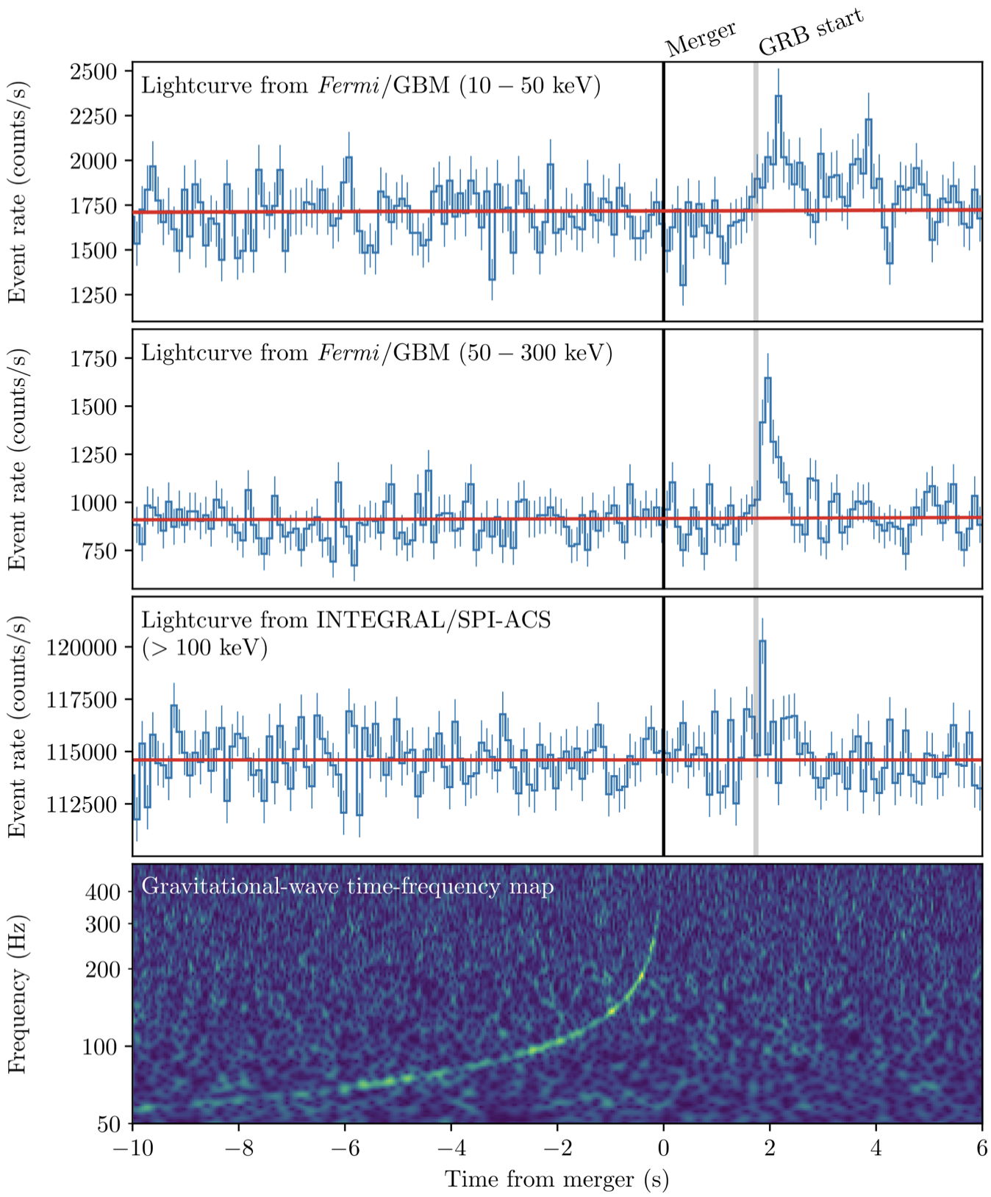
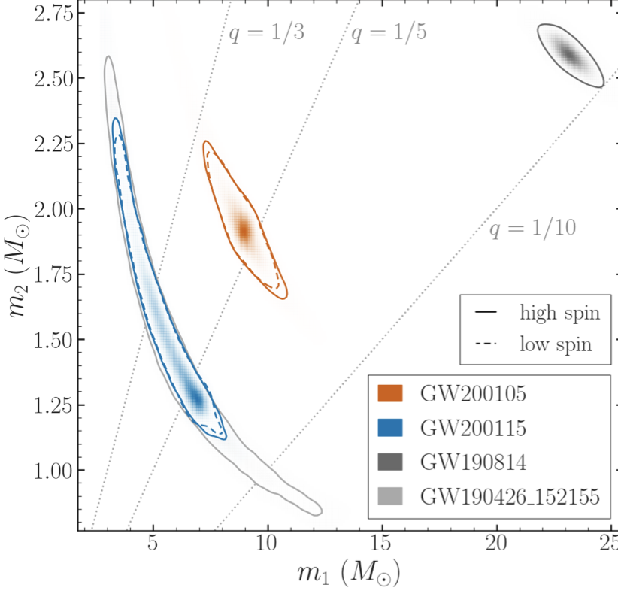

Gravitational waves from neutron star mergers
BH-NS mergers: GW200105 GW200115. No electromagnetic counterpart, but as expected: the NS is not supposed to be tidally disrupted before it plunges under black hole horizon:
$$\frac{ΔU}{U}∼\frac{GM_{BH}R_{NS}}{R_{BH}^{2}}\frac{R_{NS}}{GM_{NS}}≃0.2\left[\frac{M_{BH}}{{5M}_{NS}}\right]{\left[\frac{R_{NS}}{R_{BH}}\right]}^{2}$$
NS-NS mergers: GW170817 GW190425. GW190425 has no detectable electromagnetic counterpart, as expected (distance 160 Mpc,4 times further than GW170817).
2 s
GW170817
LIGO-VIRGO-KAGRA: 2106.15163
LIGO-VIRGO+FERMI+INTEGRAL: 1710.05833

Slide 7
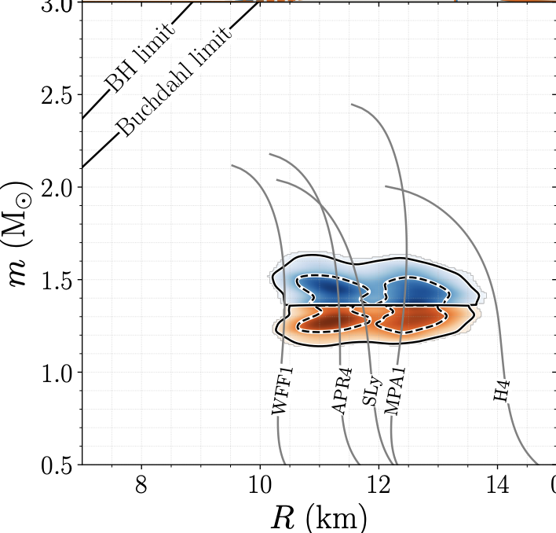
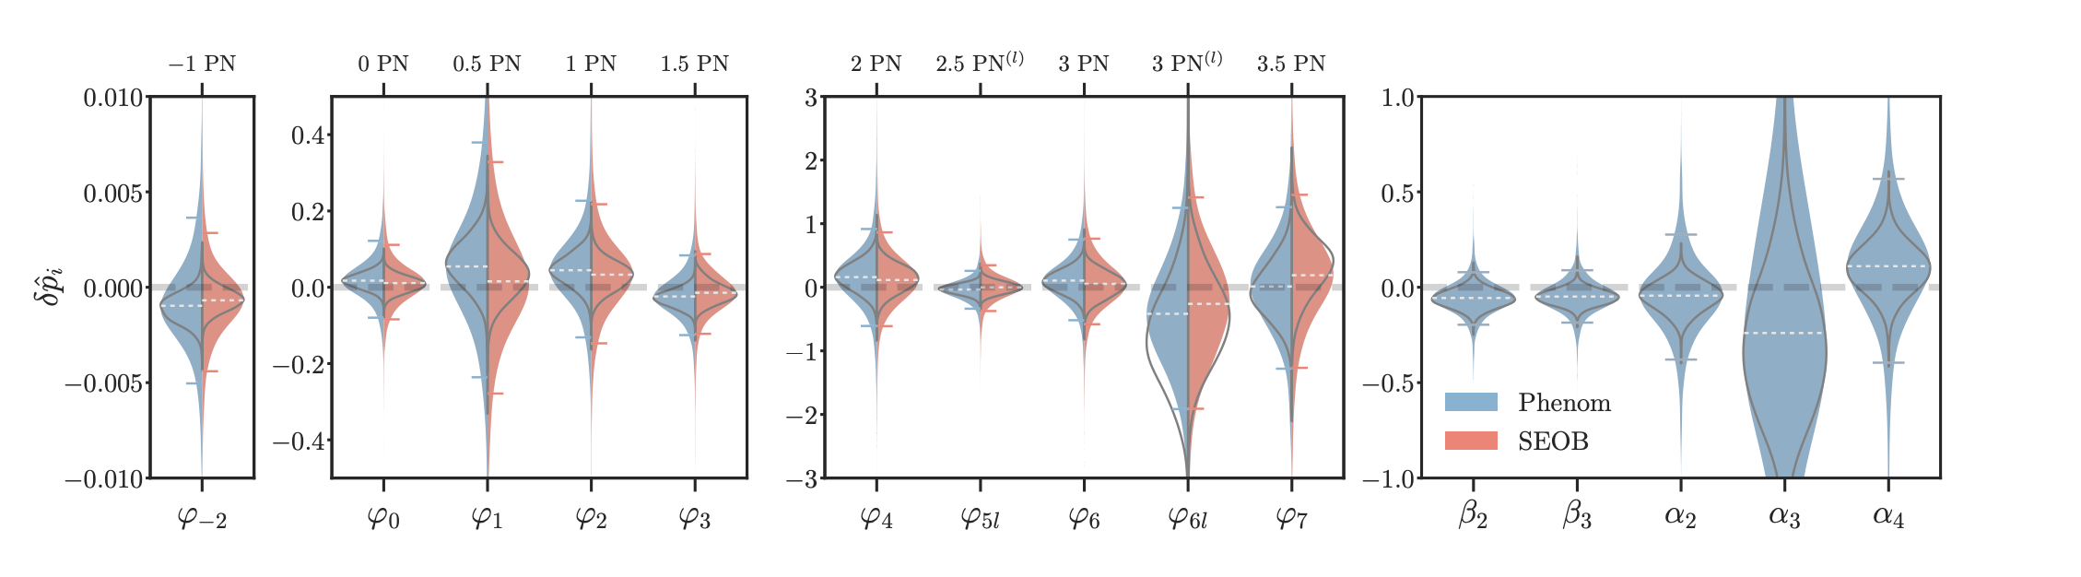
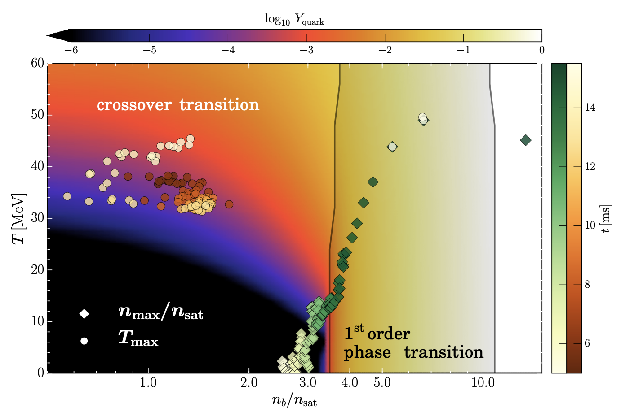
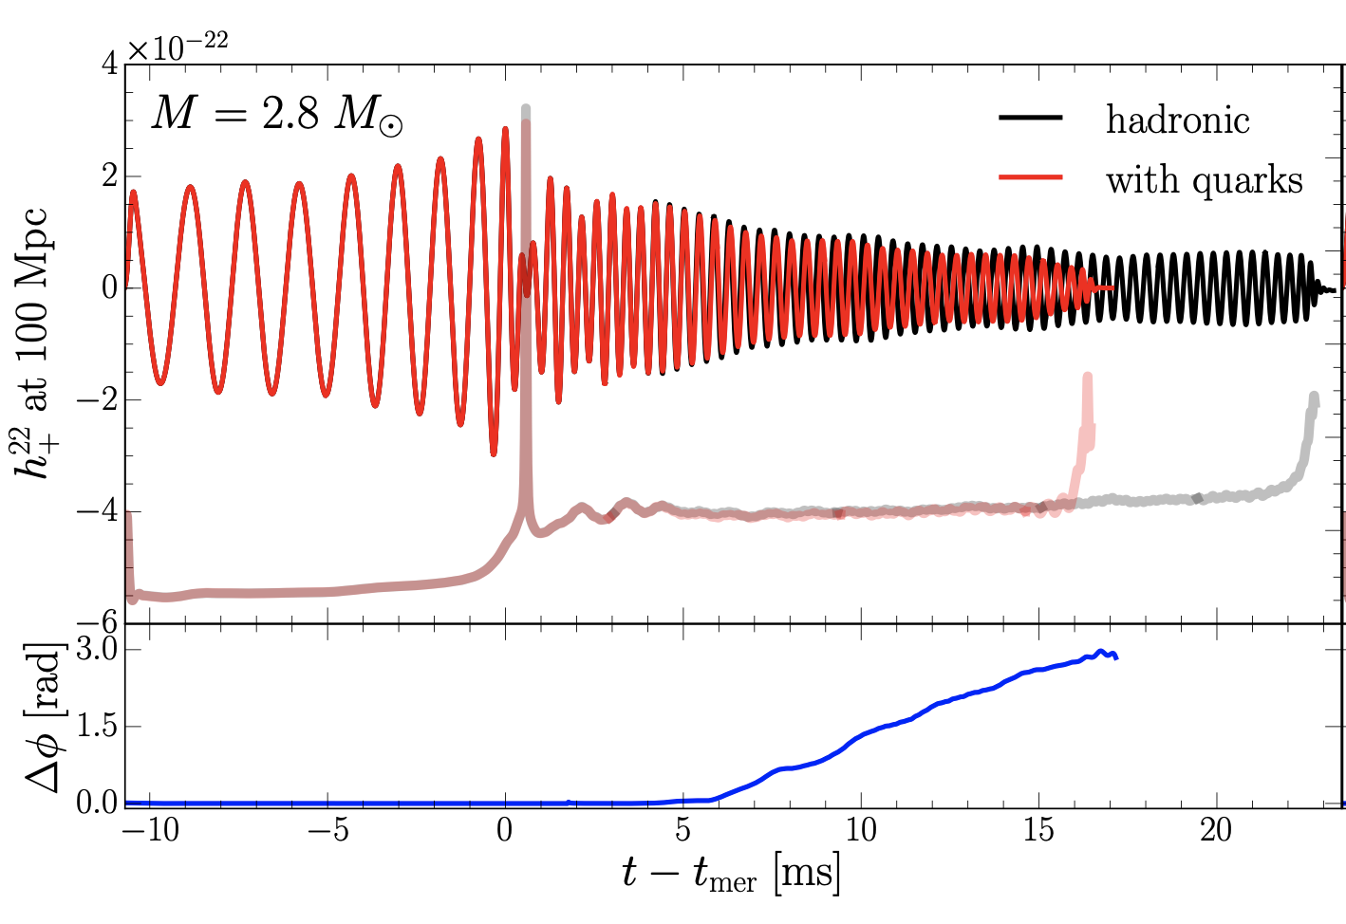
GW events implications for fundamental physics
Straightforward test of “speed of light vs. speed of gravity”: $Δv/c ≤{10}^{−15}$
LIGO/VIRGO Collab. arXiv:2010.14529
Constraints on post-Newtonian parameters from O2 run
LIGO/VIRGO Collab. arXiv.1805.11581
Tidal deformation of the two inspiraling neutral stars influences the shape of the GW signal. This can be used to constrain the equation of state of nuclear matter inside the neutron stars.
Most et al. arXiv:1807.03684
Post-merger “ring-down” phase waveform is sensitive to possible QCD phase transition that may occur in the collapsing merger object.

Slide 8
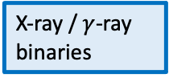
Multi-messenger astronomy and the extreme Universe
EM: electromagnetic
GW: gravitational wave
NU: neutrino
EM: microwave telescopes
EM: Cherenkov telescopes
EM: visible/UV telescopes
EM: space-based
$γ$-ray telescopes
EM: air shower arrays
EM: infrared telescopes
EM: X-ray telescopes
CR: cosmic ray
EM: radio telescopes
1
1e5
1e10
1e15
1e20
E, eV
”Time-domain astronomy”: observations of transient sources
$ν$, Hz
1e-10
1e-5
1
1e5
1e10
1e15
Binary systems:
– NS + normal star EM, ……… NU(?)
– BH + normal star EM, ……… NU(?)
– NS + NS: GW, EM ……. NU(?)
– NS + BH: GW, ……. EM, NU(?)
– BH +BH: GW, ……. EM, NU(?)
Supernovae / collapsars: EM, NU, ……… GW(?)
Isolated neutron stars / pulsars: EM, ……… GW, NU(?)
X-ray / $γ$-ray
binaries
CR: direct detection
NU: 1e5 m³ scale water
Cherenkov detectors
NU: km³ scale water / ice
Cherenkov detectors
CR: air shower arrays
GW: pulsar timing arrays
GW: space-based
interferometers
GW: ground-based
interferometers
Short GRBs (?)
Long GRBs (?)
43 decades in energy / frequency
FRBs(?)
Short GRBs (?)

Slide 9
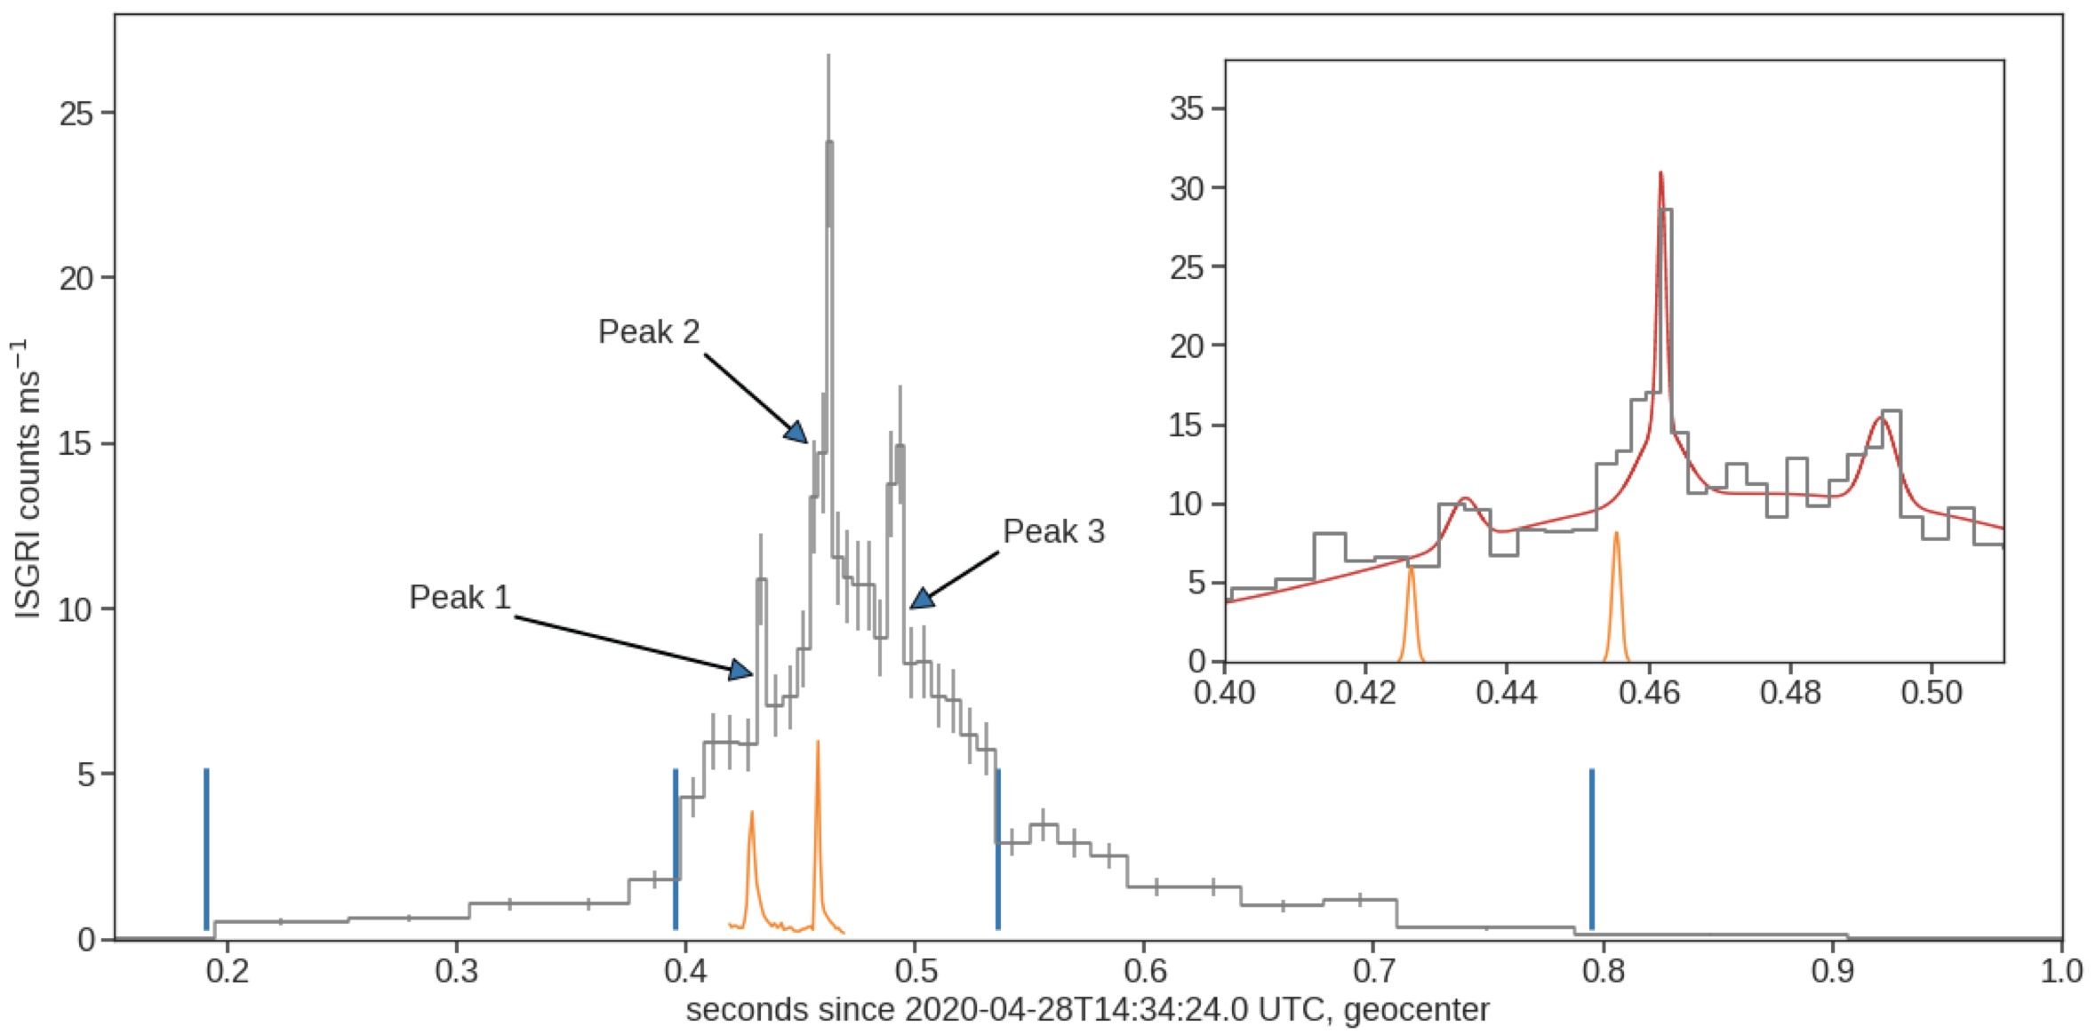
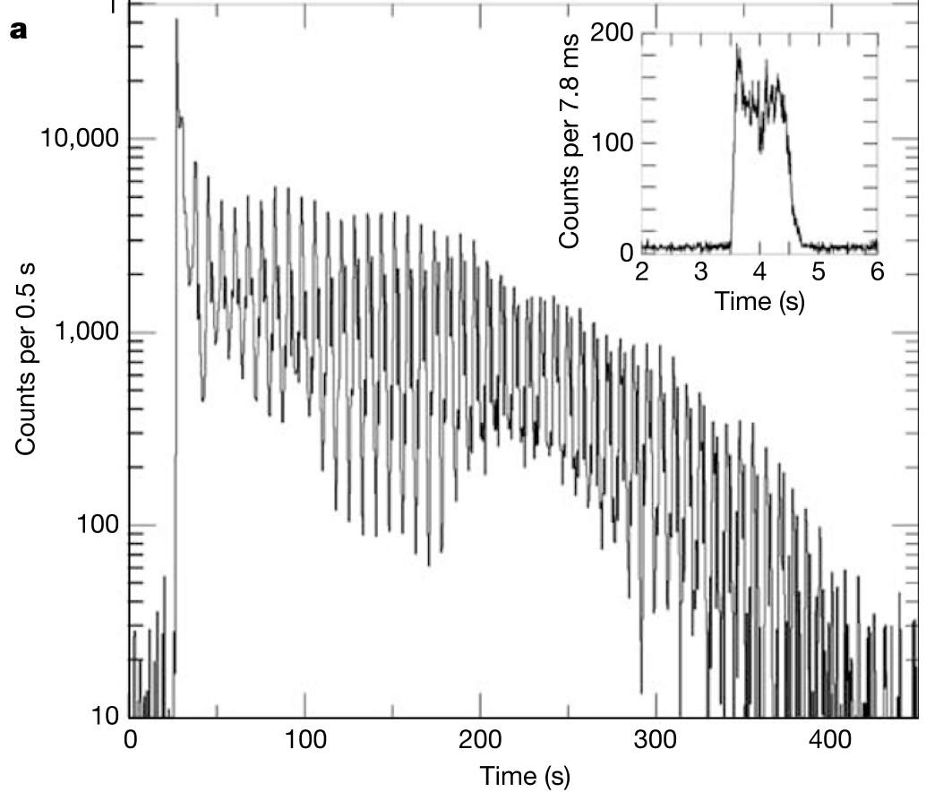
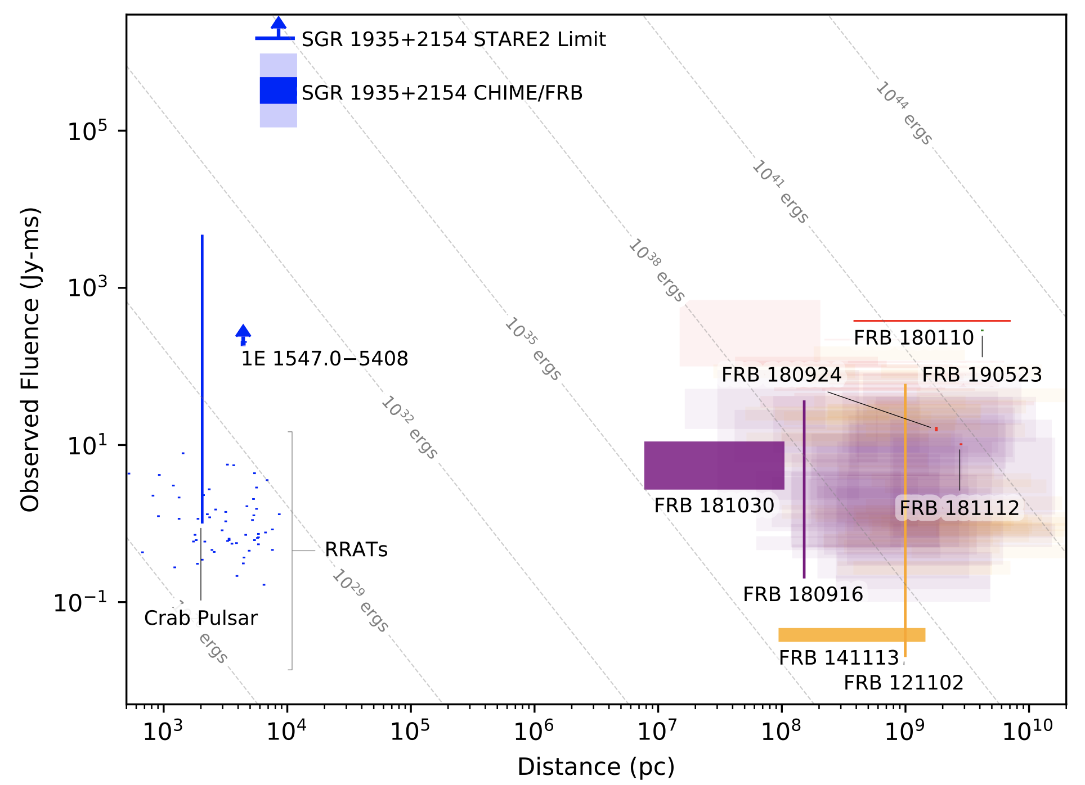


Short gamma-ray bursts (GRB), Fast Radio Bursts (FRB), magnetars
Binary neutron star mergers is one of several possible mechanisms of short GRBs (<2 s spikes of gamma-ray flux). Such mergers produce multi-wavelength “afterglow” emission in radio-visible-X-ray bands due formation of a “kilonova”.
Another type of short GRBs is produced by soft gamma repeaters (magnetars, neutron stars with extremely strong magnetic field, ${10}^{14}−{10}^{15}G$) are known to produce short GRB like giant flares. Flares of magnetars in other galaxies may account of a significant fraction of short GRBs.
Soft gamma repeater SGR 1935+2154 flare has recently been associated also to another phenomenon: Fast Radio Burst (FRB), $μs−ms$ long spikes of radio flux.
Before this event only extragalactic FRBs have been detected, no evident counterparts, sometimes repeatedly from the same sky direction.
Before this event, no magnetar bursts have been associated to radio counterparts…..
Hurley et al. astro-ph/0502329
SGR 1806-20
Mereghetti et al., 2005.06335
CHIME/FRB collab., 2005.10324.

Slide 10
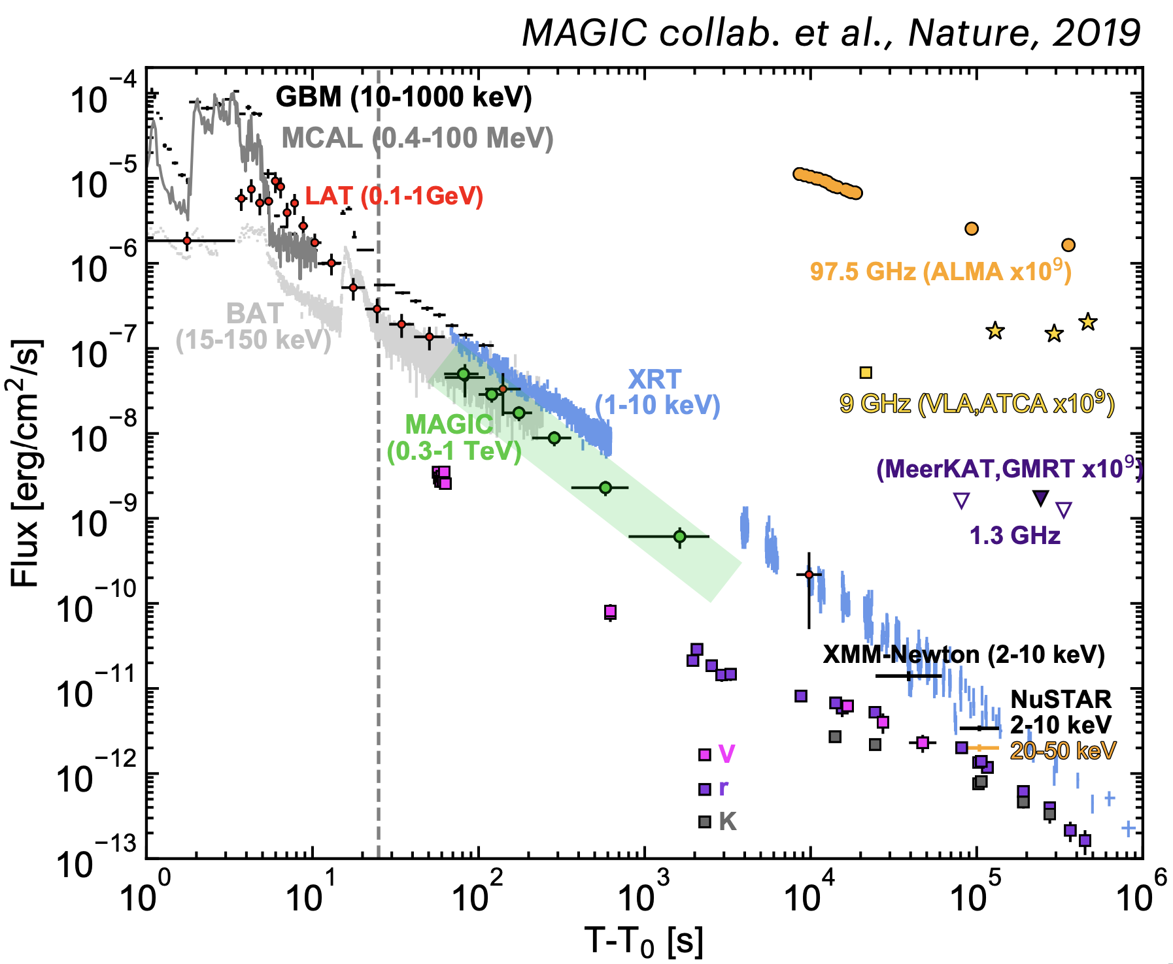
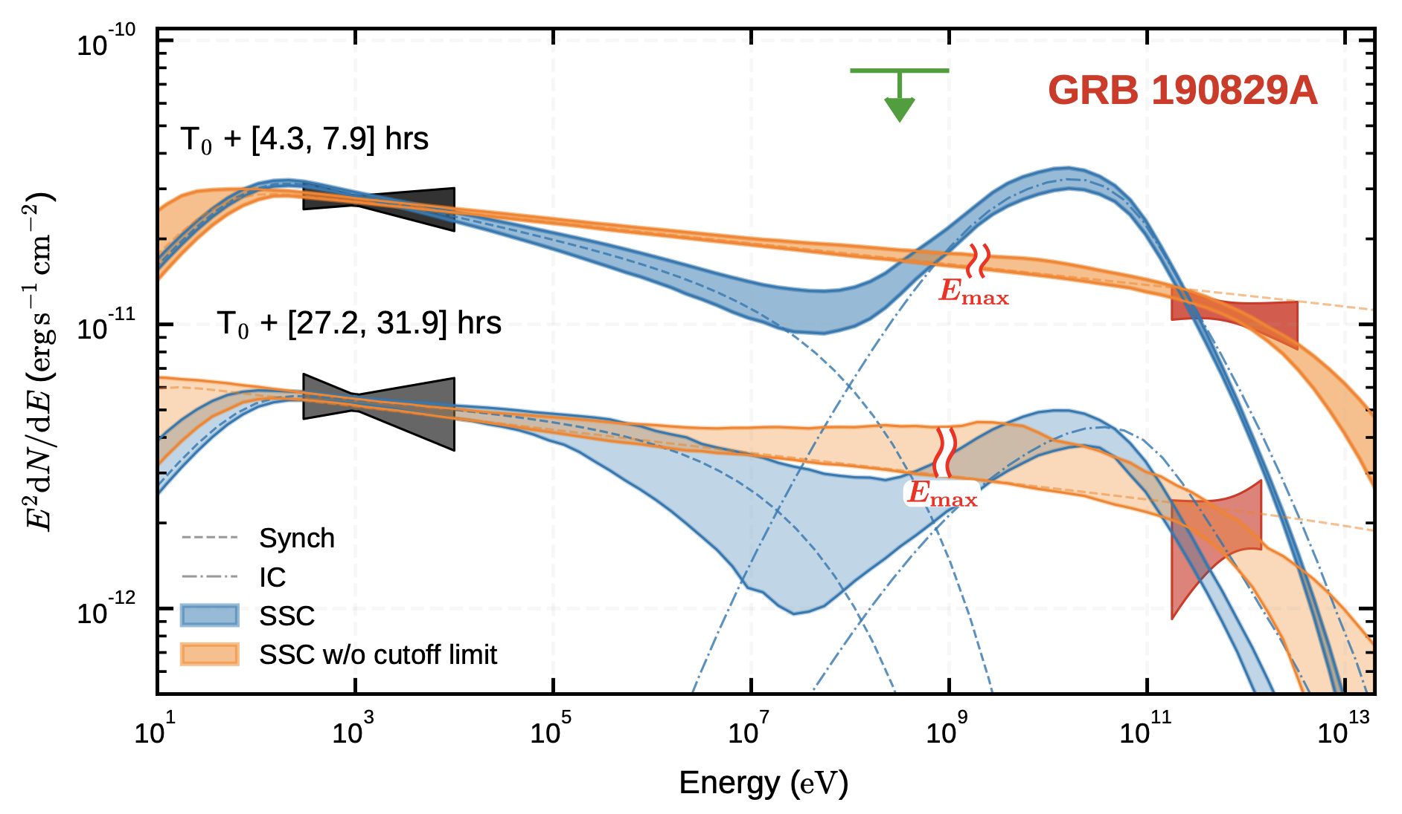
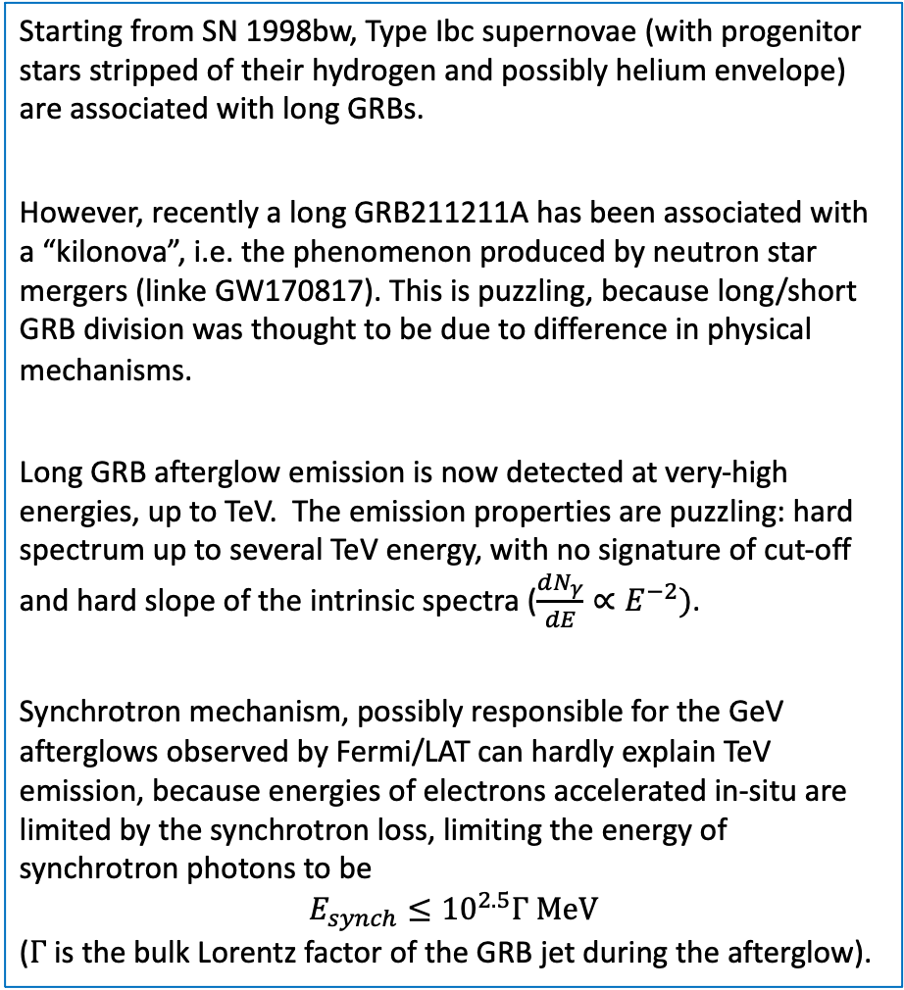
Core collapse of massive stars, supernovae, long GRBs
Starting from SN 1998bw, Type Ibc supernovae (with progenitor stars stripped of their hydrogen and possibly helium envelope) are associated with long GRBs.
However, recently a long GRB211211A has been associated with a “kilonova”, i.e. the phenomenon produced by neutron star mergers (linke GW170817). This is puzzling, because long/short GRB division was thought to be due to difference in physical mechanisms.
Long GRB afterglow emission is now detected at very-high energies, up to TeV. The emission properties are puzzling: hard spectrum up to several TeV energy, with no signature of cut-off and hard slope of the intrinsic spectra ($\frac{dN_{γ}}{dE}∝E^{−2})$.
Synchrotron mechanism, possibly responsible for the GeV afterglows observed by Fermi/LAT can hardly explain TeV emission, because energies of electrons accelerated in-situ are limited by the synchrotron loss, limiting the energy of synchrotron photons to be
$$E_{synch}≤{10}^{2.5}Γ MeV$$
($Γ$is the bulk Lorentz factor of the GRB jet during the afterglow).
GRB 190114C

Slide 11
Multi-messenger astronomy and the extreme Universe
EM: electromagnetic
GW: gravitational wave
NU: neutrino
EM: microwave telescopes
EM: Cherenkov telescopes
EM: visible/UV telescopes
EM: space-based
$γ$-ray telescopes
EM: air shower arrays
EM: infrared telescopes
EM: X-ray telescopes
CR: cosmic ray
EM: radio telescopes
1
1e5
1e10
1e15
1e20
E, eV
1e-5
1
1e15
$ν$, Hz
1e-10
1e5
1e10
Ultra-light Dark Matter
Hidden sector Dark Matter
Pre-inflationary axion
Hidden thermal relics, WIMPless DM
Post-inflationary axion
Asymmetric DM
Primordial black holes
Freeze-in DM
QCD axion
SIMPs/ELDERs
Sterile neutrino
Superheavy DM
WIMPs

Slide 12
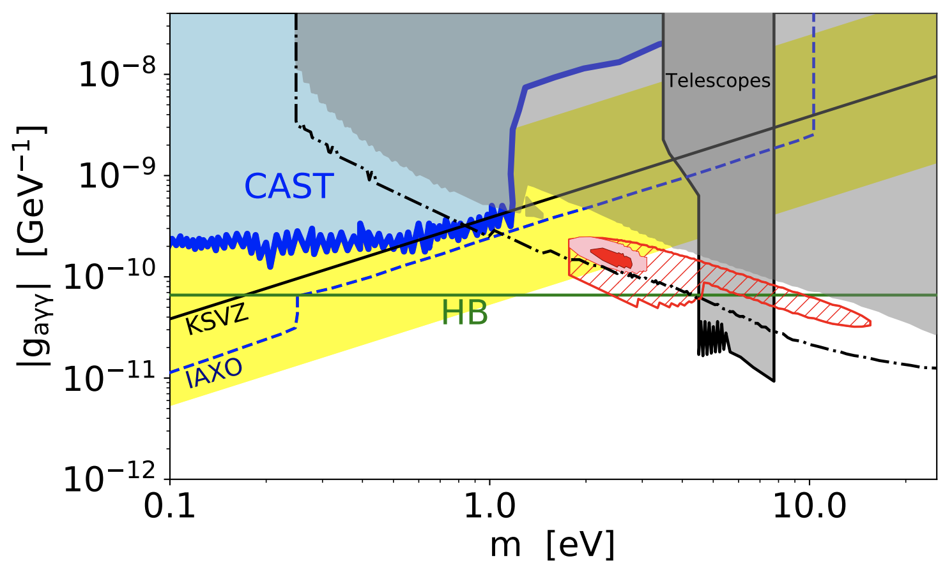
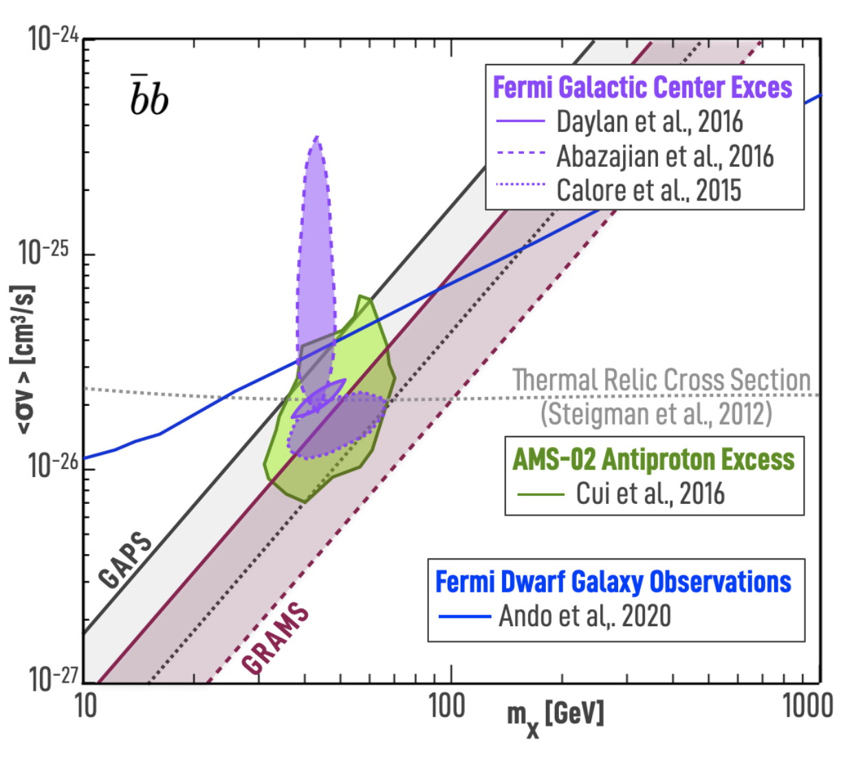
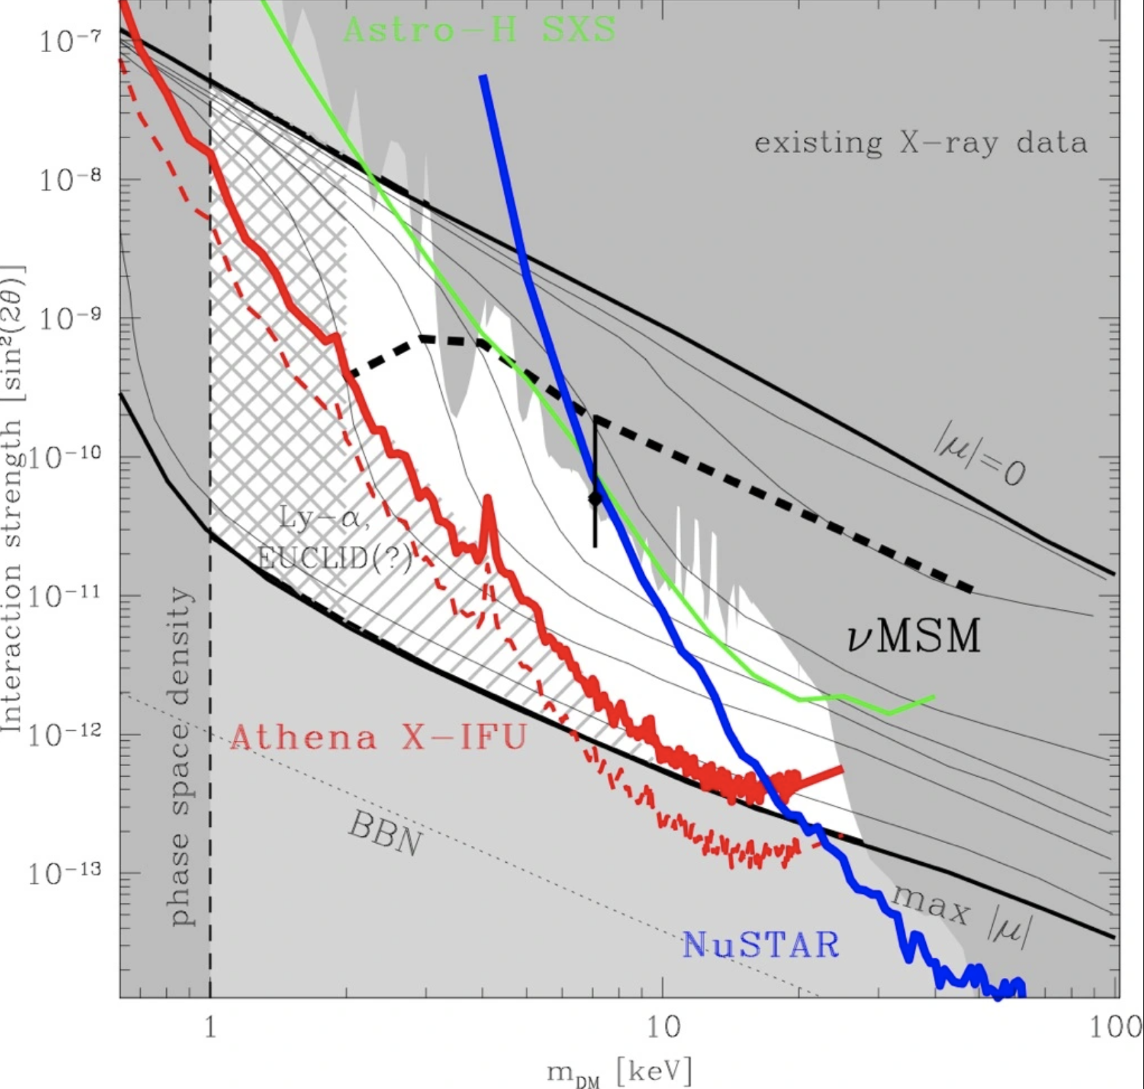
Multi-wavelength probes of fundamental physics (examples)
Korochkin, AN, Semikoz, 1911.13291
An excess of extended/diffuse gamma-ray flux (compared to reference diffuse flux model) is observed in Fermi/LAT. It can be interpreted as due to annihilation of WIMPs with thermal relic cross-section.
An excess of visible / infrared Extragalactic Background Light (EBL) is seen by direct measurement experiments and is consistent with constraints from gamma-ray attenuation. It can be interpreted as due to decays of axion-like particles with masses in eV range
arXiv:2203.06859
“Unidentified” X-ray emission lines in the spectra of galaxies and galaxy clusters (including of diffuse X-ray emission from the Milky Way) can be due to the decaying sterile neutrino dark matter. An evidence for such a line at 3.5 keV is debated.
Snowmass2021 paper: arXiv:2203.06859
AN, Malyshev, arXiv:1509.02758

Slide 13
The highest energy frontier
EM: electromagnetic
GW: gravitational wave
NU: neutrino
EM: microwave telescopes
EM: Cherenkov telescopes
EM: visible/UV telescopes
EM: space-based
$γ$-ray telescopes
EM: air shower arrays
EM: infrared telescopes
EM: X-ray telescopes
CR: cosmic ray
EM: radio telescopes
1
1e5
1e10
1e15
1e20
E, eV
1e-5
1
1e15
$ν$, Hz
1e-10
1e5
1e10
CR: direct detection
NU: 1e5 m³ scale water
Cherenkov detectors
NU: km³ scale water / ice
Cherenkov detectors
CR: air shower arrays
GW: pulsar timing arrays
GW: space-based
interferometers
GW: ground-based
interferometers
43 decades in energy / frequency

Slide 14
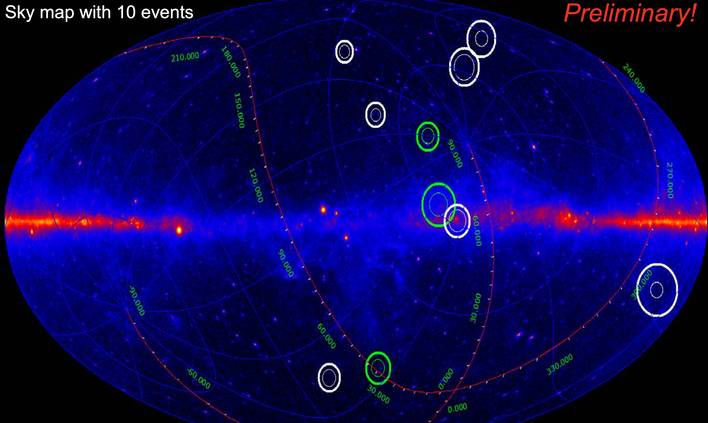
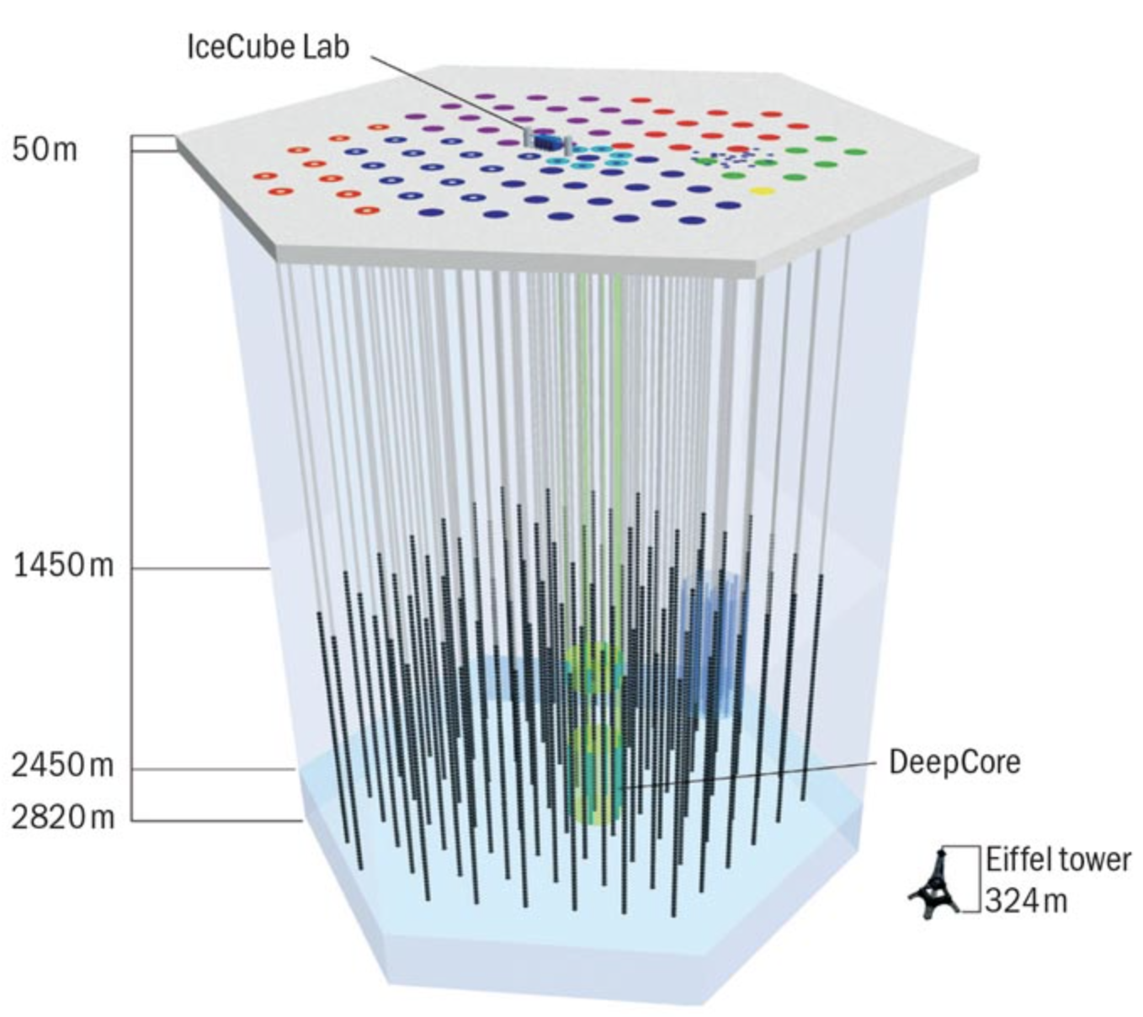
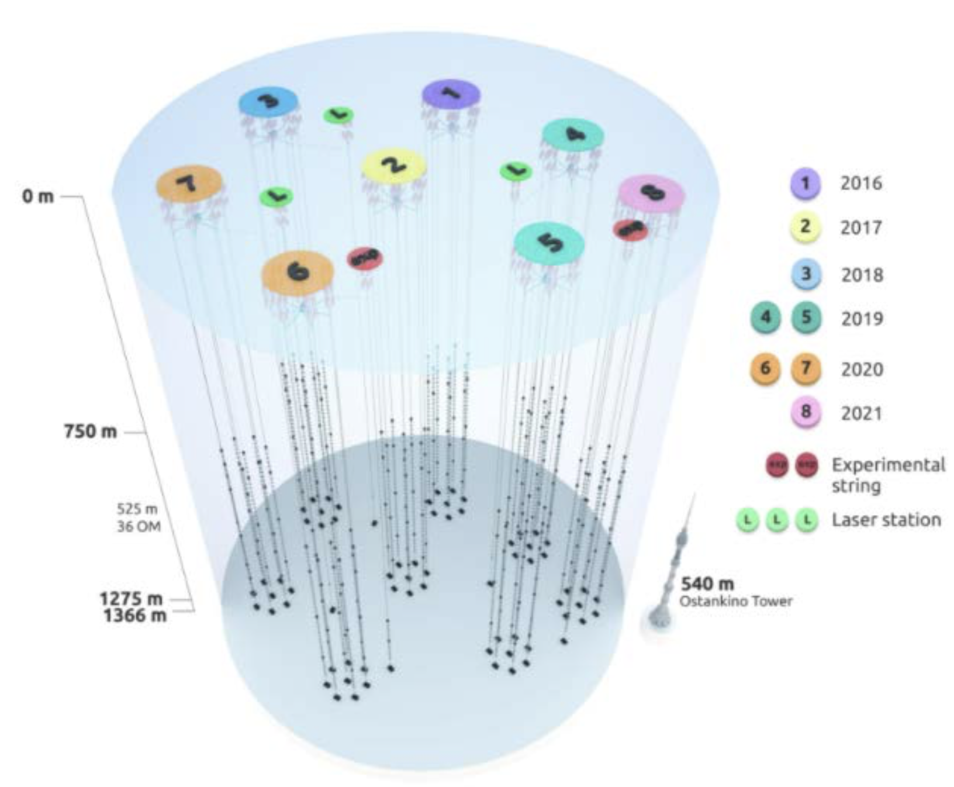
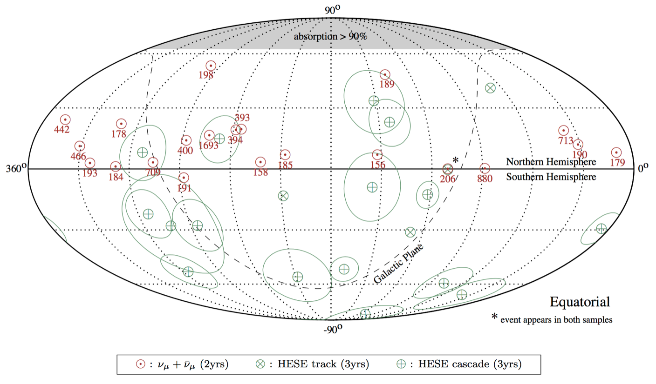
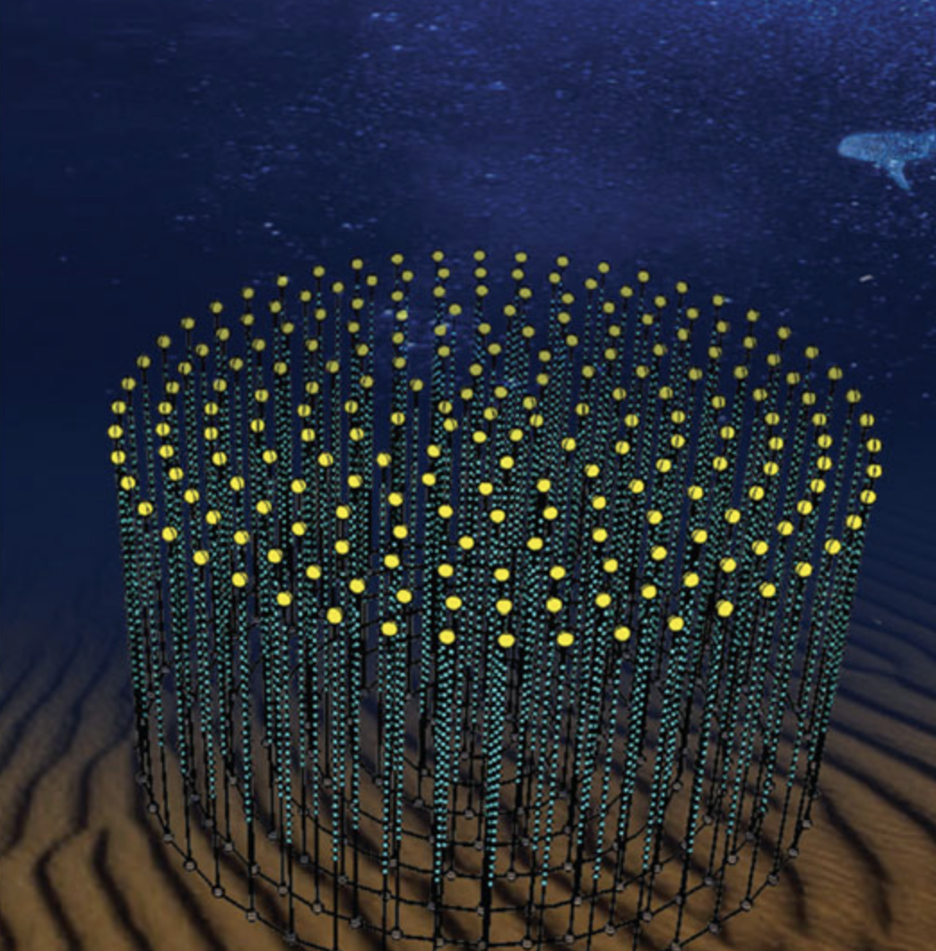
Astrophysical neutrinos in 10 TeV - 10 PeV range
Large volumes of ice or water are used as Cherenkov detectors to detect tracks of charged particles produced in interactions of high-energy neutrinos.
Baikal GVD and KM3NET (water) are joining IceCube (ice) as km³ scale detectors. They have comparable performance to IceCube for neutrino detection in muon channel, but better angular resolution in cascade channel.
Baikal-GVD (2021)
Baikal GVD (7 clusters)
Cascade events, E>100 TeV
(Galactic coordinates)
Baikal GVD Collab. ICRC2021
KM3NET
IceCube HESE (cascades and tracks)E>30 TeV
(Equatorial coordinates)
IceCube Collab. 1507.04005

Slide 15
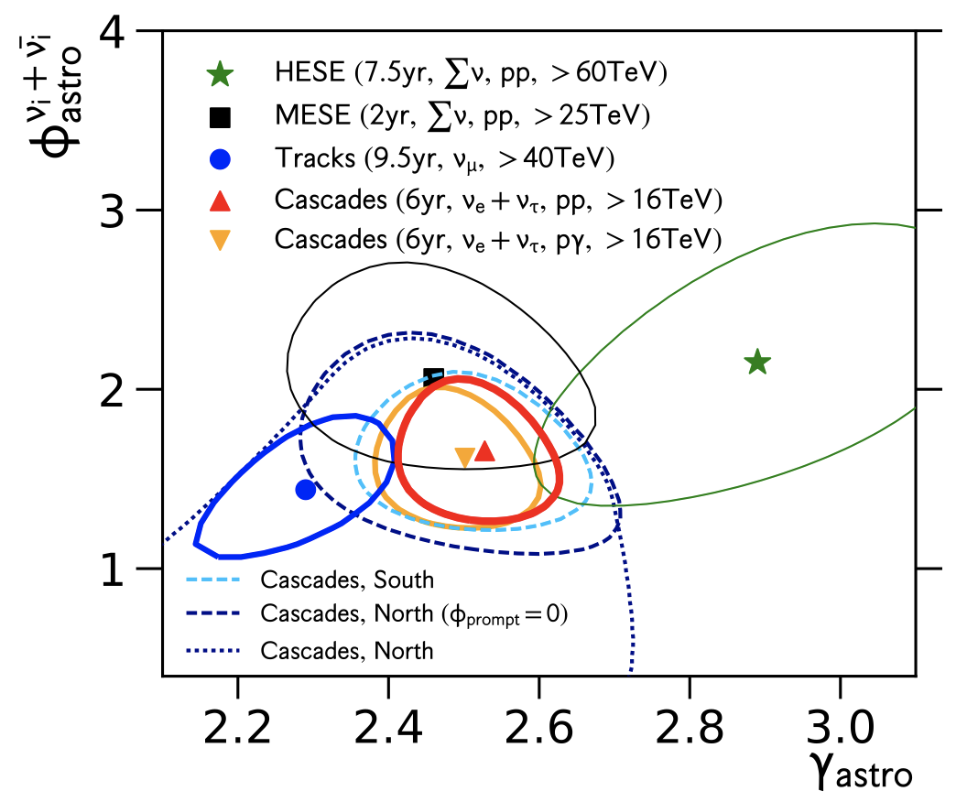
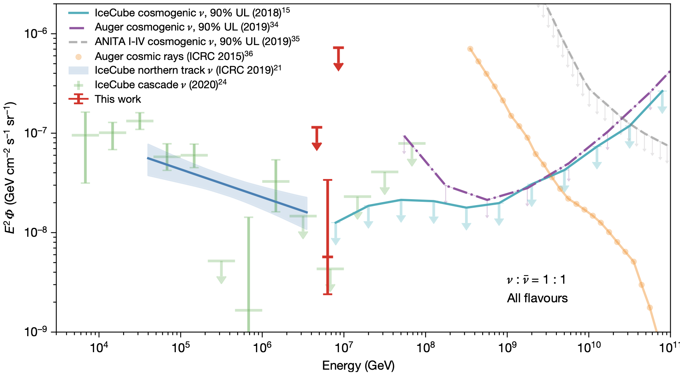
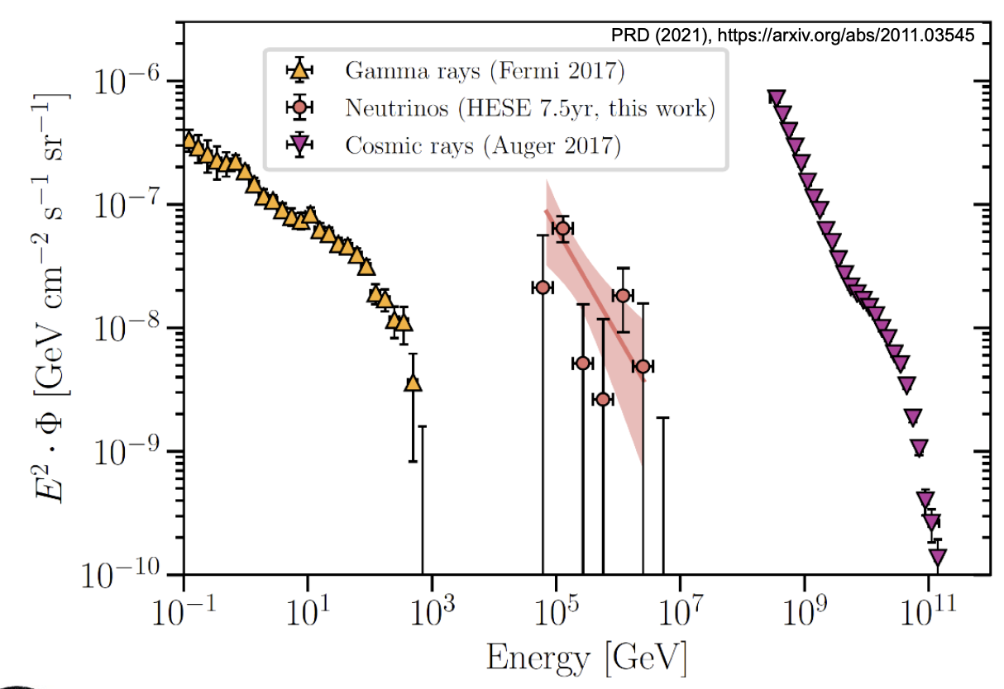

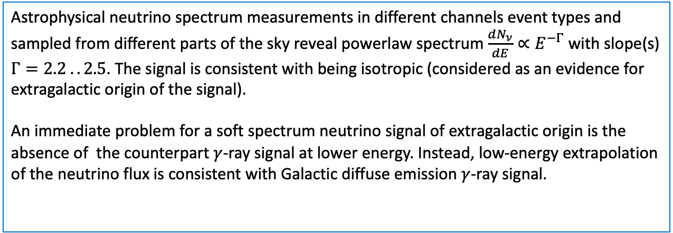
Astrophysical neutrinos in 10 TeV - 10 PeV range
Astrophysical neutrino spectrum measurements in different channels event types and sampled from different parts of the sky reveal powerlaw spectrum $\frac{dN_{ν}}{dE}∝E^{−Γ}$ with slope(s)
$Γ=2.2 .. 2.5$. The signal is consistent with being isotropic (considered as an evidence for extragalactic origin of the signal).
An immediate problem for a soft spectrum neutrino signal of extragalactic origin is the absence of the counterpart $γ$-ray signal at lower energy. Instead, low-energy extrapolation of the neutrino flux is consistent with Galactic diffuse emission $γ$-ray signal.
Isotropic $γ$-ray background
cascades
muon
neutrino
tracks
6 PeV cascade event
IceCube Collab. 1908.09551, 2001.09520, https://doi.org/10.1038/s41586-021-03256-1

Slide 16
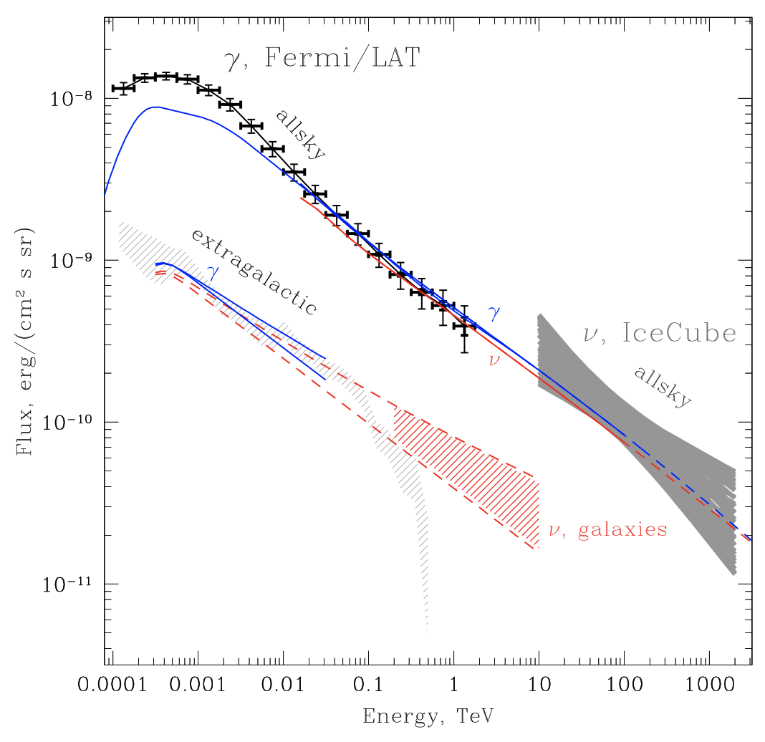
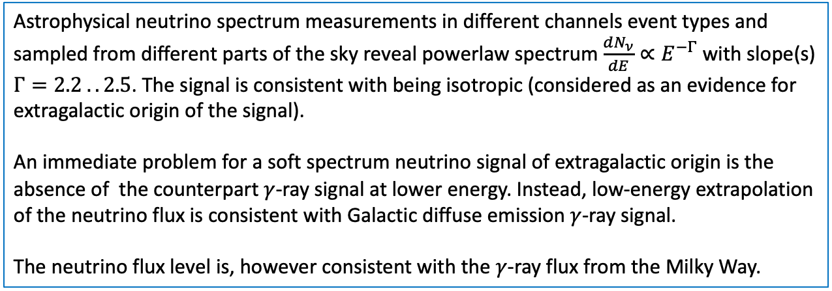
Astrophysical neutrinos in 10 TeV - 10 PeV range
Astrophysical neutrino spectrum measurements in different channels event types and sampled from different parts of the sky reveal powerlaw spectrum $\frac{dN_{ν}}{dE}∝E^{−Γ}$ with slope(s)
$Γ=2.2 .. 2.5$. The signal is consistent with being isotropic (considered as an evidence for extragalactic origin of the signal).
An immediate problem for a soft spectrum neutrino signal of extragalactic origin is the absence of the counterpart $γ$-ray signal at lower energy. Instead, low-energy extrapolation of the neutrino flux is consistent with Galactic diffuse emission $γ$-ray signal.
The neutrino flux level is, however consistent with the $γ$-ray flux from the Milky Way.
Extension of gamma-ray measurements into the energy range of neutrino signal should help: there is no clear understanding of physics of cosmic ray propagation in the Milky Way and of the origin of the locally observed slope of the cosmic ray spectrum.
AN, Semikoz 1412.1690, 1907.06061
IceCube Collab. 1908.09551, 2001.09520, https://doi.org/10.1038/s41586-021-03256-1

Slide 17
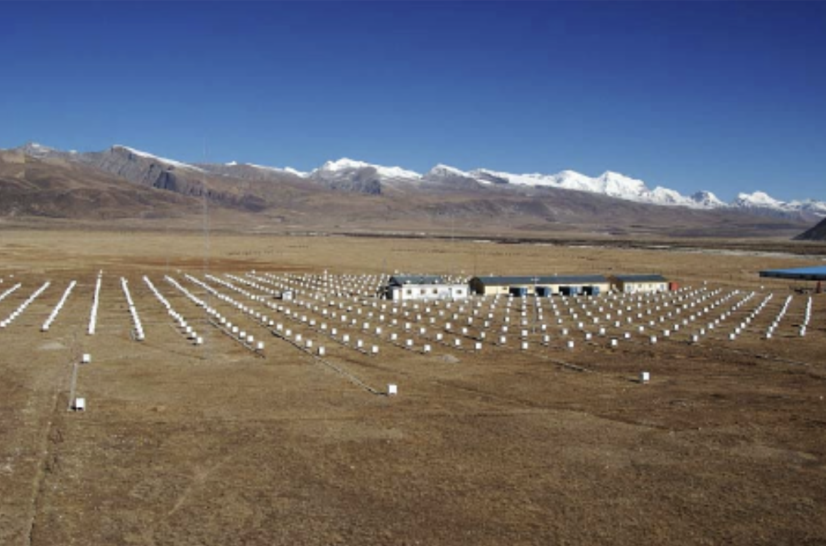
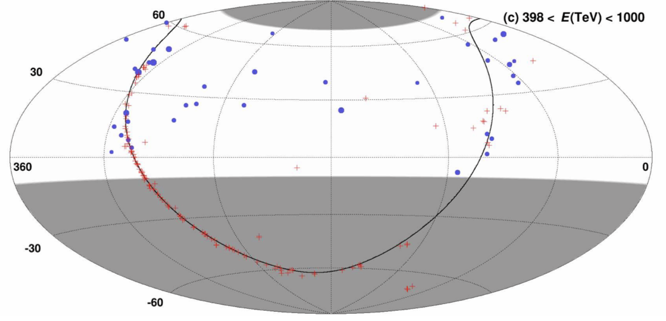
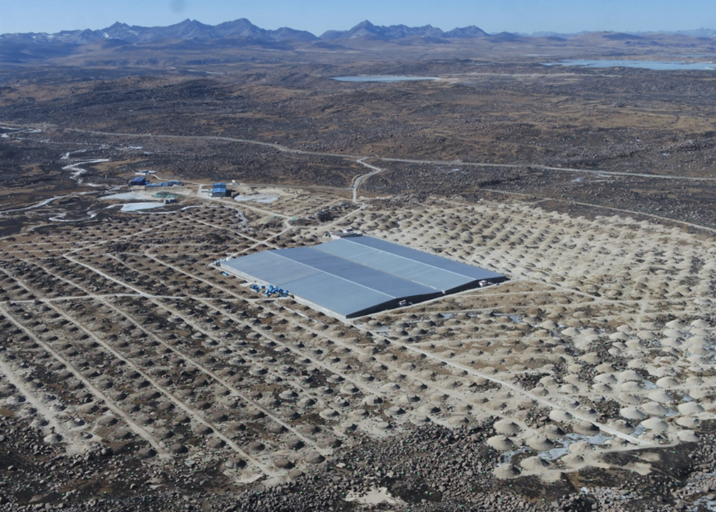
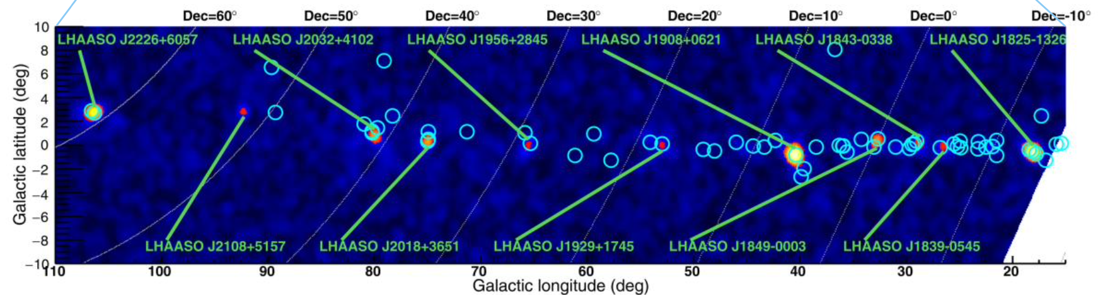


Gamma-rays with energies up to 1 PeV
Tibet AS$γ$-ray map E>398 TeV
Tibet AS experiment
LHAASO sky map E>100 TeV
LHAASO experiment
Water Cherenkov detectors, arrays of scintillator counters and muon detectors are used to detect particle air shower induced by $γ$-rays and distinguish them from background showers produced by proton and nuclei.
Tibet Collab. 2104.05181
LHAASO Collab. https://doi.org/10.1038/s41586-021-03498-z

Slide 18
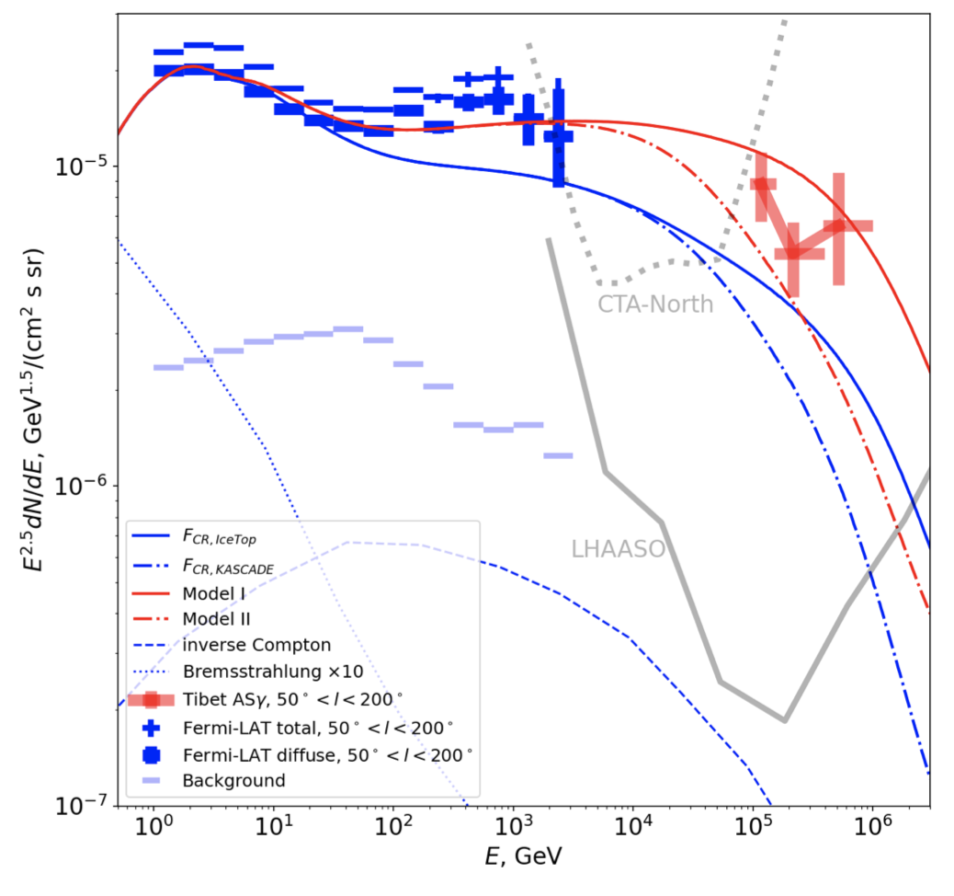
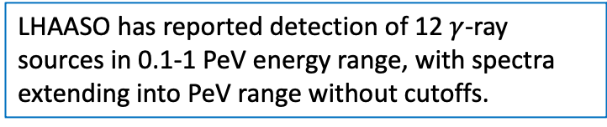
Gamma-rays with energies up to 1 PeV
Tibet AS$γ$-ray map E>398 TeV
Tibet AS collaboration has reported detection of diffuse emission in the energy range up to 1 PeV (overlapping with that of IceCube neutrino signal) from parts of the Galactic Plane.
Combination of Tibet AS measurements with those of Fermi/LAT telescope suggests that average cosmic ray spectrum is harder than locally measured and has a knee feature.
LHAASO has reported detection of 12 $γ$-ray sources in 0.1-1 PeV energy range, with spectra extending into PeV range without cutoffs.
Tibet Collab. 2104.05181
Koldobskiy, AN, Semikoz, 2105.00959,
AN, Semikoz, Vovk, 2107.06541
LHAASO Collab. https://doi.org/10.1038/s41586-021-03498-z

Slide 19
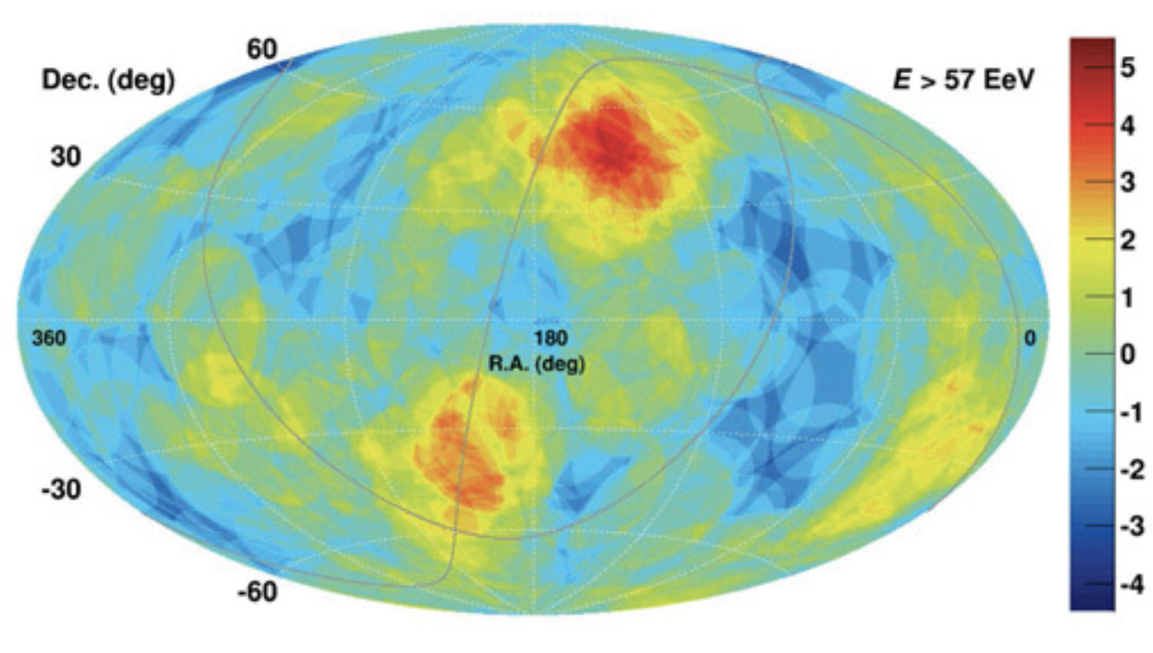
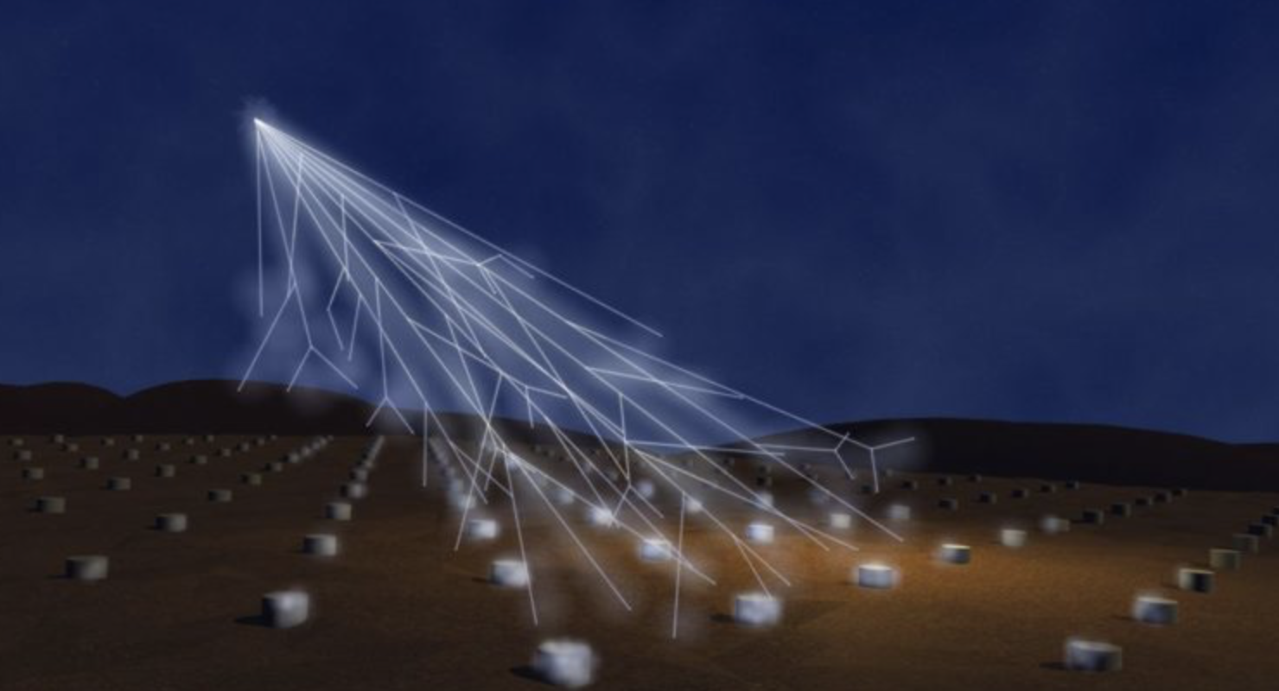



UHECR astronomical observational window?
Arrays of water Cherenkov detectors and scintillator pads spread over areas up to are used to detect highest energy cosmic rays. Two main experiments: Pierre Auger Observatory (covering 3000 km² area) in Southern hemisphere and Telescope Array (upgrading to cover 3000 km² area) in Northern hemisphere.
Pierre Auger observatory is currently undergoing an upgrade installing muon detectors and radio antennae network, to improve measurements of identity of primary UHECR particles.
Telescope Array “hotspot”
Strongest intermediate angular
scale clustering in Auger field of view
UHECR are charged particles that are only slightly deflected by Galactic magnetic field: $θ≃1^{∘}$ for 10²⁰ eV protons. If most of the UHECR are protons, their arrival directions point (almost) to their source location on the sky.
Up to now no isolated sources of UHECR have been detected through analysis of clustering of UHECR arrival directions on the sky.
Large angular scale anisotropy of UHECR arrival directions (dipole) has been detected by Pierre Auger Observatory. Intermediate angular scale anisotropy (20-25 degrees scale) has been reported by both Telescope Array and Pierre Auger Observatory.
Telescope Array fluorescence detectors
Auger detector unit
Pierre Auger Observatory (public data release): arXiv:2206.13492

Slide 20



UHECR observational window?
Auger and Telescope array measurements indicate that Northern and Southern sky spectra differ at the highest energy end. The spectra are consistent in the part of the sky visible to both experiments, if cross-calibration is performed (10% level correction of energy scale).
Analysis of composition of UHECR flux by Auger indicates that the highest energy flux is dominated by heavy nuclei. This is not confirmed (yet?) by Telescope Array.
Heavy nuclei composition of UHECR flux complicates clustering analysis aimed at the search of UHECR sources via backtracing of their UHECR arrival directions. Uncertainties of knowledge of Galactic magnetic field strongly affect precision of the analysis.
Pierre Auger Collab. ICRC 2021

Slide 21



Highest energy probes of fundamental physics (examples)
K.Engel et al. (Snowmass2021), arXiv:2203.10074
IceCube astrophysical neutrino flux can contain a signal from Dark Matter decays in the Milky Way halo. IceCube limits on anisotropy of neutrino flux and LHAASO mapping of diffuse gamma-ray emission will test this possibility.
AN, Semikoz, arXiv:2001.11881
Lorentz invariance violation would manifest itself in the photon dispersion relation $E^{2}−p^{2}=±E^{n+2}/{E_{LIV}^{\left(n\right)}}^{n}$ that results in delay / advance of arrival time of higher energy photons. Non-observation of this effect (e.g. in GRB signal) imposes lower bounds on the characteristics energy scales $E_{LIV}^{(n)}$.
Modification of the dispersion relation also modifies the thresholds of reactions, specifically of the $γγ→e^{+}e^{−}.$ Mere observations of the highest energy gamma-rays from astronomical sources imposes lower bounds on $E_{LIV}^{(n)}$.

Slide 22
Summary

