Slide 1
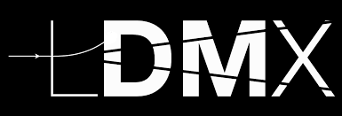


LDMX: A Search for Dark Matter Using a High Intensity Electron Beam
E. Craig Dukes
University of Virginia
(on behalf of the LDMX collaboration)
September 9, 2022

Slide 2
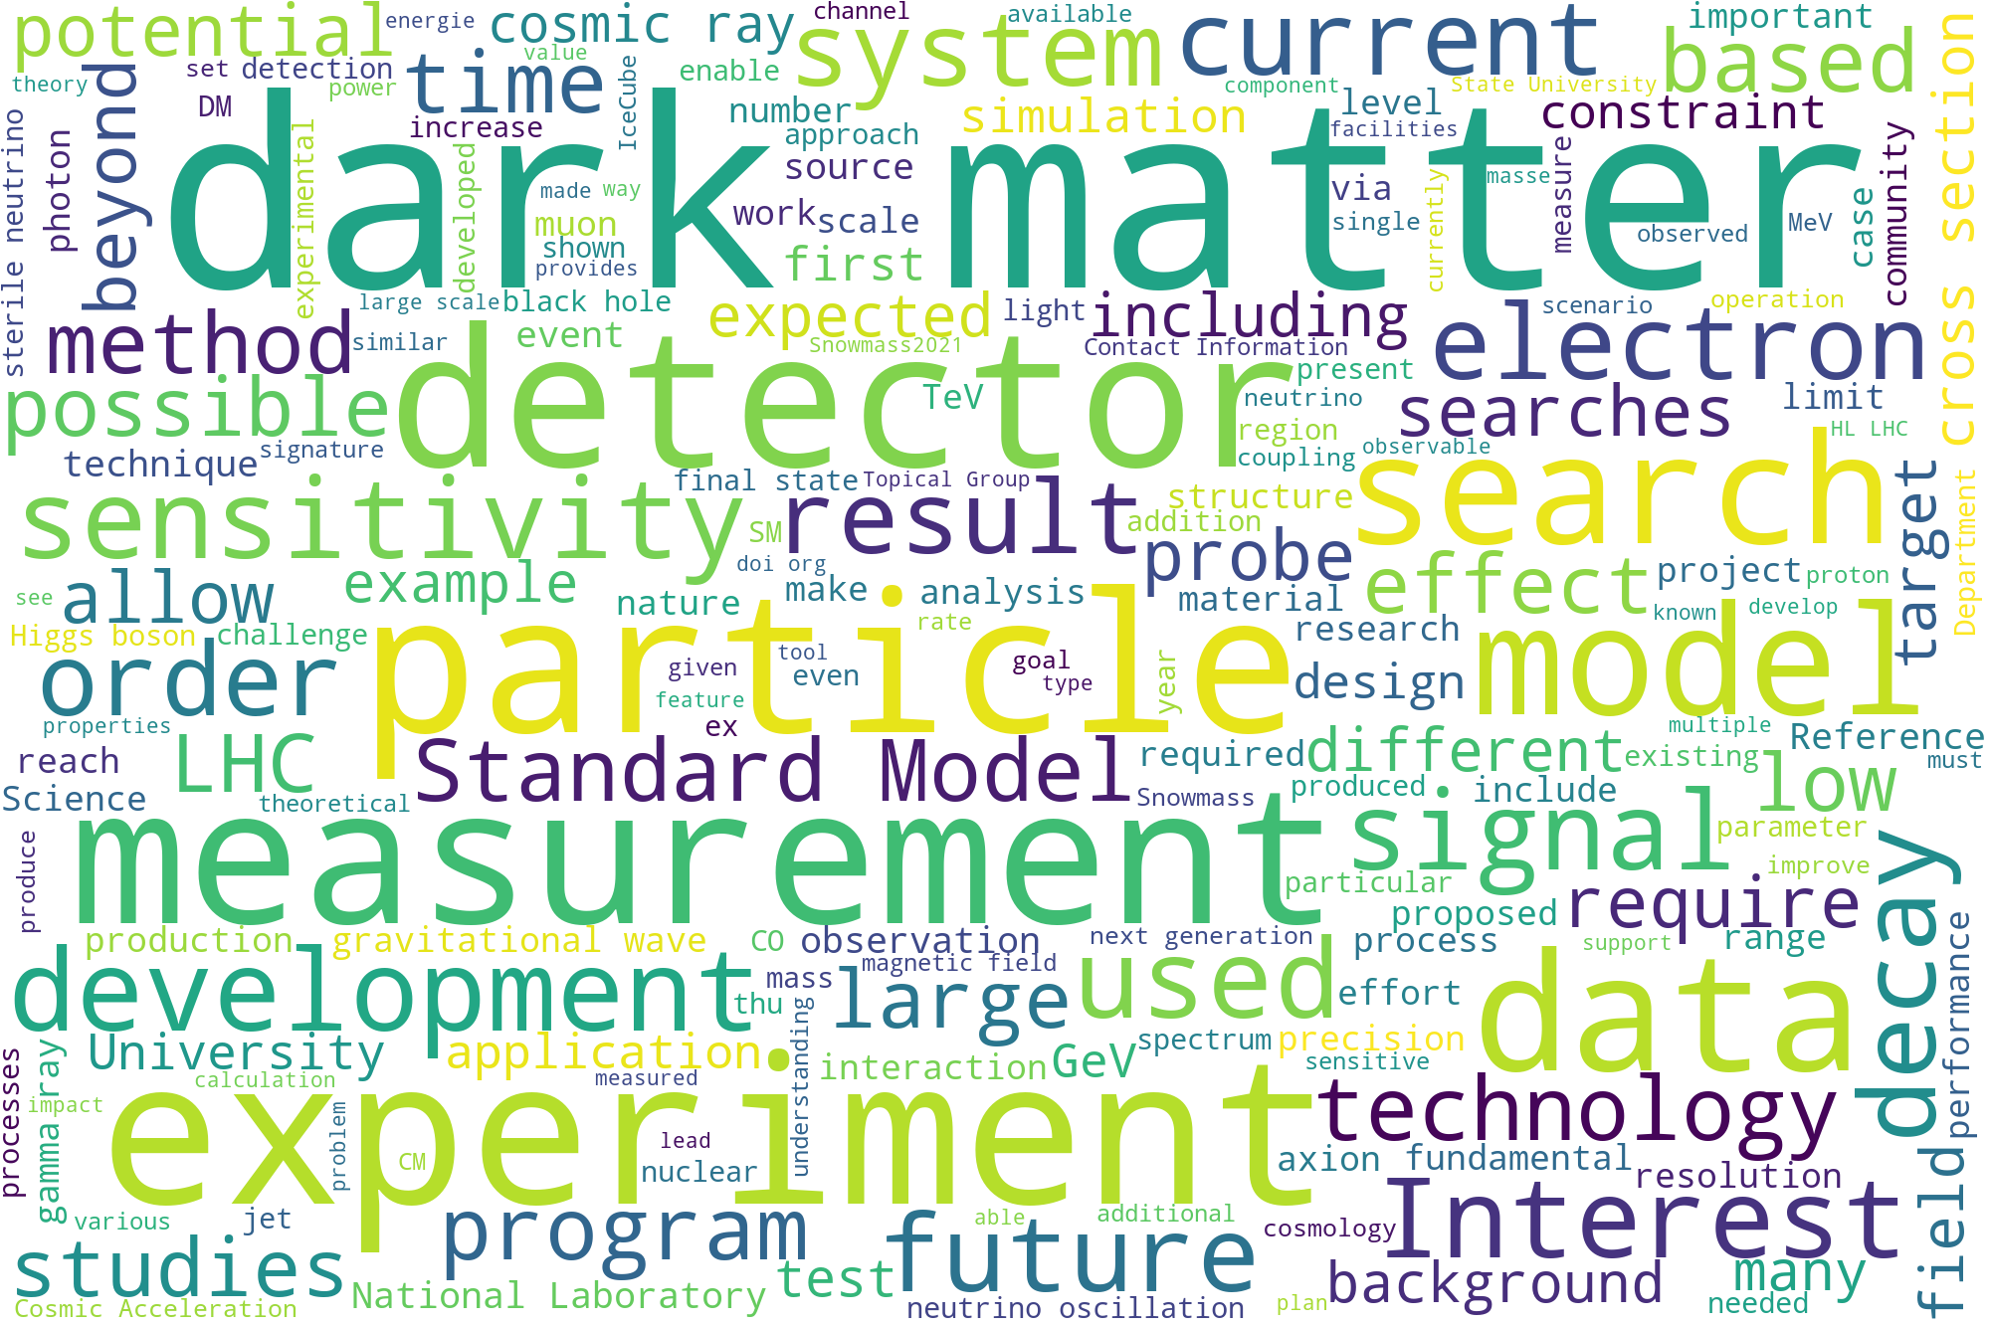
Dark Matter is Hot: Snowmass 2022 Letters of Intents
Word clouds from 522 Letter of Intents submitted for the USA decadal planning study (Snowmass 2022) for elementary particle physics, which was help this July
Identifying the nature of this exotic matter is the outstanding particle physics goal of our time

Slide 3
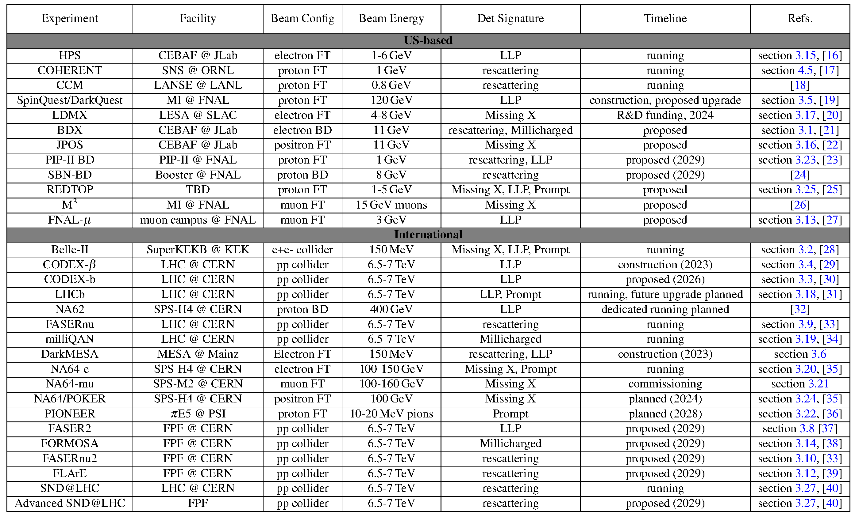

Dark Matter: Accelerator Searches Landscape Keeps Growing
Experiments and Facilities for Accelerator-Based Dark Sector Searches (arXiv.2206.0422)

Slide 4
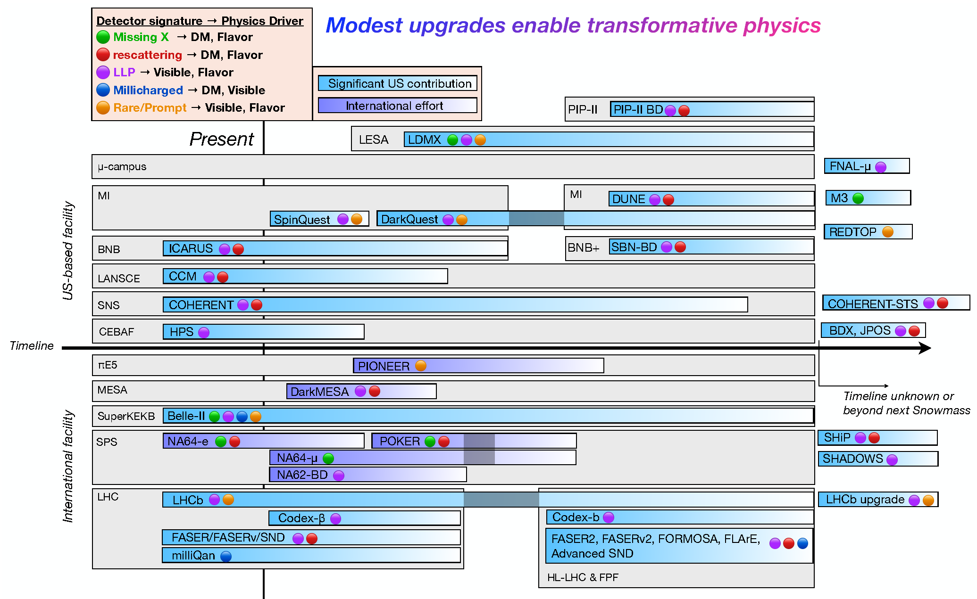
Dark Matter: Accelerator Searches Landscape
Experiments and Facilities for Accelerator-Based Dark Sector Searches (arXiv.2206.0422)

Slide 5
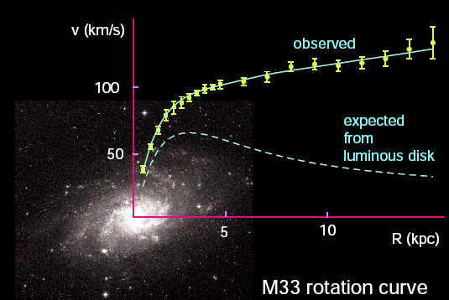
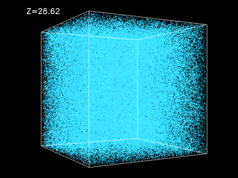
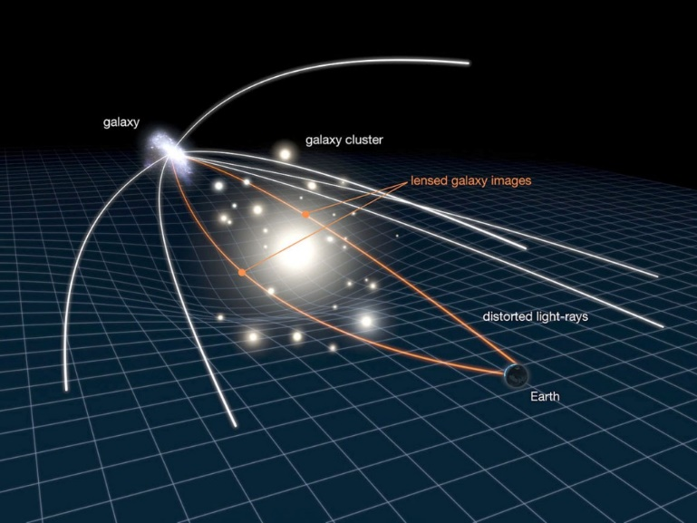
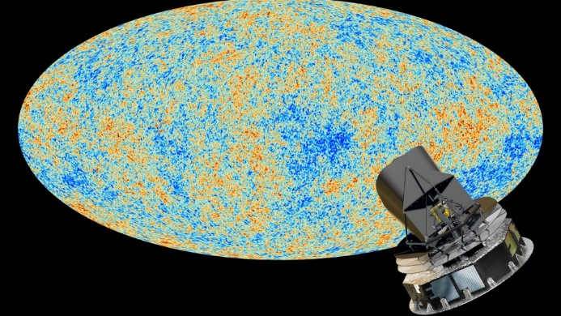
Dark Matter Exists: Gravitational Evidence
Four sources on vastly different scales: galactic to universal
Galactic rotation curves
Gravitational lensing
Large scale structure of universe
Microwave background radiation
Best estimate: 85% of the mass of the universe is dark matter
Dark matter was present at the beginning of the universe

Slide 6

Composition of Matter in Universe
DM density: ~0.3 GeV/cm
Flux: ~30,000/s∙cm² @100 km/s (if mass is 100 GeV)
We know the DM was present in the early universe
The fact that the densities of DM and SM are roughly the same suggest that they were perhaps coupled in the early universe
1% Stars
7% Gas
SM Matter
7% Diffuse gas
Dark Matter
85% Dark Matter

Slide 7
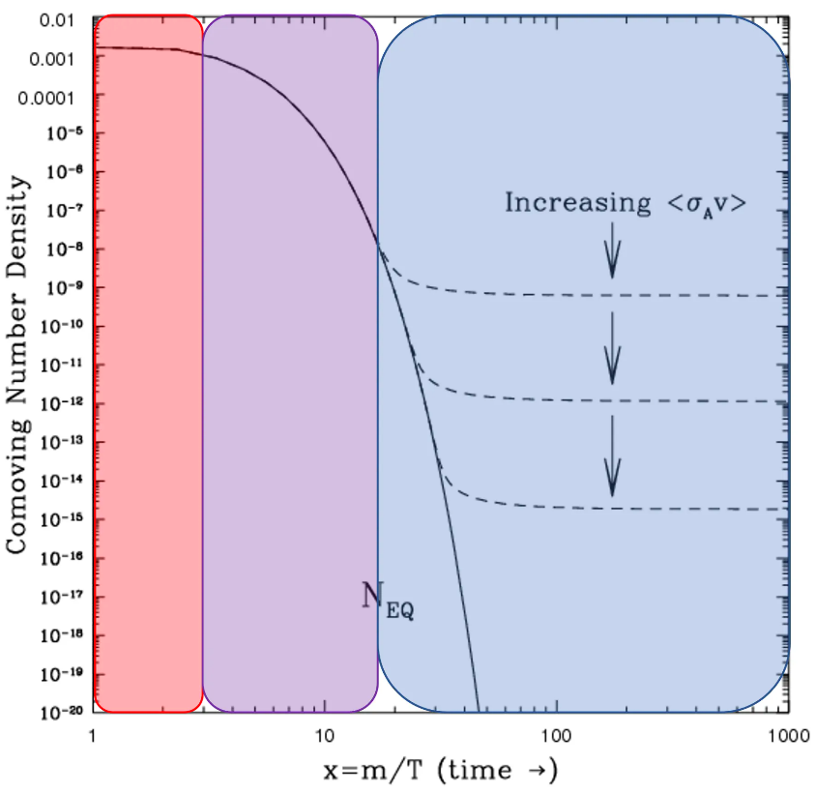
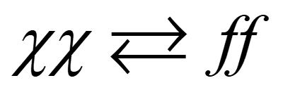
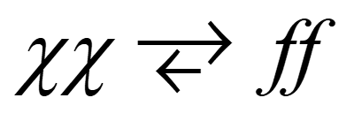
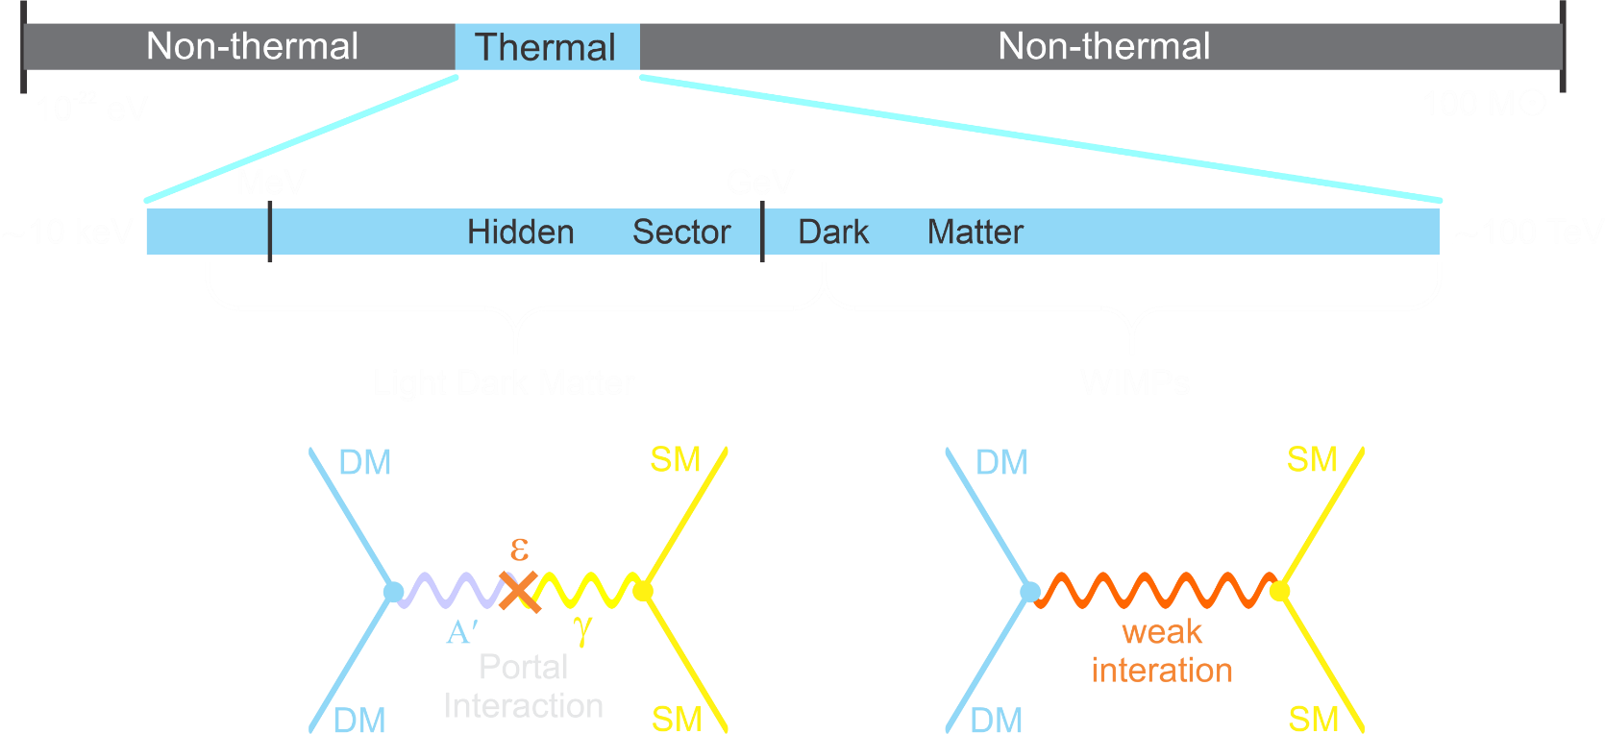
Dark Matter: Thermal Relic Production
Assume DM was in thermal equilibrium with SM in the very early universe:
Universe cooled to the point that DM pairs no longer produced
Universe kept cooling such that DM annihilations ceased
Present density:
LDMX (Light Dark Matter eXperiment) goal is to probe this region with a sensitivity the encompasses the thermal target predictions
Sub-GeV DM:
M_{χ} < 10 MeV: early BBN problems comparatively under-explored
WIMP thermal DM:
M_{χ} < 2 GeV: early freeze out, too much DM
Region is being well explored

Slide 8
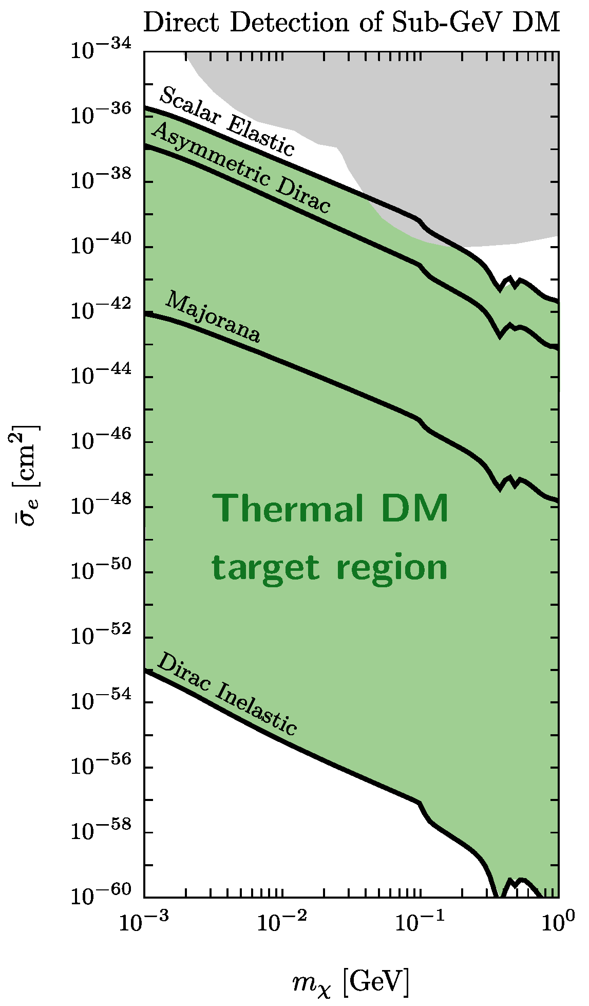
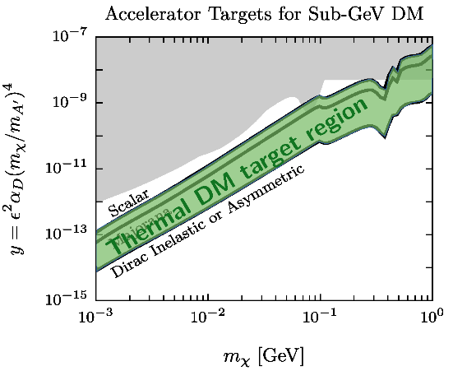
Accelerator Production: Advantages
Direct Detection:
Strong velocity/spin dependence of scattering spreads out direct detection cross sections
Accelerator Production:
Range of freeze-out interaction strengths much more compact: spans factor of ~ 30 for a given DM mass
All thermal targets within reach

Slide 9
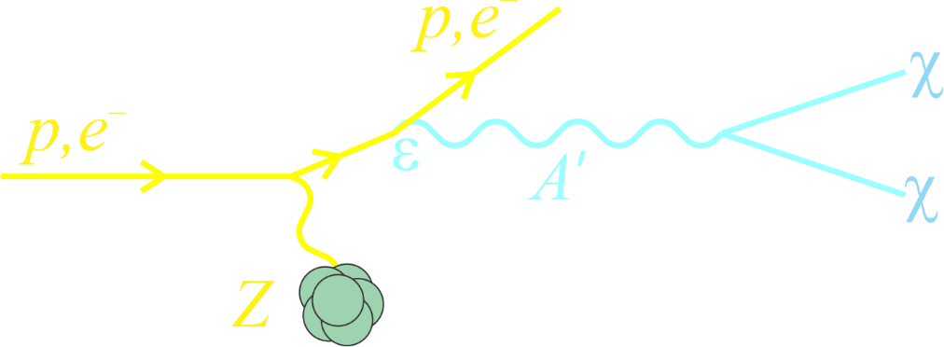
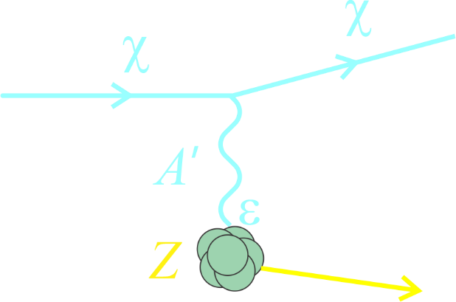
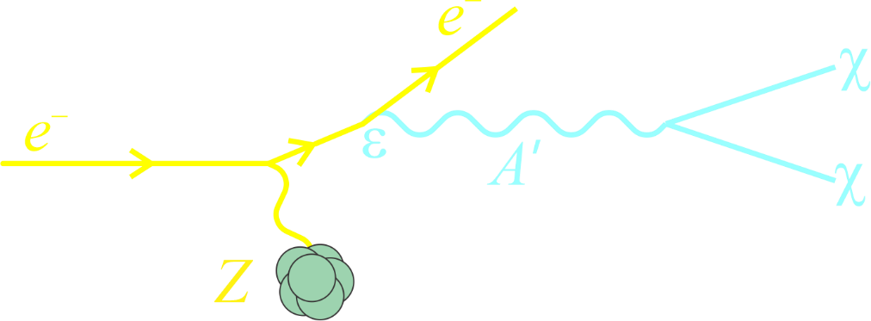
Searching for Dark Matter with Fixed-Target Experiments
Beam dump
Missing energy / momentum
+
Probes dark sector coupling
Suppressed by ε⁴
Large yield, particularly for low mediator masses
No DM detection penalty
LDMX has chosen this path

Slide 10
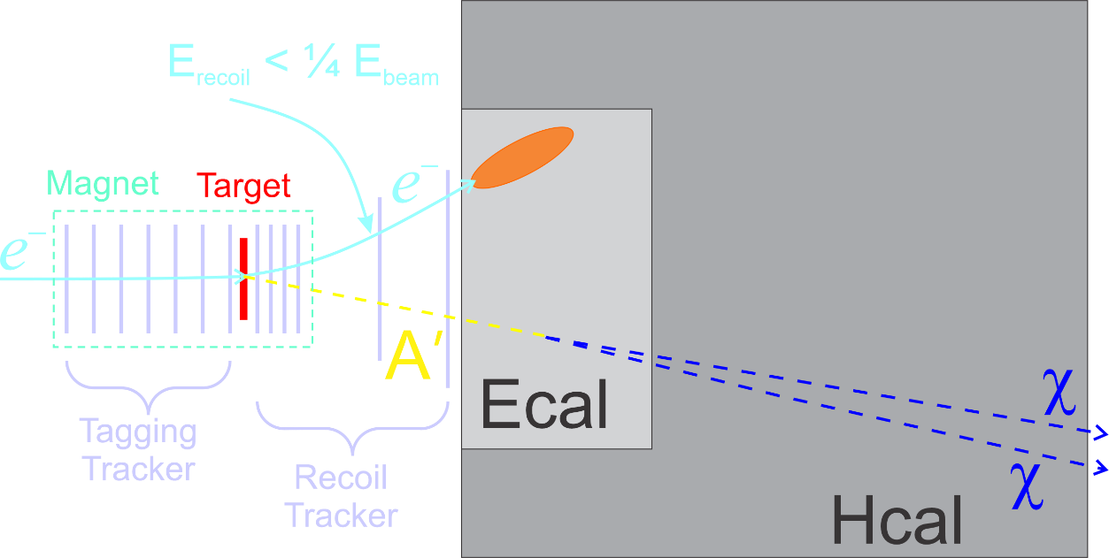
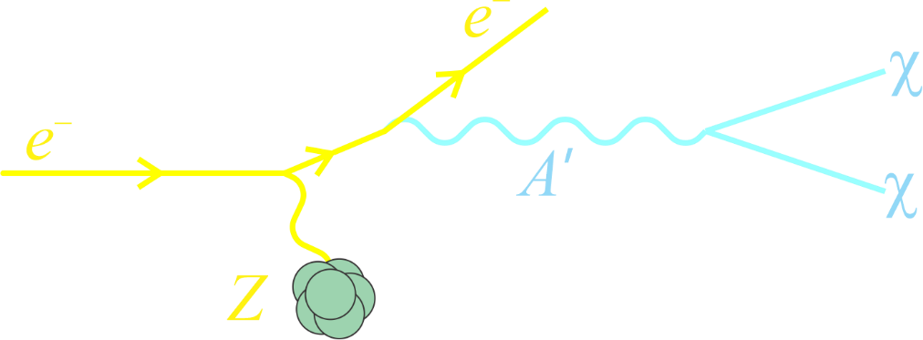
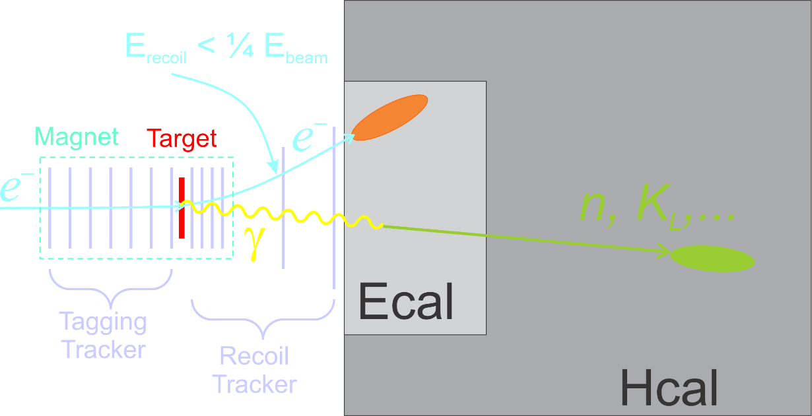
Experimental Technique in a Nutshell
LDMX uses missing momentum technique
Beam:
Parasitically use the SLAC LCLS II beam (4 GeV): ~40 MHz e⁻
Signal:
Substantial energy loss by the 4 GeV beam electron
Large recoil electron p_{T}
Absence of any additional visible final-state particles
Apparatus
Thin production target to produce DM bremsstrahlung
Precision tracking of the electron before/after target
Excellent EM and Hadronic calorimetry to capture background gammas, neutrons produced by photo-nuclear and electro-nuclear processes, as well as other backgrounds
Signal
Background

Slide 11
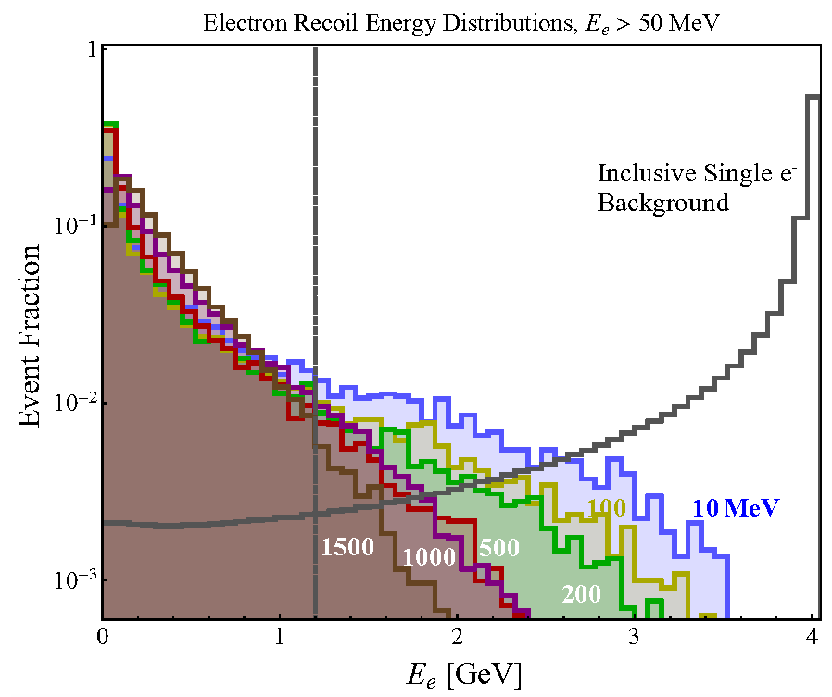
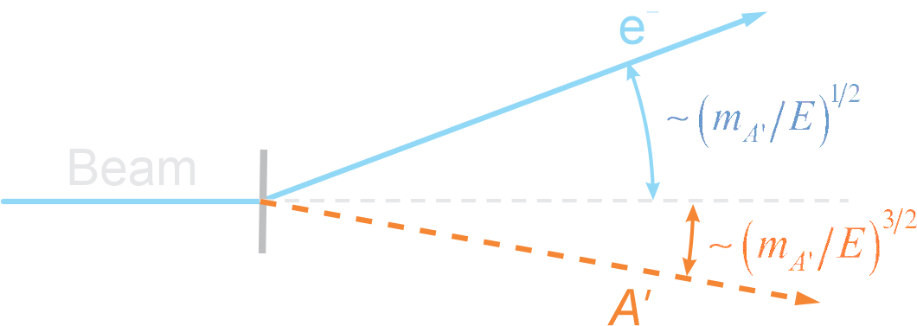
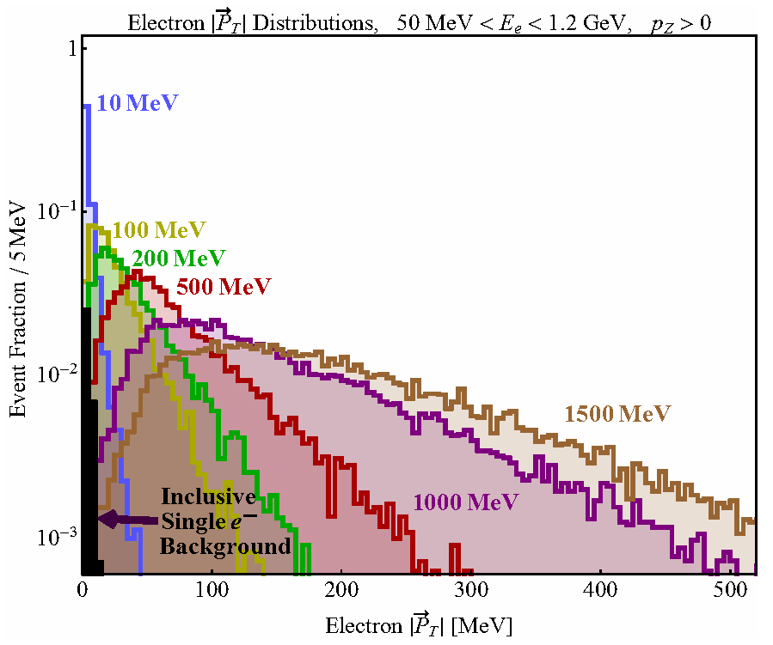
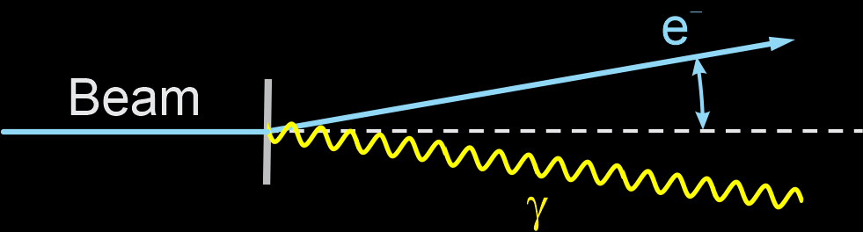
Electron Parameters: Signal & Background
Difference between SM and Dark A’ bremsstrahlung is the latter carries away much more of the beam energy and transverse momentum than SM bremsstrahlung
Larger the A’ mass, the greater the difference from SM bremsstrahlung
Recoil Electron Energy
DM
Signal:
Background:
Recoil Electron p_{T}
DM

Slide 12
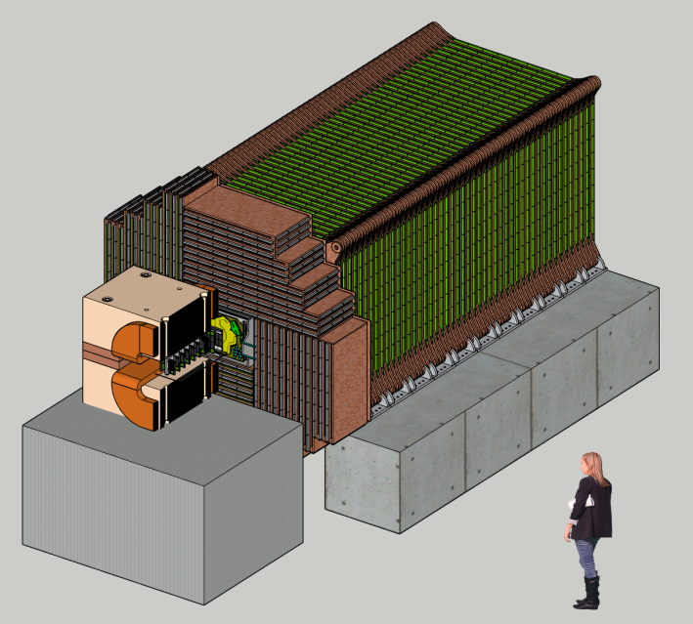
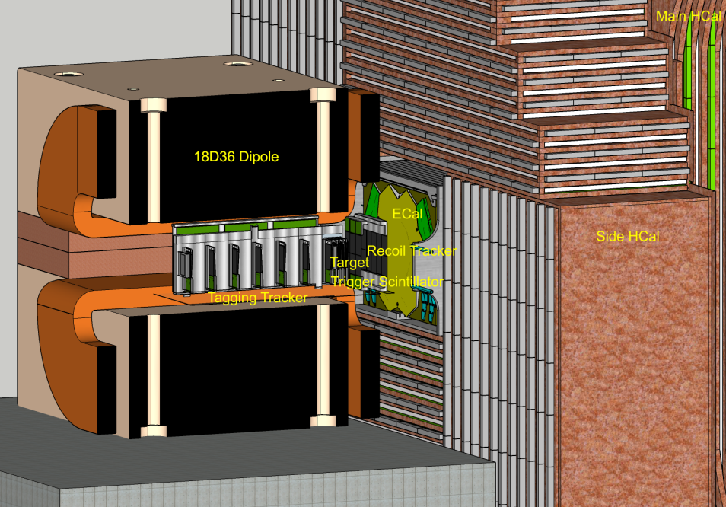
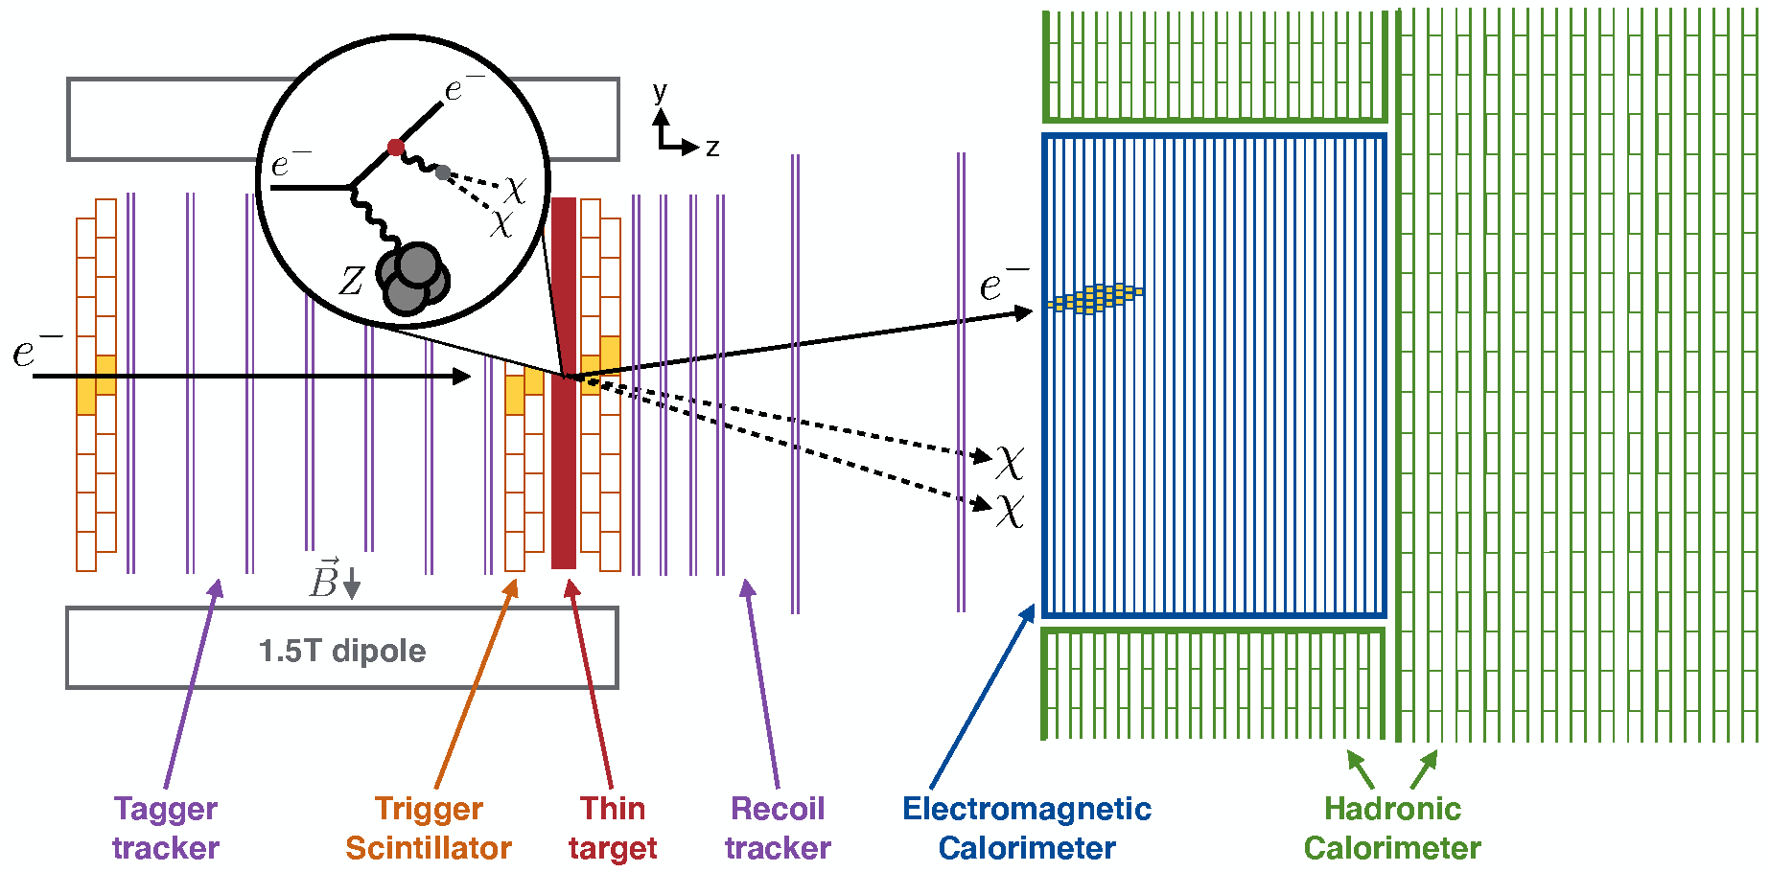
Apparatus
Quasi-beam dump experiment: tag and measure each incoming electron
Use existing detector technologies that have been designed for high rate / high radiation environments: (1) to keep costs down, and (2) to allow the apparatus to be fabricated quickly
Hadronic Calorimeter
1 m
EM Calorimeter

Slide 13
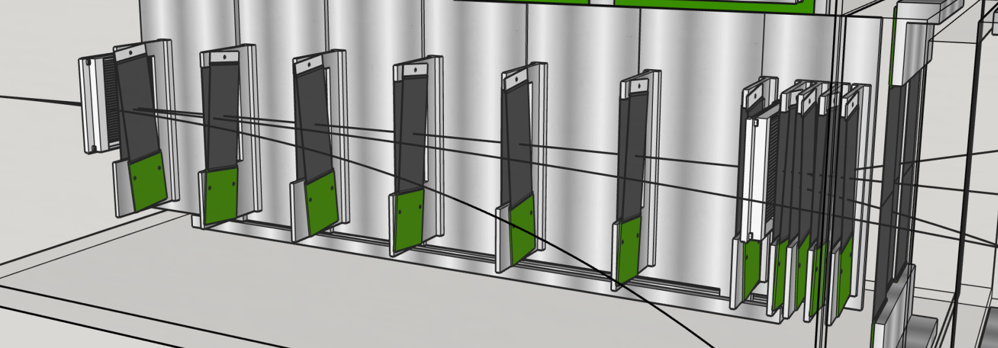
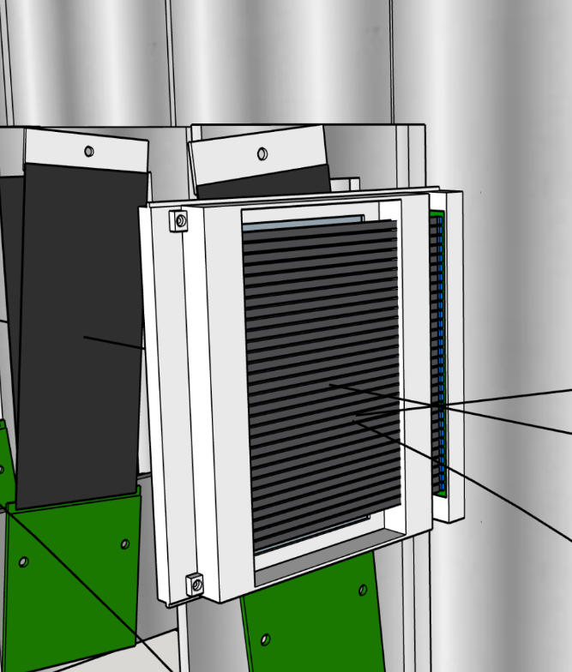
Apparatus: Trigger Scintillator
Low-energy ECal trigger requires knowledge of #e⁻/pulse: average ~1 e⁻/25 ns pulse
Thin segmented scintillator:
  2 offset layers/station: 48 total counters
  3 mm pitch
Note: 40 MHz e⁻ beam spot is large: ~20 cm²
2 mm deep x 3 mm wide strips

Slide 14
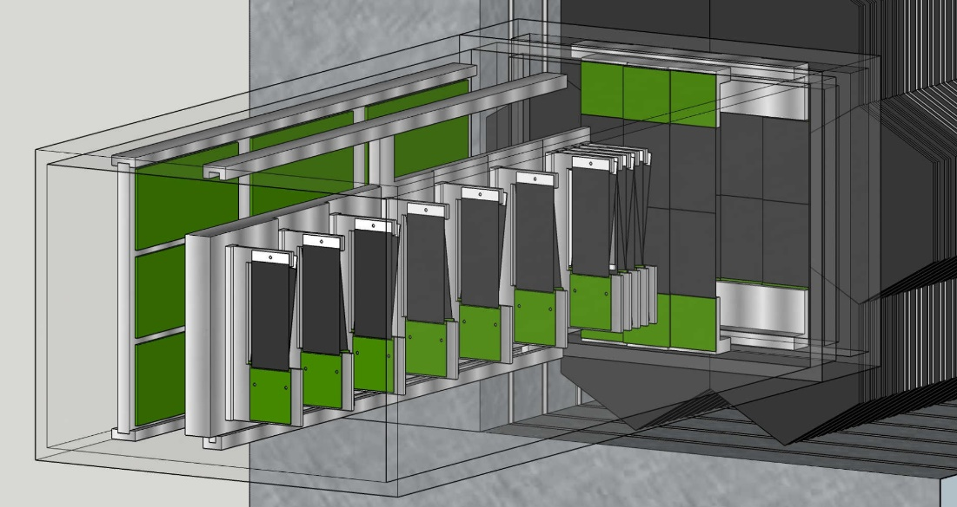
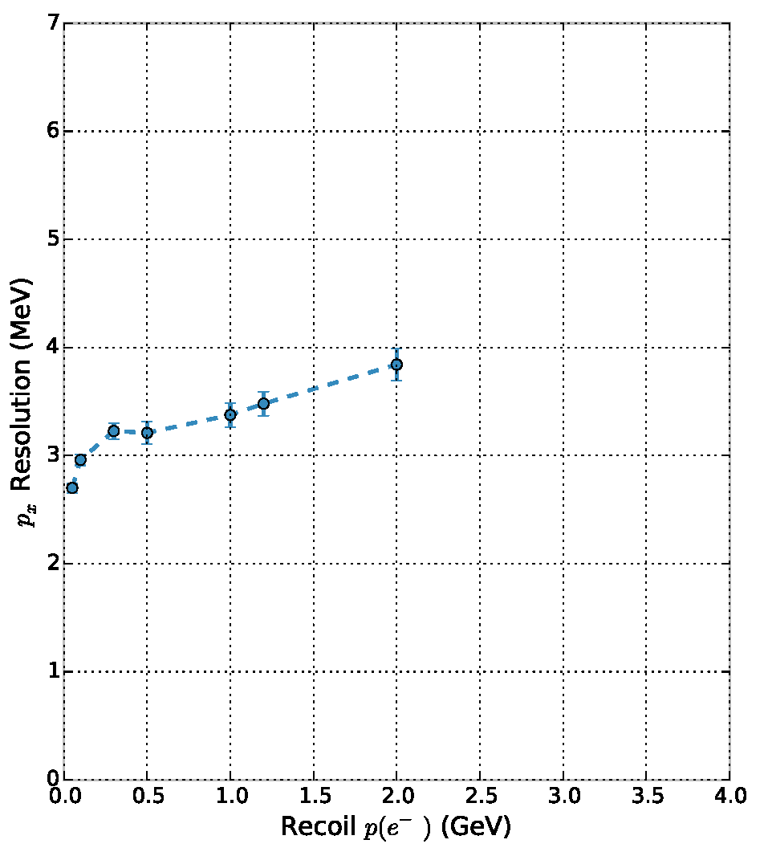
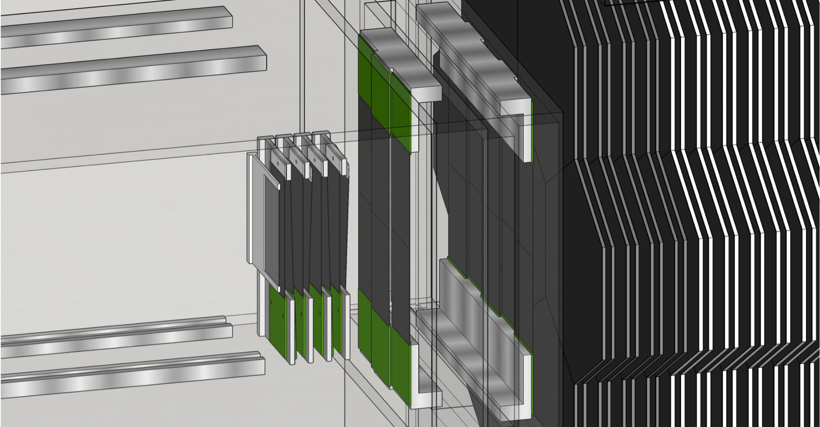
LDMX Apparatus: Tagger & Recoil Tracker
Tagger / Recoil tracker inside 1.5 T dipole field / fringe field measure momentum of incoming / recoil e⁻ to <1%
Double-sided silicon, Based on Vtx Tracker for HPS expt (JLab)
4 MHz/mm² rate capability
0.7% X₀ per 3d hit
6 (60) μm hor (ver) resolution; ~2 ns timing resolution

Slide 15
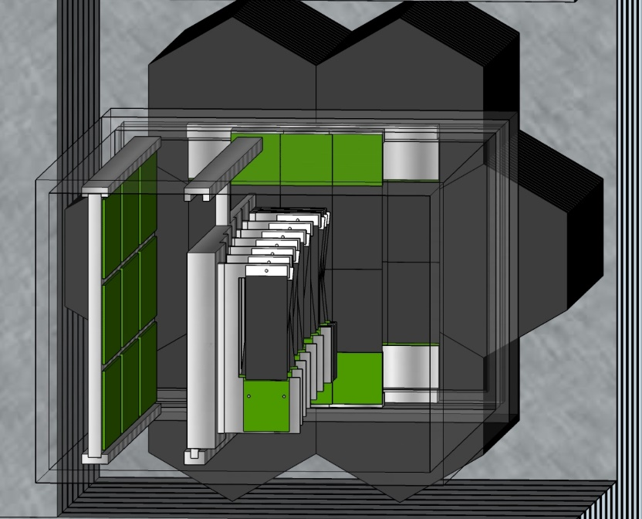
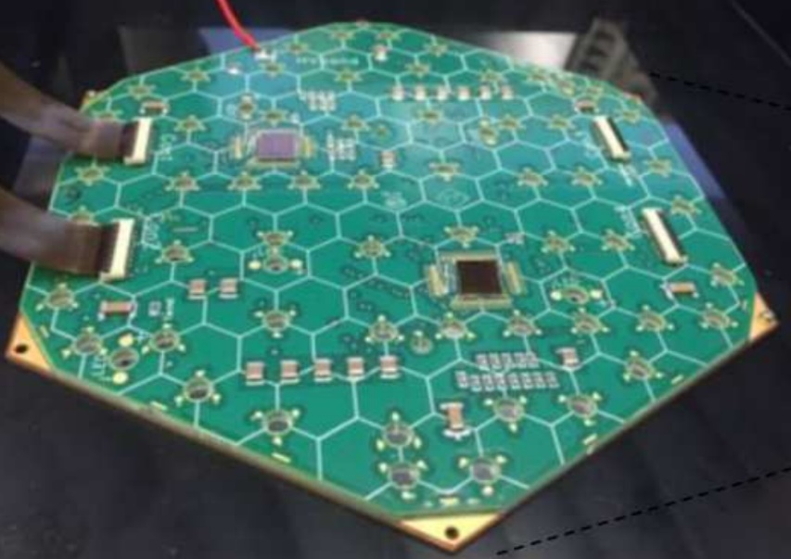
LDMX Apparatus: Electromagnetic Calorimeter
Based on CMS Phase-II forward high granularity calorimeter (HGC) upgrade
Tungsten-Silicon sampling calorimeter: σ(E)/E∼20%/√E
High granularity (0.56 cm² pad area): 68% of EM shower <1 cm 1st 15 layers
Deep: 40 X₀
Radiation hard: max dose for LDMX is 3 x 10¹³ n/cm²
Provides a fast energy trigger: E < 1.2 GeV
ECal
ECal
ECal

Slide 16
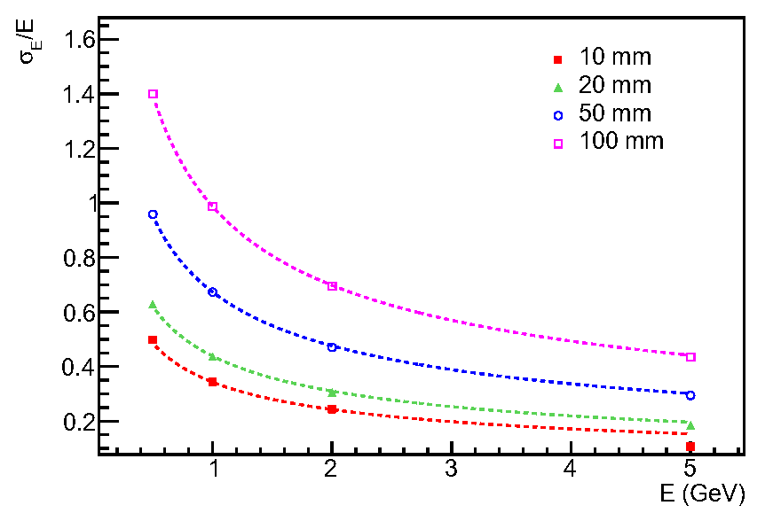
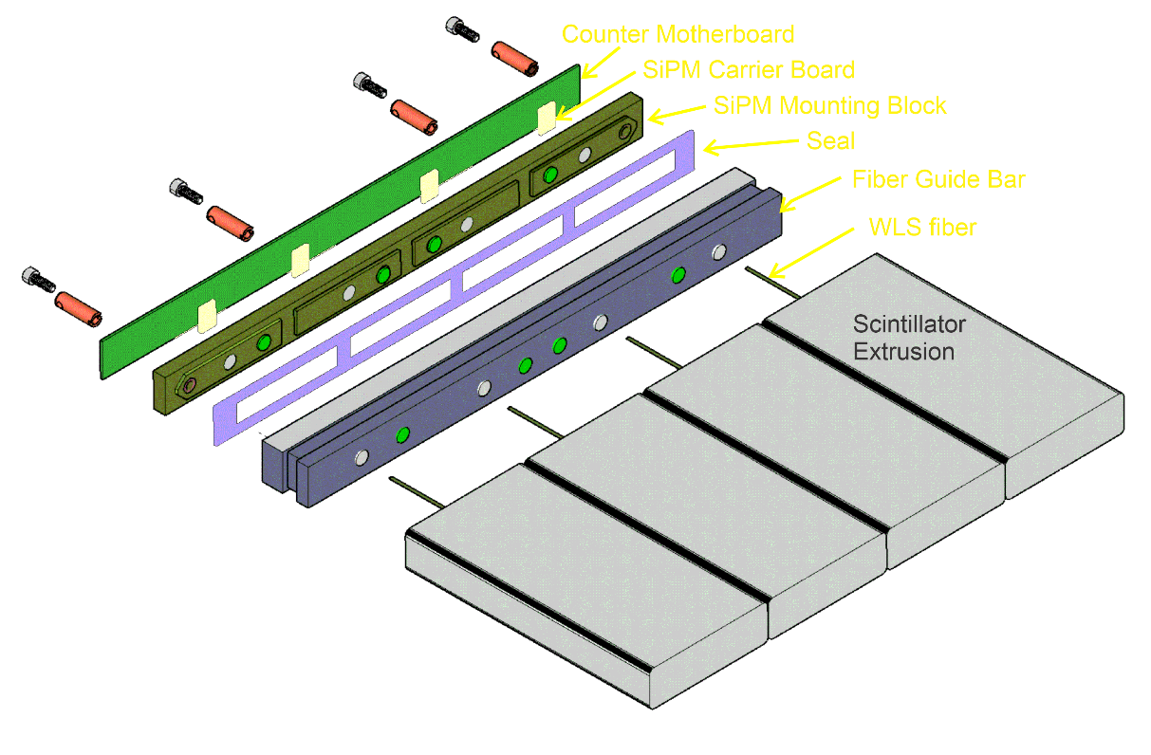
LDMX Apparatus: Hadronic Calorimeter
Detects neutral hadrons/neutrons produced in photonuclear reactions in ECal/target with high effi., EM showers escaping ECal, and MIPs (muons)
Iron-scintillator sampling calorimeter: 96 layers of 20/25 mm PS/Fe
Extruded 5x2 cm² scintillator bars with inserted wavelength-shifting fibers, read out with Silicon Photomultipliers (SiPMs)
Active element based on the Mu2e Cosmic Ray Veto detector
Deep: 17λ_{I}
Energy resolution for neutrons
HCal
Readout manifold for 4 counters

Slide 17
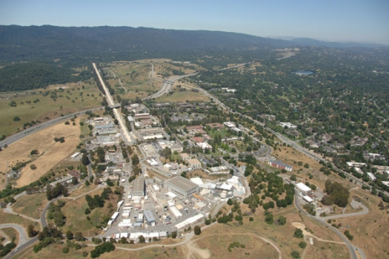

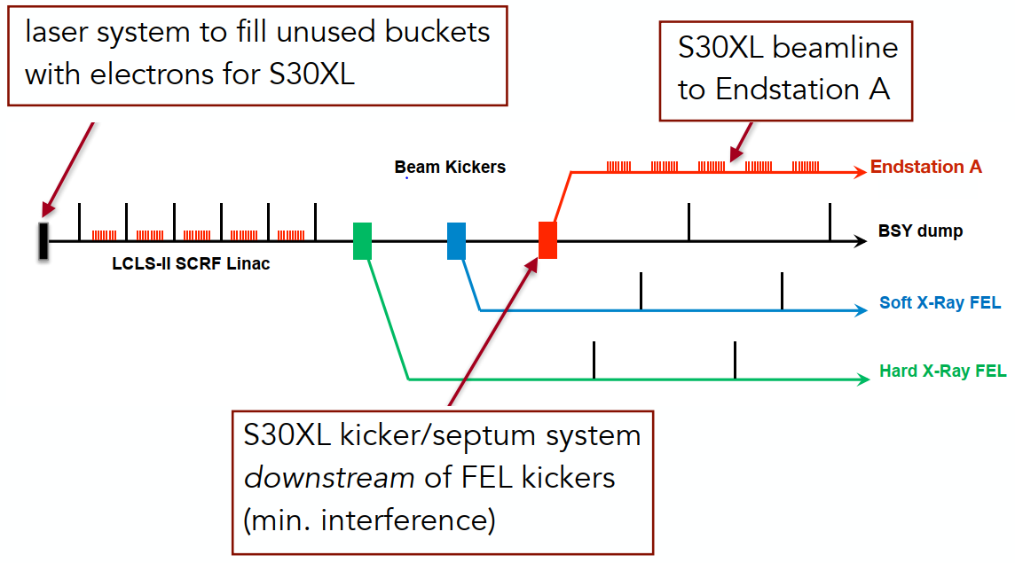
LDMX Mounted SLAC Linac Coherent Light Source
LDMX will use new beamline (LESA) being built for the upgraded SLAC Light Source (LCLS-II) to be commissioned in 2023-2024
Need a tiny fraction of the LCLS-II beam
Parasitic: 55% duty factor (600 ns/1100 ns)
Phase I: 4 GeV bean @ 40 MHz → O(10¹⁴) e⁻ in a 1 year run
Phase II: 8 GeV beam (LCLS-II-HE) → O(10¹⁶) e⁻ in a 3 year run
Future: eSPS (16 GeV) at CERN?
Endstation A

Slide 18
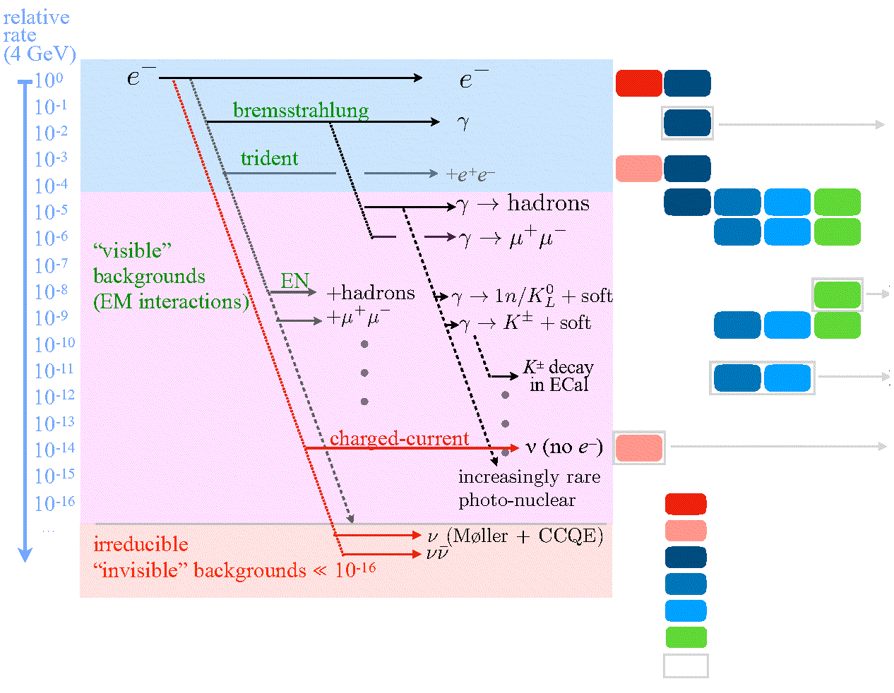
Backgrounds, Backgrounds, Backgrounds . . .
Incoming Outgoing Veto Handles Design Drivers
Gaussian energy fluctuations
ECal depth, resolution,
hermiticity
Rare reactions: products escape HCal and/or anomalous energy deposition
HCal depth, segmentation,
hermiticity
All systems combined:
< 1 background event with signal efficiency ~30-50% for O(4x10¹⁴) electrons
ECal 3D granularity, MIP-sensitivity
Recoil Tracker acceptance
Track momentum
Track multiplicity
ECal energy/segmentation
ECal Boosted decision tree
ECal track
HCal hits/depth
Design driver
Neutrino “floor”
Tools
Åkesson et al, JHEP04 (2020) 003.
Note: transverse momtnum not used as a discriminant in these studies

Slide 19
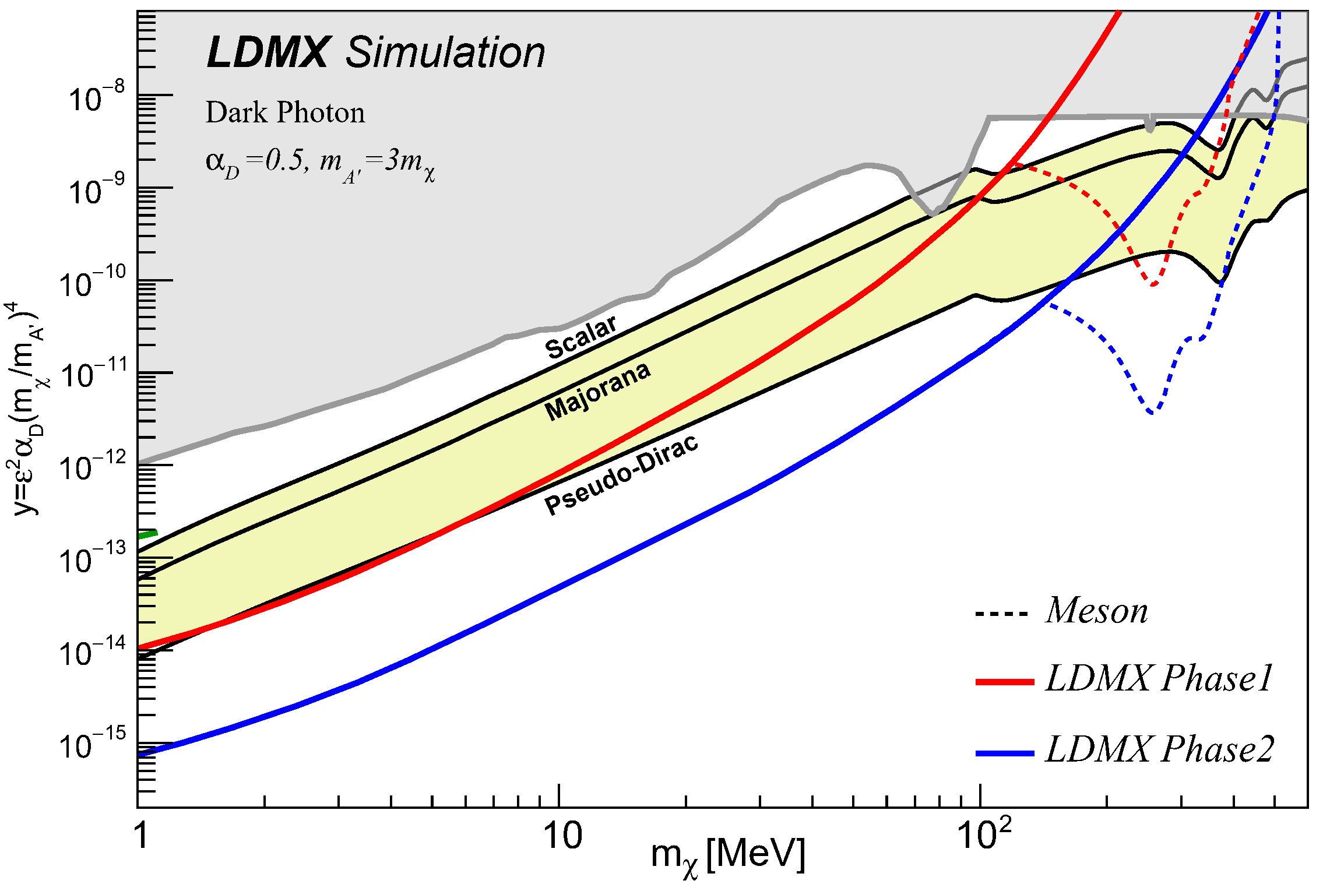
Putting it all Together: LDMX Dark Matter Reach
We are sensitive to a broad range of the m_{χ} parameter space for a wide range of thermal targets, assuming a Dark Photon portal
Present limits
LDMX
Phase 1: 4 GeV
O(10¹⁴) electrons
Phase 2: 8 GeV
O(10¹⁶) electrons
Thermal targets

Slide 20
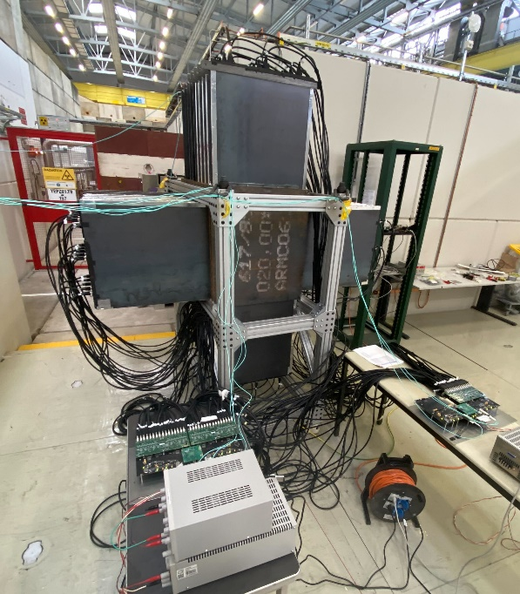
Timeline
2009 Bjorken, Essig, Schuster, and Toro: “New Fixed-Target Experiments to Search for Dark Gauge Forces”; PRD 80 (2009) 075018
2015 Izaguirre, Krnjaic, Schuster, and Toro explore possibilities of a missing momentum experiment; PRL 115, 251301 (2015)
2015 Dark Sectors Workshop: LDMX at SLAC
Detailed initial design study completed (arXiv:1808.05219)
Collaboration formed
2021 LDMX received prototype funding in FY22 as part of the DOE Dark Matter New Initiatives project
  2022 Successful test-beam run at CERN
2023 Fabrication starts, beamline (LESA) commissioning
2025 First beam LDMX Phase-I
2026-2028 8 GeV upgrade (LCLS-II-HE)
2028 First beam LDMX Phase-II
Past
Future

Slide 21

LDMX Collaboration
“Small” collaboration by modern HEP standards
Strong set of collaborating institutions
Strong support from the funding agencies, in USA and in Europe
And finally: apologies for leaving out other physics topics that will be addressed by LDMX: such as: direct DM search, Axion-like particles, milli-charged particles, electron-nucleus scattering measurements

Slide 22
Backup Slides

Slide 23
Signal vs Background: Electron Recoil Energy Distribution
Dark A’ bremsstrahlung carries away much more of the beam energy and transverse momentum.
Larger the A’ mass, the greater the difference from SM bremsstrahlung
Signal:
Background:

Slide 24
Signal vs Background: P_{T} Distribution
p_{T} distributions of SM bremsstrahlung and Dark A’ bremsstrahlung are quite different.
Larger the A’ mass, the greater the difference from SM bremsstrahlung
Signal:
Dark A’ bremsstrahlung carries away much more of the beam energy and transverse momentum.
Larger the A’ mass, the greater the difference from SM bremsstrahlung
Background:
DM

Slide 25
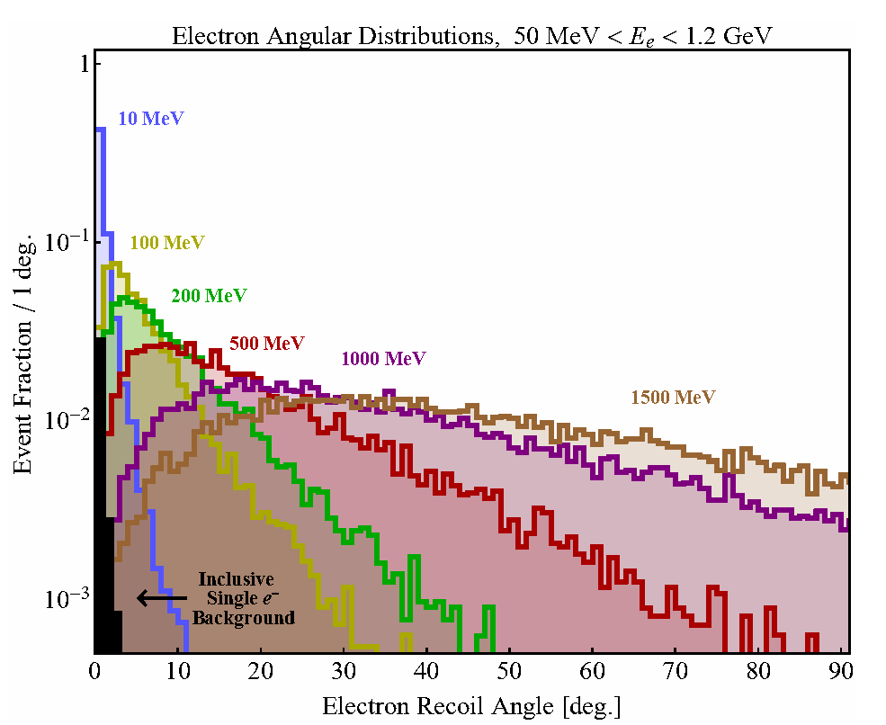
Signal vs Background: Angular Distribution
Angular distributions of SM bremsstrahlung and Dark A’ bremsstrahlung are quite different.
Larger the A’ mass, the greater the difference from SM bremsstrahlung
Signal:
Background:
DM

Slide 26
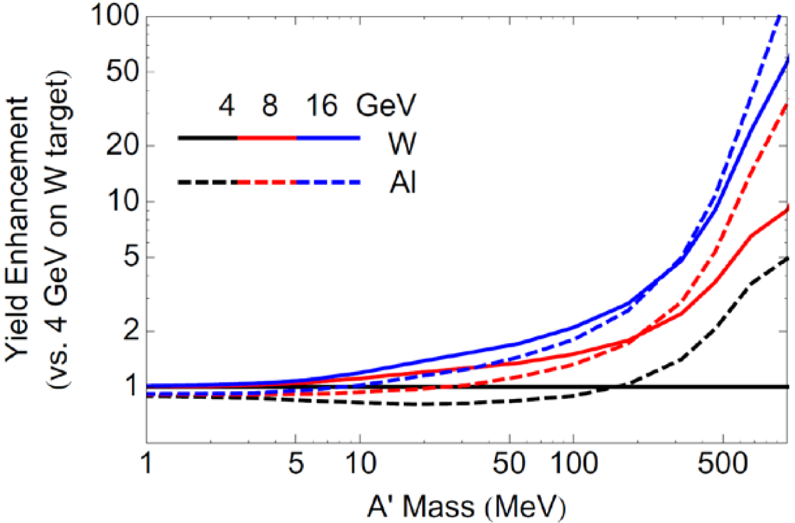
Effect of Beam Energy on Dark Matter Yield
The Phase II LDMX run luminosity will attain 50X more statistics than Phase I, but at 8 GeV rather than 4 GeV.
First studies of the leading photon-induced backgrounds show that the ECal veto alone rejects at least 10 − 20X more background at 8 GeV than 4 GeV. HCal-only veto efficiencies also improve, while signal efficiencies are kept at the same level.
This improvement is expected a priori because (a) more energetic final-state particles are easier to reject, (b) cross-sections for two-body photonuclear reactions, the most challenging to reject, fall as 1/E³, and (c) decay-in-flight backgrounds are further suppressed when the decaying meson is boosted.

Slide 27
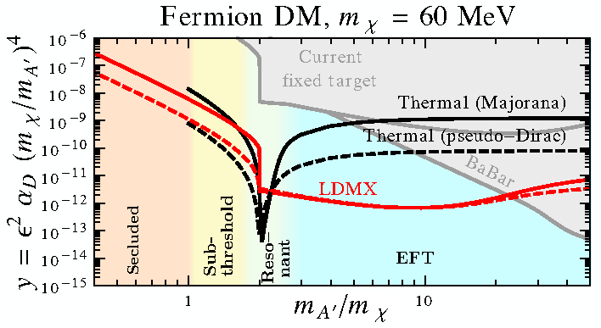
LDMX: Dependence on Dark Photon Mass

Slide 28
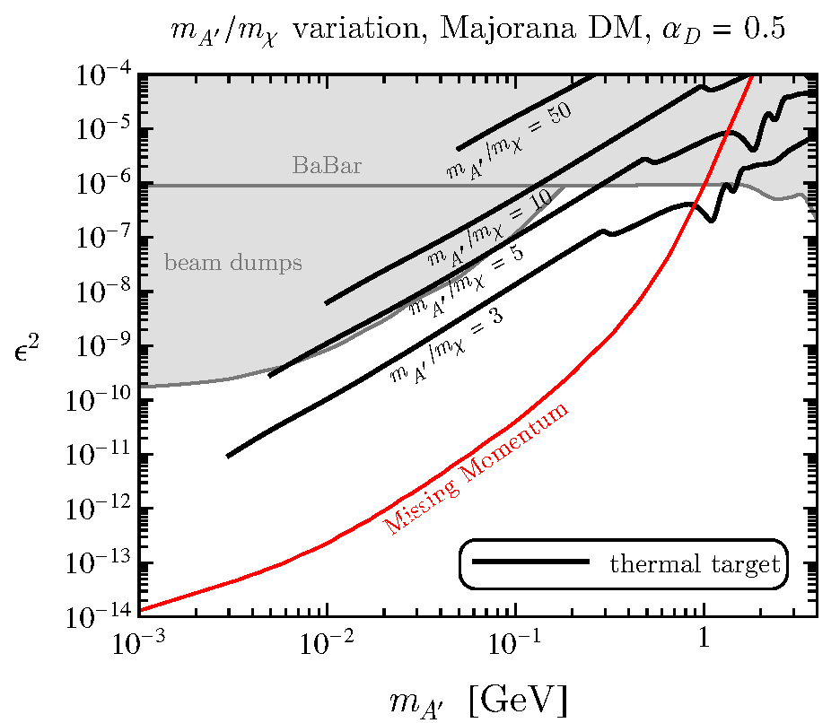
Parameter Dependence: m_{A’}/m_{χ}
α_{D} is fixed as the m_{A’} /m_{χ} ratio varies. The sensitivity of accelerators is shown in the ε² vs m_{A’} plane. Note that the thermal freeze-out curves move to larger values of ε² as m_{A’} /m_{χ} is increased, while the accelerator sensitivity does not change.
LDMX typically choses m_{A’}/m_{χ} = 3

Slide 29
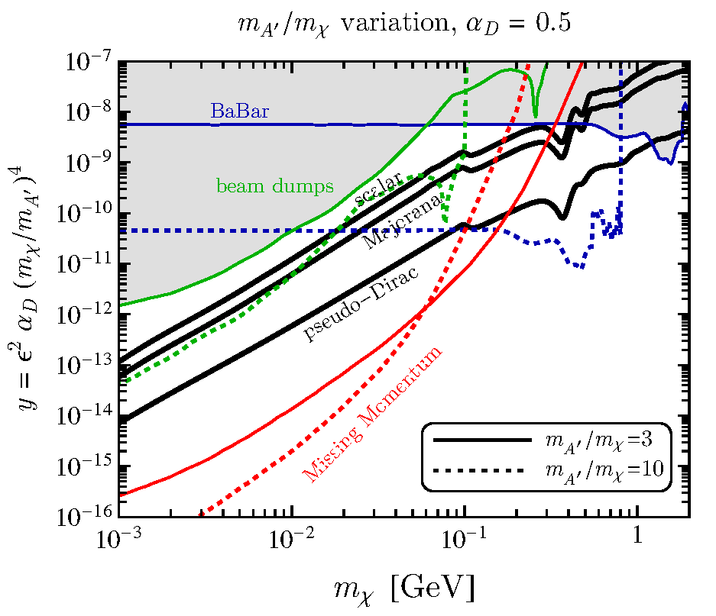
Parameter Dependence: m_{A’}/m_{χ}
α_{D} is fixed as the m_{A’} /m_{χ} ratio varies, but now shown in the y vs m_{χ} plane. Thermal freeze-out curves do not vary, but the accelerator sensitivity shifts to lower values of y and lower m_{χ} as m_{A’} /m_{χ} is increased.

Slide 30
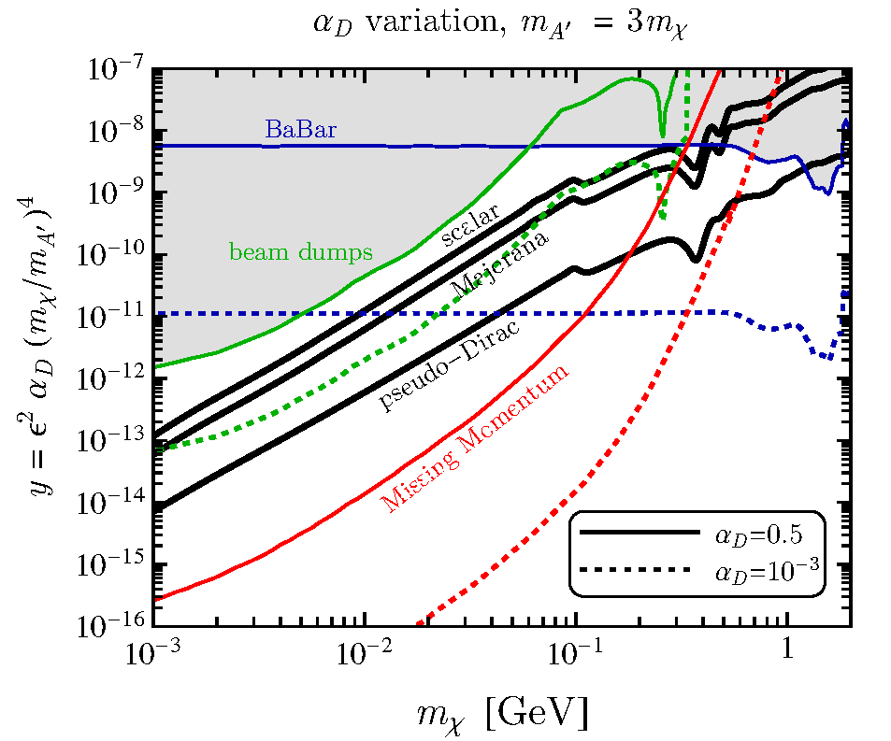
Parameter Dependence: α_{D}
Parameter space in the y vs m_{χ} plane where the dotted curves show how the constraints and projections vary for the choice α_{D} = 10⁻³. For fixed values of y, a smaller α_{D} requires a larger ε² (i.e. larger mediator coupling), which makes that parameter point easier to constrain. Hence, accelerator sensitivity generally improves in the y vs m_{χ} plane for smaller α_{D}. Note that the thermal freeze-out curves in this plane are identical for both
values of α_{D} shown here because the thermal abundance scales with y.

Slide 31
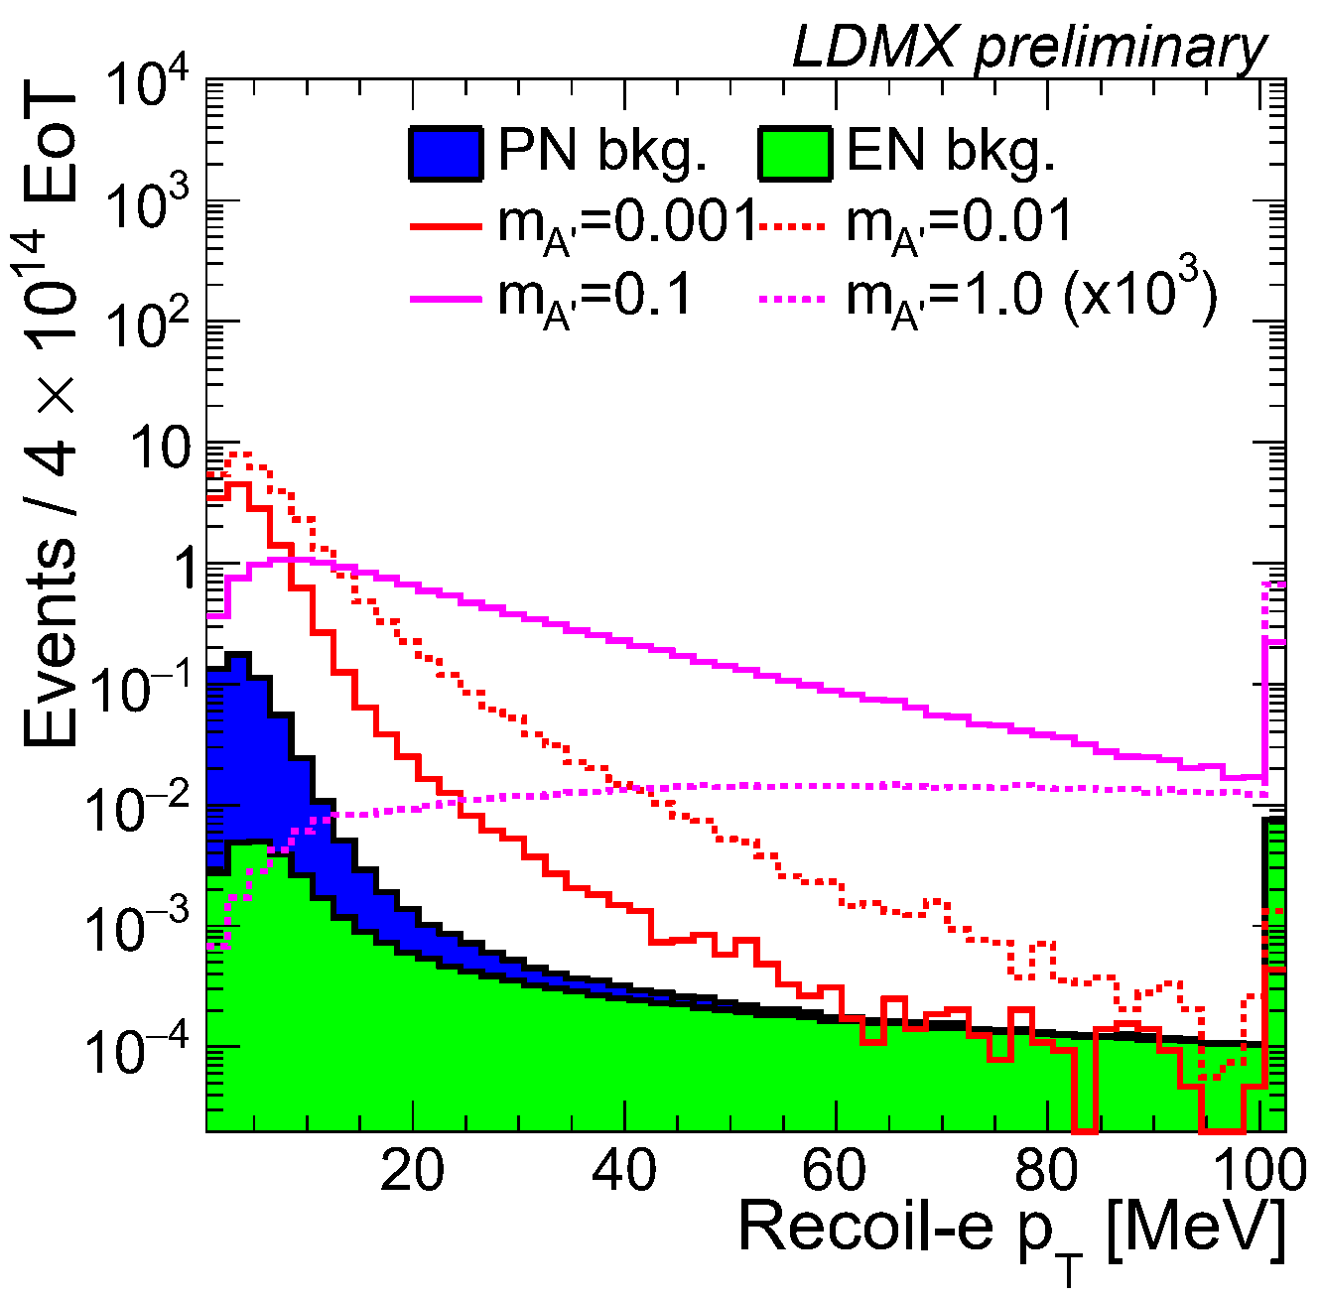
Sensitivity
Distribution of recoil electron p_{T} for backgrounds (solid histograms) and dark matter signals with mediator masses of 0.001, 0.01, 0.1, and 1 GeV after all analysis selections. Signal yields are scaled to the thermal freeze-out elastic scalar dark matter model, assuming α_{D} = 0.5 and m_{χ}=m_{A’} = 1/3.

Slide 32
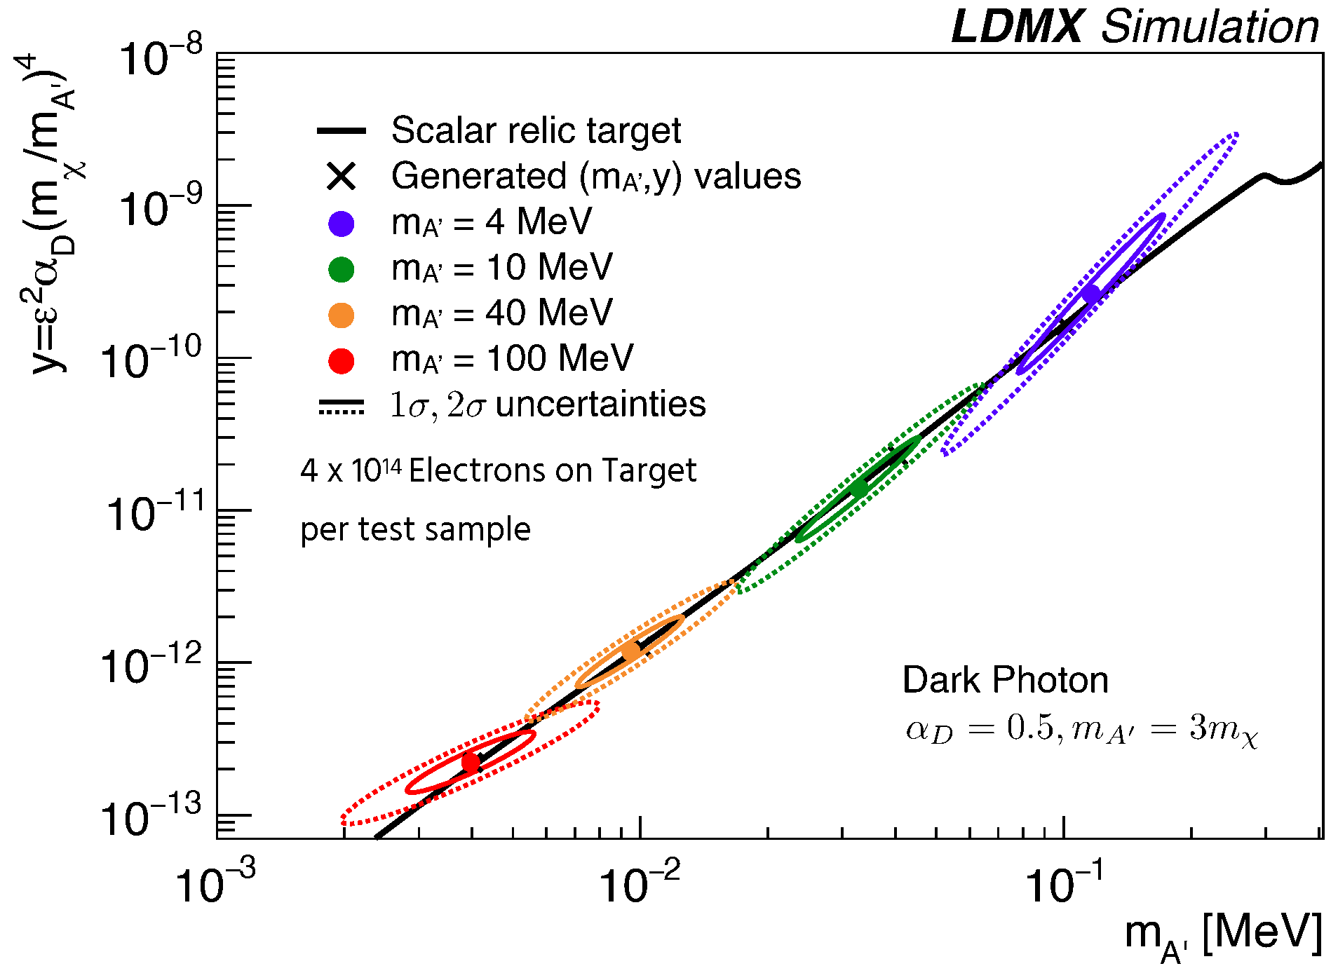
Knowing Transverse Momentum and Energy give Clue to A’ Mass
Combine p_{T} and E to get a handle on the mediator mass

Slide 33
Backup: Present Limits

Slide 34
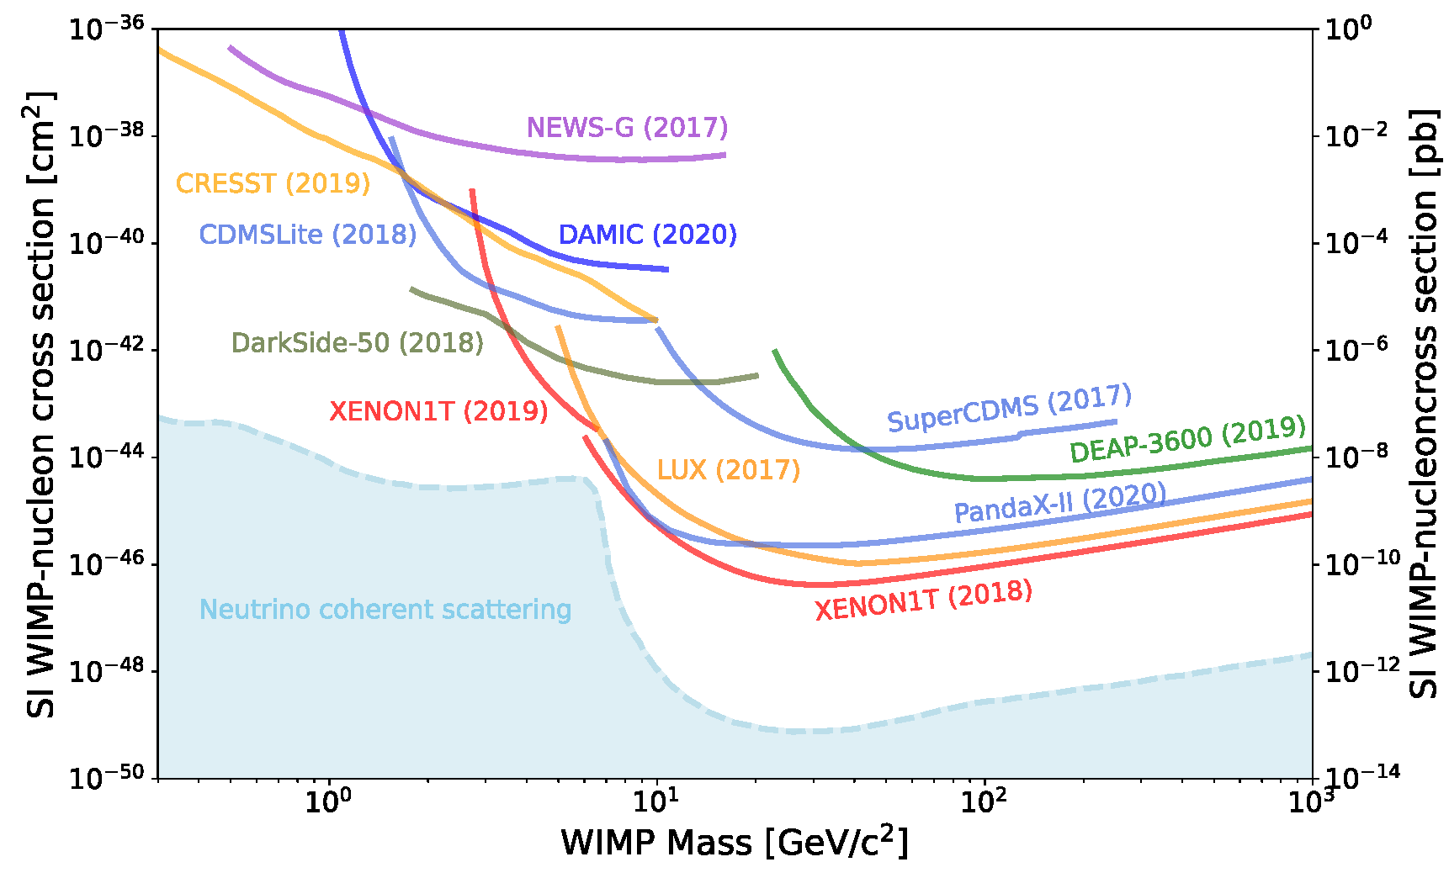
Direct Search Limits

Slide 35
Backup: Backgrounds

Slide 36

Electron Kinematic Cut Efficiencies

Slide 37
Backgrounds
Low energy beam electrons
  Must repeatedly scatter to mimic beam energy (< 1 x 10⁶)
Electrons reconstructed with E < 1.2 GeV
  ECal alone: < 1 x 10¹⁵
  Recoil tracker: adds at least another 5 orders of magnitude
Electron undergoes a hard bremsstrahlung leaving electron with < 1.2 GeV:
  ECal fluctuations mismeasure the photon energy
    4 x 10¹⁴ EoT: ~10⁻² events
  The photon converts into a μ⁺μ⁻ pair
    6.6 x 10¹⁴ EoT: 1 event
  The photon undergoes a photo-nuclear or electro-nuclear interaction
    Photo-nuclear – 4 x 10¹⁴ EoT: 0.24 events
    Electro-nuclear – 4 x 10¹⁴ EoT: 0.013 events

Slide 38

Backgrounds: Low Momentum Beam Particles
Most low-momentum particles are swept away by the spectrometer magnet
Must have large-angle (50 mrad each) multiple scattering in 6 tagging tracker stations
10⁶ 1.2 GeV beam electrons reconstructed in tagging tracker. None has momentum greater than 1.4 GeV

Slide 39


Backgrounds: Non-Interacting Electrons
The combination of the recoil tracker and ECal must reject 4 GeV electrons reconstructed as having < 1.2 GeV energy
  Phase 1: 4 x 10¹⁴
  Phase 2: 1 x 10¹⁶
ECal alone: < 1 x 10¹⁵
Recoil tracker: adds at least another 5 orders of magnitude
Recoil tracker momentum for incoming 4 GeV electrons that lose little energy in target and trackers.
ECal reconstructed energy for 1.2 GeV e⁻ plus 2.8 GeV γ (and A’ signal events)

Slide 40
Backgrounds: Hard Bremsstrahlung with Low Energy Deposit in ECal
Simulated 1.2 GeV recoil e⁻ with 2.8 GeV γ propagated collinearly into ECal
# events with < 1.5 GeV in ECal with 1 x 10¹⁴ EOT is ~ 0.01
ECal reconstructed energy for 1.2 GeV e⁻ plus 2.8 GeV γ (and A’ signal events)

Slide 41


Backgrounds: Di-muon Production
Muon pair conversion rate: 9.1 x 10⁻⁷ per electron
Photoconversion
Bethe-Heitler

Slide 42

Backgrounds: Electro-Nuclear

Slide 43


Backgrounds: Photo-Nuclear
Tools:
Shower profile rejection using the ECal
Hadronic tails with a high efficiency, large angular coverage HCal veto
Track and hit multiplicity vetoes using the tagging and recoil trackers
Photo-nuclear and signal energy in ECal for events where the recoil electron is in the ECal fiducial region

Slide 44



Backgrounds: Photo-Nuclear
Tools:
Shower profile rejection using the ECal
Hadronic tails with a high efficiency, large angular coverage HCal veto
Track and hit multiplicity vetoes using the tagging and recoil trackers
Number of hits if last tagging track plane for signal and target photo-nuclear events (blue)
Max PE in a module in HCal per event for signal and target/ECal photo-nuclear events (orange/blue)
Number of hits if last recoil track plane for signal and target photo-nuclear events (blue)

Slide 45
Backgrounds: Neutrino
Neutrino trident processes:
irreducible background
~10⁻¹⁸ hard bremsstrahlung
O(10⁻⁵) events (Phase 1)
Multiple interactions in target + charged-current scattering
Moller electron at O(100) MeV followed by the charged-current scattering of the incident electron
Soft bremsstrahlung by the incident electron with asymmetric conversion of the resulting photon, with low-energy positron absorbed in the target and high-energy electron escaping, and O(0.01) events (Phase 1)

Slide 46
Backup: Apparatus

Slide 47


Apparatus: Recoil Tracker
Downstream layers
Upstream stereo layers

Slide 48

Tracker Resolution: Transverse Momentum
p_{x} resolution (MeV)
p_{y} resolution (MeV)

Slide 49

Tracker Resolution: Impact Parameter
Vtx_{x} resolution (μm)
Vtx_{y} resolution (μm)

Slide 50


Apparatus: Electromagnetic Calorimeter
Si-W sampling calorimeter
500 μm thick
3 x 10¹³ n/cm² (1 MeV n-equiv) @ 10¹⁴ EOT
Readout: CMS HGCROC front-end chip
ECal
Fluence at shower max (1 MeV n-equiv) with 10¹⁴ e⁻ with a beamspot area of 32 cm².
ECal
ECal

Slide 51



Electromagnetic Calorimeter: Recoil Electron Distribution
Recoil electron misses ECal for a significant fraction of signal events
Total energy deposited in ECal for events where the recoil electron misses (left) and hits (right)

Slide 52


Electromagnetic Calorimeter: Signal vs Photo-nuclear Background
A Boosted Decision Tree (BDT) is used to discriminate against phot-nuclear events

Slide 53
Apparatus: Hadronic Veto System
Purpose: detect neutral hadrons and neutrons produced in photonuclear reactions in ECal or target with high efficiency, EM showers escaping ECal, and minimum-ionizing particles (MIPs) such as muons
Energy resolution for neutrons
HCal

Slide 54
Backup: Trigger & DAQ

Slide 55

Trigger Strategy
Uses information from: trigger scintillator, ECal & Hcal
Substantial energy loss of incoming e⁻ < 20% of
incidence energy
Absence of any additional visible final-state particles
Trigger scintillator strips count # of incident electrons
(strips above threshold)
Stray low-energy beam halo particles must be
rejected with high efficiency
40 MHz → 10 kHz (safety factor of 2.5X)
DAQ bandwidth: 25 kHz (tracker readout ASIC w 2x safety factor)
10 Gb/s DAQ rate
3.5 μs latency to deliver trigger decision to front-end controllers
Trigger hardware: ATCA-based APx board developed for CMS L1 Trigger upgrad

Slide 56



Triggers
Trigger efficiency for single beam electron vs missing energy threshold

Slide 57


Data Acquisition
Off-detector trigger and readout electronics share a single ATCA crate
DAQ bandwidth 25 kHz (5X safety factor)
3.1 kB/event
77.6 MBps total bandwidth
Full sample of 2 x 10¹¹ events requires 500 TB storage (no L3 trigger)

