Slide 1
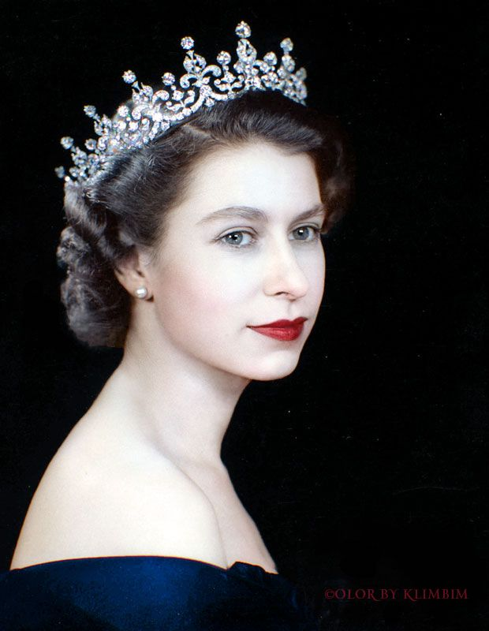
Her Majesty The Queen
1926-2022

