Slide 1



Towards the first demonstration of gravitational quantum states of atoms with a cryogenic hydrogen beam
03.02.2023
SMI Seminar
Carina Killian

Slide 2
Outline
Part I: Introduction and Motivation
Part II: Gravitational Quantum states (GQS)
Part III: Measurement of GQS
Part IV: Experimental Setup & Status

Slide 3
Part I
Introduction
Notes:
So, lets start with Gravitational Quantum States.

Slide 4

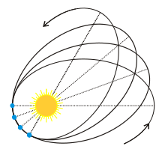
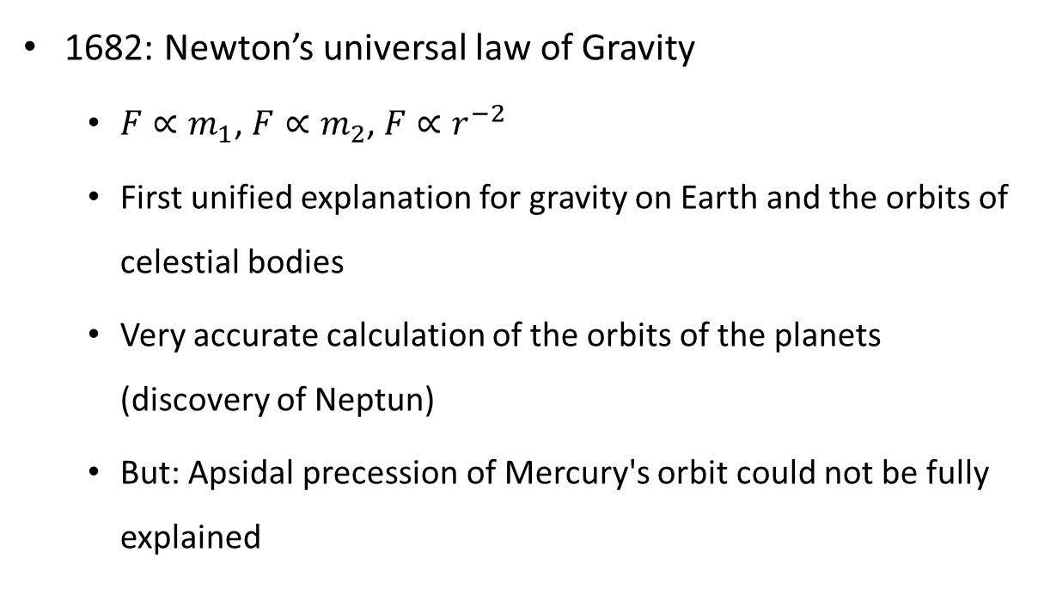
A brief history of Gravity
1682: Newton’s universal law of Gravity
  $F∝m_{1}$, $F∝m_{2}$, $F∝r^{−2}$
  First unified explanation for gravity on Earth and the orbits of celestial bodies
  Very accurate calculation of the orbits of the planets (discovery of Neptun)
  But: Apsidal precession of Mercury's orbit could not be fully explained
?

Slide 5
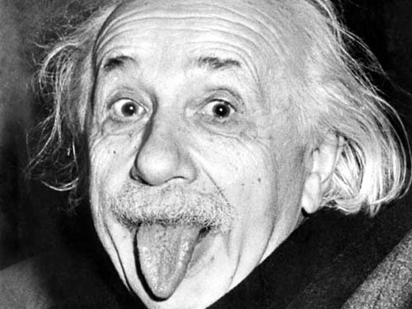
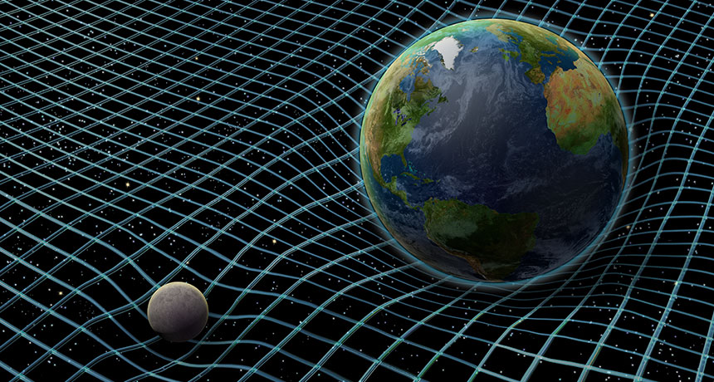
A brief history of Gravity
1915: Einstein’s General Theory of Relativity (GR)
  Gravity = geometric property of spacetime
  Predicts and describes
    Correct orbit of Mercury ✔
    Gravitational redshift ← detected 1960 ✔
    Black holes ← detected 1971 ✔
    Gravitational lensing ← detected 1979 ✔
    Gravitational waves ← detected 2016 ✔

Slide 6
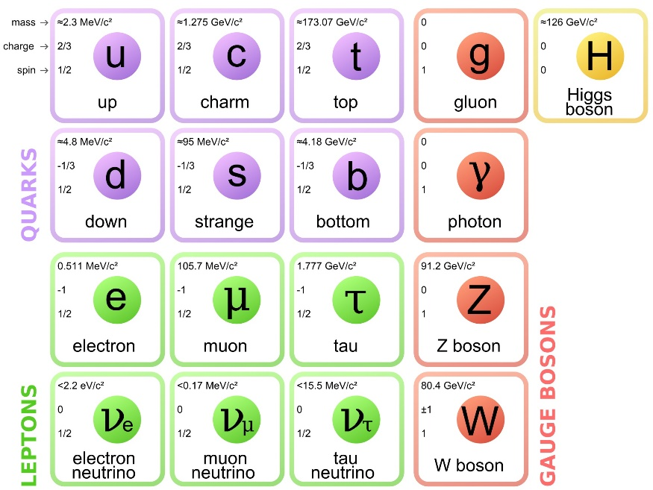
A brief history of Gravity
~1960s: Standard Model of particle physics (SM)
  Predicts and classifies all known elementary particles
  Describes 3 of 4 fundamental interactions (electromagnetic-, strong-, weak interaction)
  Gravity not described by SM
Today: Neither SM nor GR are complete theories

Slide 7
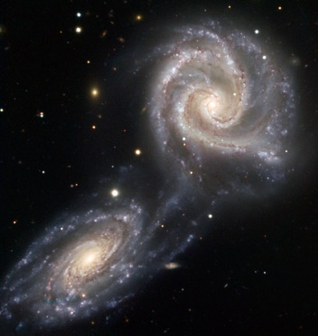
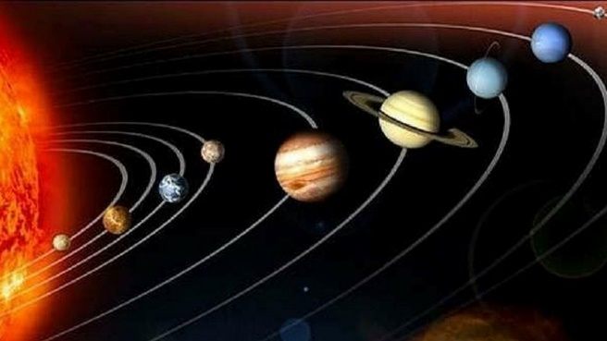

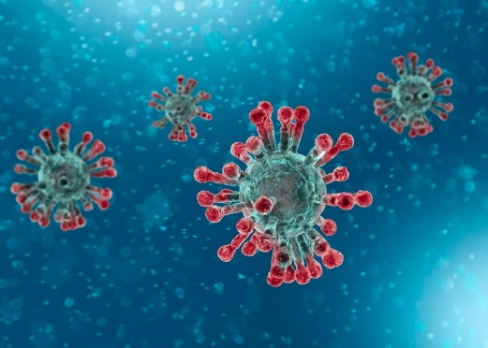


Gravity on different scales
?
Macroscopic scales
Microscopic (≤ µm) scales
Gravitational interaction accurately described by Newton’s Law in most cases.
In the limit of high mass densities / high velocities → GR
Gravity escapes perception
How can the gravitational interaction be described at “quantum mechanical” scales?
Are there any deviations from Newton’s Law?

Slide 8
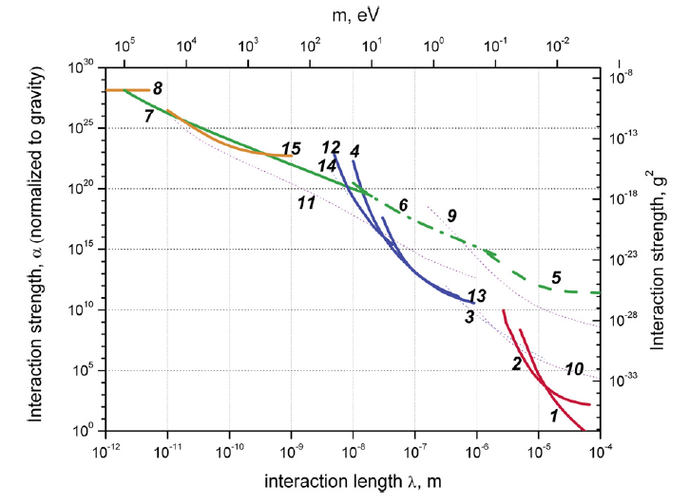
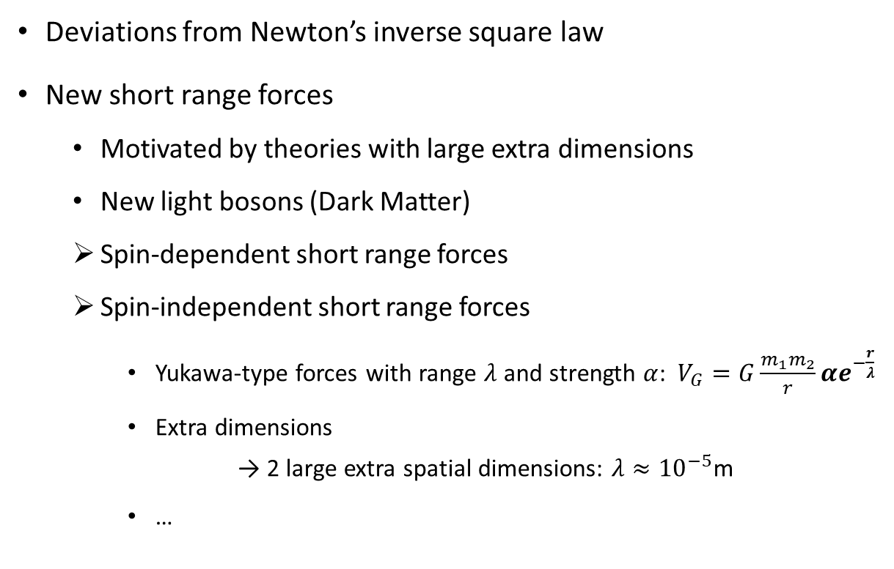
Motivation for Gravity tests on small scales
Deviations from Newton’s inverse square law
New short range forces
  Motivated by theories with large extra dimensions
  New light bosons (Dark Matter)
  Spin-dependent short range forces
  Spin-independent short range forces
    Yukawa-type forces with range $λ$ and strength $α$: $V_{G}=G\frac{m_{1}m_{2}}{r}αe^{−\frac{r}{λ}}$
    Extra dimensions → 2 large extra spatial dimensions: $λ≈{10}^{−5}$m
    …
UCN GQS
Exclusion plot for new spin-independent interactions [1]
1,2: short-range gravity in torsion balance
4,12,13: Extra forces on top of Casimir and v.d.W interactions
5: neutron Gravitational Quantum States (GQS)
6: neutron whispering gallery effects
7: neutron scattering on nuclei
8: precision measurements of exotic atoms
15: low mass bosons from the sun in a high-purity germanium detector
[1] Antoniadis, Ignatios & Baessler, S. & Büchner, M. & Fedorov, Valery & Hoedl, Seth & Lambrecht, Astrid & Nesvizhevsky, V.V. & Pignol, Guillaume & Protasov, K. & Reynaud, Serge & Sobolev, Yu. (2010). Short-range fundamental forces. Forces fondamentales à courte portée.

Slide 9
Part II
Gravitational Quantum States
Notes:
So, lets start with Gravitational Quantum States.

Slide 10
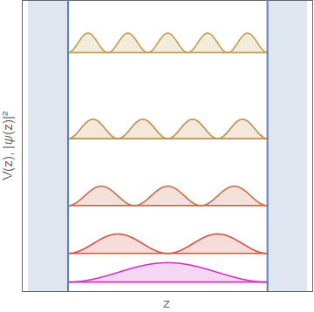
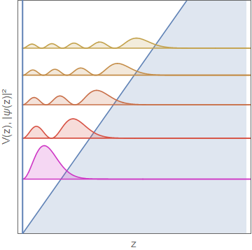
Quantum bound states
Particle trapped in potential well → Settled in quantum bound state
Examples:
    Particle in a box (infinite wall, square well)
    Particle in a linear potential (triangular potential well) → Airy functions Ai

Slide 11
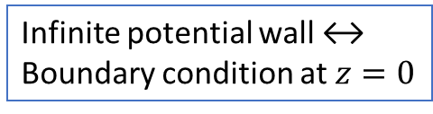
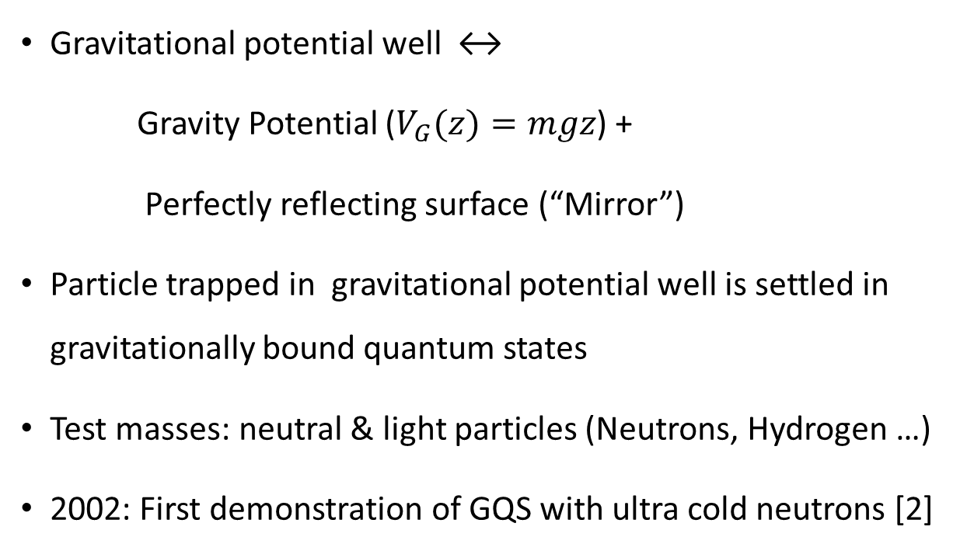
Gravitational Quantum States (GQS)
Gravitational potential well ↔
Gravity Potential ($V_{G}(z)=mgz$) +
Perfectly reflecting surface (“Mirror”)
Particle trapped in gravitational potential well is settled in gravitationally bound quantum states
  Test masses: neutral & light particles (Neutrons, Hydrogen …)
  2002: First demonstration of GQS with ultra cold neutrons [2]
Infinite potential wall ↔
Boundary condition at $z=0$
Linear potential
[2] V. Nesvizhevsky et al., Quantum states of neutrons in the Earth's gravitational field. Nature 415, 297–299 (2002). https://doi.org/10.1038/415297a

Slide 12
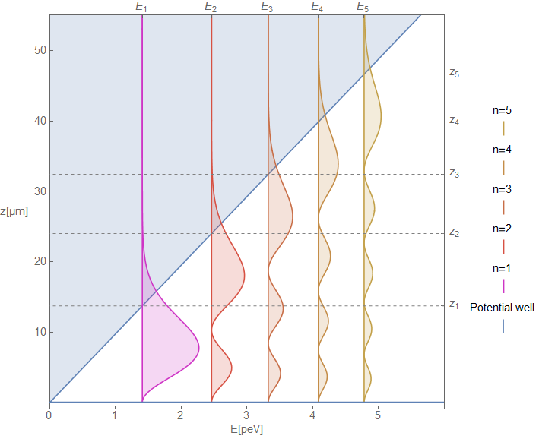
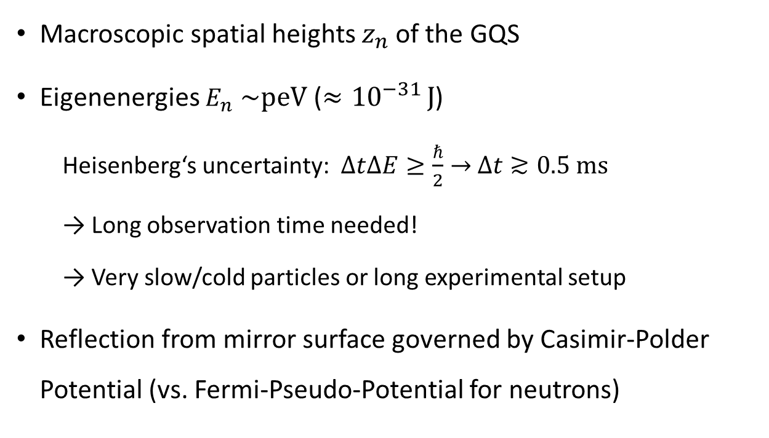
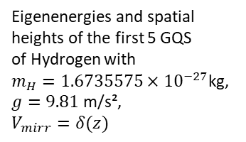

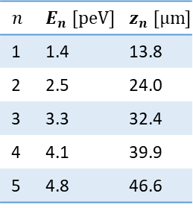
GQS of atomic hydrogen
  Macroscopic spatial heights $z_{n}$of the GQS
  Eigenenergies $E_{n}$ $\sim$peV ($≈{10}^{−31 }J$)
  Heisenberg‘s uncertainty: $∆t∆E≥\frac{ℏ}{2}→$ $∆t≳0.5 ms$
  → Long observation time needed!
  → Very slow/cold particles or long experimental setup
Reflection from mirror surface governed by Casimir-Polder Potential (vs. Fermi-Pseudo-Potential for neutrons)
$$\overset{⃑}{g}$$
$$n$$ | $$E_{n} [peV]$$ | $$z_{n} [µm]$$
1 | 1.4 | 13.8
2 | 2.5 | 24.0
3 | 3.3 | 32.4
4 | 4.1 | 39.9
5 | 4.8 | 46.6
Eigenenergies and spatial heights of the first 5 GQS
of Hydrogen with
$m_{H}=1.6735575×{10}^{−27}$kg,
$g=9.81$m/s²,
$$V_{mirr}=δ(z)$$

Slide 13
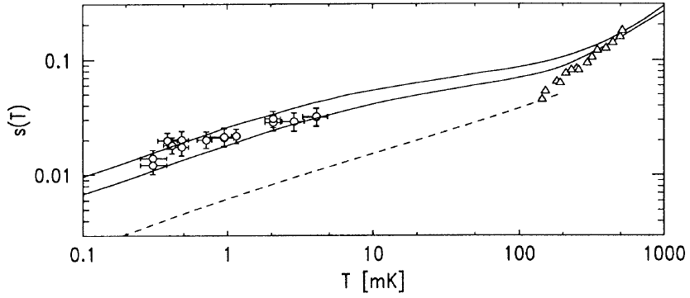
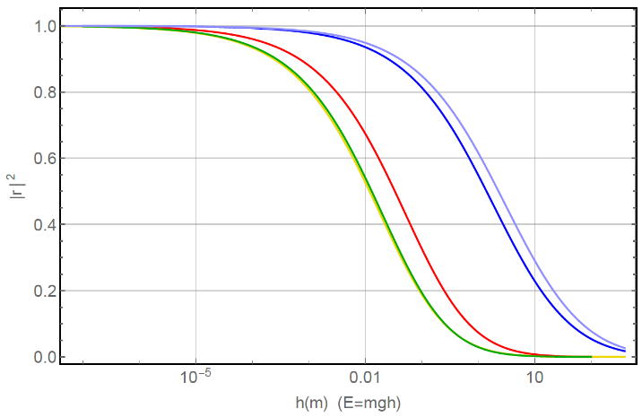
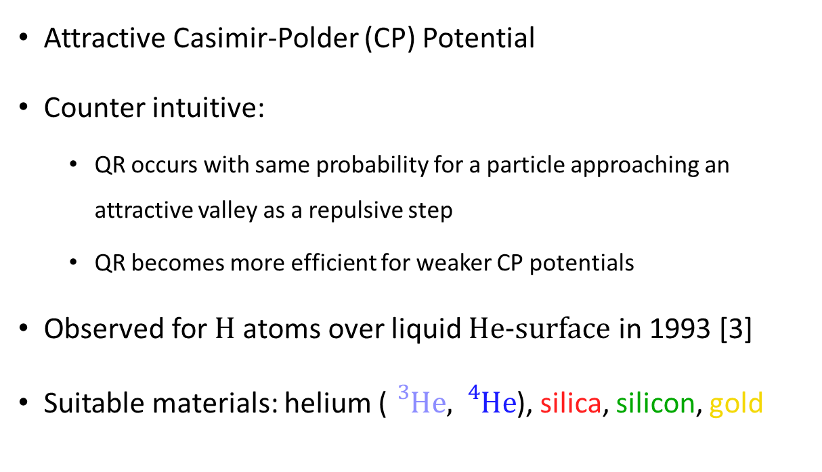
Quantum Reflection (QR)
Attractive Casimir-Polder (CP) Potential
Counter intuitive:
  QR occurs with same probability for a particle approaching an attractive valley as a repulsive step
  QR becomes more efficient for weaker CP potentials
Observed for H atoms over liquid He-surface in 1993 [3]
Suitable materials: helium (${}_{}^{3}{He},{}_{}^{4}{He}$), silica, silicon, gold
Sticking probability of H on thick He film. Taken from [3].
Quantum reflection probability for antihydrogen as a function of the free fall height of the atom h (∝ energy E = mgh) for different materials: 3He (light blue), 4He (dark blue), silica (red), silicon(green) and gold (yellow).
Taken from [4].
[3] Ite A. Yu, John M. Doyle, Jon C. Sandberg, Claudio L. Cesar, Daniel Kleppner, and Thomas J. Greytak. Evidence for universal quantum reflection of hydrogen from liquid 4He. Phys. Rev. Lett., 71:1589–1592, Sep 1993.
[4] Crépin, P.-P. and Kupriyanova et al. Quantum reflection of antihydrogen from a liquid helium film. EPL 119, 1286-4854 (2017). http://dx.doi.org/10.1209/0295-5075/119/33001
Notes:
Which brings me to my quick excurs to quantum reflection.
The CP potential is an attractive potential, so classically, one would expect a particle to be accelerated towards an attractive potential and to be reflected from it.
But according to the reciprocity theorem, quantum reflection occurs with the same probability when a particle moves towards a repulsive potential step as when a particle approaches an attractive potential valley, as indicated within the upper figures.
Another counter intuitive property of QR is, that it gets more and more efficient, the weaker the CP potential gets.
And as th CP potential is material dependent, also the probability of QR is material dependent. As you can see on the lower figure, helium 3 turns out to be most suitable.
But, eventhough QR works, the effect of the presence of the CP potential has to e taken into account

Slide 14
Part III
Measurement of GQS
Notes:
Which leads me to my second part, the measurement of GQS with atomic Hydrogen.

Slide 15
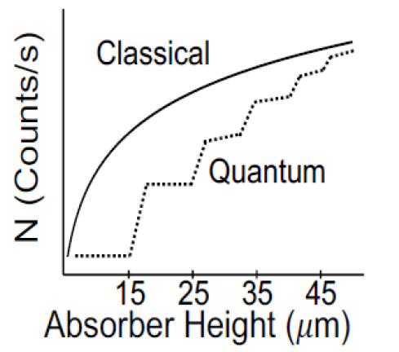
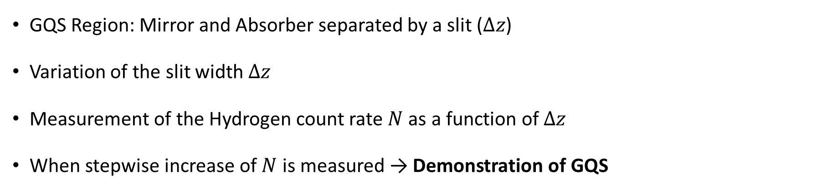






Measurement Principle
GQS Region: Mirror and Absorber separated by a slit ($∆z$)
Variation of the slit width $∆z$
Measurement of the Hydrogen count rate $N$ as a function of $∆z$
When stepwise increase of $N$ is measured → Demonstration of GQS
$$∆z=z_{2}$$
$$∆z=z_{3}$$
Cryogenic
H-Beam
Absorber
$$∆z<z_{1}$$
$$∆z=z_{1}$$
$$∆z<z_{1}$$
$$∆z$$
H-Detection
Mirror
Notes:
region for the gqs measurement will consist of a Hydrogen-Mirror and an absorber.
The mirror will reflect the Hydrogen atoms and the absorber will scatter the atoms that are high enough to reach it.
separated by the slit width delta z which is changed during the measurement.
in the presence of gqs, the mirror-absorber-system will only become transparent
when the slit width reaches the height of the first gqs, so approximately 15 µm.
Then, all of the atoms in the gravitational quantum groundstate will pass
and all of the others will still be reflected.
Until delta z reaches the height of the second state. Then, also the second state will pass, and so on.
Classically, a continuous dependence is expected.
So if we measure this stepwise behavior predicted by gqs, we demonstrate gqs for hydrogen!

Slide 16
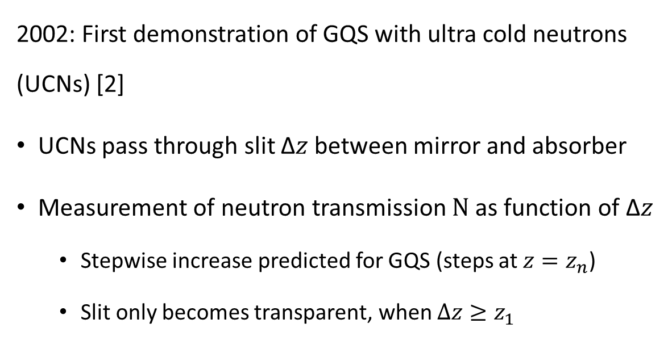



Measurement of GQS with ultra cold neutrons
2002: First demonstration of GQS with ultra cold neutrons (UCNs) [2]
UCNs pass through slit Δ𝑧 between mirror and absorber
Measurement of neutron transmission $N$ as function of Δ𝑧
  Stepwise increase predicted for GQS (steps at $z=z_{n}$)
  Slit only becomes transparent, when $Δz≥z_{1}$
Absorber
Neutron
detector
Collimator
Bottom mirrors
$$z=z_{1}$$
$$z=z_{2}$$
$$z=z_{3}$$
0
1
.
)
1
–
s
0
.
0
s
1
t
n
u
o
c
(
N
–
1
3
0
0
1
0
2
0
3
0
4
0
A
b
s
o
r
b
e
r
h
e
i
g
h
t
(
m
)
First demonstration of GQS ith UCNs: The neutron throughput vs. the absorber height Δ𝑧 and experimental setup. Figures taken from [2].

Slide 17
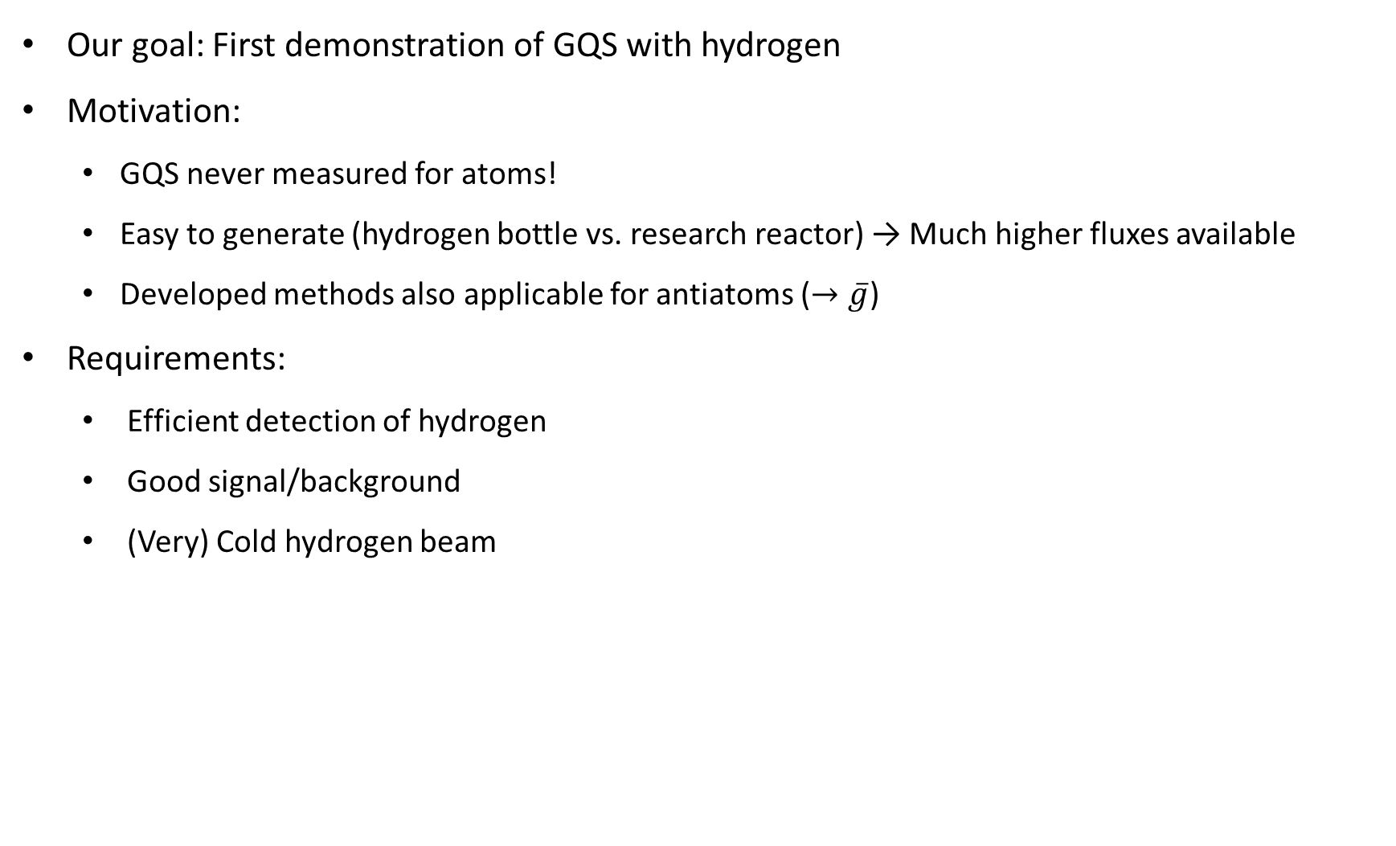
Measurement of GQS with hydrogen
  Our goal: First demonstration of GQS with hydrogen
  Motivation:
    GQS never measured for atoms!
    Easy to generate (hydrogen bottle vs. research reactor) → Much higher fluxes available
    Developed methods also applicable for antiatoms ($→\overline{g}$)
Requirements:
  Efficient detection of hydrogen
  Good signal/background
  (Very) Cold hydrogen beam

Slide 18
Part IV
Experimental Setup & Status

Slide 19



Hydrogen beam – Experimental setup 2021
Hydrogen source
Cryo-chamber
Chopper to modulate the atomic beam
Beamline
Hydrogen detection system
Coldhead
Chopper
Photodiode
$$p_{s}$$
HeNe-Laser
H-Detection
Nozzle
MW
discharge
cavity
Skimmer
H-Bottle
$$p_{cc}$$
$$p_{dc}$$
Turbo 1
Turbo 2

Slide 20
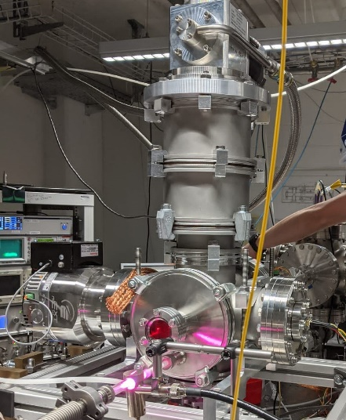
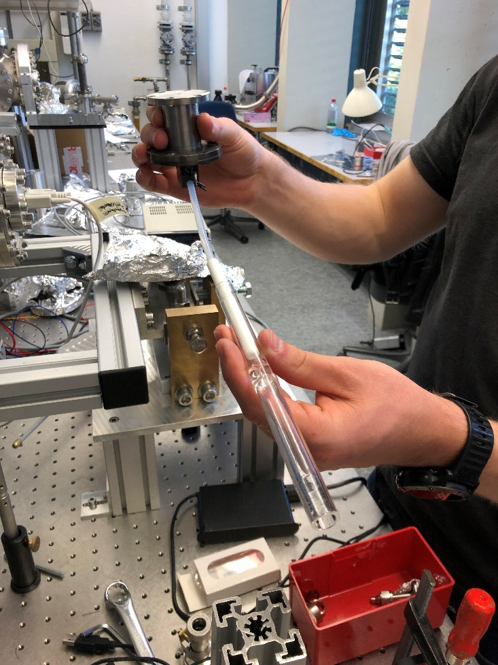
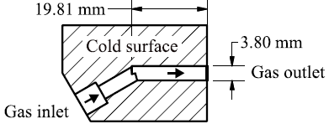
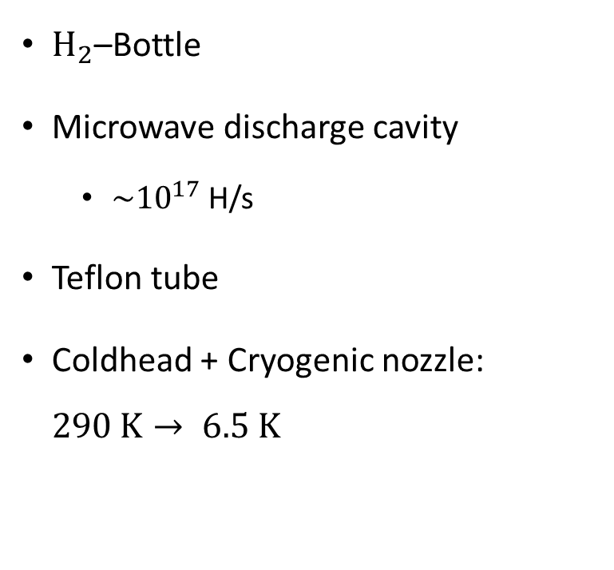
Hydrogen source
$H_{2}$–Bottle
Microwave discharge cavity
  $\sim {10}^{17}$ H/s
Teflon tube
Coldhead + Cryogenic nozzle: $290 K→ 6.5 K$

Slide 21




Detection of hydrogen - overview
Ionization Potential
2s
$$∆E=10.2eV→f≈246THz→λ≈121.8nm$$
$$λ=243nm$$
Ionization of $H$ with a pulsed UV-laser ($λ=243$nm)
  $H→H^{+}+e^{−}$
  2 photon excitation (1S-2S) + 1 photon ionization
Detection of $H^{+}$ with an MCP
Integrated MCP-Signal $∝H$- count rate
1s
Signal
MCP
Atomic H-Beam
$$H^{+}$$
UV laser
UV laser
Side view
Top view

Slide 22
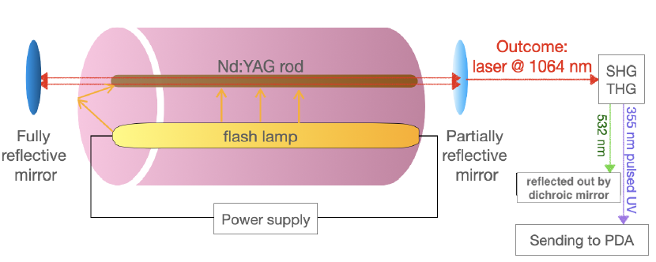
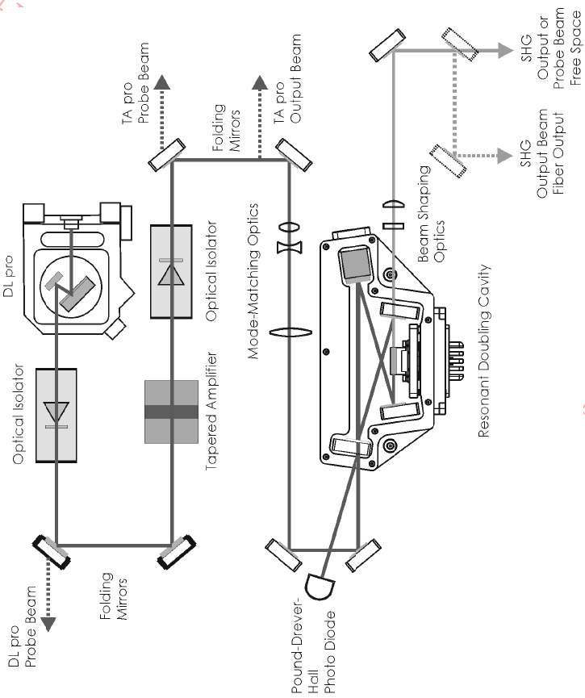
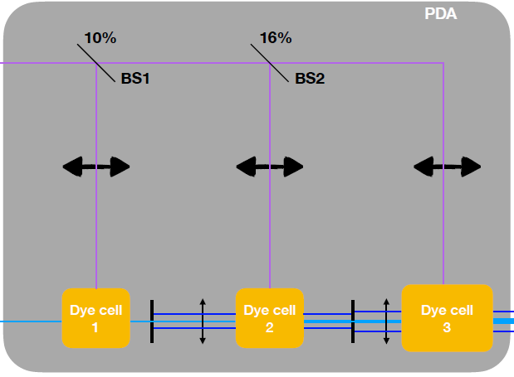
Detection of Hydrogen – Laser system
Seeder Laser
  CW diode laser
  Fundamental: 972 nm
  SHG → 486 nm
  ~200 mW
Pump Laser
  Nd:YAG
  Fundamental: 1064 nm
  THG → 355 nm
  Q-switch: 10 Hz, 10 ns
  ~100 mJ
Dye Amplfier
  3 Dye cells, filled with Coumarin 102
  Output: Pulse-amplified 486 nm
  ~8-10 mJ
BBO
  SHG 486 → 243
  ~1 mJ
Nd:YAG
BBO
Seeder Laser
Dye Amplifier
Simon’s talk in 2 weeks

Slide 23
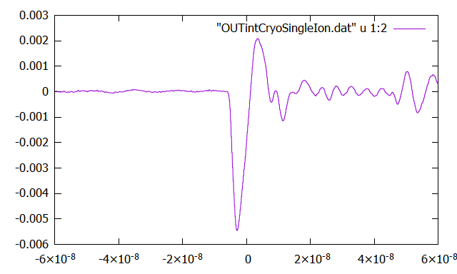
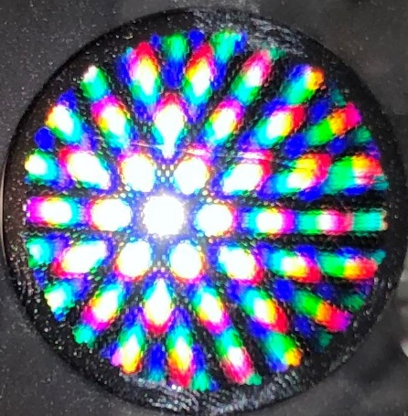
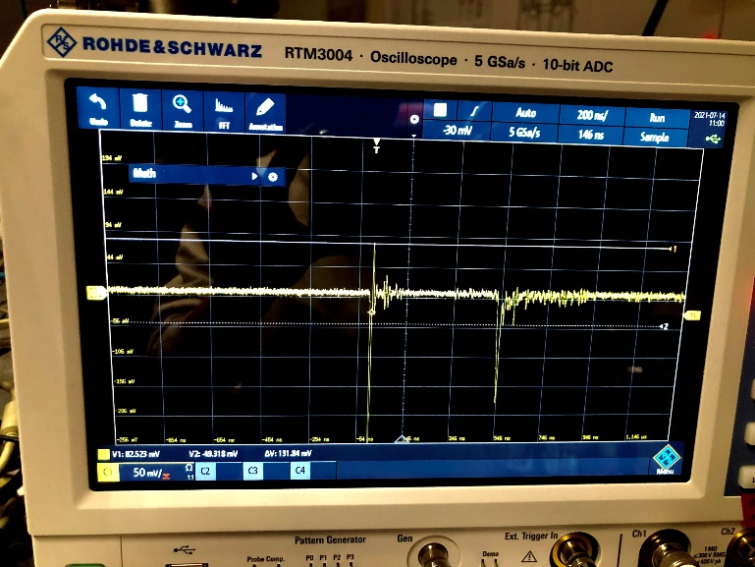
Detection of Hydrogen - MCP
Microchannel plate (MCP)
  (Single) particle detection
    Single Ion: ~5.5 mV signal height
  Amplification via secondary emission
Read out of signal: Oscilloscope
Grid
Micro-channel
plate
Anode
Laser
H+
Signal

Slide 24
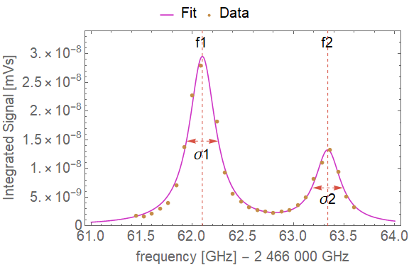
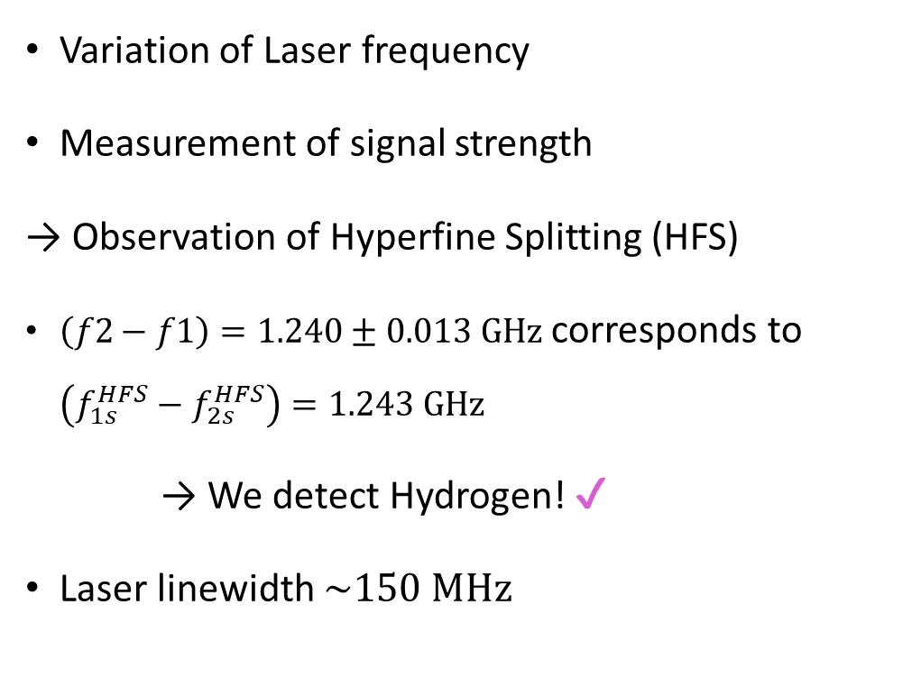
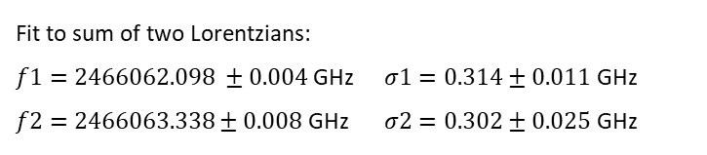
Test of Hydrogen Detection
Variation of Laser frequency
Measurement of signal strength
→ Observation of Hyperfine Splitting (HFS)
$\left(f2−f1\right)=1.240±0.013 GHz$ corresponds to $\left(f_{1s}^{HFS}−f_{2s}^{HFS}\right)=1.243 GHz$
→ We detect Hydrogen! ✔
Laser linewidth $\sim 150 MHz$
Fit to sum of two Lorentzians: $f1=2466062.098 ±0.004$ GHz $f2=2466063.338±0.008$ GHz | $σ1=0.314±0.011$ GHz $σ2=0.302±0.025$ GHz
Notes:
But how do we now that we actually detect atomic hydrogen?
frequency sweep while measuring the signal.
able to observe the Hyperfinesplitting
The two peaks of the data point were fitted and their difference calculated.
It corresponds to the difference of the groundstate hyperfine splitting and the hyperfinesplitting in the 2s state and
agrees well with the theoretical value.
So it is save to say that we do detect atomic hydrogen!

Slide 25
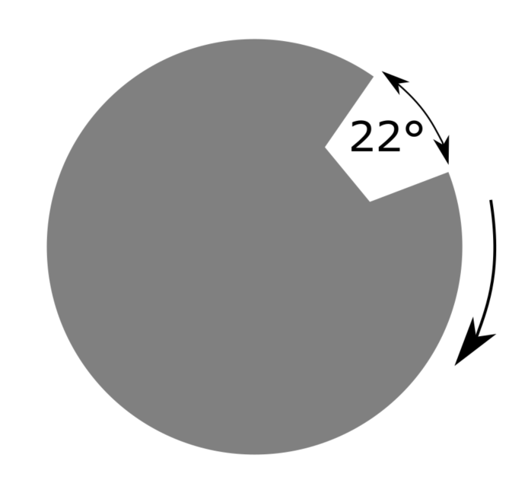
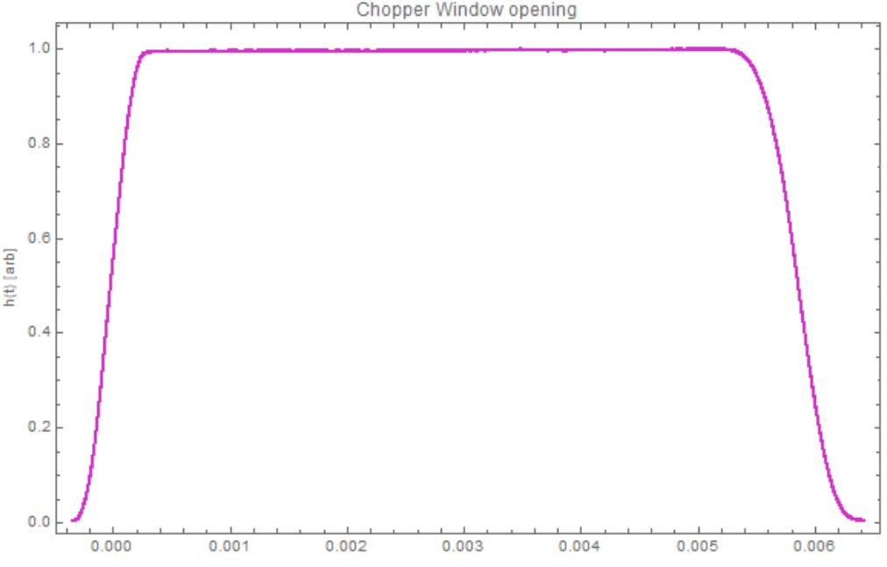
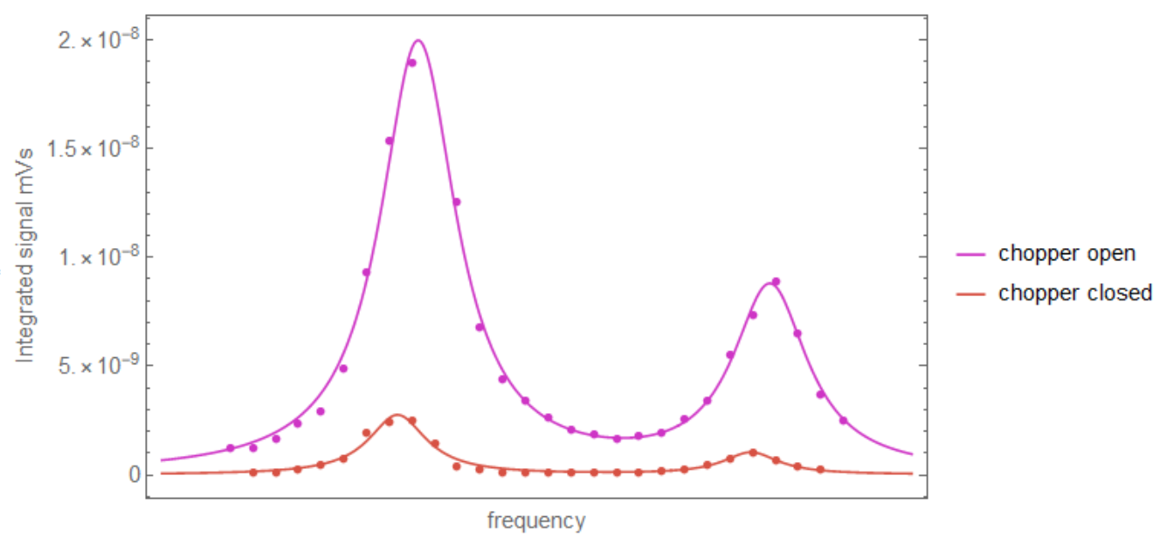
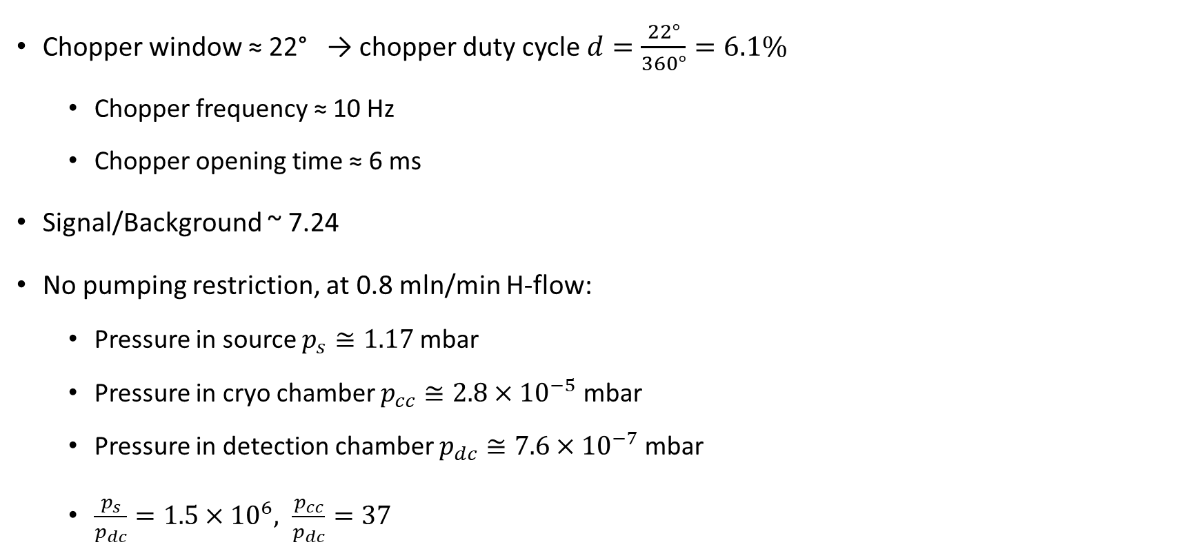
Chopper and Background
Chopper window ≈ 22° → chopper duty cycle $d=\frac{22°}{360°}=6.1\%$
  Chopper frequency ≈ 10 Hz
  Chopper opening time ≈ 6 ms
Signal/Background ~ 7.24
No pumping restriction, at 0.8 mln/min H-flow:
  Pressure in source $p_{s}≅1.17$ mbar
  Pressure in cryo chamber $p_{cc}≅2.8×{10}^{−5}$ mbar
  Pressure in detection chamber $p_{dc}≅7.6×{10}^{−7}$ mbar
  $\frac{p_{s}}{p_{dc}}=1.5×{10}^{6}, \frac{p_{cc}}{p_{dc}}=37$

Slide 26
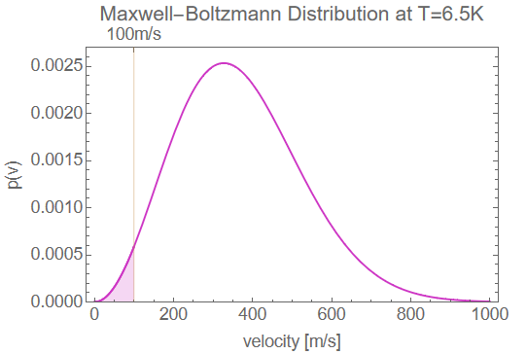
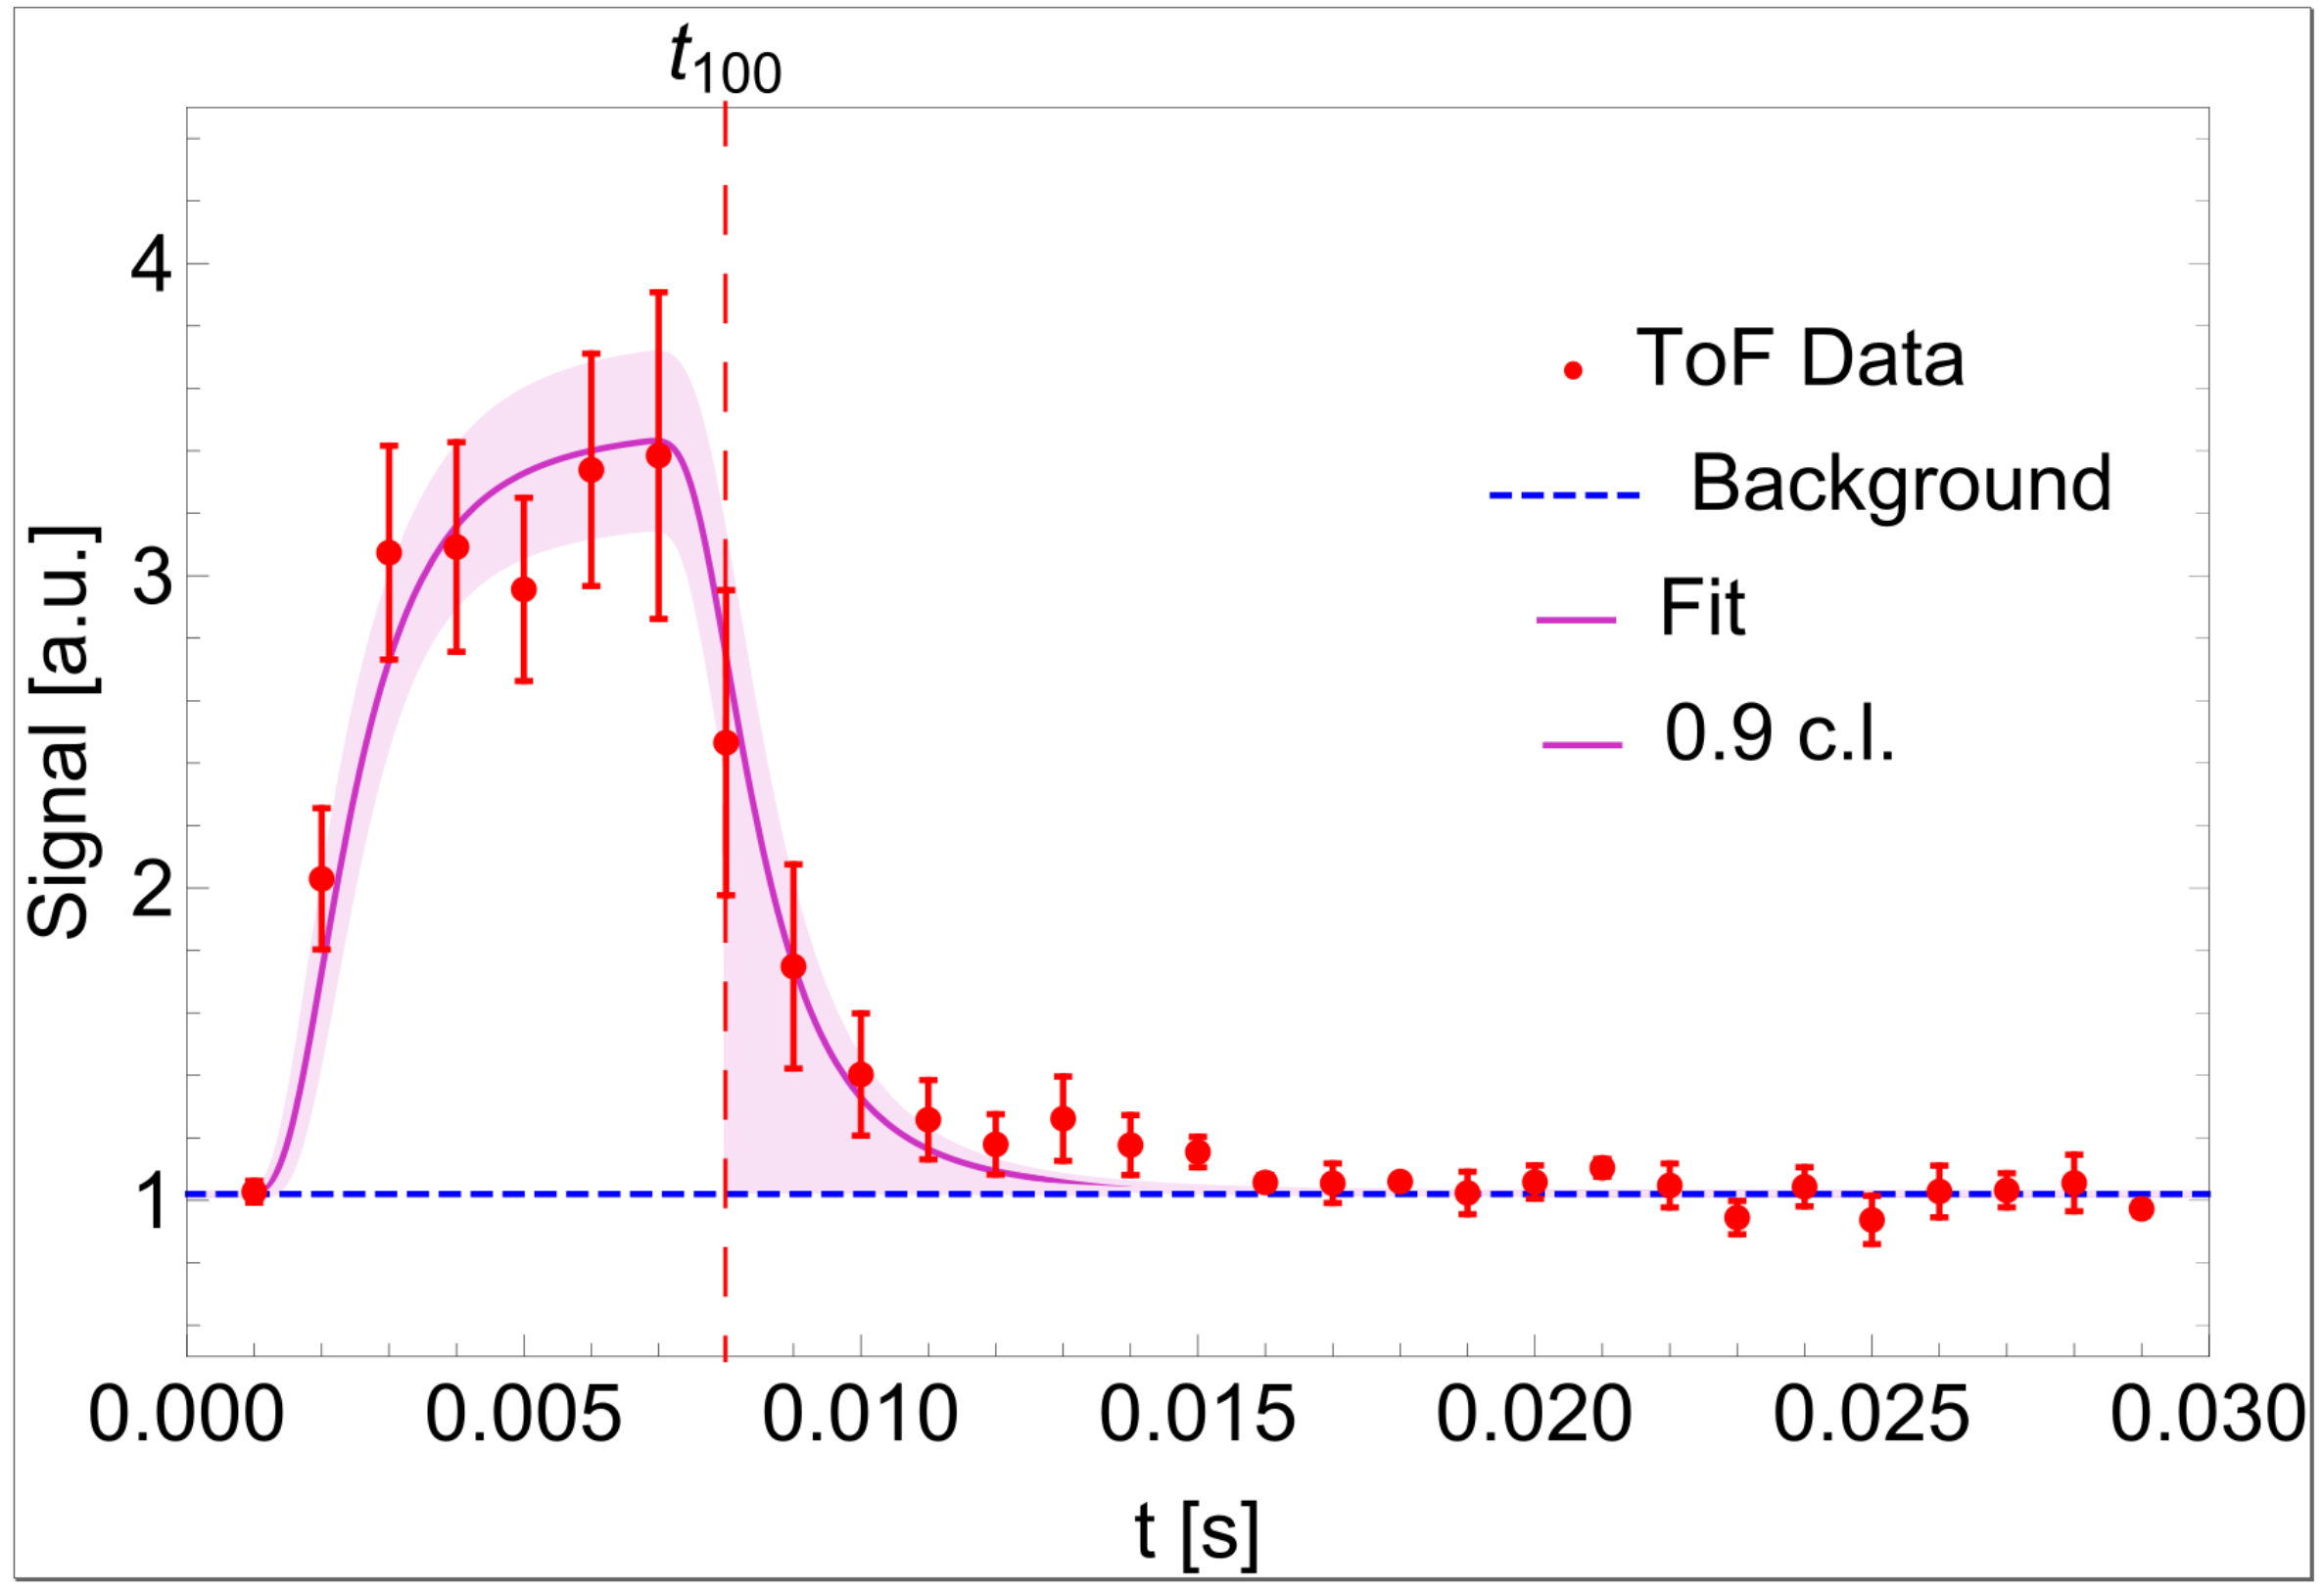
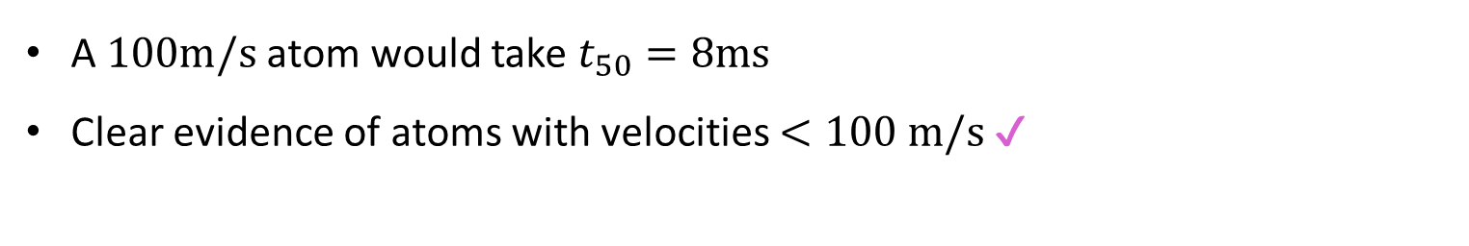
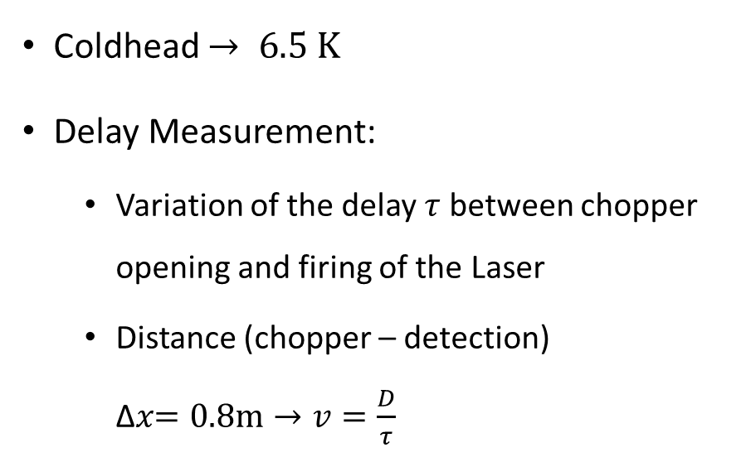
Velocities of the Hydrogen Beam
Coldhead $→ 6.5 K$
Delay Measurement:
  Variation of the delay $τ$ between chopper opening and firing of the Laser
  Distance (chopper – detection) ∆𝑥$=0.8m→v=\frac{D}{τ}$
A $100m/s$ atom would take $t_{50}=8ms$
Clear evidence of atoms with velocities $<100 m/s$ ✔
Notes:
need a hydrogen beam with a sufficient amount of low velocity atoms.
coldhead cools the beam down to 6.5 K
in theory there should be atoms present with velocities below 50 m/s.
To experimentally validate, we performed a delay measurement
the time between the chopper opening and the firing of the laser, hence the detection, was varied.
So a time of flight measurement.
The recorded datapoints you can see on the lower plot. With a distance of 80 cm between the chopper and the detection, the time a 50 m/s atom would take is 16 ms. And as you can see, there is clear evidence of atoms with velocities less than 50 m/s.

Slide 27
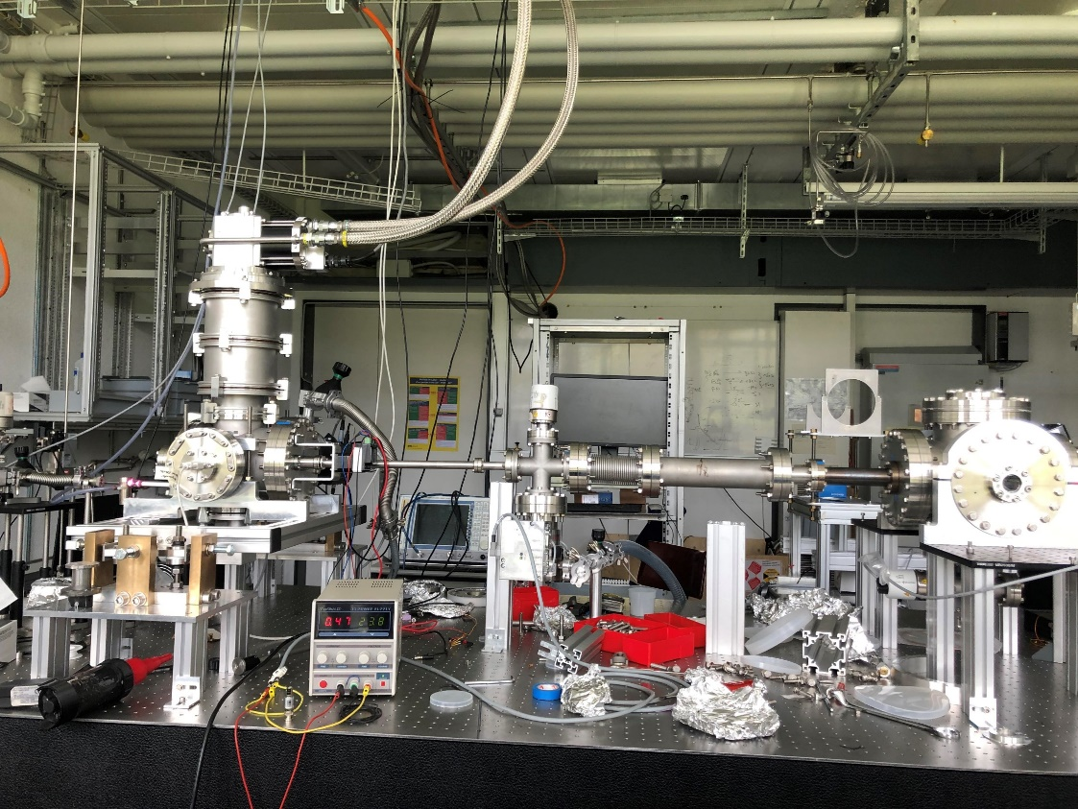
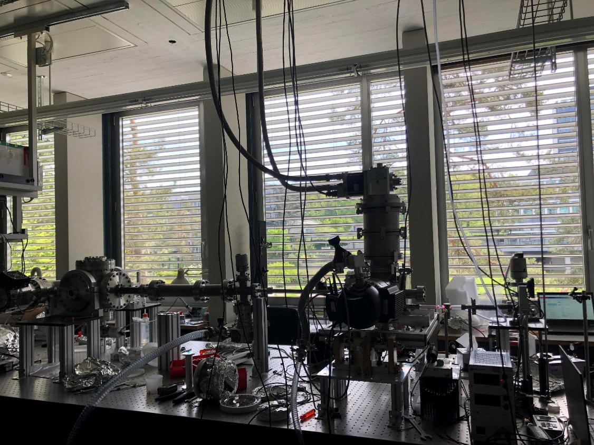
2022 - New Lab

Slide 28





New Coldhead
Heat-shield added → $4.2 K$
→ ~ 2 x more H with velocities $≤100$ m/s

Slide 29





Installation of slits
Three height adjustable slits
  1st slit: 100 µm slitwidth
  2nd & 3rd slit: 1 mm slitwidth
Separation of vacuum regions
  3 Turbopumps installed (4th coming soon)
  4 Vacuum gauges
  $\frac{p_{s}}{p_{dc}}=1.3×{10}^{7}, \frac{p_{cc}}{p_{dc}}=340$ @ H-flow = 0.8 ml/min
  Improvement of $\frac{p_{s}}{p_{dc}}$ and $\frac{p_{cc}}{p_{dc}}$ of $\sim$1 order of magnitude!
Coldhead
Slit 2
Slit 3
Chopper
Skimmer
Slit 1
$$p_{s}$$
Detection
chamber
H-Bottle
MW
discharge
cavity
$$p_{cc}$$
Turbo 2
Turbo 3
$$p_{dc}$$
Turbo 1
New!
Turbo 4
Coming soon

Slide 30






Installation of slits
Velocity selecting aperture
  Selection of specific velocity with adjustment of slit-heights
  Selection of velocity components: $v_{z}\left(GQS−Region\right)=0$

Slide 31






Reinstallation of the Laser system
Moved laser system from Ps lab to H lab
$H$ (~600 ns) and$H_{2}O$(~3µs) Peak visible
Frequency sweep: $\left(f2−f1\right)=1.23±0.02 GHz$
Laser
$$H$$
$$H_{2}O$$

Slide 32


Intensity dependency
Laser energy sweep
  $I=P/{(ω}_{0}^{2}π)$, $ω_{0}^{}$… laser beam waist
  $I^{3}$ dependency until $\sim 5×{10}^{6}$W/cm² (saturation of 2S ionization)
  $I^{2}$ dependency until $\sim 3×{10}^{7}$W/cm² (saturation of 1S2S excitation)[6]
Goal: run laser at point of saturation
  Compress beam size
  Installation of telescope & better UV mirrors
But:
  ETH laser system unstable and hard to optimize
  Runs at $\sim 1$mJ UV energy
  → SMI laser system runs stable at $\sim 4$ mJ
  → will be shipped to ETH in 2 weeks
First characterization measurements done this week
Simon’s talk in 2 weeks
[6] S.W. Downey, R.S. Hozack, Saturation of three-photon ionization of atomic hydrogen and deuterium at 243 nm. Opt. Lett. 14(1), 15–17 (1989). https://doi.org/10.1364/OL.

Slide 33

Hydrogen Beam – Current Status
2021:
  Efficient detection of the H atoms ✔
  Atomic Hydrogen beam with velocities $v<100 m/s$ ✔
2022:
  New Coldhead → estimated rate improvement of the rate by a factor of 2 ✔
  Pumping restriction ✔
  Re-installation of the Laser-system and first characterization measurements ✔
Notes:
managed to detect hydrogen with a pulsed UV laser very efficiently.
sufficient amount of 50 m/s atoms and lower present in the beam.
With our efficient detection scheme r
rates of approximately 100 atoms per laser pulse are expected.
With these requirements met, our next step will be the installation of a GQS region
The mirror will have a length of approximately 30 cm and a flatness of 0.5 µm.
With 50 m/s atoms this means that we have an observationtime of 6 ms!

Slide 34




Hydrogen Beam – Outlook
SMI laser system shipped to ETH: $1$ mJ → $4$mJ
New UV-mirrors and telescope
  Compress laser beam to get higher intensities
  Higher intensities: saturation & higher ionization efficiency
More characterization measurements
  Background
  Delay measurement
Installation af GQS chamber
Slit 2
Slit 3
GQS Region
Detection
chamber
$$p_{s}$$
H-Bottle
MW
discharge
cavity
Turbo 4
$$p_{dc}$$
$$p_{cc}$$
Turbo 2
Turbo 3
Turbo 1
Coming soon
under construction
Notes:
managed to detect hydrogen with a pulsed UV laser very efficiently.
sufficient amount of 50 m/s atoms and lower present in the beam.
With our efficient detection scheme r
rates of approximately 100 atoms per laser pulse are expected.
With these requirements met, our next step will be the installation of a GQS region
The mirror will have a length of approximately 30 cm and a flatness of 0.5 µm.
With 50 m/s atoms this means that we have an observationtime of 6 ms!

Slide 35




Thank you for your attention!

