Slide 1
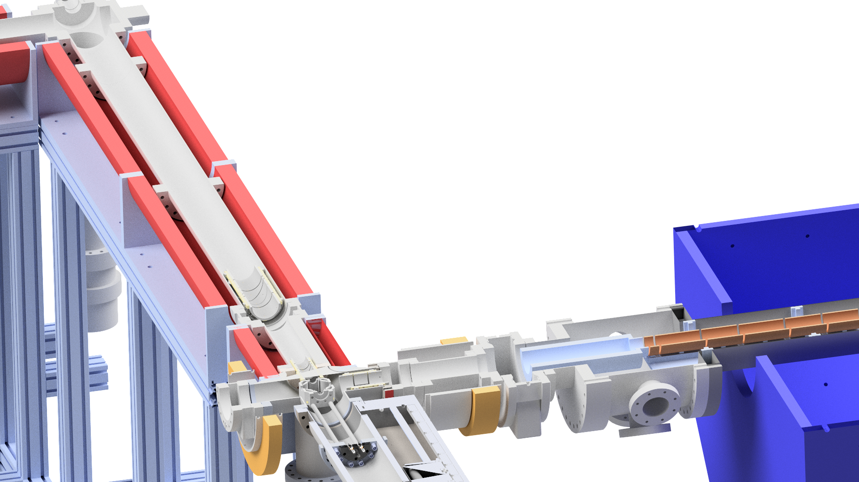
SMI internal seminar:
Simulations and design of a quadrupole deflector for slow extracted antiprotons
M. Bumbar
20.01.2023

Slide 2
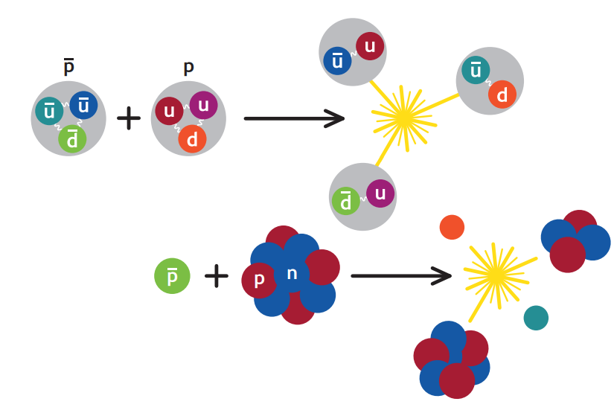
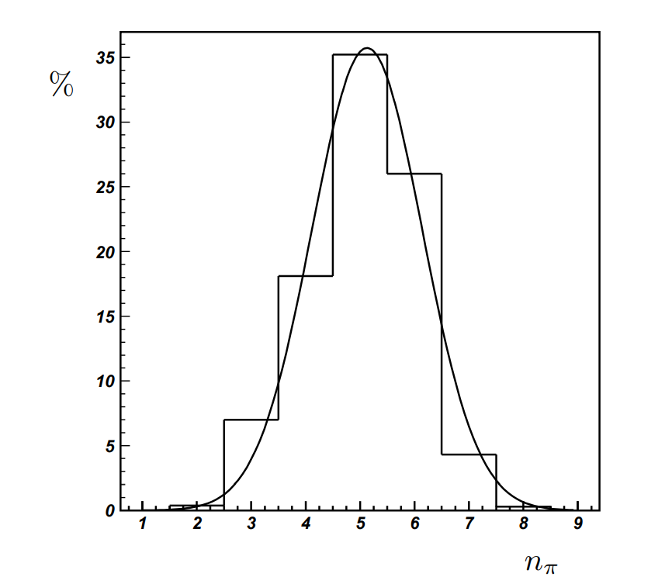
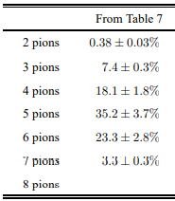
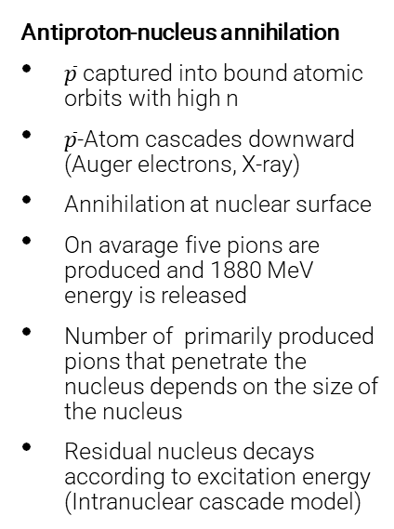

Antiproton annihilation at rest
Antiproton-nucleon annihilation
No elementary particles
Annihilation on quark level
$N\overline{N}$ annihilations do not necessarily annihilate all quark-antiquark pairs
$\overline{p}p \backslash n\overline{p}$ are still actively studied
Antiproton-nucleus annihilation
$\overline{p}$ captured into bound atomic orbits with high n
$\overline{p}$-Atom cascades downward (Auger electrons, X-ray)
Annihilation at nuclear surface
On avarage five pions are produced and 1880 MeV energy is released
Number of primarily produced pions that penetrate the nucleus depends on the size of the nucleus
Residual nucleus decays according to excitation energy (Intranuclear cascade model)
E.Klempt, C. Batty, J.-M. Richard. The antinucleon-nucleon interaction at low energy: annihilation dynamics. Physics Reports, Elsevier, 2005, 413, oo.197-317. ff10.1016/j.physrep. 2005.03.002ff.ffin2p3-00023533

Slide 3

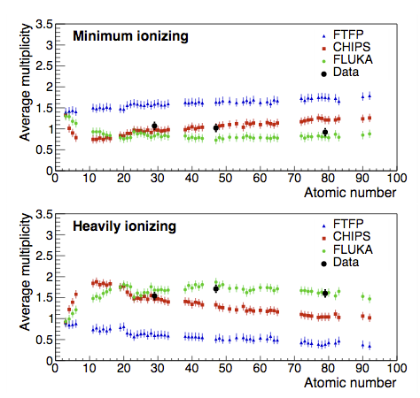



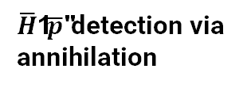
Experiments at the Antiproton Decelerator (CERN)
Efficient detection, correct tagging of events
Simulations-based detector design and
event reconstruction - GEANT4 (Fritjof, CHIPS models), FLUKA
Developed for HEP, extrapolated to low energies
None of them use annihilation data on nuclei
No model describes the existing data correctly
ASACUSA
PUMA
$\overline{H}$/$\overline{p}$ detection via
annihilation
S. Aghion et al. 2017 JINST 12 P04021
Notes:
measure properties of antimatter
hbar spectroscopy or determine the gravitational behaviour of antimatter; trap and transport antiprotons to see its interactions with exotic nuclei; compares the magnetic moments of p and pbar
majority detects the hbar or pbar through measuring the annihilation products.
if you want efficient detection and correct tagging of events the antiproton-nucleus annihilation is the most important process
to design the experiments’ detectors and to reconstruct detected event simulations are needed. for this the mostly used programmes are geant4 with fritjof and chips physics models or fluka. but there is a problem with these models as they have all been developed for hep and were only extrapolated to low energies which are important for the AD experiments. Additionally none of the models were produced using the annihilation on nuclei, but rather on single hadrons. This leads to the fact that no model can describe the existing data correctly.
Here you can see the multiplicities of minimum ionizing annihilation products and hi annihilation products. in black you can see three results for copper silver and gold. in blue red and green sim models, none can describe data for larger range of atomic numbers. the goal of the experiment now is to measure the multiplicities and energies for annihilations on a number of nuclei in order to produce data that can be integrated into the simulation models.

Slide 4
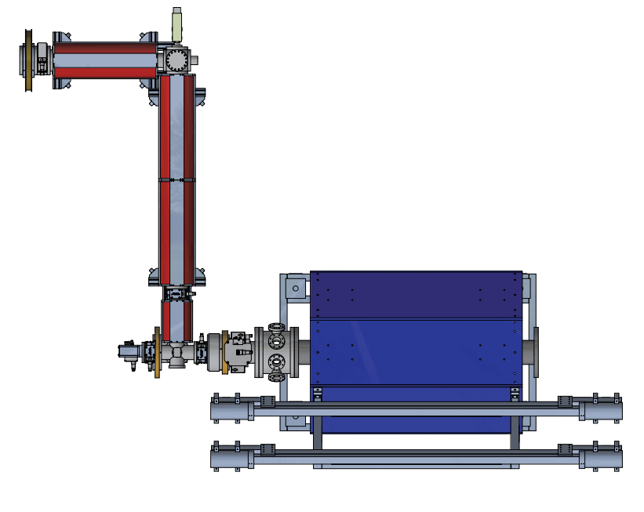
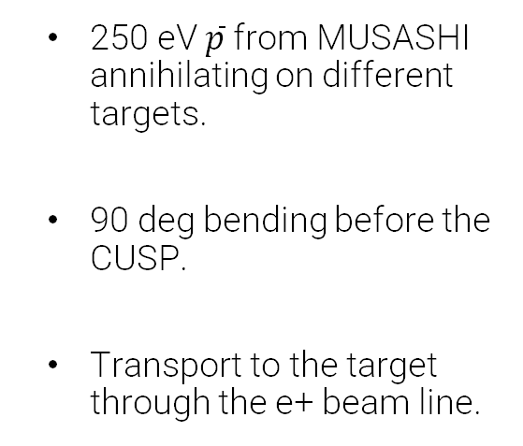
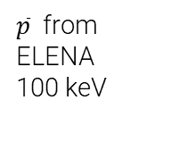
Experimental setup
Detector and foil
250 eV $\overline{p}$ from MUSASHI annihilating on different targets.
90 deg bending before the CUSP.
Transport to the target through the e+ beam line.
e⁺ transfer line
$\overline{p}$ from ELENA
100 keV
MUSASHI
Quadrupole bender

Slide 5
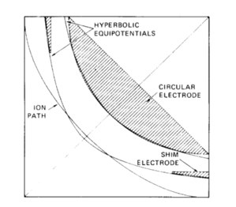
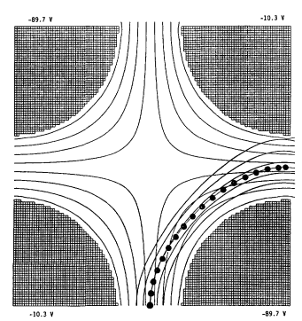
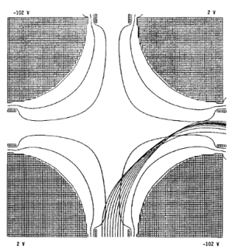
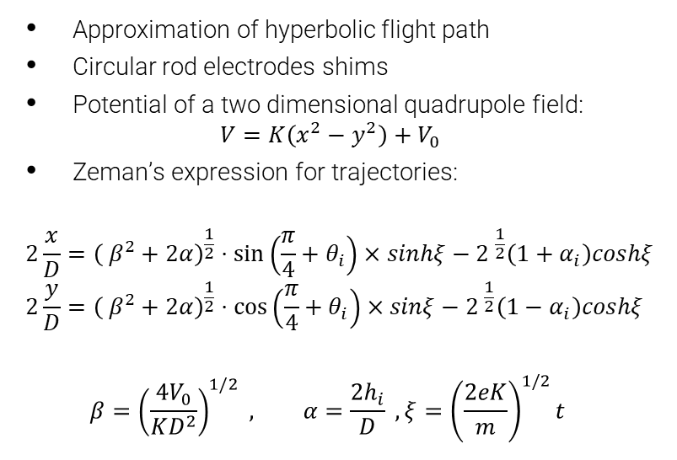
Quadrupole deflector
Source:
Review of Scientific Instruments 48, 1079 (1977); https://doi.org/10.1063/1.1135188 Published Online: 26 August 2008​
Approximation of hyperbolic flight path​
Circular rod electrodes​ shims
Potential of a two dimensional quadrupole field:
$$V=K\left(x^{2}−y^{2}\right)+V_{0}$$
Zeman’s expression for trajectories:
$$2\frac{x}{D}={\left( β^{2}+2α\right)}^{\frac{1}{2}}⋅\sin\left(\frac{π}{4}+θ_{i}\right)×sinhξ−{2 }^{\frac{1}{2}}\left(1+α_{i}\right)coshξ$$
$$2\frac{y}{D}={\left( β^{2}+2α\right)}^{\frac{1}{2}}⋅\cos\left(\frac{π}{4}+θ_{i}\right)×sinξ−{2 }^{\frac{1}{2}}\left(1−α_{i}\right)coshξ$$
$$β={\left(\frac{4V_{0}}{KD^{2}}\right)}^{1/2} , α=\frac{2h_{i}}{D} , ξ={\left(\frac{2eK}{m}\right)}^{1/2}t$$
Source:
Journal of Vacuum Science & Technology A 8, 3244 (1990); https://doi.org/10.1116/1.576571Submitted: 06 September 1989 . Accepted: 25 November 1989 . Published Online: 04 June 1998

Slide 6
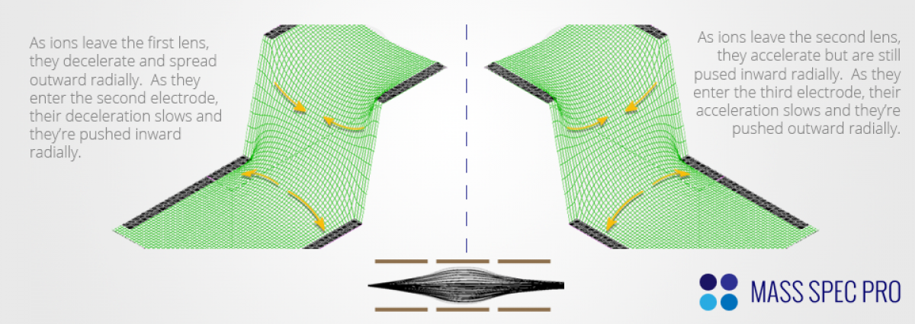
Einzel lenses

Slide 7
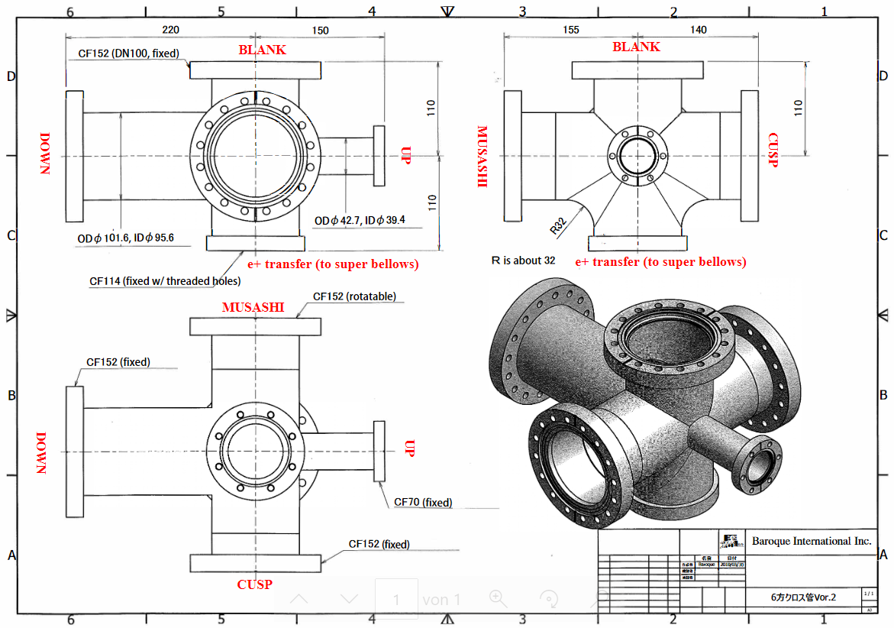
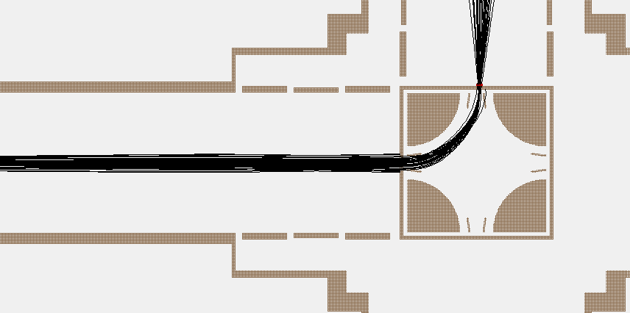
Limiting factors
Diameter restrictions from flange diameter
Big beams are hard to bend
  Losses at entrance
  and/or
  Aberrations at exit
Optimization for our setup and beam
68 mm
actuator

Slide 8
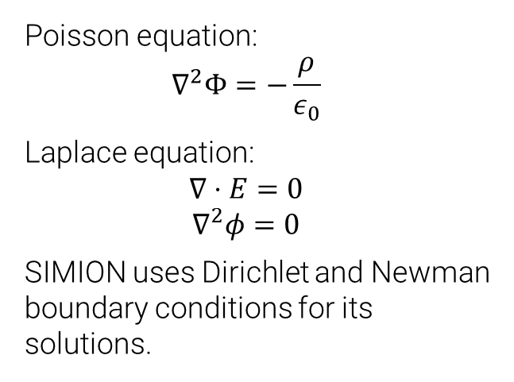
SIMION 8.1
Electrostatic and magnetic field modelling program
Boundary value problems
finite difference method/ over relaxation
Runge-Kutta
Solves partial differential equations
Laplace Equation
Potential arrays
  electrostatic potential or scalar magnetic potential
  electrode or non-electrode
Poisson equation:
$$∇^{2}Φ=−\frac{ρ}{ε_{0}}$$
Laplace equation:
$$∇⋅E=0$$
$$∇^{2}φ=0$$
SIMION uses Dirichlet and Newman boundary conditions for its solutions.

Slide 9
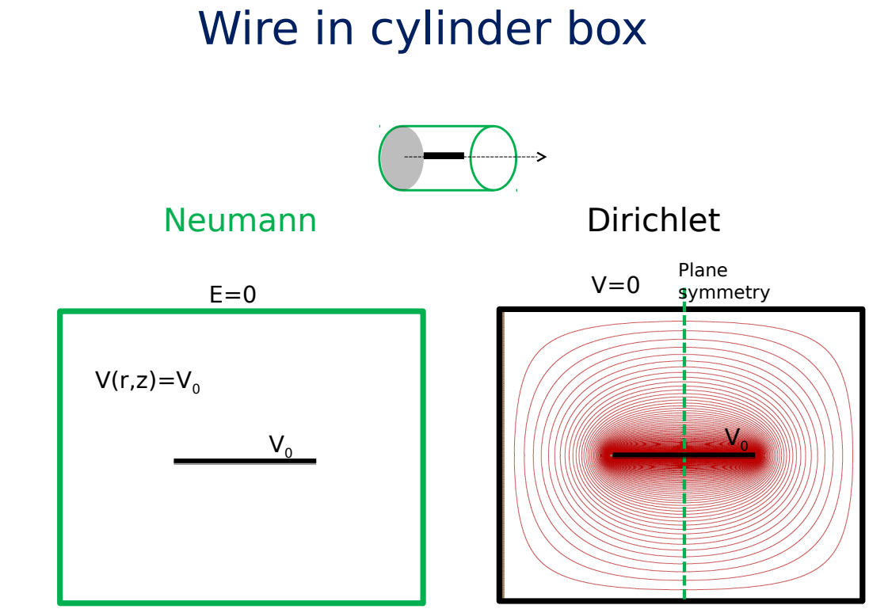
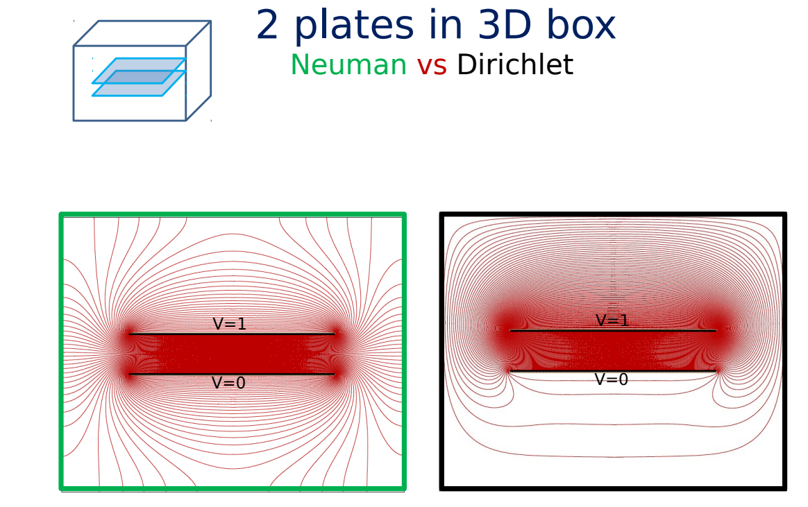
Uniqueness theorems
Dirichlet boundary conditions are typically voltages on the surfaces of electrodes
Neumann boundary conditions are generally (k=0) , corresponding to planes of mirror symmetry or by By default, non-electrode PA edges are taken as zero Neumann boundary conditions
Source:
https://simion.com/docs/ganil-2015/talk_eric_giglio.pdf

Slide 10
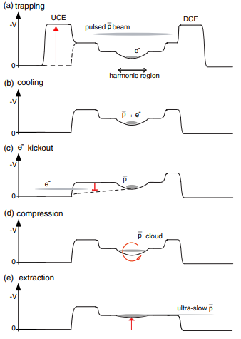
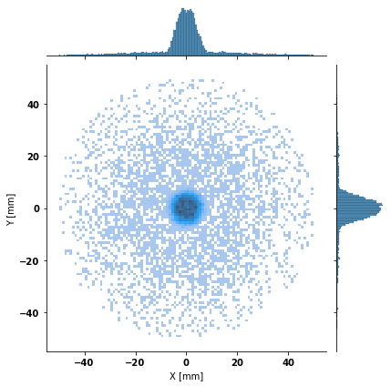

Simulations
$σ_{x}$: 11.30 mm
$σ_{y}$: 11.36 mm
$Transmission$: 77.72%
$Center$: 63%
$Halo$: 37%
Simulations start with extraction
Beam consists of two parts
Information about the beam needed for optimization
E3
Kuroda, N. et. Al. (2012). Development of a monoenergetic ultraslow antiproton beam source for high-precision investigation. Physical Review Special Topics - Accelerators and Beams. 15. 10.1103/PhysRevSTAB.15.024702.
MUSASHI
Coil A
Coil C
E2
E1
Multi Ring Electrode (MRE)
Extraction Electrodes (EE)

Slide 11
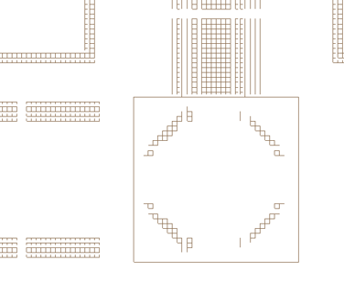
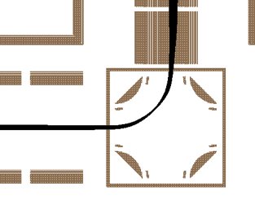
Resolution
mmgu = 2mm
mmgu = 0.4 mm

Slide 12
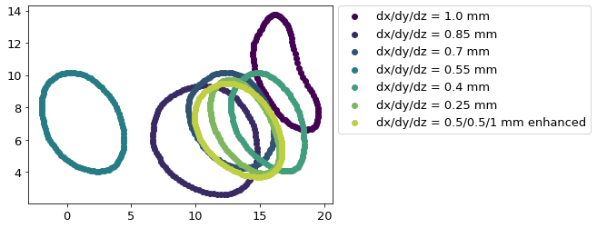
Resolution/PA grid size

Slide 13
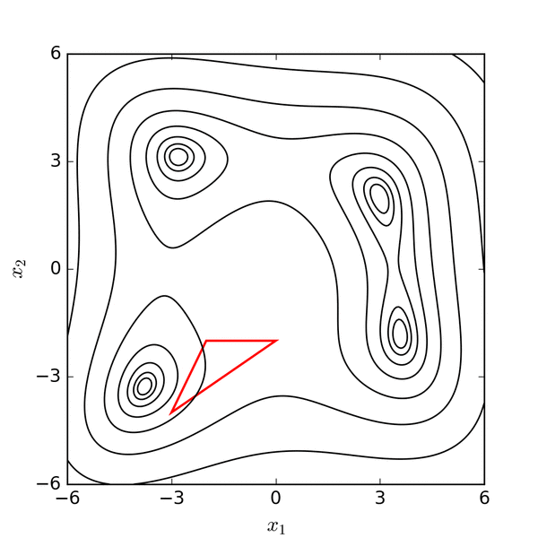
Geometry sweep
Nelder-Mead method
Simplex Optimizer
Finds local minima
  Starting point
  Step size
Optimizes results of a function (spot size)
Results of the function depend on used beam
  No randomized beams
Applies changes to electrodes
  Voltage
  Geometry
Source: https://commons.wikimedia.org/wiki/File:Nelder-Mead_Himmelblau.gif

Slide 14
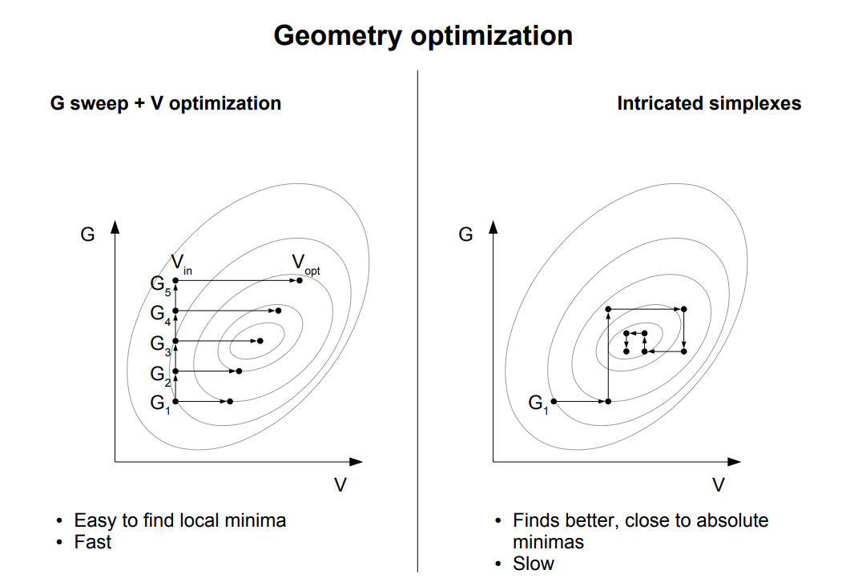
Source:
https://simion.com/docs/ganil-2015/talk_pierre_chauveau.pdf

Slide 15
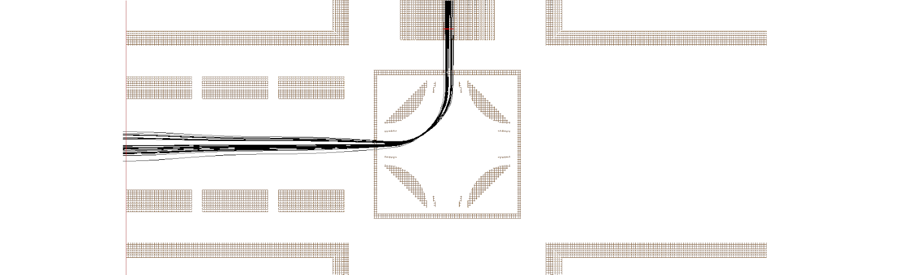
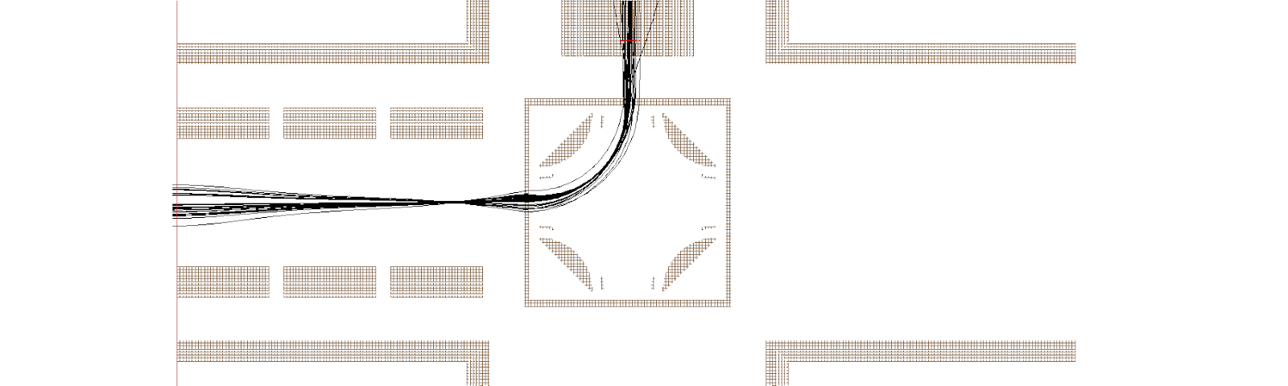
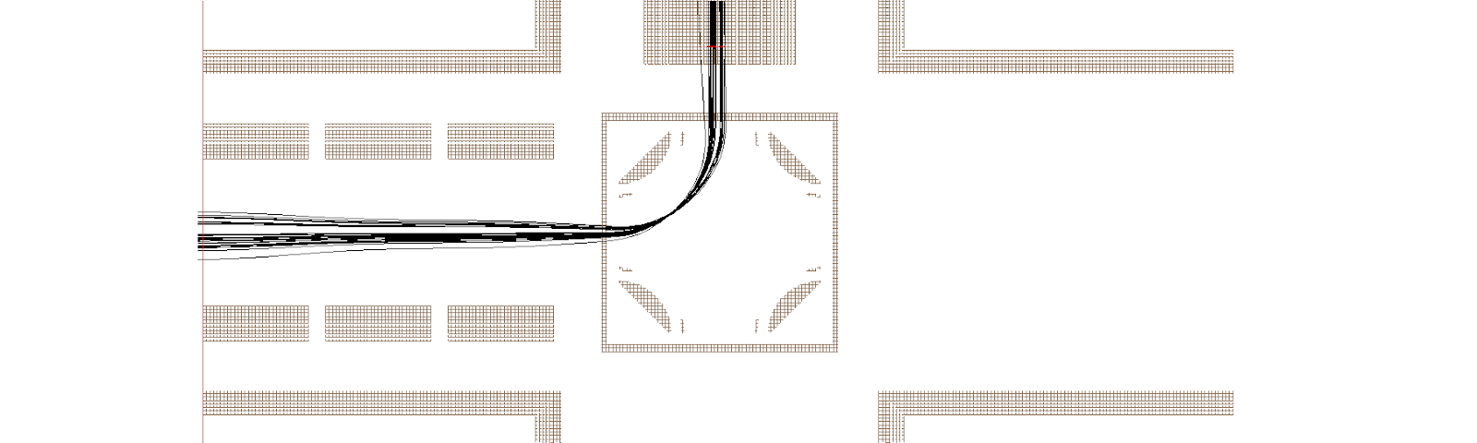
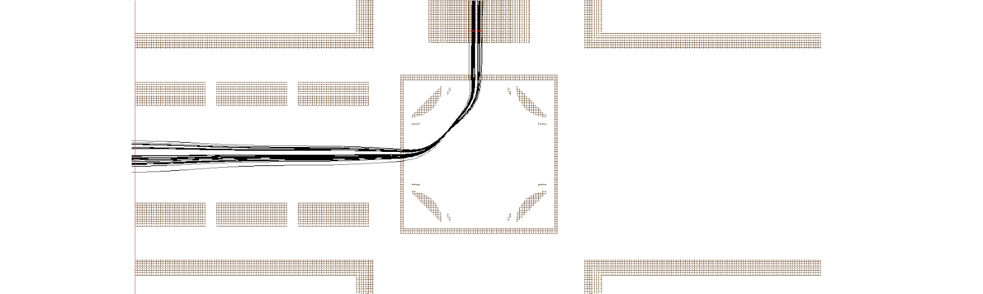
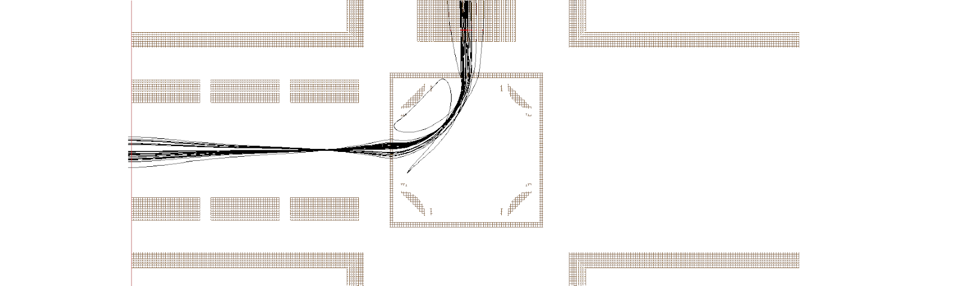
Geometry sweep

Slide 16
Results

Slide 17
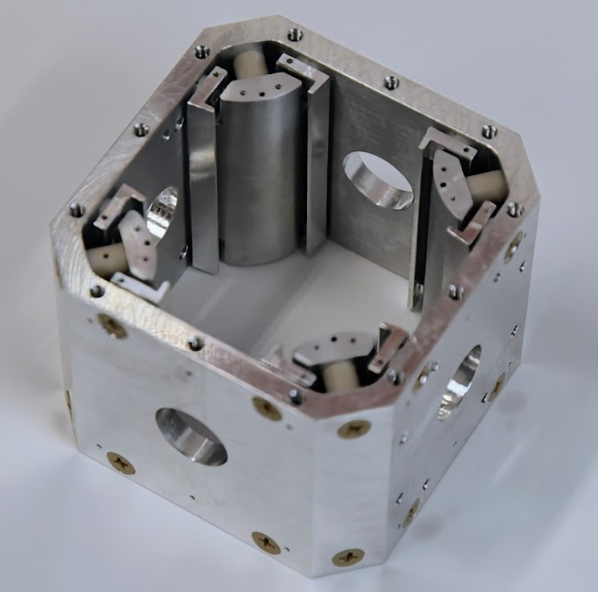
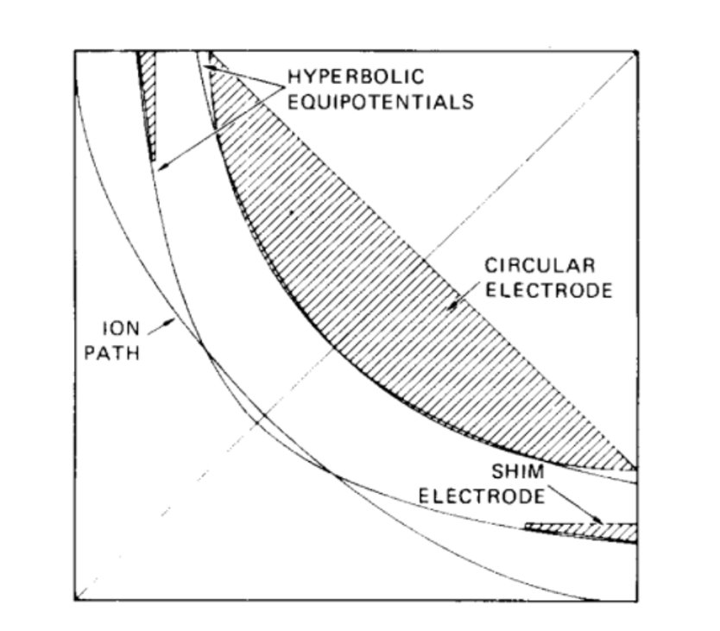
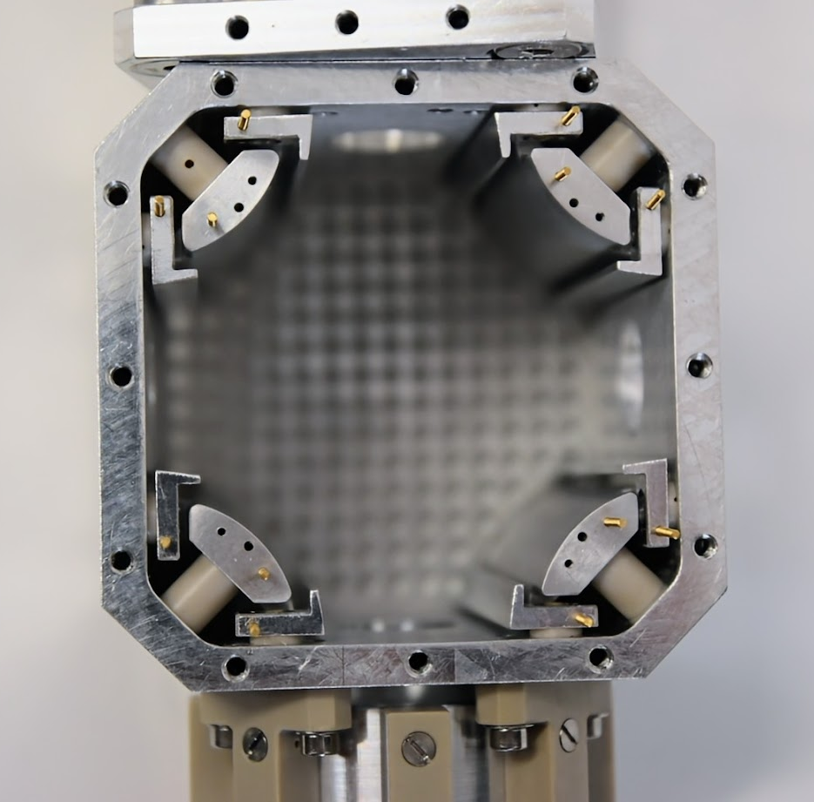
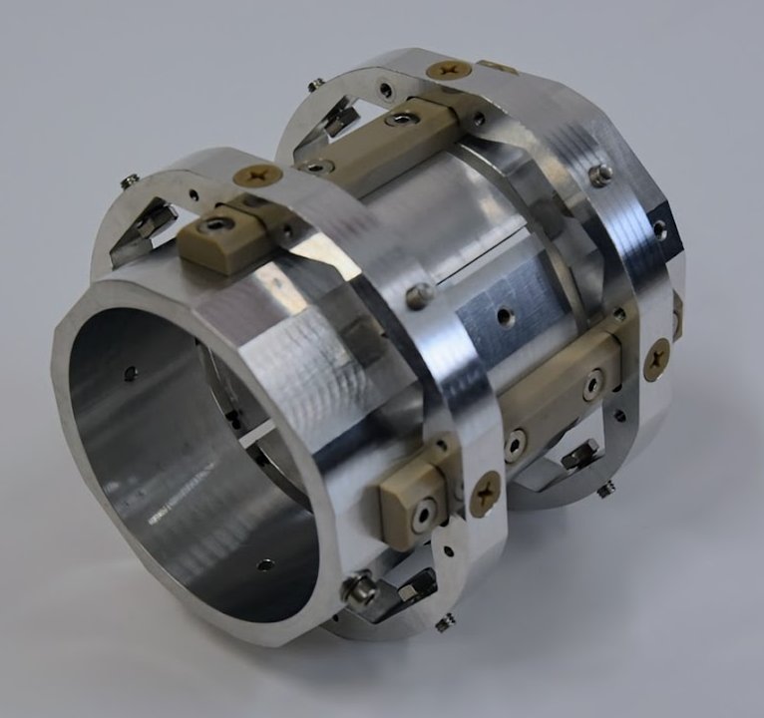
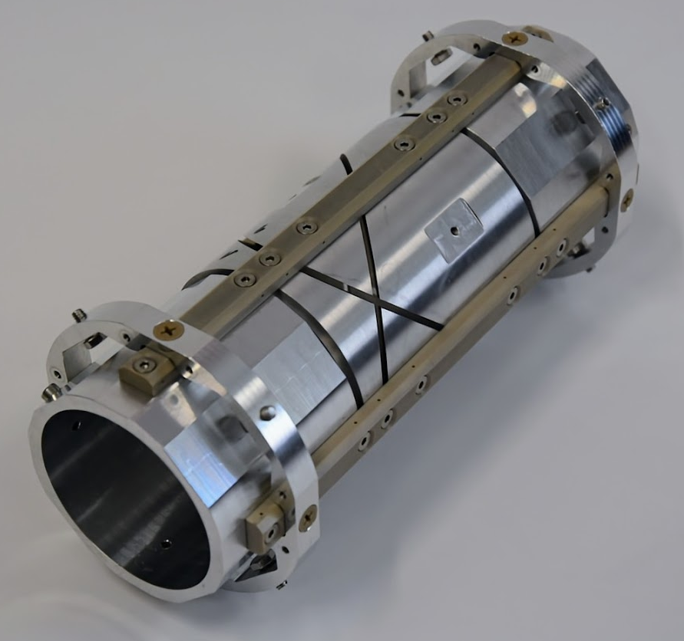
Quadrupole deflector
Approximation of hyperbolic flight path
  Circular rod electrodes
  Shims
Geometry optimized for our beam by geometry sweeps
Source: Review of Scientific Instruments 48, 1079 (1977); https://doi.org/10.1063/1.1135188 Published Online: 26 August 2008
Einzel lenses
E1: Straight cut middle ring
E2, E3: Sikler- type einzel lenses
Glasfiber reinforced PEEK for the mounts

Slide 18
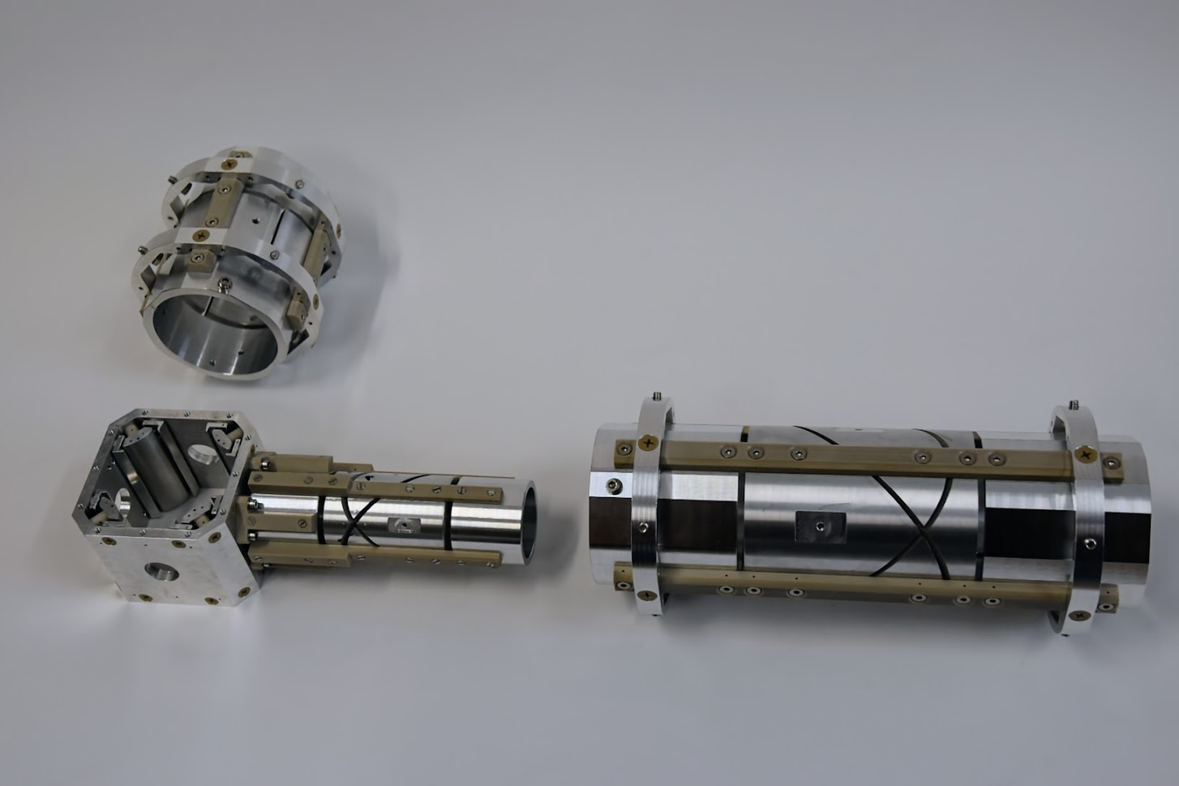
E1
Operated by an actuator
Deflector and E2 can be moved as one unit
Sizes made to match the current apparatus
E2
E3

Slide 19
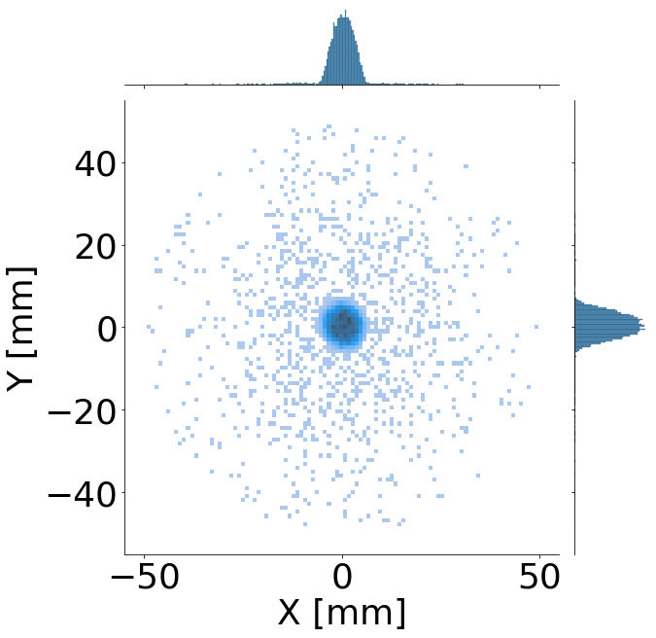
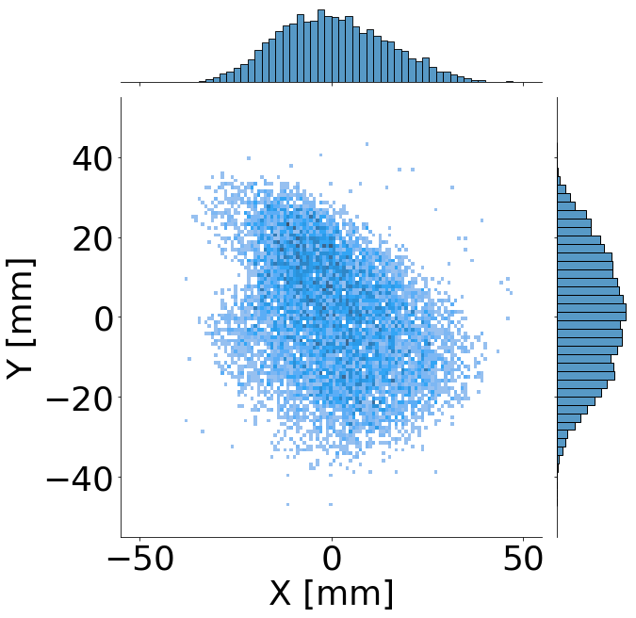
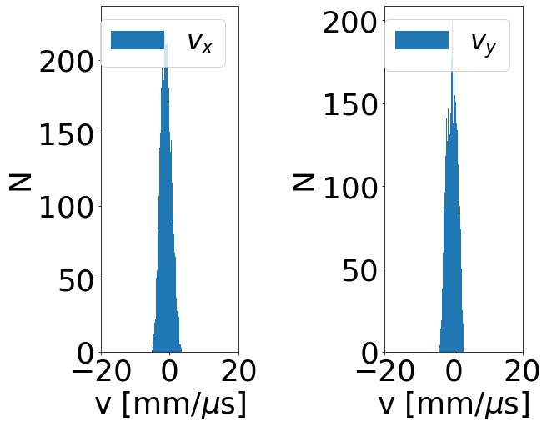
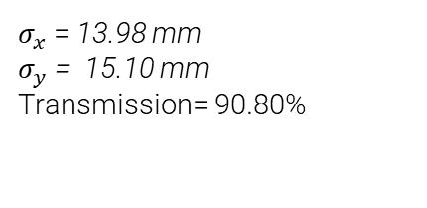

2 Einzel lenses
$σ_{x}$= 6.84 mm
$σ_{y}$ = 6.15 mm
$σ_{x}$= 13.98 mm
$σ_{y}$ = 15.10 mm
Transmission= 90.80%
Input:
Output:

Slide 20
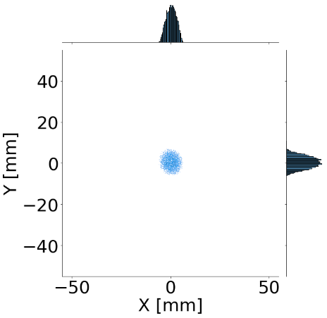
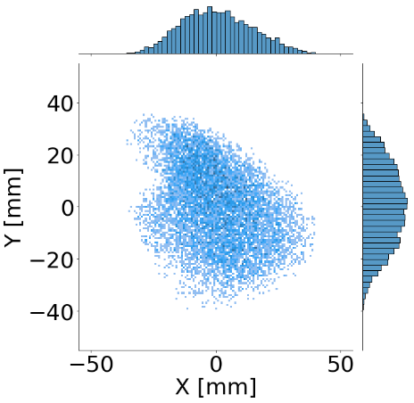
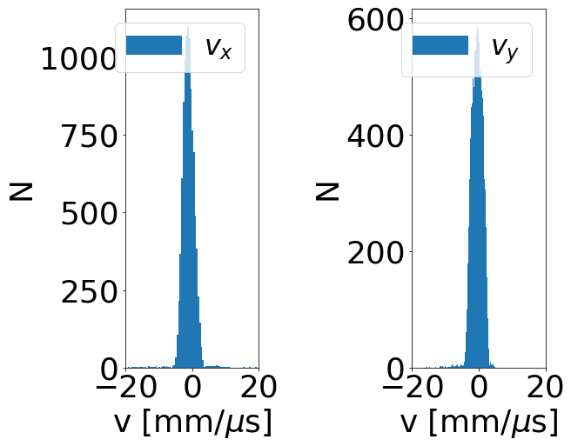


2 Einzel lenses (only center part)
$σ_{x}$= 2.61 mm
$σ_{y}$= 2.45 mm
$σ_{x}$= 13.86 mm
$σ_{y}$ = 14.99 mm
Transmission = 99.99 %
Input:
Output:

Slide 21



Third Einzel
Detector and foil
Because of unsatisfactory results a third Einzel is necessary.
Two possible mounting positions
  At the gate valve
  Close to the target
Focusing einzel
Gate valve

Slide 22




3 Einzel lenses (E3 at GV)
$σ_{x}$= 6.36 mm
$σ_{y}$= 6.17 mm
$σ_{x}$ = 5.63 mm
$σ_{y}$ = 5.47 mm
Transmission= 91.89 %
Input:
Output:

Slide 23





3 Einzel lenses (E3 at GV)
$σ_{x}$= 2.61 mm
$σ_{y}$= 2.40 mm
$σ_{x}$ = 5.36 mm
$σ_{y}$ = 5.08 mm
Transmission = 100 %
Input:
Output:

Slide 24





3 Einzel lenses (E3 at GV)
$σ_{x}$= 4.86 mm
$σ_{y}$= 4.45 mm
$σ_{x}$ = 9.35 mm
$σ_{y}$ = 9.43 mm
Transmission = 87.29 %
Input:
Output:

Slide 25





3 Einzel lenses (E3 before bellow)
$σ_{x}$= 6.66 mm
$σ_{y}$= 6.18 mm
$σ_{x}$ = 2.94 mm
$σ_{y}$ = 2.86 mm
Transmission= 89.76%
Input:
Output:

Slide 26





3 Einzel lenses (E3 before bellow)
$σ_{x}$= 2.62 mm
$σ_{y}$= 2.44 mm
$σ_{x}$ = 2.91 mm
$σ_{y}$ = 2.82 mm
Transmission= 99.22 %
Input:
Output:

Slide 27

Carbon coating
Metal surfaces are not perfect equipotentials
  Grain boundaries
  Surface contamination
Forces created by patch potentials can be significant for charged particles
Secondary electron emission
  A: untreated Al alloy
  B: alodine-treated Al alloy
  C: Al alloy covered with a-C film
  D: alodine-treated Al alloy covered with a-C film
Source:
https://doi.org/10.1016/j.matlet.2022.133085

Slide 28



Current status
Completed:
  Electrodes are finished and cleaned
  Flange with feedthroughs are ready
  Delivery for the actuator is confirmed for March 2023
  Cable and shielding cleaned
  Carbon coating of the electrodes
To do:
  Electrical connections
  Shipping and installation

Slide 29

Thank you for your attention

Slide 30

B-field along Z-axis

Slide 31


Solenoid lenses

Slide 32


HIGAKI A

Slide 33


Penning-trap MUSASHI
Data is necessary for the optimization process
Beam consists of a halo and a center part
Only extraction step was simulated
Kuroda, N. et. Al. (2012). Development of a monoenergetic ultraslow antiproton beam source for high-precision investigation. Physical Review Special Topics - Accelerators and Beams. 15. 10.1103/PhysRevSTAB.15.024702.
$σ_{x}$: 11.30 mm
$σ_{y}$: 11.36 mm
$Transmission$: 77.72%
$Center$: 63%
$Halo$: 37%
Multi ring electrode (MRE)
Extraction electrode (EE)

