Slide 1
Non-neutral plasma manipulation for antihydrogen production
Andreas Lanz
SMI internal seminar
CERN
13.01.2023

Slide 2
Outline
Experimental method
Previous results and motivation for plasma handling
Penning-Malmberg traps and plasma control methods
Cusp trap
Positron system
Proton source

Slide 3
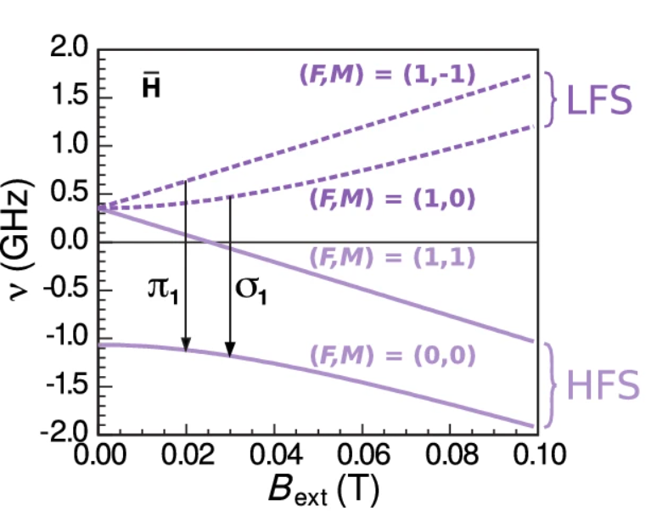
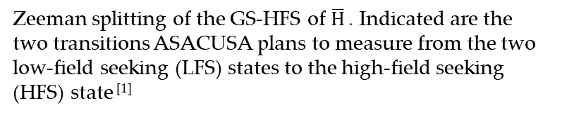
Introduction
Ppm measurement of the ground-state hyperfine splitting of antihydrogen in a B-field free region
Spinpolarised antihydrogen beam
Zeeman splitting of the GS-HFS of $\overline{H}$ . Indicated are the two transitions ASACUSA plans to measure from the two low-field seeking (LFS) states to the high-field seeking (HFS) state ^{[1]}

Slide 4
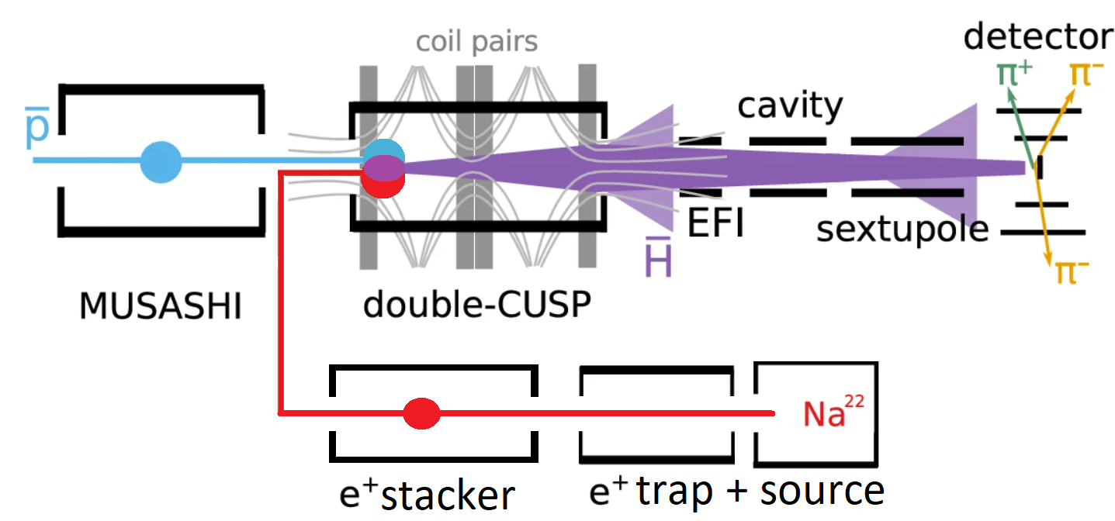
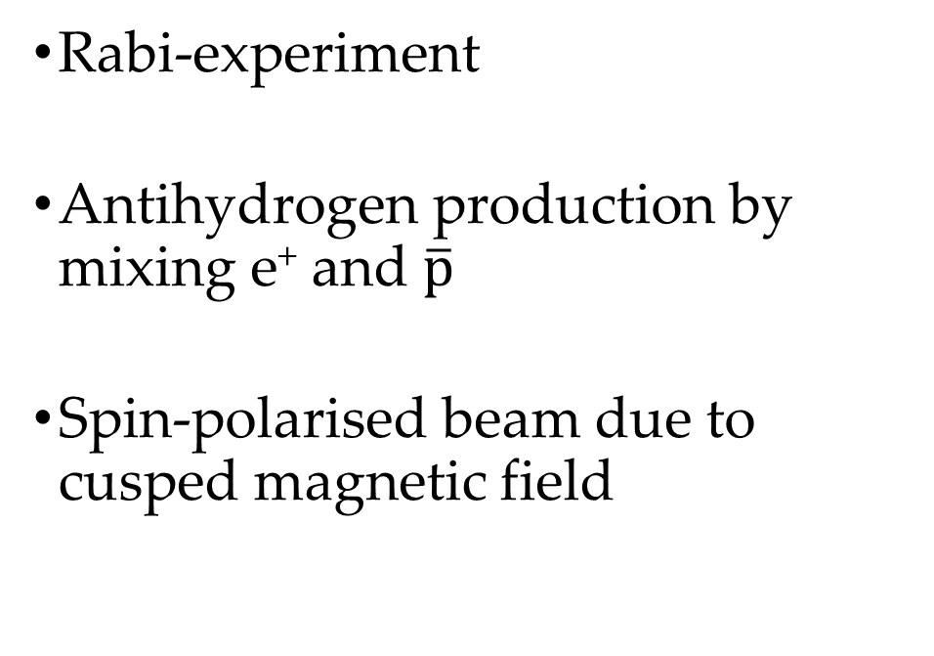
Experimental method
Rabi-experiment
Antihydrogen production by mixing e⁺ and $\overline{p}$
Spin-polarised beam due to cusped magnetic field
Sketch of the experimental setup. The positrons from the Na²² source produce antihydrogen by mixing with antiprotons in the double-cusp trap. The spin-polarised antihydrogen beam enters the cavity, where transitions from LFS to HFS states are induced. These states get deflected by the sextupole yielding a decrease in countrate at the transition frequency (sketch modified from ^{[1]} )

Slide 5
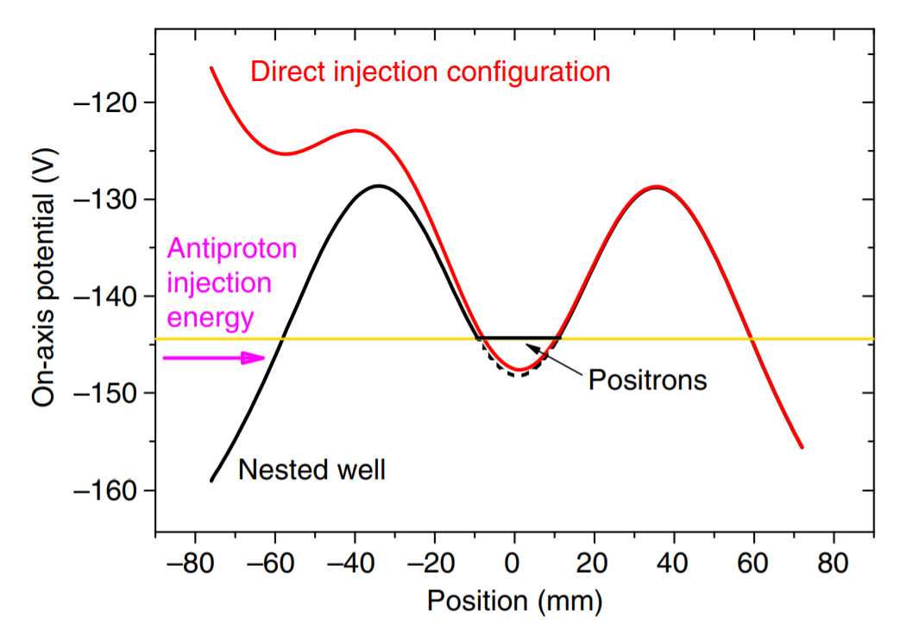
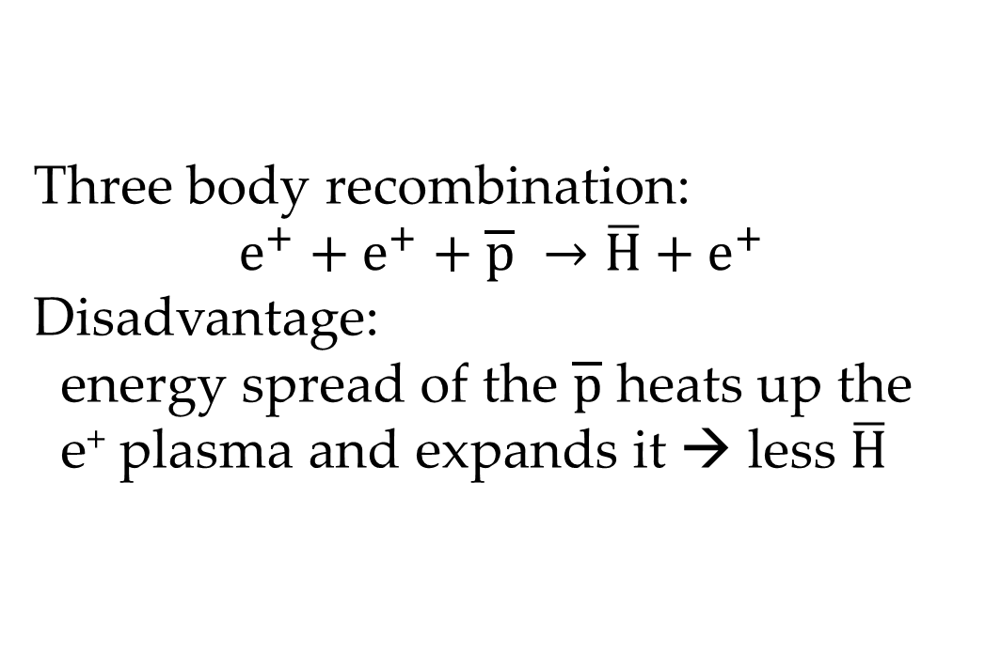
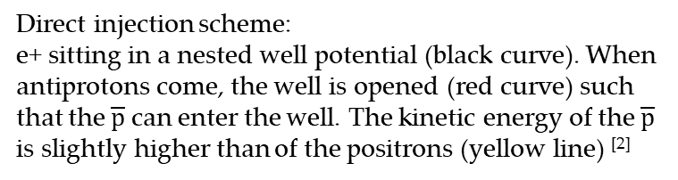
Mixing scheme
Direct injection
Three body recombination:
$$e^{+}+e^{+}+\overline{p} →\overline{H}+e^{+}$$
Disadvantage:
energy spread of the $\overline{p}$ heats up the
e⁺ plasma and expands it → less $\overline{H}$
Direct injection scheme:
e+ sitting in a nested well potential (black curve). When antiprotons come, the well is opened (red curve) such that the $\overline{p}$ can enter the well. The kinetic energy of the $\overline{p}$ is slightly higher than of the positrons (yellow line) ^{[2]}

Slide 6
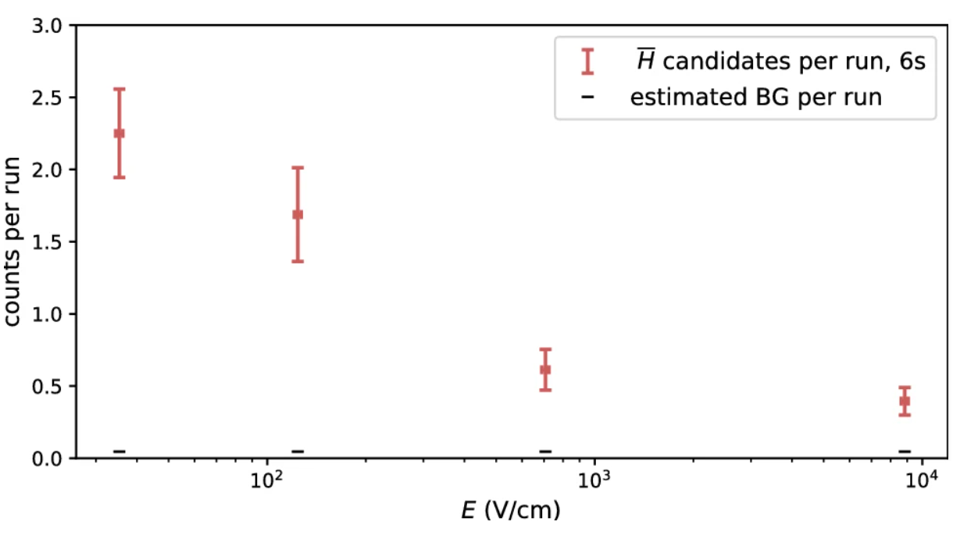
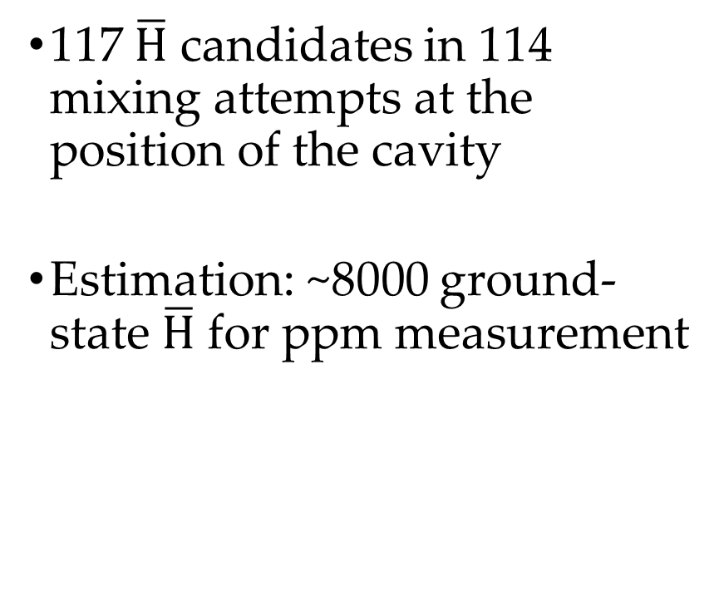
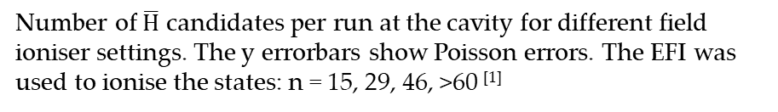
Quantum state distribution
117 $\overline{H}$ candidates in 114 mixing attempts at the position of the cavity
Estimation: ~8000 ground-state $\overline{H}$ for ppm measurement
Number of $\overline{H}$ candidates per run at the cavity for different field ioniser settings. The y errorbars show Poisson errors. The EFI was used to ionise the states: n = 15, 29, 46, >60 ^{[1]}

Slide 7
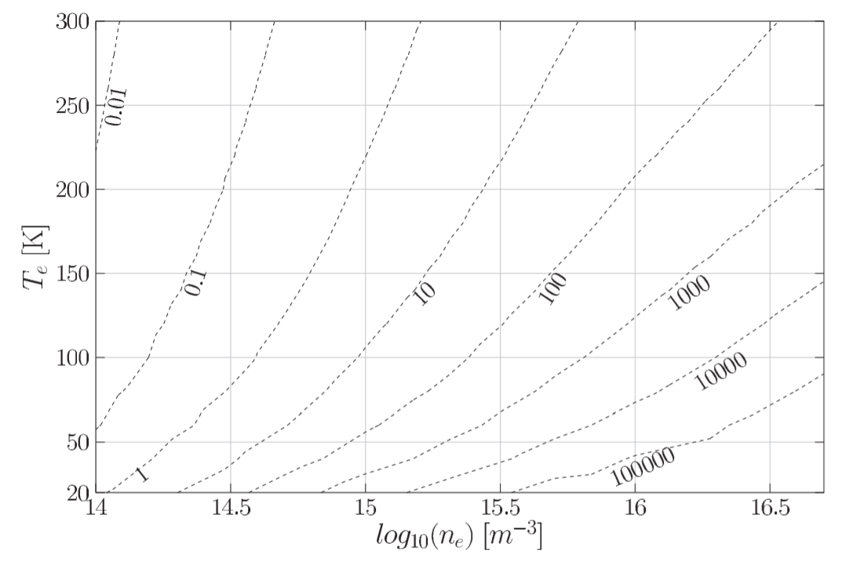
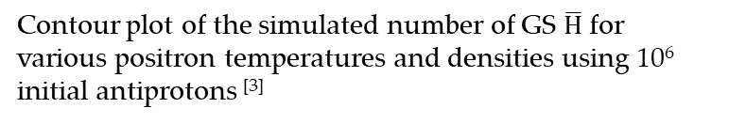
GS-Antihydrogen production
Contour plot of the simulated number of GS $\overline{H}$ for various positron temperatures and densities using 10⁶ initial antiprotons ^{[3]}

Slide 8
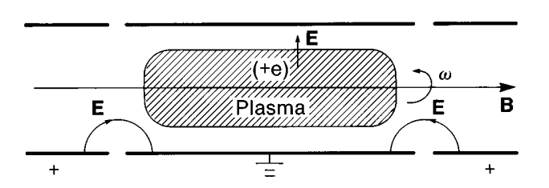
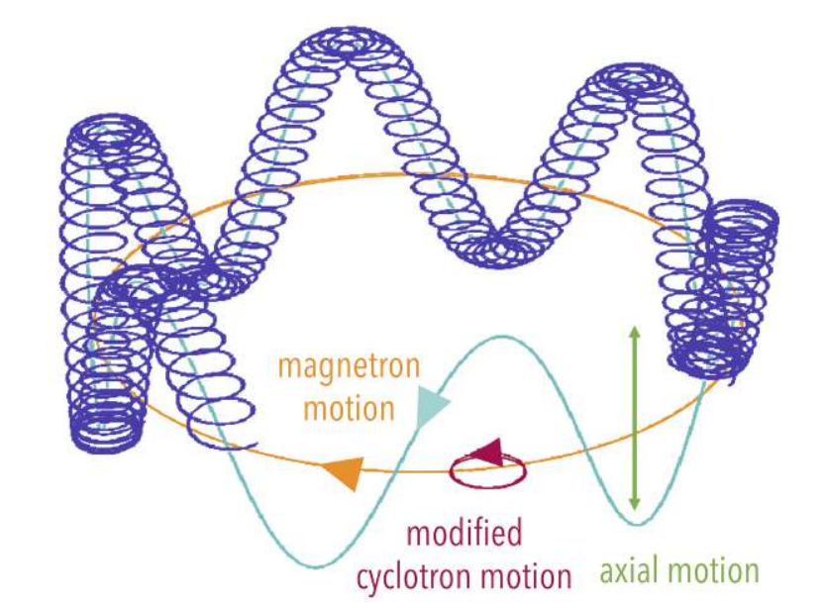


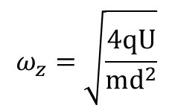




Penning-Malmberg trap
Axial confinement: electric Potential
Radial confinement: Magnetic field
Schematic of a plasma in a Penning-Malmberg trap^{[4]}
$$ω_{z}=\sqrt{\frac{4qU}{md^{2}}}$$
$ω_{z}$ … axial motion
$ω_{±}=\frac{1}{2}(ω_{c}±\sqrt{ω_{c}^{2}−2ω_{z}^{2}}$)
$ω_{+}$ … modified cyclotron frequency
$ω_{−}$ … magnetron frequency
$$ω_{c}=ω_{+}+ω_{−}=\frac{qB_{z}}{m}$$
$ω_{c}$ … cyclotron frequency
Motion of a single particle in a Penning-Malmberg trap^{[3]}

Slide 9
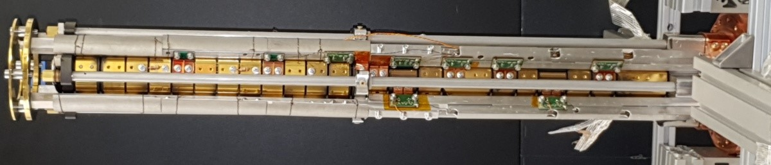
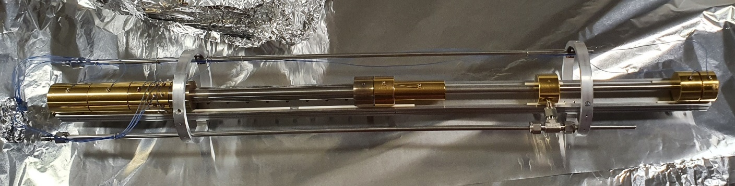
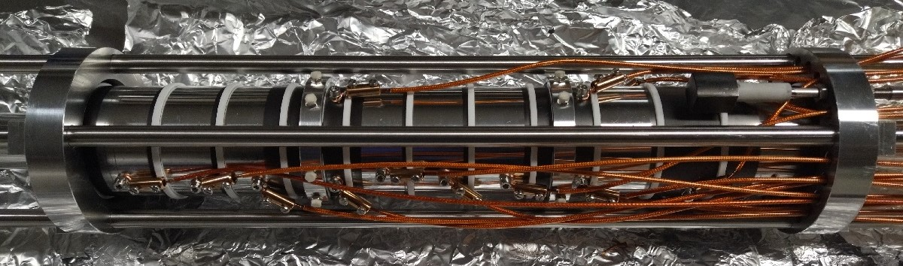
Trap in real life
Picture of the Cusp trap (top) positron trap (middle) & stacker (bottom)

Slide 10
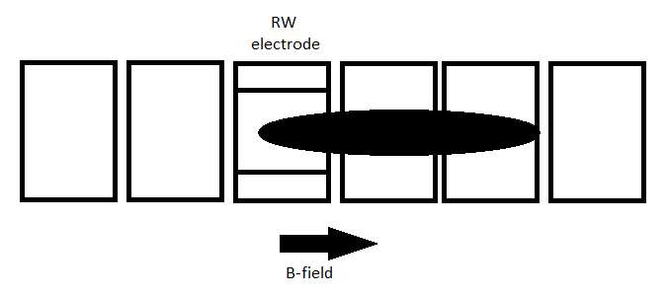
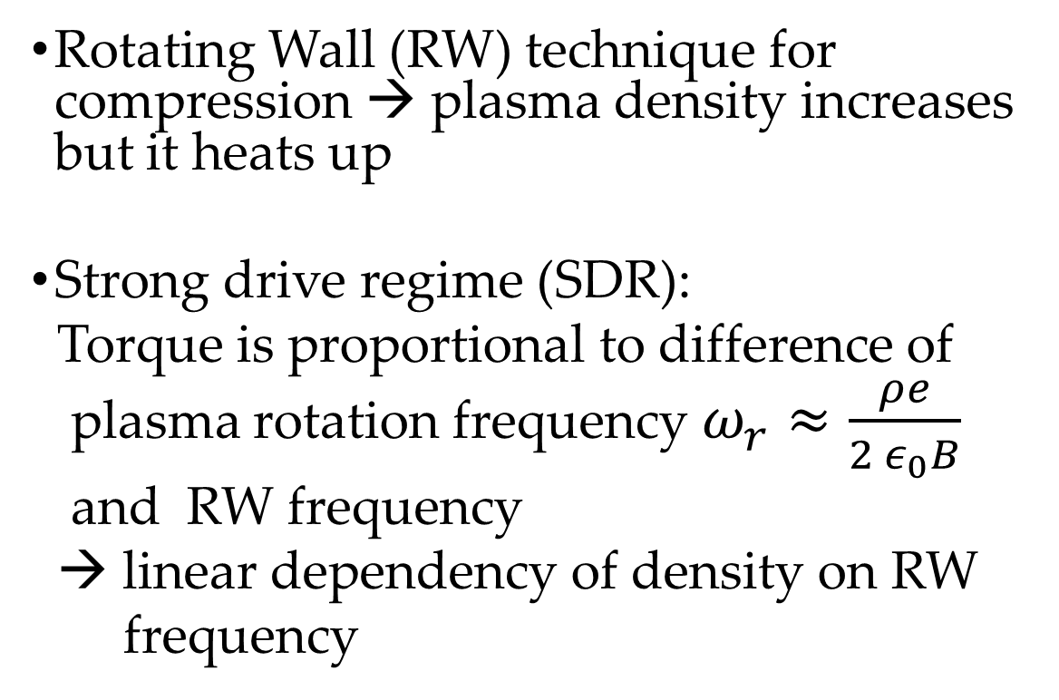
Plasma manipulation I
Rotating Wall (RW) technique for compression → plasma density increases but it heats up
Strong drive regime (SDR):
Torque is proportional to difference of
plasma rotation frequency $ω_{r}≈\frac{ρe}{2 ε_{0}B}$
and RW frequency
→ linear dependency of density on RW
frequency
Schematic of an MRE and the rotating wall technique. The plasma gets compressed by a rotating electric field applied on the RW electrode by inducing a torque on the plasma.

Slide 11
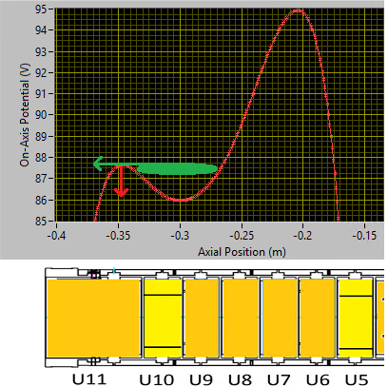
Plasma manipulation II
Evaporative cooling (EVC) for space charge control
Releasing the particles with highest energy → plasma cools down but expands
Schematic of EVC in the old Cusp trap. On-axis potential of the cusp trap (top) with indicated lowering of the potential (red arrow) and release of particles (green arrow). Sketch of the MRE (bottom).

Slide 12
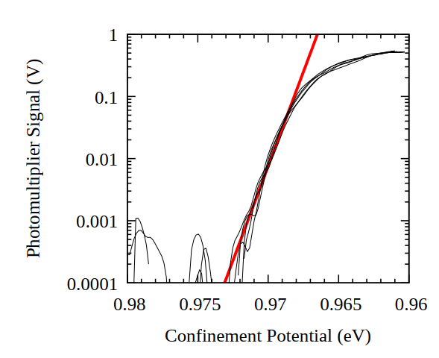
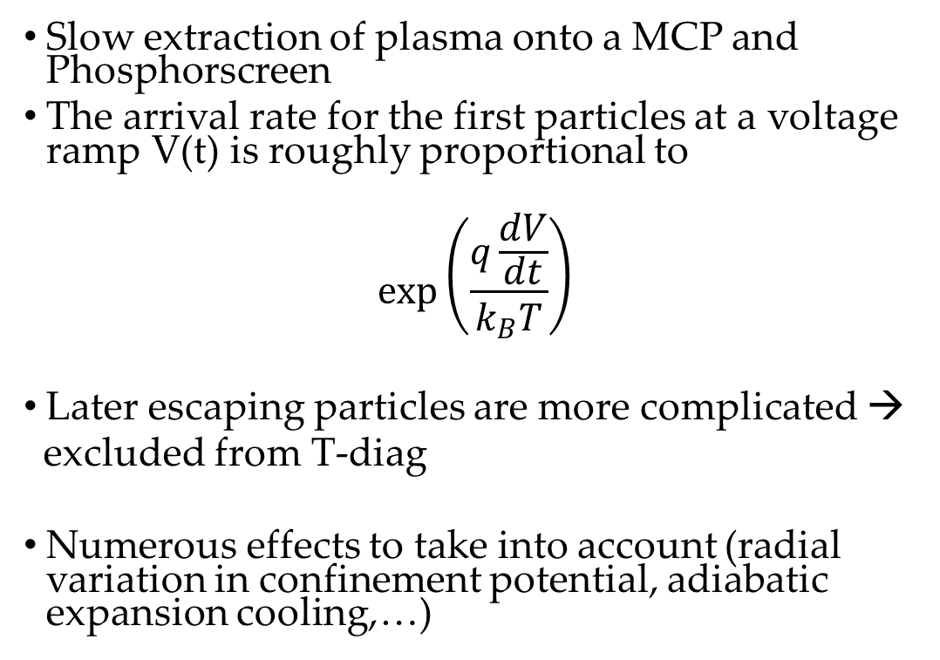
Temperature diagnostic
Slow extraction of plasma onto a MCP and Phosphorscreen
The arrival rate for the first particles at a voltage ramp V(t) is roughly proportional to
$$\exp\left(\frac{q\frac{dV}{dt}}{k_{B}T}\right)$$
Later escaping particles are more complicated →
excluded from T-diag
Numerous effects to take into account (radial variation in confinement potential, adiabatic expansion cooling,…)
T-diagnostics for 5 electron plasmas (black, overlaid) and one fit (red) with a result of T=8K ^{[6]}.

Slide 13
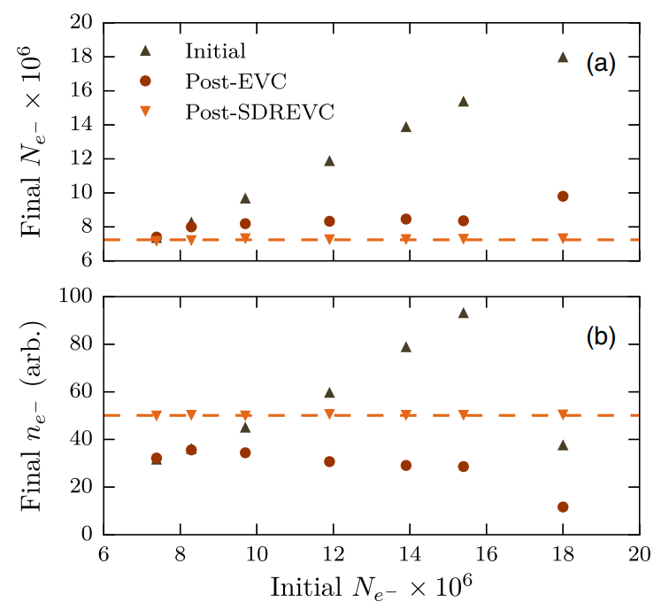
Plasma manipulation III
SDREVC: Combined technique of RW in the Strong drive regime (SDR) and evaporative cooling (EVC) - First shown by the ALPHA collaboration
Highly reproducible plasma independent of the initial number of particles
First result by ALPHA showing SDREVC with electrons. The final number of electrons (a) and final density (b) as functions of the initial number of electrons. One can see a highly reproducible number and density independent of the initial particle number ^{[7]}

Slide 14
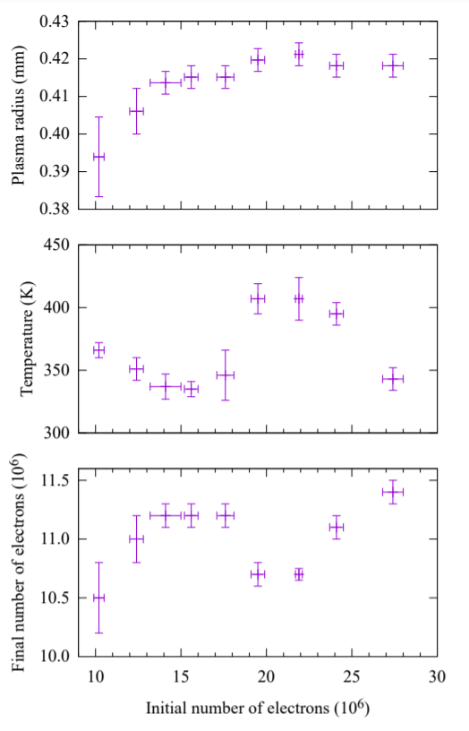
Results with e⁻: SDREVC (old trap)
High reproducibility (control r_{p}, T and N at a level of 1%, 2% and 3%, respectively), independent on initial particle number
First time SDREVC in a strong magnetic mirror field
Plasma radius, temperature and number of particles immediately after SDREVC ^{[8]}.

Slide 15
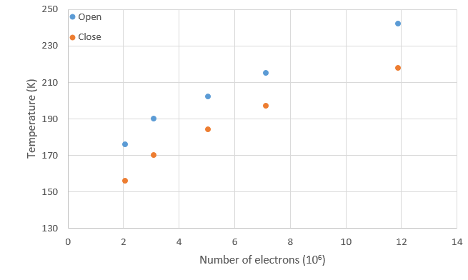
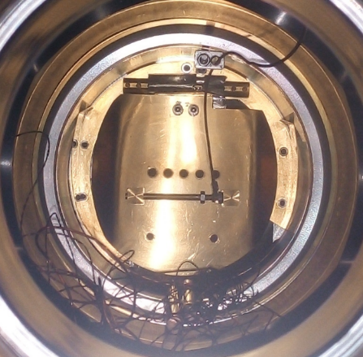
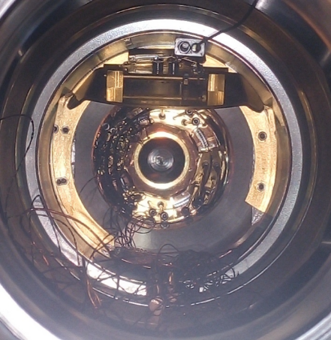
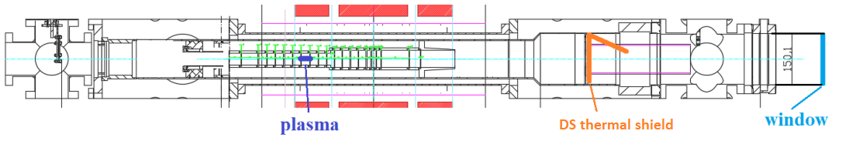
Plasma T in old Cusp trap
Did not manage to decrease T below 130K (trap temperature 70K) without EVC
Used thermal shield to block microwaves from room temperature regions
Plasma T as a function of the state of the thermal shield. The plasma is consistently 20K hotter if the shield is open.
Pictures of the thermal shield in the closed (left) and open (right) state.

Slide 16
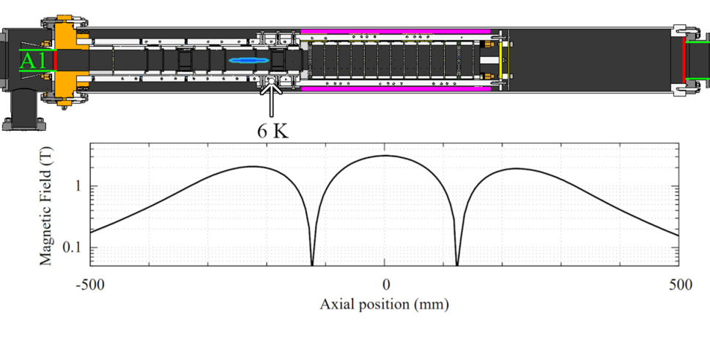
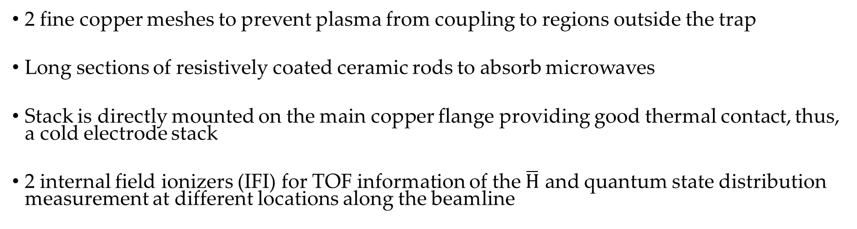
Upgrade of Cusp trap
2 fine copper meshes to prevent plasma from coupling to regions outside the trap
Long sections of resistively coated ceramic rods to absorb microwaves
Stack is directly mounted on the main copper flange providing good thermal contact, thus, a cold electrode stack
2 internal field ionizers (IFI) for TOF information of the $\overline{H}$ and quantum state distribution measurement at different locations along the beamline
Picture of the new MRE. The ceramic rods and the connection of the stack to the main copper flange are visible.
Drawing of the Cusp trap electrodes and on-axis magnetic field^{[9]}

Slide 17
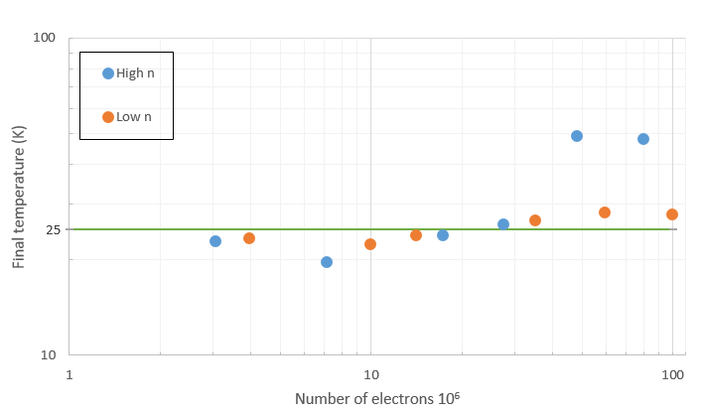
Results with e⁻ (new trap)
Decreased the MRE temperature of the Cusp trap by a factor of two to ~6K
The temperature of a plasma with density of 10⁸ cm⁻³ is ~100K colder than in the previous trap, albeit having 25 times more particle
Final plasma temperature as a function of initial electrons. “Low n” refers to a plasma with half the density of the “High n” dataset. The radii of the plasmas were held constant (0.8mm: High n, 1.1mm: Low n) → density and the length of the plasma varied in the same sense as N^{[9]}.

Slide 18
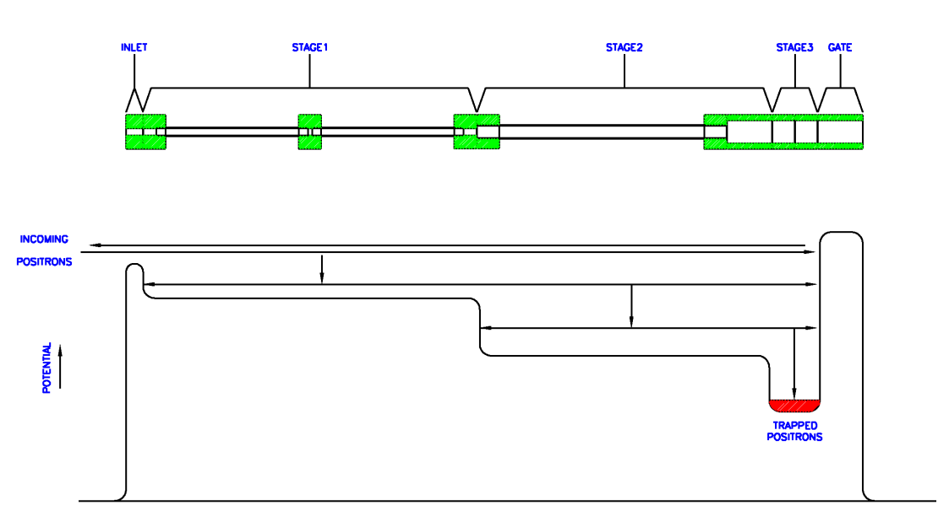
Positron system: Source + Trap
Commercial buffer gas trap from First Point Scientific Inc.
e⁺ from a ²²Na source are moderated by a conical Ne-ice moderator
Energy loss due to collisions with buffer gas (N₂)
Schematic of the positron trap (top) and the corresponding trapping potential (bottom) ^{[10]}
Picture of the electrode stack. Positrons from ²²Na source enter from the left

Slide 19
Positron System: Stacker
Continuous accumulation (“stacking”) of e⁺ while antiproton preparation
Electrodes spray-painted with colloidal graphite
Designed for transferring ~10⁸ e⁺ in one bunch to the Cusp trap
Picture of the MRE of the stacker. The electrodes are spray painted with colloidal graphite for absorbing light and reducing variation in surface potentials.

Slide 20
Upgrade of the e⁺ system I
Old system
Stacking in Cusp trap → Contaminate the Cusp trap
0.6T field (superconducting magnet), liquid He cooling was used
Long time to produce bunches of e⁺ (about 2 million in 30s, 4mCi source)
    ~67k /s
New system
New Stacker→ only when necessary transfer to Cusp trap
500G field, water cooling is used
Higher production efficiency (1M e⁺ per second, 24mCi source, Aarhus)
    ~167k /s (assuming 4mCi source)

Slide 21
Upgrade of the e⁺ system II
Old system
Moderator efficiency: ~0.25%
Moderator lasts half a day
New system
Moderator efficiency: ~0.5% (Aarhus)
Moderator lasts two weeks (Aarhus)

Slide 22
Reality in the upgraded positron system
Many problems had to be solved:
    Vacuum leaks
    Electrical noise
    Cryo pump died
    Maintenance of coldhead
    Magnet short to ground
    Control PC died
2.1k e⁺/s: trapping efficiency ~1.5% (Aarhus: 35%)
Positrons in Cusp trap: ~1k e⁺/cycle
→ Fixing in progress!

Slide 23
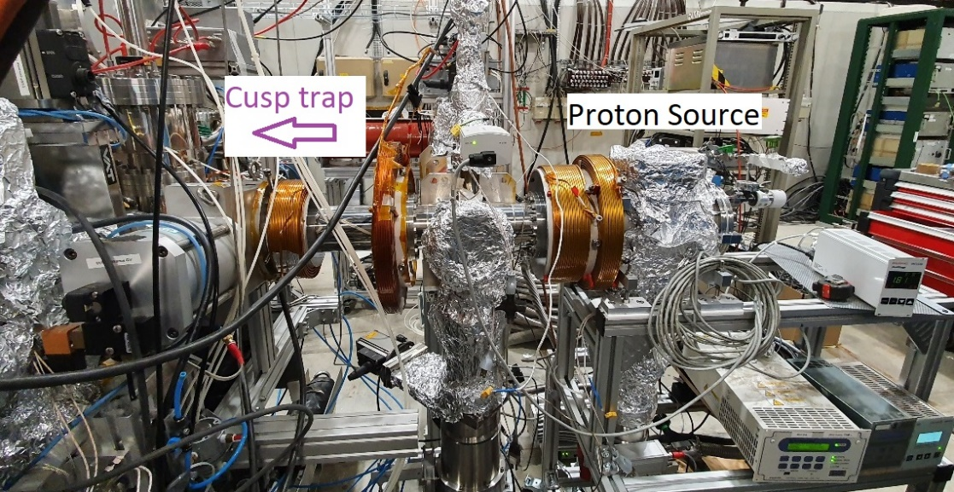
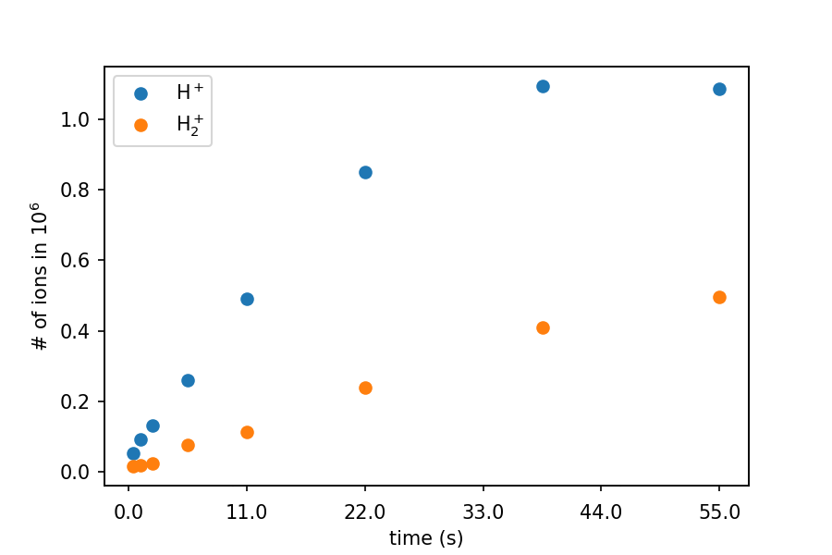
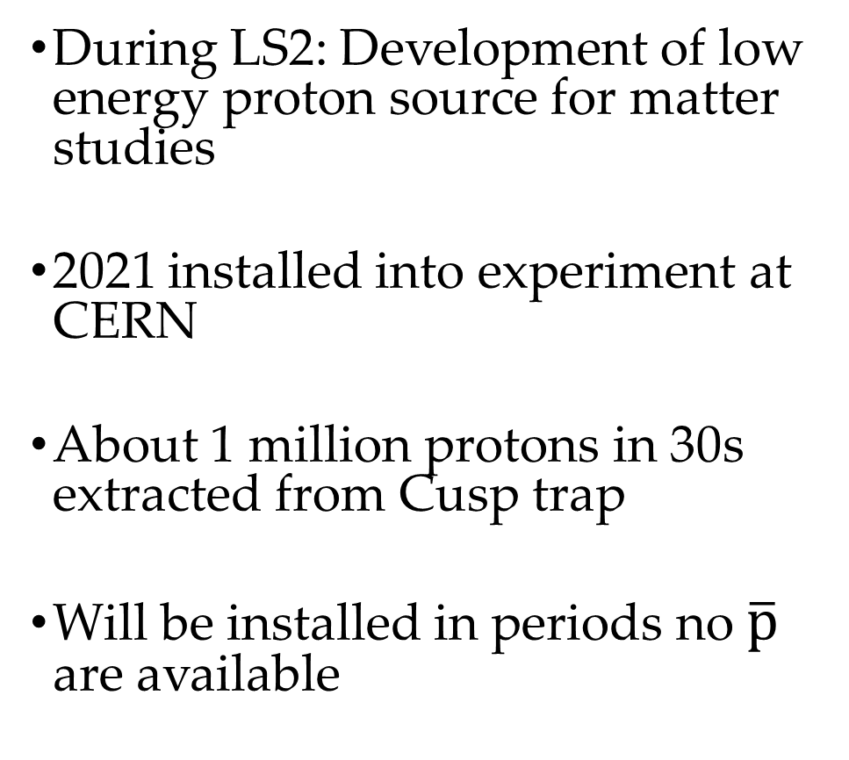
Proton Source
During LS2: Development of low energy proton source for matter studies
2021 installed into experiment at CERN
About 1 million protons in 30s extracted from Cusp trap
Will be installed in periods no $\overline{p}$ are available
Protons are caught in the Cusp trap and extracted onto MCP + Phosphor Screen.
The contaminant H₂⁺ ions were produced by hot protons colliding with residual gas molecules in the Cusp trap ^{[6]}.

Slide 24
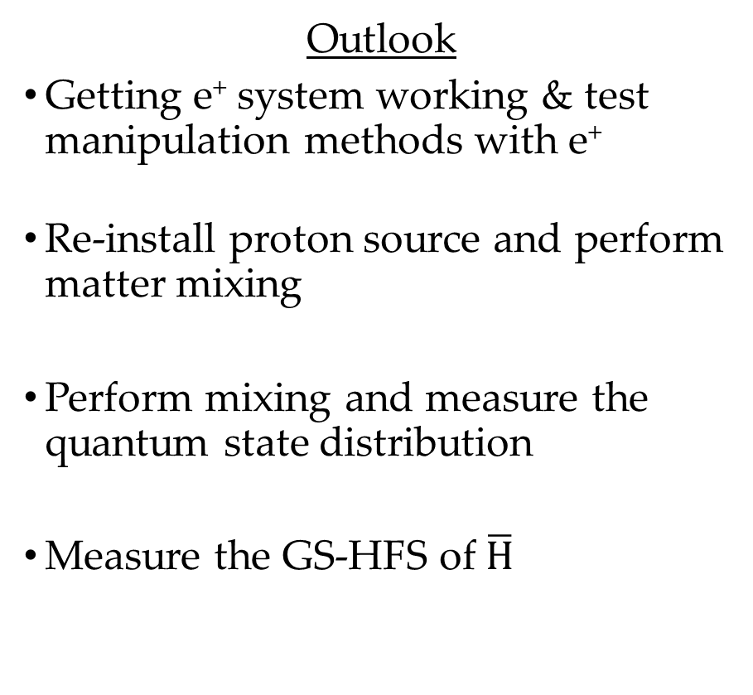
Summary
Demonstrated that SDREVC works in the cusped magnetic field over a wide range of initial particle number
Achieved ~6K in the Cusp MRE
Achieved a cold, reproducible electron plasma of ~25K (~5x colder than previously achieved in the Cusp trap)
New positron system installed
Proton source installed and tested
Outlook
Getting e⁺ system working & test manipulation methods with e⁺
Re-install proton source and perform matter mixing
Perform mixing and measure the quantum state distribution
Measure the GS-HFS of $\overline{H}$

Slide 25
Acknowledgments
ASACUSA collaboration
E. Hunter, D.J. Murtagh, D. Pristauz-Telsnigg (Stefan Meyer Institute):
  Designing (D. P-T), building & Testing of the Cusp trap
G. Maero, M. Rome (Università degli Studi di Milano):
  Designing, building & installation of the stacker
Funding:
  FWF & INFN

Slide 26
References
[1] Kolbinger, B., Amsler, C., Cuendis, S.A. et al. Measurement of the principal quantum number distribution in a beam of antihydrogen
atoms. Eur. Phys. J. D 75, 91 (2021). https://doi.org/10.1140/epjd/s10053-021-00101-y
[2] Kuroda N & Ulmer, Stefan et al. A source of antihydrogen for in-flight hyperfine spectroscopy. Nature communications. 5. 3089. 10.1038/ncomms4089 (2014)
[3] Radics B., Murtagh D. J., Yamazaki Y. Scaling behavior of the ground-state antihydrogen yield as a function of positron density and temperature from classical-trajectory Monte Carlo simulations. Physical Review A 90, 032704 (2014)
[4] Weiser A., A low energy proton source for ASACUSA’s matter studies, master’s thesis, University of Vienna (2020)
http://cds.cern.ch/record/2748624
[5] Dubin, D., & O'Neil, T. (1999). Trapped nonneutral plasmas, liquids, and crystals (the thermal equilibrium states). Rev. Mod. Phys., 71, 87–172
[6] Hori, M., & Widmann, E., Status report of the ASACUSA experiment - progress in 2021 and plans for 2022 CERN (2022) https://cds.cern.ch/record/2799130/files/SPSC-SR-301.pdf
[7] Amsler, C., Barna, D., et.al Status report of the ASACUSA experiment - progress in 2020 and plans for 2021, CERN. (2021)
[8] Ahmadi M. et al. Enhanced Control and Reproducibility of Non-Neutral Plasmas. Phys. Rev. Lett. 120, 025001 (2018)
[9] C. Amsler et al. (2022). Reducing the background temperature for cyclotron cooling in a cryogenic Penning–Malmberg trap. Physics of Plasmas, 29(8), 083303.
[10] Manual of the FPS trap, from FPSI

