Slide 1




GRASIAN
GRAvity, Spectroscopy and Interferometry with ultra-cold Atoms and Neutrons
Symposium for the 20th birthday of the Stefan Meyer Institute
Pauline Yzombard, laboratoire Kastler Brossel
On behalf of the GRASIAN collaboration
https://grasian.eu

Slide 2
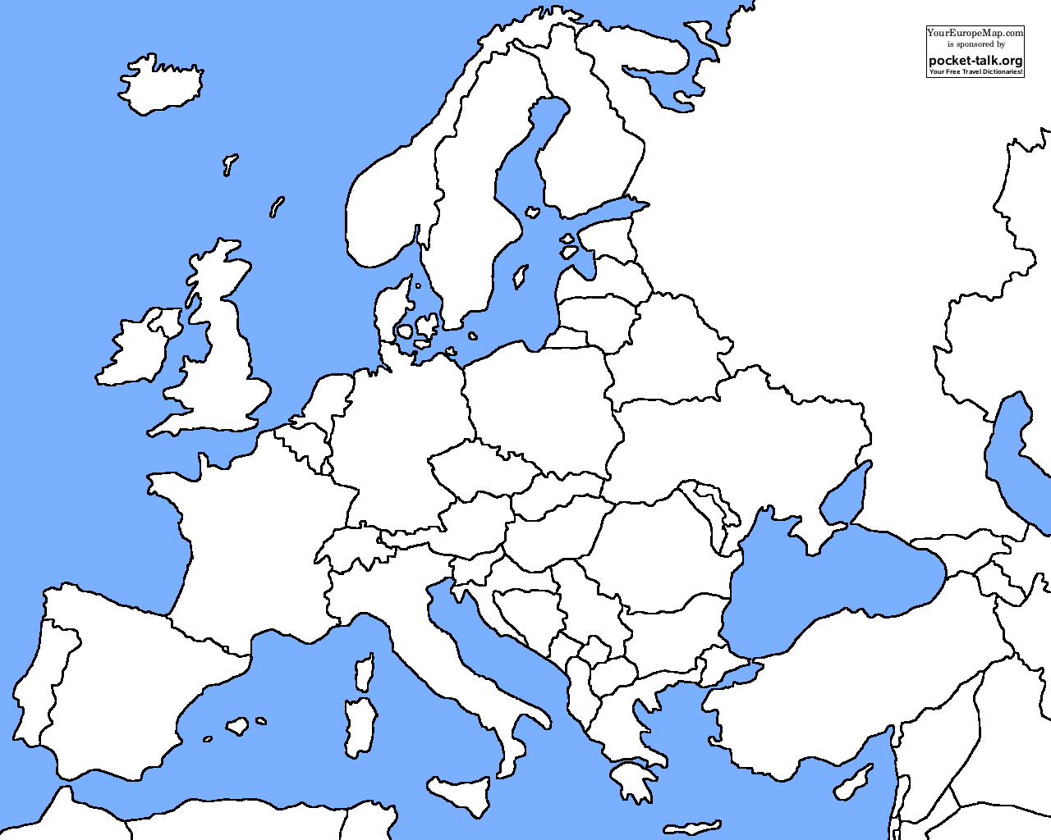







GRASIAN Collaboration
5 institutes accros Europe
Institut Max von Laue – Paul Langevin,
Institute of Particle Physics and Astrophysics, ETH Zürich.
Laboratoire Kastler Brossel,
Stefan Meyer Institute,
University of Turku, Wihuri Physical Laboratory
Studying Gravitational Quantum States (GQS) and whispering gallery states of neutrons/hydrogens for:
Short range fundamental forces caused by dark matter, extra dimension, new light bosons, dark energy
• CPT and Lorentz invariance violation (matter/antimatter tests)
• QED tests (spectroscopy)
0

Slide 3
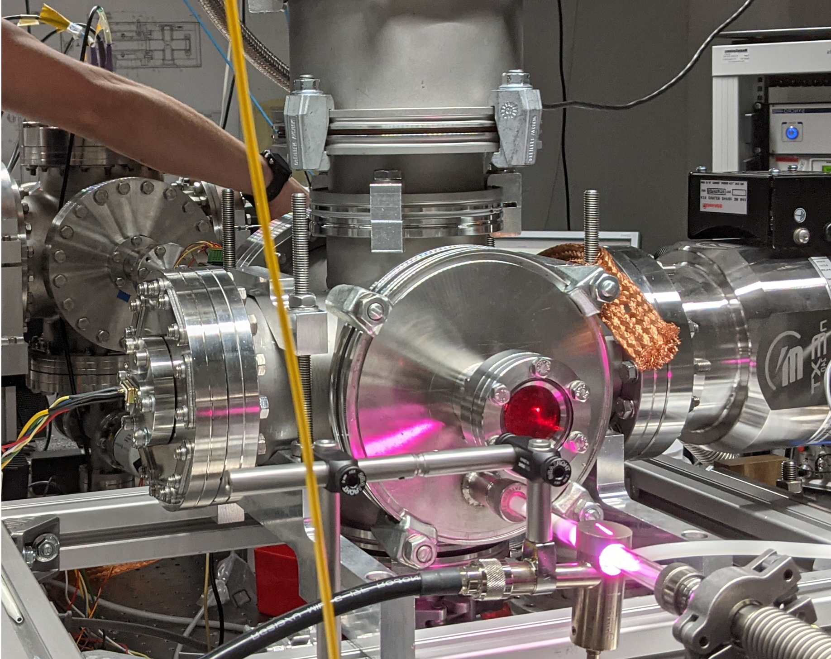
Overview
https://grasian.eu
Gravitational quantum states, Was ist das ?
The “in-beam” experiment @ETH Zürich/ SMI
The “trapped” experiment @Turku University (Finland)
The whispering galleries experiment @ ILL Grenoble (France)

Slide 4
Overview
https://grasian.eu
Gravitational quantum states, Was ist das ?
The “in-beam” experiment @ETH Zürich/ SMI
The “trapped” experiment @Turku University (Finland)
The whispering galleries experiment @ ILL Grenoble (France)

Slide 5
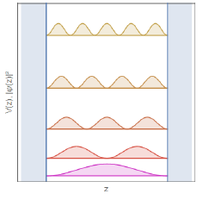
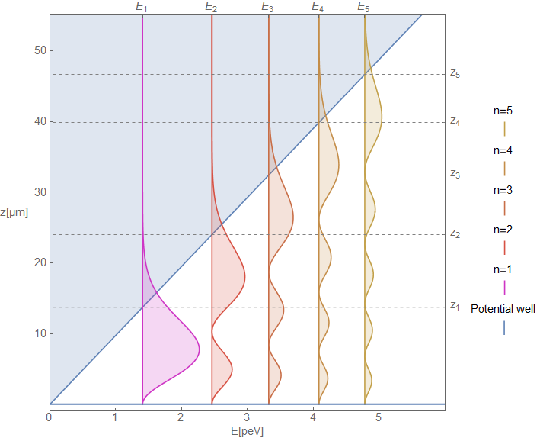
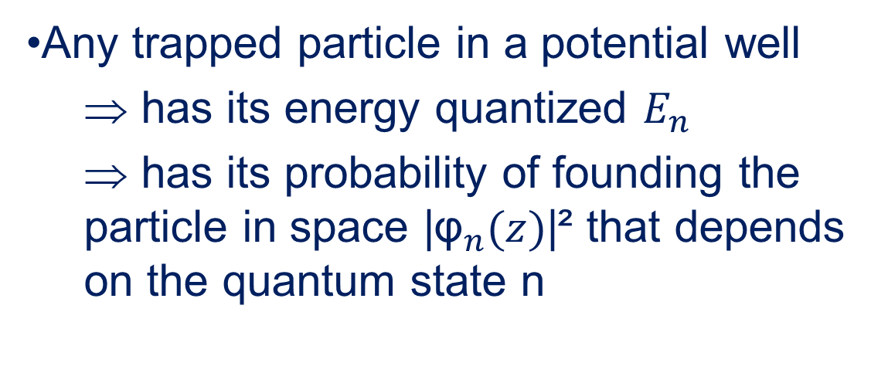
1. Gravitational quantum states (GQS), Was ist das ?
Z(µm)
Potential well
g
Gravity potential: mgz
Any trapped particle in a potential well
  ⇒ has its energy quantized $E_{n}$
  ⇒ has its probability of founding the particle in space |${\text{φ}}_{n}(z)$|² that depends on the quantum state n
0
Atom mirror
Example:
1D infinite squared well
1
International collaboration: GRASIAN https://grasian.eu

Slide 6
1. Gravitational quantum states (GQS), Was ist das ?
Potential well
Z(µm)
g
Gravity potential: mgz
Particle confined: (1D trap)
  In the top: by Gravitational potential
  In the bottom: by quantum reflections onto the surface
  ⇒ behaves like an “atom mirror”.
0
Atom mirror
Quantum reflection: specular reflection of the slow particle (wave-packet) which sees a steep potential step when approaching to the surface
1
International collaboration: GRASIAN https://grasian.eu

Slide 7
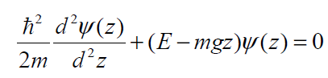
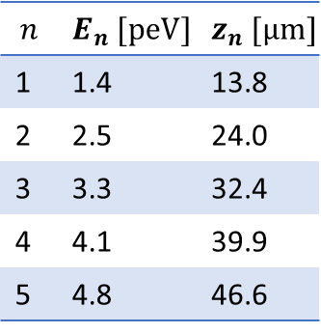
1. Gravitational quantum states (GQS), Was ist das ?
Potential well
Z(µm)
g
Particle confined: (1D trap)
Solution Ψ = Airy function
(z_{n}= zeros of the function)
0
Atom mirror
$$n$$ | $$E_{n} [peV]$$ | $$z_{n} [µm]$$
1 | 1.4 | 13.8
2 | 2.5 | 24.0
3 | 3.3 | 32.4
4 | 4.1 | 39.9
5 | 4.8 | 46.6
2

Slide 8
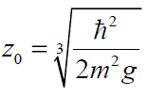

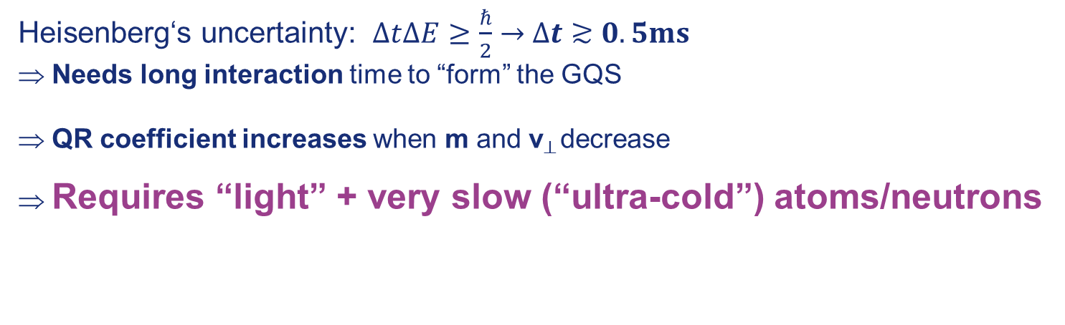

1. Gravitational quantum states (GQS), Was ist das ?
Potential well
Z(µm)
g
Gravity potential: mgz
Particle confined: (1D trap)
Solution Ψ = Airy function
(z_{n}= zeros of the function)
0
Atom mirror
Eigenenergies $E_{n}$ $\sim$peV (~100Hz)
with ~5.8µm
Heisenberg‘s uncertainty: $∆t∆E≥\frac{ℏ}{2}→$ $∆t≳0.5ms$
Needs long interaction time to “form” the GQS
QR coefficient increases when m and v⊥ decrease
⇒ Requires “light” + very slow (“ultra-cold”) atoms/neutrons
$$n$$ | $$E_{n} [peV]$$ | $$z_{n} [µm]$$
1 | 1.4 | 13.8
2 | 2.5 | 24.0
3 | 3.3 | 32.4
4 | 4.1 | 39.9
5 | 4.8 | 46.6
2

Slide 9
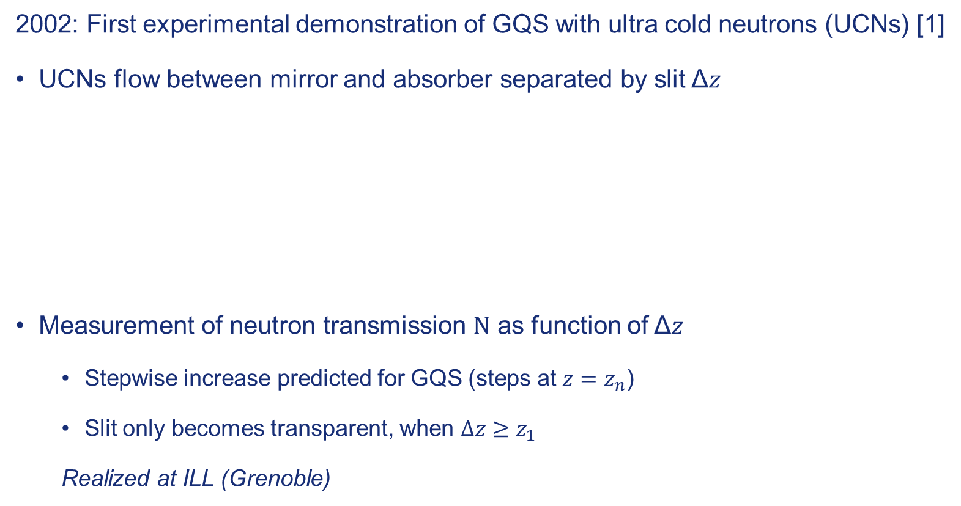



GQS of ultra cold neutrons (UCNs)
2002: First experimental demonstration of GQS with ultra cold neutrons (UCNs) [1]
UCNs flow between mirror and absorber separated by slit Δ𝑧
Measurement of neutron transmission $N$ as function of Δ𝑧
  Stepwise increase predicted for GQS (steps at $z=z_{n}$)
  Slit only becomes transparent, when $Δz≥z_{1}$
  Realized at ILL (Grenoble)
$$z=z_{1}$$
$$z=z_{2}$$
$$z=z_{3}$$
0
1
.
Absorber
Neutron
detector
)
1
–
s
0
.
0
s
1
t
n
u
o
c
Collimator
Bottom mirrors
(
N
–
1
3
0
0
1
0
2
0
3
0
4
0
A
b
s
o
r
b
e
r
h
e
i
g
h
t
(µm)
Figures taken from [1].
[1] Nesvizhevsky, V., et al. Quantum states of neutrons in the Earth's Gravitational field. Nature 415, 297–299 (2002). https://doi.org/10.1038/415297a
3

Slide 10
Overview
https://grasian.eu
Gravitational quantum states, Was ist das ?
The “in-beam” experiment @ETH Zürich/ SMI
The “trapped” experiment @Turku University (Finland)
The whispering galleries experiment @ ILL Grenoble (France)

Slide 11
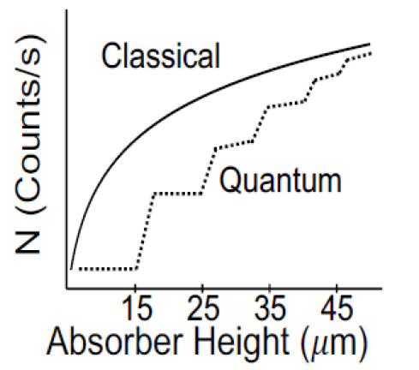
2. The “in-beam” experiment @ETH Z/SMI towards the 1st demonstration of GQS with H
Mimicking the neutron historical experiment
In development at ETH Zurich (2020-2023) and SMI (2024 and future)
$$∆z=z_{2}$$
$$∆z=z_{3}$$
Cryogenic
H-Beam
Absorber
$$∆z<z_{1}$$
$$∆z=z_{1}$$
$$∆z<z_{1}$$
$$∆z$$
H-Detection
Mirror
4

Slide 12


2. The “in-beam” experiment @ETH Z/SMI towards the 1st demonstration of GQS with H
Mimicking the neutron historical experiment
In development at ETH Zurich (2020-2023) and SMI (2024 and future)
$$∆z=z_{2}$$
$$∆z=z_{3}$$
Cryogenic
H-Beam
Absorber
$$∆z<z_{1}$$
$$∆z=z_{1}$$
$$∆z<z_{1}$$
$$∆z$$
H-Detection
Mirror
  Motivation (H vs. neutrons):
    GQS never measured for atoms! Different
    interaction potential with surface compared to neutron
    research of short-range extra forces
    a
    Easy to generate (hydrogen bottle vs.
    research reactor) → Much higher fluxes available
    Developed methods also applicable for antiatoms ($→\overline{g}$)
  Motivation (H vs. neutrons):
    GQS never measured for atoms! Different
    interaction potential with surface compared to neutron
    research of short-range extra forces
    a
    Easy to generate (hydrogen bottle vs.
    research reactor) → Much higher fluxes available
    Developed methods also applicable for antiatoms ($→\overline{g}$)
4

Slide 13
2. The “in-beam” experiment @ETH Z/SMI towards the 1st demonstration of GQS with H
Mimicking the neutron historical experiment
In development at ETH Zurich (2020-2023) and SMI (2024 and future)
$$∆z=z_{2}$$
$$∆z=z_{3}$$
Cryogenic
H-Beam
Absorber
$$∆z<z_{1}$$
$$∆z=z_{1}$$
$$∆z<z_{1}$$
$$∆z$$
H-Detection
Mirror
  Motivation (H vs. neutrons):
    GQS never measured for atoms! Different
    interaction potential with surface compared to neutron
    research of short-range extra forces
    a
    Easy to generate (hydrogen bottle vs.
    research reactor) → Much higher fluxes available
    Developed methods also applicable for antiatoms ($→\overline{g}$)
  Motivation (H vs. neutrons):
    GQS never measured for atoms! Different
    interaction potential with surface compared to neutron
    research of short-range extra forces
    a
    Easy to generate (hydrogen bottle vs.
    research reactor) → Much higher fluxes available
    Developed methods also applicable for antiatoms ($→\overline{g}$)
Requirements:
  Efficient detection of hydrogen
  Good signal/background
  (Very) Cold hydrogen beam:
    Slow: v║ ~ 50 m/s horizontally
    Highly collimated (v⊥~3 cm/s)
4

Slide 14
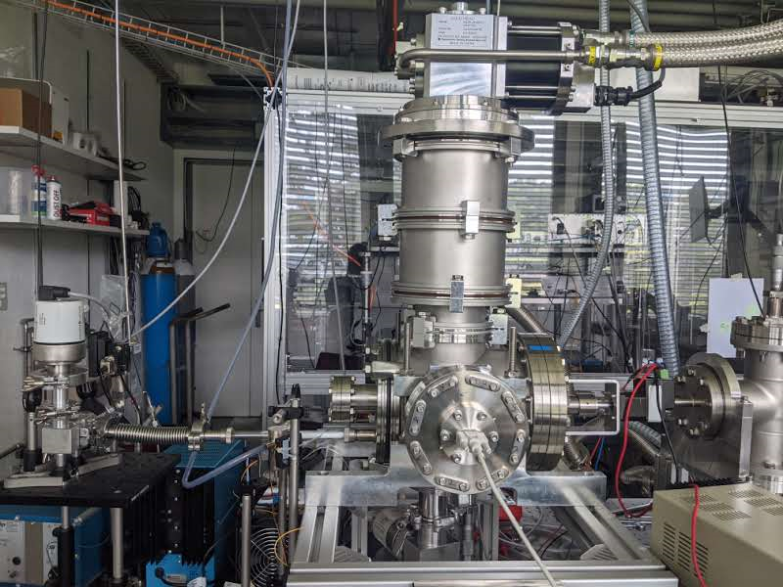
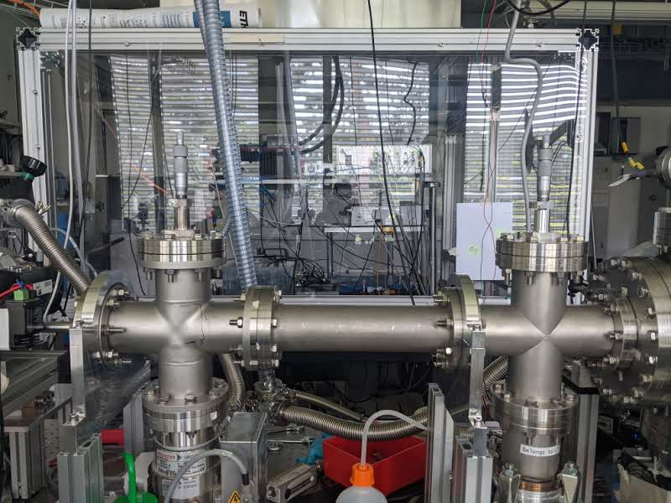
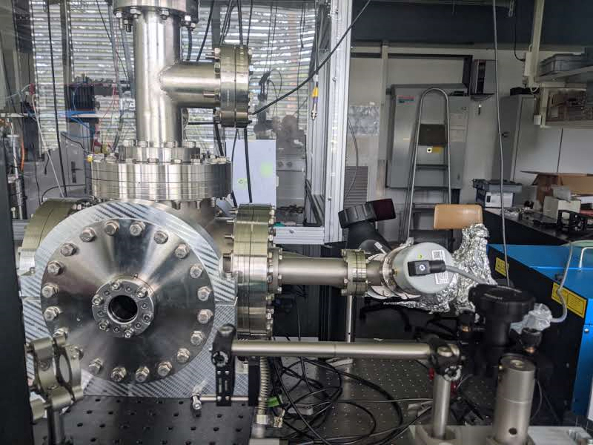


2. The “in-beam” experiment @ETH Z
In pictures (ETH Zürich setup – 2020-2023)
Differential pumping
Hbeam chamber
Slit 2
Slit 3
Detection chamber
Cold head (4.2 K)
Slit 2
Slit 3
Detection chamber
H₂-Bottle
MW
discharge
cavity
$$p_{dc}$$
$$p_{cc}$$
Turbo 2
Turbo 3
5
Turbo 1
Turbo 4
UV laser

Slide 15
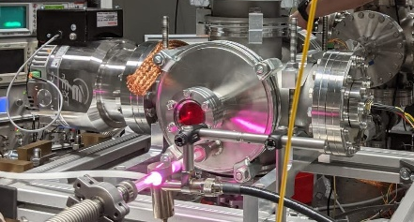
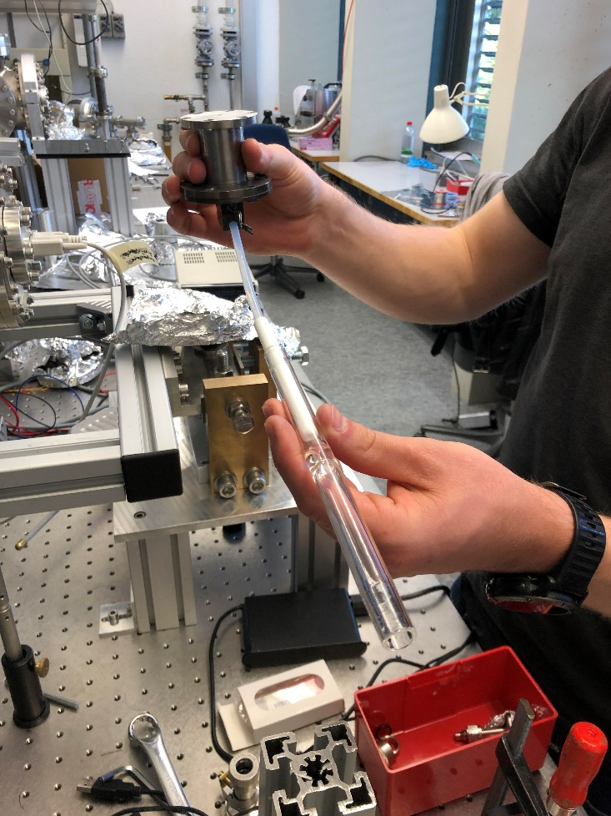
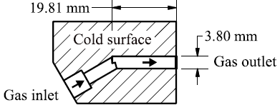
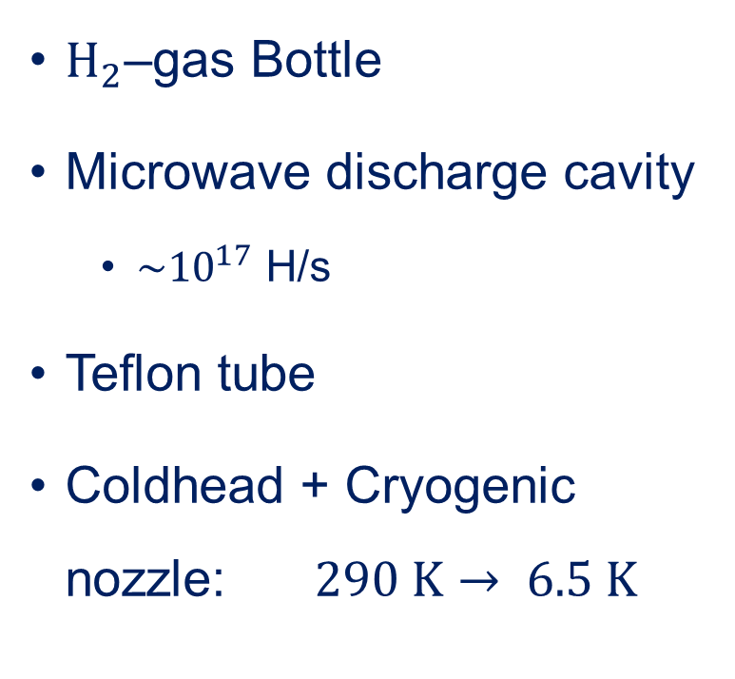
Hydrogen source
$H_{2}$–gas Bottle
Microwave discharge cavity
  $\sim {10}^{17}$ H/s
Teflon tube
Coldhead + Cryogenic nozzle: $290 K→ 6.5 K$
6
Slide: courtesy of C. Killian

Slide 16




Detection of hydrogen – overview
Ionization Potential
2s
$$∆E=10.2eV→f≈246THz→λ≈121.8nm$$
$$λ=243nm$$
Ionization of $H$ with a pulsed UV-laser ($λ=243$nm)
  $H→H^{+}+e^{−}$
  2 photon excitation (1S-2S) + 1 photon ionization
Detection of $H^{+}$ with an MCP
Integrated MCP-Signal $∝H$- count rate
1s
Hydrogen energy diagram
Signal
MCP
Atomic H-Beam
$$H^{+}$$
UV laser
7
UV laser
Side view
Top view
Slide: courtesy of C. Killian

Slide 17
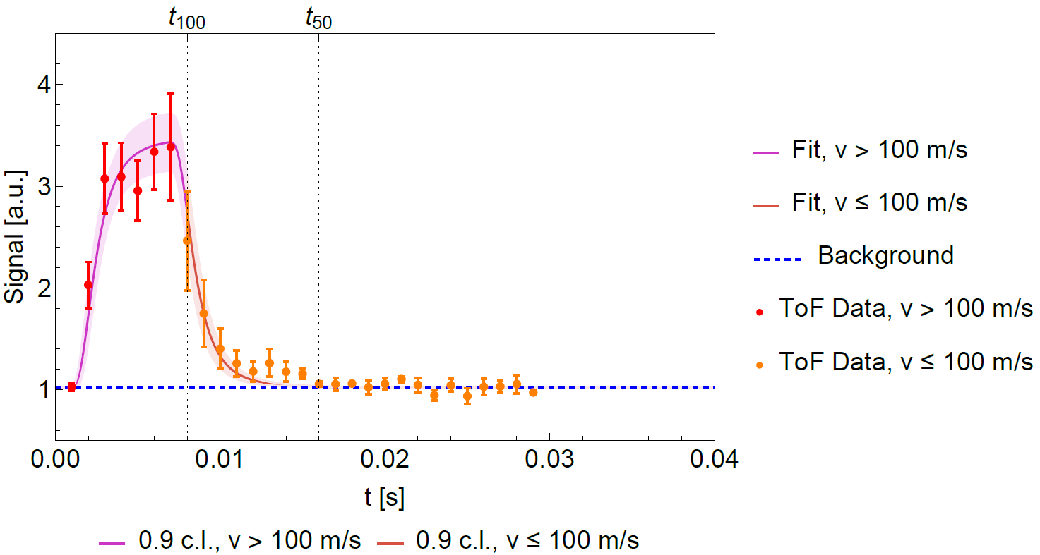
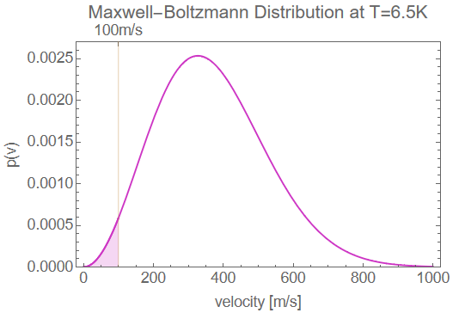
2. Characterization of the H-beam source (ETH Z)
Work performed in 2020- 2022, [2] Killian, Carina, et al.
Goal: generating H atoms @ v║ ~ 50-100 m/s horizontally
Selection of the atoms in the tails of the Maxwellien distribution
ToF measurement
8
[2] Killian, Carina, et all (Grasian Collaboration) Grasian: towards the first demonstration of Gravitational quantum states of atoms with a cryogenic hydrogen beam. Eur. Phys. J. D, 77(3):50, 2023.

Slide 18
2. Optimization of the background (ETH Z)
Work performed in 2023, [3] Killian Carina, et al.
Goal: reducing as much as possible the background H signal (“H rest gas in the chamber” not coming from the H beam directly)
9

Slide 19
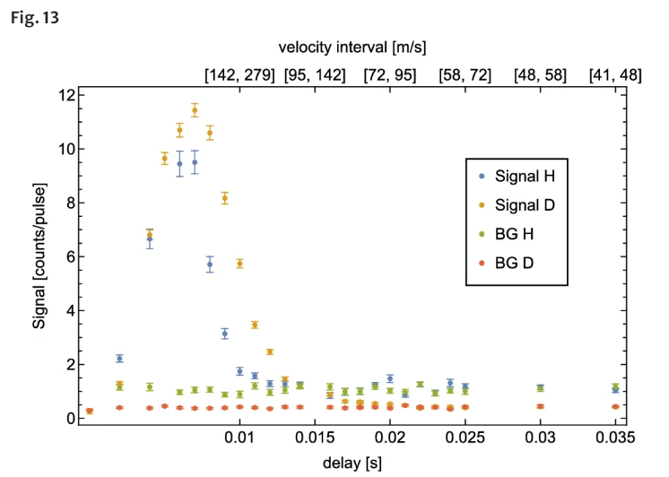
2. Optimization of the background (ETH Z)
Work performed in 2023, [3] Killian Carina, et al.
Goal: reducing as much as possible the background H signal (“H rest gas in the chamber” not coming from the H beam directly)
Switching to Deuterium atoms
9
[3] Killian, Carina, et al. (Grasian Collaboration) GRASIAN: shaping and characterization of the cold hydrogen and deuterium beams for the forthcoming first demonstration of gravitational quantum states of atoms. Eur. Phys. J. D, 78 132 2024.

Slide 20
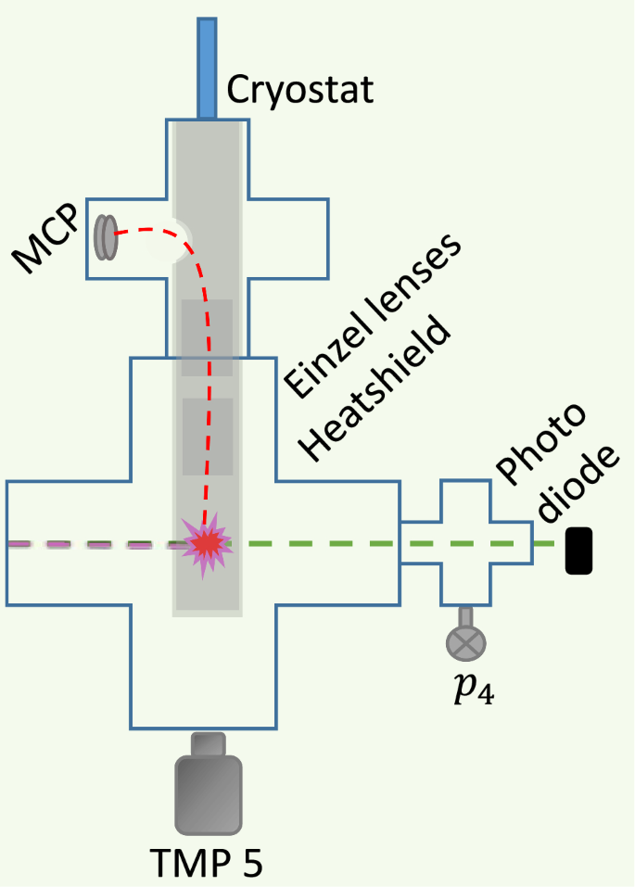
2. Optimization of the background (ETH Z)
Work performed in 2023, [3] Killian Carina, et al.
Goal: reducing as much as possible the background H signal (“H rest gas in the chamber” not coming from the H beam directly)
Switching to Deuterium atoms
Test of
cryogenic shield
in the detection
Chamber
(Turku design
-S. Vasiliev-
Wet cryostat)
Total reduction of the background signals by 2 orders of magnitude
9
[3] Killian, Carina, et al. (Grasian Collaboration) GRASIAN: shaping and characterization of the cold hydrogen and deuterium beams for the forthcoming first demonstration of gravitational quantum states of atoms. Eur. Phys. J. D, 78 132 2024.

Slide 21
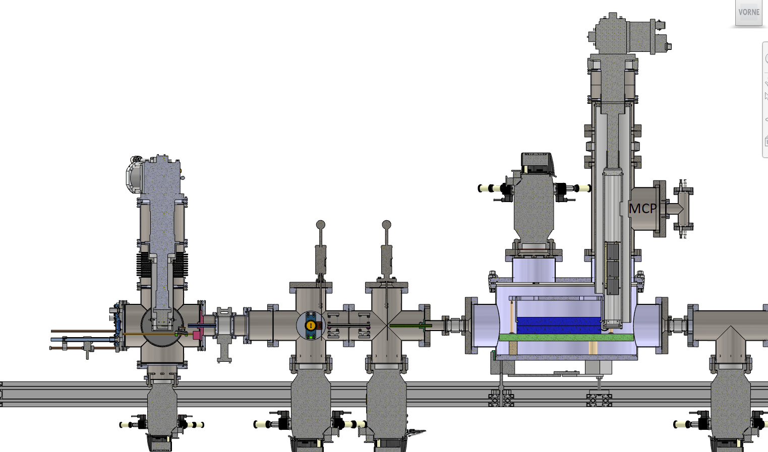
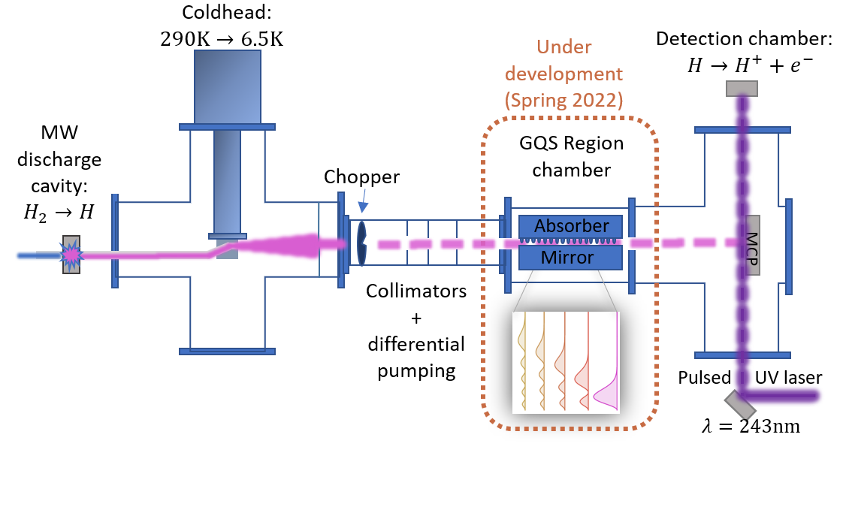
2. The “in-beam” experiment @SMI
Experimental status – new design (2024)
Mirror and
absorber
Cryo-shield
Cryogenic
H source
Collimation zones
With 2 adjustable slits
GQS formation
zone
GQS chamber
10
Photodetachment laser (detection zone)

Slide 22
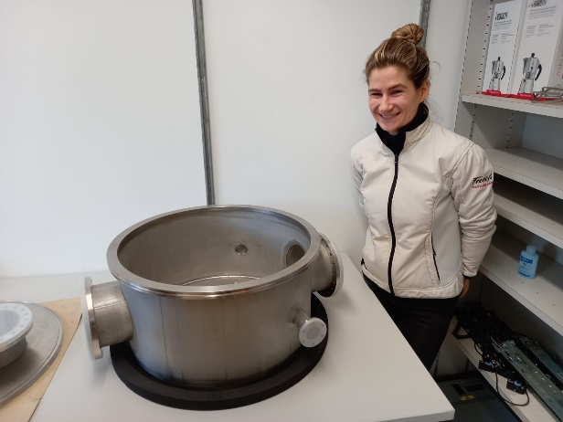
2. The “in-beam” experiment @SMI
Experimental status – new design (2024)
The GQS chamber
Design & manufacturing @ ETH Z
Mirror and
absorber
Cryo-shield
Cryogenic
H source
Collimation zones
With 2 adjustable slits
GQS formation
zone
GQS chamber
10
Photodetachment laser (detection zone)

Slide 23
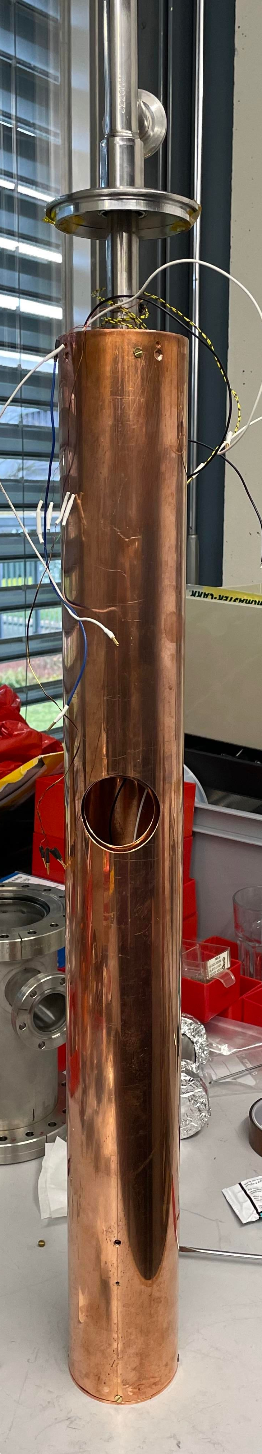
2. The “in-beam” experiment @SMI
Experimental status – new design (2024)
Mirror and
absorber
Cryo-shield
New Cryo-shield
SMI’s new design
(dry system)
Cryogenic
H source
Collimation zones
With 2 adjustable slits
GQS chamber
10
Photodetachment laser (detection zone)

Slide 24
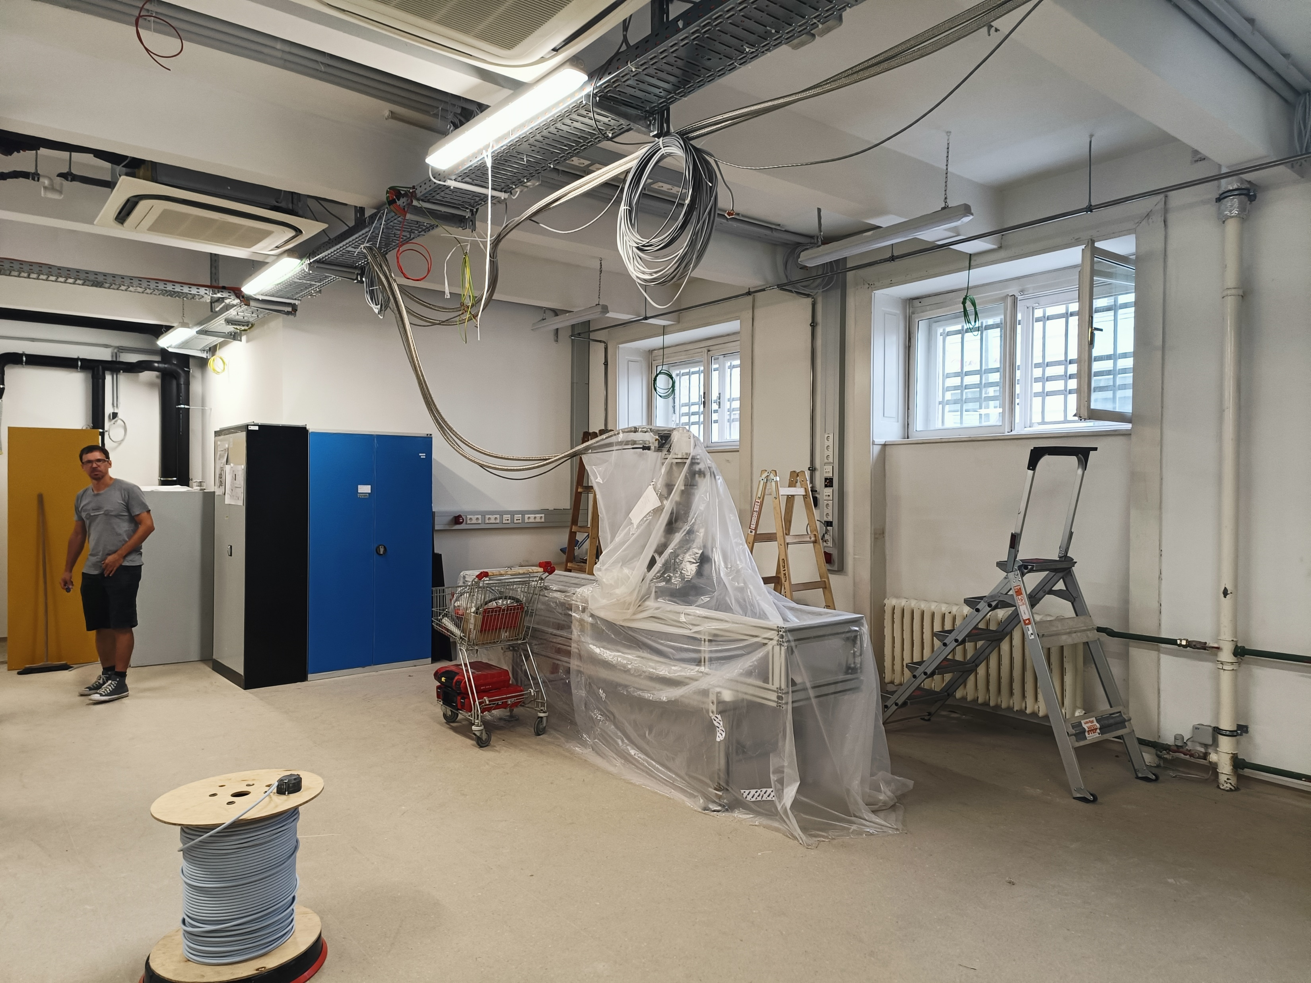
2. The “in-beam” experiment @SMI
Experimental status – new design (2024)
30th of July 2024 !
A fully refurbished lab !
11

Slide 25
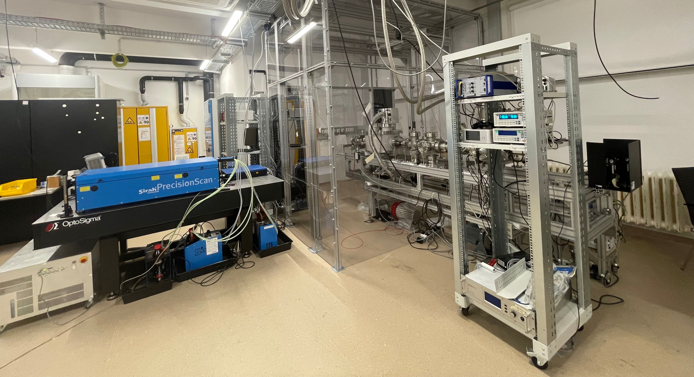
2. The “in-beam” experiment @SMI
Experimental status – new design (2024)
September 2024 !
A fully refurbished lab !
11

Slide 26
Improved results (Elio et Carina)
12

Slide 27
Improved results
Requirements:
  Efficient detection of hydrogen
  Good signal/background
  (Very) Cold hydrogen beam:
    Slow: v║ ~ 50 m/s horizontally
    Highly collimated (v⊥~3 cm/s)
(to be confirmed soon)
In progress
Ready for first trials of GQS observations on H beam soon !
13

Slide 28
Overview
https://grasian.eu
Gravitational quantum states, Was ist das ?
The “in-beam” experiment @ETH Zürich/ SMI
The “trapped” experiment @Turku University (Finland)
The whispering galleries experiment @ ILL Grenoble (France)

Slide 29
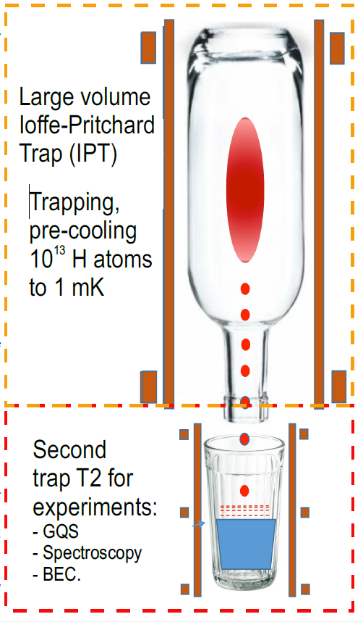
3.The “trapped” experiment @Turku University,Finland
Goal: trapping ultra-cold H for long-living GQS
Idea:
Magnetic bottle (IPT) and magneto gravity (T2) traps in cryogenic environment
(<100 mK)
V. V. Nesvizhevsky, et al.
A magneto-Gravitational trap for precision studies of Gravitational quantum states. Eur. Phys. J. C 123, 1–10 (2020)
14

Slide 30
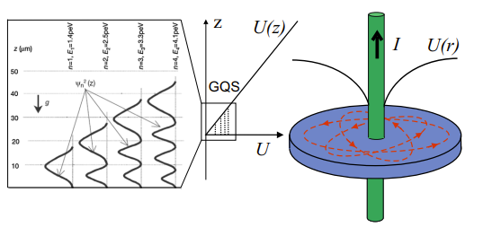
3.The “trapped” experiment @Turku University,Finland
Goal: trapping ultra-cold H for long-living GQS
Idea:
Magnetic bottle (IPT) and magneto gravity (T2) traps in cryogenic environment
(<100 mK) [4]
[4] V. V. Nesvizhevsky, et al.
A magneto-Gravitational trap for precision studies of Gravitational quantum states. EPJ. C 123, 1–10 (2020)
Magneto-Gravitational trap:
Z-axis trapped by gravity and QR
Radial trapping: magnetic confinement
14

Slide 31
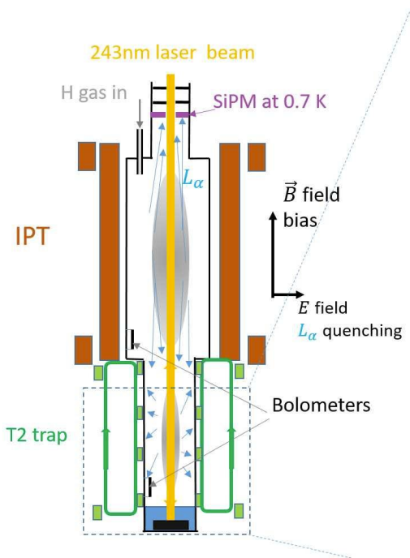
3.The “trapped” experiment @Turku University,Finland
Goal: trapping ultra-cold H for long-living GQS
Idea:
Magnetic bottle (IPT) and magneto gravity (T2) traps in cryogenic environment
(<100 mK) [4]
[4] V. V. Nesvizhevsky, et al.
A magneto-Gravitational trap for precision studies of Gravitational quantum states. EPJ. C 123, 1–10 (2020)
Magneto-Gravitational trap:
Z-axis trapped by gravity and QR
Radial trapping: magnetic confinement
15

Slide 32
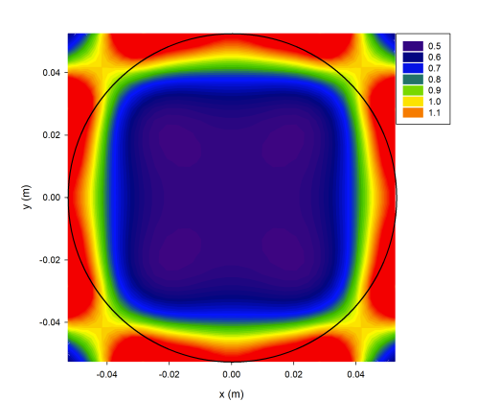
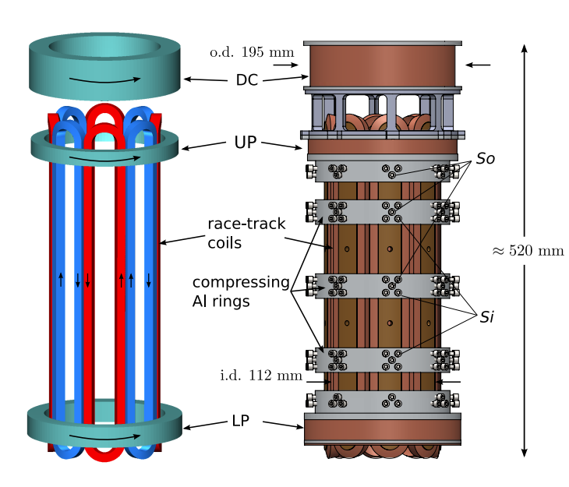
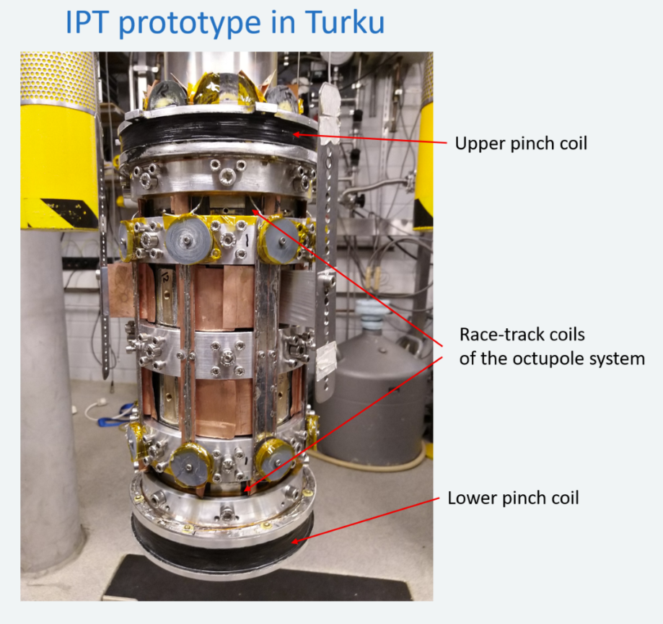
The IPT trap: a large octupole magnetic trap [5]
Trapping region
of low-field H seekers
[5] J. Ahokas, et al., A large octupole magnetic trap for research with atomic hydrogen, RSI 93 (2022) ARTN 023201
16

Slide 33
The IPT trap: a large octupole magnetic trap [5]
Trapping region
of low-field H seekers
First trapping results obtained
In parallel: development of ultra-stable 243nm CW to perform spectroscopy of 1S-2S H atoms (and for long term, resolved GQS states !)
[5] J. Ahokas, et al., A large octupole magnetic trap for research with atomic hydrogen, RSI 93 (2022) ARTN 023201
16

Slide 34
Overview
https://grasian.eu
Gravitational quantum states, Was ist das ?
The “in-beam” experiment @ETH Zürich/ SMI
The “trapped” experiment @Turku University (Finland)
The whispering galleries experiment @ ILL Grenoble (France)

Slide 35
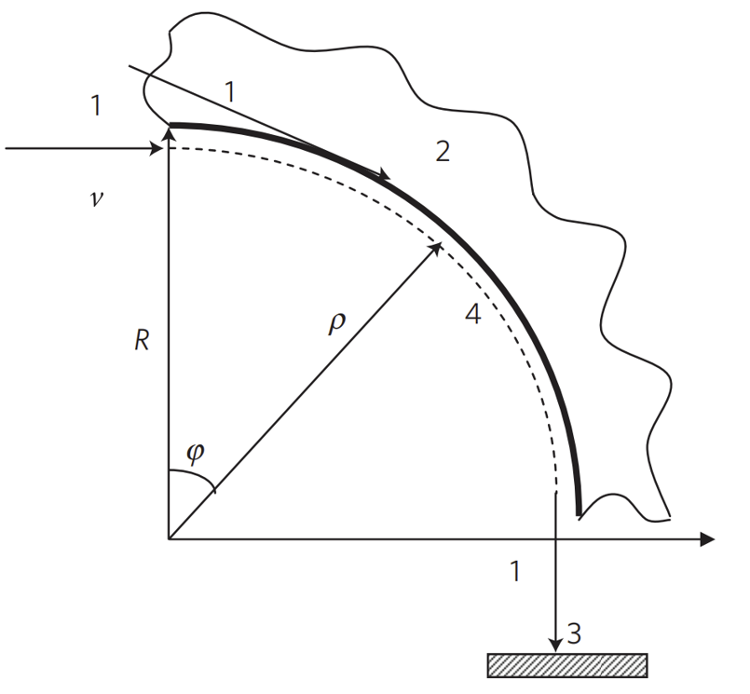
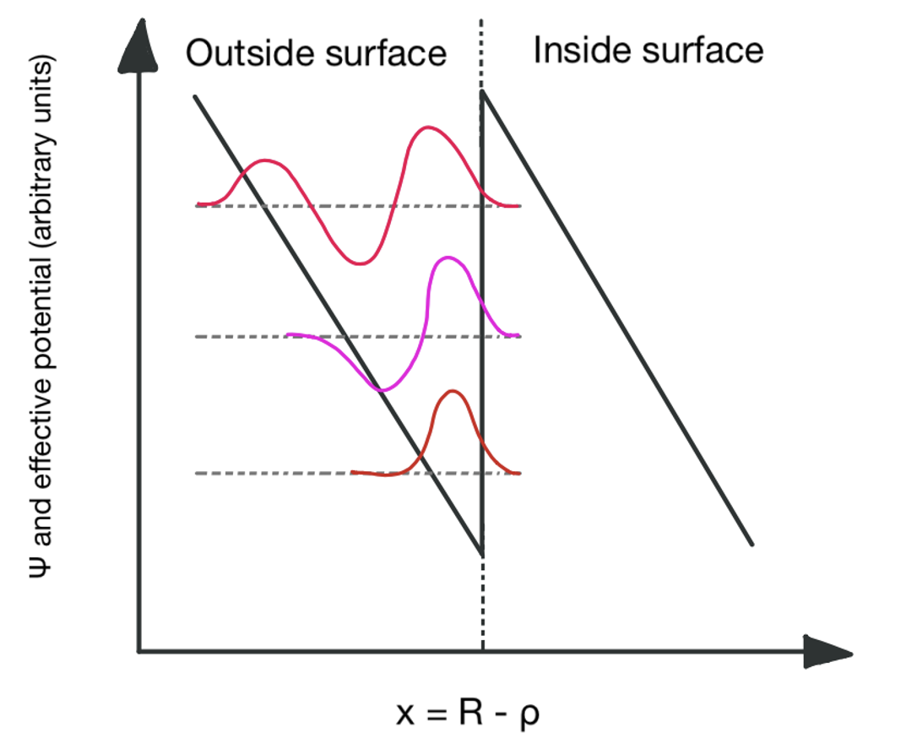
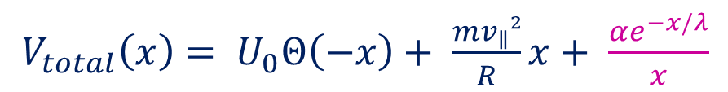
4. The whispering galleries experiment @ ILL Grenoble (France)
With Ultra-cold NEUTRONS
Whispering modes
Research for 5th force
$V_{total}\left(x\right)= U_{0}Θ\left(−x\right)+ \frac{mv_{∥}²}{R}x+ \frac{αe^{−x/λ}}{x}$
17
Hypothetical Yukawa-type force

Slide 36
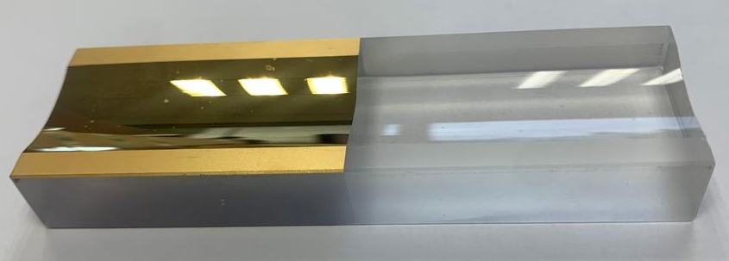
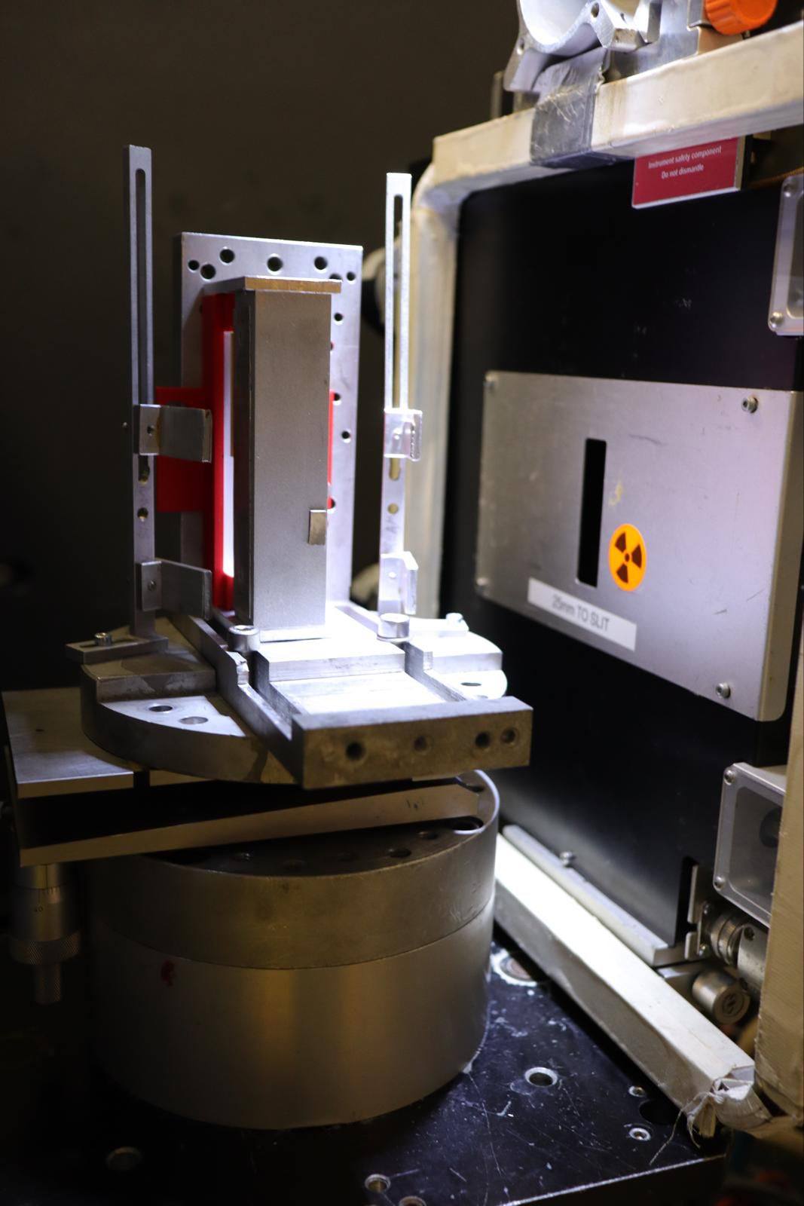
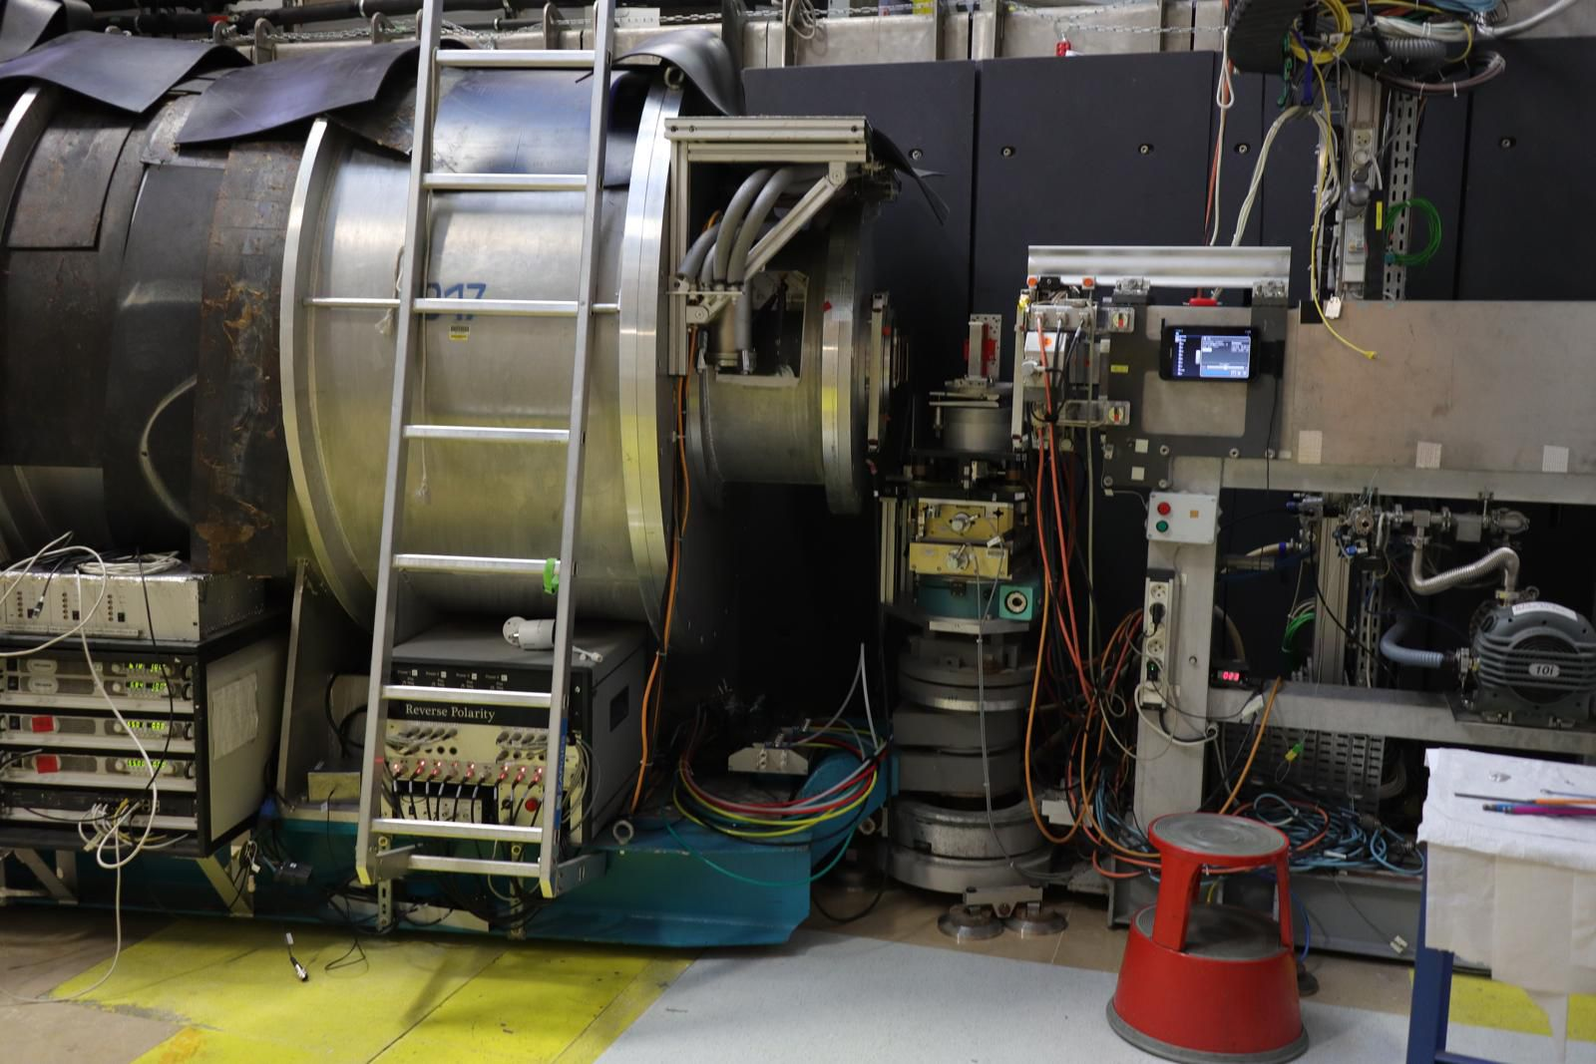
4. The whispering galleries experiment @ ILL Grenoble (France)
With Ultra-cold NEUTRONS
Whispering modes
18

Slide 37
4. The whispering galleries experiment @ ILL Grenoble (France)
With Ultra-cold NEUTRONS
Whispering modes
Last beam time in spring 2023
Data analysis and modelling under progresses (Katharina Schreiner and Jason Pioquinto, Serge Reynaud, Valery Nesvizhevsky
18

Slide 38
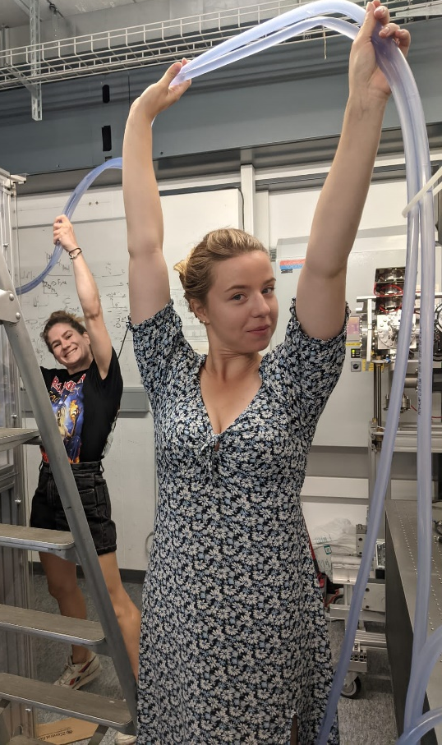
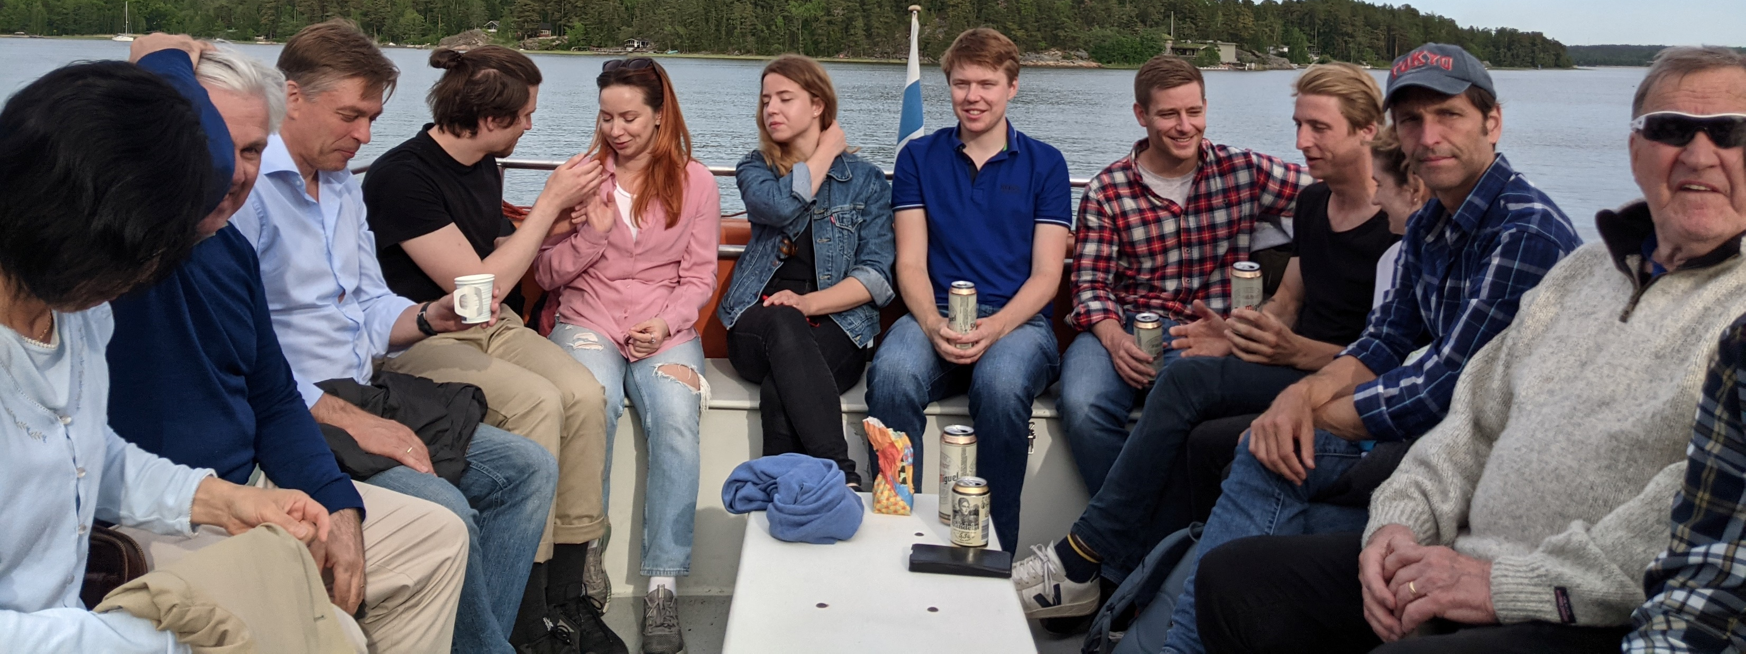
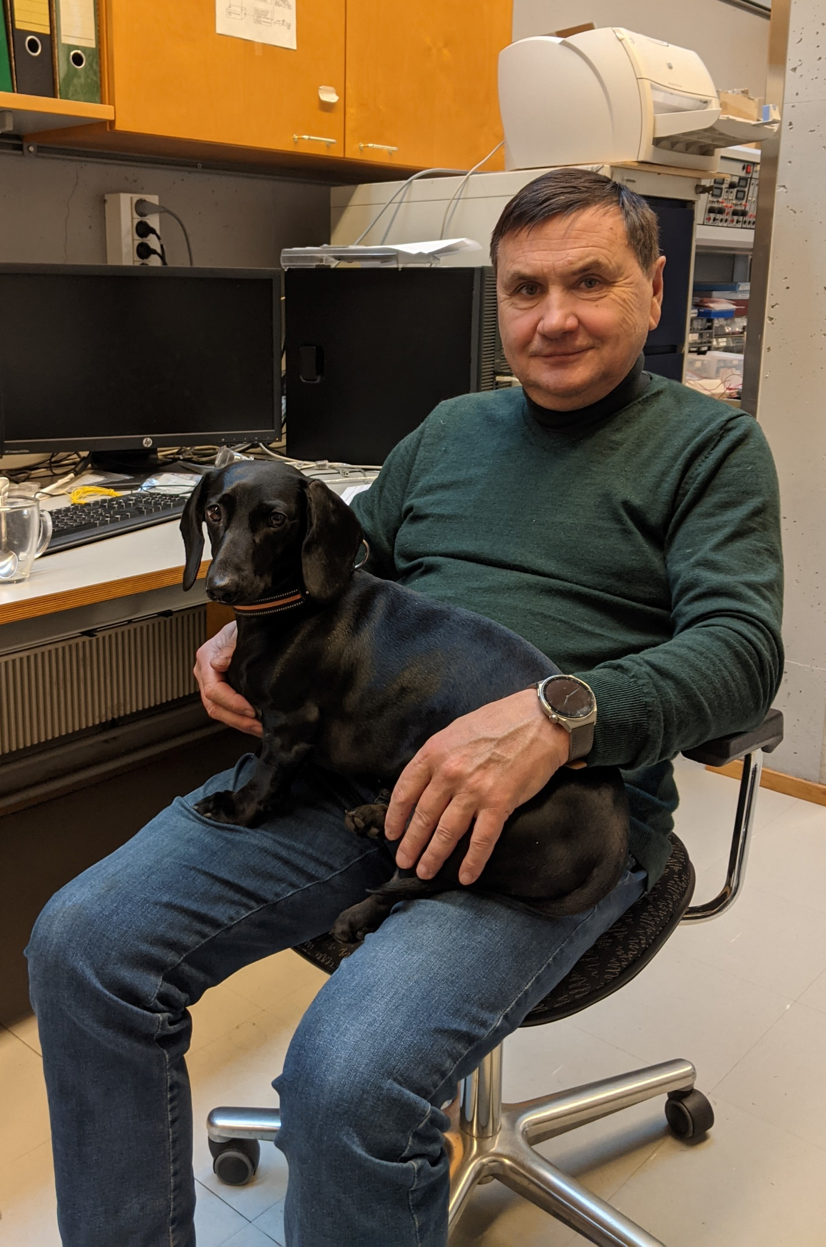
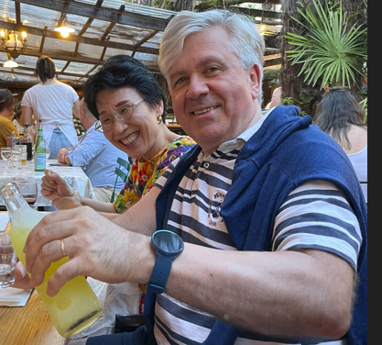
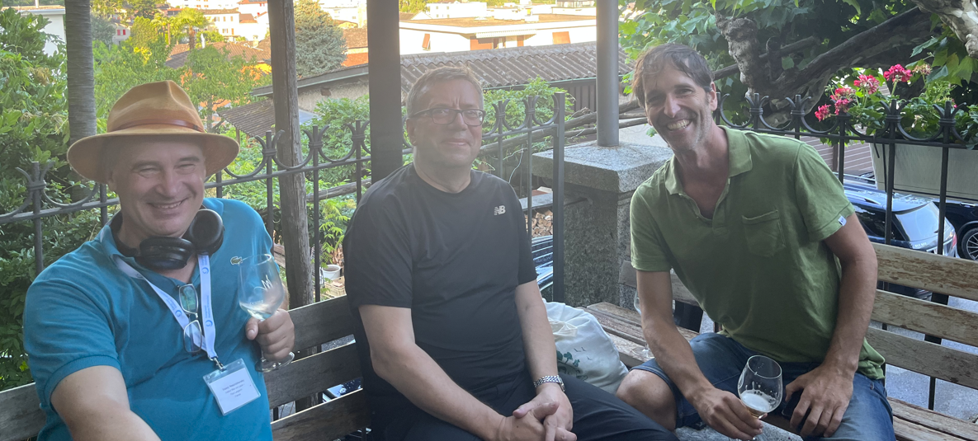
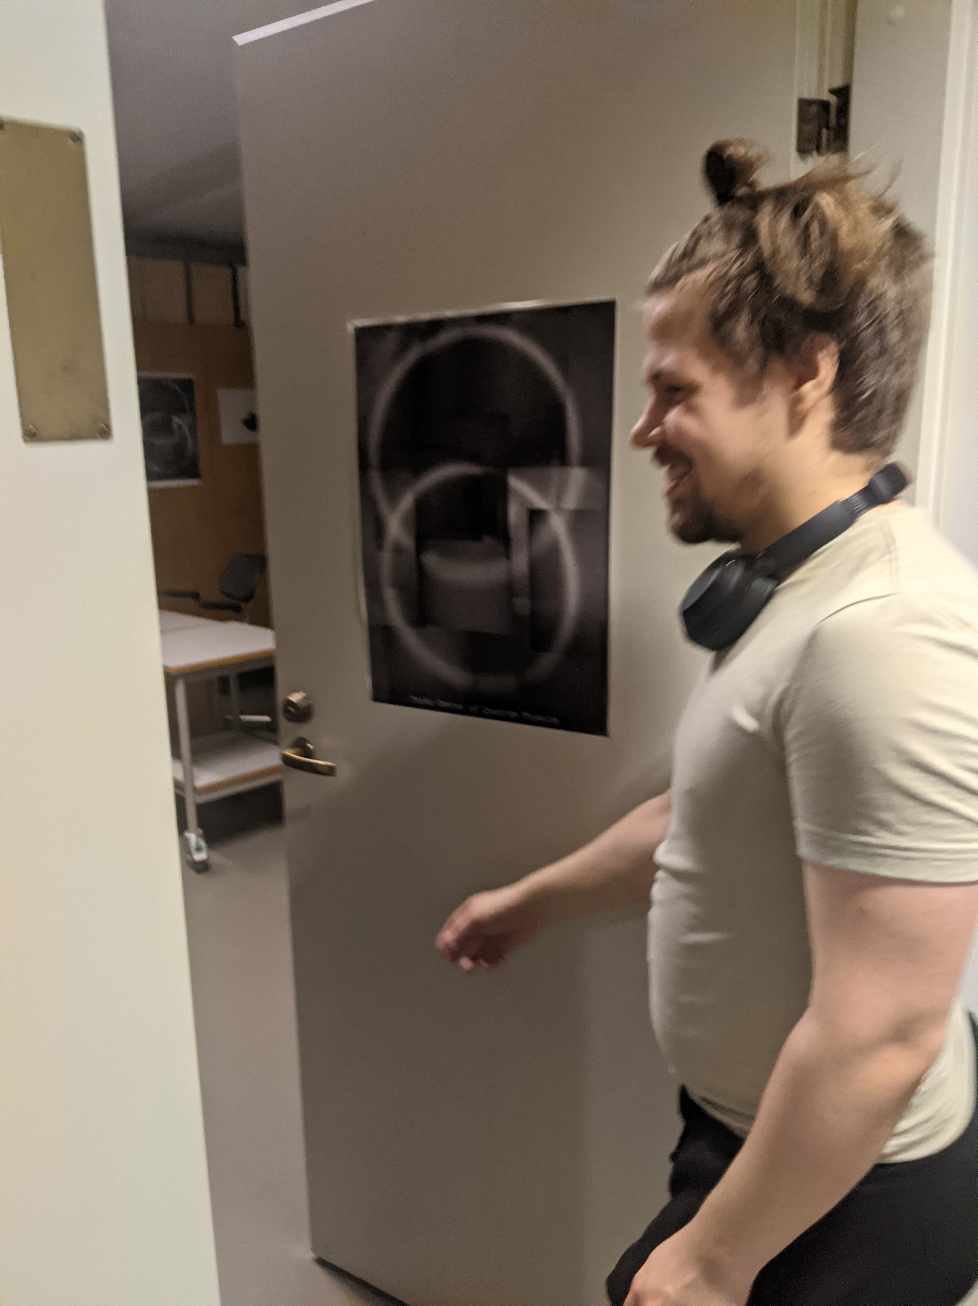
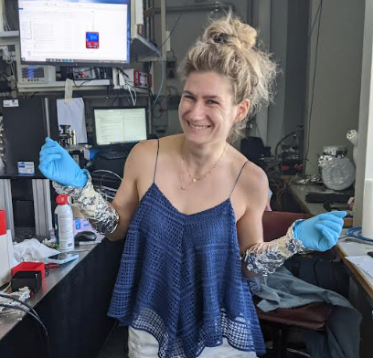



Otto
Lucile
Julien
Thanks for your attention
Katharina
Schreiner
Carina
Killian
Paul
Martin

Slide 39
Bonus project ?

Slide 40

What else can we do with GQS of H/anti-H ?
Measuring the interferences of several GQS on (anti-)hydrogen atoms
and extracting “g” value with 1e-4 uncertainty (application for GBAR)
Clade P. et al. Quantum interference measurement of the free fall of anti-hydrogen, Eur. Phys. J. D, 76:209, 2022.

Slide 41
Appendix

Slide 42






Gravity on different scales
?
Macroscopic scales
Microscopic (≤ µm) scales
Gravitational interaction accurately described by Newton’s Law in most cases.
In the limit of high mass densities / high velocities → General relativity
Gravity escapes perception
How can the gravitational interaction be described at “quantum mechanical” scales?
Are there any deviations from Newton’s Law?

Slide 43


Motivation for Gravity tests on small scales
Deviations from Newton’s inverse square law
New short range forces
  Motivated by theories with large extra dimensions
  New light bosons (Dark Matter)
  Spin-dependent short range forces
  Spin-independent short range forces
    Yukawa-type forces with range $λ$ and strength $α$: $V_{G}=G\frac{m_{1}m_{2}}{r}αe^{−\frac{r}{λ}}$
    Extra dimensions → 2 large extra spatial dimensions: $λ≈{10}^{−5}$m
    …
UCN GQS
Exclusion plot for new spin-independent interactions [2]
1,2: short-range gravity in torsion balance
4,12,13: Extra forces on top of Casimir and v.d.W interactions
5: neutron Gravitational Quantum States (GQS)
6: neutron whispering gallery effects
7: neutron scattering on nuclei
8: precision measurements of exotic atoms
15: low mass bosons from the sun in a high-purity germanium detector
[2] Antoniadis, Ignatios & Baessler, S. & Büchner, M. & Fedorov, Valery & Hoedl, Seth & Lambrecht, Astrid & Nesvizhevsky, V.V. & Pignol, Guillaume & Protasov, K. & Reynaud, Serge & Sobolev, Yu. (2010). Short-range fundamental forces. Forces fondamentales à courte portée.

Slide 44




Slide 45


Gravitational/magnetic shift of the whispering gallery
WG Measurements in other particles:
  Possible to measure in Mu, Ps (gravitational shift)
  With smaller velocities measurement of gravitational shift possible with antihydrogen (Gbar)
Test measurement: In future measurements we want to measure gravitational shift, this experiment is to test the measurement and analysis procedure
We add a magnetic field with a strong gradient (20T/m)
By controlling the polarization we should be able to observe a shift in the lines depending on the gradient orientation w.r.t. the neutron polarization
The potential barrier will be broader/smaller, changing the tunneling probability and lifetime
We can observe this effect if we see statistical significance in (more specifically a vertical shift (see next slide))
$f =\frac{N_{UP} − N_{DOWN}}{\sqrt{σ_{UP}^{2}+σ_{DOWN}^{2}}}$

Slide 46

Hydrogen GQS
Length scale depends on gravity and mass of particle
High background with hydrogen, Deuterium measurement has less background but states closer to mirror surface
Experimental limit: Minimally measured distance between mirror and scatterer (distinction between classical and quantum model must be feasible at this length scale)
Maximal observation time:
  Better resolution
  Higher scattering probability of particles passing below scatterer
Velocities of <100ms⁻¹ needed (cryogenic beam at ~6K)
Goal is proof existence of GQS (resolution of first step) rather than resolution of multiple excited states (more challenging due to significant increase in necessary observation time)

