Slide 1
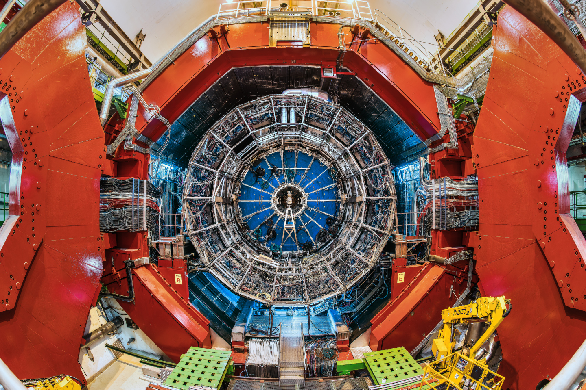


ALICE and the
Quark-Gluon Plasma
Marco van Leeuwen, Nikhef and CERN
20 Years of Stefan Meyer Institute
11 November 2024

Slide 2
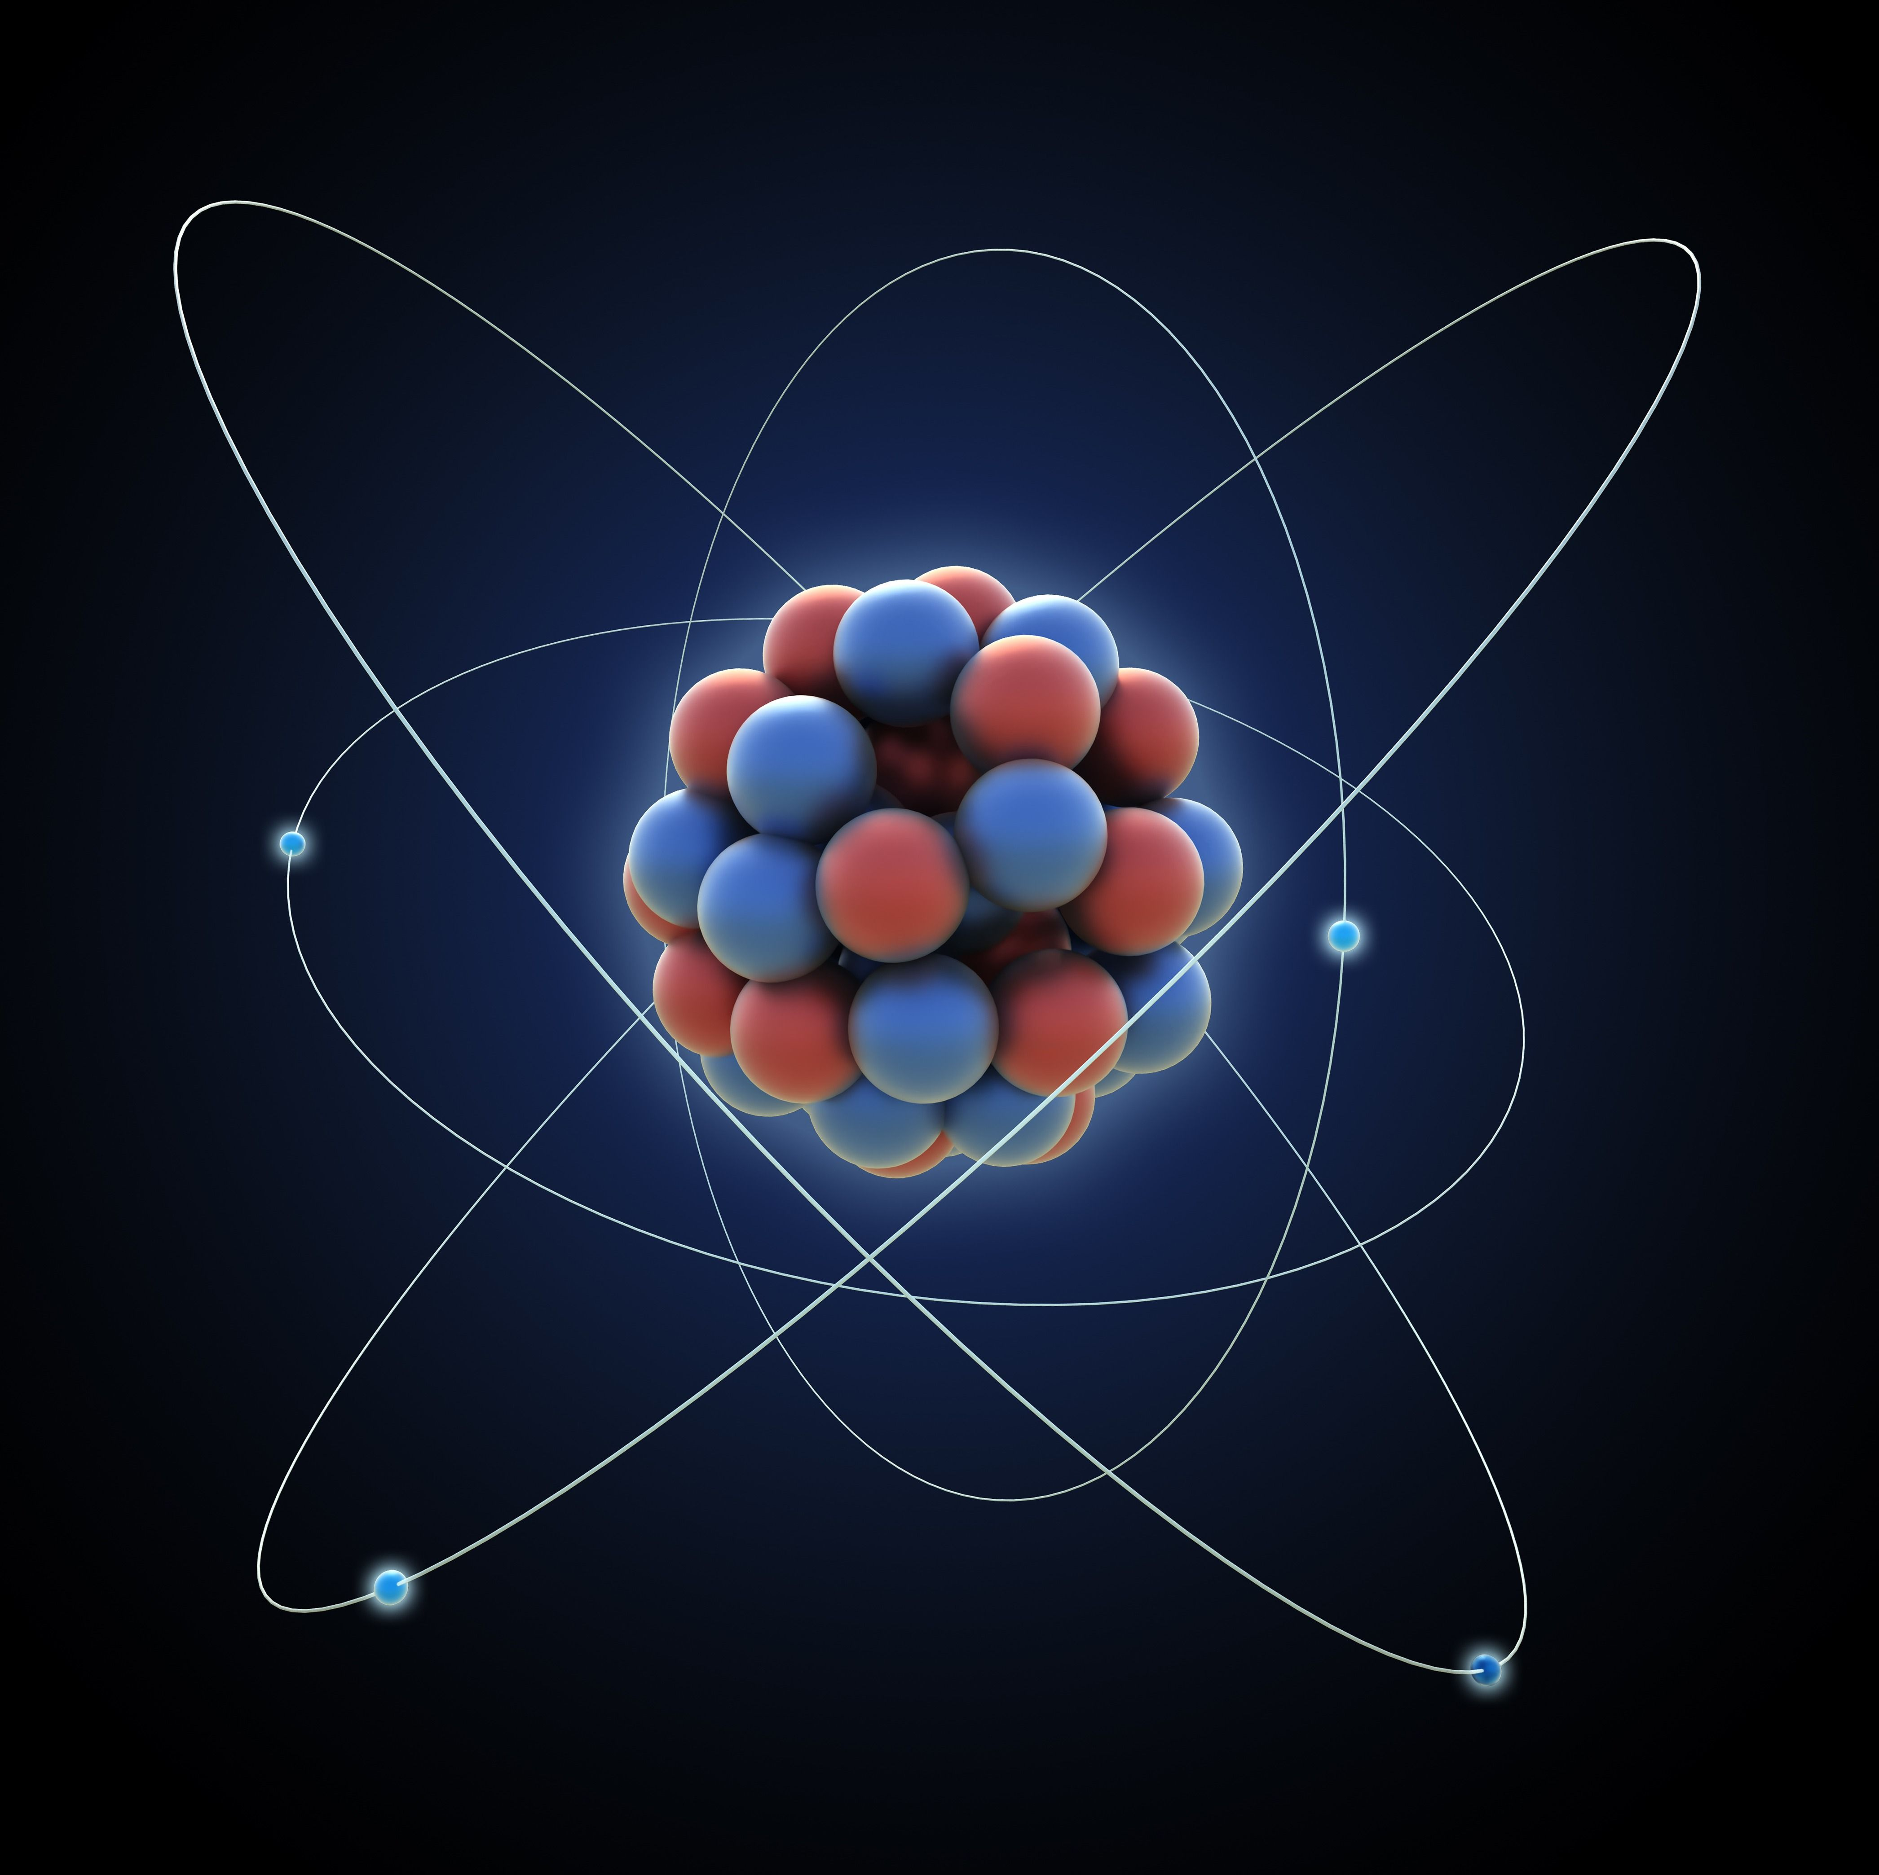
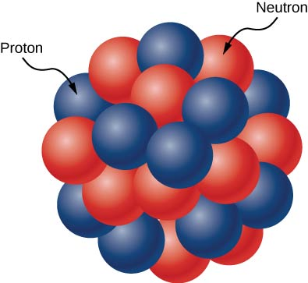
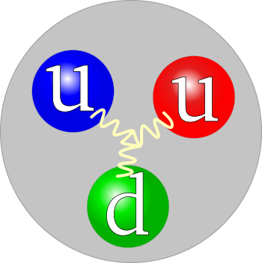
Energy scales: ionisation energy
Atom
Atomic nucleus
Hadron
(proton)
thoughtco.com
Wikimedia Commons image by Jacek Rybak
Binding energy
5 eV - 100 keV
1 - 10 MeV
> 100 MeV
Temperature (K)
10⁴ ⁻ 10⁹
10¹⁰ ⁻ 10¹¹
10¹²
Heavy-ion collisions: study properties of strongly interacting ‘bulk’ matter — Quark-Gluon Plasma
… and understand how they emerge from the underlying theory
ALICE and the Quark-Gluon Plasma | SMI 20 year workshop, Vienna | Marco van Leeuwen

Slide 3
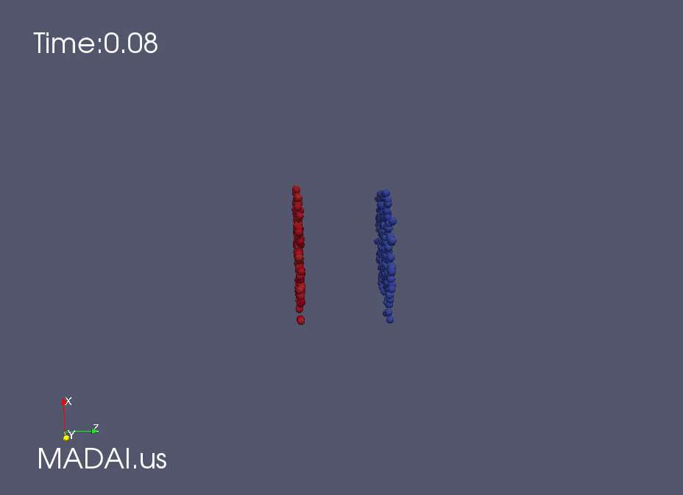
Heavy ion collisions: Little Bangs
MADAI
Stages of the collision: initial stages — QGP/fluid stage — hadron formation (freeze out)
‘Little Bang’: recreate primordial matter in the laboratory
ALICE and the Quark-Gluon Plasma | SMI 20 year workshop, Vienna | Marco van Leeuwen

Slide 4
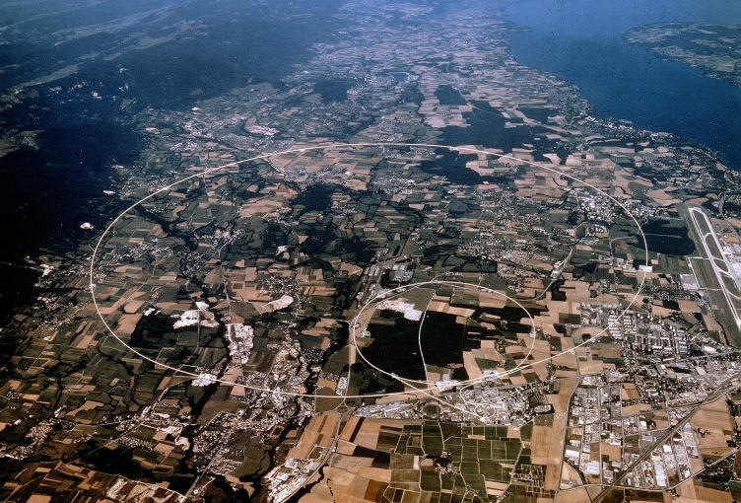
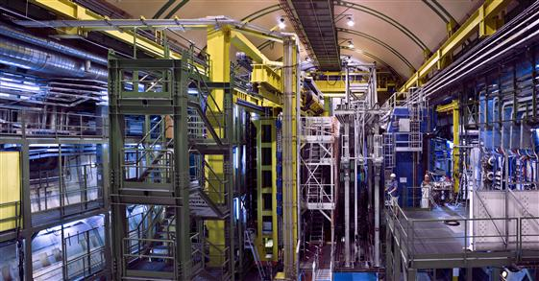
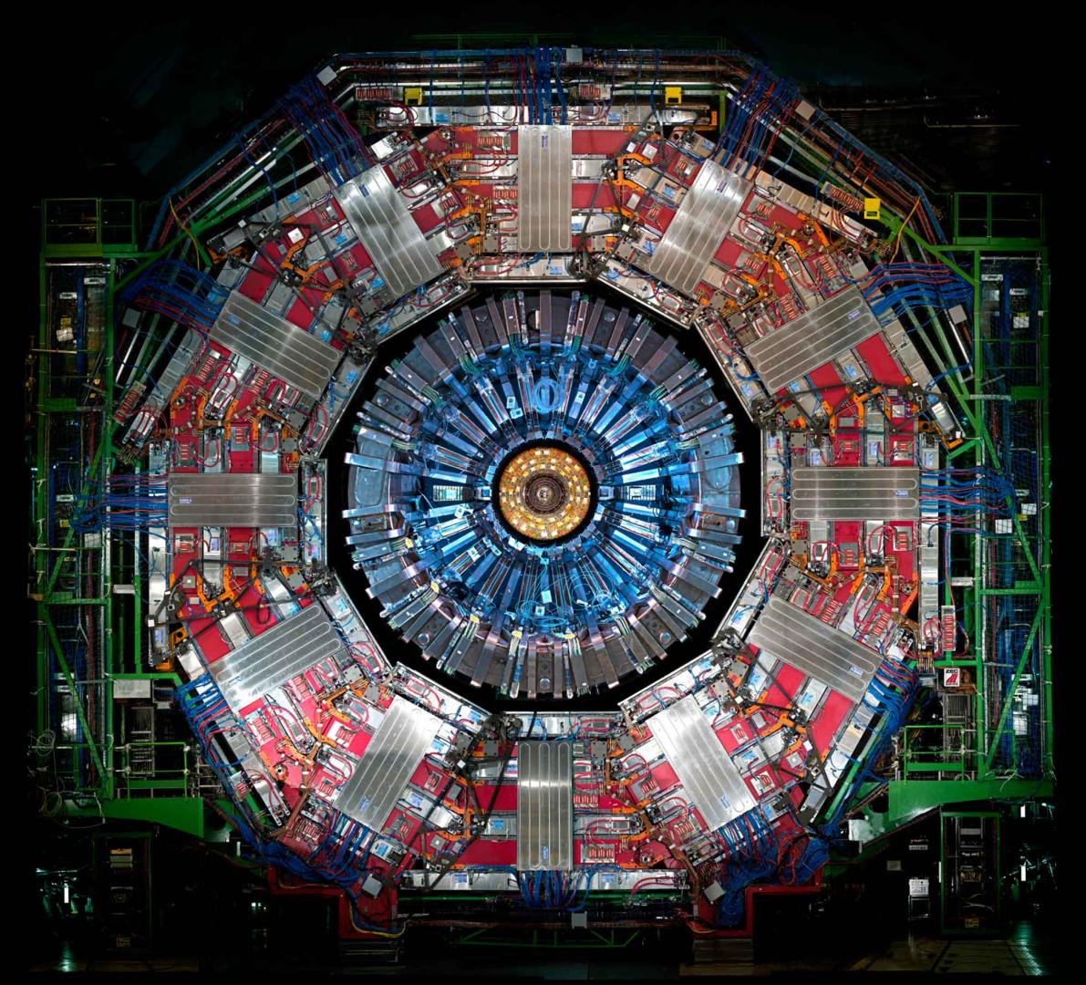
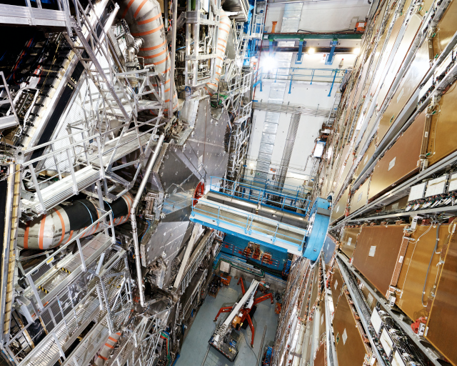
The Large Hadron Collider
LHCb
CMS
CMS
LHCb
ATLAS
ATLAS
ALICE
ALICE
ALICE: dedicated heavy-ion experiment
ATLAS, CMS: general purpose pp detectors
LHCb: forward detector, optimised for flavour physics
Pb-Pb collisions: √sNN = 2.76, 5.02, 5.36 TeV
pp collisions √s = 7, 8, 13, 13.6 TeV
other systems: p-Pb, Xe-Xe, O-O, p-O
ALICE and the Quark-Gluon Plasma | SMI 20 year workshop, Vienna | Marco van Leeuwen

Slide 5
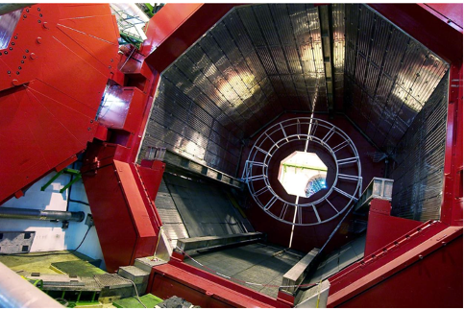
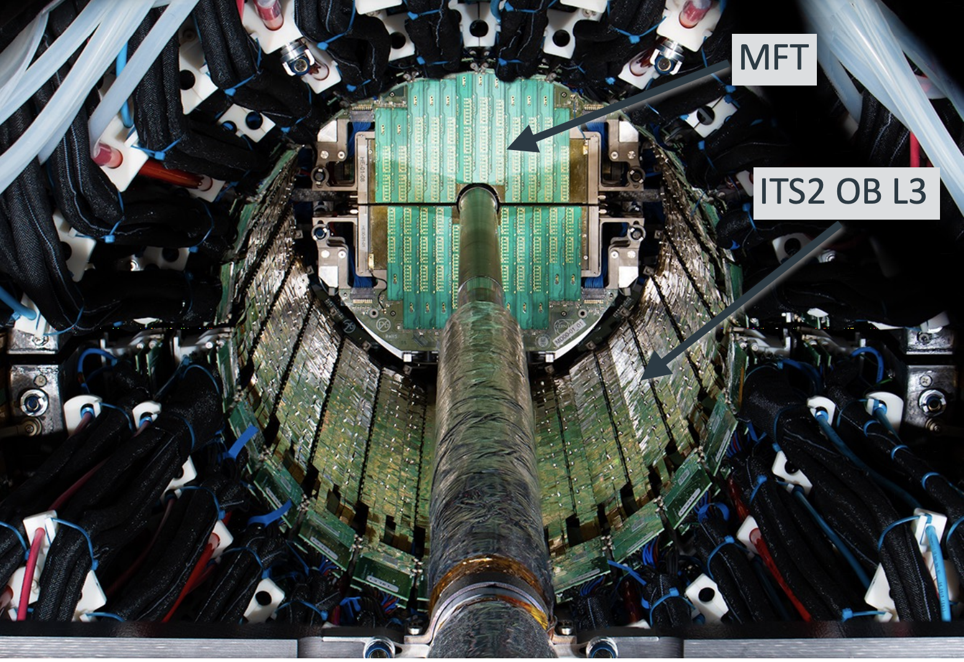
ALICE at the Large Hadron Collider
The Large Hadron Collider
ALICE: A Large Ion Collider Experiment
CMS
LHCb
ATLAS
ALICE
Letter of Intent: 1993
First installation: 2006-2008
Major upgrades installed: 2022
pp collisions √s = 7, 8, 13, 13.6 TeV
Pb-Pb collisions: √sNN = 2.76, 5.02, 5.36 TeV
Low-mass detectors — excellent pointing resolution
Particle identification: dE/dx in TPC, TRD, TOF, HMPID, EMCal, Muon system
other systems: p-Pb, Xe-Xe, O-O, p-O
Upgraded to streaming readout, 50 kHz PbPb
ALICE and the Quark-Gluon Plasma | SMI 20 year workshop, Vienna | Marco van Leeuwen

Slide 6
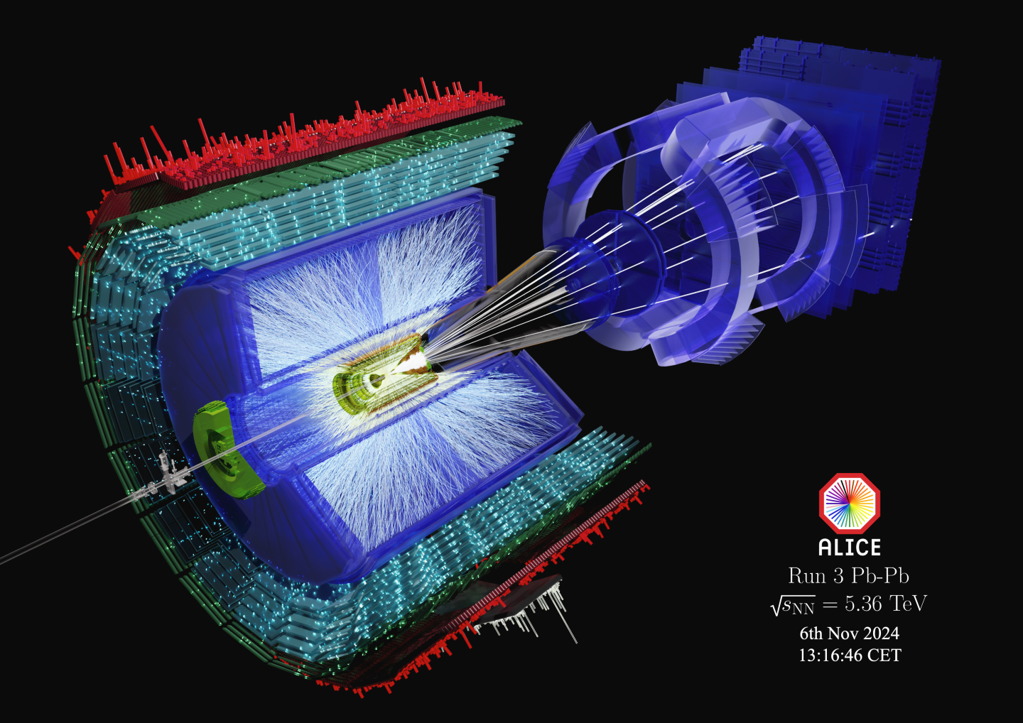

Slide 7
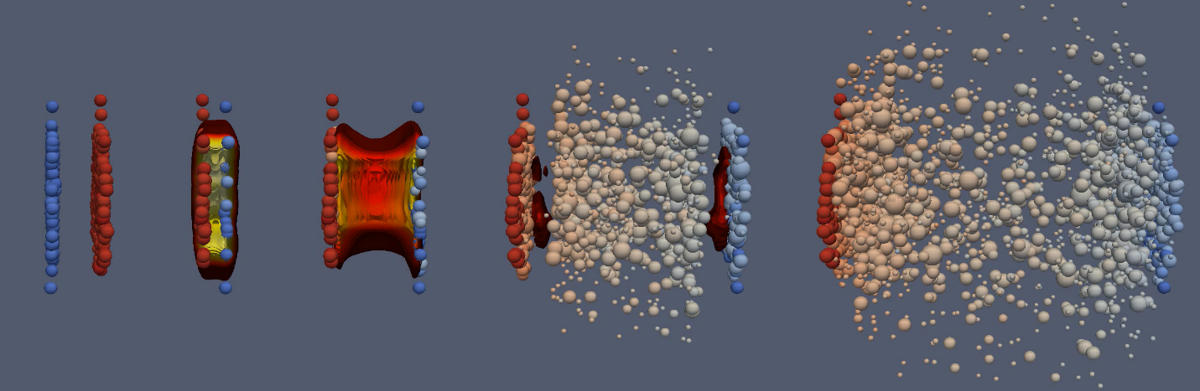
QGP, expansion
Intial stages
Final state: hadron scattering
Step 1: temperature

Slide 8
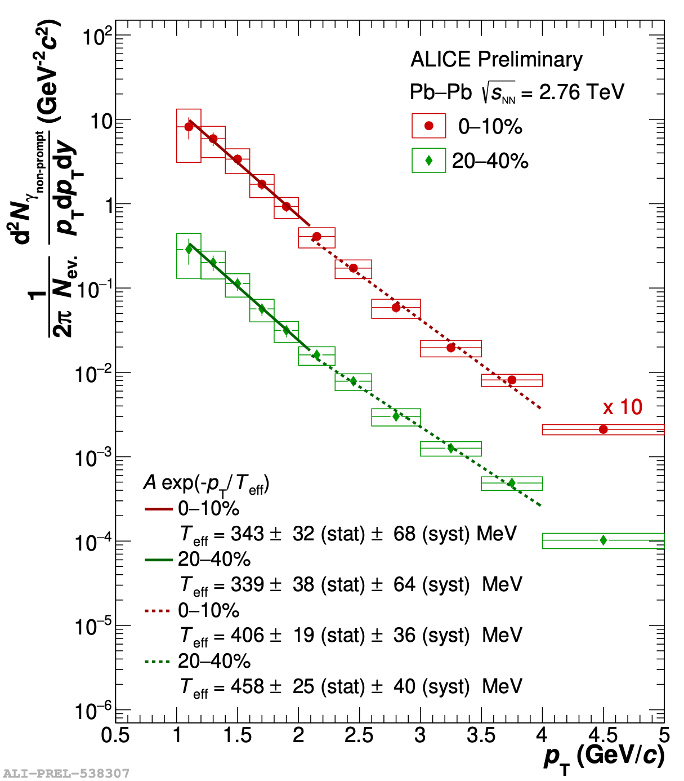
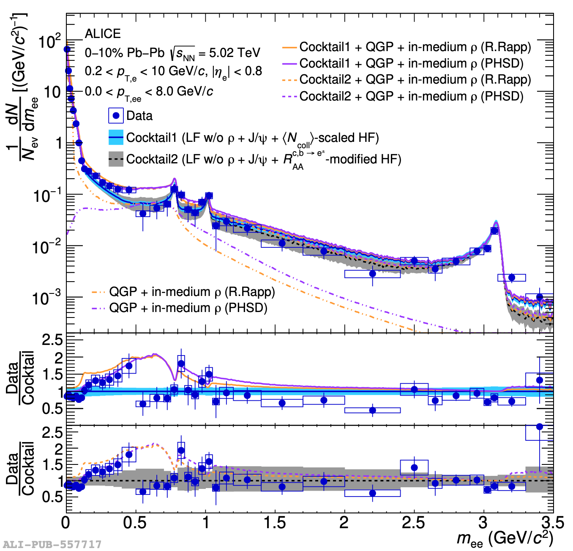
Taking the temperature: photons and dileptons
Direct photon excess spectrum
Dielectron mass spectrum
arXiv:2308.16704
Electromagnetic radiation (real) photons and dielectrons (virtual photons) measure the temperature of the QGP
Challenging measurement: large background from hadronic decays
Apparent (blue-shifted) temperature T ≈ 350 MeV

Slide 9
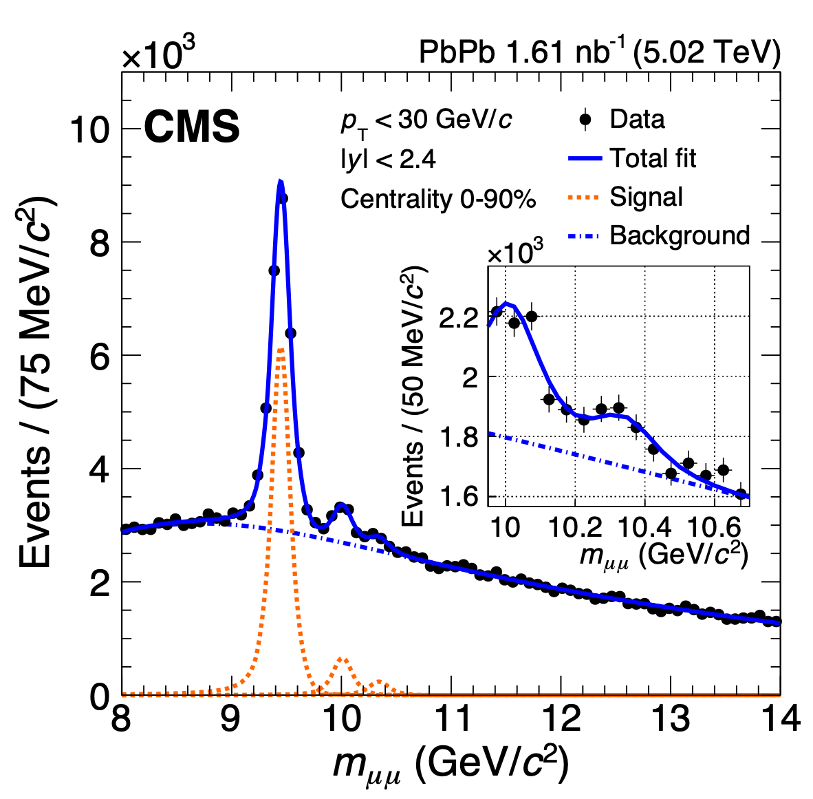
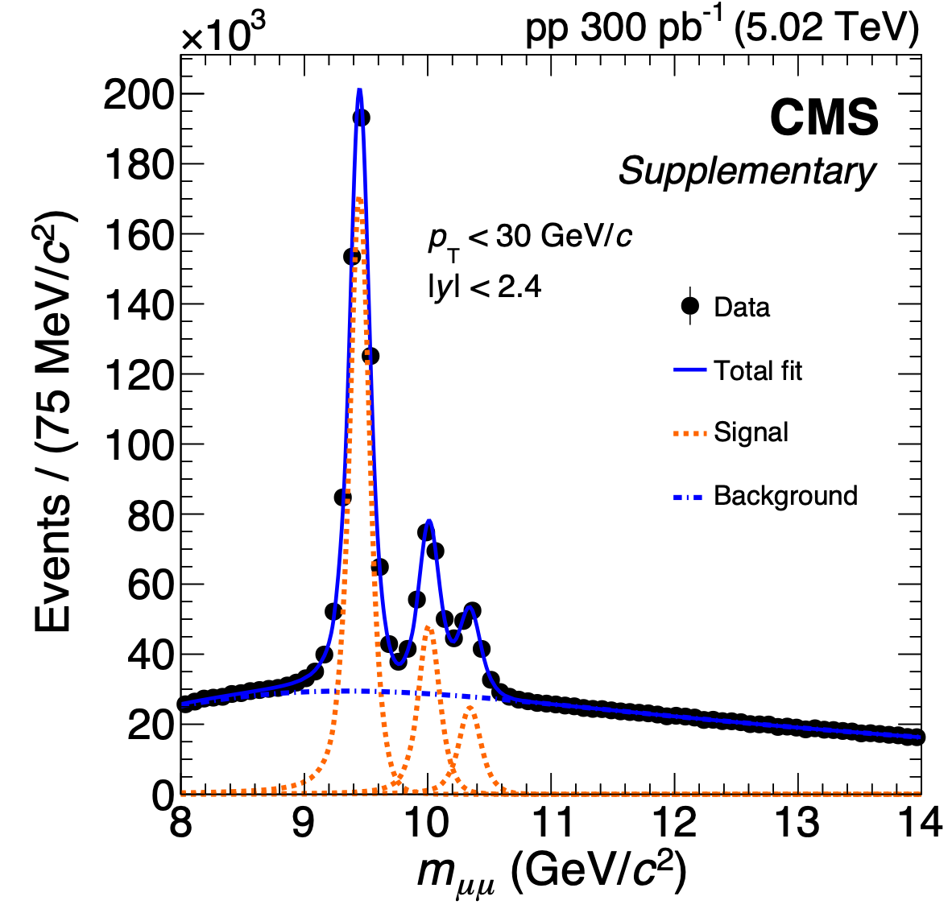
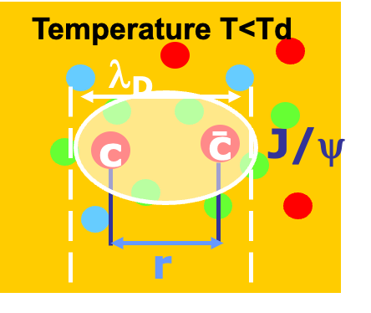
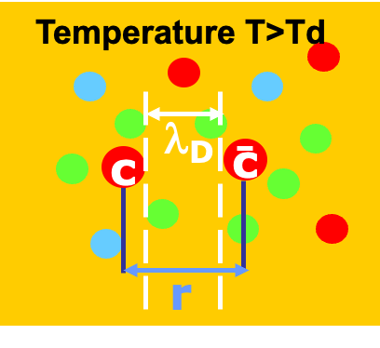


Gauging the temperature: melting of quarkonia
Di-muon mass spectrum: pp
Di-muon mass spectrum: Pb-Pb
Binding force screened when
$$r>λ_{d}$$
Binding of quarkonia ($b\overline{b}$, $c\overline{c}$ bound states) screened at higher temperature, density
Higher states suppressed in Pb-Pb collisions
CMS, arXiv:2303.17026
ATLAS, PRC 107, 054912
TAMU: Du, He, Rapp, PRC 96, 054901
ALICE and the Quark-Gluon Plasma | SMI 20 year workshop, Vienna | Marco van Leeuwen

Slide 10
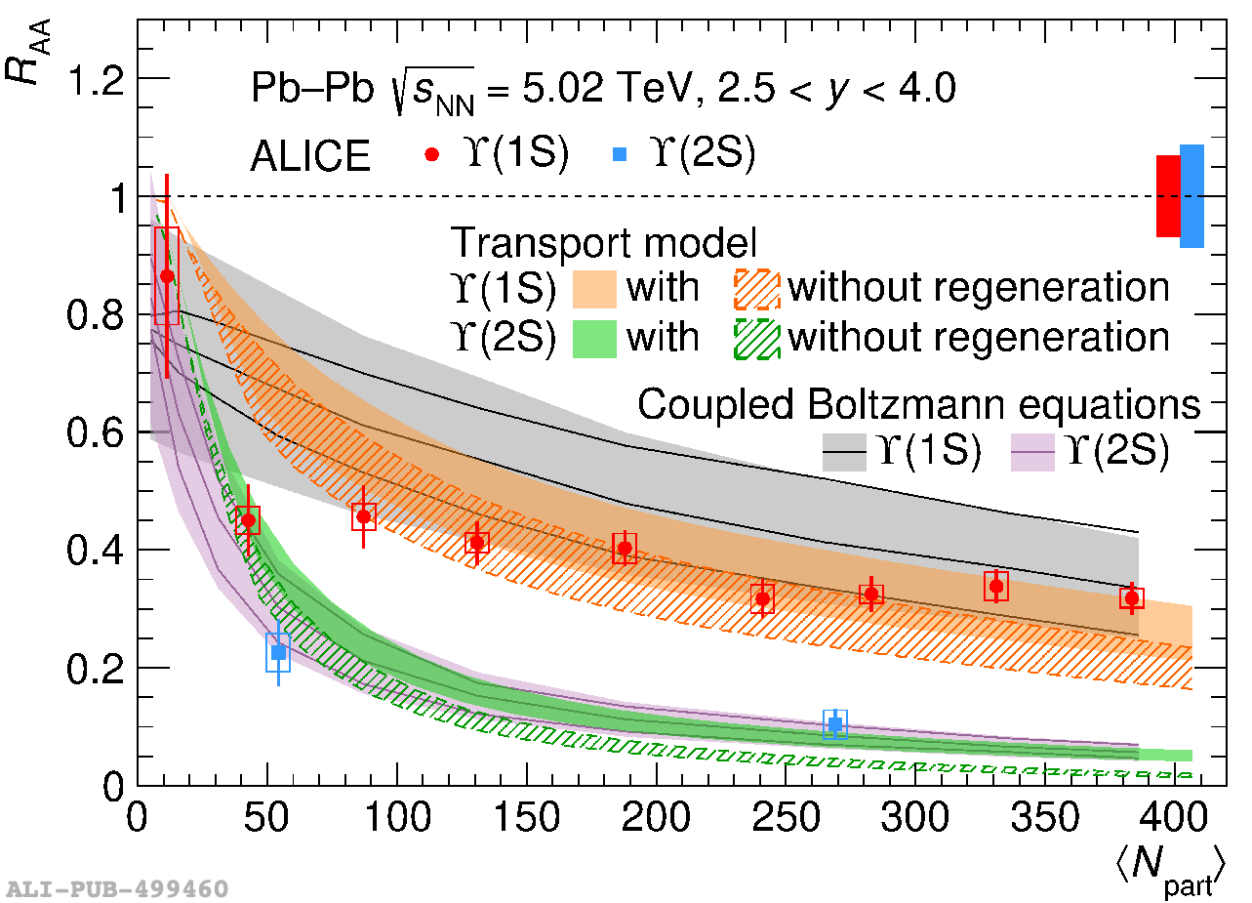
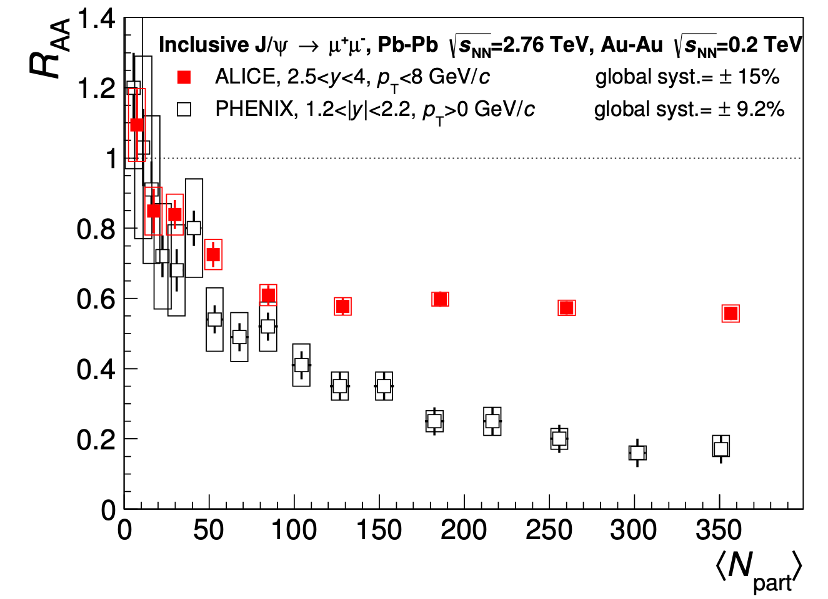
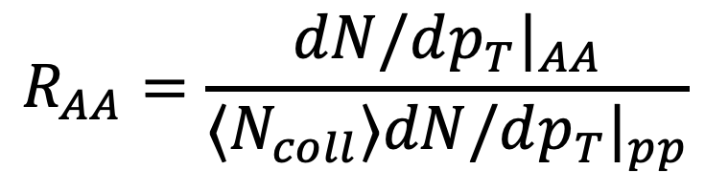
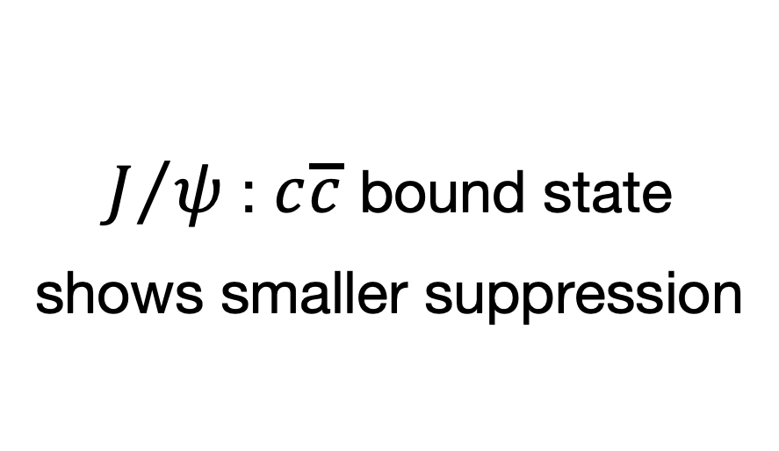
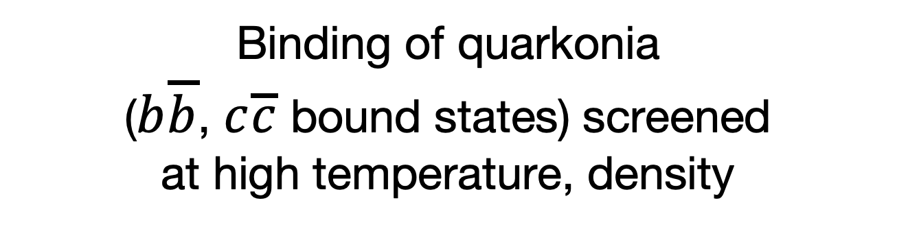
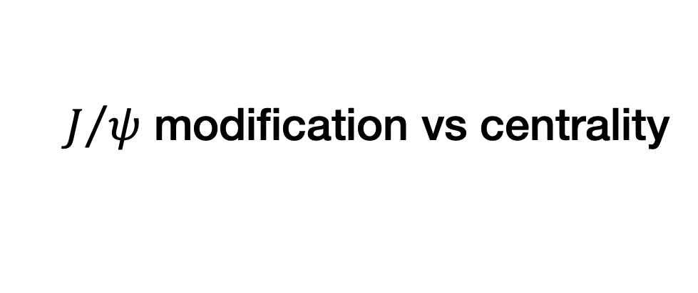

Quarkonia: nuclear modification factor
Nuclear modification vs centrality
$J/ψ$ modification vs centrality
PLB 822, 136579
Binding force screened when
$$r>λ_{d}$$
ALICE, JHEP 05 (2016) 179
PHENIX, PRC 84, 054912
Binding of quarkonia
($b\overline{b}$, $c\overline{c}$ bound states) screened
at high temperature, density
Nuclear modification factor
$J/ψ$ : $c\overline{c}$ bound state
shows smaller suppression
$$R_{AA}=\frac{dN/dp_{T}|_{AA}}{⟨N_{coll}⟩dN/dp_{T}|_{pp}}$$
Large suppression — dissociation in central events
Larger effect for higher states — weaker binding
RAA = 1: no effect
RAA = 0: complete suppression
ALICE and the Quark-Gluon Plasma | SMI 20 year workshop, Vienna | Marco van Leeuwen

Slide 11
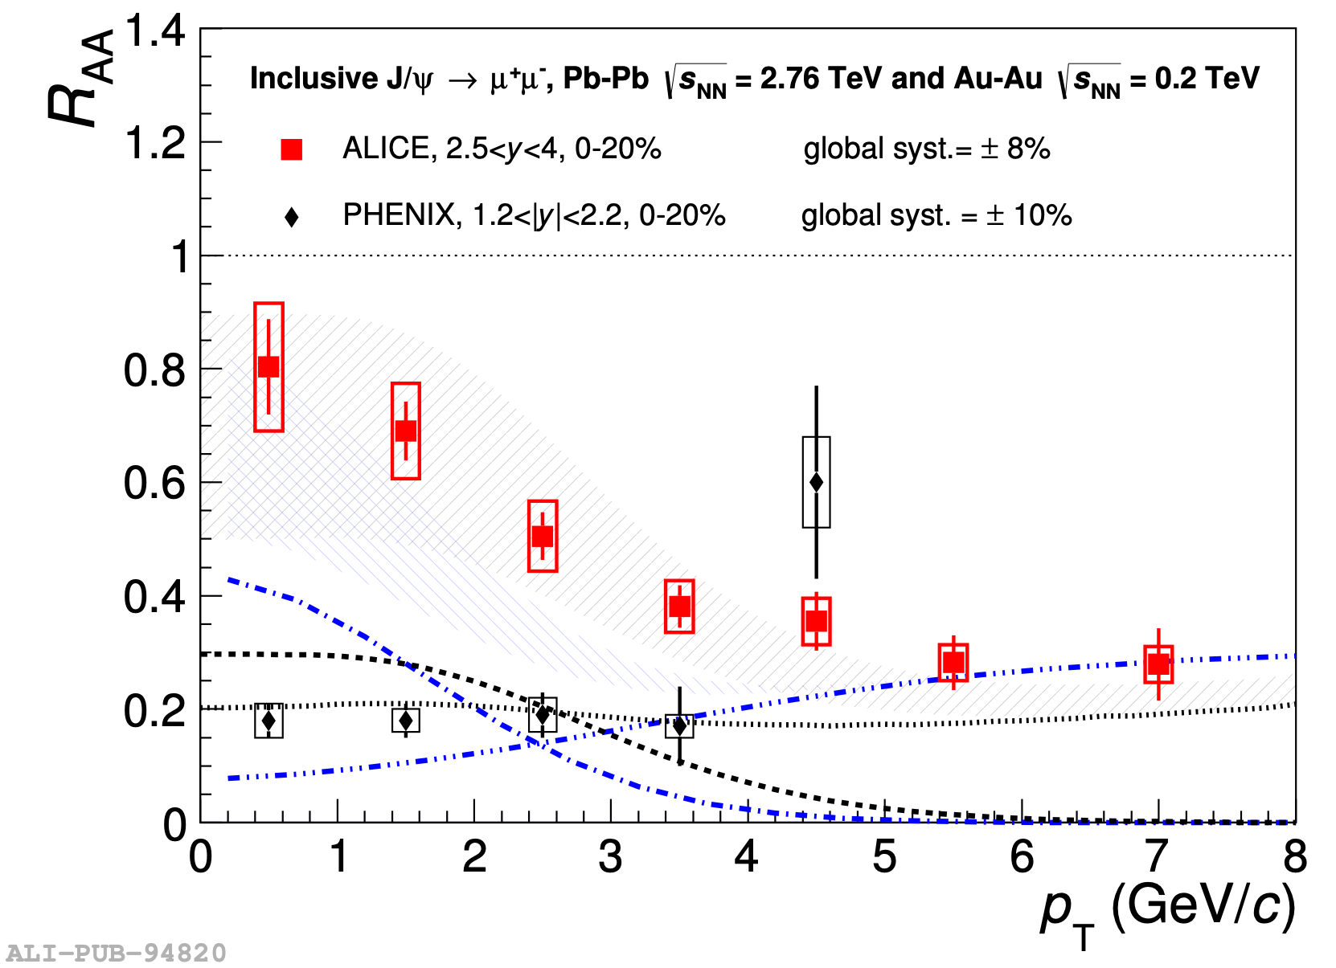
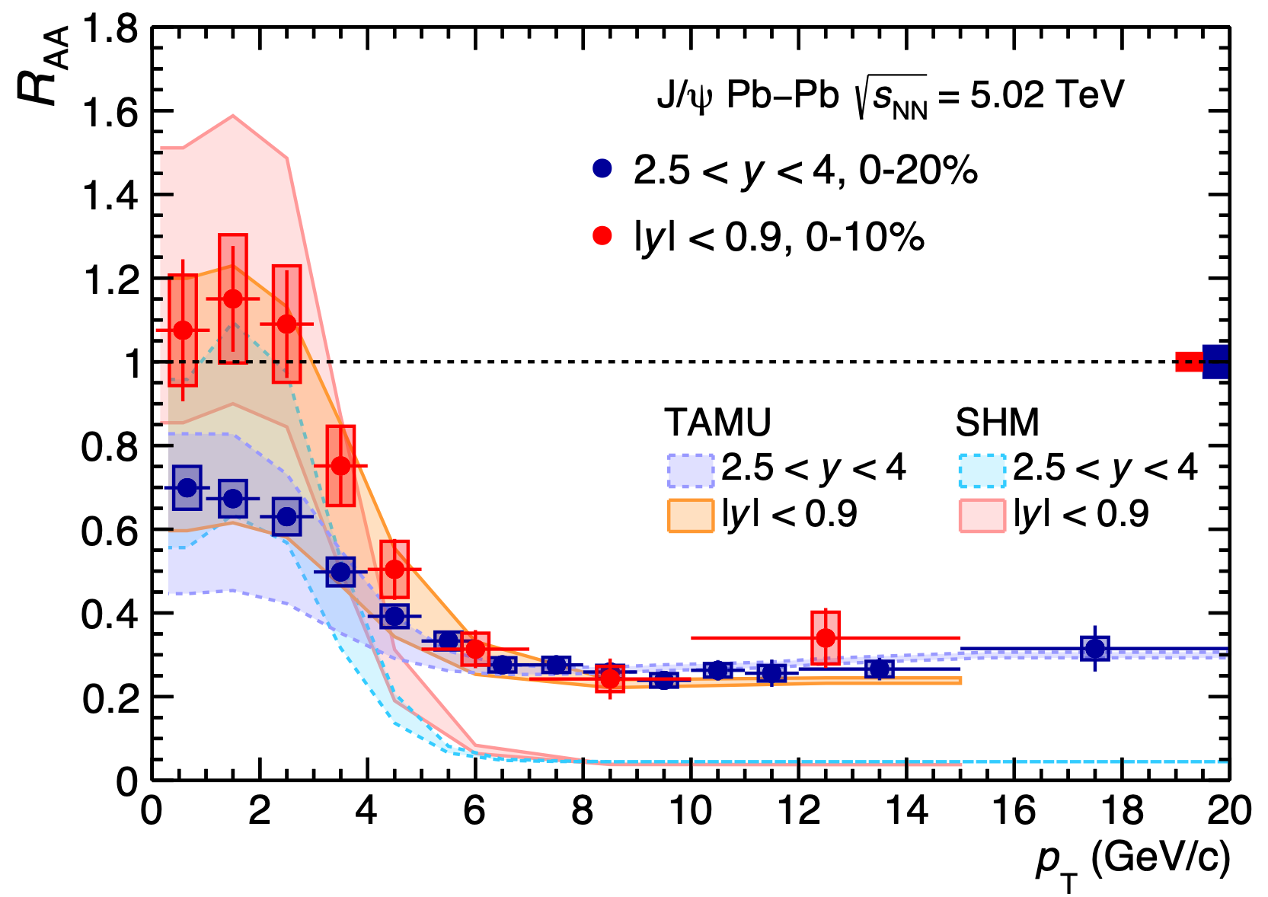
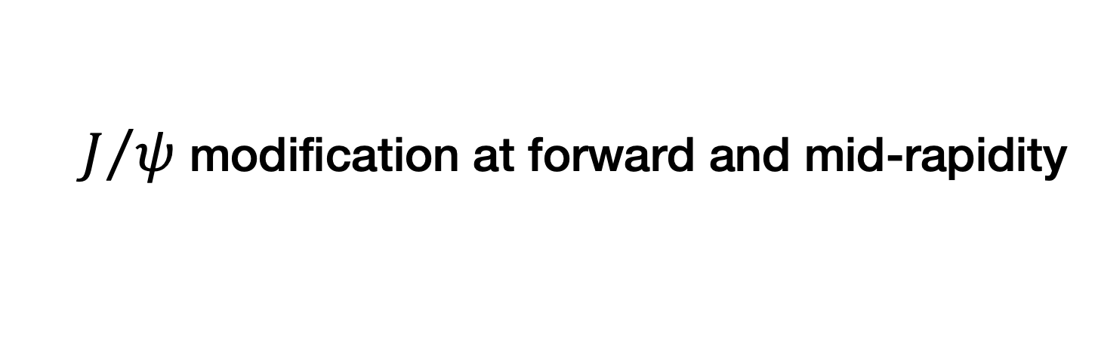


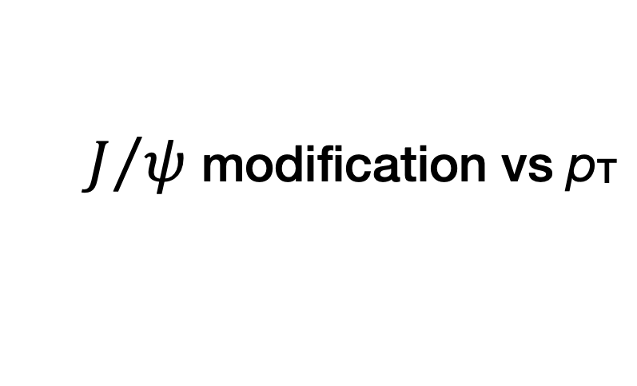
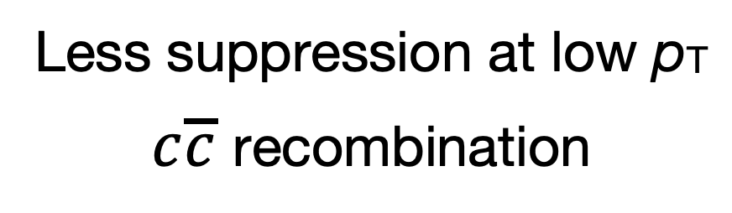
Early stage temperature: melting of charmonia ($J/ψ$)
$J/ψ$ modification vs pT
$J/ψ$ modification at forward and mid-rapidity
ALICE, arXiv:2211.04384
Less suppression at low pT
$c\overline{c}$ recombination
In agreement with coalescence expectation:
larger $c\overline{c}$ density at mid-rapidity
ALICE, arXiv:1506.08804
PHENIX, arXiv:1103.6269
Transport models: arXiv:1102.2194, arXiv:1401.5845
ALICE and the Quark-Gluon Plasma | SMI 20 year workshop, Vienna | Marco van Leeuwen

Slide 12
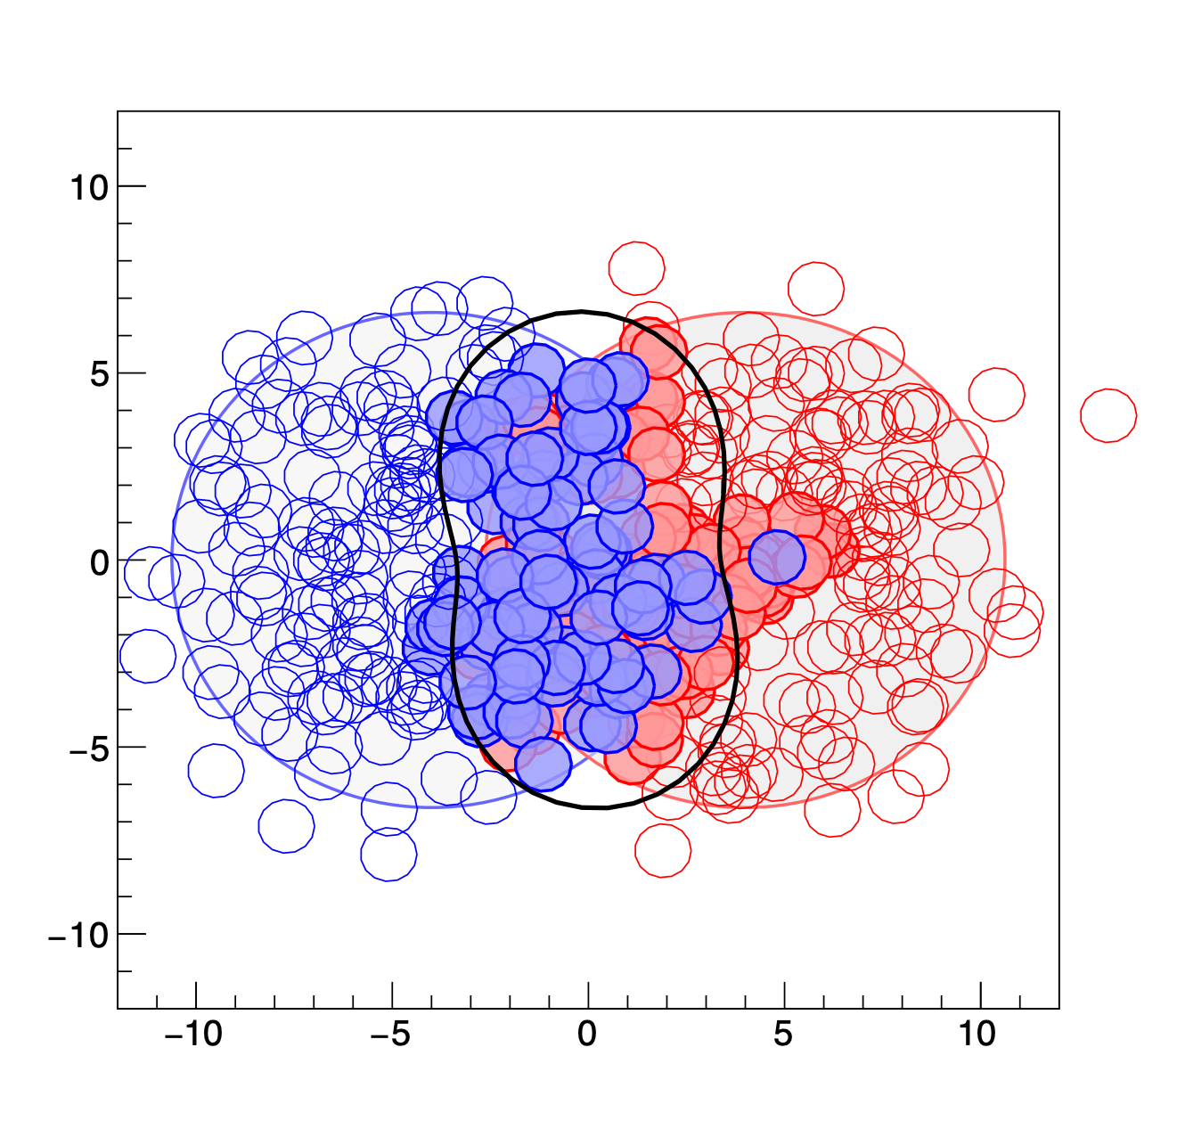
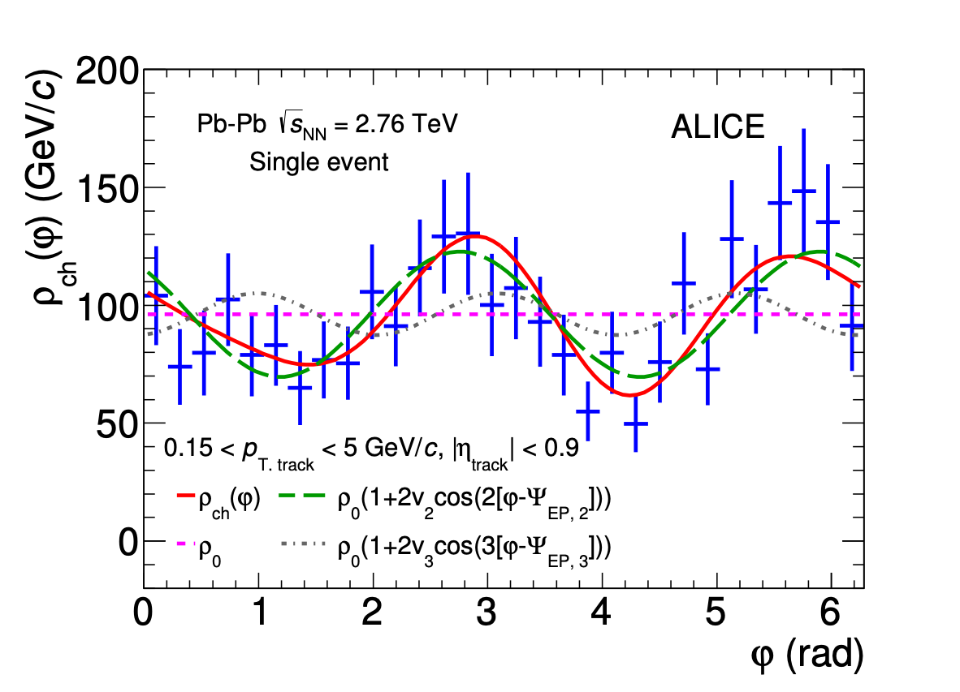
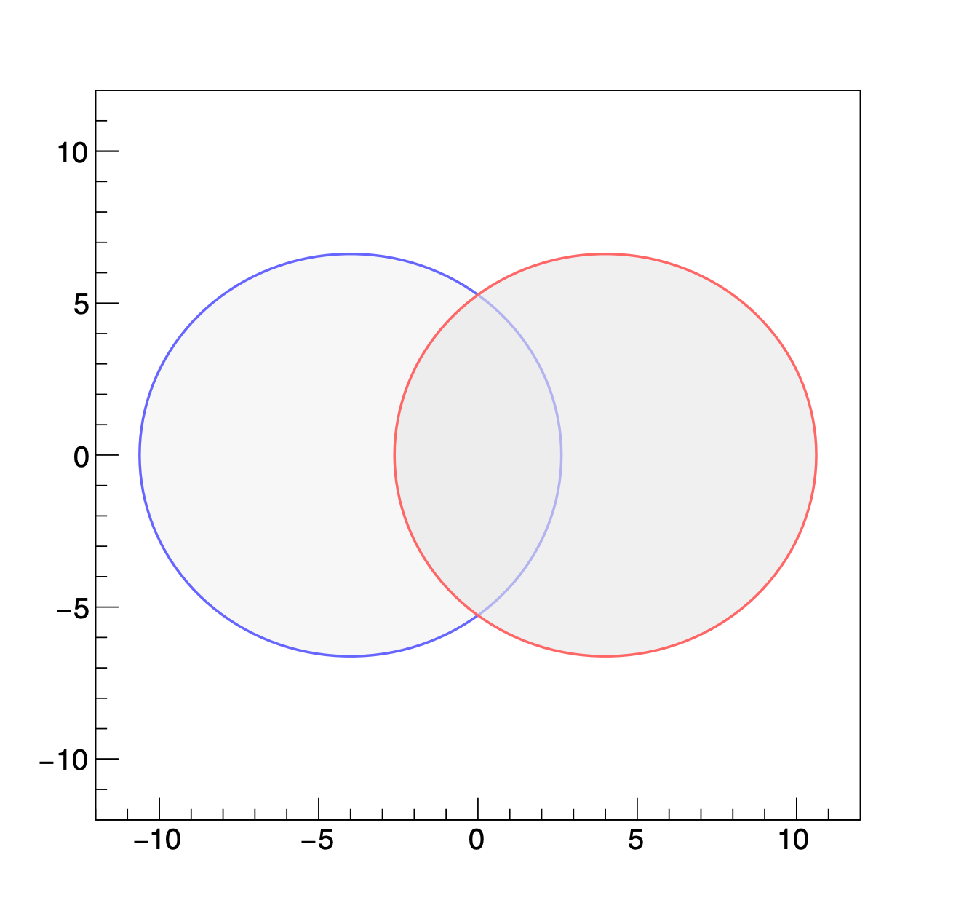
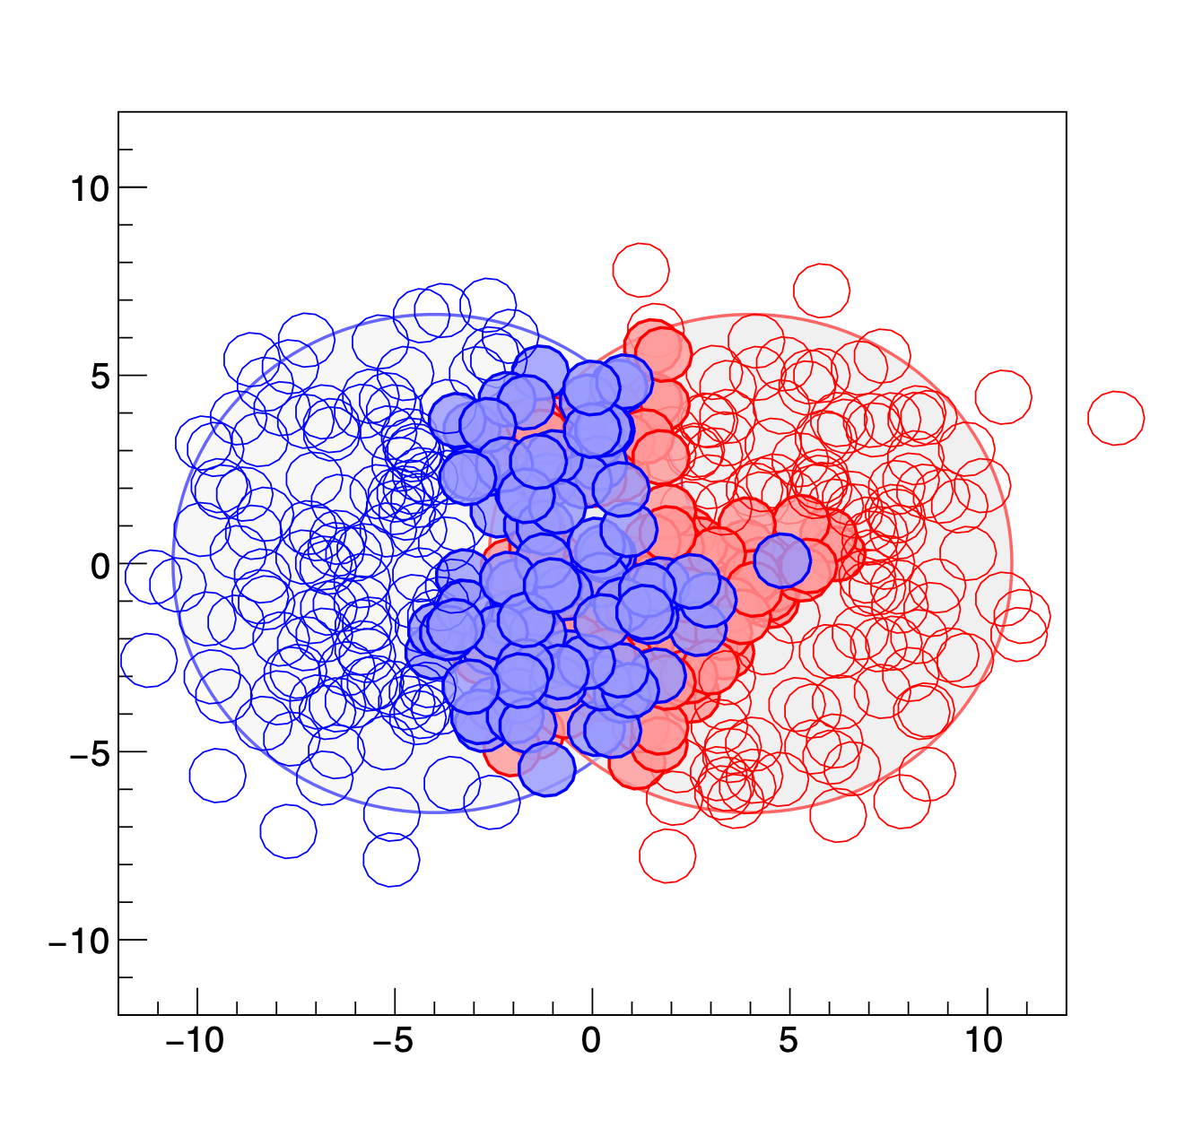
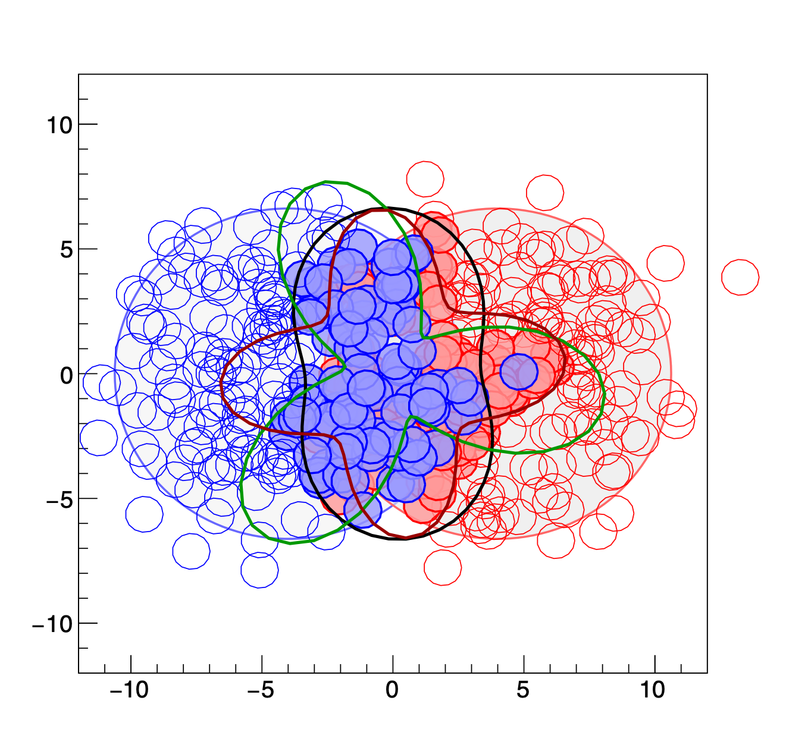
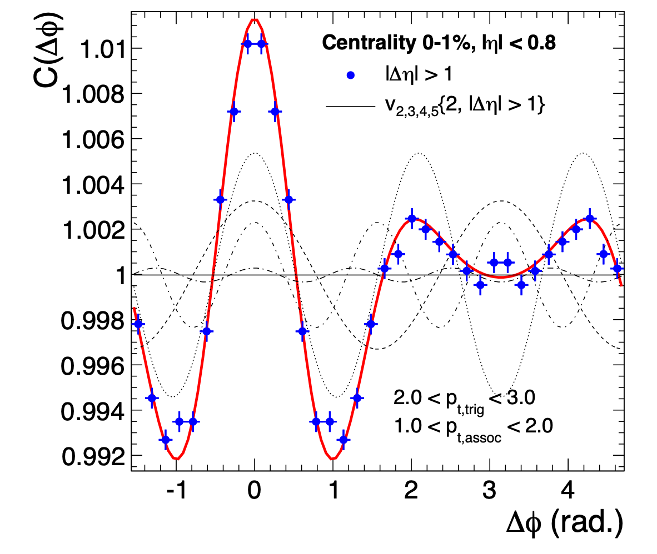
Azimuthal anisotropy: initial and final states
Simulated event: location of nucleons
Azimuthal distribution single event
ALICE, PLB 753, 511
Sum over many events
Characterise shape by harmonics:
Initial state spatial anisotropies εn are transferred into
final state momentum anisotropies vn
by pressure gradients, flow of the Quark Gluon Plasma
ALICE and the Quark-Gluon Plasma | SMI 20 year workshop, Vienna | Marco van Leeuwen

Slide 13
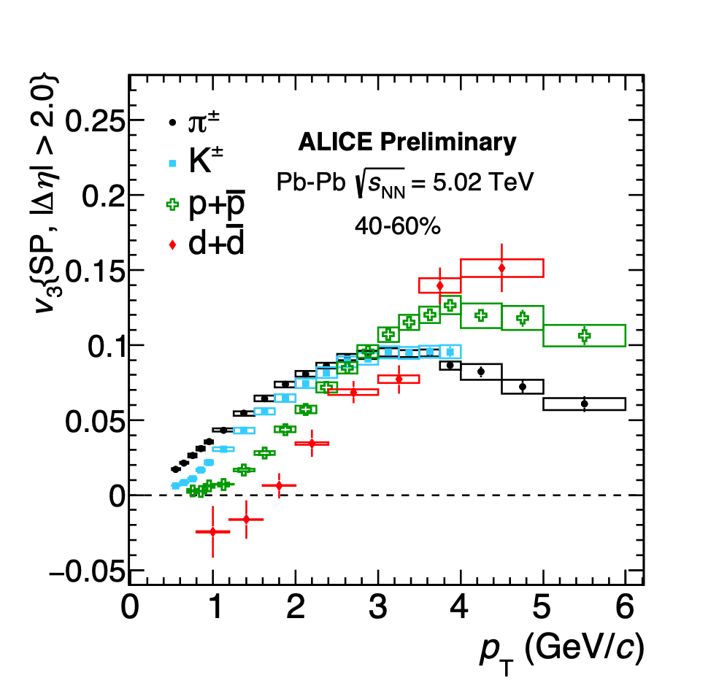
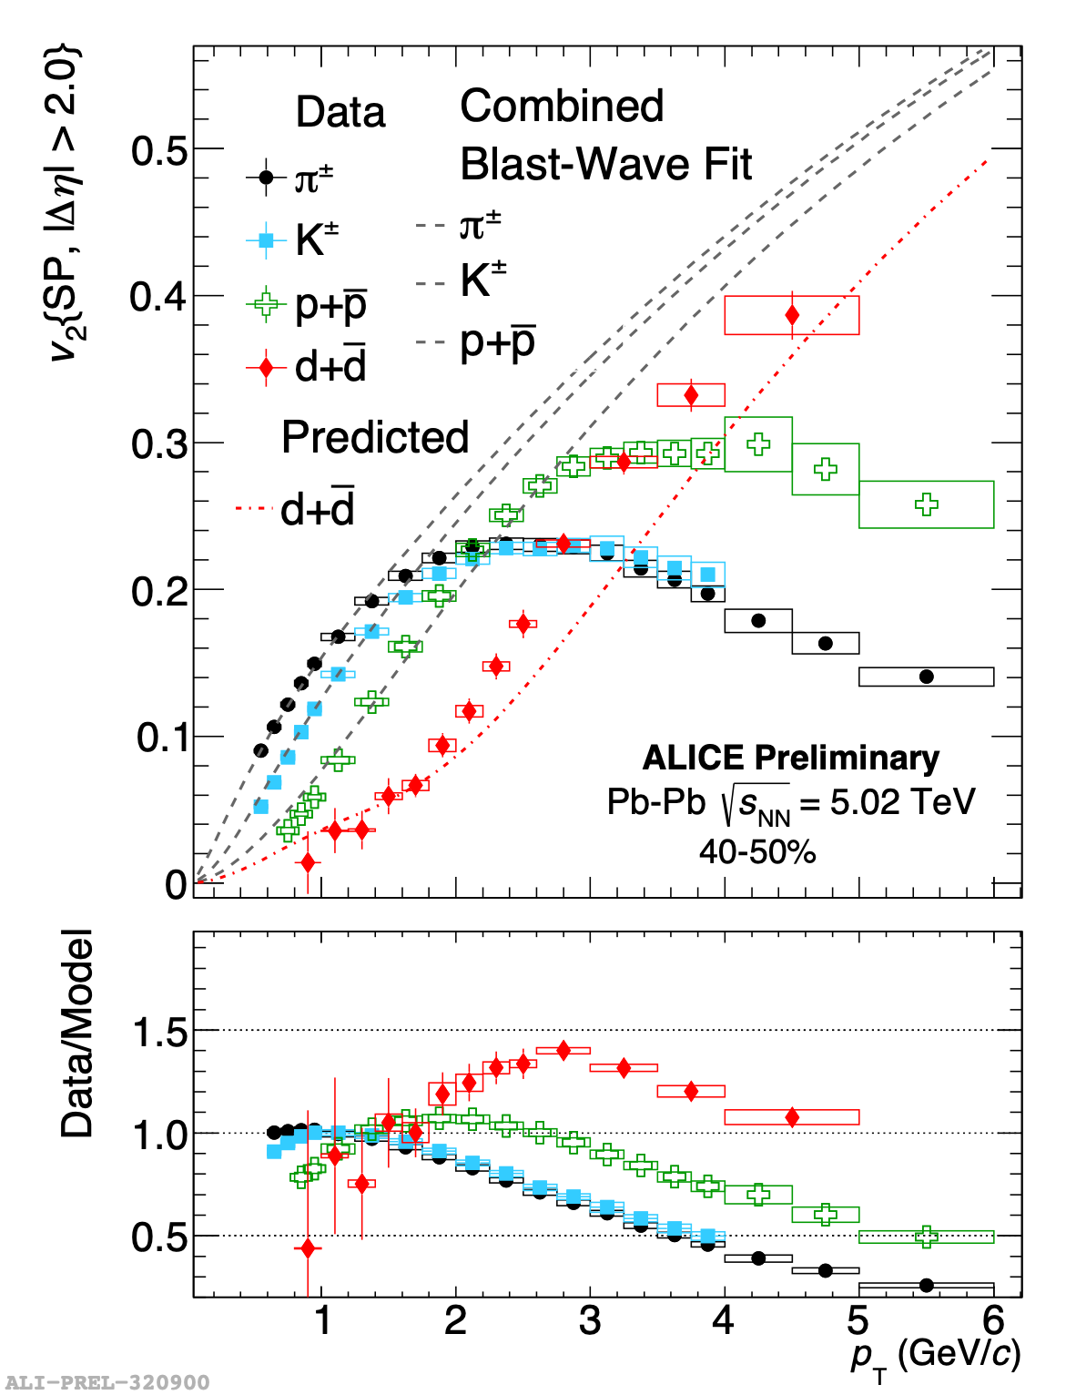
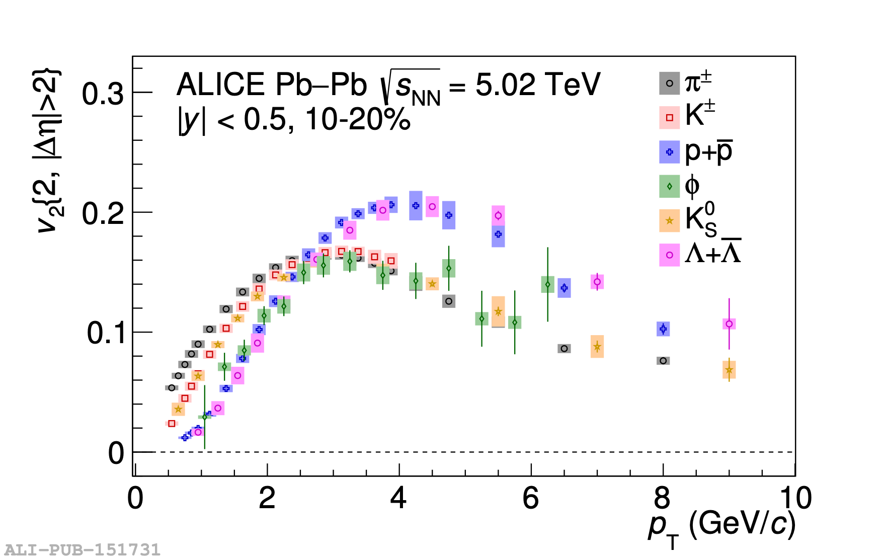
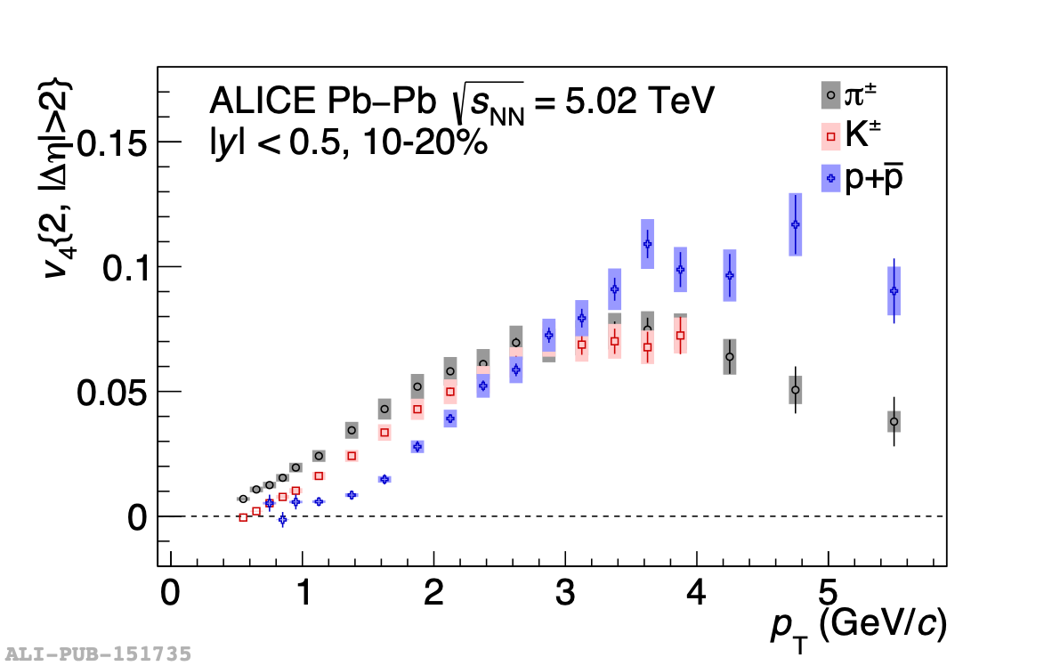
Anisotropic flow: initial state and QGP expansion
v2 of deuterons
v3
Elliptic flow v2
JHEP09 (2018) 006
v4
Mass-dependence of v₂ measures flow velocity
Even light nuclei flow !
ALICE and the Quark-Gluon Plasma | SMI 20 year workshop, Vienna | Marco van Leeuwen

Slide 14
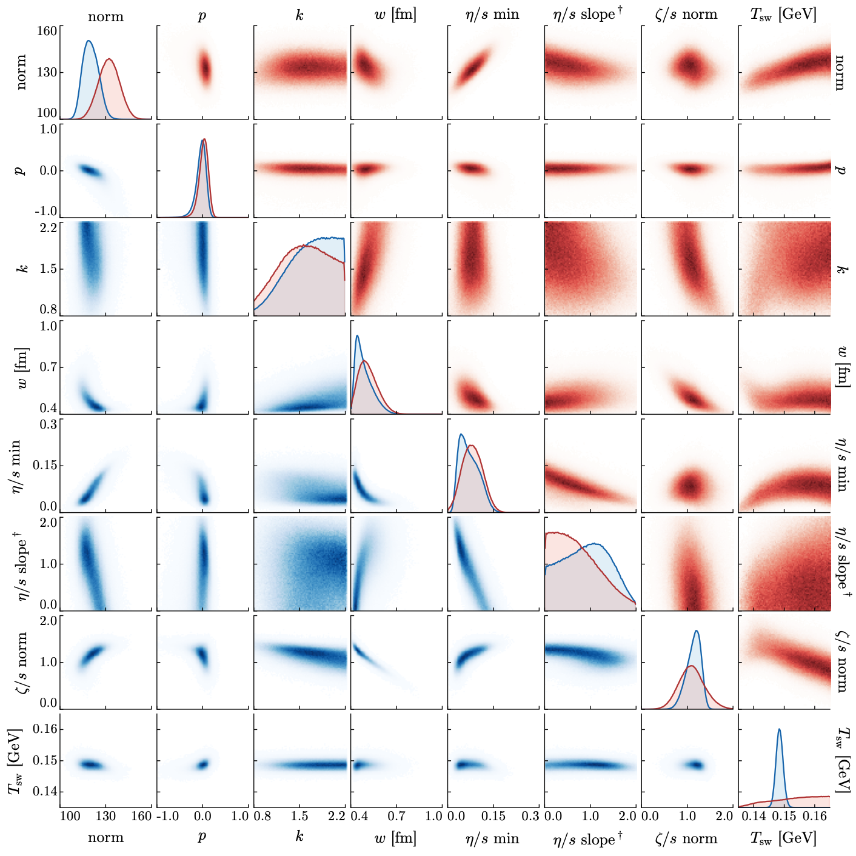
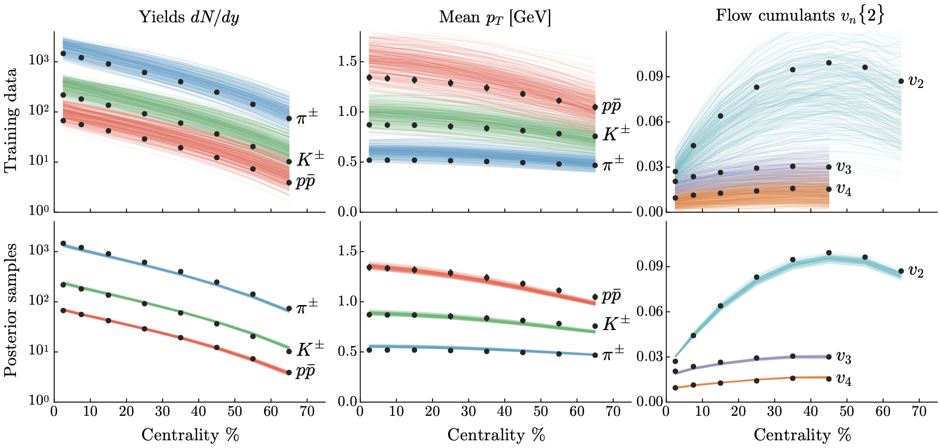
Constraining initial state and plasma properties simultaneously: Bayesian inference
Model parameters — posterior
Experimental input: yields, mean pT and harmonic flow vs pT
J. E. Bernhard et al, PRC 94, 024907
Model: initial anisotropies + medium response
Exploration of a large parameter space: investigate reliability/robustness of the model
ALICE and the Quark-Gluon Plasma | SMI 20 year workshop, Vienna | Marco van Leeuwen

Slide 15
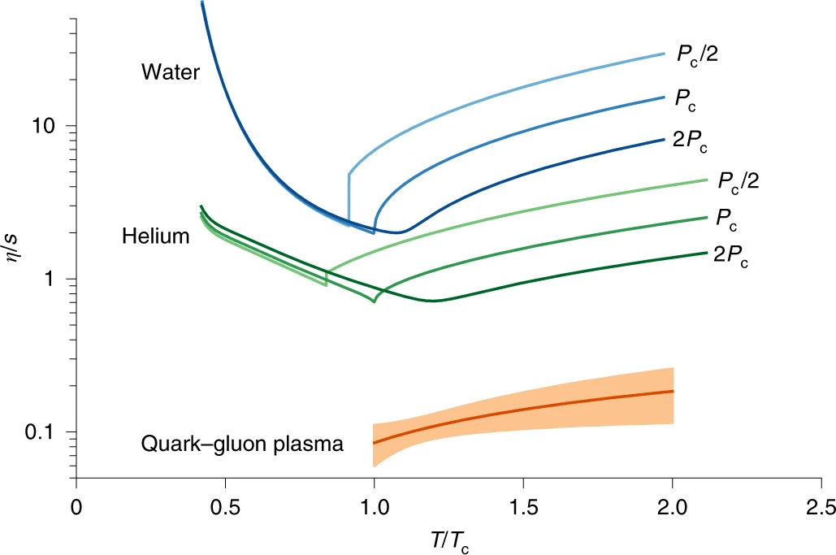
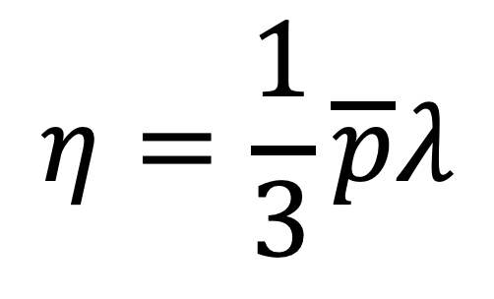
A global fit to anisotropic flow: main result
Viscosity of the QGP compared to ‘regular’ liquids
Viscosity-to-entropy ratio: dimensionless quantity
$$η=\frac{1}{3}\overline{p}λ$$
Small viscosity ⇒ small mean free path
QGP is a strongly interacting gas/liquid
J. E. Bernhard et al, Nature Physics 15, 1113–1117,
PRC 94, 024907
ALICE and the Quark-Gluon Plasma | SMI 20 year workshop, Vienna | Marco van Leeuwen

Slide 16
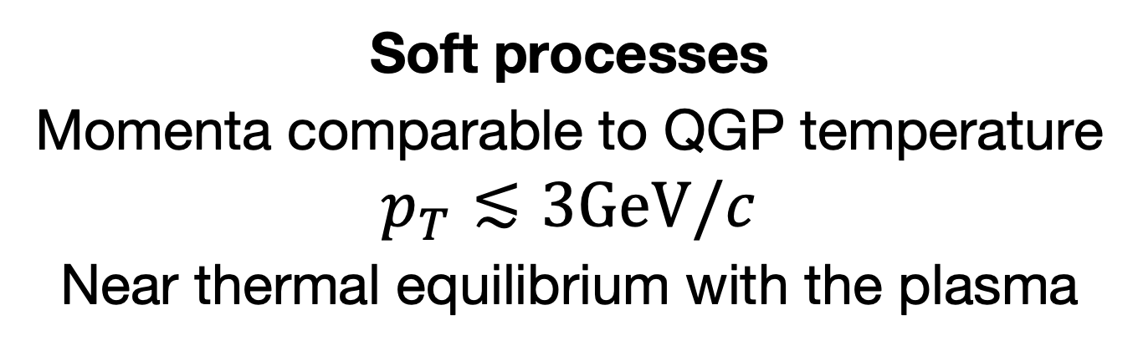
Messengers of the Plasma: soft and hard processes
Soft processes
Momenta comparable to QGP temperature
$$p_{T}≲3GeV/c$$
Near thermal equilibrium with the plasma
‘particles from the QGP’
Hard processes: large momenta >> TQGP
Short formation time: initial production independent of QGP formation
Start out far out of thermal equilibrium: approach equilibrium through interactions
Short life time: expect only partial equilibration
‘Hard probes’ of interactions with the QGP
ALICE and the Quark-Gluon Plasma | SMI 20 year workshop, Vienna | Marco van Leeuwen

Slide 17
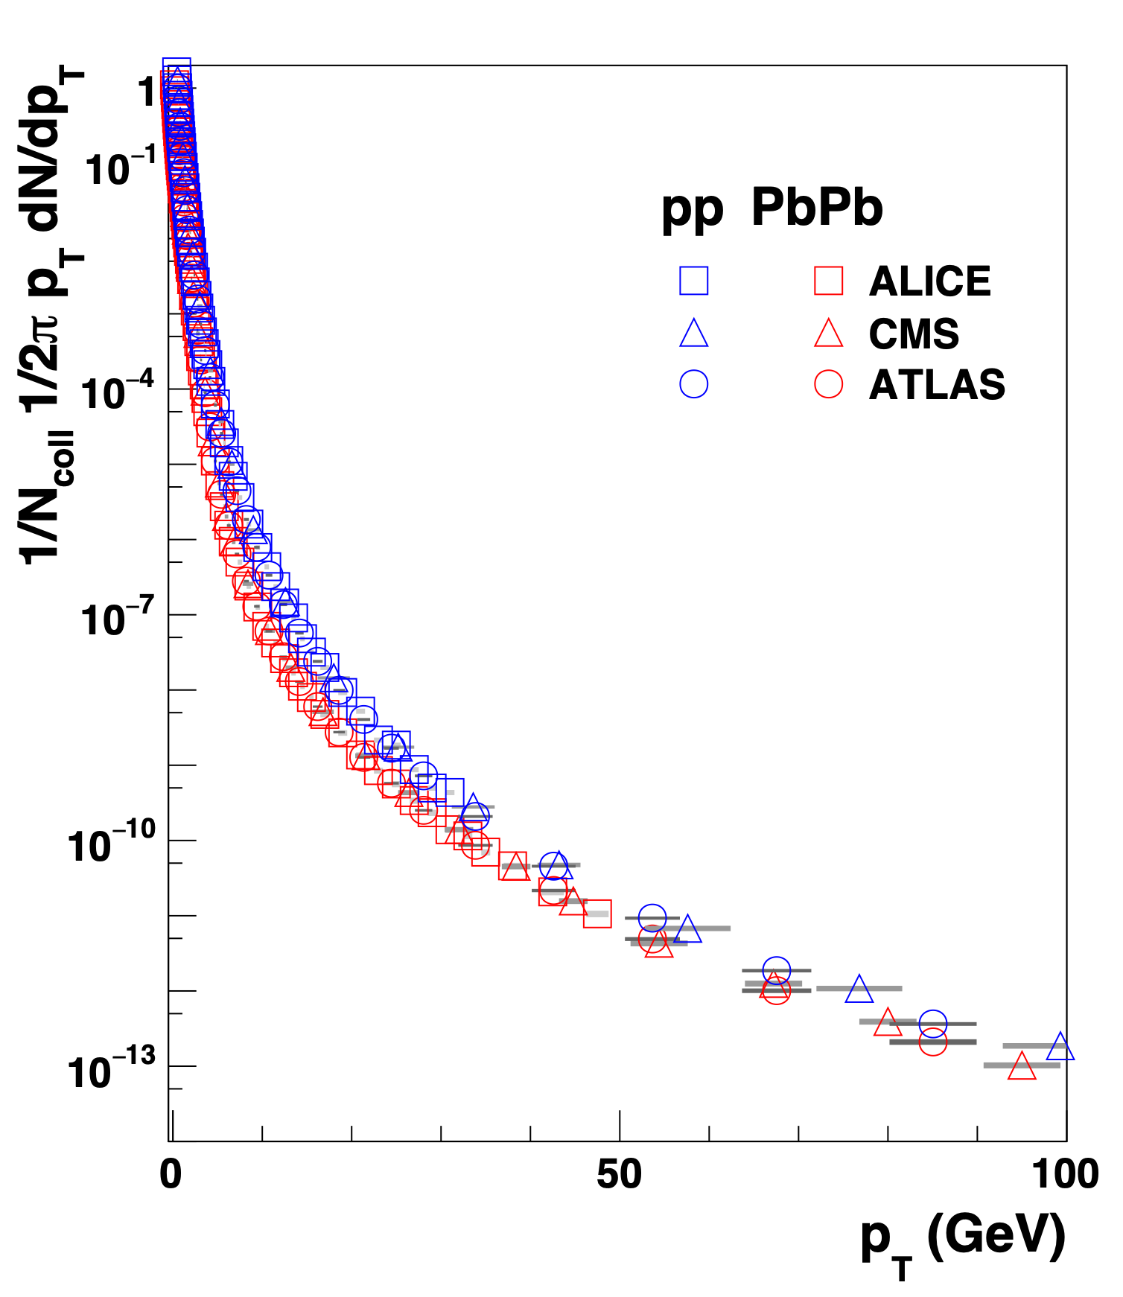
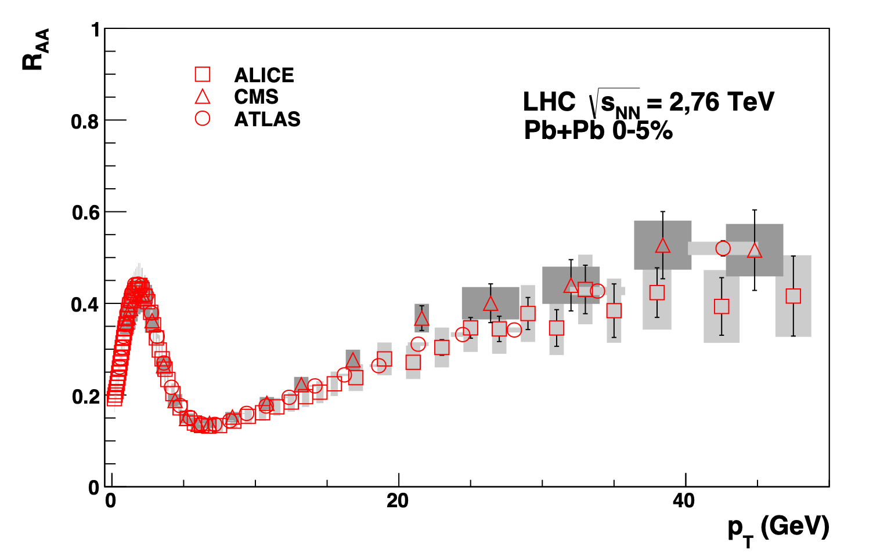
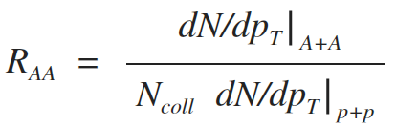
Nuclear modification of pT spectra
ALICE, PLB720, 52
CMS, EPJC, 72, 1945
ATLAS, arXiv:1504.04337
Charged particle pT spectra
Nuclear modification factor
Low pT:
soft production,
Npart scaling
Energy loss
Energy loss
R_{AA} < 1
Pb+Pb: clear suppression (RAA < 1): parton energy loss
ALICE and the Quark-Gluon Plasma | SMI 20 year workshop, Vienna | Marco van Leeuwen

Slide 18
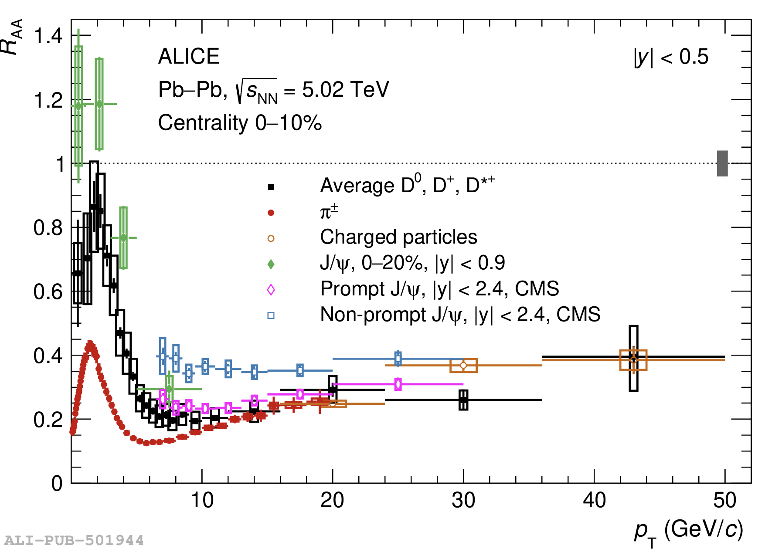
Nuclear modification and elliptic flow of D mesons
charm quarks, m >> T are produced in an initial hard scattering
Nuclear modification factor: light and heavy flavours
Elliptic flow v2
ALICE, JHEP 01 (2022) 174
ALICE, JHEP 01 (2022) 174
Initial production isotropic: azimuthal asymmetry due to interactions
⇒ approach to thermal equilibrium
ALICE and the Quark-Gluon Plasma | SMI 20 year workshop, Vienna | Marco van Leeuwen

Slide 19
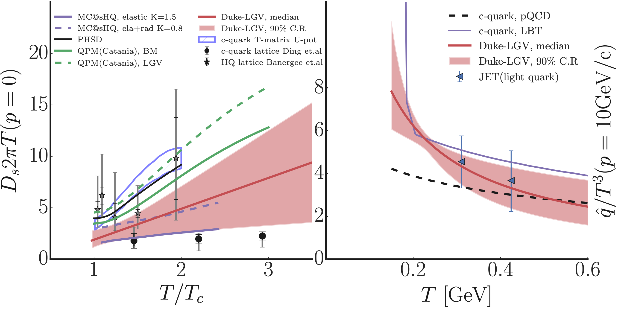



Heavy flavor transport coefficient: Bayesian fit
Diffusion coefficient Ds
Transport coefficient $\overset{̂}{q}$
Y. Xu et al, PRC 97, 014907
$$\overset{̂}{q}=\frac{⟨q_{⊥}^{2}⟩}{λ}$$
$$⟨r^{2}⟩=6D_{s}t$$
Data constrain transport properties of the QGP
Results agree with lattice QCD/pQCD expectations
and between light and heavy flavour sector
ALICE and the Quark-Gluon Plasma | SMI 20 year workshop, Vienna | Marco van Leeuwen

Slide 20



Elliptic flow of charm and beauty quarks: mass dependence
J/𝜓 ($c\overline{c}$) and 𝛶 ($b\overline{b}$) elliptic flow
Open charm, beauty elliptic flow
PRL 123, 192301
arXiv:2307.14084
Quarkonia: flow generated by quark flow and coalescence
Charmonia: large elliptic flow — Bottomonia: compatible with no flow
Non-prompt D mesons (open beauty)
show smaller v2
Beauty quarks flow less than charm quarks: larger mass, slower thermalisation
Open and hidden flavor allow to investigate impact of hadronisation, light quark flow
ALICE and the Quark-Gluon Plasma | SMI 20 year workshop, Vienna | Marco van Leeuwen

Slide 21





Energy loss: di-jet asymmetry
Softdrop splitting angle θg
Energy fraction of second jet
$$x_{J}=\frac{p_{T,1}}{p_{T,2}}$$
ATLAS, PLB 774, 379
ALICE, PRL 128, 102001
Di-jet energy imbalance: jets lose energy
as they propagate through the plasma
More in K Rajagopal’s presentation Tuesday
ALICE and the Quark-Gluon Plasma | SMI 20 year workshop, Vienna | Marco van Leeuwen

Slide 22
Detector upgrades

Slide 23






Recent ALICE upgrades
D⁺ and Ds⁺ in Pb-Pb
New ITS and MFT
Impact parameter resolution
Full pixel detector 13 Gpixels
Improved spatial resolution
Hypertriton
TPC: GEM readout
$${}_{Λ}^{3}H→^{3}He+π$$
Improved pointing resolution and readout rate:
record 50 kHz Pb-Pb collisions (50x more minimum bias events)
ALICE LS2 upgrade paper: arXiv:2302.01238
ALICE and the Quark-Gluon Plasma | SMI 20 year workshop, Vienna | Marco van Leeuwen

Slide 24





Run 3 results: elliptic flow of anti-nuclei and charm mesons
${}^{3}\overline{He}$ elliptic flow
Elliptic flow of D, Ds
$$\frac{dN}{dφ}∝(1+v_{2})cos(φ−Ψ_{2})$$
First large Pb-Pb data sample with upgraded detectors collected in 2023
Larger samples, better pointing resolution: improved precision
Much more to come!
ALICE Status Report | RRB meeting 28-30 Oct | MvL

Slide 25



ALICE upgrade projects
LS4: ALICE 3
LS3 upgrades
Forward Calorimeter
ITS 3
TDR approved
TDR approved
ALICE 3 LoI:
CERN-LHCC-2022-009
ALICE 2
ALICE 2.1
ALICE 3
LHC
LS2
LHC
Run 3
LHC
LS3
LHC
Run 4
LHC
LS4
LHC
Run 5
2021
2022
2023
2024
2025
2026
2027
2028
2029
2030
2031
2032
2033
2034
2035
2036
2037
ALICE and the Quark-Gluon Plasma | SMI 20 year workshop, Vienna | Marco van Leeuwen

Slide 26



Silicon pixel sensor development
Inner tracking system
High-resolution, low-mass vertex detectors are crucial
for detection/identification of heavy flavour hadrons and
electron-positron pairs (thermal radiation)
Development and adoption of monolithic active pixel sensors
in CMOS technology
ITS3 development
DPTS test paper arXiv:2212.08621
Thinned silicon can be curved: ultra-light structures
ALICE and the Quark-Gluon Plasma | SMI 20 year workshop, Vienna | Marco van Leeuwen

Slide 27



LHC Run 5 and 6: ALICE 3
Compact detector system with
High-resolution vertex detector: excellent pointing resolution
Particle Identification over large acceptance: muons, electrons, hadrons, photons
Fast read-out and online processing
Retractable vertex tracker
Improvements in precision, rate, acceptance
ALICE 3 Letter of Intent
(CDS: LHCC-2022-009)
Notes:
neuartiges Detektorkonzept
große Akzeptanz → Si-Tracker
sehr gute Pointing Auflösung
PID über große Akzeptanz

Slide 28















ALICE 3: an ambitious physics program
Dielectrons: thermal radiation and chiral symmetry restoration
$D\overline{D}$ correlations: charm diffusion
Heavy flavour v2
$$p_{T}^{D^{0}}>4GeV/c$$
$$2<p_{T}^{{\overline{D}}^{0}}<4GeV/c$$
Thermalisation of heavy quarks
Direct measure of temperature
and expansion of early stage
Multi-charm baryons
Chiral symmetry restoration
Exotic states and hadron interactions
$D^{0}D^{∗+}$ momentum correlations
$χ_{c1}(3872)$ production
… and more
c-deuteron

Slide 29
Conclusion
Heavy-ion collisions at LHC provide unique laboratory to study strongly interaction matter
  Hottest and densest matter available in the laboratory
  Properties: low viscosity, short mean free path
  Slower thermalisation for beauty than charm: mass dependence
Large upgrade for Run 3: improved precision, new channels
  Many new results to come in the next years
Future upgrades: focus on thermal radiation, chiral symmetry restoration, thermalisation, structure of exotic hadrons (interaction potentials)

Slide 30

Thanks for your attention
Start of heavy-ion run 6 November 2024: the quest continues…

Slide 31


Summary
LHC heavy-ion program: multi-body QCD and the
properties of strongly interacting matter at high T
Dissociation (‘melting’) of quarkonia: very high density and T
Determine properties of QGP: viscosity and transport coefficients
  Viscosity very small: close to lower limit $η/s=1/4π$
  Slower thermalisation for beauty than charm
First measurements of thermal radiation expected with upgraded detector in Run 3 + 4
  ALICE 3: next-generation upgrade for run 5 and 6
ALICE, arXiv:2211.04384

Slide 32



Temperature of the QGP: electromagnetic radiation
Dielectron mass distribution
T vs energy
Dielectron v2
Projected temperature
from electromagnetic radiation
Temperature
from hadron abundances
‘chemical freeze-out’
Light flavour hadron abundances consistent with common chemical freeze-out
Limiting temperature: ~155 MeV
Electromagnetic radiation gives access to temperature of QGP before hadronisation
Cleanest signal: dilepton pairs
Expected T at LHC: 300-400 MeV
Unique access to time evolution of temperature
via v2, pT dependence of T
Slope measures
temperature

Slide 33




Comparison to ITS 3
Correlated dielectron distribution
Relative syst uncertainty from HF decay bkg
ALICE 3 mass spectrum
HF decays produce correlated background
Large for $m_{ee}≳1GeV/c^{2}$
Can be effectively suppressed in ALICE 3
Large improvement in
systematic uncertainty
High precision: access $ρ−a_{1}$ mixing

Slide 34


ALICE upgrades in Long Shutdown 2 (2019-2021)
New ITS and MFT
TPC: GEM readout
Full pixel detector
Improved spatial resolution
Continuous readout
Fast Interaction Trigger
Online event processing
ALICE LS2 upgrade paper: arXiv:2302.01238
ALICE upgrade for Run 3, 4: improve pointing resolution, readout rate (50 kHz for HI events)
ALICE and the Quark-Gluon Plasma | SMI 20 year workshop, Vienna | Marco van Leeuwen

Slide 35





Heavy-flavour transport: DD̅ azimuthal correlations
ALICE 3 projection: $D\overline{D}$ correlations
Charm azimuthal correlations
c
$$p_{T}^{D^{0}}>4GeV/c$$
$$2<p_{T}^{{\overline{D}}^{0}}<4GeV/c$$
S. Cao et al., private comm.,
based on PLB 838 (2023) 137733
c
ALICE Run 3 + 4 projection
Angular decorrelation directly probes QGP scattering
  Signal strongest at low pT
Very challenging measurement:
need good purity, efficiency and η coverage
→ heavy-ion measurement only possible with ALICE 3

Slide 36







Hadron formation: multi-HF hadrons
Yield vs mass
Strangeness tracking
Λc
Ωc
J/ψ
Ξcc
Run 5 & 6
cd
Ωccc
A Andronic et al, JHEP 07 (2021) 035
Run 3 & 4
3x charm
ct
2x charm
1x charm
$$Ω_{ccc}$$
$$Ξ_{cc}^{++}→Ξ_{c}^{+}+π^{+}$$
c
c
c
$$Ξ_{c}^{+}→Ξ^{−}+2π^{+}$$
c̅
c̅
c
c̅
c
c̅
Multi-charm baryons: unique probe of hadron formation
Statistical hadronisation model: very large enhancement in AA
Specific relation between yields: $g_{c}^{n}$ for n-charm states
ALICE 3: unique experimental access
to multi-charm baryons
See also presentation by Antonin Maire
ALICE and the Quark-Gluon Plasma | SMI 20 year workshop, Vienna | Marco van Leeuwen
Notes:
Im Folgenden nur Beispiele

Slide 37







Heavy-ion collisions as a laboratory for hadron physics
$T_{cc}^{+}$ discovery
DD* momentum correlation
$$D^{0}D^{∗+}$$
$$D^{0}{\overline{D}}^{∗0}$$
vs
LHCb, Nat Phys 18 (2022) 7, 751
Several exotic heavy flavour states identified
Loosely bound meson molecule or tightly bound tetraquark?
Study binding potential with final state interactions
‘femtoscopic correlations’
$D^{0}D^{∗+}$: nature of $T_{cc}^{+}$
$D^{0}{\overline{D}}^{∗0}$: nature of $χ_{c1}(3872)$
Bound states produce specific pattern vs system size
ALICE and the Quark-Gluon Plasma | SMI 20 year workshop, Vienna | Marco van Leeuwen

Slide 38


A global fit to anisotropic flow: main result
J. E. Bernhard et al, Nature Physics 15, 1113–1117,
PRC 94, 024907
Viscosity vs T
Shear viscosity
Viscosity of the QGP compared to well-known liquids
Bulk viscosity
QGP has a very small ‘specific viscosity’ ⇒ small mean free path
Viscosity close to fundamental lower bound
ALICE and the Quark-Gluon Plasma | SMI 20 year workshop, Vienna | Marco van Leeuwen

