Slide 1




Ab-Initio Study of Antiproton-Nucleus System at Low Energies
Alireza Dehghani
Supervisor: Dr. Guillaume Hupin
PhD Funded by ANR NECTAR
IJCLab, CNRS/IN2P3 & Université Paris-Saclay, Orsay, France

Slide 2
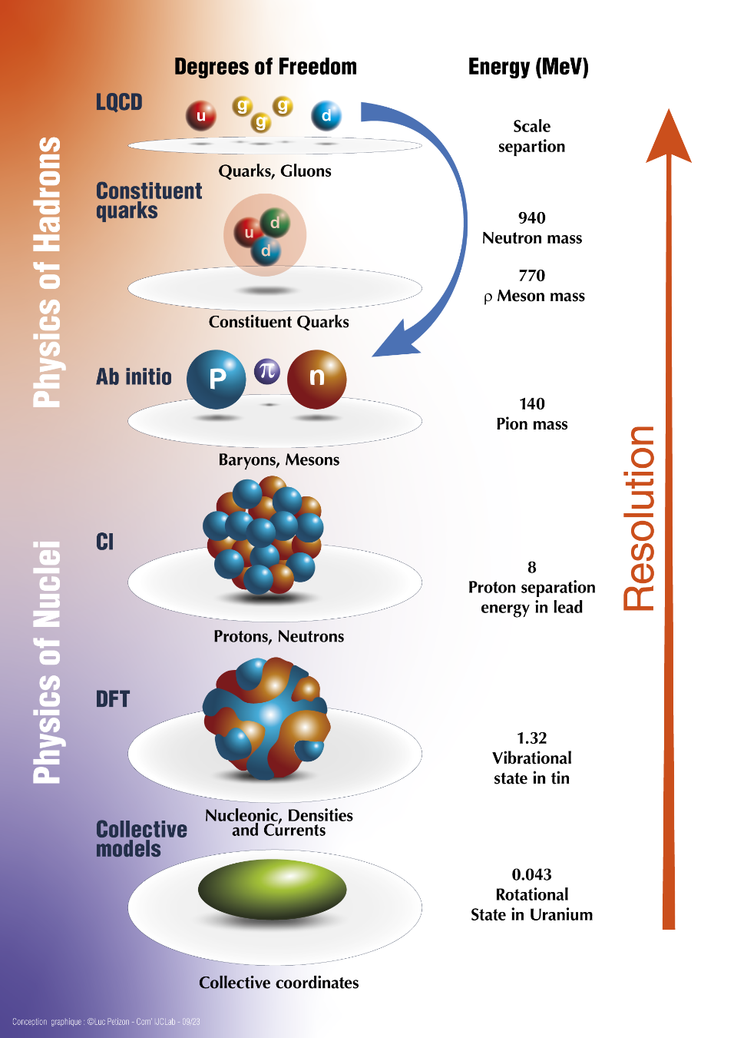

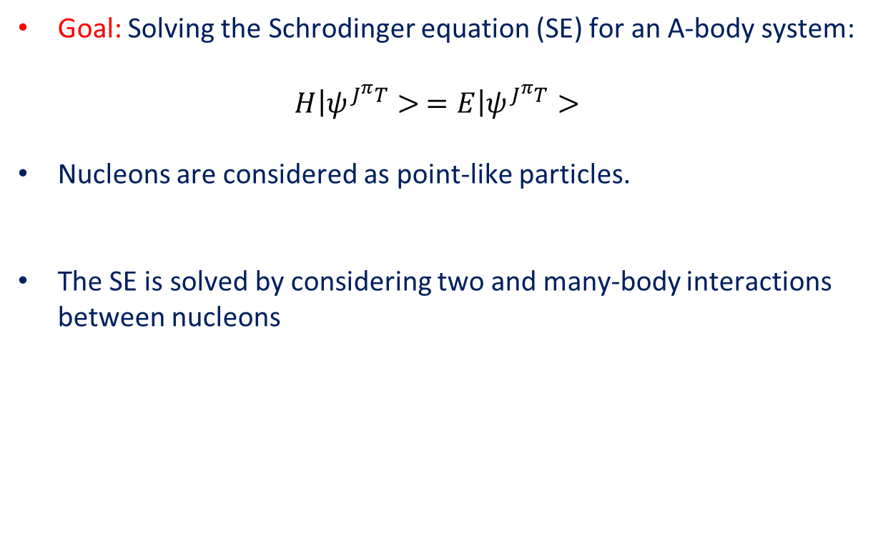


Ab-Initio (from the beginning) Nuclear Theory
Goal: Solving the Schrodinger equation (SE) for an A-body system:
$$\left.H\right|ψ^{J^{π}T}> =\left.E\right|ψ^{J^{π}T}>$$
Nucleons are considered as point-like particles.
The SE is solved by considering two and many-body interactions between nucleons
$$V_{13}$$
$$V_{123}$$
$$V_{23}$$
$$V_{12}$$

Slide 3
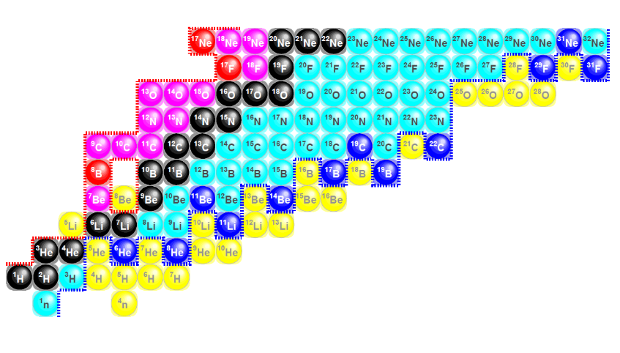

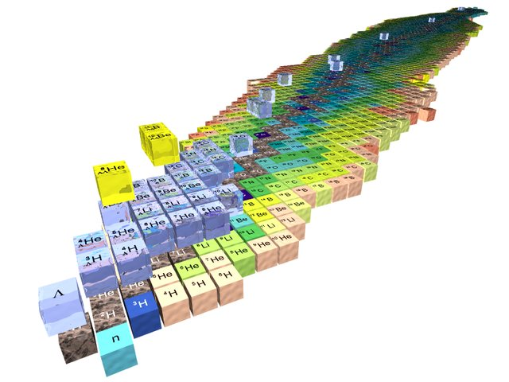
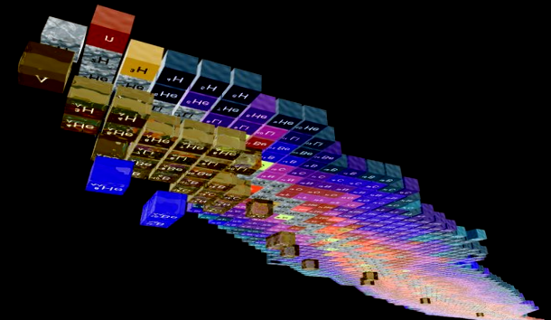

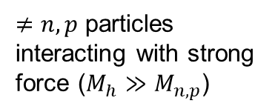
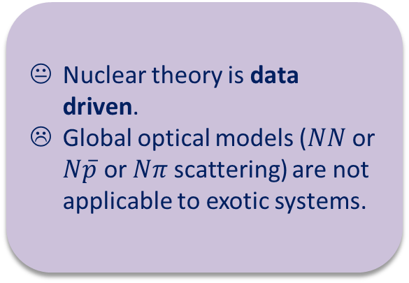
Research axis: Complex reactions with s- and p-shell nuclei
Complexity of scattering problem
Complexity of many-body solution
Both
Nuclear theory is data driven.
Global optical models ($NN$ or $N\overline{p}$ or $Nπ$ scattering) are not applicable to exotic systems.
$≠n,p$ particles interacting with strong force ($M_{h}≫M_{n,p}$)
$$M_{h}≤M_{n,p}$$
Credits H. Lenske
Notes:
The research axis is basically two-fold:
1- More complex reactions
2- Towards heavier mass systems
In higher resolution:
We want to study halo nuclei with full glory NN+3N interaction
Study break up and FSI
Etc…

Slide 4










Building block - Chiral EFTs
Weinberg ‘90’91’92 Ordóñez and vK ’92 etc…
Importance
$$𝒪(1)$$
$$𝒪(Q/M_{hi})$$
A. Tichai, et. al. Front. Phys. 8, 164 (2020)
Friar ’97
High quality nuclear interactions (at N³LO).
Various fits and successes.
Weinberg PC wrong: no renormalizability.
Correct power counting: active research
Development of improved power counting $⟶$ high-precision/high-orders.
Stability of p-shell nuclei.
How does chiral expansion perform under forthcoming LQCD data?
Notes:
Chiral effective field theory was proposed by Weinberg in the 90’ using naive dimensional analysis in the power counting.
In this PC, high-order chiral EFT perform well and allow many-body practitioners to have high-quality nuclear interactions thus to connect to experiments.
For instance, I show the evolution of binding energy of Oxygen and Calcium isotopes using many-body perturbation theory (2nd order +N3LO) from the contributors.
Already, several fitting procedures of LEC exist and produce interaction of various quality.
There is a strong interest in the community to depart from Weinberg PC, which we know to be non-renormalizabled. Others PC are being developed: see the scribble on the slide.
In France, there is a strong research program going forward in that direction, at this stage the goals are:

Slide 5
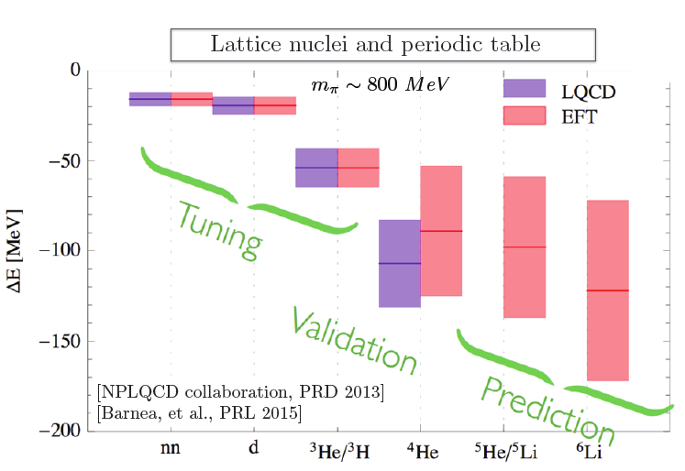
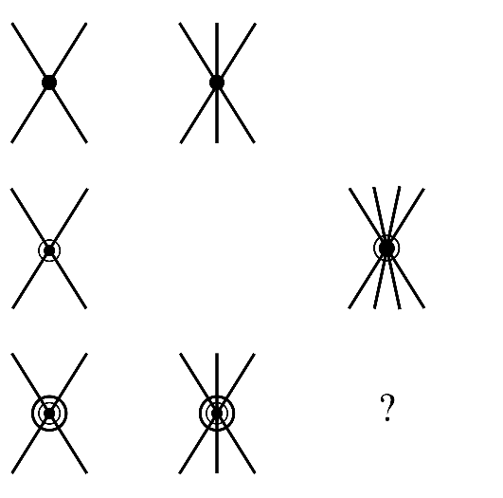


Building block - Pionless EFT
Importance
From LQCD to nuclear $π$EFT
$$𝒪(1)$$
$$𝒪(Q/M_{hi})$$
$$𝒪(Q^{2}/M_{hi}^{2})$$
Renormalizable, connection to LQCD.
H.-W. Hammer, S. König, and U. van Kolck Rev. Mod. Phys. 92, 025004 (2020)
High-precision pionless EFT for ab initio nuclear studies.
Stability of p-shell nuclei (NLO).
Pionless EFT in the many-body sector: mass reach.
Pionless EFT for antinucleon systems /hypernuclei ?
Notes:
Another applicable EFT for low-energy nuclear physics is pion-less EFT. Again this research program is very active.
Established PC obeys renormalizability and connection to LQCD results shows the validation of pionless EFT for nuclear sector (fig).

Slide 6
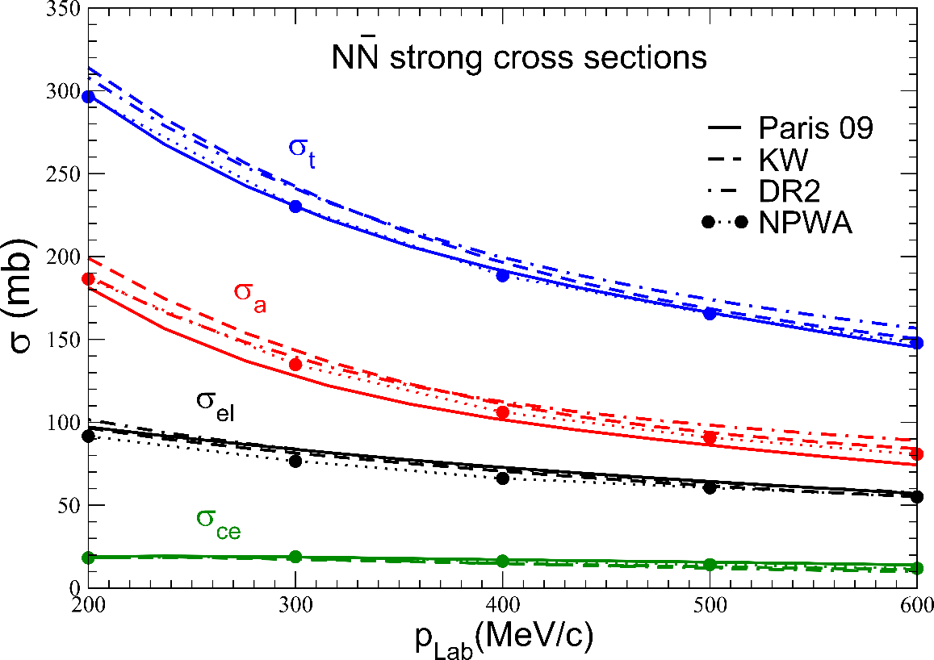
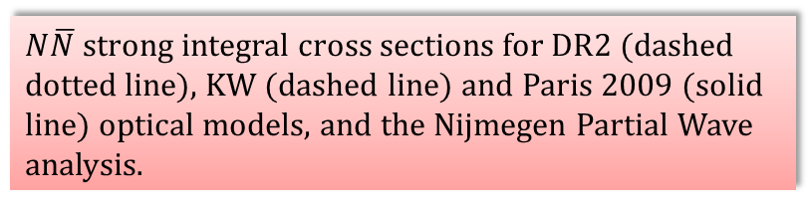
$N\overline{N}$: agreement to data
Despite significant disparities, old models, evaluation (PWA), and Chiral EFT parametrization yield similar agreements in integrated cross-sections.
$N\overline{N}$ strong integral cross sections for DR2 (dashed dotted line), KW (dashed line) and Paris 2009 (solid line) optical models, and the Nijmegen Partial Wave analysis.
J. Carbonell et al. Eur. Phys. Jour. A 59 (2023)

Slide 7
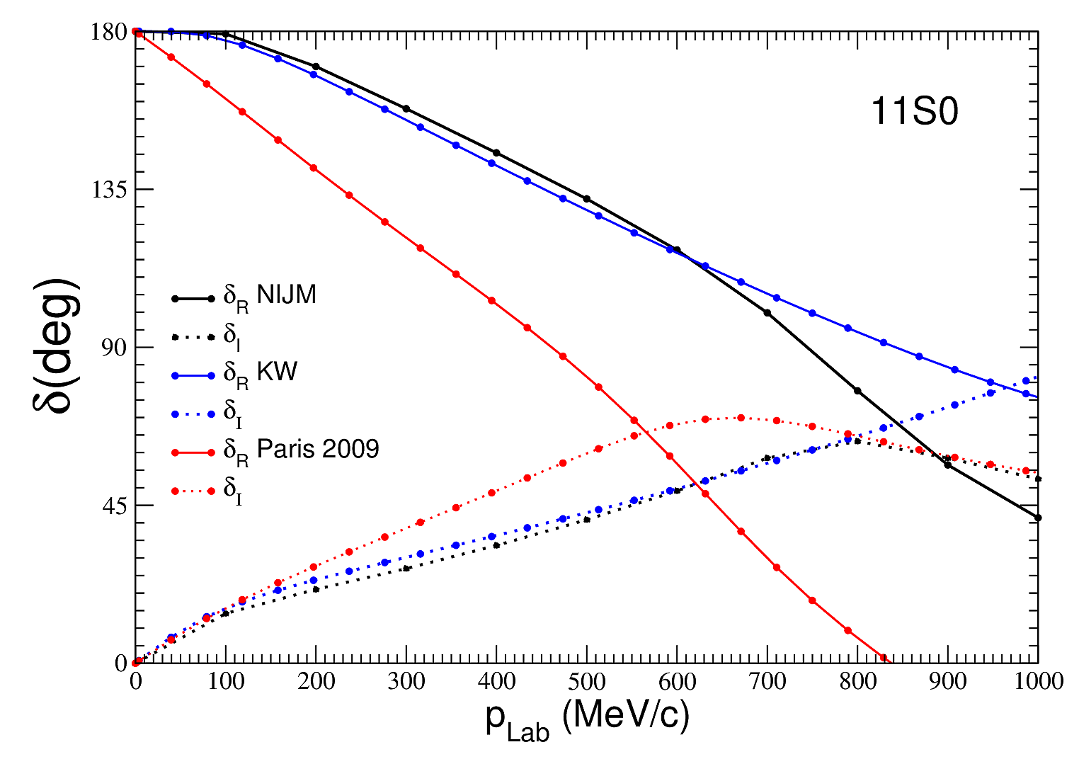
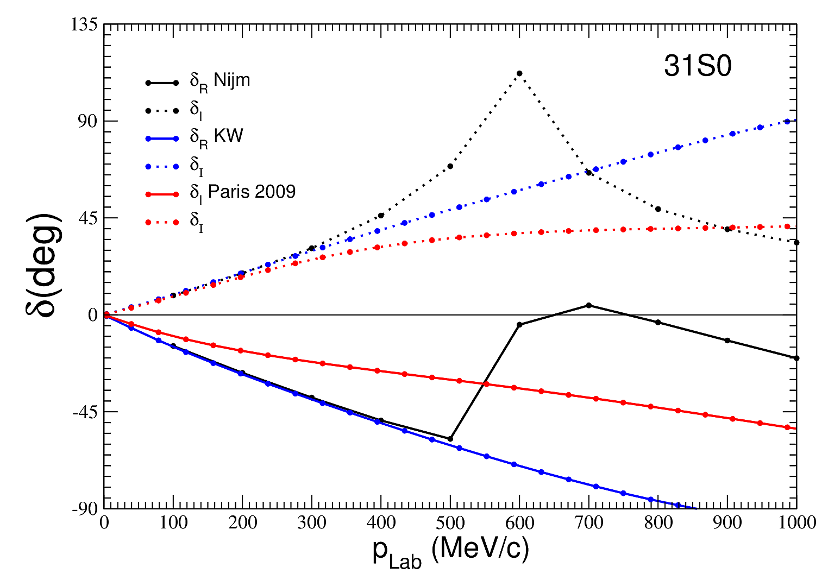
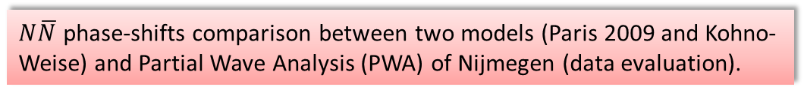
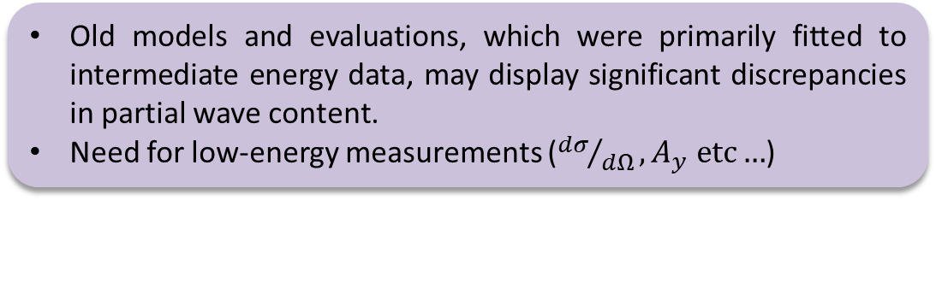
$N\overline{N}$: phase-shift analysis
Old models and evaluations, which were primarily fitted to intermediate energy data, may display significant discrepancies in partial wave content.
Need for low-energy measurements (${dσ}/{dΩ},A_{y} etc…$)
$N\overline{N}$ phase-shifts comparison between two models (Paris 2009 and Kohno-Weise) and Partial Wave Analysis (PWA) of Nijmegen (data evaluation).
J. Carbonell et al. Eur. Phys. Jour. A 59 (2023)

Slide 8
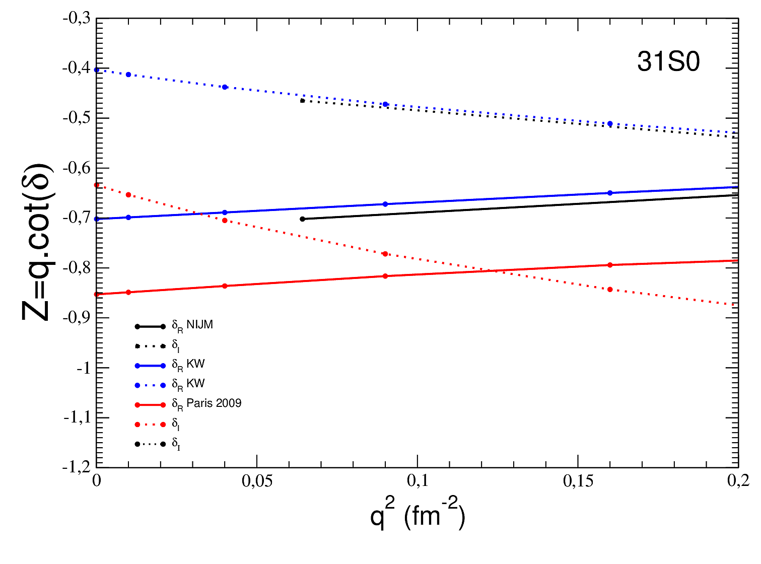
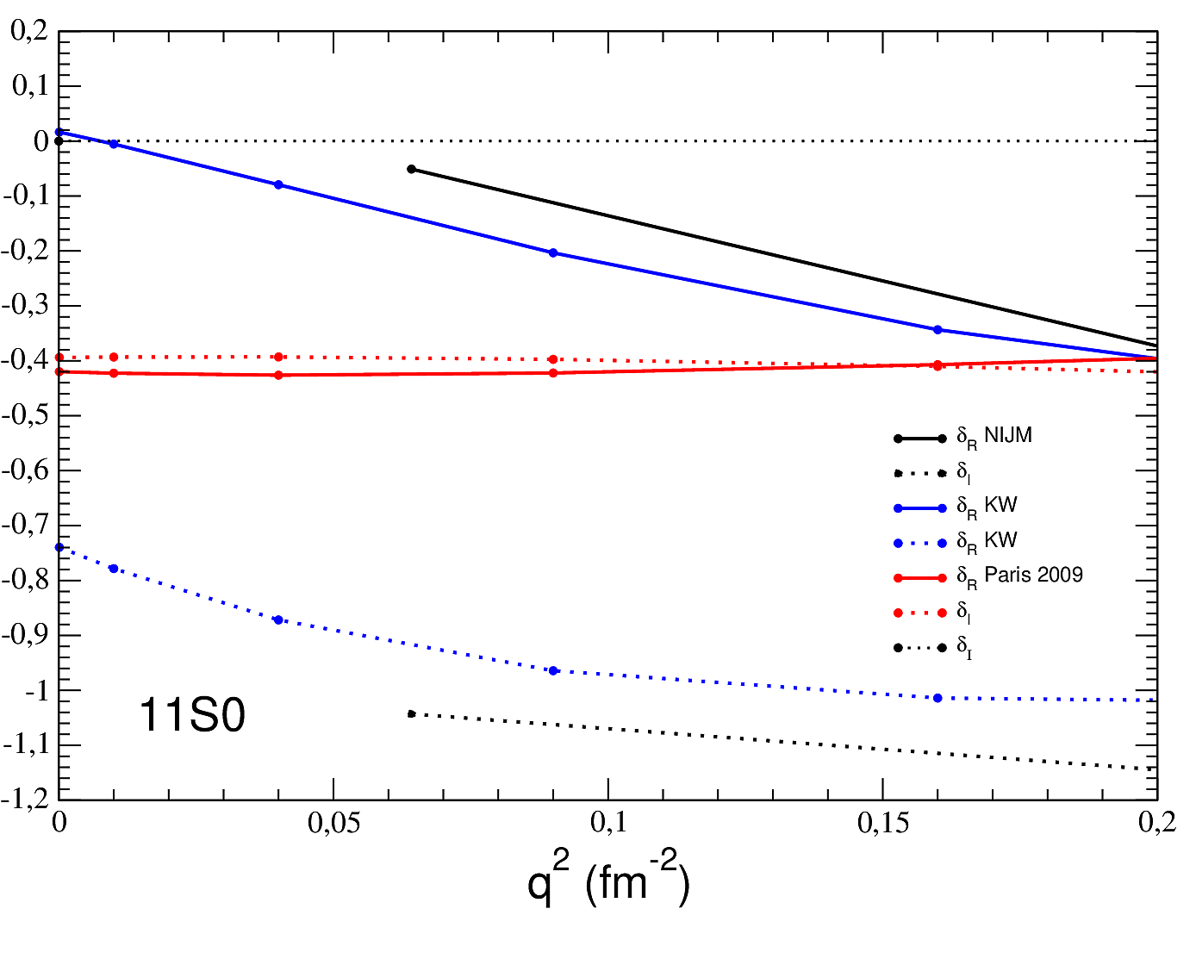
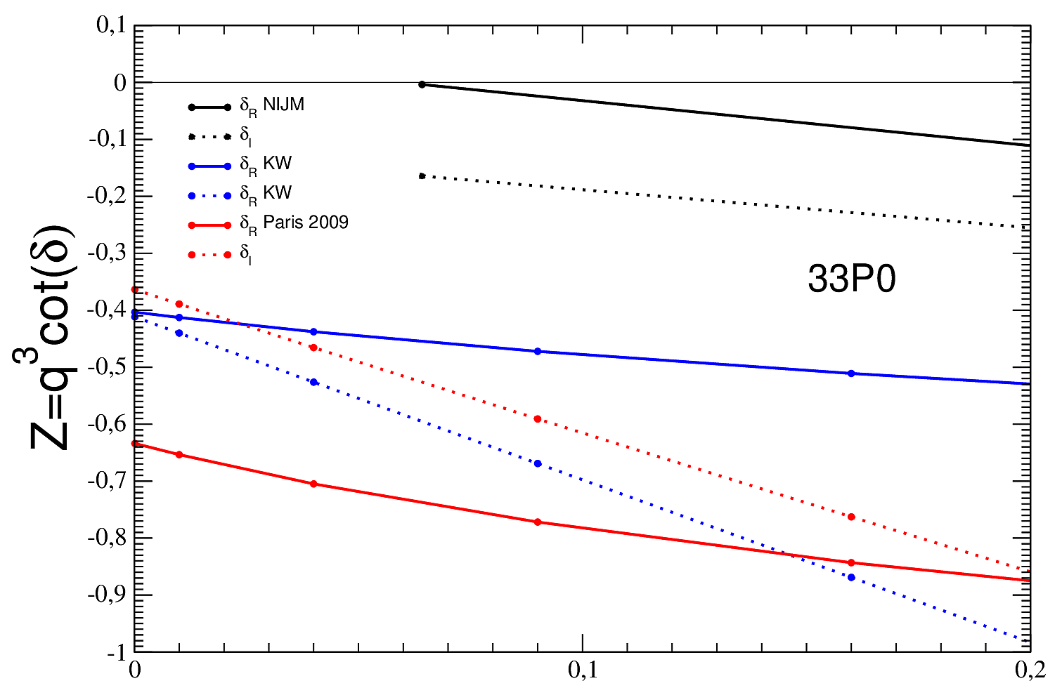
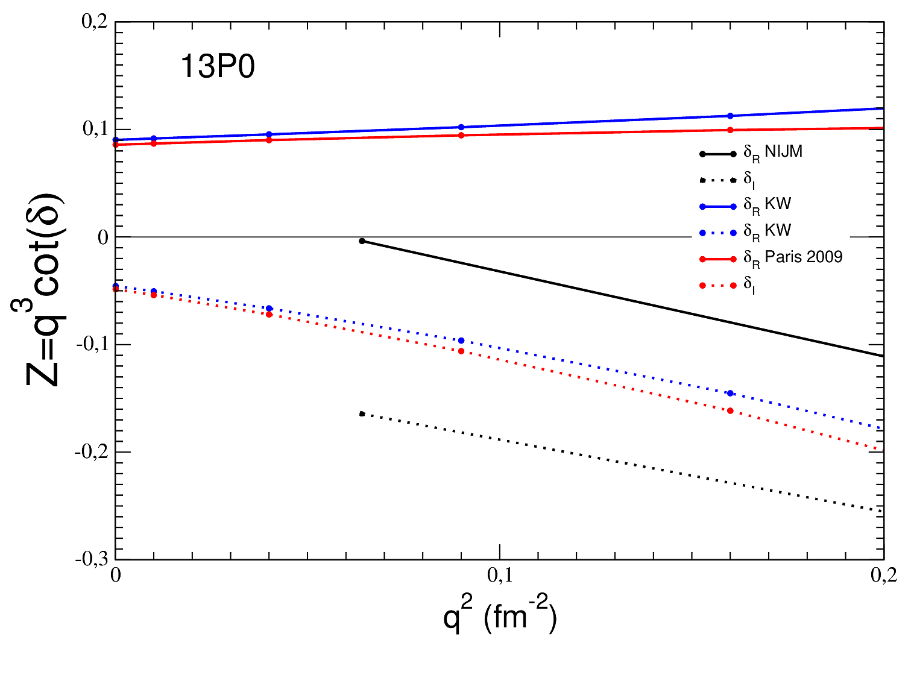
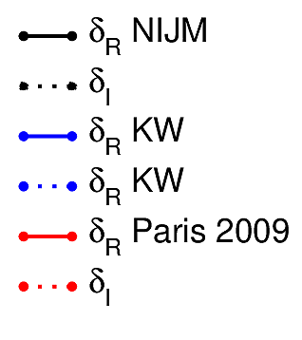







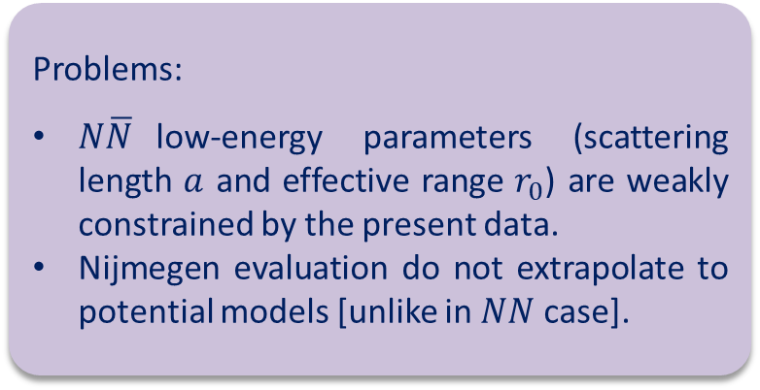
$N\overline{N}$: low-energy limit
$$−\frac{1}{a}$$
$$\frac{1}{2}r_{0}$$
Problems:
$N\overline{N}$low-energy parameters (scattering length $a$ and effective range $r_{0}$) are weakly constrained by the present data.
Nijmegen evaluation do not extrapolate to potential models [unlike in $NN$ case].
$$Z_{r}$$
$$Z_{I}$$
$$Z_{r}$$
$$Z_{I}$$
$$Z_{r}$$
$$Z_{I}$$

Slide 9

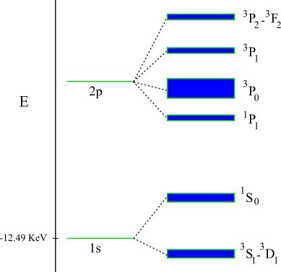
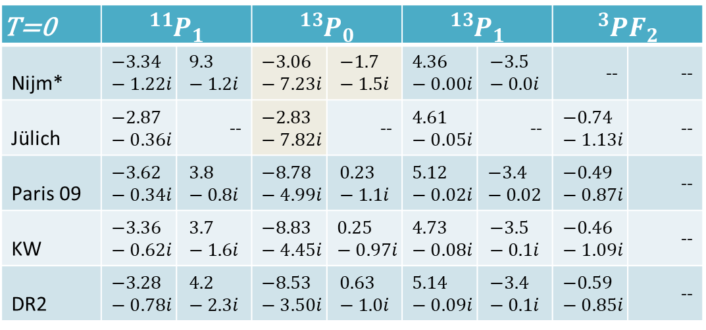
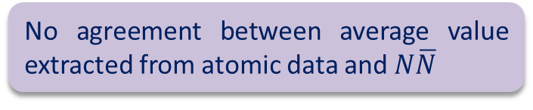
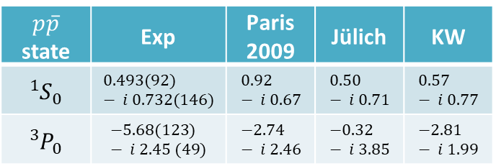
$N\overline{N}$: Effective Range Expansion parameters and protonium data
Qualitative agreement for some waves but accuracy do not exceed 10%
Low-energy theories need high accuracy at and below threshold
Nuclear shifted levels
Coulomb
+Nuclear
T=0 | $${{}_{ }^{11}P}_{1}$$ |  | $${{}_{ }^{13}P}_{0}$$ |  | $${{}_{ }^{13}P}_{1}$$ |  | $${{}_{ }^{3}{PF}}_{2}$$
Nijm* | $$−3.34−1.22i$$ | $$9.3−1.2i$$ | $$−3.06−7.23i$$ | $$−1.7−1.5i$$ | $$4.36−0.00i$$ | $$−3.5−0.0i$$ | -- | --
Jülich | $$−2.87−0.36i$$ | -- | $$−2.83−7.82i$$ | -- | $$4.61−0.05i$$ | -- | $$−0.74−1.13i$$ | --
Paris 09 | $$−3.62−0.34i$$ | $$3.8−0.8i$$ | $$−8.78−4.99i$$ | $$0.23−1.1i$$ | $$5.12−0.02i$$ | $$−3.4−0.02$$ | $$−0.49−0.87i$$ | --
KW | $$−3.36−0.62i$$ | $$3.7−1.6i$$ | $$−8.83−4.45i$$ | $$0.25−0.97i$$ | $$4.73−0.08i$$ | $$−3.5−0.1i$$ | $$−0.46−1.09i$$ | --
DR2 | $$−3.28−0.78i$$ | $$4.2−2.3i$$ | $$−8.53−3.50i$$ | $$0.63−1.0i$$ | $$5.14−0.09i$$ | $$−3.4−0.1i$$ | $$−0.59−0.85i$$ | --
$$p\overline{p}$$ state | Exp | Paris 2009 | Jülich | KW
$${{}_{ }^{1}S}_{0}$$ | $$0.493(92) − i 0.732(146)$$ | $$0.92 − i 0.67$$ | $$0.50 − i 0.71$$ | $$0.57 − i 0.77$$
$${{}_{ }^{3}P}_{0}$$ | $$−5.68(123) − i 2.45 (49)$$ | $$−2.74 − i 2.46$$ | $$−0.32 − i 3.85$$ | $$−2.81 − i 1.99$$
No agreement between average value extracted from atomic data and $N\overline{N}$
Scattering length and effective range over the years, same data.

Slide 10
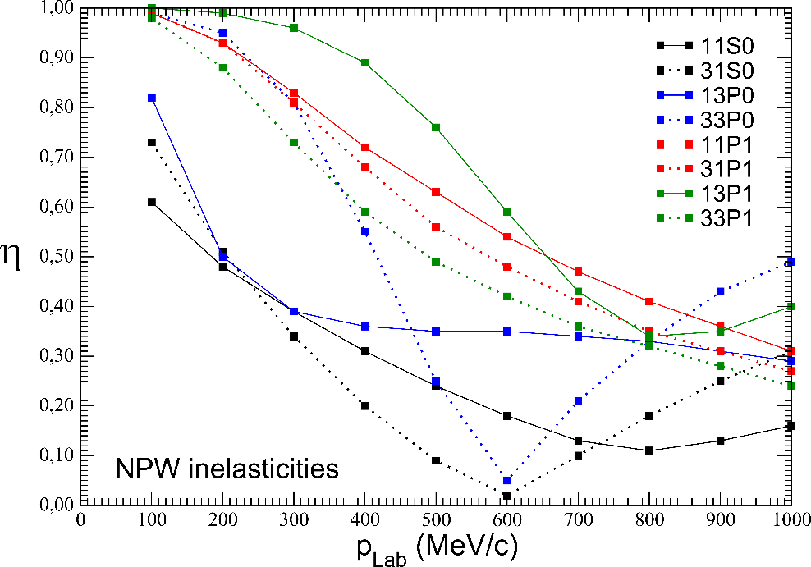

$N\overline{N}$: an example of issues to address
Fitting S-matrix components when the number data points is low, may lead to ambiguities, e.g. limit where a wave is totally absorptive and do not contribute to the elastic/c.e. cross-section. Alternative fits reproduced equally well the data (overfitting!).
$N\overline{N}$ inelasticities extracted from data (PWA).
J. Carbonell et al. Eur. Phys. Jour. A 59 (2023)

Slide 11
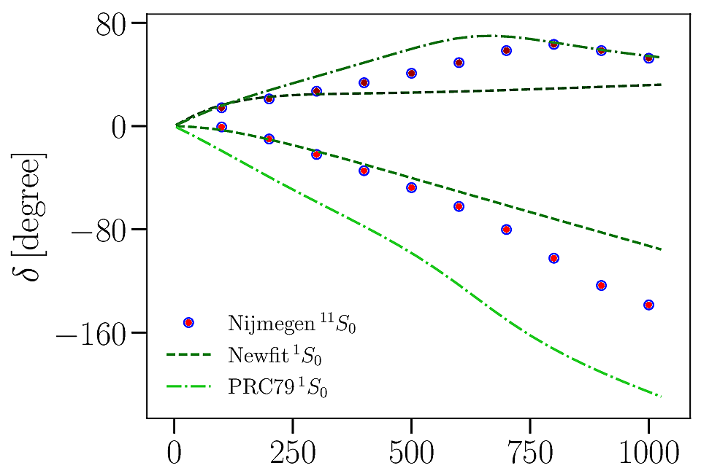
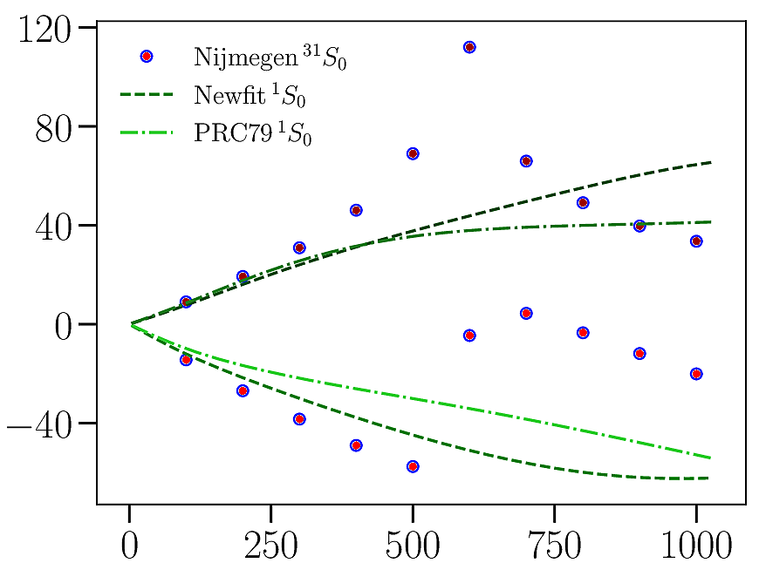
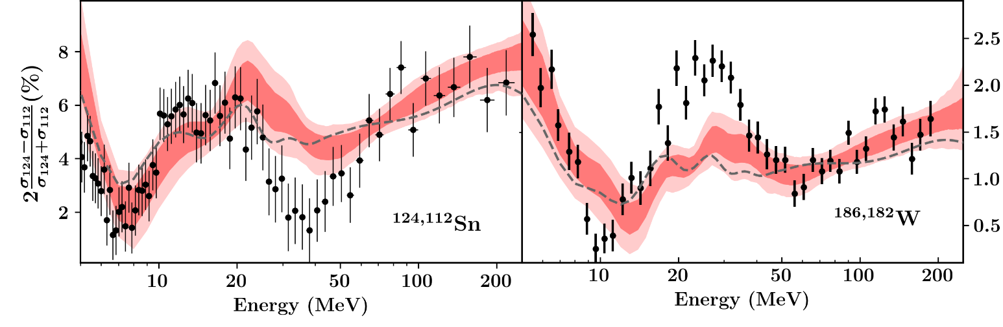
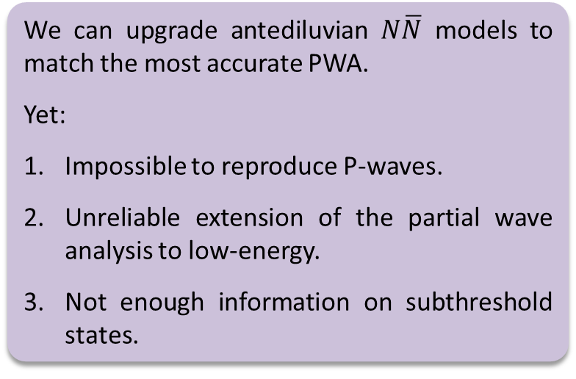
$N\overline{N}$: Needs for new fit with uncertainty quantifications from $A>2−3$ propagation
We can upgrade antediluvian $N\overline{N}$ models to match the most accurate PWA.
Yet:
Impossible to reproduce P-waves.
Unreliable extension of the partial wave analysis to low-energy.
Not enough information on subthreshold states.
Modern Nucleon-Nucleus optical potentials come with uncertainty quantifications, which reflect the measurements uncertainties and the limitation of the functional form of optical model
C. D. Pruitt et al. Phys. Rev. C 107 (2023)
Notes:
One of our goal is to update the old optical models with the modern features used in the Nucleus-Nucleon sector namely uncertainty quantification shown in the bottom figure.

Slide 12

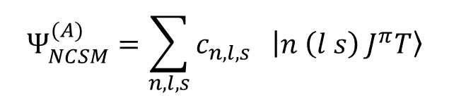


Ab-Initio No-Core Shell Model (NCSM)
Suitable for studying static properties of nuclei like the energy spectrum.
In the NCSM, the wavefunction of the A-body system is expanded using A-body Harmonic oscillator (HO) basis, e. g., for A=2:
$$Ψ_{NCSM}^{(A)}=\sum_{n,l,s}{c_{n,l,s} \left|\left.n \left(l s\right){ J}^{π}T\right\rangle \right.}$$
$$N_{max}$$
$$N_{max}=\max\left(2n+l\right)$$
$$ℏΩ$$
Expansion coefficients (unknown)
Basis states
No-Core Shell Model

Slide 13
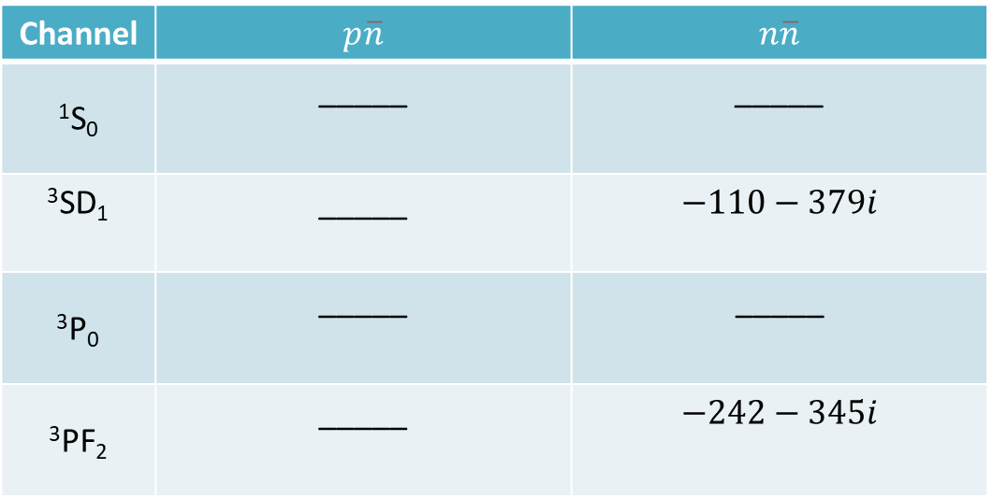
Example of No-Core Shell Model calculation: Quasi-bound states
Channel | $$p\overline{n}$$ | $$n\overline{n}$$
¹S₀ | _____ | _____
³SD₁ | _____ | $$−110−379ⅈ$$
³P₀ | _____ | $$\text{_____}$$
³PF₂ | _____ | $$−242−345ⅈ$$
Quasi-bound states (in MeV) obtained from Kohno-Weise $N\overline{N}$potential using NCSM.
Results are obtained using $N_{max}=200$and $ℏω=20$.

Slide 14
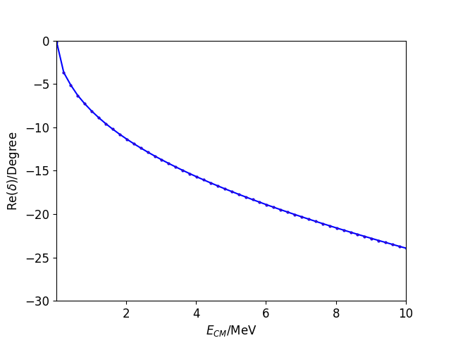
Example of No-Core Shell Model calculation: Scattering
Real part of ¹S₀ $\overline{p}n$ scattering phaseshift calculated using Complex Scaling method with $θ=20°$and $n_{r}=450$.

Slide 15

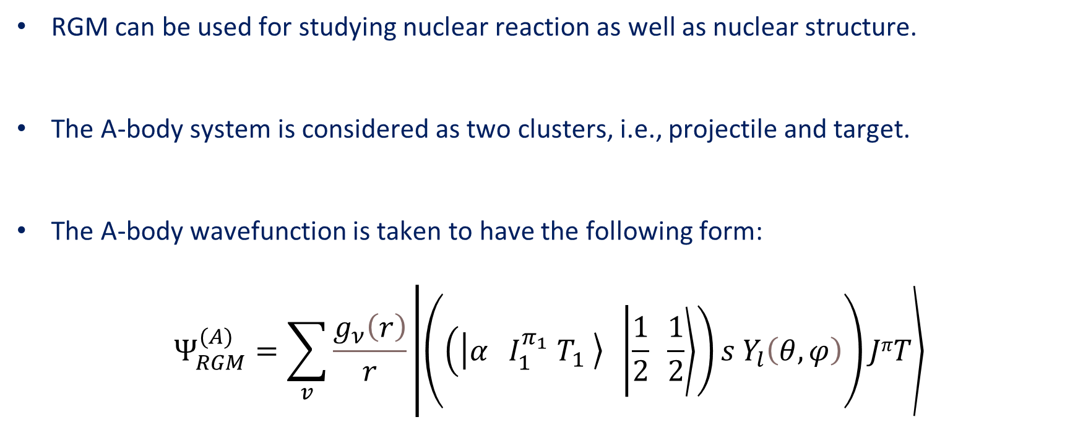
NCSM + Resonating Group Method (NCSM/RGM)
RGM can be used for studying nuclear reaction as well as nuclear structure.
The A-body system is considered as two clusters, i.e., projectile and target.
The A-body wavefunction is taken to have the following form:
$$Ψ_{RGM}^{(A)}=\sum_{v}{\frac{g_{ν}\left(r\right)}{r}\left.\left|\left.\left.\left.\left(\left(\left.\left|\left.α{ I}_{1}^{π_{1}}{ T}_{1} \right\rangle \right.\right.\right.\left. \left|\left.\frac{1}{2} \frac{1}{2}\right\rangle \right.\right)s Y_{l}\left(θ,φ\right)\right.\right)\right.JπT\right\rangle \right.\right.}$$
$$r$$
Relative
Target
Relative (angular part)
Projectile

Slide 16
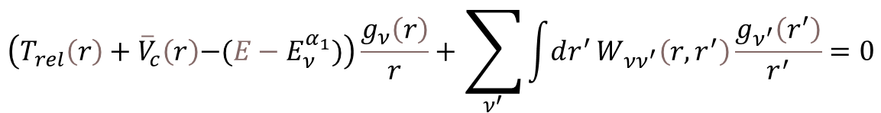
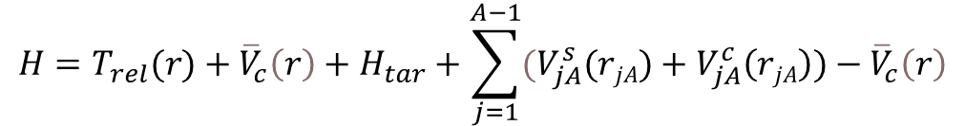
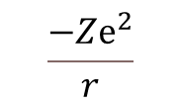
NCSM + Resonating Group Method (NCSM/RGM)
The Hamiltonian (neglecting the three-body force) can be written as:
The RGM equation then becomes:
$$H=T_{rel}(r)+{\overline{V}}_{c}\left(r\right)+H_{tar}+\sum_{j=1}^{A−1}{{(V}_{jA}^{s}(rjA)+V_{jA}^{c}\left(rjA\right))−{\overline{V}}_{c}\left(r\right)}$$
$$\left(\left.T_{rel}\left(r\right)+{\overline{V}}_{c}\left(r\right)\right.\right.\left.−({E−E}_{ν}^{α_{1}})\right)\frac{g_{ν}\left(r\right)}{r}+\sum_{ν^{′}}{\int{ⅆr^{′}}W_{νν^{′}}\left(r,r^{′}\right)\frac{g_{ν^{′}}\left(r^{′}\right)}{r^{′}}}=0$$
$$\frac{−Zⅇ^{2}}{r}$$
Target (binding) energy
Contribution of interaction between target and projectile

Slide 17
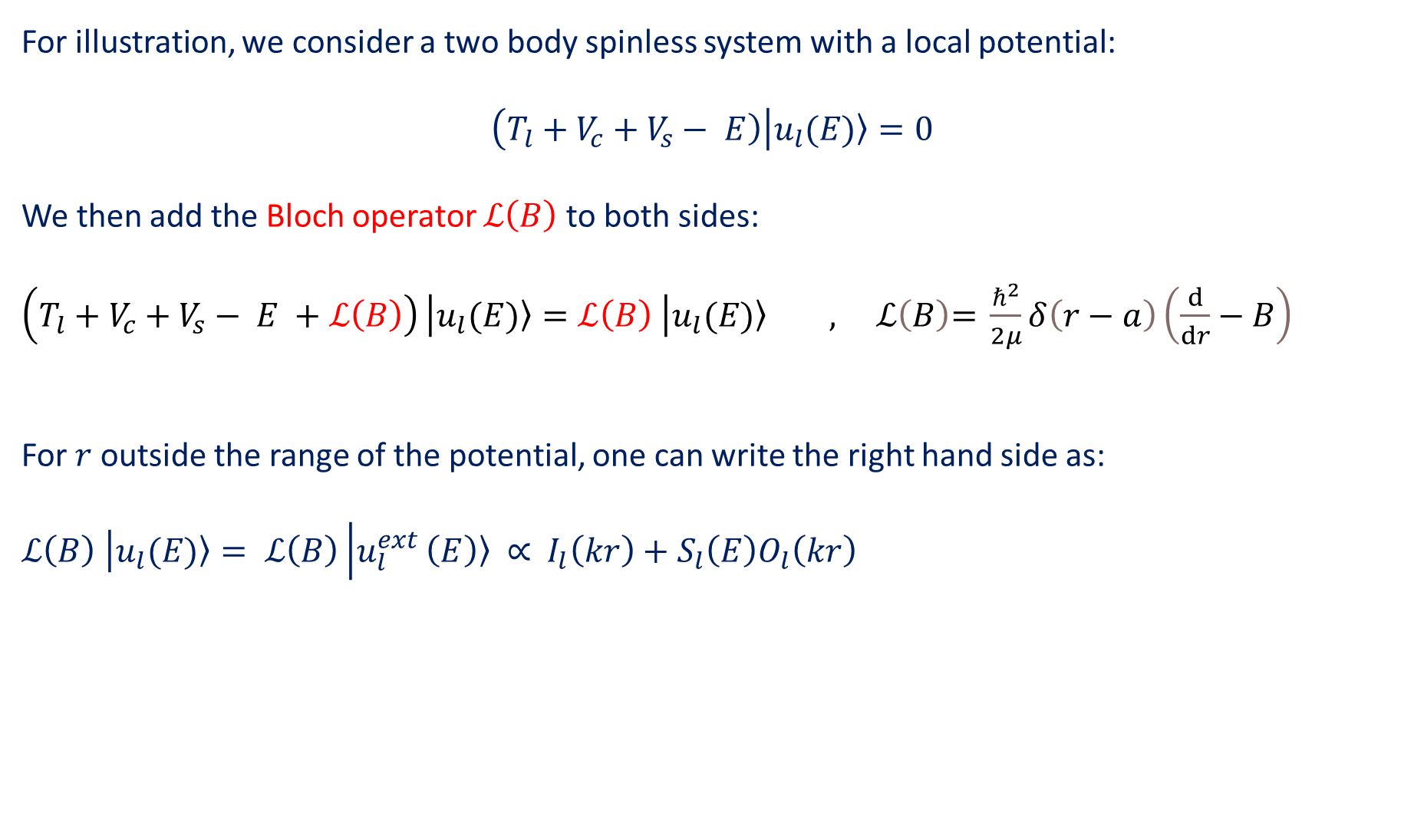
Solving Method: R-Matrix
For illustration, we consider a two body spinless system with a local potential:
$$\left(\left.T_{l}+V_{c}+V_{s}− \left.E\right)\right.\right.\left|u_{l}\right.\left.(E)\right\rangle =0$$
We then add the Bloch operator $ℒ\left(B\right)$ to both sides:
$\left(\left.T_{l}+V_{c}+V_{s}− \left.E +ℒ\left(B\right)\right)\right.\right.\left|u_{l}\right.\left.(E)\right\rangle =ℒ\left(B\right)$ $\left|u_{l}\right.\left.(E)\right\rangle , ℒ\left(B\right)\text{= }\frac{ℏ^{2}}{2μ}δ\left(r−a\right)\left(\frac{ⅆ}{ⅆr}−B\right)$
For $r$ outside the range of the potential, one can write the right hand side as:
$ℒ\left(B\right)$ $\left|u_{l}\right.\left.(E)\right\rangle = ℒ\left(B\right)\left|\left.u_{l}^{ext}\right.\right.\left.\left(E\right)\right\rangle$ $∝$ $I_{l}\left(kr\right)+S_{l}\left(E\right)O_{l}\left(kr\right)$
Channel radius
Arbitrary
parameter

Slide 18
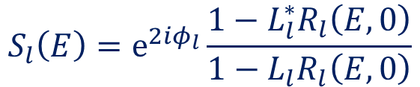

Solving Method: R-Matrix
We then expand the internal wavefunction using the lagrange basis:
$\left|u_{l}^{int}>=\right.$ $\sum_{j}{A_{j}}\left|\left.\left.f_{j}\right\rangle \right.\right.$
The R-Matrix (setting $B=0$) can be defined as:
$R_{l}\left(E\right)=\frac{u_{l}\left(a\right)}{a u_{l}^{′}\left(a\right)}=\frac{u_{l}^{int}\left(a\right)}{a{ u}_{l}^{ext^{′}}\left(a\right)}$ $= \frac{ℏ^{2}}{2μa}\sum_{i,j}^{n_{s}}{f_{i}\left(a\right){\left(C^{−1}\right)}_{ij}f_{j}\left(a\right)}$
$${ C}_{ij}=\left\langle f_{i} | {\left(\left.T\right.\right.}_{l}+V_{c}+V_{s}− \left.E +ℒ\left(0\right)\right) | f_{j}\right\rangle$$
Some algebra gives:
$$S_{l}\left(E\right)=ⅇ^{2iφ_{l}}\frac{1−L_{l}^{∗}R_{l}\left(E,0\right)}{1−L_{l}R_{l}\left(E,0\right)}$$

Slide 19
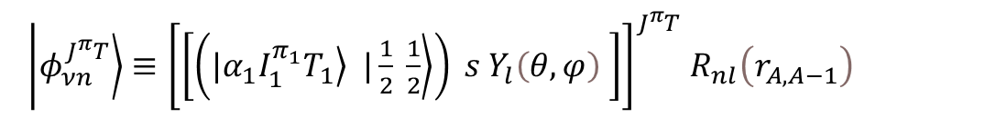
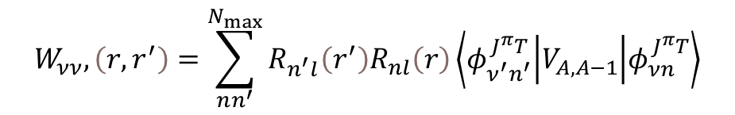
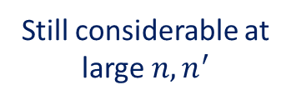
Numerical Challenges
$$\left(\left.T_{rel}\left(r\right)+{\overline{V}}_{c}\left(r\right)\right.\right.\left.−({E−E}_{ν}^{α_{1}})\right)\frac{g_{ν}\left(r\right)}{r}+\sum_{ν^{′}}{\int{ⅆr^{′}}W_{νν^{′}}\left(r,r^{′}\right)\frac{g_{ν^{′}}\left(r^{′}\right)}{r^{′}}}=0$$
$$W_{νν},\left(r,r^{′}\right)=\sum_{nn^{′}}^{N_{max}}{R_{n^{′}l}\left(r^{′}\right)R_{nl}\left(r\right)}\left\langle φ_{ν^{′}n^{′}}^{J^{π}T} | V_{A,A−1} | φ_{νn}^{J^{π}T}\right\rangle$$
$\left|\left.\left.φ_{νn}^{J^{π}T}\right\rangle \right.\right.≡{\left[\left[\left(|\left.α_{1}I_{1}^{π_{1}}T_{1}\right\rangle |\left.\frac{1}{2} \frac{1}{2}\right\rangle \right) s Y_{l}\left(θ,φ\right) \right]\right]}^{J^{π}T}$ $R_{nl}\left(r_{A,A−1}\right)$
Harmonic oscillator wavefunctions
Still considerable at large $n,n^{′}$
Convergence and other numerical issues

Slide 20
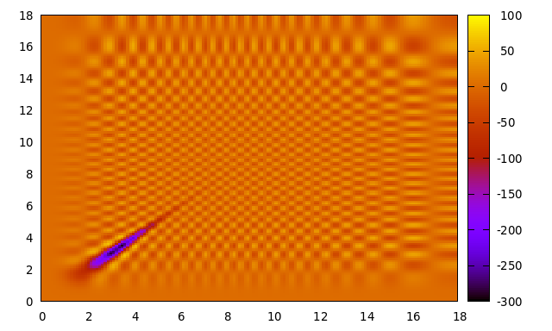
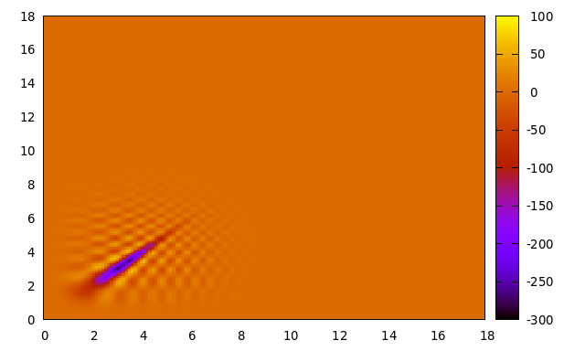
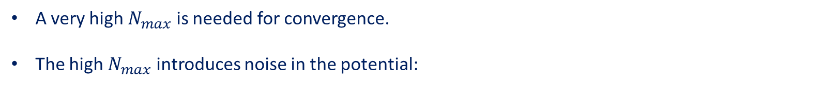
Numerical Challenges
A very high $N_{max}$is needed for convergence.
The high $N_{max}$ introduces noise in the potential:
Real part of the RGM potential for antineutron-deuteron system in ²S_{1/2} channel before and after regularization.

Slide 21
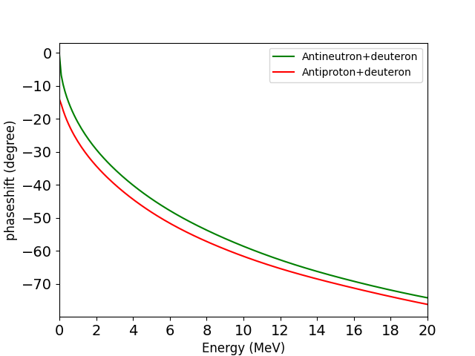

Results for A=3 system (phaseshift + binding energy)
Quasi-bound state
$$E_{QB}=−21 −153i MeV$$
Real part of Antinucleon-deuteron phaseshift in ²S_{1/2} channel with a = 18 fm and $N_{max}$= 80.

Slide 22
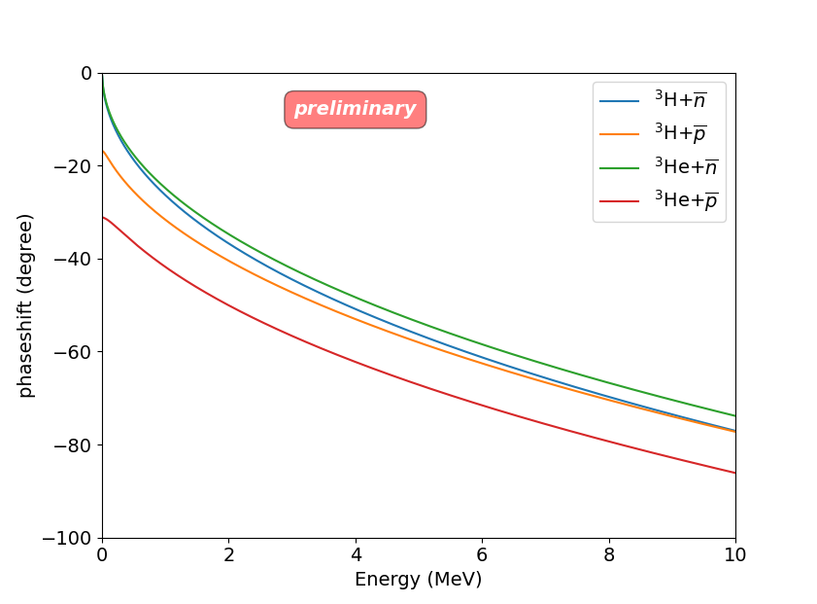
Preliminary results for A=4 system
Real part of A=4 system phaseshift in ¹S₀ channel with a = 10 fm and $N_{max}$= 30.

Slide 23


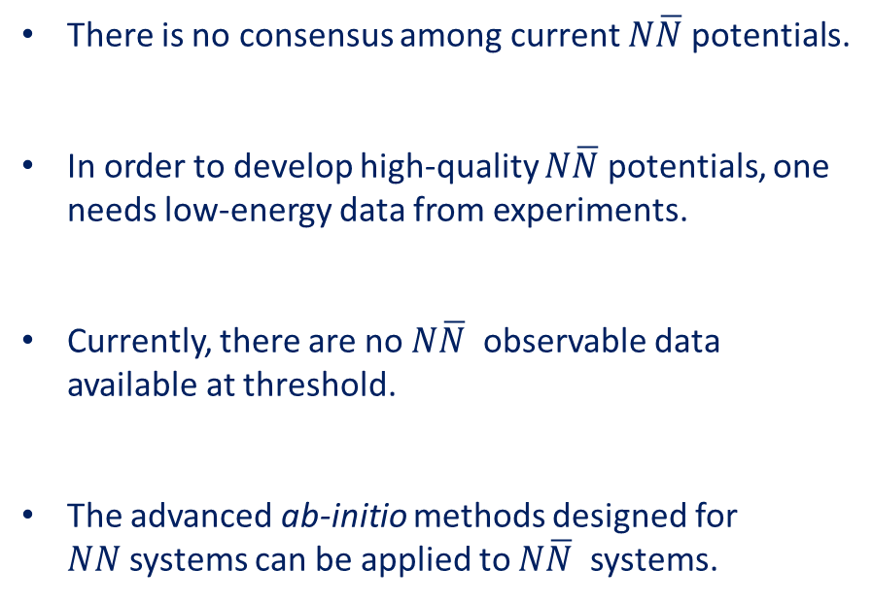
Conclusion and Outlook
There is no consensus among current $N\overline{N}$potentials.
In order to develop high-quality $N\overline{N}$potentials, one needs low-energy data from experiments.
Currently, there are no $N\overline{N}$ observable data available at threshold.
The advanced ab-initio methods designed for $NN$systems can be applied to $N\overline{N}$ systems.
Stable
Halo nuclei
Within some confidence
Exact

