Slide 1
Future opportunities at the CERN Antimatter Factory
D. Gamba, F. Butin, L. Ponce
ACKNOWLEDGEMENT: D. Aguglia, C. Amsler, M.E. Angoletta, W. Bartmann, R. Billen, J. Borburgh, J. Bremer, M. Calviani, R. Caravita, C. Carli, Y. Dutheil, S. J. Freeman, S. Gilardoni, J. Hangst, W. Hofle, M. Hori, L. Joergensen, R. Jones, T. Lefevre, B. Lefort, O. Marqversen,
A. Newborough, D. Nisbet, A. Obertelli, Y. Papaphilippou, P. Perez, G. Petrika, A. Sinturel , T. Todorcevic, S. Ulmer, C. Vendeuvre,
M. Wehrle… … and many more colleagues!!
09/04/2024 – Future Nuclear and Hadronic Physics at the CERN-AD workshop (FuPhy2024)

Slide 2
Outline
Today’s AD/ELENA Facility
  What it is and how it works
Current Beam Performance
  Extrapolation toward possible short time-scale improvements
Possible Paths for Extending the Physics Reach of the Facility
  Engaging in forward-thinking to match possible future experimental requirements with (minor) changes
    DISCLAIMER 1: based on informal discussions only!
Wrapping up and Conclusions
DISCLAIMER 2: most slides based on recent talks at Chamonix 2024 and PBC 2024 workshops. No commitments from CERN for any study/upgrade of AD/ELENA at this stage!
IMPORTANT: text in RED in this presentation is waiting for YOUR inputs!

Slide 3







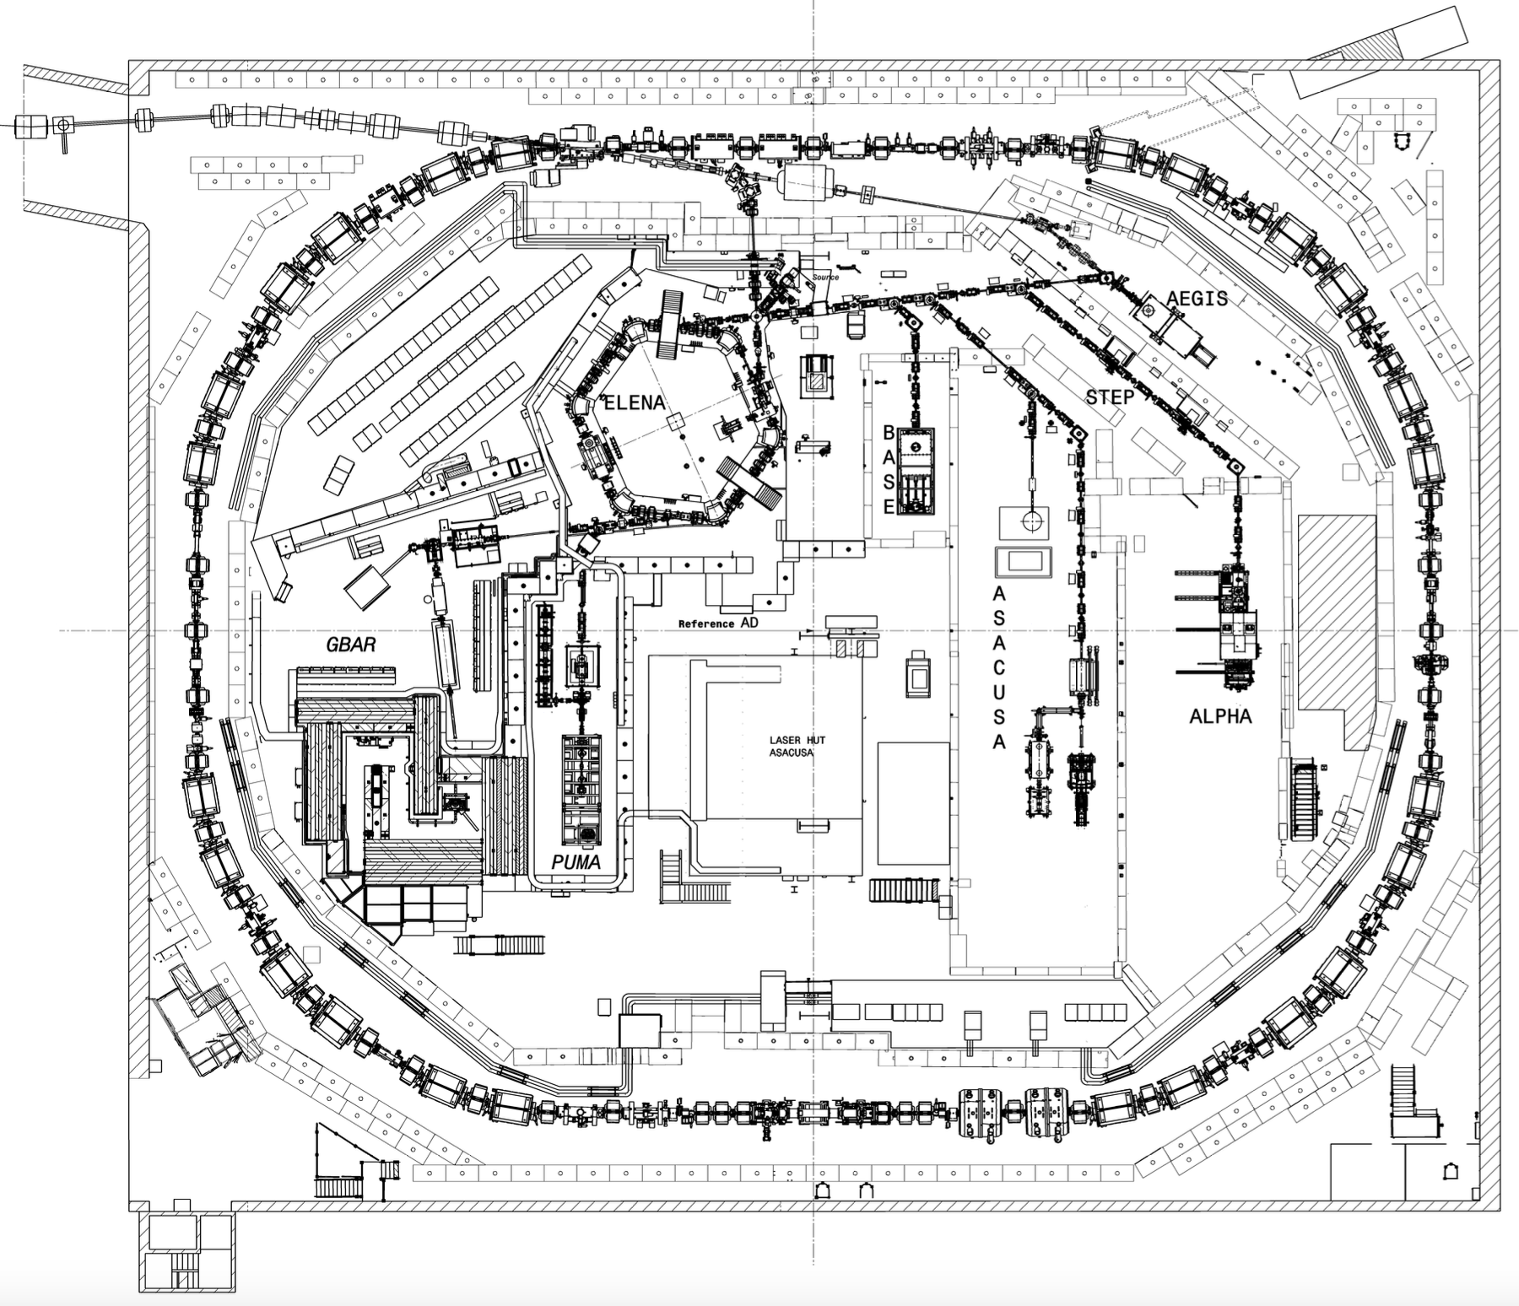
AD/ELENA: a Unique pbar Facility!
The only place in the world with low energy pbars in a synchrotron!
  It seems unlikely to have similar capabilities elsewhere for the next 10-20 years
Serving 60 Research Institutes/Universities – 350 Scientists – 6 Active Collaborations
ASACUSA
Antiprotonic helium spectroscopy
BASE, BASE-STEP
Fundamental properties
of the proton/antiproton, tests of clock WEP / tests of exotic physics / antimatter-dark matter interaction, etc...
PUMA
Antiproton/nuclei scattering to study neutron skins
AD ring length: 182 m
26 GeV protons
on iridium target
antiprotons
Momentum selection
(3.57 GeV/c) chicane
30 m
AD deceleration
(to 5.3 MeV)
- since 1999 -
ALPHA,
Spectroscopy of 1S-2S in antihydrogen
ASACUSA, ALPHA
Spectroscopy of GS-HFS in antihydrogen
ALPHA, AEgIS, GBAR
Test free fall weak equivalence principle with antihydrogen
ELENA decelerator
(to 100 keV)
- since 2018 -
antihydrogen
Electrostatic transfer line to experiments
- since 2021 -

Slide 4
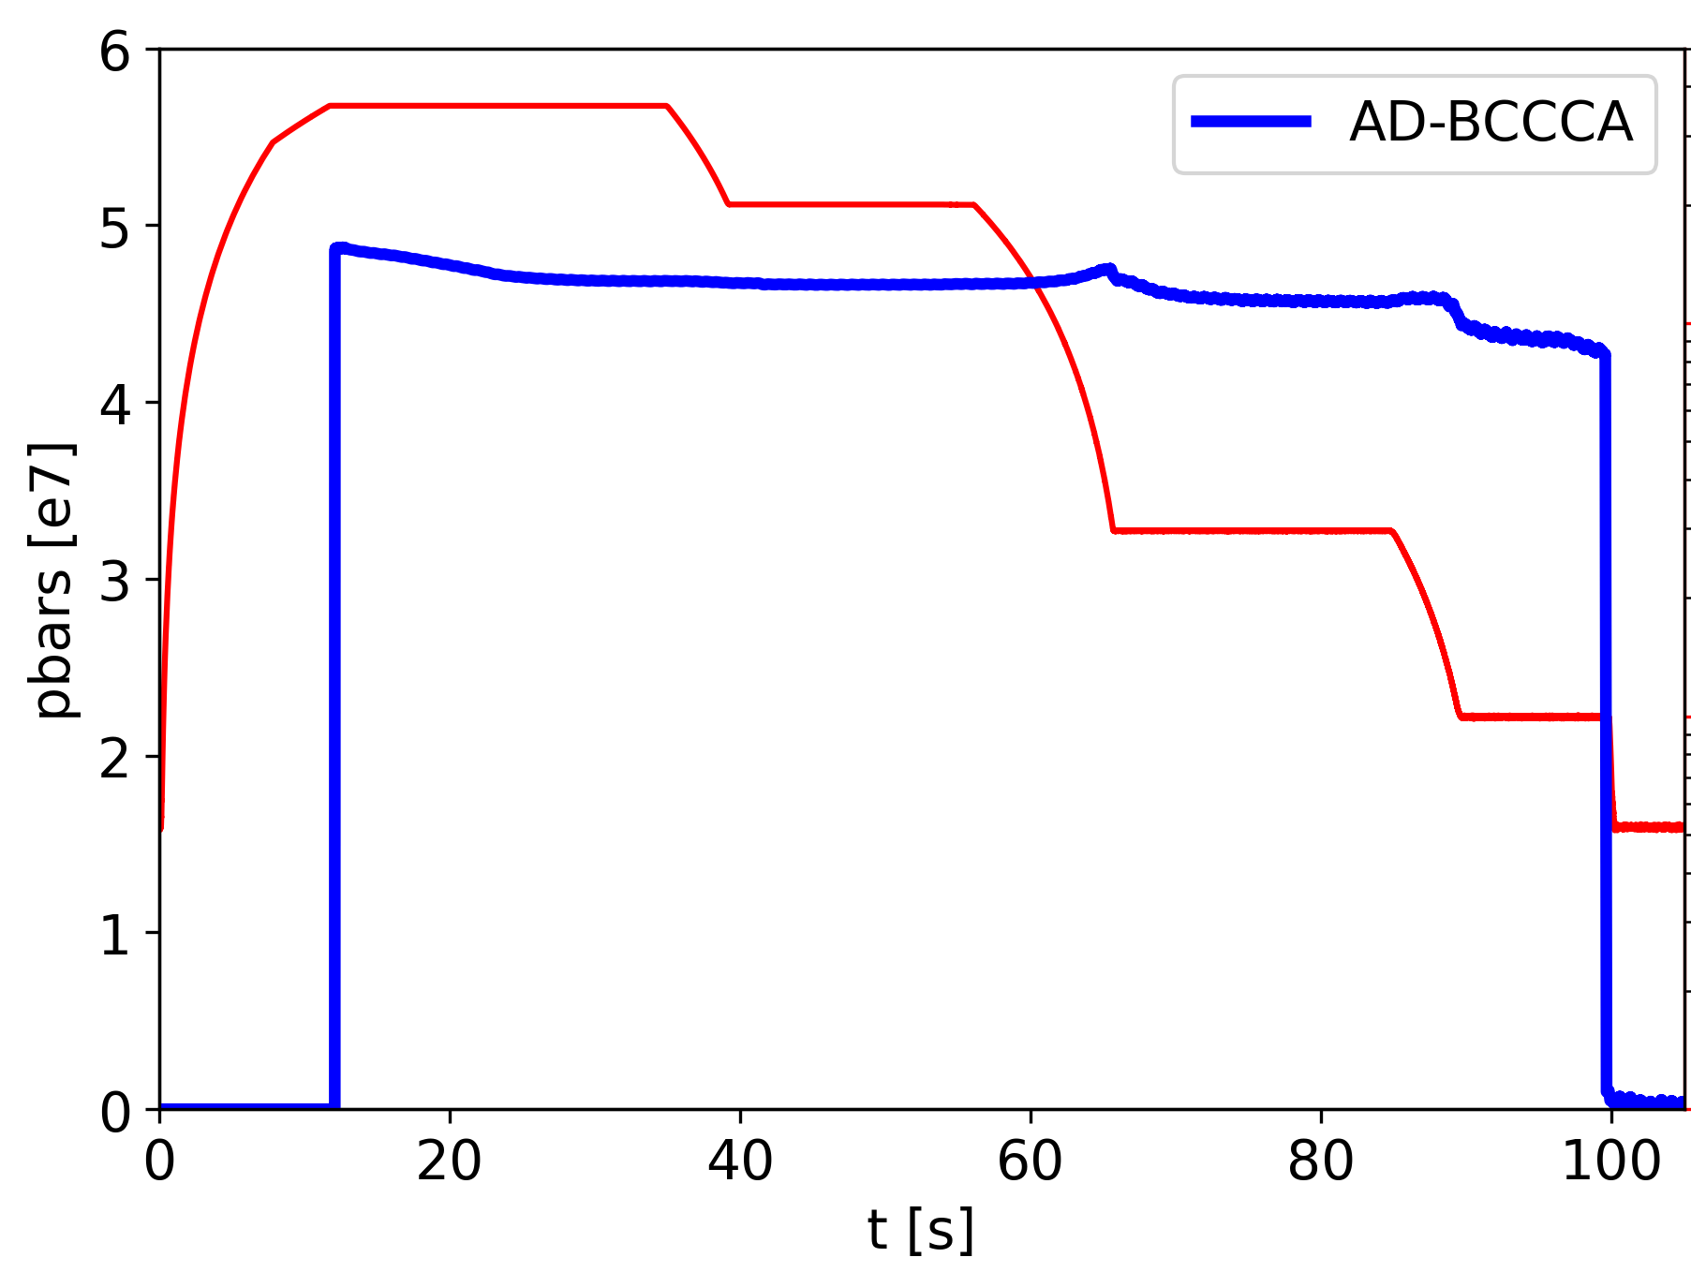
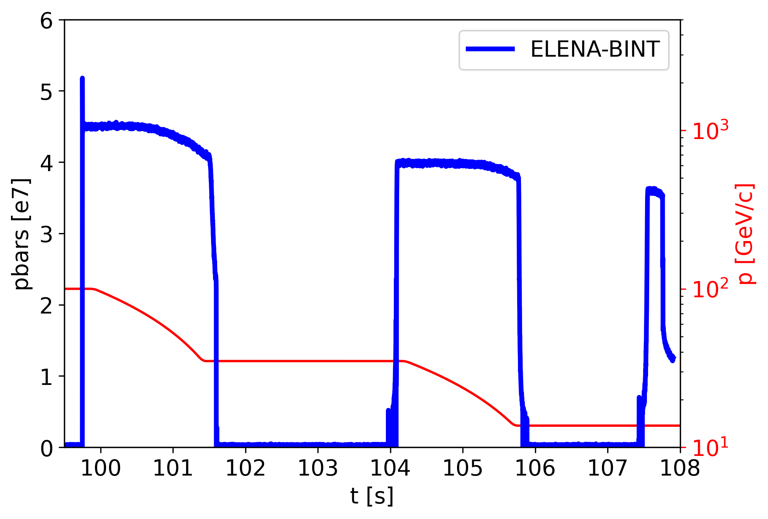
From 25 GeV p to 100 keV pbar: 4e7 pbars/2’
Generating pbars from 26 GeV/c protons (yield of the order of 3e-6 pbar/p)
Up to 80% deceleration efficiency from 2.75 GeV (3.57 GeV/c) to 100 keV (13.7 MeV/c)
  Thanks to several stochastic and electron cooling steps
Up to 4e7 pbars every 2 minutes delivered to experiments
p from
PS
p-pbar
yield
AD Cooling and
Deceleration
Transfer to
ELENA
ELENA Cooling and
Deceleration
to users
p
2e13
1.8e13
AD s-cooling
ELENA e-cooling
AD e-cooling
PS eje
FTA9053
(AD target)

Slide 5
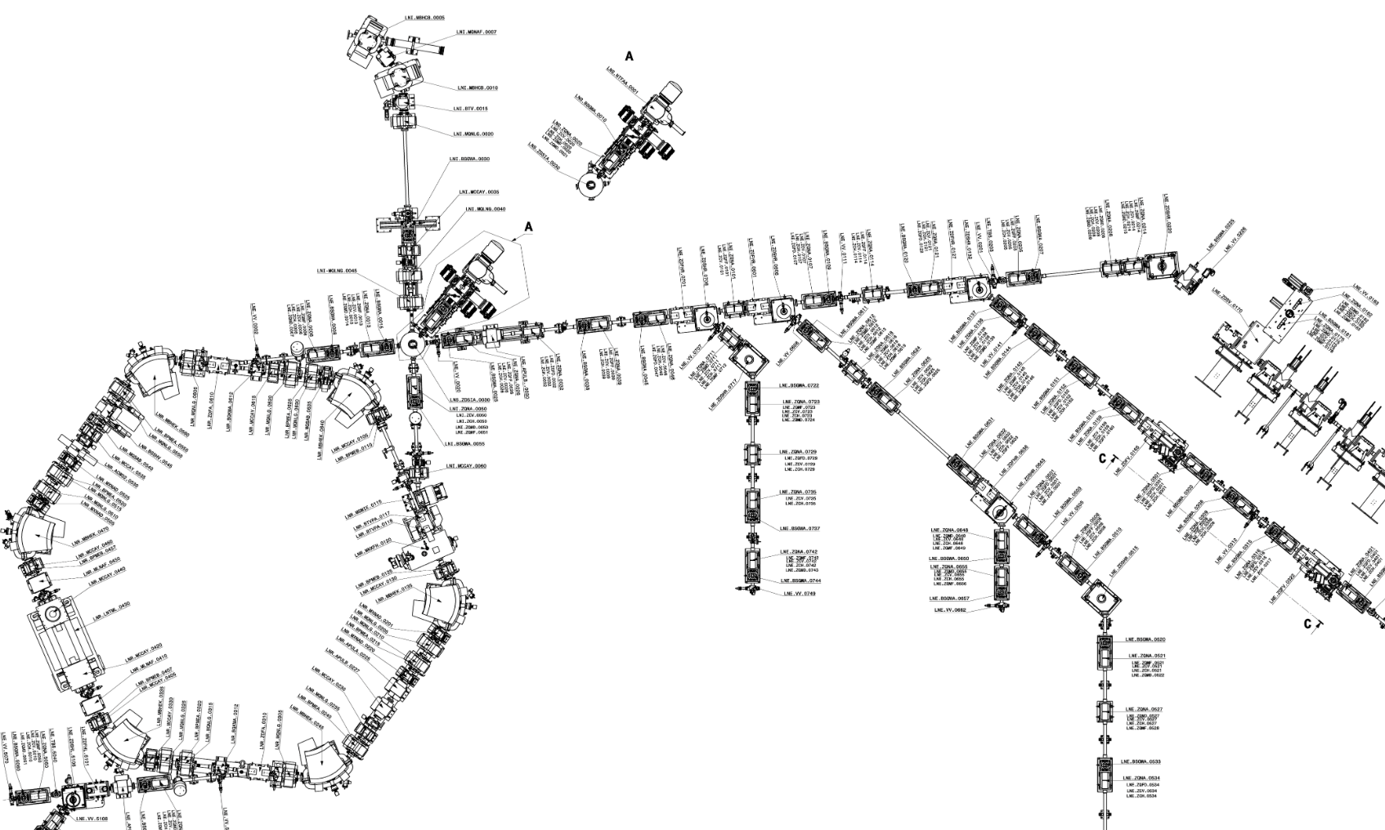
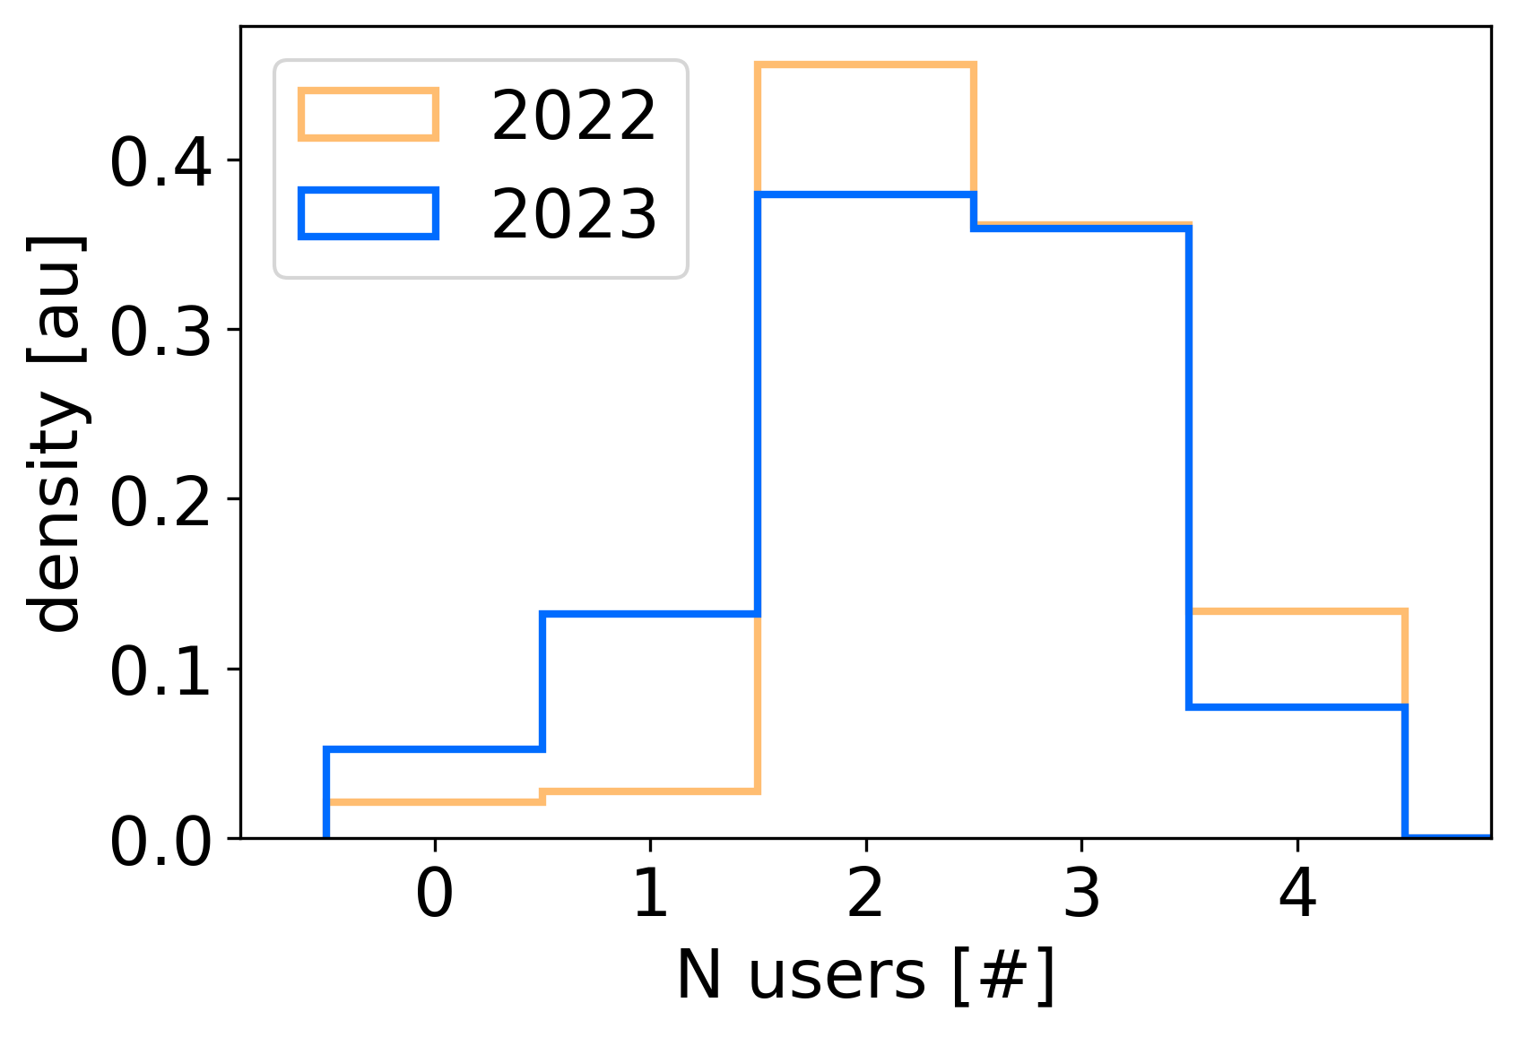
Serving 4 Users at a Time
AD produces 1 bunch at 5.3 MeV
ELENA: 4 bunches at 100 keV
  <150 ns FWHM
  <1e-3 RMS dp/p
  <4 um emittances (<2 um in 2024?)
Up to 4 experiments served at the same time with 1e7 pbars/bunch
  24/7 beam availability was the key game changer for AD users!
  ~30% of bunches “wasted”, but comfortable for (most) experiments present “ELENA R&D” phase…
ELENA can use H⁻ from a local source: instrumental for commissioning, but also used for physics (GBAR)
Pbars from AD
H⁻ from
local source

Slide 6
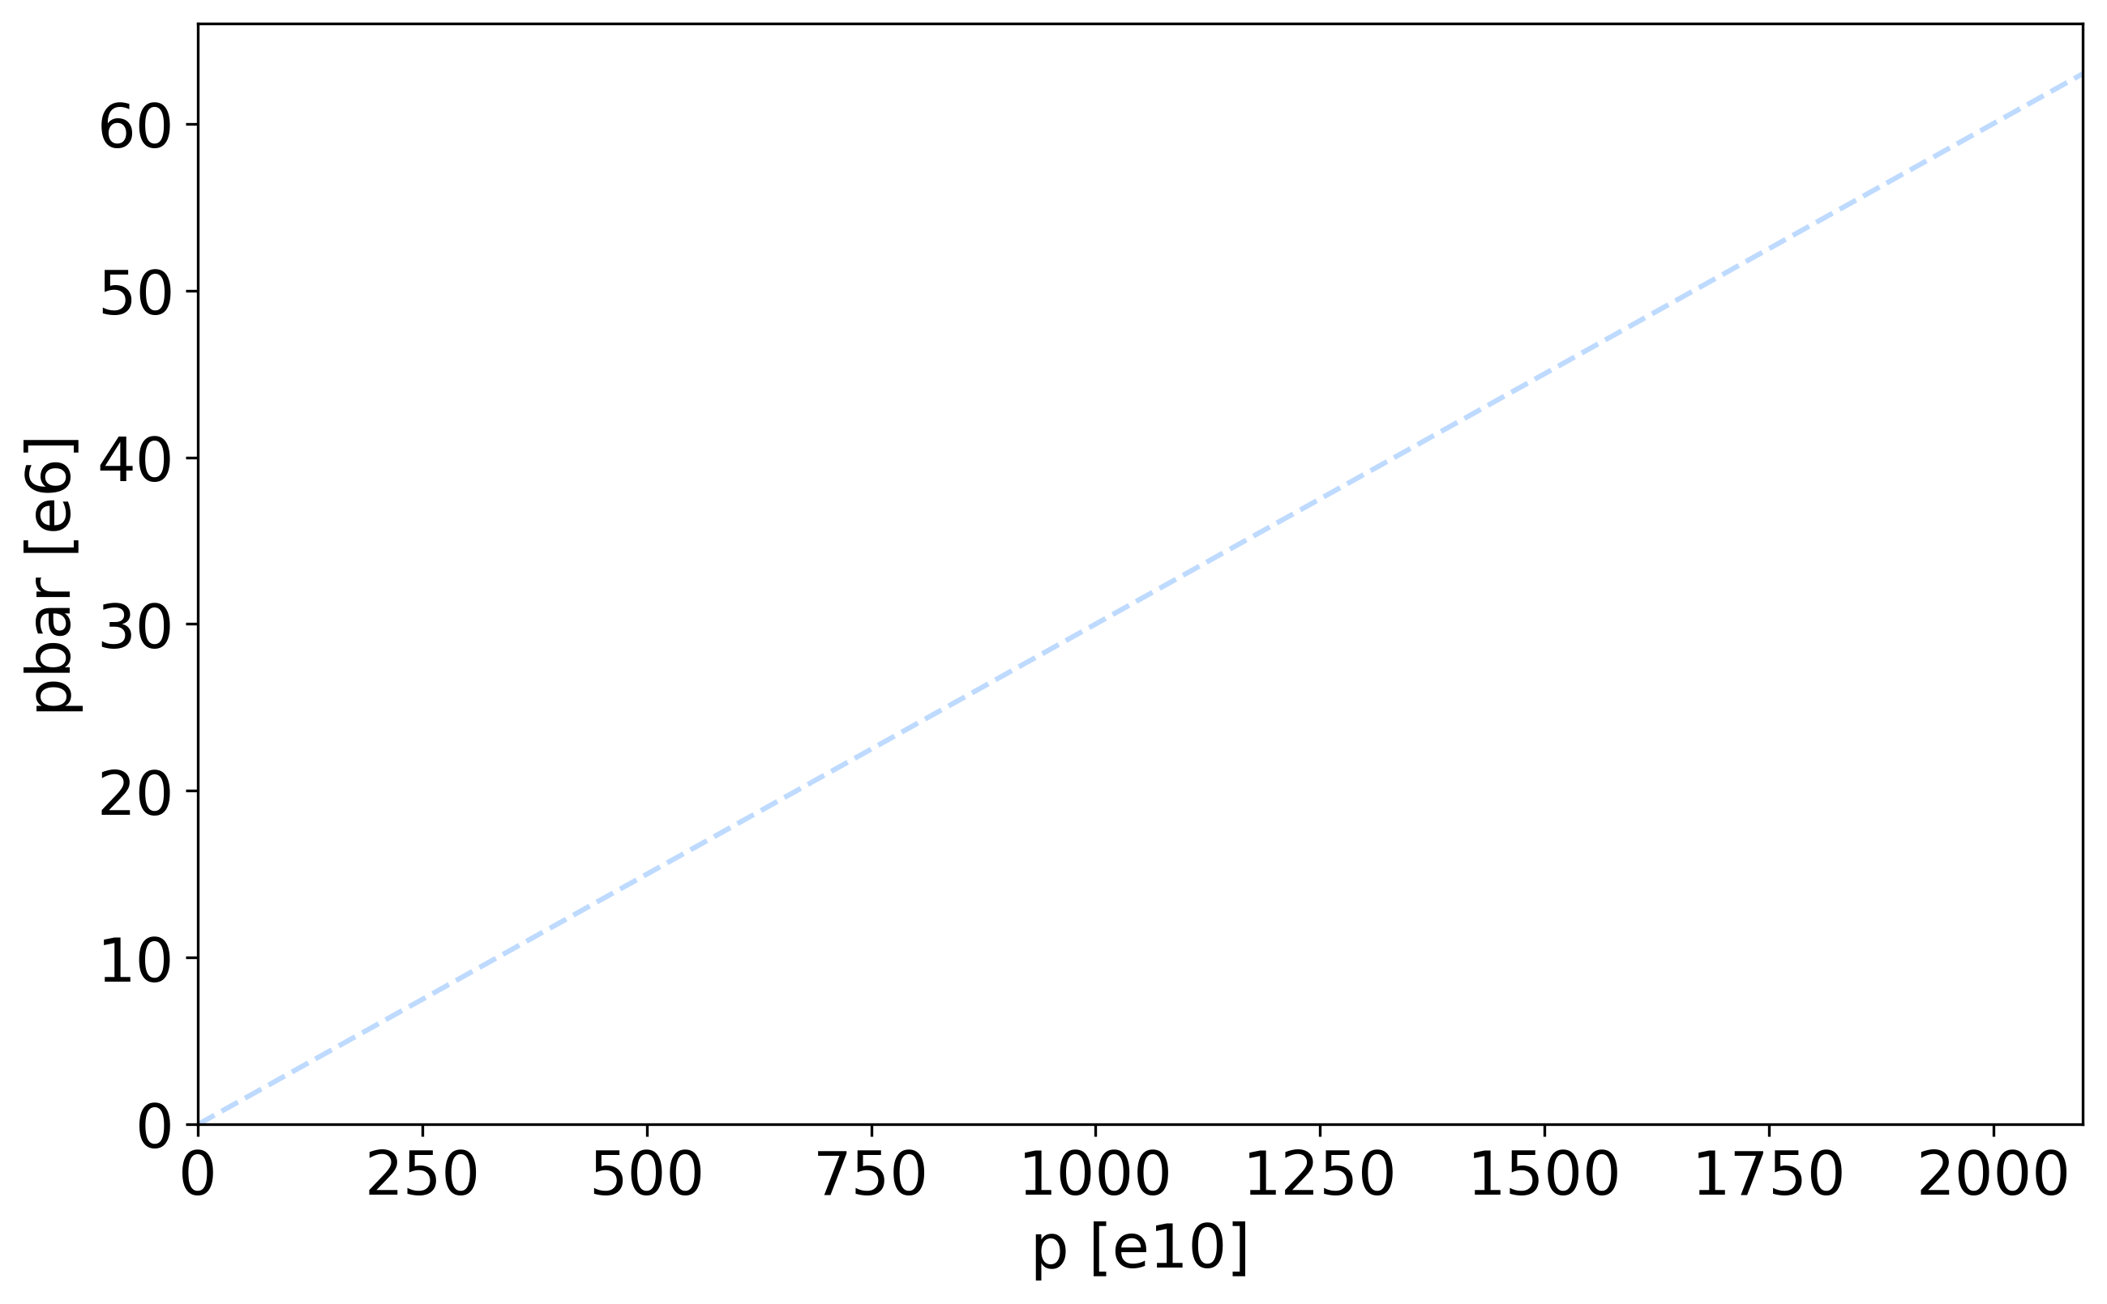
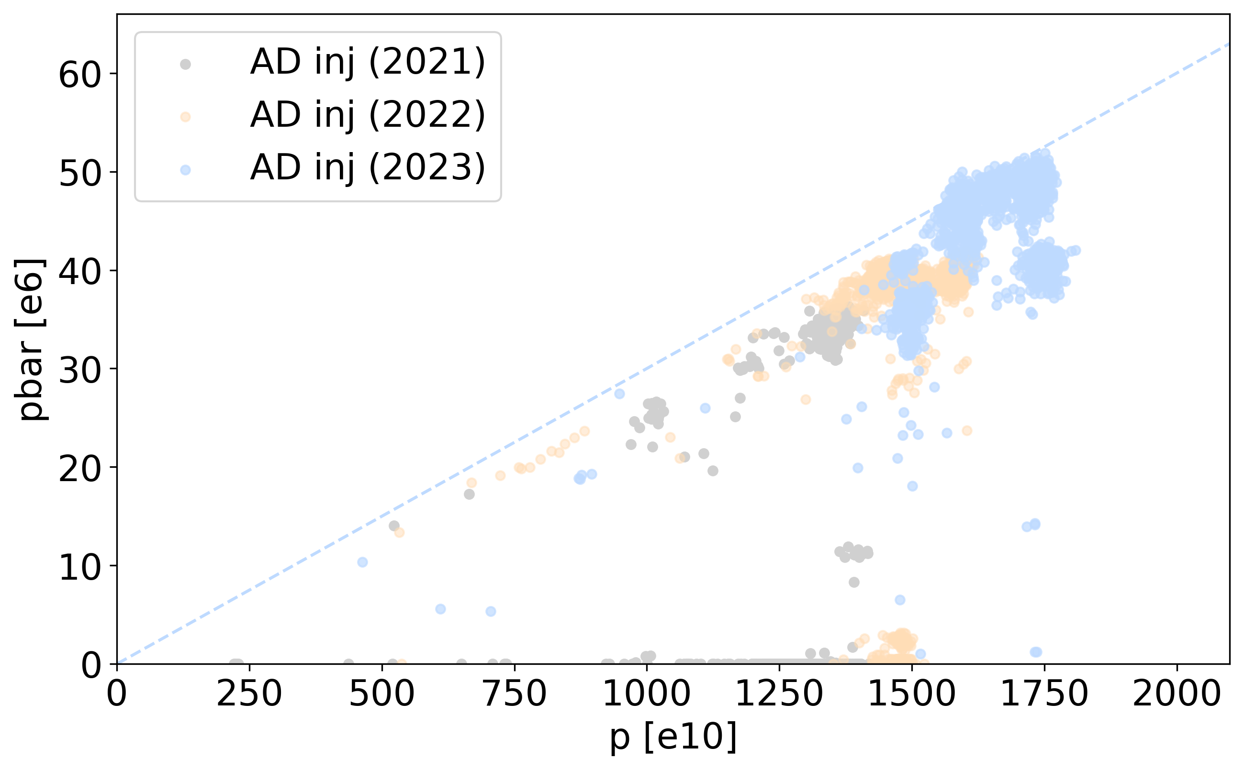
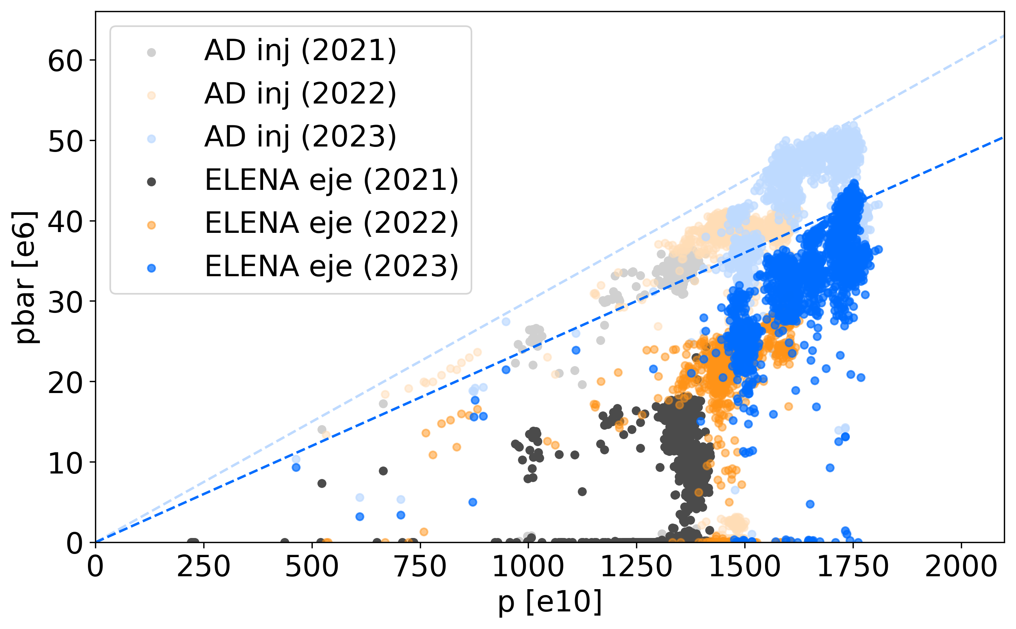
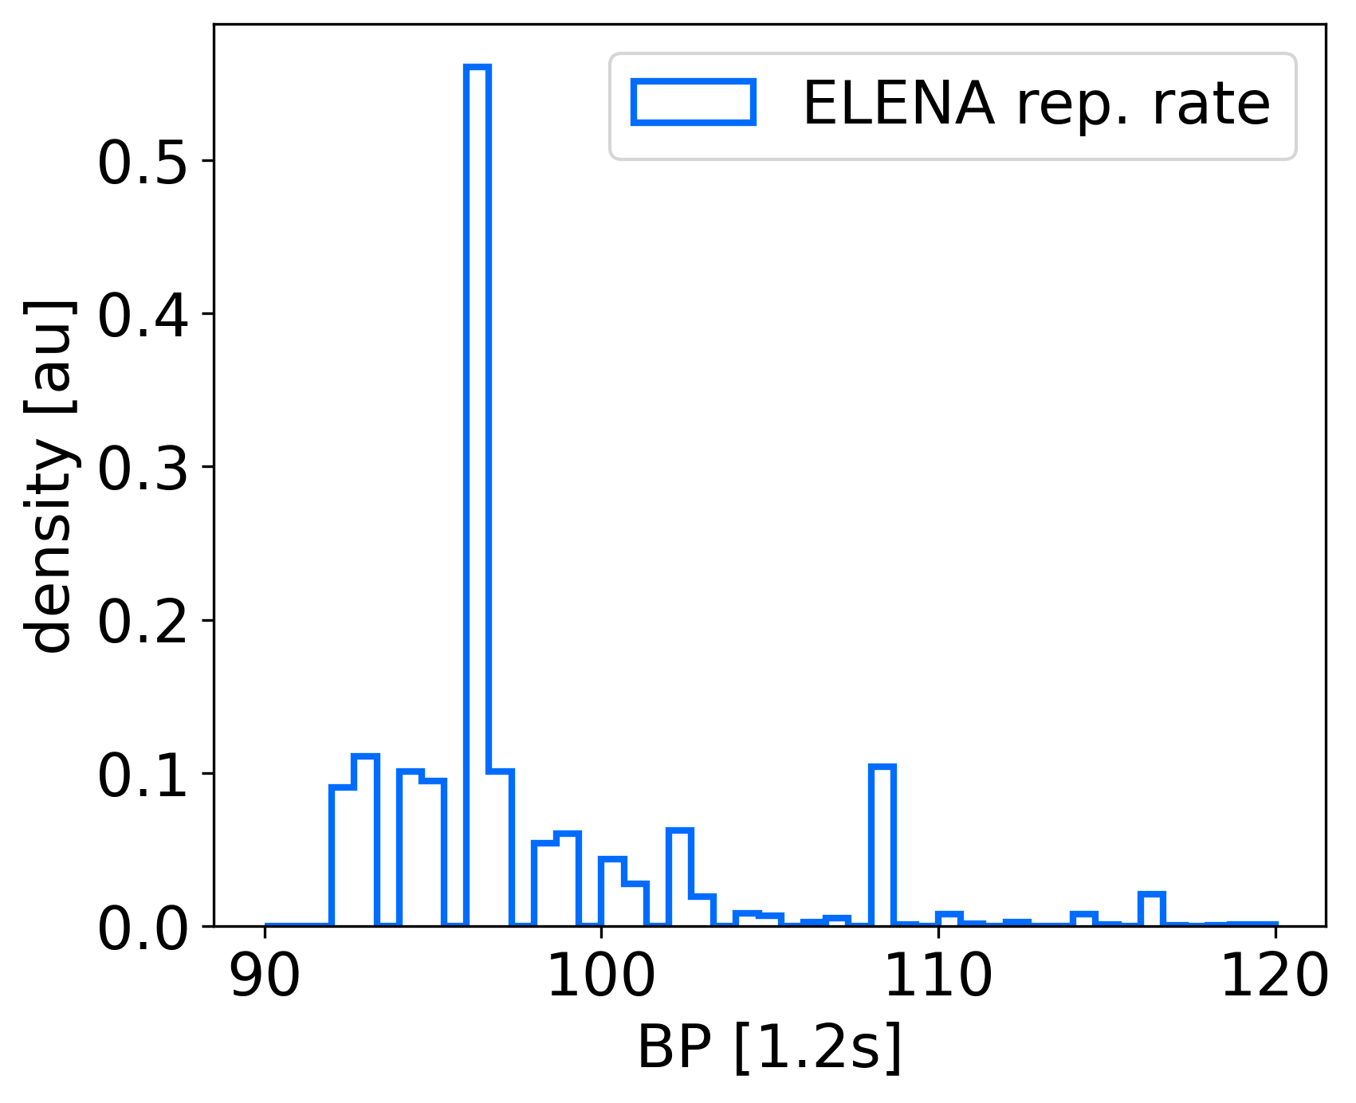
Toward x2 pbar Flux than Design
Time between consecutive cycles
3e-6 pbar/p
80% AD+ELENA
transmission
p on target pre-LS2
About x2 pbars
than design!
ELENA Design
Max p in PS (2023)
With present hardware and ongoing optimisation efforts we could think of reaching:
10-20% increase in beam intensity (stability to be improved with consolidated hardware/instrumentation)
10-20% reduction in cycle length (stability mainly linked to p production scheduling)

Slide 7
Happy Users with Ambitious Goals. Future is Now !
Present users are happy
  No strong request for “better” or “more” beam: still exploring the potential of ELENA!
  Request for higher shot-to-shot repeatability, beam availability and continuity
    Investment in modern technologies/techniques crucial for enhanced beam stability and efficient operation (this includes optics, control, instrumentation, …)
    Paramount to finalise/pursue AD consolidation efforts
      This is an opportunity for AD-related upgrades, if requested !
    Must ensure a long term pbar-facility lifespan (20+ years)
Most technological challenges and ambitions are after the handover point!
  See inspiring talk by S. Ulmer at PBC annual workshop 2024
  No clear direction for new/future (beam) requirements from AD/ELENA
    can we anticipate (your) future user wishes ?!
    Time for triggering upgrade studies is now !

Slide 8
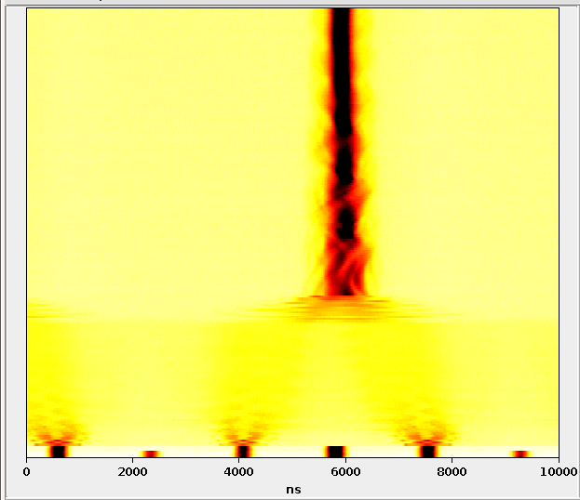
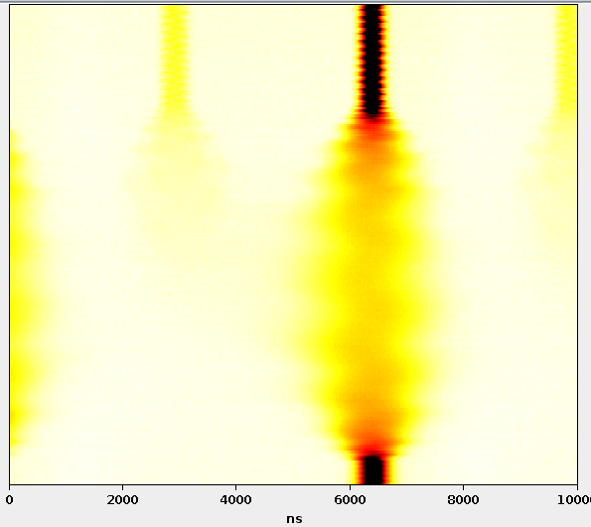
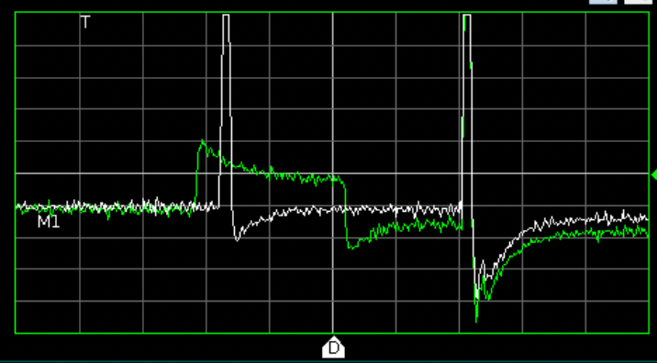
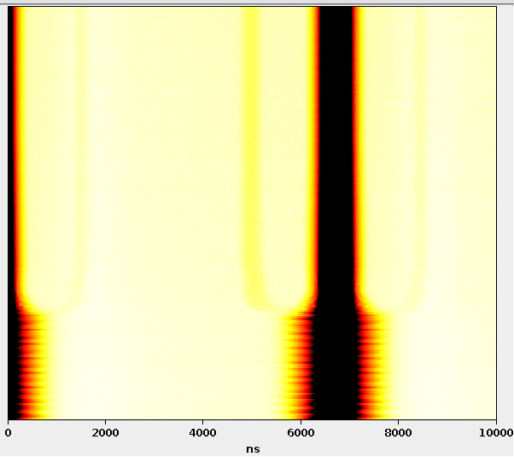
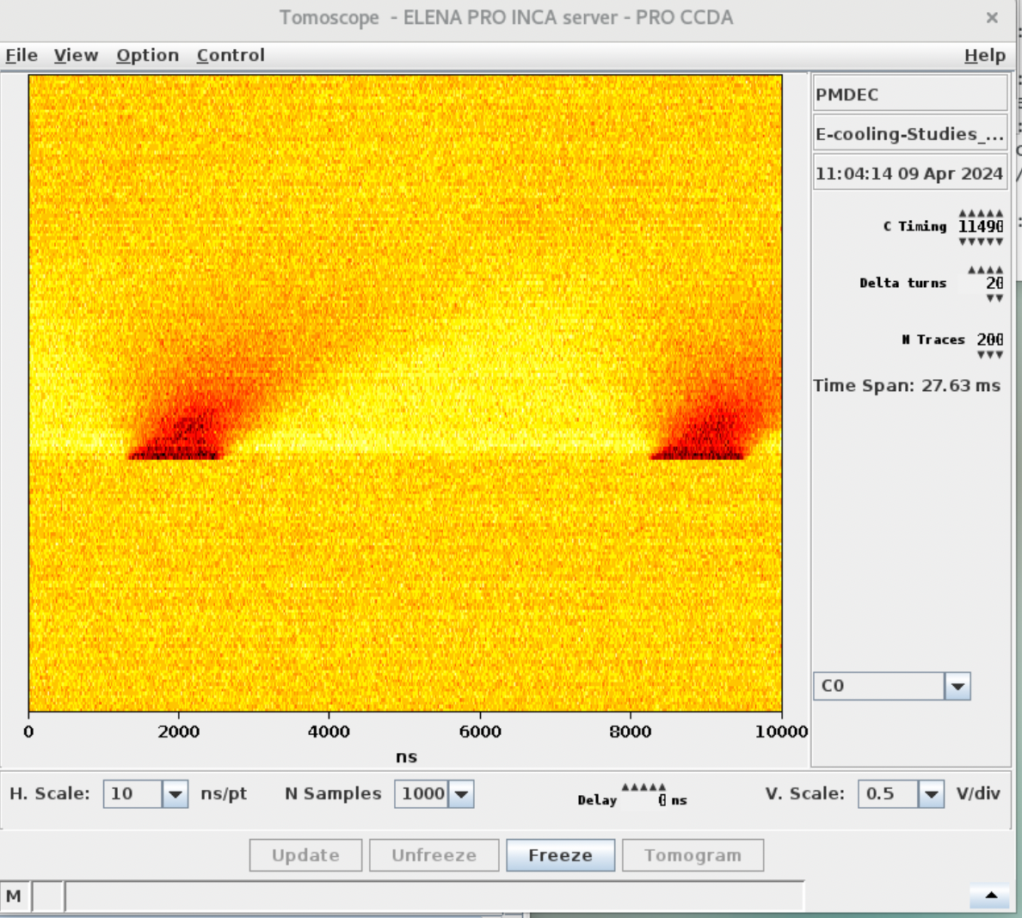
Short-Term Opportunities Leveraging on ELENA
ELENA still has some un-explored potential at extraction
  E.g.: producing 1-to-5 bunches (instead of today’s 4), or other “exotic” configurations, e.g.:
1 turn @ 100 keV
normal
bunch
(reference)
calibration
Low intensity bunch ready to be extracted…
… and repeat ...
∆t=~100 ms
square
bunch
∆t=~500 ms
∆t=~500 ms
“Stack” staying in ELENA
2 us/div
Leftover bunches merged into one
(e.g. for PUMA filling?)
Some beam
go to populate nearby backet…
Particles staying
inside ELENA
(seen till debunching)
1 turn @ 100 keV
”Standard bunch” extracted toward standard experiment
Coasting beam:
monitor sees nothing
1 turn @ 100 keV
1 turn @ 100 keV
Mostly requiring some minor modifications, new logic, tests, …
  We need user (your!) requests well in advance (months) to allow to properly test those schemes!

Slide 9
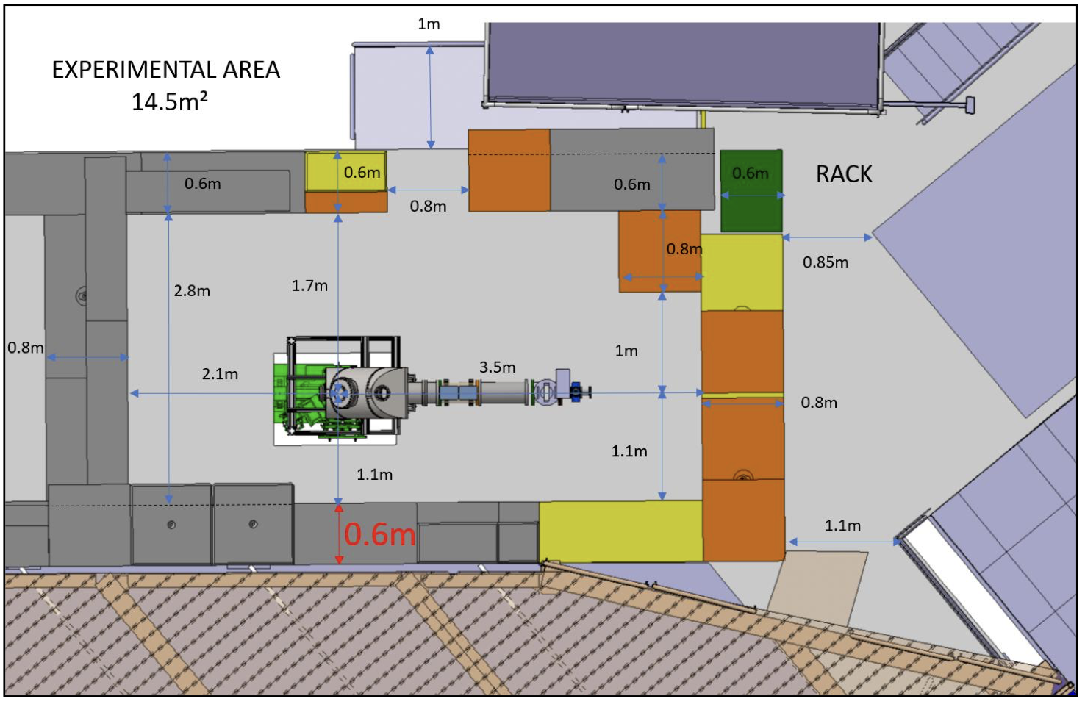
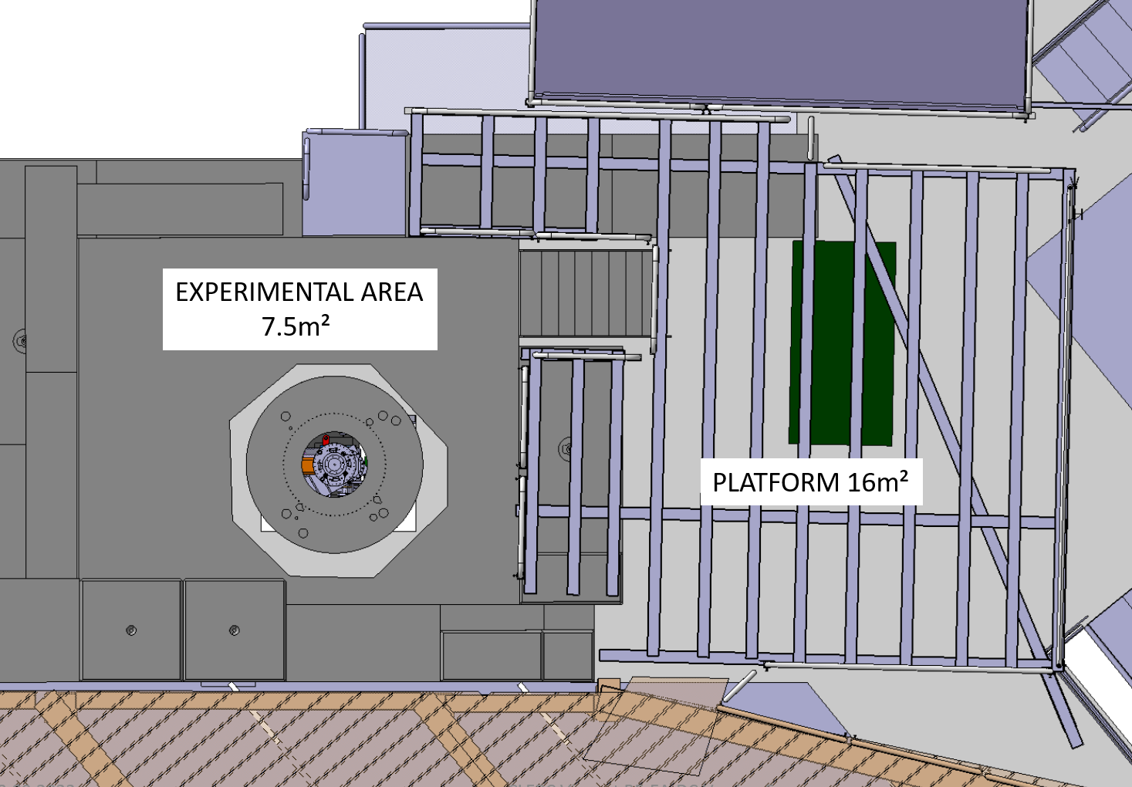
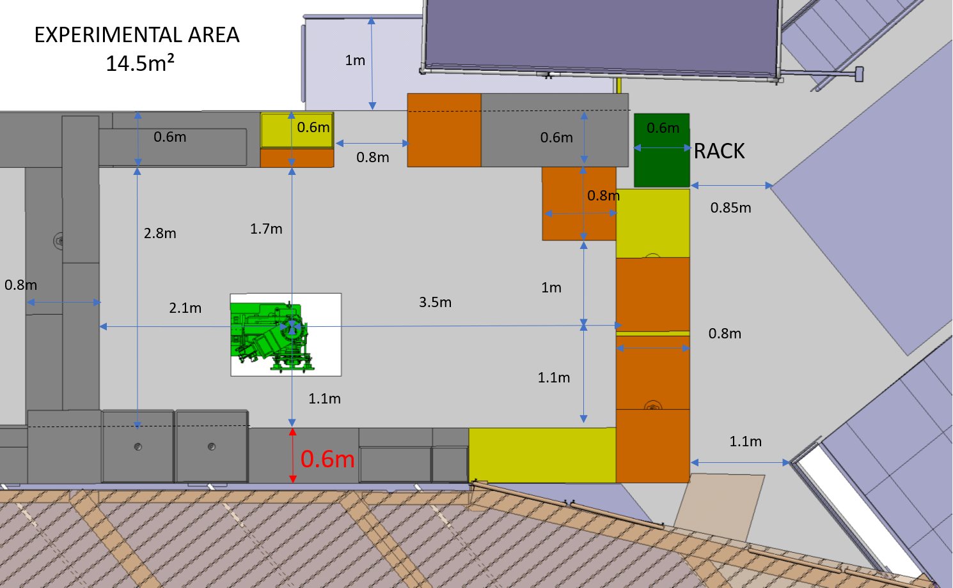
TELMAX: a new Test Area for new Ideas and Users
Refurbishment of the old ATRAP2 area and conversion into a TEst Line for Machine And eXperiments:
    For accelerator equipment tests (e.g. instrumentation)
    For experimental equipment characterization
    (e.g. foils, detectors R&D/calibration)
    …
The area reorganized to increase usable surface :
    Standard services will be provided (electricity plugs, demineralized water, compressed air, etc.…)
    Changes described in the ECR: EDMS 2975107
    Normally available by end of 2024 !
Beam-time request strategy being formalized
  will normally be a regulated by “standard” SPSC Beam Time Requests as for other facilities
  Start expressing your interest now ! e.g. to F. Butin
PS: Possible to add standard CERN diagnostics in the future...
Example of a
possible upgrade
Courtesy M. Wehrle

Slide 10
If one is allowed to dream…
… looking Beyond the Horizon

Slide 11
Higher Intensity? e.g x2?
Already at 80% AD+ELENA deceleration efficiency, i.e. up to 20% gain at very most
Already at the maximum p intensity in the PS:
  10% to gain at very most on PS-to-AD proton transport efficiency
  Present target design already at engineering limits and radiation levels close to limits!
Directly increasing the pbar yield (AD target/horn design? Transport in DI line?)
  Not obvious gain: lengthly and complex studies requiring dedicated beamtime
One way could be accumulation at AD injection
  Tested during early AD times (see CERN-ACC-Note-2019-0025)
  Possible to reach more than x2 in intensity (optimistically, up to x10), but it requires dedicated studies
Note 1: We might be limited by radiation levels in the AD hall
Note 2: bunch properties at ELENA extraction will be affected (higher emittance, length, …)
Note 3: Accumulation in traps? Your business: probably easier, but also less efficient on flux…

Slide 12
Higher Rep. Rate? e.g. x2?
Cycle length driven by cooling processes in AD (~50%)
  New AD e-cooler designed to hopefully gain 10% on cycle time
  Maybe possible to save 10% on cycle time with an “improved” s-coolling?
  Maybe trying injecting in AD at a lower momentum?
Additional inefficiencies from beam control
  Maybe possible to save 10% on cycle time with “improved” power converters?
  Maybe possible to save 10% on cycle time with better beam instrumentaton/controls?
Overall, maybe possible to gain a factor 2, at most (from 110 to 60 s cycle time)
  Investment on hardware/studies needed, if requested!
Note 1: We might be limited by radiation levels in the AD hall
Note 2: It requires also higher use of proton cycles!

Slide 13
Different Energy? e.g. from 100 MeV to 50 keV?
Note: RP aspects to be evaluated!
Considering reviving AD extraction up to 500 MeV/c (~125 MeV E_{k}) to, e.g., AEGIS zone
  It might require exclusive beam use, limiting ELENA's multi-user capacity
  Could be studied, if requested!
Extraction up to 100 MeV/c (5.3 MeV E_{k}) from ELENA?
  Requires to install a more powerful extraction kicker + septum (as the injection one)
  Adaptation or redesign of transfer line(s) will be required, potentially using new magnets
  Could be studied, if requested!
Lower energy possible down to ~85 keV
  but never tested in operation!
  below (~50 keV?) could be studied, if requested!

Slide 14
Slow Extraction from ELENA and/or AD?
Courtesy Y. Dutheil et al. – CERN SY-ABT
In concert with experiment requests at the time, the ELENA ring wasn’t designed for slow extraction and no studies were done for this
Presently bunched beam is fast extracted
  500 mm long device with 400 mm plates provides ~ 40 kV.m integrated field to achieve 220 mrad deflection
Resonant slow extraction with an electrostatic septum blade to provide continuous spill from ~100 ms to >>1 s might be possible
  Drop-in replacement of present extraction device could reach extraction up to 450 keV with a voltage of 10 kV, although transport to an experimental area is presently limited to ~100 keV
Slow extraction from the AD ring may be challenging due to higher energy and limited space on the ring lattice
Note 1: Activities need to reach CERN approval before significant resources can be allocated!
Note 2: Already done/planned within experiments at low energy (a few 100 eV) … and you seems to be happy already

Slide 15
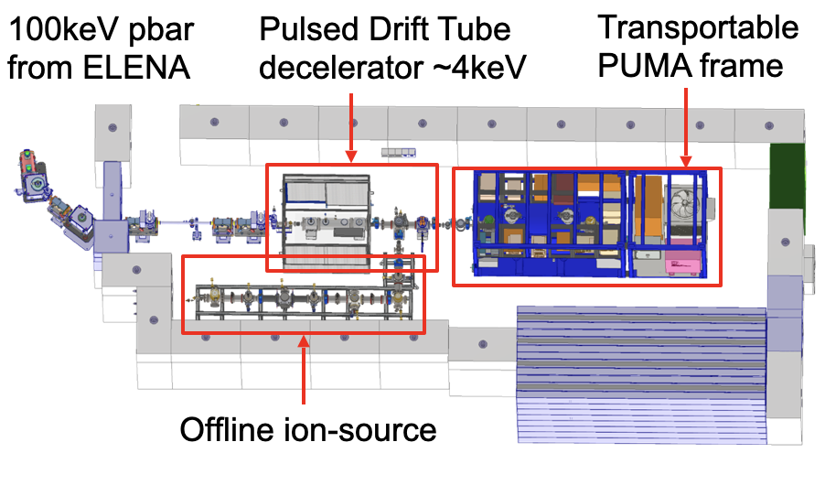
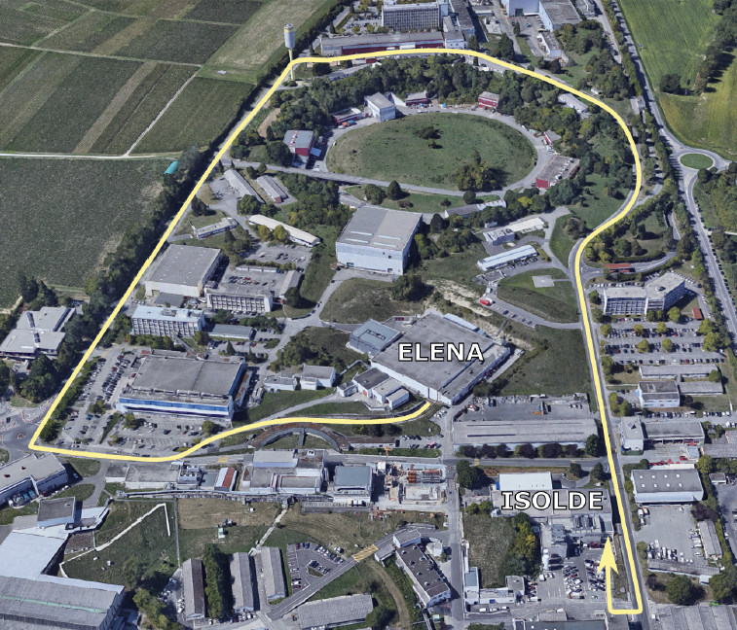
More Off-Site Traps? e.g. a common portable trap?
PUMA and STEP plan to fill a trap that will allow to transport cold pbars to other facilities (e.g. to ISOLDE for PUMA)
  Several challenges to be demonstrated!
  For STEP, the main reason is to “escape” the AD hall’s electromagnetically noisy environment
  First results should come soon! See C. Klink talk
Will this open new experimental possibilities?
  Shall CERN acquire trap technology and provide “standard” pbar-filled “bottles” for users?
    Discarded in the past: too different user needs… will the PUMA/STEP experience change the picture?
    Maybe you could produce a “common” proposal for a general-purpose trap?

Slide 16
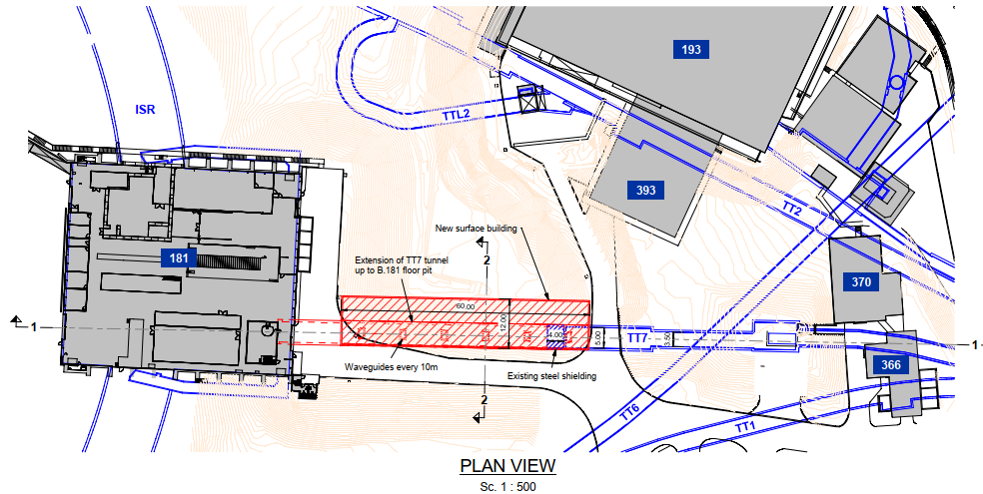
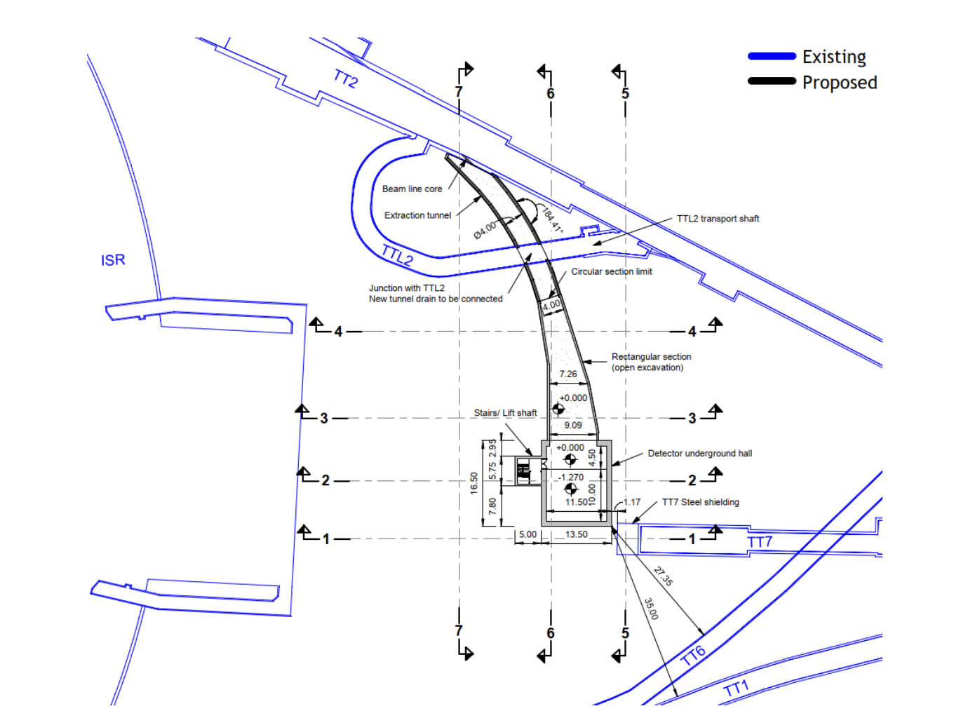
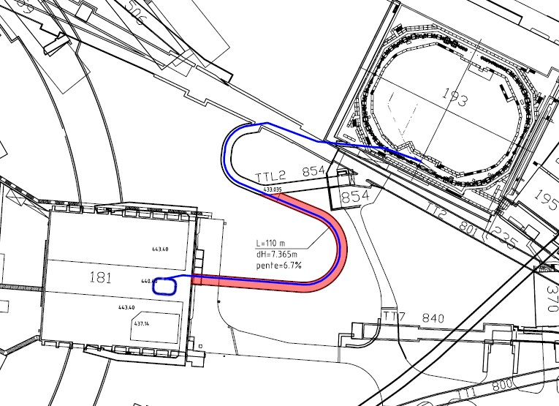
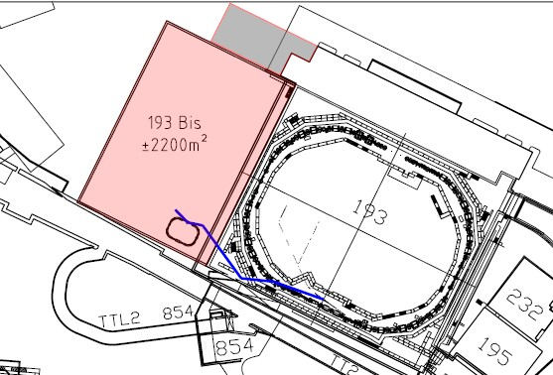
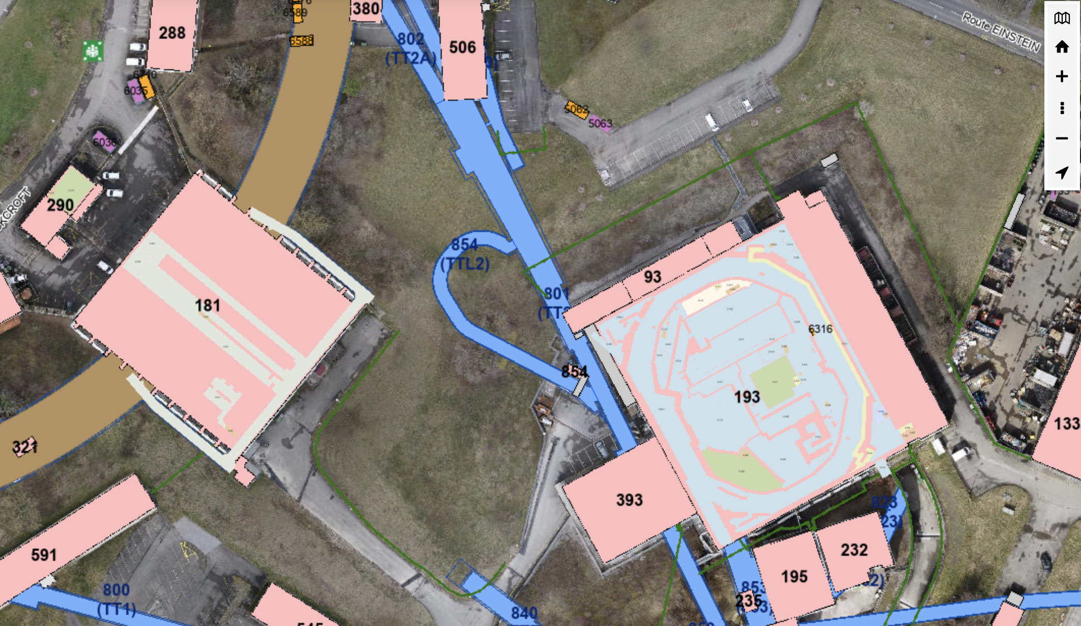
Bigger Exp. Area? e.g. 1000m² more?
One must be looking outside of the AD hall, looking at other projects:
Muon Collider “low power” test area
eSPS test area
Alternative location for ELENA studied in 2009
TTL2 is empty and not useful, today.
  What about new building (493?) with semi-underground experimental area for “high energy” experiments?
  It could take protons from PS, pbars (up to 3.5 GeV/c?) from AD, e⁻ from eSPS?, used as Muon Collider “low power” test area? (e.g. A, B, …)…
  Could be studied, if requested!
Hosting a COSY-like ring (184 m) will require some more thinking…
New “493”
Building?
~1000+ m²?
A
B

Slide 17
New Particle types? What about Antideuteron?
From the AD target: Antideuteron
  Maybe possible to have 10 to 1e4 antideuteron at AD injection already today
    Assuming they could be decelerated/trapped, would those numbers be interesting?
    S-cooling and RF systems are the most likely to require some key modifications to allow deceleration
  A new target and/or full facility might be required
  Could be studied, if requested!
In the experiments (their core business, but can AD/ELENA help?)
  Anti-Hydrogen molecule
    Might benefit from higher pbar intensity/shot
  Anti-Neutrons
    Typically, requires slow extraction at high energy (>100 MeV/c) on a target
  Antiprotonic atoms (see AEGIS, ASACUSA, …)
    E.g. production of S(uuddss) hexaquark (dark matter candidate) from pbar - ³He reaction in a trap
    Might benefit from higher pbar flux (intensity or rep-rate)

Slide 18
Overview of “Independent” Upgrade Cases
Any of these (except TELMAX) will require well-defined physics experiment cases!
The actual cost and feasibility of each option will be evaluated if and when required.
External ”high energy” experimental hall?
TELMAX
Test Experimental Area
AntiDeuteron production and deceleration
(need to upgrade also
the s-cooling and RF?)
Higher pbar flux:
x2 on rep rate
x2 on pbar intensity
“Intermediate energy”
(5.3-0.1 MeV) experimental area with single bunch and slow extraction capabilities
“High energy”
(125-5.3 MeV) Experimental area with single bunch and slow extraction capabilities
Pbar filling station
(100 keV)
for “CERN-standard” movable traps
Low energy
(100 keV)
experimental area for present and new (e.g. H2bar) experiments

Slide 19
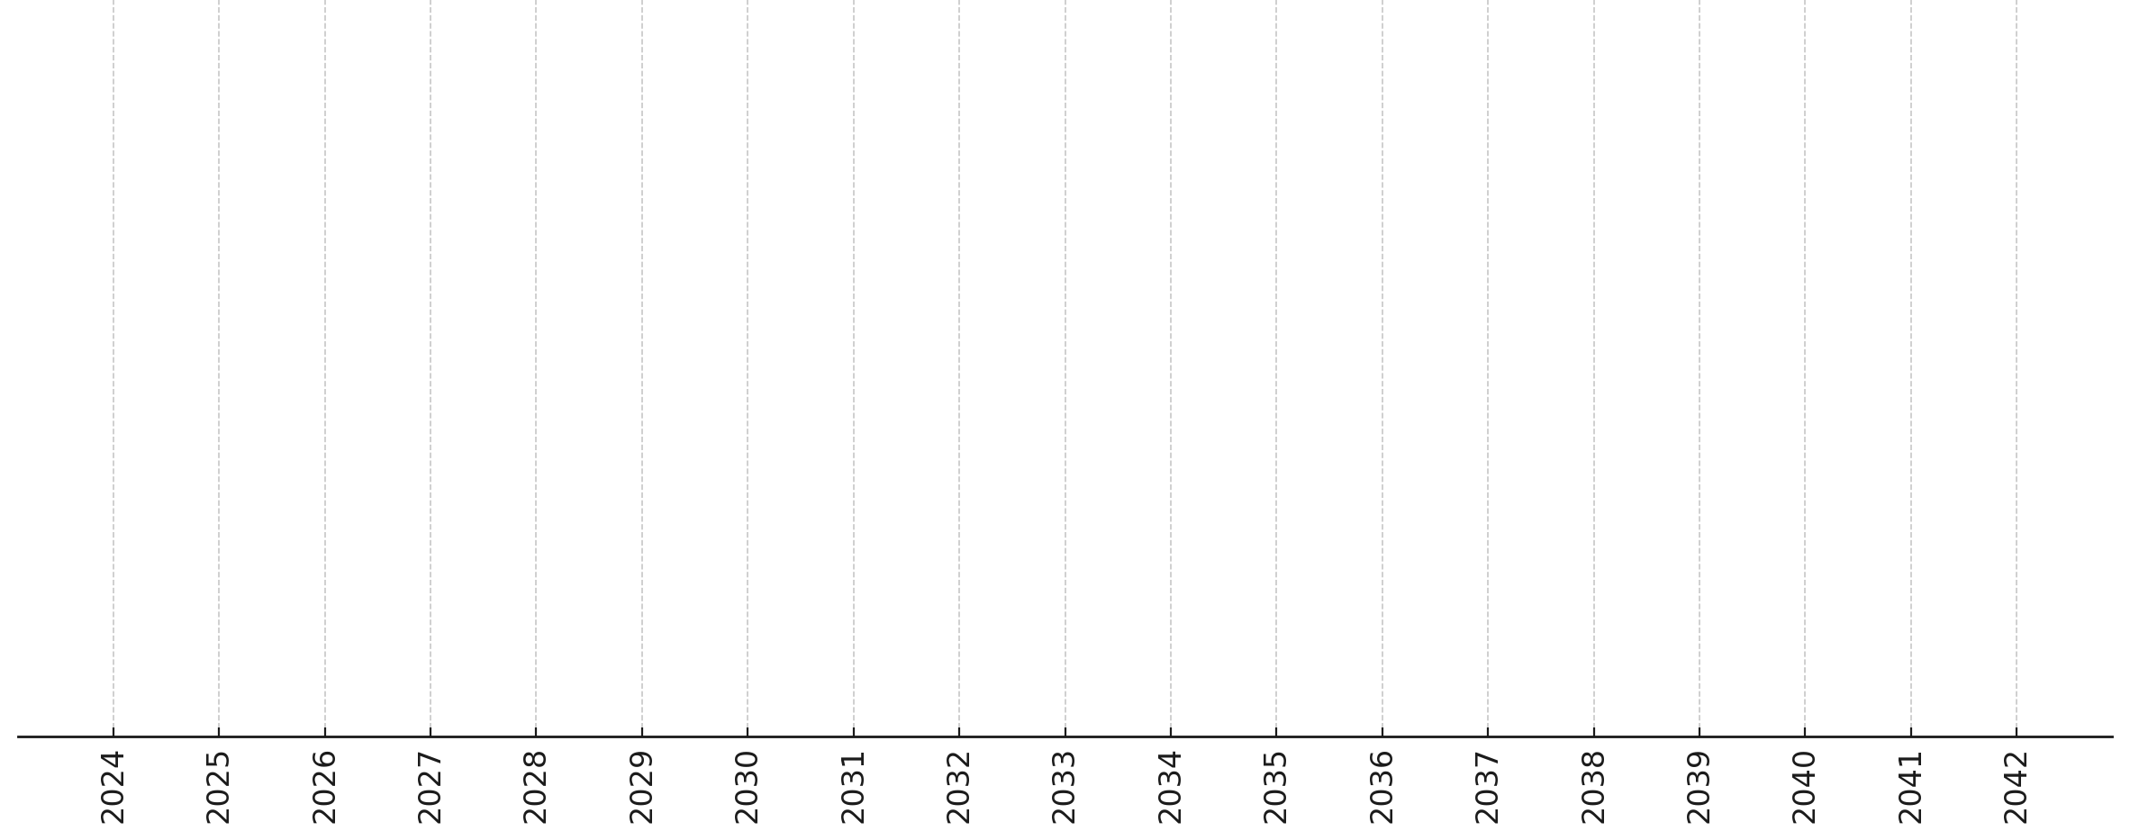
Overall Long-Term Timeline Proposal
Today
LS3 2026-27
LS4 2033
LS5 2039
End Run 6: 2042
… “Baseline” Consolidations
… Guaranteeing Efficient, Safe and Sustainable Operation …
Collect Future User Needs… e.g.:
PBC Workshop – CERN – March 2024
FuPhy Workshop – Vienna – April 2024
EXA/LEAP - Vienna - August 2024
SPSC – CERN – February(?) 2025
Permit new, challenging experiments, e.g.:
Exotic Annihilation/Antineutron Experiments?
Completely new physics experiments?
More OFF-Site Experiments?
…
Study and Implement needed upgrades, e.g.:
Low/high energy, multi-turn extraction
Antideuteron Production and Deceleration
Accumulation in CERN-standard traps
…
Prepare the future of low/high energy antimatter physics at CERN…

Slide 20
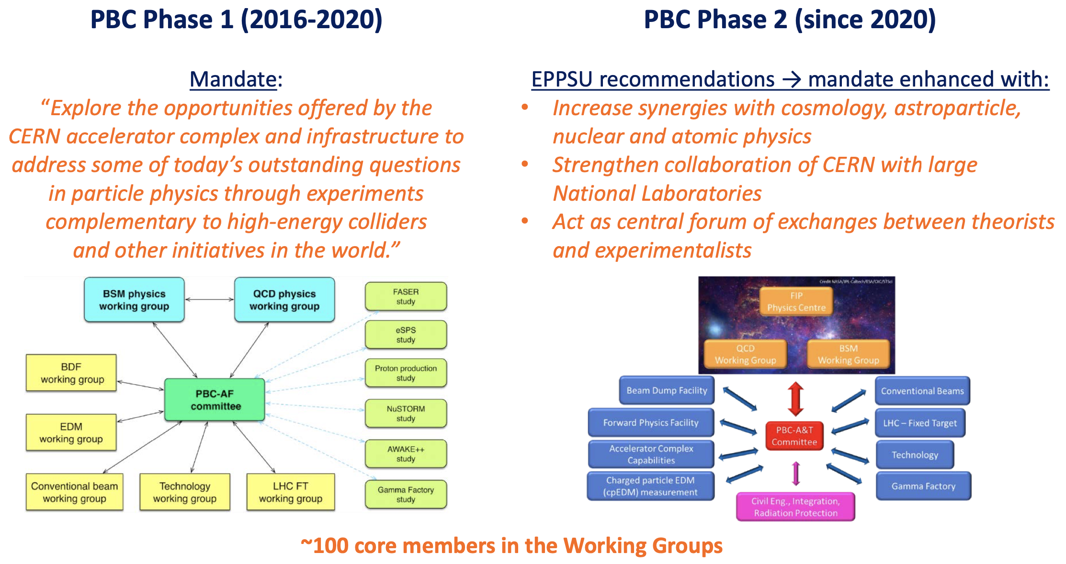
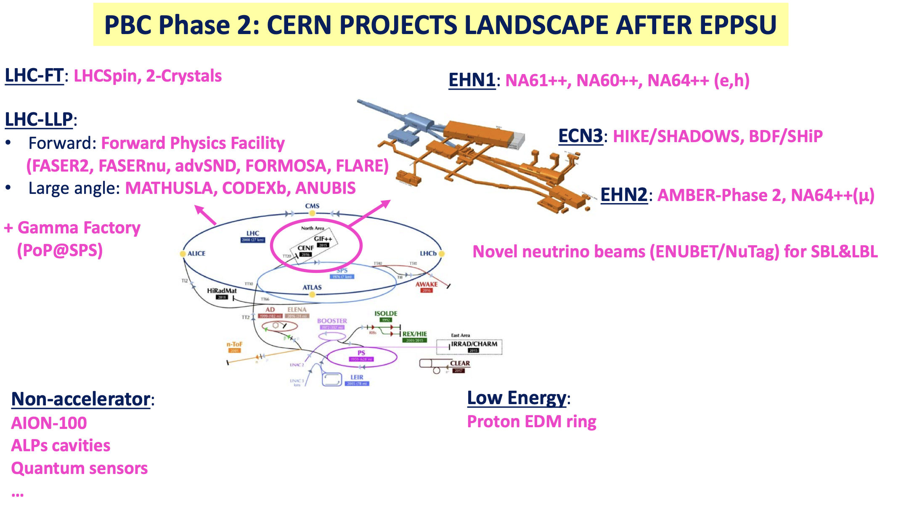
PBC Study Group at CERN is a Possible Partner
CERN has put in place the Physics Beyond Collider Study Group in 2016 to support studies for new experiment/proposals at CERN
  see for example ECFA2022 and PBC2024 and PBC official website
(to my knowledge) no AD/ELENA experiment is presently profiting of this programme
  It is the natural interlocutor to assess and possibly fund feasibility studies for new experiments!
Slides from C. Vallee at PBC Workshop 2024

Slide 21
Conclusions
AD/ELENA Facility is a unique facility worldwide
  Unique globally, with no realistic alternative for the next 20+ years.
  Consistently delivers 4e7 antiprotons at 100 keV bi-minute to six thriving collaborations
  High satisfaction across the physics user community
Short-term Prospects
  Potential for minor performance improvements (+10-20% intensity and repetition rate)
  We can still take advantage of some flexibility in ELENA (e.g. number of bunches/extractions)
  Establish the TELMAX Beam test area to boost component development and support new/old users
Long-term Prospects
  Extend facility's physics reach is possible, depending on emerging cases
  Hardware consolidation within AD presents new use case opportunities
  PBC is an asset framework to intercept and actualize new requests (e.g. support feasibility studies)
Looking forward to new, exciting, yet realistic, user requests to trigger relevant studies!

Slide 22
APPENDIX

Slide 23
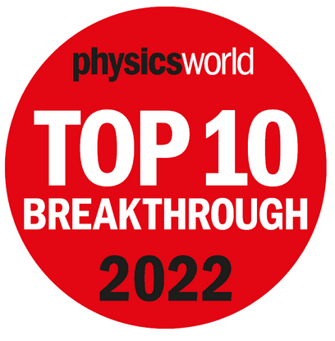
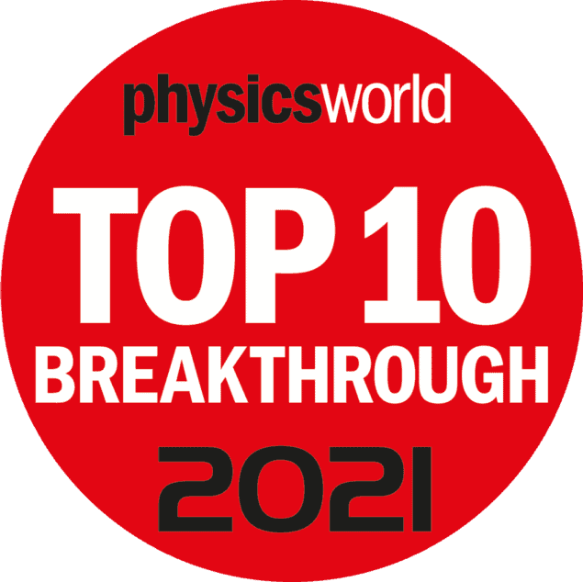
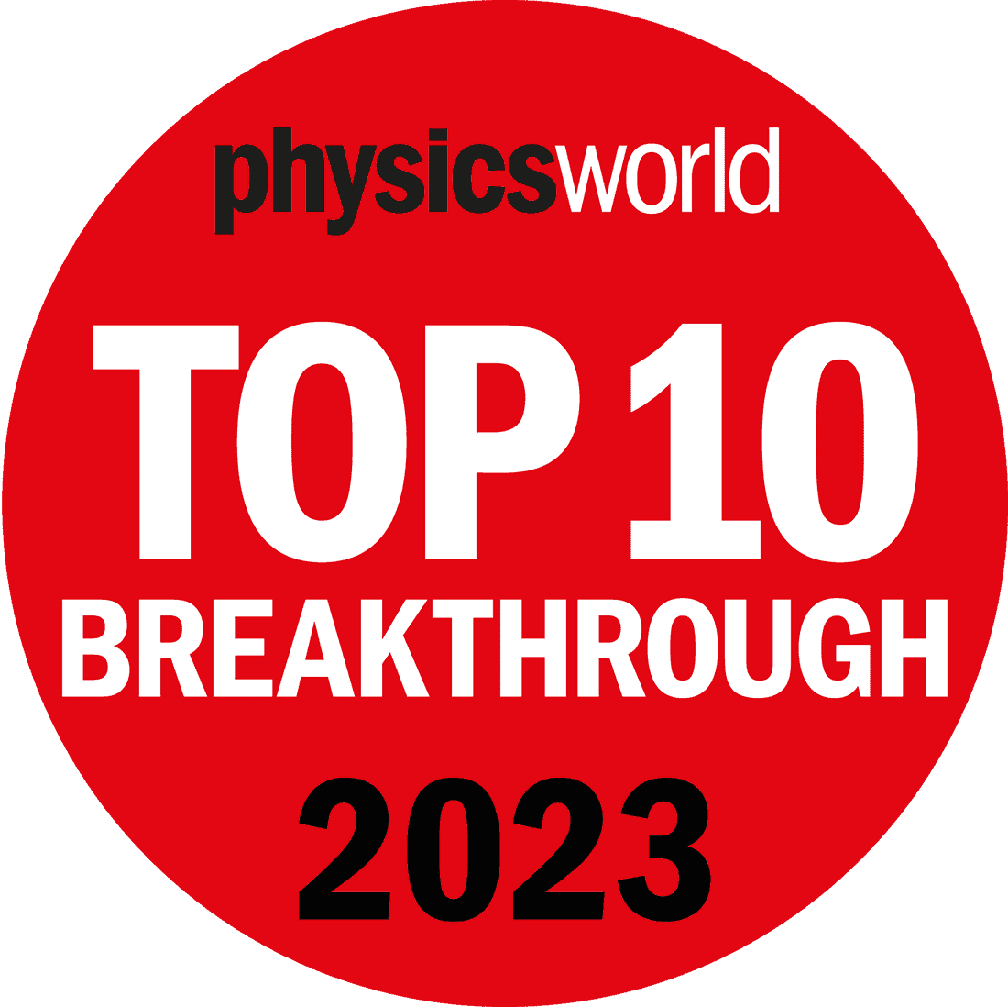
Timeline
LS2 2019-2021
New AD Target
Major AD magnets
and RF consolidation
…
2007
First feasibility study of ELENA
LS1 2013-2014
S-Cooling controls(?)
Instrumentation
1996
Design Study of the Antiproton Decelerator (AD)
2000
START of AD
for physics
2009
START of
AD-CONS
2011
ELENA project
approved
2018
ELENA commissioning
2021
START of ELENA
for physics
2010
1996
END of pbar physics @LEAR:
CERN to concentrate on low energy pbar physics only in AD
2002
First Hbar
production and detection
2010
START of Hbar physics in traps
2017
Observation of 1S–2S transition in trapped Hbar
2021
laser-cooled Hbar and sympathetically cooled p
2023
Antimatter does
not fall up…
Timestep between major results/changes: ~5-10 years

Slide 24
How did we get here?
Modest investments relative to CERN's capabilities
  Leveraging on the possibility of reusing existing hardware
Exceptional commitment from a handful of individuals, coupled with the goodwill of numerous others
  Not turn-key machines: several unique technologies/features!
Resilient user community conducting extensive, intricate, long, and unparalleled experiments on a restricted budget and with scarce resources
  Over two decades of specialized expertise challenging to replicate
Made possible by CERN's existing infrastructure and expertise
Might be impossible to replicate this anywhere else!

Slide 25
Current Facility Challenges: Infrastructure
Hardware Aging, especially the AD!
  AD made from hardware recycled from previous facilities
    Example risk: water leak in special magnet in 2023 disrupted 10% of physics operation time
  Ongoing consolidation efforts since the facility's early days
Liquid Helium Demand
  Our users are among the top consumers of liquid helium at CERN
    Presently running at maximum helium capacity, and often not enough…
Space Constraints
  AD hall predominantly occupied by experimental setups
  Complex experiments with lengthy timelines (>5 years) from setup to initial results
  Limited space for new/bigger experiments and/or auxiliary installation,…

Slide 26
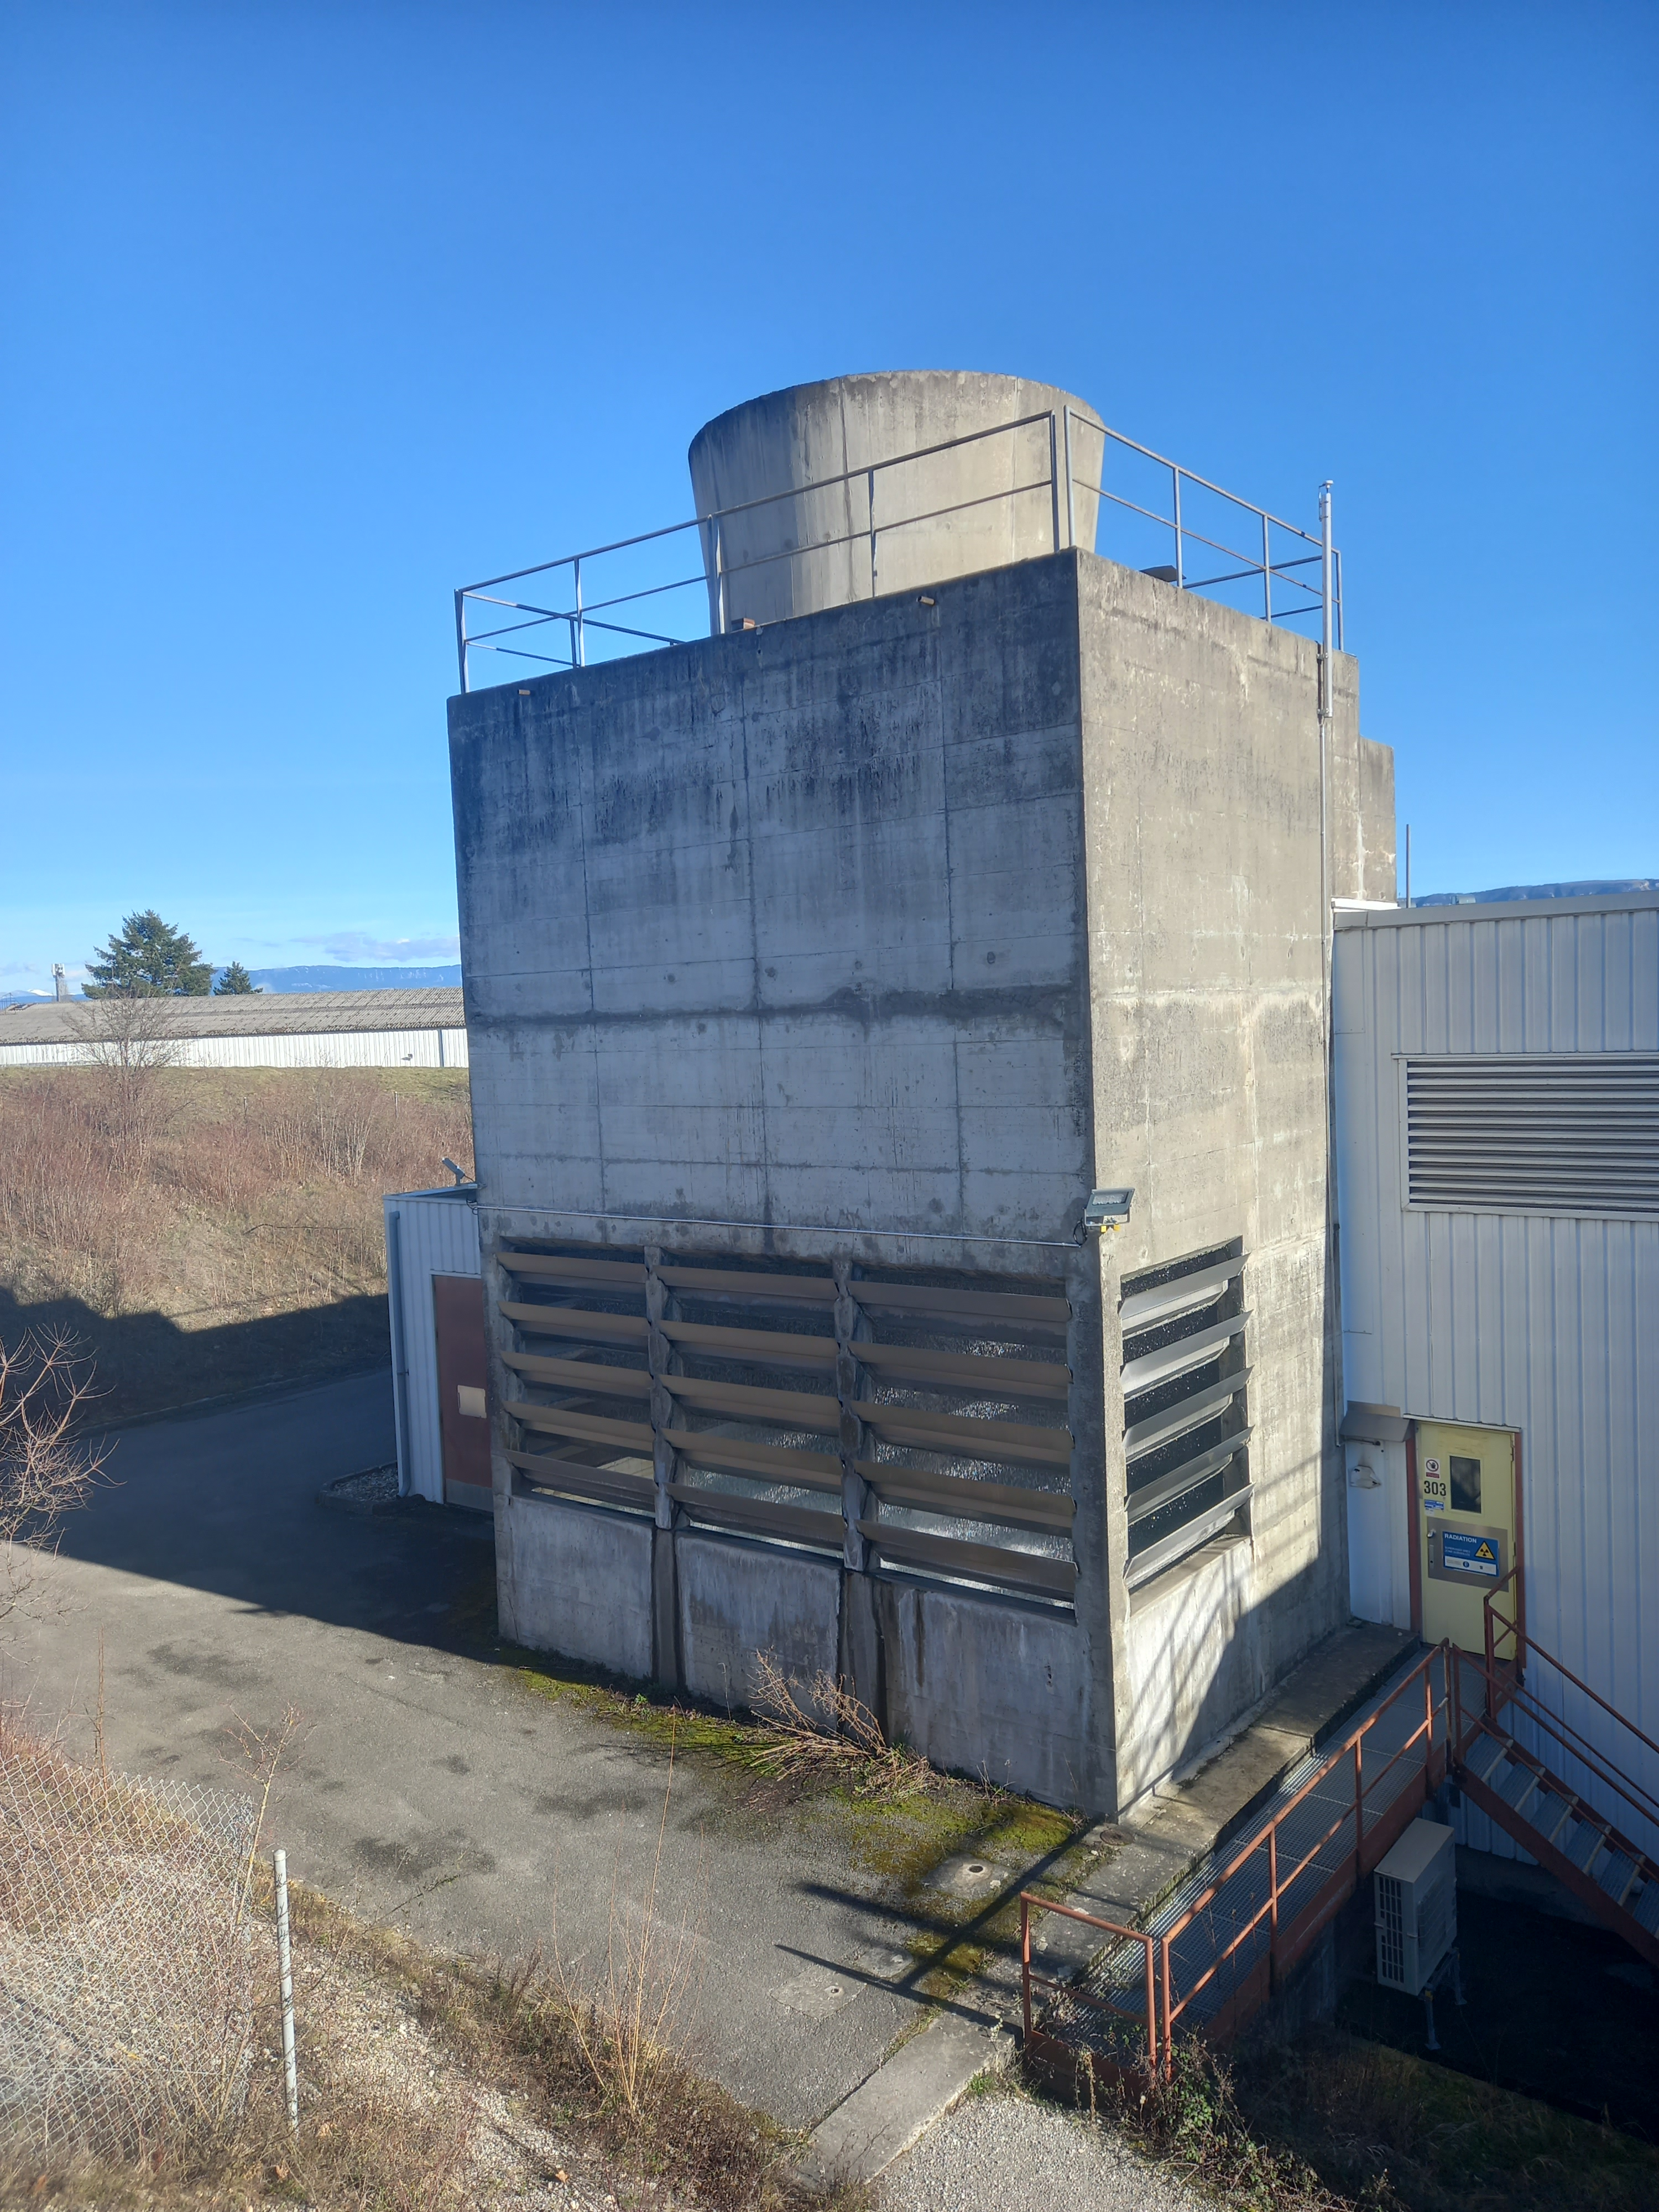
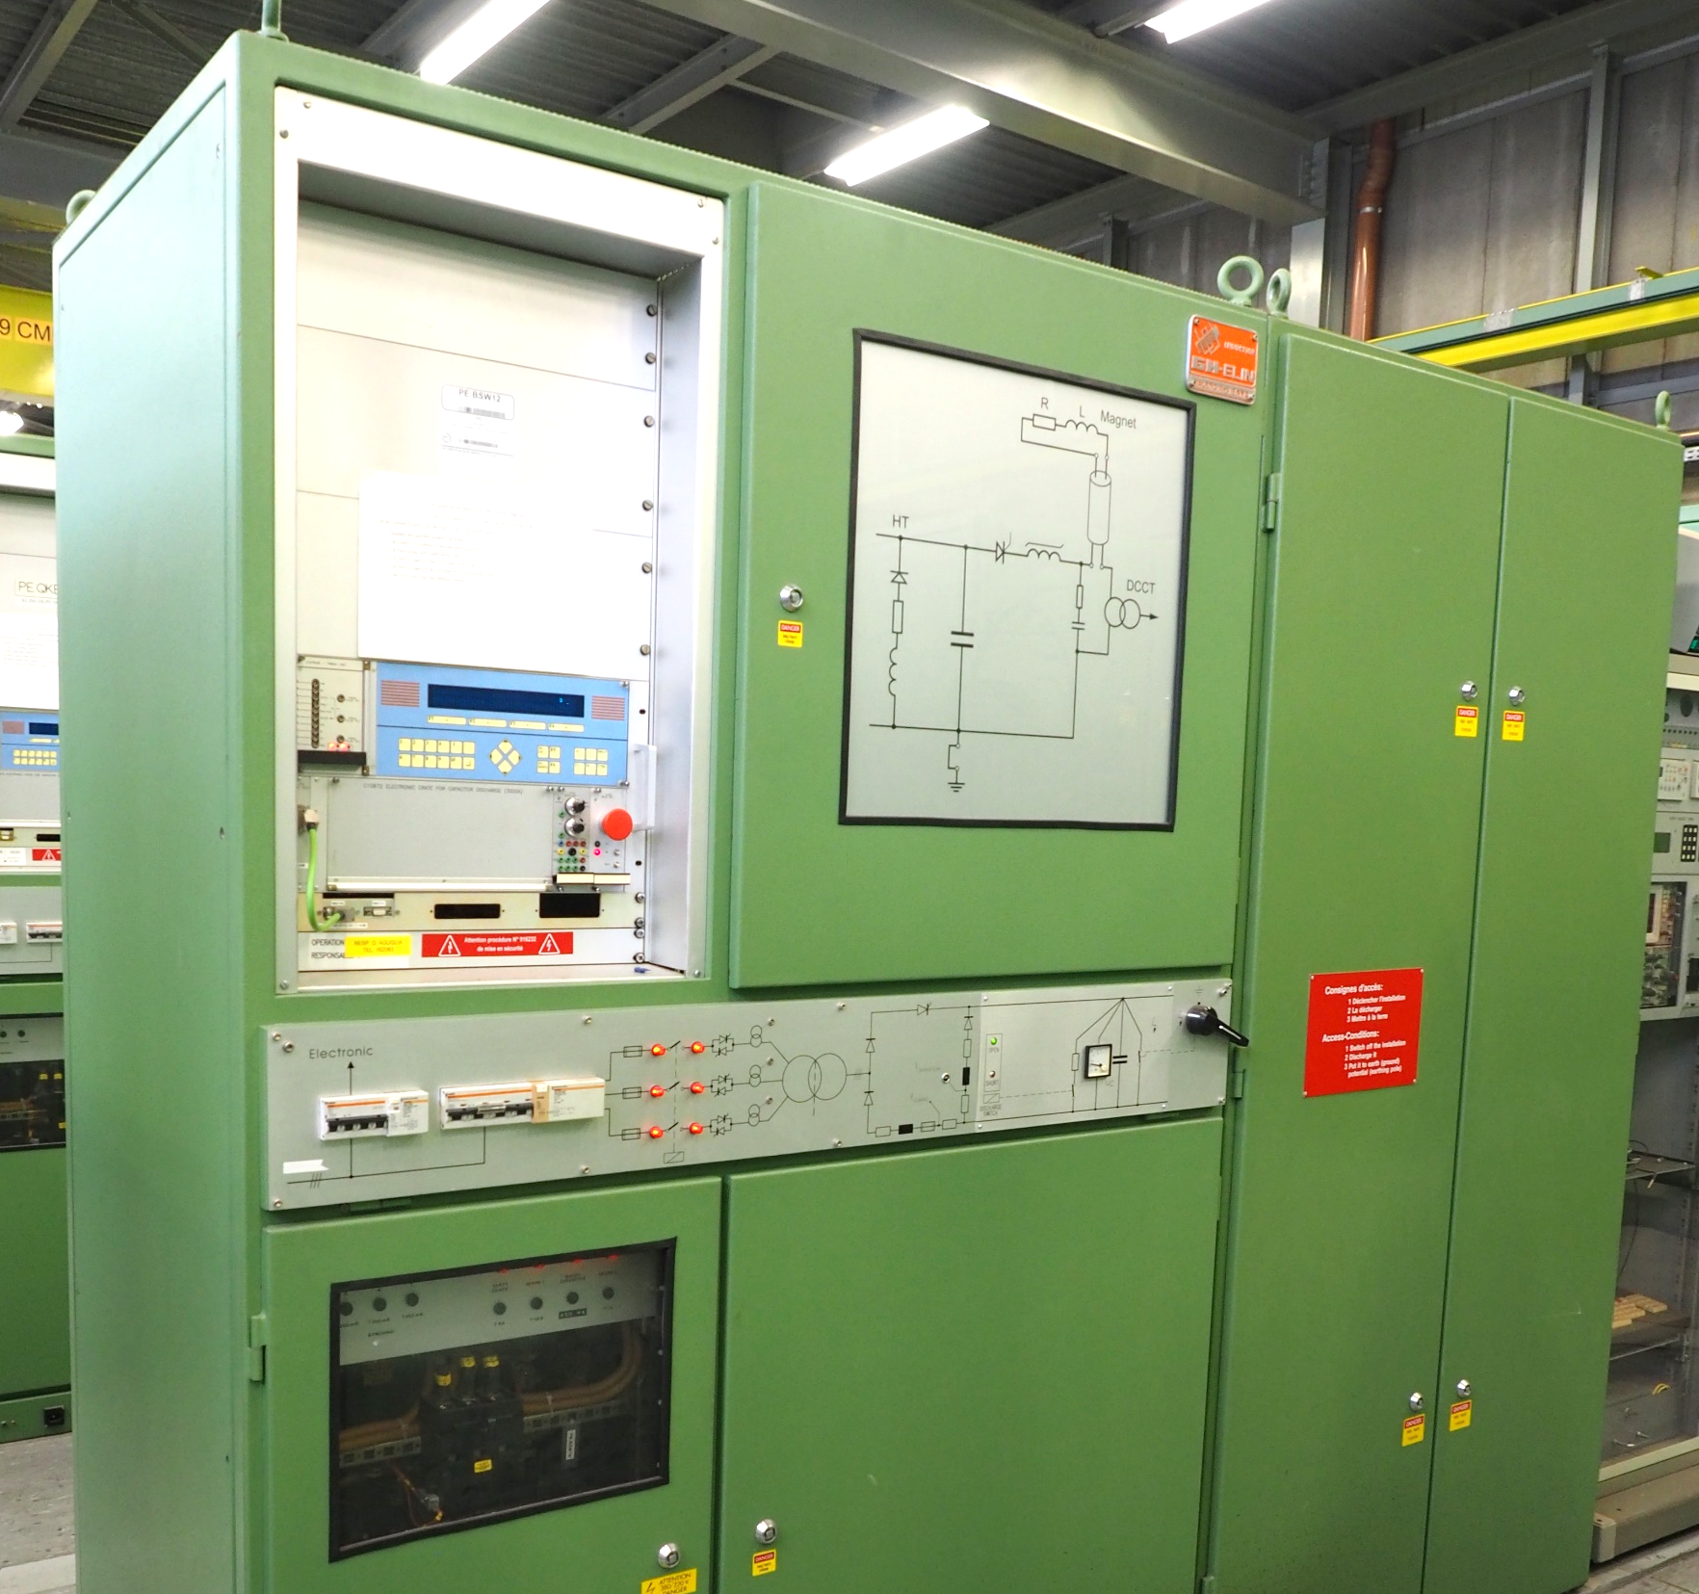
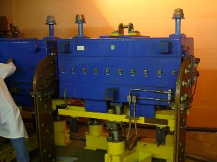
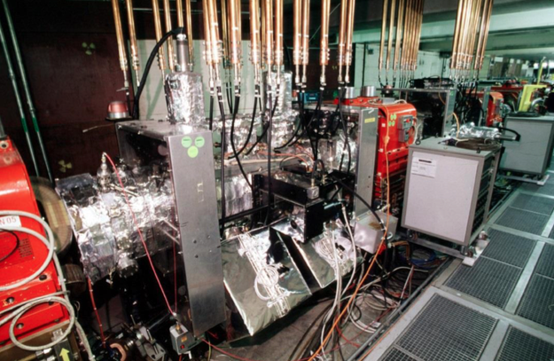
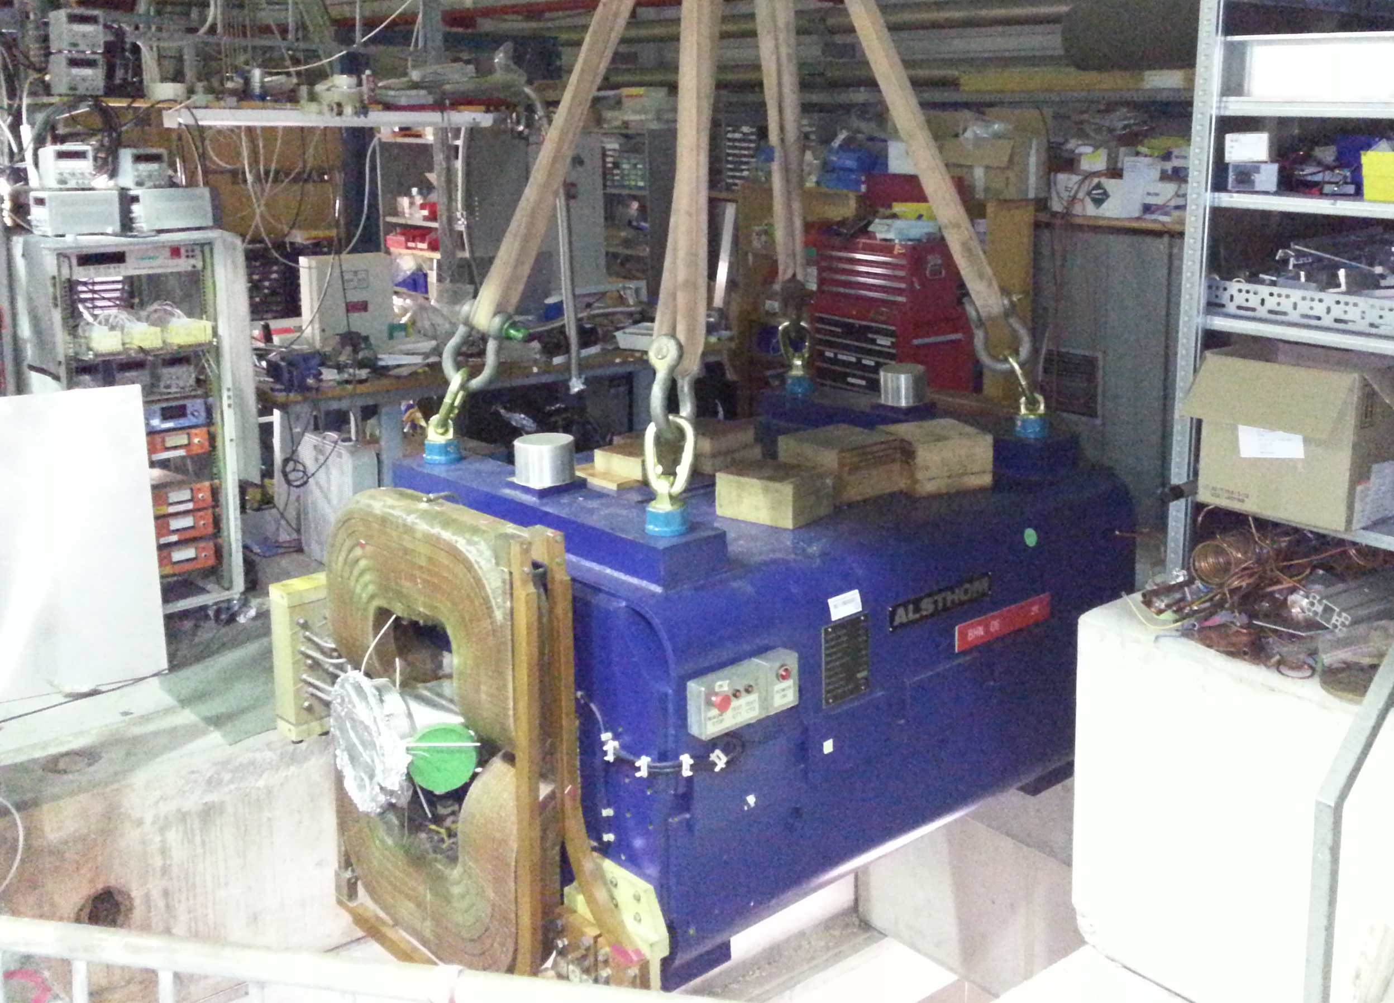
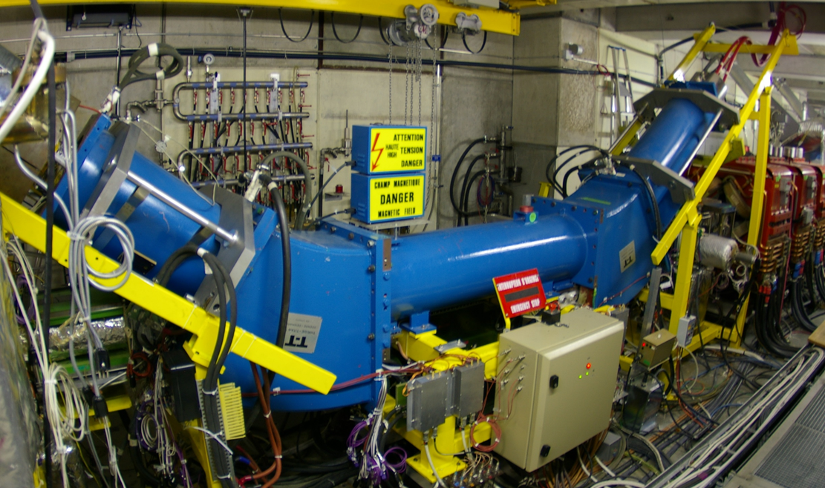
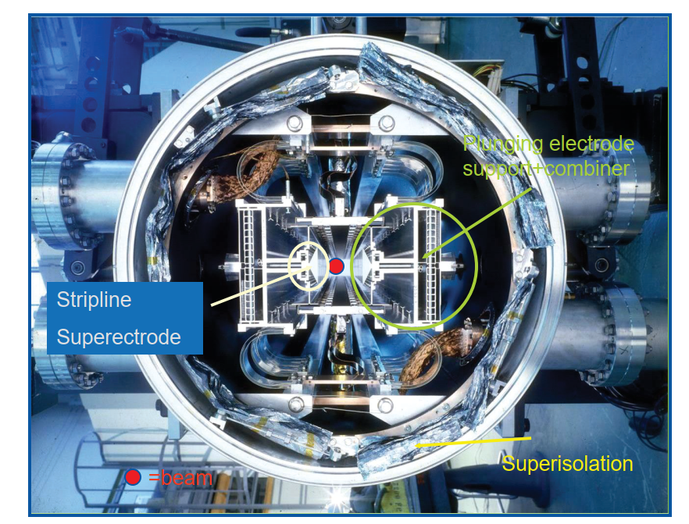
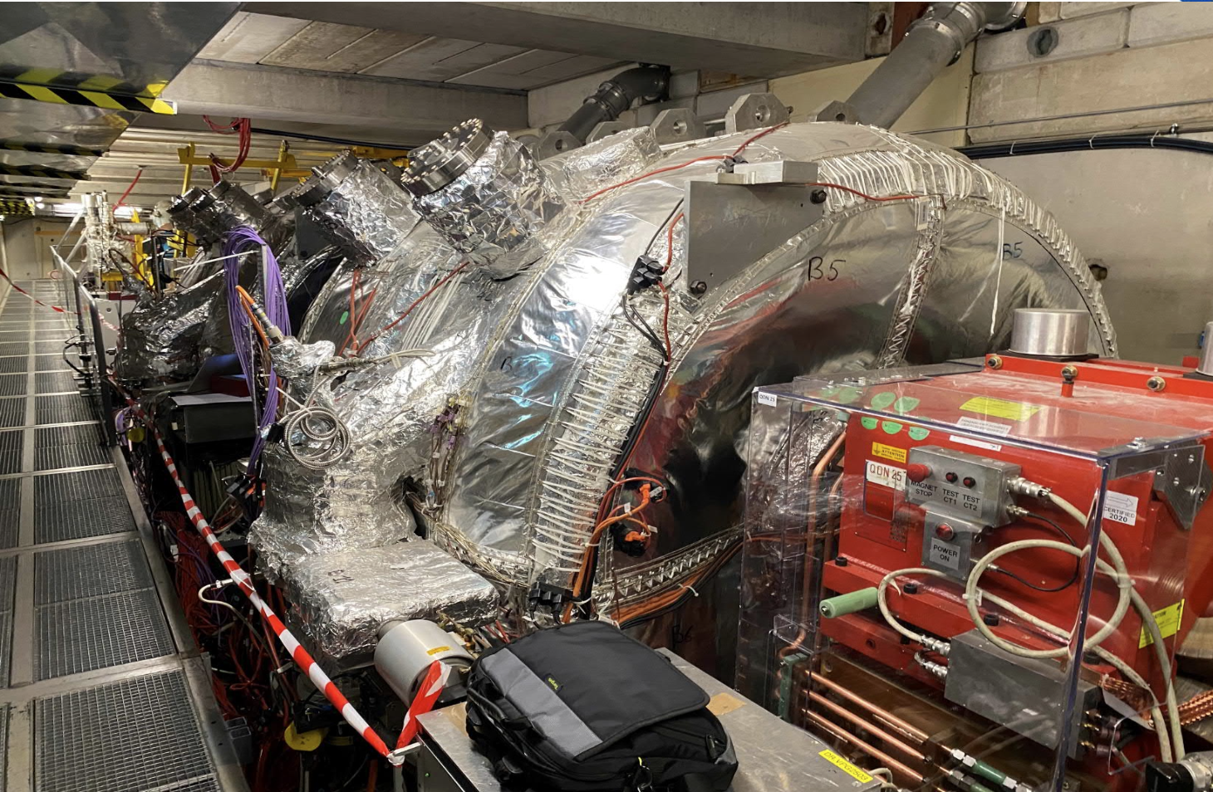
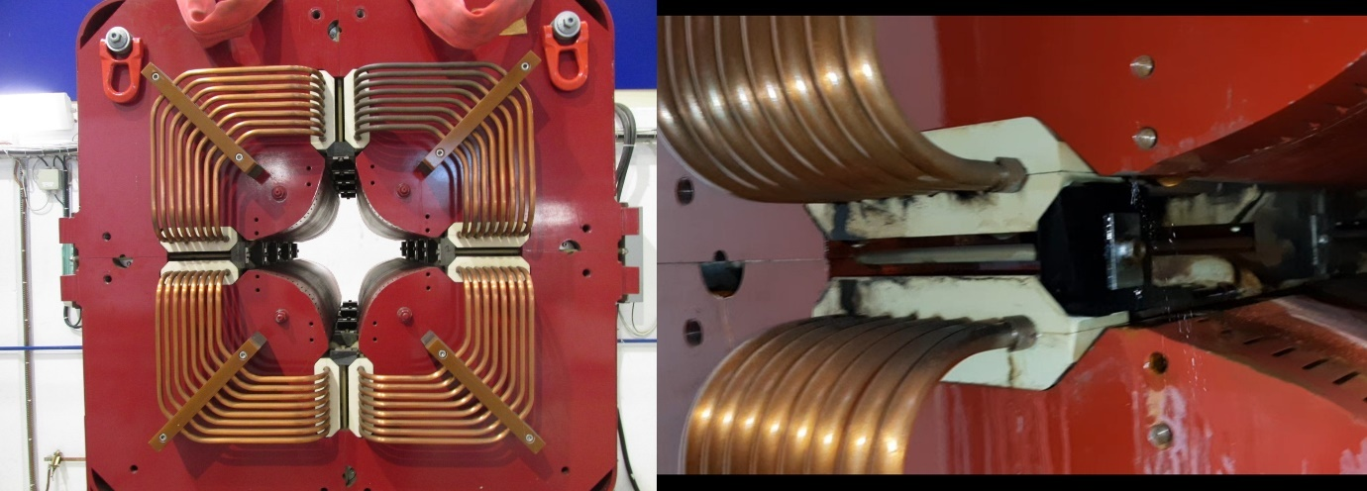
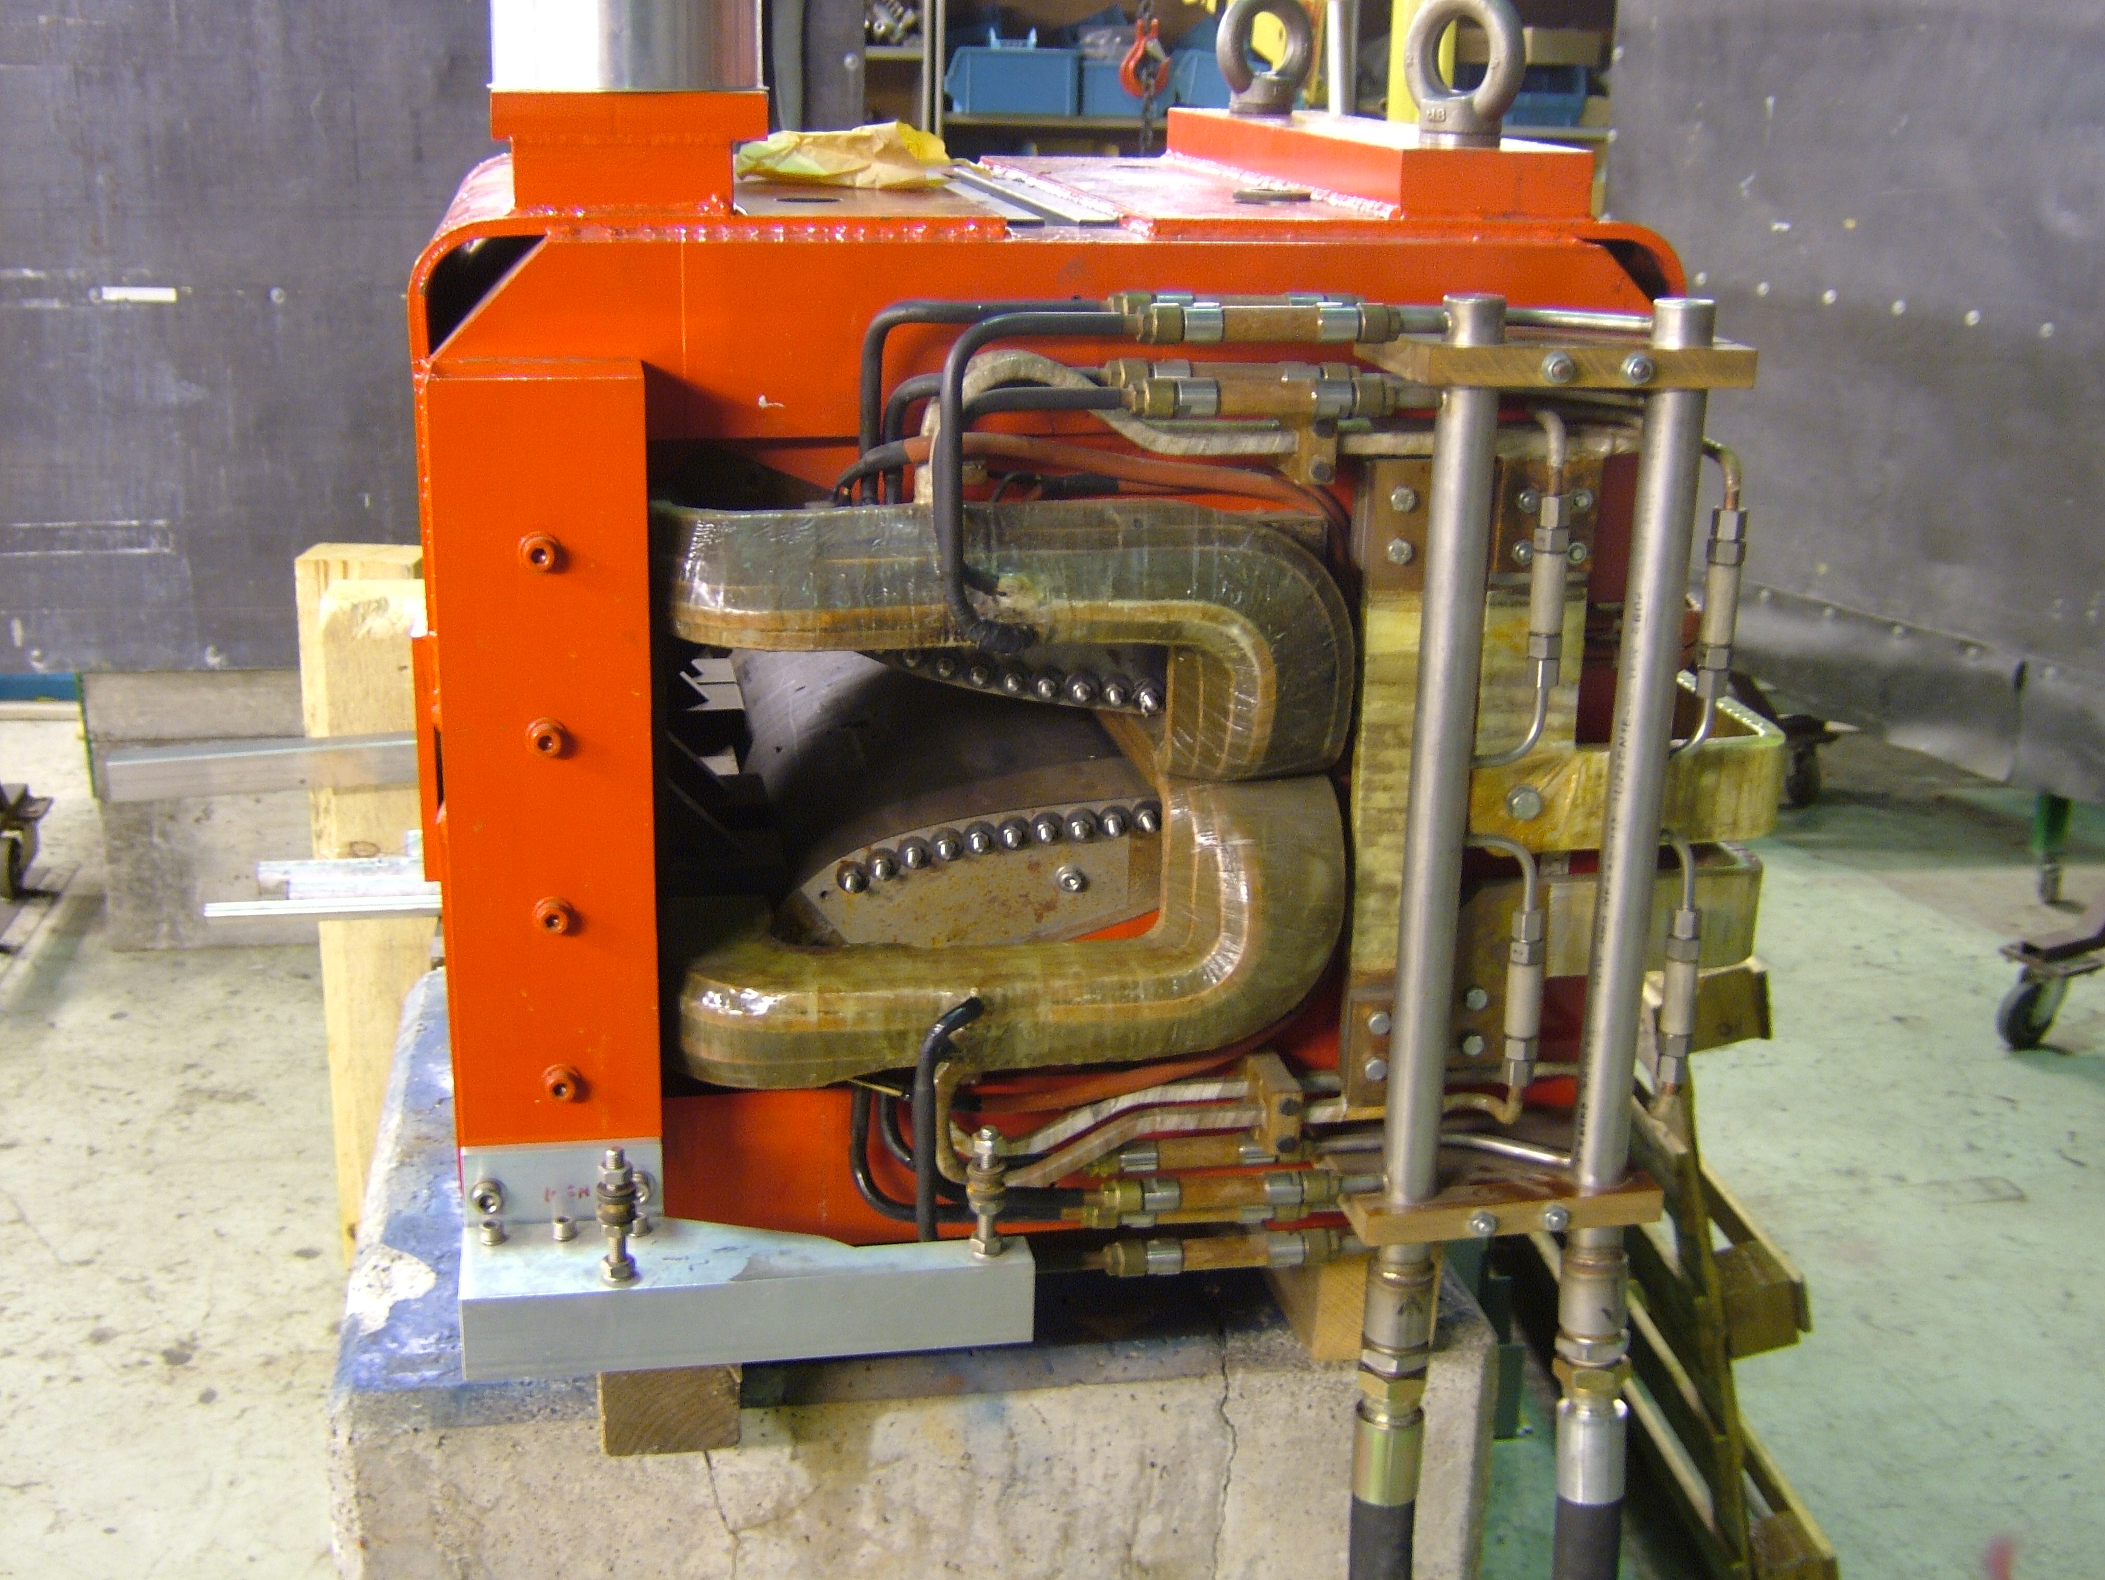
Hardware: Most Critical/Aged Items
Outdated (and not very “green”) cooling and ventilation systems
Outdated Power Converters
Critical reliability and
spare availability for
s-cooling kickers
and power amplifiers
Injection line magnets with high risk of breakdown and no spare
AD magnets consolidation being finalised
Outdated e-cooler design,
critical in spare parts
S-Cooling pickup with
no spares, limited know-how
Outdated LLRF and HLRF for C10 cavities

Slide 27
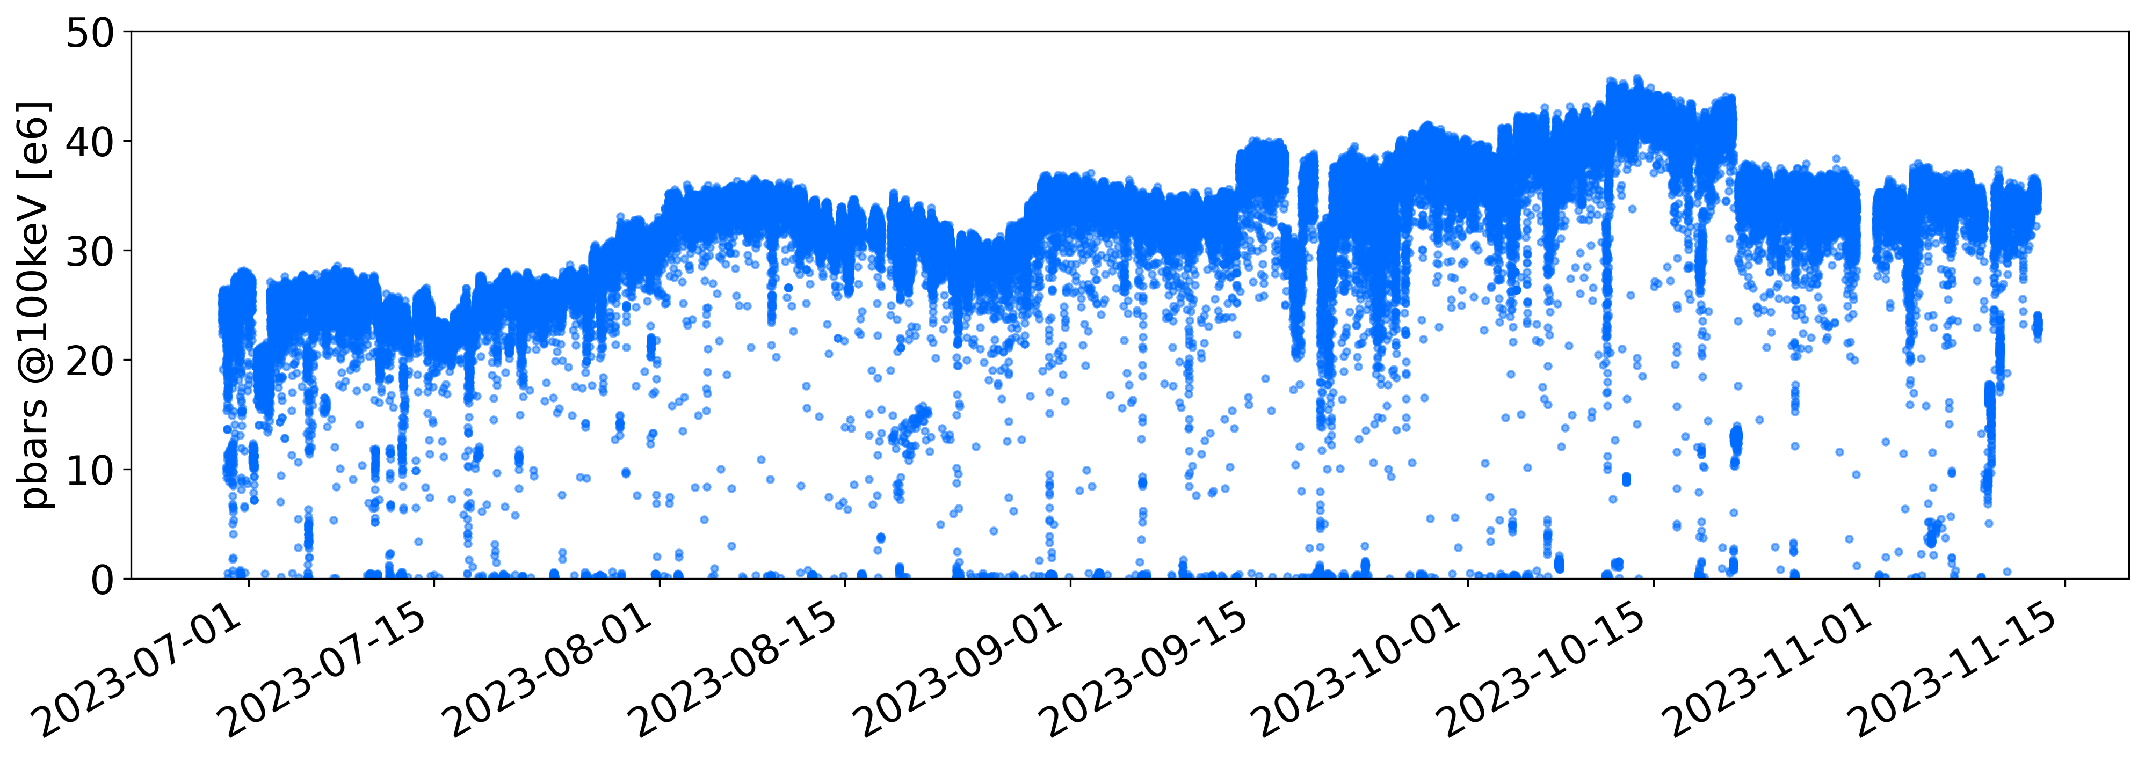
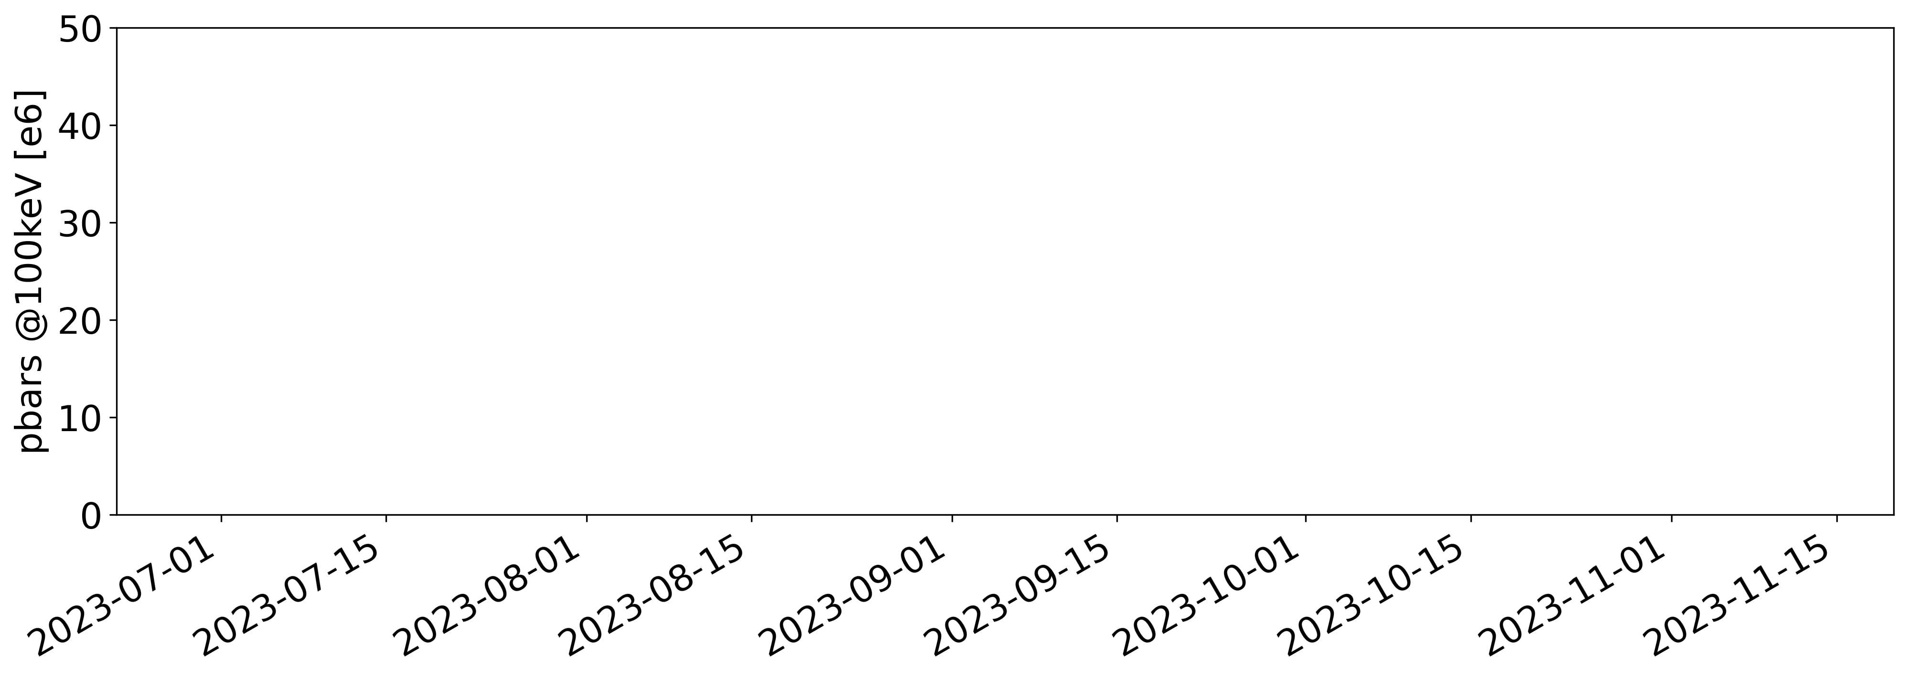
Main user requirements: stability and reproducibility!
Main request: stable intensity of more than 25e6 pbar every ~120 s (typically, higher flux is better)
  Acceptable to have slow intensity drifts over time scales of days/weeks
Total Intensity at ELENA extraction
Time between consecutive cycles
2023 data
2023 data
Ideal case
Ideal case
“Acceptable”
  In practice, quite some intensity variation/fluctuation (>20%!) over the year
      Slow improvements thanks to motivated operation team
      Slow/fast degradations due to natural drifts and hardware faults/issues
      Shot-to-shot fluctuations due to non-reproducibility of several sub-systems
    Also, repetition rate variation driven by PS super-cycle composition and beam scheduling strategy
      Not much we can do about it, but CERN-timing long-term plans to upgrade protons scheduling strategy

Slide 28
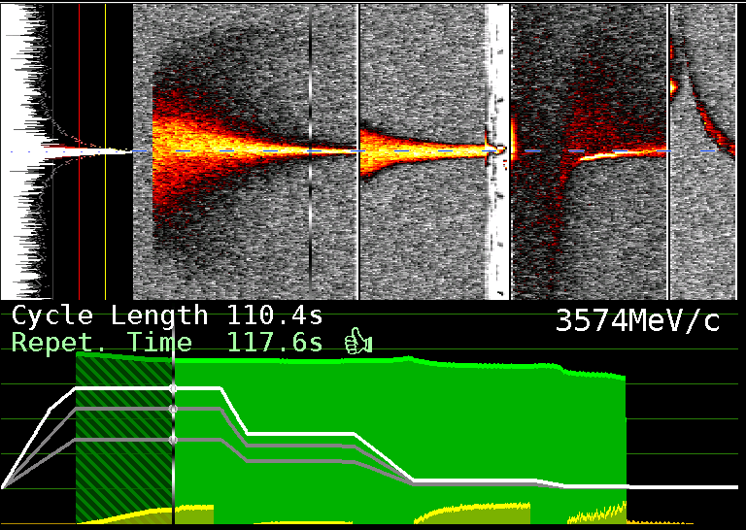
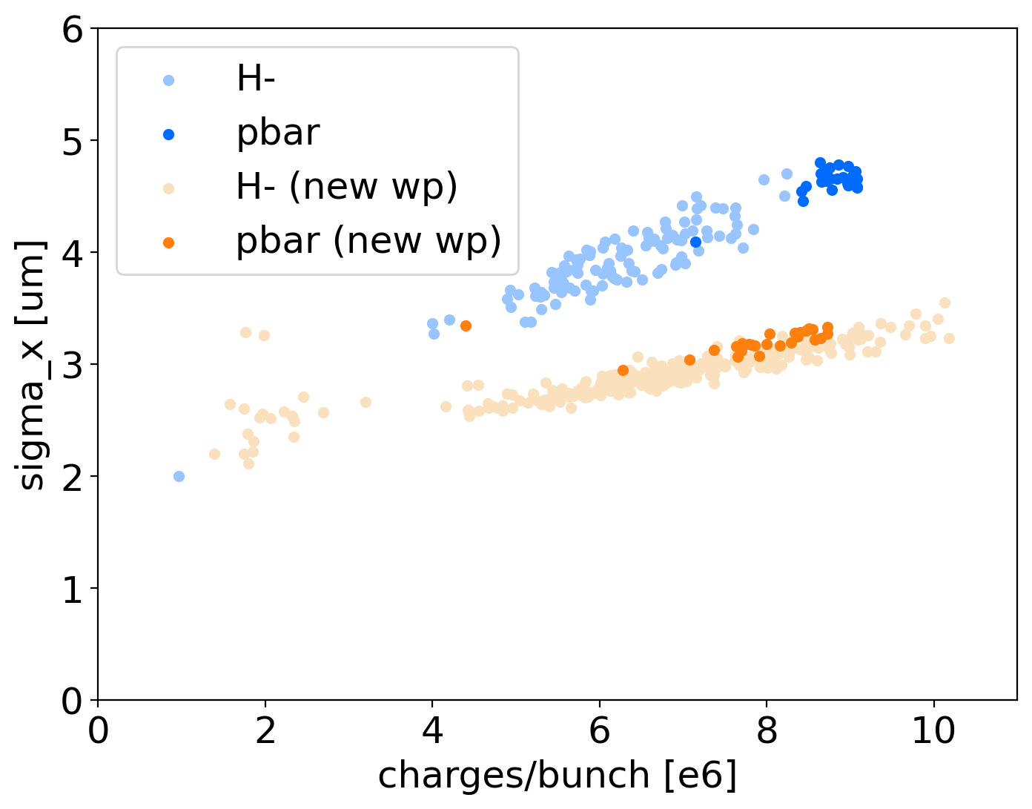
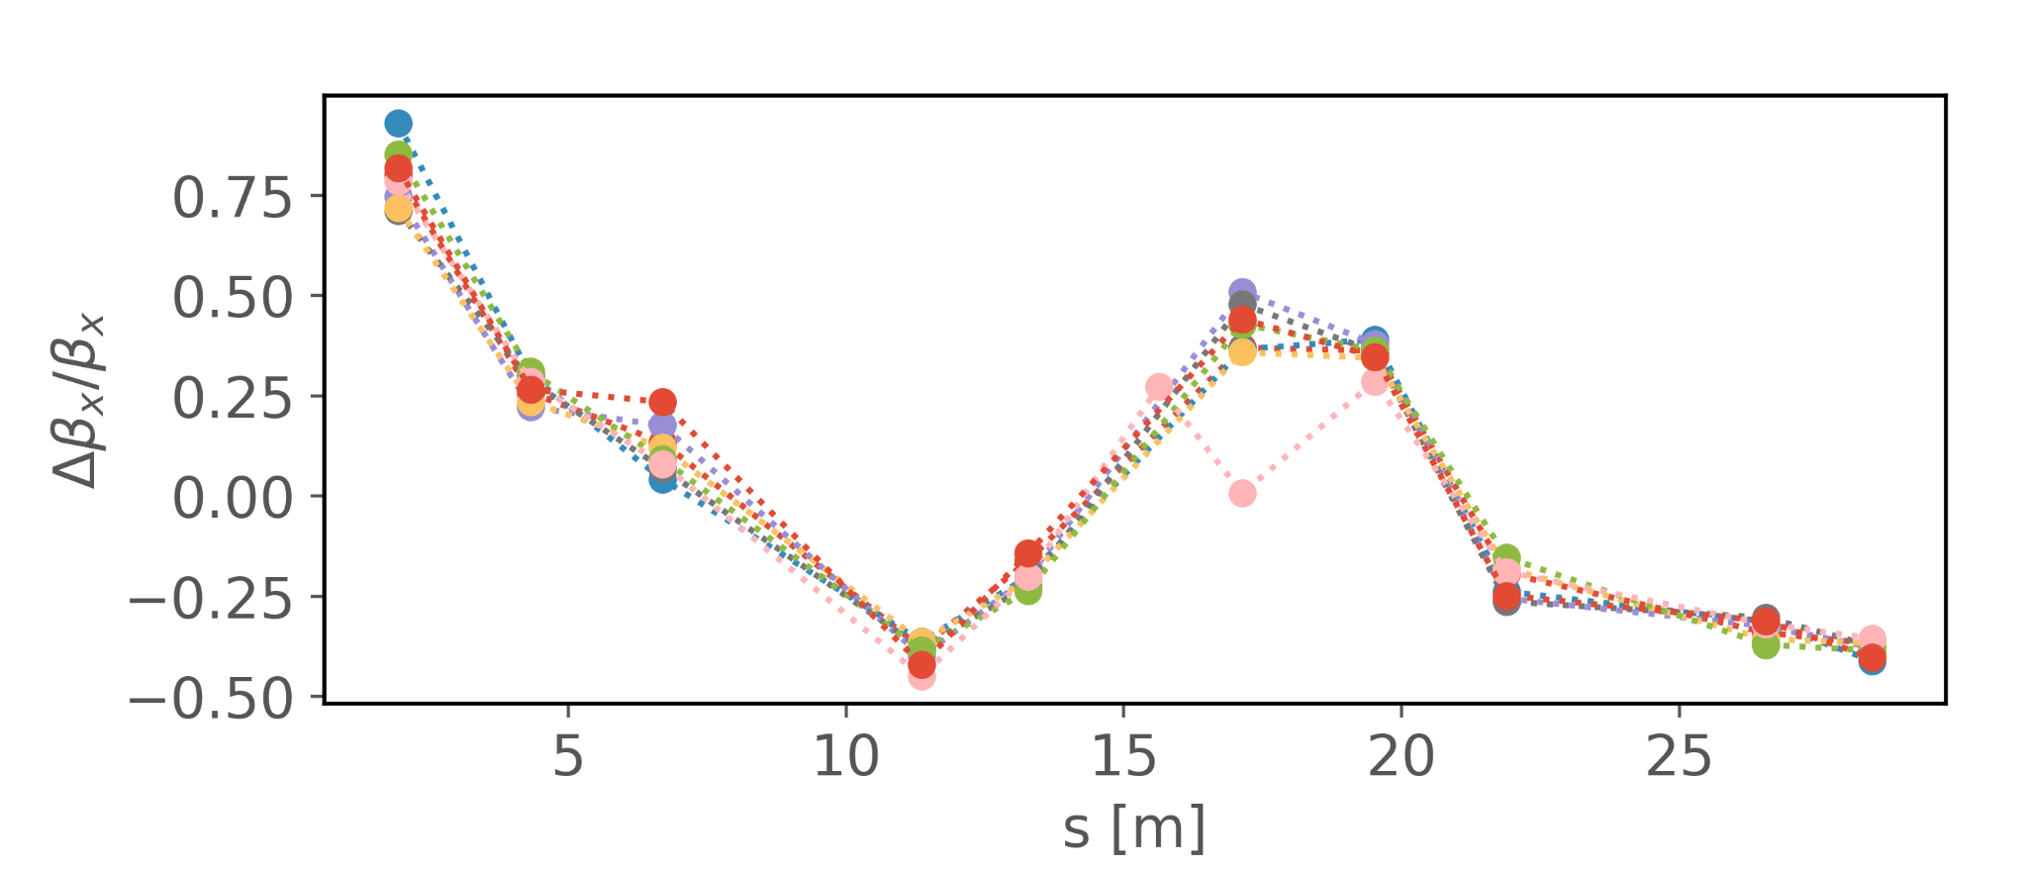
Current Facility Challenges: Beam Control
Challenges in Beam Diagnostics in measuring very low intensity and low energy beams
  Mainly relying on Schottky and Intensity measurements
    i.e. indirect measurement of many possible faults/effects
  Only destructive transverse beam profile measurements
Dedicated operation team :
  Maintain high machine availability
    E.g. Finding solutions to run without BHZ-TRIM in 2022…
  Obtain the best performance from existing hardware
    E.g. toward ELENA design emittances, …
  Respond to user needs
    E.g. Optimise beam transport from ELENA to traps …
  Follow-up constant consolidation needs, often unique systems
    E.g. electron and stochastic cooling consolidations …
Schottky and Intensity (BCCCA) in AD
Toward ELENA design emittances!
About x2 emittance reduction!
First optics measurements in ELENA show large beta-beating, to be further studied.

Slide 29
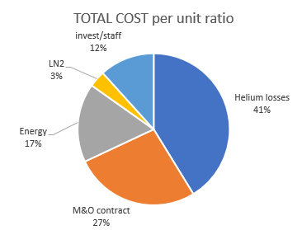
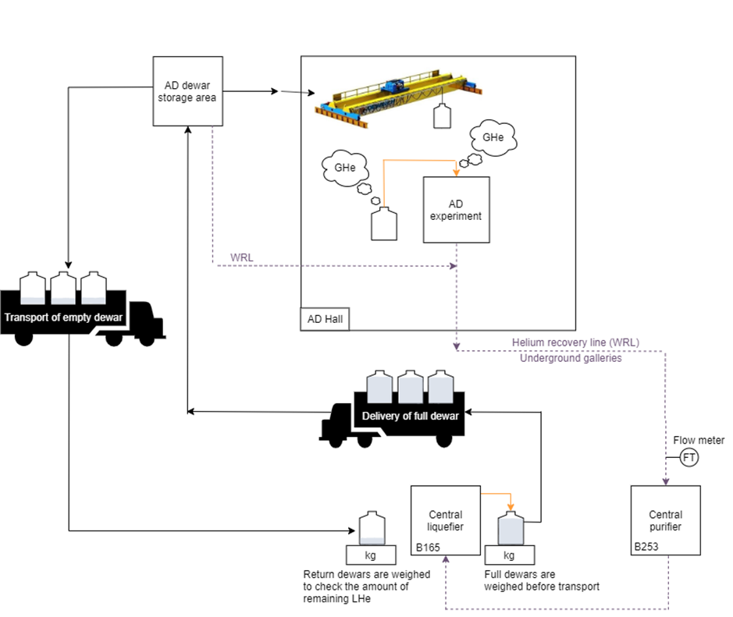
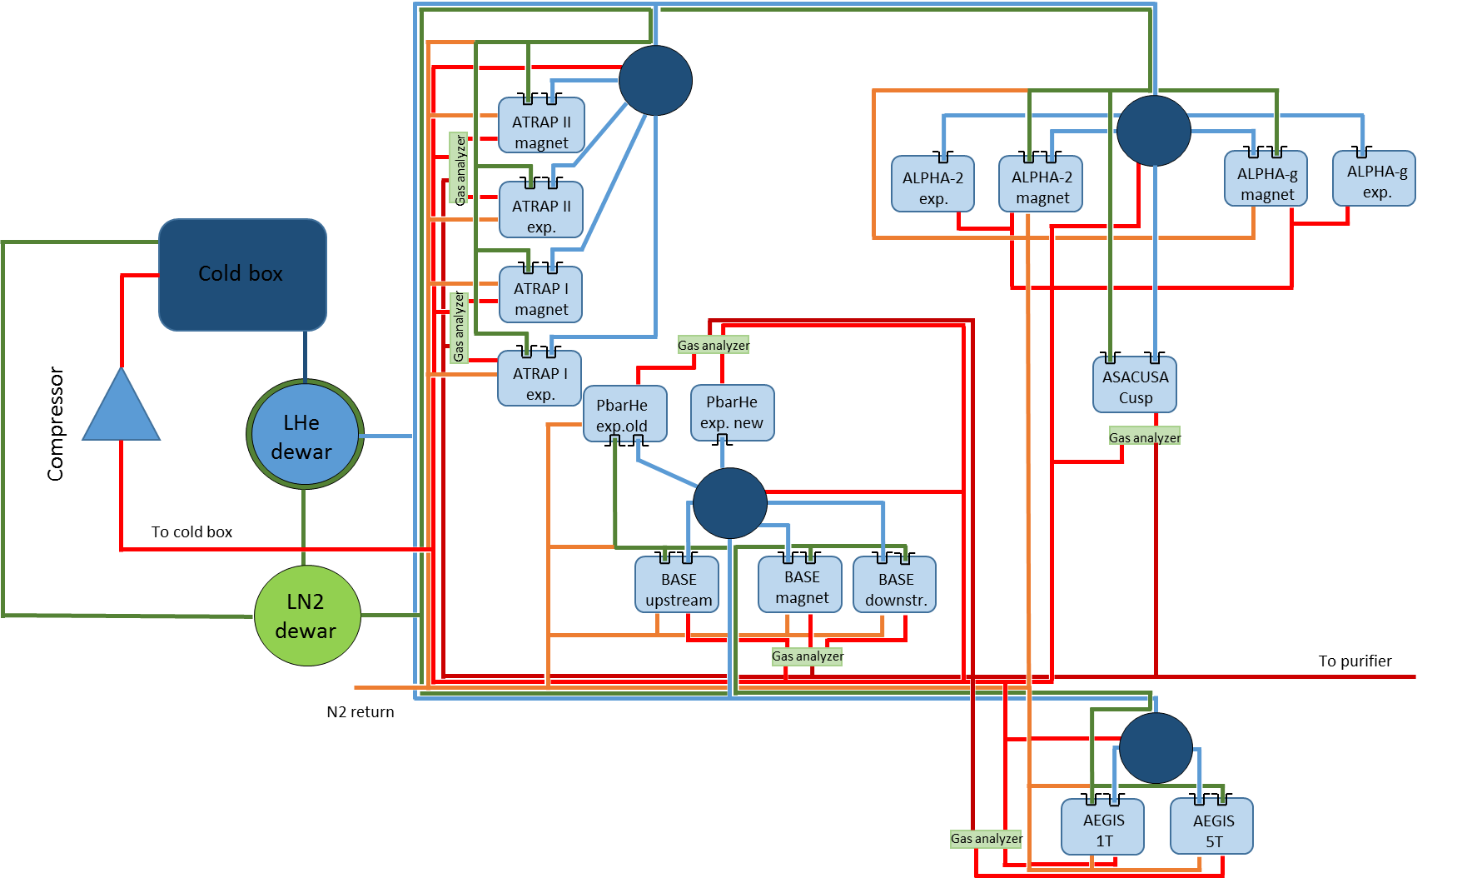
Users Helium Consumption
CERN cost in 2022: ~2 MCHF for ~700x500L dewars of LHe
  “Constantly” at 20 dewars/week delivery (CERN max capacity: 25 Dewars/week)
  ~3140 m3/year of gHe (roughly 88 kCHF), mainly needed for pressurize Dewars for lHe transfer
Alternative cooling methods, e.g. cryocoolers, will require long/costly RD program
Closed circuit system with local liquefier:
  Addresses distribution and safety concerns, offering a more eco-friendly solution!
  Cost 8.3 MCHF + 8.5 FTE (only possible after LS3), savings 0.6 MCHF/year!

Slide 30
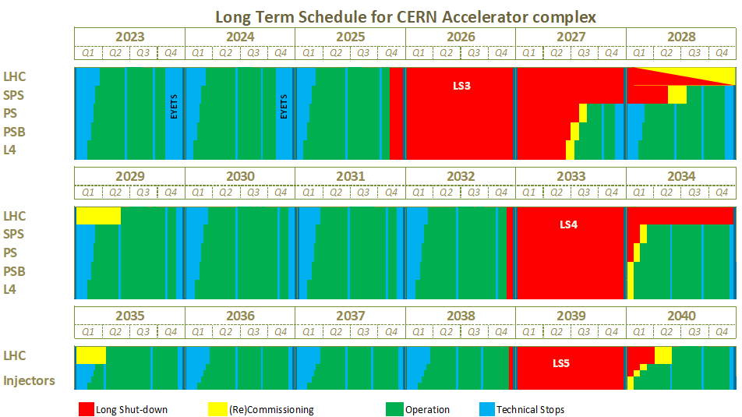
EDMS 2311633 V3.0

