Slide 1



The Lsym experiment
Maria Pasinetti

Slide 2
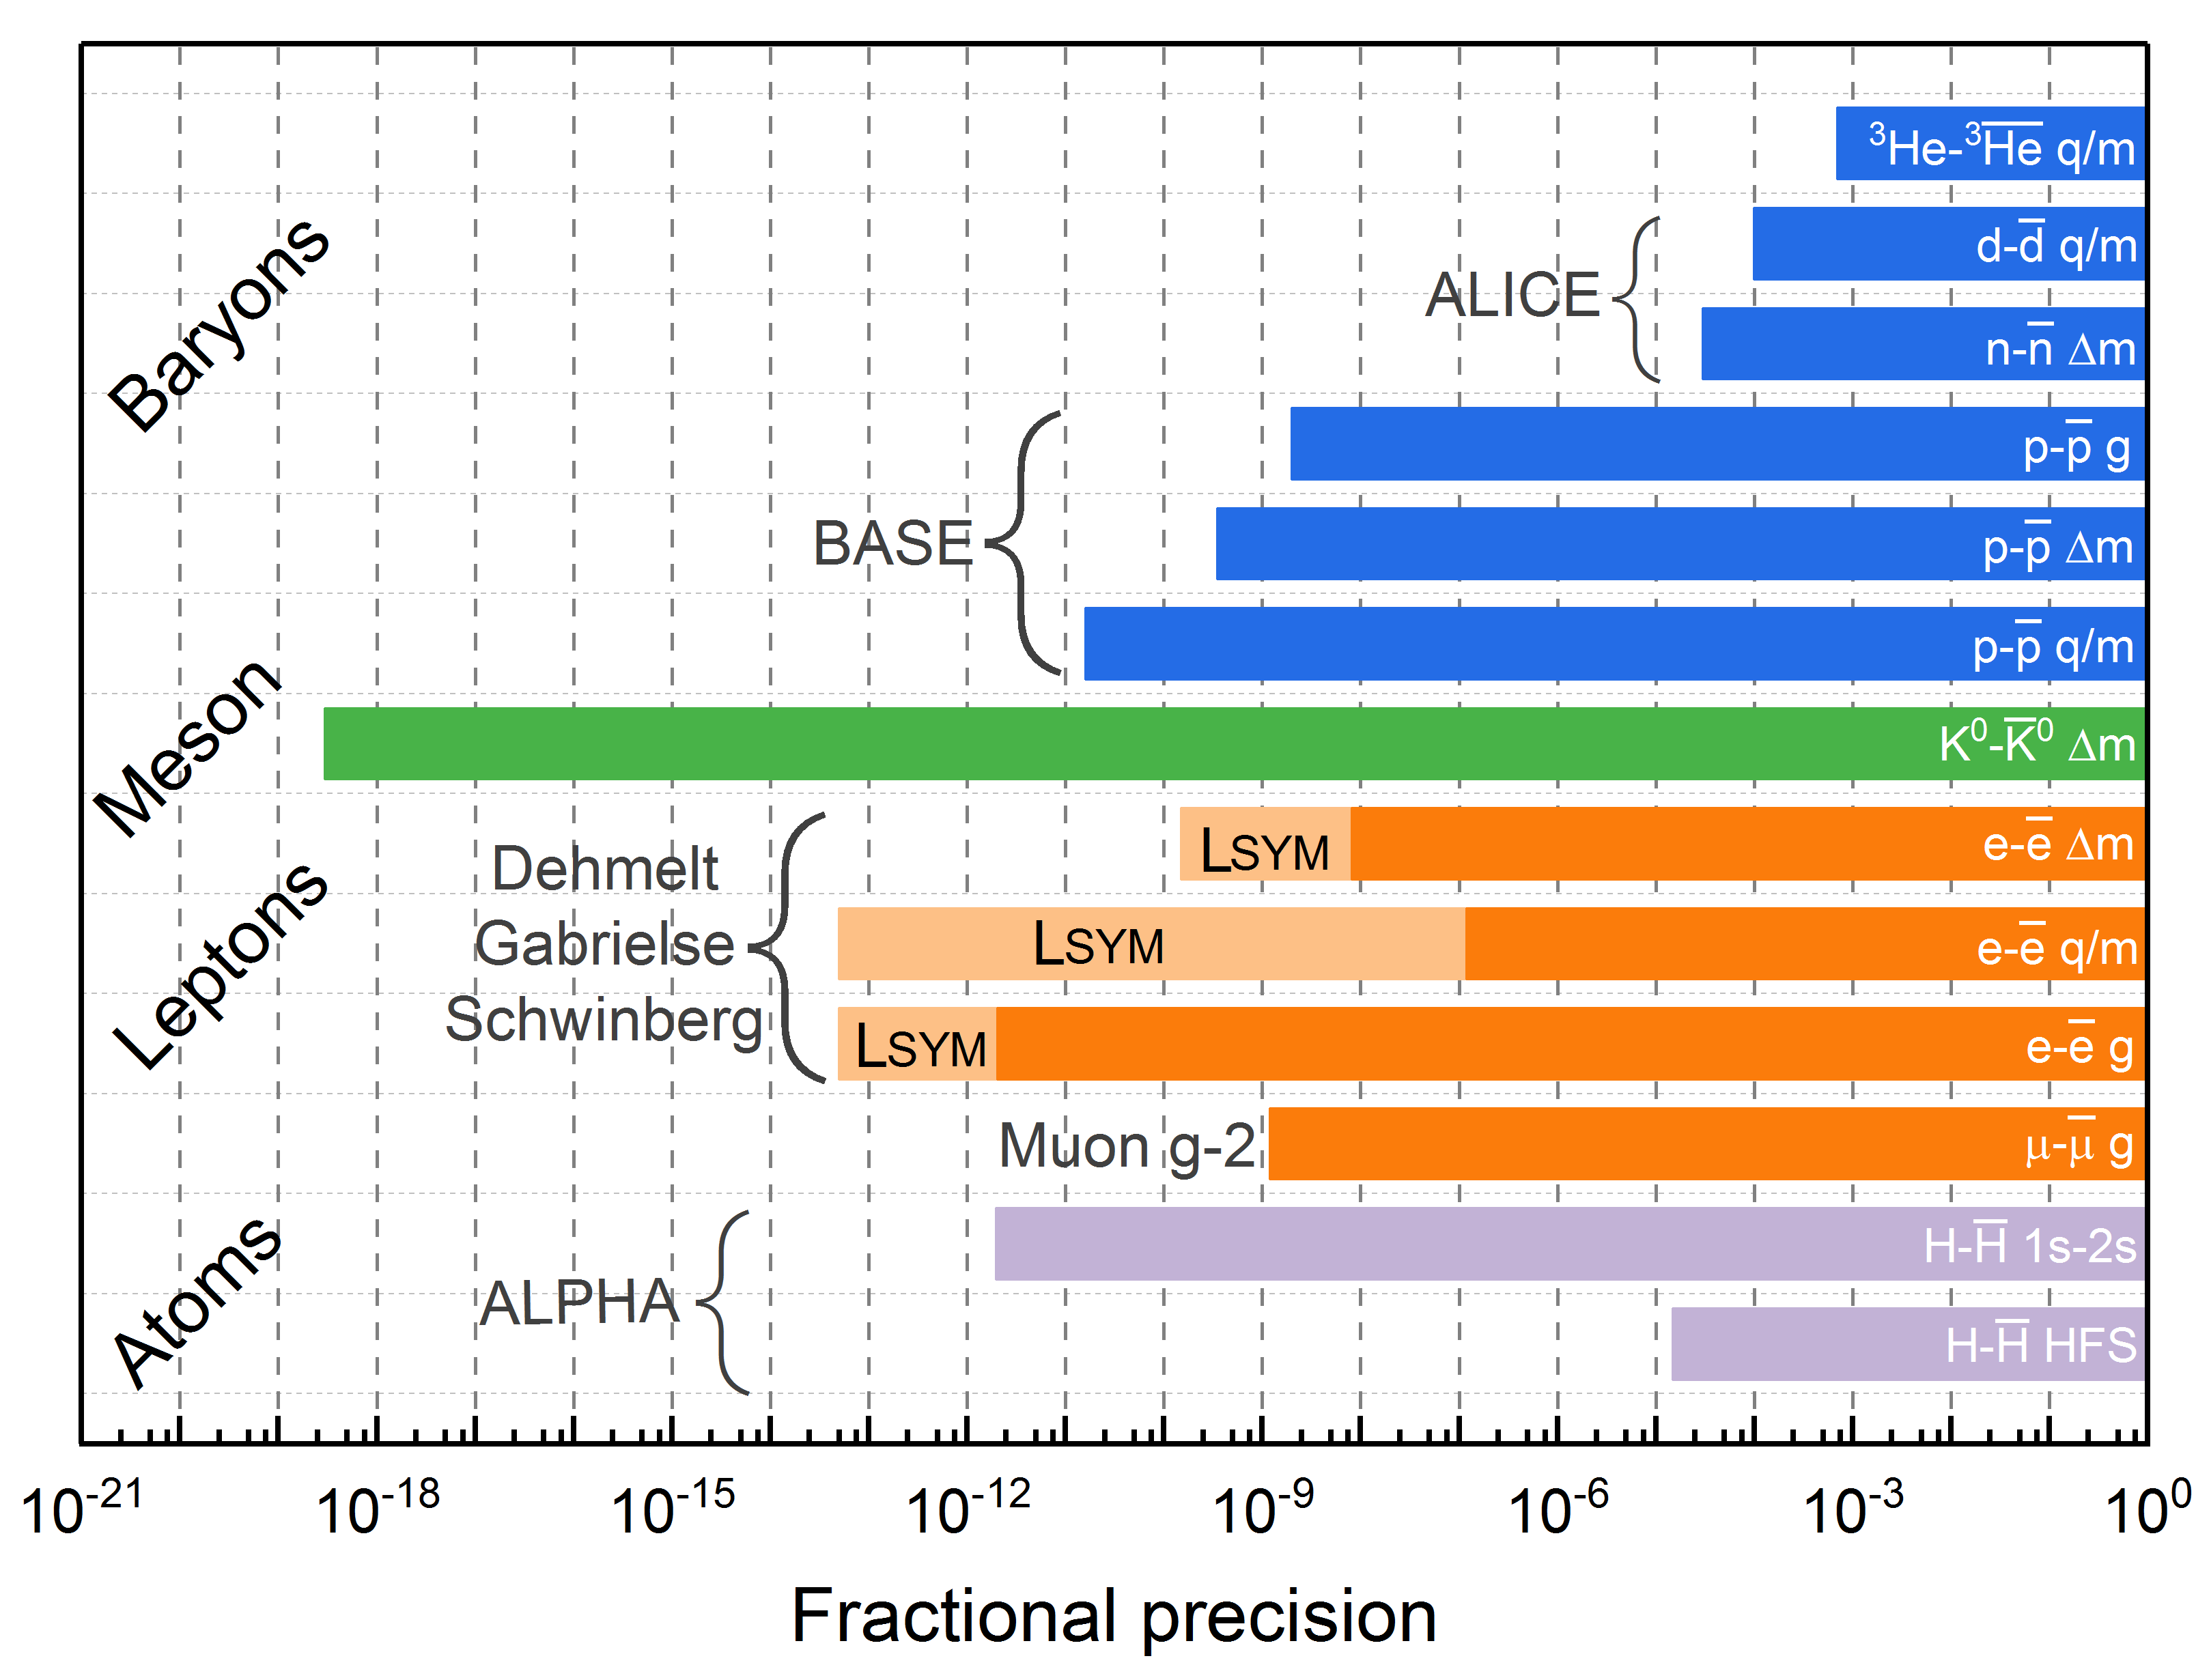
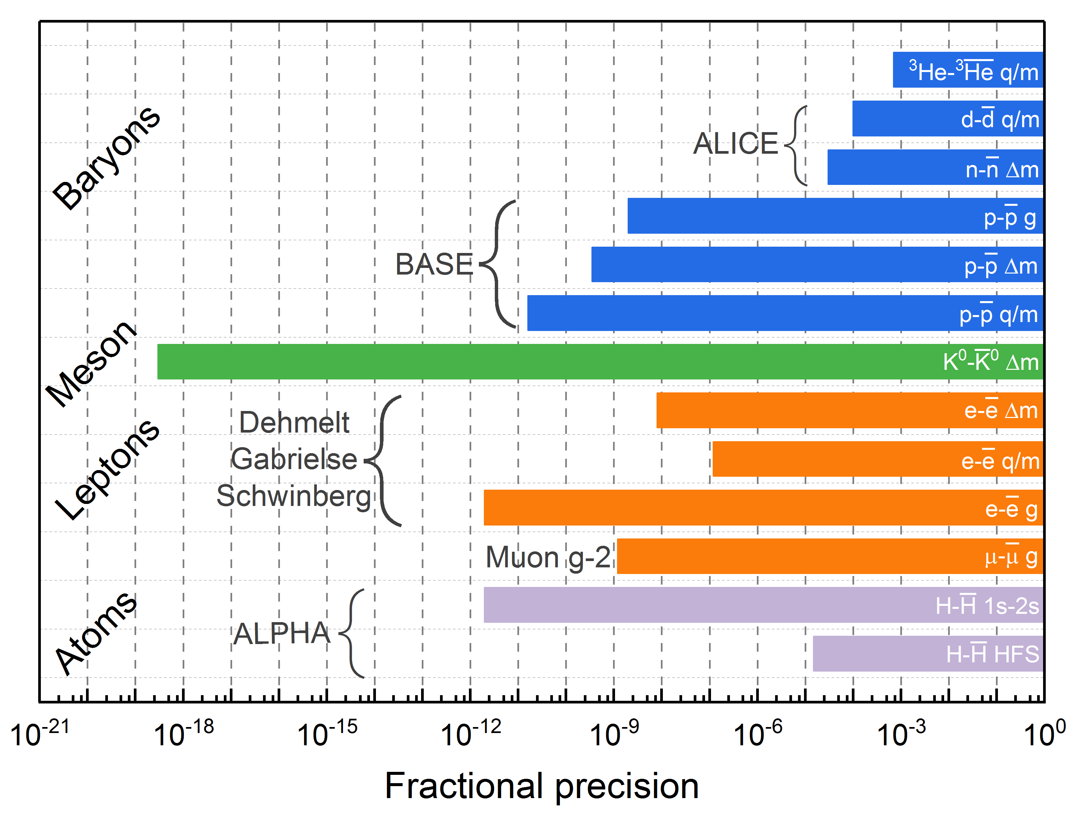
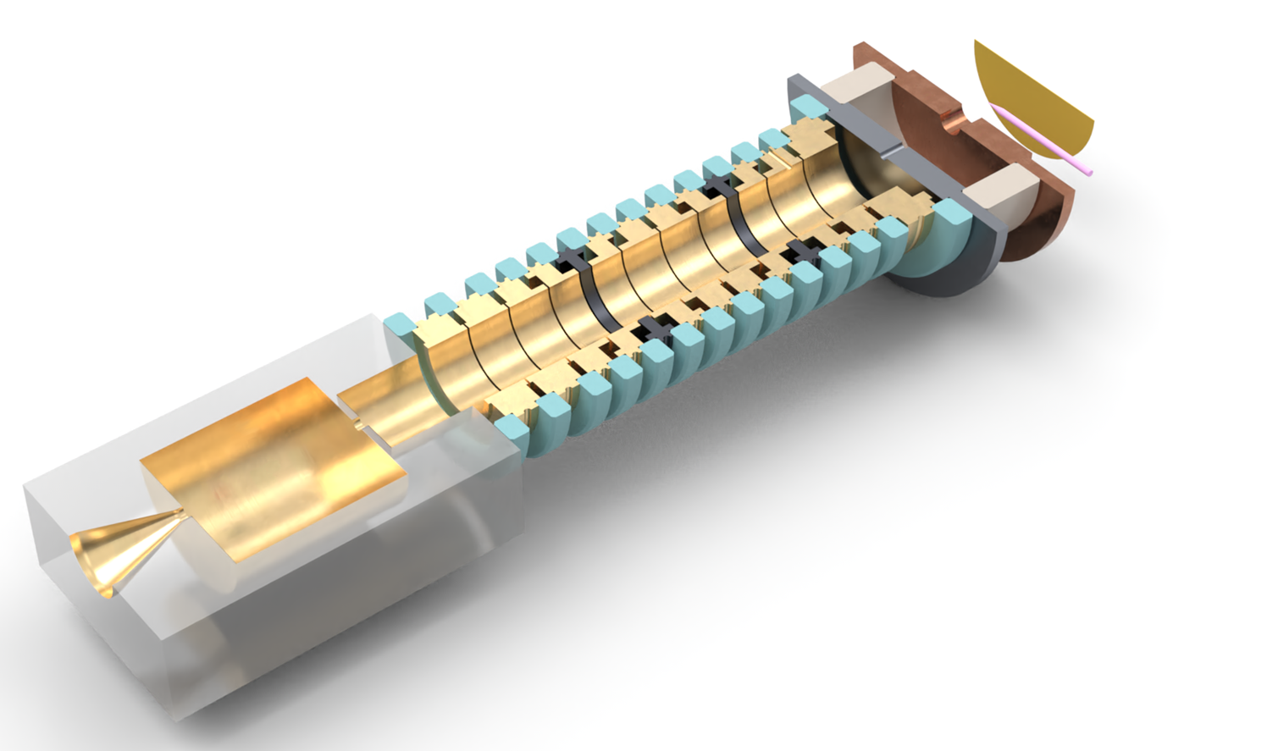


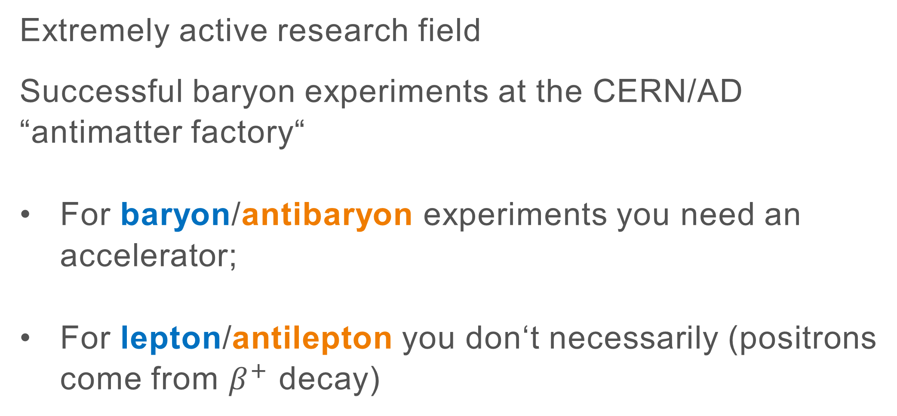
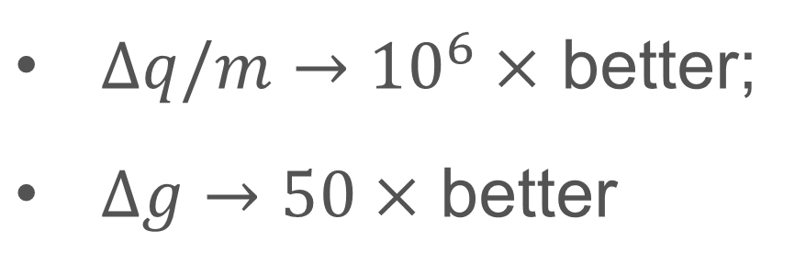
Laboratory searches for CPT violation
Extremely active research field
Successful baryon experiments at the CERN/AD “antimatter factory“
For baryon/antibaryon experiments you need an accelerator;
For lepton/antilepton you don‘t necessarily (positrons come from $β^{+}$ decay)
Matter
Antimatter
The lepton symmetry experiment
Lsym new electron/positron Penning Trap experiment aiming at
$Δq/m→{10}^{6}×$ better;
$Δg→50×$ better
2
Max-Planck-Gesellschaft | Maria Pasinetti 29.08.2024 – EXA/LEAP WIEN 2024
Max-Planck-Gesellschaft | Maria Pasinetti
Notes:
The main goal of the experiment is to investigate CPT violation in the lepton sector of the standard model
CPT violation search is a very active research field, there have been many successful experiments, for example the baryon/antibaryon experiments at the CERN antimatter factory
We can distinguish between baryon/antibaryon experiments and lepton/antilepton experiments.
The first ones require an accelerator in order to produce the antimatter particles, while lepton/antilepton experiments usually don’t.
LSym is in this second category: this is how it would insert in the picture
It is a lepton/antilepton experiment that’s being designed currently in Heidelberg as the “successor” of the LIONTRAP experiment

Slide 3
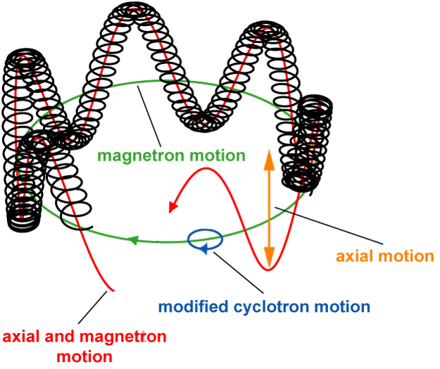




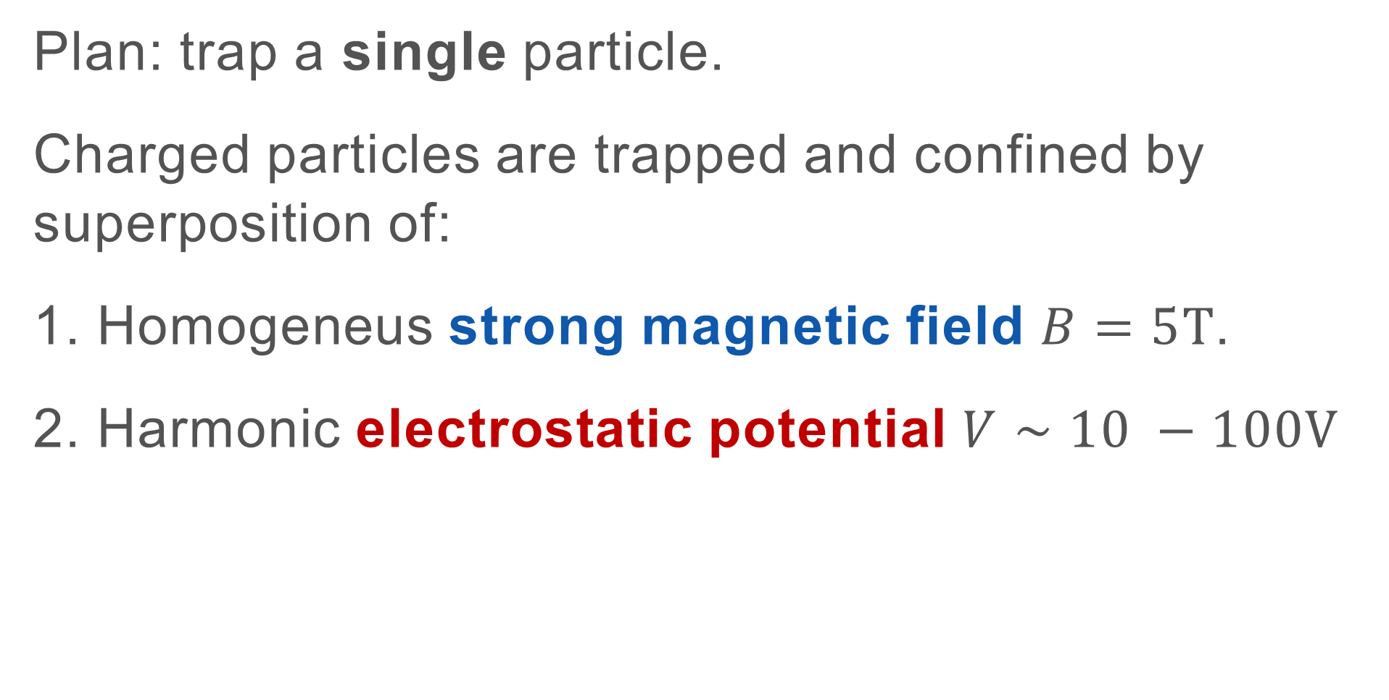
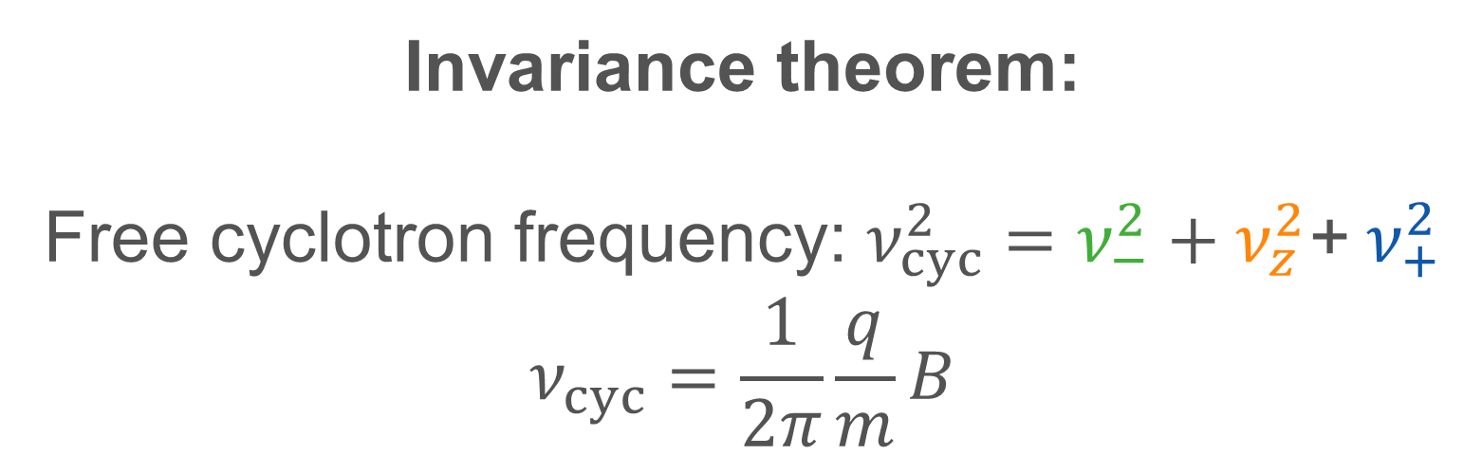
The Lsym Penning trap
Plan: trap a single particle.
Charged particles are trapped and confined by superposition of:
1. Homogeneus strong magnetic field $B=5T$.
2. Harmonic electrostatic potential $V∼10 −100V$
Three independent eigenmotions:
$$e^{+}$$
Reduced cyclotron
frequency:
~149 GHz
Magnetron drift
frequency:
~ 10 kHz
Axial frequency:
~ 50 MHz
$ν_{−}$
Invariance theorem:
Free cyclotron frequency: $ν_{cyc}^{2}=ν_{−}^{2}+ν_{z}^{2}$+ $ν_{+}^{2}$
$$ν_{cyc}=\frac{1}{2π}\frac{q}{m}B$$
$$ν_{z}$$
$$ν_{+}$$
3
Max-Planck-Gesellschaft | Maria Pasinetti 29.08.2024 – EXA/LEAP WIEN 2024
Max-Planck-Gesellschaft | Maria Pasinetti
Notes:
In the lsym Penning trap we plan to trap a single positron
charged particles get trapped by a superposition of electro and magnetostatic fields.
A strong magnetic field and an harmonic electrostatic potential
The superposition of these fields causes the charged particle to follow a peculiar motion, which can be separated into 3 different motions (axial, magnetron, cyclotron), each of which has a specific frequency.
Helium ax 19MHz
Magn drift 10kHz
Axial 600kHz
10^-8 voltage source stability REL
10^11 magnetic field stability REL

Slide 4
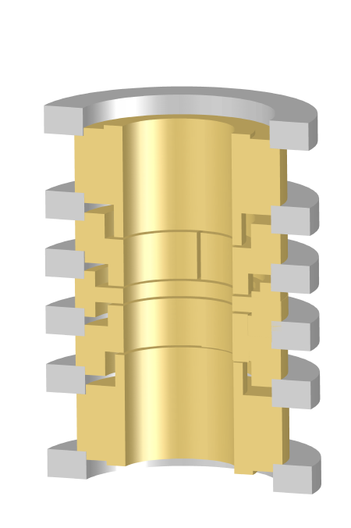
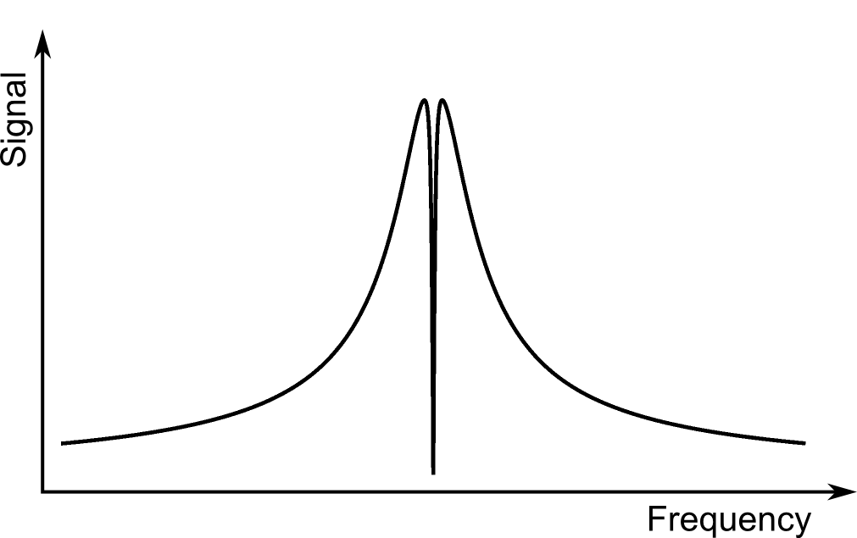
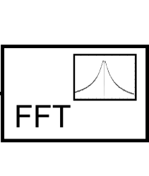
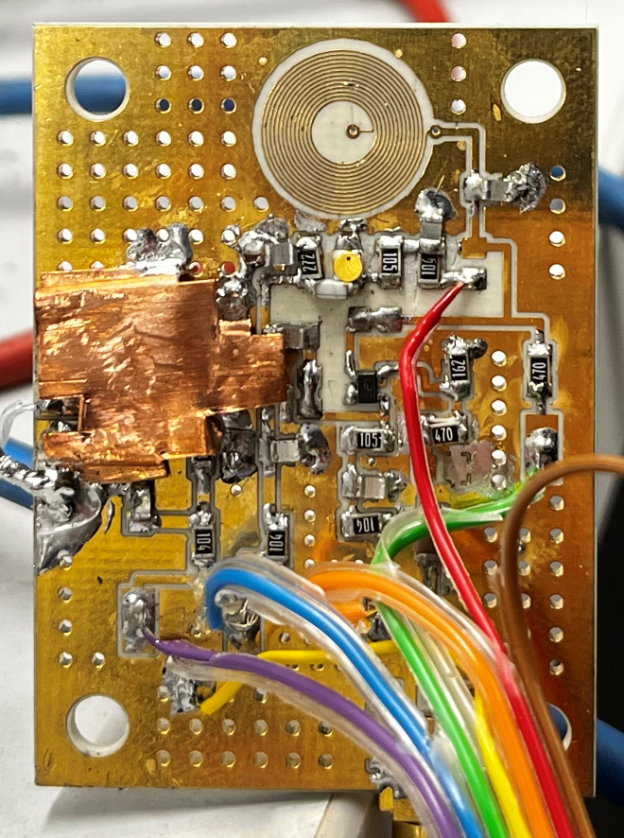
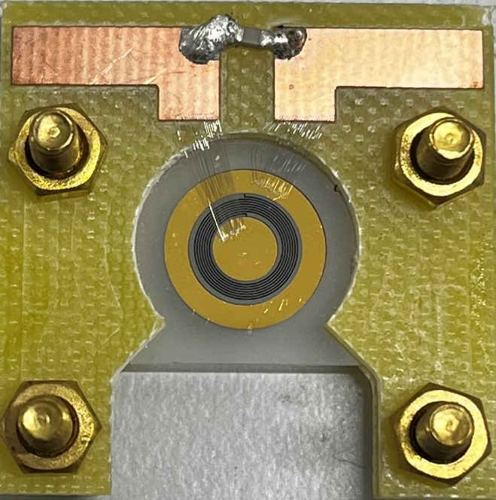

Detection: axial frequency
Oscillating positron induces image charges in the electrodes;
Tank circuit with high impedance;
Cryogenic low noise amplifier;
FFT to obtain the frequency;
A
+
FFT
Oscillating positron
Positron axial frequency $ν_{e^{+}}\sim 50 MHz$
Planar positron resonator
Cryogenic amplifier
4
Max-Planck-Gesellschaft | Maria Pasinetti 29.08.2024 – EXA/LEAP WIEN 2024
Max-Planck-Gesellschaft | Maria Pasinetti
Notes:
We will look at the detection technique for the AXIAL frequency:
The positron oscillating in the trap, induces image current in the trap electrodes.
By connecting a high impedance tank circuit to the electrodes one can pick up this signal, which will have the frequency of the oscillating ion.
The signal is then amplified with a cryogenic low noise amplifier, and analyzed using a FFT to find the frequency.
Using this technique the positron is resistively cooled until it reaches thermal equilibrium with the tank circuit.
Dip width: ~1Hz, positron slightly few hertz
GOAL
Amp:
1. e_n < 0.5nV/sqrt(Hz)
2. i_n < 165 fA/sqrt(HZ)
Res:
Q>1500

Slide 5
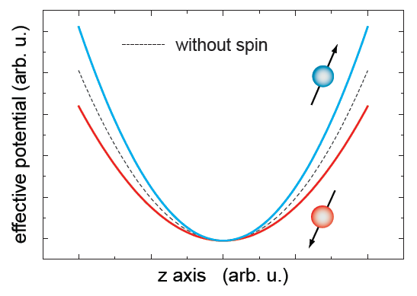
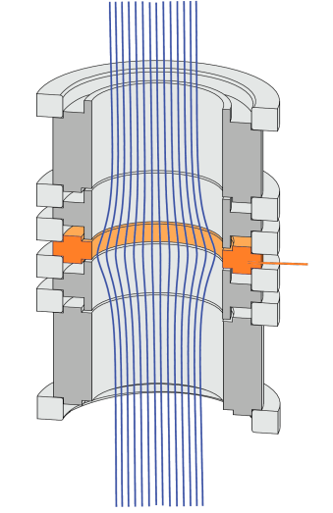
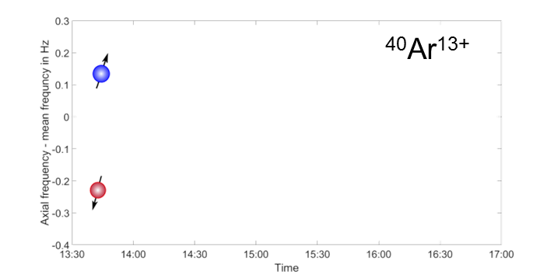
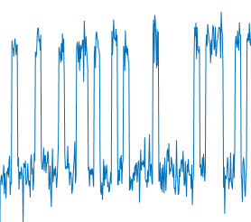
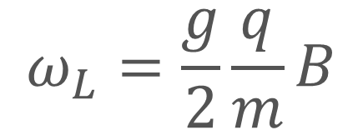
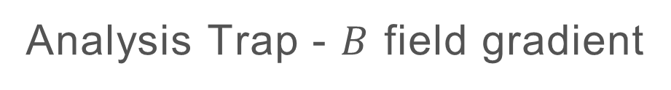
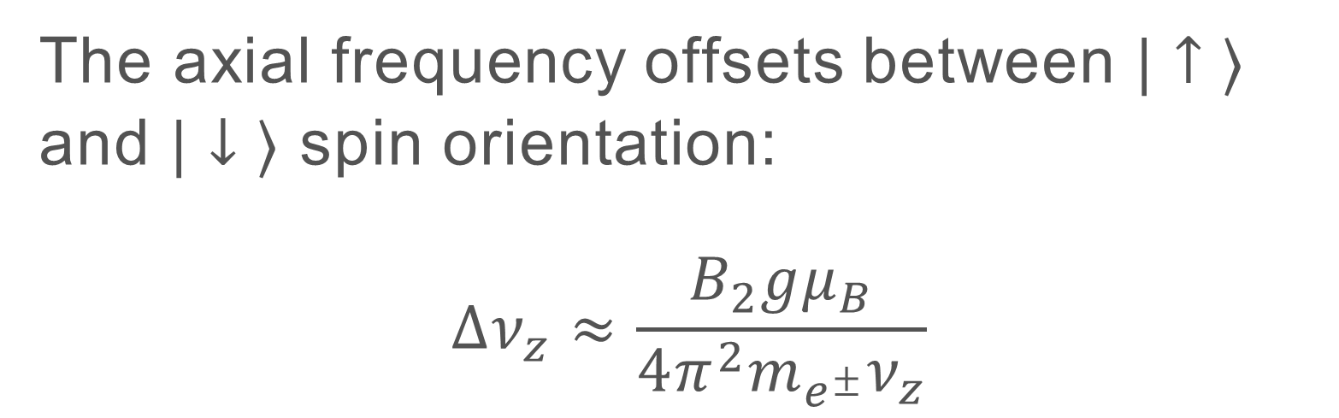
Detection: Larmor frequency
Magnetic bottle
Positron and electron are spin particles, which will follow a spin precession (Larmor) motion in the strong magnetic field of the Penning trap.
$$ω_{L}=\frac{g}{2}\frac{q}{m}B$$
Ferromagnetic ring
Continuous Stern-Gerlach effect:
The axial frequency offsets between $|↑ ⟩$ and $|↓ ⟩$ spin orientation:
$$Δν_{z}≈\frac{B_{2}gμ_{B}}{4π^{2}m_{e^{±}}ν_{z}}$$
Analysis Trap - $B$ field gradient
5
Max-Planck-Gesellschaft | Maria Pasinetti 29.08.2024 – EXA/LEAP WIEN 2024
Max-Planck-Gesellschaft | Maria Pasinetti
Notes:
Since positron and electron are particles with spin, their spin will follow a precession (Larmor) motion around the magnetic field lines.
We are interested in measuring this frequency and the technique that we will use employs the CONTINUOUS STERN GERLACH EFFECT:
In order to use this technique, we first have to produce a gradient in the magnetic field: this is done by inserting a ferromagnetic ring in the so called “analysis trap”
While oscillating in this gradient, whether the particle is in spin up or down, it will experience a different effective potential, therefore its axial frequency will offset from the value it would have if it had no spin.
The difference in axial frequency between state up and state down is given by this formula and is of the order of couple hundreds of mHz for ions (that have been measured previously).
INHOMOGENEITY
B₂≈10mT/mm²
B2 = 10.5e3T/m2

Slide 6
Spin state determination
Note: we don’t know the spin state before flipping!
Inject a microwave at the Larmor frequency
Analysis Trap
Measure the axial frequency offset and determine the spin state
Cavity Trap
Max-Planck-Gesellschaft | Maria Pasinetti 29.08.2024 – EXA/LEAP WIEN 2024
Notes:
Our trap will look something like this:
It will be composed of 2 main sections:
A resonant cavity trap, with a very homogeneous B field
An analysis trap, which will present the B field inhomogeneity
The measurement cycle works like this: we will have the particles trapped in the Cavity Trap, where we will inject a microwave with the corresponding Larmor frequency. If we hit the particle at the correct Larmor frequency, we can cause a spin flip of the state of particle.
Then with the transport electrodes we’ll move the particle to the analysis trap, without loss of the spin state
Here we measure the axial frequency offset due to the continuous stern Gerlach effect, and finally determine the spin state of the particle
The measured value of the Larmor frequency of the particle is then given by the frequency that successfully flips the spin.
Note that we don’t know the initial spin state before performing a successful spin flip

Slide 7
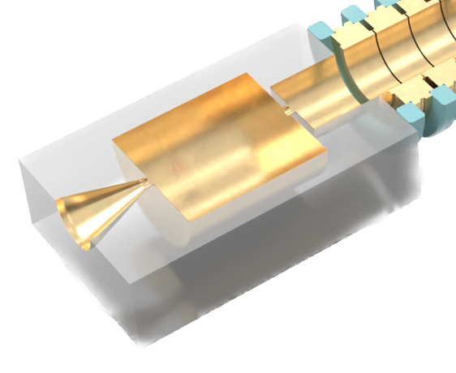

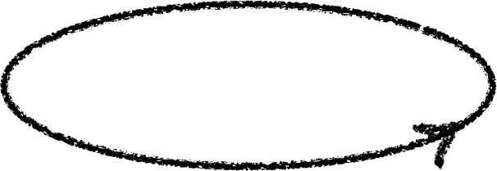

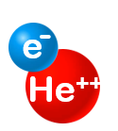

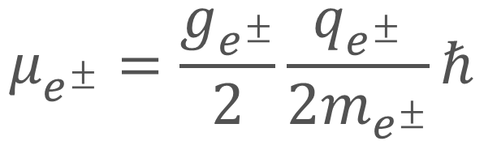
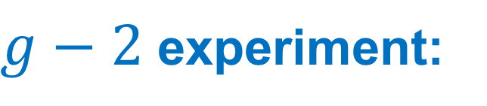
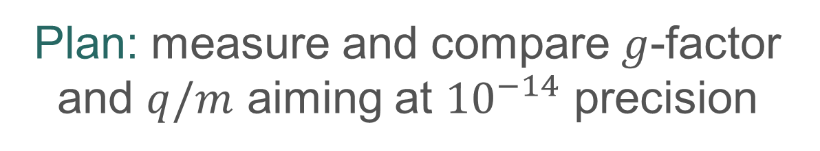
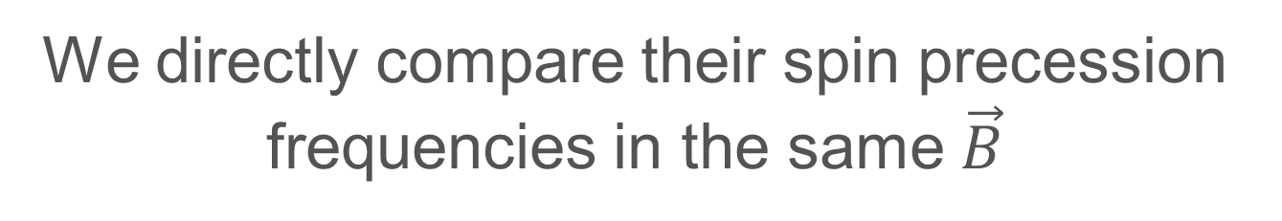
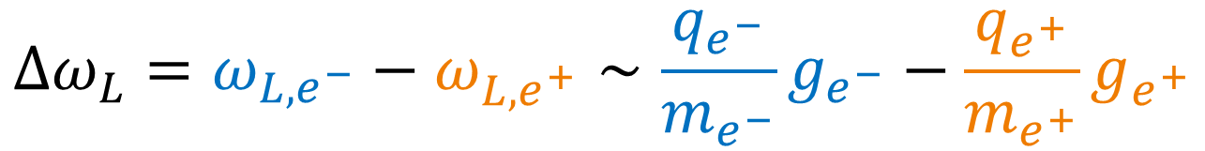
The lsym project
Goal: measure magnetic moment of electron and positron
$$μ_{e^{±}}=\frac{g_{e^{±}}}{2}\frac{q_{e^{±}}}{2m_{e^{±}}}ℏ$$
Key concept of the experiment: simultaneously trap $e^{+}$ and (bound) $e^{−}$
$g−2$ experiment:
Our experiment:
Spin anomaly frequency is measured for each and compared to cyclotron:
We directly compare their spin precession frequencies in the same $\vec{B}$
$$Δω_{L}=ω_{L,e^{−}}−ω_{L,e^{+}}∼\frac{q_{e^{−}}}{m_{e^{−}}}g_{e^{−}}−\frac{q_{e^{+}}}{m_{e^{+}}}g_{e^{+}}$$
$$a_{e}≡\frac{g−2}{2}≡\frac{ω_{a}}{ω_{c}}$$
Plan: measure and compare $g$-factor and $q/m$ aiming at ${10}^{−14}$ precision
Measure coherent difference solving magnetic field instability
    [Sailer, T., Debierre, V., Harman, Z. et al. Measurement of the bound-electron g-factor difference in coupled ions. Nature 606, 479–483 (2022)]
7
Max-Planck-Gesellschaft | Maria Pasinetti 29.08.2024 – EXA/LEAP WIEN 2024
Max-Planck-Gesellschaft | Maria Pasinetti
Notes:
With the use of these various techniques we aim to eventually measure the magnetic moment of electron and positron.
The novelty of the experiments consists in simultaneously trapping electron and positron in the same trap.
Since they have opposite charge, we use a little trick, and the electron will be bound to a Helium nucleus
It’s a different type of measurement when compared to a typical g-2 experiment: in a g-2 the spin anomaly frequency is measured separately for each particle and then compared to the cyclotron frequency
In our experiment we test CPT by directly comparing their spin precession frequency in the same magnetic field
The plan is to measure and compare the g-factor and q/m at 10^-14 precision
The way we achieve this result is by measuring the coherent difference between the frequencies, and lower the uncertainty due to the magnetic field instability (usually this limits the precision to 10^-11).
This technique has been developed previously at the ALPHATRAP experiment by Tim Sailer (neon isotopes)
N OTE:
Rcyc = 50 micron
Spin anomaly frequency goes from nu+=1 state down -> nu+=0 state up

Slide 8
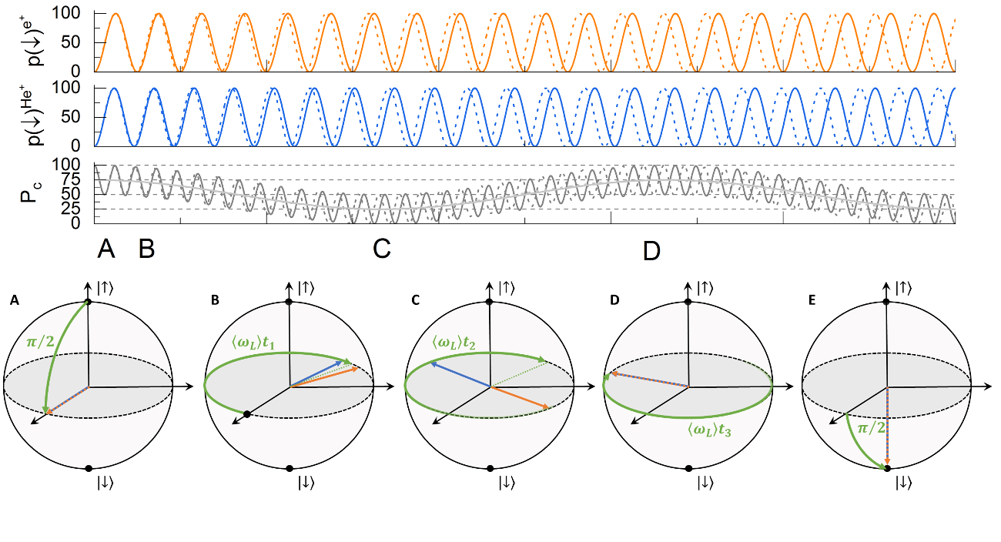
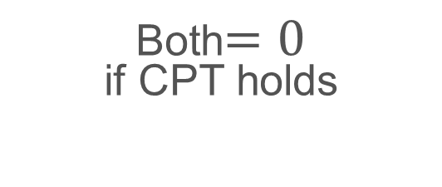
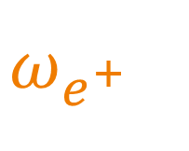

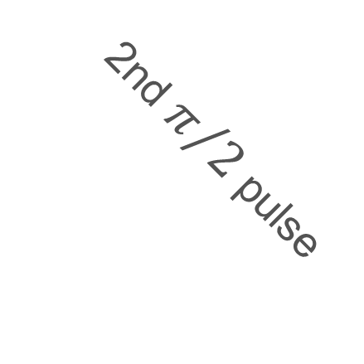
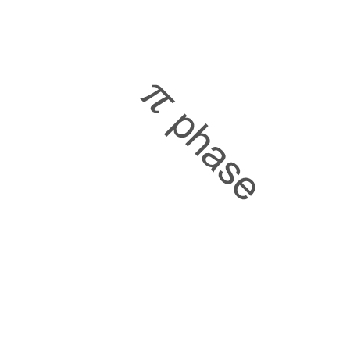
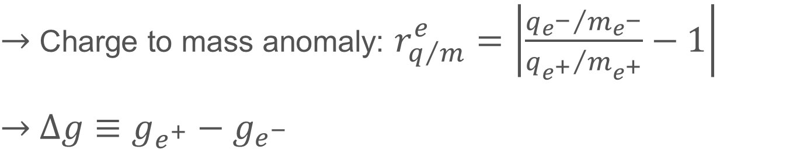
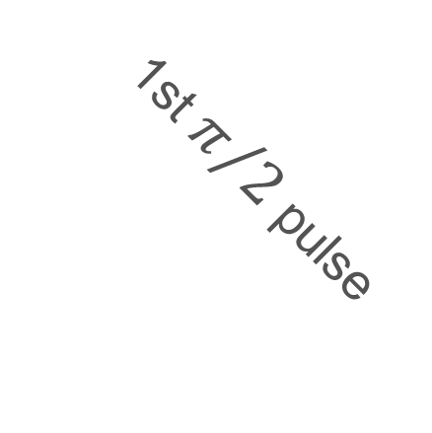
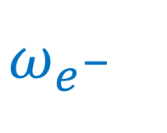
coherent spin difference precession
Dual Ramsey measurement
Decoherence-free measurement
frequency
+
-
+
-
$$ω_{e^{+}}$$
$$ω_{e^{−}}$$
time
$$Δω_{L}=ω_{L,e^{−}}−ω_{L,e^{+}}∼\frac{q_{e^{−}}}{m_{e^{−}}}g_{e^{−}}−\frac{q_{e^{+}}}{m_{e^{+}}}g_{e^{+}}$$
$$\}$$
$→$ Charge to mass anomaly: $r_{q/m}^{e}=\left|\frac{{q_{e^{−}}}/{m_{e^{−}}}}{{q_{e^{+}}}/{m_{e^{+}}}}−1\right|$
$→$ $Δg≡g_{e^{+}}−g_{e^{−}}$
Both$=0$
if CPT holds
$π$ phase
In phase
2nd $π/2$ pulse
1st $π/2$ pulse
Slow relative precession
8
Max-Planck-Gesellschaft | Maria Pasinetti 29.08.2024 – EXA/LEAP WIEN 2024
Max-Planck-Gesellschaft | Maria Pasinetti
Notes:
In this graph we see spin precession frequencies of electron and positron as a function of time:
If CPT holds, these two would be exactly the same, while if we imagine CPT break they would have slightly different values
The fluctuations of the B field influence the Larmor frequencies of the two particles, but by measuring simultaneously the difference between the frequencies, such fluctuations are cancelled out
We then get two values from this measurements
q/m
Delta g
Both should be =0 if either is not, that would mean CPT break
The way we perform this measurement is basically through a dual Ramsey measurement of the positron and the Helium ion
1) We prepare the two particles in let’s say spin up state
2) The first π/2 pulses rotates them onto the equator of the Bloch sphere (A), where they begin the rapid precession with ωL
NOTE: if their Larmor frequencies were the exact same, they would rotate together. In other words, by putting ourselves in the co-rotating frame, the spin vectors would “stand still”
3) Any small difference between the two frequencies, either due to the binding effect of the helium or to a potential CPT break causes a slow relative rotation of the spin vectors
4) The second pi/2 pulse then projects the spins either on same or opposite spin-states, depending on their relative phase
Looking at the top graphs, the colored plots represent the probability of finding either particle in the down state
They show loss of coherence due to the B field fluctuations (dotted)
The grey plot is the combined probability of finding both particles in the up state, and the slow beat is independent of the B-field fluctuations,
If CPT holds, this difference in frequencies is only due to the binding effect of the helium on the electron, which is well known and can be subtracted.
If whatever value is left after the subtraction is different from 0, we have found CPT break!

Slide 9
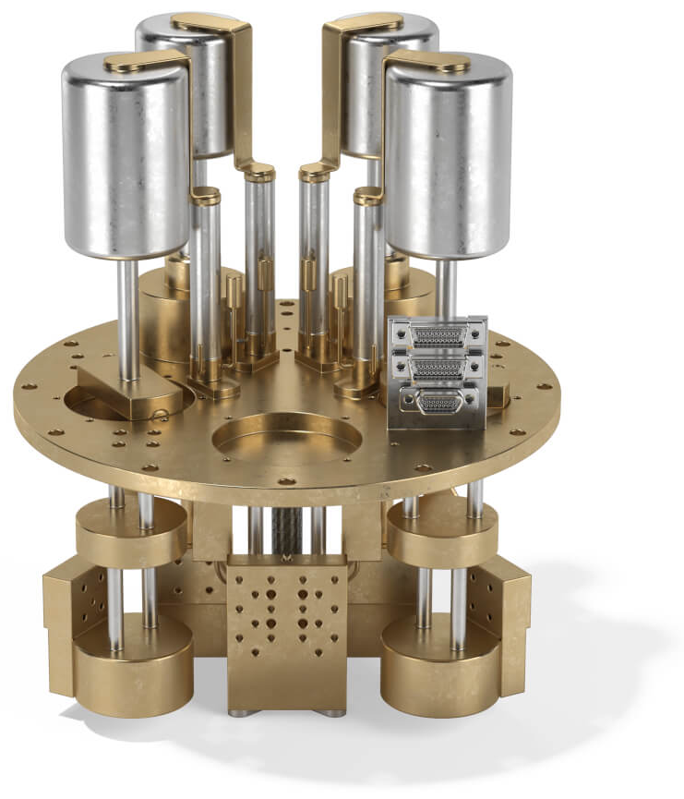
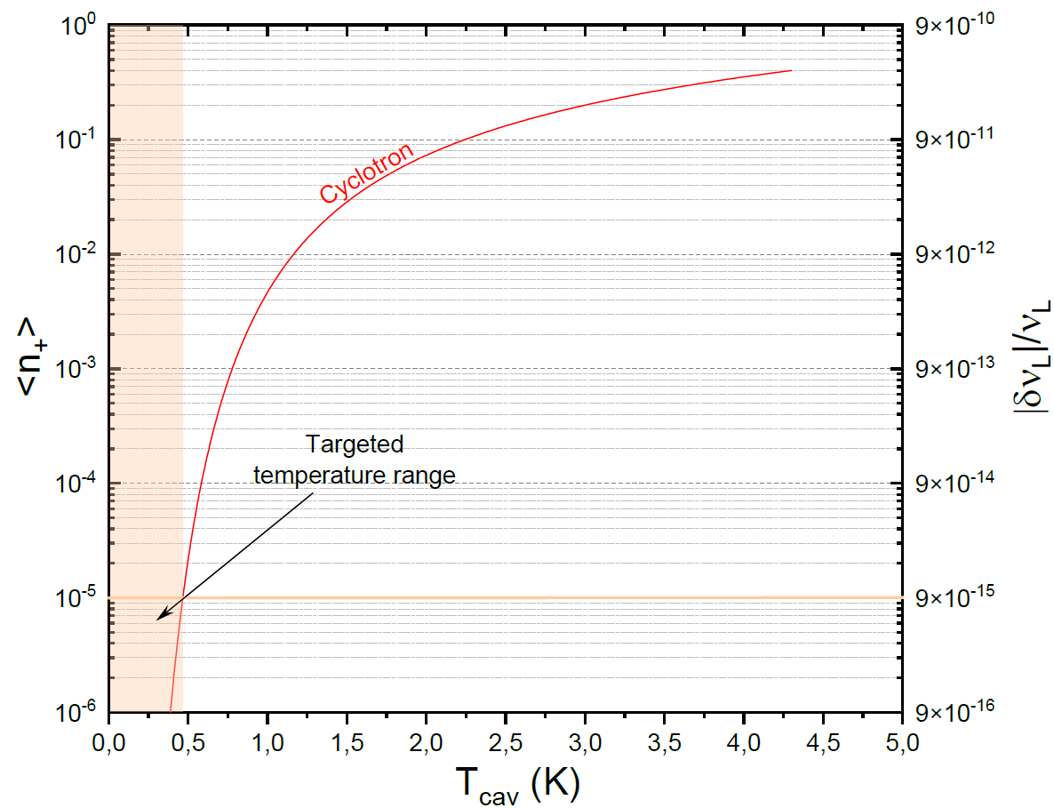
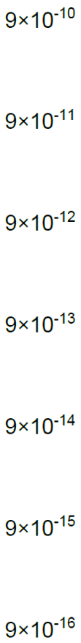

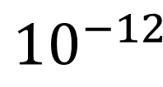
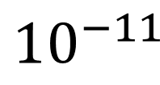

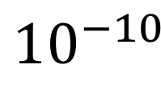

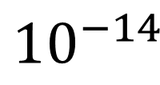
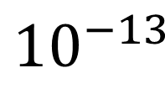
The lsym setup
Different temperature stages:
300 K (room temperature) $→$ 77 K $→$ 4 K $→$ 300 mK
This is reached with a ³He cooler: we need the $e^{+}$ in the motional ground state to reduce the relativistic shift
Room-temperature electronics and feed-troughs
µwave inlet
Liquid nitrogen (77K)
³He sorption cooler (300mK)
Liquid helium(4.2K)
$${10}^{−9}$$
300mK fridge
4K coupling
$${10}^{−10}$$
$${10}^{−11}$$
Relativistic shift (relative)
$${10}^{−12}$$
Electronics (4.2K)
300mK thermal link
$${10}^{−13}$$
Waveguide and filter
300mK electronics
Trap chamber (300mK)
$${10}^{−14}$$
300mK stage
Trap stack with CavityTrap
Superconducting magnet (SuMa)
³He evaporation fridge
9
Max-Planck-Gesellschaft | Maria Pasinetti 29.08.2024 – EXA/LEAP WIEN 2024
Max-Planck-Gesellschaft | Maria Pasinetti
Notes:
The setup of the experiment has a superconducting magnet producing a 5T B field
The trap chamber containing the experiment is inserted in this strong stable field
This setup has different T stages
A room temperature 300 K stage
A 4K helium cooled stage
A 300mK stage
This is necessary in order to ensure that the positron is in its motional ground state.
Since the e+ has a very small mass it is very sensitive to relativistic shifts, and wanting to be at the -14 precision we need to stay under 500mK
4K section is connected to the 3He sorption cooler which allows us to reach 300mK
Chase cryogenics commercial device

Slide 10
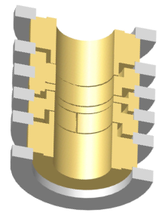
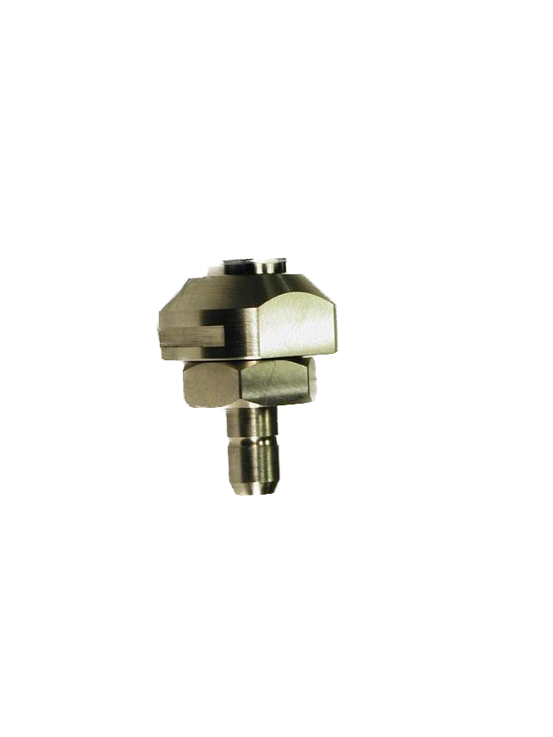


Positron trapping technique
Source (²²Na, 15 MBq) at room temperature in the final setup (safely removable)
$$\vec{B}$$
Some slow $e^{+}$ will pick up an $e^{−}$ close to the moderator surface:
$→$ Positronium atom (Ps*) in a high Rydberg state $→$ $e^{+}$ and $e^{−}$ are very weakly bound and will follow the $\vec{B}$ field lines
The Ps* atom is ionized by the $\vec{E}$ within the trapping well
300 mK
Moderator&converter
4 K
[Estrada, J., et al. "Field ionization of strongly magnetized rydberg positronium: A new physical mechanism for positron accumulation." Physical review letters 84.5 (2000): 859.]
77 K
²²Na
10
Max-Planck-Gesellschaft | Maria Pasinetti 29.08.2024 – EXA/LEAP WIEN 2024
Notes:
We get the positrons from a 22Na source blabla
Why don’t we just trap by opening and closing the trap. In fact, the positrons are emitted through radioactive decay: it is a random process, so the trap has to be either always open or always closed
By leaving it open one can either
Make them lose energy within the trap
Construct a neutral system and ionize it at the right spot
We chose the second
This technique was developed by the Gabrielse group in Harvard
To trap the positron we will use a technique developed by the gabrielse group, which will work like this:
Don’t want to use buffer gas cause that would ruin our perfect vacuum
This trapping technique is pretty straightforward but it’s in a sense blind,
meaning we only detect the positrons once we trap one
Test with LIONTRAP setup BECAUSE WE DON’T HAVE ONE YET
Swap some electrodes with the source & holder

Slide 11



Positron trapping technique - TEST
LIONTRAP test setup:
Swapped some electrodes with the adaptor piece;
Source stays permanently in the trap stack at $T=4 K$, in a holder, locked in the adaptor piece.
Detection system for axial frequency of $e^{+}$:
Planar resonator;
Resonant amplifier;
Resonance frequency $∼30 MHz$.
Max-Planck-Gesellschaft | Maria Pasinetti 29.08.2024 – EXA/LEAP WIEN 2024

Slide 12


Current status
UP next
Magnet is charged to 5T
Radioactive source has arrived (15MBq)
300 mK cooler has been tested
Detection system for positron&helium axial frequency is being tested
Test the Rydberg positronium $e^{+}$ capture technique with old LIONTRAP setup
Develop and implement final setup for the room temperature positron source at Lsym
In conclusion
At Lsym we will simultaneously trap a positron and an electron to run a CPT test, comparing:
Charge-to-mass ratio
g-factor
Of $e^{+}$ and $e^{−}$ with 14 digit precision $→$ thanks to novel decoherence-free type of measurement
12
Max-Planck-Gesellschaft | Maria Pasinetti 29.08.2024 – EXA/LEAP WIEN 2024

Slide 13


Thank you for the attention
We offer positions, feel free to contact us!
Thanks to the team!
Sven Sturm, Fabian Raab,
Sangeetha Sasidharan, Andreas Thoma, Lukas Holtmann, Benny Bauer, Paul Holzenkamp
This project has received funding from the European Research Council (ERC) under the European Union's Horizon 2020 research and innovation programme under grant agreement No 101097850
13
Max-Planck-Gesellschaft | Maria Pasinetti 29.08.2024 – EXA/LEAP WIEN 2024

Slide 14
Backup slides

Slide 15



The positron source
²²Na source: $β^{+}$ decay with continuous, high energy spectrum $→$ moderation
Mono-energetic positrons ($∼$ 3 eV)
n° of $e^{+}$ per eV
W moderator
Our source: Activity: $∼$15 MBq $→$ rather weak compared to the other antimatter experiments: we only need to trap a single positron
15
Max-Planck-Gesellschaft | Maria Pasinetti 29.08.2024 – EXA/LEAP WIEN 2024
Max-Planck-Gesellschaft | Maria Pasinetti
Notes:
We need to get the positrons inside of the trap: we use a sodium22 source
When they are emitted they are fast so they have to be slowed down -> moderation

Slide 16

Comprate to g-2
Limit: Cavity mode self-interaction @ x10⁻¹³
16
Max-Planck-Gesellschaft | Maria Pasinetti 29.08.2024 – EXA/LEAP WIEN 2024
Max-Planck-Gesellschaft | Maria Pasinetti
Notes:
We need to get the positrons inside of the trap: we use a sodium22 source
When they are emitted they are fast so they have to be slowed down -> moderation

Slide 17


Setup for Rydberg positronium test
Test this technique with LIONTRAP setup:
Swap some electrodes with source holder (& adaptor piece)
Creation Trap
Precision Trap
²²Na
Moderator
Source will be in the 4K section for this test
$$\vec{B}$$
mini-EBIT
17
Max-Planck-Gesellschaft | Maria Pasinetti 29.08.2024 – EXA/LEAP WIEN 2024
Notes:
For this reason we are preparing a test for this technique using the old LIONTRAP experiment setup we took from Mainz

Slide 18

Positron trapping technique – PLAn b
⁴He already available for the $e^{−}$
Positron goes through moderator $→$ slows down;
Slow positron enters the trap section with ⁴He $→$ slow down even further with collisions
Losing energy within the trap it is then trapped
Advantage: more efficient (?)
Disadvantage: needs intermediate detection to optimize (much more complicated setup)
Moderated positron detection requires steering
⁴He gas cloud
$$\vec{B}$$
300 mK
Moderator
4 K
77 K
²²Na
18
Max-Planck-Gesellschaft | Maria Pasinetti 29.08.2024 – EXA/LEAP WIEN 2024
Notes:
[…]
This trapping technique is pretty straightforward but it’s in a sense blind
We only detect the positrons once we trap one
Test with LIONTRAP setup BECAUSE WE DON’T HAVE ONE YET

