Slide 1
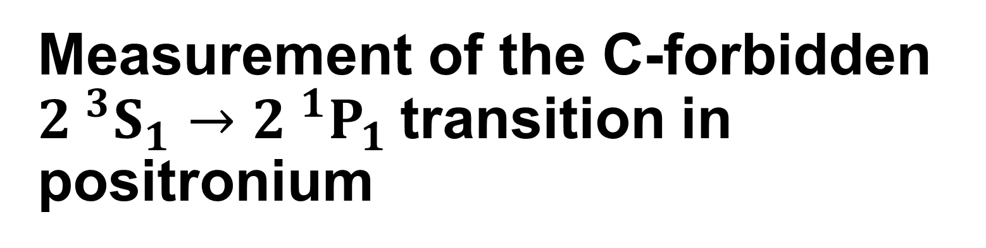
Measurement of the C-forbidden ${2 }^{3}S_{1}→{2 }^{1}P_{1}$transition in positronium
Rebecca J. Daly
Department of Physics and Astronomy, University College London,
Gower Street, London, WC1E 6BT, United Kingdom
rebecca.daly.18@ucl.ac.uk

Slide 2
K. P. Habdas, S. D. Hogan, R. E. Sheldon* and D. B. Cassidy Department of Physics and Astronomy, University College London, Gower Street, London, WC1E 6BT, United Kingdom J. Pérez-Ríos Department of Physics and Astronomy, Stony Brook University, Stony Brook, New York 11794, US *present address: SMI

Slide 3
Positronium (Ps)
The bound state of an electron and a positron.
Hydrogenic atom.
Fine structure unlike hydrogen (annihilation, spin-orbit coupling, spin-spin interactions).
Purely leptonic, ideal system for testing bound state QED theory.
Has eigenstates of C (charge conjugation), P (parity) and CP (charge conjugation and parity) - ideal for testing fundamental symmetries.

Slide 4
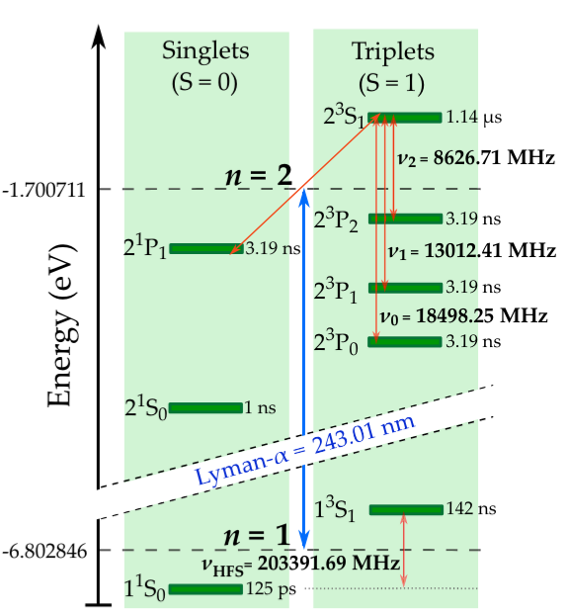
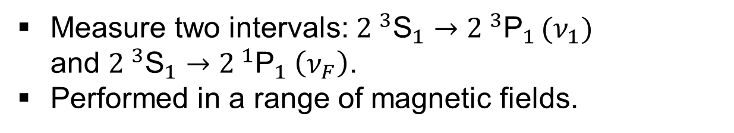

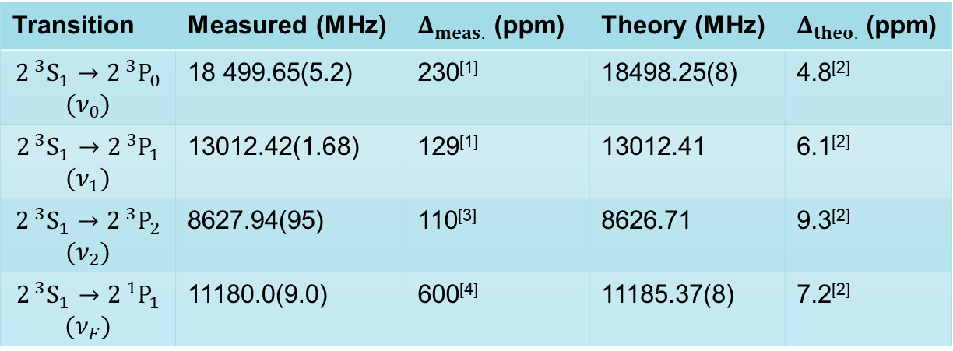
State of Ps n = 2 tests
Measure two intervals: ${2 }^{3}{\text{S}}_{1}→{2 }^{3}{\text{P}}_{1 }(ν_{1})$ and ${2 }^{3}{\text{S}}_{1}→{2 }^{1}{\text{P}}_{1} \left(ν_{F}\right)$.
Performed in a range of magnetic fields.
$ν_{F}$ = 11185.37 MHz
Transition | Measured (MHz) | $Δ_{meas.}$ (ppm) | Theory (MHz) | $Δ_{theo.}$ (ppm)
$$2^{ 3}S_{1}→2^{ 3}P_{0}$$ $$(ν_{0})$$ | 18 499.65(5.2) | 230^{[1]} | 18498.25(8) | 4.8^{[2]}
$$2^{ 3}S_{1}→2^{ 3}P_{1}$$ $$(ν_{1})$$ | 13012.42(1.68) | 129^{[1]} | 13012.41 | 6.1^{[2]}
$$2^{ 3}S_{1}→2^{ 3}P_{2}$$ $$(ν_{2})$$ | 8627.94(95) | 110^{[3]} | 8626.71 | 9.3^{[2]}
$$2^{ 3}S_{1}→2^{ 1}P_{1}$$ $$(ν_{F})$$ | 11180.0(9.0) | 600^{[4]} | 11185.37(8) | 7.2^{[2]}
¹D. Hagena, et al, Phys. Rev. Lett., 71:2887–2890 (1993).
²A. Czarnecki et al, Phys. Rev. A 59, 4316 (1999).
³R. E. Sheldon et al, Phys. Rev. Lett. 131, 043001 (2023).
⁴R. Ley et al, Hyperfine Interactions, 89(1):327–341 (1994).

Slide 5
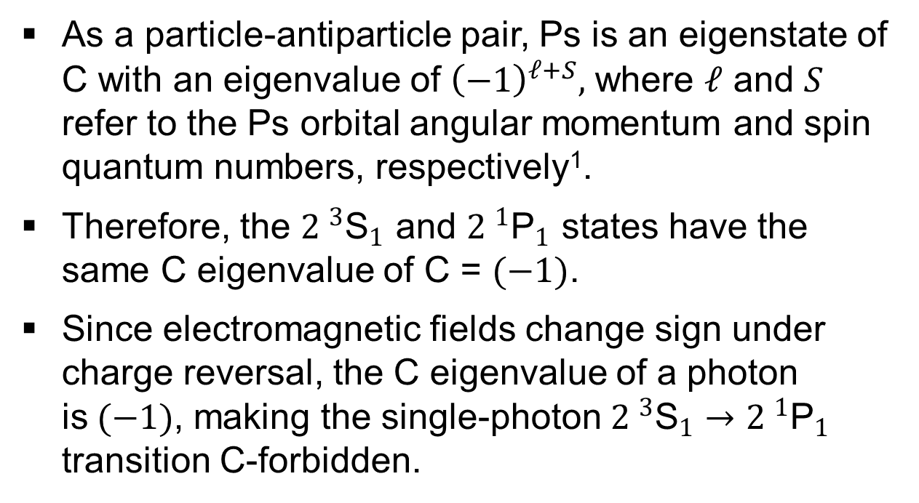
Charge (C) symmetry
As a particle-antiparticle pair, Ps is an eigenstate of C with an eigenvalue of ${\left(−1\right)}^{ℓ+S},$ where $ℓ$ and $S$ refer to the Ps orbital angular momentum and spin quantum numbers, respectively¹.
Therefore, the ${2 }^{3}{\text{S}}_{1}$ and ${2 }^{1}{\text{P}}_{1}$ states have the same C eigenvalue of C = $(−1)$.
Since electromagnetic fields change sign under charge reversal, the C eigenvalue of a photon is$(−1)$, making the single-photon ${2 }^{3}{\text{S}}_{1}→{2 }^{1}{\text{P}}_{1}$ transition C-forbidden.
$ν_{F}$ = 11185.37 MHz
¹Bernreuther, W., Nachtmann, O. Z. Phys. C - Particles and Fields 11, 235–245 (1981).

Slide 6
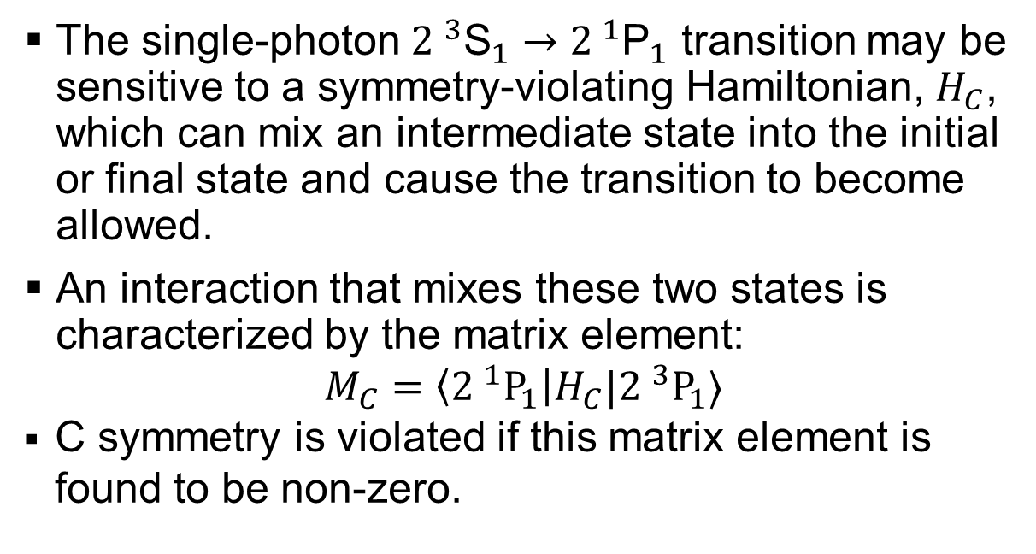
State of Ps n = 2 tests
The single-photon ${2 }^{3}{\text{S}}_{1}→{2 }^{1}{\text{P}}_{1}$ transition may be sensitive to a symmetry-violating Hamiltonian, $H_{C}$, which can mix an intermediate state into the initial or final state and cause the transition to become allowed.
An interaction that mixes these two states is characterized by the matrix element:
$$M_{C}=\left\langle {2 }^{1}P_{1}\right|H_{C}|{2 }^{3}P_{1}⟩$$
C symmetry is violated if this matrix element is found to be non-zero.
/
$ν_{F}$ = 11185.37 MHz
/
/
¹D. Hagena, et al, Phys. Rev. Lett., 71:2887–2890 (1993).
²A. Czarnecki et al, Phys. Rev. A 59, 4316 (1999).
³R. E. Sheldon et al, Phys. Rev. Lett. 131, 043001 (2023).
⁴R. Ley et al, Hyperfine Interactions, 89(1):327–341 (1994).

Slide 7
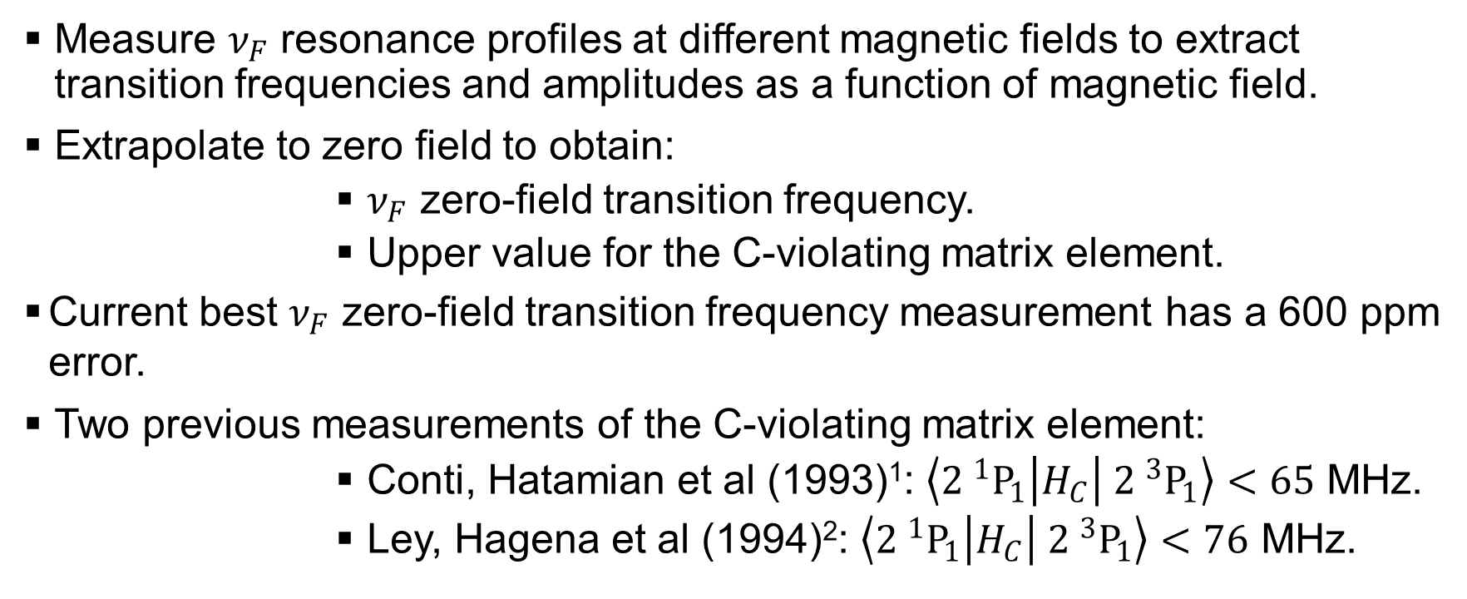
Symmetry tests
Measure $ν_{F}$ resonance profiles at different magnetic fields to extract transition frequencies and amplitudes as a function of magnetic field.
Extrapolate to zero field to obtain:
$ν_{F}$ zero-field transition frequency.
Upper value for the C-violating matrix element.
Current best $ν_{F}$ zero-field transition frequency measurement has a 600 ppm error.
Two previous measurements of the C-violating matrix element:
Conti, Hatamian et al (1993)¹: $\left\langle {2 }^{1}P_{1}\right|H_{C}\left| {2 }^{3}P_{1}\right\rangle <65$ MHz.
Ley, Hagena et al (1994)²: $\left\langle {2 }^{1}P_{1}\right|H_{C}\left| {2 }^{3}P_{1}\right\rangle <76$ MHz.
/
/
¹D. Hagena, et al, Phys. Rev. Lett., 71:2887–2890 (1993).
²R. Ley et al, Hyperfine Interactions, 89(1):327–341 (1994).

Slide 8
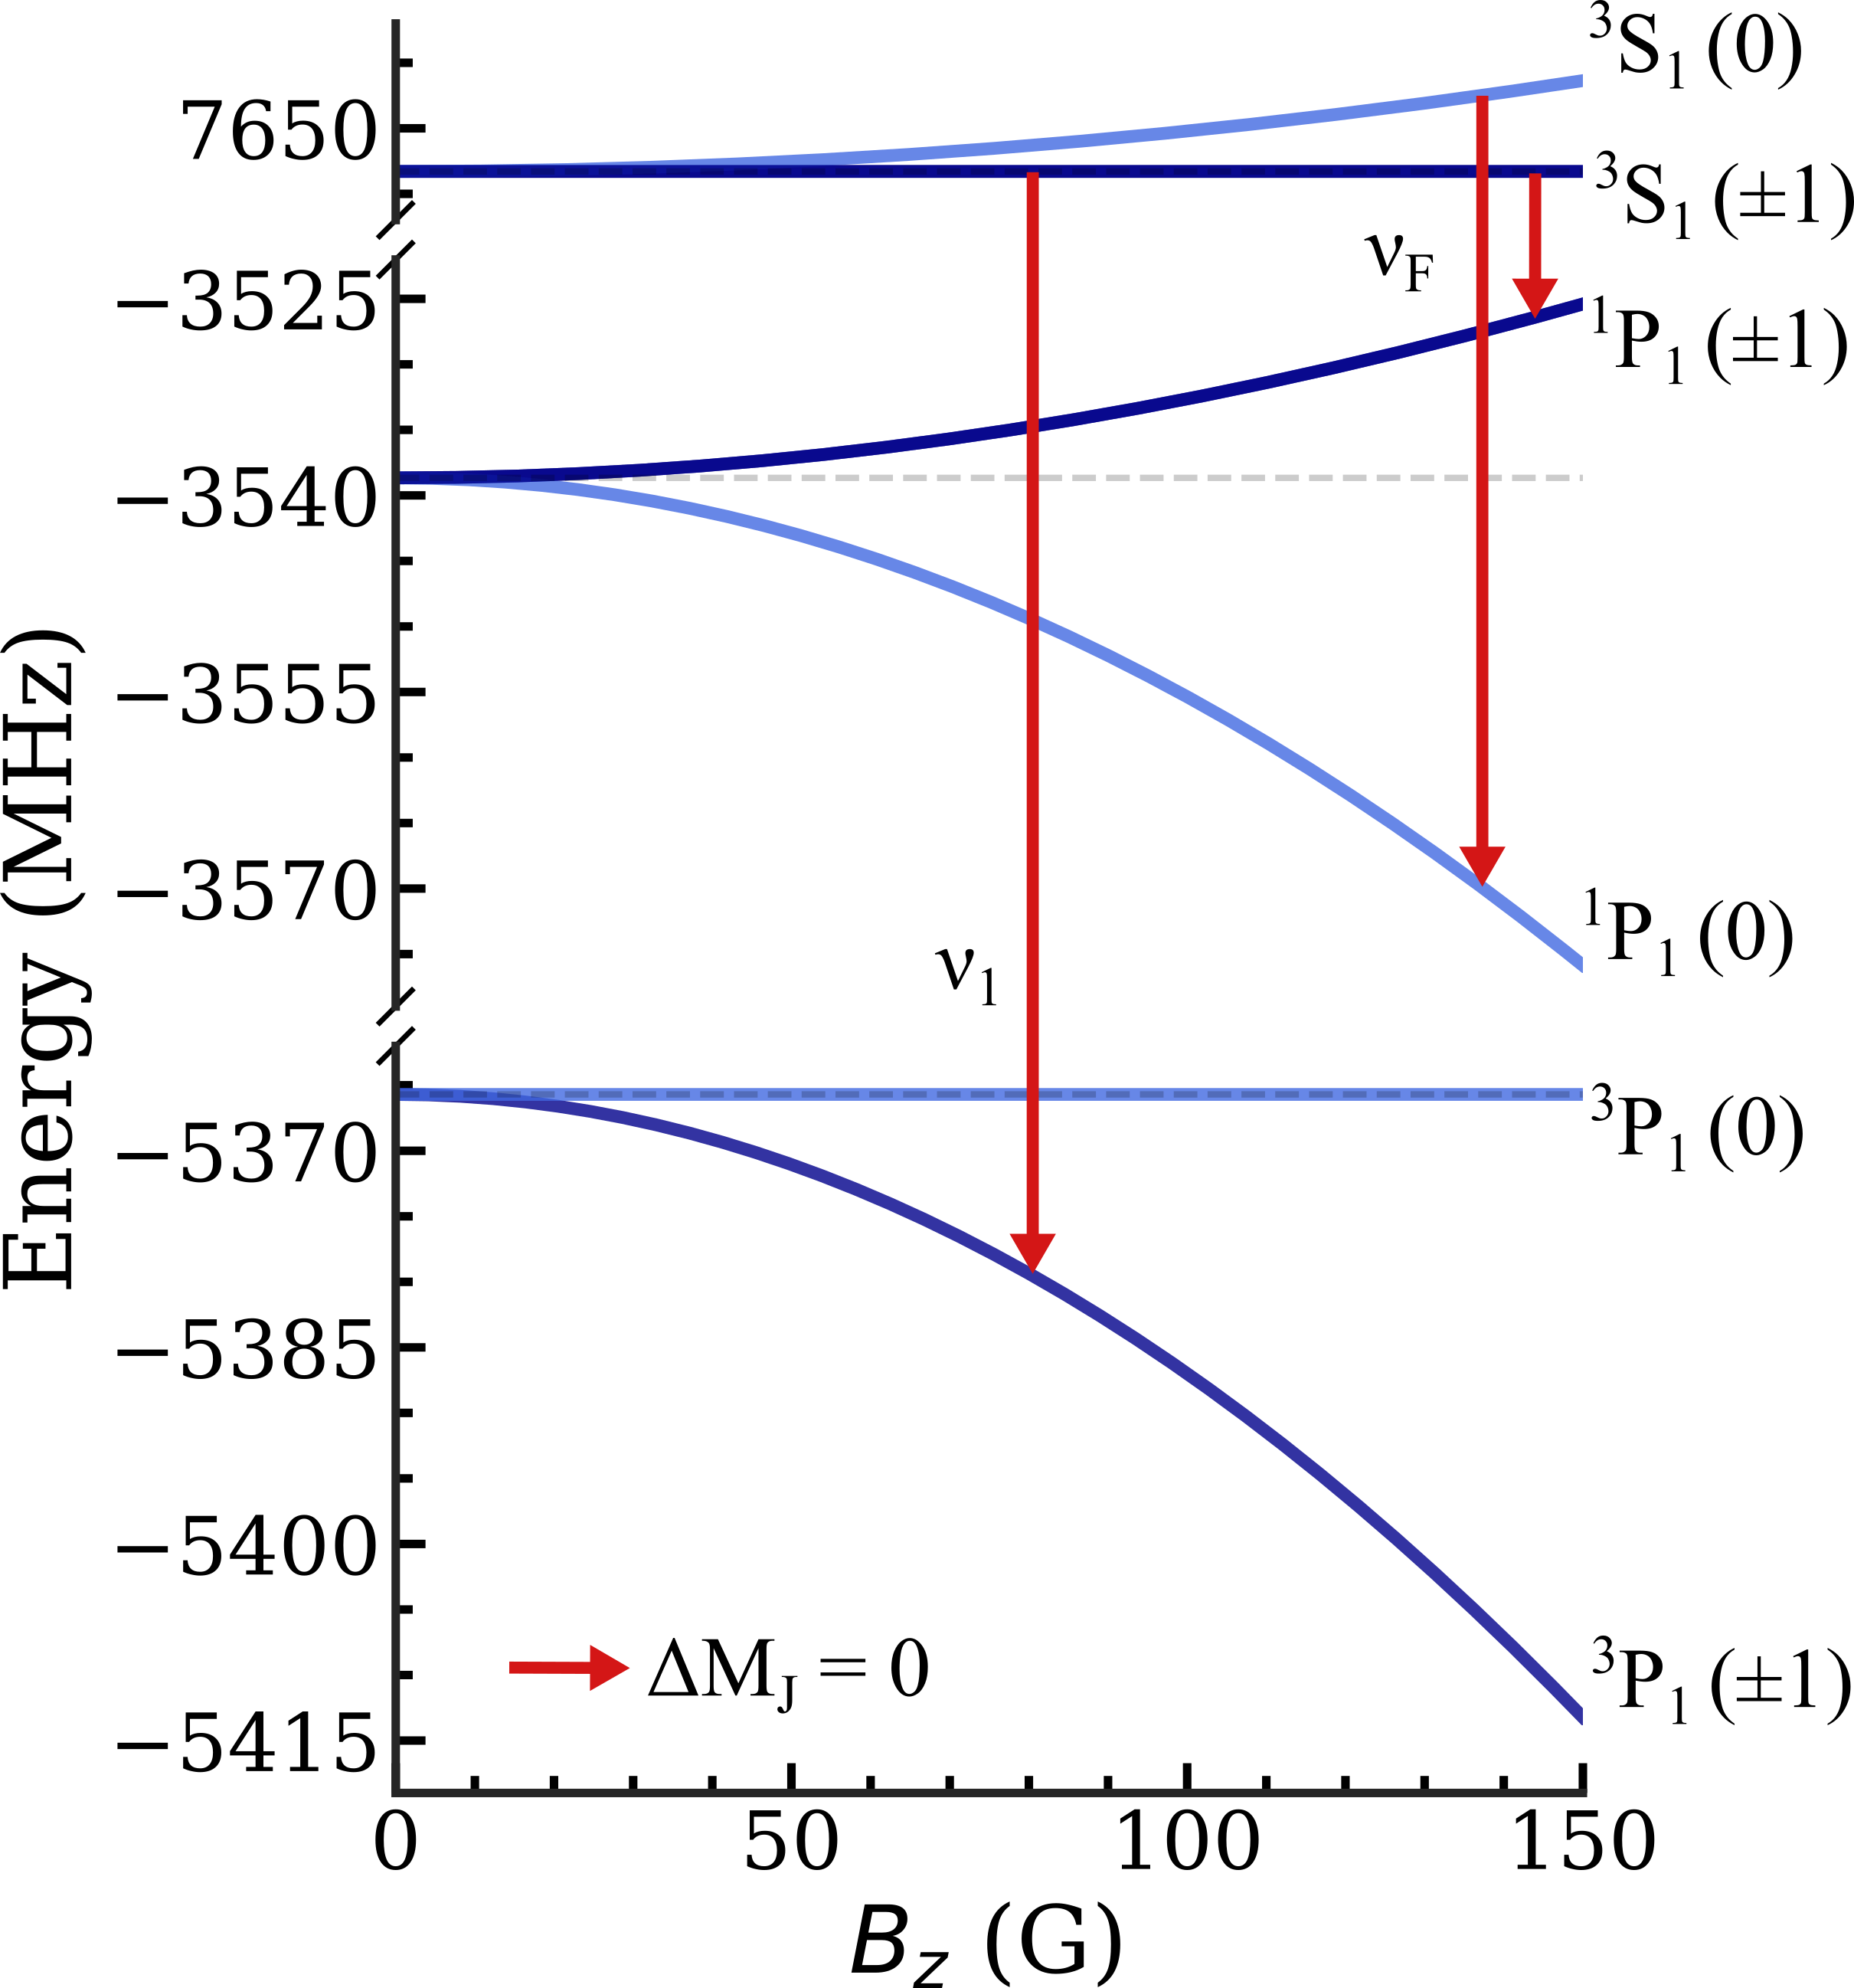
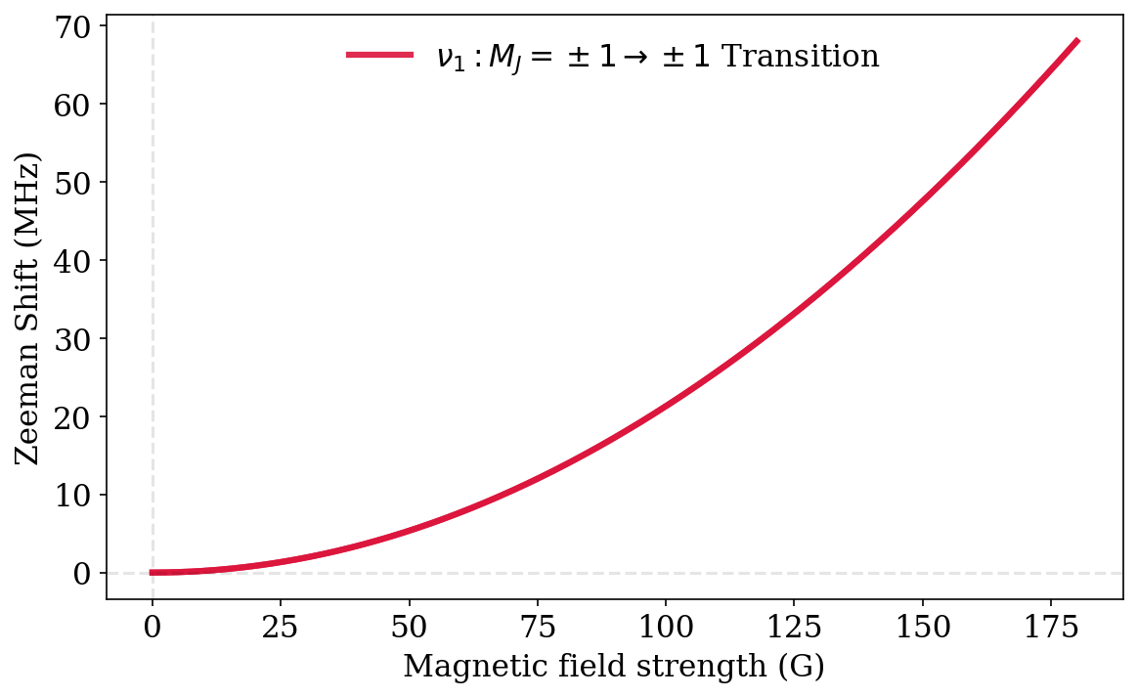
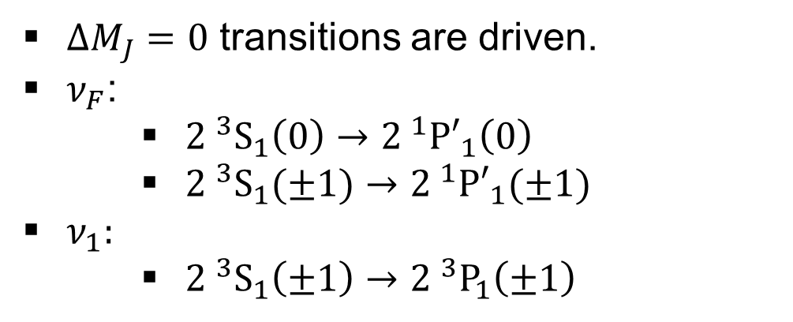

Microwave transitions
$ΔM_{J}=0$ transitions are driven.
$ν_{F}$:
${2 }^{3}S_{1}\left(0\right)→{2 }^{1}{P′}_{1}\left(0\right)$
${2 }^{3}S_{1}(±1)→{2 }^{1}{P′}_{1}(±1)$
$ν_{1}:$
${2 }^{3}S_{1}\left(±1\right)→{2 }^{3}P_{1}\left(±1\right)$
$$ν_{1}$$

Slide 9
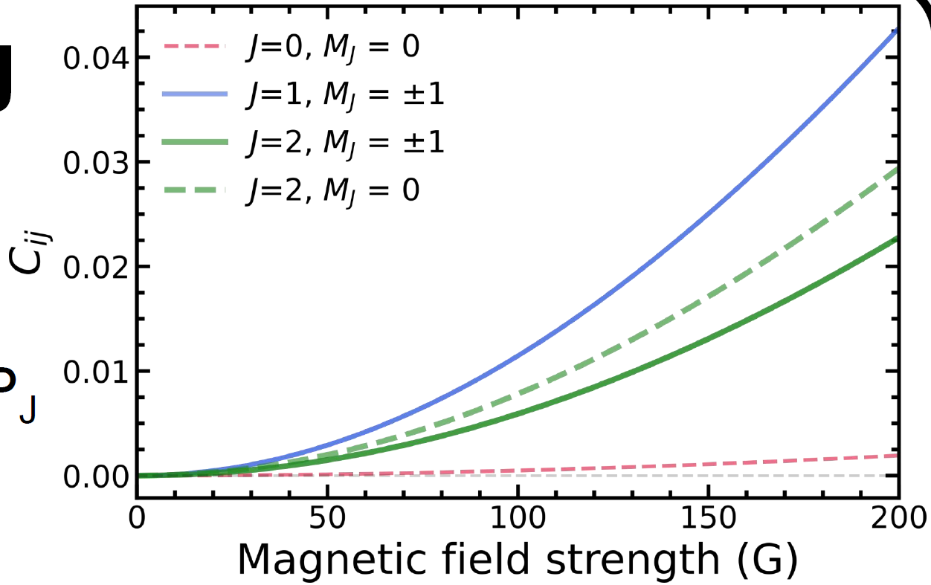
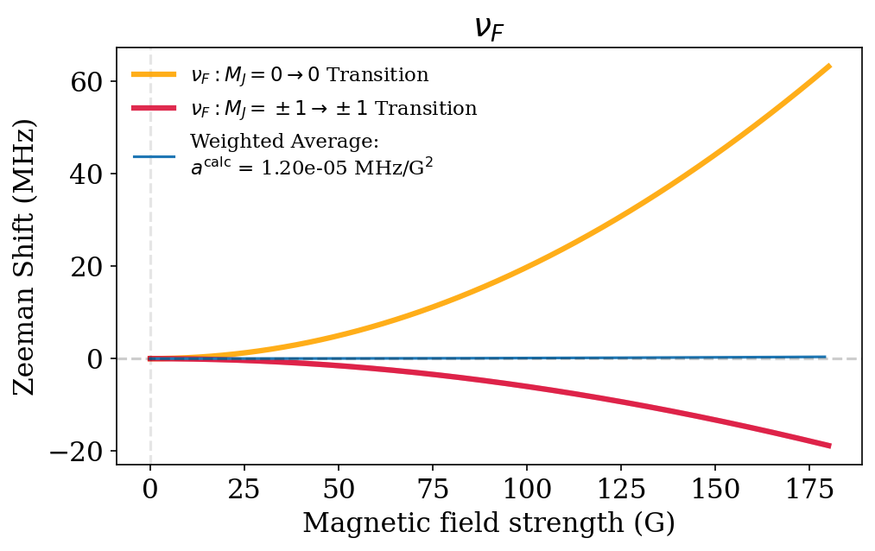
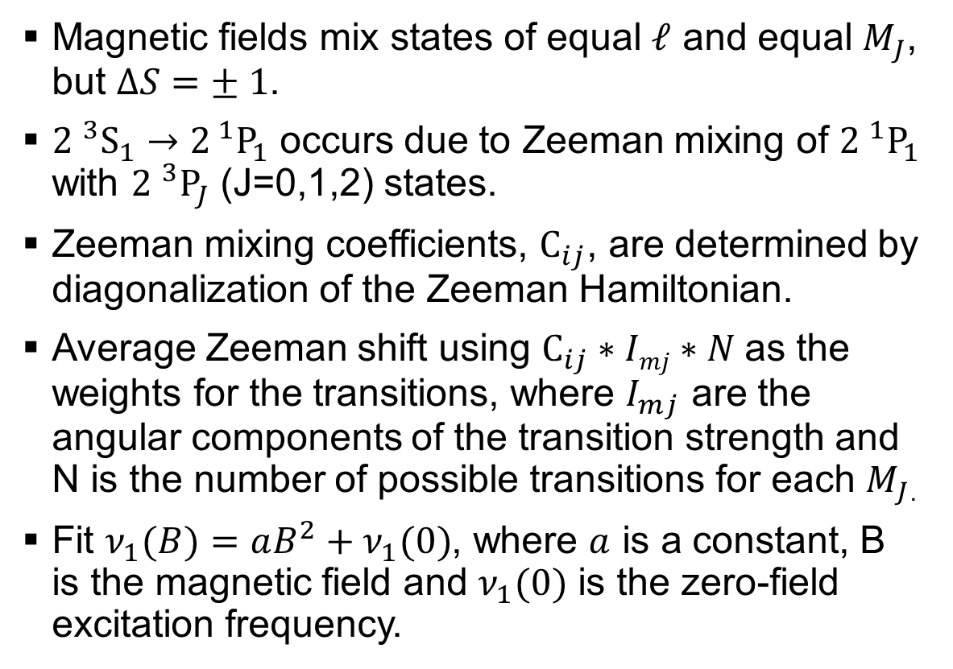

Microwave transitions
Magnetic fields mix states of equal $ℓ$ and equal $M_{J}$, but $ΔS=± 1$.
${2 }^{3}S_{1}→2^{ 1}P_{1}$ occurs due to Zeeman mixing of ${2 }^{1}P_{1}$ with ${2 }^{3}P_{J}$ (J=0,1,2) states.
Zeeman mixing coefficients, $C_{ij}$, are determined by diagonalization of the Zeeman Hamiltonian.
Average Zeeman shift using $C_{ij}∗Imj∗N$as the weights for the transitions, where $I_{mj}$ are the angular components of the transition strength and N is the number of possible transitions for each $M_{J}$.
Fit $ν_{1}(B)=aB^{2}+ν_{1}(0)$, where $a$ is a constant, B is the magnetic field and $ν_{1}(0)$ is the zero-field excitation frequency.
$$ν_{F}$$

Slide 10
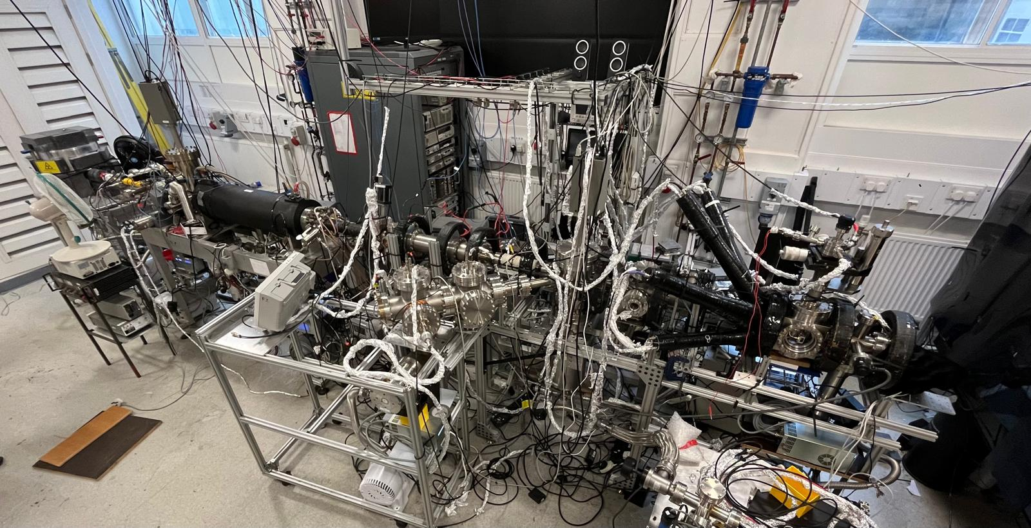
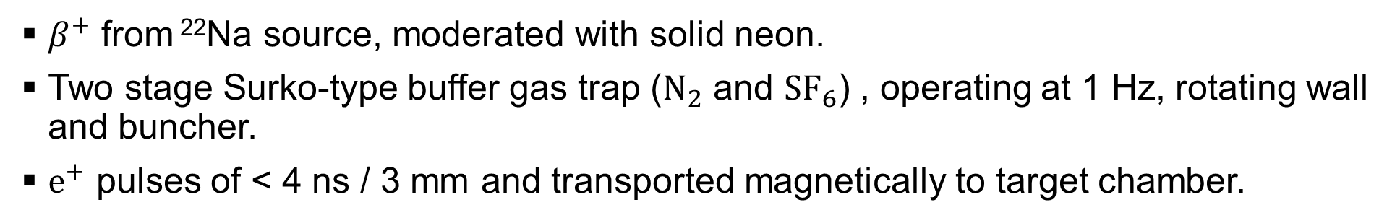
Beamline
z
See B. S. Cooper et al, Rev. Sci. Instrum. 86, 103101 (2015) for details on beamline
$β^{+}$ from ²²Na source, moderated with solid neon.
Two stage Surko-type buffer gas trap ($N_{2}$ and ${SF}_{6}$) , operating at 1 Hz, rotating wall and buncher.
$e^{+}$ pulses of < 4 ns / 3 mm and transported magnetically to target chamber.

Slide 11
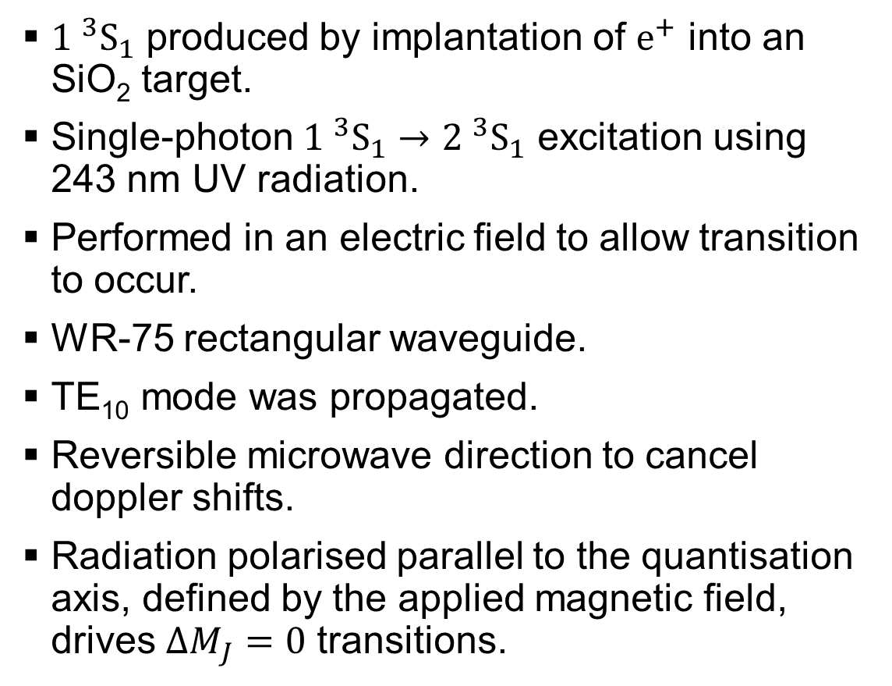
Ps production and excitation
${1 }^{3}S_{1}$ produced by implantation of $e^{+}$ into an SiO₂ target.
Single-photon ${1 }^{3}S_{1}→{2 }^{3}{\text{S}}_{1}$ excitation using 243 nm UV radiation.
Performed in an electric field to allow transition to occur.
WR-75 rectangular waveguide.
TE₁₀ mode was propagated.
Reversible microwave direction to cancel doppler shifts.
Radiation polarised parallel to the quantisation axis, defined by the applied magnetic field, drives $ΔM_{J}=0$ transitions.

Slide 12
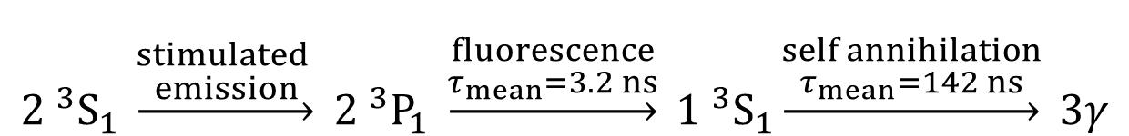
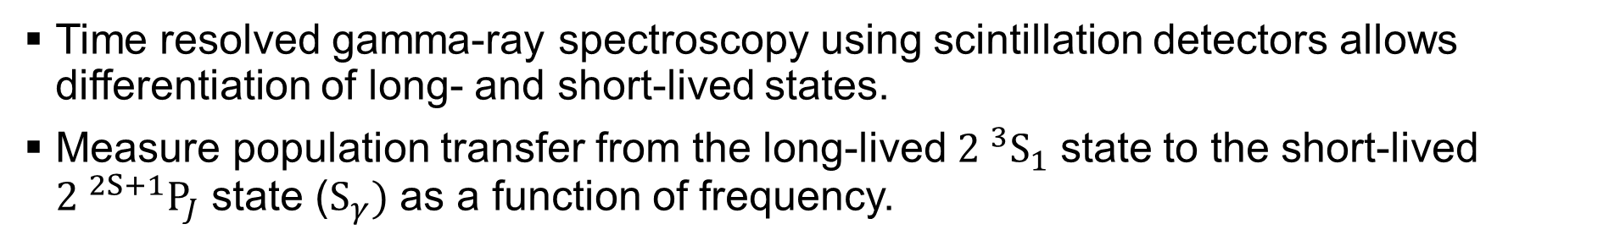
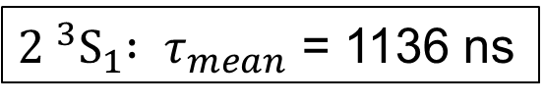
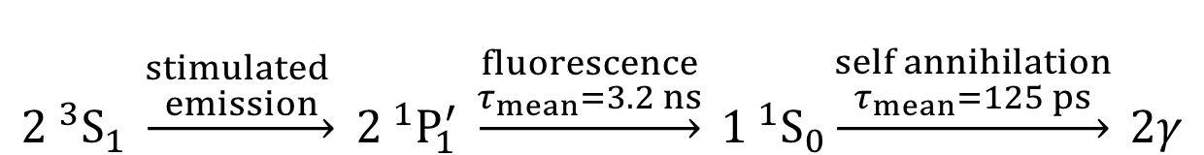
Line shape measurements
Time resolved gamma-ray spectroscopy using scintillation detectors allows differentiation of long- and short-lived states.
Measure population transfer from the long-lived ${2 }^{3}S_{1}$ state to the short-lived ${2 }^{2S+1}P_{J}$ state ($S_{γ})$ as a function of frequency.
$${2 }^{3}S_{1} \underset{→}{\begin{aligned}stimulated \\ emission\end{aligned}} {2 }^{3}P_{1} \underset{→}{\begin{aligned}fluorescence \\ τ_{mean}=3.2 ns\end{aligned}} {1 }^{3}S_{1}\underset{→}{\begin{aligned}self annihilation \\ τ_{mean}=142 ns\end{aligned}} 3γ$$
$${2 }^{3}S_{1} \underset{→}{\begin{aligned}stimulated \\ emission\end{aligned}} {2 }^{1}P_{1}^{′} \underset{→}{\begin{aligned}fluorescence \\ τ_{mean}=3.2 ns\end{aligned}} {1 }^{1}S_{0}\underset{→}{\begin{aligned}self annihilation \\ τ_{mean}=125 ps\end{aligned}} 2γ$$
${2 }^{3}S_{1}{ : τ}_{mean}$ = 1136 ns

Slide 13
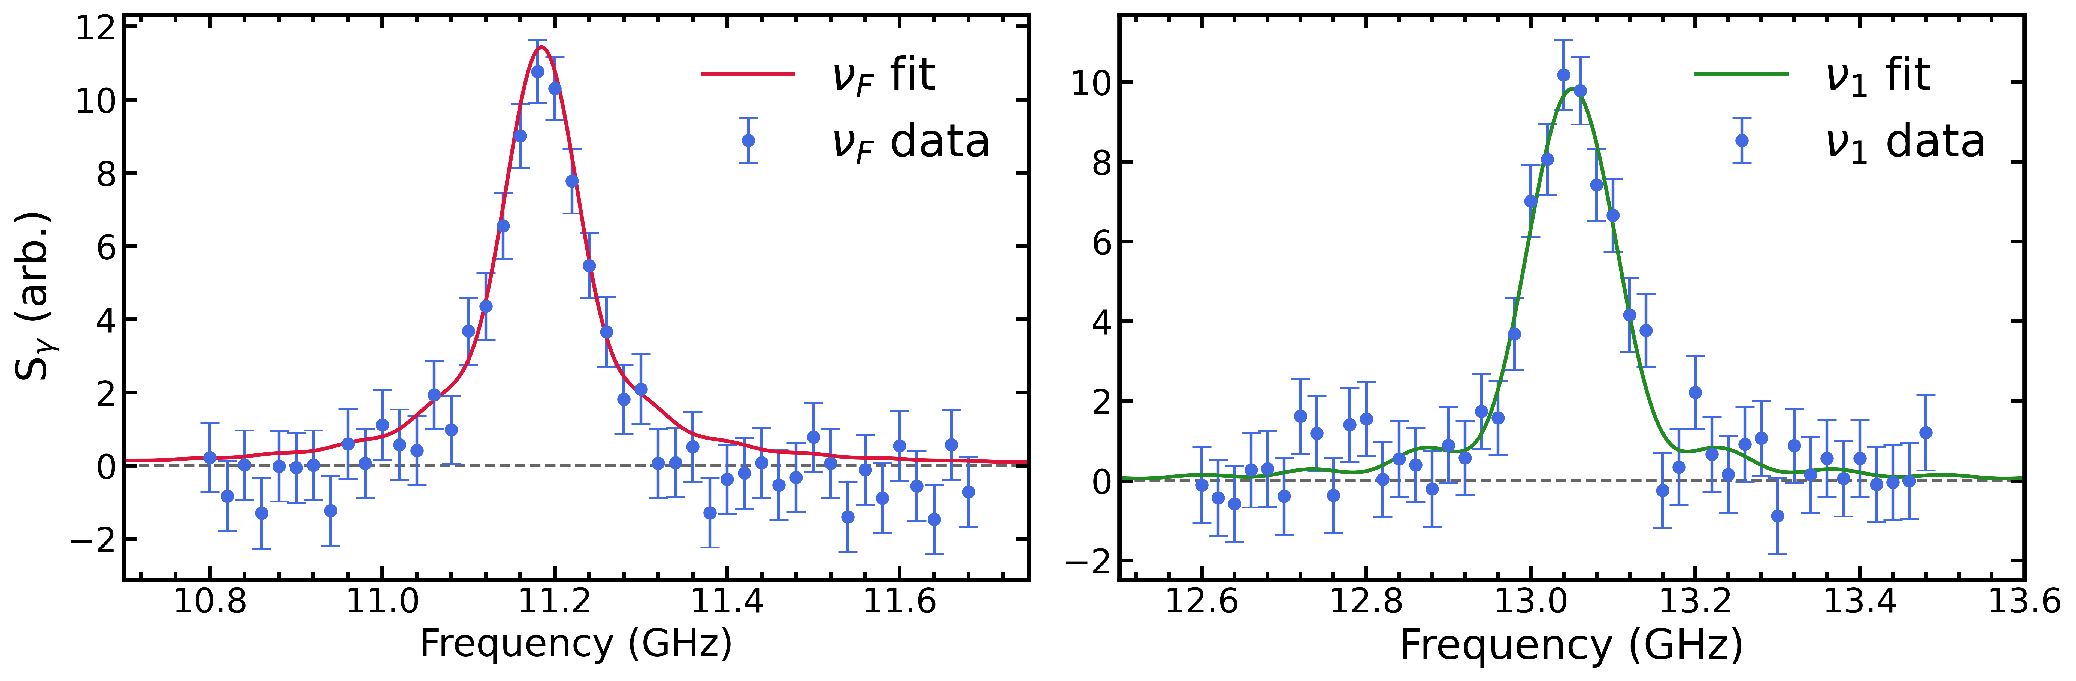
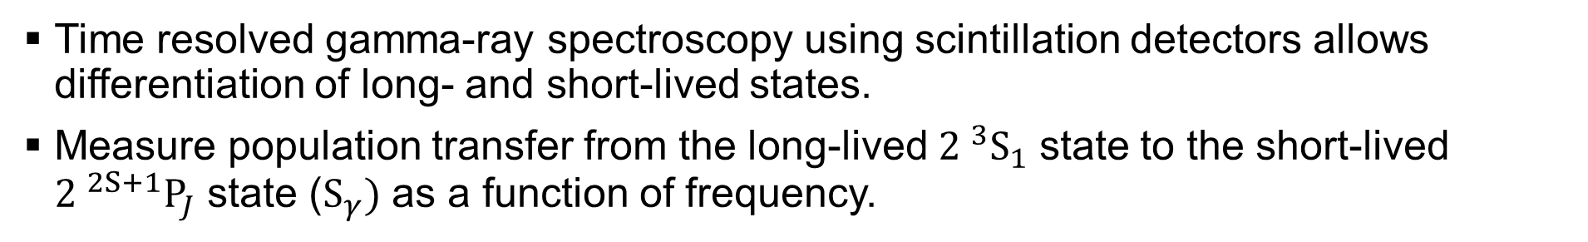
Line shape measurements
Time resolved gamma-ray spectroscopy using scintillation detectors allows differentiation of long- and short-lived states.
Measure population transfer from the long-lived ${2 }^{3}S_{1}$ state to the short-lived ${2 }^{2S+1}P_{J}$ state ($S_{γ})$ as a function of frequency.

Slide 14
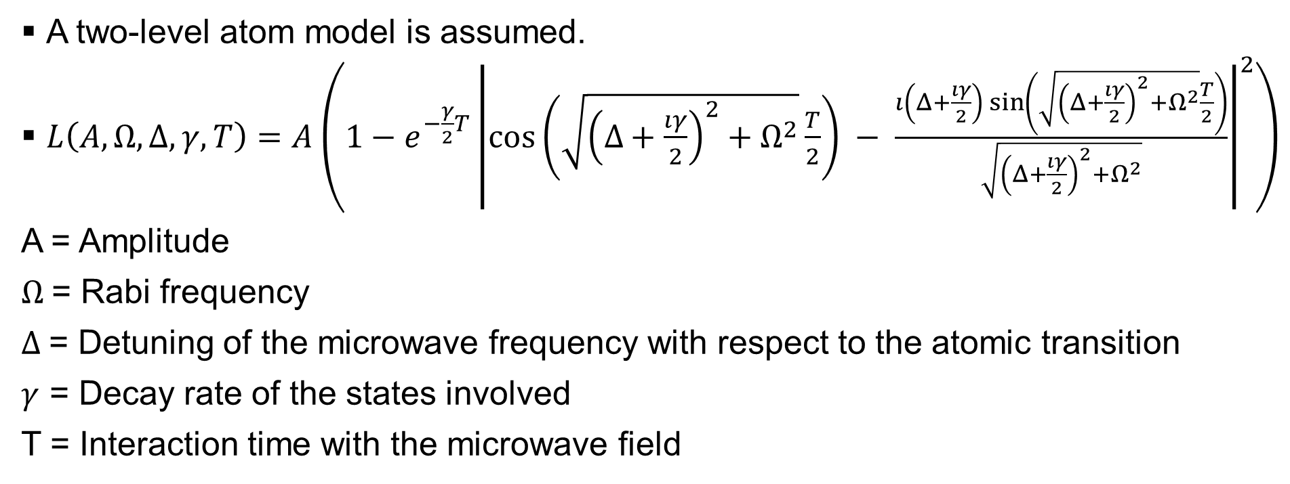
Our line shape model
A two-level atom model is assumed.
$L\left(A,Ω,Δ,γ,T\right)=A\left(1−e^{−\frac{γ}{2}T}{\left|\cos\left(\sqrt{{\left(Δ+\frac{ıγ}{2}\right)}^{2}+Ω^{2}}\frac{T}{2}\right) − \frac{ı\left(Δ+\frac{ıγ}{2}\right)\sin\left(\sqrt{{\left(Δ+\frac{ıγ}{2}\right)}^{2}+Ω^{2}}\frac{T}{2}\right)}{\sqrt{{\left(Δ+\frac{ıγ}{2}\right)}^{2}+Ω^{2}}}\right|}^{2}\right)$
A = Amplitude
$Ω$= Rabi frequency
$Δ$= Detuning of the microwave frequency with respect to the atomic transition
$γ$ = Decay rate of the states involved
T = Interaction time with the microwave field

Slide 15
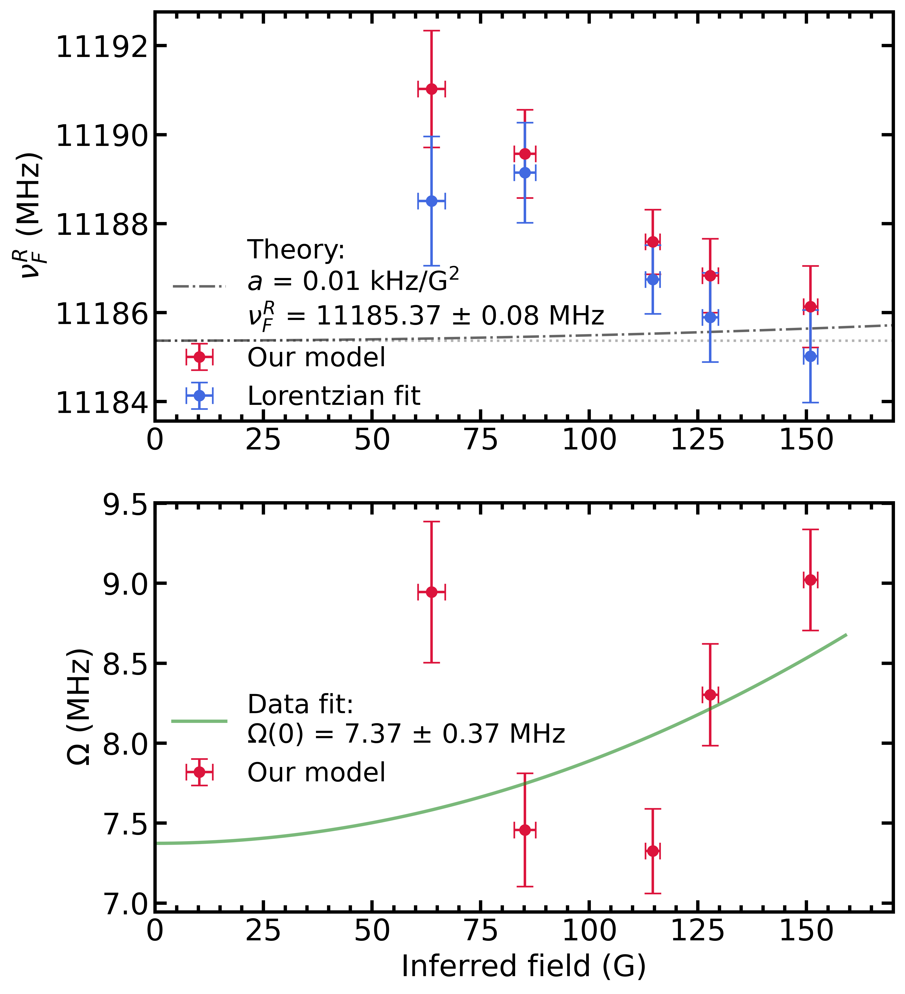
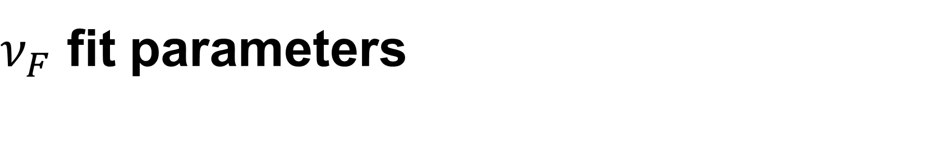
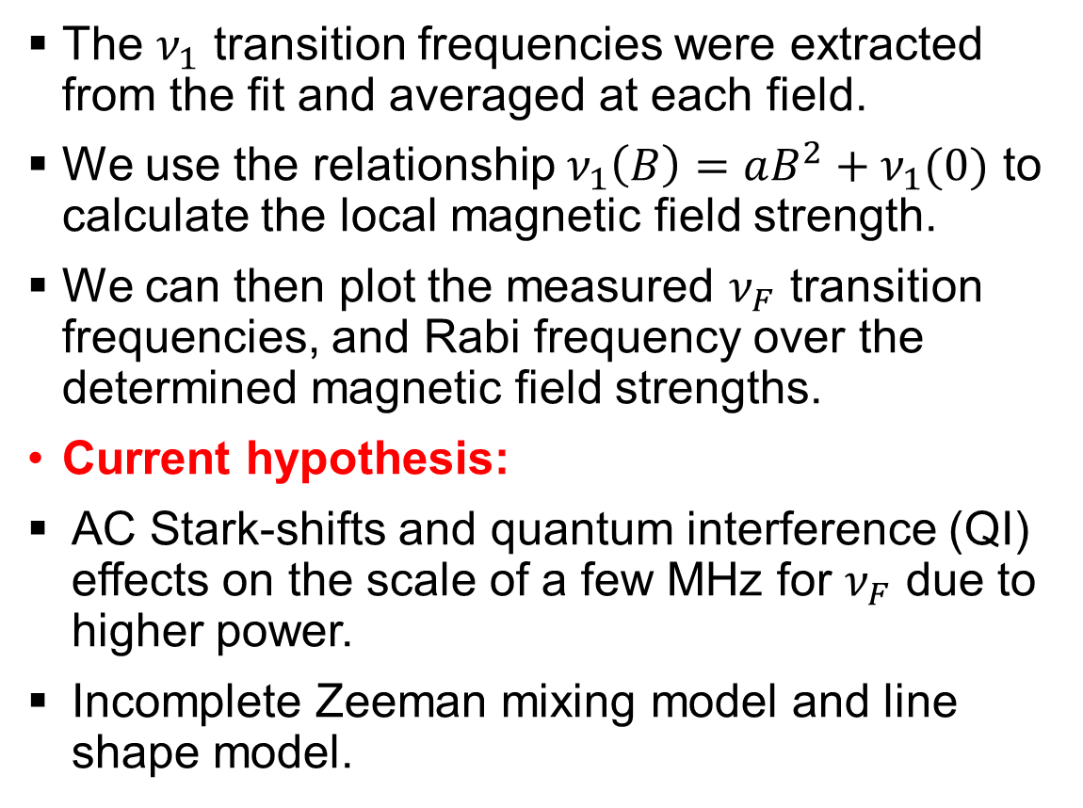
$ν_{F}$ fit parameters
The $ν_{1}$ transition frequencies were extracted from the fit and averaged at each field.
We use the relationship $ν_{1}\left(B\right)=aB^{2}+ν_{1}(0)$ to calculate the local magnetic field strength.
We can then plot the measured $ν_{F}$ transition frequencies, and Rabi frequency over the determined magnetic field strengths.
Current hypothesis:
AC Stark-shifts and quantum interference (QI) effects on the scale of a few MHz for $ν_{F}$ due to higher power.
Incomplete Zeeman mixing model and line shape model.

Slide 16
Systematic errors
No first order Doppler shifts due to reversible microwave direction.
From previous work¹ we estimate second order Doppler shifts to be < 1 kHz, and the effect of stray electric fields to be < 10 kHz.
Work on the Zeeman mixing model and line shape model is ongoing.
AC stark shifts and QI effects will be determined by simulations and calculations.
¹L. Gurung et al, Phys. Rev. A 103, 042805 (2021).

Slide 17
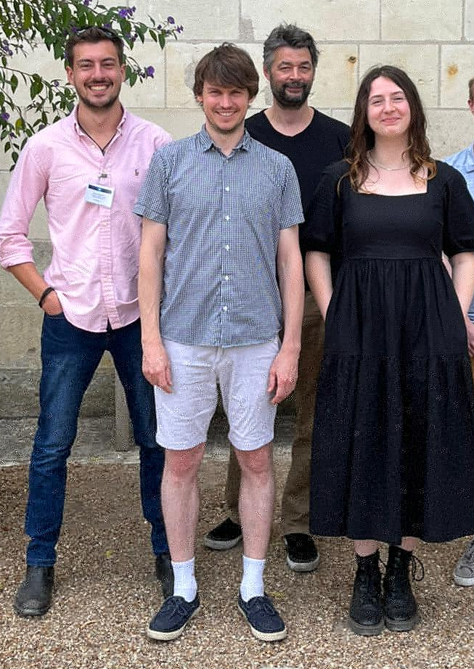


Ongoing work
Thank you!
Continue development of Zeeman mixing and line shape models.
The impact of AC stark shifts and QI effects will be determined by simulations and calculations.
Lower power measurements were run to mitigate these effects and can be fully analysed with a complete model.
@PsSpectroscopy

Slide 18
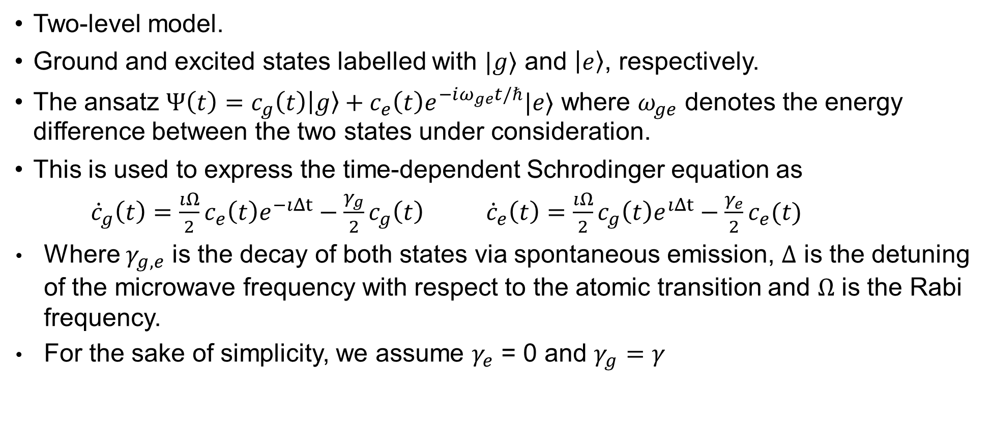
Line shape model background
Two-level model.
Ground and excited states labelled with $|g⟩$ and $\left|e\right\rangle$, respectively.
The ansatz $Ψ\left(t\right)=c_{g}\left(t\right)\left|g\right\rangle +c_{e}\left(t\right)e^{−iω_{ge}t/ℏ}|e⟩$ where $ω_{ge}$ denotes the energy difference between the two states under consideration.
This is used to express the time-dependent Schrodinger equation as
${\dot{c}}_{g}\left(t\right)=\frac{ıΩ}{2}c_{e}\left(t\right)e^{−ıΔt}−\frac{γ_{g}}{2}c_{g}\left(t\right) {\dot{c}}_{e}\left(t\right)=\frac{ıΩ}{2}c_{g}\left(t\right)e^{ıΔt}−\frac{γ_{e}}{2}c_{e}(t)$
Where $γ_{g,e}$ is the decay of both states via spontaneous emission, $Δ$ is the detuning of the microwave frequency with respect to the atomic transition and $Ω$ is the Rabi frequency.
For the sake of simplicity, we assume $γ_{e}$ = 0 and $γ_{g}=γ$

Slide 19
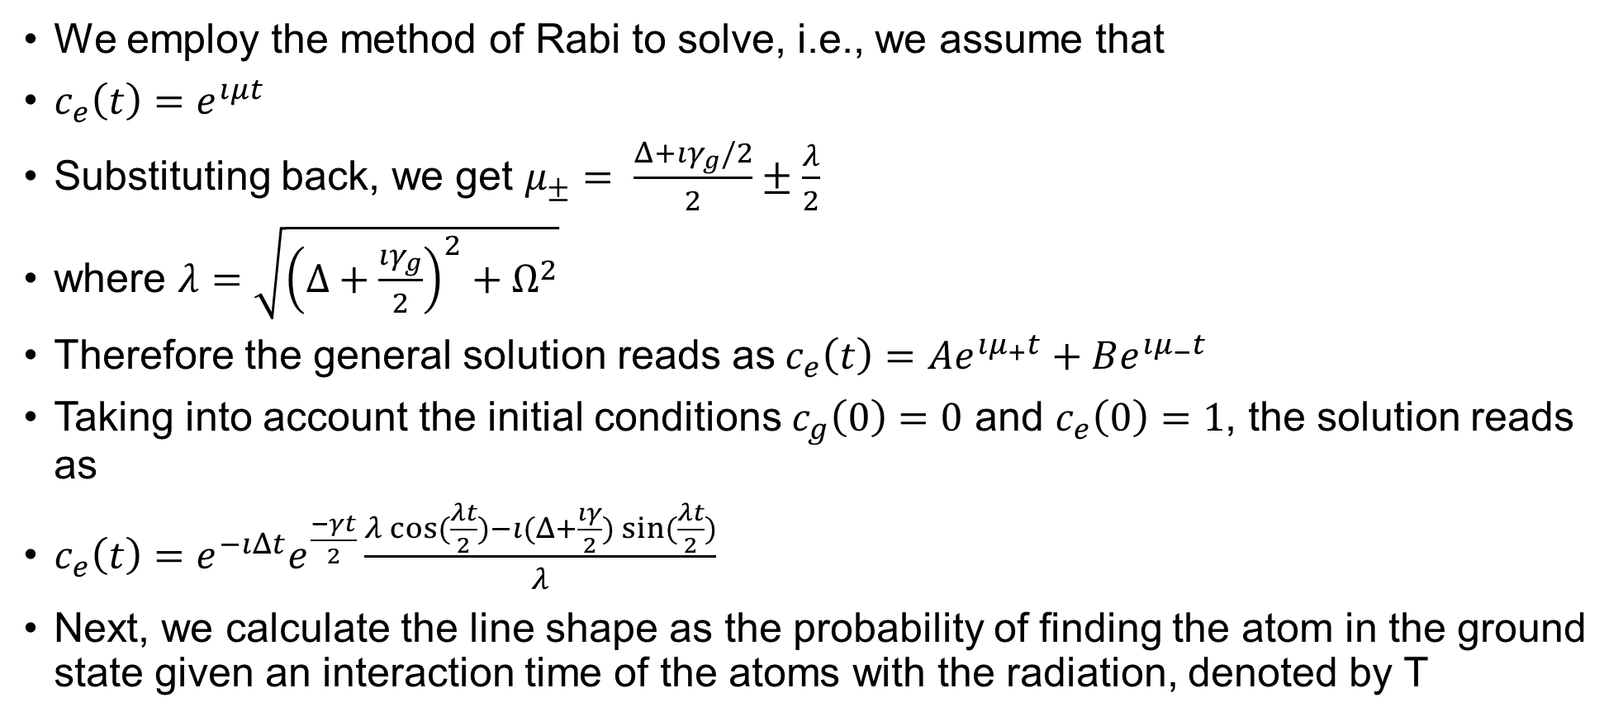
Line shape model background
We employ the method of Rabi to solve, i.e., we assume that
$c_{e}\left(t\right)=e^{ıμt}$
Substituting back, we get $μ_{±}= \frac{Δ+ıγ_{g}/2}{2}±\frac{λ}{2}$
where $λ=\sqrt{{\left(Δ+\frac{ıγ_{g}}{2}\right)}^{2}+Ω^{2}}$
Therefore the general solution reads as$c_{e}\left(t\right)=Ae^{ıμ_{+}t}+Be^{ıμ_{−}t}$
Taking into account the initial conditions $c_{g}\left(0\right)=0$ and $c_{e}\left(0\right)=1$, the solution reads as
$c_{e}\left(t\right)=e^{−ıΔt}e^{\frac{−γt}{2}}\frac{λ\cos{(\frac{λt}{2})}−ı(Δ+\frac{ıγ}{2})\sin{(\frac{λt}{2})}}{λ}$
Next, we calculate the line shape as the probability of finding the atom in the ground state given an interaction time of the atoms with the radiation, denoted by T

