Slide 1
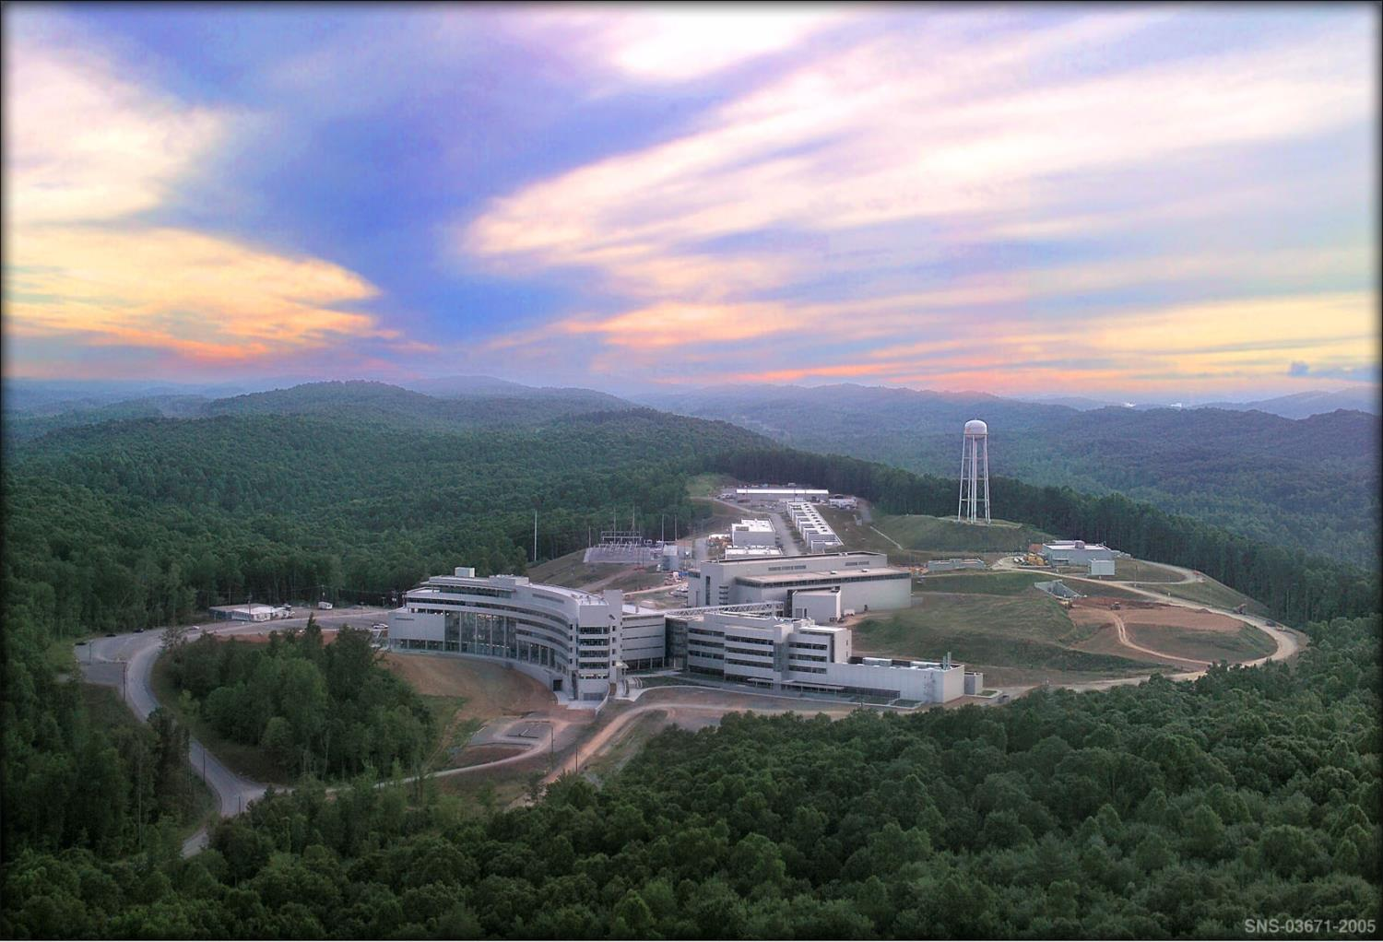


Neutron beta decay puzzle pieces
Stefan Baeβler
Inst. Nucl. Part. Phys.

Slide 2
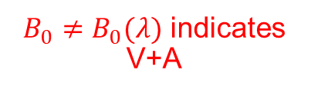





Correlation coefficients in neutron beta decay
$${\vec{σ}}_{n}$$
e⁻
p
n
Observables in neutron beta decay, as a function of generally possible coupling constants:
$$\overline{ν_{e}}$$
$B_{0}≠B_{0}(λ)$ indicates V+A
Nonzero $b$ or $b_{ν}$ indicates S,T
$$dΓ∝ρ\left(E_{e}\right)\left(1+a\frac{p_{e}}{E_{e}}\cos{({\vec{p}}_{ν},{\vec{p}}_{e})}+b\frac{m_{e}}{E_{e}}+A_{0}\frac{p_{e}}{E_{e}}\cos{({\vec{σ}}_{n},{\vec{p}}_{e})}+\left(B_{0}+b_{ν}\frac{m_{e}}{E_{e}}\right)\cos{({\vec{σ}}_{n},{\vec{p}}_{ν})}\right)$$
$a_{0}=a_{0}\left(λ\right)$ with $λ=g_{A}/g_{V}$
$$A_{0}=A_{0}\left(λ\right)$$
C.F. v. Weizsäcker, Z. f. Phys. 102,572 (1936), M. Fierz, Z. f. Phys. 104, 553 (1937), J.D. Jackson et al., PR 106, 517 (1957)
Notes:
2

Slide 3
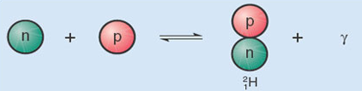
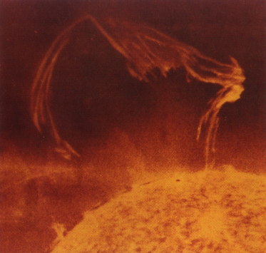
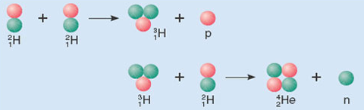
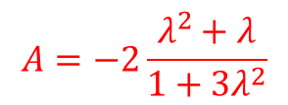

The coupling constants of semileptonic weak interactions
Coupling Constants in Neutron Decay
g_{A} = G_{F}·V_{ud}·λ
$$τ_{n}^{−1}∝\left(g_{V}^{2}+3g_{A}^{2}\right)$$
p = (udu)
u
e⁻
W±
ν_{e}
g_{V} , g_{A}
g_{V} = G_{F}·V_{ud}
d
n = (ddu)
$$A=−2\frac{λ^{2}+λ}{1+3λ^{2}}$$
n → p + e⁻ + ν_{e}
Primordial Nucleosynthesis
Solar cycle
p
e⁻
²H⁺
e⁺
W±
W±
ν_{e}
n
ν_{e}
p + p
n + ν_{e} ↔ p + e⁻
p + p → ²H⁺ + e⁺ + ν_{e}
Start of Big Bang Nucleosynthesis, Primordial ⁴He abundance
Start of Solar Cycle, determines amount of Solar Neutrinos

Slide 4
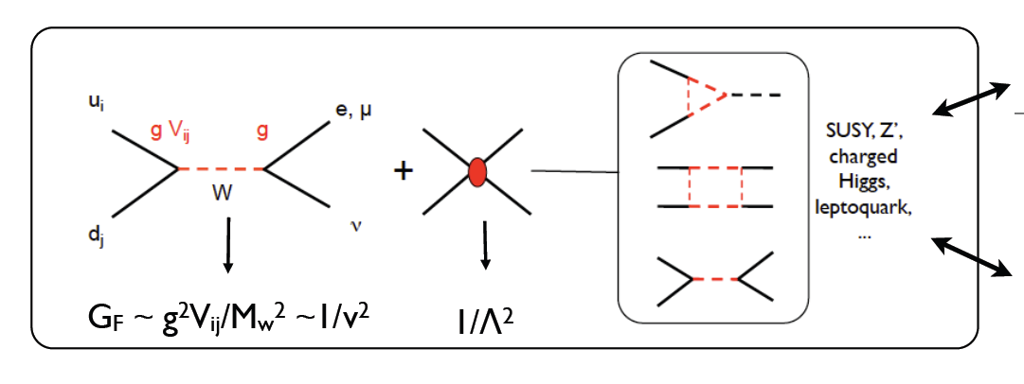






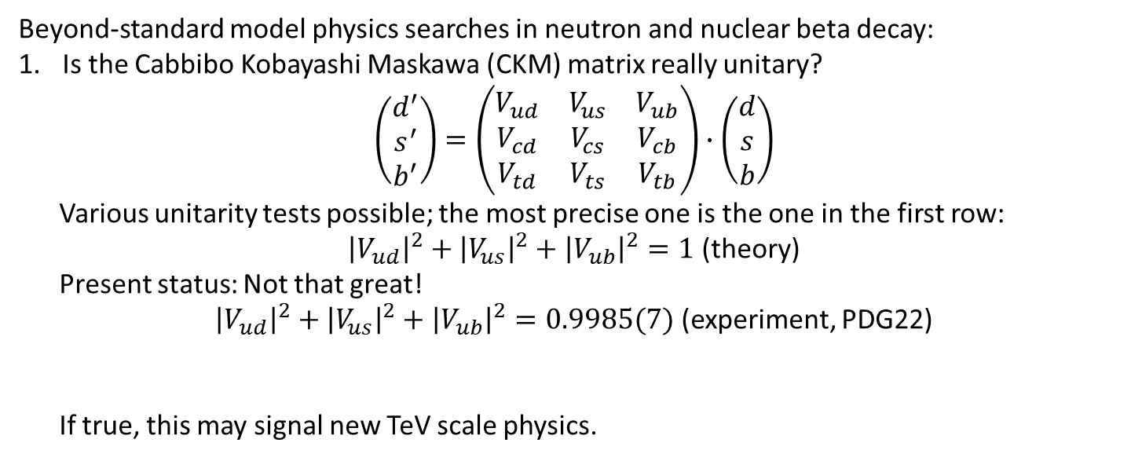

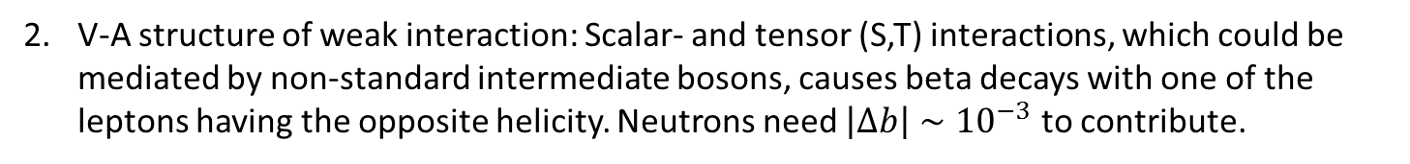
Puzzle: Explain CKM unitarity
Beyond-standard model physics searches in neutron and nuclear beta decay:
Is the Cabbibo Kobayashi Maskawa (CKM) matrix really unitary?
$$\left(\begin{matrix}d^{′} \\ s^{′} \\ b^{′}\end{matrix}\right)=\left(\begin{matrix}V_{ud} & V_{us} & V_{ub} \\ V_{cd} & V_{cs} & V_{cb} \\ V_{td} & V_{ts} & V_{tb}\end{matrix}\right)∙\left(\begin{matrix}d \\ s \\ b\end{matrix}\right)$$
Various unitarity tests possible; the most precise one is the one in the first row:
${\left|V_{ud}\right|}^{2}+{\left|V_{us}\right|}^{2}+{\left|V_{ub}\right|}^{2}=1$ (theory)
Present status: Not that great!
${\left|V_{ud}\right|}^{2}+{\left|V_{us}\right|}^{2}+{\left|V_{ub}\right|}^{2}=0.9985(7)$ (experiment, PDG22)
If true, this may signal new TeV scale physics.
This evaluation combines data from superallowed beta decays, Kaons, and new theoretical corrections.
$V_{ub}$ is so small that we ignore it here.
V-A structure of weak interaction: Scalar- and tensor (S,T) interactions, which could be mediated by non-standard intermediate bosons, causes beta decays with one of the leptons having the opposite helicity. Neutrons need $\left|Δb\right|∼{10}^{−3}$ to contribute.
Specific models: E.g.
W. Marciano, A. Sirlin, PRD 35, 1672 (1987).
R. Barbieri et al., PLB 156, 348 (1985)
K. Hagiwara et al., PRL 75, 3605 (1995)
A. Kurylov, M. Ramsey-Musolf, PRL 88, 071804 (2000)
$${\vec{σ}}_{n}$$
$${\vec{σ}}_{e}$$
e⁻
e⁻
$${\vec{σ}}_{e}$$
p
n
$${\vec{σ}}_{ν}$$
$${\vec{σ}}_{ν}$$
$$\overline{ν_{e}}$$
$$\overline{ν_{e}}$$
Energy scale of new physics: $Λ≥11$ TeV V. Cirigliano et al., NPB 830, 95 (2010)

Slide 5
Puzzle: Explain CKM unitarity
Beyond-standard model physics searches in neutron and nuclear beta decay:
Is the Cabbibo Kobayashi Maskawa (CKM) matrix really unitary?
$$\left(\begin{matrix}d^{′} \\ s^{′} \\ b^{′}\end{matrix}\right)=\left(\begin{matrix}V_{ud} & V_{us} & V_{ub} \\ V_{cd} & V_{cs} & V_{cb} \\ V_{td} & V_{ts} & V_{tb}\end{matrix}\right)∙\left(\begin{matrix}d \\ s \\ b\end{matrix}\right)$$
Various unitarity tests possible; the most precise one is the one in the first row:
${\left|V_{ud}\right|}^{2}+{\left|V_{us}\right|}^{2}+{\left|V_{ub}\right|}^{2}=1$ (theory)
Present status: Not that great!
${\left|V_{ud}\right|}^{2}+{\left|V_{us}\right|}^{2}+{\left|V_{ub}\right|}^{2}=0.9985(7)$ (experiment, PDG22)
If true, this may signal new TeV scale physics.
This evaluation combines data from superallowed beta decays, Kaons, and new theoretical corrections
V-A structure of weak interaction: Scalar- and tensor (S,T) interactions, which could be mediated by non-standard intermediate bosons, causes beta decays with one of the leptons having the opposite helicity. Neutrons need $\left|Δb\right|∼{10}^{−3}$ to contribute.
Specific models: E.g.
W. Marciano, A. Sirlin, PRD 35, 1672 (1987).
R. Barbieri et al., PLB 156, 348 (1985)
K. Hagiwara et al., PRL 75, 3605 (1995)
A. Kurylov, M. Ramsey-Musolf, PRL 88, 071804 (2000)
$${\vec{σ}}_{n}$$
$${\vec{σ}}_{e}$$
e⁻
e⁻
$${\vec{σ}}_{e}$$
p
n
$${\vec{σ}}_{ν}$$
$${\vec{σ}}_{ν}$$
$$\overline{ν_{e}}$$
$$\overline{ν_{e}}$$
Energy scale of new physics: $Λ≥11$ TeV V. Cirigliano et al., NPB 830, 95 (2010)

Slide 6
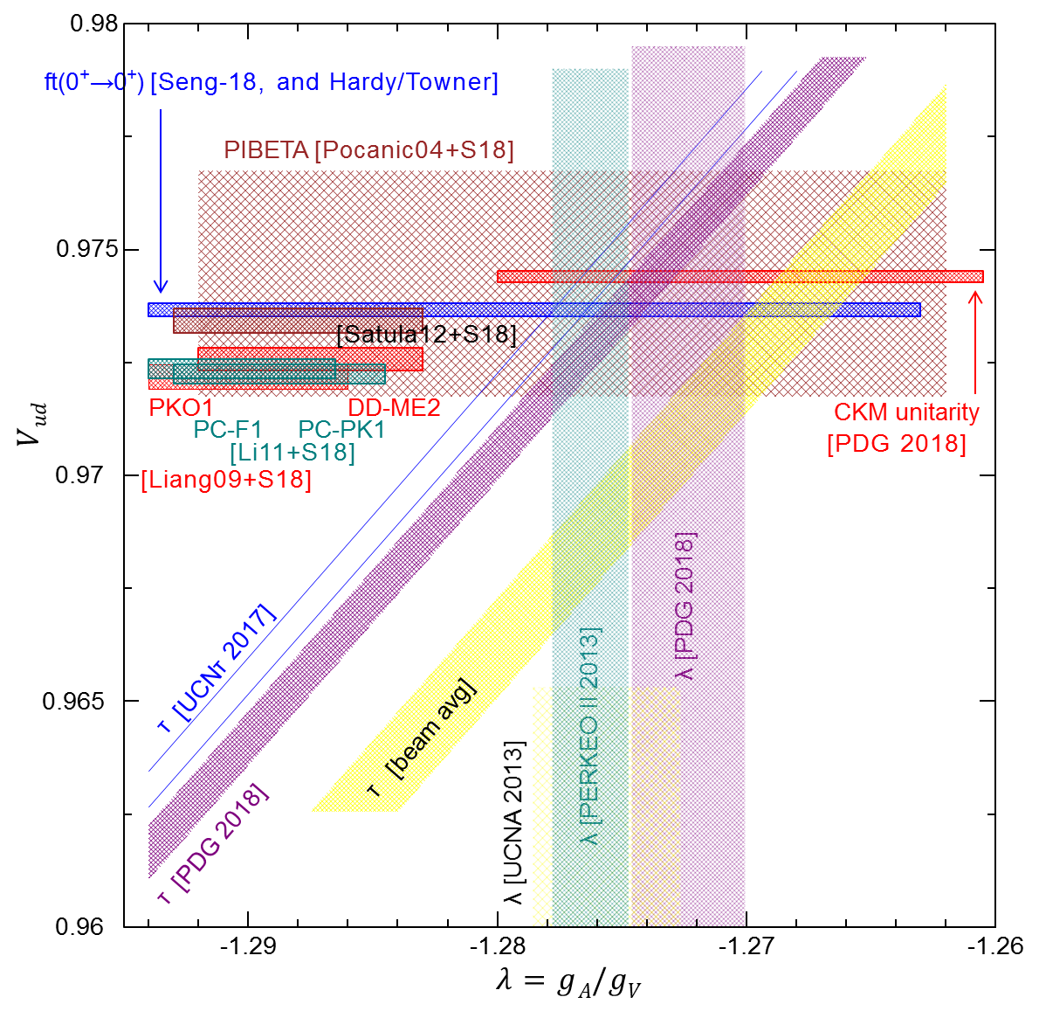
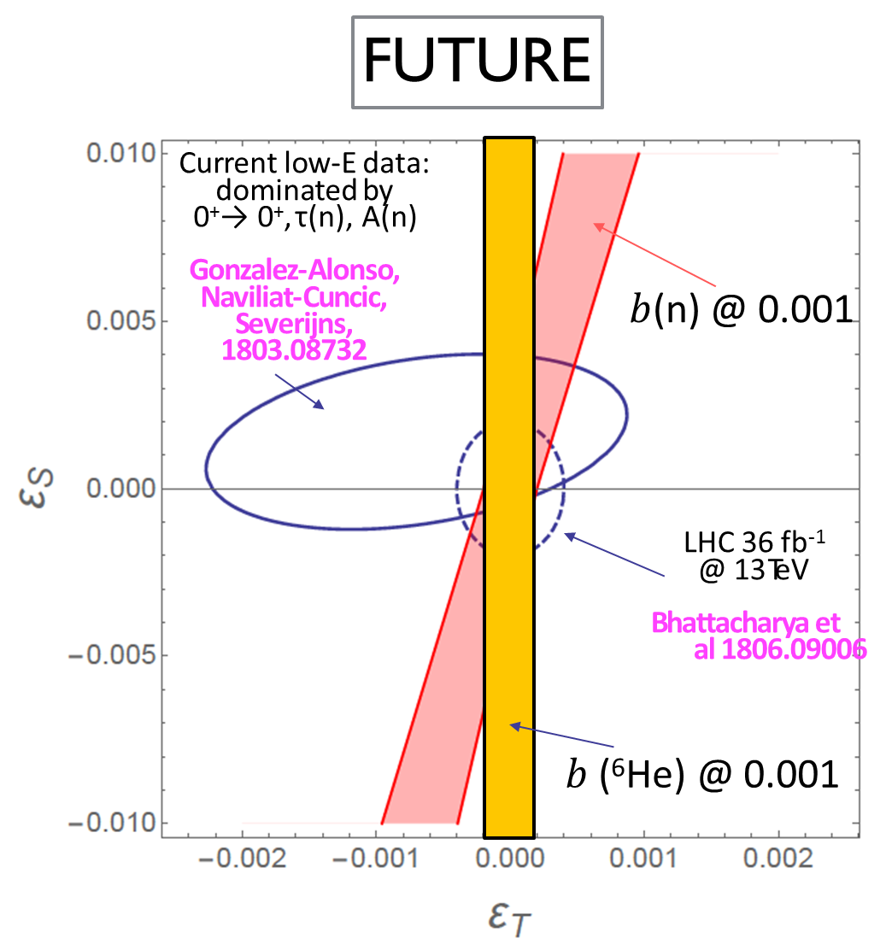
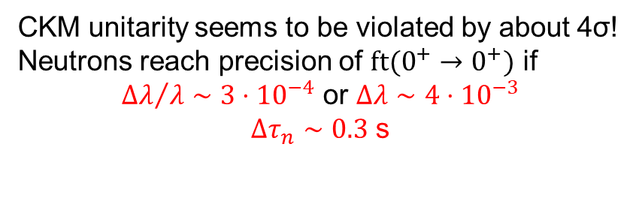
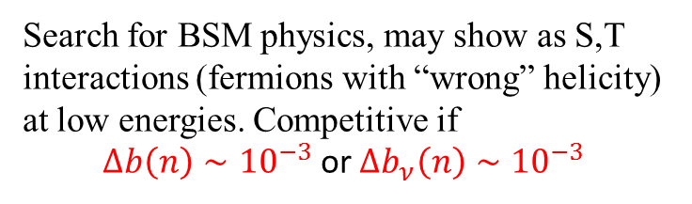
Motivation for precise determination of neutron beta decay correlations
LHC-Search for $pp→e+ν+$ thero stuff and $pp→e+e+$ other stuff
Status:
10/2018
CKM unitarity seems to be violated by about 4σ!
Neutrons reach precision of $ft(0^{+}→0^{+})$ if
${Δλ}/λ∼{3⋅10}^{−4}$ or $Δλ∼4⋅{10}^{−3}$
$Δτ_{n}∼0.3$ s
Search for BSM physics, may show as S,T interactions (fermions with “wrong” helicity) at low energies. Competitive if
$Δb\left(n\right)∼{10}^{−3}$ or $Δb_{ν}\left(n\right)∼{10}^{−3}$

Slide 7
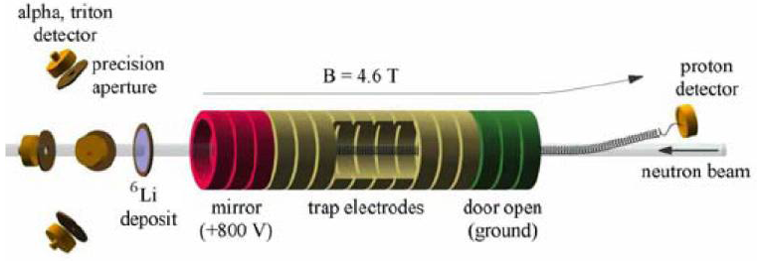
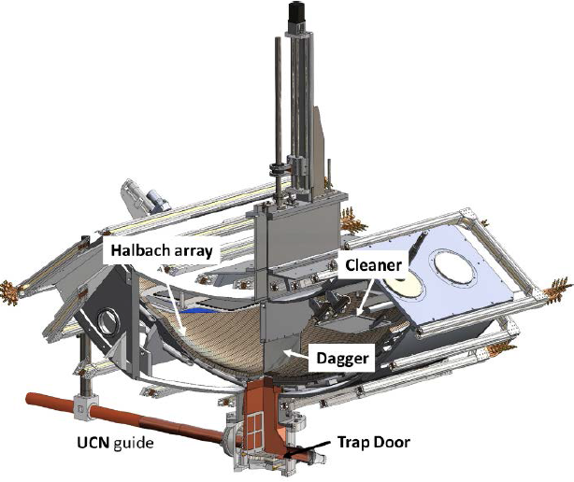
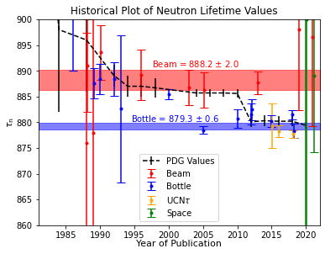
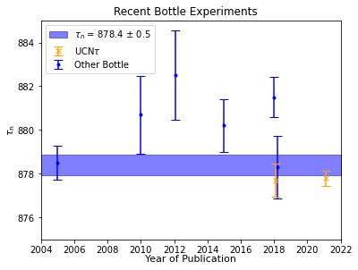
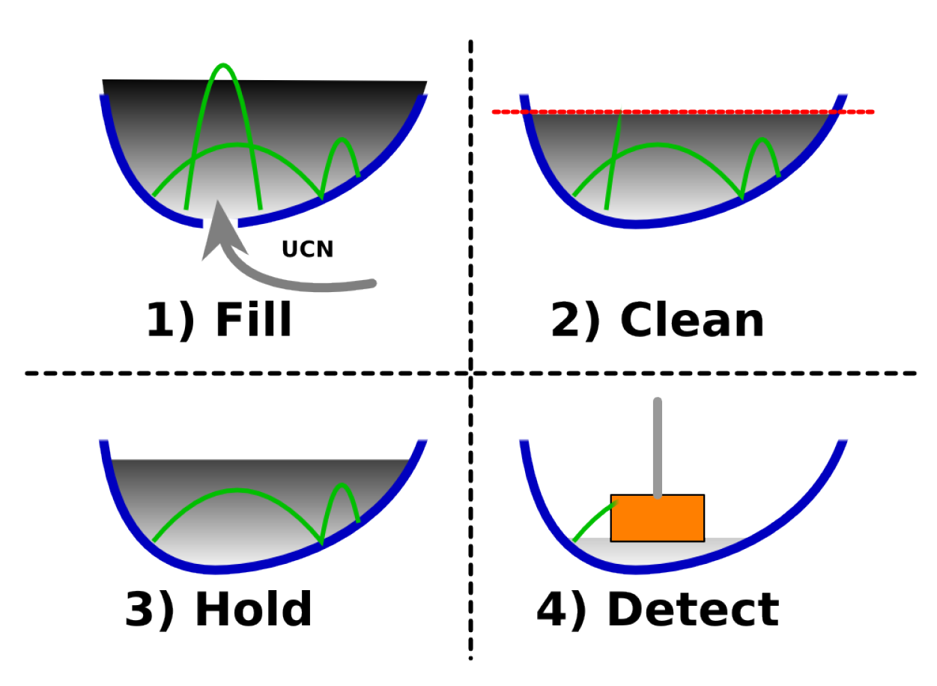
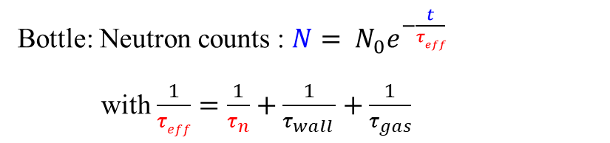
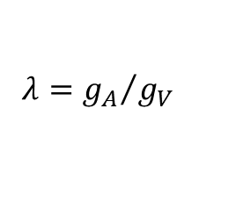
Neutron Decay Puzzle 1 (old, but significant): Lifetime
Beam: Decay rate: $\frac{dN}{dt}=\frac{N}{τ_{n}}$
NIST-BL1/2
Bottle: Neutron counts : $N= N_{0}e^{−\frac{t}{τeff}}$
with $\frac{1}{τeff}=\frac{1}{τ_{n}}+\frac{1}{τ_{wall }}+\frac{1}{τ_{gas}}$
UCNTAU
Courtesy F. Gonzalez
Discrepancy between beam and bottle may be real (decay into dark particle, not otherwise detected, or an experiment error. Many new experiments:
Magnetic bottles (UCNTAU+, LANL, τSPECT, TRIGA Mainz; PENELOPE, TU München)
Beam Lifetime BL2 and BL3, NIST
UCNProBe, LANL: UCN trap in which both decay rate and neutron count decay are observed.

Slide 8







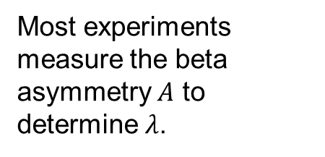

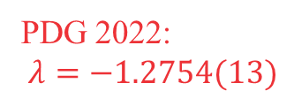
Neutron Decay Puzzle 2 (new, not very significant): Lambda
A
C
O
R
N
(
2
0
2
0
)
(
N
a
b
g
o
a
l
)
Most experiments measure the beta asymmetry $A$ to determine $λ$.
a
S
P
E
C
T
(
2
0
2
0
)
(
p
N
a
b
g
o
a
l
)
P
E
R
K
E
O
I
I
I
(
2
0
1
9
)
U
C
N
A
(
2
0
1
8
)
(
)
A
C
O
R
N
(
2
0
1
7
)
P
E
R
K
E
O
I
I
(
2
0
1
3
)
$$λ$$
f
r
o
m
$$A$$
U
C
N
A
(
2
0
1
3
)
(
)
You have heard B. Märkisch’s talk
U
C
N
A
(
2
0
1
0
)
(
)
$$λ$$
f
r
o
m
$$a$$
B
y
r
n
e
(
2
0
0
2
)
$$λ$$
f
r
o
m
$$A/B$$
P
E
R
K
E
O
I
I
(
2
0
0
2
)
(
)
Result confirmed with UCNA., no puzzle.
M
o
s
t
o
v
o
i
(
2
0
0
1
)
Y
e
r
o
z
o
l
i
m
s
k
i
i
(
1
9
9
7
)
P
E
R
K
E
O
I
I
(
1
9
9
7
)
(
)
BUT: $λ$ from neutrino electron correlation coefficient $a$ is different by $3σ$ (or: aSPECT and PERKEO III disagree)
PDG 2022:
$$λ=−1.2754(13)$$
L
i
a
u
d
(
1
9
9
7
)
P
E
R
K
E
O
(
1
9
8
6
)
S
t
r
a
t
o
w
a
(
1
9
7
8
)
-1.30
-1.28
-1.26
$$λ=g_{A}/g_{V}$$

Slide 9
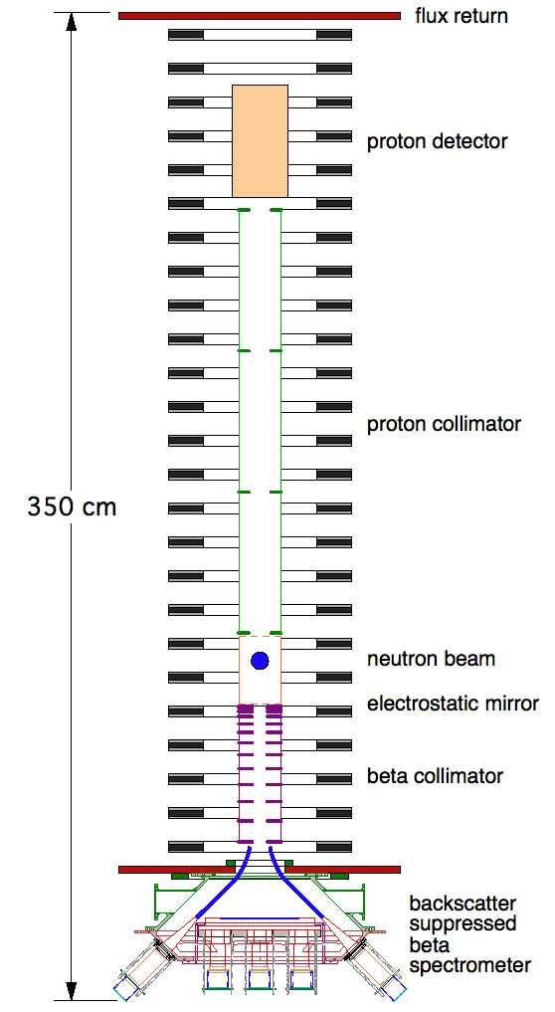
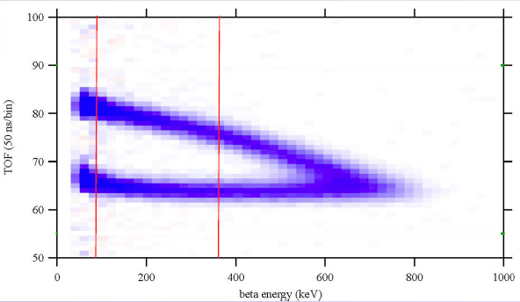
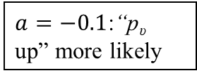
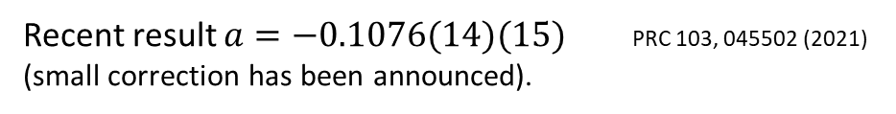
aCORN
e⁻
p
n
fit range
Magnetic
field
$a=−0.1$:“p_{υ} up” more likely
Recent result $a=−0.1076(14)(15)$ PRC 103, 045502 (2021)
(small correction has been announced).
See F. Glück’s talk
Notes:
9

Slide 10
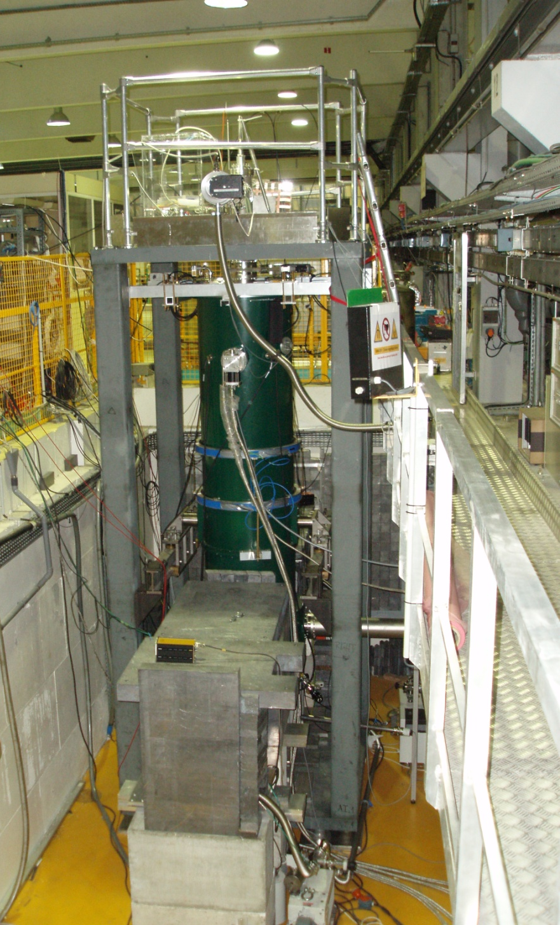
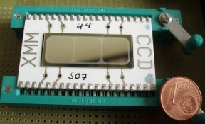
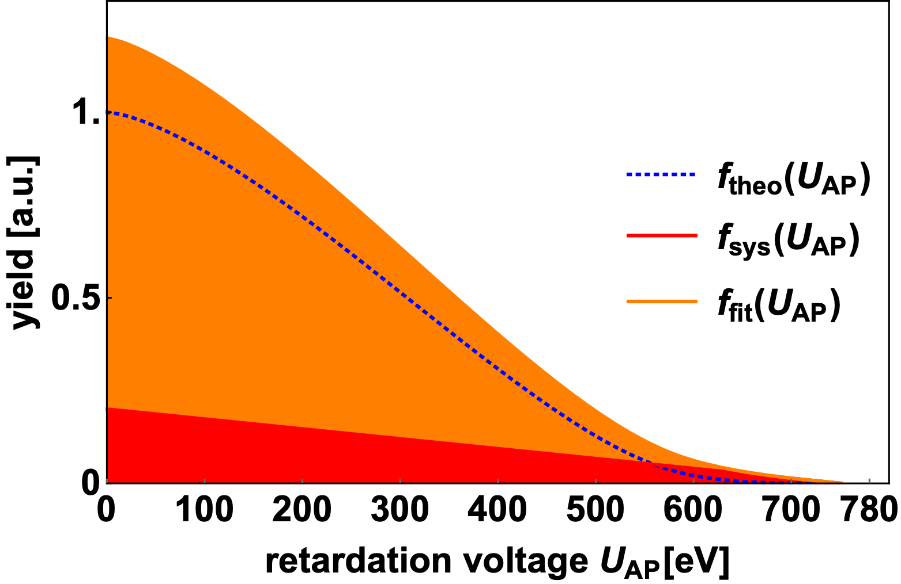
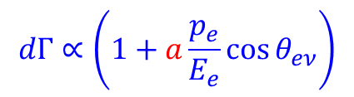


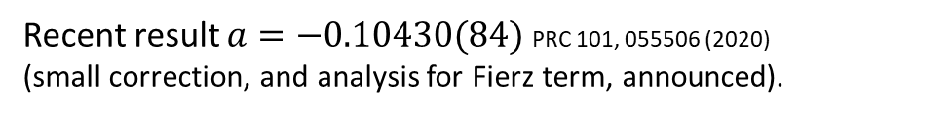
aSPECT @ ILL Grenoble
n
e⁻
$$dΓ∝\left(1+a\frac{p_{e}}{E_{e}}\cos{θ_{eν}}\right)$$
p
$$θ_{eν}$$
$$\overline{ν_{e}}$$
Proton Detector
Magnetic
field
Decay rate w(E)
Spectrum for a = +0.3
… for a = -0.103 [PDG2016]
0
200
400
600
Analyzing Plane
Electrode
Proton kinetic energy E [eV]
*
*
Protons
*
Neutron Decay
*
*
*
*
*
*
*
Recent result $a=−0.10430(84)$ PRC 101, 055506 (2020)
(small correction, and analysis for Fierz term, announced).

Slide 11
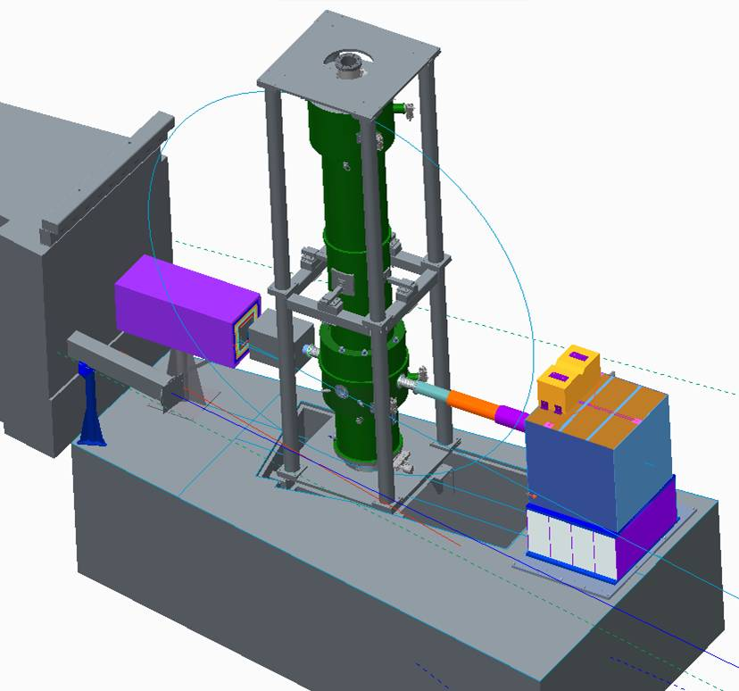
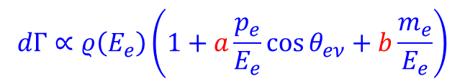

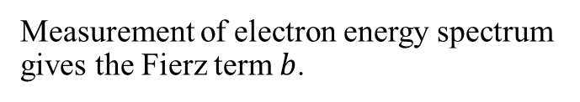
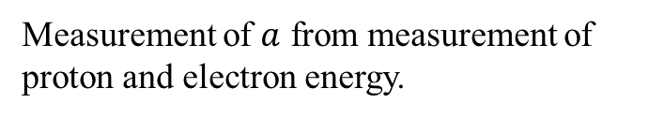

The Nab experiment
n
e⁻
Nab @ Fundamental Neutron Physics Beamline (FNPB) @ Spallation Neutron Source (SNS)
p
$$θ_{eν}$$
$$\overline{ν_{e}}$$
Multipixel Si detectors for decay electrons and protons
$$dΓ∝ρ\left(E_{e}\right)\left(1+a\frac{p_{e}}{E_{e}}\cos{θ_{eν}}+b\frac{m_{e}}{E_{e}}\right)$$
8 meters
Measurement of electron energy spectrum gives the Fierz term $b$.
Measurement of $a$ from measurement of proton and electron energy.
Cold Neutron Beam from left
General Idea: J.D. Bowman, Journ. Res. NIST 110, 40 (2005)
Original configuration: D. Počanić et al., NIM A 611, 211 (2009)
Asymmetric configuration: S. Baeßler et al., J. Phys. G 41, 114003 (2014)

Slide 12


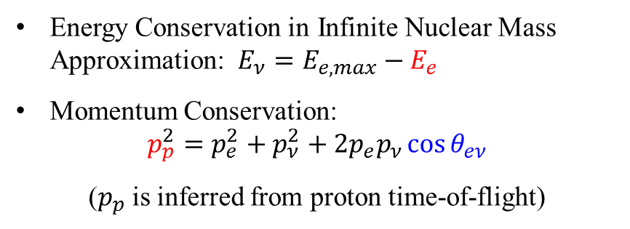
Idea of the cos θ_{eν} spectrometer Nab @ SNS
n
e⁻
Energy Conservation in Infinite Nuclear Mass Approximation: $E_{ν}=E_{e,max}−E_{e}$
Momentum Conservation:
$$p_{p}^{2}=p_{e}^{2}+p_{ν}^{2}+2p_{e}p_{ν}\cos{θ_{eν}}$$
($p_{p}$ is inferred from proton time-of-flight)
p
$$θ_{eν}$$
$$\overline{ν_{e}}$$
$$dΓ∝ρ\left(E_{e}\right)\left(1+a\frac{p_{e}}{E_{e}}\cos{θ_{eν}}+b\frac{m_{e}}{E_{e}}\right)$$
1.5
Proton phase space (Dalitz plot)
Probability (arb. units)
E_{e} =
1.25
700 keV
cos θ_{eν} = 1
236 keV
1
0.75
75 keV
p_{p}² [MeV²/c²]
0.5
cos θ_{eν} = 0
cos θ_{eν} = -1
450 keV
0.25
0
0
0.2
0.4
0.6
0.8
E_{e} [MeV]

Slide 13
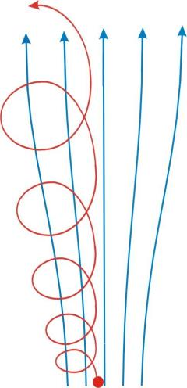

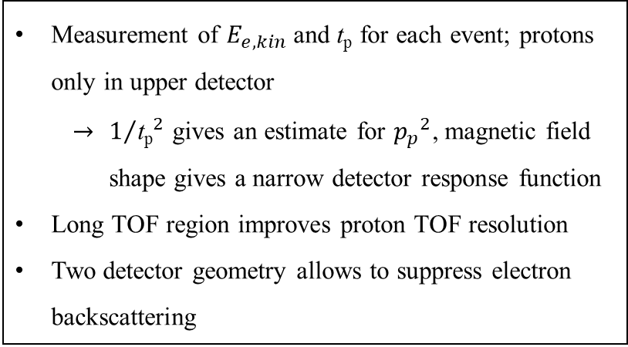



Nab spectrometer principle: measurement of E_{e} and t_{p}
- 30 kV
$$p_{∥}$$
$$p_{⊥}$$
Magnetic Field
TOF region
(low field)
Adiabatic conversion
4 m flight path skipped
magnetic filter
region (field maximum)
Proton Trajectory
$$p_{∥}$$
decay volume
$$p_{⊥}$$
0 kV
Measurement of $E_{e,kin}$ and $\text{t}\text{p}$ for each event; protons only in upper detector
    $1/{{\text{t}\text{p}}_{}^{2}}$ gives an estimate for ${p_{p}}^{2}$, magnetic field shape gives a narrow detector response function
Long TOF region improves proton TOF resolution
Two detector geometry allows to suppress electron backscattering
Neutron
beam
1 m flight path skipped
0-1 kV

Slide 14





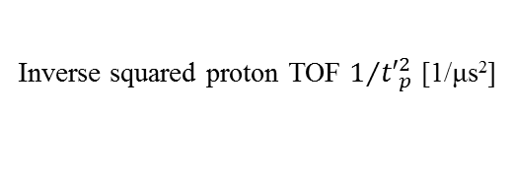

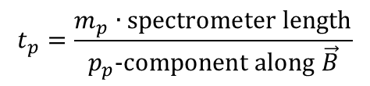



Nab data analysis
$$1+a\frac{p_{e}}{E_{e}}\cos{θ_{eν}\left({p_{p}}^{2}\right)}$$
Full GEANT4 spectrometer simulation:
p_{p}² distribution
$$\cos{θ_{eν}\left({p_{p}}^{2}\right)}=−1$$
$E_{e,kin}=150$ keV
$$\cos{θ_{eν}\left({p_{p}}^{2}\right)}=+1$$
$E_{e,kin}=300$ keV
12000
$E_{e,kin}=450$ keV
$E_{e,kin}=450$ keV
8000
Yield
0.0
0.5
1.0
1.5
4000
$E_{e,kin}=600$ keV
p_{p}² [MeV²/c²]
$E_{e,kin}=750$ keV
0
0
0.002
0.004
0.006
$$t_{p}=\frac{m_{p}∙\text{spectrometer} \text{length}}{p_{p}\text{−}\text{component} \text{along} \vec{B}}$$
Inverse squared proton TOF $1/{{t′}_{p}^{2}}$ [1/μs²]
Data analysis: Use edge to determine or verify the spectrometer TOF response function.
Then, use central part to determine slope and correlation coefficient a. Need agreement for all.

Slide 15
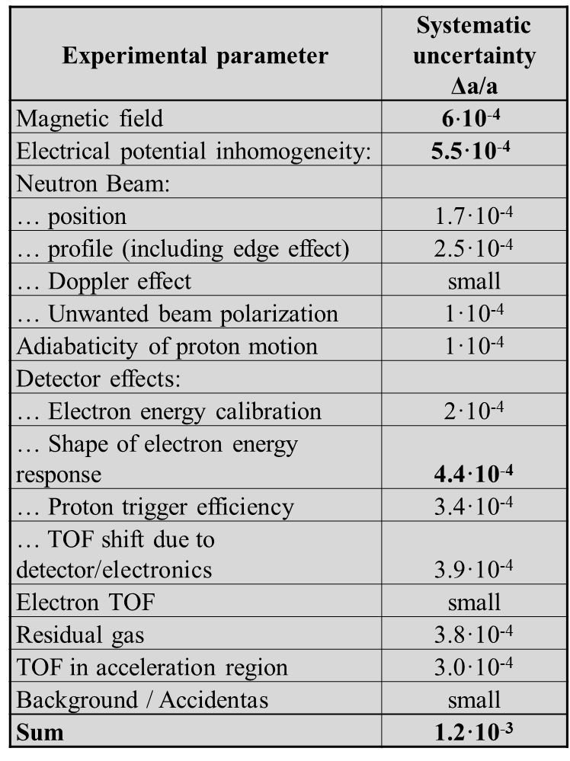
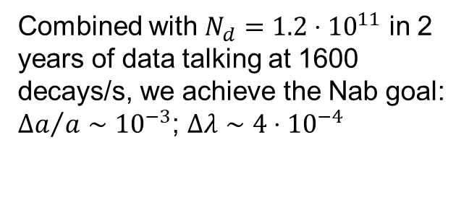
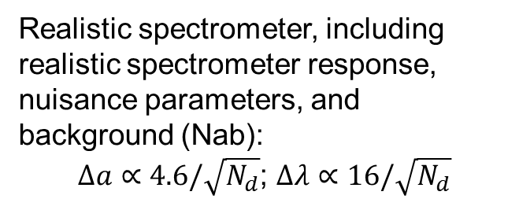
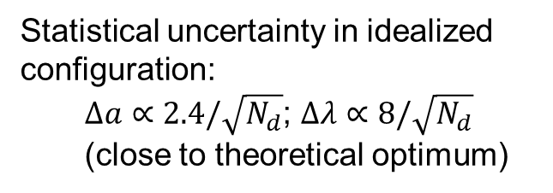
Nab-a goal for SNS
Experimental parameter | Systematic uncertainty Δa/a
Magnetic field | 6$⋅$10⁻⁴
Electrical potential inhomogeneity: | 5.5·10⁻⁴
Neutron Beam:
… position | 1.7·10⁻⁴
… profile (including edge effect) | 2.5·10⁻⁴
… Doppler effect | small
… Unwanted beam polarization | 1·10⁻⁴
Adiabaticity of proton motion | 1·10⁻⁴
Detector effects:
… Electron energy calibration | 2·10⁻⁴
… Shape of electron energy response | 4.4·10⁻⁴
… Proton trigger efficiency | 3.4·10⁻⁴
… TOF shift due to detector/electronics | 3.9·10⁻⁴
Electron TOF | small
Residual gas | 3.8·10⁻⁴
TOF in acceleration region | 3.0·10⁻⁴
Background / Accidentas | small
Sum | 1.2·10⁻³
Statistical uncertainty in idealized configuration:
  $Δa∝2.4/\sqrt{N_{d}}$; $Δλ∝8/\sqrt{N_{d}}$
  (close to theoretical optimum)
Realistic spectrometer, including realistic spectrometer response, nuisance parameters, and background (Nab):
  $Δa∝4.6/\sqrt{N_{d}}$; $Δλ∝16/\sqrt{N_{d}}$
Combined with $N_{d}=1.2⋅{10}^{11}$ in 2 years of data talking at 1600 decays/s, we achieve the Nab goal: ${Δa}/a∼{10}^{−3}$; $Δλ∼4⋅10^{−4}$

Slide 16
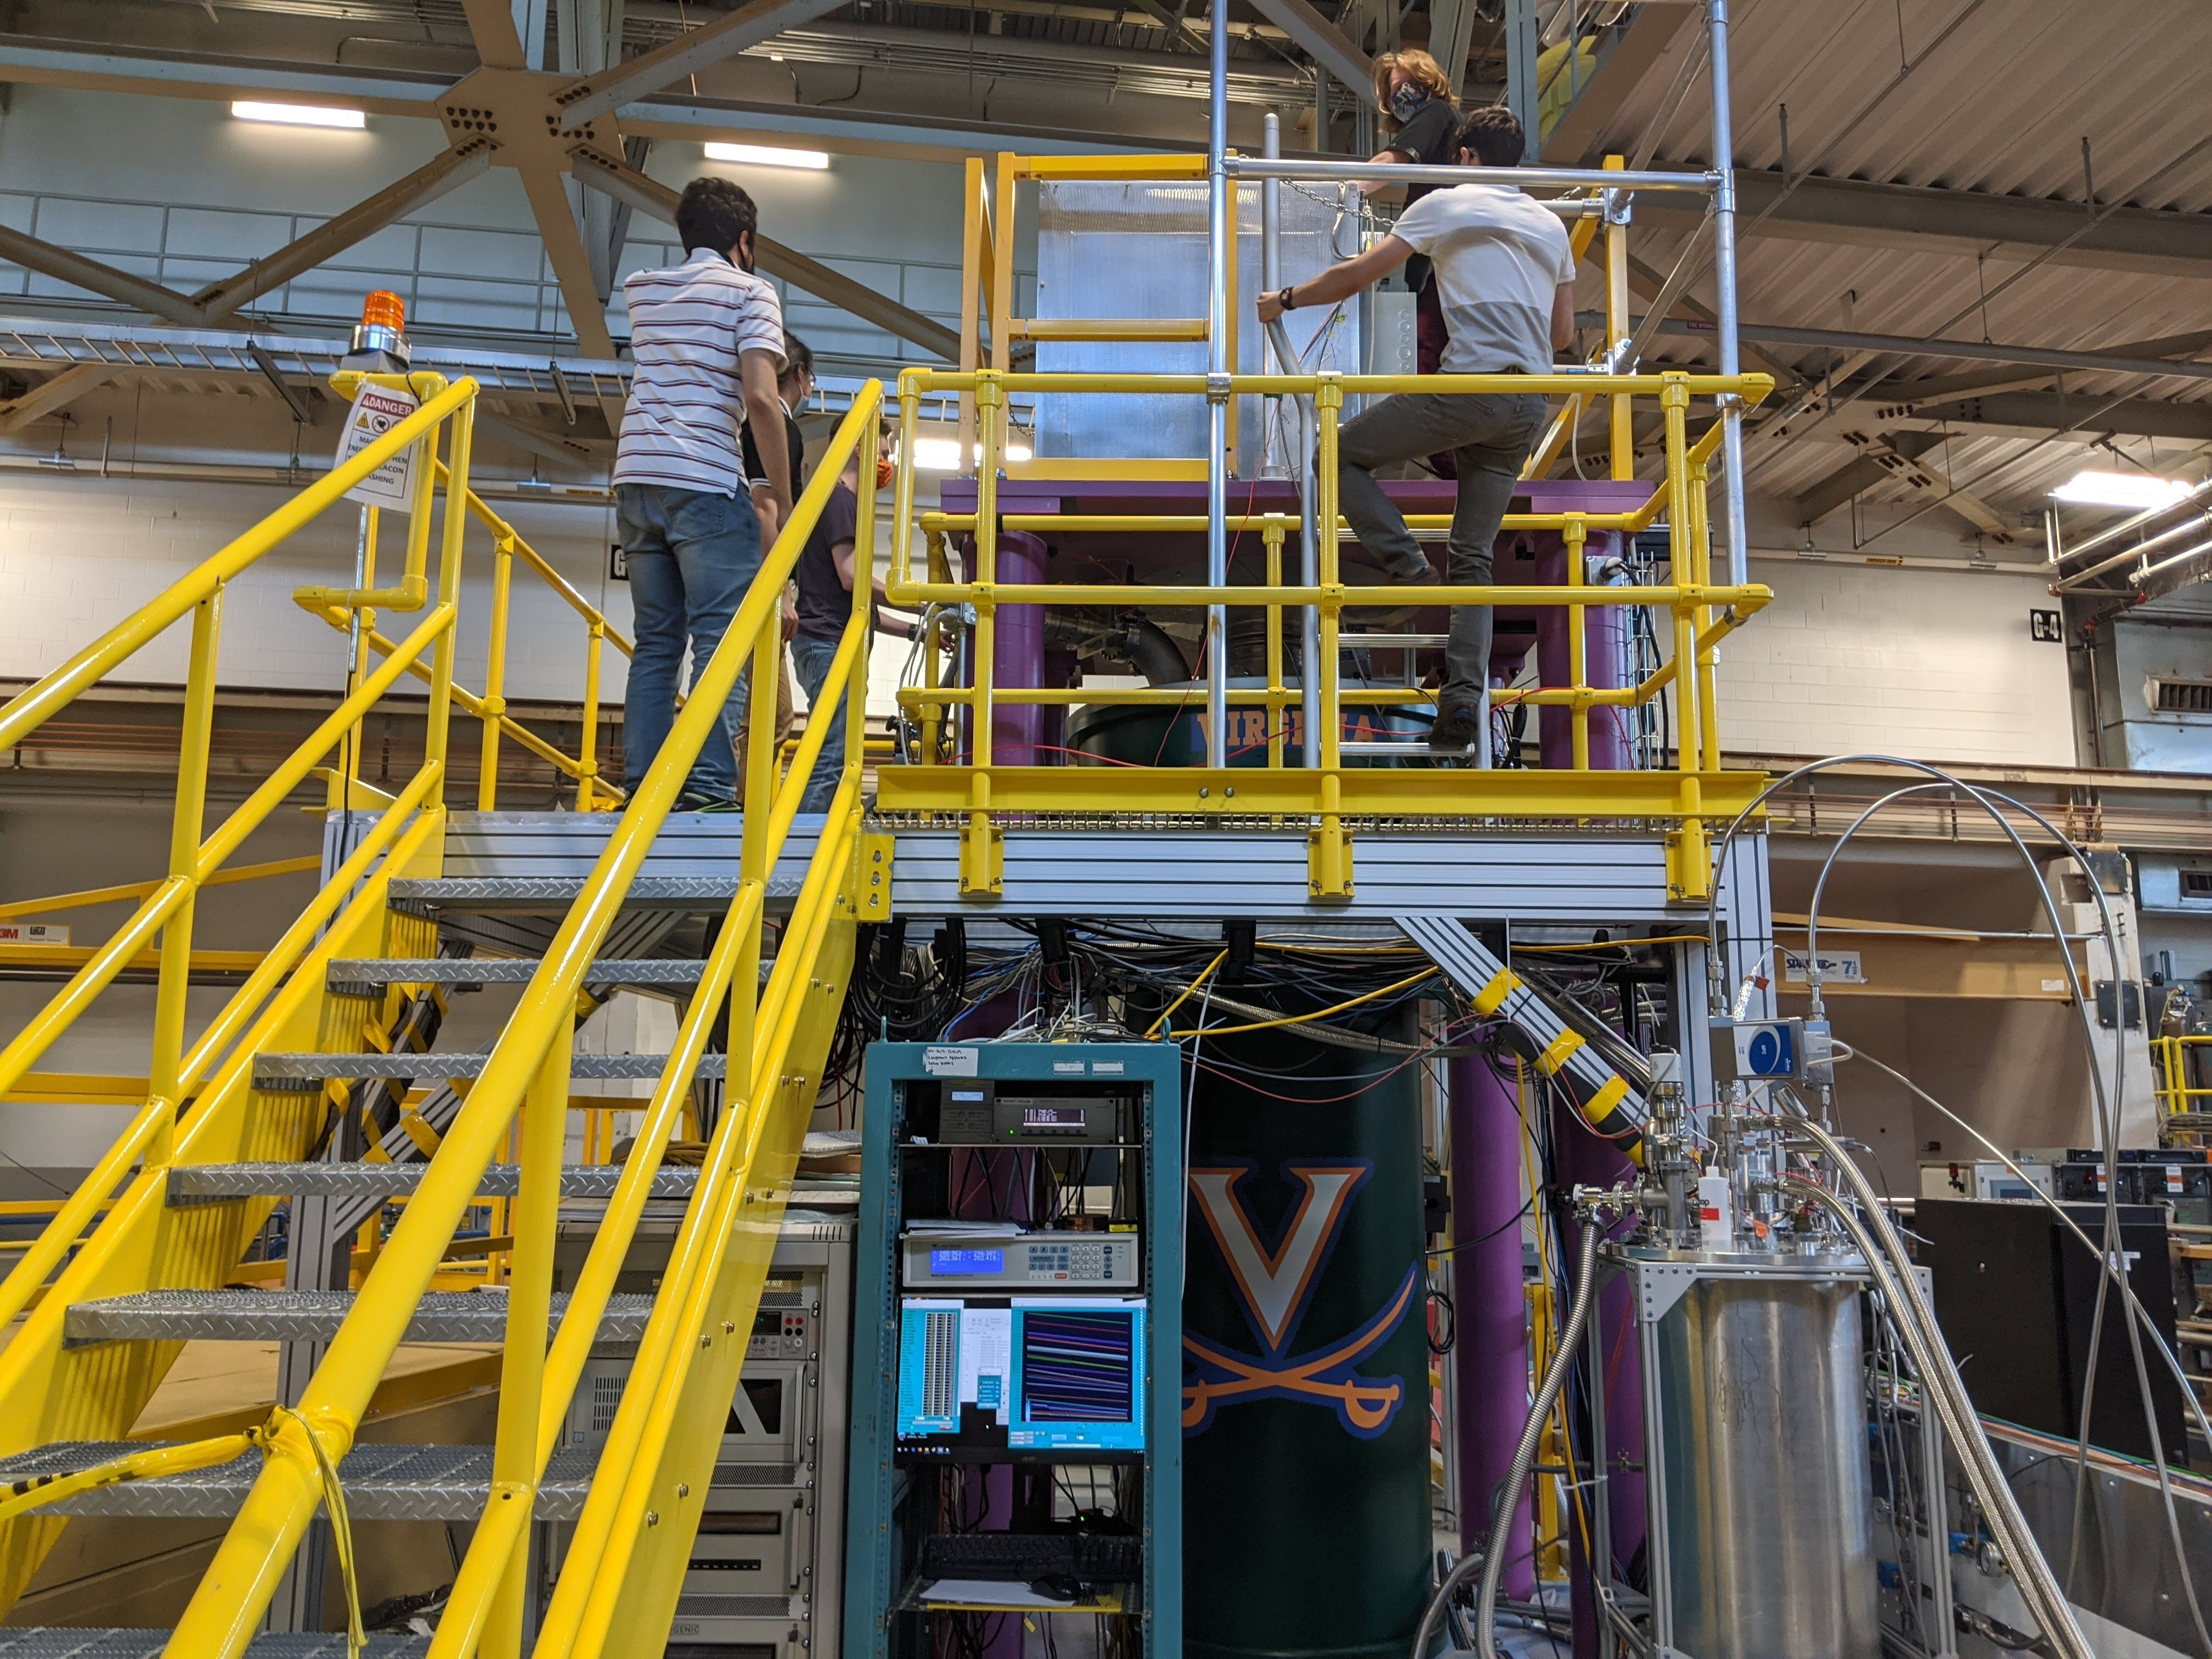
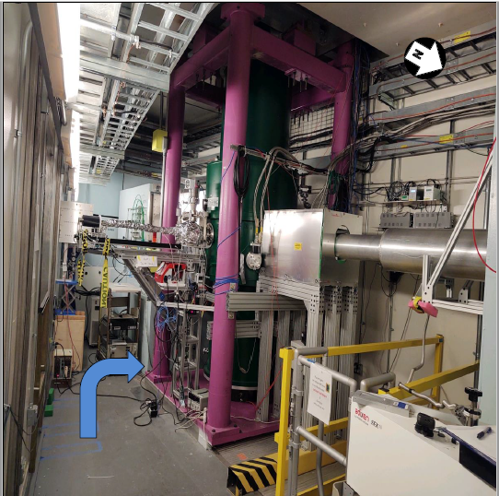

Nab experiment status and another puzzle
Nab experiment installation completed September 2021
Now in commissioning phase, that is, the collaboration is working on understanding all subsystems
However, another puzzle, although not of any general interest:
  Since last summer, the magnet does not cool down any more. We are not out of trivial solutions, but we are losing lots of possible beam time.

Slide 17
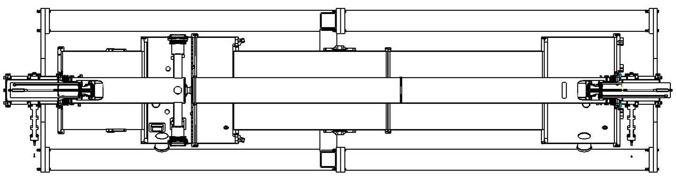












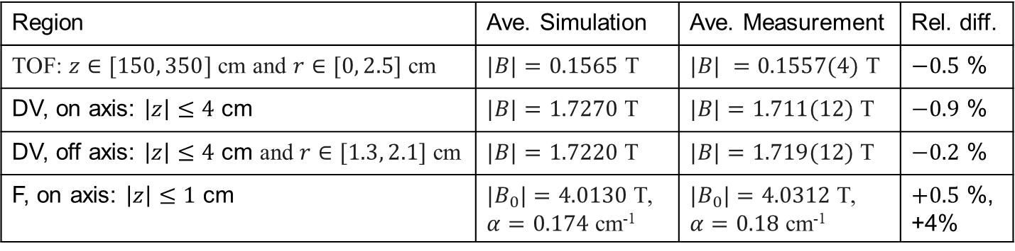


Initial results of Nab magnetic field mapping
Filter and TOF regions:
4
filter region (F)
3
$Bz$ [T]
2
1
decay volume (DV)
TOF region
0
-50
0
50
100
150
$z$ [cm]
Region | Ave. Simulation | Ave. Measurement | Rel. diff.
TOF: $z∈[150, 350]$cm and $r∈[0, 2.5]$ cm | $|B|=0.1565$ T | $|B| =\text{0.1557(4)}$ T | $−0.5$ %
DV, on axis: $\left|z\right|≤4$ cm | $|B|=\text{1.7270}$ T | $|B|=\text{1.7}\text{11}$(12) T | $−0.9$ %
DV, off axis: $\left|z\right|≤4$ cm and $r∈[1.3, 2.1]$ cm | $|B|=\text{1.72}\text{2}\text{0}$ T | $|B|=\text{1.7}\text{19}$(12) T | $−0.2$ %
F, on axis: $\left|z\right|≤1$ cm | $|B_{0}|=4.0130$ T, $α=0.174$ cm⁻¹ | $|B_{0}|=4.0312$ T, $α=0.18$ cm⁻¹ | $+0.5$ %, +4%
In filter region, mag field magnitude can be approximated with $\left|B\right|=B_{0}\left(1−{\left(αz\right)}^{2}\right)$

Slide 18
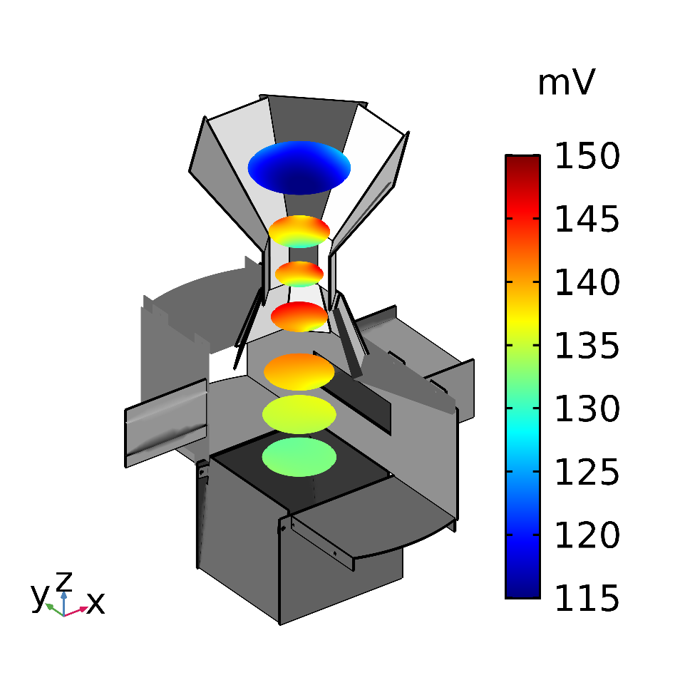

Main electrode system
The main electrode system was characterized, assembled and installed in the spectrometer magnet. It has a surface coating to minimize fluctuations of the work function.
Magnetic field
Upper part, top view:
Neutron beam
Filter
Decay volume
The project was hoping to know the difference between the voltage in decay volume and filter region to 25 mV (One of the project’s KPP). We achieved 10 mV (the ultimate goal).
Courtesy A. Bryant

Slide 19



Neutron beam profile measurement
Specification:
Want to know beam position in horizontal and vertical direction with accuracy of 1 mm
Want to know shape. In vertical direction, no tight constraints are expected. In horizontal direction, slope at the edges (as they are defined by the detectors, this is in software) have to be known to 3%/cm to avoid uncertainties due to edge effect.
Expected shape (Mae Scott, UT):
Measurement:
Projection of measurement
Responsible: E. Iverson, G. Dodson, SNS
(vertical gray lines: Max. size of decay volume)

Slide 20





Status of Nab experiment: Characterization of Detector
127 pixel Si detector, 2 mm thick
Energy resolution a few keV
Lower (proton) detection threshold 10 keV
Detector transit time bias sub-ns
$e^{−}$, $p$
Detetctoir Design: M. Makela et al., LANL, L. Broussard et al., ORNL
Proton source:: N. Macsai, A. Mendelsohn, M. Gericke, (U. Mantiboa), R. Mammei (U. Winnipeg)
Electron detection
Proton detection
Analysis:
Jin Ha Choi, Leendert Hayen

Slide 21






The measurement of the Fierz Interference Term $b$
e⁻
$$dΓ∝ρ\left(E_{e}\right)\left(1+a\frac{p_{e}}{E_{e}}\cos{θ_{eν}}+b\frac{m_{e}}{E_{e}}\right)$$
p
$$θ_{eν}$$
n
$$\overline{ν_{e}}$$
Systematic uncertainties:
Electron energy determination
Most stringent requirement: Non-linearity of 0.01%
Background
0 V
5
10
Detector response to decay
electron with $E_{e}=300$ keV
4
10
TOF region
(low field)
3
10
)
4 m flight path skipped
s
d
t
l
i
e
magnetic filter
region (field maximum)
n
i
u
Y
2
.
10
b
Electron spectrum:
r
a
1
(
10
2% of events in tail
(deadlayer, bremsstrahlung)
d
decay volume
l
b
= +0.1
e
i
SM
1
Y
0
50
100
150
200
250
300
0 kV
detected E_{e} [keV]
+1 kV
Neutron
beam
1 m flight path skipped
0
2
0
0
4
0
0
6
0
0
8
0
0
-30 kV
- 30 kV
$$E_{e,kin} \text{(}\text{keV}\text{)}$$
Goal: $Δb≤3⋅10^{−3}$

Slide 22





pNab: Measurement of correlation coefficients with polarized neutrons
$b$ or $b_{ν}$ may indicate S,T
$B_{0}≠B_{0}(λ)$ may indicate V+A
$$dΓ∝ρ\left(E_{e}\right)\left(1+a\frac{p_{e}}{E_{e}}\cos{({\vec{p}}_{ν},{\vec{p}}_{e})}+b\frac{m_{e}}{E_{e}}+A_{0}\frac{p_{e}}{E_{e}}\cos{({\vec{σ}}_{n},{\vec{p}}_{e})}+\left(B_{0}+b_{ν}\frac{m_{e}}{E_{e}}\right)\cos{({\vec{σ}}_{n},{\vec{p}}_{ν})}\right)$$
$$a_{0}=a_{0}\left(λ\right)$$
$$A_{0}=A_{0}\left(λ\right)$$
New addition:
Neutron beam polarizer
Goal: $\frac{ΔA}{A}∼8⋅{10}^{−4}$

Slide 23









Detector systematics
Electron energy calibration
Detector response in Si detector for incoming E_{e} = 300 keV,
(Max. impact angle of electrons is ${12}^{∘}$, due to magnetic filter)
5
²⁰⁷Bi
10
detected E_{e} for e⁻ in lower detector
$$E=g⋅x+E_{0}$$
4
detected E_{e} with only lower detector
10
width
Reconstructed energy $E$
¹⁰⁹Cd
²⁰⁷Bi
3
¹¹³Sn
10
¹³⁹Ce
Yield
(mostly)backscattering
2
Pulse height $x$
10
1
Tail amplitude $t$
$$ΔE_{max}$$
10
$$0$$
Residual
(mostly) bremsstrahlung
$$ΔE_{max}$$
1
0
50
100
150
200
250
300
Pulse height
detected E_{e} [keV]
Specification | for $Δa=3⋅10^{−5}$ In Nab | for $ΔA=3⋅10^{−5}$ In pNab | for $Δb=5⋅10^{−4}$ In Nab | for $Δb=5⋅10^{−4}$ In pNab
gain factor $(Δg/g$) | fit parameter | 0.0018 | fit parameter | 0.0008
Offset $E_{0}$ | 0.3 keV | 0.2 keV | 0.03 keV | 0.05 keV
Nonlinearity ( $ΔE_{max}$) | 1.5 keV | 0.3 keV | 0.03 keV | 0.1 keV
peak width | 1 keV | 10 keV | 3 keV | 8 keV
tail amplitude ($Δt$ of peak) | 0.01% | 2.40% | 0.1% | 0.9%
 |  |  | (numbers for Si detector, H. Li)
Requirements in pNab equal or less than what Nab requires!

Slide 24






Summary
The BIG PUZZLE: IS THE STANDARD MODEL OF ELEMENTARY PARTICLE PHYSICS FINALLY BREAKING?
Currently, unitarity of the CKM matrix is violated by about $2−3σ$. This test is based on $V_{ud}$ from superallowed nuclear decays and Kaon decays. Both inputs are under scrutiny. $2−3σ$ is not yet a big deal.
Neutron beta decay could replace nuclear beta decay if experiments gain accuracy. There is steady, albeit slow progress. Theoretically, that would be cleaner.
Neutron beta decays
0.228
Kaon decays ($K_{e3}$)
0.226
Vus
0.224
Unitarity
0.222
Superallowed nuclear decays
Kaon decays ($K_{μ2}$)
0.220
0.960
0.965
0.970
Vud
0.975
Courtesy V. Cirigliano
Physics goal for neutron beta decay should be at least ${Δτ}_{n}∼0.3$ s and $Δλ/|λ|∼3⋅{10}^{−4}$ (for unitarity test), or $Δb∼{10}^{−3}$ or and $Δb_{ν}∼{10}^{−3}$. Several experiments promise to get there.
It is insufficient to just do one experiment for each input, we need to understand current discrepancies.
Courtesy F. Gonzalez

Slide 25













The Nab collaboration
Nab collaborating institutions:
University of South Carolina, Universität Karlsruhe (TH), Universidad Nacional Autónoma de México, Western Kentucky University
Main project funding:

Slide 27



Limits for scalar(S) and tensor(T) interactions at quark level
Similar limits on $ε_{T}$ are obtained from radiative pion beta decay
M. Bychkov et al., PRL 103, 051802 (2009)
LHC limit from $p+p→e^{+}+e^{−}+X$,
Assumed validity of EFT
Fig. from V. Cirigliano, M. Gonzales Alonso, after PPNP 104, 165 (2019)
Search for BSM physics, may show as S,T interactions (fermions with “wrong” helicity) at low energies. Competitive if
$Δb∼{10}^{−3}$ or $Δb_{ν}∼{10}^{−3}$ in neutron beta decay, or $Δb∼{10}^{−3}$ in ⁶He beta decay

Slide 28







The Beta Asymmetry $A$ in neutron beta decay
Final result of UCNA:
$$A=−0.12015(34)stat (63)sys$$
UCNA
.
$${\vec{σ}}_{n}$$
e⁻
M. Brown et al., PRC 97, 035505 (2018)
p
n
$$\overline{ν_{e}}$$
Electron Detector (Plastic Scintillator)
Decay Electrons
PERKEO III
$$b=0.066(41)stat (24)sys$$
X. Sun et al., PRC 101, 035503 (2020)
Detector 1
electrons
Detector 2
Polarized Neutrons
neutrons
Neutron
Beamstop
$$A=−0.11985(17)stat (12)sys$$
B. Märkisch et al., PRL. 122, 242501 (2019)
Split Pair Magnet
PERKEO II
Magnetic Field
$$b=0.017(20)stat (3)sys$$
H. Saul et al., PRL 125, 112501 (2020)
$A=−0.11972(+53/−65)$ D. Mund et al., PRL 110, 172502 (2013)

Slide 29





Potential neutron decay sources stronger than in use in the past
Cold neutrons (PERC)
Magnetic Filter
Cryostat
Concept similar to PERKEO III, very high decay rate (up to MHz) in long neutron guide
Versatile source of decay products can be coupled with different proton or electron detectors
R×B spectrometer for $e^{−}$ or $p$ (NOMOS)
Electron or proton detector (Plastic scintillator, silicon)
(+ backscatter detector?)
MAC-E filter
(as in “aSPECT” – see later)
Transverse displacement of beam $∝p$
MLZ München, TU Vienna, U Heidelberg et al.

Slide 30

Potential neutron decay sources stronger than in use in the past
.
UCNA
Ultra cold neutrons
Recent upgrades of UCN source at LANL allow for count rates that allow for ${ΔA}/A<2⋅{10}^{−3}$ (UCNA+).
Also, improvements to detection system planned to reduce uncertainty associated with backscattering
UCN density (UCN/cm³)
200
180
160
140
120
100
80
60
40
20
0
T. Ito et al., PRC 97, 012501(R) (2018)
2004 2006 2008 2010 2012 2014 2016
Year

