Slide 1
Probing Nuclear Sizes with Precision Spectroscopy in Bosonic and Fermionic Helium
Yuri van der Werf
LaserLaB VU Amsterdam
FFK meeting Vienna, 2023

Slide 2
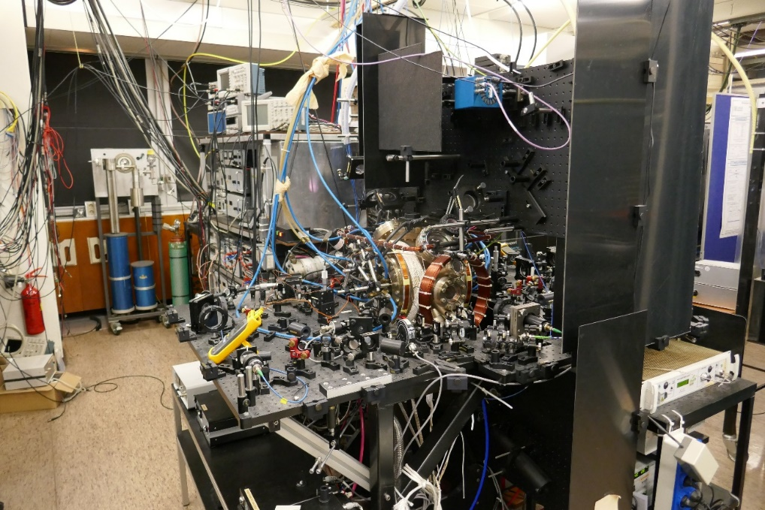
Precision measurements
for fundamental physics
Fundamental Physics
Tabletop Experiments
  High precision measurements
  Bound-state QED (theory collaborators)
  He, He⁺,H₂, HD, HT, HD⁺, H₂⁺, …
Simple, calculable, systems

Slide 3
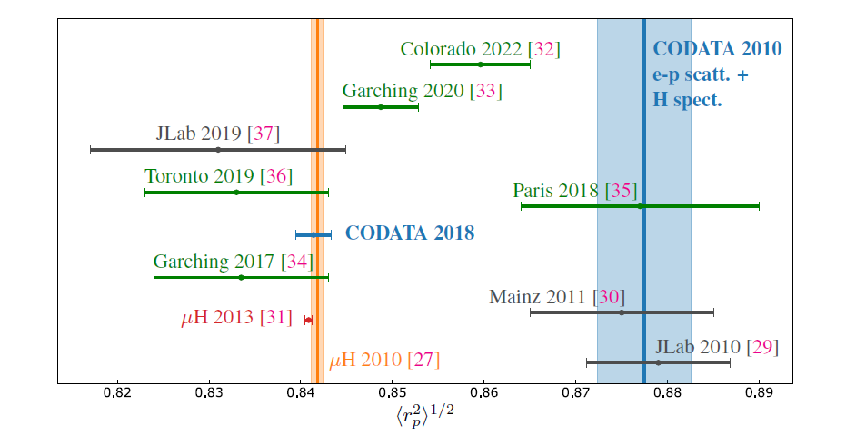
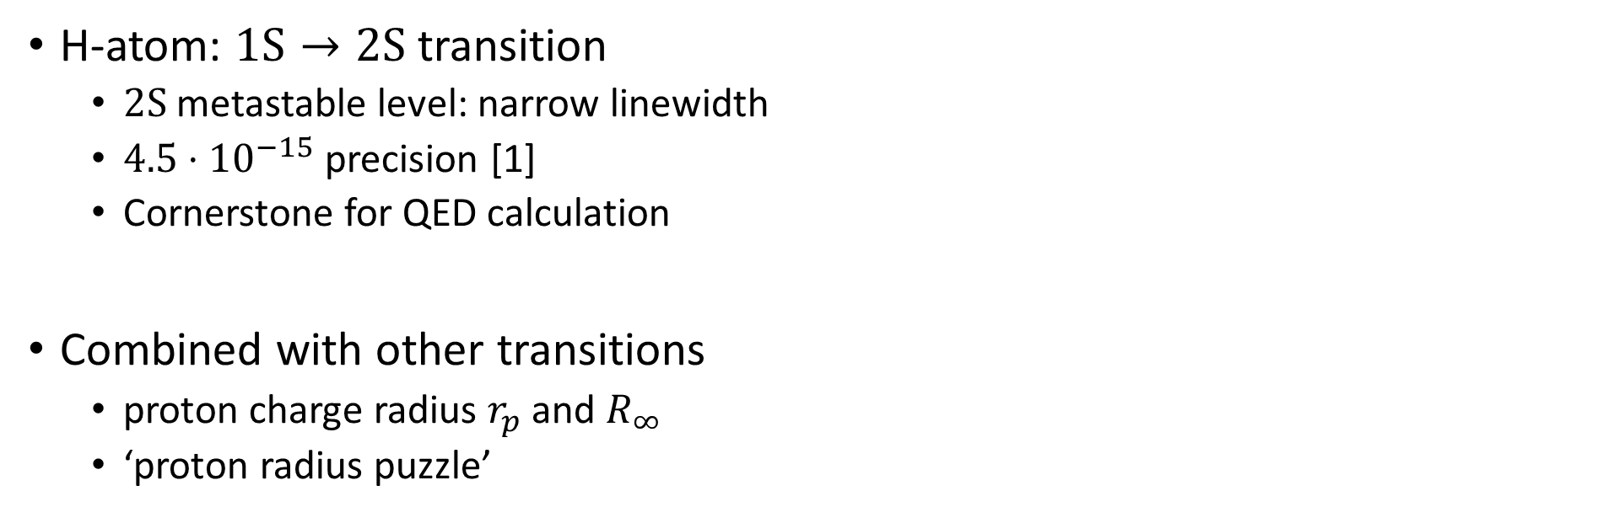
Precision measurements
For fundamental physics
Simple, calculable, systems
H
1
H-atom: $1S→2S$ transition
  $2S$ metastable level: narrow linewidth
  $4.5⋅{10}^{−15}$ precision [1]
  Cornerstone for QED calculation
Combined with other transitions
  proton charge radius $r_{p}$ and $R_{∞}$
  ‘proton radius puzzle’
1
Hydrogen
[1] Matveev et al. Phys. Rev. Lett. 110, no. 23 (June 2013): 230801.

Slide 4
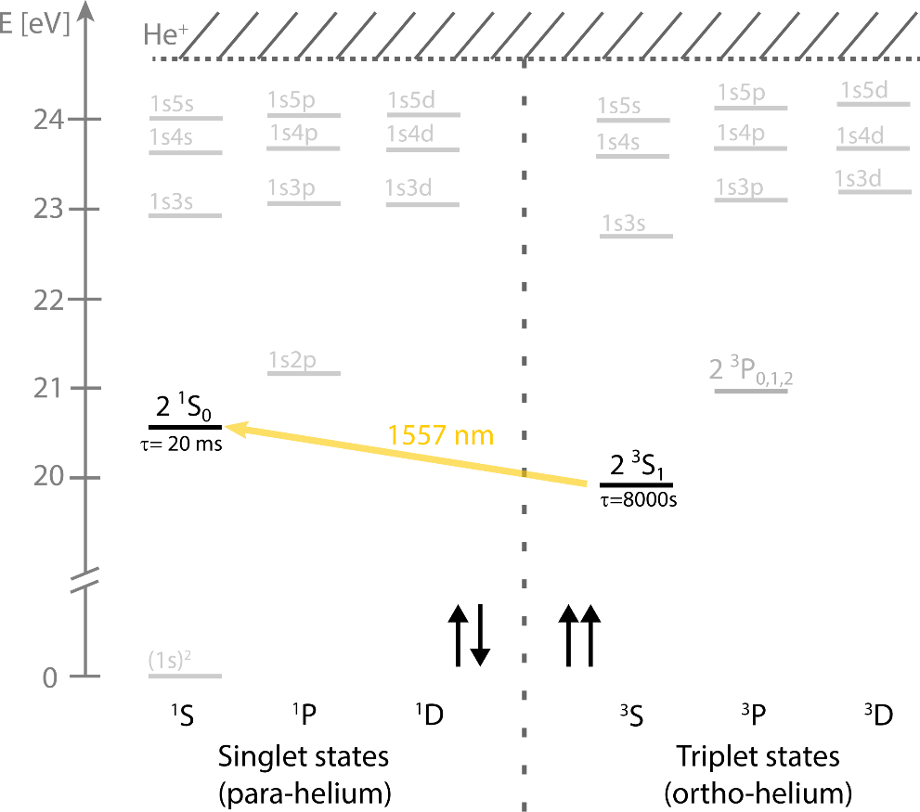
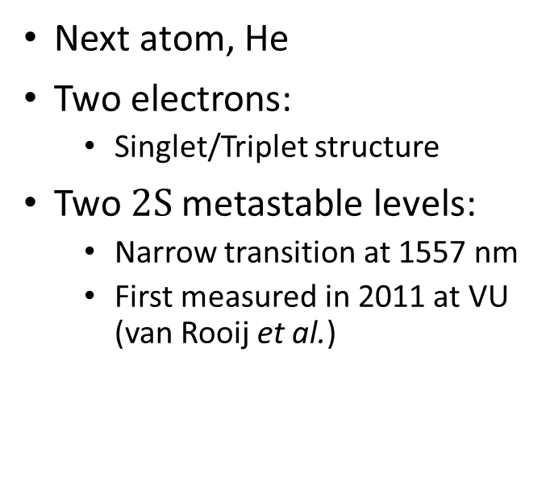
Precision measurements
For fundamental physics
He
4
Next atom, He
Two electrons:
  Singlet/Triplet structure
Two $2S$metastable levels:
  Narrow transition at 1557 nm
  First measured in 2011 at VU (van Rooij et al.)
2
Helium

Slide 5
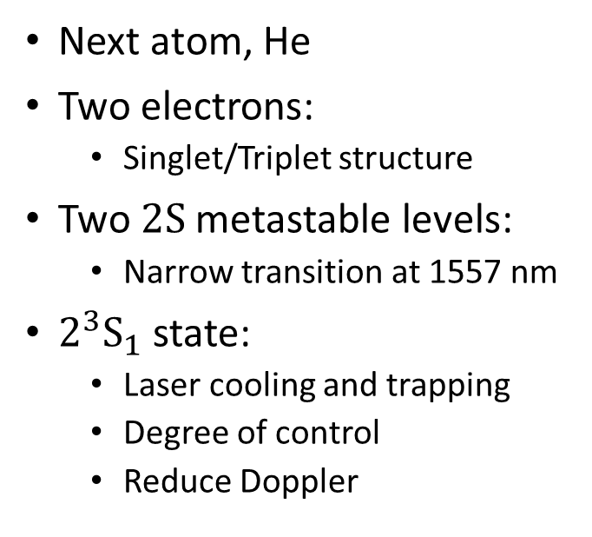
Precision measurements
For fundamental physics
He
4
Next atom, He
Two electrons:
  Singlet/Triplet structure
Two $2S$metastable levels:
  Narrow transition at 1557 nm
$2^{3}S_{1}$ state:
  Laser cooling and trapping
  Degree of control
  Reduce Doppler
2
Helium
1083 nm

Slide 6
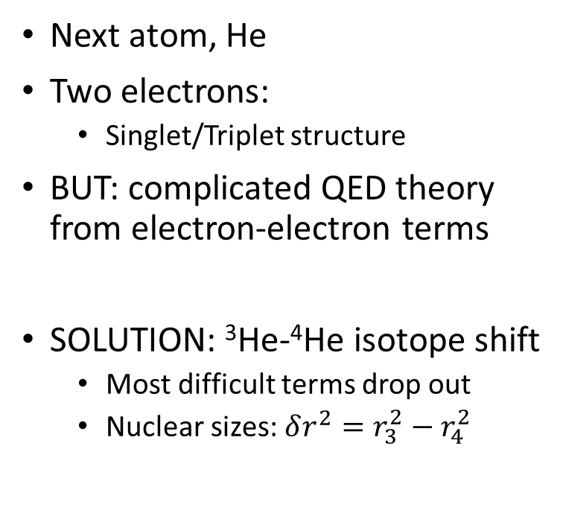
Precision measurements
For fundamental physics
He
4
Next atom, He
Two electrons:
  Singlet/Triplet structure
BUT: complicated QED theory from electron-electron terms
SOLUTION: ³He-⁴He isotope shift
  Most difficult terms drop out
  Nuclear sizes: $δr^{2}=r_{3}^{2}−r_{4}^{2}$
2
Helium

Slide 7
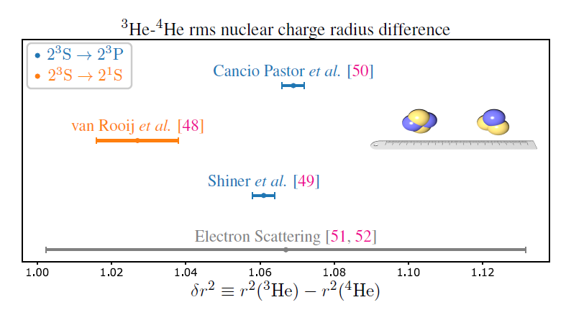
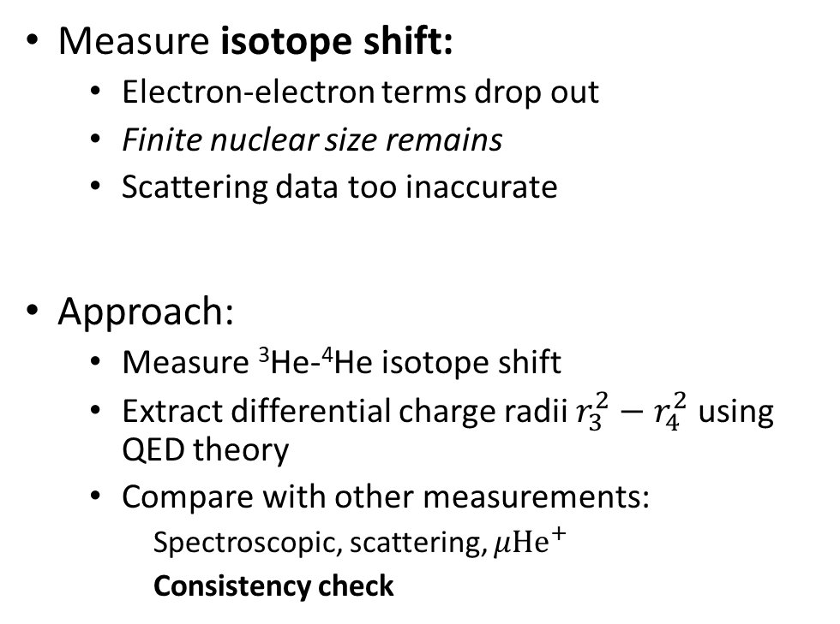
The helium atom
Measure isotope shift:
  Electron-electron terms drop out
  Finite nuclear size remains
  Scattering data too inaccurate
Approach:
  Measure ³He-⁴He isotope shift
  Extract differential charge radii $r_{3}^{2}−r_{4}^{2}$ using QED theory
  Compare with other measurements:
    Spectroscopic, scattering, $μ{He}^{+}$
    Consistency check

Slide 8
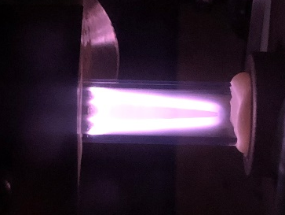
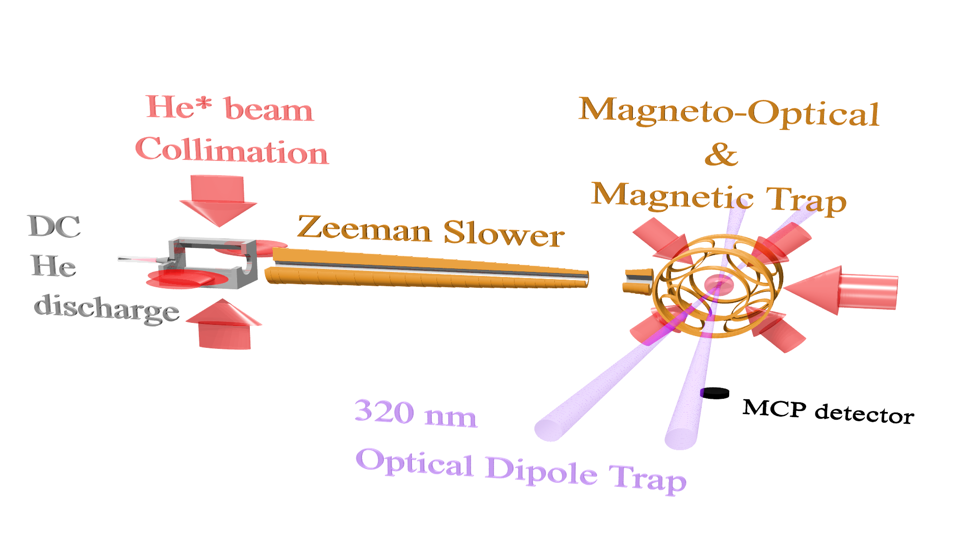
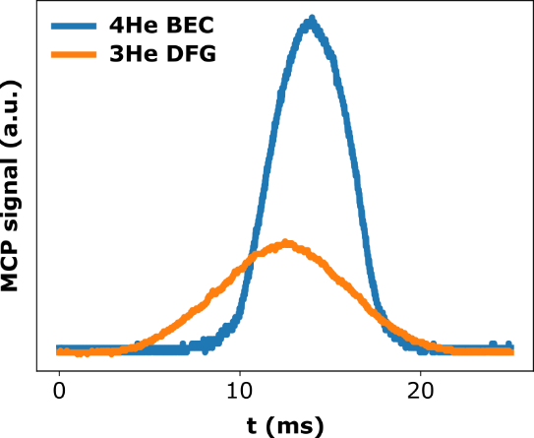
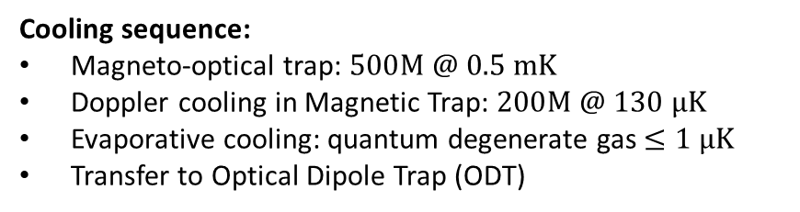
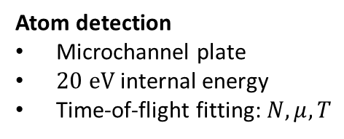
Quantum degenerate He*
Atom detection
Microchannel plate
$20 eV$ internal energy
Time-of-flight fitting: $N,μ,T$
Cooling sequence:
Magneto-optical trap: $500M @ 0.5 mK$
Doppler cooling in Magnetic Trap: $200M @ 130 μK$
Evaporative cooling: quantum degenerate gas $≤1 μK$
Transfer to Optical Dipole Trap (ODT)

Slide 9
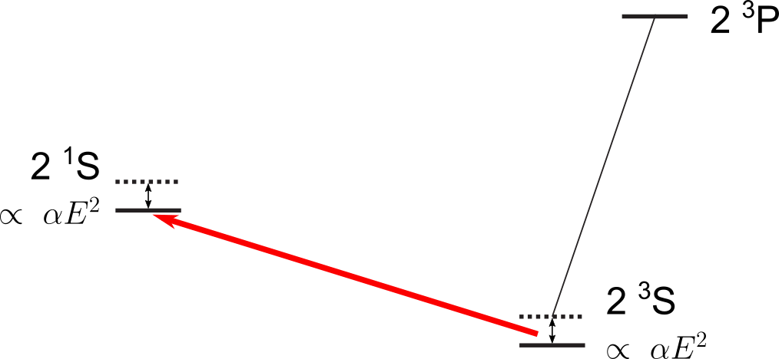
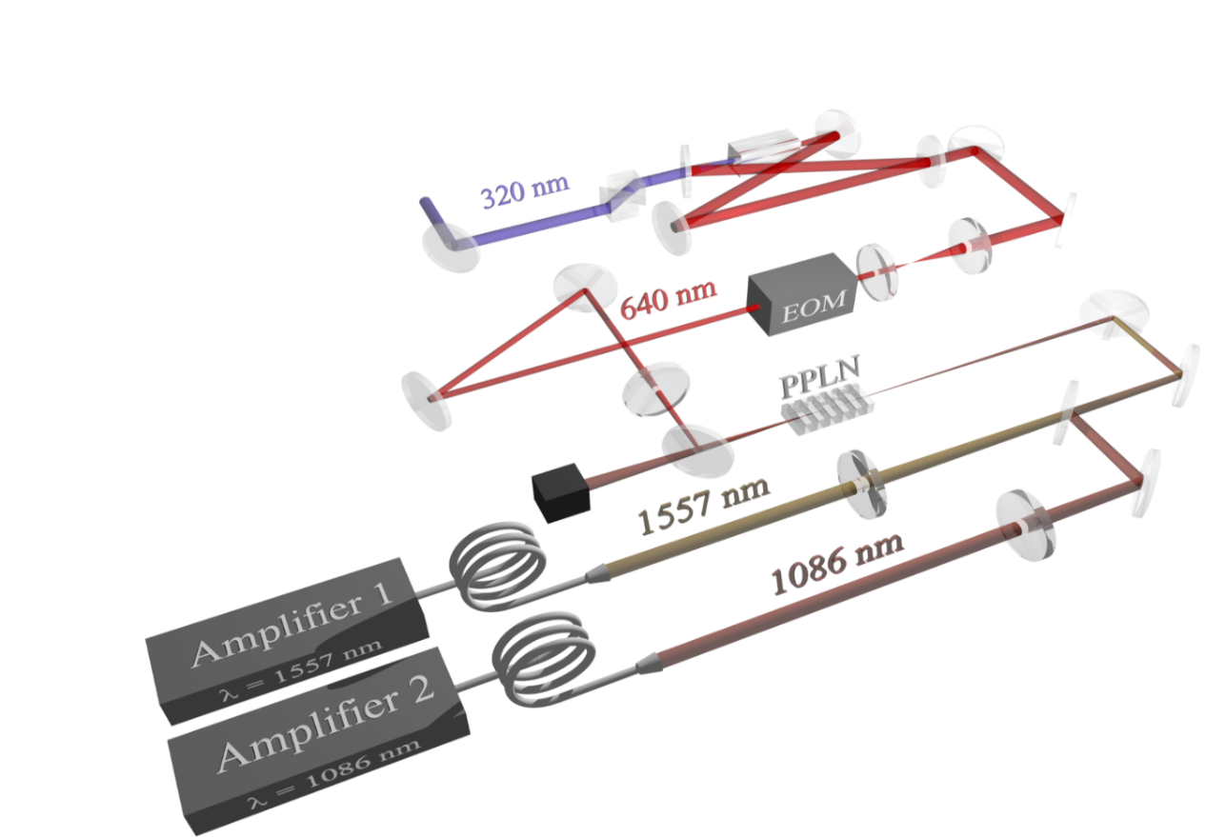
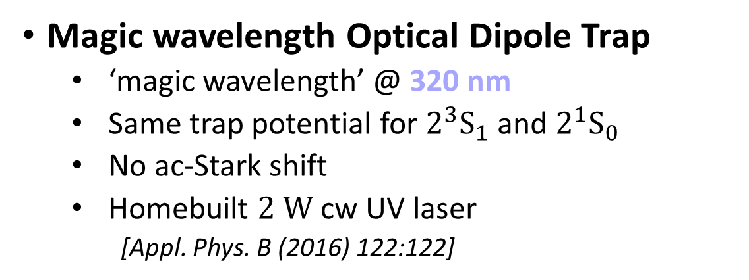
Precision Spectroscopy
Magic wavelength Optical Dipole Trap
  ‘magic wavelength’ @ 320 nm
  Same trap potential for $2^{3}S_{1}$ and $2^{1}S_{0}$
  No ac-Stark shift
  Homebuilt $2 W$ cw UV laser
    [Appl. Phys. B (2016) 122:122]
1557 nm

Slide 10
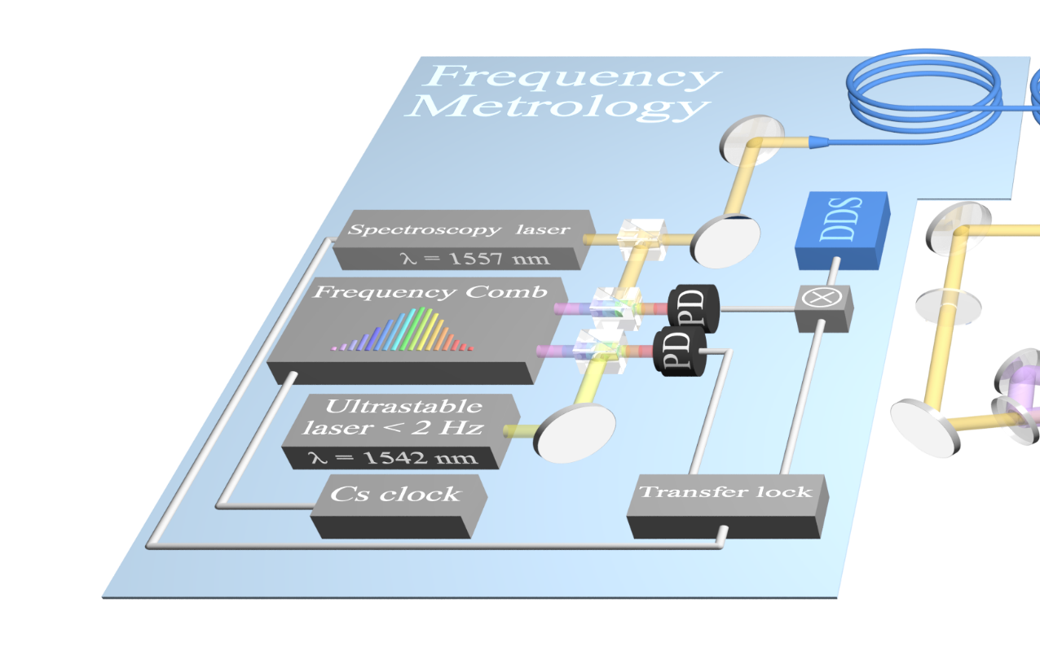


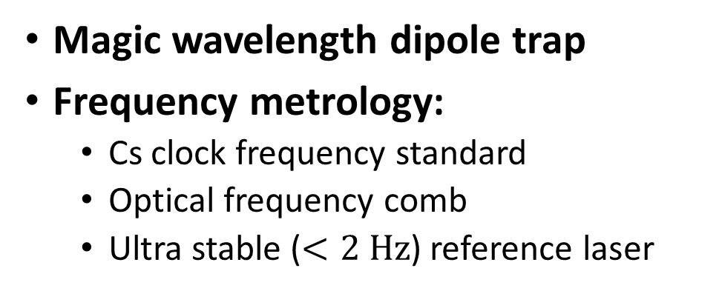
Precision spectroscopy
Two ingredients for precision spectroscopy:
Magic wavelength dipole trap
Frequency metrology:
  Cs clock frequency standard
  Optical frequency comb
  Ultra stable ($<2 Hz$) reference laser
$$|2^{1}S_{0}〉$$
$$|2^{3}S_{1}〉$$

Slide 11
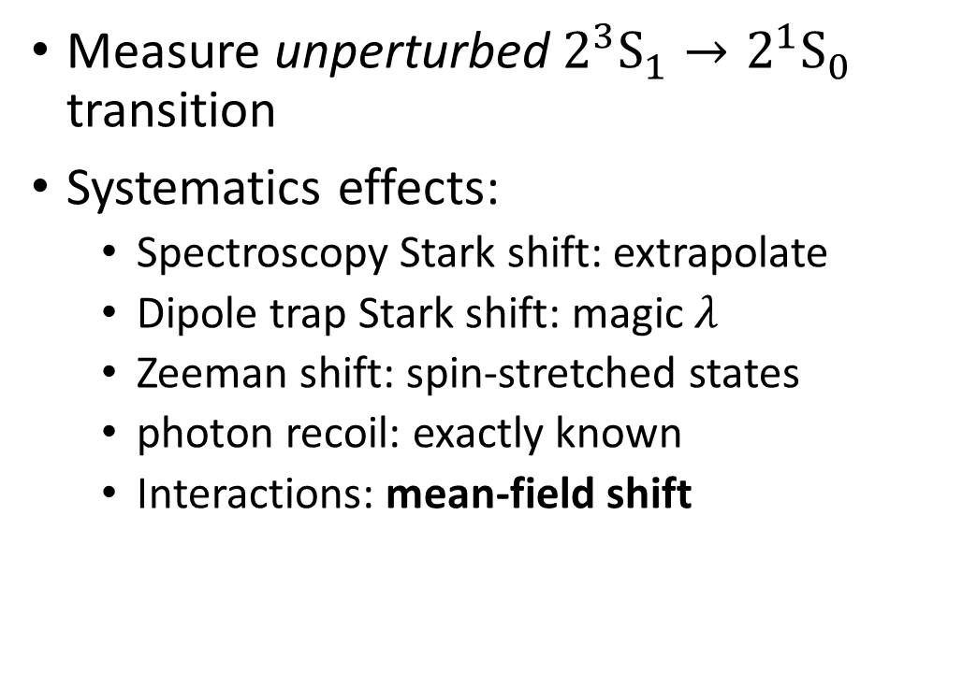


Precision spectroscopy
Measure unperturbed $2^{3}S_{1}→2^{1}S_{0}$ transition
Systematics effects:
  Spectroscopy Stark shift: extrapolate
  Dipole trap Stark shift: magic $λ$
  Zeeman shift: spin-stretched states
  photon recoil: exactly known
  Interactions: mean-field shift
$$ℏ\vec{k}$$
$$|2^{1}S_{0}〉$$
$$m_{J}= ±1$$
$$|2^{3}S_{1}〉$$

Slide 12
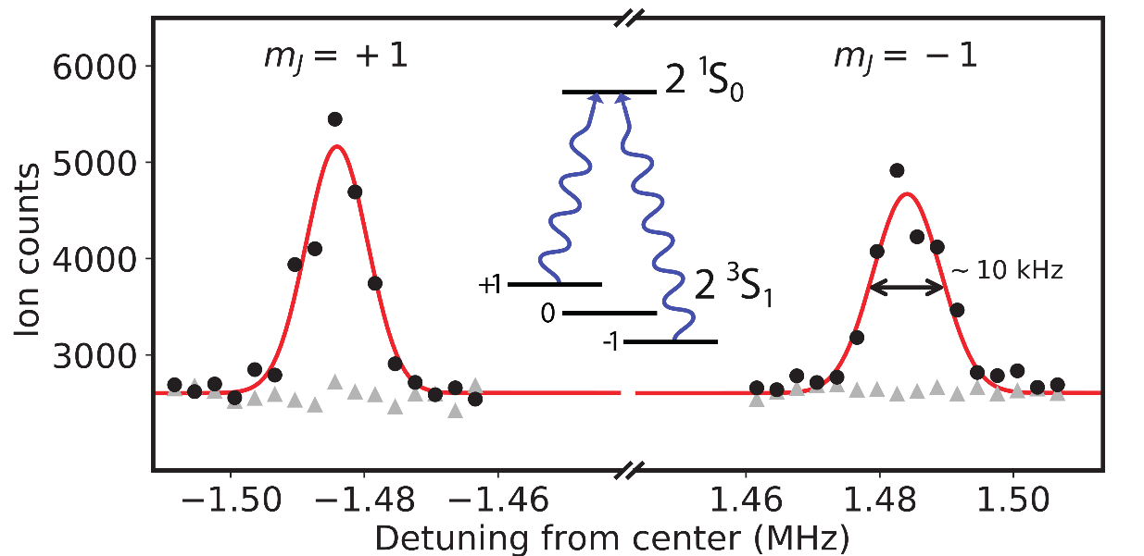
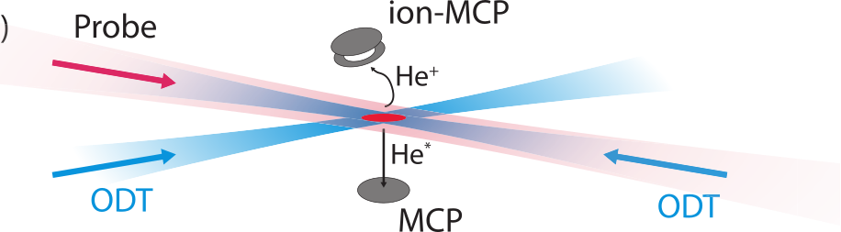
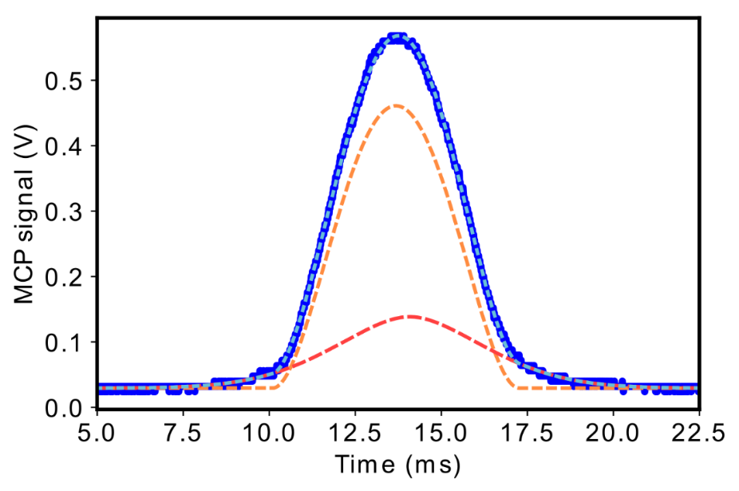
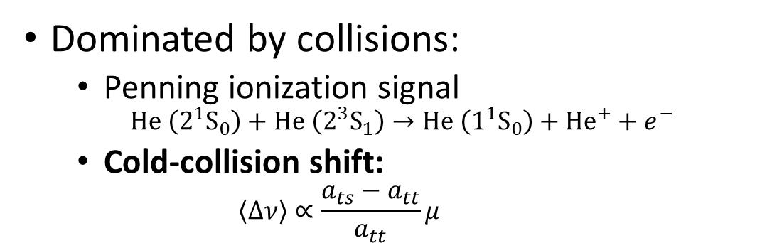

Spectroscopy of a ⁴He BEC
Dominated by collisions:
  Penning ionization signal
    $$He \left(2^{1}S_{0}\right)+He \left(2^{3}S_{1}\right)→He \left(1^{1}S_{0}\right)+He^{+}+e^{−}$$
  Cold-collision shift:
    $$\left\langle Δν\right\rangle ∝\frac{a_{ts}−a_{tt}}{a_{tt}}μ$$
single shot TOF:
Data
Fits:
BEC
Thermal
Total
$N_{C}$
$μ$
$N_{Th}$
$T$

Slide 13
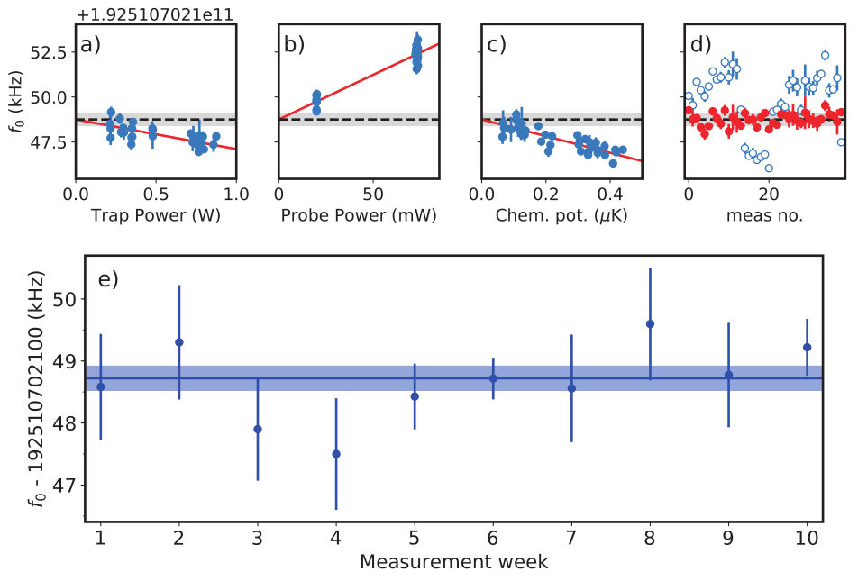

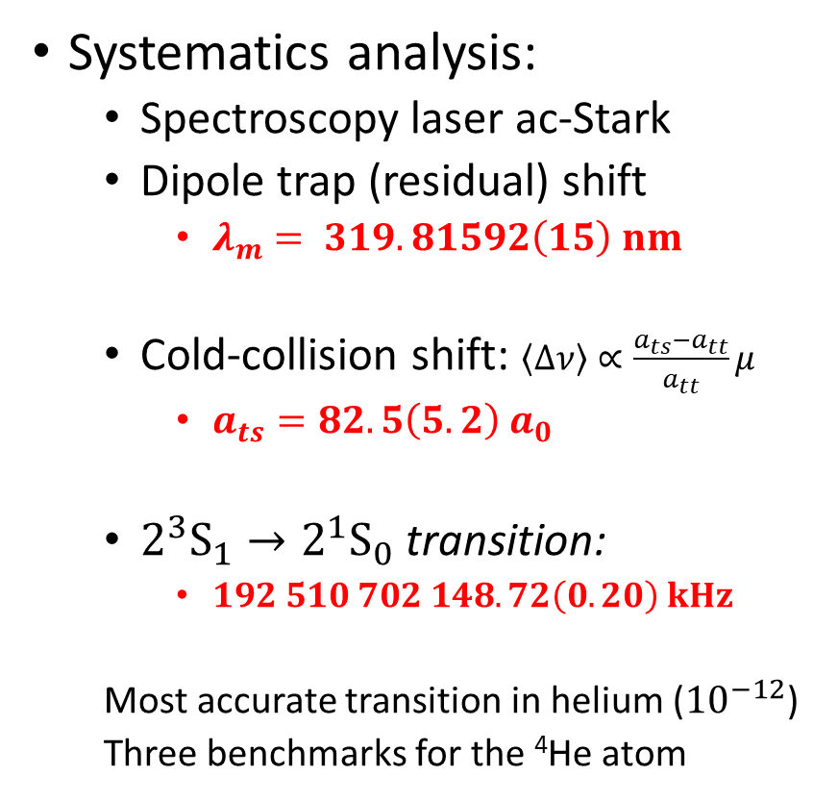
Spectroscopy of a ⁴He BEC
  Nat. Phys. 14, 1132-1137 (2018)
Systematics analysis:
  Spectroscopy laser ac-Stark
  Dipole trap (residual) shift
    $λ_{m}= 319.81592\left(15\right) nm$
  Cold-collision shift: $\left\langle Δν\right\rangle ∝\frac{a_{ts}−a_{tt}}{a_{tt}}μ$
    $a_{ts}=82.5\left(5.2\right) a_{0}$
  $2^{3}S_{1}→2^{1}S_{0}$ transition:
    $192 510 702 148.72\left(0.20\right) kHz$
  Most accurate transition in helium (${10}^{−12}$)
  Three benchmarks for the ⁴He atom
Bob Rengelink

Slide 14
Working with ³He
Production of a Degenerate Fermi Gas of ³He* and investigation of the spectral line shape

Slide 15
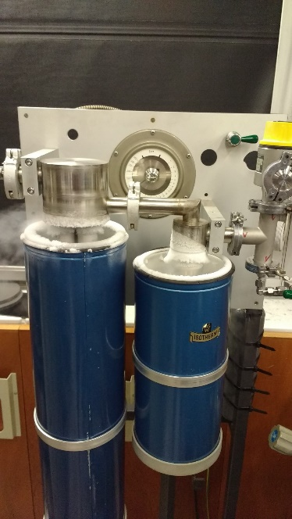
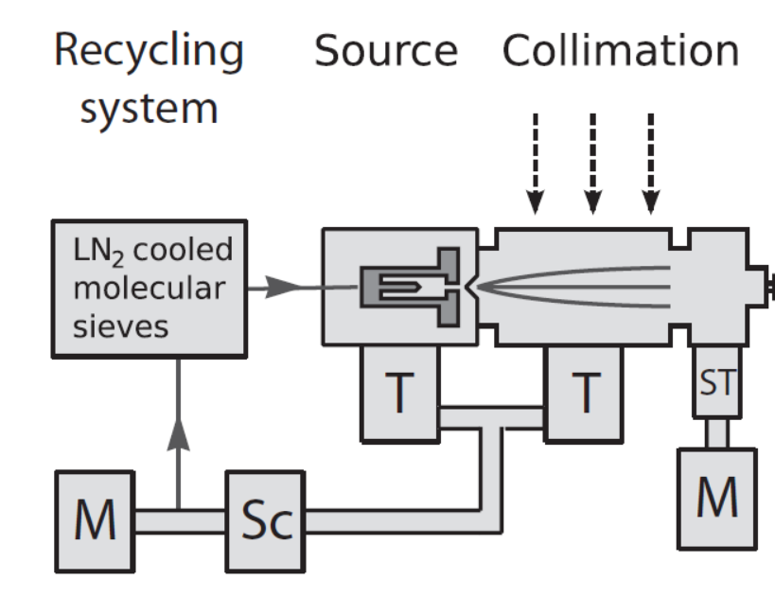
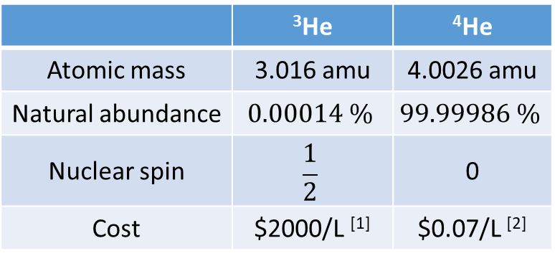
Working with ³He
Low natural abundance
Recycling system
 | ³He | ⁴He
Atomic mass | 3.016 amu | 4.0026 amu
Natural abundance | $$0.00014 \%$$ | $$99.99986 \%$$
Nuclear spin | $$\frac{1}{2}$$ | 0
Cost | $2000/L ^{[1]} | $0.07/L ^{[2]}
[1] Physics Today 62, 10, 21 (2009)
[2] Local party balloon store (2020)

Slide 16
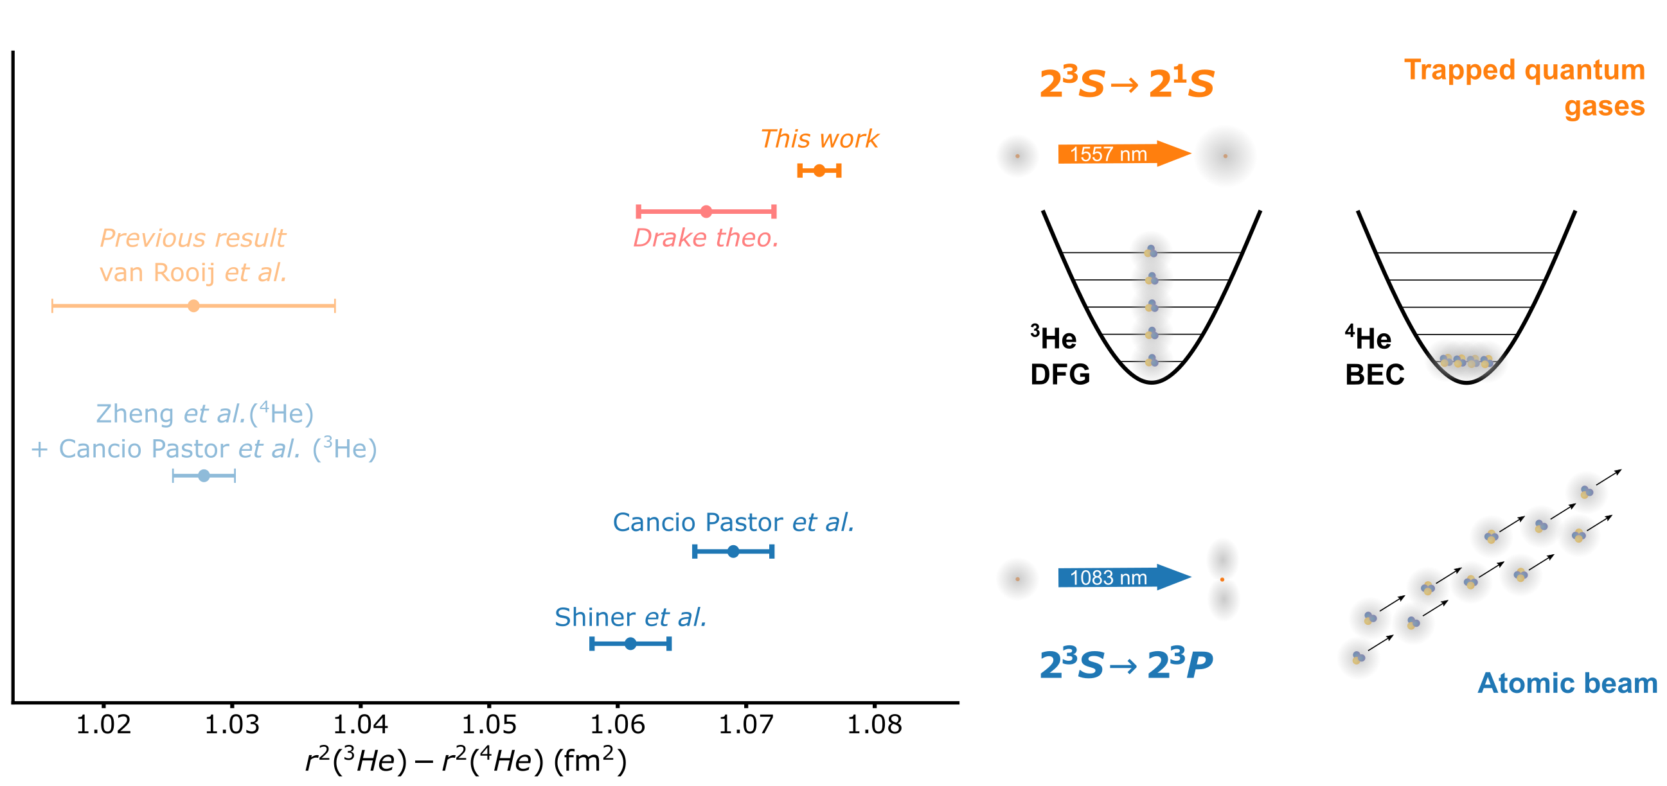
Working with ³He
Pauli principle:
Ultracold Identical Fermions don’t collide!
Sympathetic cooling with ⁴He
Fermi-Dirac distribution:
  Doppler broadening
No Penning ionisation signal:
  Measure trap depletion
No collisional shift *

Slide 17
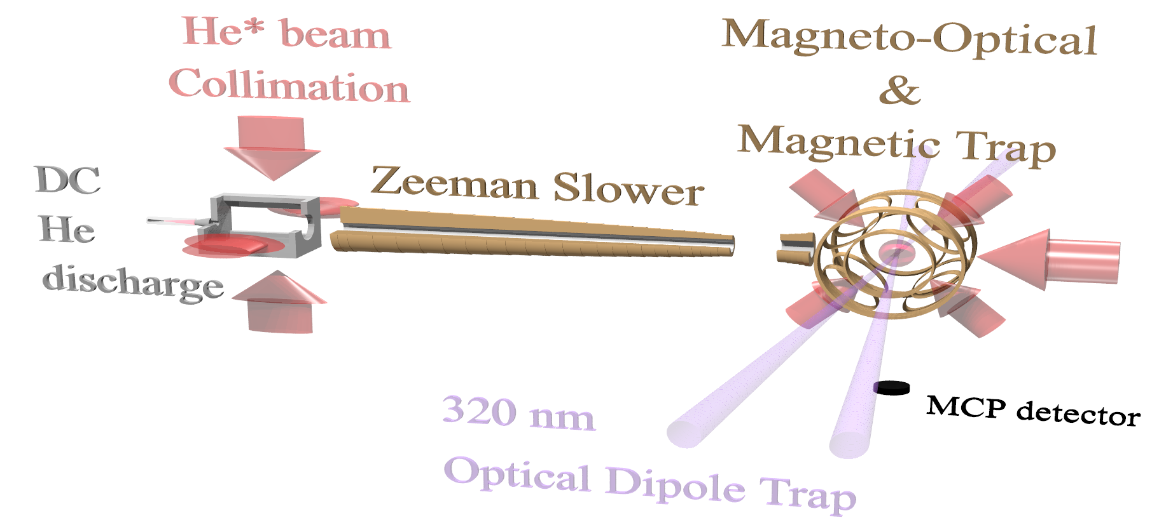
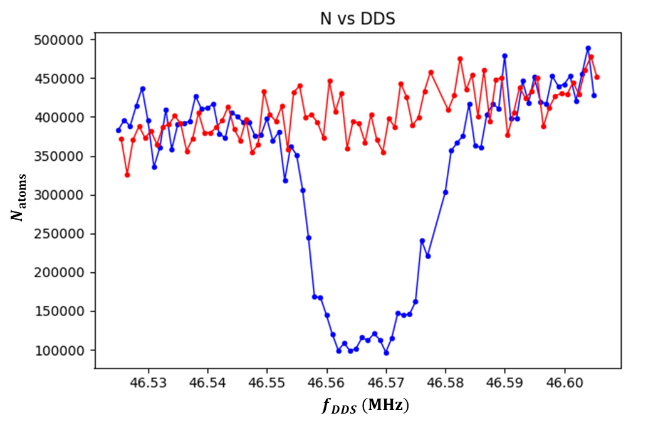
Working with ³He
Sympathetic cooling with ⁴He
Fermi-Dirac distribution:
  Doppler broadening
No Penning ionisation signal:
  Measure trap depletion
No collisional shift *

Slide 18
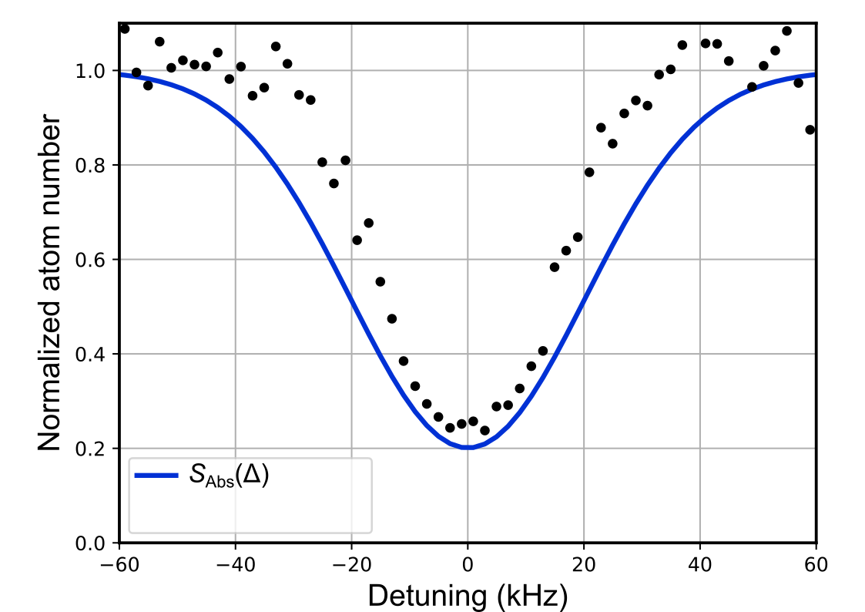

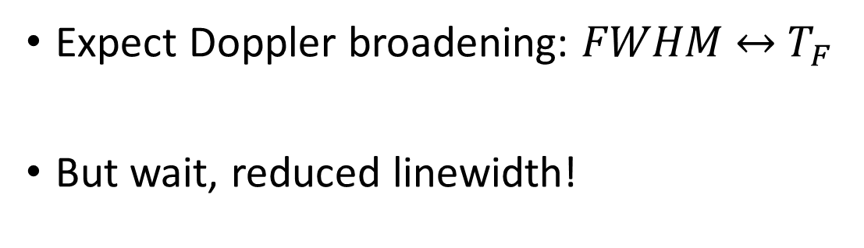
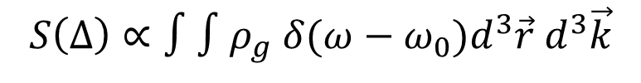
$2^{3}S_{1}→2^{1}S_{0}$ spectroscopy
Fermion line profile: Doppler broadening
$$S\left(Δ\right)∝∫∫ρ_{g}{ δ(ω−ω_{0})d}^{3}\vec{r} d^{3}\vec{k}$$
Fermi-Dirac
resonance
Juzeliūnas & Mašalas, PRA 63, 061602 (2001)
Expect Doppler broadening: $FWHM {\underset{↔}{ } T}_{F}$
But wait, reduced linewidth!

Slide 19
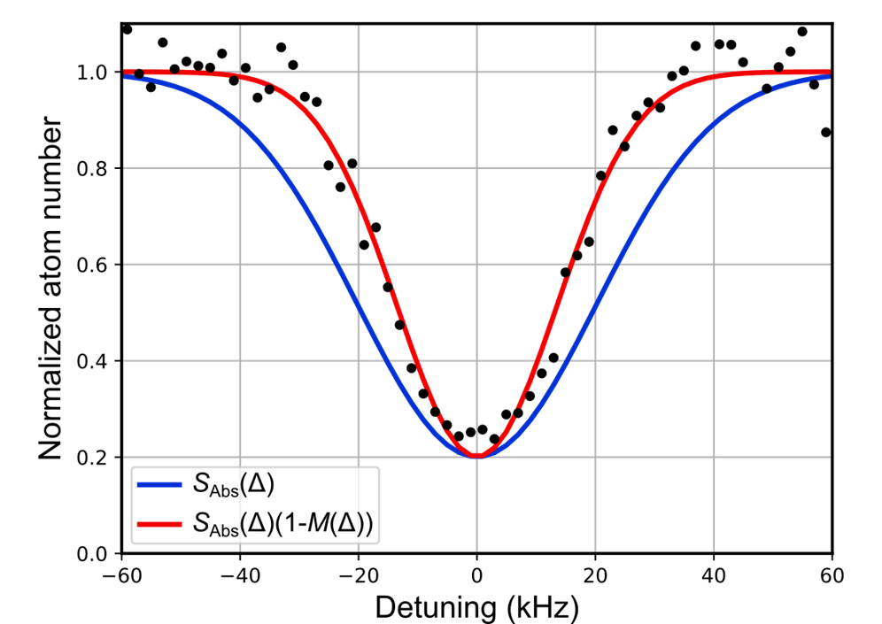
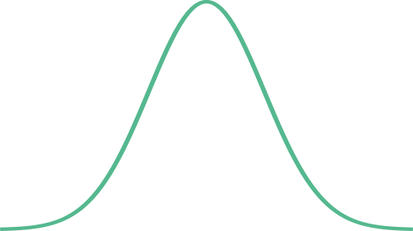
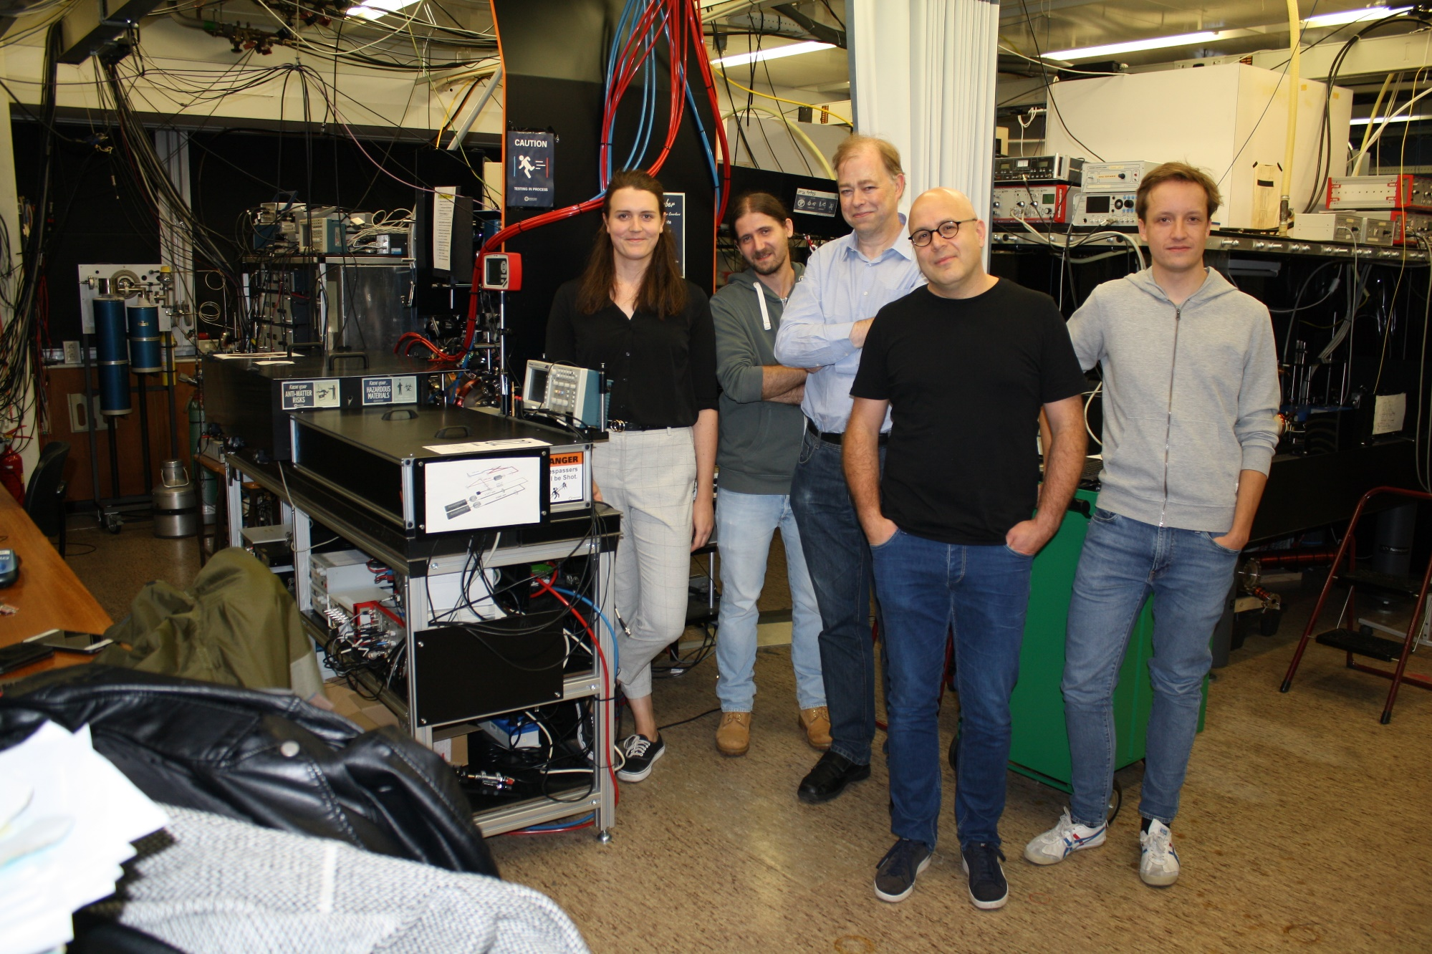
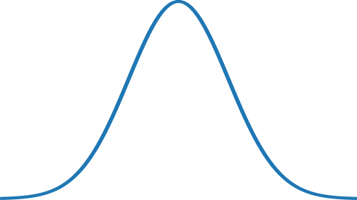
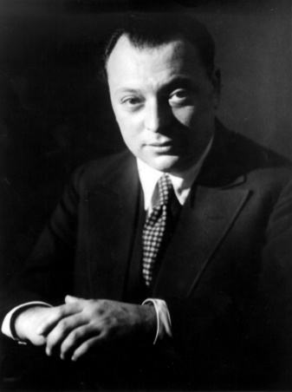

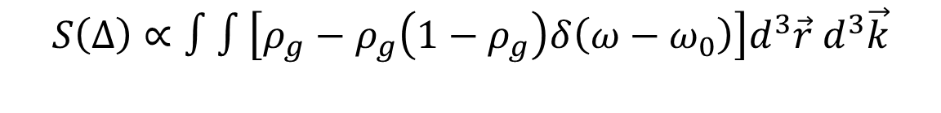
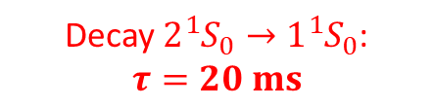



Understanding the spectral lineshape
$$S\left(Δ\right)∝∫∫\left[ρ_{g}−ρ_{g}\left(1−ρ_{g}\right)δ\left(ω−ω_{0}\right)\right]d^{3}\vec{r} d^{3}\vec{k}$$
Excitation
Blockade
Resonance
Modeling by
Raphaël Jannin
Decay $2{{}_{ }^{1}S}_{0}→1{{}_{ }^{1}S}_{0}$:
$$τ=20 ms$$
$$|2{{}_{ }^{1}S}_{0}〉$$
Stimulated emission
excitation
$$|2{{}_{ }^{3}S}_{1}〉$$
— Doppler
— Pauli
$$V(r)$$
Pauli-blocked in dense part of the gas
$$r$$

Slide 20
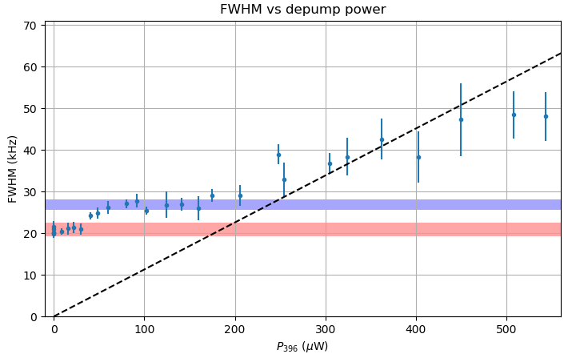

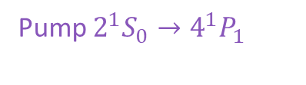
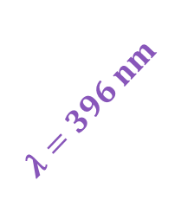
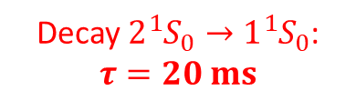

Testing the lineshape model
$$|4^{1}P_{1}〉$$
Lifetime broadening
Pump $2^{1}S_{0}→4^{1}P_{1}$
$$τ=4 ns$$
Decay $2{{}_{ }^{1}S}_{0}→1{{}_{ }^{1}S}_{0}$:
$$τ=20 ms$$
$$λ=396 nm$$
$$|2{{}_{ }^{1}S}_{0}〉$$
Doppler
Stimulated emission
excitation
Pauli
$$|2{{}_{ }^{3}S}_{1}〉$$
$$V(r)$$
Nat. Comm. 13, 6479 (2022)
$$r$$

Slide 21

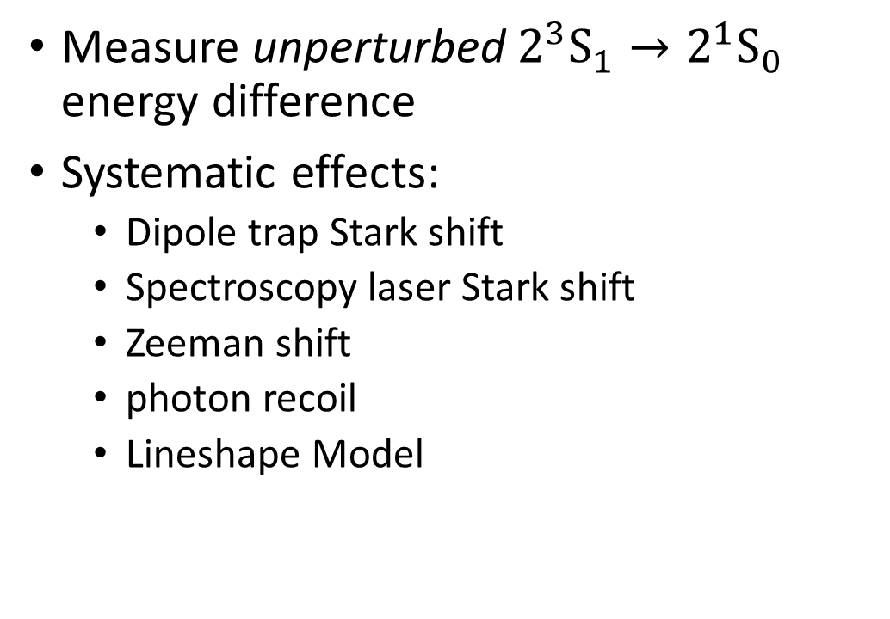


Precision spectroscopy
Measure unperturbed $2^{3}S_{1}→2^{1}S_{0}$ energy difference
Systematic effects:
  Dipole trap Stark shift
  Spectroscopy laser Stark shift
  Zeeman shift
  photon recoil
  Lineshape Model
$$m_{F}= ±1/2$$
$$ℏ\vec{k}$$
$$|2^{1}S_{0}〉$$
$$m_{F}= ±3/2$$
$$|2^{3}S_{1}〉$$

Slide 22
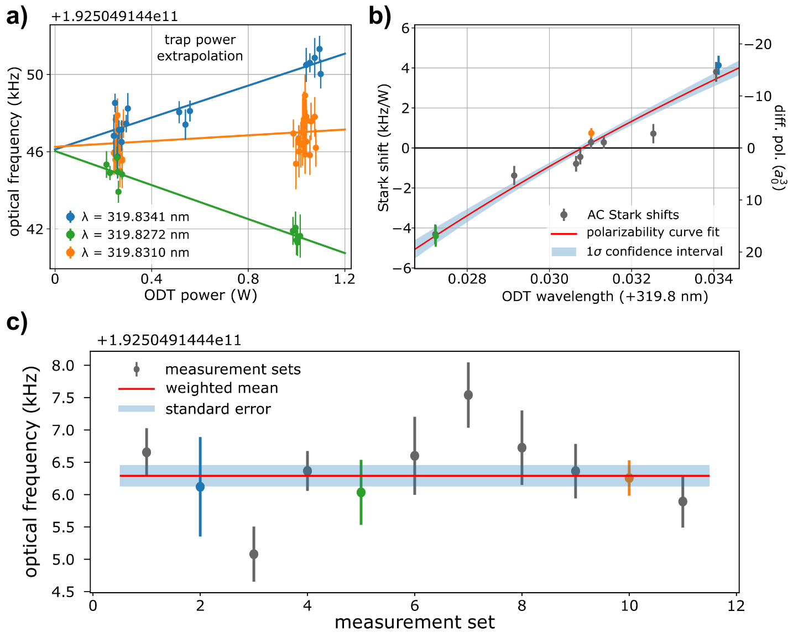
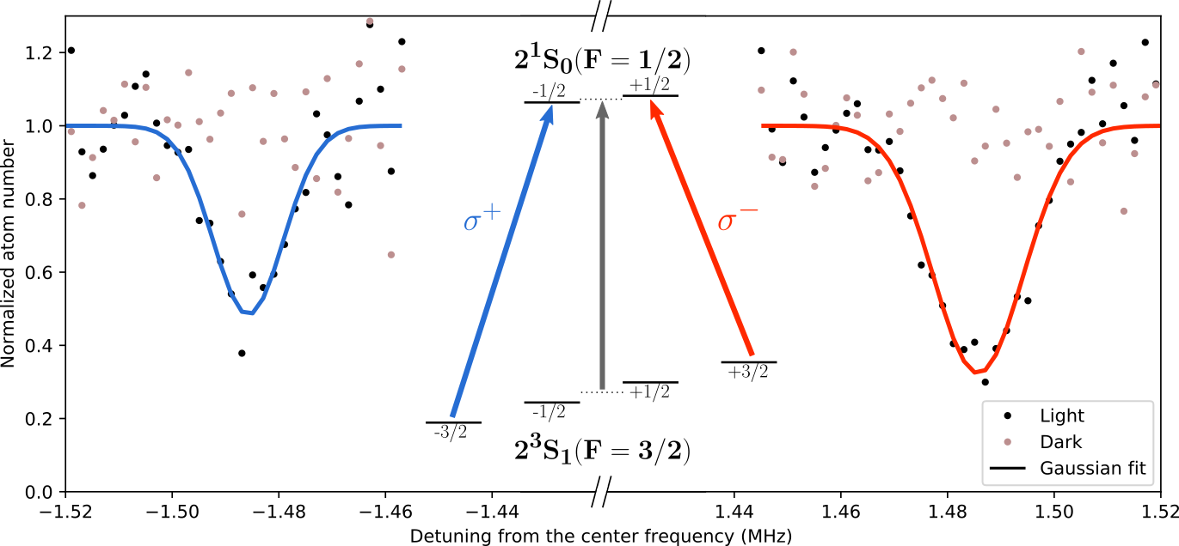



Precision spectroscopy
Systematics analysis:
$$ℏ\vec{k}$$
$$|2^{1}S_{0}, F=1/2〉$$
PRELIMINARY RESULT ³He $2^{3}S_{1}→2^{1}S_{0}$ (2022):
$$f_{0}=192 504 914 418.96\left(17\right) kHz$$
$$λ_{m}=319.830 80\left(15\right) nm$$
PRELIMINARY RESULTS
$$|2^{3}S_{1}, F=3/2〉$$
Zeeman shift

Slide 23
Nuclear Charge Radius Difference
⁴He Nat Phys 14 (2018)
+
³He 2022 PRELIMINARY
data: [Phys. Rev. A 95, 062510 (2017)]
PRELIMINARY RESULTS

Slide 24

Nuclear Charge Radius Difference
Previous Amsterdam result
(2011)
$$4.4σ$$
⁴He Nat Phys 14 (2018)
+
³He 2022 PRELIMINARY
data: [Phys. Rev. A 95, 062510 (2017)]
PRELIMINARY RESULTS

Slide 25
Nuclear Charge Radius Difference
Previous Amsterdam result
(2011)
$$4.4σ$$
⁴He Nat Phys 14 (2018)
+
³He 2022 PRELIMINARY
Prof. Shui-ming Hu
talk yesterday!
data: [Phys. Rev. A 95, 062510 (2017)]
PRELIMINARY RESULTS

Slide 26



7 kHz (4.4 $σ$) deviation?
Previous Result: non-magic wavelength
Fermi-Dirac: AC Stark shift asymmetry
Not resolved within laser bandwidth
New setup:
  magic wavelength: no AC Stark from trap
  improved laser lock: resolve quantum effects
Correction based on thermal broadening for large Fermi gases
$$192 504 914 417.2(2.0) kHz$$
[Juzeliunas & Masalas,
PRA 63, 061602 (2001)]
PRELIMINARY RESULTS

Slide 27



Nuclear Charge Radius Difference
$$σ_{exp}>Γ=8 Hz$$
$$σ_{exp}≪Γ=1.6 MHz$$
data: [Phys. Rev. A 95, 062510 (2017)]
PRELIMINARY RESULTS

Slide 28


Electrons vs. Muons
He nuclear charge radii from $μHe^{+}$ spectroscopy
  ⁴He: $1.67824\left(83\right) fm$ [Krauth et al. Nature 589, p. 527–531 (2021)]
  Fresh off the press: ³He $1.97007\left(94\right) fm$ https://arxiv.org/abs/2305.11679
PSI, Villigen

Slide 29

Electrons vs. Muons
He nuclear charge radii from $μHe^{+}$ spectroscopy
  ⁴He: $1.67824\left(83\right) fm$ [Krauth et al. Nature 589, p. 527–531 (2021)]
  Fresh off the press: ³He $1.97007\left(94\right) fm$ https://arxiv.org/abs/2305.11679
PRELIMINARY RESULTS
PSI, Villigen
*
*Also fresh:
Preliminary Hefei 2023

Slide 30


Electrons vs. Muons
$3.6σ$ from $μ{He}^{+}$
$2σ−4σ$ from $2^{3}S→2^{3}P$
Hefei ³He?
$1.9 kHz$ shift for $1σ$ agreement with muonic
Discrepancies:
  New physics? Well………………
  Very different systematics
  Theory: triplet vs. singlet
  Muonic: higher-order QED
PRELIMINARY RESULTS

Slide 31


In conclusion
Fundamental physics with ultracold helium:
  Precision spectroscopy: narrow transition
  Nuclear charge radii → most accurate $r_{3}^{2}−r_{4}^{2}$
  QED benchmark
  Comparison with other works, exciting times:
    Other spectroscopy, scattering, muonic systems
More than just the transition frequency:
  magic wavelengths: benchmarks for QED
  ⁴He BEC: insight into collisions, mean-field shift, scattering length $a_{ts}$
  ³He Fermi gas: Observation of unexpected Pauli Blockade effects
Higher precision? $Γ=8 Hz$ (experimentally challenging)
Other measurements in helium?

Slide 32


Thanks for your attention!
He* team:
Raphael Jannin
Kees Steinebach
Yuri van der Werf
Rick Bethlem
Kjeld Eikema
Bob Rengelink
Technical support:
Rob Kortekaas
Lex van der Gracht
Funding & facilities:
*
Wim Vassen:
† 11-2-2019

Slide 33

Thanks for your attention!
Questions?
Email: y.vander.werf@vu.nl

Slide 34
Precision spectroscopy
Systematics analysis: Zeeman shift
$$ℏ\vec{k}$$
$$|2^{1}S_{0}, F=1/2〉$$
$$|2^{3}S_{1}, F=3/2〉$$

Slide 35


Systematic analysis
2nd order Zeeman shift:
Using the Breit-Rabi formula with $J↔ I$
No coupling to $F=1/2$ from spin-stretched $m_{F}=±3/2$
2nd order Zeeman from coupling to $2^{3}P_{J}$, same as ⁴He: $<4 mHz/G^{2}$

Slide 36






Reduced linewidth
Tails of spectrum: reduced loss
We measure the remaining He*
Center of spectrum: high loss
$$|2{{}_{ }^{1}S}_{0}〉$$
$$|2{{}_{ }^{1}S}_{0}〉$$
Fermi-Dirac
state
occupation
Pauli Blockade
$$|2{{}_{ }^{3}S}_{1}〉$$
$$|2{{}_{ }^{3}S}_{1}〉$$

Slide 37





Systematic analysis
Cold collision shift?
  IDENTICAL cold* fermions don’t collide
  $$|g_{1}〉→α_{1}|g_{1}〉+β_{1}|e_{1}〉$$
  $$|g_{2}〉→α_{2}|g_{2}〉+β_{2}|e_{2}〉$$
$|S〉=\frac{\left(α_{1}β_{2}−α_{2}β_{1}\right)}{\sqrt{2}}⋅( | ge〉−|eg〉)$
$〈S | S〉≡G_{ge}^{(2)}$
$Δ_{mfs}=\frac{ℏa_{ge}}{m}ρ_{g}\left(r\right){⋅G}_{ge}^{\left(2\right)}<2π×1 Hz$
2
$$a_{ge}$$
1
*p-wave frozen out $T<500 mK$

Slide 38




Frequency metrology
Hz laser drift
Centralized building HVAC control!
Correction to the real SI second:
local Cs clock deviation from GPS
$$Δf=55 Hz$$

Slide 39


Finding the magic wavelength
Measurements at different wavelengths
Measure strength of the a.c. Stark shift

Slide 40


Thermodynamic shift: @320nm
$〈I_{320}〉=Δf_{Stark}/α≈5.5×{10}^{7} {Wm}^{−2}$ *
$$I_{peak}≈{10}^{8} {Wm}^{−2}$$
$$|2{{}_{ }^{1}S}_{0}〉$$
Error in a.c. Stark extrapolation?
$$|2{{}_{ }^{3}S}_{1}〉$$
Average trap intensity
Same result
* @ 1W UV power

Slide 41
Electrons vs Muons?
Amsterdam 2022 PRELIMINARY
$$σ_{exp}>Γ=8 Hz$$
??
Vastly different systems
Vastly different theory
Consistency check
Probe nuclear sizes
QED test
$$σ_{exp}≪Γ=1.6 MHz$$
data: [Phys. Rev. A 95, 062510 (2017)]
PRELIMINARY RESULTS

Slide 42












4.4 $σ$ deviation?
2011 result:
1557 nm dipole trap + direct frequency comb lock
Fermi-Dirac: AC Stark shift asymmetry
Not resolved within laser bandwidth
Verified now with new spectroscopy laser
2022 result:
magic wavelength trap + ultrastable reference laser
Fermi-Dirac: Doppler + Pauli blocking
No trap AC Stark → Fully symmetric
Quantum effects resolved (2018: ⁴He meanfield)
$$f_{0}$$
$$|2{{}_{ }^{1}S}_{0}〉$$
$$|2{{}_{ }^{1}S}_{0}〉$$
$$|2{{}_{ }^{3}S}_{1}〉$$
$$V(r)$$
$$|2{{}_{ }^{3}S}_{1}〉$$
PRELIMINARY RESULTS
$$f_{0}$$
$$r$$

Slide 43








Testing the model
  Enhanced ground state decay through $4^{1}P_{1}$ state
Eliminate the stimulated emission channel
Lift Pauli Blockade effect
$$4^{1}P_{1}$$
397 nm
$$τ \sim 26 ns$$
Decay $2{{}_{ }^{1}S}_{0}→1{{}_{ }^{1}S}_{0}$:
$$τ=20 ms$$
$$2^{1}S_{0}$$
$$|2{{}_{ }^{1}S}_{0}〉$$
$$2^{3}S_{1}$$
1557 nm
$$τ=20ms$$
Stimulated emission
excitation
$$1^{1}S_{0}$$
$$|2{{}_{ }^{3}S}_{1}〉$$
PRELIMINARY RESULT

Slide 44



Testing the model
  Enhanced ground state decay through $4^{1}P_{1}$ state
$$4^{1}P_{1}$$
397 nm
$$τ \sim 26 ns$$
$$2^{1}S_{0}$$
$$2^{3}S_{1}$$
1557 nm
$$τ=20ms$$
$$1^{1}S_{0}$$
PRELIMINARY RESULT
$$T≈95 nK$$
$$T/T_{F} 0.35 \sim 0.55$$

Slide 45

Understanding the spectral lineshape
Trapped fermionic ³He: Fermi-Dirac distribution
  Distribution over motional states in the trap
  Laser absorption Doppler broadened ($T_{F}∼1 μK$)

Slide 46




Before PhD
Master thesis work at Eindhoven University of Technology
⁸⁵Rb MOT
Rydberg excitation (780 + 480)
SLM: shaped excitation volume

Slide 47


Before PhD
Rydberg spectra:
  Lineshape mediated by interactions
  Rydberg facilitation
  Spatial resolution obscured by ion repulsion

