Slide 1
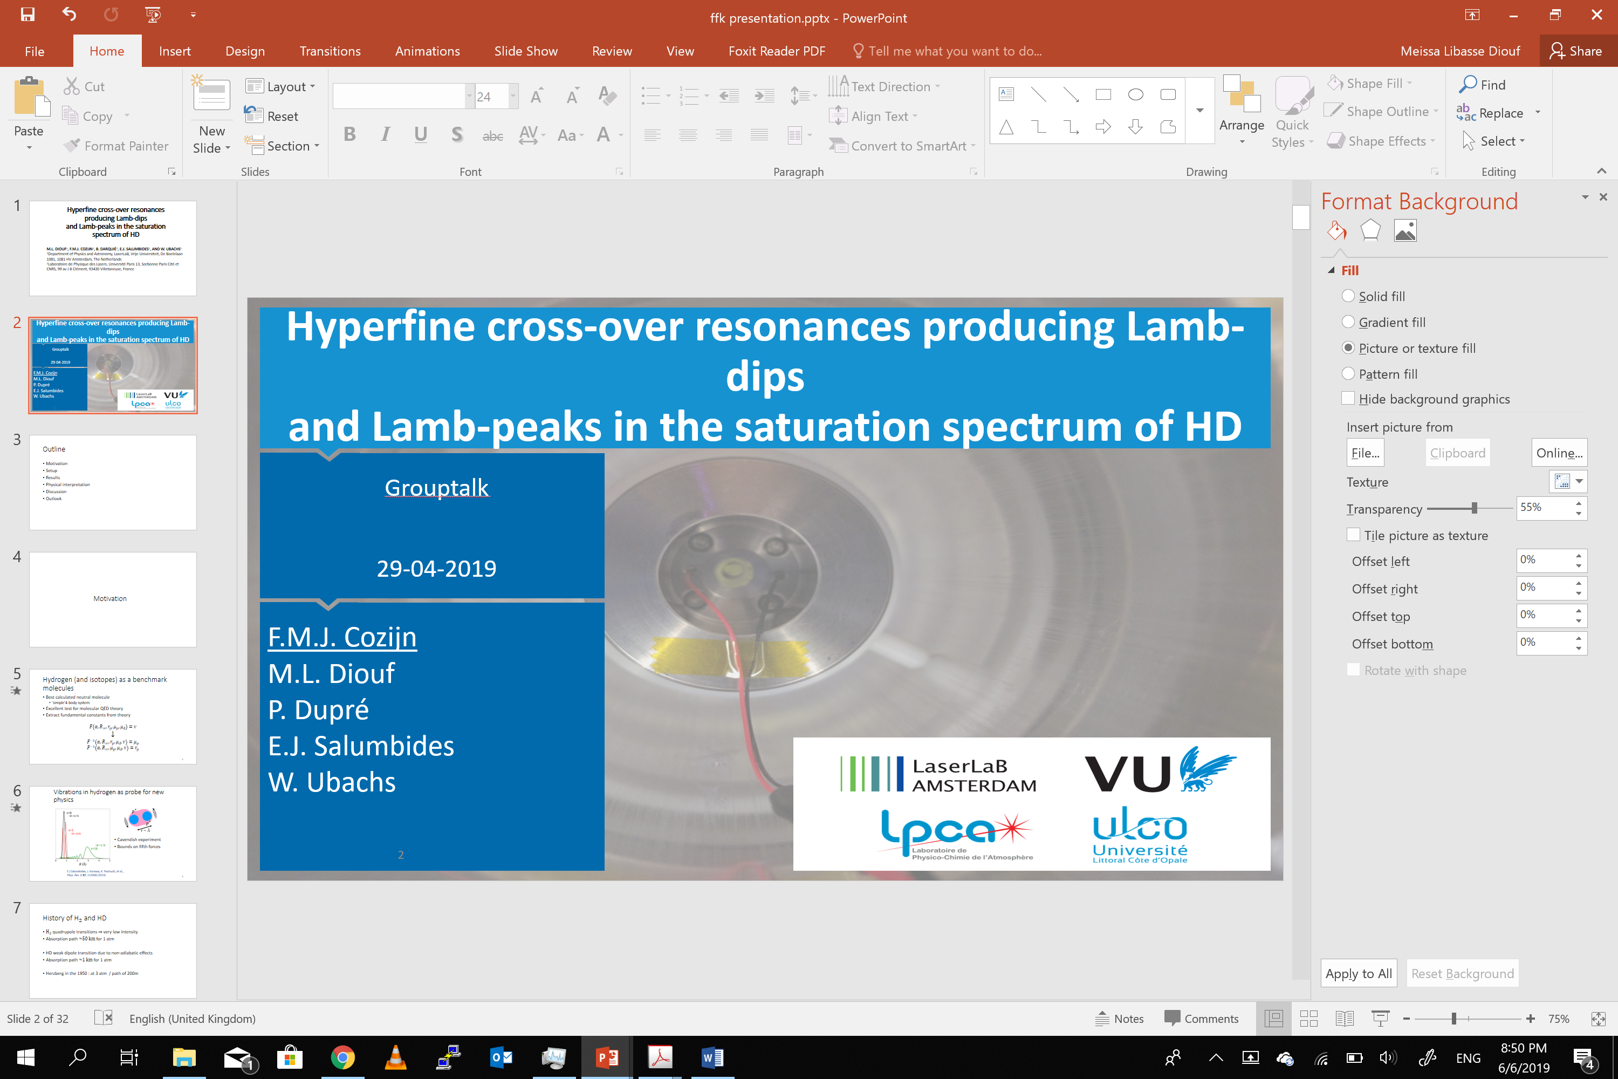

Sub-Doppler rovibrational spectroscopy
on hydrogen tritide (HT)
F.M.J. COZIJN, M.L. DIOUF and W. UBACHS
Department of Physics and Astronomy, LaserLaB, Vrije Universiteit Amsterdam, The Netherlands
V. Hermann and M. Schlösser
Tritium Laboratory Karlsruhe (TLK), Institute for Astroparticle Physics, Karlsruhe Institute of Technology (KIT),

Slide 2
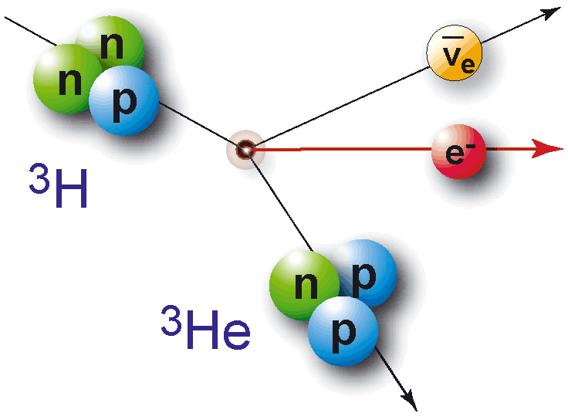
Adding tritium to the playfield
Tritium doubles the playfield of possible combinations of molecular hydrogen
  Lots of options to investigate mass dependencies
Triton is equally important within CODATA as the deuteron
  Accurate direct studies are lacking
  Last measurements in 1987 on tritiated hydrogen only at 3 GHz uncertainty^{[1]}
Radioactive
  Half-life of 12.3 years
  Beta emitter
    Mean energy of ~ 6 kEv
H
D
T
H
H2
HD
HT
D
D2
DT
T
T2
[1] D. K. Veirs and G. M. Rosenblatt , J. Mol. Spectrosc. 121, 401-419 (1987)

Slide 3
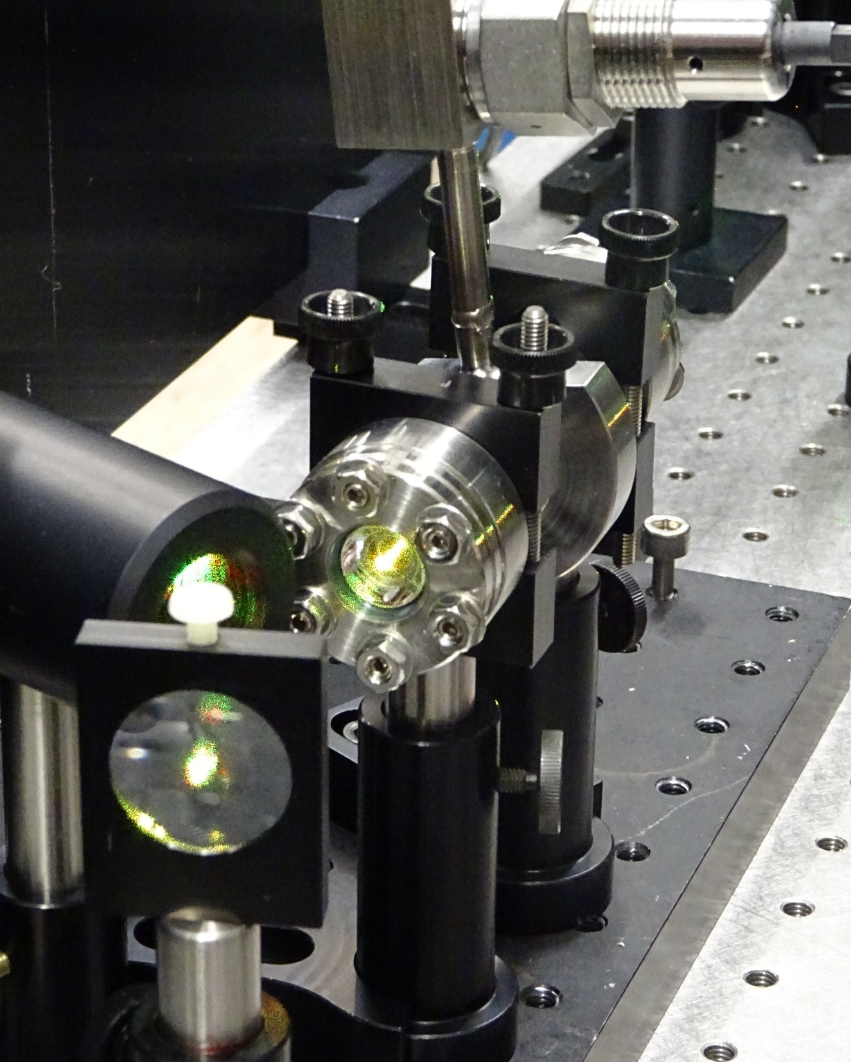
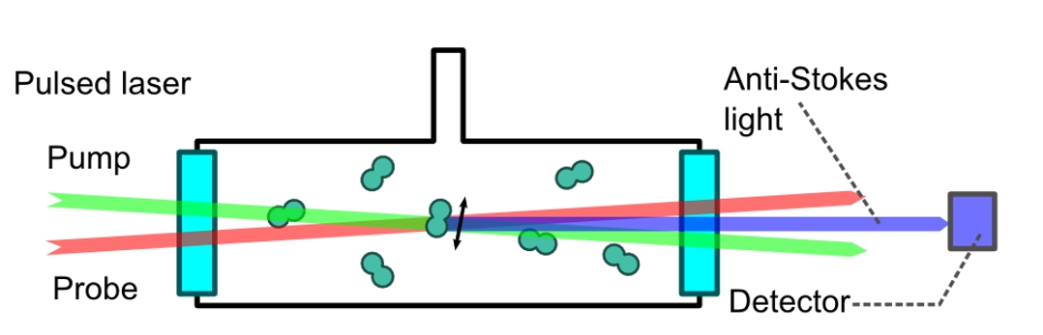
Collaboration with TLK in Karlsruhe
Tritium Laboratory Karlsruhe
  Houses the Katrin experiment for neutrino mass measurements
  Licensed for 40 grams of tritium storage
1 GBq of tritium
  Upper limit for transfer and operation in our university
  10 mbar of T₂ in 1 cm³
Successful first studies using CARS on HT, DT and T₂
  Limited accuracy of 15 MHz only^{[1,2]}
Can we do saturation spectroscopy with NICE-OHMS?
  Active pressure control
  Keep baseline vacuum low
    Actively remove outgassing components
[1] Lai et al., Phys. Rev. Res. 1, 033124 (2019)
[2] Lai et al., Phys. Chem. Chem. Phys. 22, 8973-8987 (2020)

Slide 4
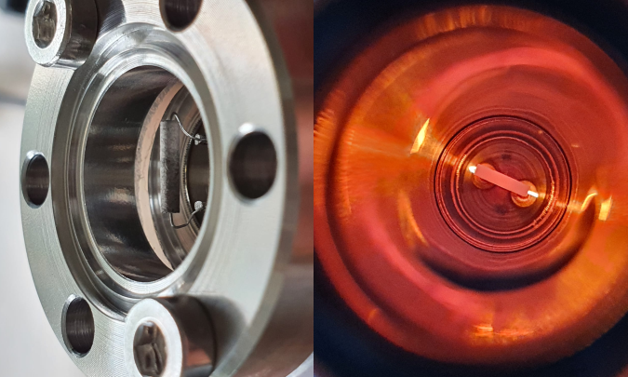
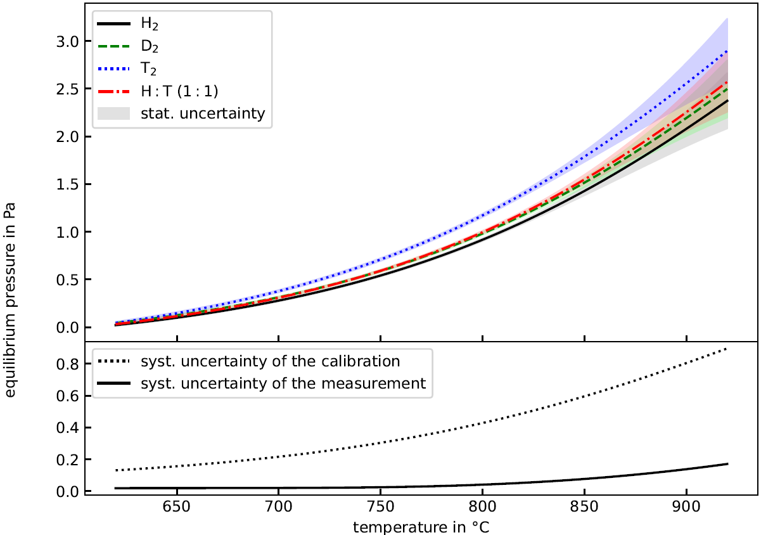
Tritium storage and pressure regulation using NEGs
Zirconium-based non-evaporable getters (NEGs) from SAES
(type St171 and St172)
Irreversible binding of (non-noble) gases
Reversible binding of hydrogen atoms when cold
  Hydrogen can be released when heated
Desorption tests with H₂, D₂, T₂ and H₂:HT:T₂ mixture (H:T = 1:1)
Getter must be loaded with a large fraction to obtain significant equilibrium pressure
Hydrogen molecular isotopes are released in equilibrium
  Maximum of ~ 50% will be released as HT
³He as an ‘outgassing’ component due to decay

Slide 5
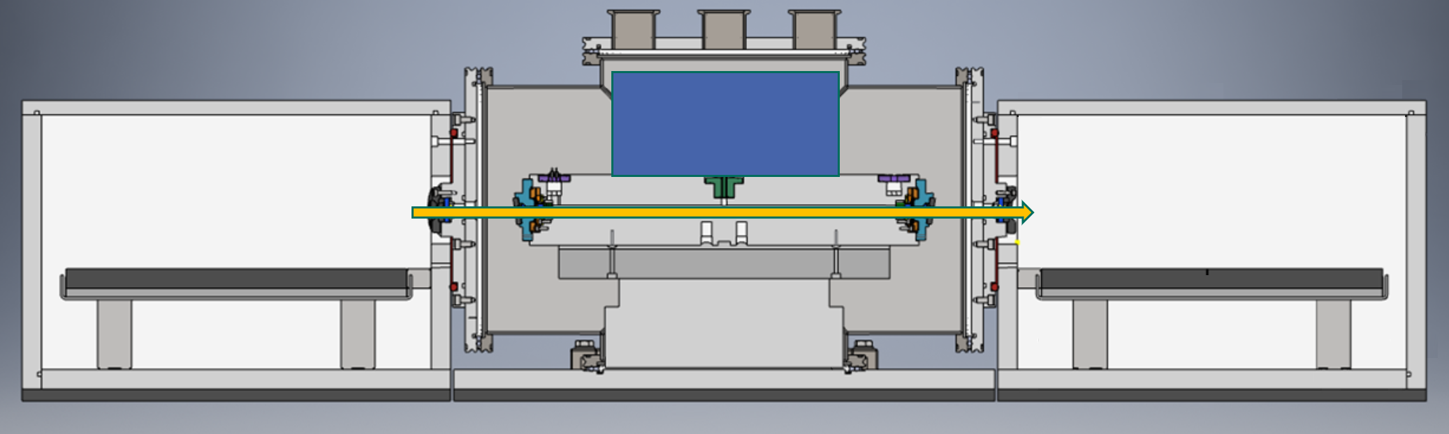
Building tritium compatible setup
Two getters
  Source getter for tritium
  Pumping getter for outgassing
Modular design
  Beam & detection optics reused from H2 experiment
Pump getter
Gauge
HT getter
Modulation optics & cavity locking detectors
Detection optics

Slide 6
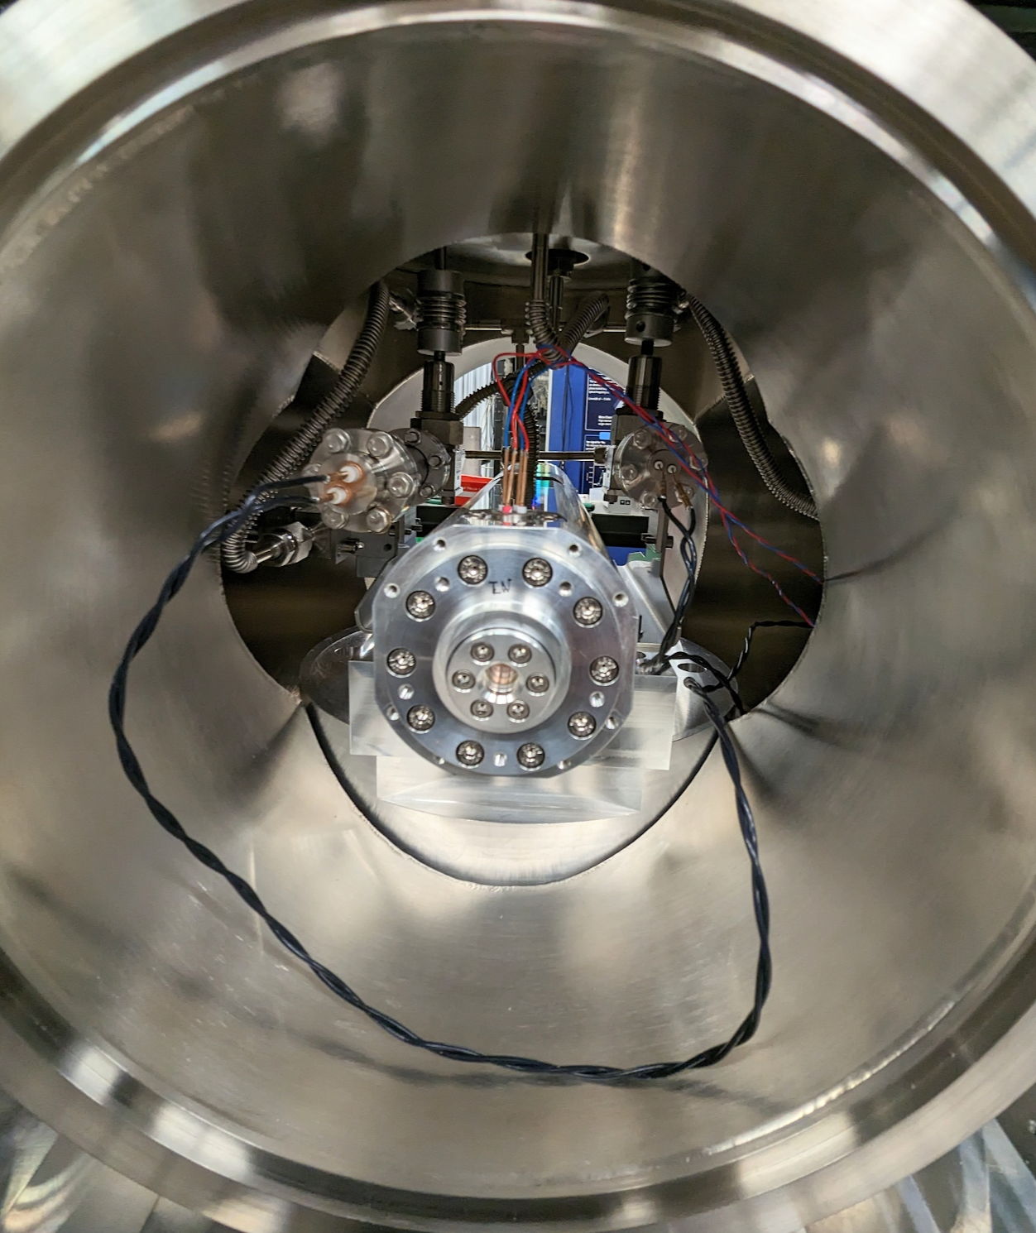
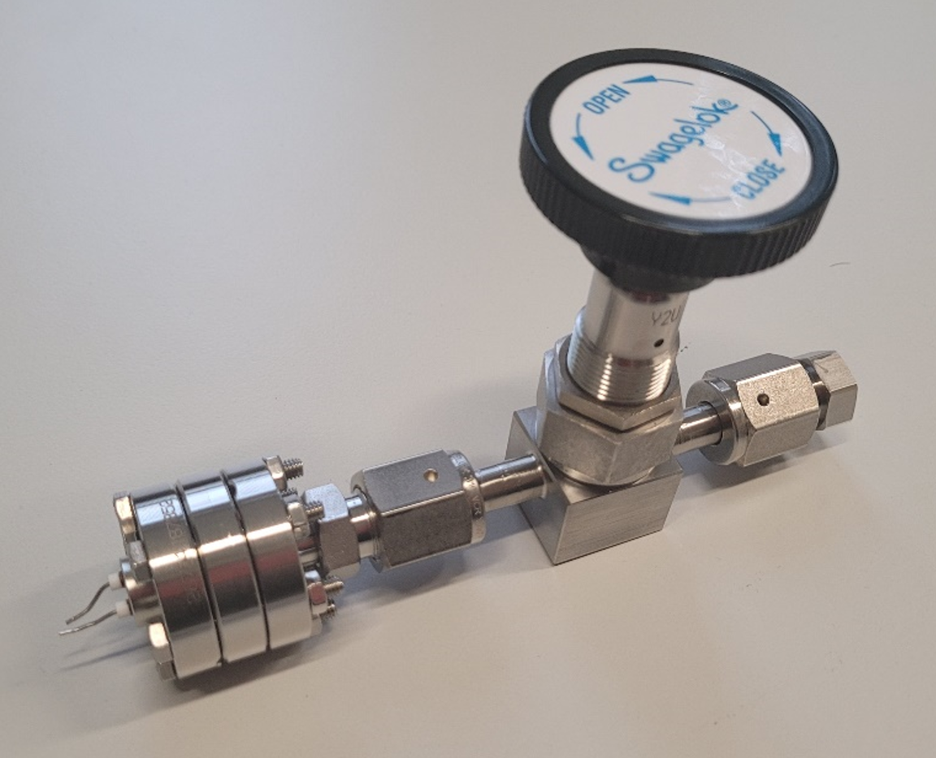
Building tritium compatible setup
Reused cryogenic cavity design for the H₂ study
  Fully metal sealed
  No teflon or other fluor containing materials to avoid radiochemistry
Cavity finesse of 150,000
Upgraded cavity piezo amplifiers

Slide 7
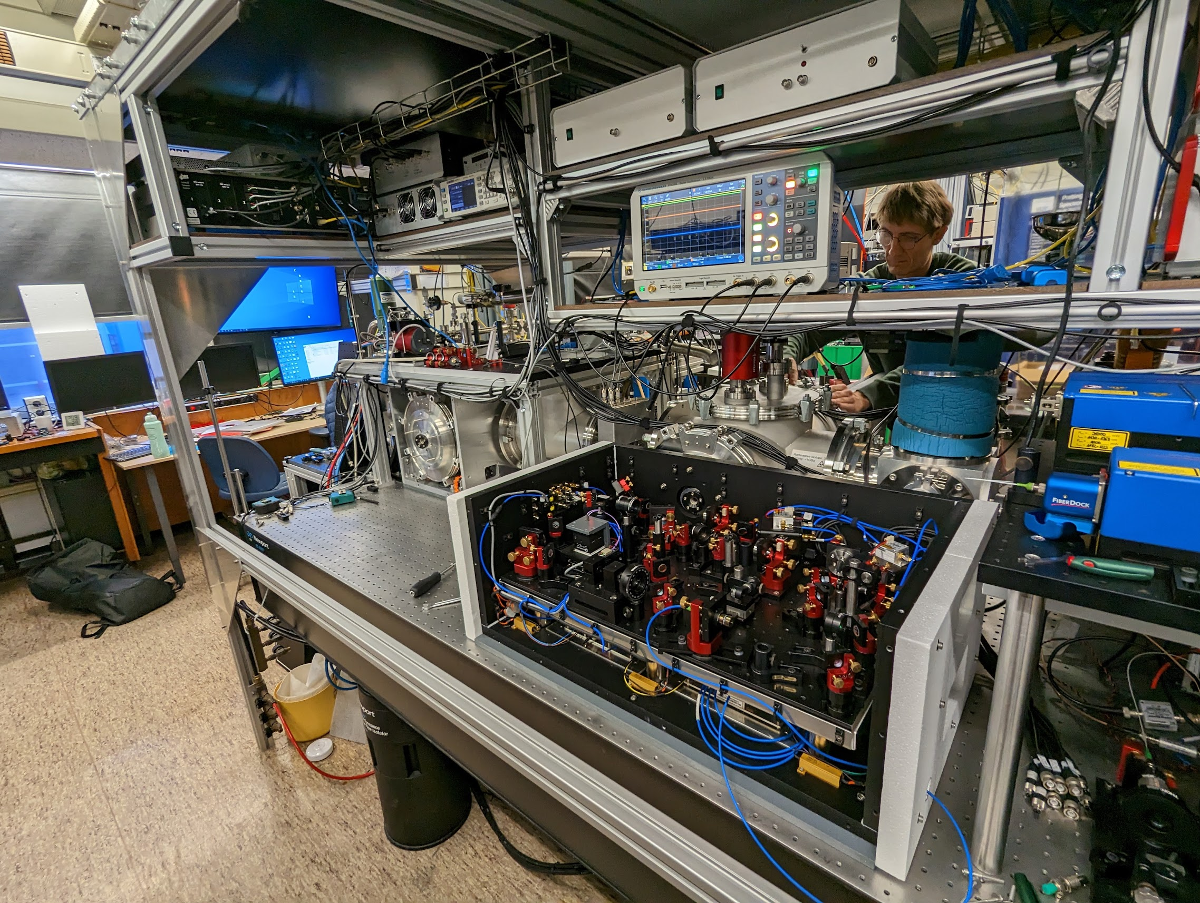

Slide 8
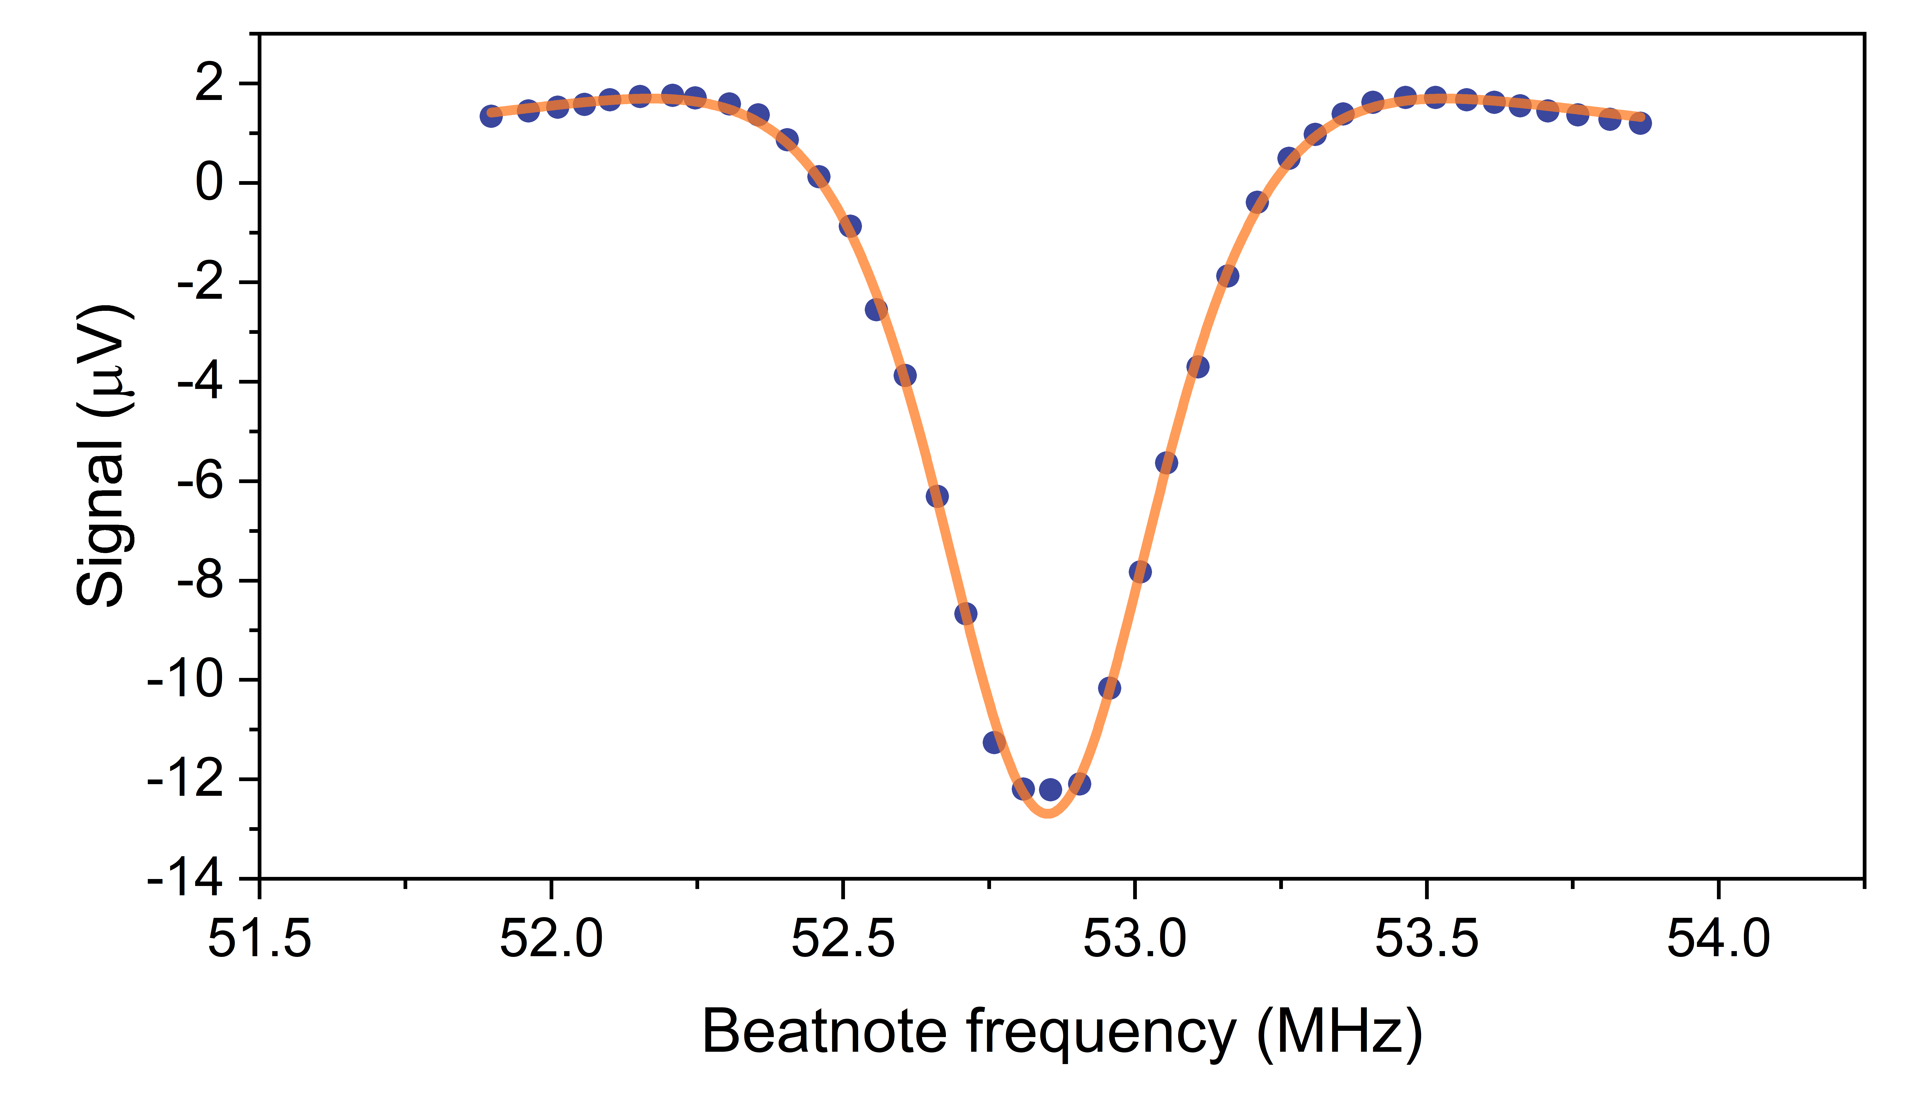
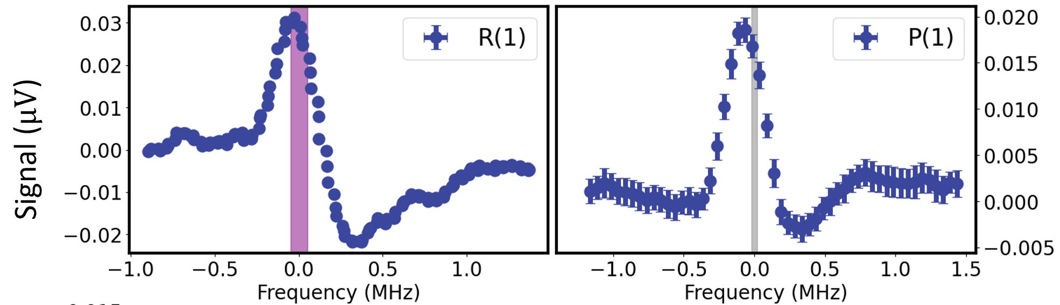



HD vs HT
n
n
p
p
p
p
n
Common properties
Weak permanent dipole
Similar overtone band and transitions are targeted
  HD R(0): 1395 nm
  HT R(0): 1474 nm
Differences
Mass
Total spin
  HD: 3/2
  HT: 1
HT has simpler hyperfine splitting
  Will this result in a less complex spectrum and lineshape?
$$v=2$$
$$v=1$$
H₂O₁₆ measurement
P(1)
R(0)
$$v=0$$
Cozijn et al., Phys. Rev. Lett. 120, 153002 (2018)
Diouf et al., Opt. Lett. 44, 4733-4736 (2019)
Diouf et al., Phys. Rev. Research 2, 023209 (2020)
Cozijn et. al., PRA 105, 062823 (2022)
Cozijn et. al., Eur. Phys. J. D 76, 220 (2022)

Slide 9
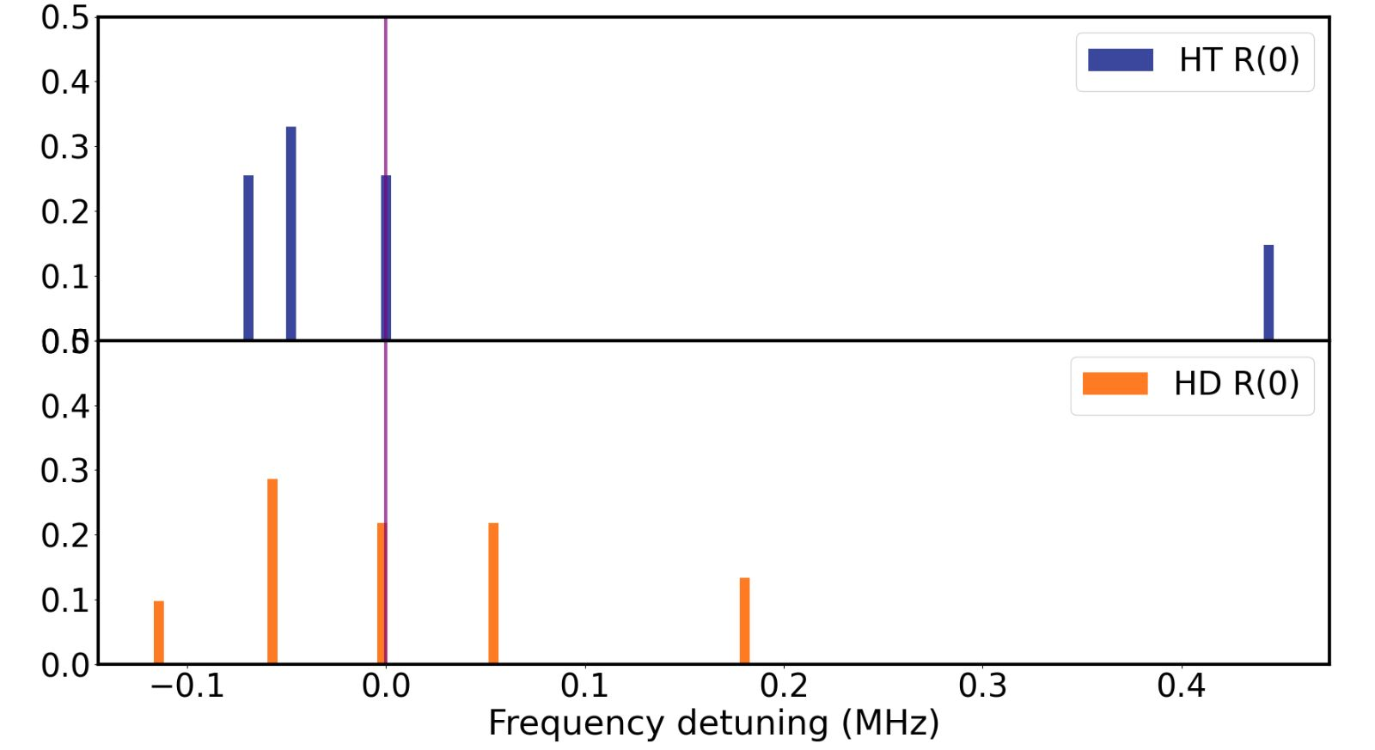
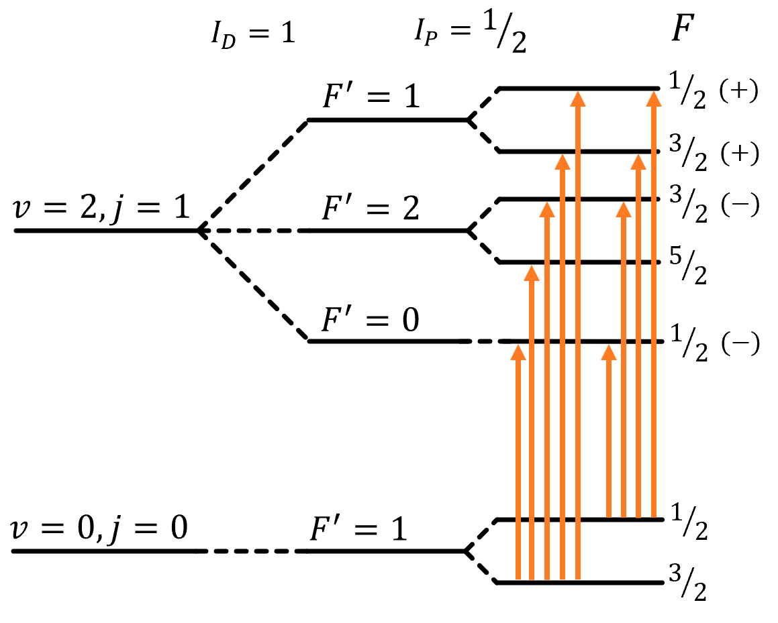
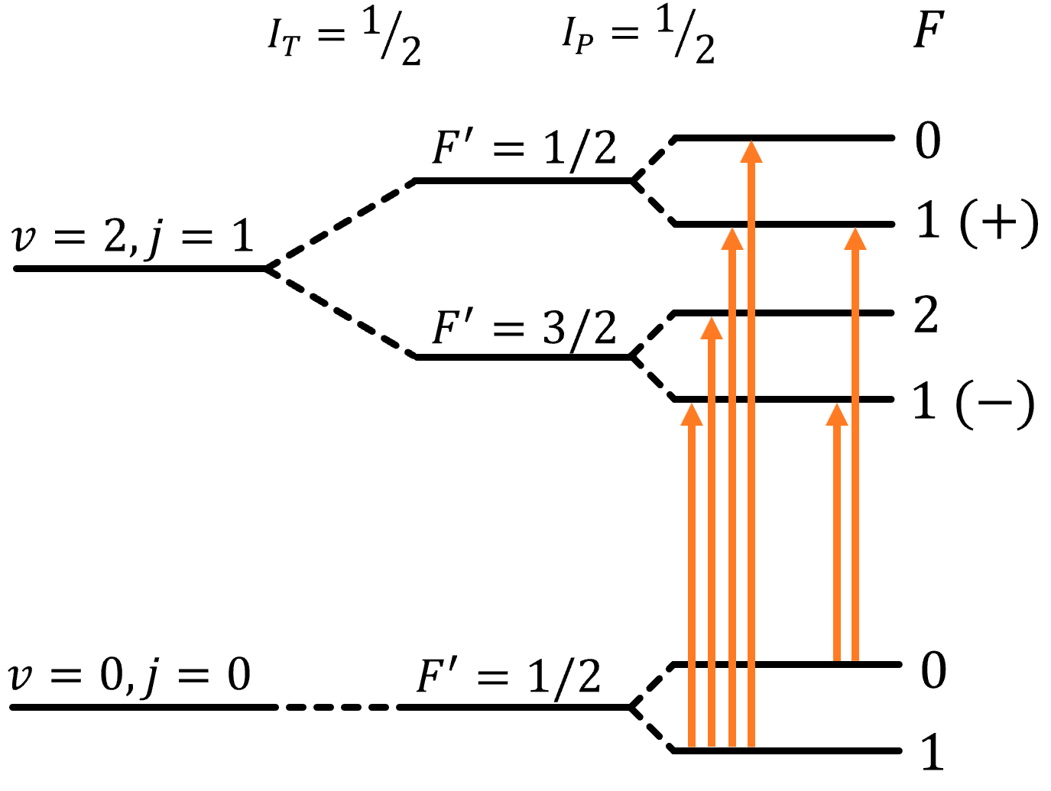
Hyperfine splitting of HD and HT
Hyperfine spectrum of HT is less complex
  4 instead of 5 near degenerate transitions
Triton g-factor much larger than deuteron g-factor
  Comparable to proton g-factor
  One outlying component
450 kHz splitting between rightmost component
  Resolvable with sufficient signal
H. Jóźwiak, H. Cybulski, P. Wcisło, JQSRT 270, 107662 (2021)

Slide 10
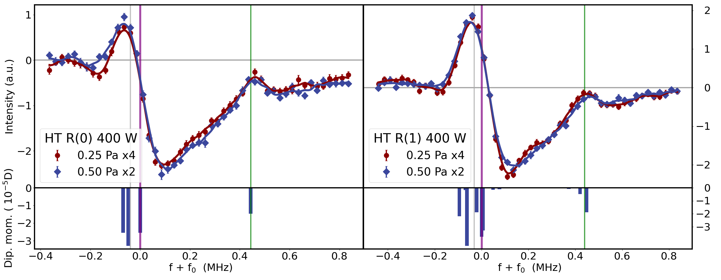
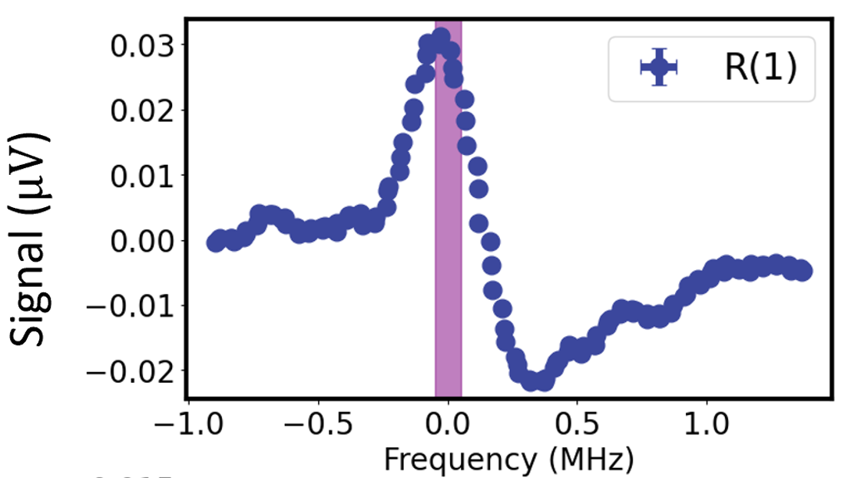
Measurements on R(0) & R(1)
(again) complicated dynamic lineshape
Overall shape matches HD R(1)
Hints of the hyperfine splitting in the spectrum
  Peaks matches with splitting
Previous HD result

Slide 11
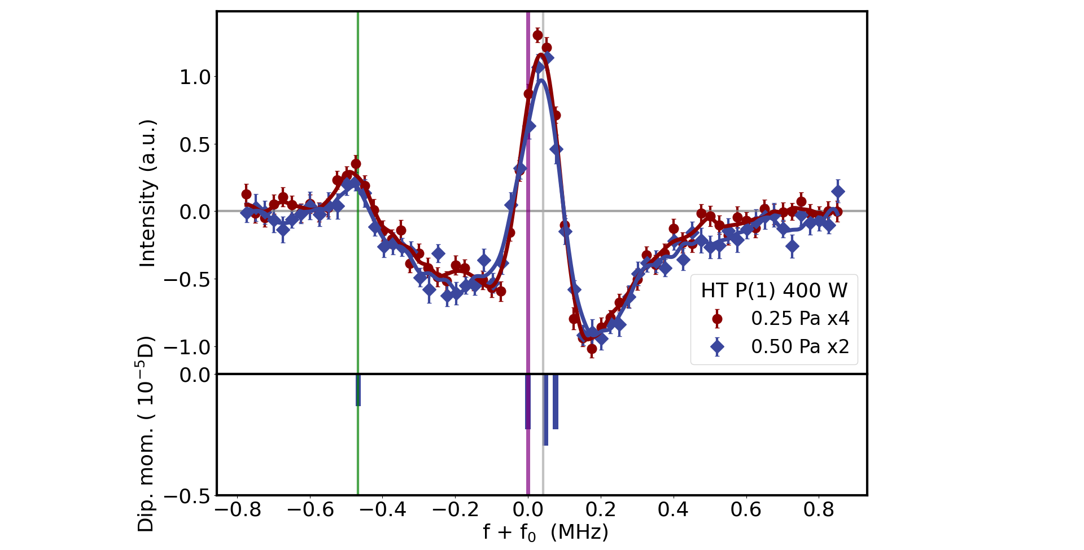
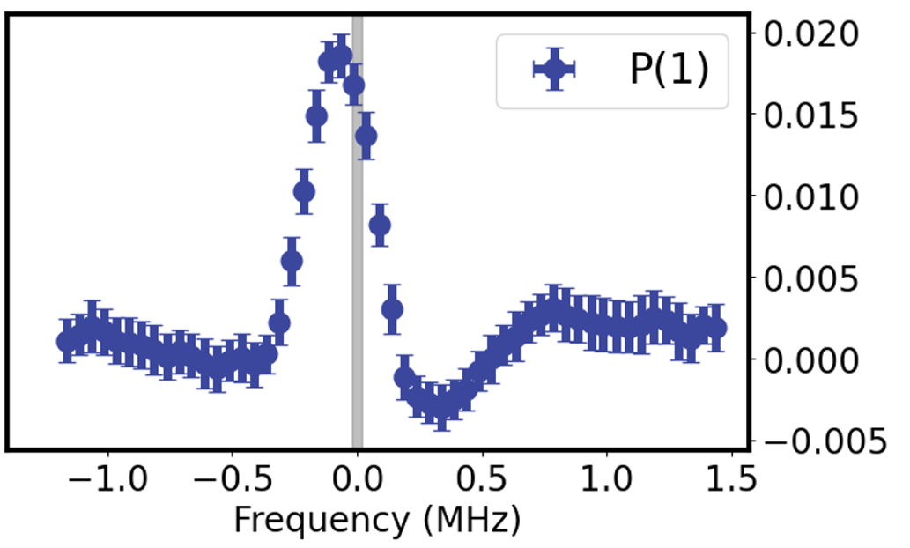
Measurements on P(1)
Also identical to the HD result
  Characteristic peaked spectrum
Isolated hyperfine component easily observable
  But what to do with it?
Previous HD result

Slide 12
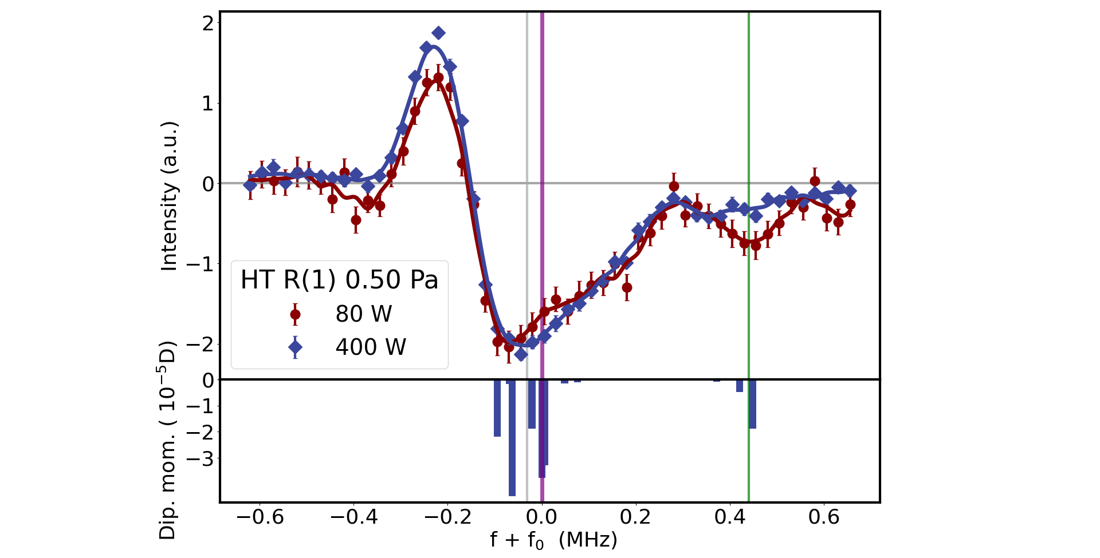
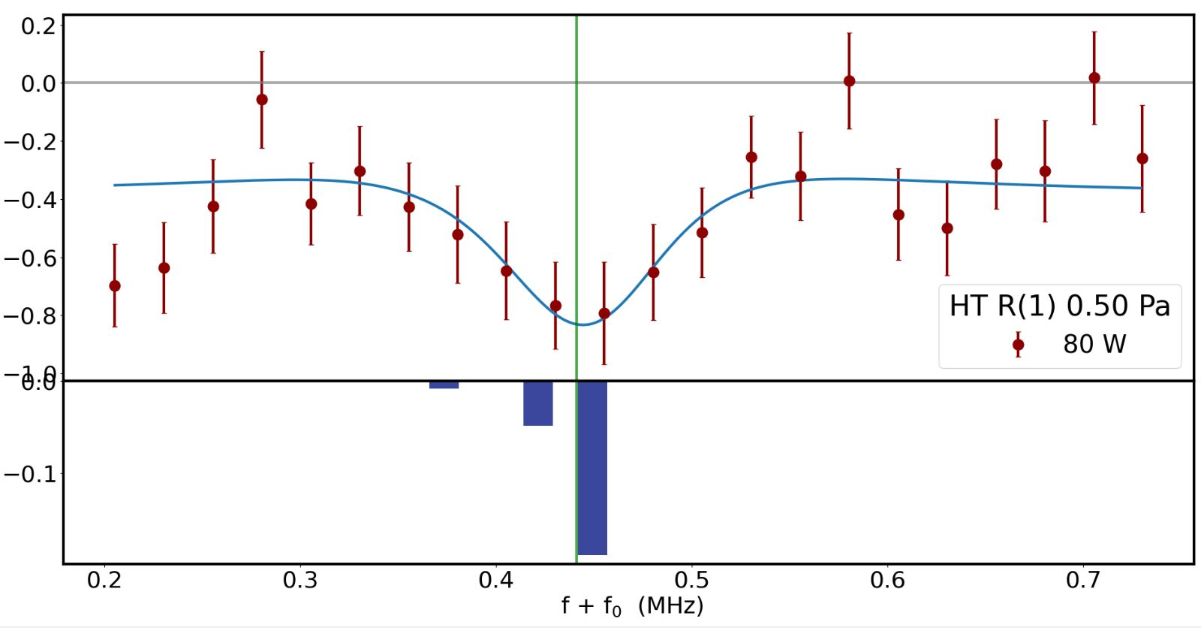
Low power measurements on R(1)
Can we repeat the ‘trick’ done in H₂
  Measurements at factor 5 lower power
Interesting feature shows at right side!
  Is it a Lamb-dip?
    Fitting function seems to work
    Multiple hyperfine components complicates accurate extraction

Slide 13
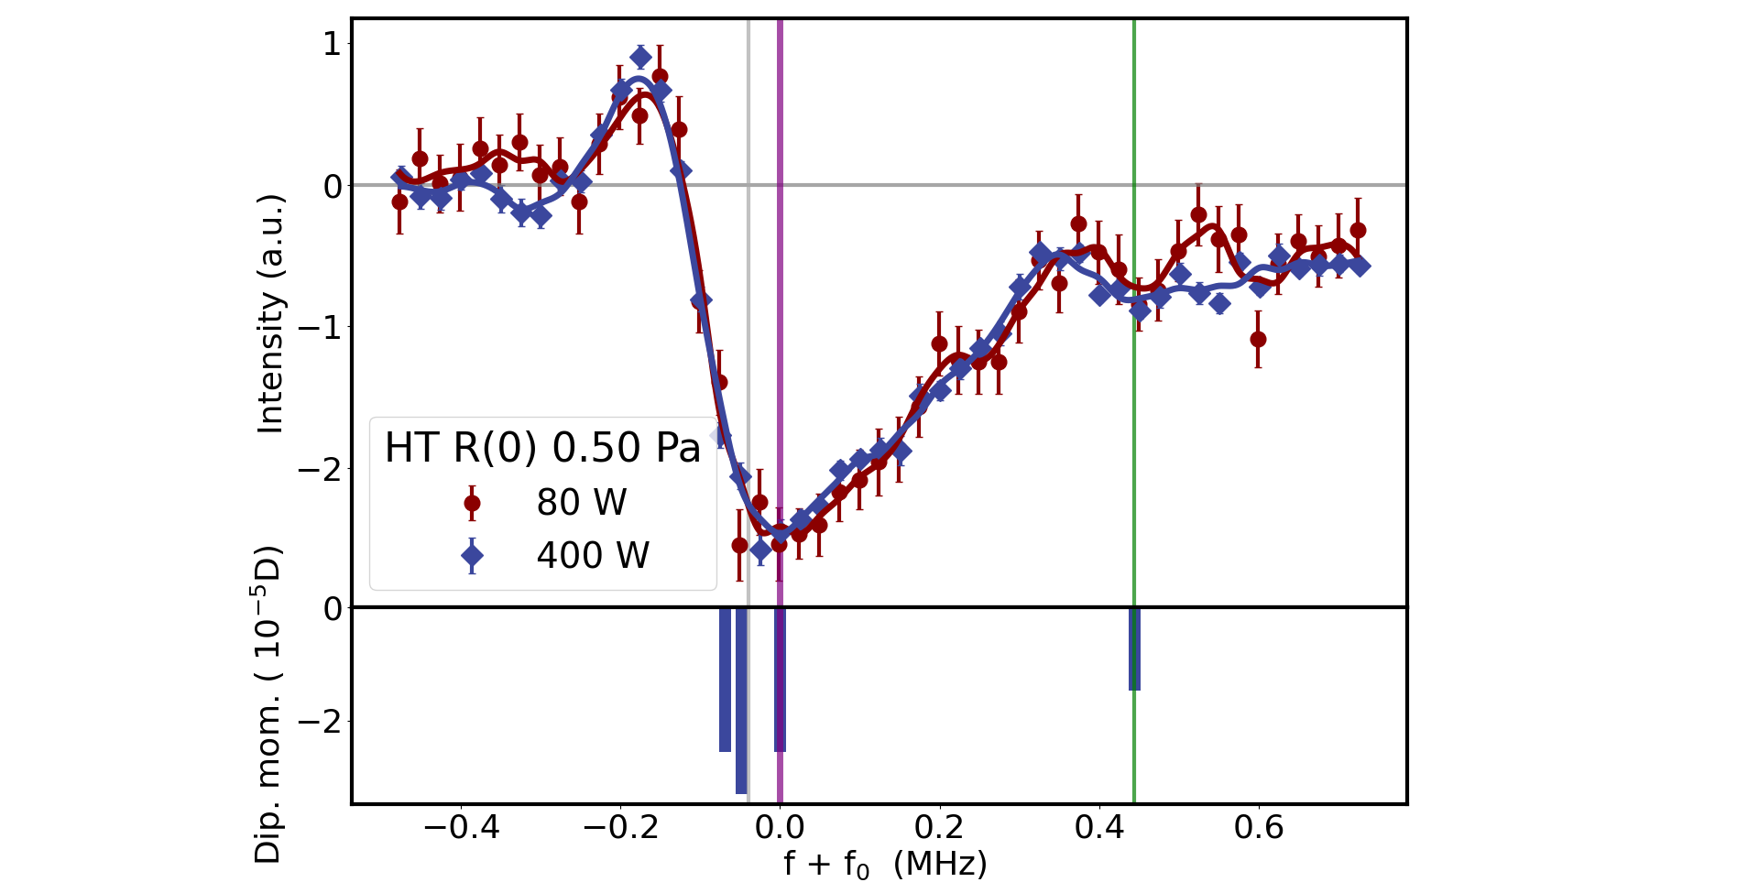
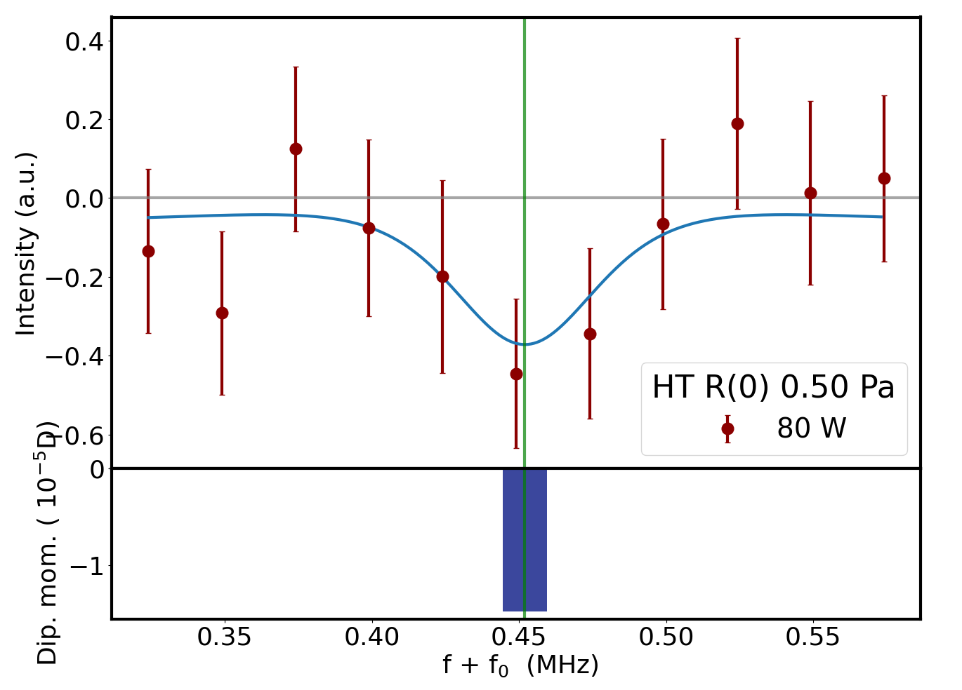
Low power measurements on R(0)
R(0) a better target due to single isolated hyperfine component
No isolated scans done yet, very preliminary data
Around 100 to 150 kHz width (FWHM)
  Narrower than lineshapes in cryogenic system?
  Noise limit old piezo amplifiers

Slide 14
Discussion
Do we see a Lamb-dip?
  If so, fitting accuracies of ~10 kHz of isolated hyperfine component can be obtained
Must we apply a recoil shift?
  Recoil shift is ‘only’ 25 kHz
  Difficult to observe effect of the 50 kHz doublet
First preliminary analysis shows (1.8 MHz) offset from theory
  Identical to overtone band HD

Slide 15
Conclusion
Getter technology allows reliable loading and storage of tritium
  Spectroscopic measurements of equal quality as non-radioactive species
  Allows more possibilities of incorporating measurements with tritiated species
No observable degradation of mirror coatings
More favorable hyperfine splitting could provide accurate marker to extract transition frequencies
  Isolated component seems to exhibit properties of an ordinary Lamb-dip at reduced power

Slide 16
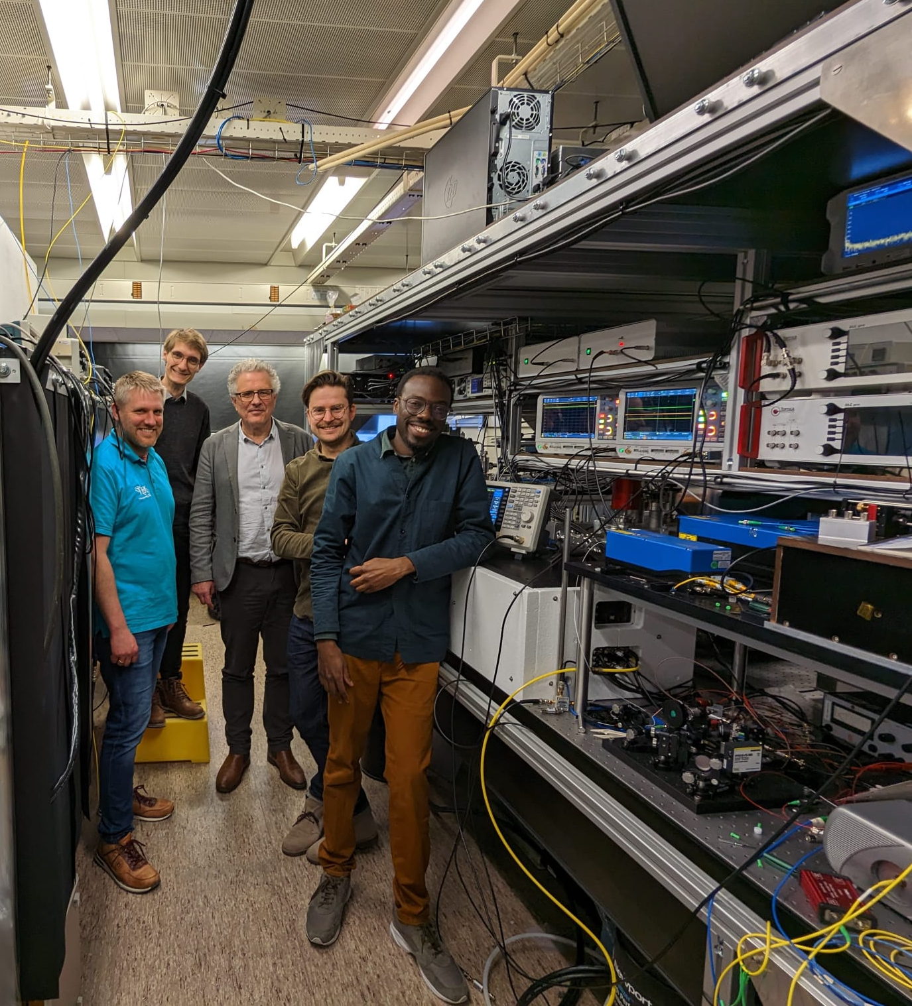

Acknowledgements & Questions
Tritium team:
Valentin Hermann
Magnus Schlösser
NICE-OHMS team:
Frank Cozijn
Meissa Diouf
Wim Ubachs

