Slide 1


DeepXS: Fast approximation of MSSM electroweak cross sections at NLO
Discrete 2018, Vienna
Based on work by Sascha Caron, Jong-Soo Kim, Sydney Otten, Krzysztof Rolbiecki, Roberto Ruiz de Austri, Jamie Tattersall
27.11.2018

Slide 2
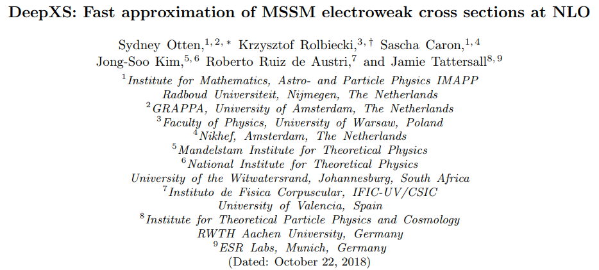
Paper is out! arxiv:1810.08312

Slide 3
This talk is …
an attempt at a compromise between physics and machine learning
tackling the thought that neural networks are magic black boxes you only have to throw data at for a perfect solution
guiding through the process of constructing an AI for predicting an LHC observable
demonstrating the fact that we can handle high-dimensional models and can go beyond low-dimensional simplified models
showing that even for a regression task, classification, active learning and feature engineering (or injection of deeper expert knowledge) might help a lot.
trying all of the above in 20 minutes.

Slide 4
What are we looking at and why?
There are reasons to believe that there is physics beyond the standard model:
Hierarchy problem
Dark Matter
Gravity at the Planck scale
Dark energy
…
Well motivated theory!
For the first two points, SUSY can provide a solution
Many possible realizations of SUSY in nature exist. The manifold of parameter combinations is 19 dimensional (pMSSM-19) and continuous.
If a signal at the LHC appears that cannot be explained by the SM, we want to be able to tell if it can be explained by SUSY and which Lagrangian parameters fit the signal best.
To create such a mapping, we need to know LHC observables like σ.
For tools that help with this, it is crucial to know the NLO electroweakino (Neutralino and Chargino) cross section within ms.

Slide 5
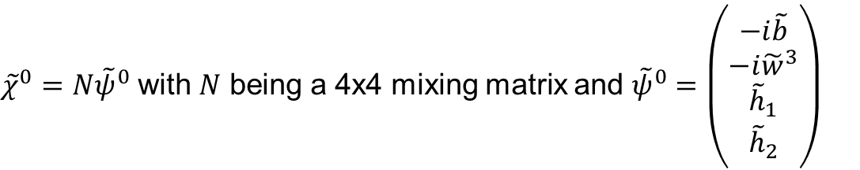

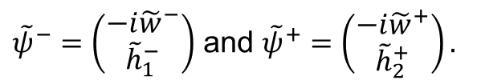

Neutralinos and Charginos
Neutralinos
four neutralinos exist: $χ_{i}^{0},i=1…4$
They are mixtures of the neutral bino, wino and higgsinos:
${\tilde{χ}}^{0}=N{\tilde{ψ}}^{0}$ with $N$ being a 4x4 mixing matrix and ${\tilde{ψ}}^{0}=\left(\begin{matrix}\begin{matrix}−i\tilde{b} \\ −i{\tilde{w}}^{3}\end{matrix} \\ \begin{matrix}{\tilde{h}}_{1} \\ {\tilde{h}}_{2}\end{matrix}\end{matrix}\right)$
Charginos
four charginos exist: $χ_{i}^{±},i=1, 2$
They are mixtures of the charged wino and higgsinos:
${\tilde{χ}}^{−T}={\tilde{ψ}}^{−T}U^{T}$ and ${\tilde{χ}}^{+}=V{\tilde{ψ}}^{+}$ with $U$ and $V$ being 2x2 mixing matrices and
${\tilde{ψ}}^{−}=\left(\begin{matrix}−i{\tilde{w}}^{−} \\ {\tilde{h}}_{1}^{−}\end{matrix}\right)$ and ${\tilde{ψ}}^{+}=\left(\begin{matrix}−i{\tilde{w}}^{+} \\ {\tilde{h}}_{2}^{+}\end{matrix}\right).$

Slide 6
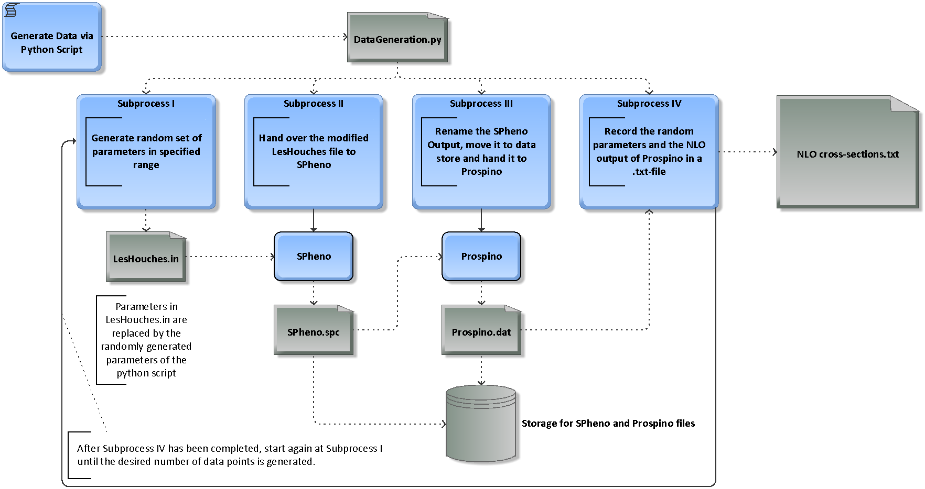
How do we generate data?

Slide 7
What is our mission?
Provide a computational tool
that gives the NLO cross section for electroweakinos
in milliseconds
with a mean absolute percentage error (mape) below 1 %
with a maximum percentage error below 10 %

Slide 8
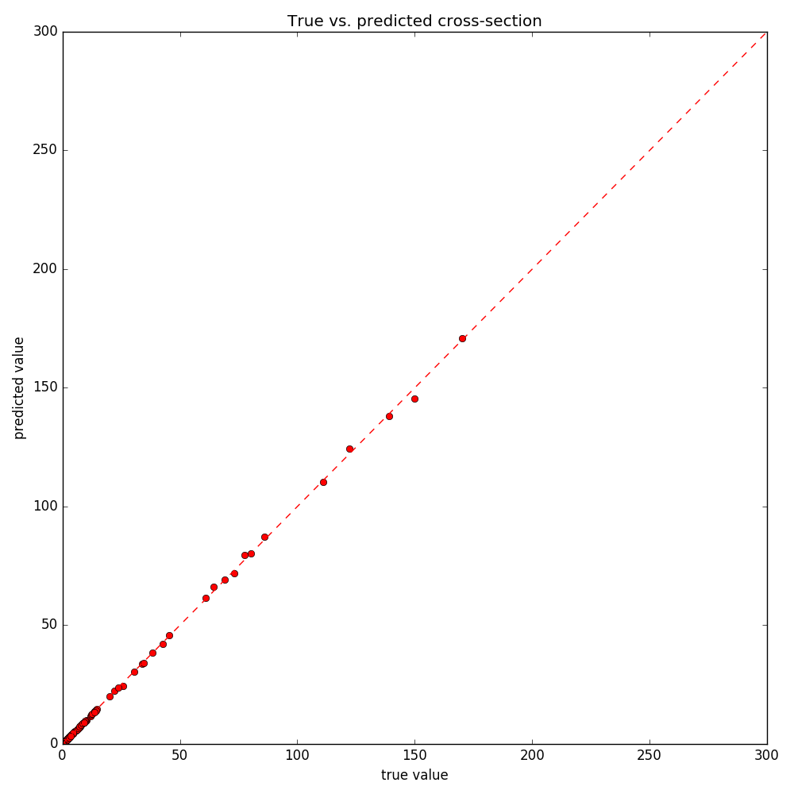
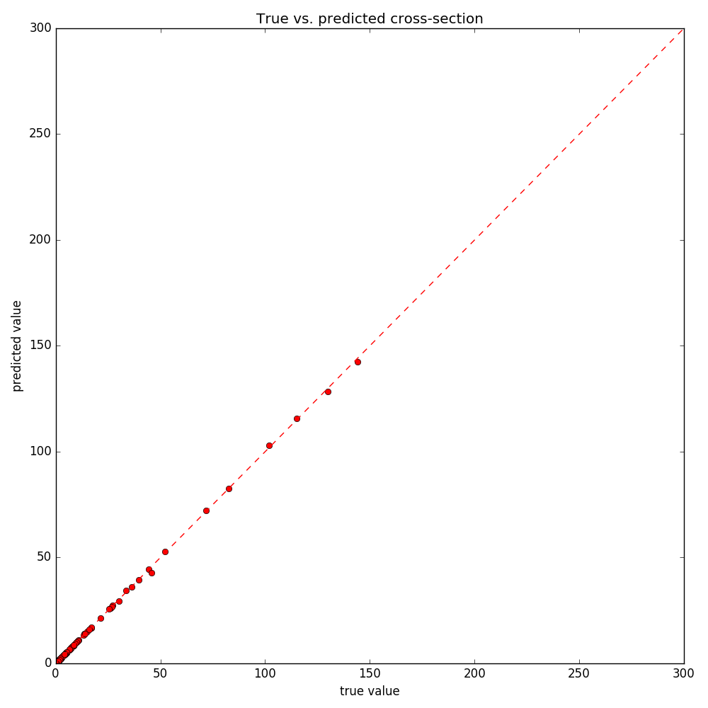


First results in 4D and 5D
$χ_{1}^{+}χ_{1}^{−}$ NLO cross section for 4D
$χ_{1}^{+}χ_{1}^{−}$ NLO cross section for 5D
Mape: 0.3 %, max. error < 5 %, #points: 18‘000
Mape: 0.3 %, max. error < 5 %, #points: 54‘000

Slide 9
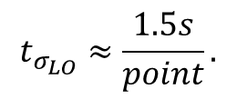
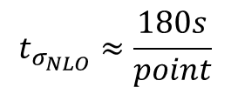

Interlude: Decomposing the NLO
$$t_{σ_{NLO}}≈\frac{180s}{point}$$
Generating NLO data takes very long!
$$t_{σ_{LO}}≈\frac{1.5s}{point}.$$
But luckily,
$$σ_{NLO}=K∙σ_{LO}$$
and
We think that:
most difficulties already show for the LO cross section
the K factors are easy because $K$ is O(1)
We generate data for these two quantities separately.
Instead of 480 $\frac{NLO points}{day∙core}$, we can now generate 57600 $\frac{LO points}{day∙core}$.

Slide 10
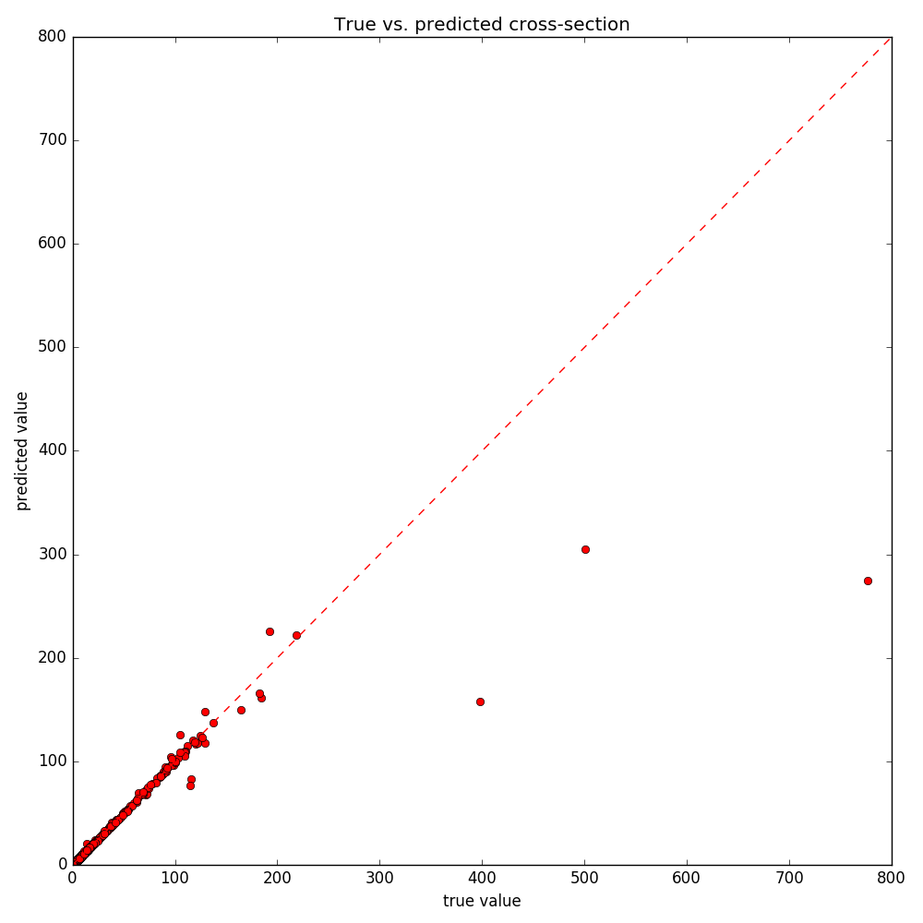

Results in 12D
$χ_{1}^{+}χ_{1}^{−}$ LO cross section for 12D
Mape: 0.5 %
Max. error: 63 %
#points: 525‘000

Slide 11
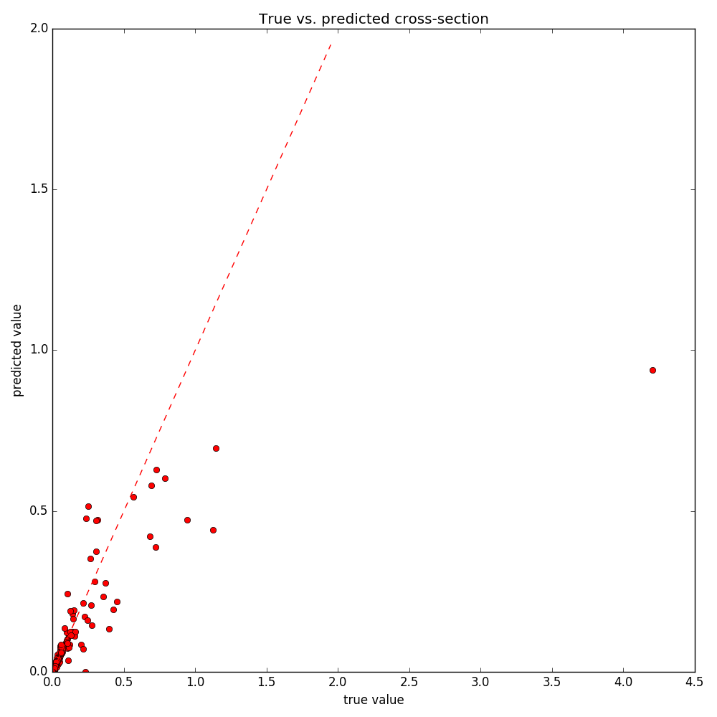

Neutralino-Neutralino pair production
$χ_{1}^{0}χ_{1}^{0}$ LO cross section for 18D
Mape: 3 %
Max. error > 100 %
#points: 870‘000

Slide 12

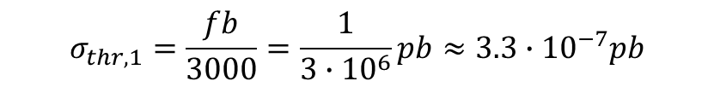

Interlude II: Cut off
The data generation so far was only restricted by the ranges of the MSSM parameters
cross sections as low as ${10}^{−10} pb$ were part of the results!
But since the integrated luminosity $L_{int}=3000 {fb}^{−1}$ and
$L_{int}∙σ=\#events$,
we can determine a threshold for $σ$ by fixing a minimum number of events in the lifetime of the LHC.
$$σ_{thr,1}=\frac{fb}{3000}=\frac{1}{3∙{10}^{6}}pb≈3.3∙{10}^{−7}pb$$
Training threshold (#events=1):
Validation threshold (#events=10):
$$σ_{thr,2}≈3.3∙{10}^{−6}pb$$

Slide 13
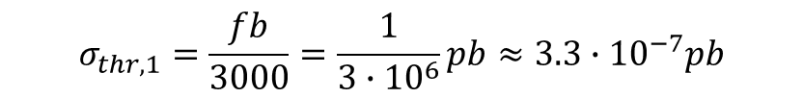
Interlude III: Classification
$$σ_{thr,1}=\frac{fb}{3000}=\frac{1}{3∙{10}^{6}}pb≈3.3∙{10}^{−7}pb$$
Training threshold (#events=1):
Extremely conservative cut off!
every point with a lower cross section is not interesting
Thus, we have two classes: 1) Interesting (label 1) 2) Not interesting (label 0).
This is an easy classification problem!
The NN needs to predict either a 0 or a 1 for a given set of MSSM parameters.
Accuracy is close to 100% in all tested 19D cases
The data generation script now is more intelligent:
By providing the trained weights, it incorporates the NN predictions and only generates interesting data.

Slide 14
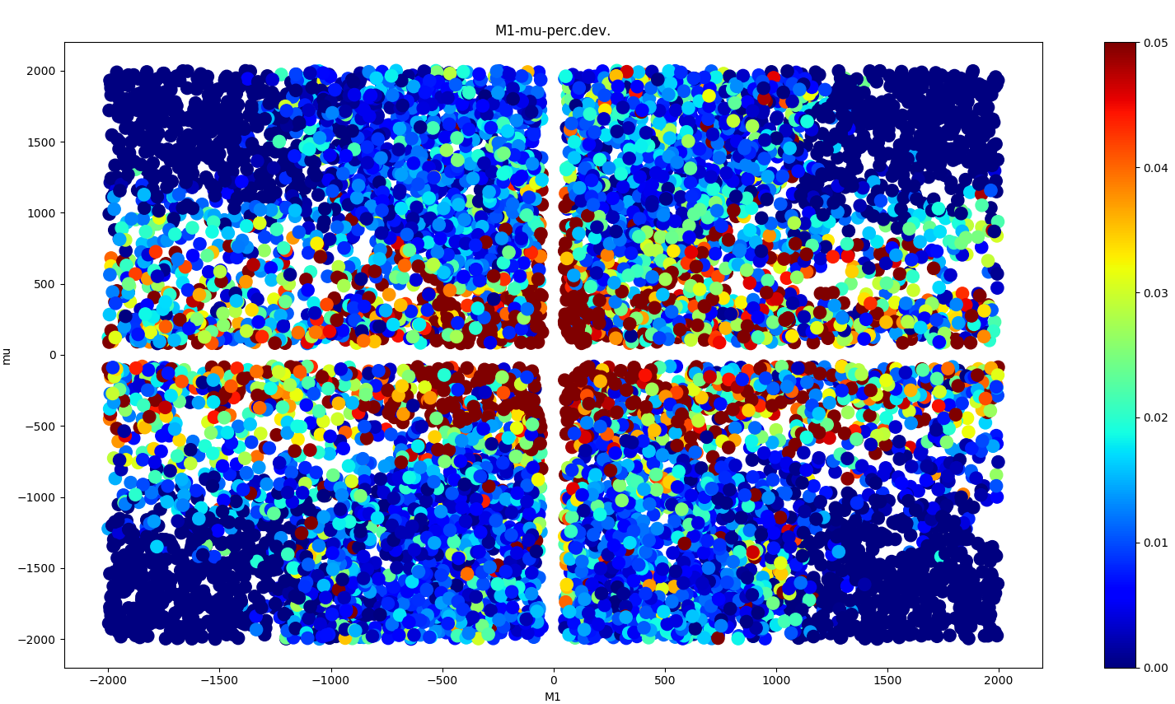
…back to 3D
Mape: 2.3 %, max. error: 307 %, 31‘075 points

Slide 15
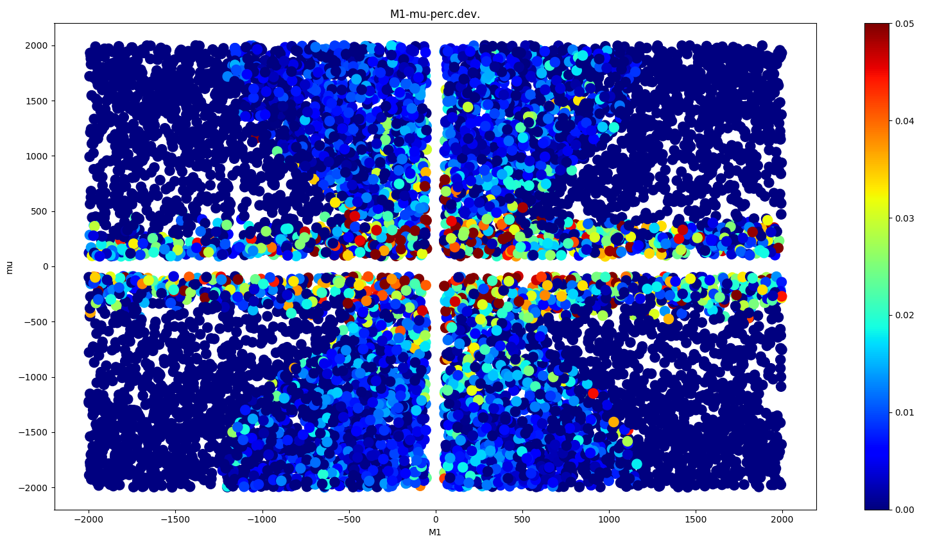
3D – oversampling problematic regions
Mape: 0.8 %, max. error: 37 %, 237‘000 points
Active Learning

Slide 16
Modifying the mapping
Idea: Train on SPheno output instead of MSSM parameters:
Back to 19 dimensional parameter space but collecting the relevant SPheno output:
Neutralino/Chargino mass(es)
Three squark masses
4 or 8 mixing matrix entries
No disadvantage: most people interested in the cross-section run SPheno anyway.
Number of dimensions reduced from 19 to 6 - 14
NN save themselves the conversion step SPheno performs
Better results!

Slide 17
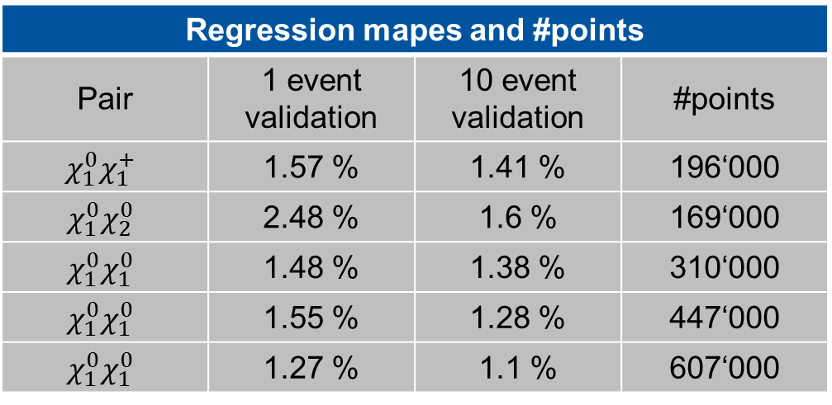
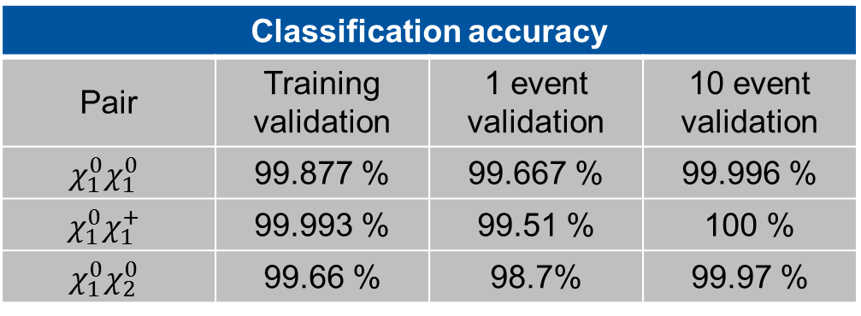
Intermediate Results
Classification accuracy
Pair | Training validation | 1 event validation | 10 event validation
$$χ_{1}^{0}χ_{1}^{0}$$ | 99.877 % | 99.667 % | 99.996 %
$$χ_{1}^{0}χ_{1}^{+}$$ | 99.993 % | 99.51 % | 100 %
$$χ_{1}^{0}χ_{2}^{0}$$ | 99.66 % | 98.7% | 99.97 %
Regression mapes and #points
Pair | 1 event validation | 10 event validation | #points
$$χ_{1}^{0}χ_{1}^{+}$$ | 1.57 % | 1.41 % | 196‘000
$$χ_{1}^{0}χ_{2}^{0}$$ | 2.48 % | 1.6 % | 169‘000
$$χ_{1}^{0}χ_{1}^{0}$$ | 1.48 % | 1.38 % | 310‘000
$$χ_{1}^{0}χ_{1}^{0}$$ | 1.55 % | 1.28 % | 447‘000
$$χ_{1}^{0}χ_{1}^{0}$$ | 1.27 % | 1.1 % | 607‘000

Slide 18
What happened next…
For the first 1-2 months, the 19-dimensional $χ_{1}^{0}χ_{1}^{0}$-case with SPheno output as neural network input was investigated and then the time-line splits.
At the end, there were three different approaches to solving the LO problem:
1. A direct approach mapping the pMSSM-19 parameters onto the cross-section
2. A direct approach mapping the SPheno output onto the cross-section
3. A decomposing approach that turns the cross-section into a sum of coefficients depending on the electroweakino and squark masses times coupling terms.
After seeing the second direct approach work much better than the first one, the first one was dismissed!
For the rest of the time, 2. and 3. were investigated in parallel.

Slide 19
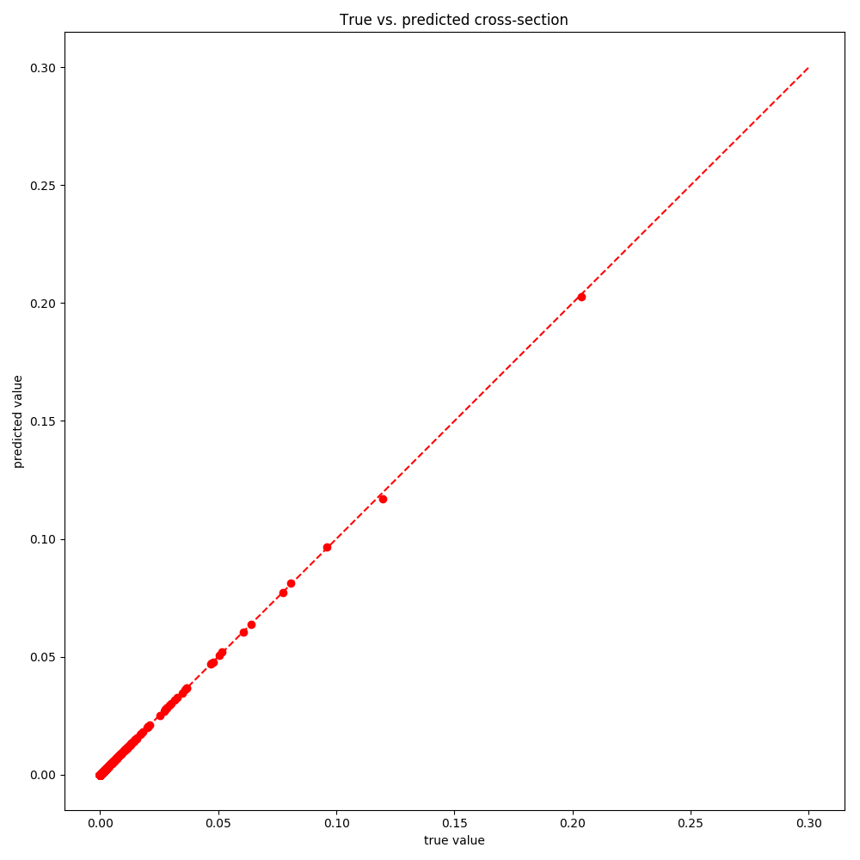
Regression on $χ_{1}^{0}χ_{1}^{0}$ at LO then and now
Mape: 3 %
Max. error > 100 %
#points: 870‘000
Mape: 0.1 %
Max. error: 5.23 %
#points: 3‘700‘000

Slide 20
Architectural recommendations from experience
(for regression and classification problems in physics)
Lots of data
Adequate preprocessing (z-score normalization, log, min-max), …
3-4 or 8 (only with selu) hidden layers
(Several) hundred neurons per layer
Up-to-date optimizer (e.g. Adam/Nadam)
Activation functions with appropriate initialization of weights
Learning Rate Scheduling and Early Stopping
Regularization if overfitting occurs (L1/L2 weight regularization, Dropout, …)

Slide 21
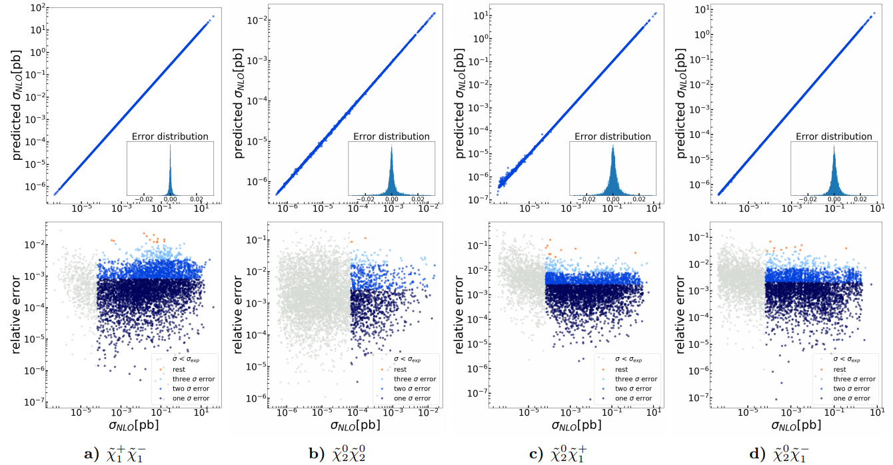
Final Results I: 10 000 Test samples

Slide 22
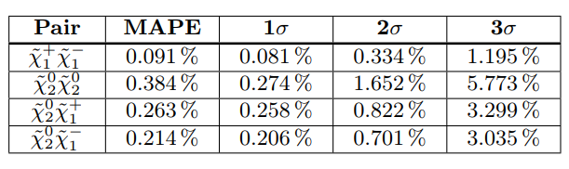
Final Results II
How did we achieve this?
Separating NLO cross section into LO and K factor prediction
Feature Engineering
Restricting the parameter space with expert knowledge
Pool-based Active Learning
Stacking
Code is open source: http://www.github.com/SydneyOtten/DeepXS

Slide 23
Thank you for your attention!

