Slide 1

Supersymmetry:
Nil Carborundum^{(*)}
Where could it be hiding?
Coannihilation of LSP with other near-degenerate sparticles?
History of the early Universe?
Global fits
Update on dark matter scattering
John Ellis
^{(*)} Don’t let the experiments grind you down!

Slide 2
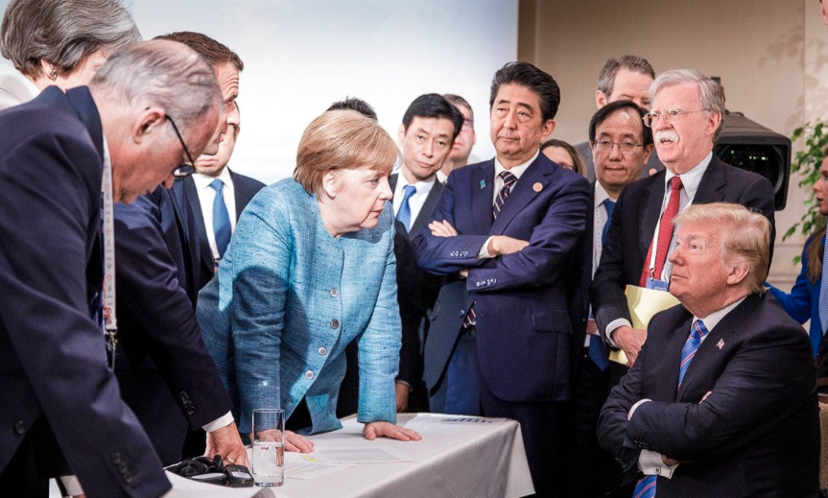
We still believe in supersymmetry
You must be joking!

Slide 3
What lies beyond the Standard Model?
Supersymmetry
New motivations
From LHC Run 1
Stabilize electroweak vacuum
Successful prediction for Higgs mass
  Should be < 130 GeV in simple models
Successful predictions for couplings
  Should be within few % of SM values
Naturalness, GUTs, string, …, dark matter
Notes:
<Foliennummer>

Slide 4
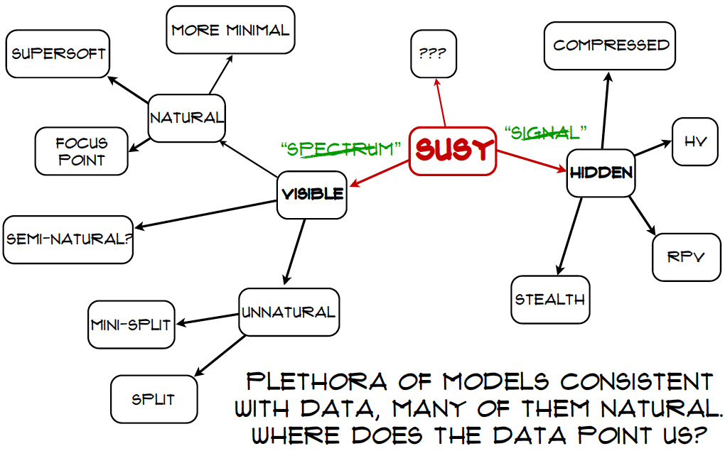
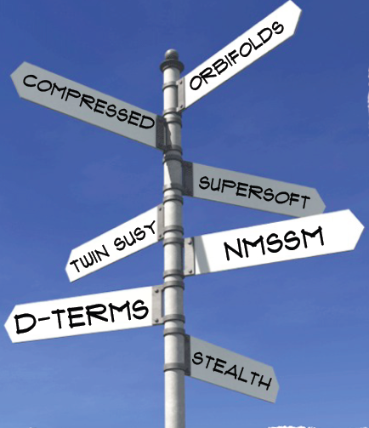
Craig@LHCP

Slide 5
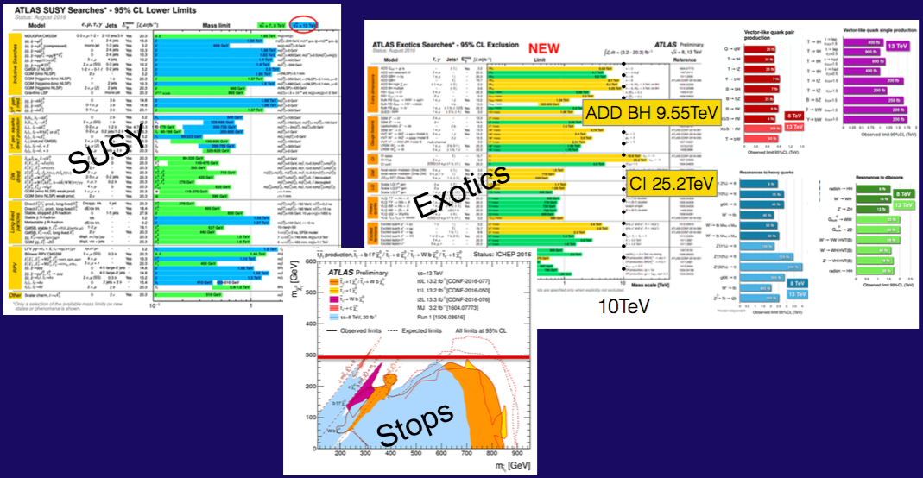
Nothing (yet) at the LHC
No supersymmetry
Nothing else, either
More of same?
Unexplored nooks?
Novel signatures?

Slide 6
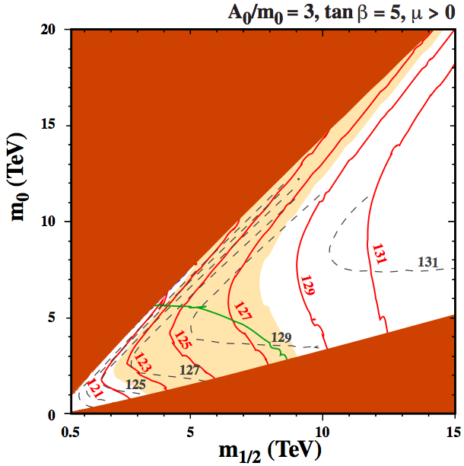
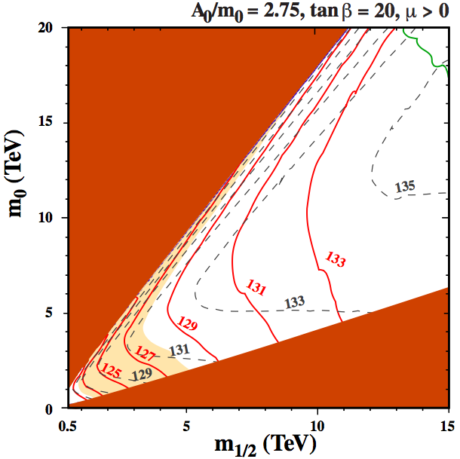
Where could it be hiding?
Bagnaschi, Bahl, JE et al, arXiv:1810.10905
Near-degeneracy of LSP and heavier sparticle(s)?
Coannihilation increases possible mass range
CMSSM
Good dark
matter density
Charged LSP
Charged LSP
Sfermion mass
Gaugino mass (TeV)
Gaugino mass (TeV)

Slide 7
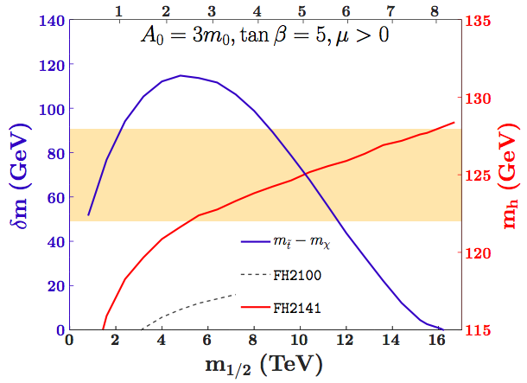
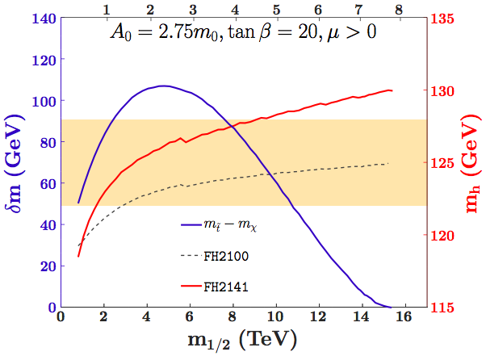
Where could it be hiding?
Near-degeneracy of LSP and heavier sparticle(s)?
Coannihilation increases possible mass range
Experimental MET signature more difficult
LSP mass
LSP mass
CMSSM
Stop-LSP mass difference
Higgs mass 125 ± 3 GeV
LSP mass ≤ 8 TeV
LSP mass ≤ 5 TeV
Bagnaschi, Bahl, JE et al, arXiv:1810.10905

Slide 8
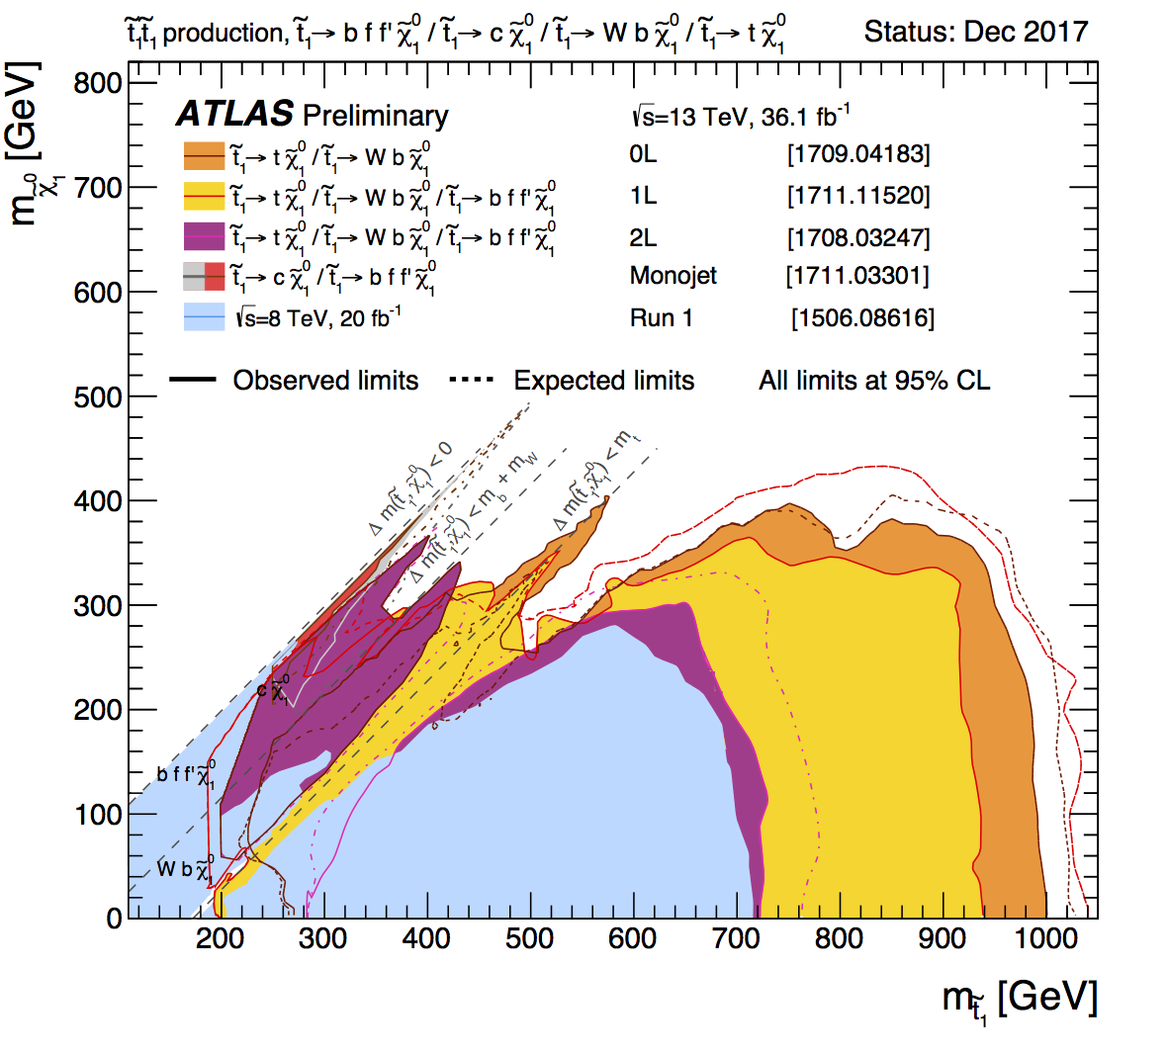
Direct Constraints on Light Stops
Limit on m_{stop}
depends on m_{LSP}
weakens as
m_{LSP}➔m_{stop}

Slide 9
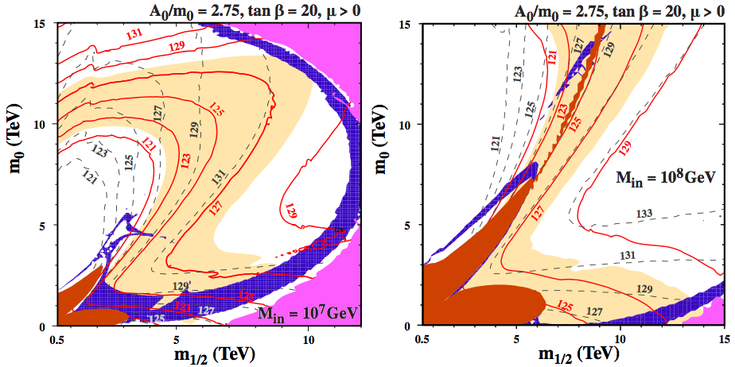
Could be more complicated if …
Bagnaschi, Bahl, JE et al, arXiv:1810.10905
Sparticle masses unify below m_{GUT} (e.g., mirage mediation) - ‘subGUT’ models
More degeneracy ➔ more coannihilation
subGUT
Sfermion mass
Good dark
matter density
Gaugino mass (TeV)
Gaugino mass (TeV)

Slide 10
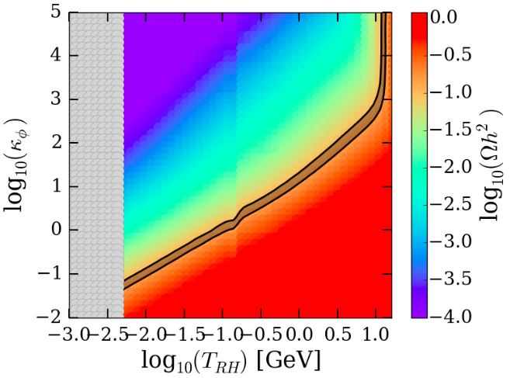
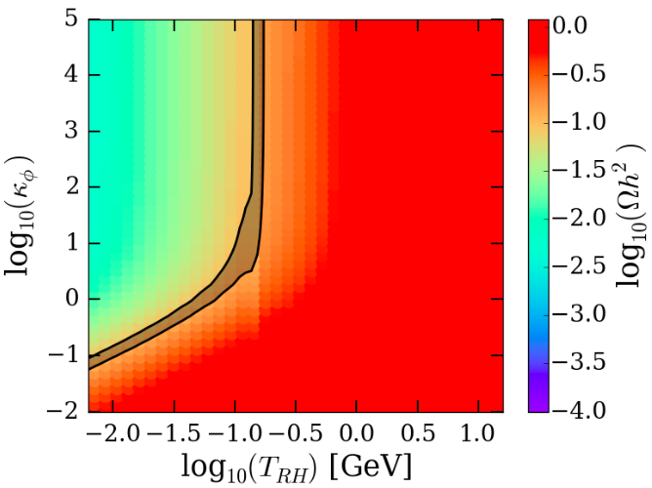
Could be more complicated if …
Arbey, JE, Mahmoudi & Robbins, arXiv:1807.00554
Different evolution of early Universe
Example with late-decaying scalar field, LSP naively “overdense”
No scalar decays to sparticles
Sparticle branching ratio 10⁻¹¹
Good relic density
Good relic density
Scalar density fraction before decay
Reheating temperature after decay
Reheating temperature after decay

Slide 11
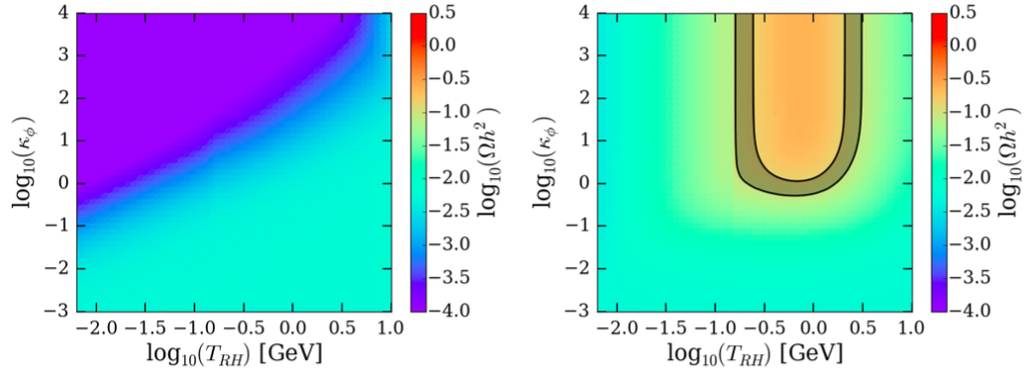
Could be more complicated if …
Arbey, JE, Mahmoudi & Robbins, arXiv:1807.00554
Different evolution of early Universe
Example with late-decaying scalar field, LSP naively “underdense”
No scalar decays to sparticles
Sparticle branching ratio 10⁻¹¹
Good relic density
Good relic density
Scalar density fraction before decay
Good relic density
Reheating temperature after decay
Reheating temperature after decay

Slide 12
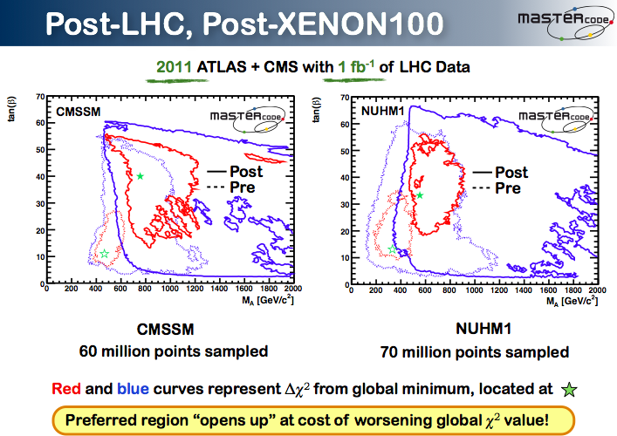

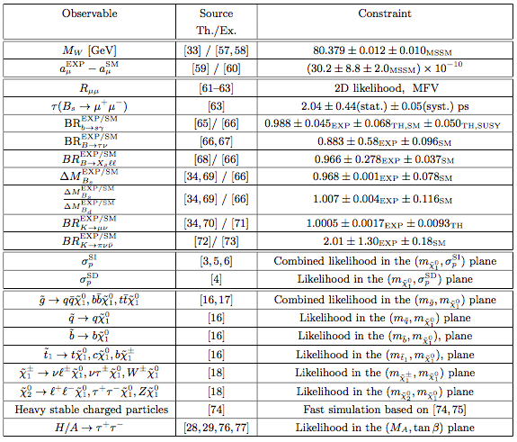
Inputs to Global Fits for New Physics
Miriam Lucio // session
Electroweak
observables
Flavour
observables:
Interpretation
requires
lattice inputs
Dark Matter
LHC
observables

Slide 13

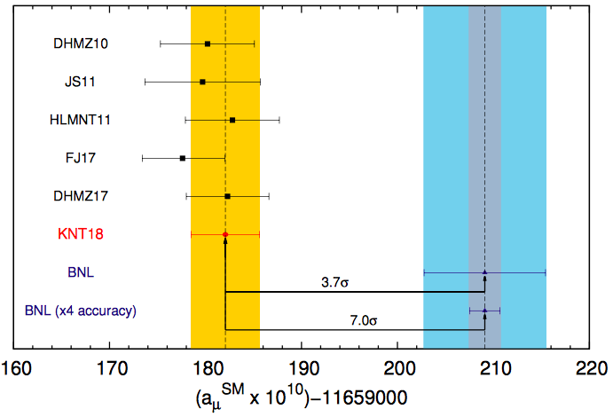
Quo Vadis g_{μ} - 2?
Strong discrepancy between BNL experiment and e⁺e⁻ data now ~ 3.7 σ
New experiment at FNAL (J-PARC)
New physics
at TeV scale?
SUSY?
Keshavarrzi, Nomura & Teubner, arXiv:1802.02995

Slide 14
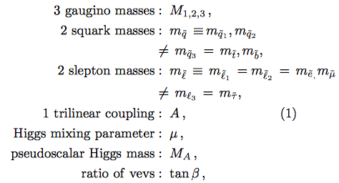
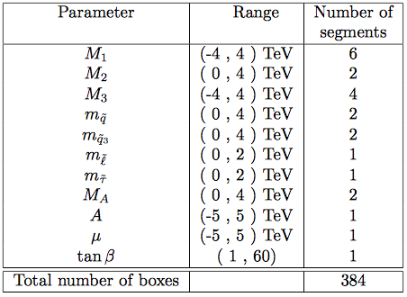
Analysis of pMSSM11
Phenomenological MSSM with 11 parameters
Sample parameter space using Multinest technique
Sampling with/without g-2
Dedicated sampling of Dark Matter regions
Sample 2 × 10⁹ points
Bagnaschi, Sakurai, JE et al, arXiv:1710.11091

Slide 15



SUSY Dark Matter Mechanisms
Bringing relic density into cosmological range often requires specific relation between sparticle masses, such as:
  Near-degeneracy, e.g..:
  Direct-channel resonance, e.g.:
Indicate by following shadings
“Blind spots”
Bagnaschi, Sakurai, JE et al, arXiv:1710.11091

Slide 16
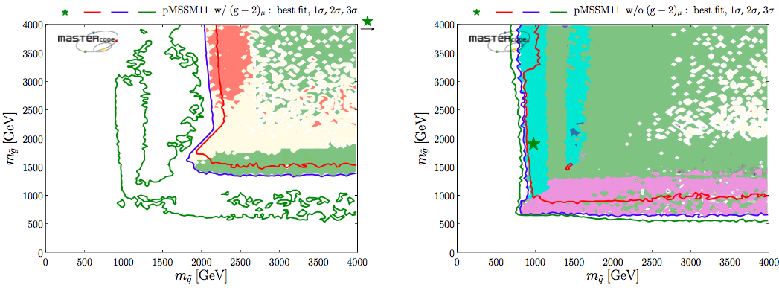
Squark & Gluino Mass Planes
Phenomenological MSSM
Fit including g_{μ}-2
Fit excluding g_{μ}-2
‘Nose’ regions where LHC sensitivity reduced
because of compressed spectrum
Bagnaschi, Sakurai, JE et al, arXiv:1710.11091

Slide 17
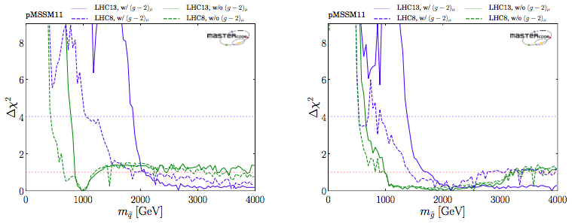
How Light can Squarks & Gluinos be?
Phenomenological MSSM
Squarks, gluinos could weigh ~ 1 TeV if drop g_{μ}-2
Bagnaschi, Sakurai, JE et al, arXiv:1710.11091

Slide 18
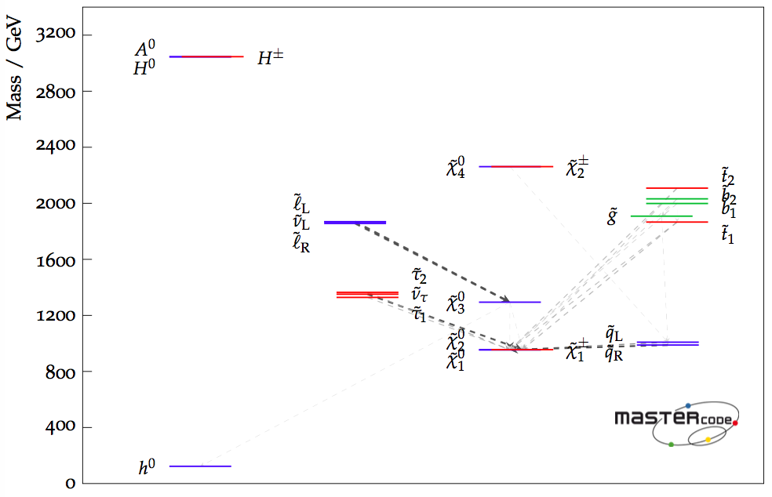
Best-Fit Sparticle Spectrum
Phenomenological MSSM
Fit without g_{μ}-2
Accessible to LHC?
Bagnaschi, Sakurai, JE et al, arXiv:1710.11091

Slide 19
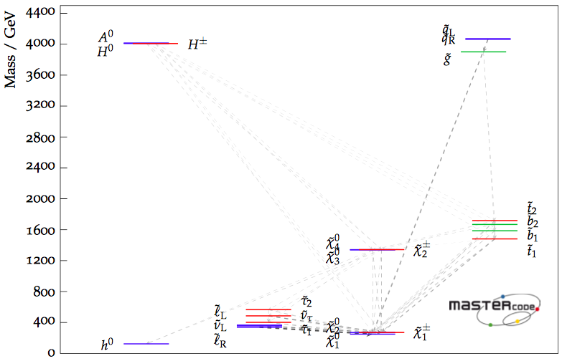
Best-Fit Sparticle Spectrum
Phenomenological MSSM
Fit with g_{μ}-2
Accessible to LHC?
Bagnaschi, Sakurai, JE et al, arXiv:1710.11091

Slide 20
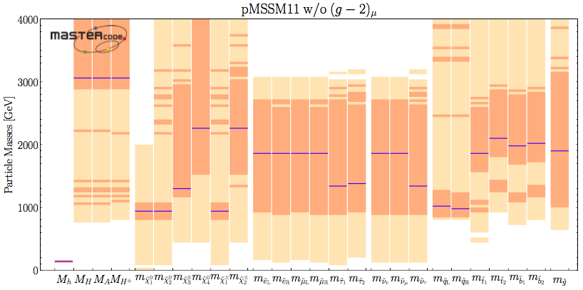
Sparticle Masses in the pMSSM
& production at e+e- colliders
Excluding g_{μ}-2
68 & 95% CL ranges
Best-fit values
Accessible in pair production at ILC500, ILC1000, CLIC
Bagnaschi, Sakurai, JE et al, arXiv:1710.11091

Slide 21
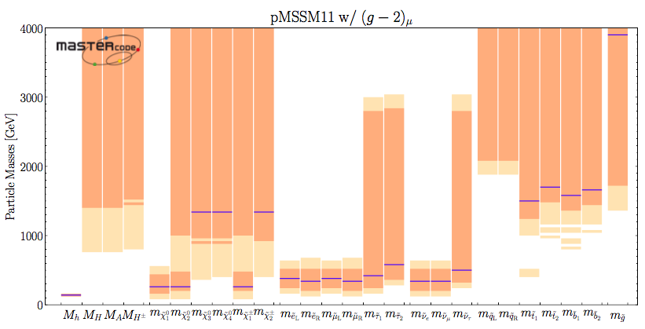
Sparticle Masses in the pMSSM
& production at e+e- colliders
Fit with g_{μ}-2
68 & 95% CL ranges
Best-fit values
Accessible in pair production at ((ILC500)), (ILC1000), CLIC
Bagnaschi, Sakurai, JE et al, arXiv:1710.11091

Slide 22
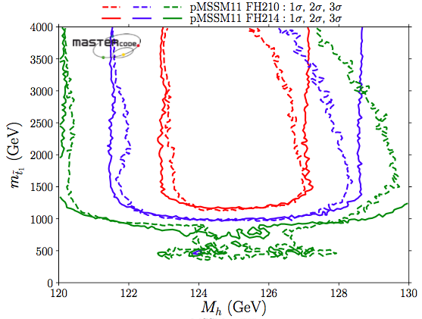
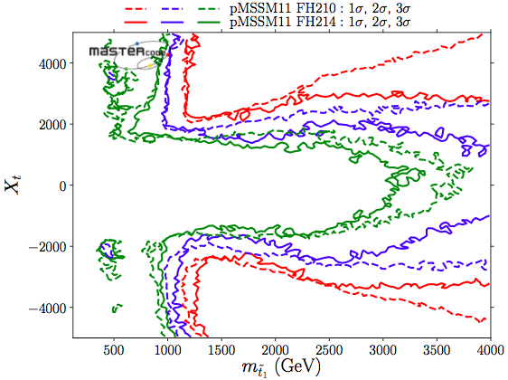
The Lighter Stop may be Light
Could still be as light as 1 TeV, even including LHC13 constraints, …
… if stop mixing is large, otherwise large stop mass is required
pMSSM11
Bagnaschi, Bahl, JE et al, arXiv:1810.10905

Slide 23
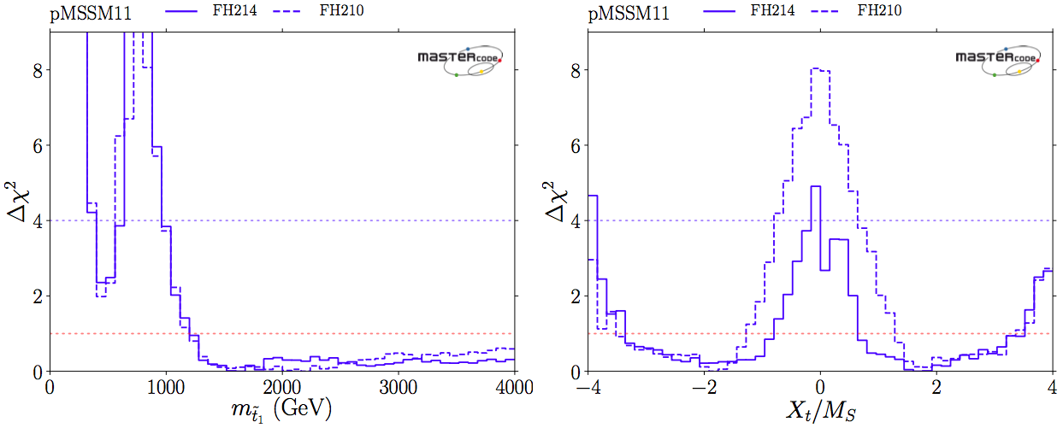
The Lighter Stop may be Light
χ² likelihood functions for m_{stop}, stop mixing
M_{stop} < 500 GeV allowed with Δχ² ~ 2
pMSSM11
Bagnaschi, Bahl, JE et al, arXiv:1810.10905

Slide 24
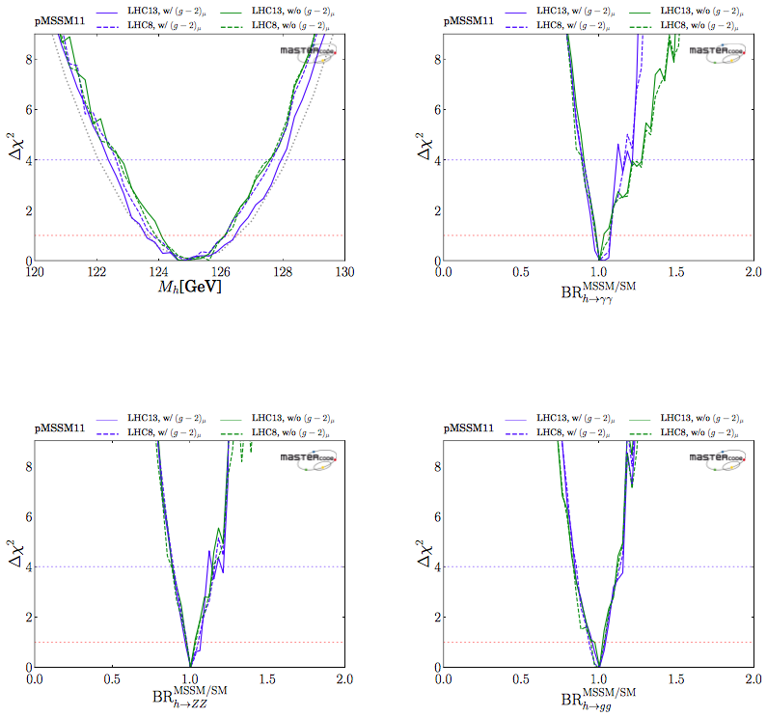
Higgs properties in the pMSSM
No issue with
measured Higgs mass
Central values of decay
BRs similar to SM
Substantial deviations
possible
pMSSM11
Bagnaschi, Sakurai, JE et al,
arXiv:1710.11091

Slide 25
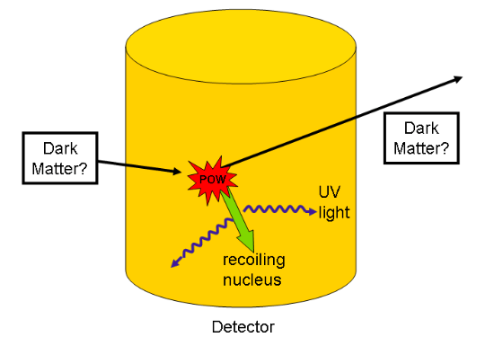
Direct Dark Matter Detection
Scattering of dark
matter particle in
deep underground
laboratory
Notes:
<Foliennummer>

Slide 26
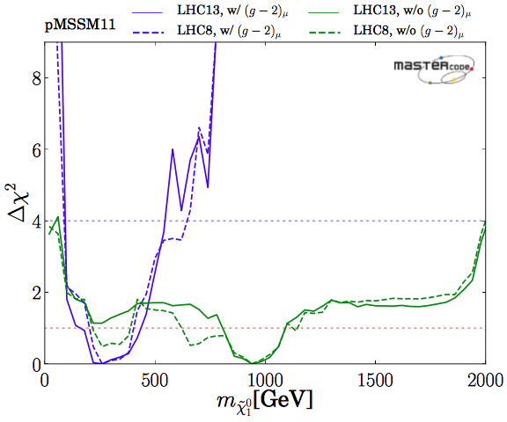
Likelihood for LSP Mass
Phenomenological
MSSM
(no assumptions
on mass parameters)
pMSSM11
With g_{μ}-2
Without g_{μ}-2
Bagnaschi et al, arXiv:1710.11091

Slide 27


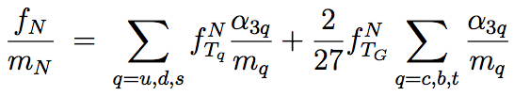


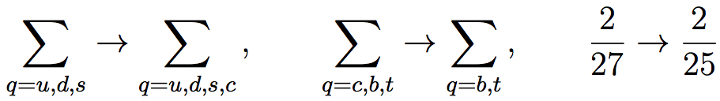
Spin-Independent LSP Scattering
Effective Lagrangian at low velocity:
Spin-independent cross-section related to α₃:
& depends on quark contributions to nucleon mass:
Can also consider 4th active quark:

Slide 28



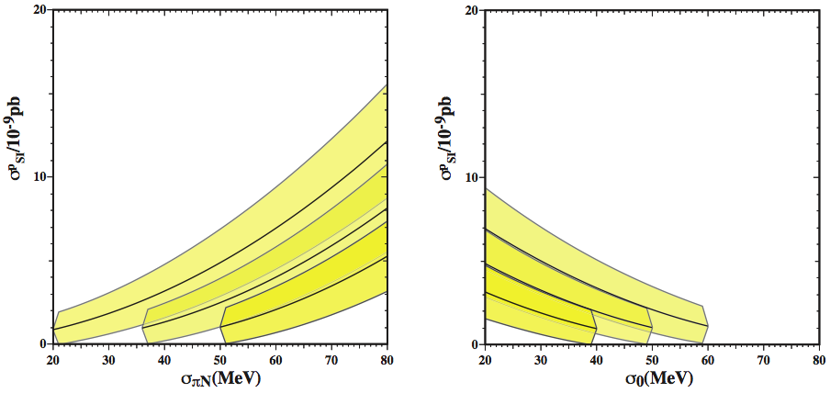
Scattering Matrix Elements
Spin-independent scattering
  Related to <N|qq|N>, obtained from
  πN scattering:
  Baryon masses:
Principal uncertainty σ_{s} :
JE, Nagata & Olive, arXiv:1805.09795

Slide 29
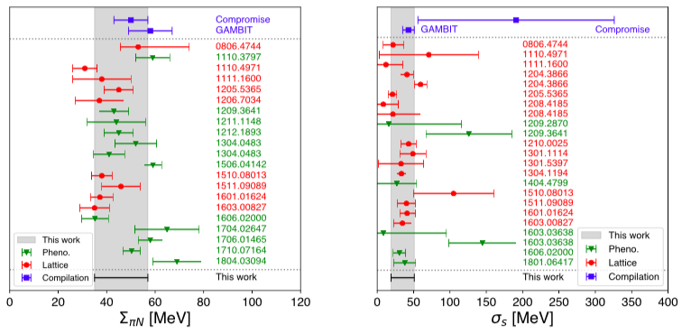
Estimates of Σ_{πN} and σ_{s}
Phenomenology – Lattice - Our compilation
JE, Nagata & Olive, arXiv:1805.09795

Slide 30
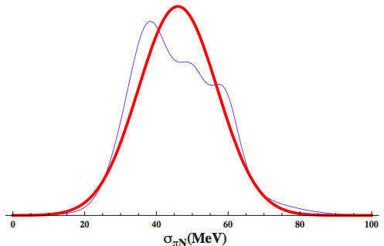
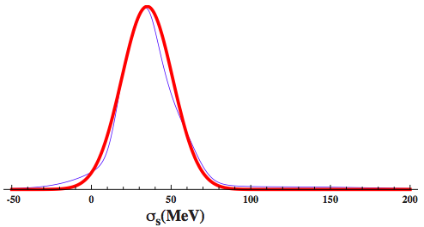


PDG-Style Ideograms
Σ_{πN}
σ_{s}
Our compilation
Our compilation
JE, Nagata & Olive, arXiv:1805.09795

Slide 31
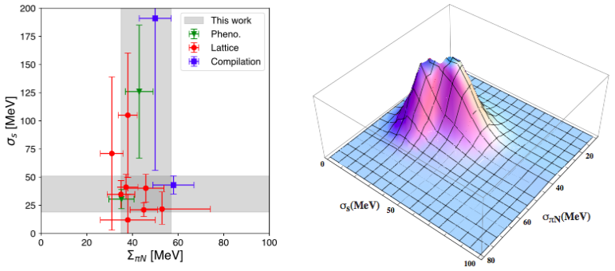
No Significant Correlation
Σ_{πN} and σ_{s} almost uncorrelated
JE, Nagata & Olive, arXiv:1805.09795

Slide 32
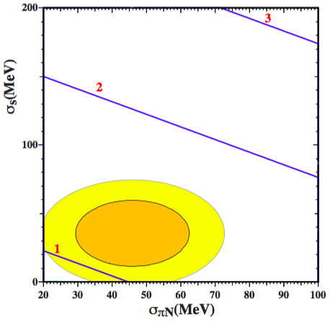
Final Result
Benchmark point in focus-point region
m₀ = 3 TeV, m_{1/2} = 8.2 TeV
A₀ = 0
tan β = 10, μ > 0
Including O(α_{s}³) with 6 quarks:
JE, Nagata & Olive, arXiv:1805.09795

Slide 33
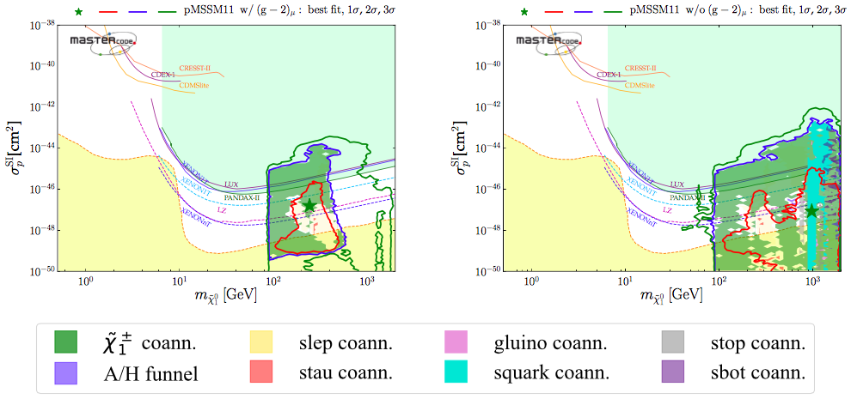
Direct Dark Matter Searches
Phenomenological MSSM
Spin-Independent Scattering
With g_{μ}-2
Without g_{μ}-2
Bagnaschi, Sakurai, JE et al, arXiv:1710.11091

Slide 34
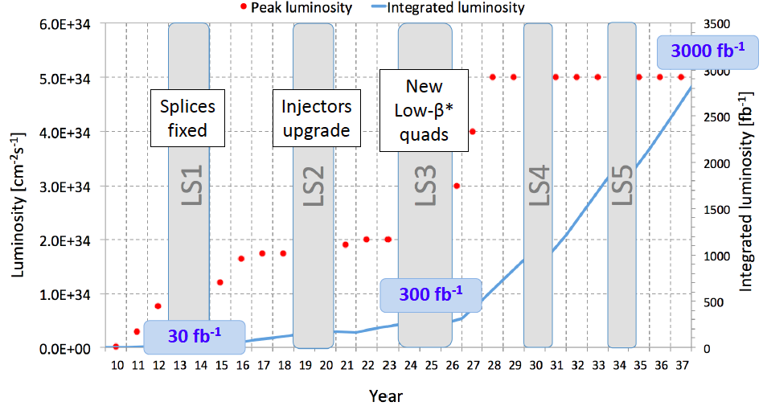
The LHC in Future Years

Slide 35


Future Circular Colliders
The vision:
explore 10 TeV scale directly (100 TeV pp) + indirectly (e⁺e⁻)

Slide 36
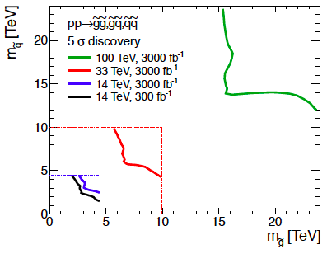
Squark-Gluino Plane
Discover 12 TeV squark,
16 TeV gluino @ 5σ

Slide 37
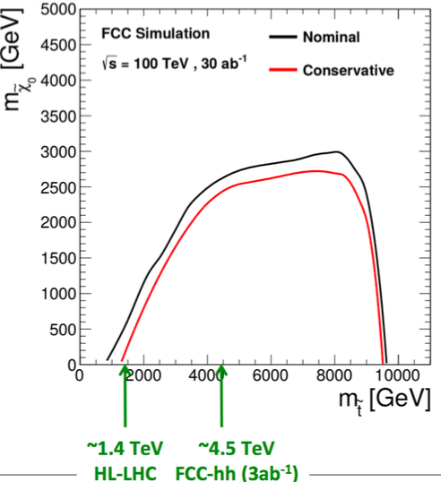
Stop coannihilation
strip could
extend beyond
Stop-Neutralino
Plane
No ‘no-lose’ theorem

Slide 38


