Slide 1

Multimessenger Astronomy and New Neutrino Physics
Kevin J. Kelly, Fermilab
DISCRETE18 -- 28 November, 2018
Based on 1808.02889 (JCAP 1810 (2018) no. 10, 048) with Pedro A.N. Machado

Slide 2
Outline
Identifying ultra-high energy neutrino sources
Probing physics with UHE Neutrinos vs. Supernova Neutrinos
Models we consider
Results

Slide 3
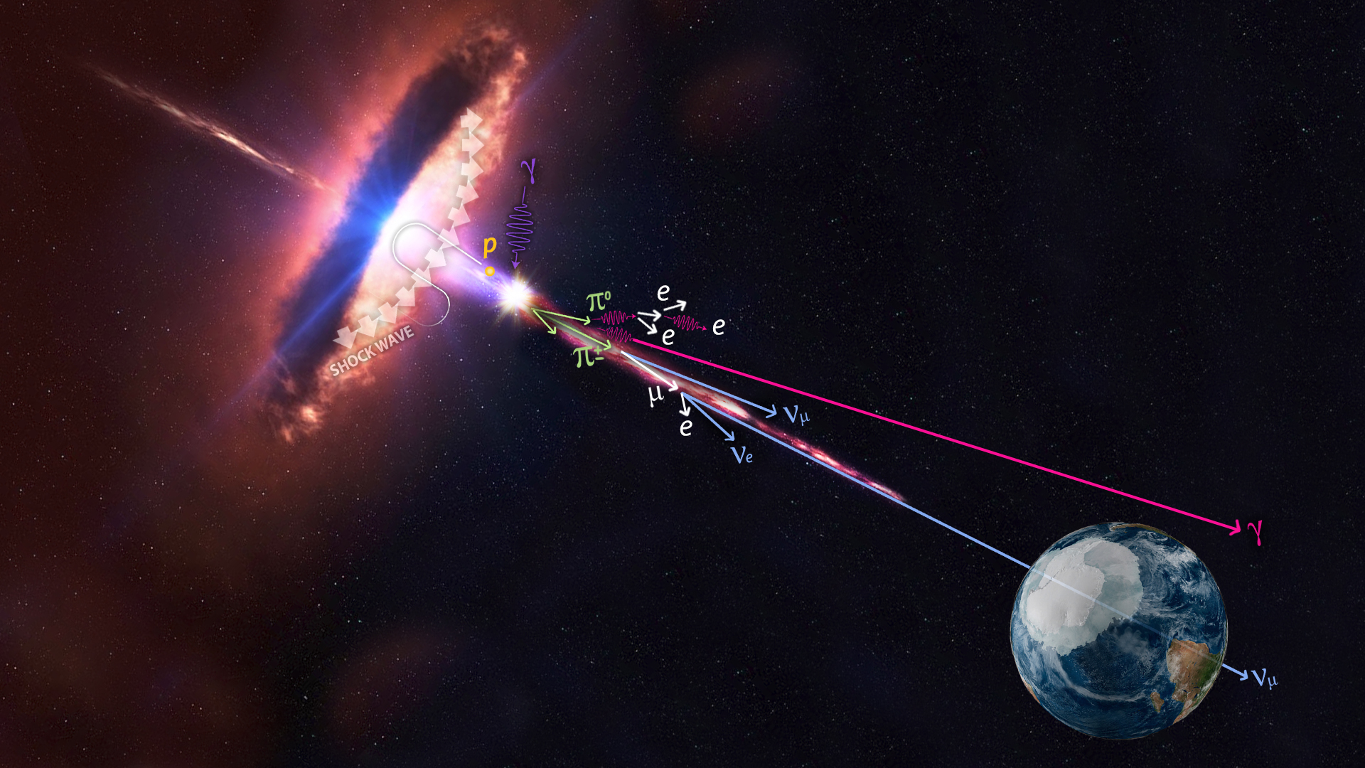
The main idea
Astrophysical environments provide sources of high-energy neutrinos. What types of models can we probe by detecting them?
To date, the only (identified) extragalactic neutrino sources:
SN1987A,
TXS 0506+056
astrobites.org

Slide 4
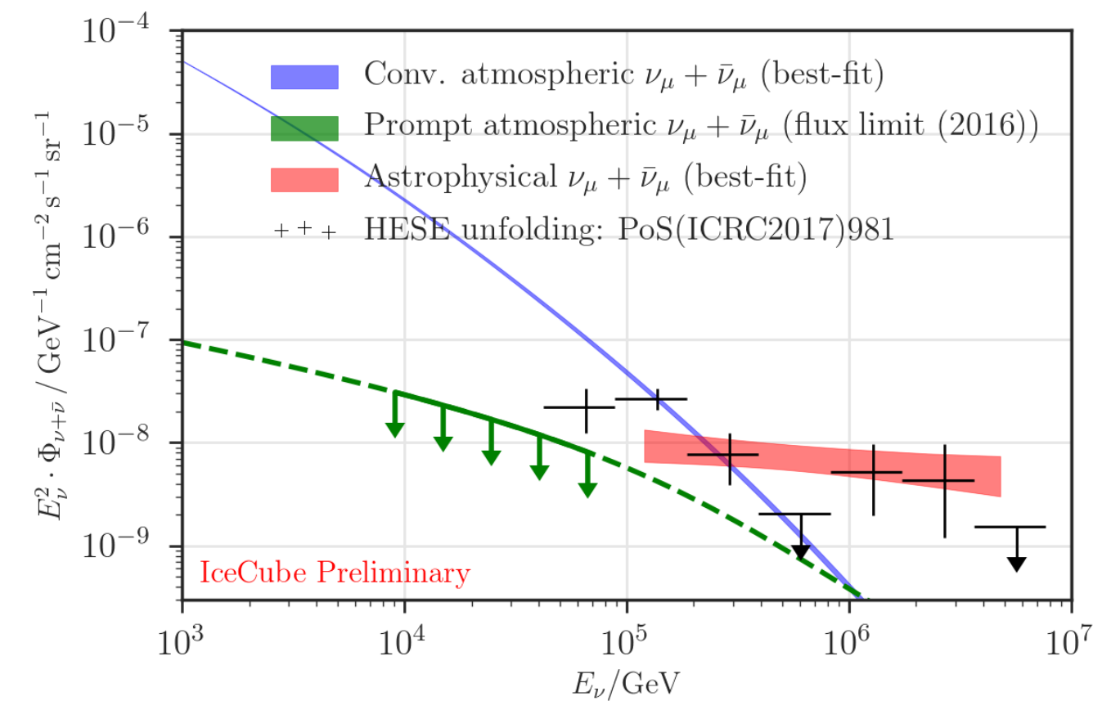
Observing astrophysical neutrinos is great, but...
[IceCube Collaboration, 1710.01191]
Knowing the origin of a given neutrino provides extra handles: propagation distance, what it traversed (galactic disk, magnetic fields, etc.)

Slide 5
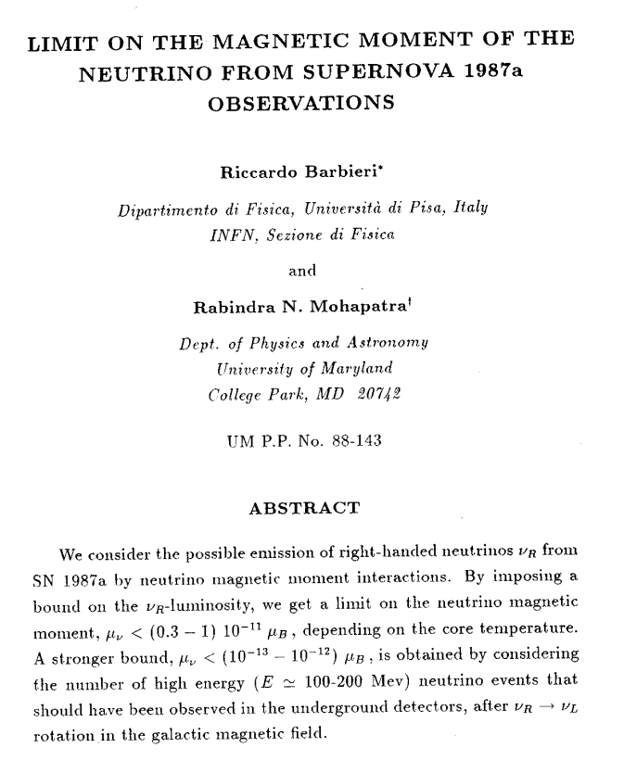
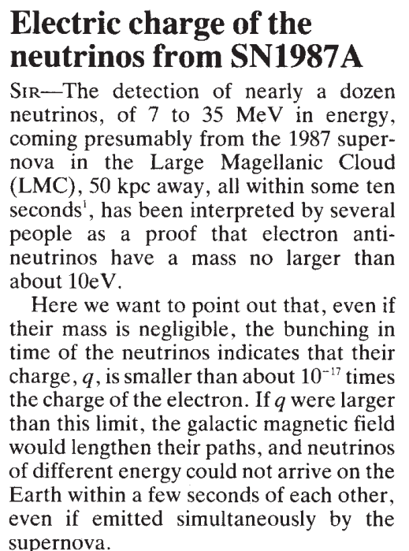
SN1987A vs. TXS 0506+056
SN1987A: Neutrino energies ~10 MeV
Distance ~50 kpc
TXS 0506+056: Neutrino energy ~290 TeV
Distance ~1.3 Gpc
29,000,000 times higher energy, 26,000 times longer distance
G. Barbiellini, G. Cocconi, 1987
R. Barbieri, R. Mohapatra, 1988
While TXS 0506+056 is probing much longer distances, searches for these (and other) new physics models actually suffer from the much larger energy!

Slide 6
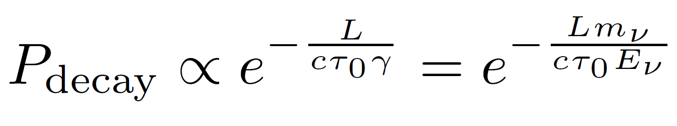
Specific (contrasting) example: Neutrino Decay
Hypothesis: probe decay of heavier neutrinos during propagation from source to Earth.
Naïve expectation: 26,000 times greater distance means commensurate sensitivity to neutrino decay length.
But,

Slide 7
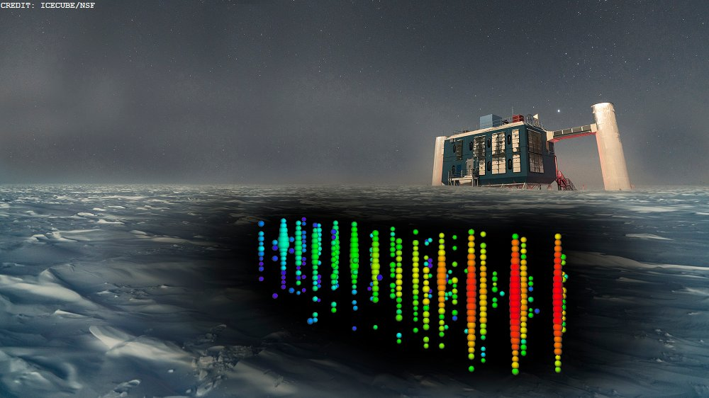
Characteristics of Ultra High Energy Cosmic Neutrinos
Processes to think about: Blazars, Neutron Star Mergers, ...

Slide 8
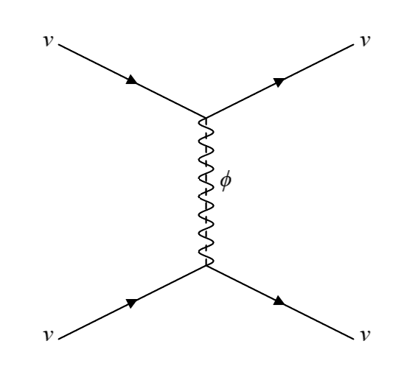
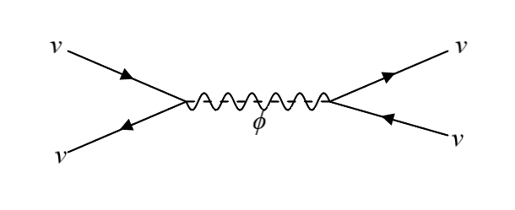
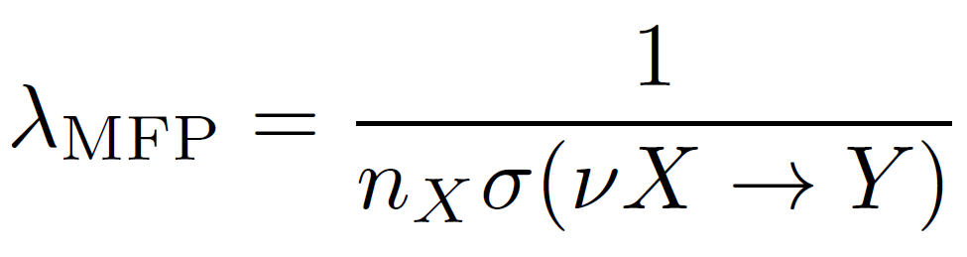
First Scenario Considered
New particle (can be scalar, pseudoscalar, vector, or axial-vector) that couples exclusively to neutrinos.
High-energy neutrinos can scatter with relic Cosmic Neutrino Background neutrinos while travelling to Earth.

Slide 9
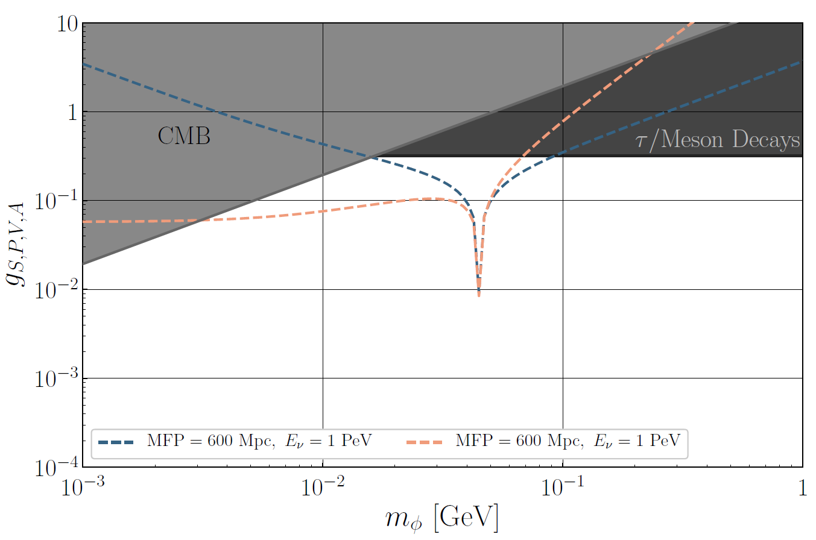
Lower Limit on Mean Free Path

Slide 10
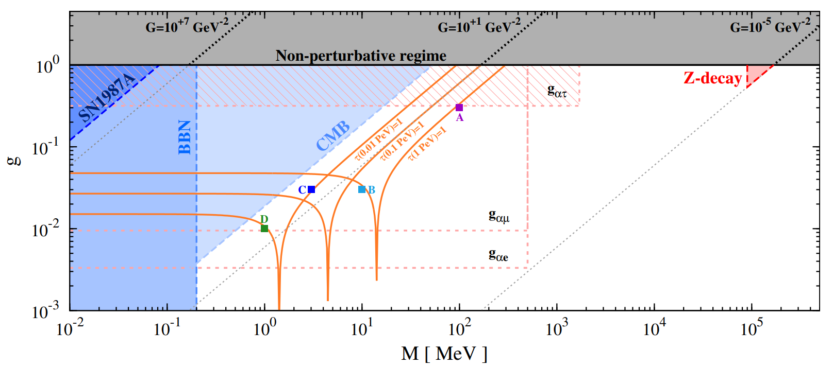
Previously Explored as “Secret Neutrino Interactions”
[Ng, Beacom 1404.2288]
When mass is large, you probe a new four-fermion interaction. Current limits are probing much stronger interactions than G_{F}. Orange lines correspond to an optical depth of 1 for a propagation length of one Hubble length.

Slide 11
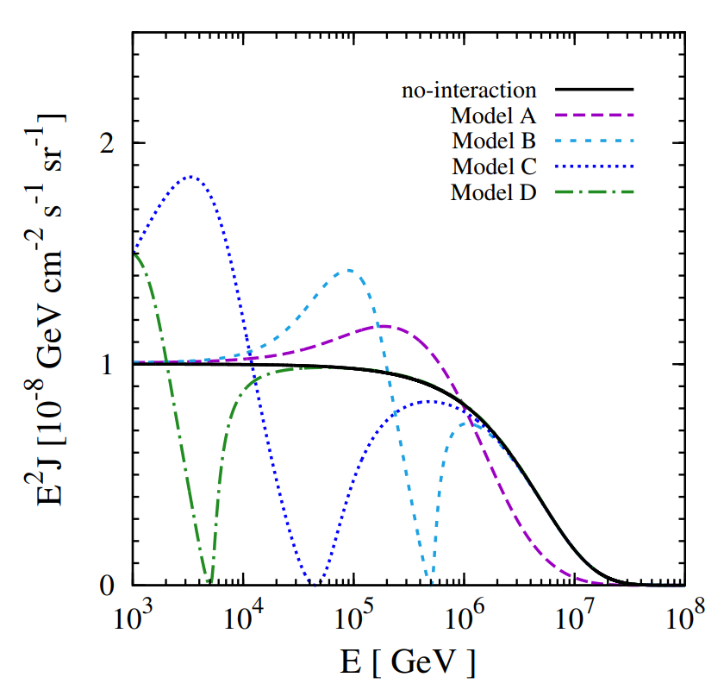
Pileup of events
For a continuous (over time) flux of neutrinos, this type of absorption would lead to a re-emission of neutrinos at lower energies.
However, we are interested in specific neutrino-producing events. A typical scattering will give large enough deflections that the neutrino will not appear to arrive coincident in time/direction with its source.
[Ng, Beacom 1404.2288]

Slide 12
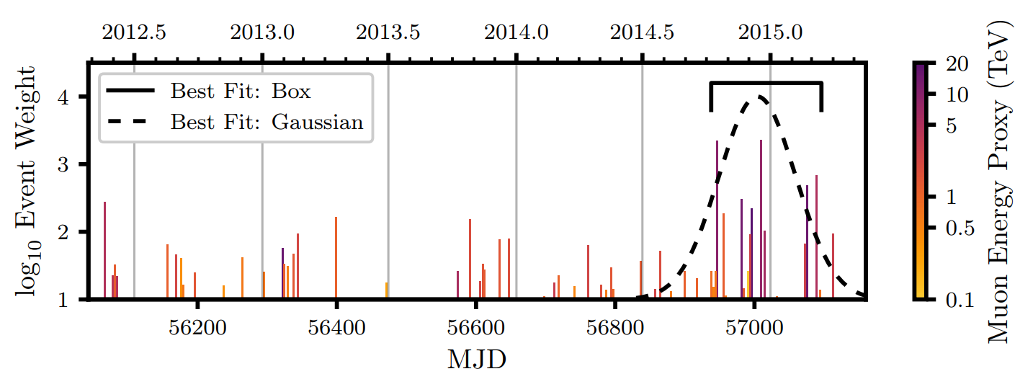
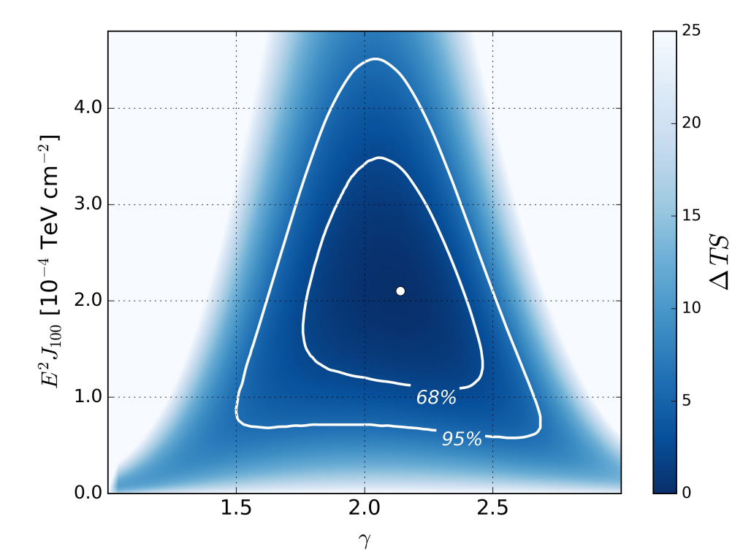
Enter TXS 0506+056
[IceCube Collaboration, 1807.08794]
After the first neutrino event detection (coincident with the location of TXS 0506+056 and in time with a gamma ray burst flare), the IceCube collaboration performed a historical analysis of their data and found a time window with 13 ± 5 excess signal events.
Neutrino fluence measured to be commensurate with gamma ray flux (measured by Fermi-LAT).

Slide 13
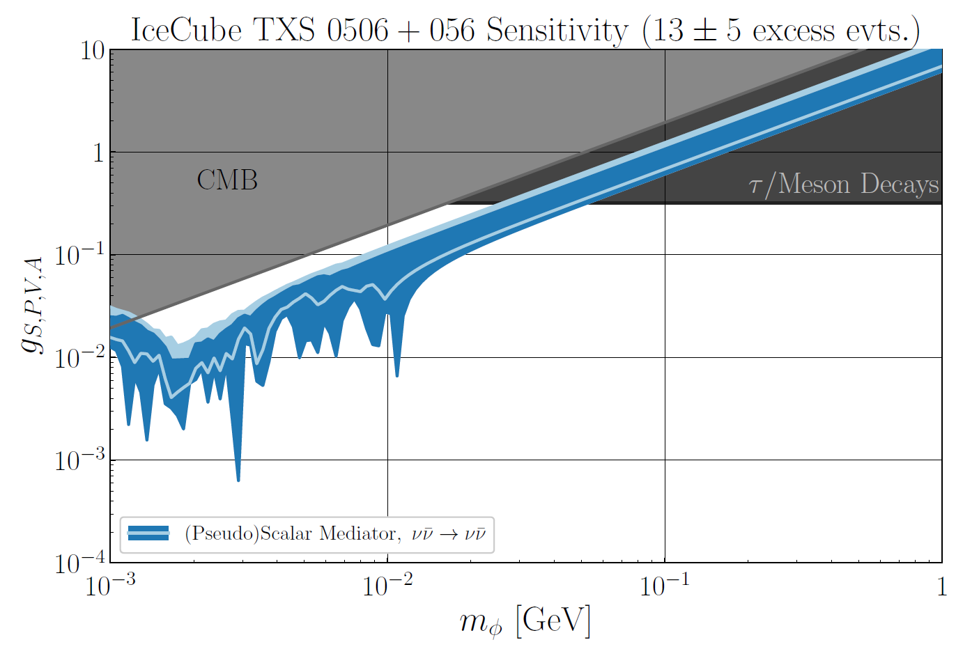
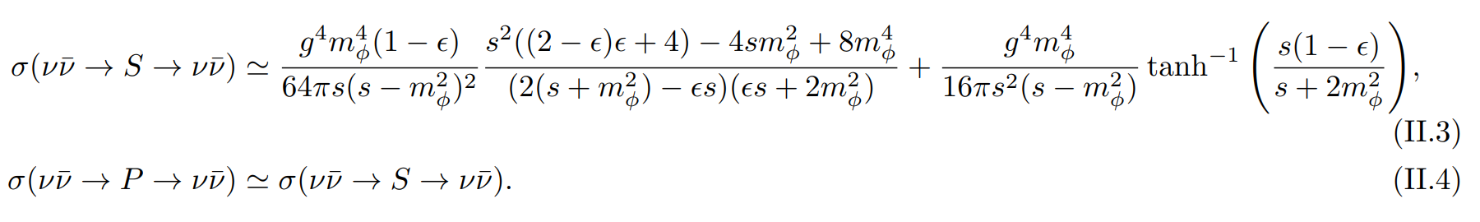
Perform Pseudoexperiments with IceCube Data

Slide 14
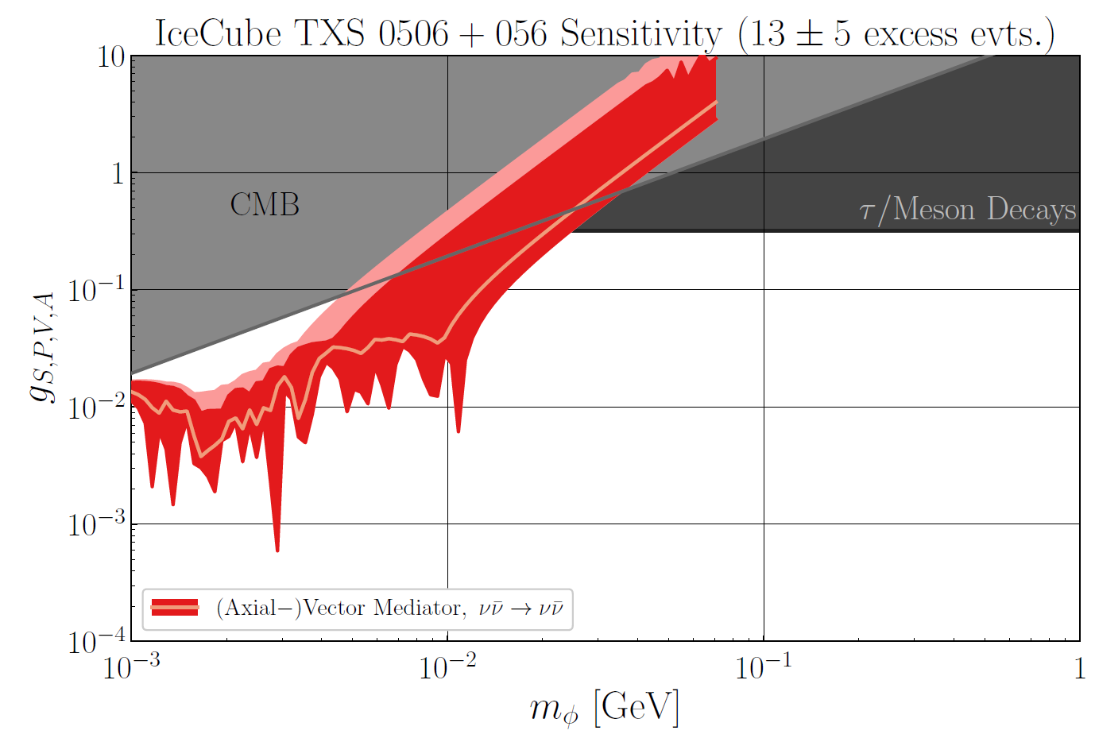
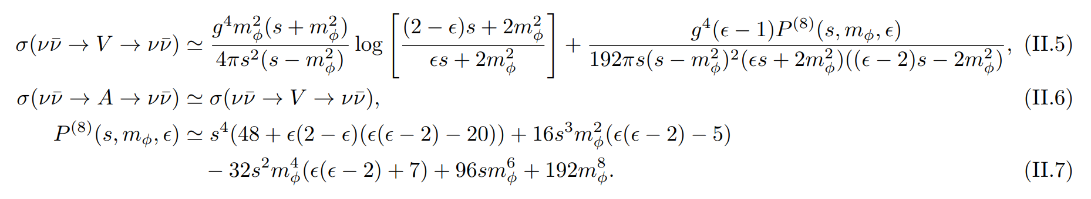
Perform Pseudoexperiments with IceCube Data

Slide 15
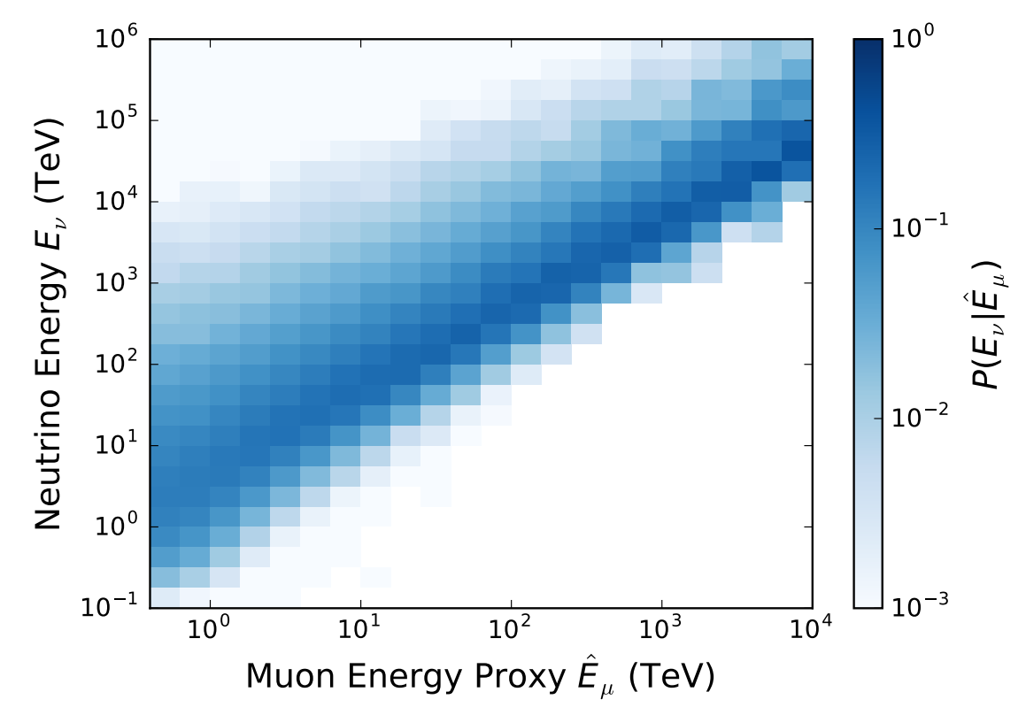
Caveat: Energy reconstruction is (far from) perfect
[IceCube Collaboration, 1807.08794]

Slide 16
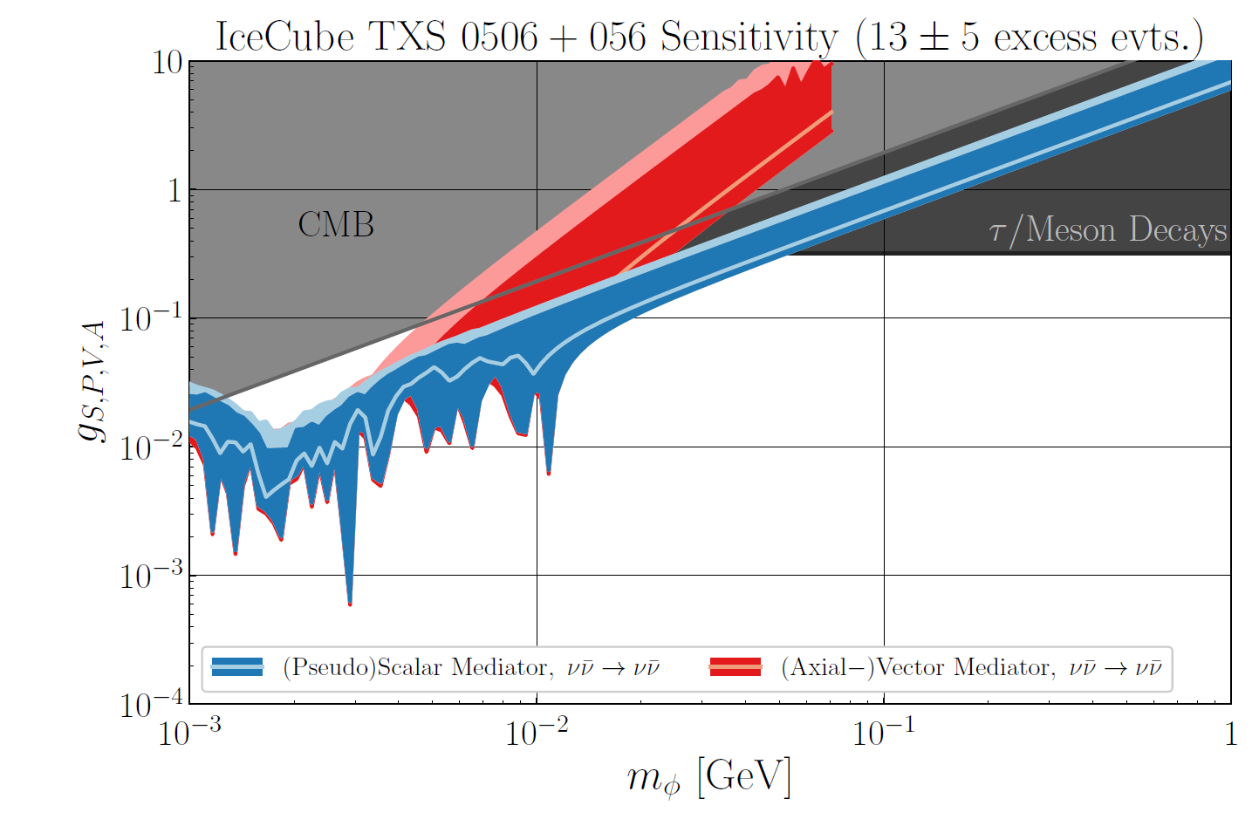
Caveat: Energy reconstruction is (far from) perfect

Slide 17
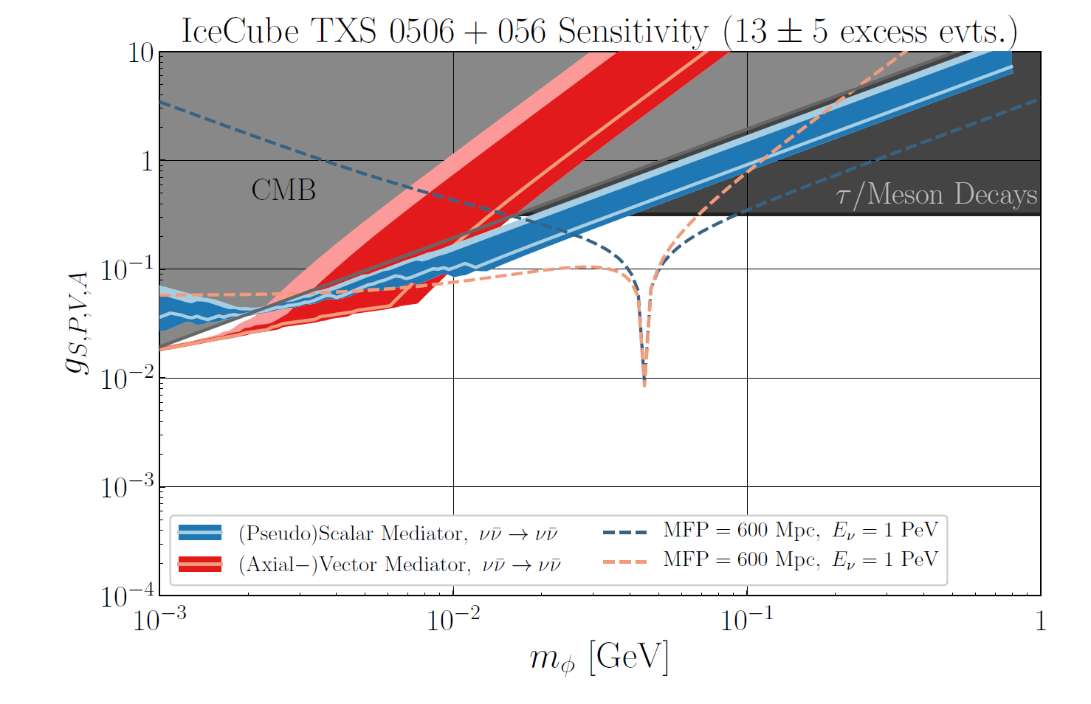
Caveat: Energy reconstruction is (far from) perfect

Slide 18
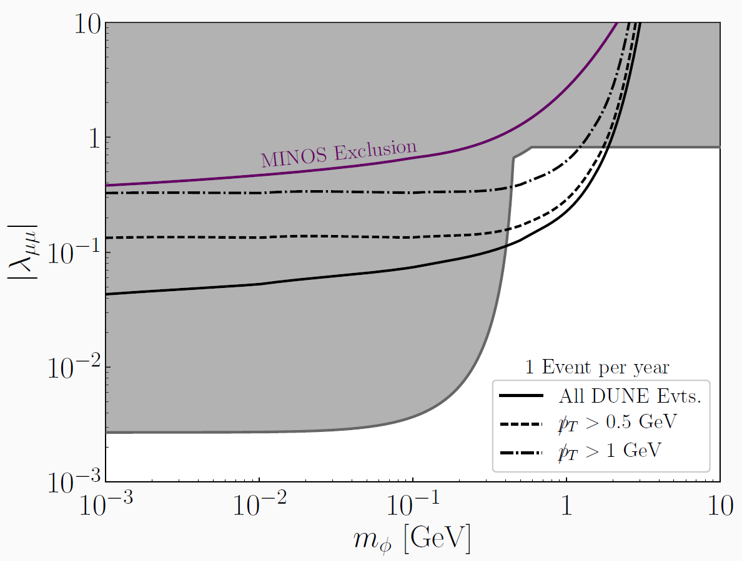
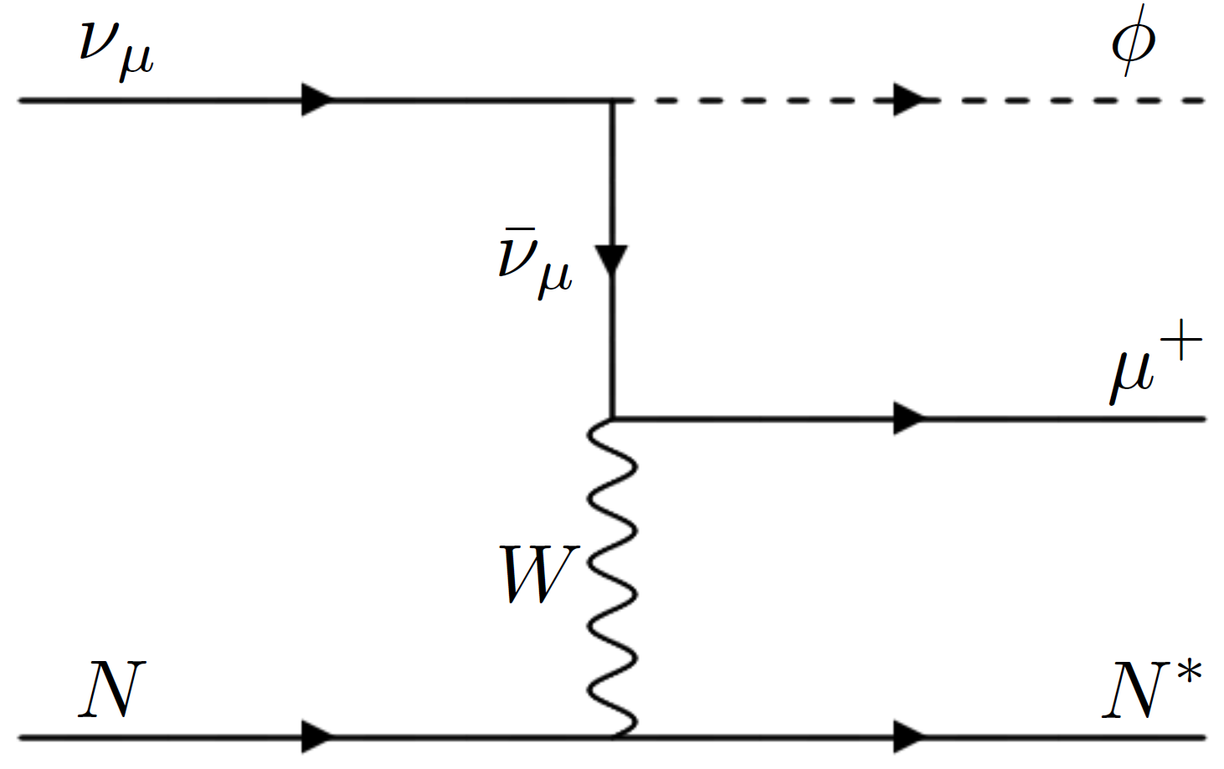
Brief aside: Terrestrial Sensitivity to 𝛎SI
Slightly different setup: scalar carries lepton number 2, can search for in DUNE near detector by looking for events with large (visible) transverse momentum.
[Jeffrey Berryman, André de Gouvêa, KJK, Yue Zhang, 1802.00009]
[KJK, Yue Zhang, Forthcoming]

Slide 19
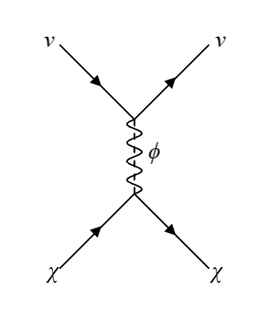
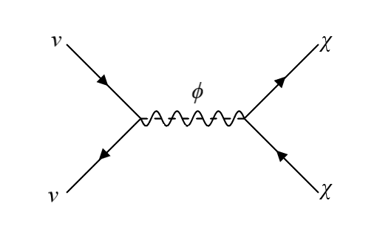
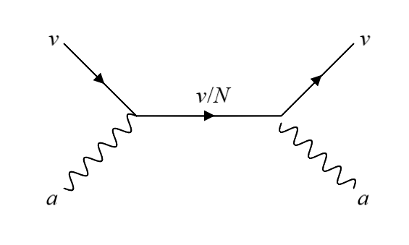
Other models to consider
Lepton-Number-Charged Axions
Neutrinophilic Dark Matter
(m_{𝟀}~ keV)

Slide 20
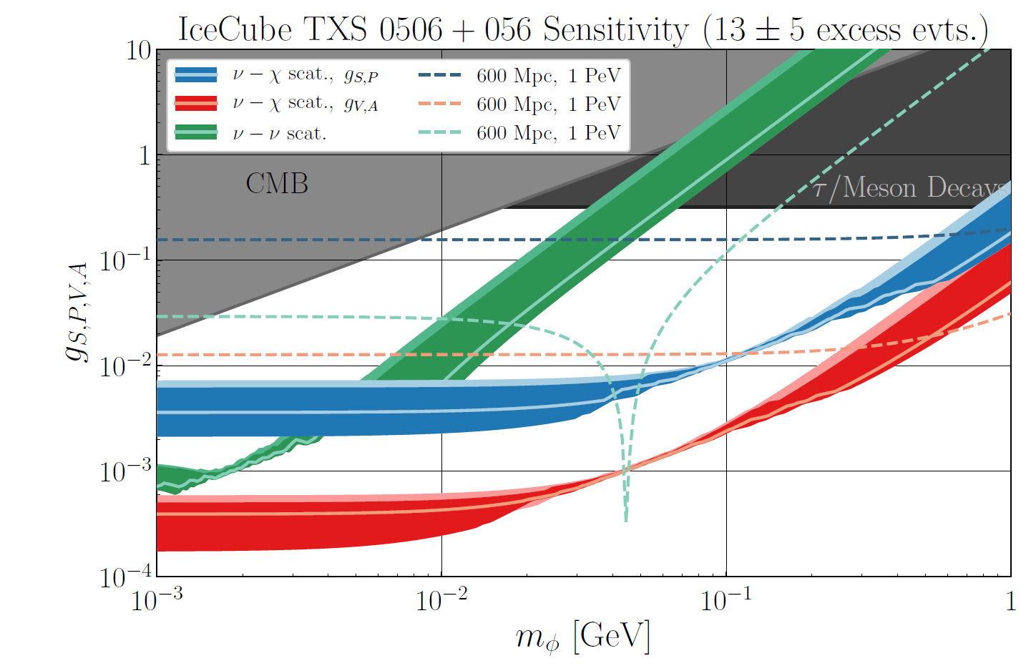
Neutrinophilic DM
Fermionic 𝜒 can serve as thermal relic dark matter for masses near MeV
[KJK, Yue Zhang, Forthcoming]
Astrophysical probes provide an alternative basis (flavor vs. mass vs. combination) to probe new couplings

Slide 21
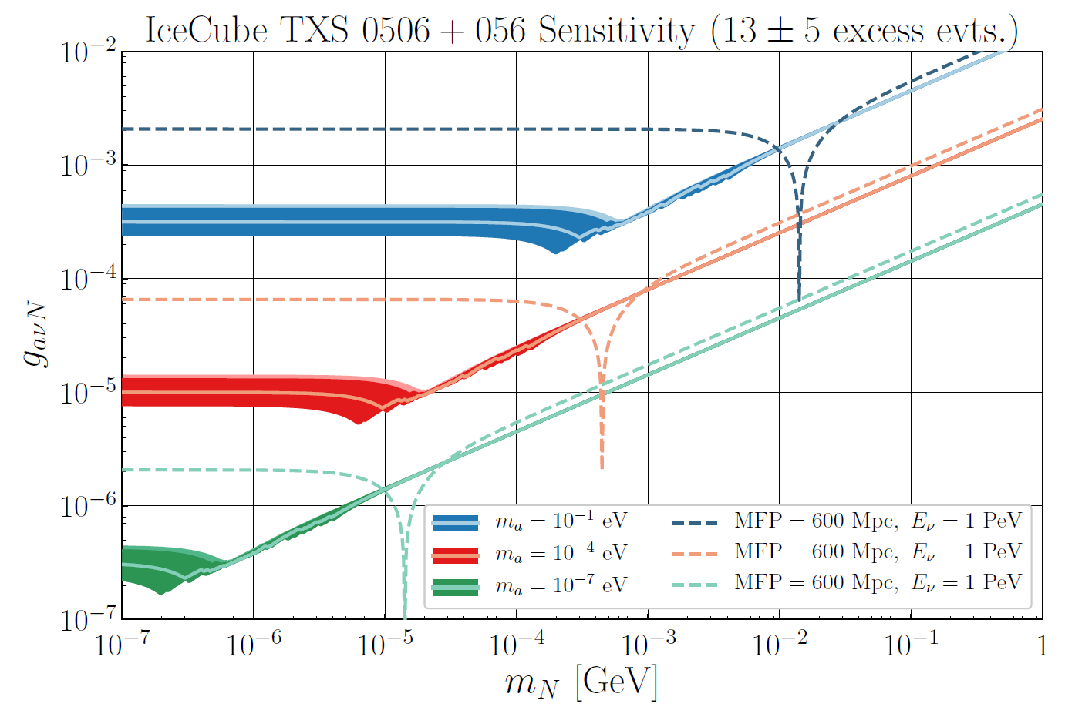
Lepton-number-charged Axions

Slide 22
Enough limits, how do we make a discovery?
This search strategy relies on observing events, recognizing that the neutrino flux matches expectations, and setting limits on the mean free path.
Non-observation of neutrinos is more challenging: which interpretation is more sensible, that the neutrino flux for a given astrophysical event is just lower, or that new physics caused neutrinos to be absorbed?
To make a discovery, we need many observations across different progenitor distances and neutrino energies -- then, the absence of events above some distance can point to this type of effect.

Slide 23
Conclusions
Identifying sources of astrophysical neutrinos gives us additional handles.
  Specifically, the distance that the neutrinos travelled allows us to make statements regarding their mean free path.
Certain classes of new physics models can be probed better than ever by high energy neutrinos travelling great distances.
Detection of such new physics is a greater challenge, but with existing and upcoming experiments, it could be possible.

Slide 24
Thank you!
Questions?

