Slide 1


Slide 2
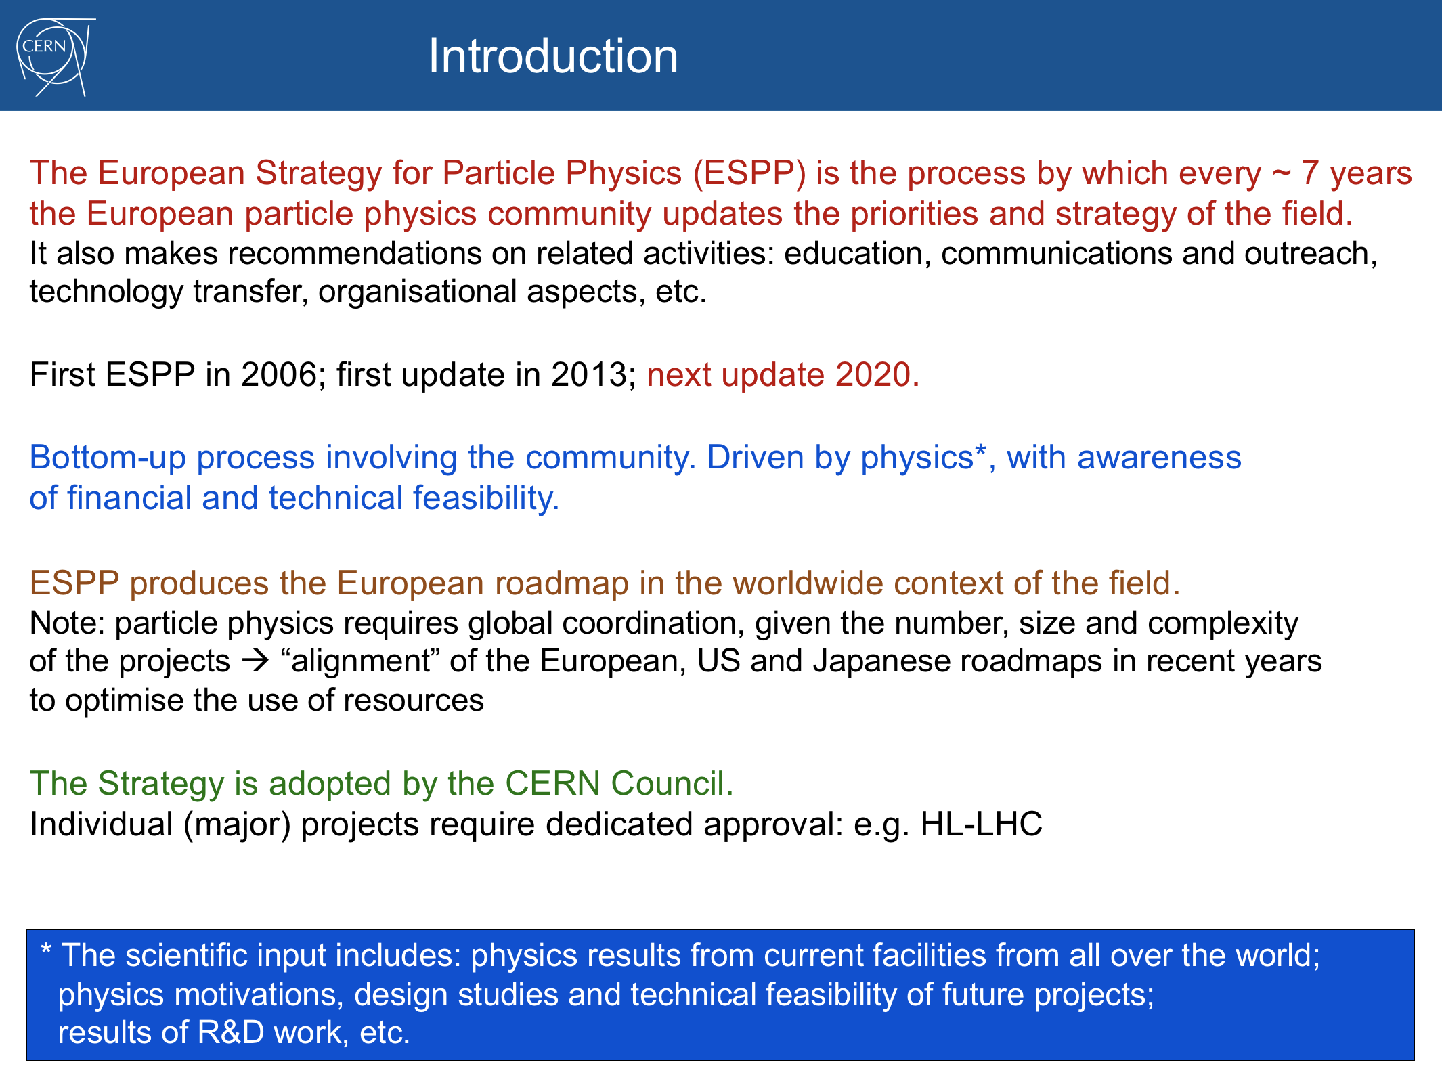

Slide 3
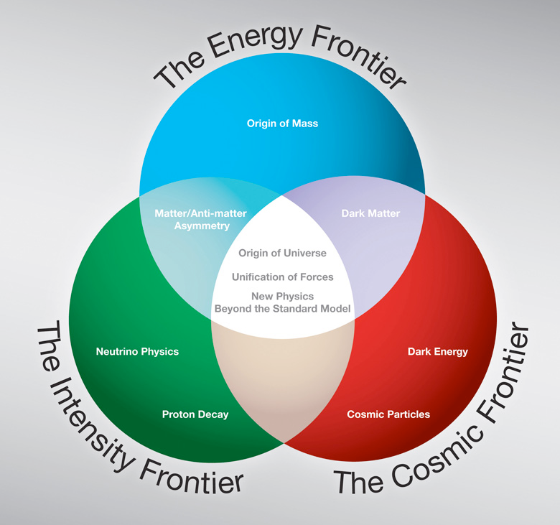
Future HEP: The Three Frontiers
After the Higgs discovery
Previous Strategy
Update: 2012-2014
Evaluation in all
regions: Europe
Asia, the Americas
•European strategy group
•Snowmass study and IP5
•Japan strategy group

Slide 4
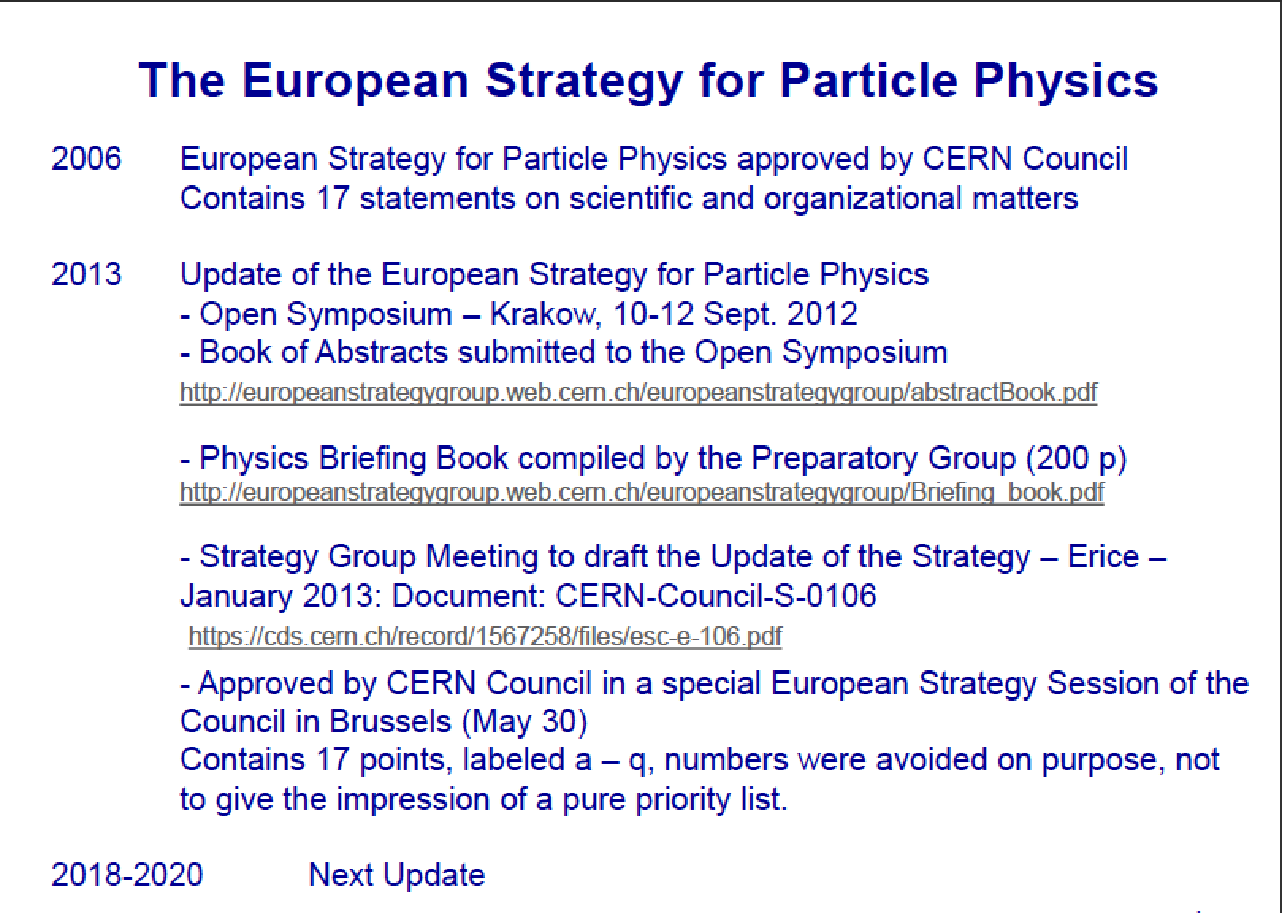

Slide 5
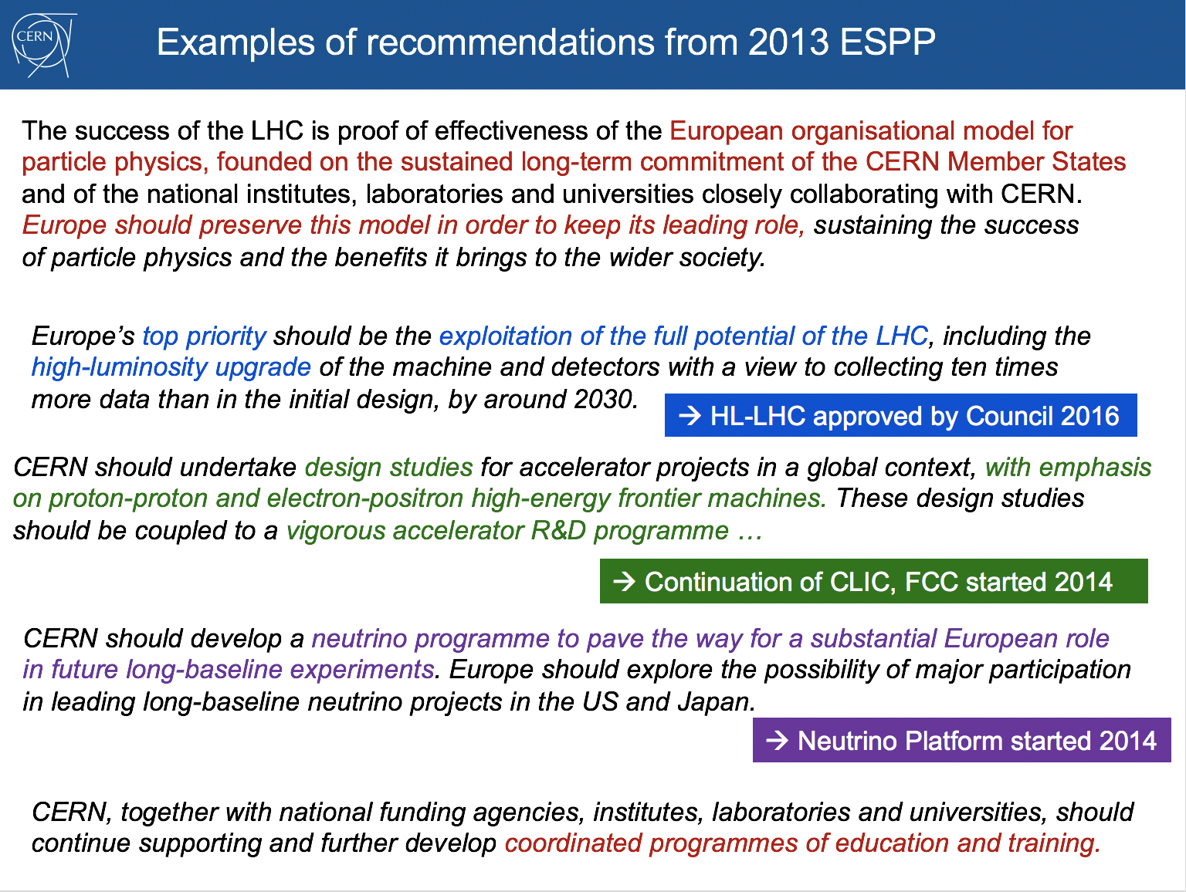

Slide 6
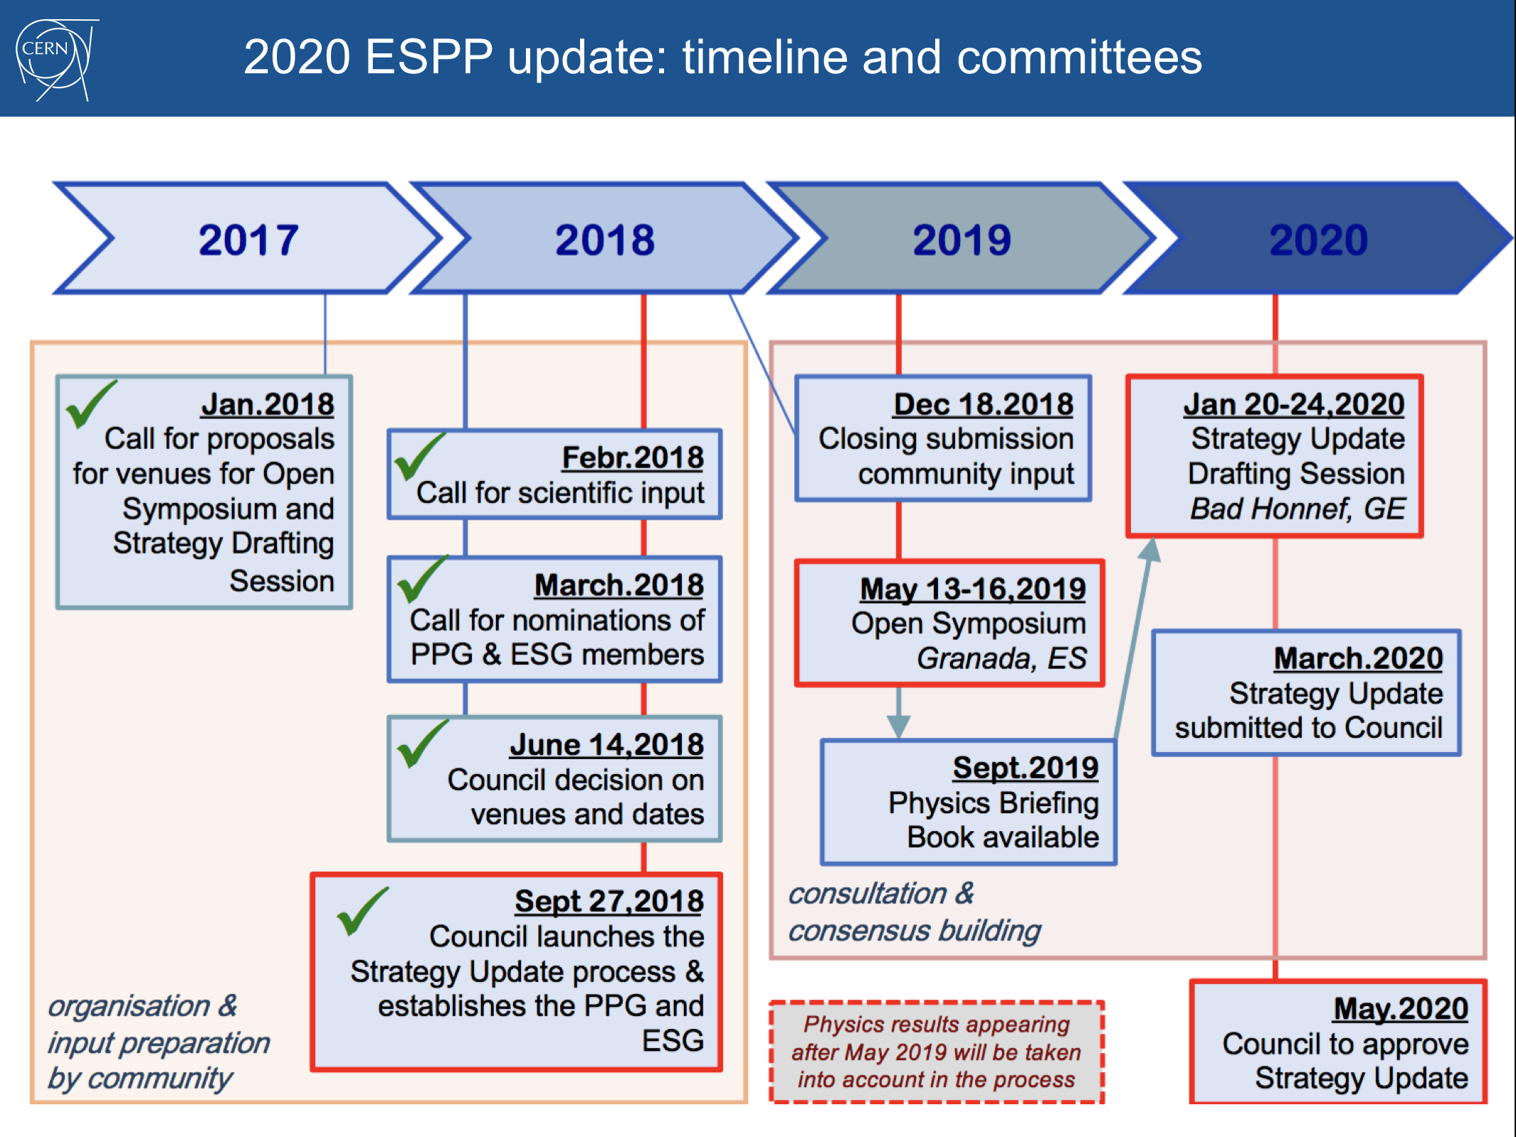

Slide 7
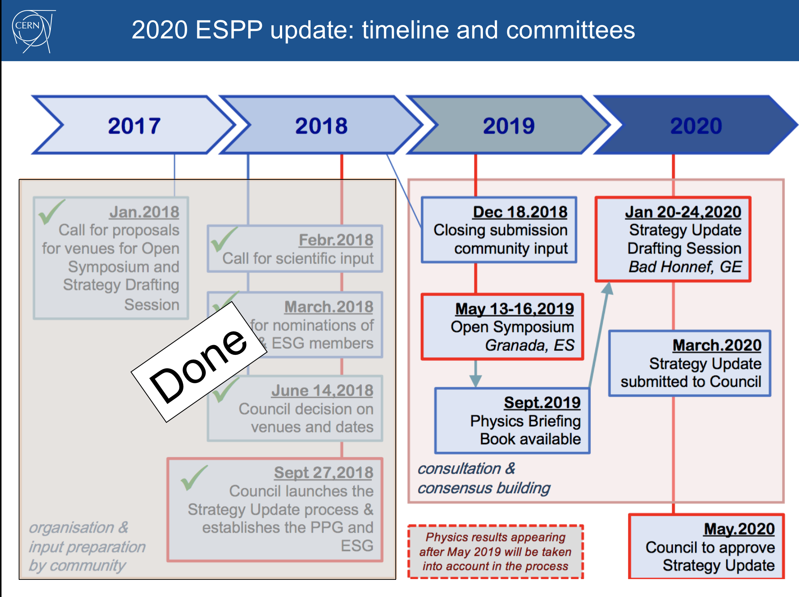

Slide 8
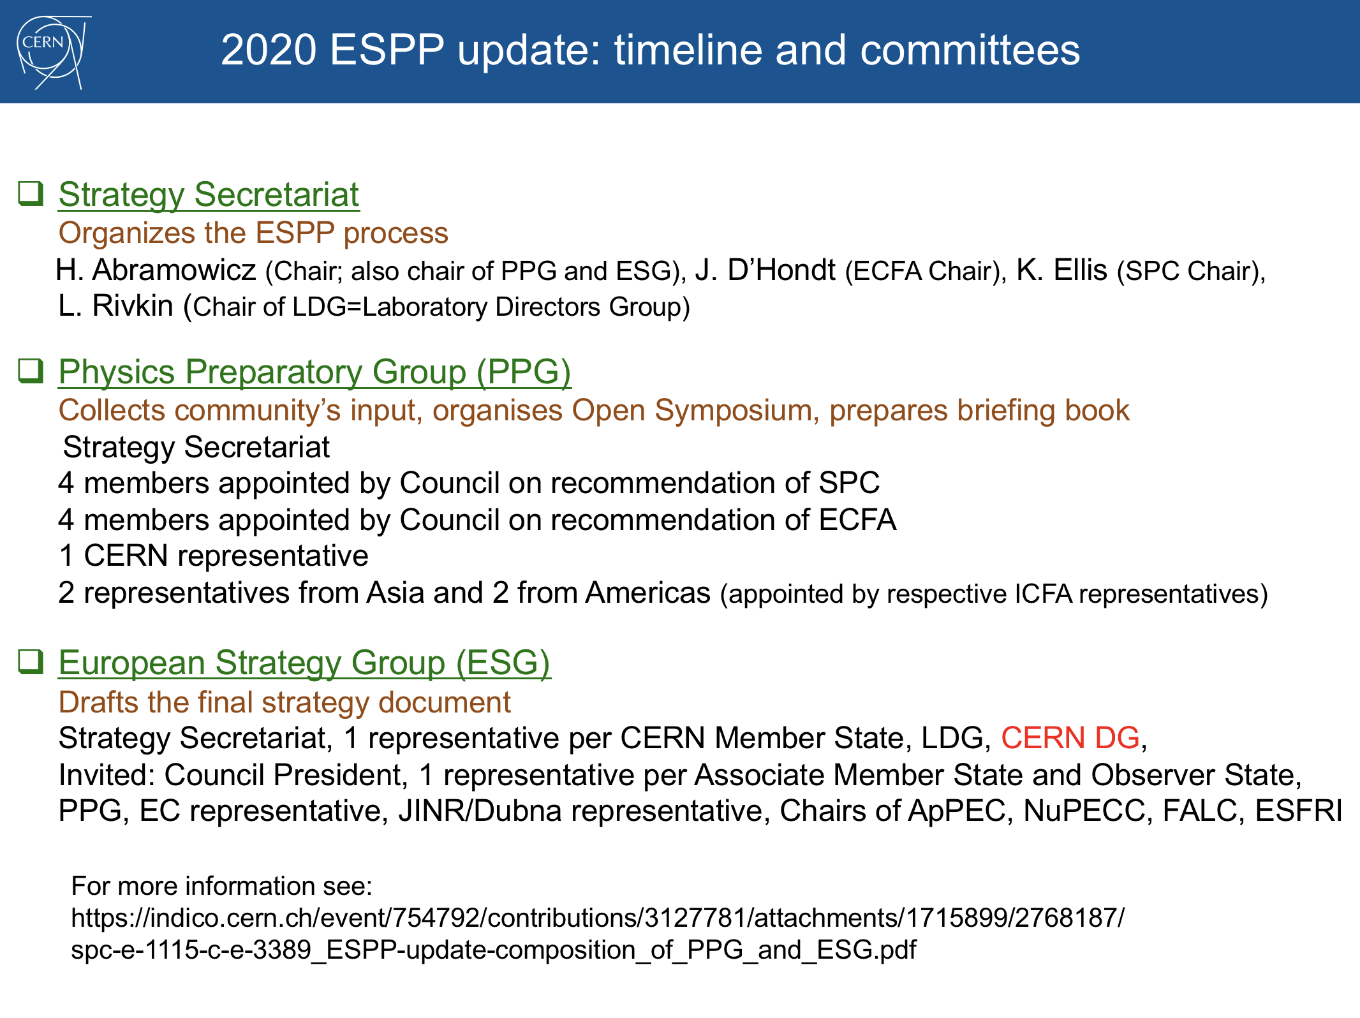
Focus on large facilities

Slide 9
The LHC Upgrade

Slide 10
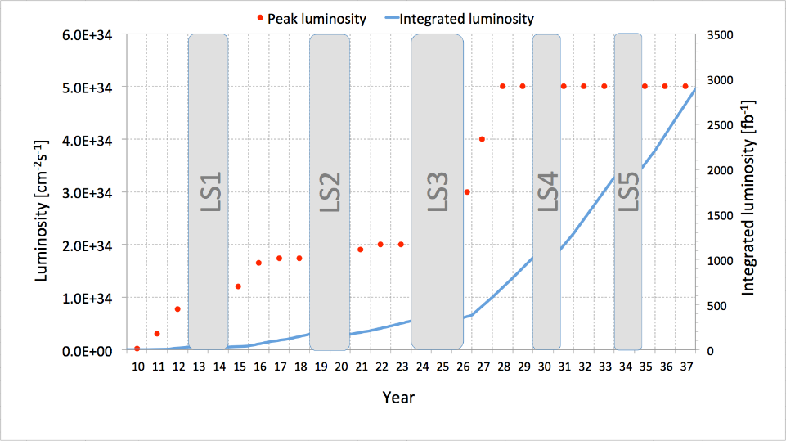
The Approved LHC Roadmap
F. Gianotti, April 2016
7-8 TeV
13-14 TeV
HL-LHC
Run 1
Run 2
Run 3
~3000 fb⁻¹
Splices
fixed
Injectors
upgrade
New
low-β*
quads
~300 fb⁻¹
~100 fb⁻¹
Approved program at CERN to collect 3-4 ab⁻¹ with the LHC (HL-LHC)
Maximize the reach for searches and for precision measurements (eg Higgs)

Slide 11
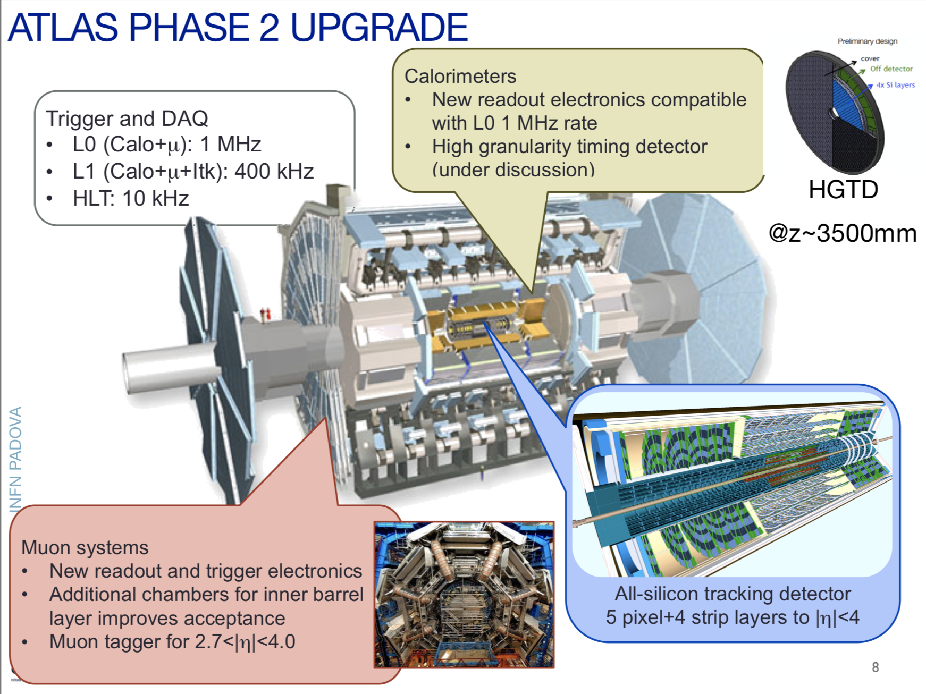
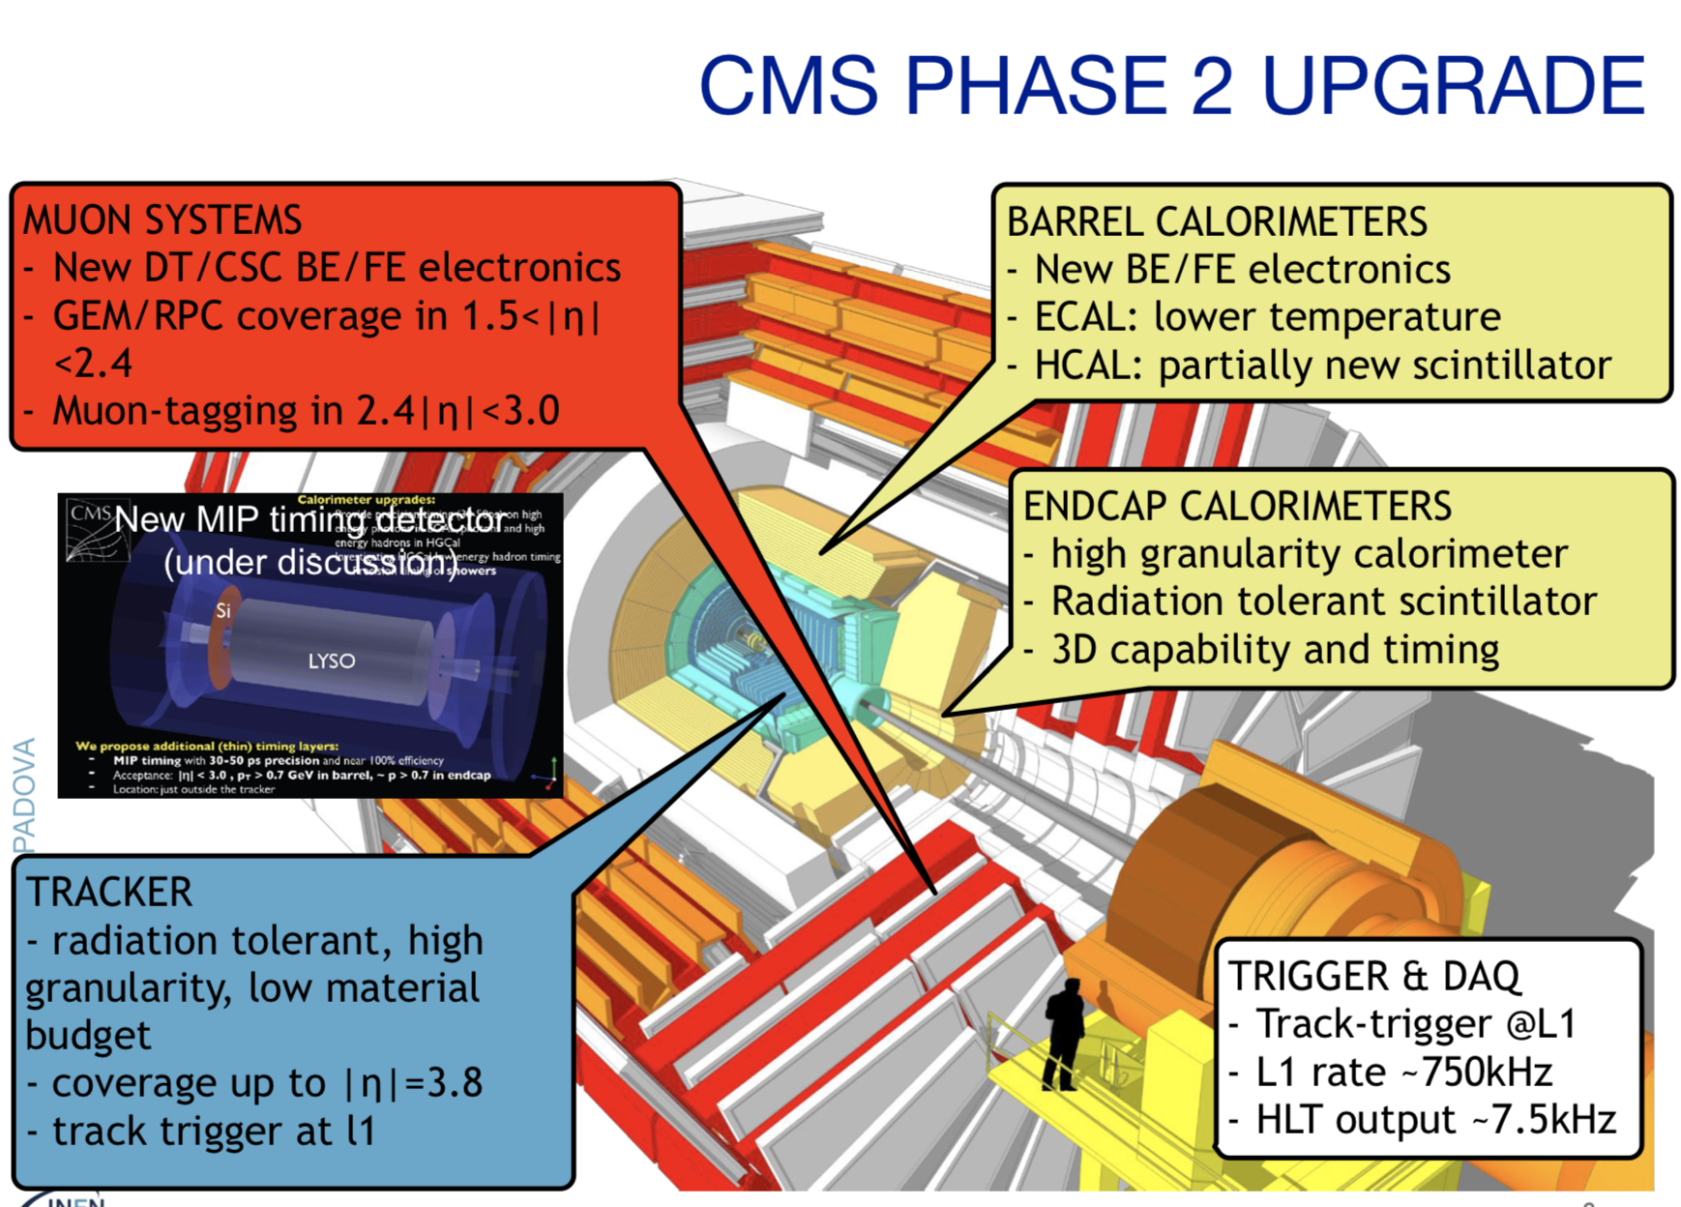
Experiments need upgrades
for the HL-LHC as well
Upgrade program under way

Slide 12
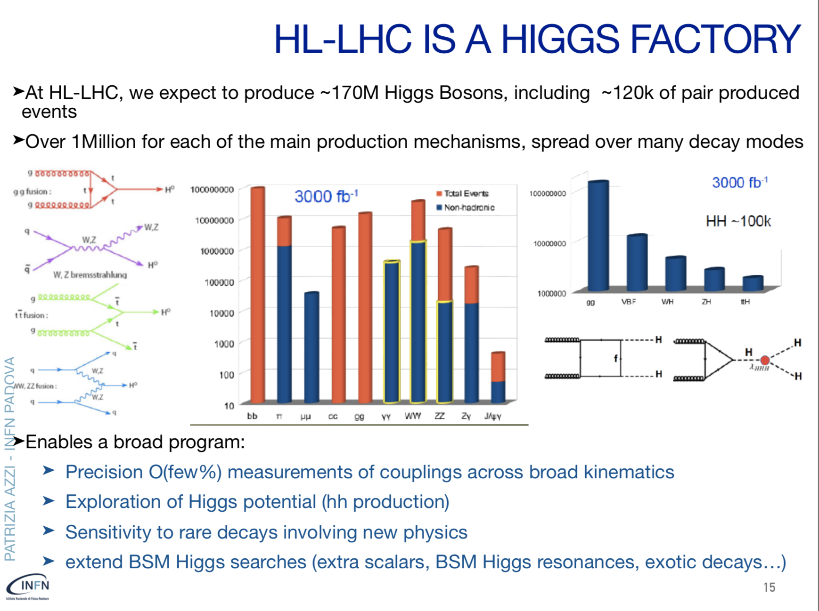
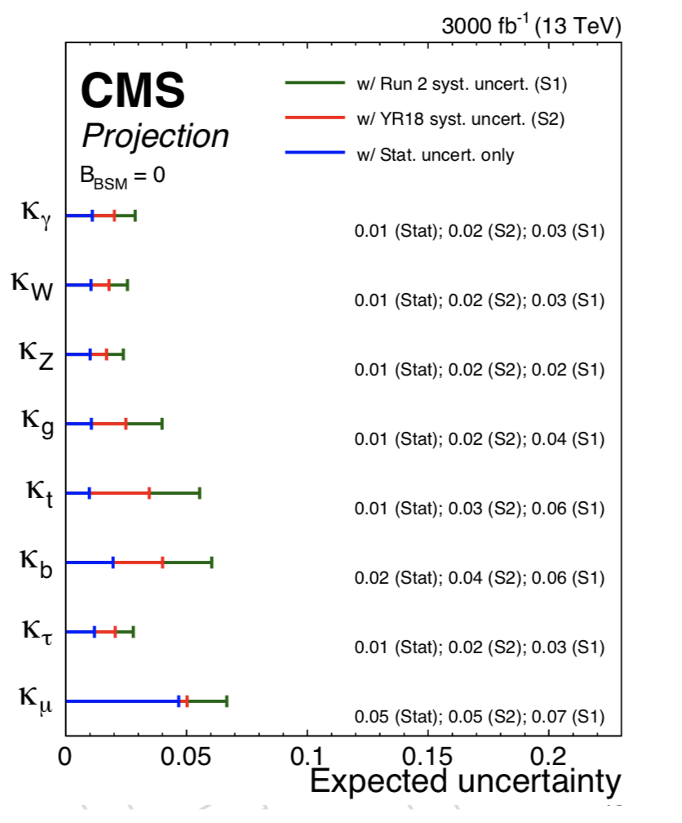

Slide 13
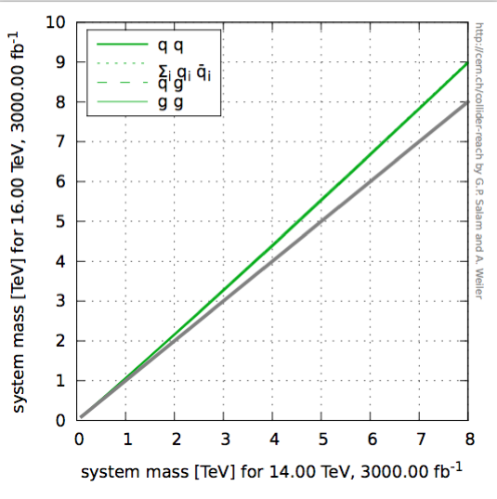
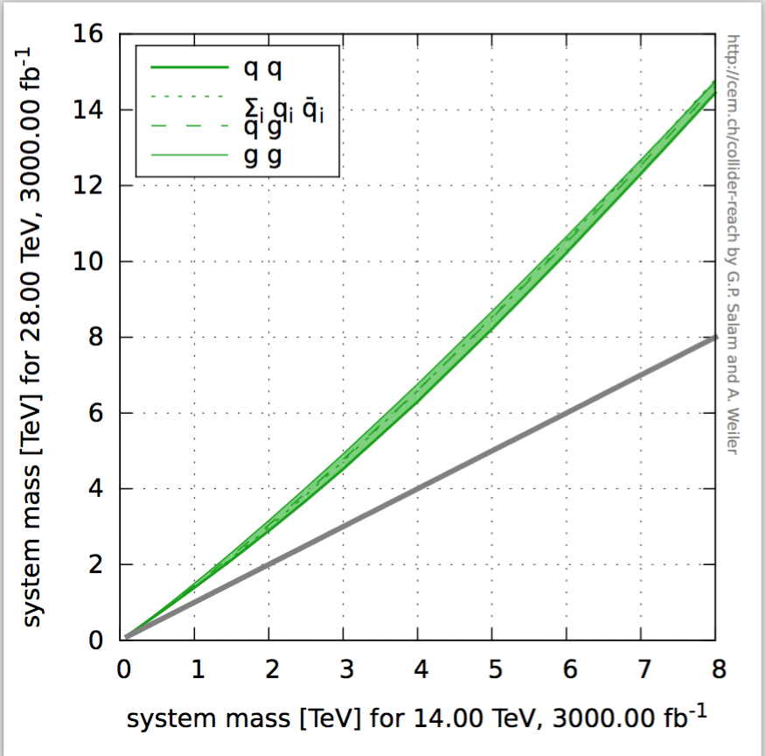
Higher Energy LHC??
F. Gianotti
FCC meeting
April 2016
16 TeV vs 14 TeV
28 TeV vs 14 TeV
HE-LHC part of
the FCC study
WG set up to explore technical feasibility of pushing LHC energy to:
design value: 14 TeV (8.3T magnet fields)
ultimate value: 15 TeV (corresponding to max dipole field of 9 T)
beyond (e.g. by replacing 1/3 of dipoles with 11 T Nb₃Sn magnets)
Identify open risks, needed tests and technical developments, trade-off
between energy and machine efficiency/availability
HE-LHC (part of FCC study): ~16 T magnets in LHC tunnel (→ √s~ 27 TeV)
uses existing tunnel and infrastructure; can be built at fixed budget
strong physics case if new physics from LHC/HL-LHC
powerful demonstration of the FCC-hh magnet technology

Slide 14
Beyond the LHC
•Proton-proton machines at higher energy…
•Electron-positron machines for high precision…
•Both? And allowing for electron-proton collisions..?
New projects will take 10-20 years before they turn
into operation, hence need a vision & studies now!
Based on the PECFA meeting @CERN November 2018

Slide 15
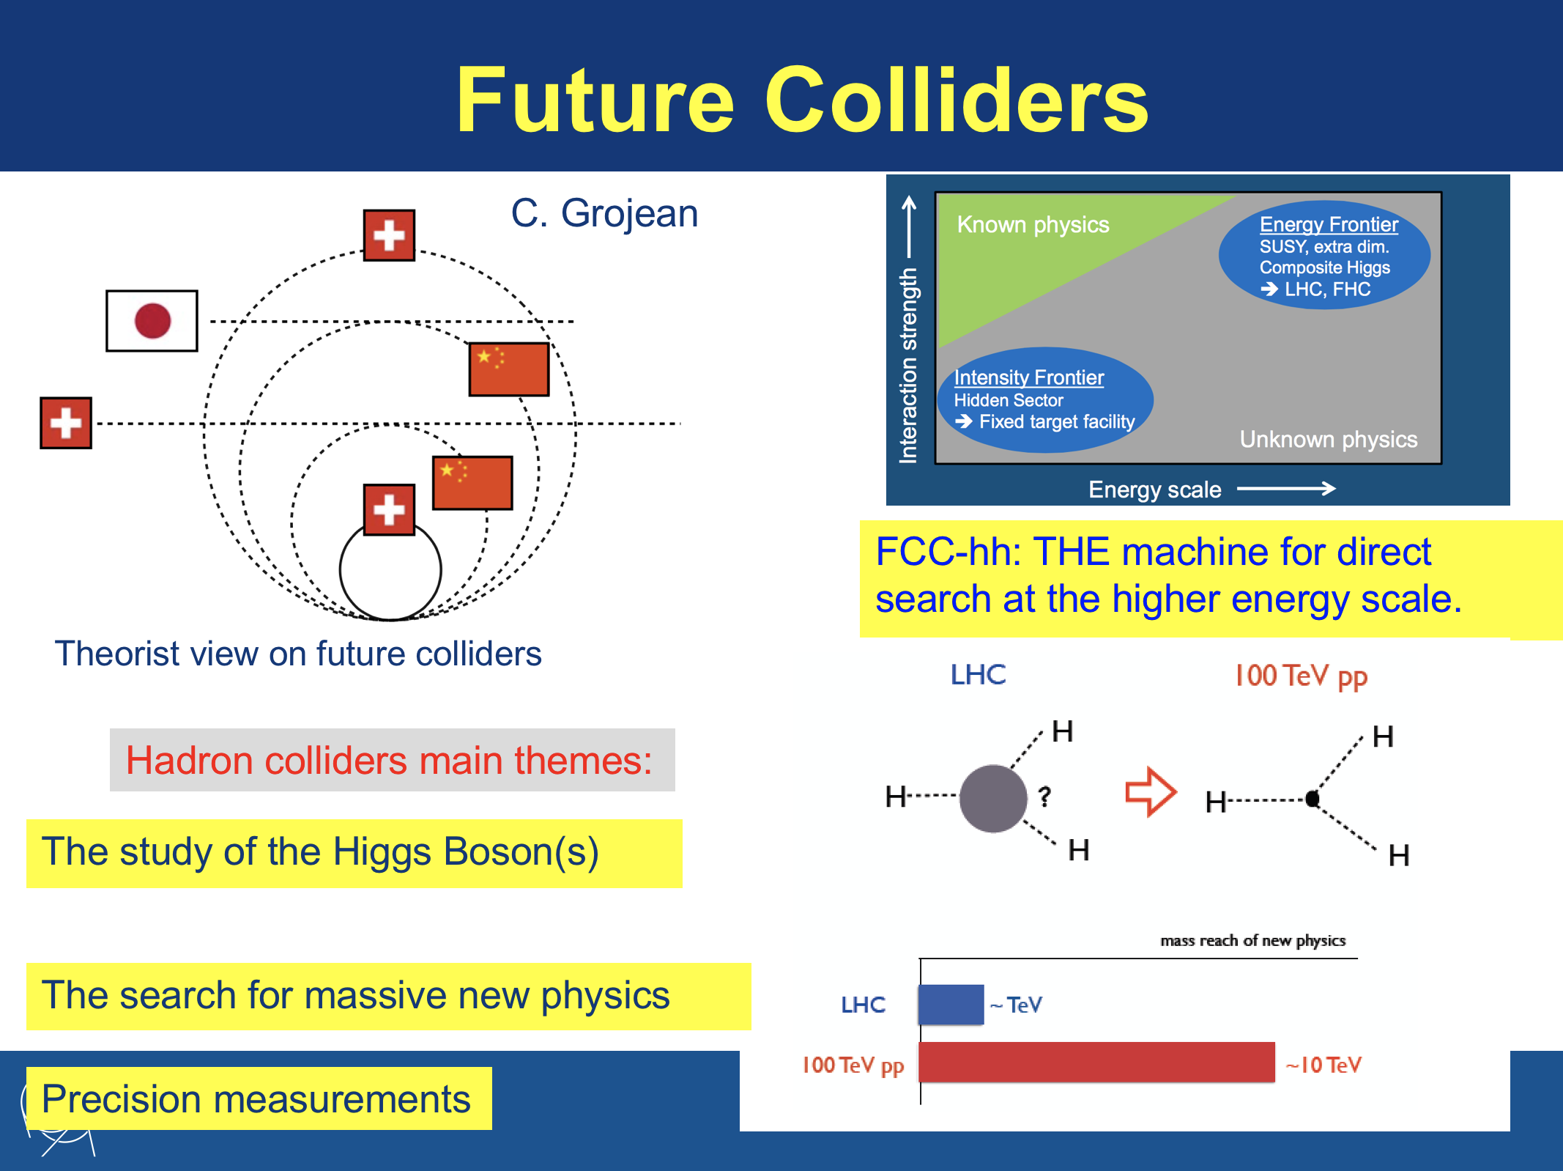

Slide 16
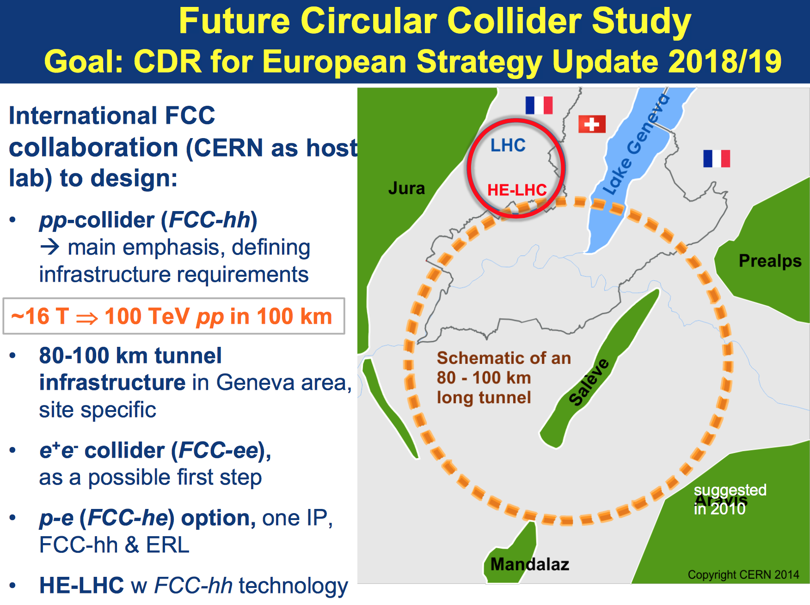
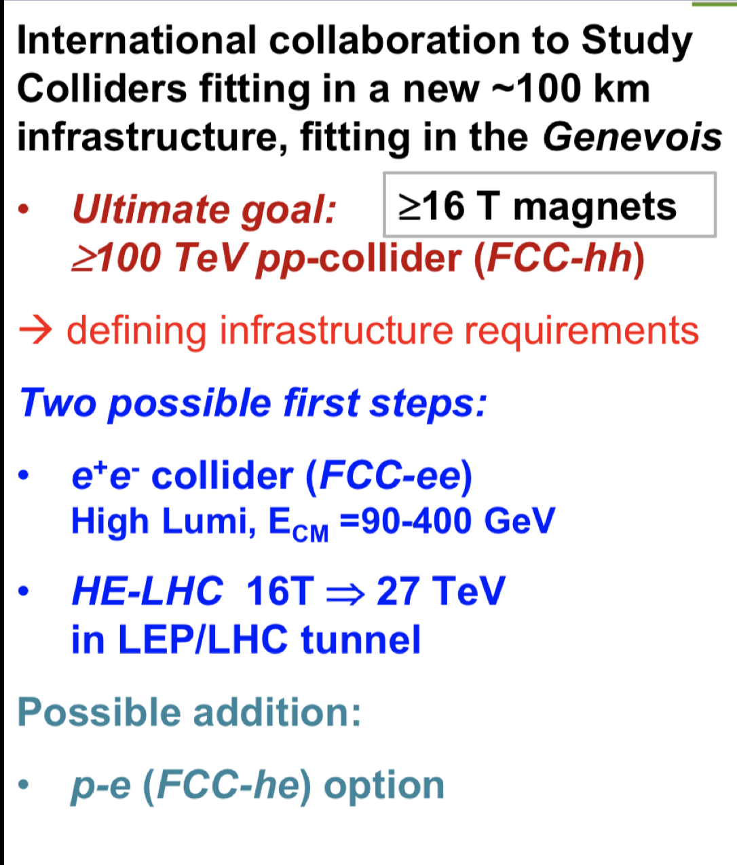

Slide 17
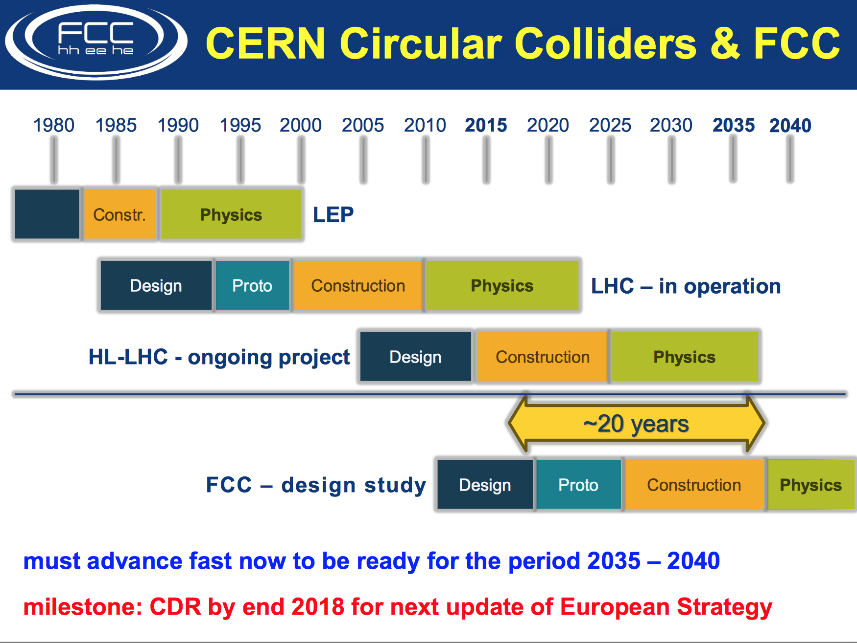

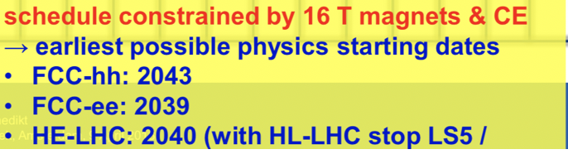
CERN Circular Colliders and FCC
1980
1985
1990
1995
2000
2005
2010
2015
2020
2025
2030
2035
Constr.
Physics
LEP
Design
Proto
Construction
Physics
LHC
Design
Construction
Physics
HL-LHC
20 years
FCC
Design
Proto
Construction
Physics
Now is the right time to plan for the period 2035 – 2040
Goal of phase 1: CDR by end 2018 for next update of European Strategy

Slide 18
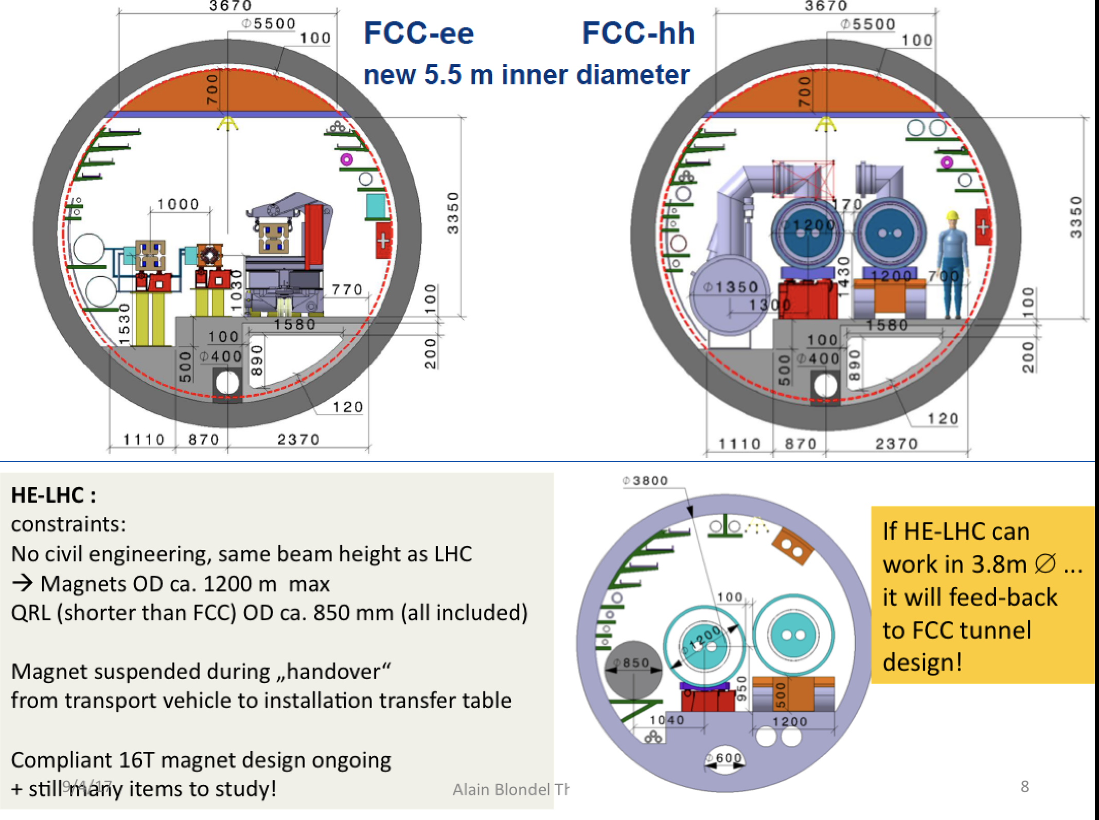

Slide 19
e+e- Colliders
•Circular colliders
FCC-ee (CERN), CEPC China)
•Linear Colliders
ILC (Japan?), CLIC (CERN)

Slide 20
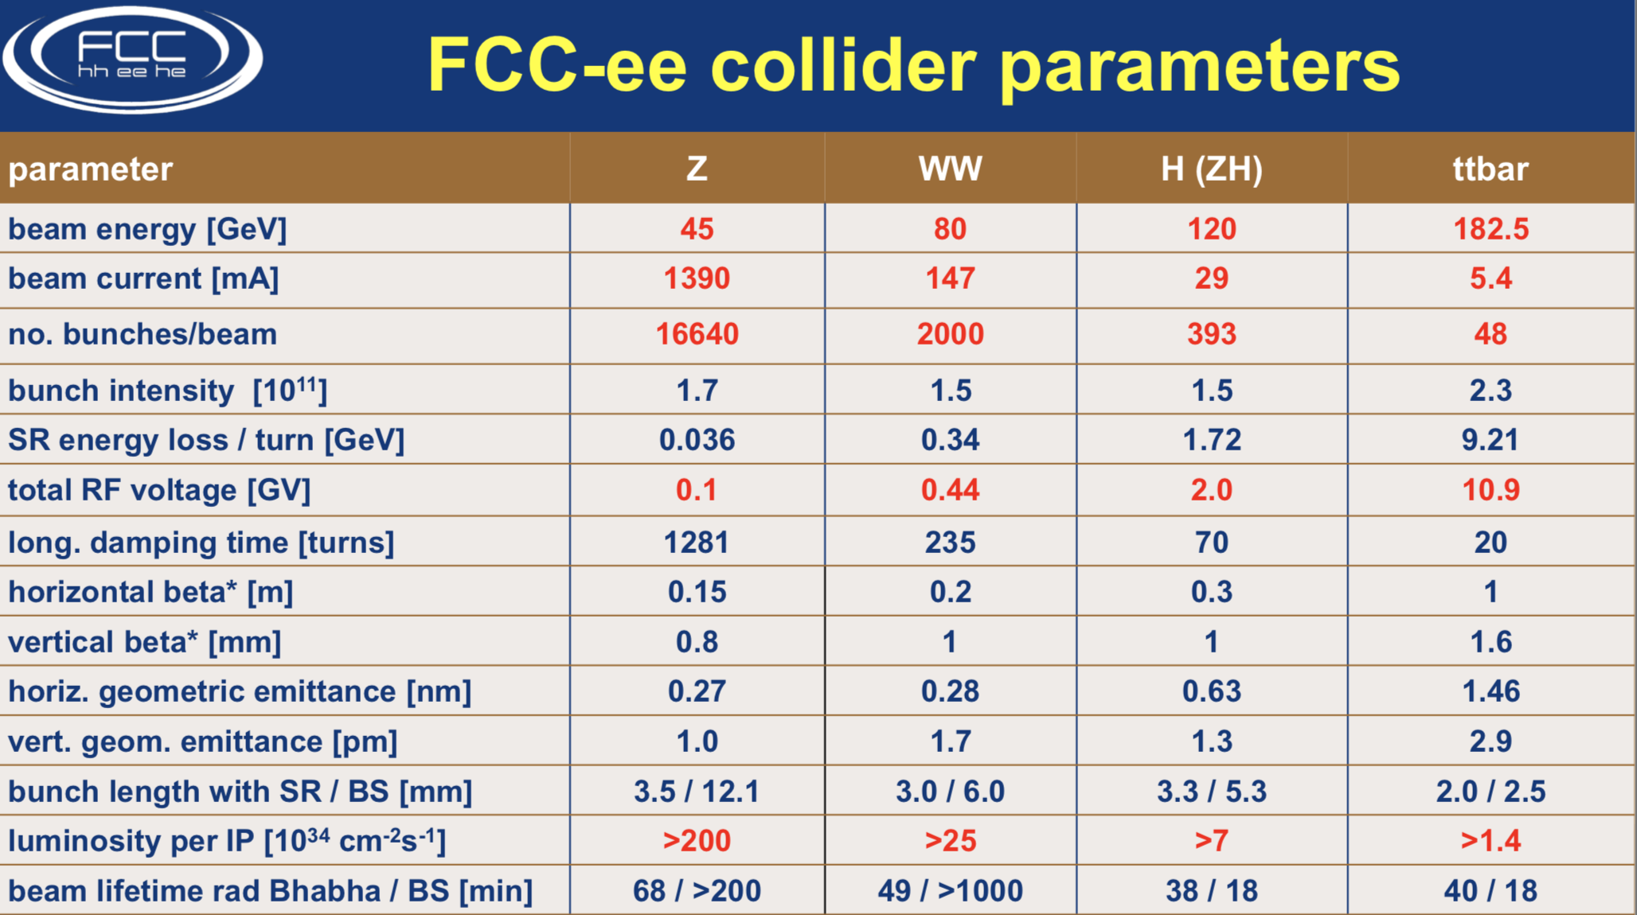

Slide 21
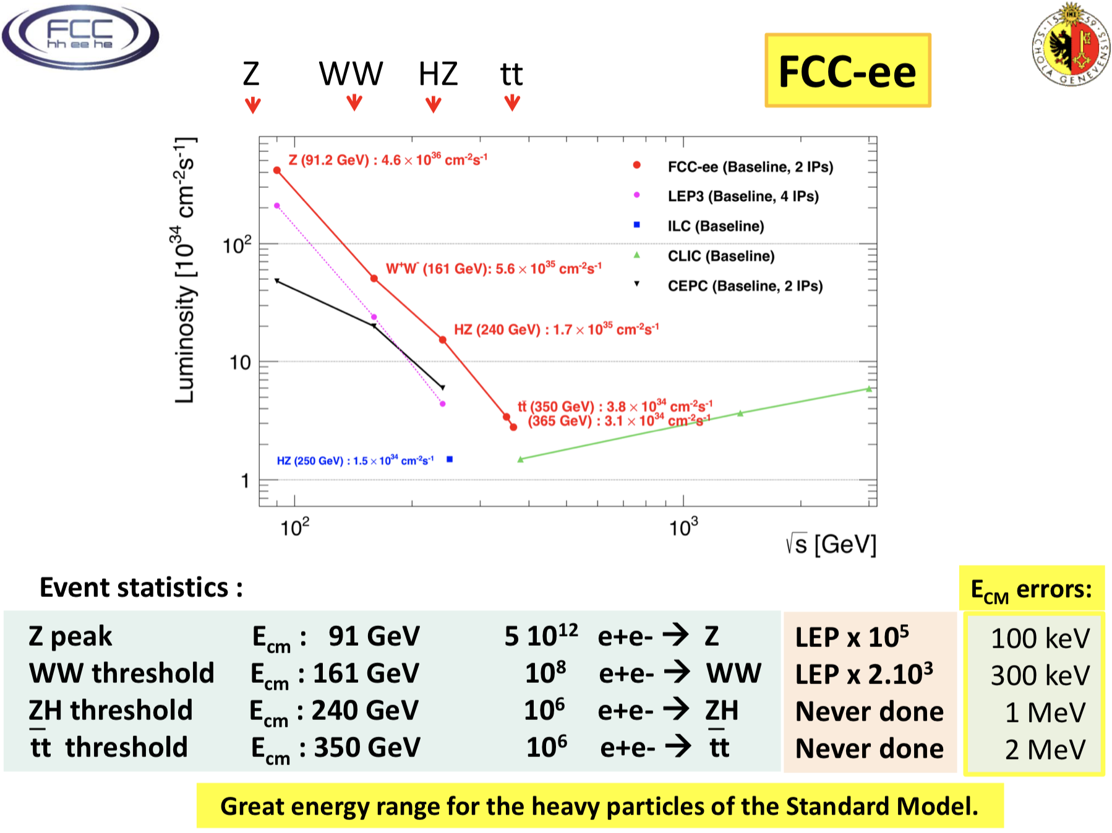
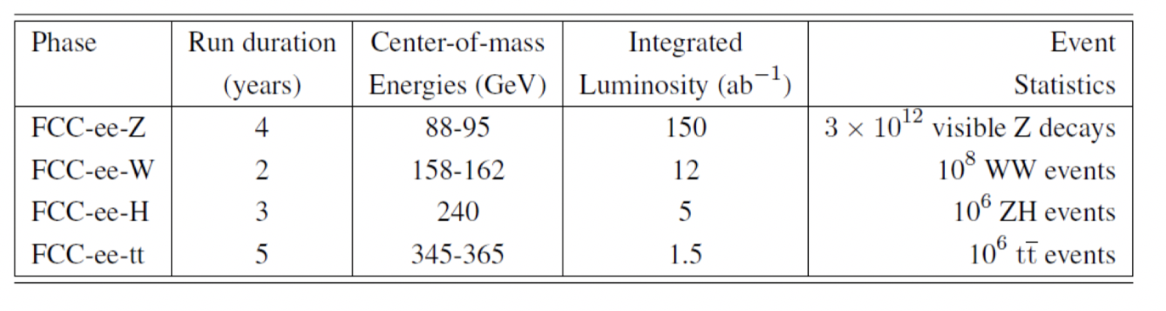

Slide 22
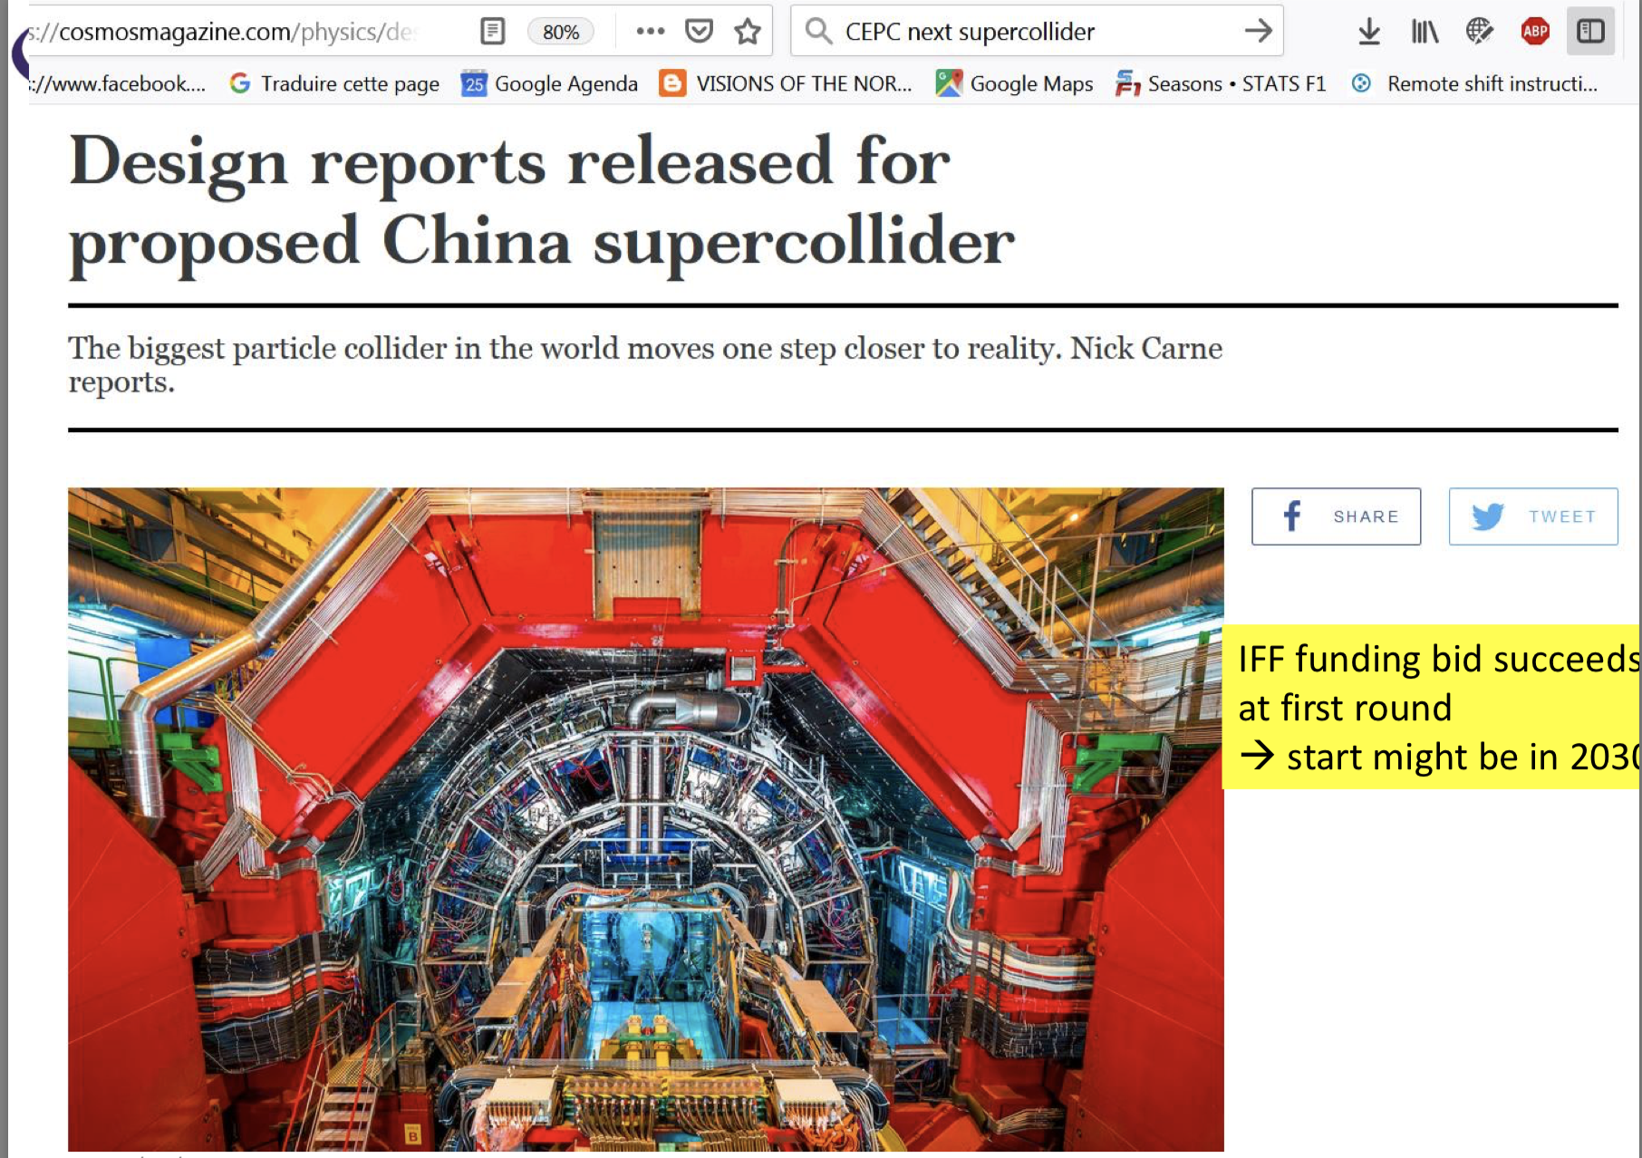
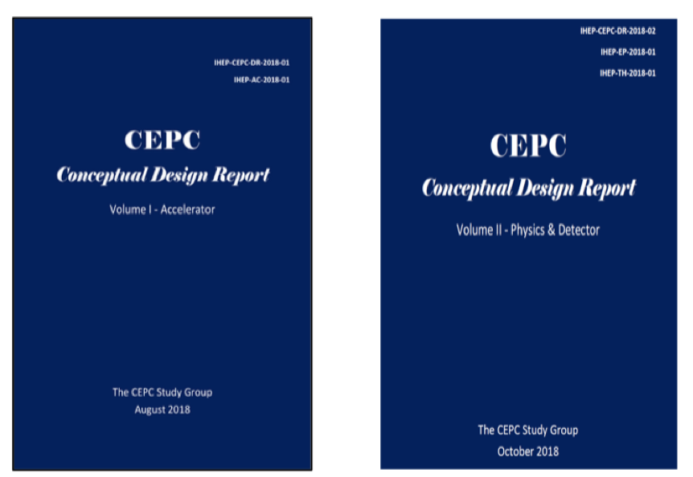
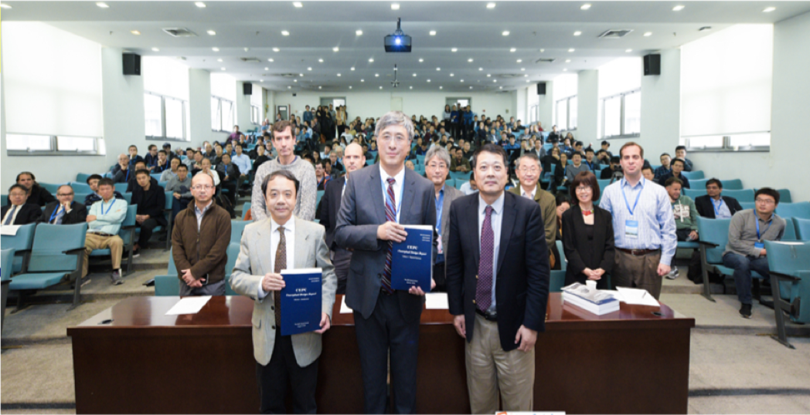
Ifff the funding bid is successful
at first round
-> physics start may be in 2030

Slide 23
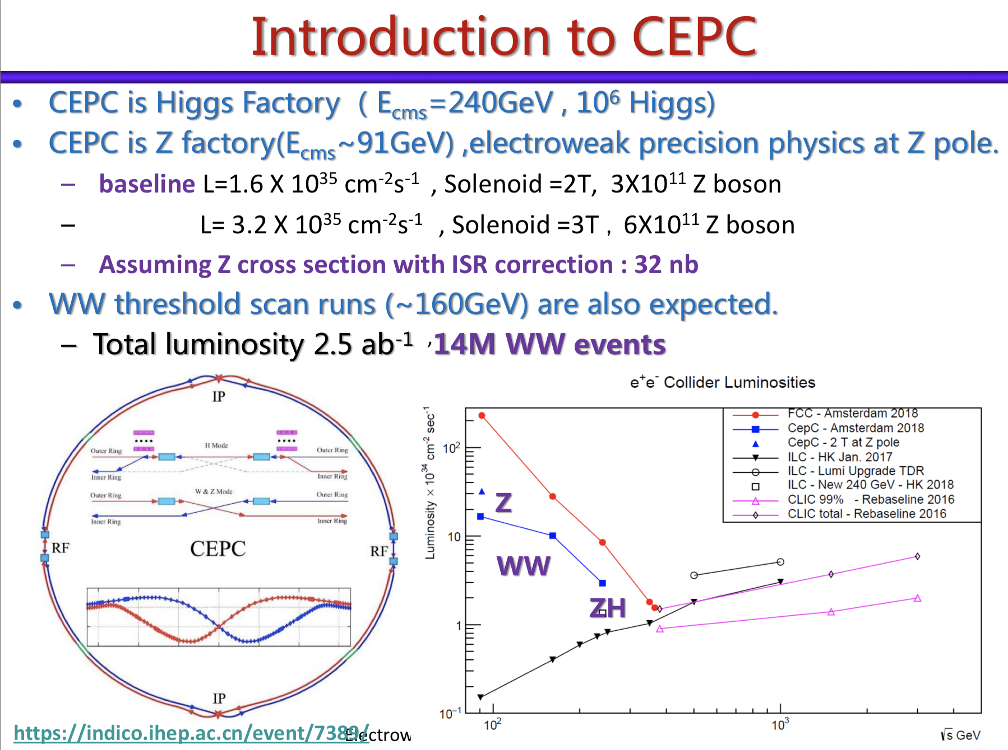
China: CEPC Project

Slide 24
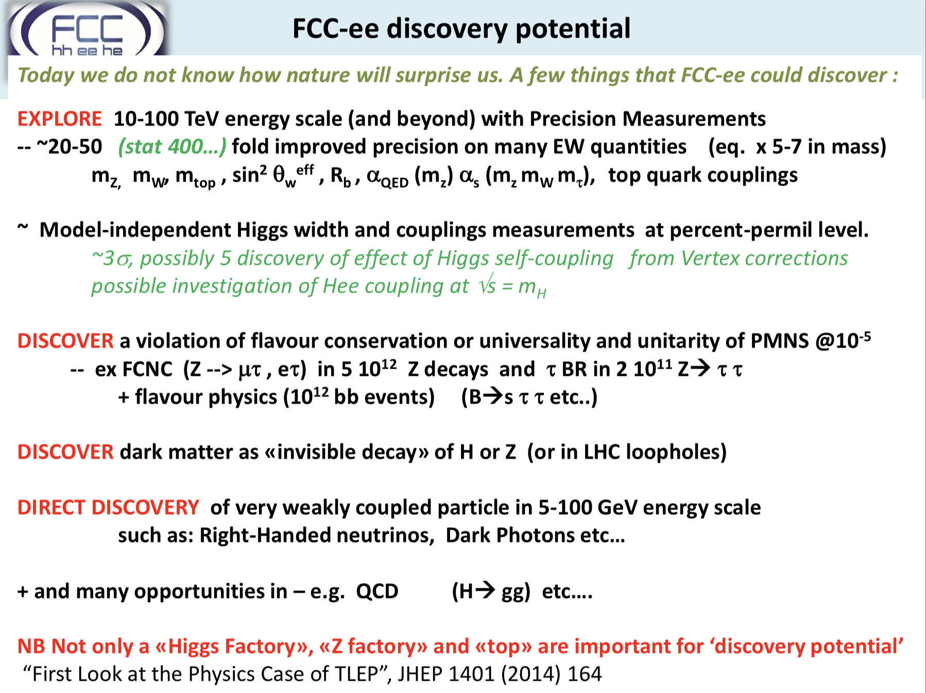

Slide 25
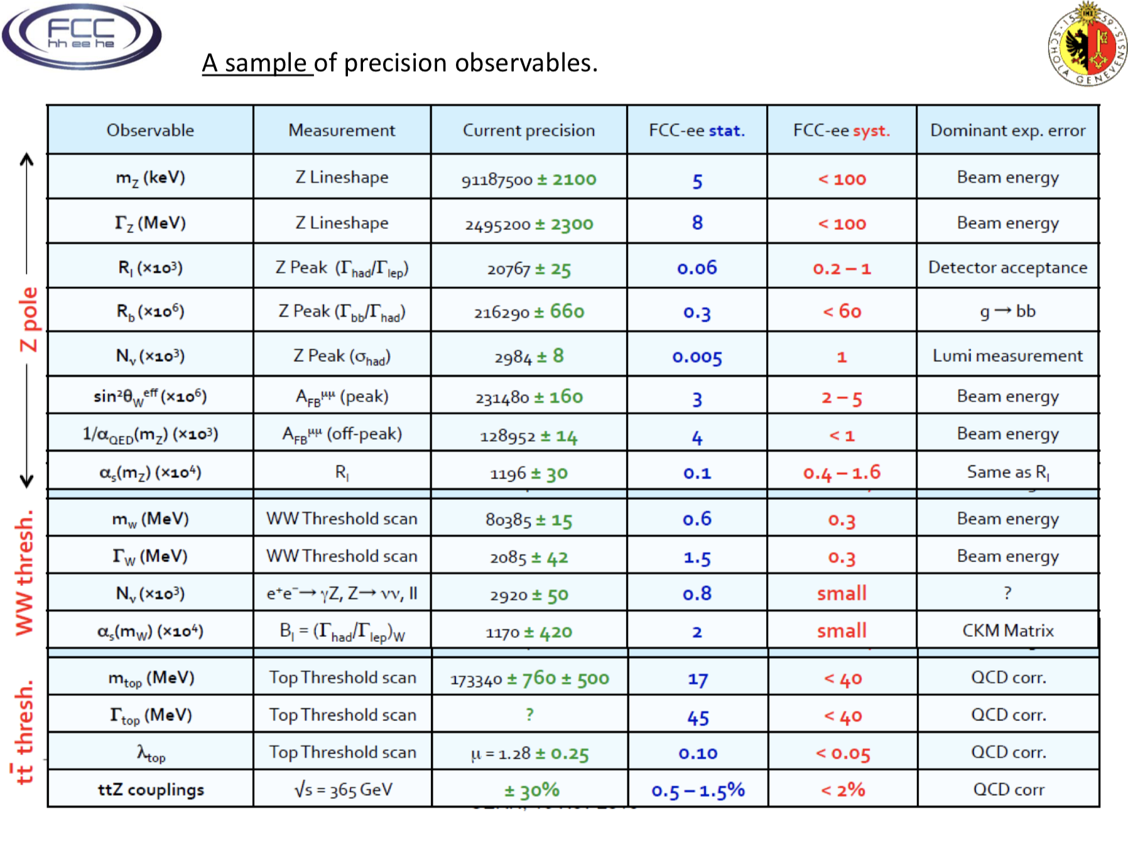

Slide 26
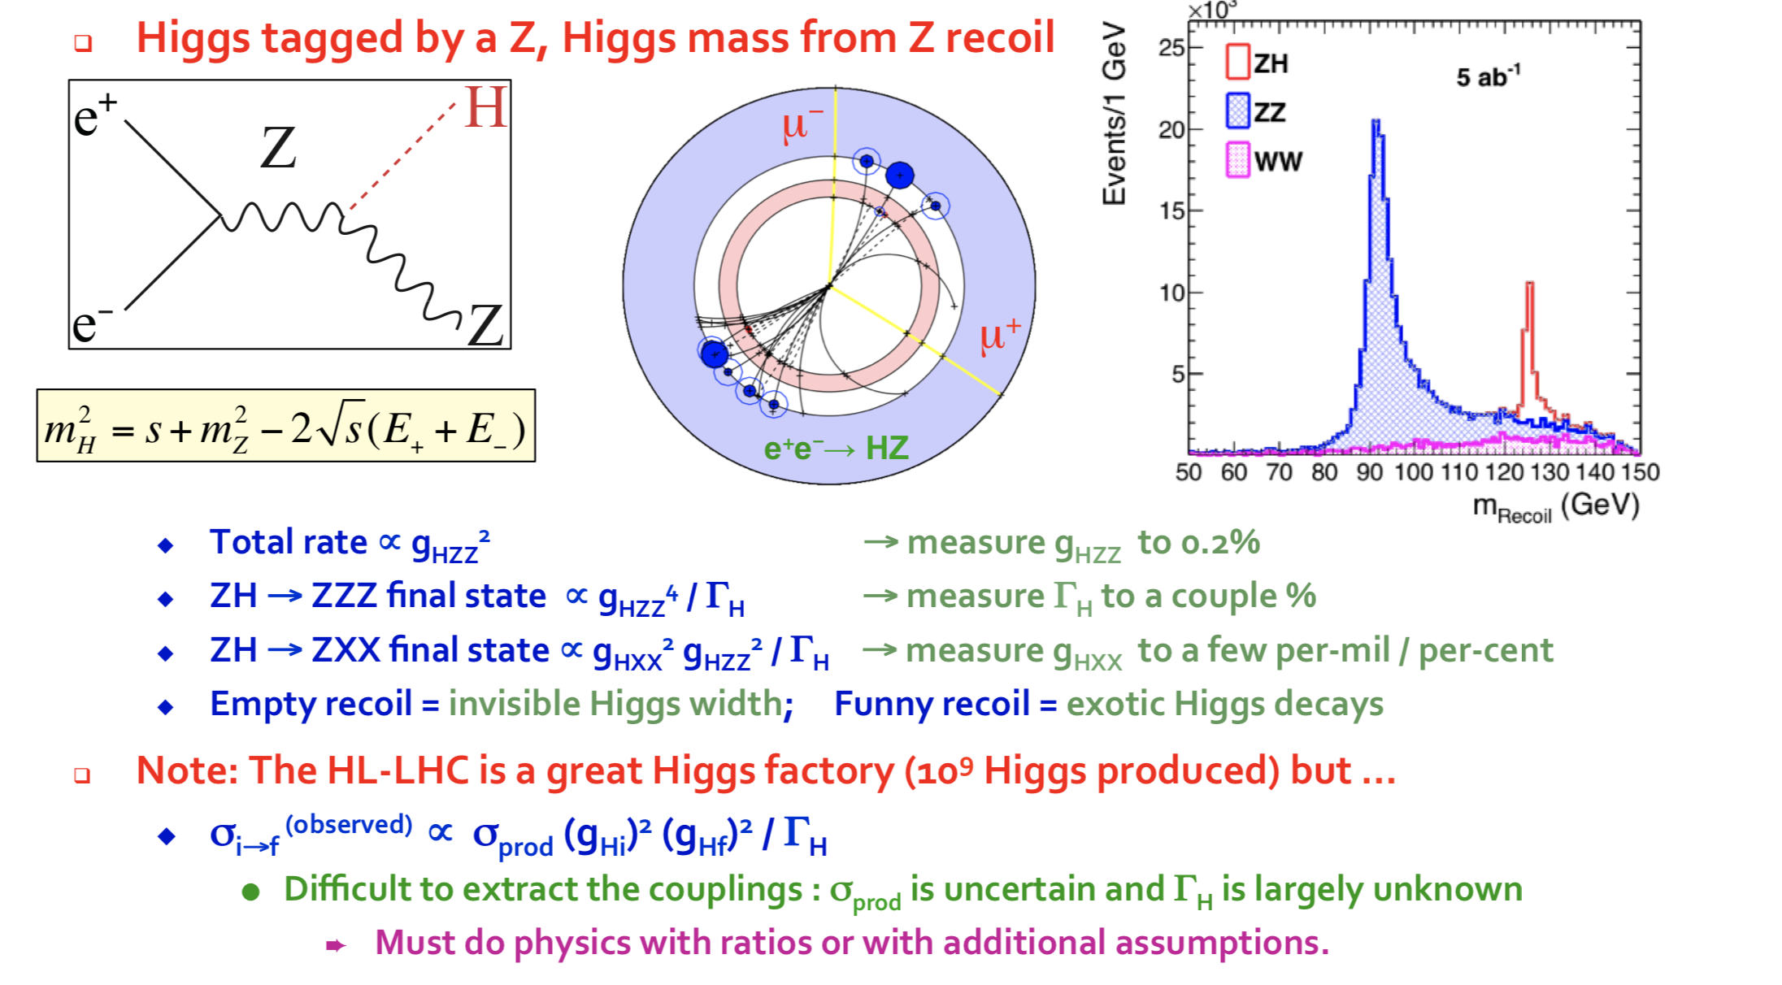
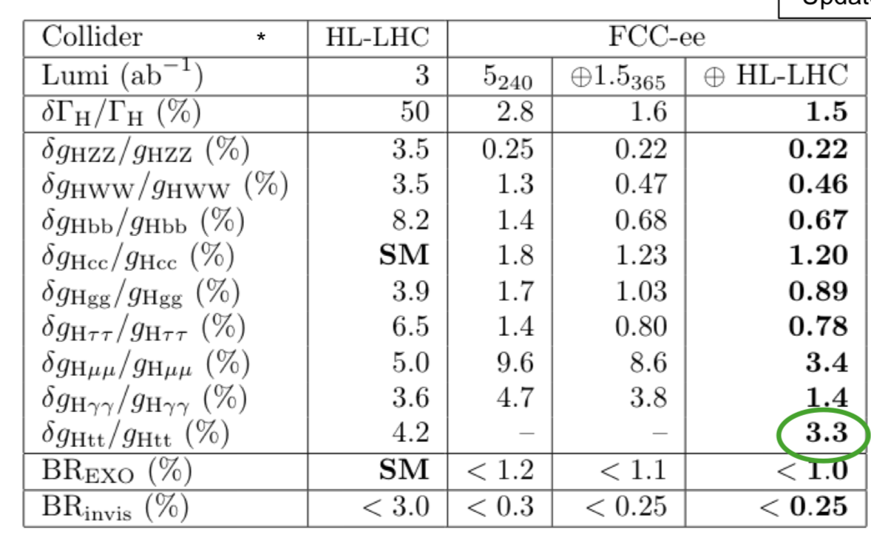
Higgs Factory

Slide 27
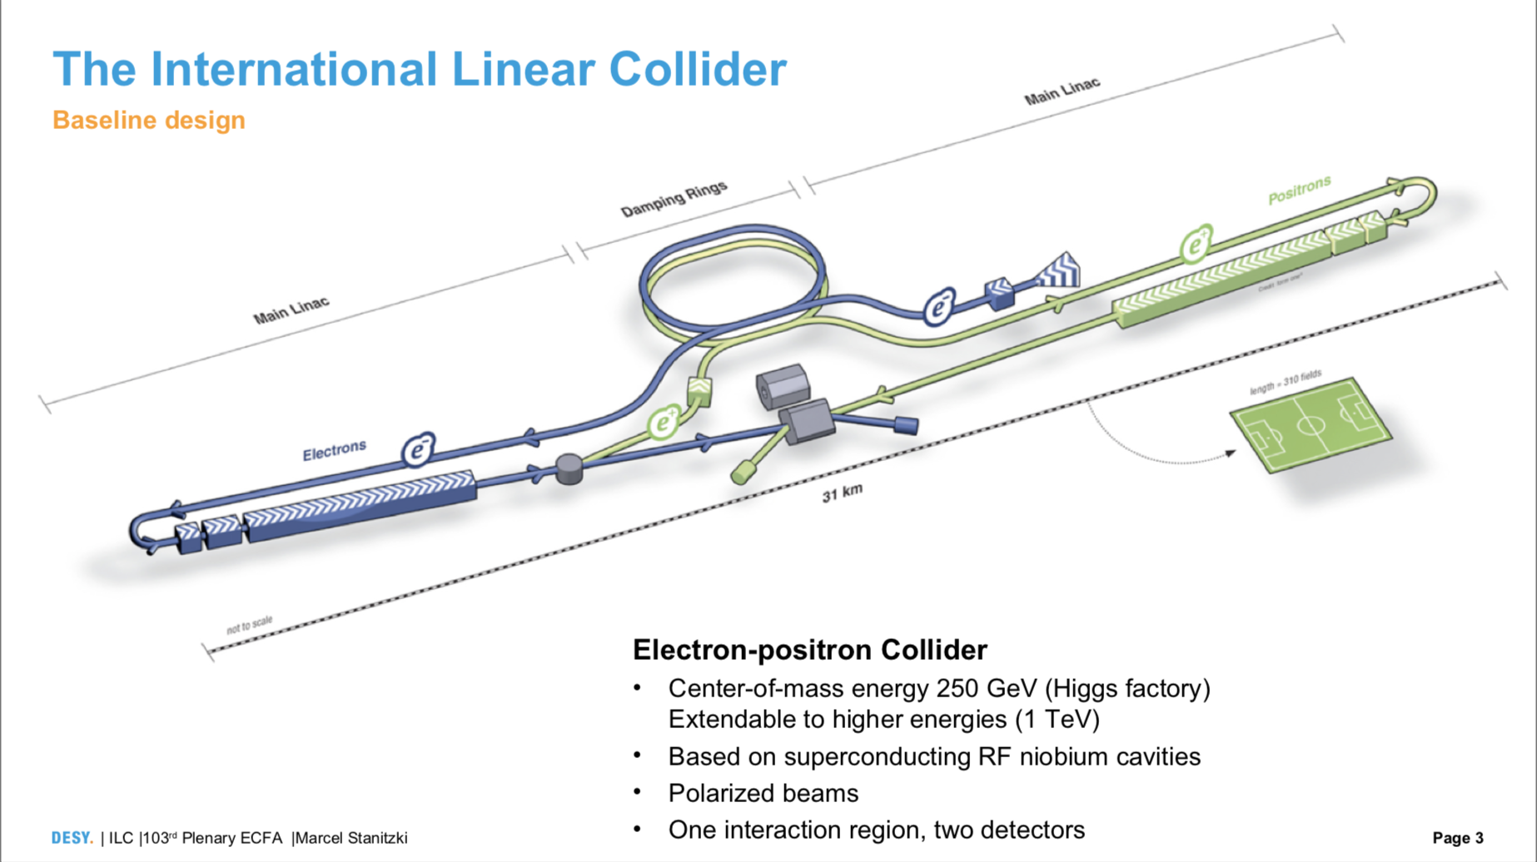

Expected:
Then a 4 years preparatory phase and 8 years construction

Slide 28
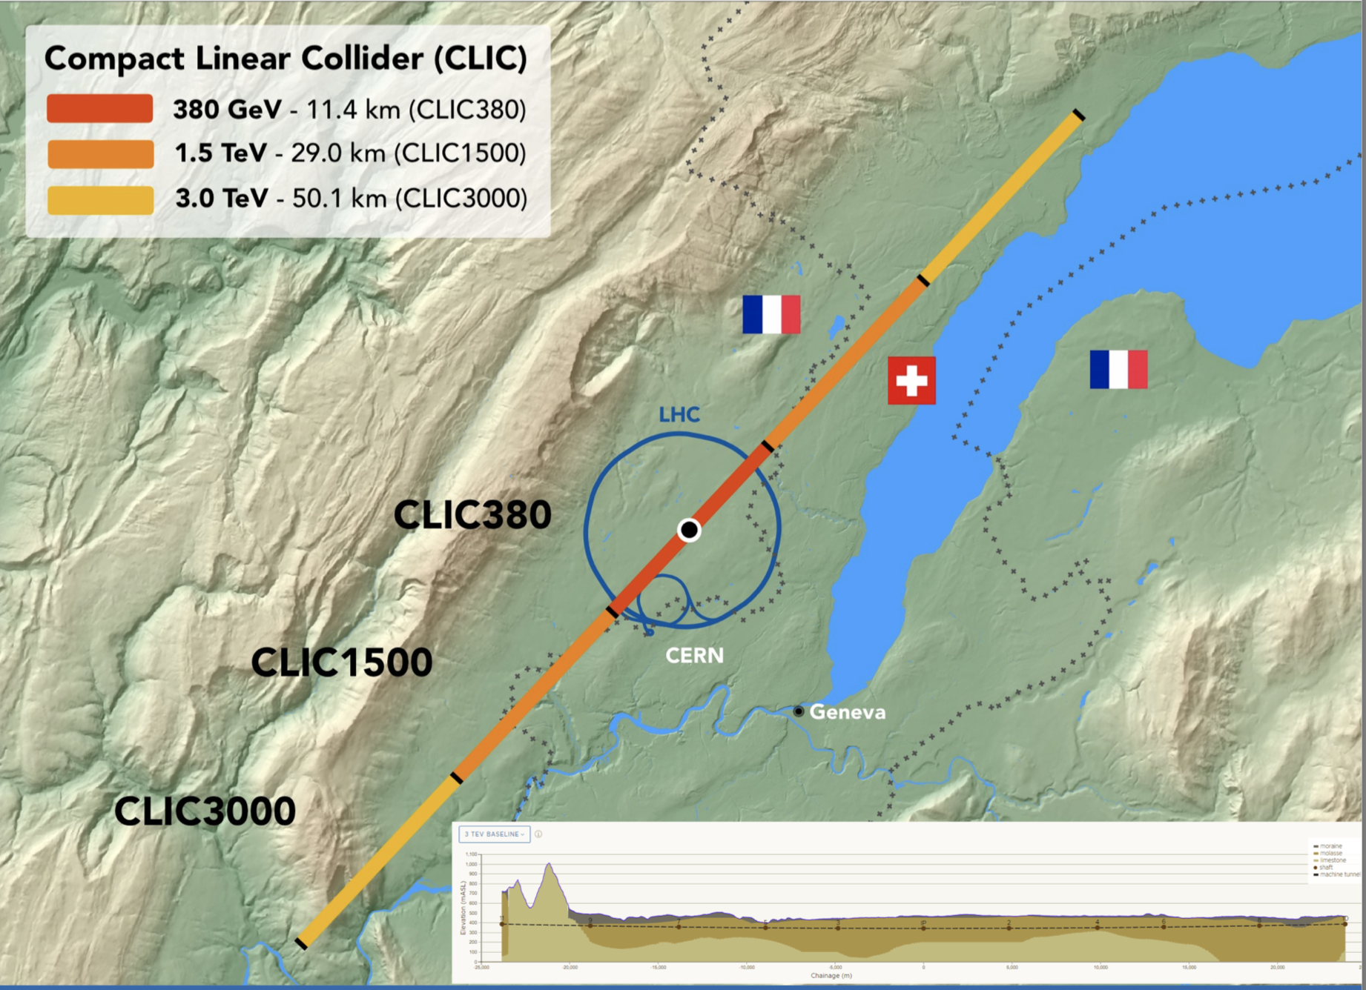

Slide 29
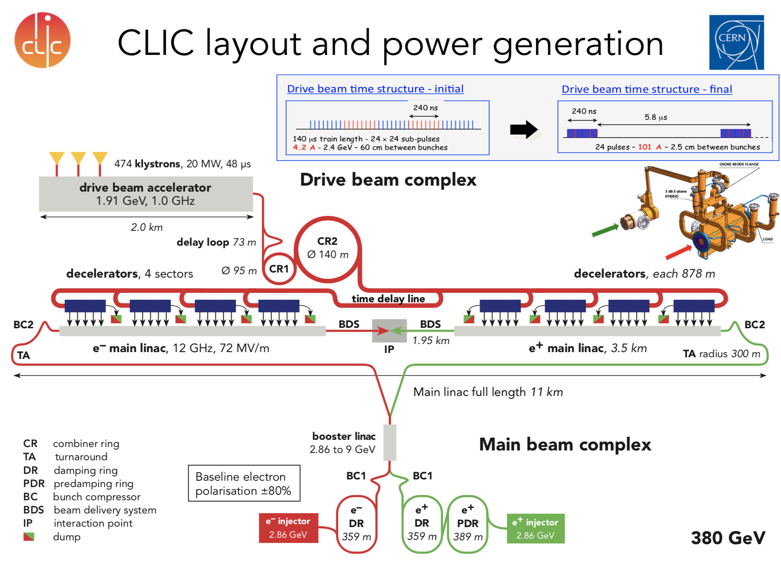
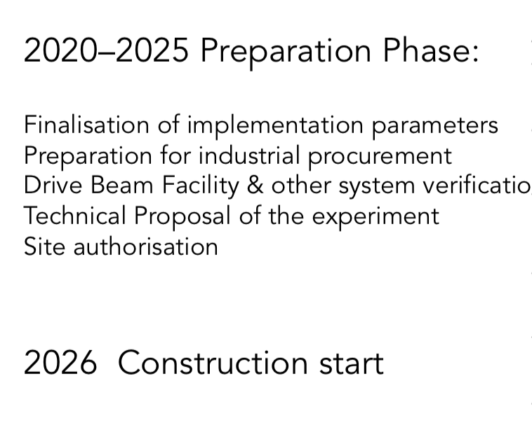

Slide 30
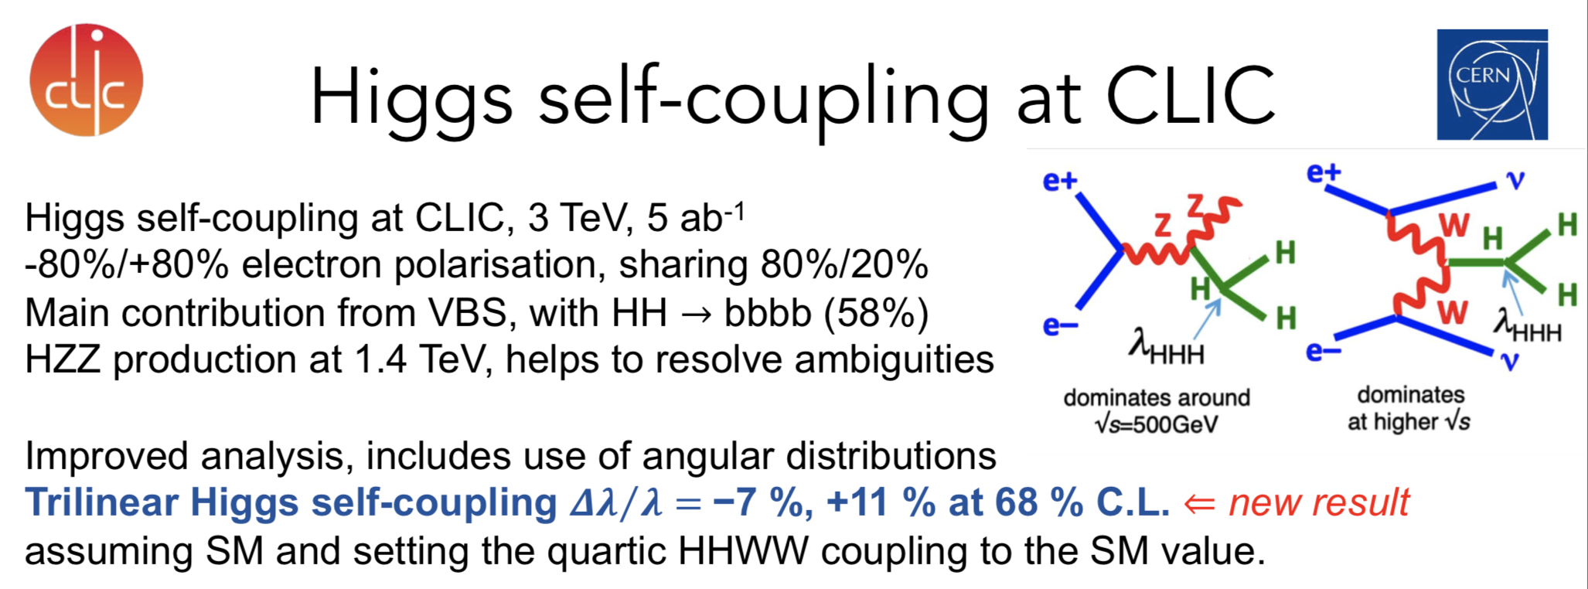
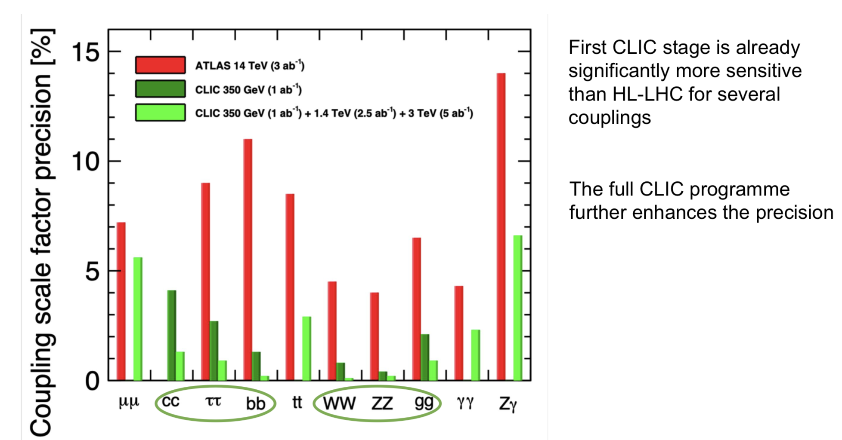
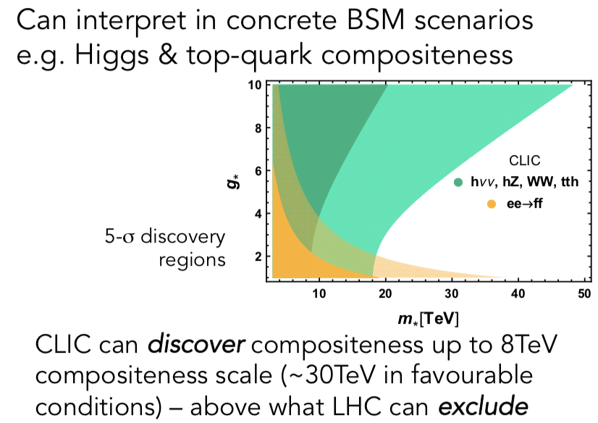
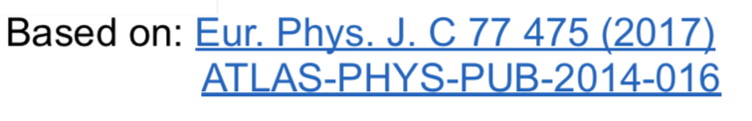
Sensitivity
via EFTs
Higgs couplings

Slide 31
Hadron Colliders
•FCC-hh (CERN)
•SppC (China)

Slide 32
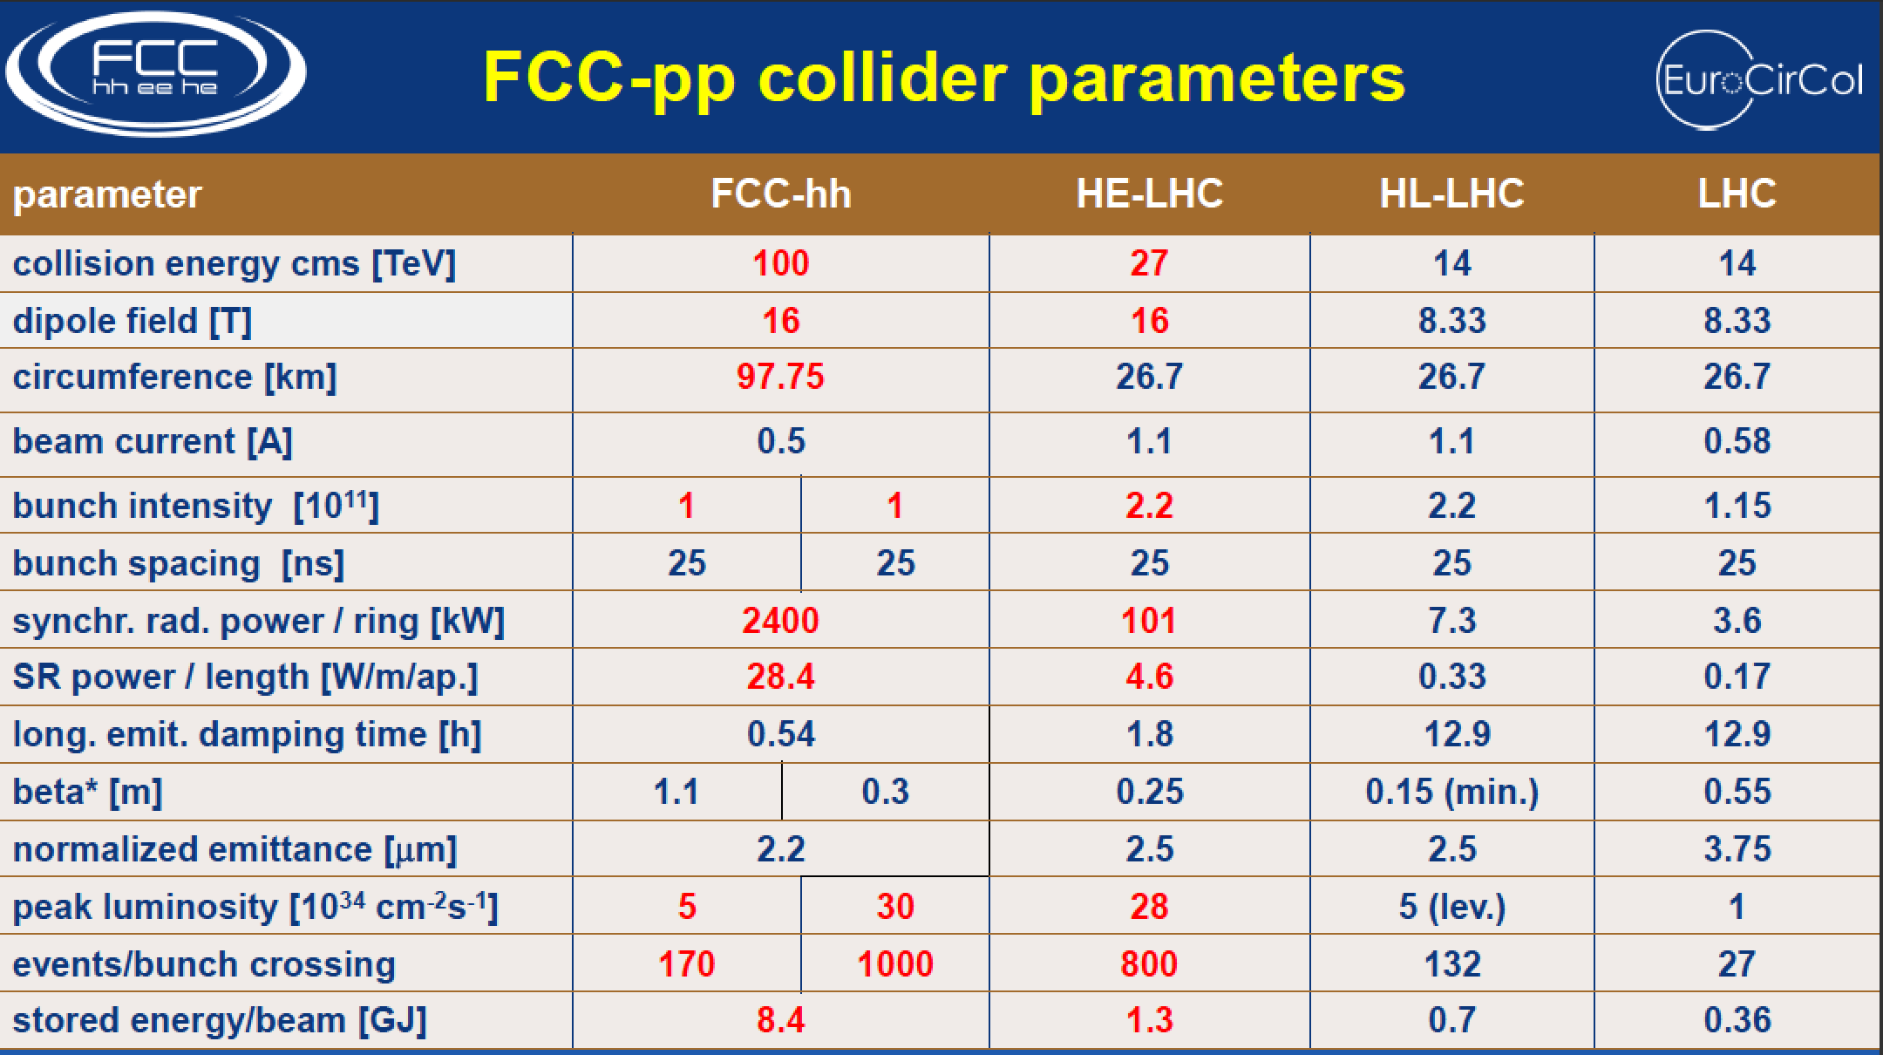

Slide 33
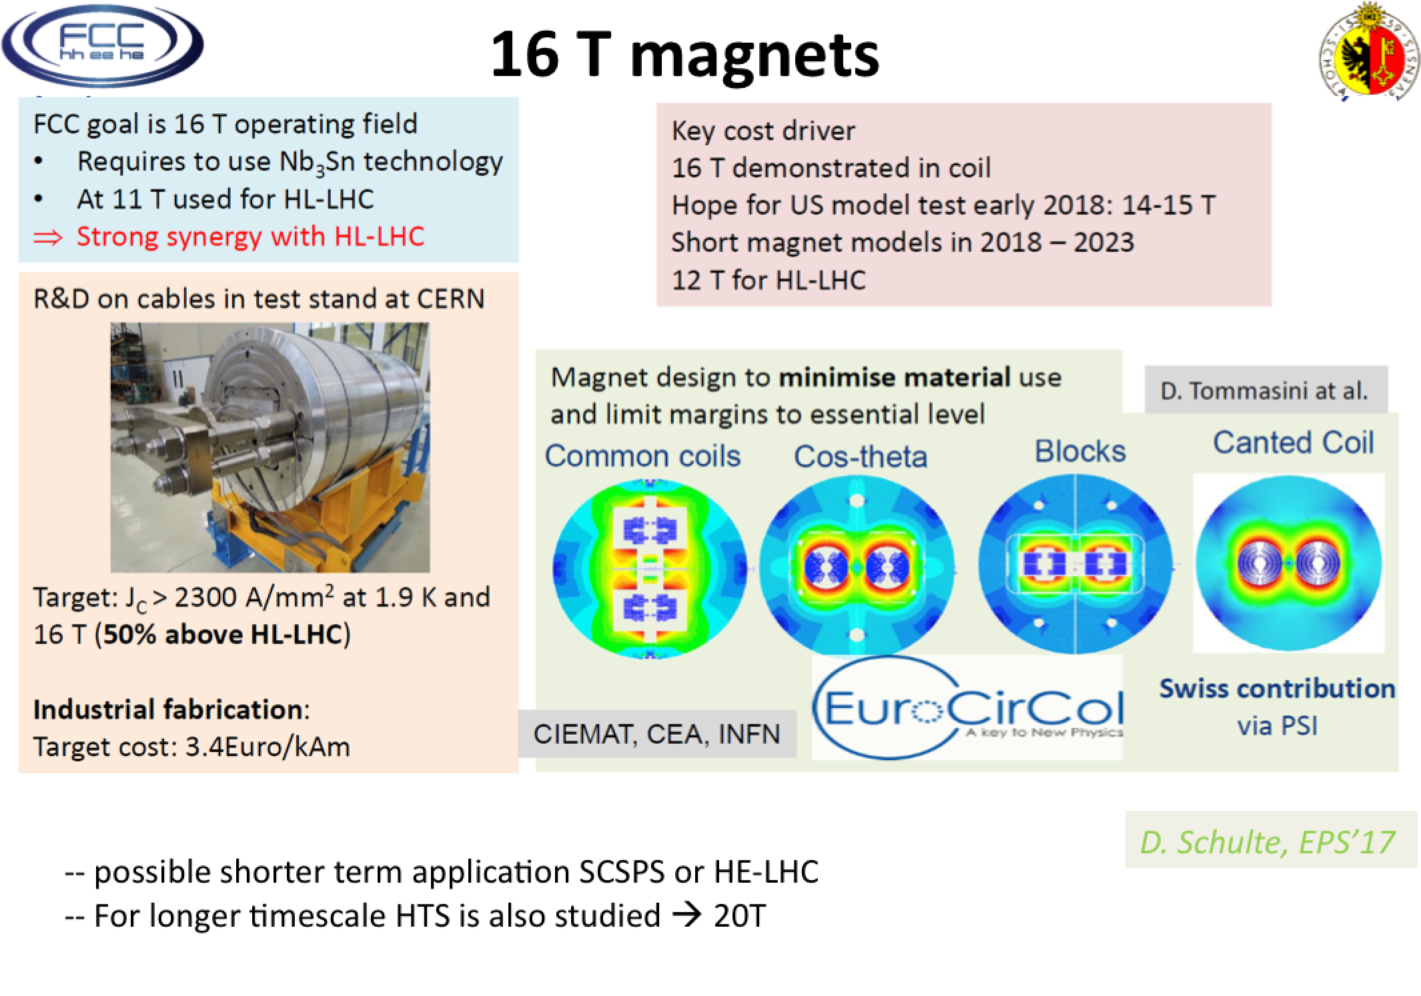
16 Tesla Magnets

Slide 34
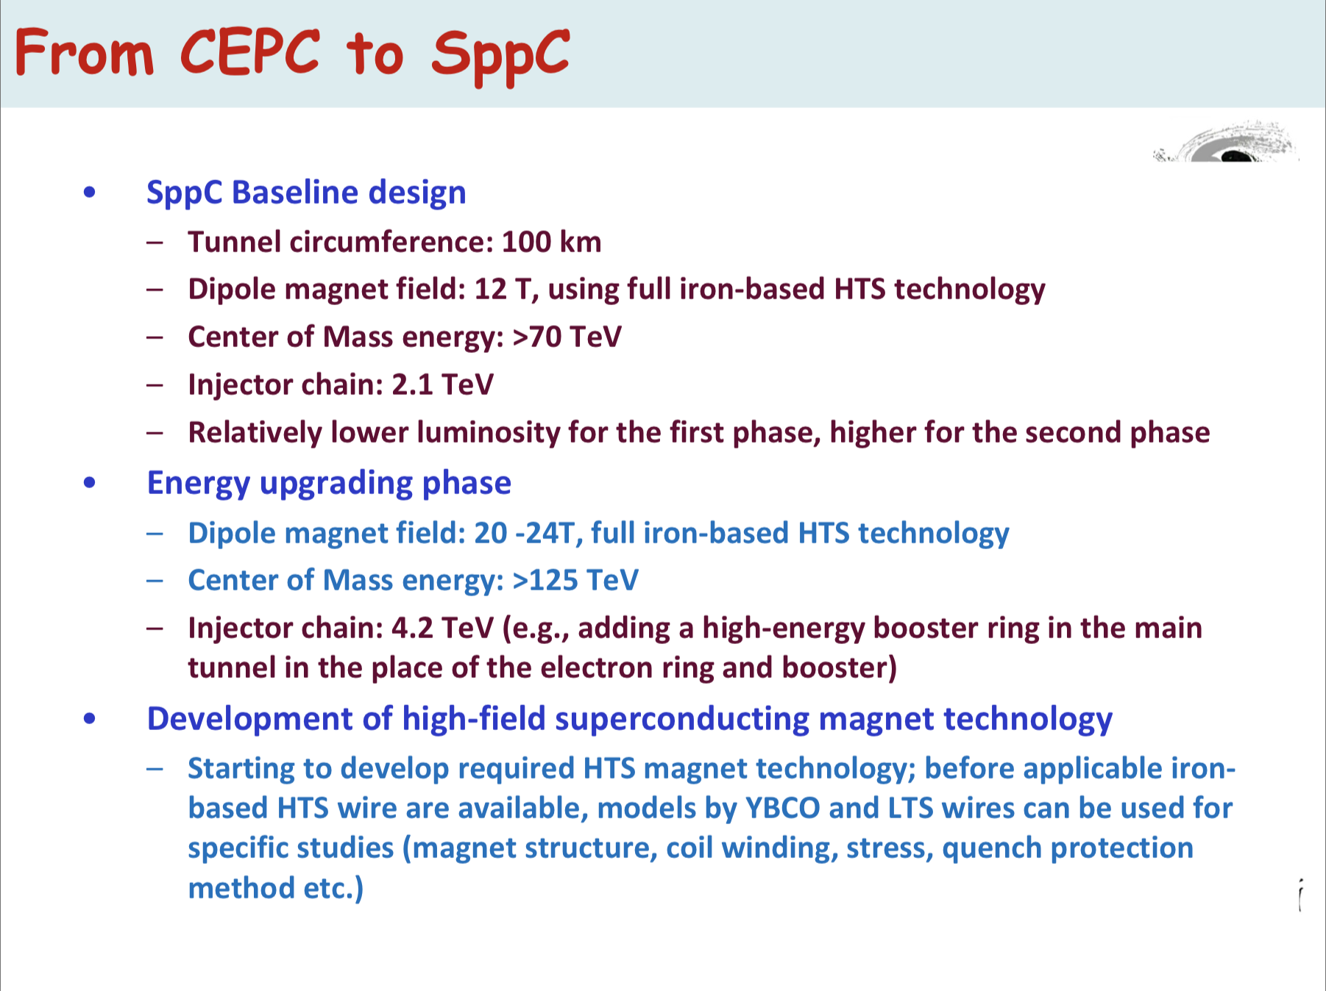
China: Hadron Collider
Make use the CEPC Tunnel

Slide 35
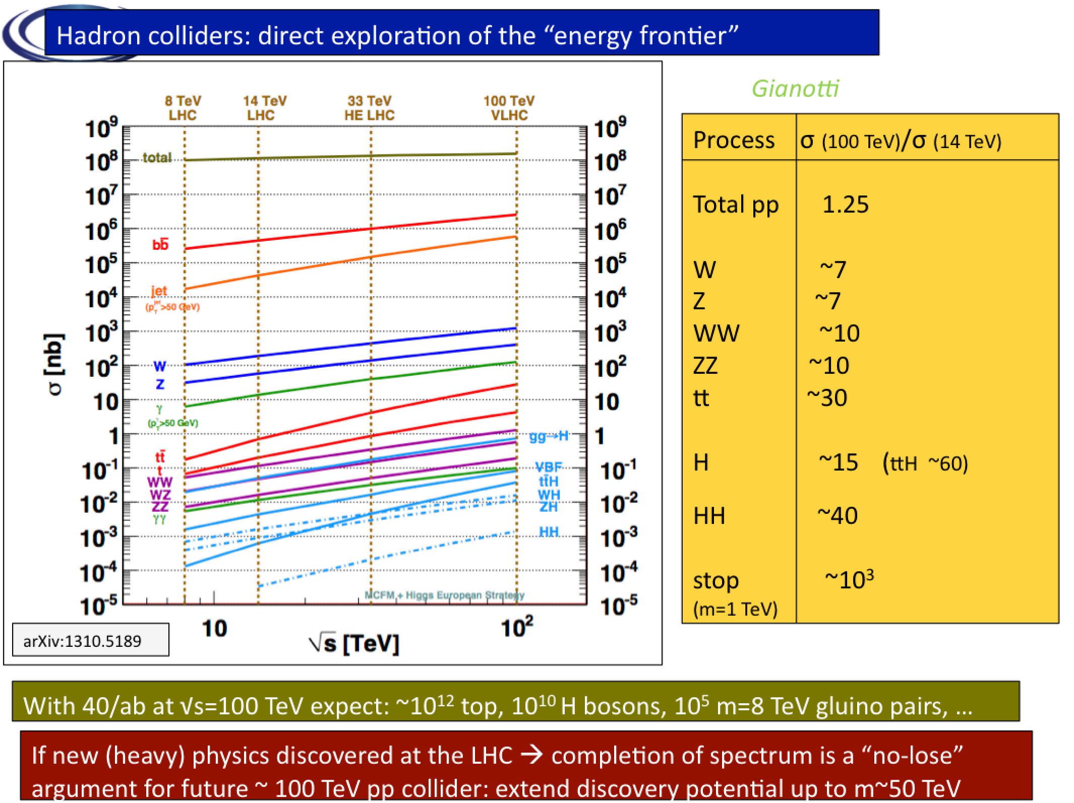
Supersymmetry

Slide 36
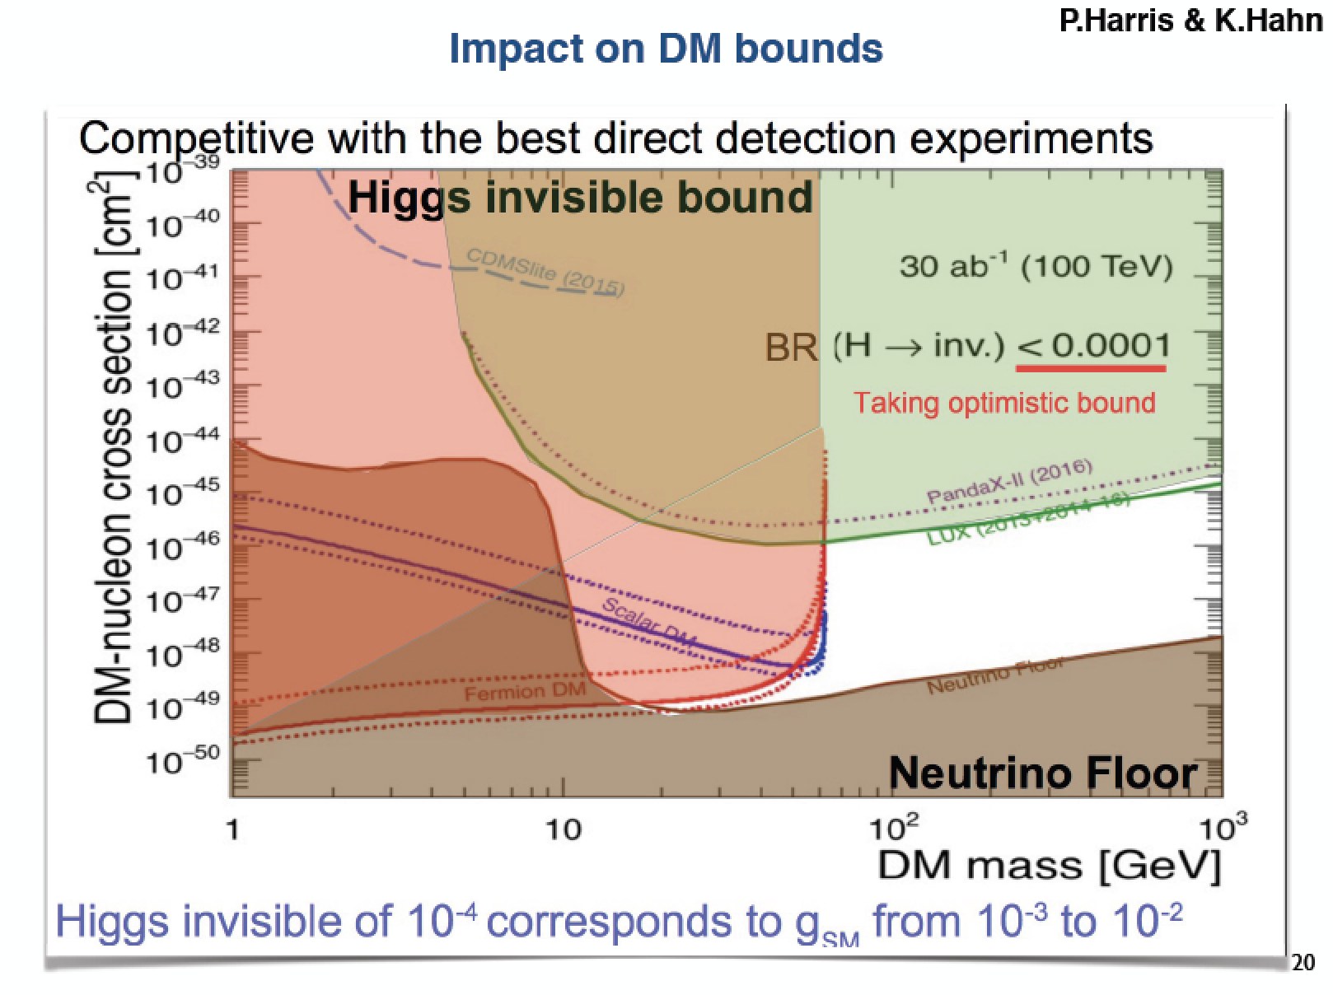
Supersymmetry

Slide 37
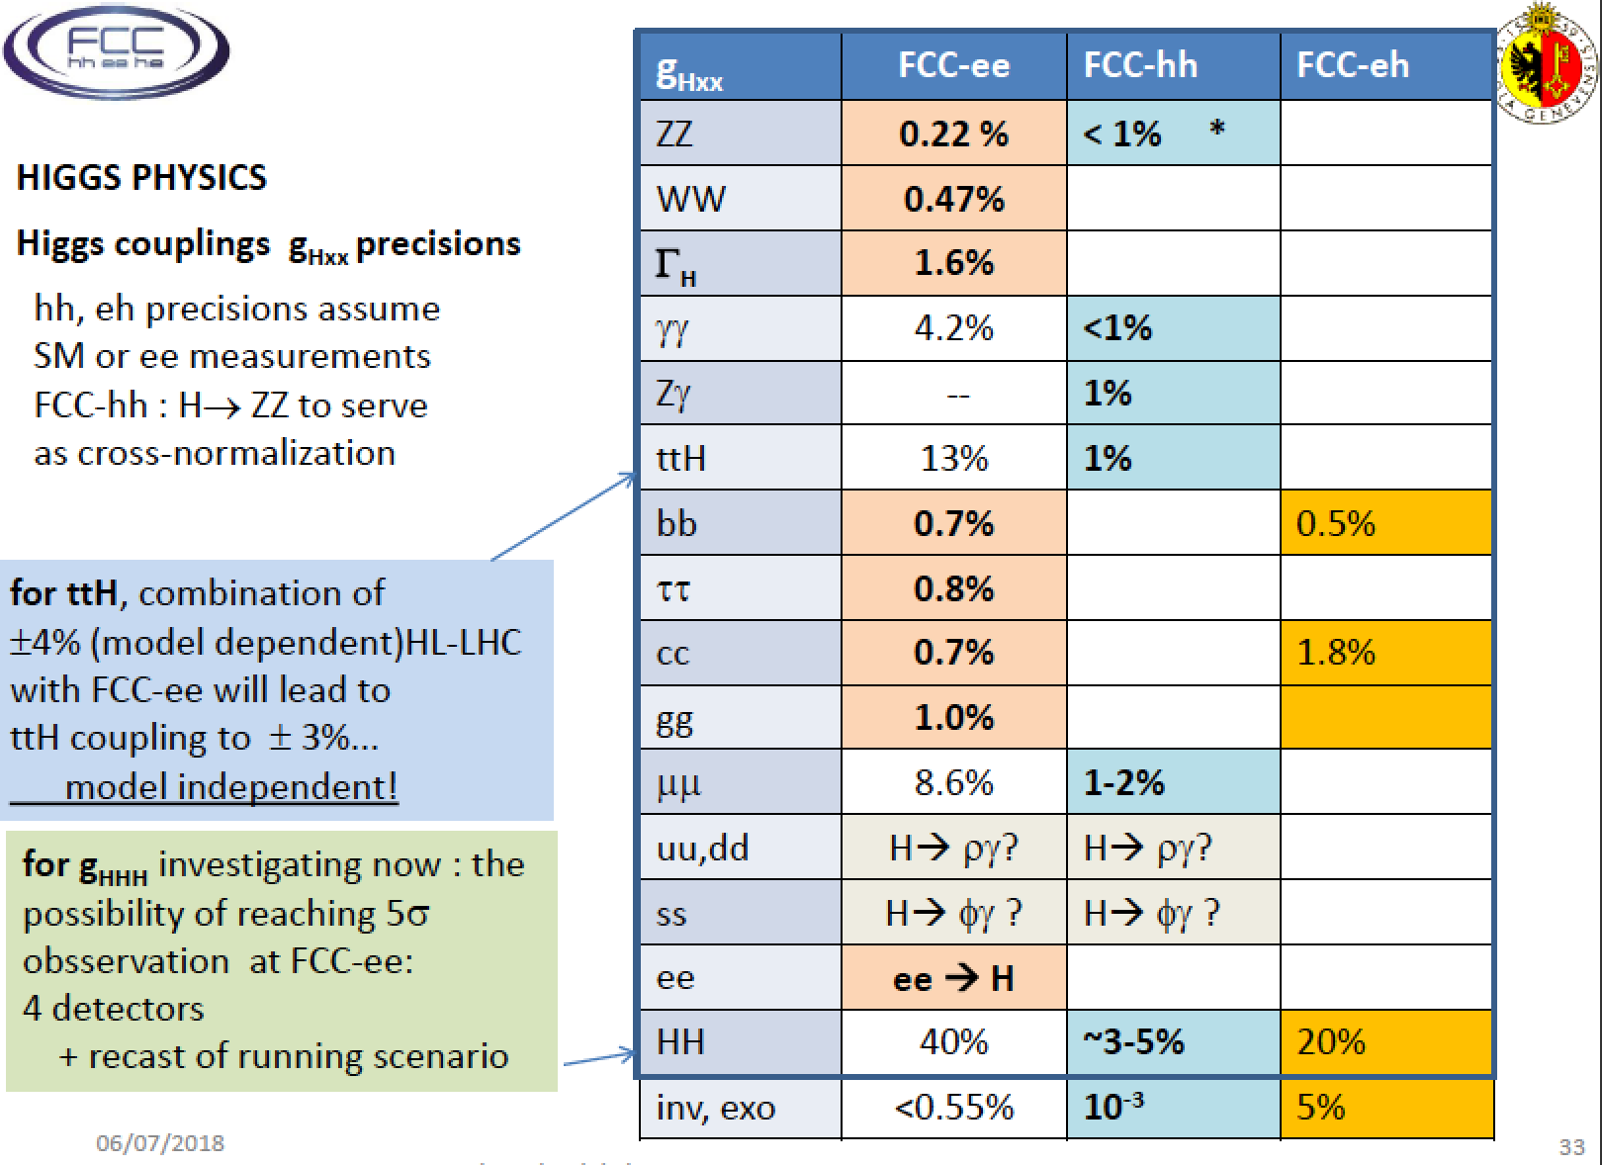
Supersymmetry

Slide 38
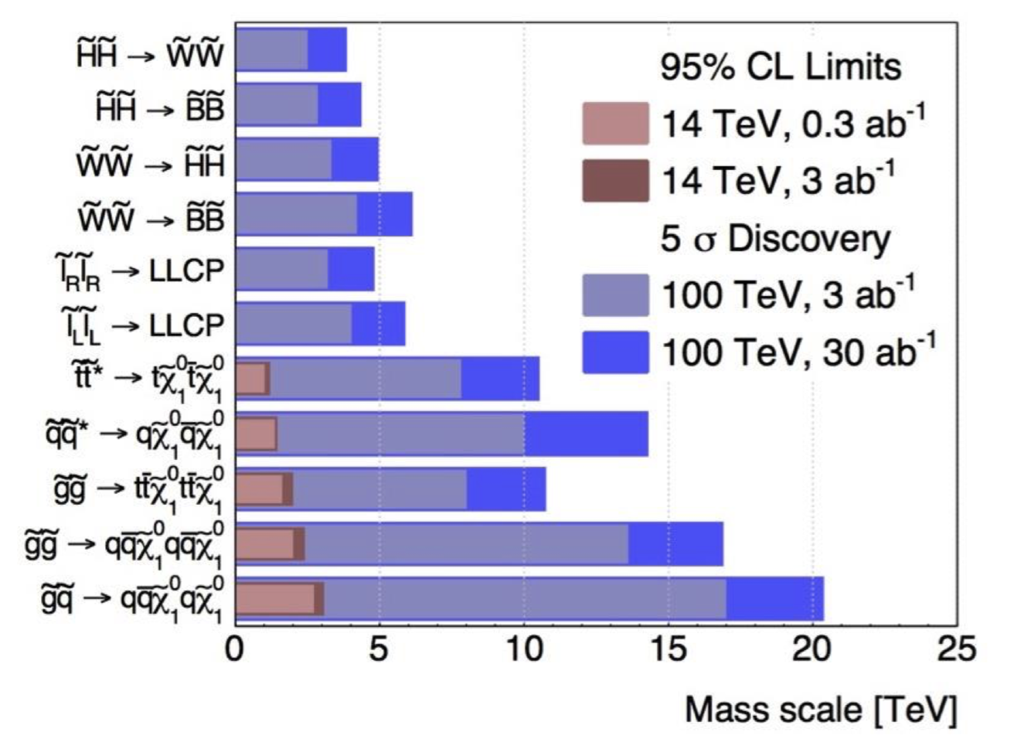
Supersymmetry

Slide 39
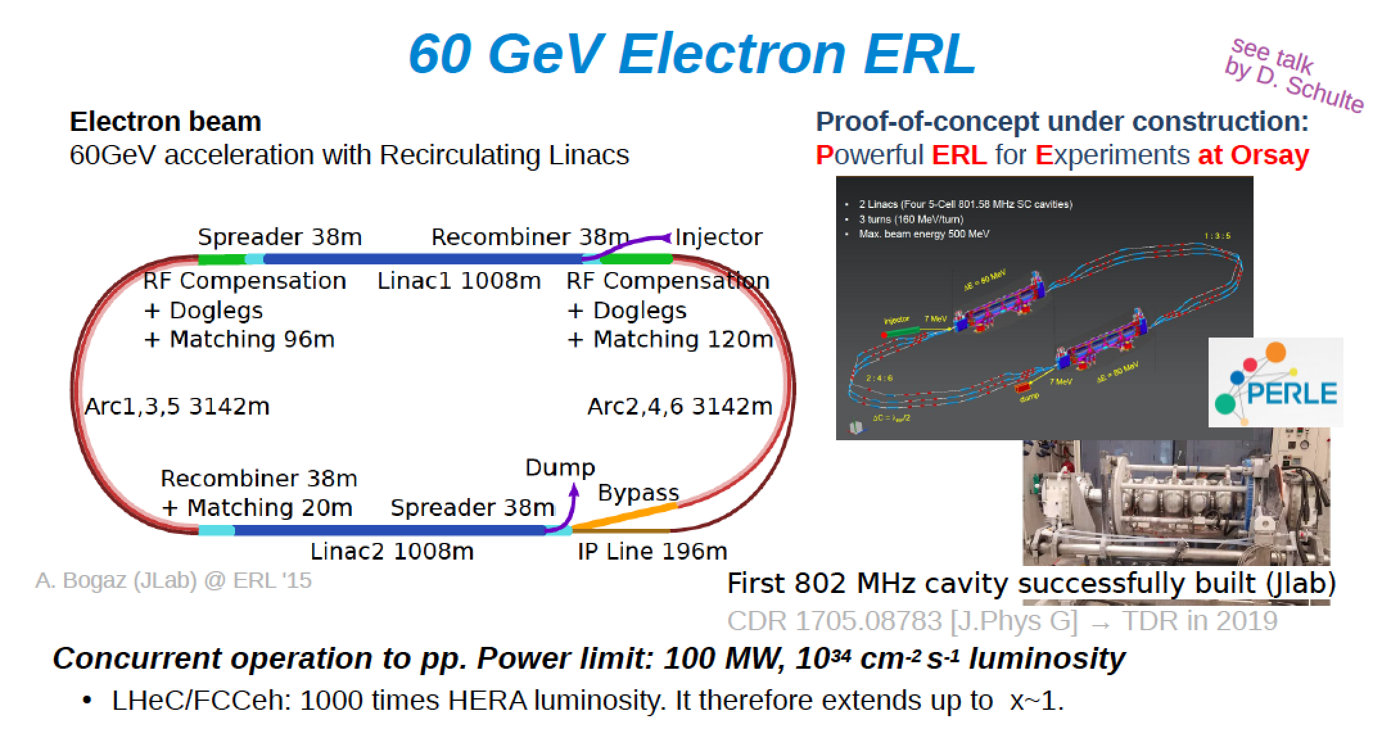
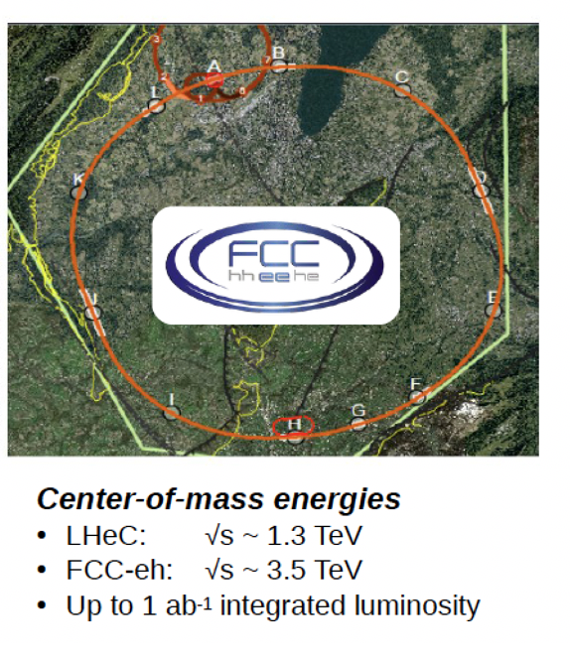
FCC-eh
Using a 60 Gev Electron Energy recovery linac
As an electron beam (PERLE Project )

Slide 40
𝝁+𝝁- Colliders
•Proton generated muon beams
MAP Scheme
•Electron generated muon collider
LEMMA Scheme

Slide 41
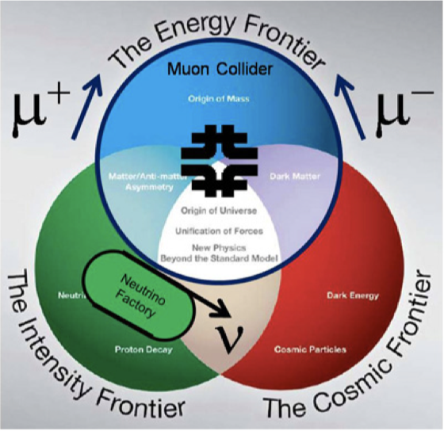
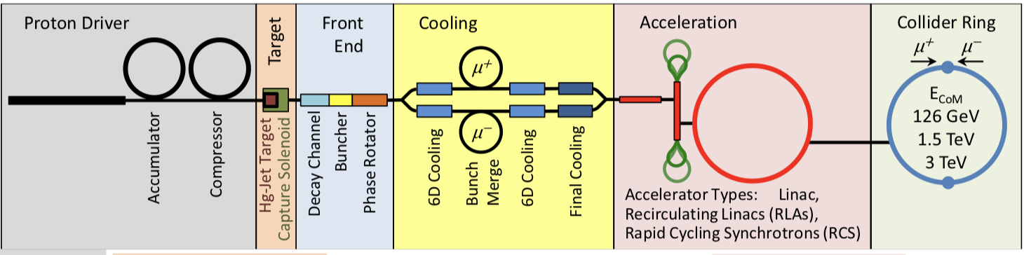




Muon Colliders
MAP
scheme

Slide 42

Muon Colliders

Slide 43
Other Projects
•Electron-Ion Collider (US)
•Intensity Frontier (CERN)
•Accelerator based Neutrino Projects

Slide 44

US Project: Electron-Ion Collider

Slide 45

CERN: Intensity Frontier

Slide 46


Slide 47

Intensity Frontier: Neutrinos

Slide 48


Slide 49


Slide 50
Summary
European Strategy Update launched
input by December 18 2018
Conclusion by May 2020
This is done in a worldwide context (US, China, Japan)
A lot of activity in preparing proposals at the energy and intensity frontier.
Outcome will affect all of future particle physics!

