Slide 1


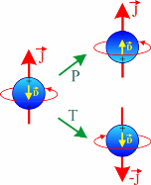
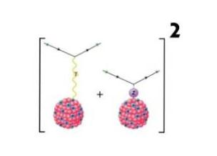
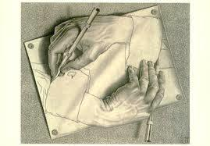
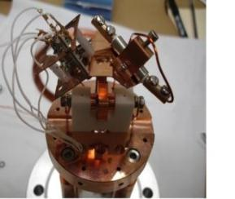


Discrete 2018, Vienna, Austria, 26-30 November 2018
Parity Violation in Atomic Systems
Klaus Jungmann
Van Swinderen Institute for Particle Physics and Gravity
University of Groningen, NL
Selection of a Few Topics & Examples neccessary
→ Focus on Transformativity
Urgent Issues
→ Precision Test of Standard Model
→ Search for New Physics
→ Value of Weinberg Angle
→ Precision Atomic Spectroscopy
Hand in Hand with Applications
→ Atomic Parity Violation & Precision Clocks

Slide 2
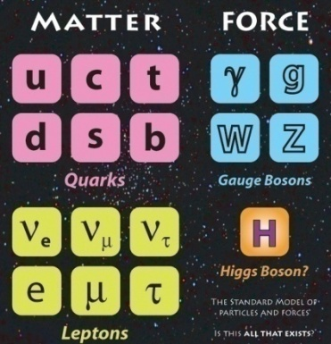
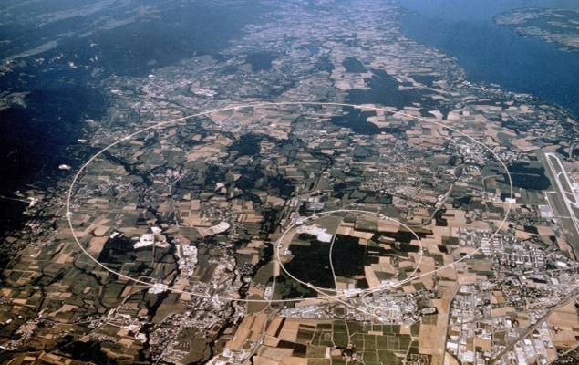
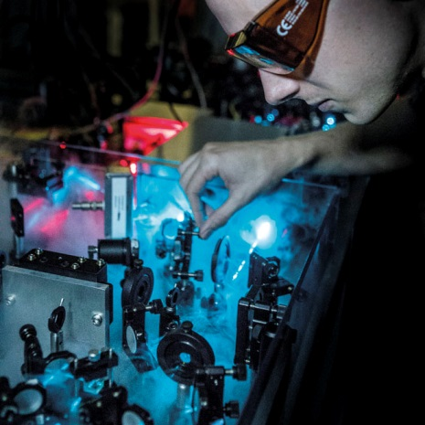
Standard Model Tests
Standard Model (SM) of particle physics is
Best Theory we have !
Still large number of open questions
e.g. particle masses, origin of parity violation, ....
Direct:
Searches for New Particles
Indirect:
High Precision Measurements
⇔
Equivalent
Approaches
LHC @ CERN
Van Swinderen Institutea
e.g. Discovery of Higgs boson,..
also: Difference Matter-Antimatter …
e.g. Atomic Parity Violation (APV),
EDM searches, …..

Slide 3
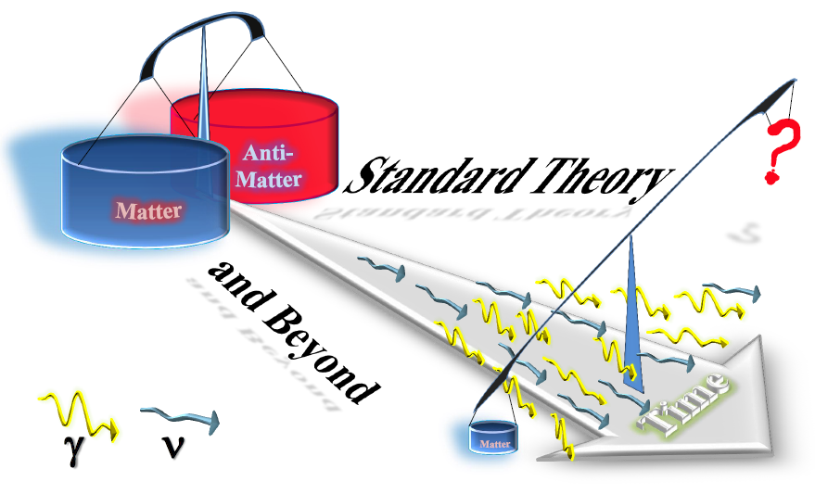
Discrete Symmetries
C,P,T,CP,CPT

Slide 4
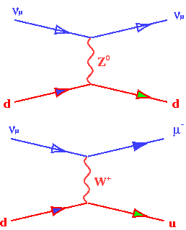
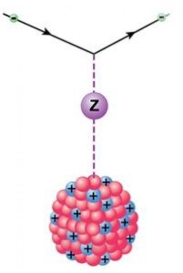
Parity
→ relatively large effects in some atoms and molecules
→ one valence electron atoms to extract precise constants
→ more complex systems to study e.g. anapole moments

Slide 5
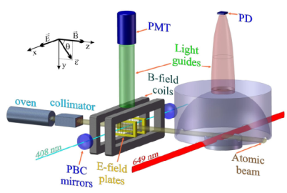

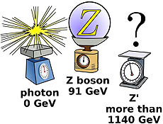
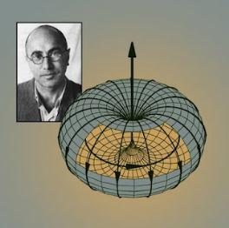
Atomic Parity Violation (APV) brief sad & glorious history
q
q
γ
e
e
Coulomb interaction:
Mediated by photons, massless, so long-ranged
Gives the atomic spectrum + selection rules
Nucleus has an electric charge Q_{EM} = Z
Strength scales  Z
Essential for the acceptance of the Standard Model, GSW theory
Neutral currents → proof in neutrino scattering experiments and APV
Agreeing “Null” results delayed acceptance of GSW theory
→ Weinberg in ‘Dreams of a Final Theory’:
“One should never believe any experiment until it has been confirmed by theory”
First APV reported from Novosibirsk with much too big effect
First APV SM test by Commins, Chu (1978) and Bouchiat & Bouchiat (1982-3) on ¹³³Cs
State-of-the-art APV result on ¹³³Cs by Wieman (1999)
Search for New Physics
Running of Weinberg angle θ_{W}
→ Modern issues:
n-distribution and search for anapole moment
Notes:
Aside from the photon-mediated coulomb interaction that give us the atomic energy levels and selection rules, there is the weak interaction. APV originates from this weak interaction, which is explicitly left-handed. It is mediated by Z0 bosons. One of the effects of APV is that atomic levels acquire a small admixture of opposite parity states. The nucleus also has a weak charge, and the strength of the interaction grows faster than Z³. The weak charge is built up from the individual contributions of quarks, which add coherently. WE ARE INTERESTED IN NEW PHYSICS. The Weinberg angle determines the relative strengths of the electromagnetic and the weak force.
The discovery of Z0 (neut) removed any doubts
about the general correctness of the theory [7] and became
a crucial success of the standard model.

Slide 6

Atomic parity violation (APV) future
q
q
γ
e
e
Coulomb interaction:
Mediated by photons, massless, so long-ranged
Gives the atomic spectrum + selection rules
Nucleus has an electric charge Q_{EM} = Z
Strength scales  Z
Search for New Physics (Z’, leptoquarks, …)
Running of Weinberg angle θ_{W}
→ Modern issues
n-distribution and search for anapole moment
Notes:
Aside from the photon-mediated coulomb interaction that give us the atomic energy levels and selection rules, there is the weak interaction. APV originates from this weak interaction, which is explicitly left-handed. It is mediated by Z0 bosons. One of the effects of APV is that atomic levels acquire a small admixture of opposite parity states. The nucleus also has a weak charge, and the strength of the interaction grows faster than Z³. The weak charge is built up from the individual contributions of quarks, which add coherently. WE ARE INTERESTED IN NEW PHYSICS. The Weinberg angle determines the relative strengths of the electromagnetic and the weak force.
The discovery of Z0 (neut) removed any doubts
about the general correctness of the theory [7] and became
a crucial success of the standard model.

Slide 7
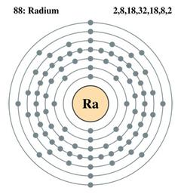
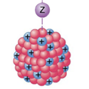
Atomic Parity Violation (APV)
Theory progressing
Need atomic structure to sub-%
One electron outside core helps
Weak ineractions scale ∝ Z³⁺
^{(or even stronger)}
Recent Theory work: (just a few examples)
Safronova et al. Rev.Mod.Phys. 90, 025008 (2018)
Ginges, Volotka Phys.Rev. A98, 032504(2018) ; Phys.Rev. A96, 062502 (2017)
Davoudiasl et al. Phys.Rev. D92, 055005 (2015); Phys. Rev. D89, 095006 (2014)
Dzuba, Flambaum Phys. Rev. A83, 052513 (2011) ; Phys. Rev. A85,012515 1-5 (2012)
Derevianko, Porsev et al. Phys.Rev. D 82, 036008 (2010) ; Phys. Rev. Lett. 102, 181601 (2009)
Safronova et al. Can. Jour. Phys. 89, 371 (2011) ; Phys. Rev. A 79, 062505 (2009)
Timmermans et al. Phys. Rev. A79, 052512 (2009) ; Phys. Rev A 78, 050501 (2008)
Sahoo et al. Phys. Rev. A 83, 030502 (2011) ; Pram. Jour. Phys. 75, 1041 (2010)
. . .

Slide 8
Atomic Parity Violation (APV)
Physics beyond the SM
Q_{W} = –N+(1–4 sin²θ_{W})Z + rad. corr. + “new physics”
q
q
V
Z⁰’
Z⁰
Extra Z’ boson in SO(10) GUTs:
e
A
e
Londen en Rosner (1986)
Marciano en Rosner (1990)
Altarelli et al. (1991)
Bound on M_{Z’} from cesium APV
(84% confidence level, ξ= 52°Derevianko 2009)
M_{z’}> 1.3 TeV/c²
(Tevatron M_{Z’}> 0.82 TeV/c²)
(full LHC M_{Z’} ~4.5 TeV/c²)
Bound (possible) on M_{Z’} from Ra⁺ APV
M_{z’}> 5 TeV/c²
The way to go!

Slide 9
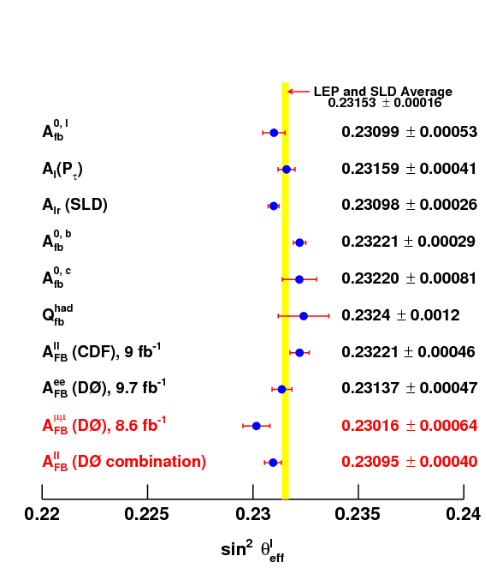
Determination of Weak Mixing Angle
Various Methods - few Examples at Z pole
Average:
sin²θw = 0.23153(16)
} m_{Higgs}
V. Abazov et al., Phys.Rev.Lett. 120, 241802 (2018)

Slide 10
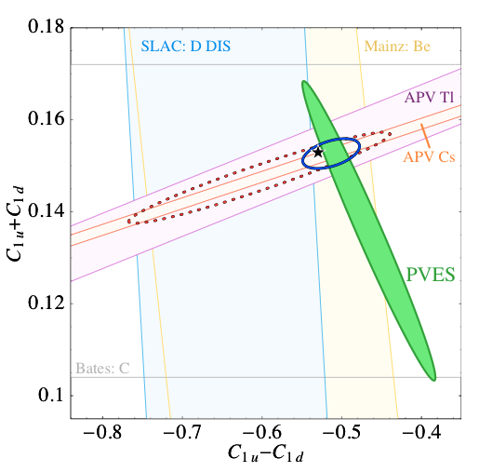
Atomic Parity Violation (APV)
Physics beyond the SM
→ APV probes orthogonal
M.J. Ramsey-Musolf and S. Su (2007)
Young et al. PRL 2007

Slide 11
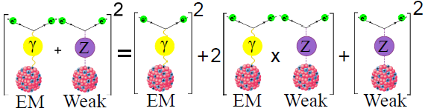
Atomic Parity Violation
Extraction of Weinberg Angle
Q_{W} = –N+(1–4 sin²θ_{W})Z + rad. corr.
Measured by light shifts
Weak charge
Depends on
atomic structure.

Slide 12
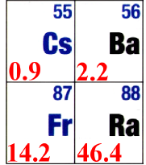
APV Calculations
Infer weak charge
q
q
V
Measure
Z⁰
Calculate atomic wavefunctions
A
e
e
Calculations:
k_{Ra} = 46.4(1.4) · 10⁻¹¹ iea₀ /N
k_{Cs} = 0.8906(26)· 10⁻¹¹ iea₀ /N
L.W. Wansbeek et al. (2008)
S-S | S-D
Cs 0.9 | Ba⁺ 2.2
Fr 14.2 | Ra⁺ 46.4
A. Derevianko et al. (2009)
APV amplitude 50 x larger → much stronger than Z³
Improved calculations needed → sub-1%
Notes:
In a single ion, one can measure the admixture of opposite parity states in the low-lying S and D levels by looking at the interference between the allowed E2 and forbidden electric dipole transition. From this term, we can extract the dipole matrix element. With atomic theory we can then determine proportionality constant k and get to the weak charge. For this, atomic theory needs to be accurate to sub-1%. As said before, the strength of the weak interaction grows faster than Z3. The calculation shown in this figure confirms that the radium ion is by far the most sensitive candidate for an APV experiment, with relevant matrix elements that are 50 times larger than in Cs. However, the theoretical accuracy is currently limited to some 3%. To improve calculation, experimental input is an absolute necessity. To provide experimental input, we

Slide 13
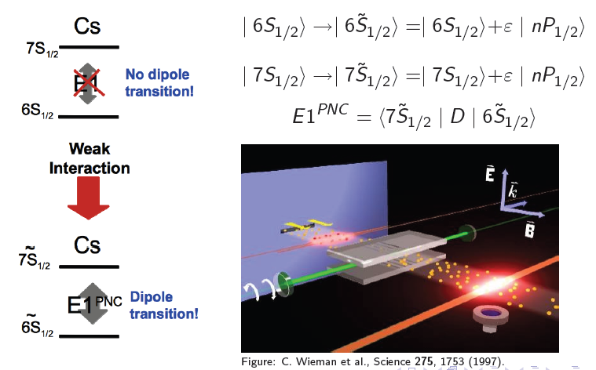
Atomic Parity Violation (APV)
The best experiment so far – Cs @ Boulder
q
q
γ
e
e
Coulomb interaction:
Mediated by photons, massless, so long-ranged
Gives the atomic spectrum + selection rules
Nucleus has an electric charge Q_{EM} = Z
Strength scales  Z
Notes:
Aside from the photon-mediated coulomb interaction that give us the atomic energy levels and selection rules, there is the weak interaction. APV originates from this weak interaction, which is explicitly left-handed. It is mediated by Z0 bosons. One of the effects of APV is that atomic levels acquire a small admixture of opposite parity states. The nucleus also has a weak charge, and the strength of the interaction grows faster than Z³. The weak charge is built up from the individual contributions of quarks, which add coherently. WE ARE INTERESTED IN NEW PHYSICS. The Weinberg angle determines the relative strengths of the electromagnetic and the weak force.
The discovery of Z0 (neut) removed any doubts
about the general correctness of the theory [7] and became
a crucial success of the standard model.

Slide 14
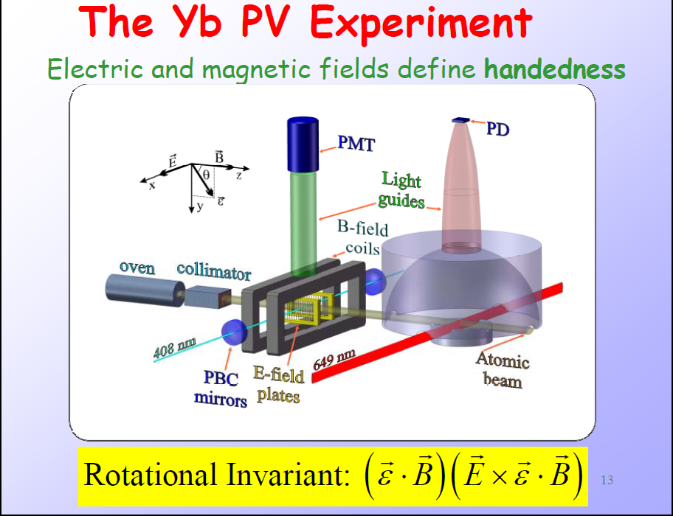
D. Budker et al.

Slide 15
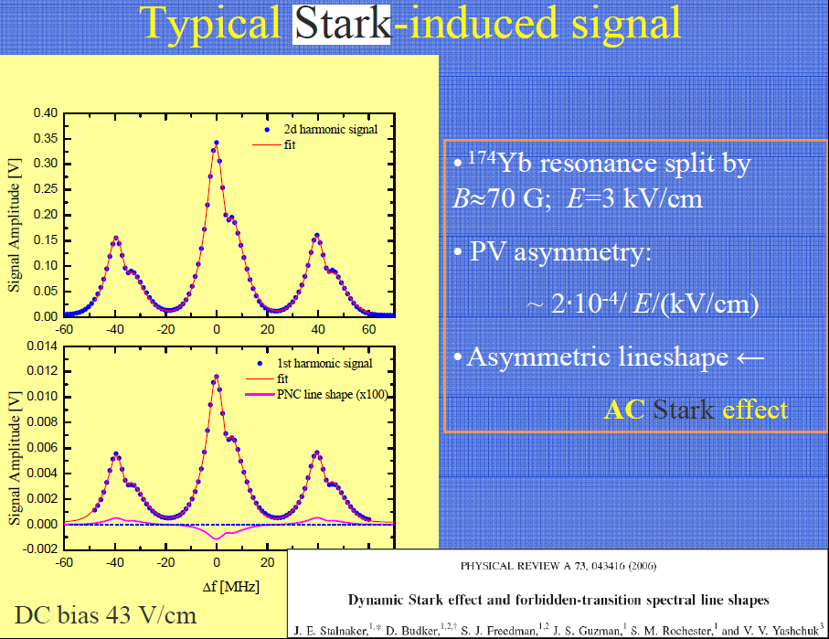
Large APV in atomic Yb
High S/N
D. Budker et al.

Slide 16
Large APV in atomic Yb
High S/N
D. Budker et al., Nature Physics Letters (2018)
200 times larger APV effect used to
study isotope shifts
Z’ mass limits
Theory not yet ready for extracting , e.g. sin² θ_{W}

Slide 17
Test of Standard Model
Electroweak Interactions

Slide 18
Test of Standard Model
Electroweak Interactions

Slide 19
Test of Standard Model
Electroweak Interactions

Slide 20
Test of Standard Model
Electroweak Interactions
S. Kumar, W. Marciano, Annu. Rev. of Nucl. Part. Sci. 63, 237 (2013)
H. Davoudiasl, Hye-Sung Lee, W. Marciano, arxiv. 1402.3620 (2014)

Slide 21
Test of Standard Model
Electroweak Interactions
work recently completed
Qweak collab.,
Nature 557, 207 (2018)
S. Kumar, W. Marciano, Annu. Rev. of Nucl. Part. Sci. 63, 237 (2013)
H. Davoudiasl, Hye-Sung Lee, W. Marciano, arxiv. 1402.3620 (2014)

Slide 22
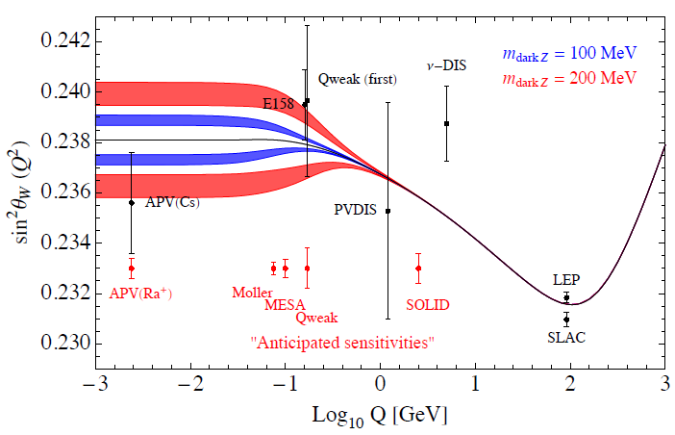
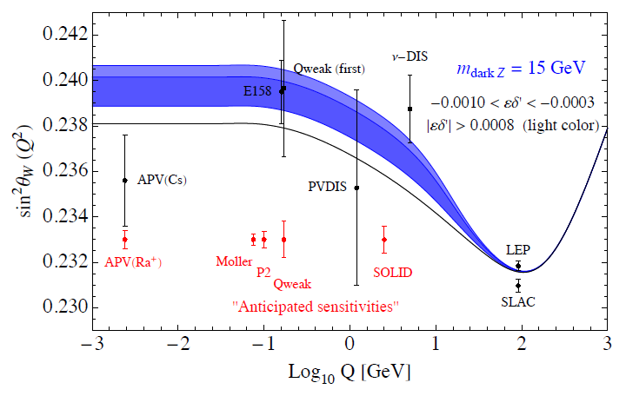
Test of Standard Model
Electroweak Interaction
work recently completed
Qweak collaboration,
Nature 557, 207 (2018)
S. Kumar, W. Marciano, Annu. Rev. of Nucl. Part. Sci. 63, 237 (2013)
H. Davoudiasl, Hye-Sung Lee, W. Marciano, arxiv. 1402.3620 (2014)
H. Davoudiasl, H. S. Lee and W. J. Marciano, Phys. Rev. D 92, 055005 (2015)

Slide 23

Atomic Parity Violation
Extraction of Weinberg Angle
7²P_{3/2}
APV effect
Ψ_{e} Ψ_{n} overlap
7²P_{1/2}
6²D_{5/2}
6²D_{3/2}
+ ε' n' ²P_{3/2}
Ra⁺
E2
E1_{APV}
Weak charge
7²S_{1/2}
+ ε n²P_{1/2}
→ Trapped single ion
Fortson, Phys. Rev. Lett. 70, 2383 (1993)
Notes:
How does the weak interaction show up in an atomic system?
Here are the lowest energy levels of the radium ion.
Effect of weak interaction is to mix opposite-parity states: now a parity-violating dipole transition amplitude arises
E1 (APV) scales as weak charge (related to Weinberg angle) times overlap between electronic and nuclear wavefunction
E1 is 11 orders of magnitude smaller than E2
Experimental trick to make it measurable: use interference (weak part too weak for actual transitions)

Slide 24
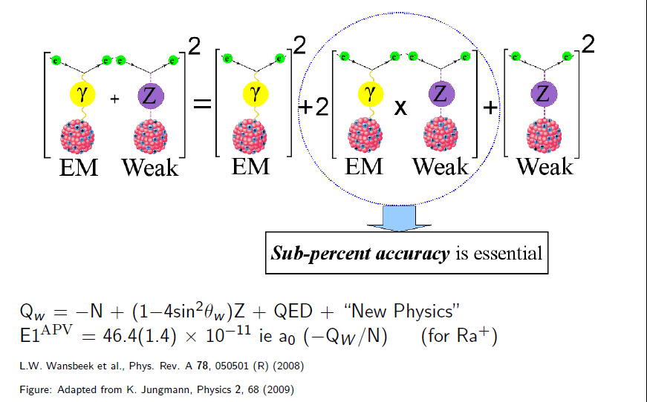
Atomic Parity Violation
basic concept

Slide 25

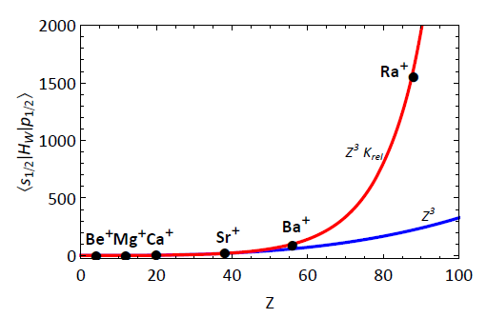
Atomic Parity Violation
Ba⁺ and Ra⁺
S-S | S-D
Cs 0.9 | Ba⁺ 2.2
Fr 14.2 | Ra⁺ 46.4
7P_{3/2}
7P_{1/2}
6D_{5/2}
6D_{3/2}
E2
E1_{APV}
7S_{1/2}
Calculated from
atomic wavefunctions
Detailed calculations → stronger than Z³
Ra⁺ superior to measure APV …
50x more sensitive to APV than current best measurement in Cs
Theory Calculations:
k_{Ra} = 46.4(1.4) · 10⁻¹¹ iea₀ /N *
k_{Cs} = 0.8906(26) · 10⁻¹¹ iea₀ /N **
*L.W. Wansbeek et al., Phys. Rev. A 78, (2008)
**A. Derevianko et al., Phys. Rev. A 79, 013404 (2009)

Slide 26
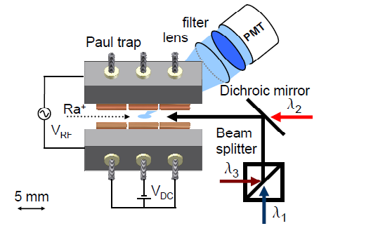
Laser Spectroscopy in Ra⁺ ions
Calculated from wavefunctions
7p²P_{3/2}
4.67(7)ns
7p²P_{1/2}
8.57(12)ns
λ₂=708 nm
λ₁=468 nm
λ₃=1079 nm
6d²D_{5/2}
6d²D_{3/2}
627(4)ms
λ₀=828 nm
7s²S_{1/2}
M. Nuñez Portela, et al., Appl. Phys. B, DOI:10.1007/s00340-013-5603-2 (2013)
O.O. Versolato, et al., Phys. Rev. A 82, 010501(R) (2010)

Slide 27
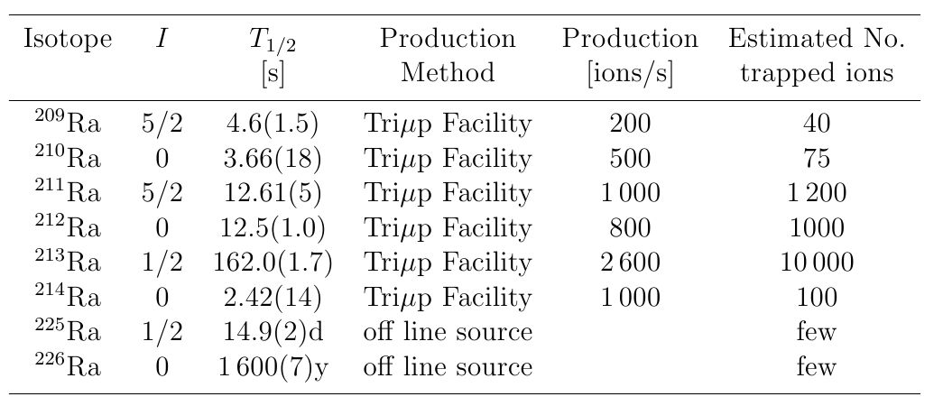
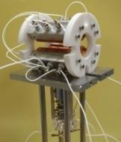
Online Ra⁺ Ion Production
R
I
B
ΔN ˃ 10
Notes:
27

Slide 28
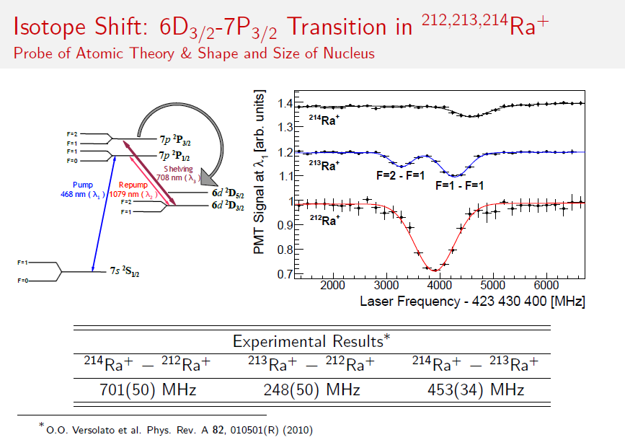

Slide 29
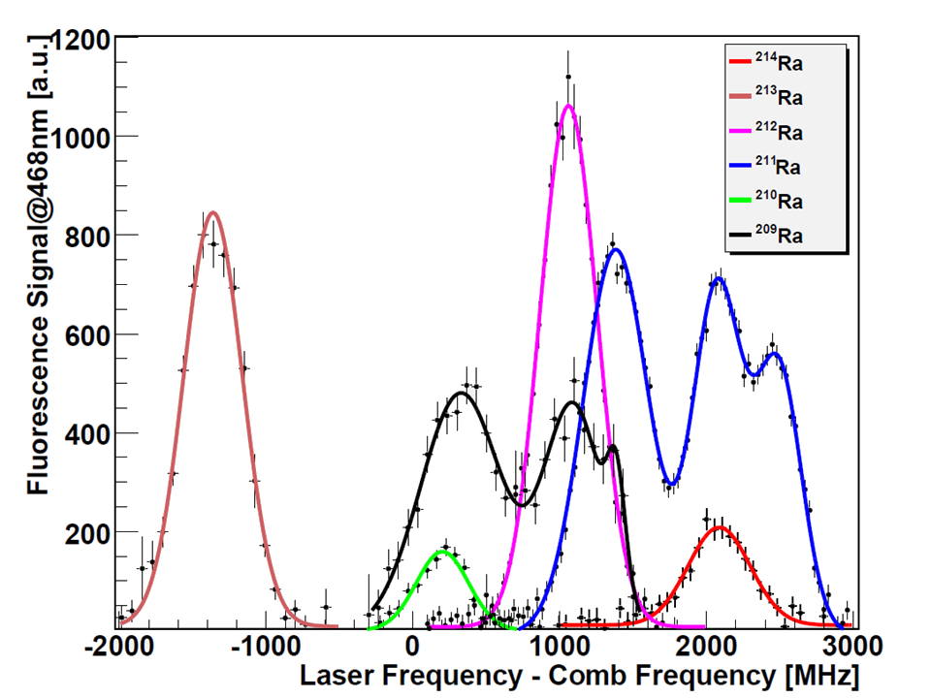
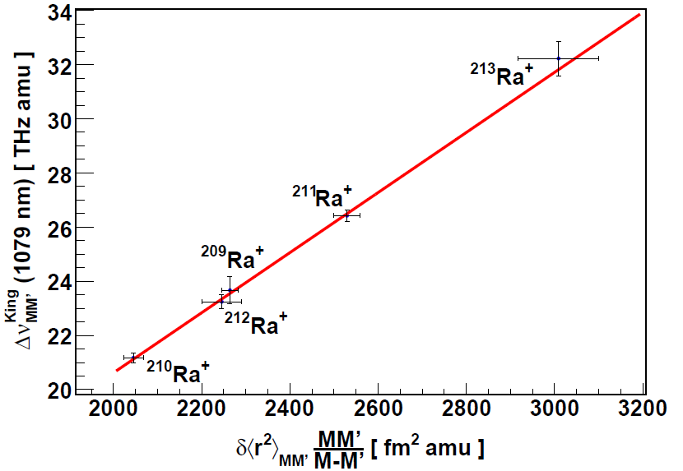
Laser Spectroscopy in Ra⁺ Ions
Probe of atomic theory & size and
shape of the nucleus
(nucleus starts to matter at sub% accuracy)
Probe of atomic wave functions
at the origin
Good agreement with theory at few % level
Theory improvement is in pipeline.
O.O. Versolato et al., Phys. Lett. A 375, 3130 (2012)
O.O. Versolato et al., Phys. Rev. A 82, 010501(R) (2010)
G.S. Giri et al., Phys. Rev. A 84, 020503(R) (2011)

Slide 30
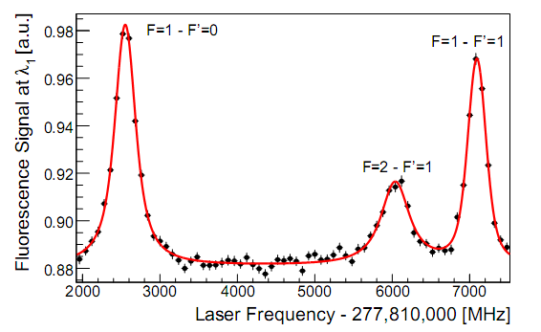
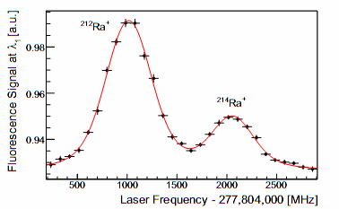
Ra⁺ Measurements @ AGOR
Hyperfine Structure:
Probe of atomic wave functions at the origin
Isotope Shifts:
Probe of atomic theory & size and shape of the nucleus
Excited State Lifetimes:
Probe of S-D E2 matrix element
% level agreement with theory
(Safronova, Sahoo,Timmermans et al.)

Slide 31
Intermezzo:
Fundamental Physics
Applied Physics
go hand in hand

Slide 32

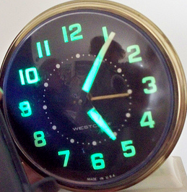
Radium has a Great Potential for
Fundamental Physics
  a Clock

Slide 33
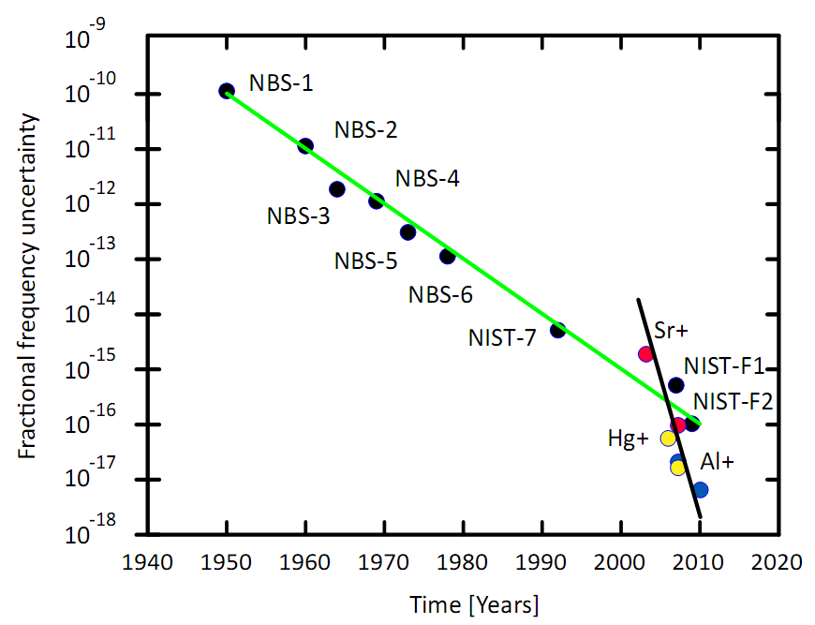
Accuracy of Frequency Standards
lowest
quadrupole shift
Ra⁺

Slide 34

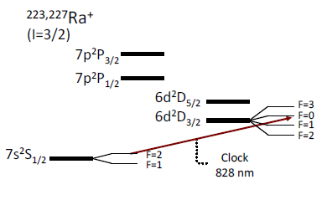
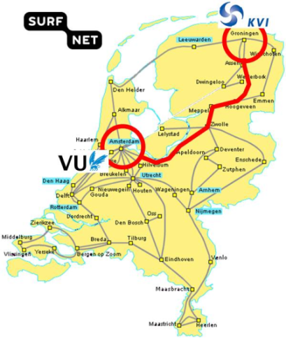
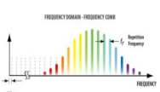

Ra⁺ Ion Atomic Clock
Narrow Transition, Ultra Stable Lasers
Low Sensitivity to external fields (for I=3/2)
Time Variation of Fine Structure Constant
Major Systematics: Quadrupole Shift
<10⁻¹⁸ ²²³Ra⁺ Atomic Clock
Note:
10⁻¹⁸ corresponds to 1 cm height difference
LaserLaB
VU Amsterdam
Al⁺ Clock
KVI
Groningen University
Ra⁺ Clock
2x280 km
Koelemeij, Eikema, Ubachs et al. Willmann, Dijck, Jungmann et al.
→ TJ Pinkert et al., Applied Optics 54, 728 (2015)
e.g. clock signal exchange significantly better than GPS

Slide 35
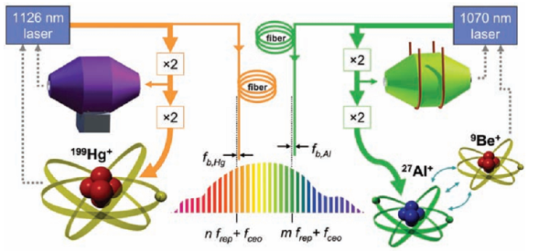


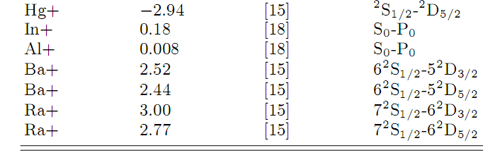
.
Sensitivity to α
O.O. Versolato et al., Phys. Rev. A 83, 043829 (2011)

Slide 36
back to
Parity
Ba⁺ almost as good as Ra⁺

Slide 37
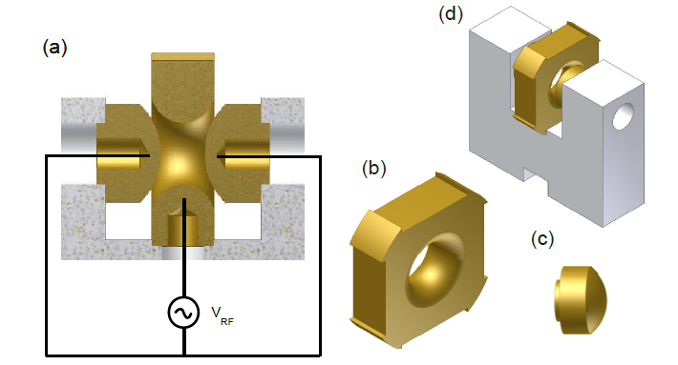
Single Ba⁺ Ion
Ra⁺
7p²P_{3/2}
To be measured
7p²P_{1/2}
λ₅=802 nm
λ₄=382 nm
λ₂=1079 nm
6d²D_{5/2}
6d²D_{3/2}
λ₁=468 nm
λ₀=828 nm
7s²S_{1/2}
Iso-electrical
Ba⁺
6p²P_{3/2}
5mm
Hyperbolic Paul Trap
6p²P_{1/2}
λ₅=615 nm
localize one ion within one wavelength
electron shelving
large volume
λ₂=649 nm
λ₄=455 nm
5d²D_{5/2}
5d²D_{3/2}
λ₁=493 nm
Ba⁺ : Precursor to Ra⁺
λ₀=2050 nm
6s²S_{1/2}

Slide 38
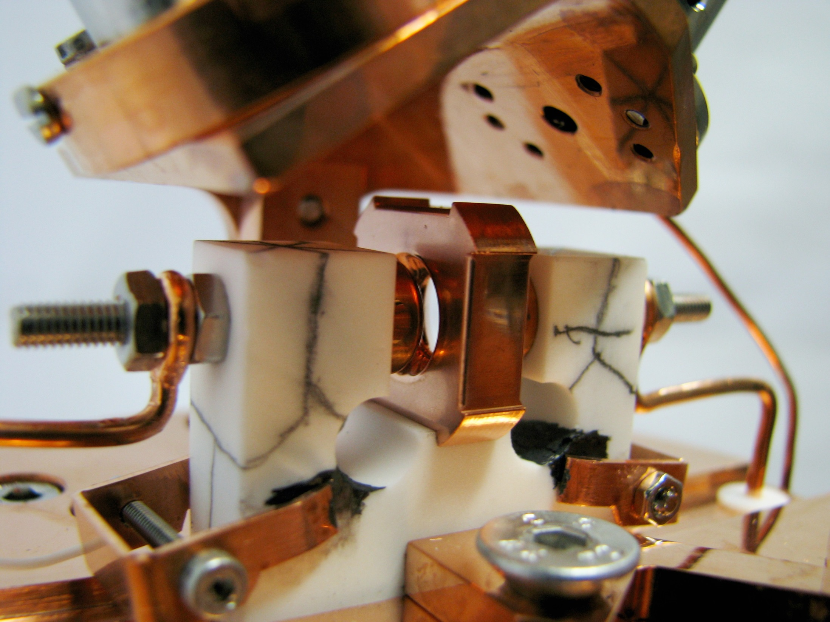
Hyperbolic Paul trap
²P_{3/2}
²P_{1/2}
650 nm
494 nm
VRF
²D_{5/2}
²D_{3/2}
5 mm
Ba⁺
²S_{1/2}
38
Notes:
38
Ion trap
38

Slide 39
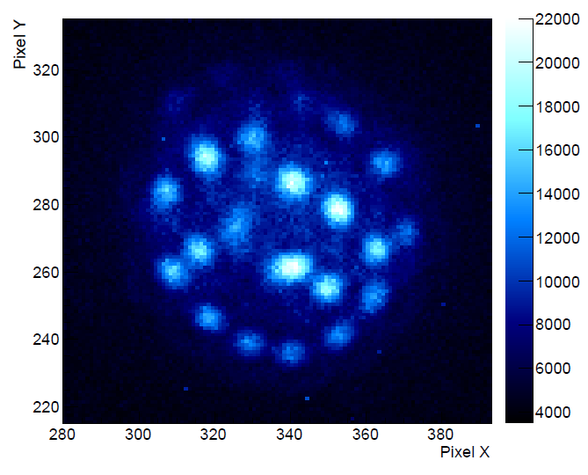
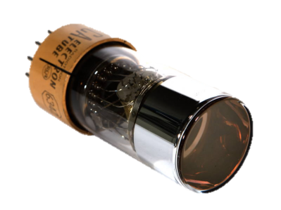
Detection Methods
EMCCD camera
10 µm
& PMT
Notes:
The usual detection methods: PMT on one side and EMCCD camera on the other

Slide 40
Ba⁺ spectroscopy
²D_{5/2} level lifetime
  Electron shelving
6²P_{3/2}
6²P_{1/2}
614 nm
Transition frequencies
  Line shape analysis
456 nm
650 nm
5²D_{5/2}
494 nm
5²D_{3/2}
6²S_{1/2}
2052 nm
¹³⁸Ba⁺
Notes:
Introduce the Ba+ level scheme
Extract these two transition frequencies

Slide 41
Ba⁺ spectroscopy
²D_{5/2} level lifetime
  Electron shelving
6²P_{3/2}
6²P_{1/2}
Transition frequencies
  Line shape analysis
LED
650 nm
5²D_{5/2}
τ ≈ 30 s
494 nm
5²D_{3/2}
²D_{5/2}
6²S_{1/2}
¹³⁸Ba⁺
Notes:
Matrix elements

Slide 42
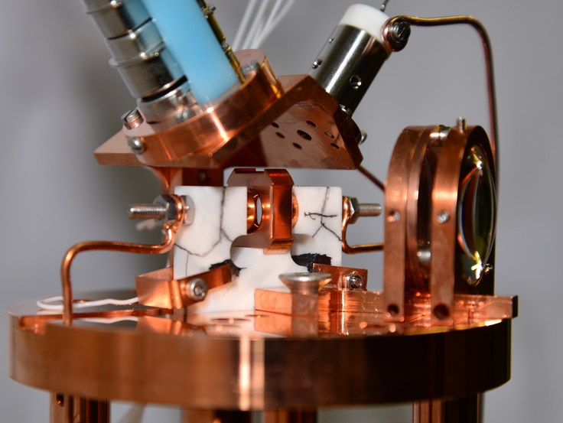
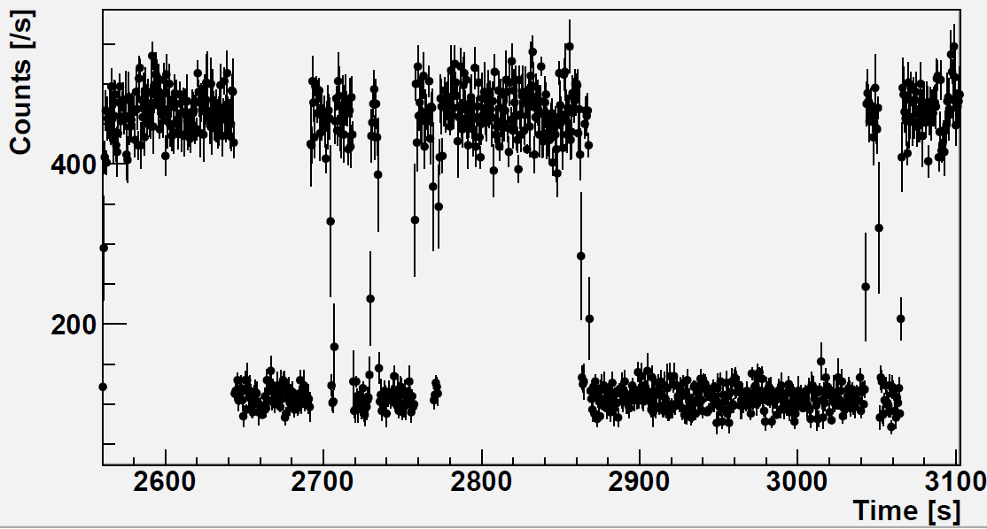
Ba⁺ Experiment : Lifetime D_{5/2}
6p²P_{3/2}
6.4 ns
Ba⁺
6p²P_{1/2}
8 ns
λ₅=615 nm
λ₄=455 nm
5d²D_{5/2}
λ₂=649 nm
λ₁=493 nm
5d²D_{3/2}
λ₀=2050 nm
6s²S_{1/2}

Slide 43
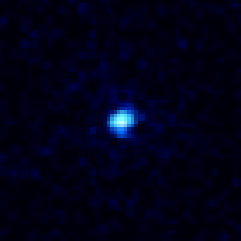
Ba⁺ Experiment : Lifetime D_{5/2}
6p²P_{3/2}
6.4 ns
Ba⁺
6p²P_{1/2}
8 ns
λ₅=615 nm
λ₄=455 nm
5d²D_{5/2}
λ₂=649 nm
λ₁=493 nm
5d²D_{3/2}
λ₀=2050 nm
6s²S_{1/2}

Slide 44
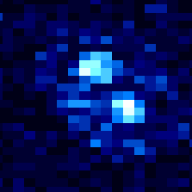
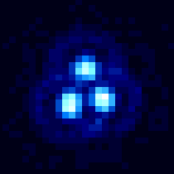


Ba⁺ 5 ²D_{5/2} Level Lifetime
²P_{3/2}
²P_{1/2}
Ba⁺
τ ≈ 30 s
²D_{5/2}
²D_{3/2}
²S_{1/2}
EMCCD camera
PMT count rate (cnt/s)
PMT signal
Time (s)

Slide 45
Ba⁺ 5 ²D_{5/2} Level Lifetime
²P_{3/2}
²P_{1/2}
Fitted ²D_{5/2} level lifetime and shelving rate
No prominent difference with single ion runs
Excellent to Investigate systematics
Ba⁺
τ ≈ 30 s
²D_{5/2}
²D_{3/2}
²S_{1/2}
1 ion shelved
2 ions shelved
all ions shelved
Mohanty et al. (in preparation)
Notes:
Diagnostic: 30 s lifetime sensitive to perturbations of ion
Determine D-state lifetime: matrix element

Slide 46



Ba⁺ Experiment : Lifetime D_{5/2}
6p²P_{3/2}
6.4 ns
Ba⁺
6p²P_{1/2}
8 ns
λ₅=615 nm
λ₄=455 nm
5d²D_{5/2}
λ₂=649 nm
λ₁=493 nm
5d²D_{3/2}
λ₀=2050 nm
Ba⁺ D_{5/2} state lifetime
6s²S_{1/2}
Experiment
Theory
τ_{D5/2} = 25.6(5) s
E.A. Dijck et al.
PRA 97, 032508 (2018)
Notes:
Dijck et al. aper with very detailed appendix ! None of 6 experts found anything that might be wrong.

Slide 47
Ba⁺ spectroscopy
²D_{5/2} level lifetime
  Electron shelving
6²P_{3/2}
6²P_{1/2}
Transition frequencies
  Line shape analysis
650 nm
5²D_{5/2}
494 nm
5²D_{3/2}
6²S_{1/2}
2052 nm
¹³⁸Ba⁺
Notes:
Introduce the Ba+ level scheme
Extract these two transition frequencies

Slide 48


Modeling of Line Shape
|²P_{1/2}⟩
Γ₁
Γ₂
Optical Bloch equation
3 level example
|4⟩
Δ₁
|3⟩
Δ₂
γ
γ
Ω₂
Ω₁
|8⟩
|7⟩
|²D_{3/2}⟩
|6⟩
|²S_{1/2}⟩
|2⟩
|5⟩
γ_{c}
|1⟩
Ba⁺
Ω₁, Ω₂
Rabi frequencies
(laser power)
Γ = Γ₁ + Γ₂
relaxation rate
γ = Γ/2
decoherence rate
Δ₁, Δ₂
laser detunings
γ_{c}
laser linewidth
Notes:
We use the optical Bloch equations
It uses the density matrix formalism and the time-dependence of the system is given by this Hamiltonian describing the interaction of the ion with the laser light and a damping matrix describing the decoherence effects.
I’m not going to go through all the math, but I just want to describe the ingredients going into this calculations:
Then there’s the spontaneous decay from the excited state which leads to relaxation of the populations, and the associated decoherence effect and finally the finite linewidth of the lasers also causes a decoherence effect.

Slide 49
Line Shapes and Polarization
494 nm linear polarized B
650 nm circularly polarized
Zeeman sublevels: 8 level system
  Magnetic field B
  Laser polarization
pmt signal
|1⟩⟨5|
|2⟩⟨8|
|²P_{1/2}⟩
650 nm laser frequency offset
|4⟩
|3⟩
494 nm linear polarized B
650 nm circularly polarized
|8⟩
|7⟩
|²D_{3/2}⟩
|6⟩
pmt signal
|²S_{1/2}⟩
|2⟩
|5⟩
|1⟩⟨8|
|2⟩⟨5|
|1⟩
650 nm laser frequency offset
Notes:
Including the Zeeman sublevels, there are now two additional parameters playing a role: the magnetic field causing Zeeman splitting and the polarization of the two laser fields with respect to this.
To illustrate that, I have two sets of data here that we collected by keeping the blue laser at a fixed frequency and varying the frequency of the red laser across its corresponding resonance. The two data sets were taken with different polarizations of the lasers.
The wide overall shape is the same, this is the one-photon peak of the transition to the excited state. But depending on polarization and magnetic field, also several dark resonance can appear. These are coherent two-photon effects that occur at frequencies where the sum of a red and a blue photon exactly matches a transition from the ground state to the D level.
So does the optical Bloch model work for fitting these line shapes? YES

Slide 50


Two-photonTransitions in single Ba⁺
6p²P_{3/2}
6.4 ns
Cool ion @
22 MHz offset
6p²P_{1/2}
8 ns
Probe transition
λ_{r}=649 nm
5d²D_{5/2}
λ_{g}=493 nm
5d²D_{3/2}
λ₀=2050 nm
6s²S_{1/2}
Cool ion @
22 MHz offset
Excellent understanding of line shapes
Absolute frequency improved by factor ~100 possible
Frequencies determined by means of optical frequency comb
Probe transition
Mayerlin Nuñez Portela, PhD Thesis, 2015.

Slide 51



Two-photonTransitions in single Ba⁺
Ba+ level scheme : 8 Zeeman sublevels.
Two photon transition : Raman resonance (δ_{R})
Strongly dependent on:
  Mangetic field strength and direction
  Laser light polarization
B ll E
B ⊥ E
PMT count rate (counts/sec)
PMT count rate (counts/sec)
Offset Frequency of 650nm (MHz)
Offset Frequency of 650nm (MHz)
→ Signals also with blue detuning!
→ Due to rapid cooling laser frequency switching

Slide 52

Raman Transitions in single Ba⁺
Ba+ level scheme : 8 Zeeman sublevels.
Two photon transition : Raman dip (δ_{R})
M. Nunez Portela, thesis 2014
B perpendicular to E
B parallel to E
δ_{R}
PMT count rate (counts/sec)
PMT count rate (counts/sec)
Offset Frequency at 650nm (MHz)
Offset Frequency at 650nm (MHz)

Slide 53
Frequency Measurements
B E
PMT signal
PMT signal
−50
−25
0
+25
+50
−50
−25
0
+25
+50
494 nm laser frequency offset [MHz]
650 nm laser frequency offset [MHz]
B E
PMT signal
PMT signal
−50
−25
0
+25
+50
−50
−25
0
+25
+50
494 nm laser frequency offset [MHz]
650 nm laser frequency offset [MHz]
Extract abs. transition frequencies to < 1 MHz
Fit optical Bloch model
²P_{3/2}
Ba⁺
²P_{1/2}
650 nm
494 nm
²D_{5/2}
²D_{3/2}
²S_{1/2}
Notes:
Coherent system: total control
Broad line shape + dip(s)
Fit parameters: transition frequencies

Slide 54

|a₁ + a₂|² is more than a₁² + a₂²
Describe Signals with Fano Profile
|a₁|²
|a₂|²
Interference feature
shifted relative to |a₂|²
$${|\left(a_{1}+a_{2 }e^{i∅}\right)|}^{2}= {|a_{1}^{}|}^{2}+{|a_{2}^{}|}^{2}+IT(∅)$$
from L. Willmann

Slide 55
Systematic Checks of all Parameters: Here, e.g., Blue Laser Detuning
Eliminate Light Shifts
Determine Transition Frequencies
Check Atomic Calculations
Exploit knowledge from
Fano resonances
Theses:
Nivedya Valappol & Elwin Dijck (2019)

Slide 56




Transition Frequencies
²P_{3/2}
Ba⁺
²P_{1/2}
650 nm
494 nm
²D_{5/2}
²D_{3/2}
494 nm
²S_{1/2}
Similar accurate data for single ion ¹³⁶Ba and ¹³⁴Ba being published (VSI; Valappol, Willmann )
Recent somewhat less precise data for Ba isotopes
(Hucul et al., 2017)
Light shift?
494 nm laser detuning varied
650 nm
No, correction in transition frequencies
for Ω₂ dependent shift consistent with
2° rotation of B-field
¹³⁸Ba⁺ Transition | Frequency [MHz]
 | [Karlsson & Litzén 1999] | This work
6s ²S_{1/2} – 6p ²P_{1/2} | 607 426 290 (100) | 607 426 262.5 (0.2)
5d ²D_{3/2} – 6p ²P_{1/2} 6d ²S_{1/2} – 5p ²D_{3/2} | 461 311 880 (100) --- | 461 311 878.5 (0.1) 146 114 384.0(0.1)
650 nm laser intensity varied
B-field
rotated 2°
879.5
879.0
One-photon peak
frequency (MHz)
878.5
Expected
461 311 878.0
0
1
2
3
4
5
Frequency 650 nm laser − 461 311 000 MHz
Power 650 nm laser (Ω₂ / Ω_{2,sat})
Frequency 650 nm laser − 461 311 000 MHz
²
²
Extract transition frequencies with 100 kHz accuracy
Data fit to optical Bloch equation model
Dijck et al., Phys. Rev. A 91, 060501(R) (2015)
Notes:
We aim to extract transition frequencies, so we need to know the frequencies of our lasers

Slide 57
Ba⁺ Transitions - King Plot
(spin 0 isotopes)
132
130
134
D. Hucul et al, PRL 119, 100501 (2017)
136
looks o.k.
N. Valappol, thesis RUG 2019

Slide 58

Atomic Parity Violation
7²P_{3/2}
7²P_{1/2}
6²D_{5/2}
6²D_{3/2}
+ ε' n' ²P_{3/2}
Ba⁺/Ra⁺
Interference:
differential light shift
E2
E1_{APV}
B₀
m_{F} = +1/2
E2 . E1_{APV}
|E2|²
7²S_{1/2}
+ ε n²P_{1/2}
ω₀
m_{F} = –1/2
ω₀
ω₀ + Δ_{diff}
RF spectroscopy
B₀
²D_{5/2} lifetime → matrix elements
Bloch equations → light shift
N. Fortson, Phys. Rev. Lett. 70, 2383 (1993)
J. A. Sherman arXiv:0907.0459v1 ( 2009)

Slide 59

Experimental Challenge: Localization to < λ/2

Slide 60

Barium APV
Light Shift Measurment – here Ba⁺

Slide 61

Light Shifts measured in Ba⁺ ion
Measured Raman dip spectrum for the 5d²D_{3/2} - 6p²P_{1/2} transition
494nm light linearly polarised in vertical direction along z-axis
650nm light circularly polarised
light shift laser polarised in the horizontal direction
magnetic field of 510μT along B_{z}-direction
Detunings were large compared to the power broadened linewidth

Slide 62

Light Shifts measured in Ba⁺ ion
Scaling of light shift with the detunings of light shifting light
Δ ν_{LS}= 0.16(3)GHz².1/Δ_{LS} , Δ_{LS} is detuning of light shifting light
Polarisation with respect to quantization axes i.e. magnetic field are important
blue shift
red shift
from A. Mohanty, l.Willmann

Slide 63


Radium & Barium for APV
Accuracy of single ion Experiments
 | Coherence Time | Projected Accuracy | Measurement Time
Ba⁺ | 80 sec | 0.2% | 1.1 day
Ra⁺ | 0.6 sec | 0.2% | 1.4 day
→ 10 days for 5 fold improvement over Cs

Slide 64












Status Atomic Parity Violation in Ba⁺/Ra⁺
Developing Ba⁺/Ra⁺ single ion trapping setup & techniques
Calculations tested
Response Λ-system to two lasers described by optical Bloch Model
Fano Profiles to analyze data
  Improved measurement of transition frequencies
  Light shift measurements started
Driving Force: Determination sin²Θ_{W} at low Q
Ion Trappers
Van Swinderen Institute, University of Groningen
Nivedya Valappol
Mayerlin Nuñez Portela
Lorenz Willmann
Klaus Jungmann
Amita Mohanty
Olivier Grasdijk
Andrew Grier
Elwin Dijck
Oliver Böll
Notes:
…
And together with my colleagues I’d like to thank you for your attention

Slide 65
Thank You !

