Slide 1





45 min
Exkl.
Disk.
Lasing and Disorder Scattering
Inspired by PT-Symmetry
Stefan Rotter
Ein Gedi
April 2013
Discrete 2018

Slide 2
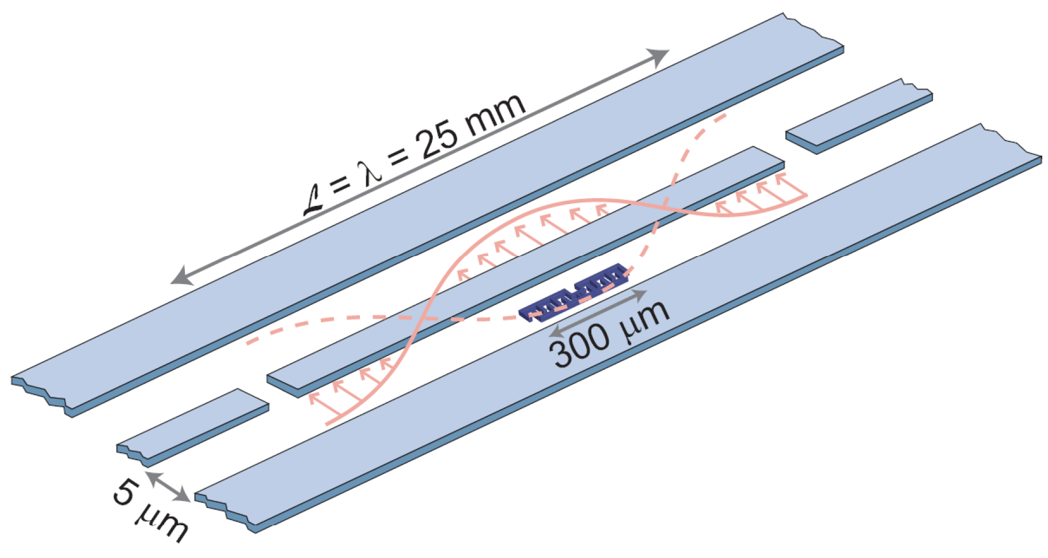
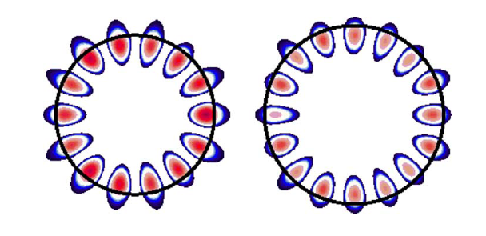
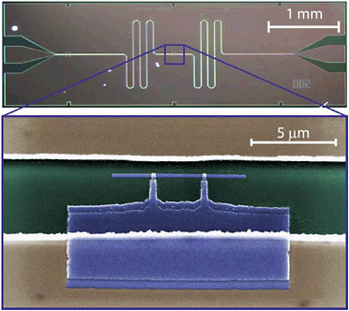
Exceptional points (EP)
Special property of non-Hermitian complex matrices
Operator/matrix becomes defective
Eigenvalues and eigenstates coalesce
d
r
J. Okolowicz, M. Ploszajczak, and
I. Rotter, Phys. Rep. 374, 271 (03)
W. D. Heiss, J. Phys. A:
Math. Gen. 37, 2455 (04)
S.B. Lee et al., PRL 103, 134101 (2009).

Slide 3

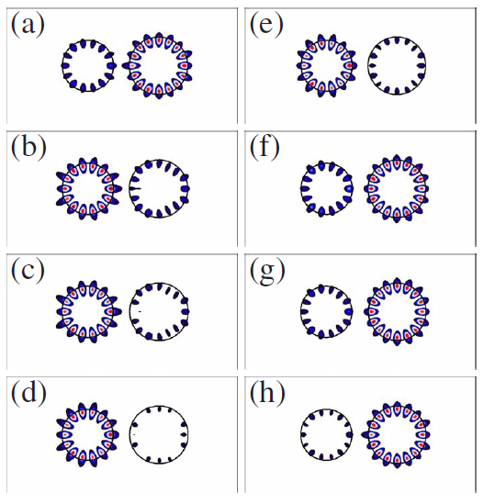
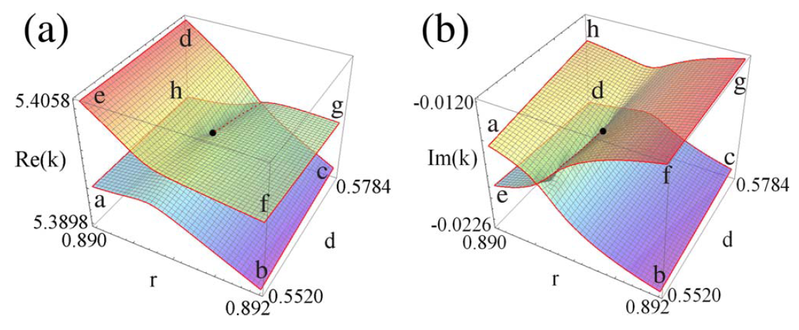
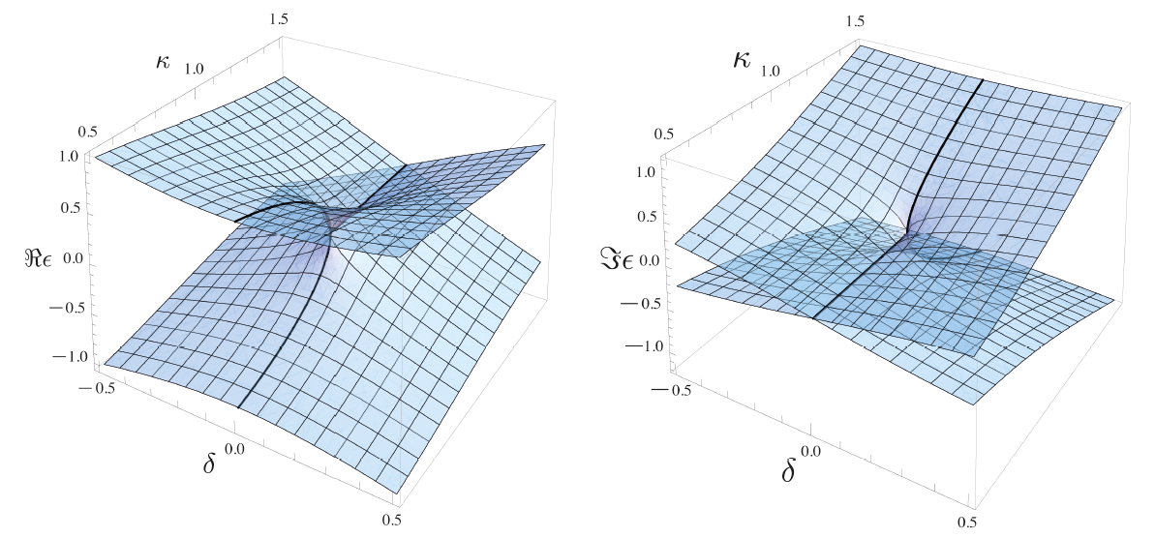
Topology in the vicinity of EP
d
r

Slide 4
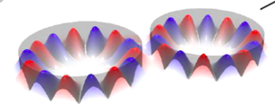
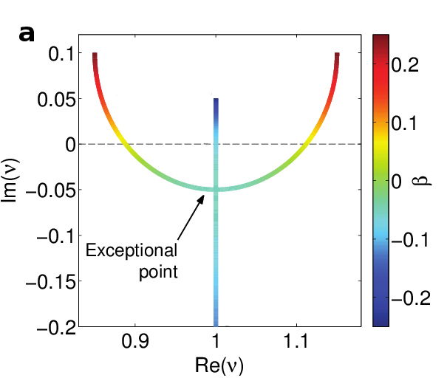
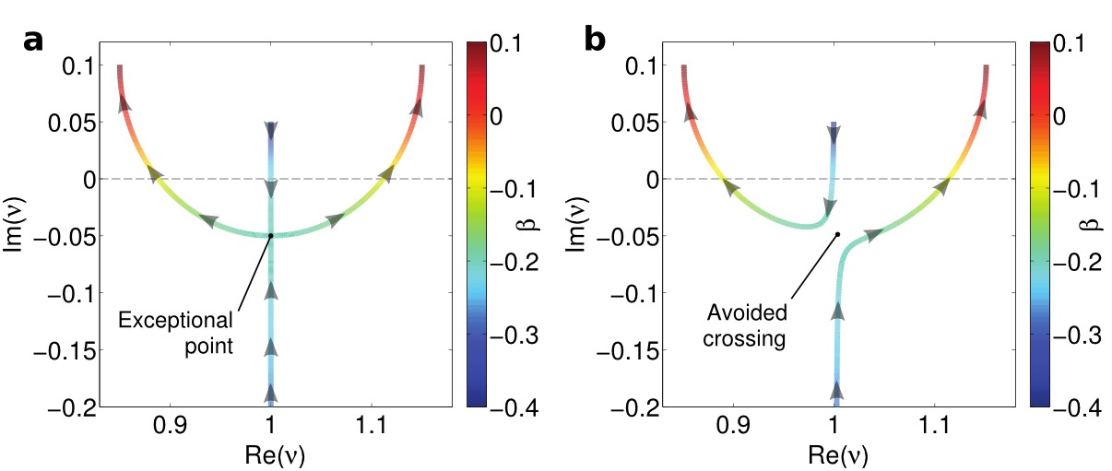
Eigenvalues around EP
Heiss, J. Phys. A:
Math. Gen. 37, 2455 (04)

Slide 5

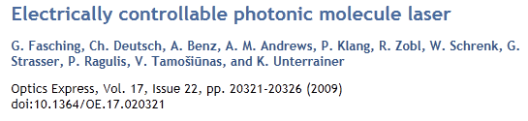
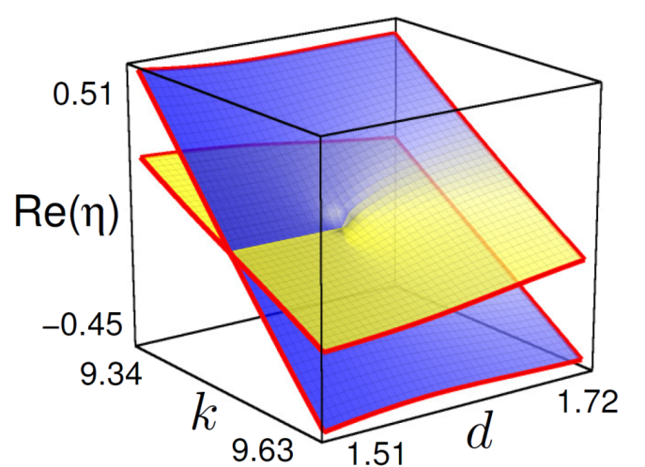
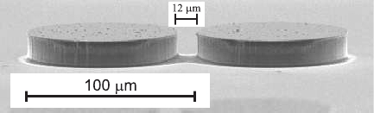
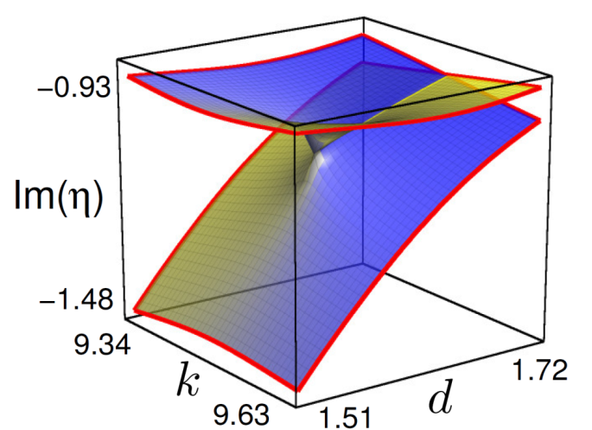
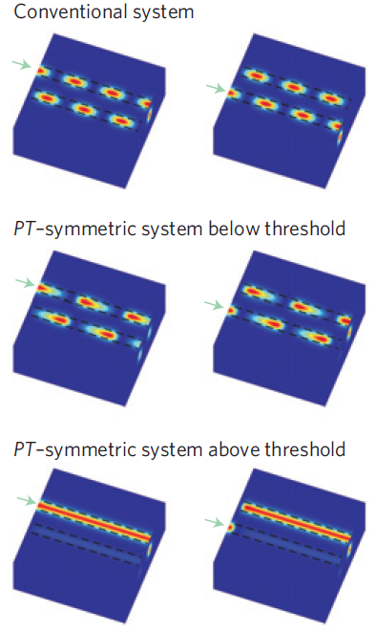
Photonic molecule laser
Photonic molecule laser
Fasching, Deutsch, Benz et al.,
Optics Express 17, 20321 (09)

Slide 6
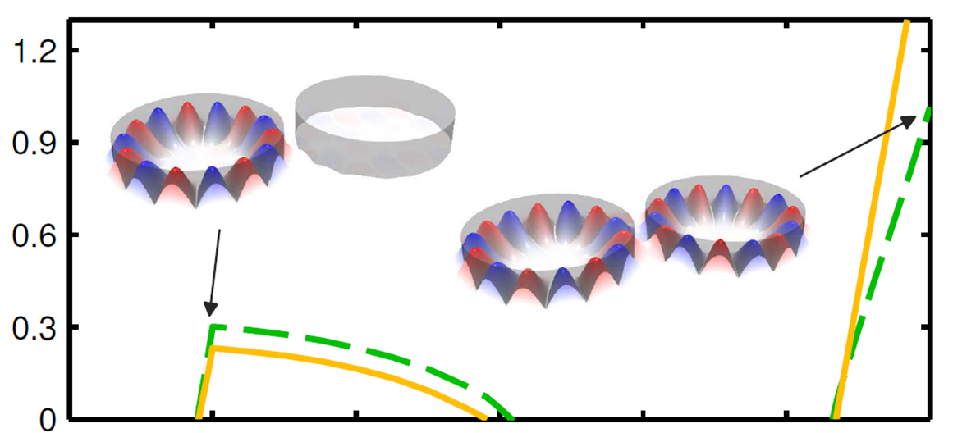
Photonic molecule laser
Photonic molecule laser
Fasching, Deutsch, Benz et al.,
Optics Express 17, 20321 (09)
Liertzer, Ge, Cerjan,
Stone, Türeci, Rotter,
PRL 108, 173901 (12)
Intensity
Pump strength

Slide 7
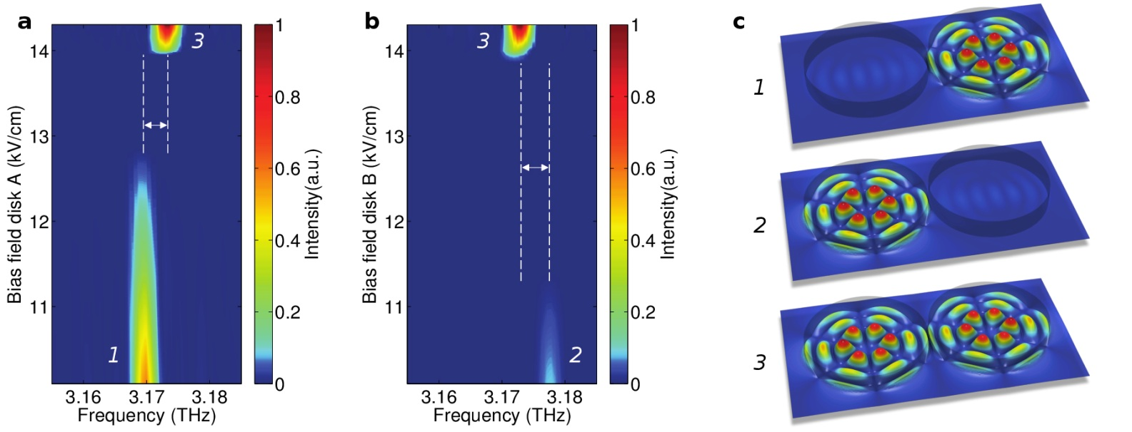
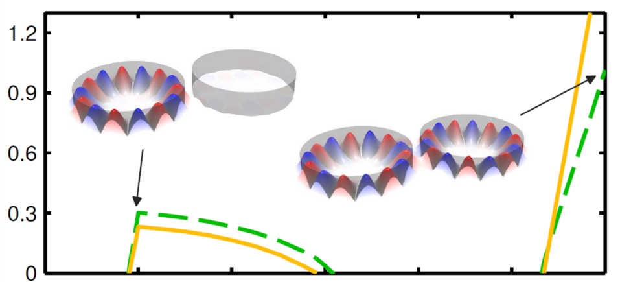

Spectral measurements
Photonic molecule laser
Brandstetter, Liertzer, Deutsch, Klang,
Schöberl, Türeci, Strasser, Unterrainer,
Rotter, Nature Comm. 5, 4034 (2014).
Intensity
Peng, Özdemir, Rotter, Yilmaz, Liertzer,
Monifi, Bender, Nori, and Yang
Science 346, 328 (2014).
Pump strength

Slide 8
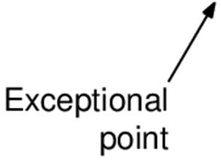
Eigenvalues of non-Hermitian matrices
Bender and Boettcher,
PRL 80, 5234 (98)
Heiss, J. Phys. A:
Math. Gen. 37, 2455 (04)

Slide 9
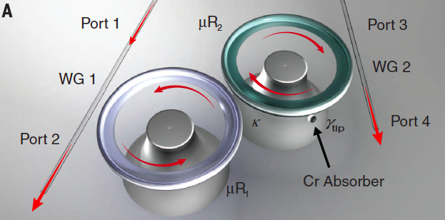
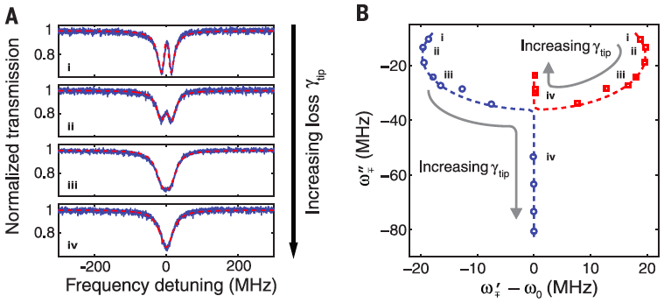

Lasers at exceptional points
Liertzer, Ge, Cerjan,
Stone, Türeci, Rotter,
PRL 108, 173901 (12)
Peng, Özdemir, Rotter,
Yilmaz, Liertzer, Monifi, Bender,
Nori, and Yang
Science 346, 328 (2014).
Brandstetter, Liertzer, Deutsch, Klang,
Schöberl, Türeci, Strasser, Unterrainer,
Rotter, Nature Comm. 5, 4034 (2014).

Slide 10
Extraction of resonance parameters

Slide 11
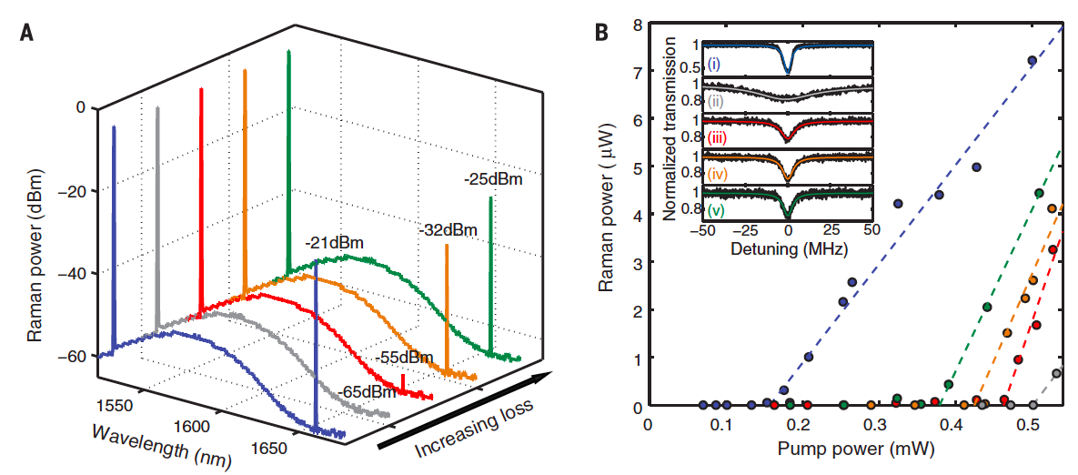


Raman lasing
B. Peng, S. K. Özdemir, S. Rotter, H. Yilmaz, M. Liertzer,
F. Monifi, C. M. Bender, F. Nori, and L. Yang
Science 346, 328 (2014).

Slide 12
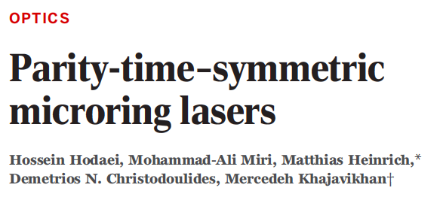
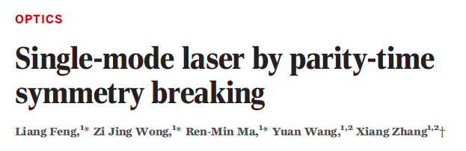

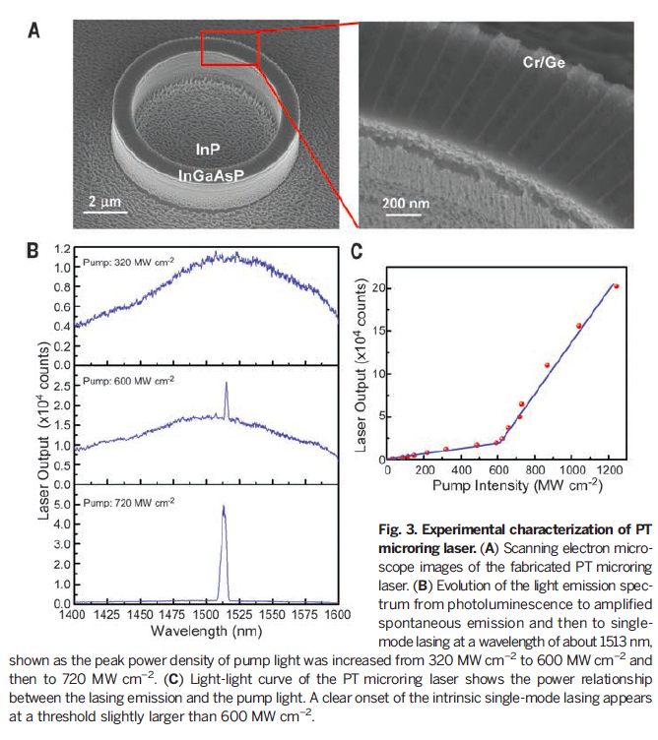
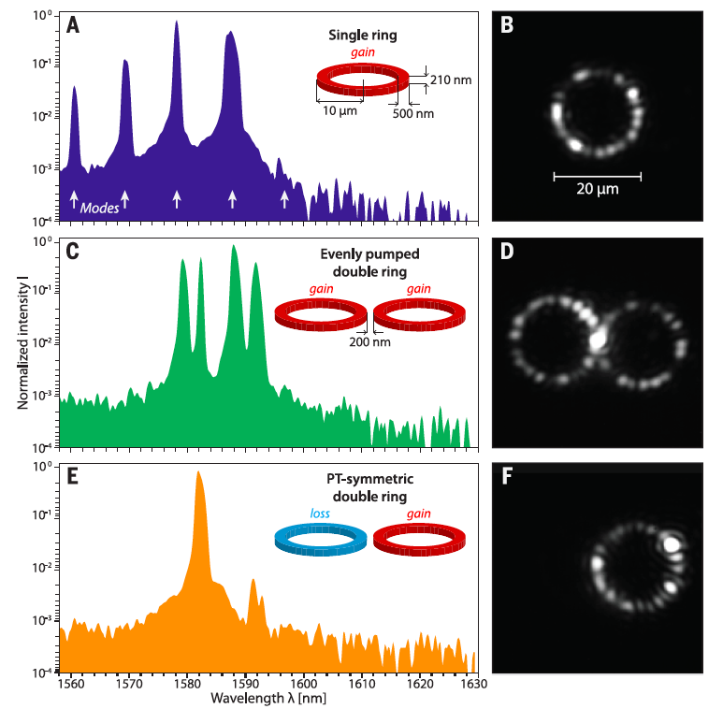
PT lasers

Slide 13
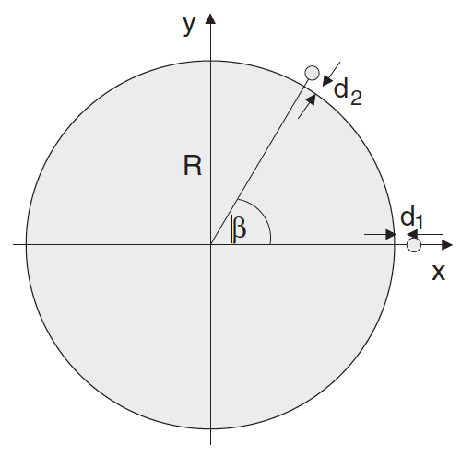
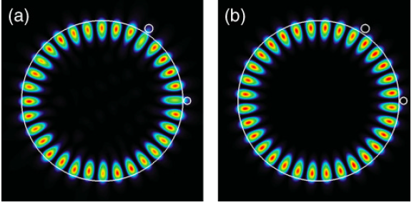
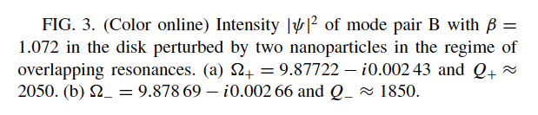
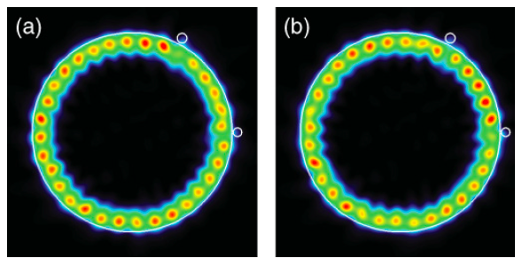
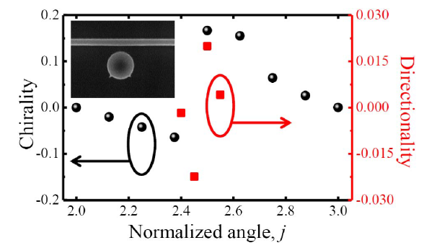
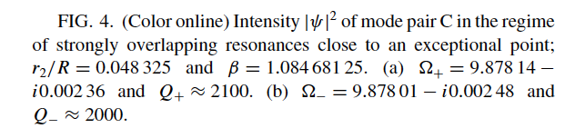
Chirality at the EP
Wiersig, Eberspächer, Shim, Ryu, Shinohara, Hentschel, Schomerus, PRA 84, 023845 (2011)
Redding, Ge, Song, Wiersig, Solomon, Cao, PRL 108, 253902 (2012).
Kim, Kwon, Shim, Jung, Yu, Optics Letters 39, 2423 (2014).

Slide 14
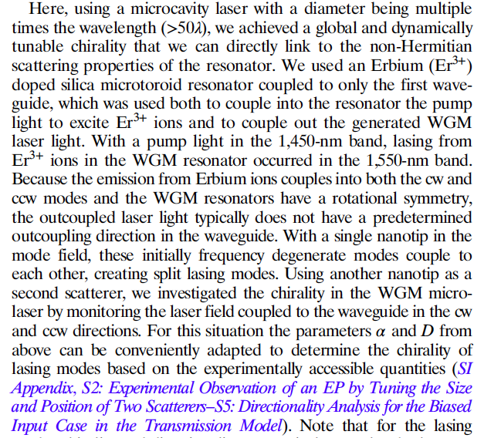
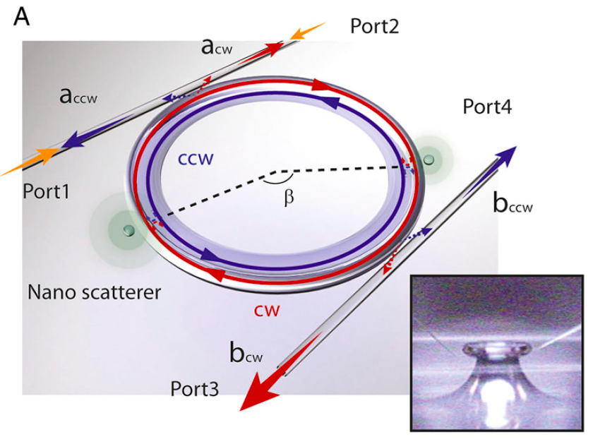
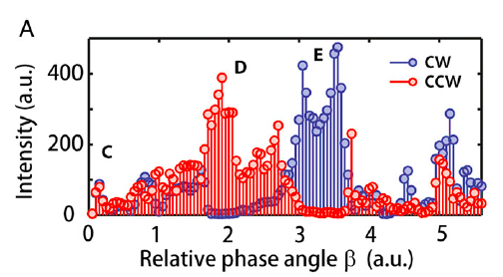
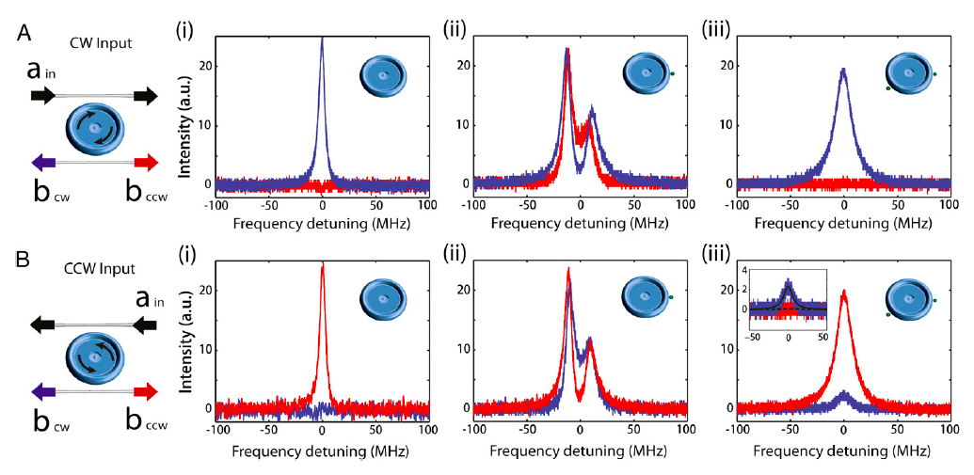
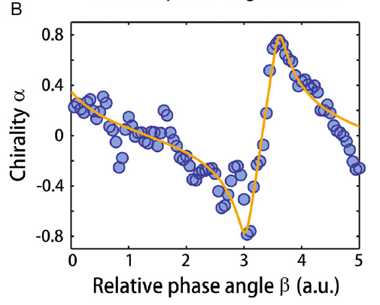
Chiral modes at the EP
Peng, Özdemir, Liertzer, Chen, Kramer, Yilmaz, Wiersig, Rotter, and Yang, PNAS 113, 6845 (16).

Slide 15
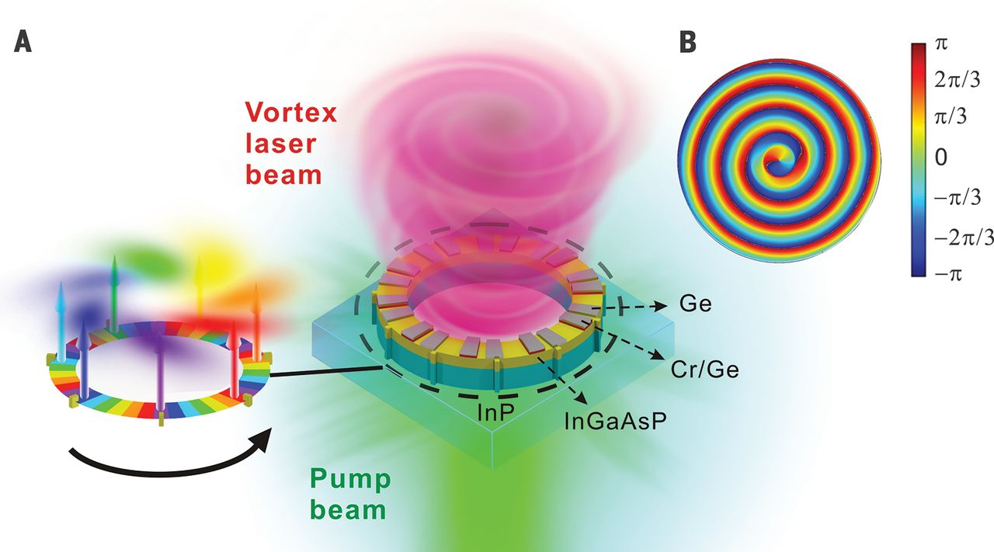
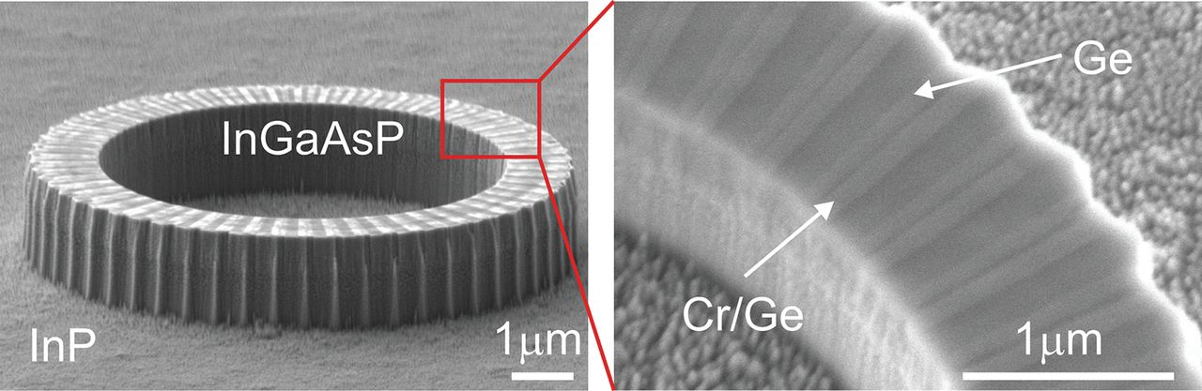

Optical angular momentum beams
Miao, Zhang, Sun,
Walasik, Longhi,
Litchinitser, Feng,
Science 353, 464 (16).

Slide 16
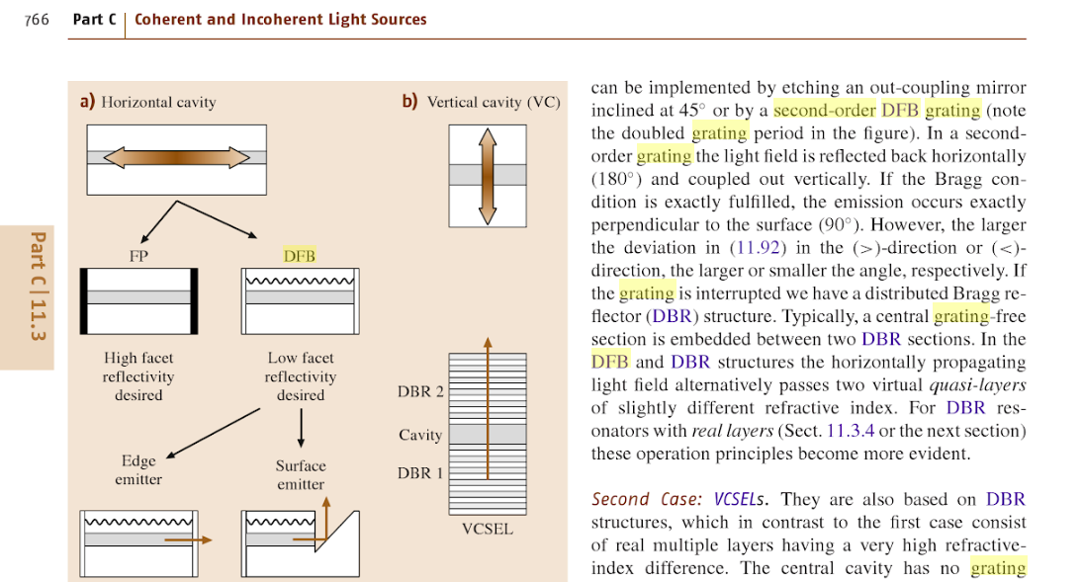
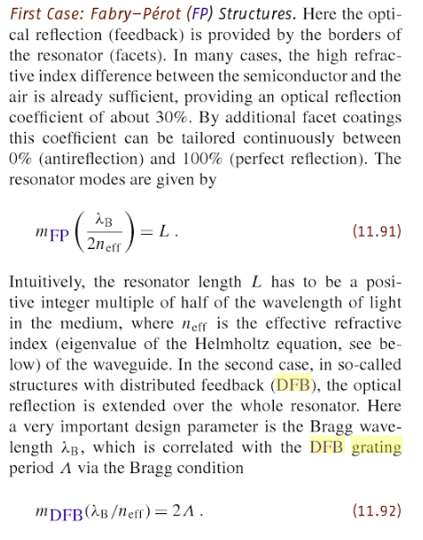
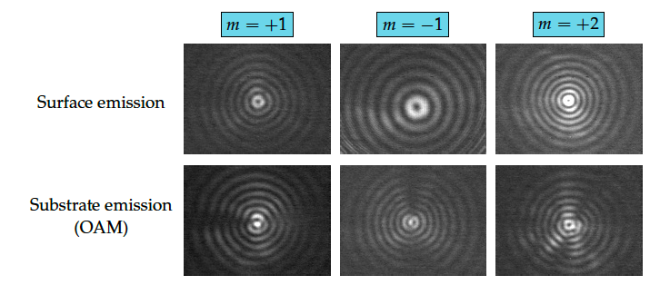
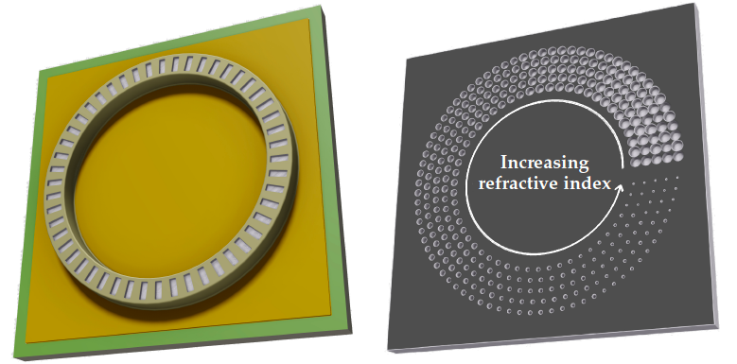
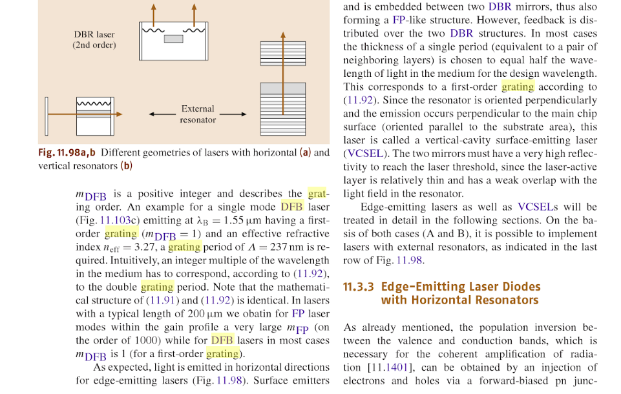
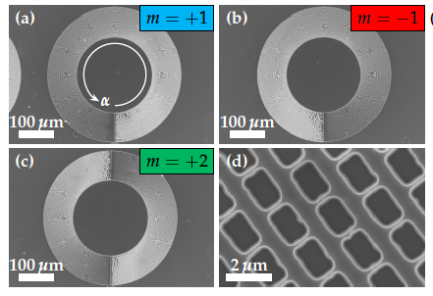
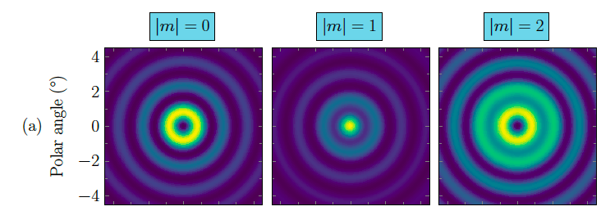
OAM Ring Quantum Cascade Laser
Theory
Szedlak, Hisch, Schwarz, Holzbauer, MacFarland, Zederbauer, Detz,
Andrews, Schrenk, Rotter, Strasser
Sci. Rep. 8, 7998 (2018).
This qcl emits in
mid-infrared

Slide 17
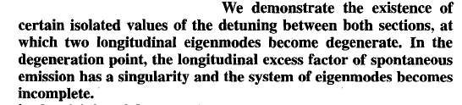
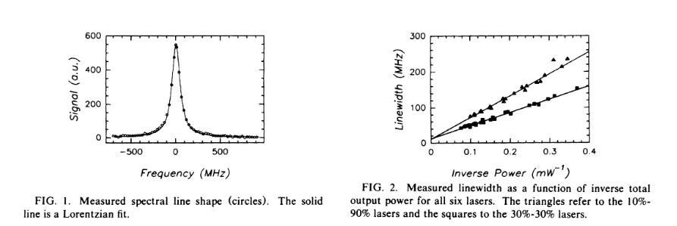
Laser linewidth and the Petermann factor
Petermann, IEEE Journal of Quantum Electronics 15, 566 (1979)
Wenzel, Bandelow, Wünsche, Rehberg, IEEE J. Quant. Electr. 32 (1996)
Cheng and Siegman
PRA 68, 043808 (2003)
Pick, Cerjan, Liu, Rodriguez, Stone,
Chong, and Johnson
PRA 91, 063806 (2015)
Hamel and Woerdman
PRL 64, 1506 (1990)
Schomerus, Frahm,
Patra, Beenakker, Physica A 278, 469 (2000)

Slide 18
Laser linewidth and the Petermann factor
Cheng and Siegman
PRA 68, 043808 (2003)
Pick, Cerjan, Liu, Rodriguez, Stone,
Chong, and Johnson
PRA 91, 063806 (2015)
Petermann, IEEE Journal of Quantum Electronics 15, 566 (1979)
Schomerus, Frahm, Patra, Beenakker,
Physica A 278, 469 (2000)
Hamel and Woerdman
PRL 64, 1506 (1990)
Berry, J. Mod. Opt. 50, 63 (2003)
Chong and Stone
PRL 109, 063902 (2012)
Wenzel, Bandelow, Wünsche, Rehberg, IEEE J. Quant. Electr. 32 (1996)

Slide 19
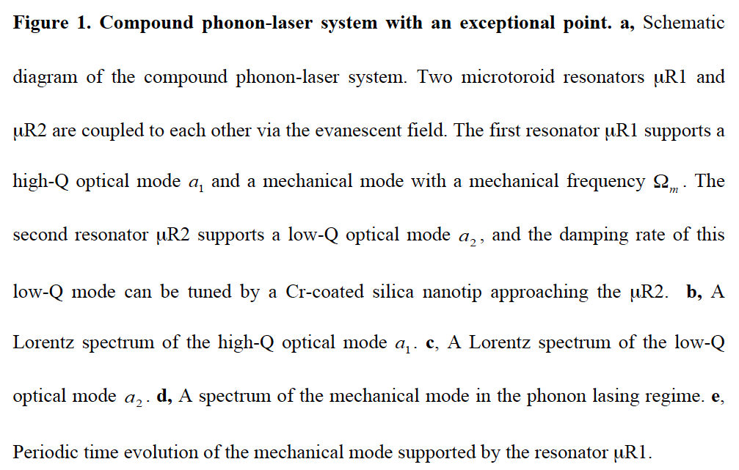
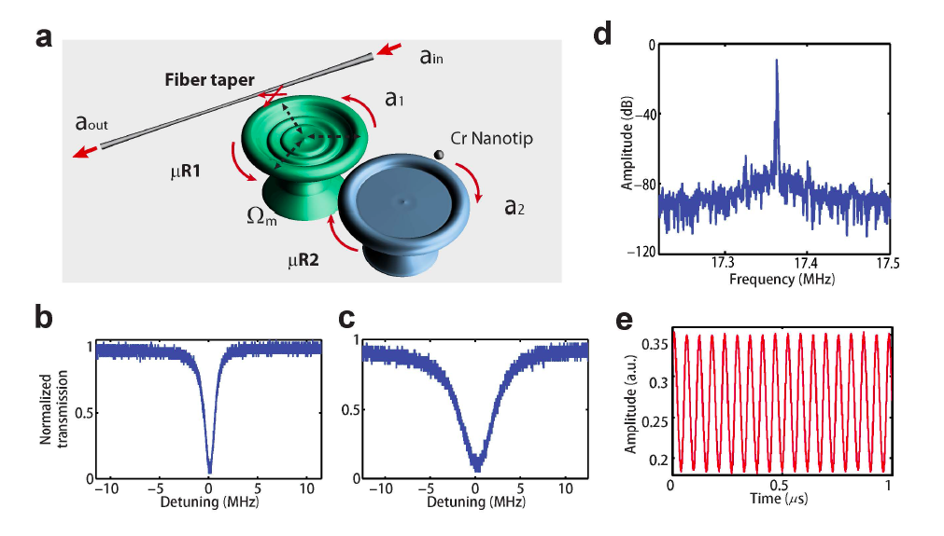
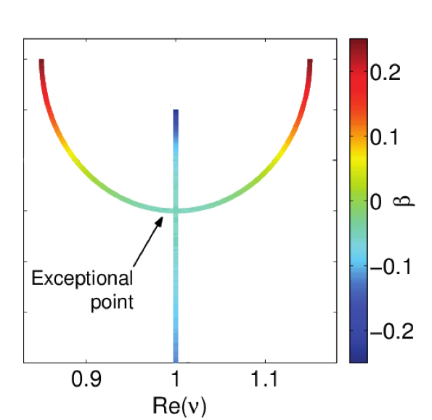

Phonon laser
Grudinin, Lee, Painter, Vahala, PRL 104 (8), 083901 (2010)

Slide 20

Non-monotonic threshold behavior
Cartarius, Main, Wunner
Exceptional points in atomic spectra
PRL 99, 173003 (2007).

Slide 21


EP in the phonon laser

Slide 22


Linewidth broadening
Zhang, Peng, Özdemir, Pichler, Krimer, Zhao, Nori, Liu, Rotter, Lang
Nature Photonics 12, 479 (2018).

Slide 23




Random Laser with directional emission
Schönhuber, Brandstetter, Hisch, Deutsch, Krall, Detz, Strasser, Rotter,
and Unterrainer, Optica 3, 1035 (2016).

Slide 24



Unidirectional invisibility
Lin, Ramezani, Eichelkraut,
Kottos, Cao, Christodoulides,
PRL 106, 213901 (2011)
Feng, Scherer et al.
Nature Mat. 12, 108 (2013)
Regensburger,
Christodoulides,
Peschel et al.,
Nature 488, 167 (2012)

Slide 25
Non-Hermitian potentials
No phase accumulation!!
For even W(x):
ε(x) is PT symmetric
Wadati, J. Phys. Soc. Jpn. 77, 074005 (2008)
Constant intensity
wave solution
Works for very general
functions W(x)

Slide 26


Light scattering in 1D
Hermitian
non-Hermitian
Makris, Brandstötter, Ambichl, Musslimani, and Rotter
Light: Science & Applications 6, e17035 (2017).

Slide 27


Crossover to constant intensity

Slide 28




Acoustic wave equation
Complex mass density (with gain and loss)
Constant pressure solution

Slide 29
Sound scattering in 1D
Hermitian
non-Hermitian

Slide 30
Constant pressure sound wave

Slide 31

Experiment

Slide 32
Experimental results
Z_{j}/Z₀
HERMITIAN
p_{j}
Z_{j}/Z₀
NON- HERMITIAN
p_{j}
Rivet, Brandstötter, Lissek, Makris, Rotter, Fleury,
Nature Physics 14, 942 (2018).

Slide 33



Broadband invisible disorder
Brandstötter,
Makris, and Rotter
arXiv:1811.04839

Slide 34

Constant pressure sound wave
Helmholtz
resonator
enlarged section
reduced
section
rigid
sphere
resistive membranes
labyrinth

Slide 35



Constant pressure sound wave
Helmholtz
resonator
enlarged section
reduced
section
rigid
sphere
resistive membranes
labyrinth
Hermitian
loss
gain
loss
loss
non-Hermitian
loss
gain
Re(p)

Slide 36


Constant pressure sound wave
Helmholtz
resonator
enlarged section
reduced
section
rigid
sphere
resistive membranes
labyrinth
Hermitian
loss
gain
loss
loss
non-Hermitian
loss
gain
p₁
p₂
p₃
p₄
|p|
p₅
p₆
p₇

Slide 37





Perfectly absorbing EP and chiral absorption
Sweeney, Hsu, Rotter, Stone
arXiv:1807.08805

Slide 38



Summary
Broadening of phonon laser linewidth at EP
Constant-pressure sound waves

Slide 39


Group at TU Wien, Vienna, Austria
Matthias
Kühmayer
Kevin
Pichler
Philipp
Ambichl
Matthias
Liertzer
Andre
Brandstötter
Dmitry
Krimer
Kostantinos
Makris
Jörg Doppler

Slide 40






People involved – Phonon Laser Experiment
Jing Zhang
Bo Peng
F. Monifi
H. Yilmaz
S. K. Özdemir
L. Yang

Slide 41







People involved – Laser Experiment (Vienna)
R. Szedlak
S. Schönhuber
M. Brandstetter
C. Deutsch
P. Klang
G. Strasser
K. Unterrainer

Slide 42







People involved – Random Anti-Laser
K. Pichler
U. Kuhl
J. Böhm
M. Kühmayer
A. Brandstötter
P. Ambichl

Slide 43

























People involved – constant pressure waves
Li Ge
H. E. Türeci
Florian Mintert
Etienne Rivet
Hervé Lissek
Romain Fleury
M. Male-
kakhlagh
H. E. Türeci
K. Makris, TU-Vienna
A. Cerjan
A. D. Stone
Dionyz Pogany

Slide 44




People involved
Li Ge
H. E. Türeci
Florian Mintert
M. Male-
kakhlagh
Konstantinos
Makris
H. E. Türeci
Andre
Brandstötter
K. Makris, TU-Vienna
Philipp
Ambichl
A. Cerjan
A. D. Stone
Dionyz Pogany
Ziad
Musslimani

Slide 45




People involved – Laser Theory
S. Esterhazy
A. Cerjan
Li Ge
H. E. Türeci
F. Nori
J. Schöberl
A. D. Stone
C. M. Bender

Slide 46









Acknowledgments
Thank you for your attention
Contact: stefan.rotter@tuwien.ac.at

