Slide 1
Neutrino-Anti-neutrino beaming across the Earth to test CPT asymmetry
27 Nov 2018, 14.45
Discrete 2018
Daniele Fargion

Slide 2
Beaming neutrino across the Earth
We considered how the longest baseline neutrino oscillation available, crossing most of Earth’s diameter, may improve the measurement and at best disentangle any hypothetical CPT violation between neutrino-antineutrino.
The distance dilution respect to OPERA it is widely recovered by largest Pingu and HK Megatons detectors and by the complete oscillation conversion.
The same τ neutrino and even the appearance of anti τ neutrino at the highest rate is well possible at ICECUBE and Pingu detector.

Slide 3
Muon disappearance counting
The νμ and anti νμ disappearance correlated with the tau appearance is considered for those events at the largest distances.
We thus propose a beam of νμ and anti νμ crossing through the Earth, within an OPERA-like experiment from CERN (or Fermilab), beaming in the direction of the IceCube–or future Pingu detector at the South Pole.
Similar beaming to future Megaton Hyper Kamiokande

Slide 4
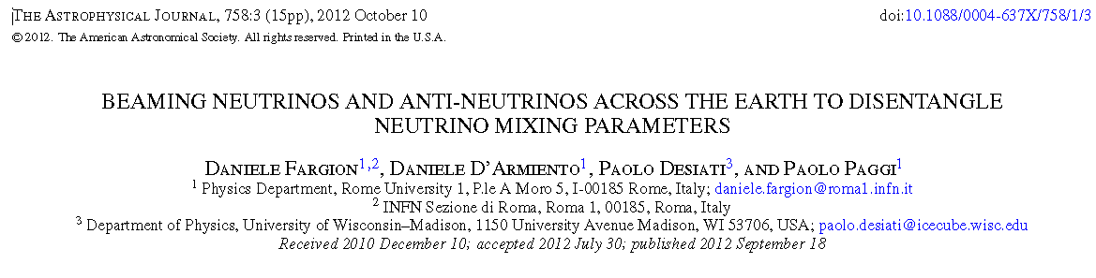
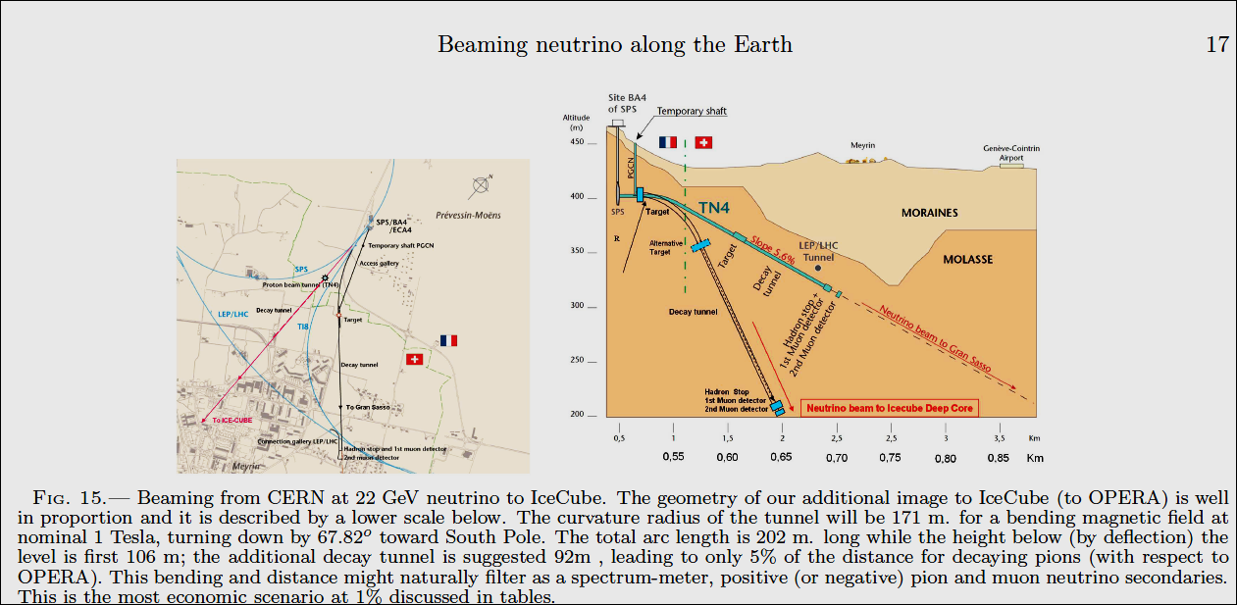
Cern beaming to the Icecube

Slide 5
The Pingu and HK Megaton detectors
The similar test may be done with future Hyperkamiokande in Japan and in Korea,
The ideal energy lies at 21 GeV to test the disappearance or (for any tiny CPT violation) and the partial anti νμ appearance.

Slide 6
The matter influence and test neutrinos while in flight inside the Earth (MSW effect) at few GeVs
Such a tuned detection experiment may lead to a strong signature of τ or anti tau generation even within its neutral current noise background events.
The tau appearance signal will be above
(or within) 10σ a year, even for one year a 1% OPERA-like experiment.
Peculiar configurations for θ13 and the hierarchy neutrino mass test may also be better addressed by a PINGU array detector beaming νμ and observing νe at 6 GeV neutrino energy windows

Slide 7
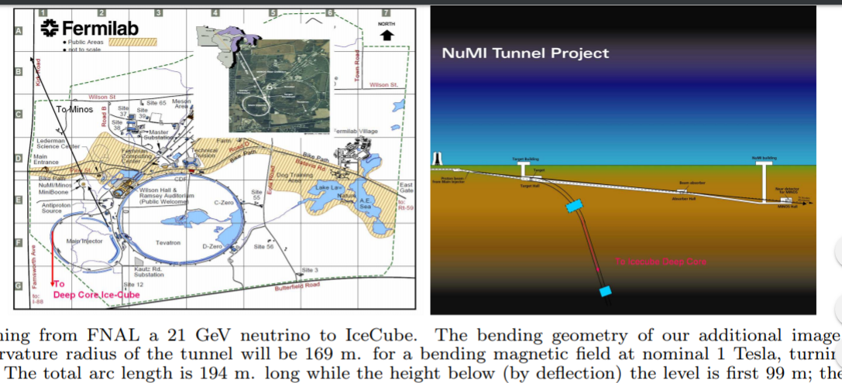
Fermi Lab beaming to
Icecube or SK (and HK)

Slide 8
Crossing muons (wider volumes) and internal events

Slide 9
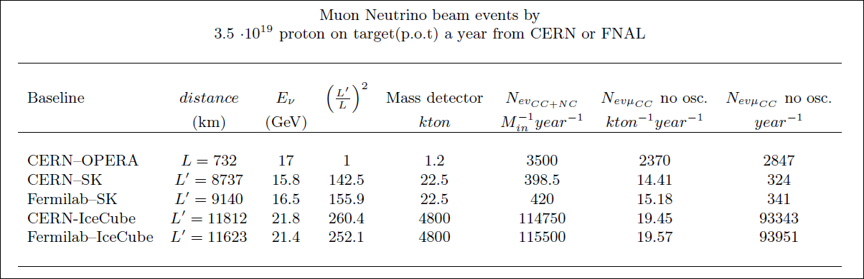
The large dilution (260) between Cern Icecube-Pingu versus Opera distances it is overcome by huge detector mass ratio (Megatons versus Kiloton, 4800) and by complete-flavor oscillation (60)

Slide 10
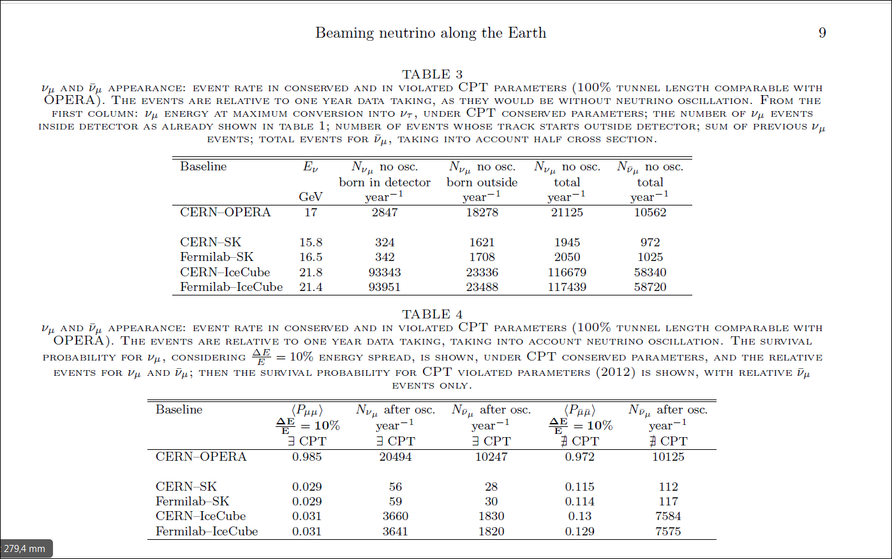
Rate of events versus Opera ones

Slide 11
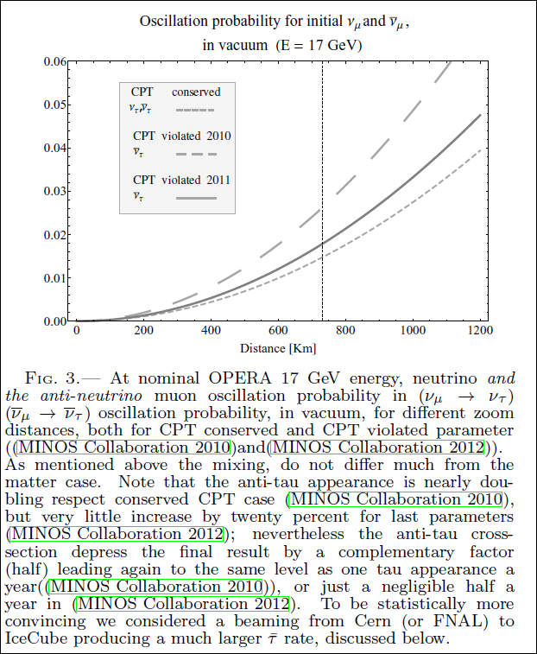
OSCILLATION with or without CPT violation

Slide 12
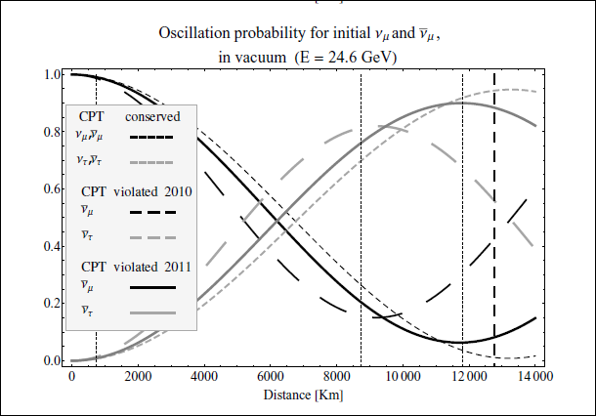
Oscillation along the Earth at 24 GeV:
(a negligible MSW effect)

Slide 13
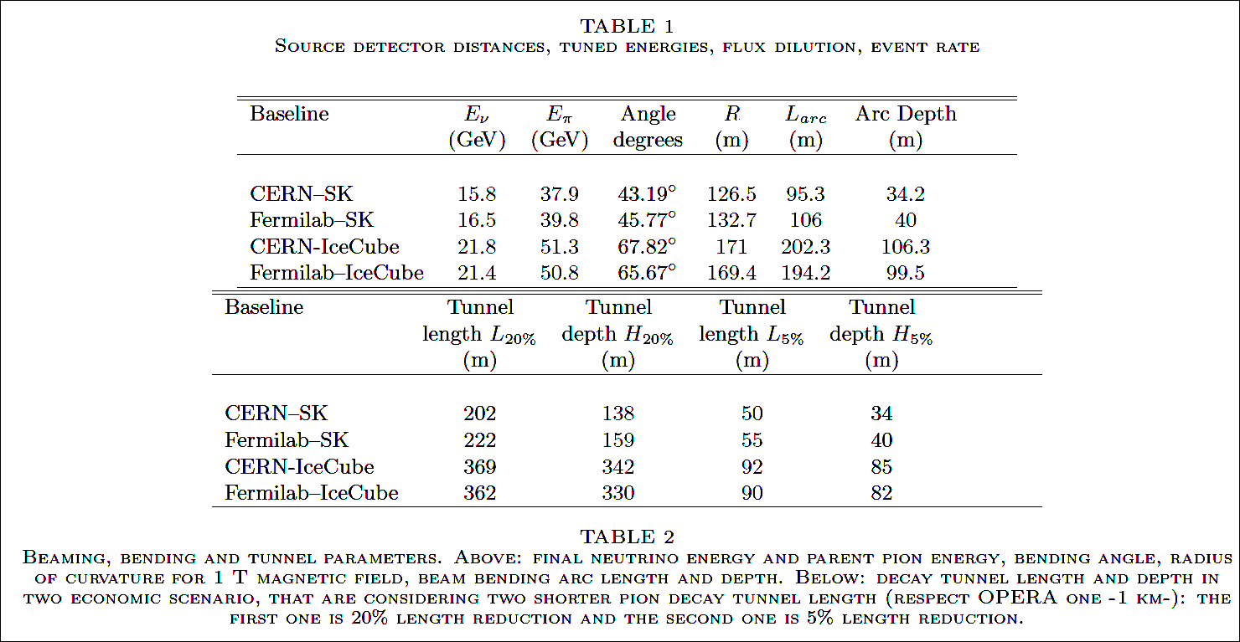
Bending pions, tunnel radius size

Slide 14
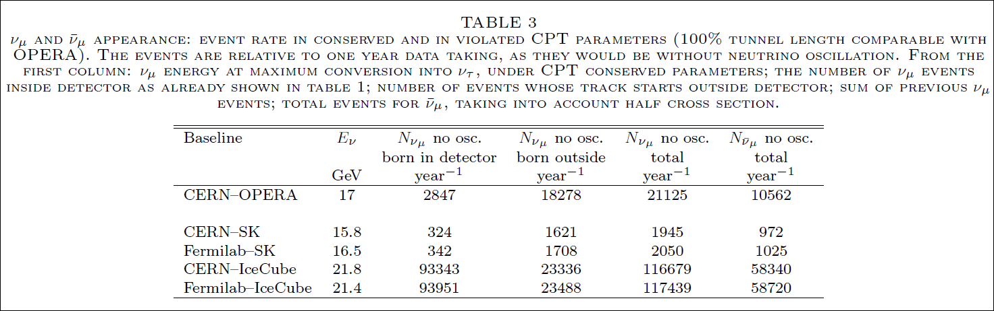
100% like opera
(a long tunnel too)

Slide 15
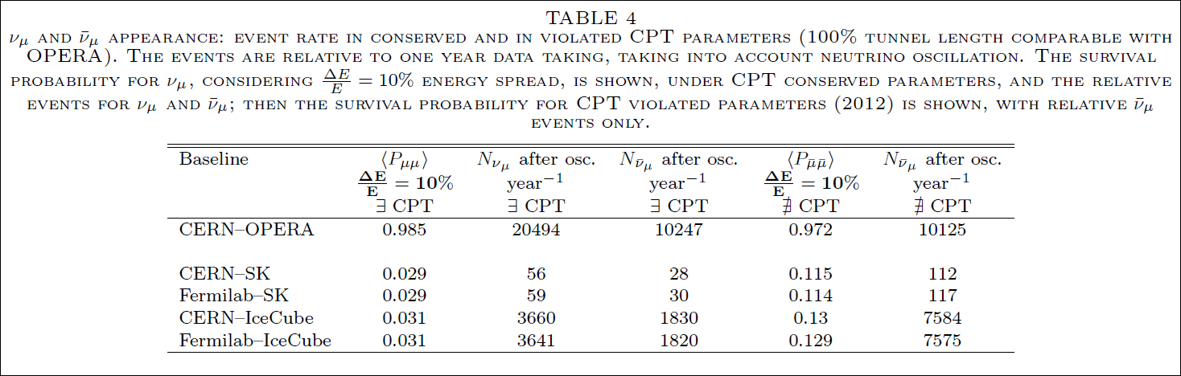
Event rate after oscillations

Slide 16
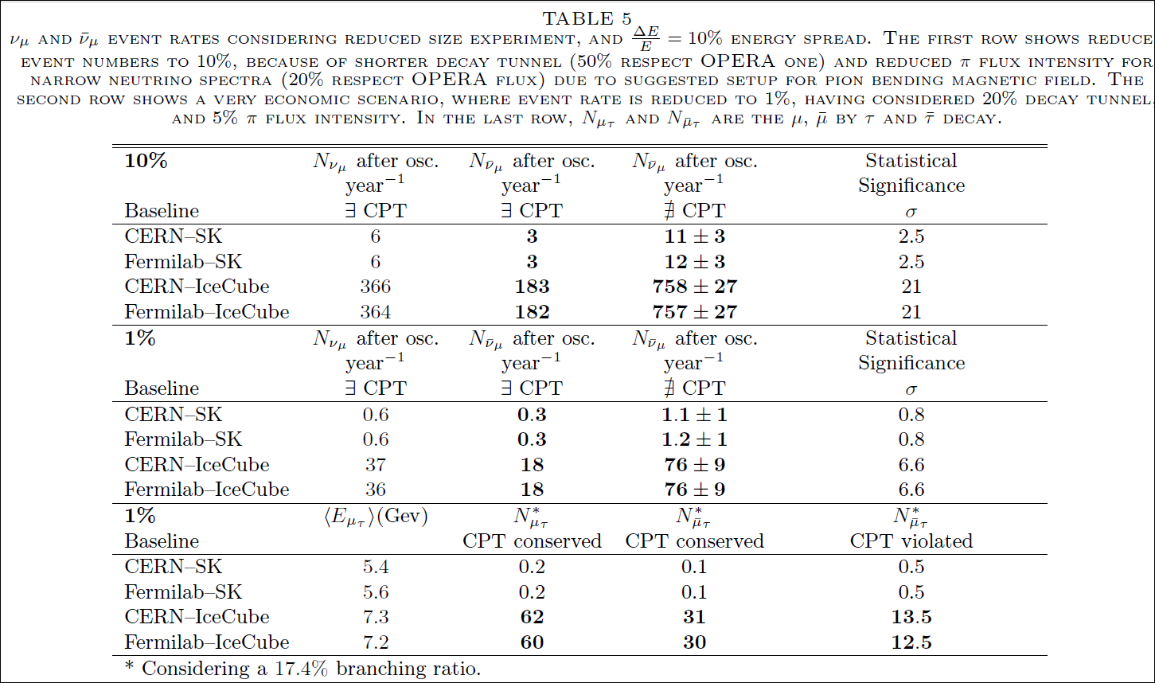
10% or 1% size beaming versus Opera

Slide 17
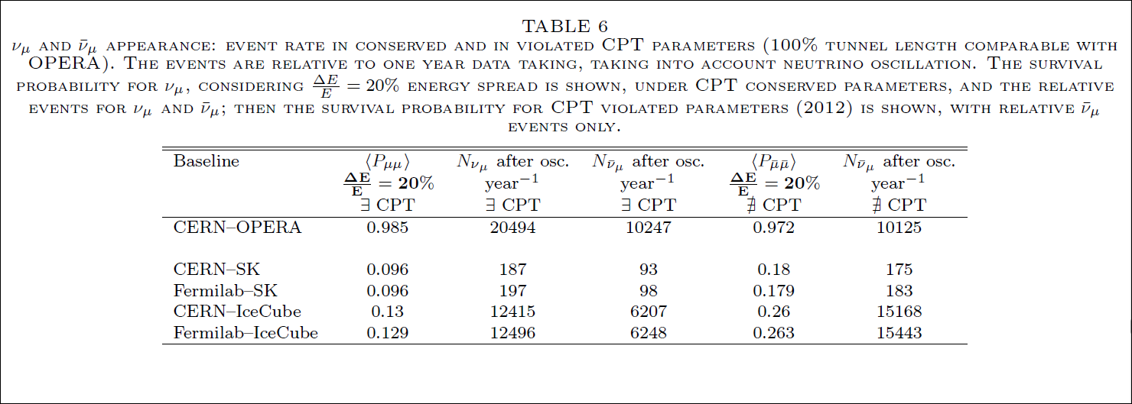
Rate assuming an energy dispersion as large as 20%

Slide 18
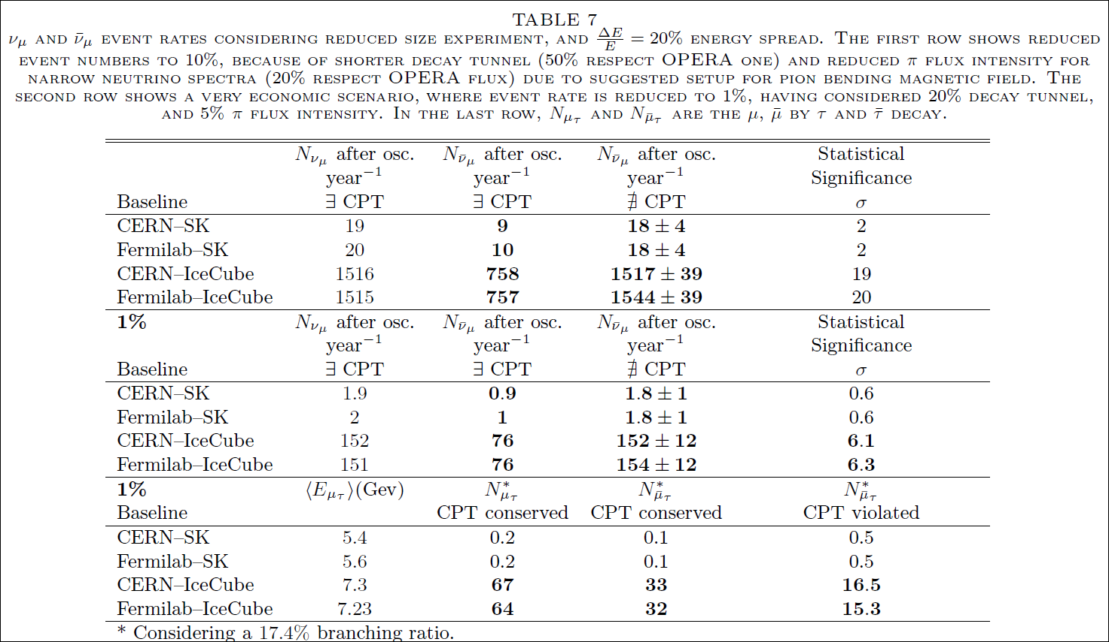
Rate assuming an energy dispersion as large as 20%

Slide 19
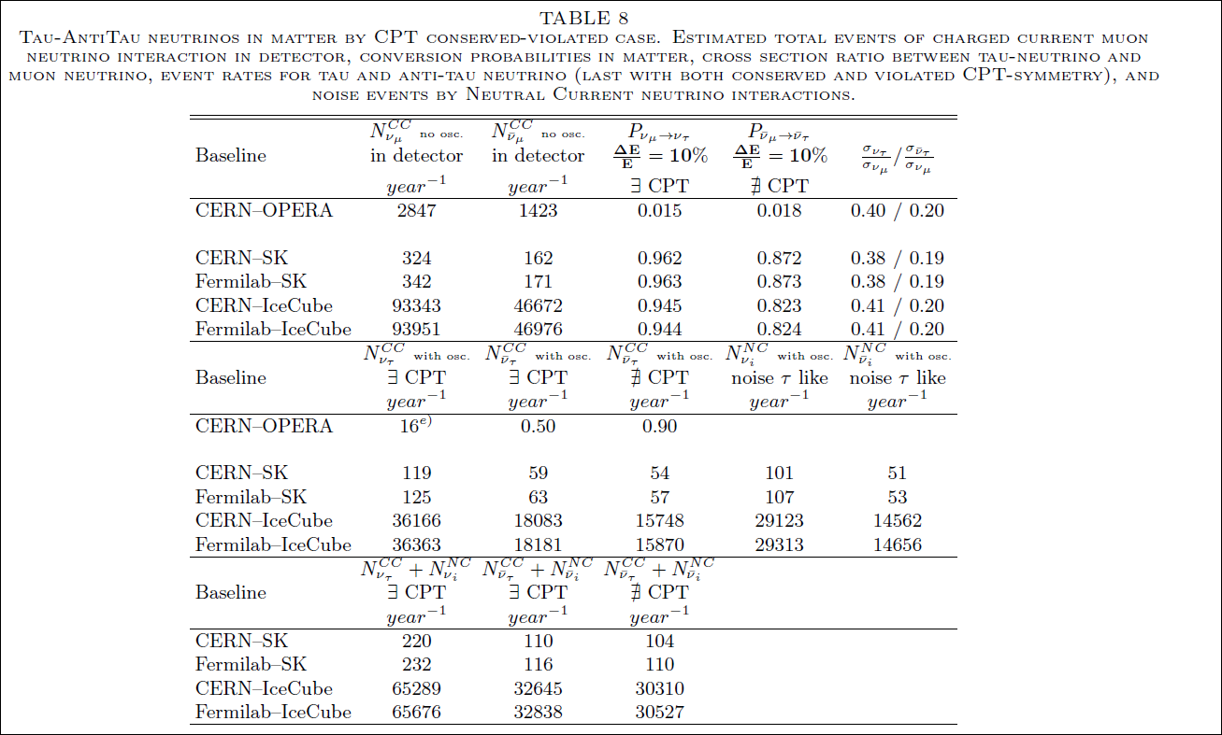
Tau appearence rate for 100%

Slide 20
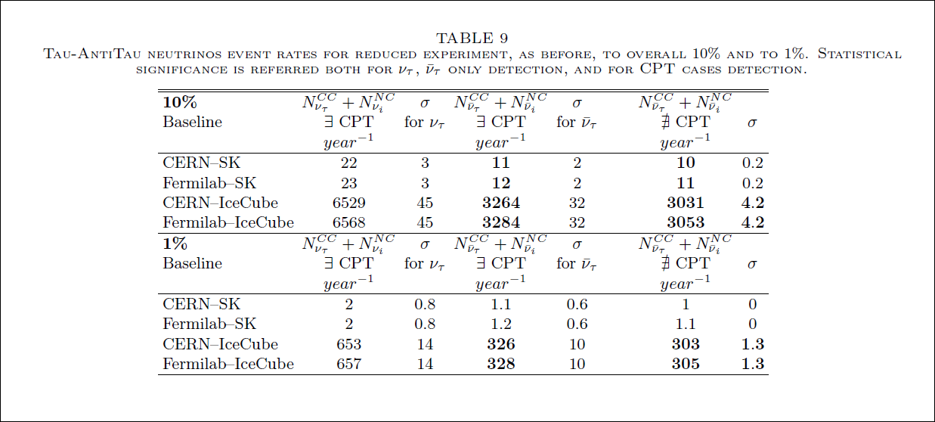
Tau appearence and CPT at 10%

Slide 21
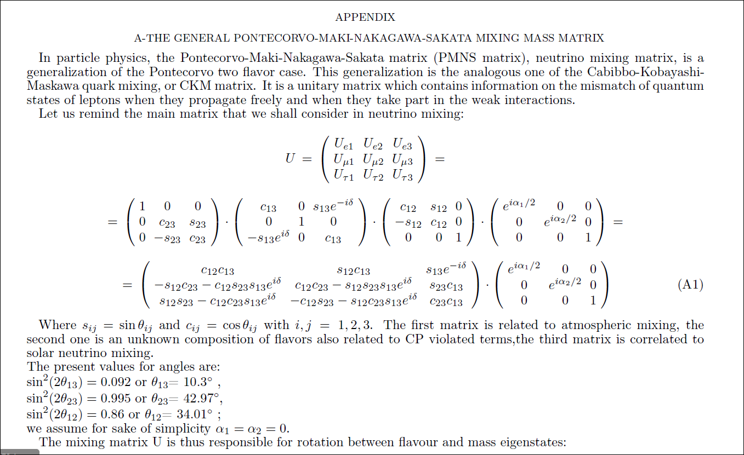
Matrix

Slide 22
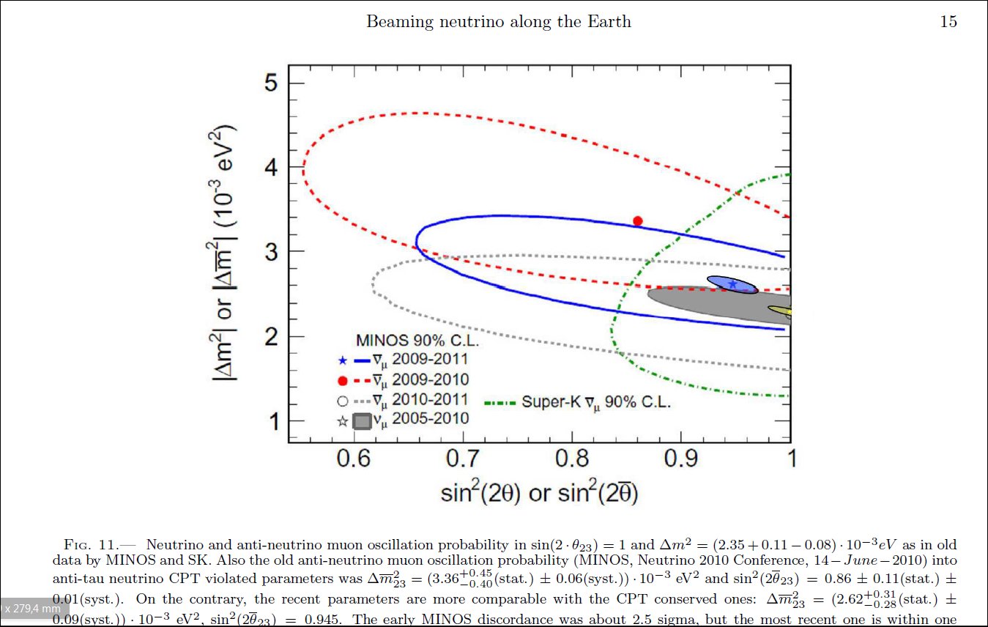
Accurancy in CPT detection

Slide 23
Conclusions
Beaming neutrino across the Earth may
become a tool for particle physics,
as MSW test, the mixing angle test, the matter anti matter symmetry test as well as
the new geological probe of MSW while crossing terrestrial interior masses.
Cern and Fermilab are the best sources.
HK and Pingu projects are the very ideal future detector at ten GeV range.

Slide 24
Additional Conclusions
Also a peculiar Fast neutrino telegraph comunication system among USA and Japan or Swiss-Japan may be born.
At an apparent neutrino speed ( neutrino Earth diameter crossing versus photon circumnavigation) faster than light one.
Economic and security systems may enjoy and neutrino science too.

Slide 26
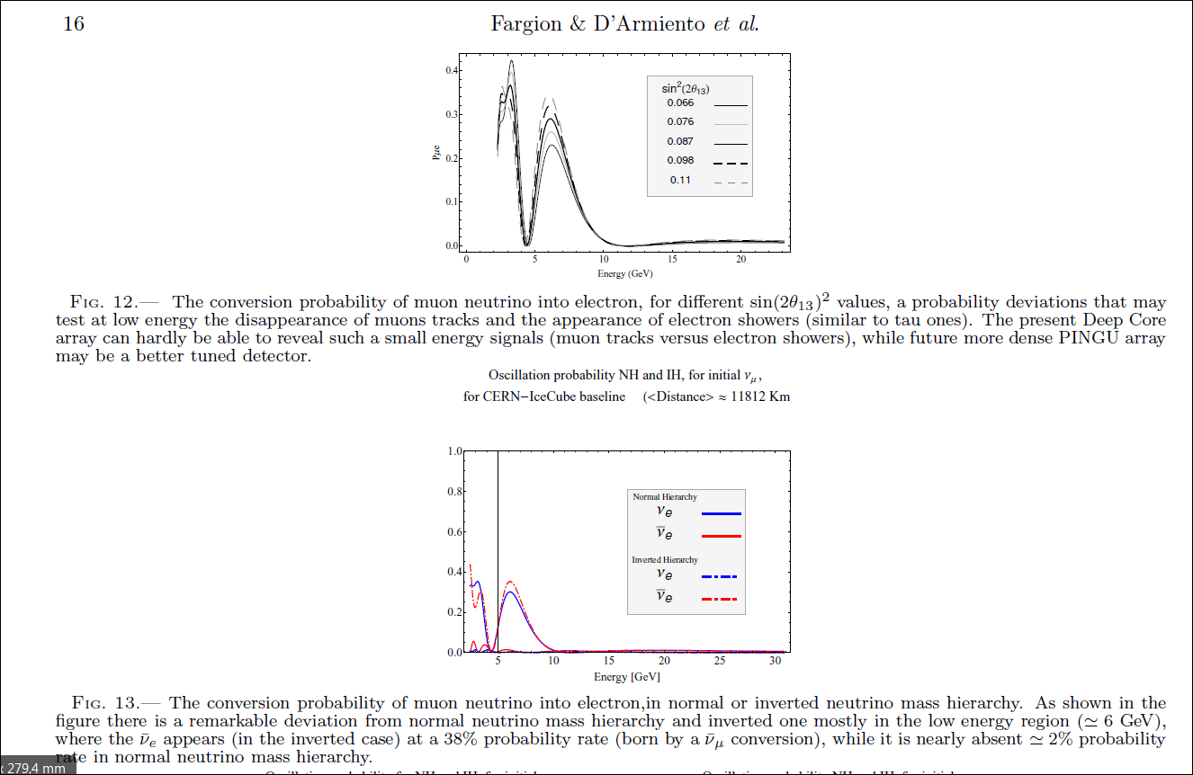

Slide 27
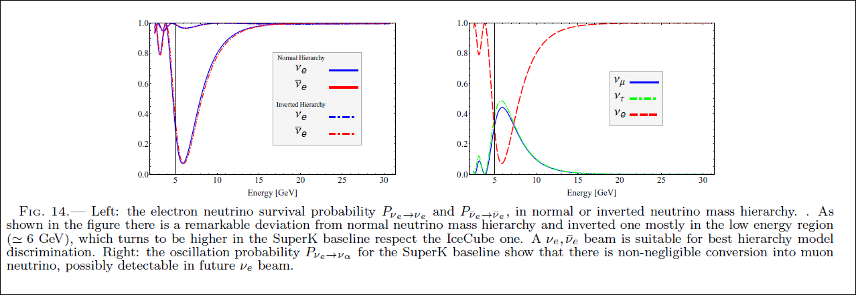
Hierarchy mass detection

Slide 28
Comunication across the Earth
Beaming neutrino along the whole Earth may become a day, a three and a half times
"faster than light" telegraph able to send a fast message within 40 millisecond second along continents for any trade message across the Earth. In CERN-Deep Core configuration the neutrino reaches the detector with a precursor time of at least 1.03 · 10−2s. A wide time for fast science.
Different applications as the economic ones may be also of great interest.

