Slide 1

Anti-Neutrino Glashow resonance rate testing matter antimatter symmetry
26 Nov 2018, 17:40
25m
Johannessaal
Invited Talk [10] Multimessenger probes of the universe Multimessenger probes of the universe
Speaker
Daniele Fargion (Rome University 1 Sapienza and INFN)

Slide 2
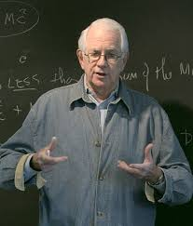
Anti neutrino electron – electron Glashow resonance role
Abstract
Extended Icecube
(as well as future
Tau Airshower array detectors as
AUGER, POEMMA, GRAND, Anita)
would be soon able to reach a PeVs –EeV range of energy where decades of anti-neutrino electron (resonant at Glashow peak) on rest electron may be put in front of muon tracks in a weighted statistical way.

Slide 3
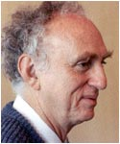
The matter and antimatter ratio
The same Tau,
(Discovered by M.Perl)
And its tau neutrino and
Electron and muon ratio weighted with the Glashow signals may play a fine tuned role in understanding the final and the primordial mixed flavor components.

Slide 4
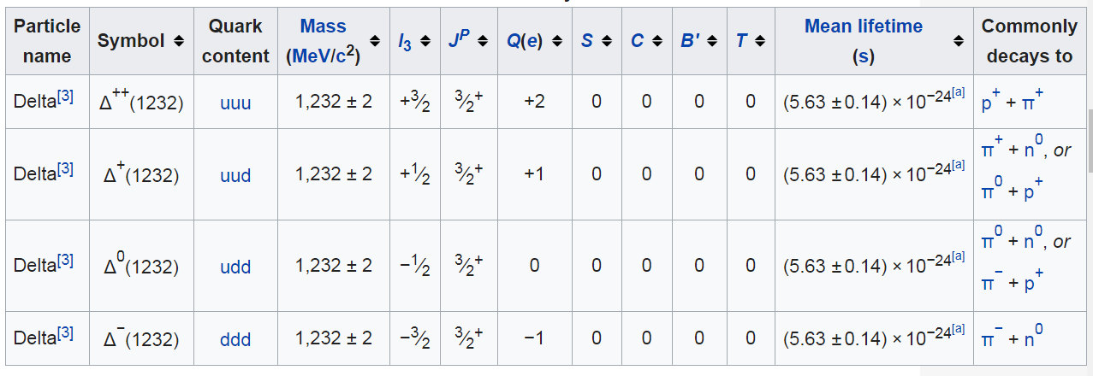
Any source of an matter –antimatter asymmetry in GZK cut off?
Proton and photons make + Delta
An anti-matter AGN would be source of antiproton
Whose GZK will produce - Delta
and negative pions.

Slide 5
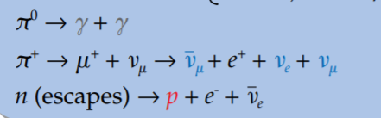
An asymmetry in secondary Positive pion decay by GZK cut off
These 0.1EeV positive pion may decay in
Positive muon and muon neutrino
(the most energetic) that it mix in electron ones
Later softer secondaries with gamma tails
Antimatter makes Delta - …. Negative Pion.
The whole asymmetry in a matter Universe versus an anti-matter Universe may be the ratio between neutrino (most enegetic)
Versus anti-neutrino (less energetic) in antimatter case

Slide 6
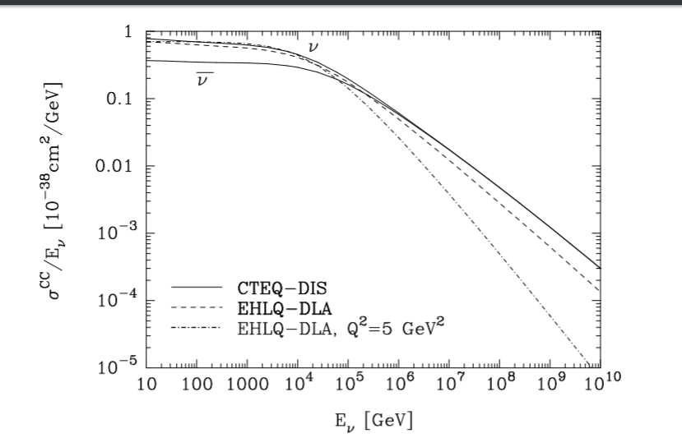
Neutrino anti-neutrino ratio not easely detectable

Slide 7
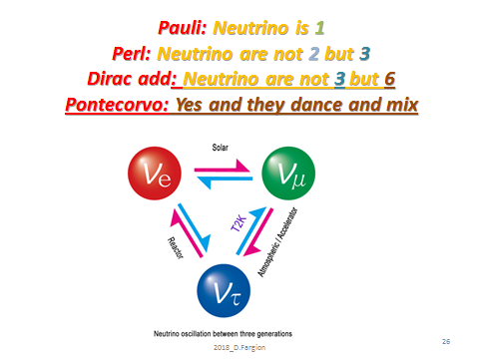
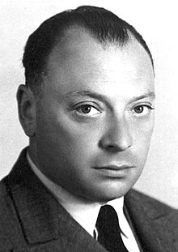
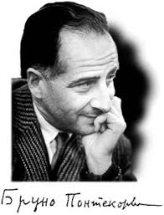
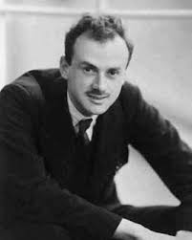

Slide 8
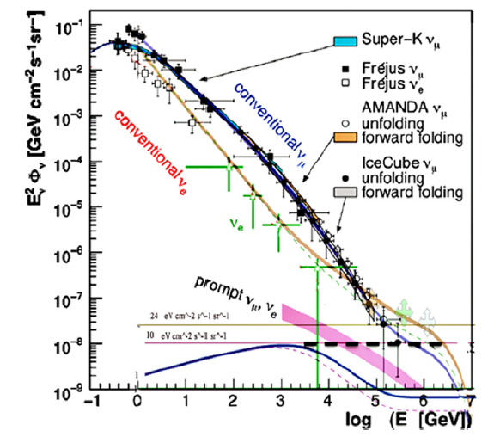
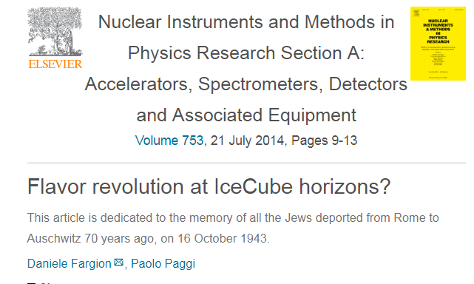
2013 : The ICECUBE flavor revolution

Slide 9
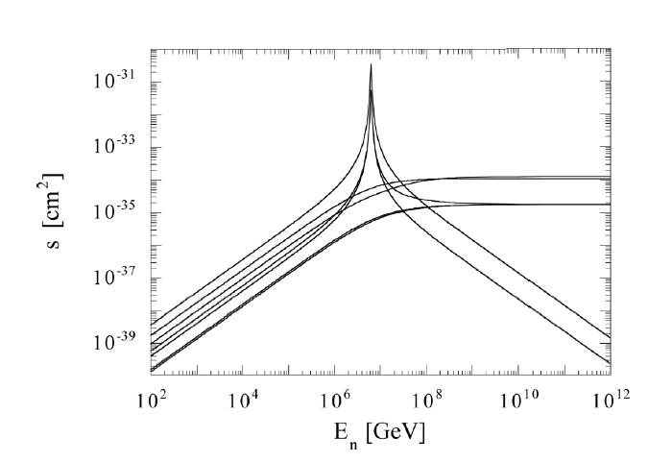
The anti neutrino -electron resonance (into W ) cross section

Slide 10
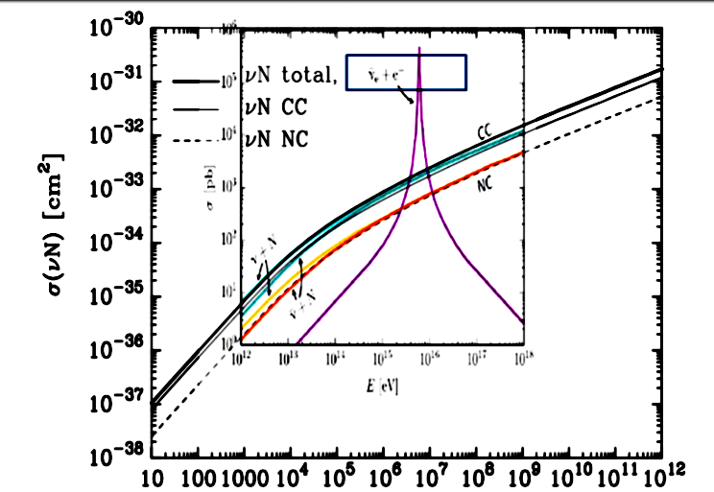
Anti neutrino electron Glashow resonance versus the neutrino hadron interactions: a symmetric Universe may hide or amplify the peak

Slide 11
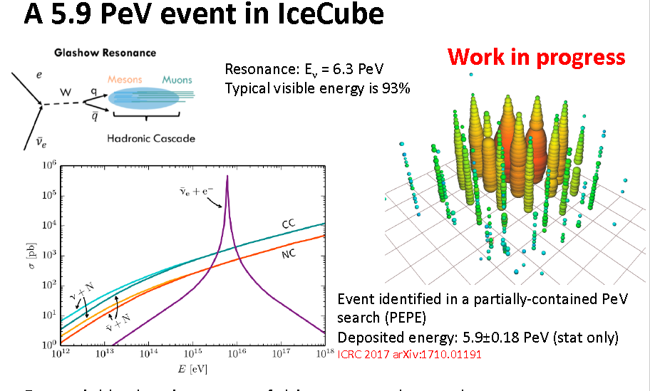
2018: A final Glashow resonance ?

Slide 12
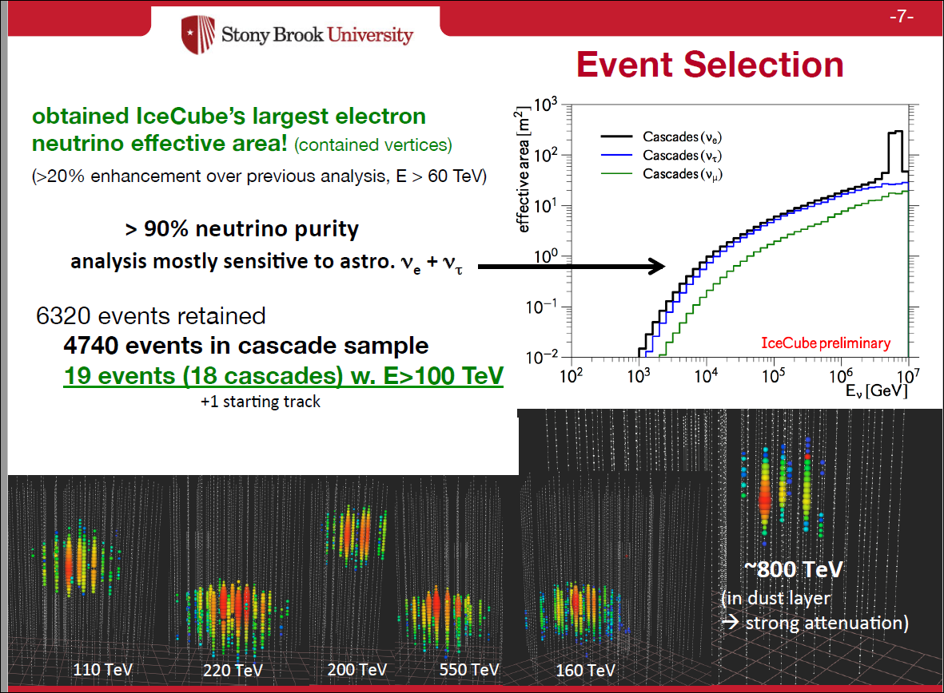

Slide 13
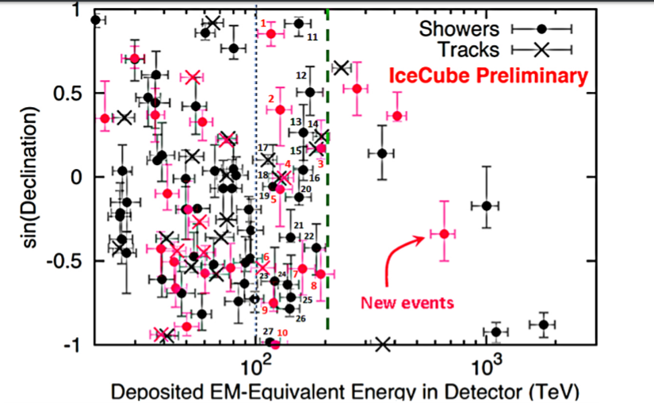
There is tension between
HESE and Crossing Muons
No guaranteed neutrino astronomy without (enough) taus

Slide 14
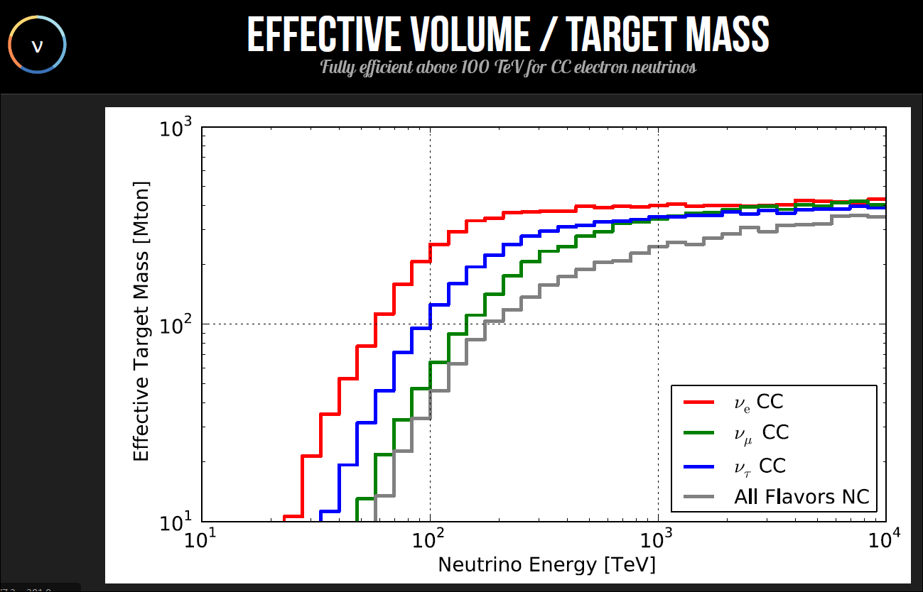
Acceptance of neutrinos in icecube

Slide 15
Back to the present Neutrino Astronomy goals and hopes:
Why urgent neutrino astronomy?

Slide 16
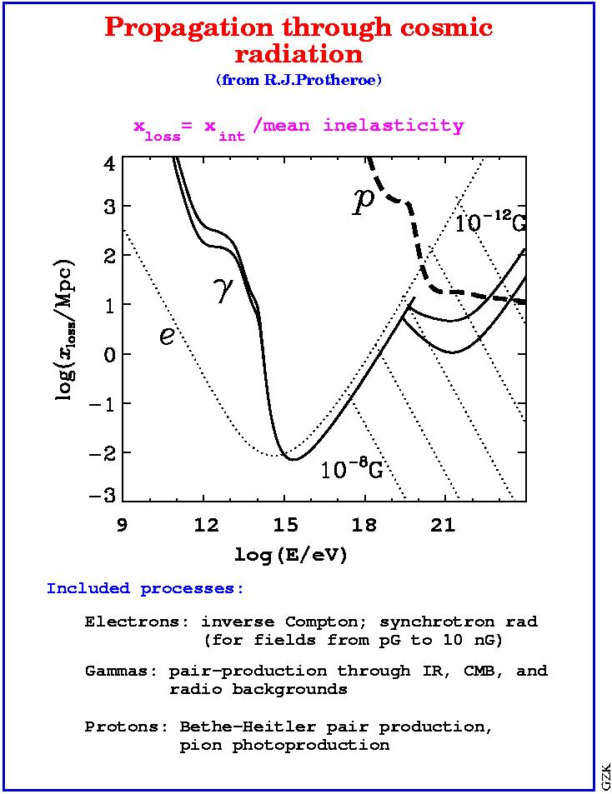
Why Neutrino may see where and what gamma
and UHECR are no allowed to?
accelerated protons interact:
=> the energy fluences in γ-rays and
neutrinos are comparable due to
isospin symmetry.
For neutrinos the observable spectrum
is practically identical to the production
spectrum, whereas γ-rays pile up below
the pair production threshold on the
CMB at a few 10¹⁴ eV.
The Universe acts as a calorimeter for
the total injected electromagnetic energy
above the pair threshold. This constrains
gamma but only part of the neutrino fluxes.

Slide 17
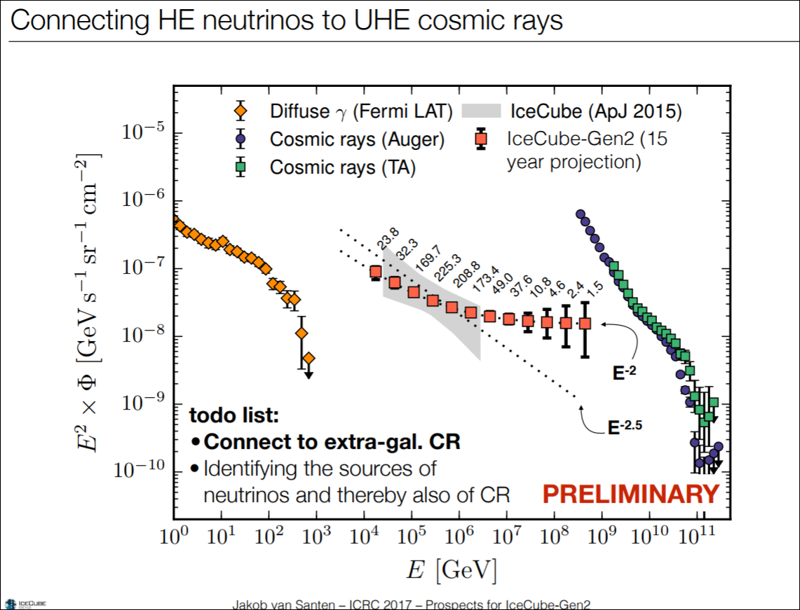
Gen 2 icecube will find hundreds of PeVs events and tens of Glashow ones

Slide 18
Present Neutrino Astronomy
Muon Neutrino sky (Tens TeV-PeVs):
Icecube HESE : BECAUSE FLAVOR CHANGES
Icecube Crossing (or trough going) muons :
22 Sept 2017 AGN connection
Tau Airshower search (Pevs –EeV) in:
AUGER (Surface Detectors or Fluorescence Telescope) and TA
ASHRA: (Cherenkov array telescope)
GRAND: (Chinese Radio Array)
POEMMA: (Skimming Cherenkov satellite)
ANITA: radio balloons in Antartide.

Slide 19
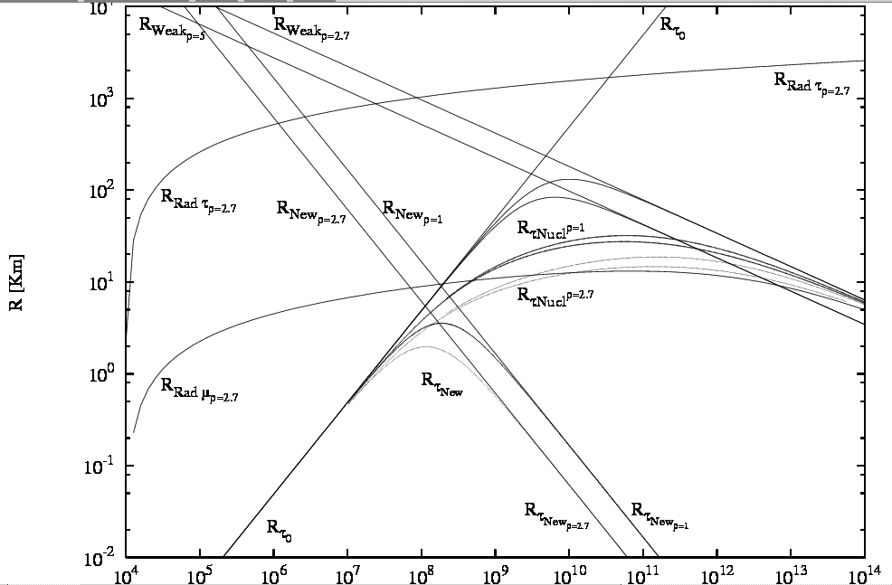
Unstable tau versus muons at highest energy

Slide 20
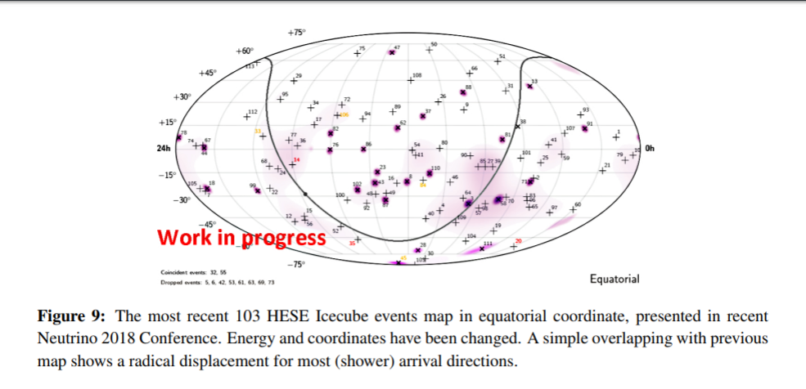
Out of rarest correlated ICECUBE event on 22 Sept 2017 event…
Very little correlation with sources

Slide 21
Contradictory Icecube Gamma correlating events
Search for steady point-like sources in the astrophysical muon neutrino flux with 8 years of IceCube data IceCube Collaborationa :
Few days ago..
arXiv:1811.07979v1

Slide 22
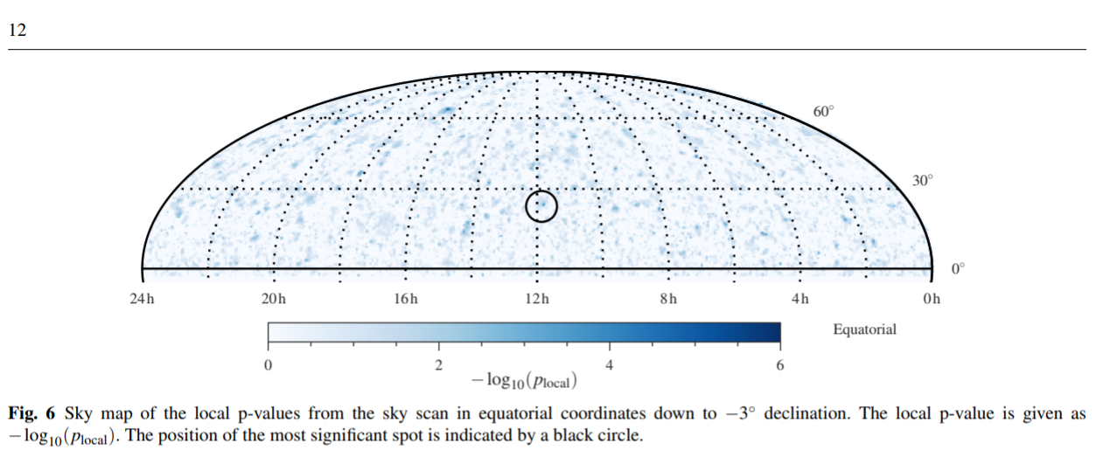
Homogeneous ICECUBE neutrino sky: missing galactic plane and gamma sources.

Slide 23
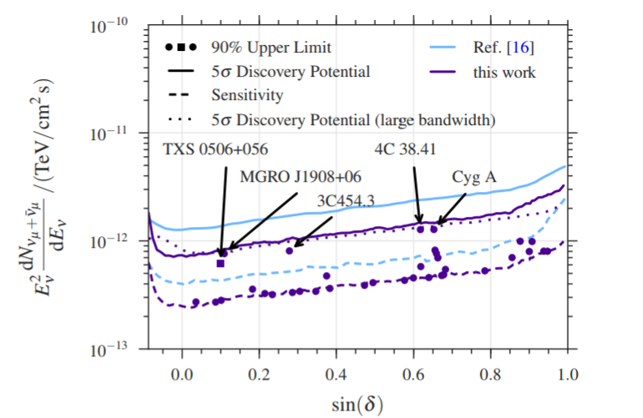
No signals from brightest gamma sources

Slide 24
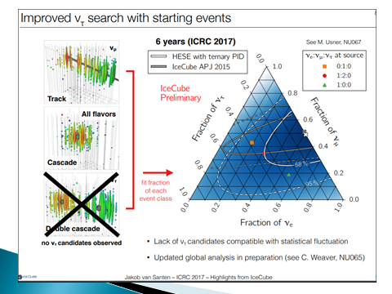
Present Flavor ratio in HESE
(internal neutrino events)
(more consistent with charmed ones)

Slide 25
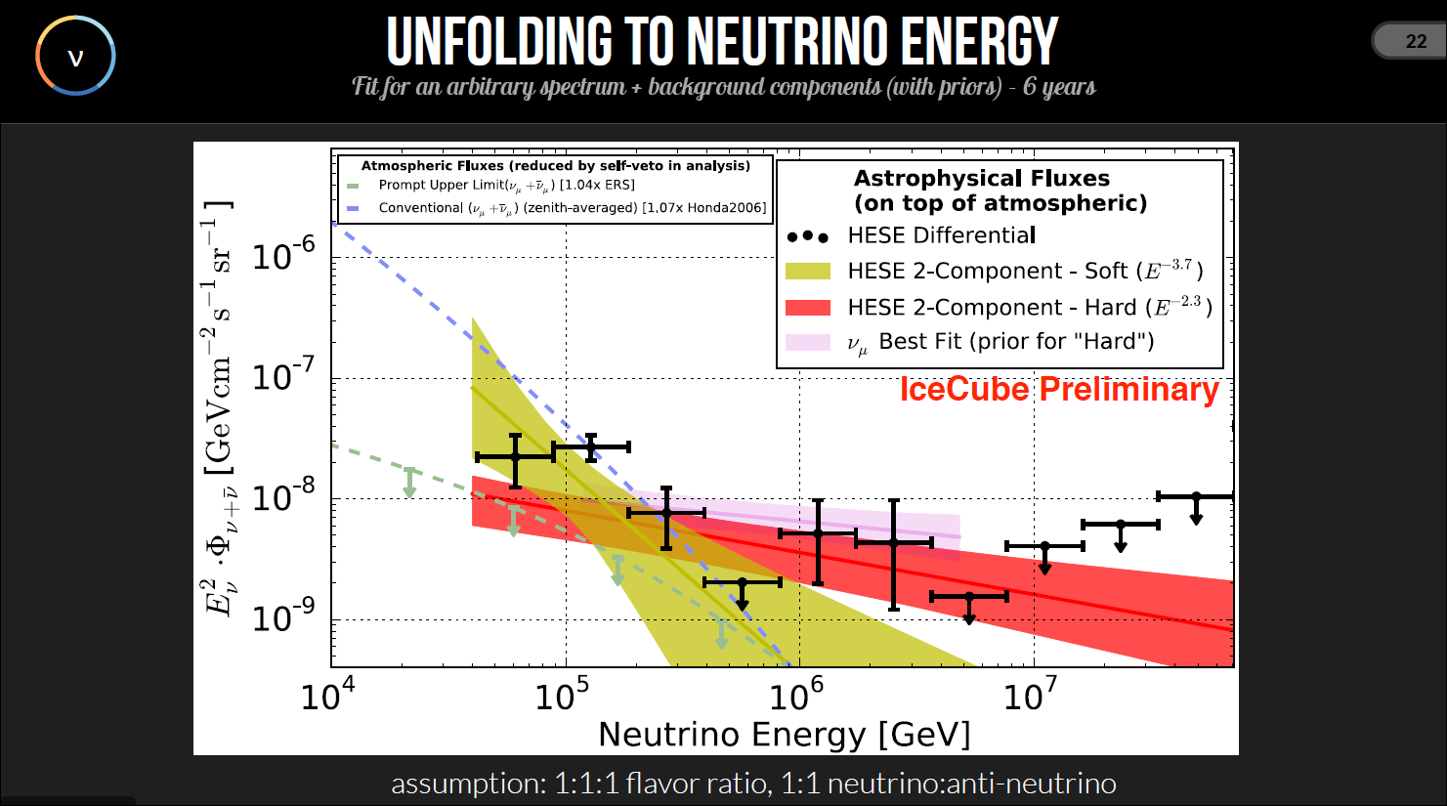

Slide 26
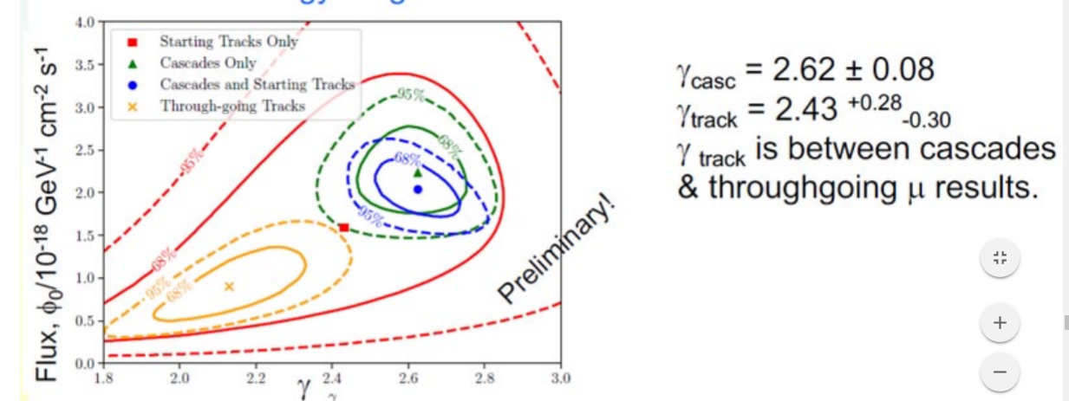
HESE and trough-going muons:
Two different nature?

Slide 27
The ICECUBE puzzle escape room:
Possibly also a Charmed neutrino noise may play a role (hiding the real Astronomy)
The tau neutrinos and the antineutrino Glashow resonance and double bangs may soon clarify the state of art.

Slide 28
Why Tau Airshower is so foundamental?
PeVs-EeV neutrino are related to UHECR
Muons are polluted by atmospheric CR
Electron too are a little polluted by CR too.
Tau neutrino guaranted by Cosmic mixing
Tau Airshower does not produce just 1 tracks
But tau airshower produce (PeV-> Million) (EeV -> Billions) secondaries in huge area (km square size)
Huge natural amplifier at UHE energies. One signal is like km size area

Slide 29
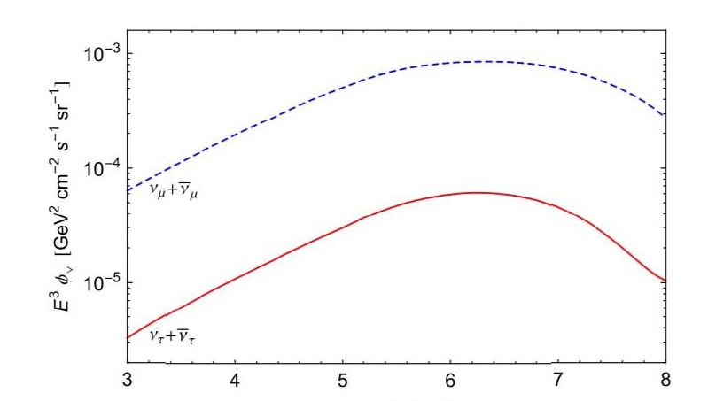

Atmospheric Charmed Tau are suppressed respect to muon ones: Negligible noises
But Astrophysical ones are not: born by mixing

Slide 30
Muon neutrino at high energy
(TeVs) cannot oscillate to tau along Earth : But they must mix in astrophysic space.
Therefore tau astronomy is noisefree

Slide 31
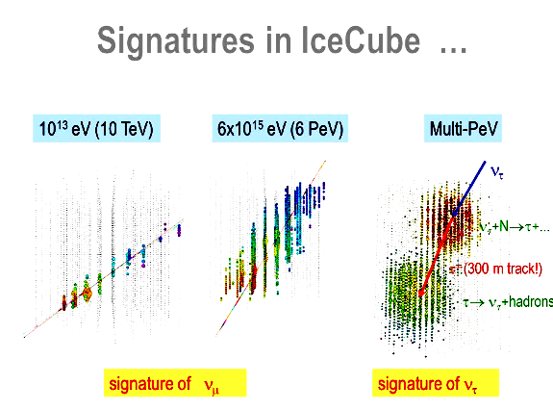
The first idea ;Tau double bang :
Second idea :Bang in and out..

Slide 32
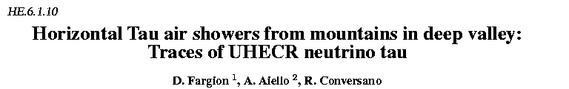
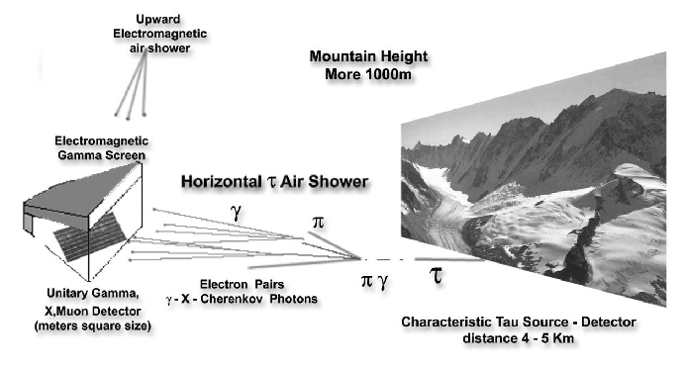
26th ICRC,He 6.1.09, p.396-398.1999.

Slide 33
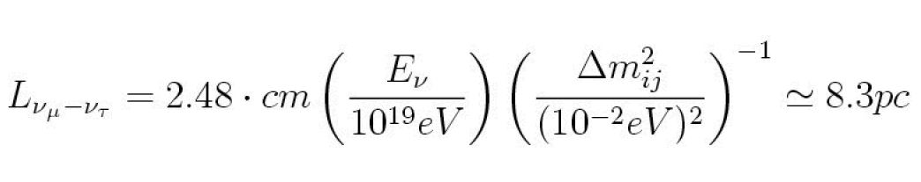
Why Horizontal – Upward Tau Showering is so much linked to neutrino mass and mixing ?
Because mixing, even for minimal neutrino masses guarantee the flavour transformation: from Muon Neutrinos to the Tau Neutrinos. (Kamiokande 98’)
Galactic and cosmic distances are huge respect oscillation lenghts.
8.3 pc

Slide 34
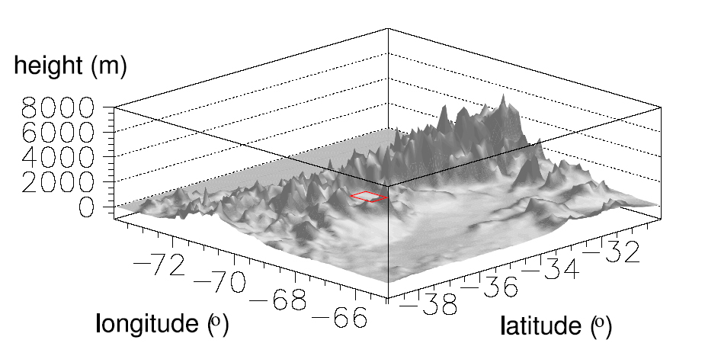
The Ande Shadows on AUGER
Pastor et. All 2005

Slide 35
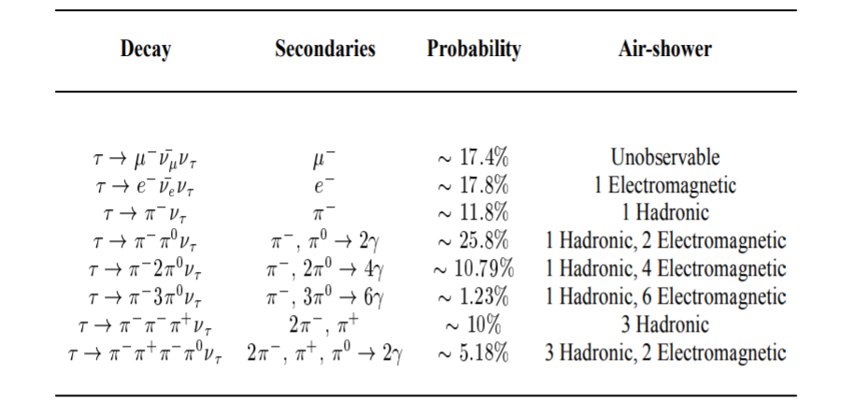
Tau Air-Showers. In principle Astronomy versus Elementary Particle: Tau Channels Modes

Slide 36
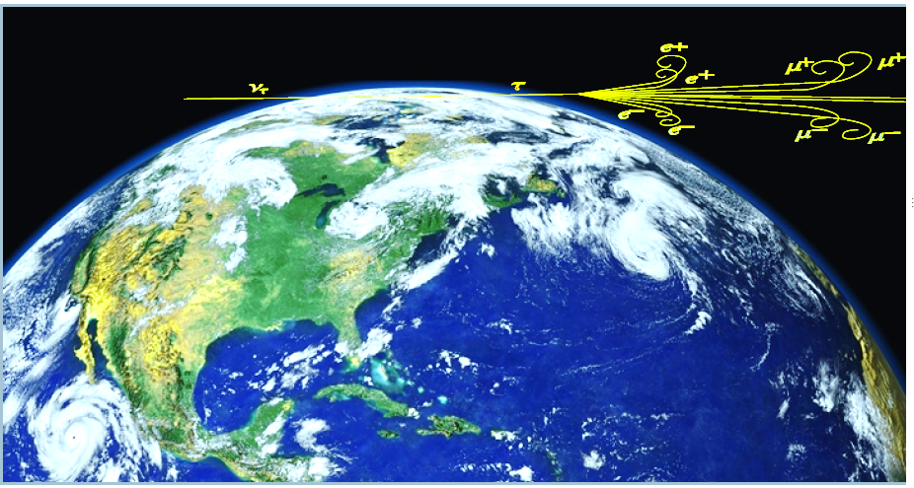
Tau Airshower= Skimming Neutrino

Slide 37
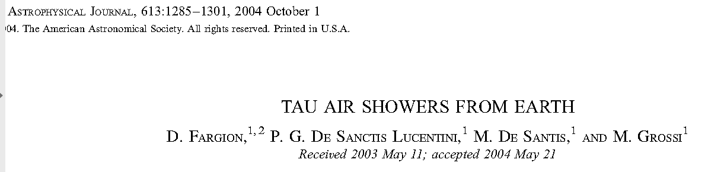
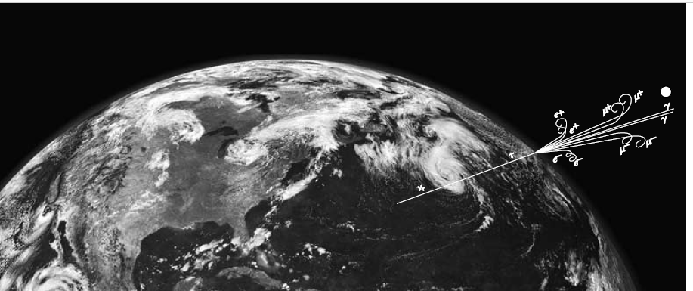
Tau escaping from Earth
Because Earth opacity, mostly PeV upward. EeV only horizontal

Slide 38
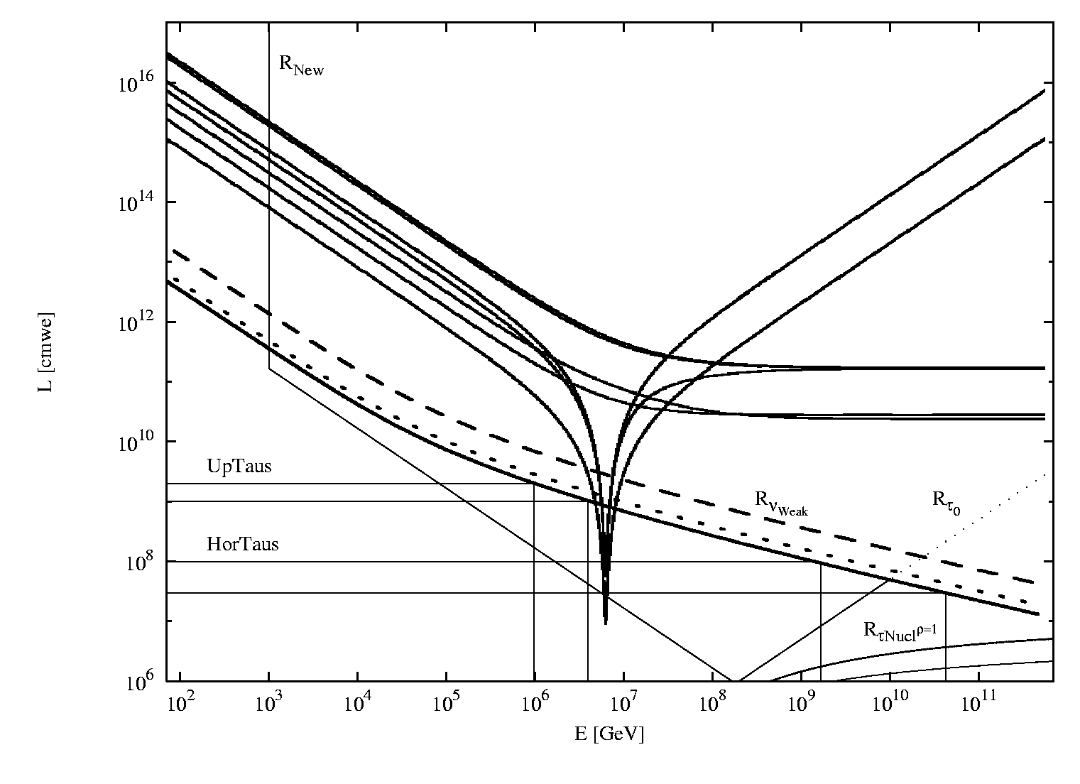
The Earth act as a beam dump and the atmosphere as a calorimeter to amplify the Tau Air-Shower :ANITA events
Charged current:
Neutral current:
Glashow Resonance(E = 6.3 × 10¹⁵ eV):
Cascade

Slide 39
Earth Opacity by Inner Earth Density Structures

Slide 40
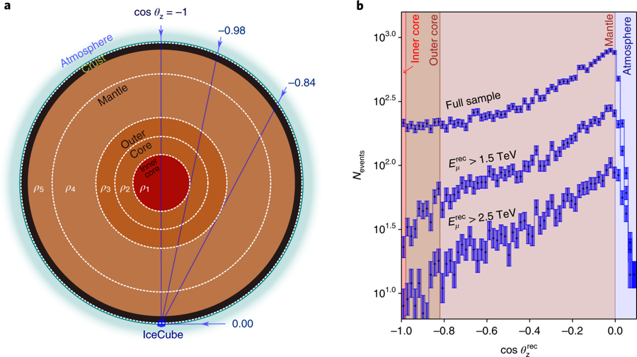
Neutrino tomography of Earth
Andrea Donini, Sergio Palomares-Ruiz & Jordi Salvado
Nature Physics (2018)

Slide 41
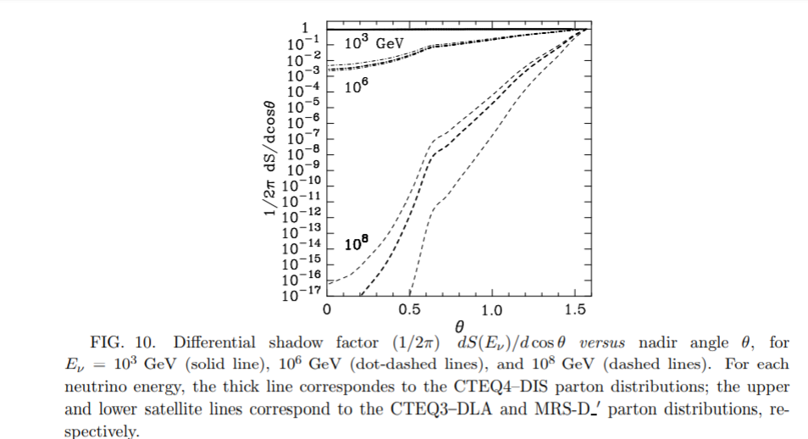
Opacity
Without
Tau regeneration
Ghandi 1998
Too much severe.

Slide 42
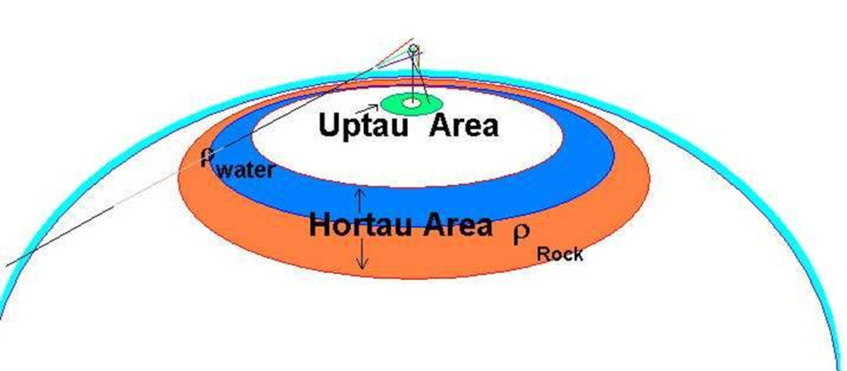
Pevs UpTau versus EeV Hortau

Slide 43
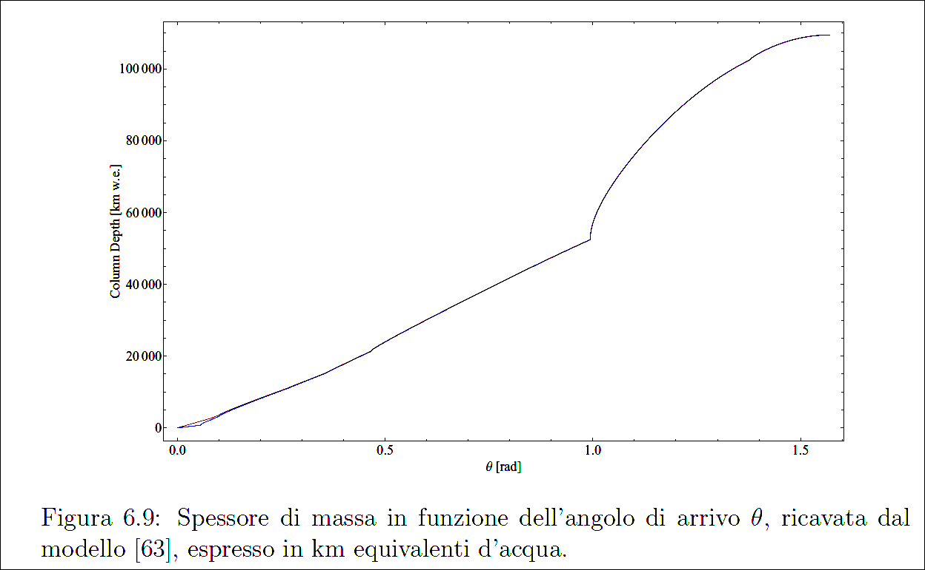

Slide 44
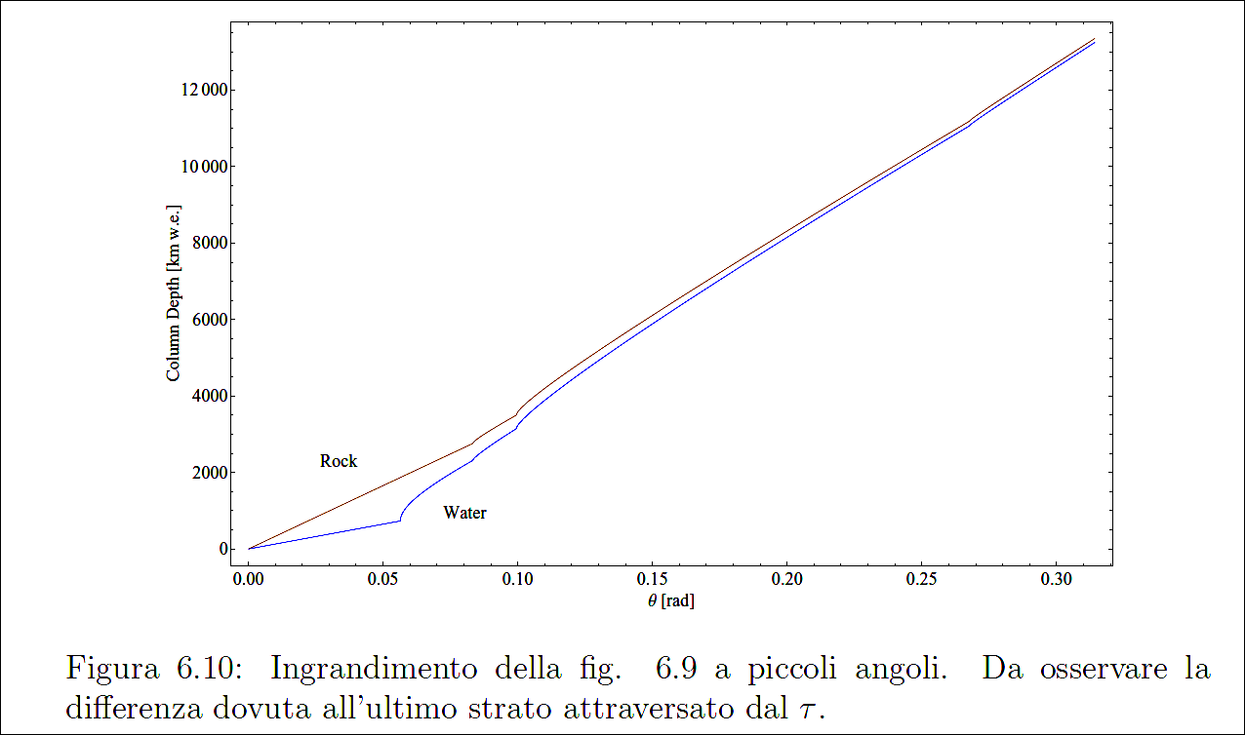

Slide 45
Water
Water
Expected Tau events at different angles.
GZK input neutrino flux
Rock
Rock

Slide 46
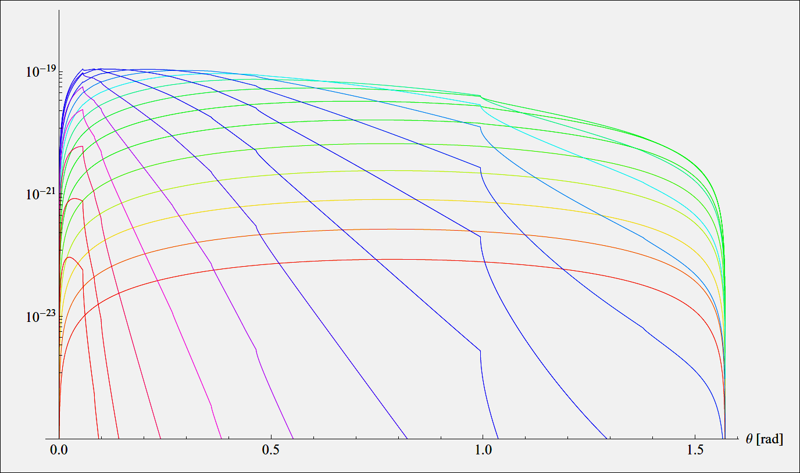
Differential escaping tau for Fermi spectra
17
16
14
15
13
12
16
11
17
18
21
20
19

Slide 47
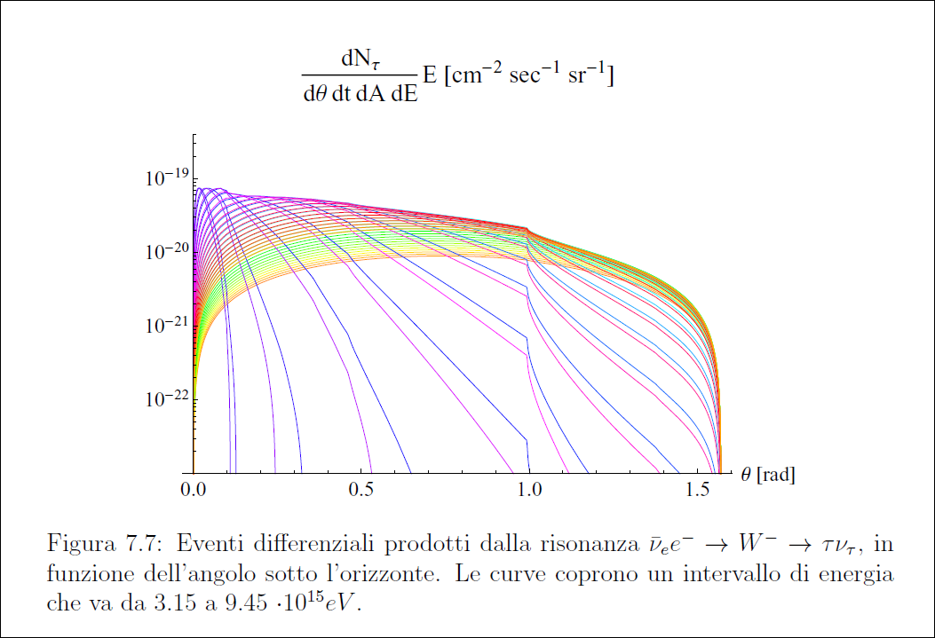
Resonant Glashow component

Slide 48
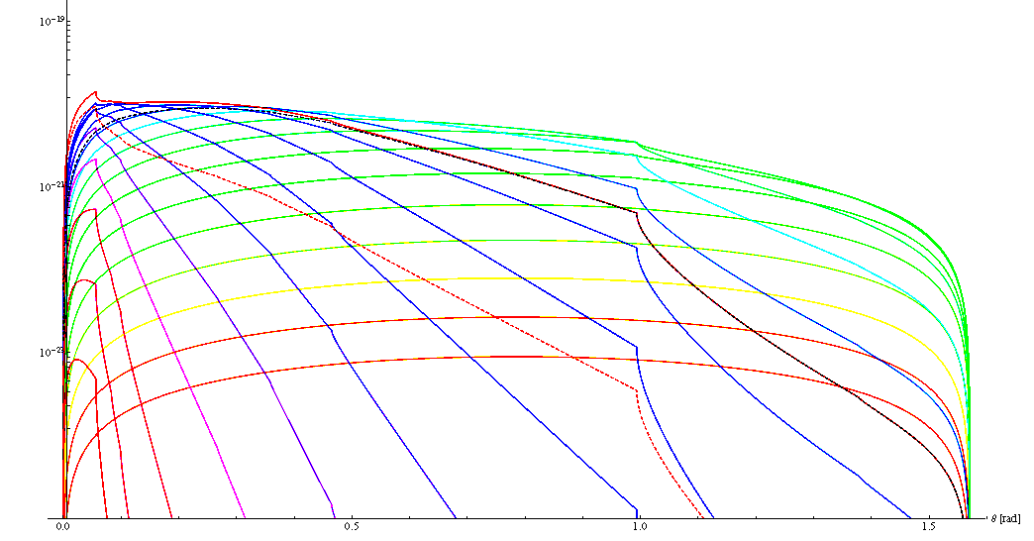
Both contribute united

Slide 49
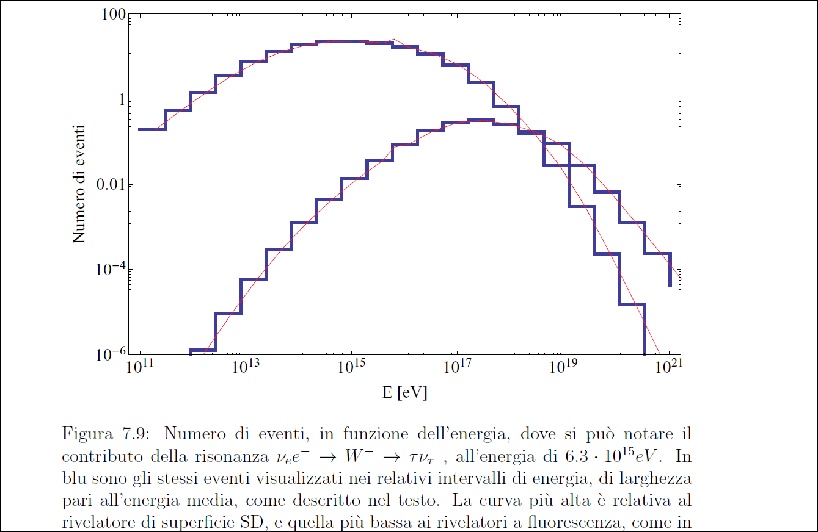
EXPECTED IN AUGER every 3 years

Slide 50
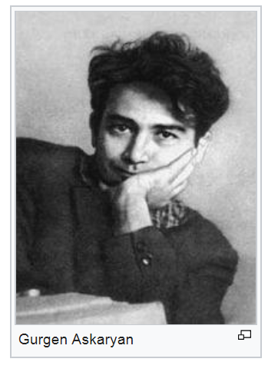
Ashkarian coherent radiation inspired and lead Gorham group to searach for upgoing radio burst due to UHE neutrino shower inside the earth: the Anita I-II-III-IV balloon flight,

Slide 51
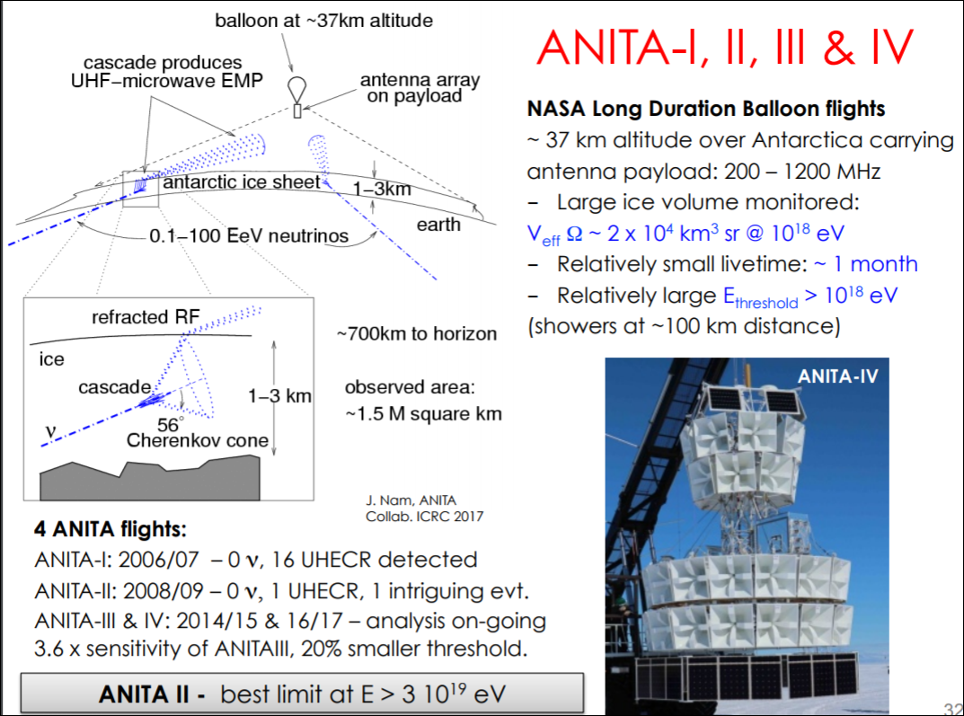
ANITA II--IV

Slide 52
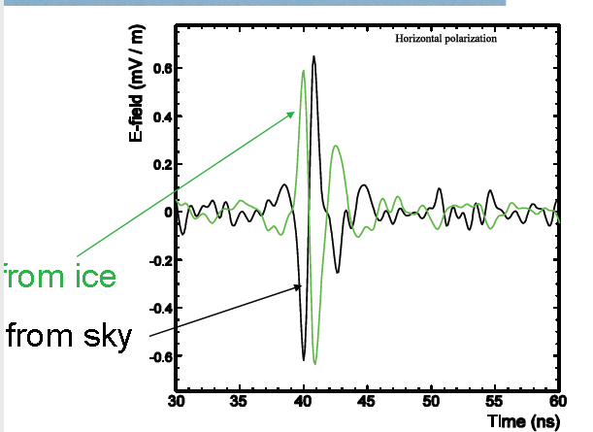
Anita reflected versus Tau: the polarity change for downward showers: Ashkarian foresee vertical polarization: tau horizontal

Slide 53
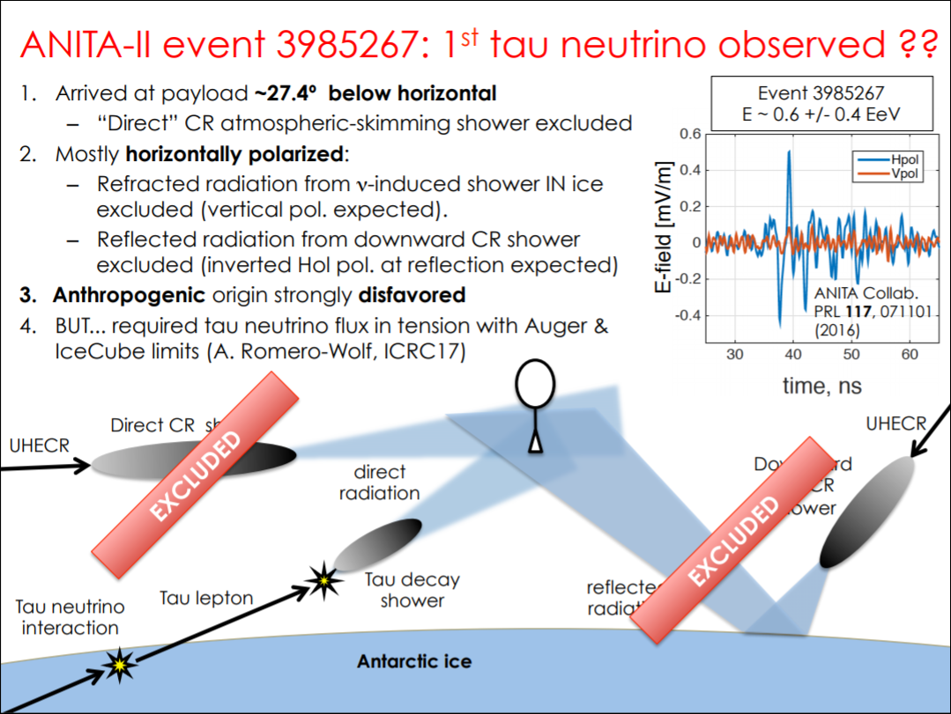

Slide 54


Slide 55

Not Ashkarian but a Tau signal?

Slide 56
Conclusions
PeVs and EeVs neutrinos carry the anti-neutrino resonant signature that it may weight the CPT symmetry: Their presence it must be present also in their angular upward distribution and double bangs.
The same Antineutrino electron and the tau might (or better to say,must) lead to skimming Tau Airshowers and double bang in ICECUBE
These events, contrary to most odds and recent articles, might be already recorded in ANITA radio upward signals: be tuned…
.

Slide 57

Thank you for the kind attention
In memory of
Lise Meitner

Slide 58

Lise and Albert, before the storm

Slide 60

Darmiento DF updated

Slide 61

Maybe the Icecube TeV-PeV HESE are mostly charmed noise? The Tau role

Slide 62

Upward Tau Airshower at array crown detectors: Crown vertical array

Slide 63
Horizontal Air Showers :
A new Cosmic Ray Frontier
Neutrino and UHECR Air-showers telescopes versus
τ
ν_{τ}
A New mountain of views
The Iceberg peak of a New Cosmic Ray Spectroscopy
Muon lepton tracks. Atmospheric
Versus astrophysical signals:
The vertical downward pollution
versus the upward Earth opacity

Slide 64



Slide 65


Slide 66


Slide 67

Poemma

Slide 68

Attraverso la terra

Slide 69

Neutrino-Antineutrino cross section ratio hardly detectable above hundred TeV

Slide 70
An eventual unexpected ratio
Glashow resonance it is the
best detectable test of antimatter

Slide 71










Tuning to Air Showers by atmosphere filter at different angles and altitudes: splitting charges
20 km.
Earth Horizons edge

