Slide 1

Testing QED with Precision Spectroscopy of the Helium Atom
Yu Robert Sun
孙羽
University of Science and Technology of China,
Hefei, Anhui, P. R. China
Notes:
Good morning , I am very appreciate to have this chance to give a talk here, and I will give a talk on testing QED with preic… My name is Yu Sun ,and I come form…

Slide 2
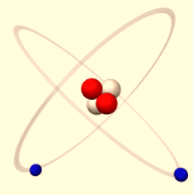
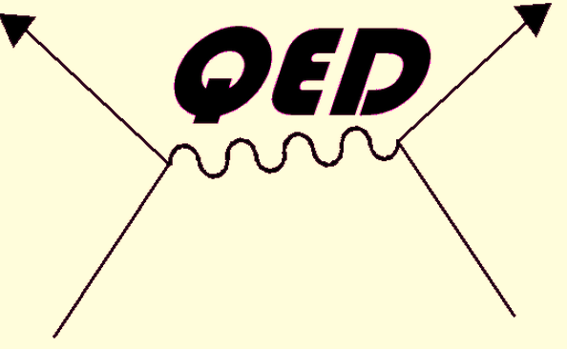
Introduction : Simple Atom, Fundamental Physics
QED Theory Test
High Precision-Quantum Calculation
⁴He
Fine Structure
³He/⁴He IS
Nuclear Charge Radius
Electric Dipole Forbidden Transition
[Shui-ming Hu, Zheng-Tian Lu, Zong-Chao Yan,
Front. Phys. China, 2009,4(2), 165]
2
Notes:
Simple structure , Helium atoms play, It is also among, with the calculation…., It can , main task, around the main task, Our project are proposed , three professor, test ,mearue

Slide 3


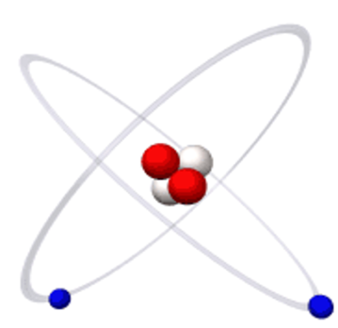
Introduction : Simple Atom, Fundamental Physics
3¹D₂
3³D₁
3³P₀
3³D
1324MHz
3³P
8114MHz
3³D₂
668nm
86MHz
104ns
3³P₁
3³D₃
2¹P₁
659MHz
3³P₂
Li_Bang Wang
588nm
0.58ns
Li-Bang Wang
Muelle
389 nm
2058.7nm
2³P₀
2³P
2¹S₀
29.617GHz
1083 nm
97.88ns
2³P₁
19.7ms
2.291GHz
1557 nm
2³S₁
2³P₂
Vassen
7870s
58.4nm
Eikema
1¹S₀
Notes:
丰富而有分明的能级系统

Slide 4
He-4 (1s2p) 2³P Fine Structure Interval Splitting
Testing the QED theory
Measure the fine structure constant α
He-4 (1s2p) 2³S-2³P Transition frequency
Testing the QED theory
He nuclear charger radius

Slide 5
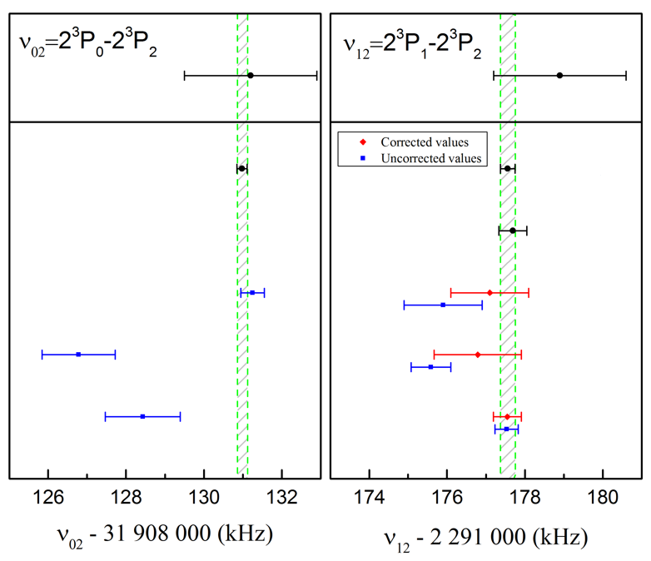
He-4 (1s2p) 2³P Fine Structure Interval Splitting
Pachucki’10
Pachucki’10
He-4 2³P_{J}
Theory
³P₀
Experiment
ν₀₂ 32GHz
Hu’17
Hu’17
³P₁
ν ₁₂ 2.3GHz
Hu’15
³P₂
Laser Spectra, Atomic Beam
Shiner’10
Shiner’00
1083nm
Gabrielse’05
Saturation Spectra, Cell
Gabrielse’05
Hessels’01
Microwave Spectra, Atomic Beam
Hessels’09
1s2s ³S₁
Notes:
We are most interesting, It has two intervals, 2.3,32, Through this picture, once in the history, under the testing of …. The theory physics re-examine , right now the theoretic ,,but the result between different experiments ..

Slide 6
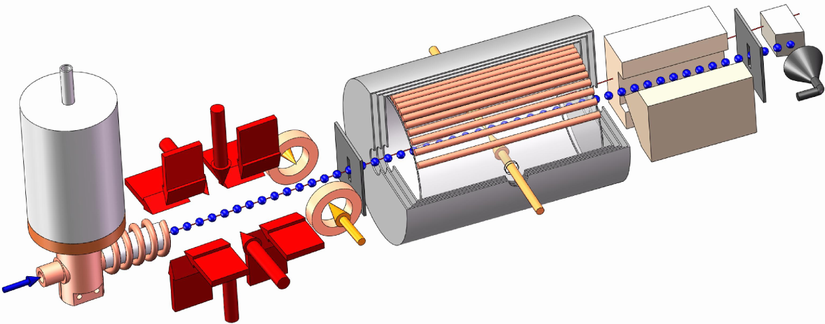
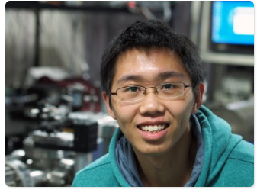
Experimental Configuration
Laser cooling based atomic beam system
Stern- Gerlach
Magnet
Pre-Cooling
Cosine Coil
Helmholtz Coil
Channeltron
Detector
Magnetic shield
3-meter long beam line
well shielded space
Atomic source
Laser Cooling Scheme
2³P
2³P₁
Pump laser
σ⁺
Probe laser
Δ₂
2³S₁
m=0
m=+1
2³S₁
m=+1
m=-1
m=-1
m=0
Xin Zheng
Notes:
用这套原子束流系统我们可以测量23P1-2，以及23P0-2的能级间隔

Slide 7
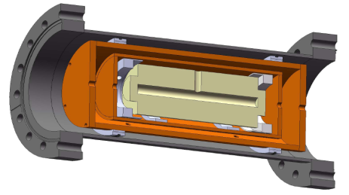
Optical Setup
PDH locking scheme
Fiber Master Laser
Fiber EOM
+1st
-1st
15.6GHz
Temperature controlled ULE cavity
Phase lock module
15GHz
Beat Signal
÷8
2³P₂
Phase lock module
Phase lock module
Cooling Laser
ECDL Probe Laser I
ECDL Probe Laser II
2³S₁
Phase lock module
2.3GHz
Beat Signal
Frequency Accuracy
Power Stabilization
2³P₁
Shutter I
Shutter II
Pump Laser
Fiber coupler
2³S₁
Power Noise Eater

Slide 8
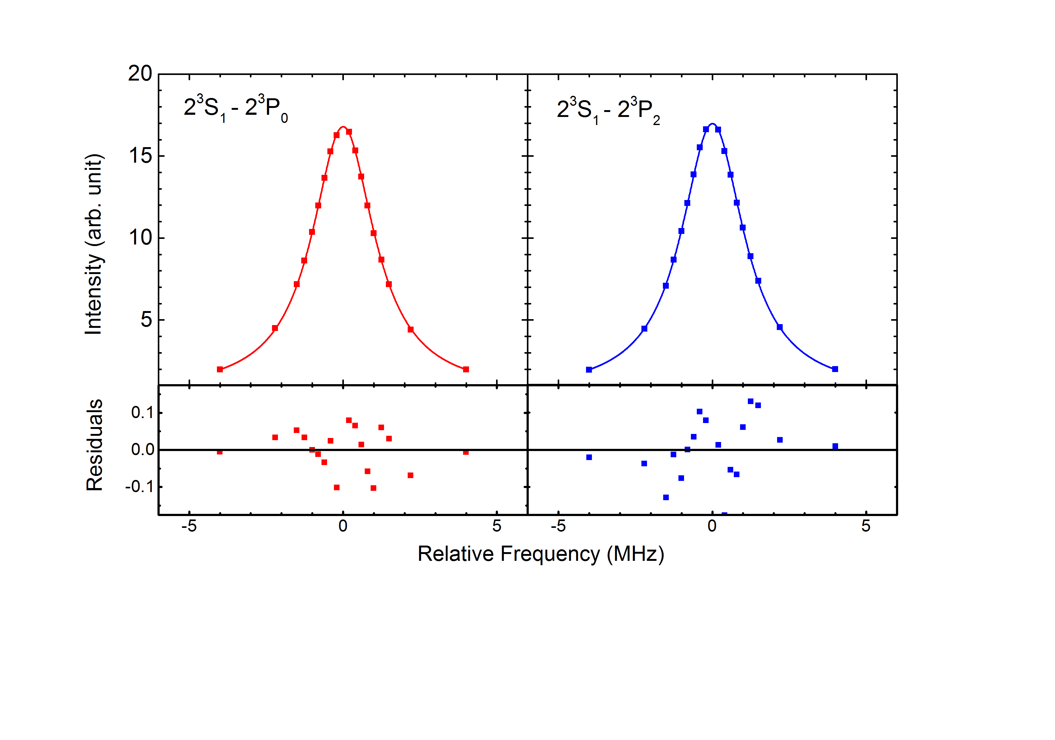
Spectral Signal

Slide 9
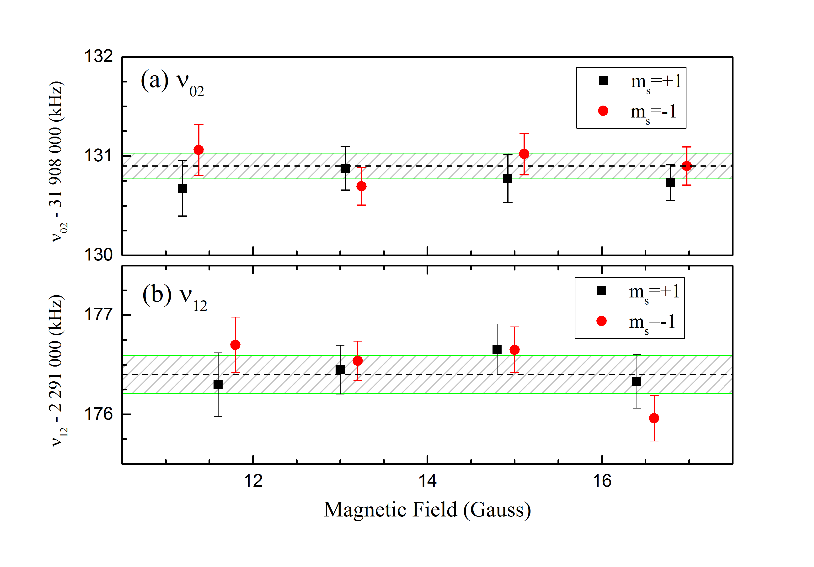
Systematic Check -- Magnetic Field
The magnetic field intensity
was determined with an
accuracy within 2mGauss
Contribution to the uncertainty
less than 60Hz
The contribution due to the
residual magnetic field
Less than 0.3mGauss contribution
to less than10Hz in the probe region
Second Order Zeeman shift
Z. C. Yan and G. W. F. Drake, Phys. Rev. A 50,R1980(1994)

Slide 10
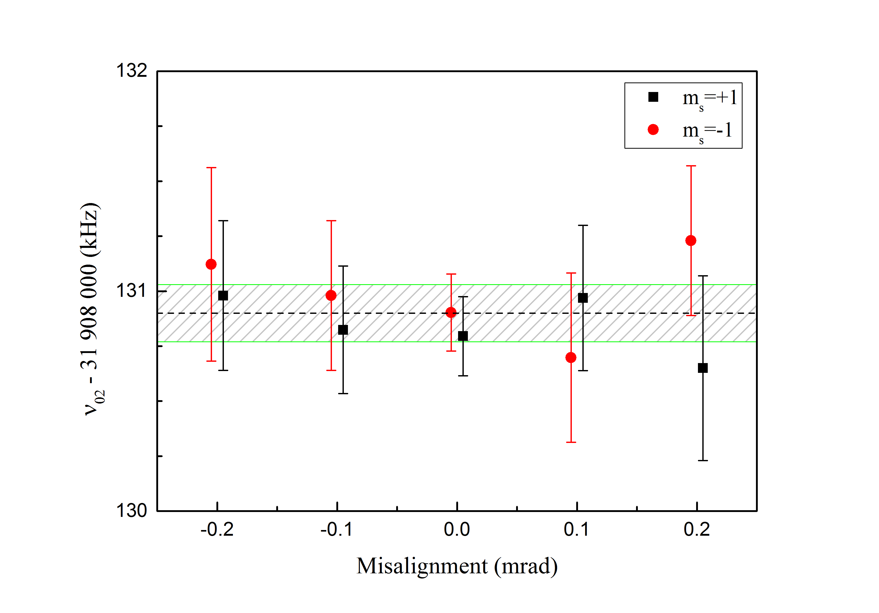
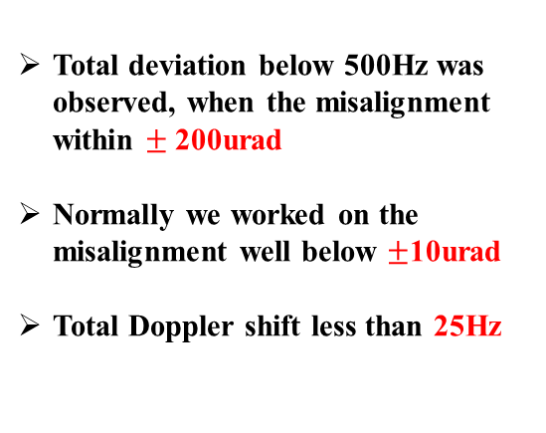
Systematic Check – First Order Doppler Effect
Retro-Reflection Probe laser Beam
Atomic Beam
Total deviation below 500Hz was observed, when the misalignment within $±$200urad
Normally we worked on the misalignment well below $±$10urad
Total Doppler shift less than 25Hz

Slide 11
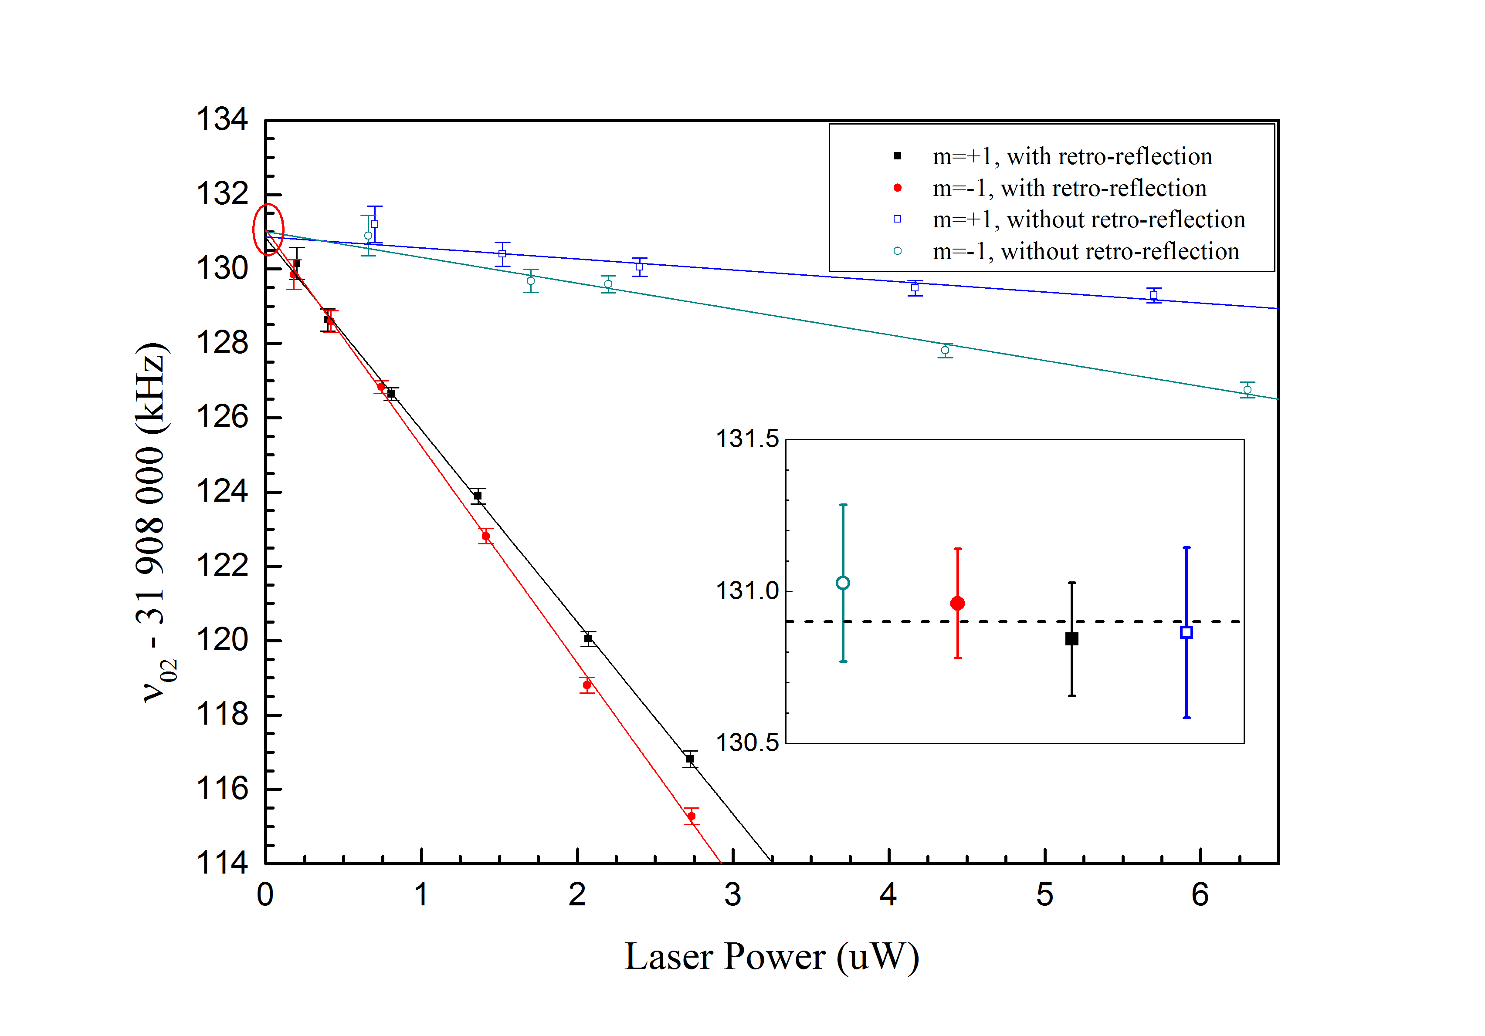
Systematic Check – Laser Power
Power is lower than
1/4 saturation intensity
Extrapolate to the
zero laser power limit
Combined with the slopes
and the linearity of laser
power measurement
Total uncertainty within 60Hz

Slide 12
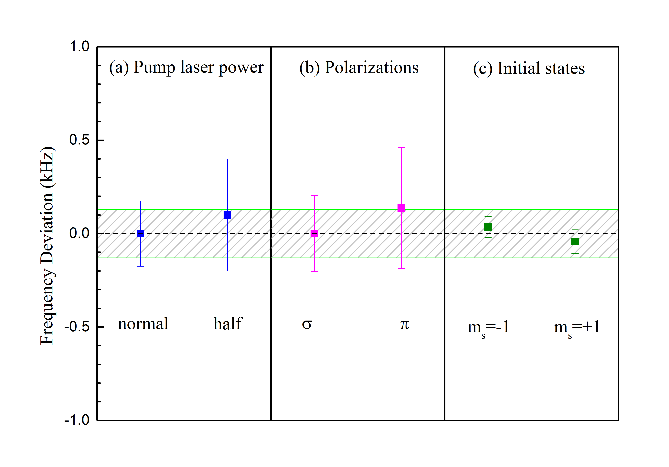
Systematic Check – Other Effect

Slide 13
Uncertainty Budget (in kHz)
Uncertainty budget(in kHz)
Source | ν₀₂ | Δν(1σ) | ν₁₂ | Δν(1σ)
Statistical | 31 908 130.90 | 0.06 | 2 291 176.35 | 0.08
Zeeman effect |  | 0.06 |  | 0.09
Laser power |  | 0.06 |  | 0.06
First-order Doppler |  | 0.03 |  | 0.03
Stray light |  | 0.02 |  | 0.02
Laser polarization |  | 0.03 |  | 0.08
Initial states |  | 0.04 |  | 0.04
Quantum interference | +0.08 | 0.03 | +1.21 | 0.10
Total | 31 908 130.98 | 0.13 | 2 291 177.56 | 0.19
Physical Review A 91, 030502(R) (2015)
Physical Review Letters 118,063001 (2017)

Slide 14
Conclusion
Pachucki’10
Pachucki’10
Hu’17
Hu’17
Hu’15
Shiner’10
Shiner’00
Gabrielse’05
Gabrielse’05
Hessels’01
Hessels’09
The uncertainty of the ν₀₂ interval is reduced to 0.13kHz
Confirmation of the α⁵Ry QED corrections
Would allow an independent determination of the α with a precision of about 2E-9
provided theoretical predictions reach a similar level of accuracy

Slide 15
He-4 (1s2p) 2³P Fine Structure Interval Splitting
Testing the QED theory
Measure the fine structure constant α
He-4 (1s2p) 2³S-2³P Transition frequency
Testing the QED theory
He nuclear charger radius

Slide 16

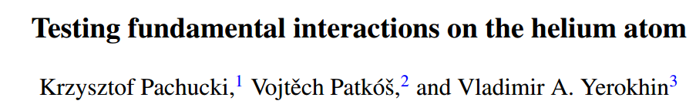
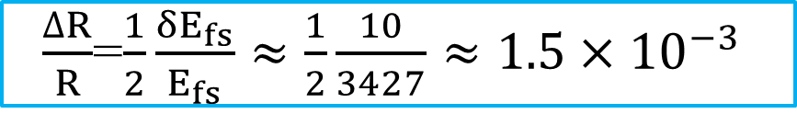
He-4 (1s2p) 2³S-2³P Transition frequency
Aim
Measure absolute frequency of 2³S-2³P of ³He and ⁴He
Accuracy at least within 10kHz
$\frac{∆R}{R}$=$\frac{1}{2}\frac{δE_{fs}}{E_{fs}}≈\frac{1}{2}\frac{10}{3427}≈1.5×{10}^{−3}$
Test of fundamental physics can be obtained
not only from the hydrogenic systems
but also from the few body atomic
Systems, such as He and He-like ions.
μ-H/H
μ-He/He
Physical Review A 95,062510 (2017)

Slide 17
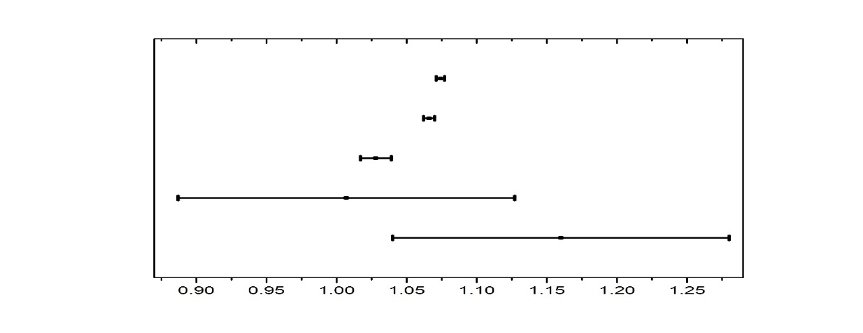
He-4 (1s2p) 2³S-2³P Transition frequency
Isotopic shift (³He&⁴He) $→$The nuclear charge radius discrepancy
2³P-2³S saturated absorption
2³P-2³S laser spectroscopy
Atom trap 2¹S-2³S
Electron-scattering
nuclear theory
δr²[³He-⁴He](fm²)
³He/⁴He 2¹S-2³S -R.van Rooij et al, Science 333,196(2011)
³He/⁴He 2³P-2³S–P.Cancio Pastor et al, PRL 108,143001(2012)
E(³He,2³P₀^{1/2}-2³S₁^{3/2})-E(⁴He,2³P₂-2³S₁）-D.Shiner, PRL 74,3553(1995)
“The results forδR² derived from the 2³P-2³S and 2¹S-2³S transitions are shown to disagree with each other by about four standard deviations. The reason of this disagreement is presently not known”
- K. Pachuchi and V. A. Yerokhin J. Phys. Chem. Ref. Data(2015)
Notes:
Another interesting thing we can do is to test the isotopic shift of the He-3 and He-4 atom. The current puzzle that 23P-23S and 21s-23s transitions disagree with each other by four standard deviations are still unknown. Take advantage of our beam system and the frequency comb system, we shall improve the current measurement to a precise of 1 kHz. So hopefully we can solve this puzzle.

Slide 18
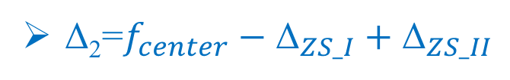
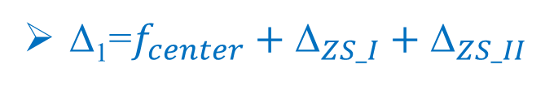

Experiment Methods
2³P₀
2³P₁
Pump laser
Δ₂
Δ₁
Probe laser
π
2³S₁
m=+1
2³S₁
m=-1
m=0
m=-1
m=0
m=+1
Δ₁=$f_{center}+{\text{Δ}}_{ZS_I}+{\text{Δ}}_{ZS_II}$
Δ₂=$f_{center}−{\text{Δ}}_{ZS_I}+{\text{Δ}}_{ZS_II}$
$f_{center}=({\text{Δ}}_{1}+{\text{Δ}}_{2}){\text{/2−}\text{Δ}}_{ZS_II}$

Slide 19
He-4 (1s2p) 2³S-2³P Transition frequency
Problem to be solved
Laser Frequency Metrology
First Order Doppler Effect

Slide 20

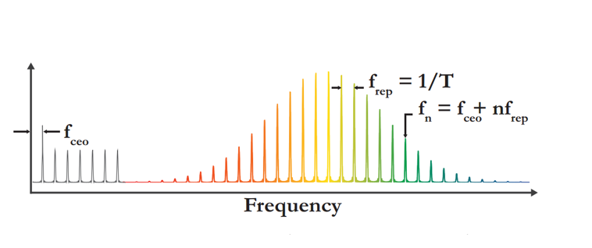
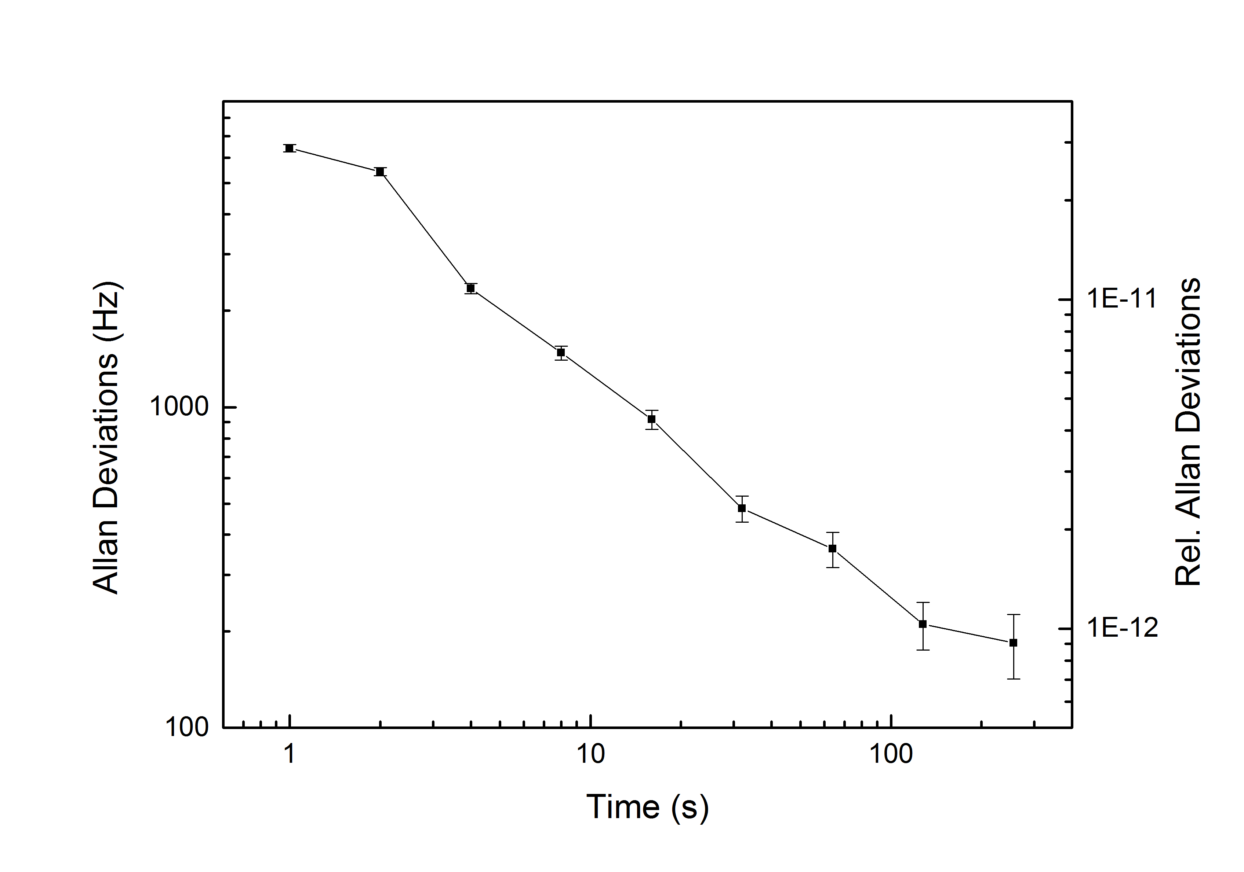
Laser Frequency Metrology
Laser Frequency Metrology
Frequency Measurement
Fiber Master Laser
PDH locking scheme
10MHz Ref clock
GPS Served
Rubidium Clock 2E-12
Frequency Comb
GPS Served Rubidium Clock
Accuracy can be within 550Hz

Slide 21
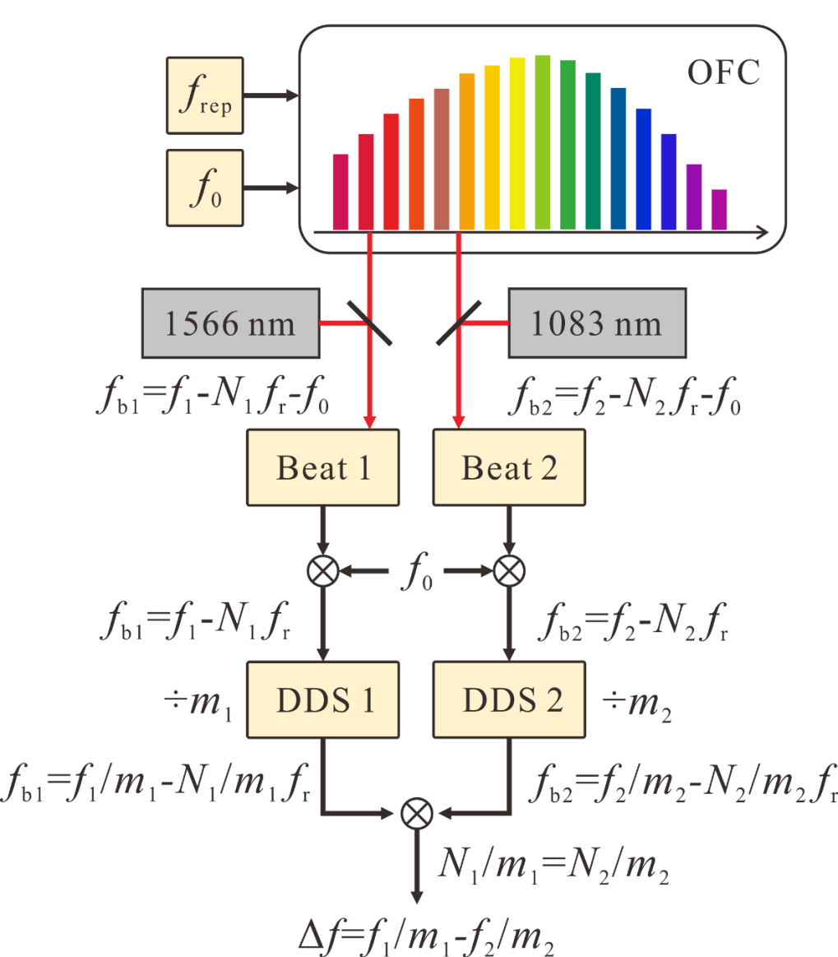
Probe laser line-width discriminate
Δf = f_{b1} – f_{b2} = f₁ – f₂ + (N₂ – N₁) f_{r}
Δf = f₁₅₆₆/m₁ – f₁₀₈₃/m₂
Y. Yao et. al. Applied Physics Letter 109,131102(2016)

Slide 22
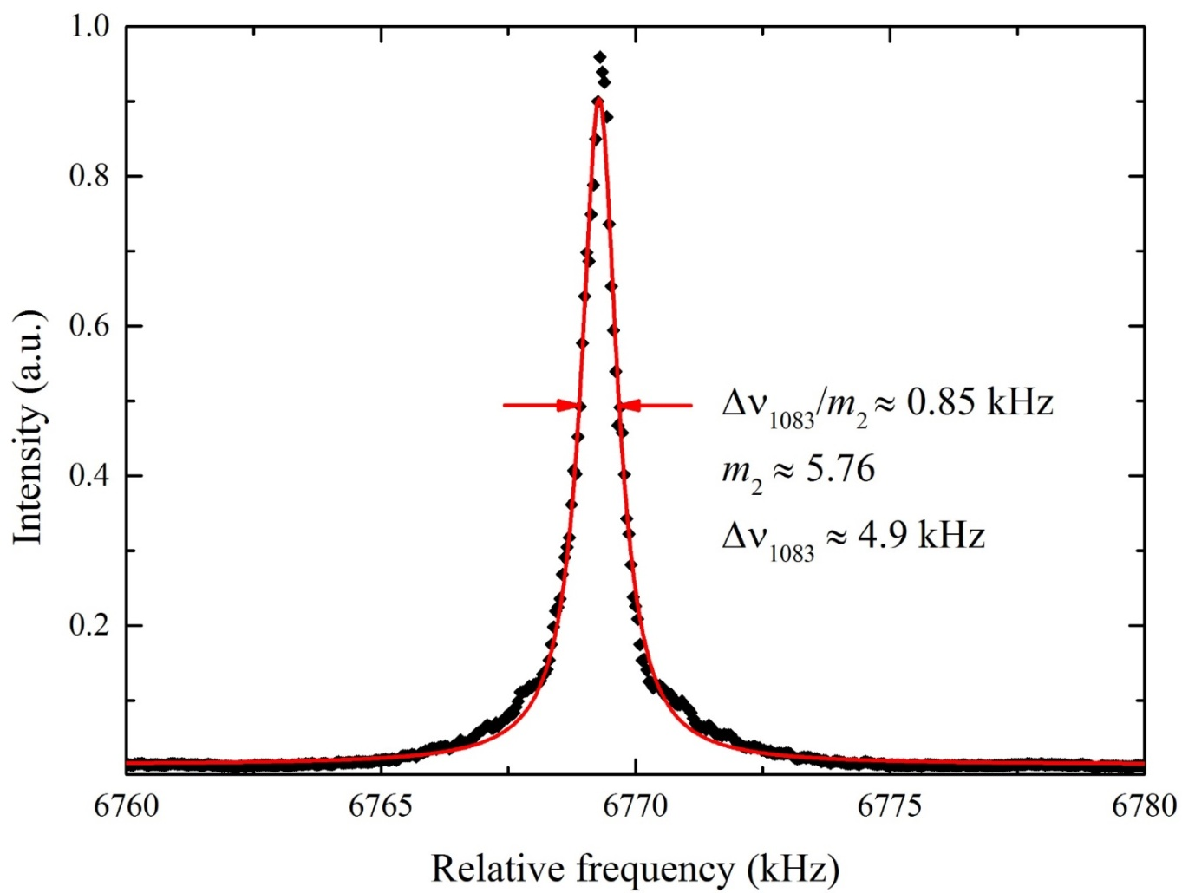
Laser line-width measurement
Avg: 60 times
Sweep time: 200 ms
RBW: 100 Hz

Slide 23
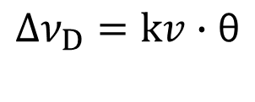
First Order Doppler
First Order Doppler
θ
$$Δν_{D}=kv∙\text{θ}$$
Probe Laser
No Doppler cancel
Atomic Beam
θ
Probe Laser
With Doppler cancel
Atomic Beam

Slide 24
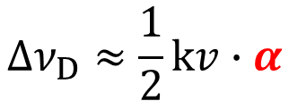
First Order Doppler—Cancel mechanism
α
Probe laser
$$Δν_{D}≈\frac{1}{2}kv∙α$$
Atomic beam
10urad correspond to about 3kHz derivation
Cancel Mechanism
Cat’s eye optical method
Active Feedback method
Fiber
Beam Splitter
Achromatic lens
Atomic beam
Collimator
Fiber head
MFD7.7um
Atomic beam
Detector
Focus=ƒ
Waist
PLL
PI
PZT-H
PZT-V
Physical Review Letters 92,023001 (2004)
PI
Can. J. Phys. 83,301 (2005)
Physical Review Letters 105,123001 (2010)
Optics Express 24,17470 (2016)

Slide 25
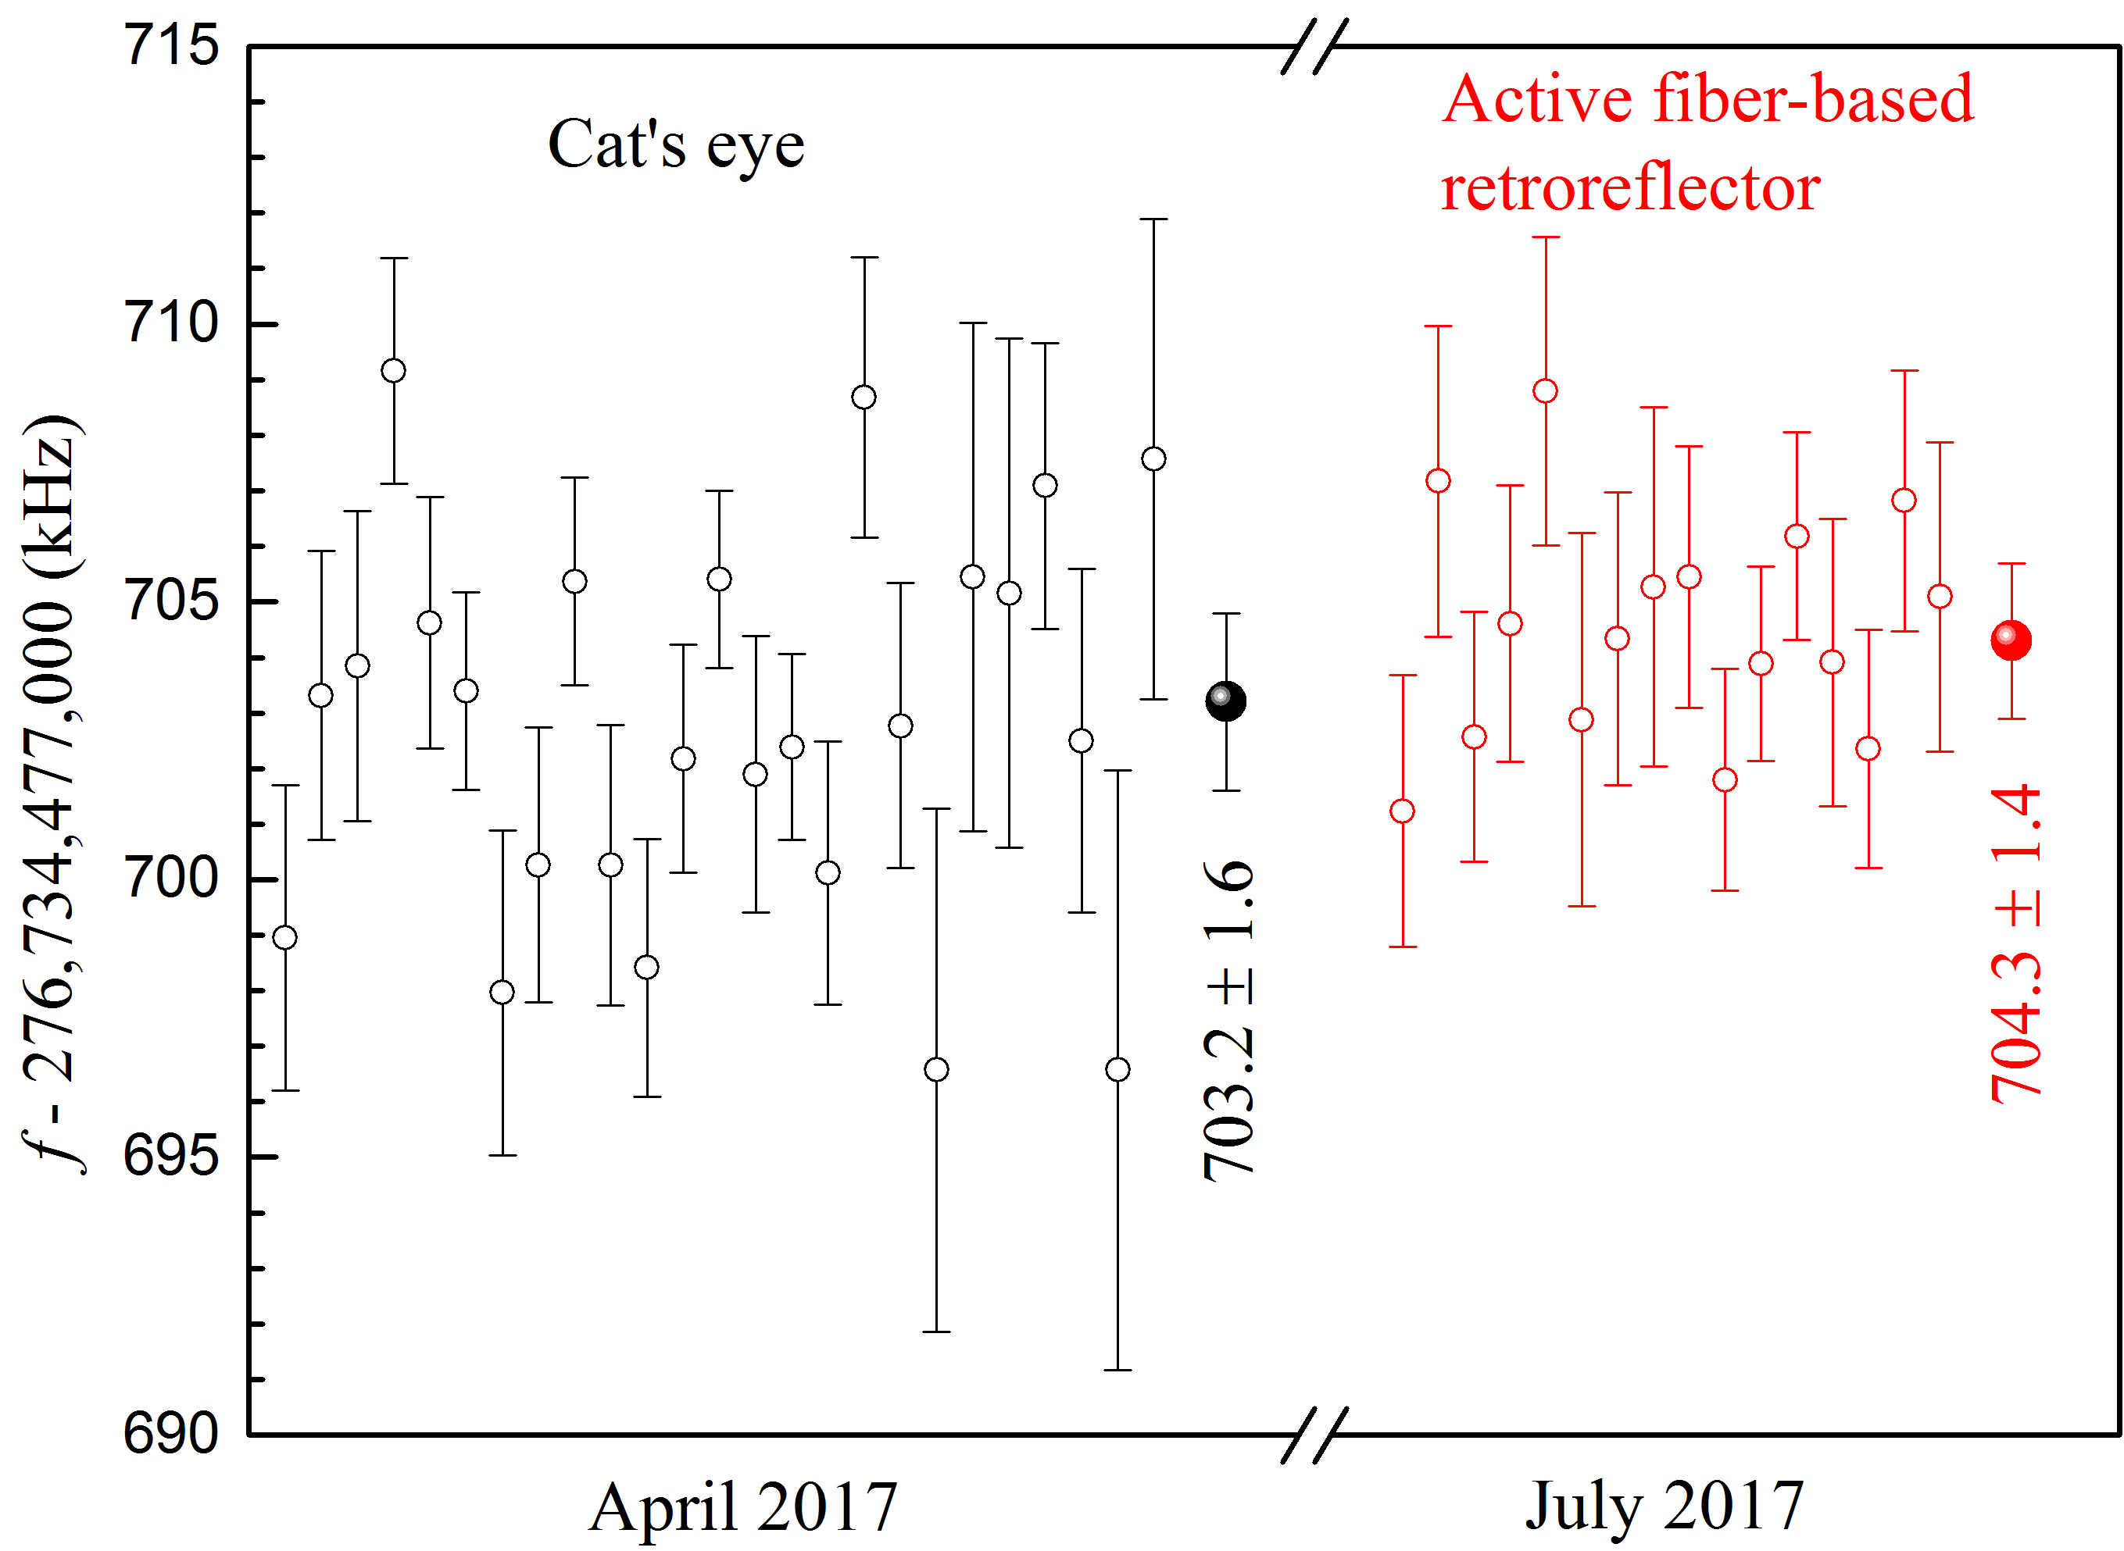
Systematic Check -- Doppler Effect
April 2017
July 2017
4

Slide 26


Doppler Effect—Atomic longitudinal velocity distribution
Measure longitudinal velocity of the atomic beam
$$Δν_{D}≈kv∙θ$$
Transvers cooling light
UV light、2¹S helium atoms
2³S helium atoms
0.5mm Slit
Probe laser
$$θ$$
0.5mm Slit
2m

Slide 27
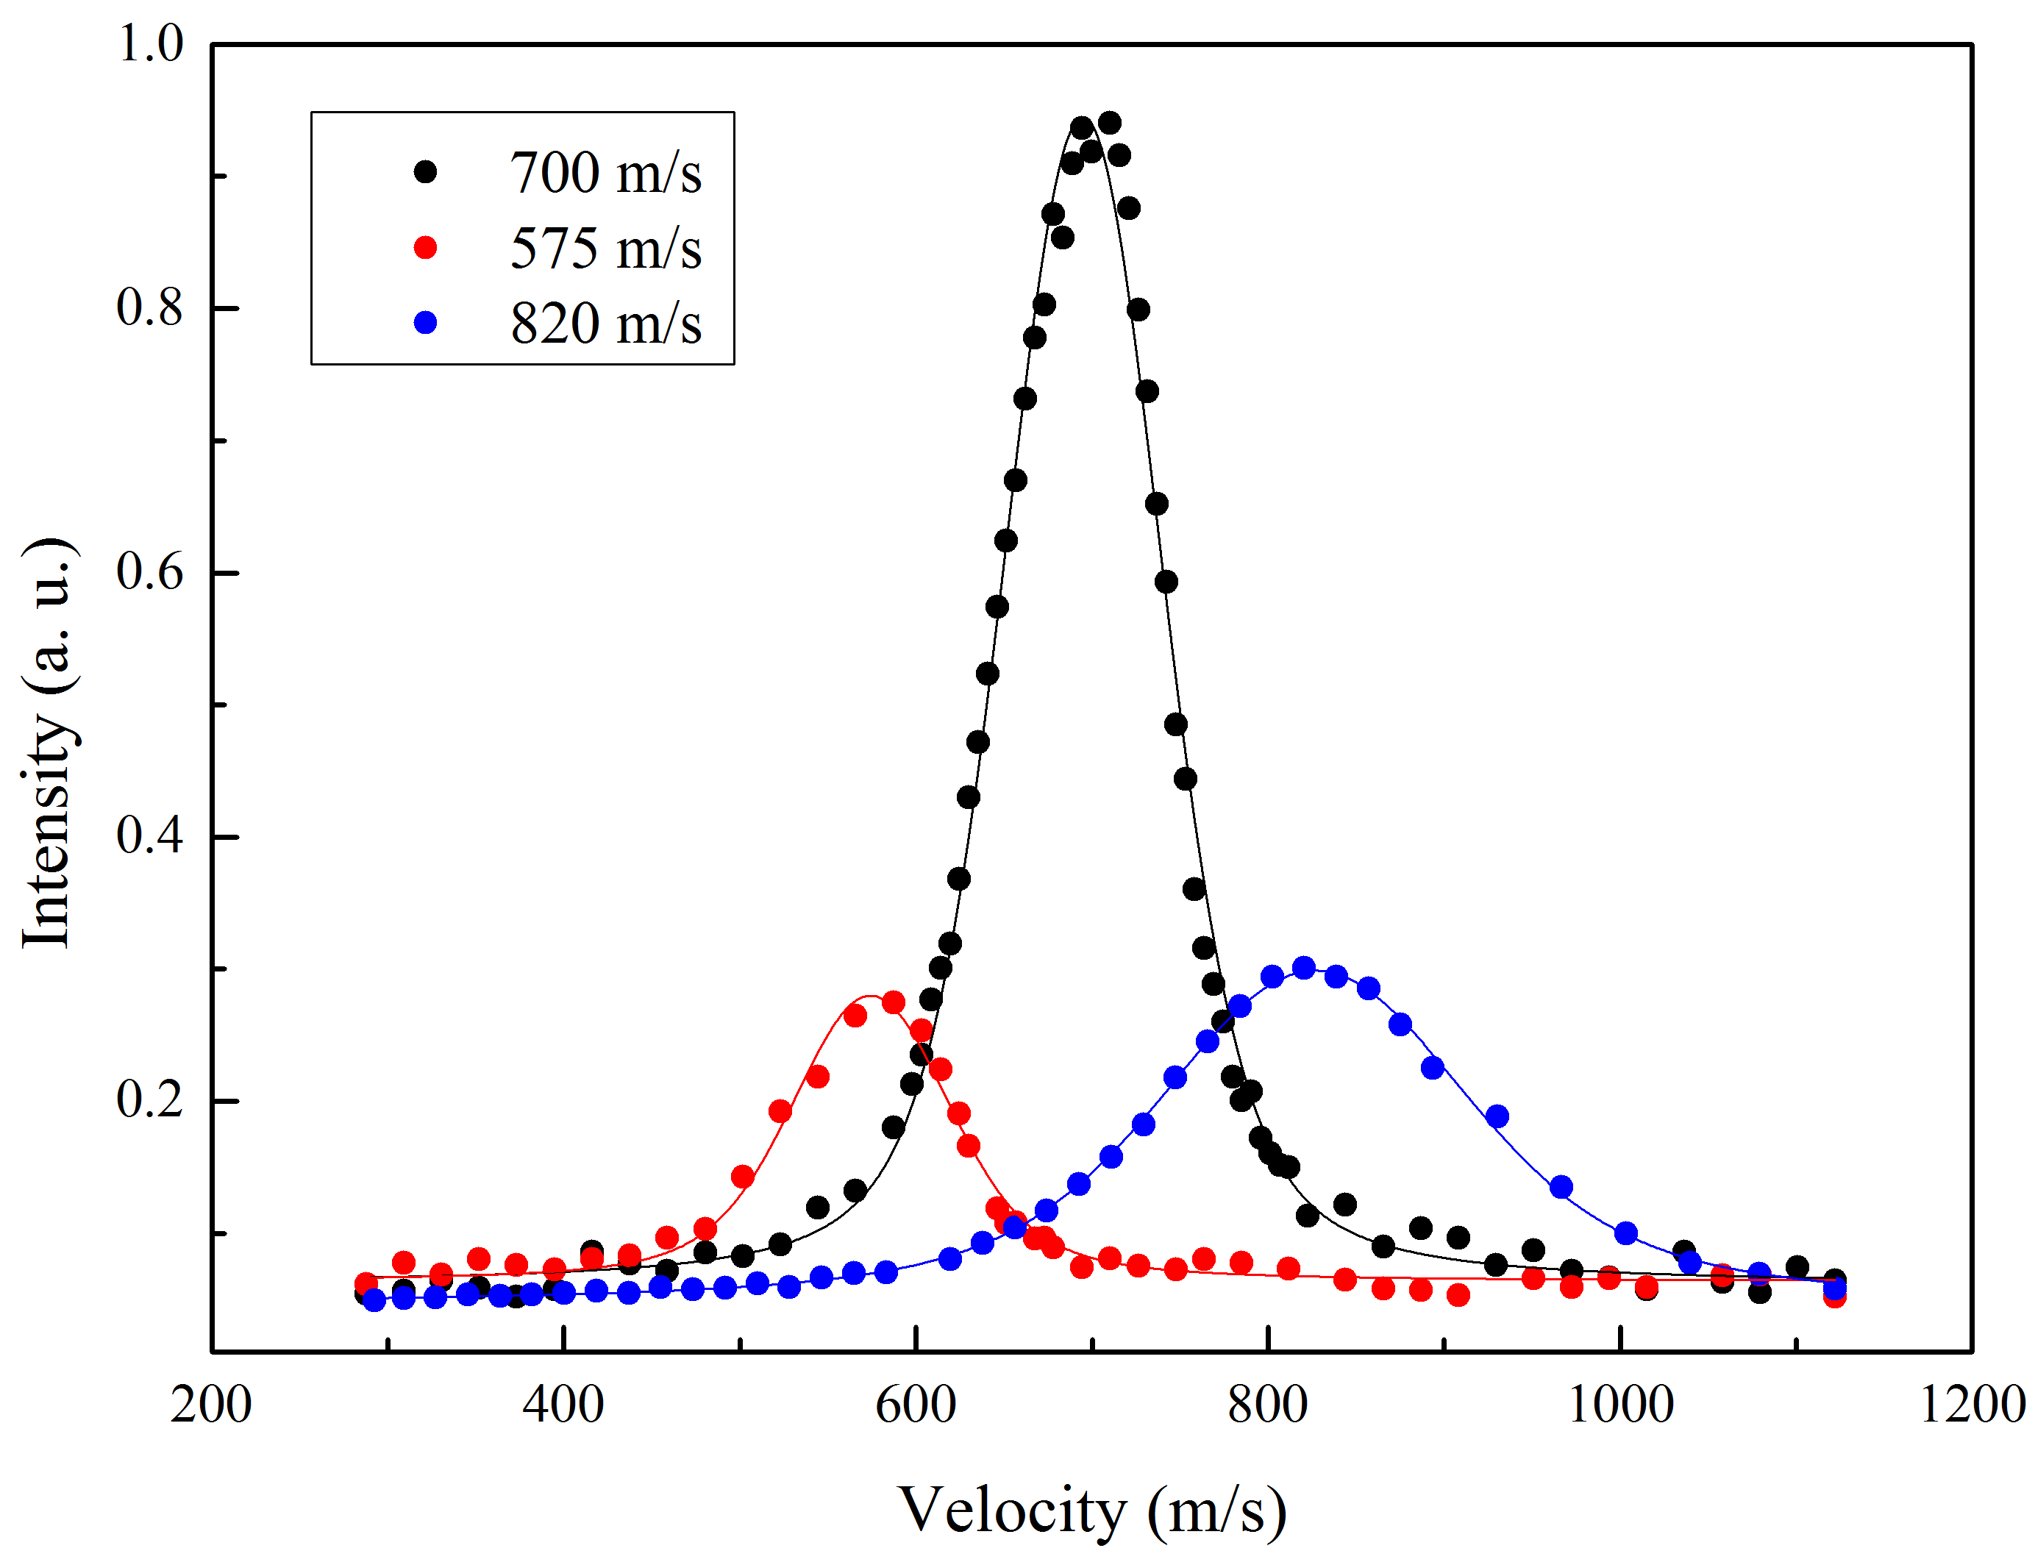
Doppler Effect—Atomic longitudinal velocity distribution

Slide 28
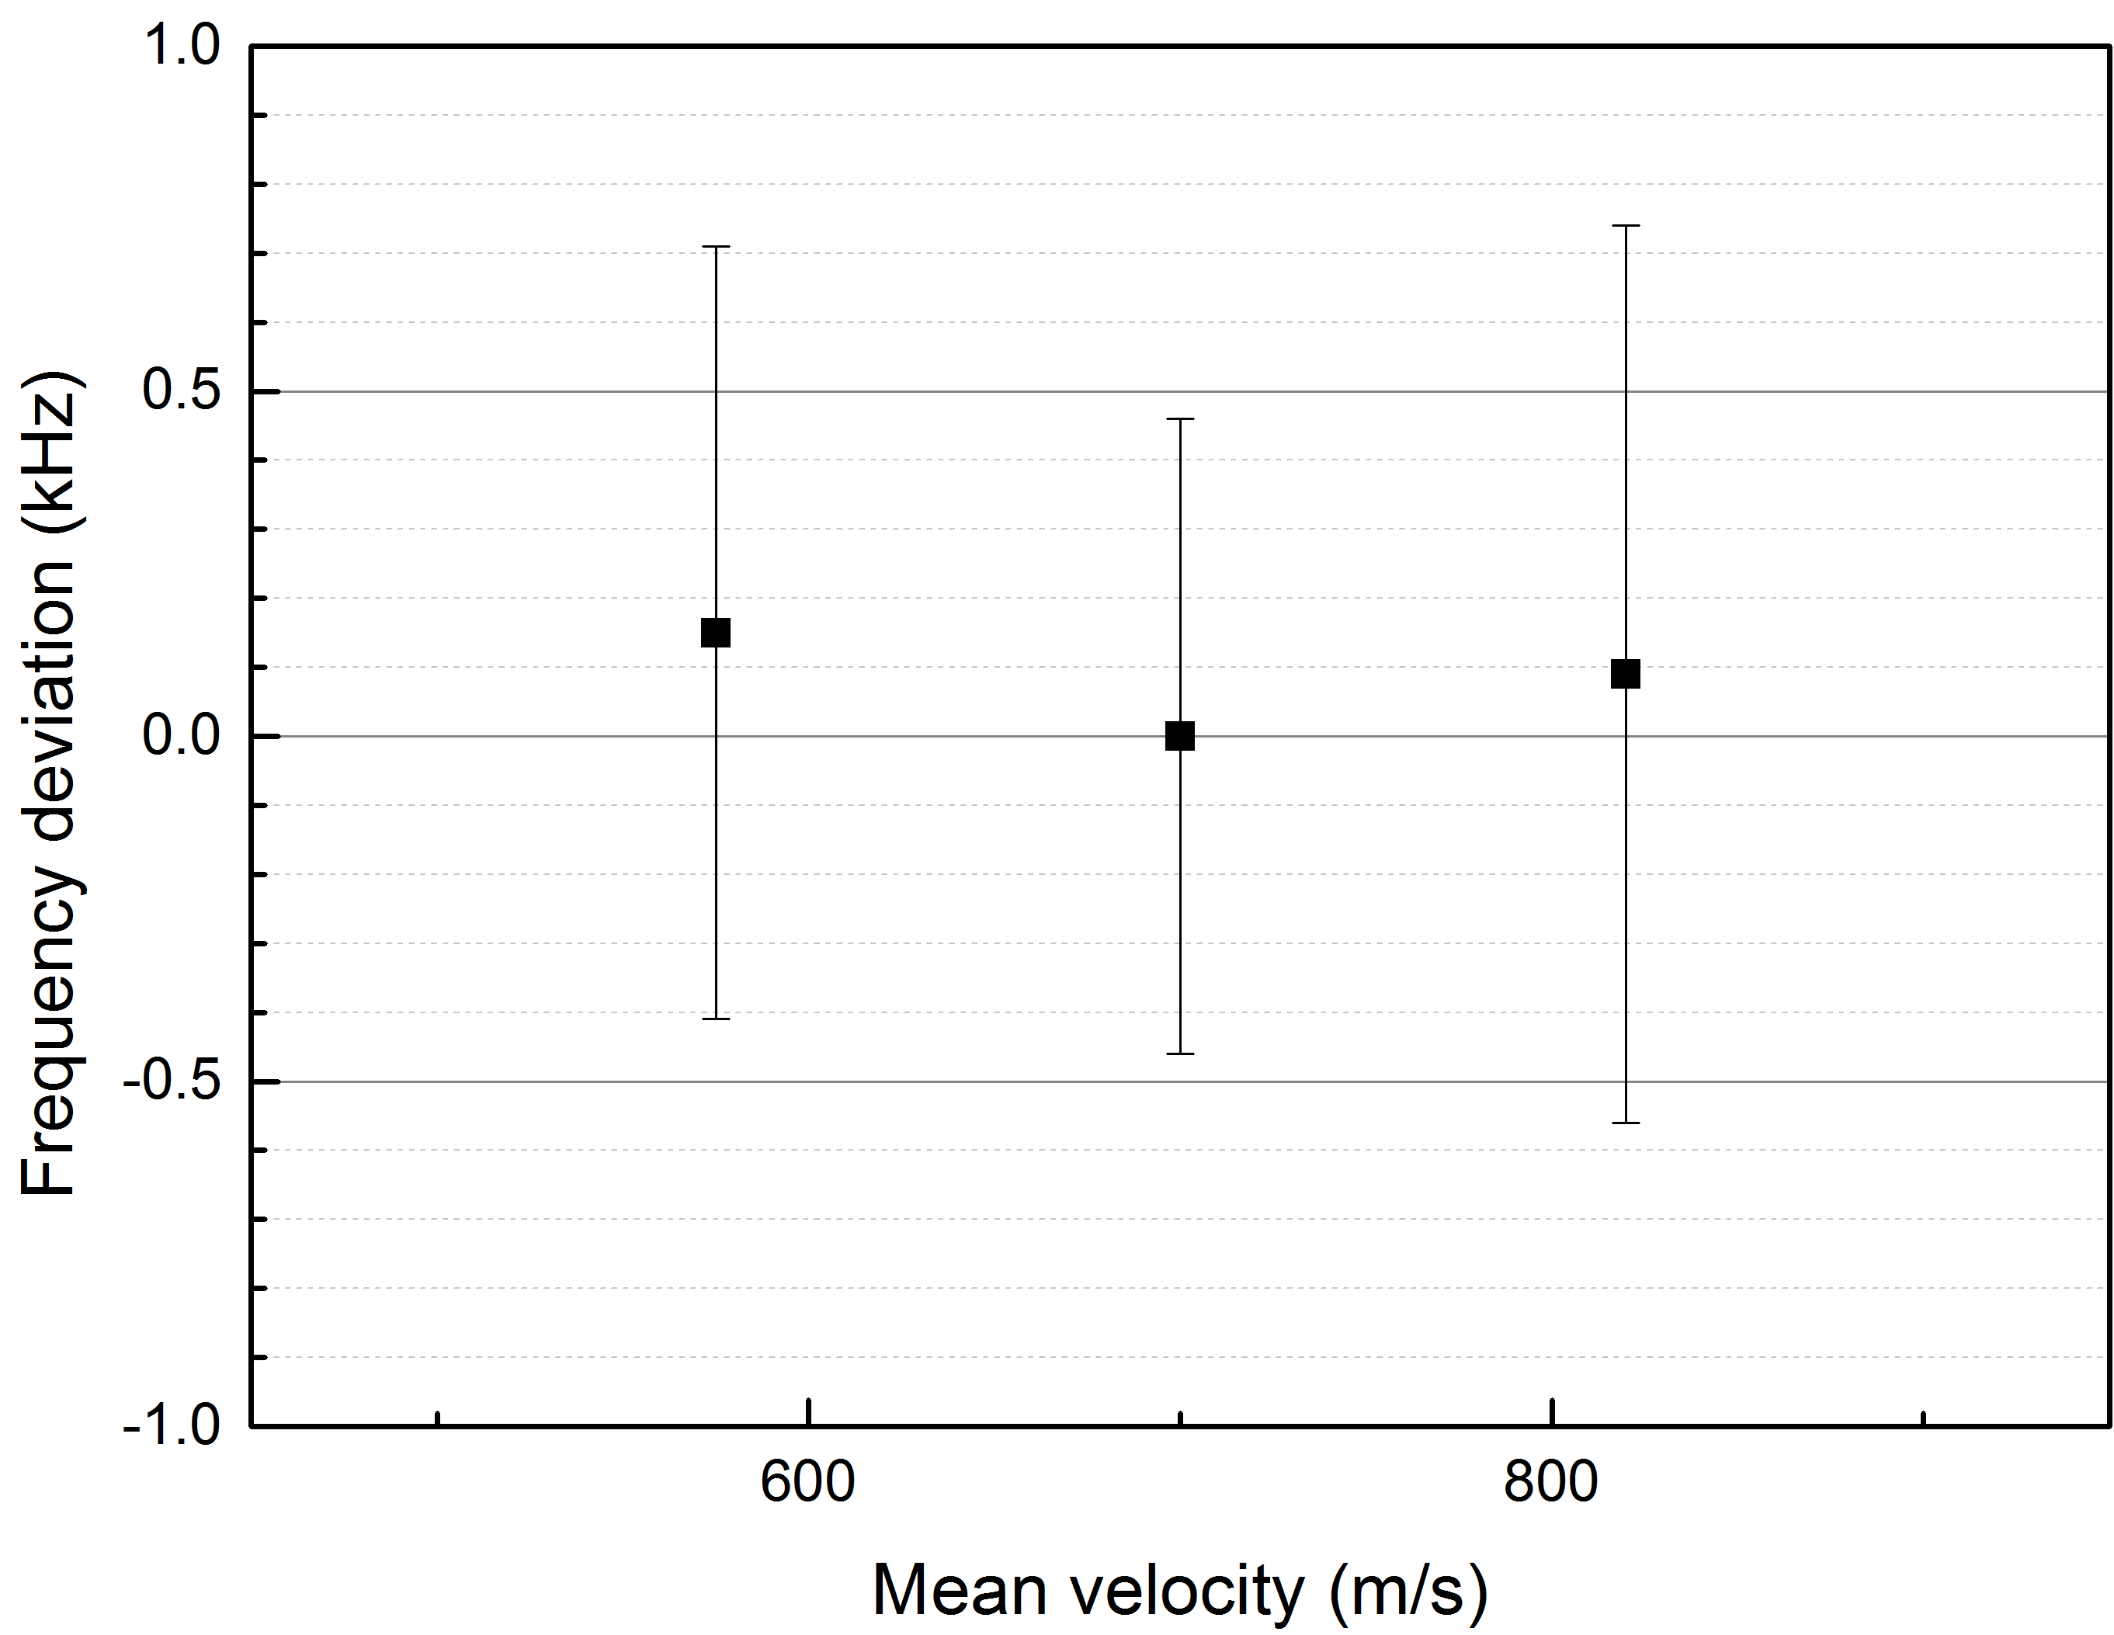
Doppler Effect—Atomic longitudinal velocity distribution
Standard Deviation
0.36kHz
Velocity Range
1/3 mean velocity
Residual first-order
Doppler shift
1.1kHz

Slide 29
Measurement of 2S-2P Transition frequency
2³S₁-2³P₁ Uncertainty budget(in kHz)
Source | Correction [kHz] | uncertainty [kHz] | Rel.uncertainty [10⁻¹²]
Statistical | - | 0.50 | 1.8
Frequency metrology | - | 0.55 | 2.0
First-order Doppler | - | 1.00 | 3.6
Line Shape | - | 0.40 | 1.2
Second-order Doppler | +0.70 | 0.15 | 0.5
Laser power | - | 0.10 | 0.3
Quantum interference | +0.60 | 0.10 | 0.3
Stray light | - | 0.05 | 0.2
Zeeman effect | - | 0.01 | 0.04
Recoil shift | -42.20 | -
Total | -40.90 | 1.4 | 5.0
 | ƒ₀ | ƒ₁ | ƒ₂
USTC | 276 764 094 657.2(1.4) | 276 734 477 703.8(1.4) | 276 732 186 526.2(1.4)
Florenceª | 276 764 094 707.3(2.1) | 276 734 477 752.5(2.0) | 276 732 186 620.2(15.0)

Slide 30
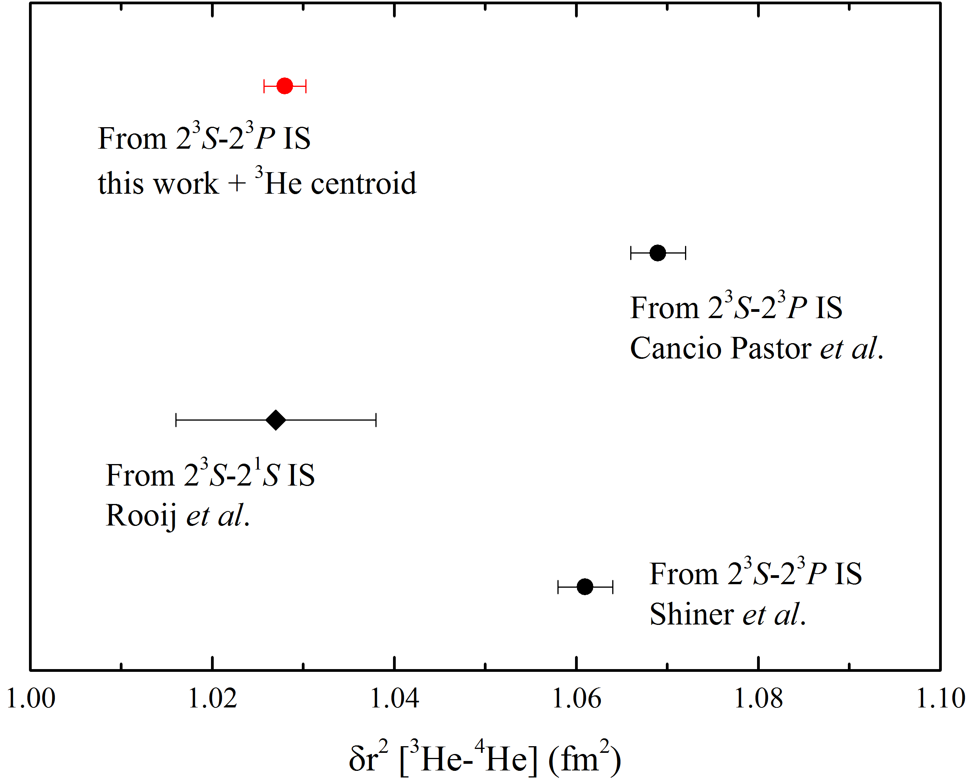
Measurement of 2S-2P Transition frequency
?
USTC ⁴He 2017+³He Florence 2012
(Florence 2012)
Florence 2004 ⁴He+Florence 2012 ³He
Amsterdam 2011
Yale 1995

Slide 31
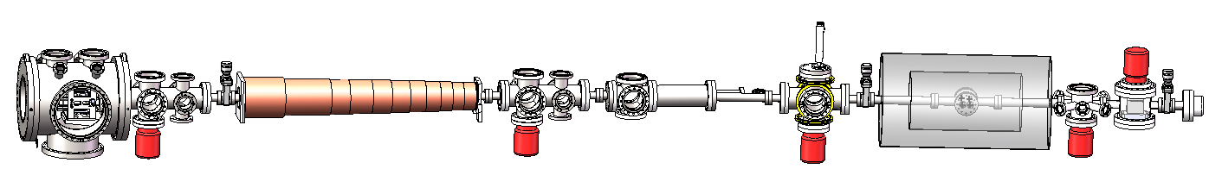

Outlook
Further improvement of the accuracy to 1kHz or sub-kHz
Transverse Cooling
Zeeman Slower
Stern-Gerlach
2D-MOT
2D-MOT
deflect
pump
probe
RF
excitation
Laser Cooling
State preparation
Spec. measurement
State-selection
Detection
Use Zeeman Slower to Reduce the velocity to 100m/s
Reduce an order of factor of first order Doppler effect
Velocity extrapolation
Second-Doppler Effect Estimate
Jiao-Jiao Cheng
Notes:
In the meanwhile we would like to make some improvement of our old setup to make a better fine measurement. We plan to use..

Slide 32






Acknowledgement
USTC
Thank You !!!
Shui-ming Hu
Xin Zheng
Zheng-Tian Lu
Jiao-Jiao Chen
Wei Jiang
NIM
NTS
Zhan-Jun Fang
Fei Meng
Hai-Feng Jiang
University of Warsaw
K. Pachuchi
UNB (CA)
Zong-Chao Yan
Funding:

Slide 34
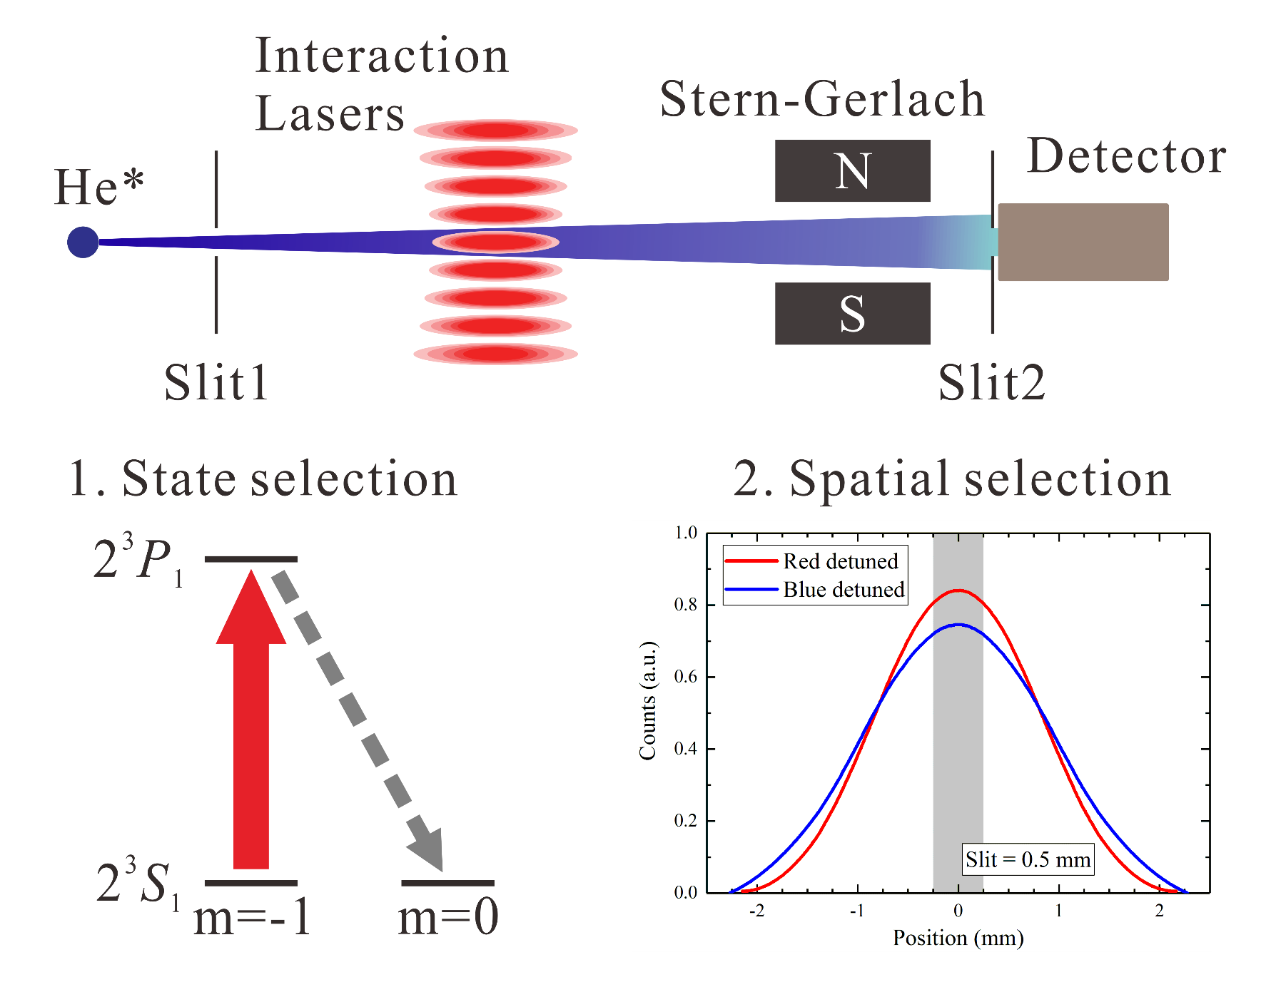

Slide 35
