Slide 1

Michael W. Heiss
ETH Zürich – Institute for Particle Physics and Astrophysics – group of Prof. Rubbia
Positronium precision spectroscopy:
Measuring the 1S-2S and excited state hyperfine transitions
this work is supported by the SNF grant 166286 - PI: Paolo Crivelli

Slide 2
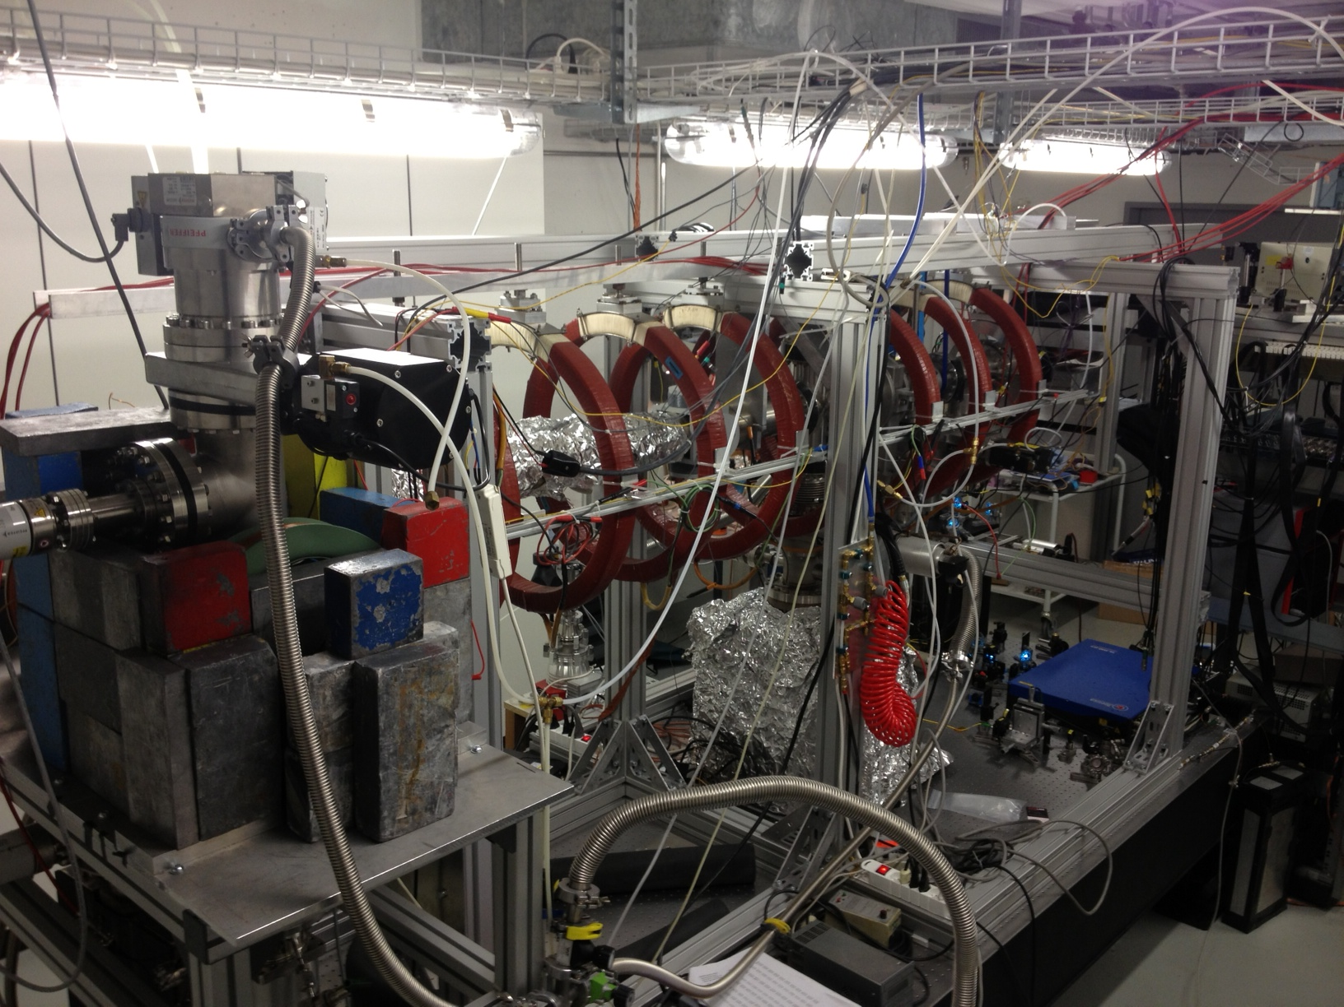
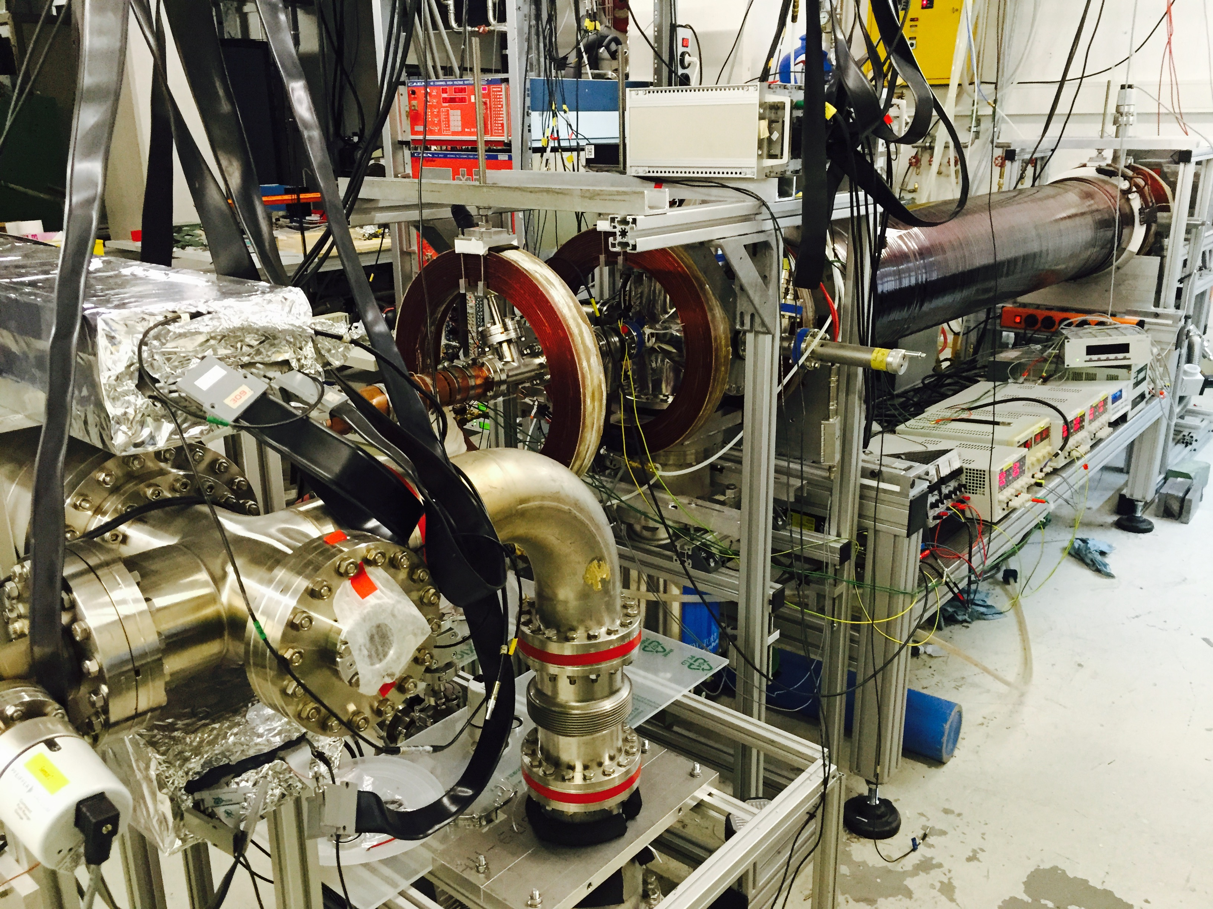
ETH slow positron beamlines
Continuous beam (since 2012)
Pulsed beam (since 2015)
Pulsed beam (since 2015)

Slide 3
ETH slow positron beamlines
Continuous beam (since 2012)
Pulsed beam (since 2015)
Pulsed beam (since 2015)
see talk by
Carlos Vigo Hernandez
tomorrow, 16:50

Slide 4
ETH slow positron beamlines
Continuous beam (since 2012)
Pulsed beam (since 2015)
Pulsed beam (since 2015)
see talk by
Carlos Vigo Hernandez
tomorrow, 16:50
+Bonus: e+ moderation, back-scattering, Ps formation

Slide 5
ETH slow positron beamlines
Continuous beam (since 2012)
Pulsed beam (since 2015)
Pulsed beam (since 2015)
see talk by
Carlos Vigo Hernandez
tomorrow, 16:50
+Bonus: e+ moderation, back-scattering, Ps formation

Slide 6

Motivation – Part 1 1S-2S HFS
Ps is purely leptonic system
(almost) free from
  QCD effects
  weak force effects
Precision test bench for
  bound state QED

Slide 7
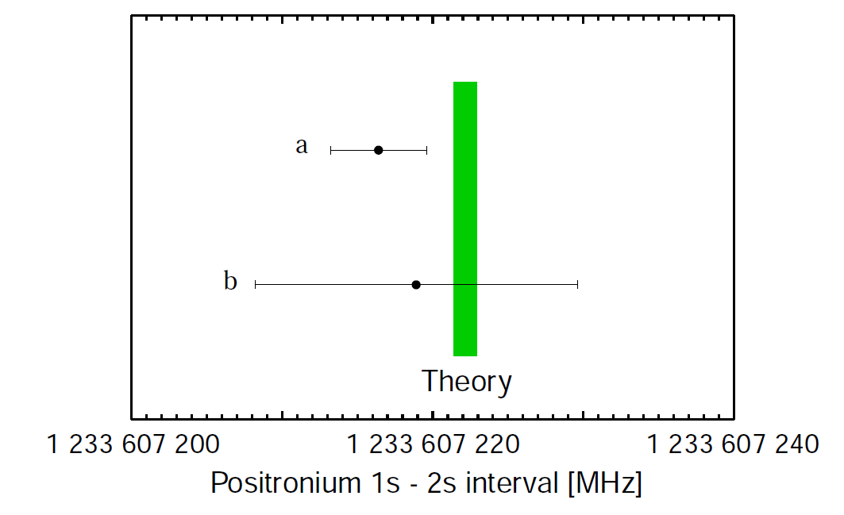
Motivation – Part 1 1S-2S HFS
Theory:
Ps is purely leptonic system
(almost) free from
  QCD effects
  weak force effects
Precision test bench for
  bound state QED
1S-2S transition
  0.5 ppb precision
  check bound state QED up to order α⁷m
ν^{theory} = 1233607222.2(6) MHz
K. Pachucki and S.G. Karshenboim,
Phys. Rev. A60, 2792 (1999).
K. Melnikov and A. Yelkhovsky,
Phys. Lett. B458, 143 (1999).
G. Adkins, Parsons and Fell,
PRL 115 233401 (2015)
Experiments:
νª = 1233607216.4(3.2) MHz
M. S. Fee et al., Phys. Rev. Lett. 70, 1397 (1993)
ν^{b} = 1233607218.9(10.7) MHz
see next talk by
Gregory Adkins
S. Chu, A. P. Mills, Jr. and J. Hall, Phys. Rev. Lett. 52, 1689 (1984)
S. G. Karshenboim, Phys. Rep. 422, 1 (2005)

Slide 8
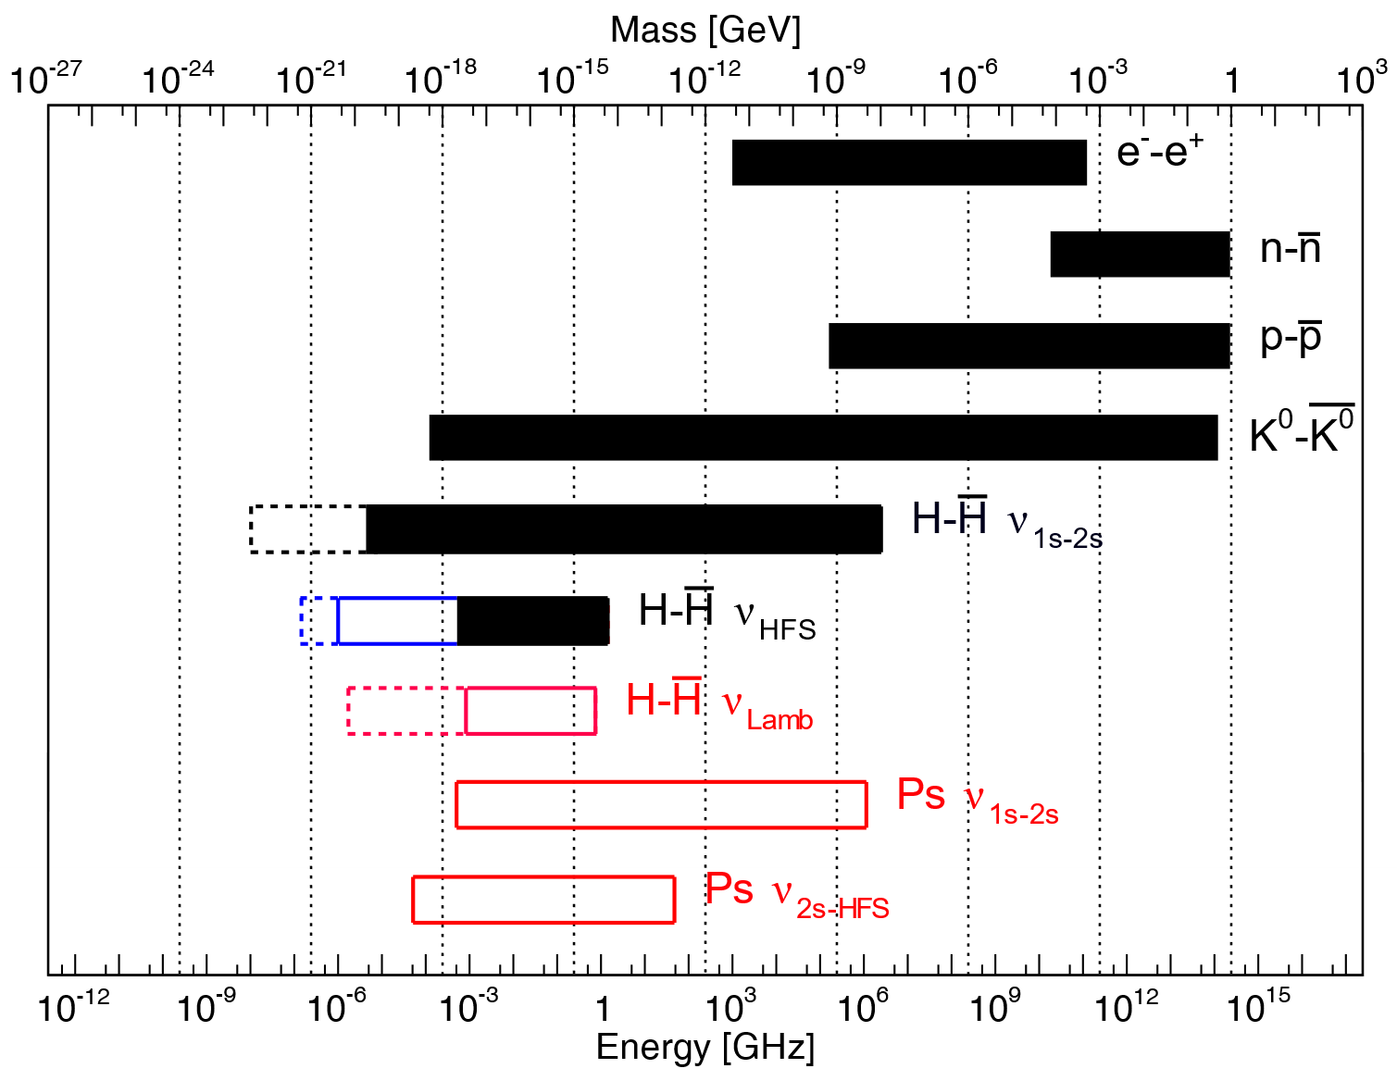
Additional Motivation: CPT violation
see talks on behalf of
ALPHA and ASACUSA
Adapted from: E. Widmann et al., Hyperfine Interact. 215, 1 (2013).

Slide 9
Ps 1S-2S: laser system
Requirements:
- High power (up to 1 kW) at 486 nm → detectable signal
- Long term stability (continuous data taking over days)
- Scanning of the laser ≈ 100 MHz

Slide 10
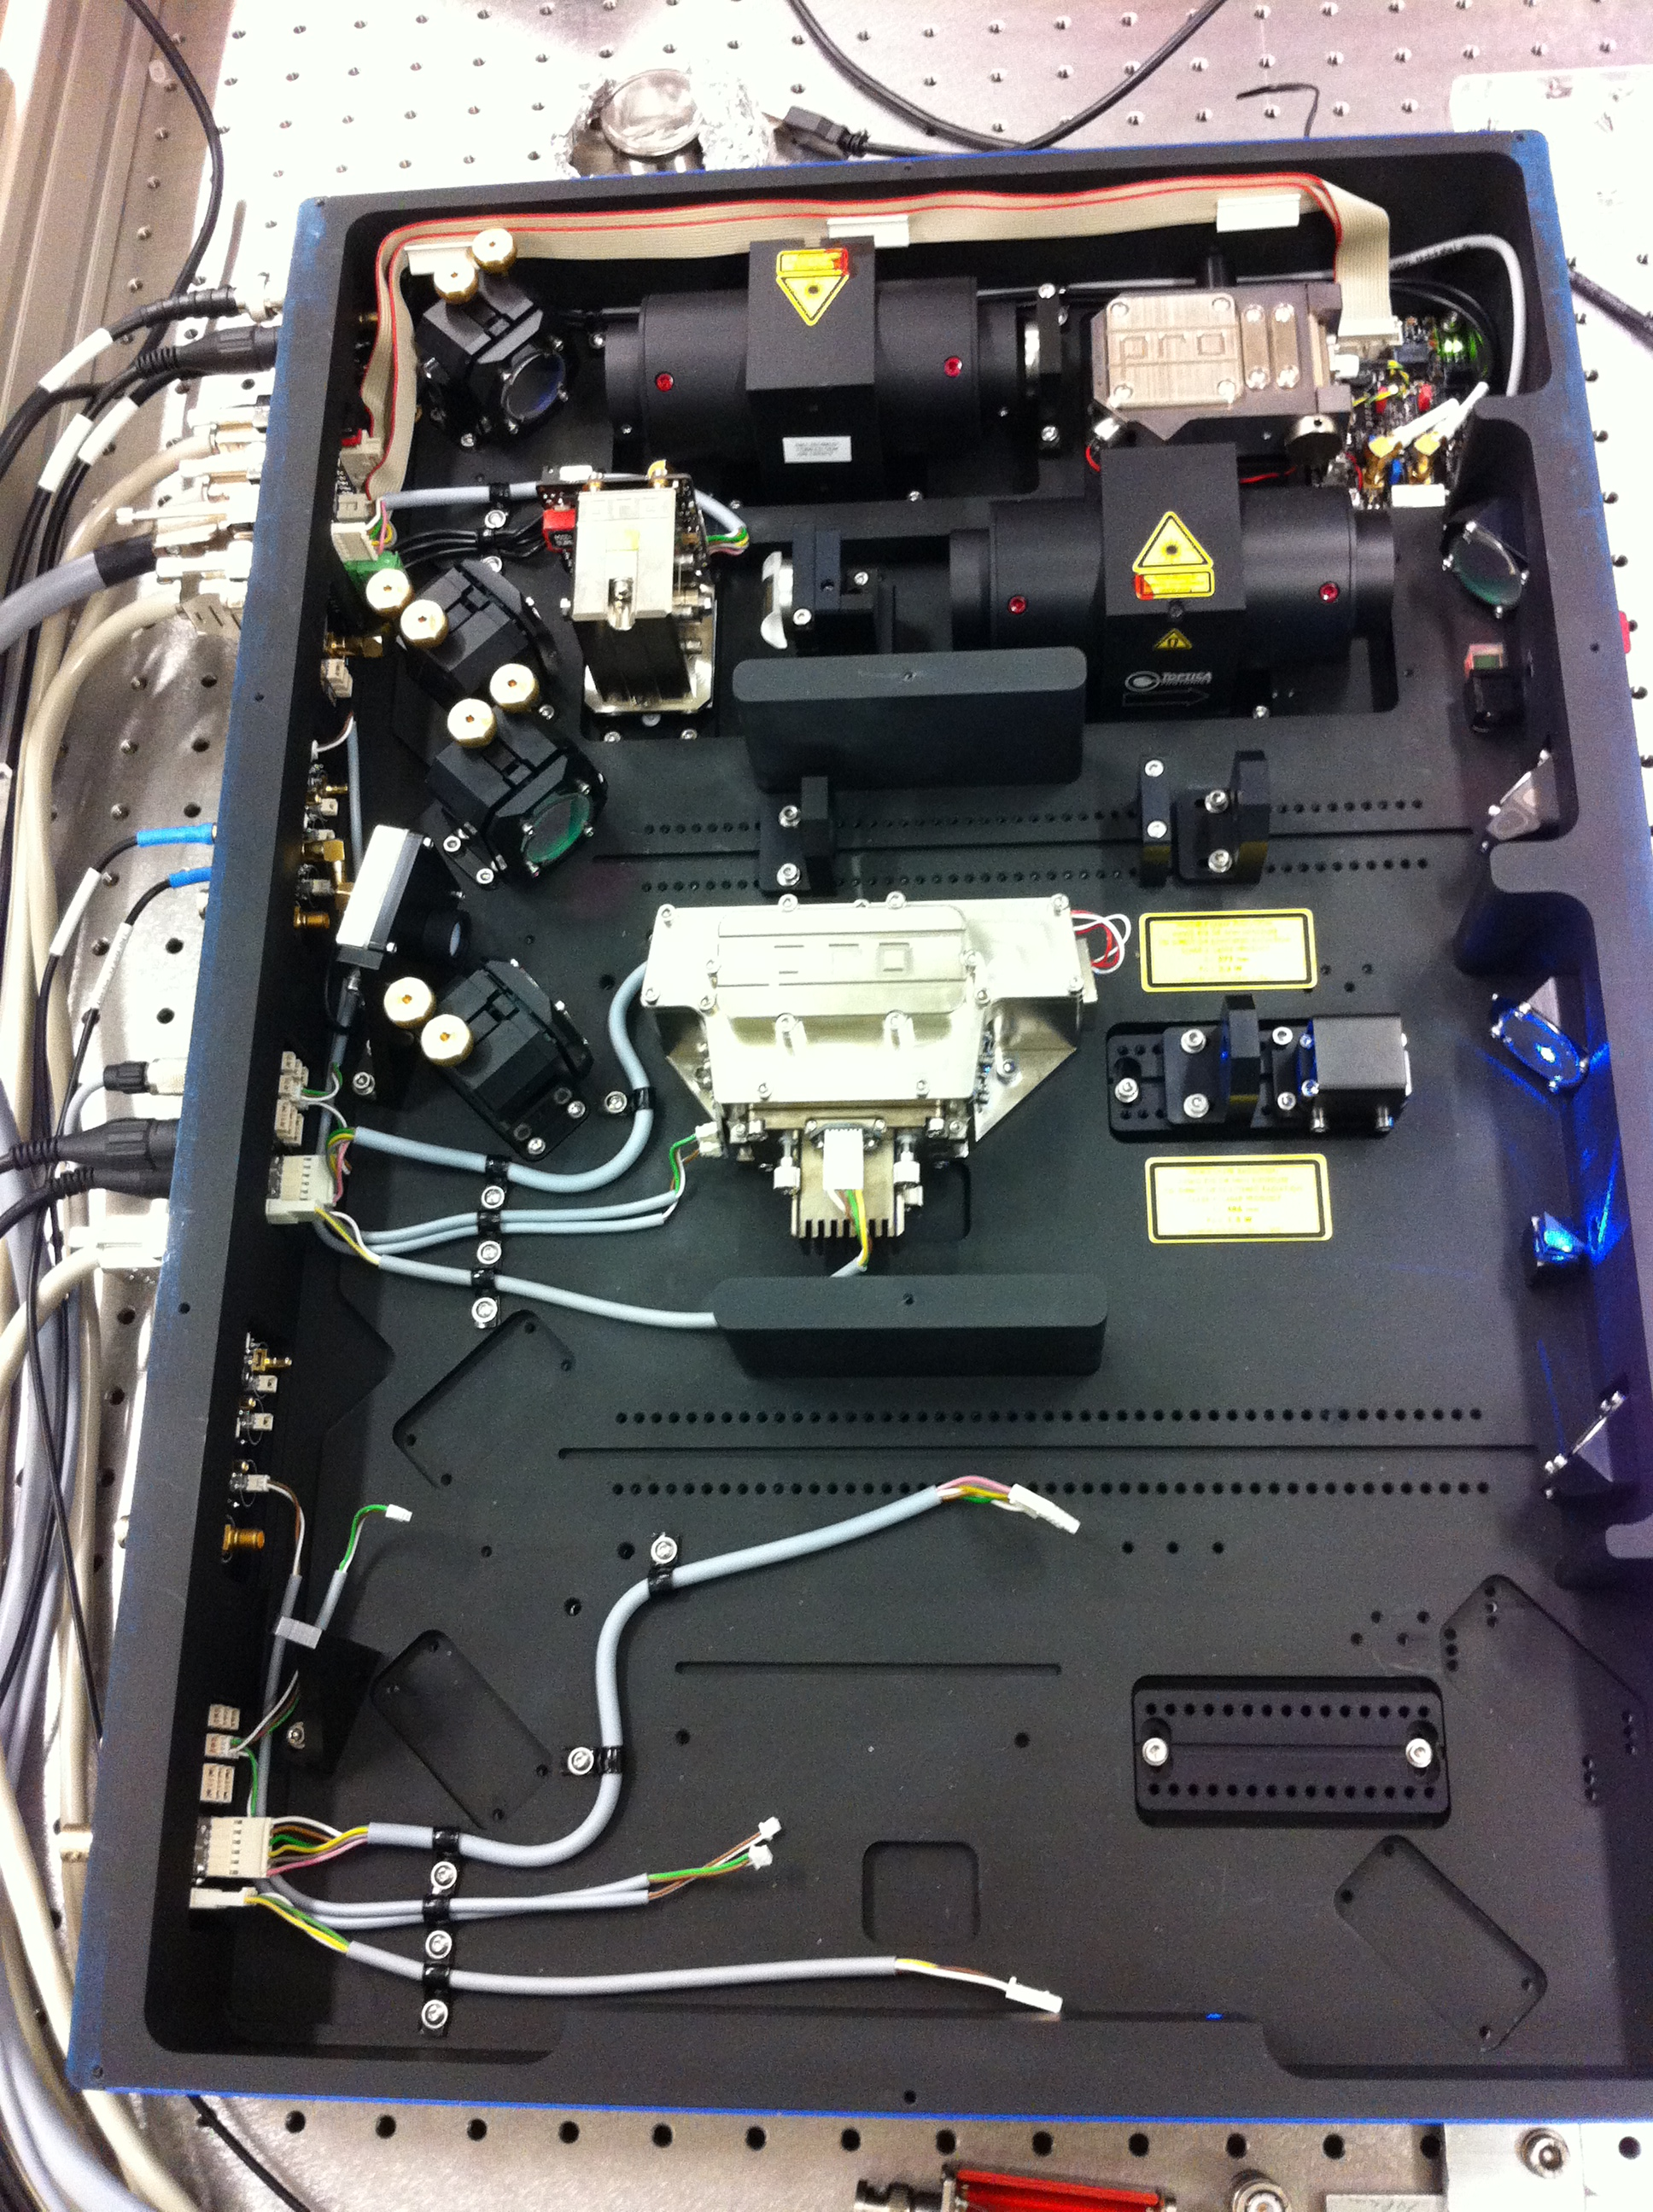
Ps 1S-2S: laser system
972nm diode laser
Requirements:
- High power (up to 1 kW) at 486 nm → detectable signal
- Long term stability (continuous data taking over days)
- Scanning of the laser ≈ 100 MHz
3W Tapered
Amplifier
SHG cavity with LBO crystal
Light at 486nm
1W, 200kHz

Slide 11
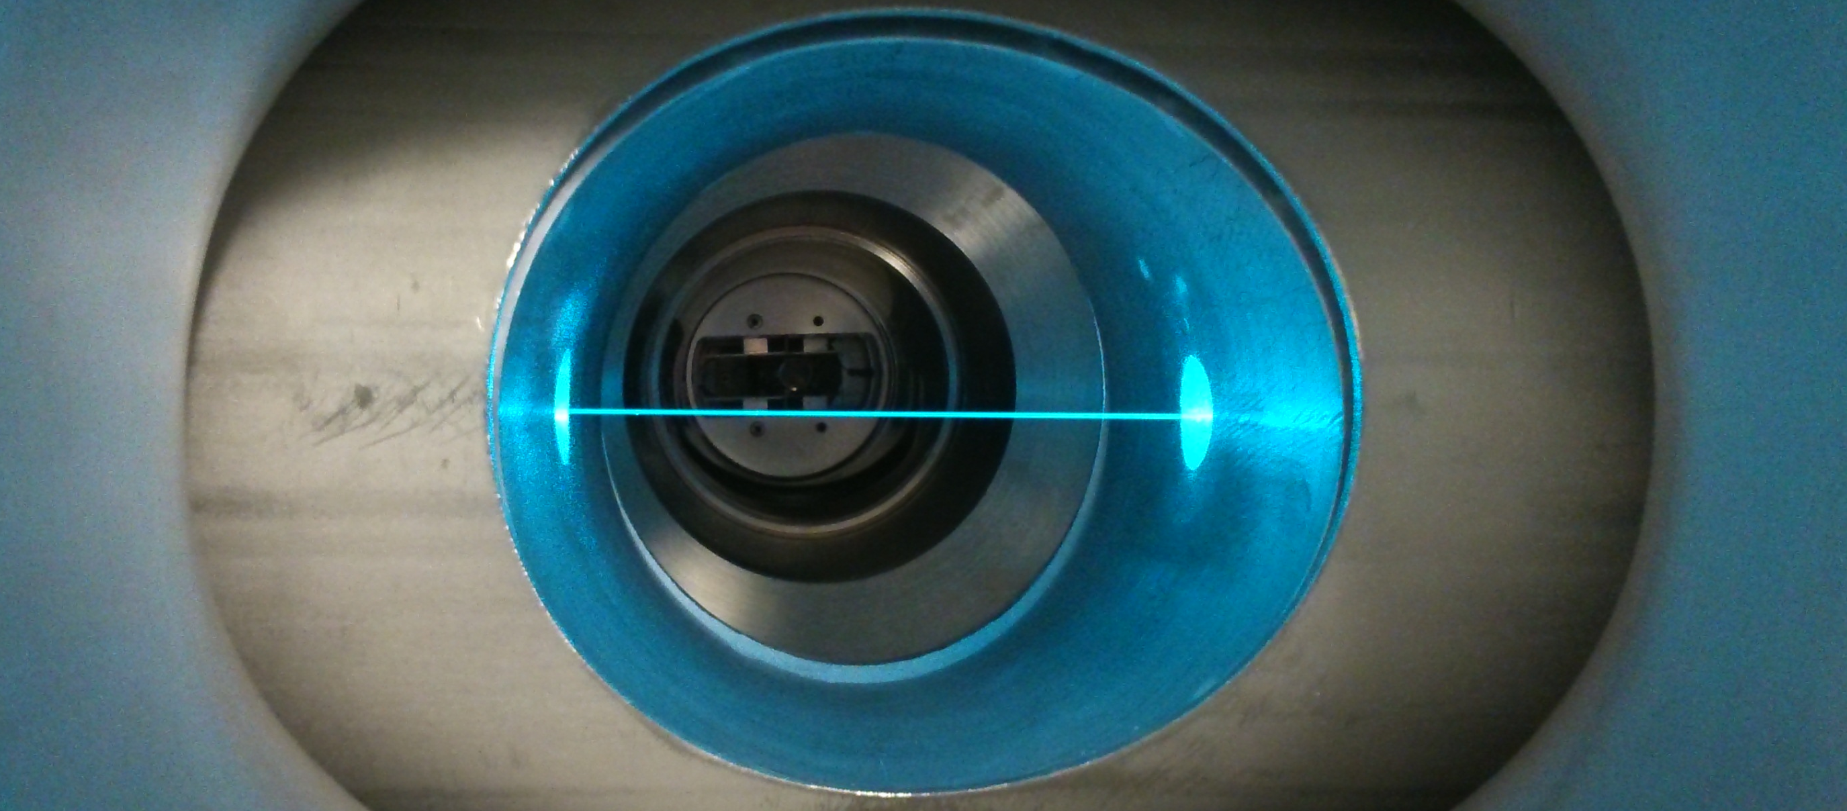
Ps 1S-2S: laser system
972nm diode laser
Requirements:
- High power (up to 1 kW) at 486 nm → detectable signal
- Long term stability (continuous data taking over days)
- Scanning of the laser ≈ 100 MHz
3W Tapered
Amplifier
Incoming
laser beam
e+ beam
SHG cavity with LBO crystal
oPs
Light at 486nm
1W, 200kHz
Ps target
Vacuum 10⁻⁹ mBar
Mirror 1 mounted in double piezo-actuator
Mirror 2
High finesse resonator for power build up
500 mW 1 kW

Slide 12
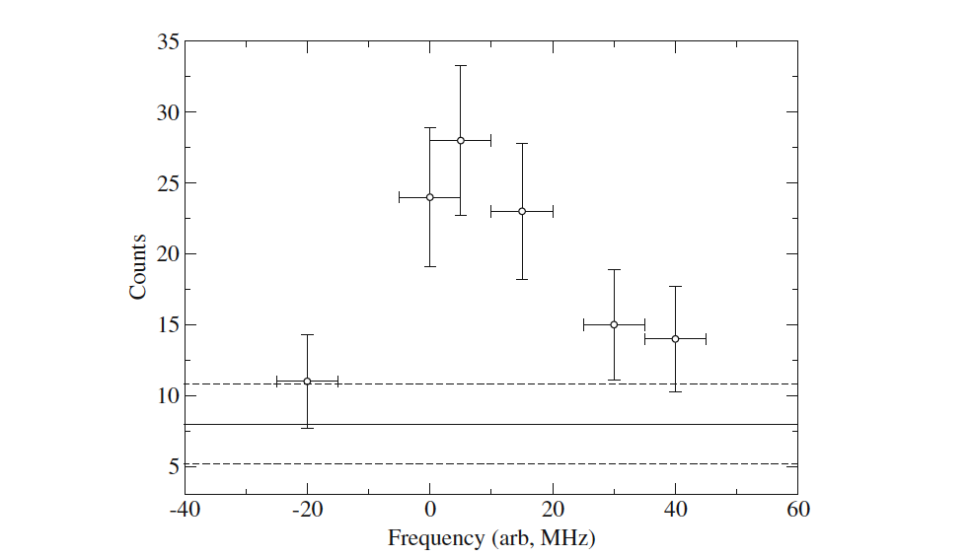
Ps 1S-2S: preliminary results (2014)
First successful scans
(about 3 hours data taking,
~ 10⁶ positronium atoms/point)
S/N ratio should be improved.
D.Cooke et al, Hyperfine Interact. 233 (2015) 1-3, 67.

Slide 13
Ps 1S-2S: preliminary results (2014)
First successful scans
(about 3 hours data taking,
~ 10⁶ positronium atoms/point)
S/N ratio should be improved.
Need for a bunched beam → use buffer gas trap
→ noise from accidentals reduced by 2 orders of magnitude
→ In addition to lifetime method possibility to use pulsed lasers for systematic studies and increased signal rate
D.Cooke et al, Hyperfine Interact. 233 (2015) 1-3, 67.

Slide 14
Ps 1S-2S: Updated detection techniques
PbWO4
486nm
SiO₂
target
MCP
PI e+
e⁺
MCP
Mu-metal shield
Direct photo-ionization in the exciting laser

Slide 15
Ps 1S-2S: Updated detection techniques
PbWO4
486nm
SiO₂
target
MCP
PI e+
e⁺
MCP
532nm
Mu-metal shield
Direct photo-ionization in the exciting laser
2S photo-ionization in separate laser

Slide 16
Ps 1S-2S: Updated detection techniques
PbWO4
486nm
SiO₂
target
MCP
Rydberg Ps
e⁺
MCP
~400ns TOF
~736nm
Mu-metal shield
Direct photo-ionization in the exciting laser
2S → Rydberg (e.g. 20P) and field ionization on MCP
  allows for correction of second order doppler shift (main systematic!)

Slide 17
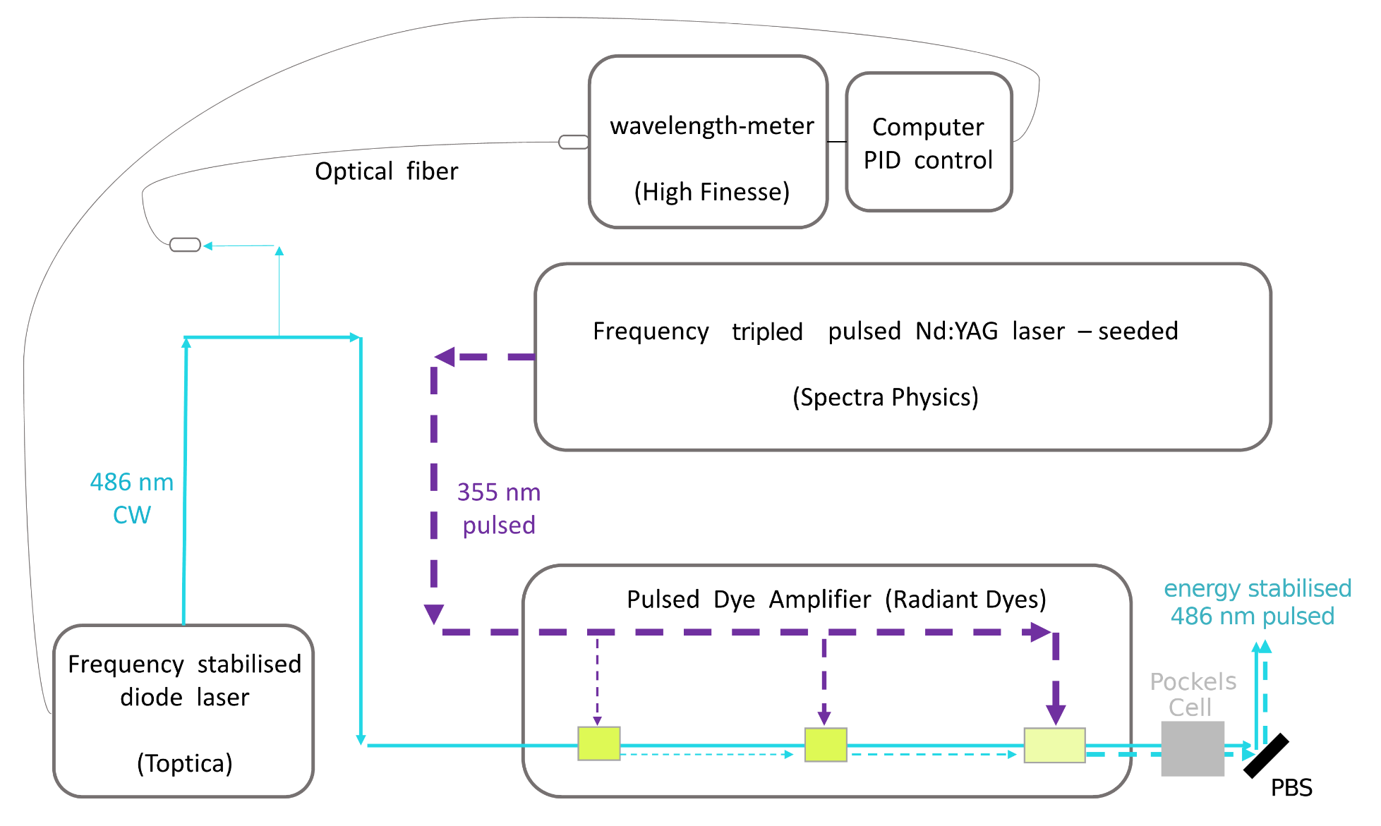
Ps 1S-2S: Pulsed laser scheme

Slide 18
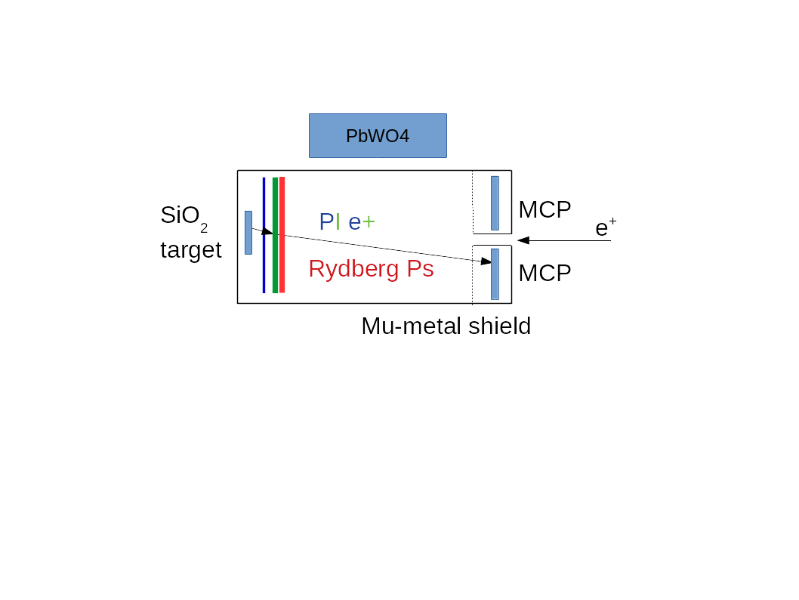
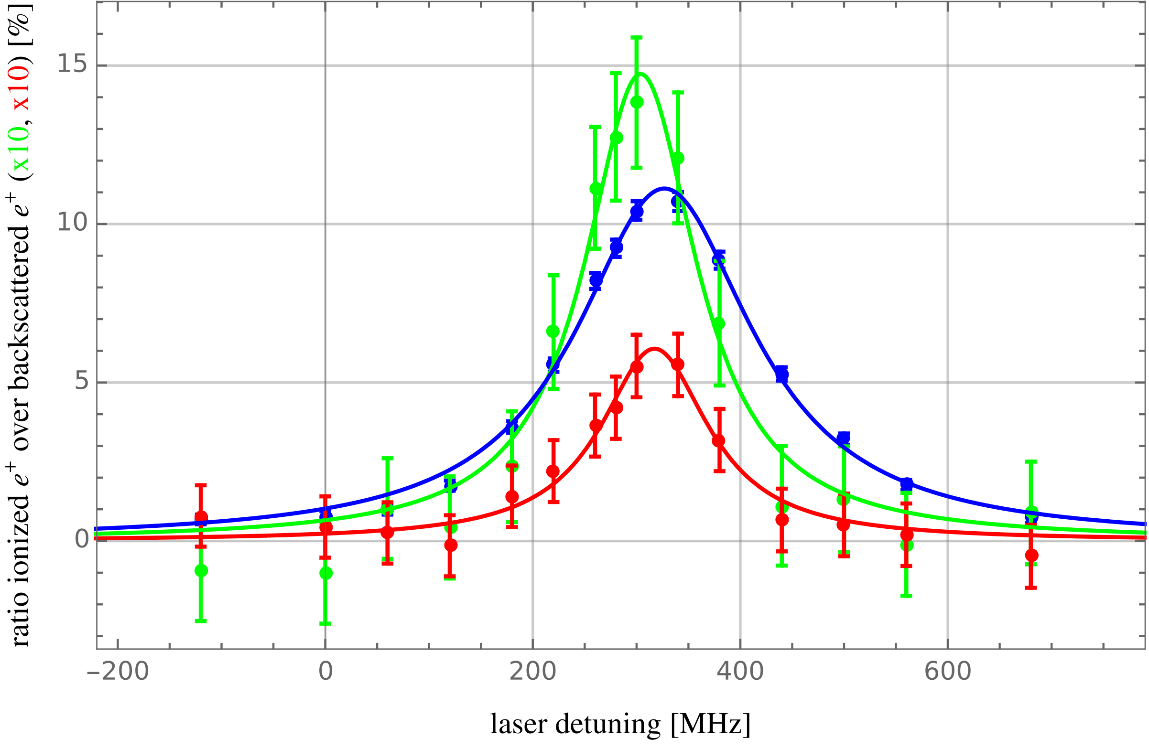
Ps 1S-2S: Pulsed laser scheme

Slide 19
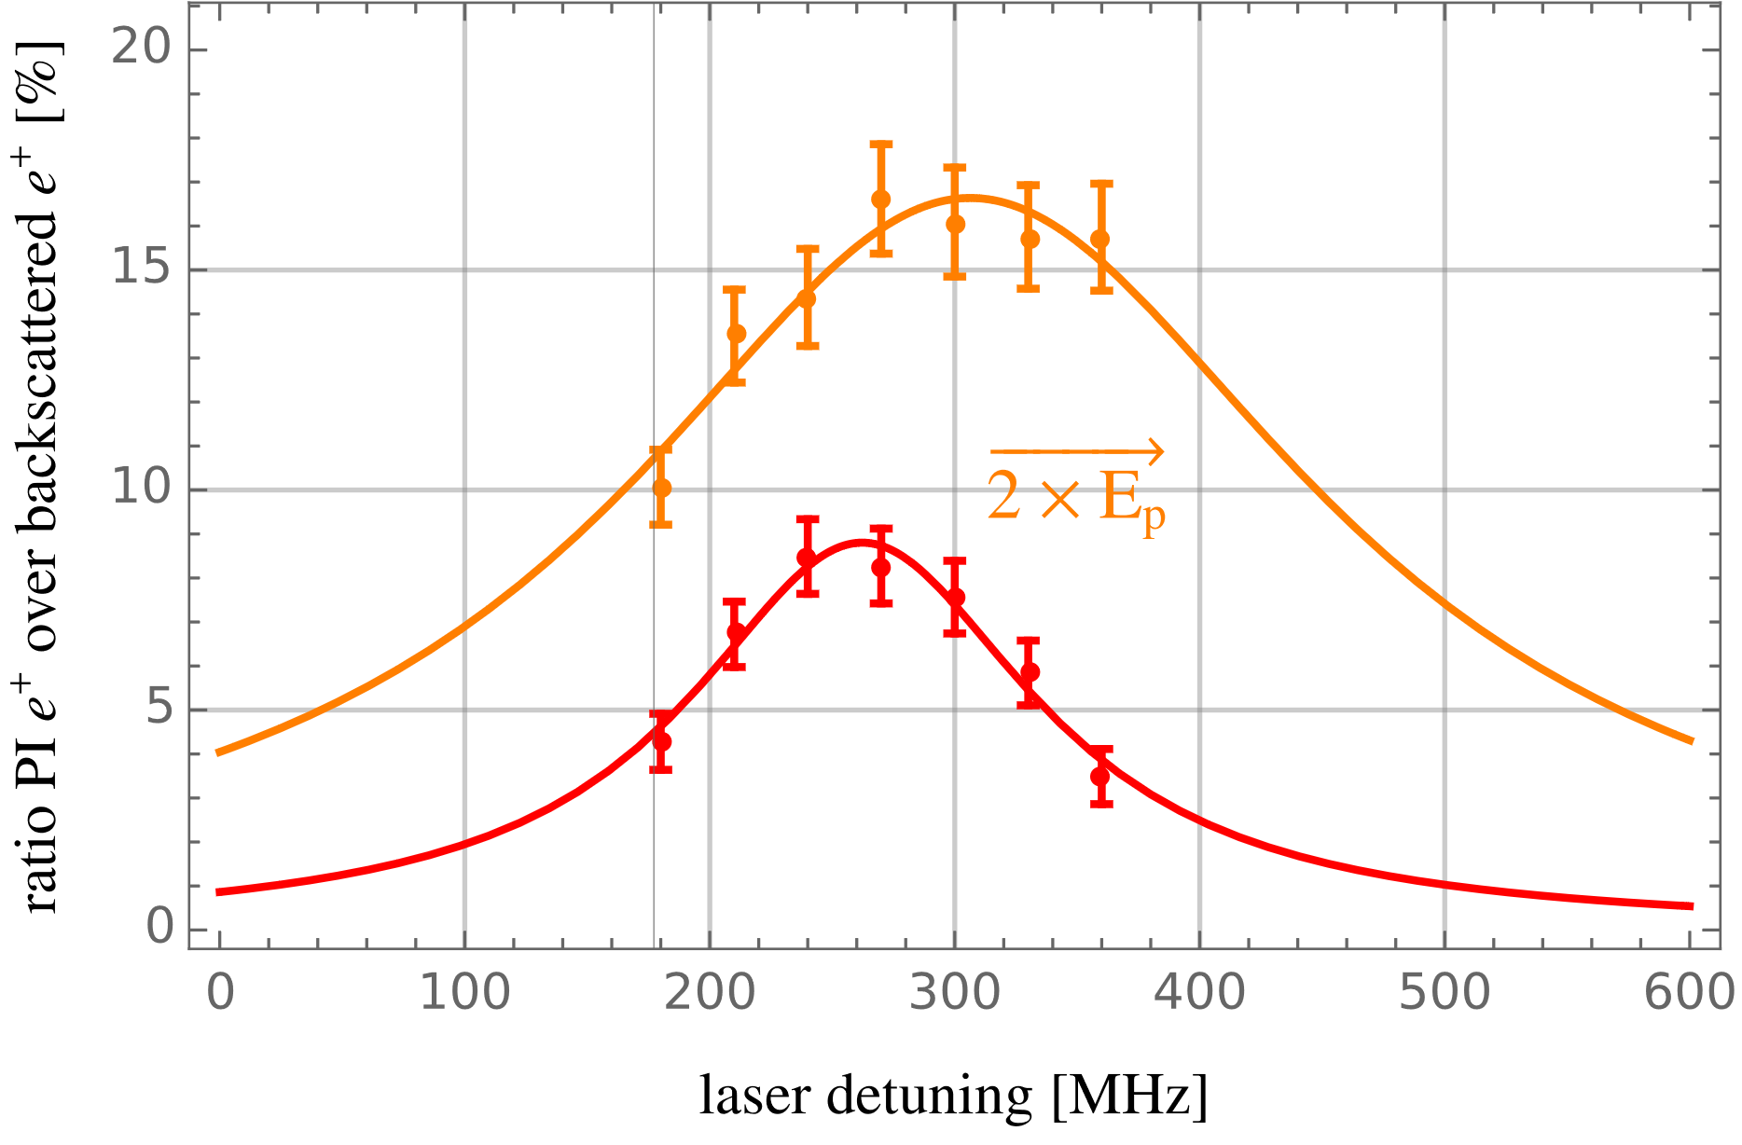
Ps 1S-2S: Studies of systematics
AC stark shift
  correct via extrapolation

Slide 20
Ps 1S-2S: Studies of systematics
Residual first order doppler shift
Camera
vacuum chamber
positrons
ring MCP
detector
Ps
tiltable
piezo mount
beam sampler
silica thin film target

Slide 21

Ps 1S-2S: Studies of systematics
Residual first order doppler shift
Camera
vacuum chamber
positrons
ring MCP
detector
tilt by angle δ
$$Δν ∝ v_{Ps}⋅δ$$
Ps
tiltable
piezo mount
beam sampler
silica thin film target

Slide 22
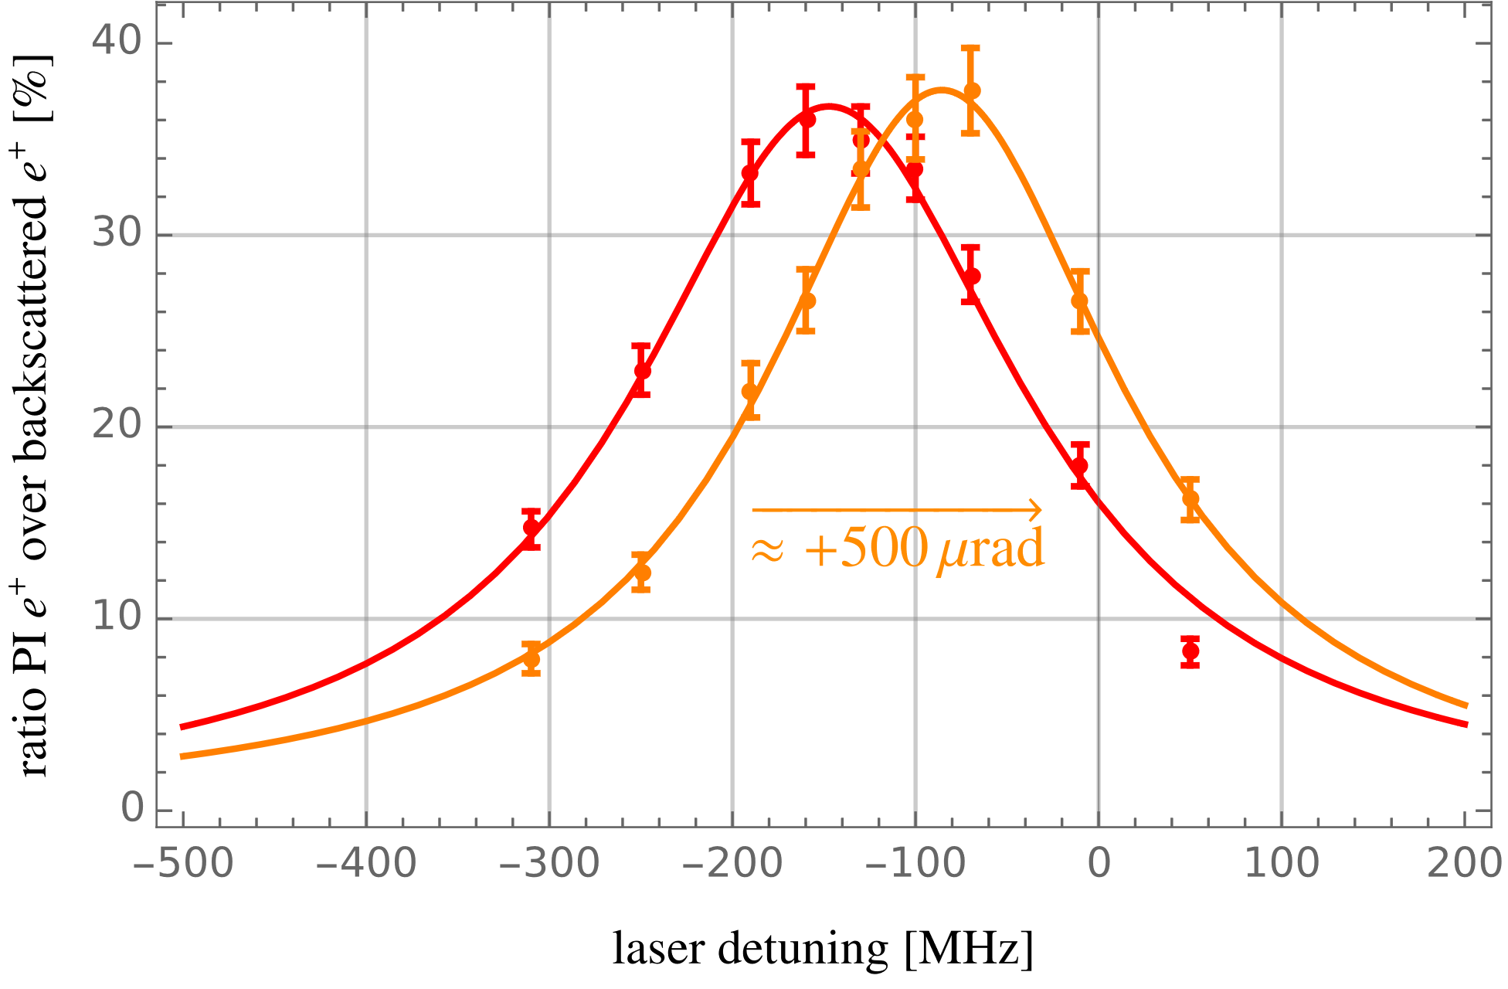
Ps 1S-2S: Studies of systematics
Residual first order doppler shift

Slide 23
Ps 1S-2S: Status and outlook
Status
  pulsed beam operational
  enhancement cavity installed and locked
  new detection schemes tested with pulsed dye amplifier and additional dye laser
  systematic studies with pulsed laser underway

Slide 24
Ps 1S-2S: Status and outlook
Status
  pulsed beam operational
  enhancement cavity installed and locked
  new detection schemes tested with pulsed dye amplifier and additional dye laser
  systematic studies with pulsed laser underway
Outlook
  next step: switch to CW excitation
  precision of 0.5 ppb feasible
    stringent test of current QED calculations
    constrain SME coefficients (measure sidereal shifts)
  further improvements require cold positronium (e.g. via Rydberg deceleration)

Slide 25
Motivation – Part 2 1S-2S HFS
Ps is purely leptonic system
(almost) free from
  QCD effects
  weak force effects
Precision test bench for
  bound state QED

Slide 26
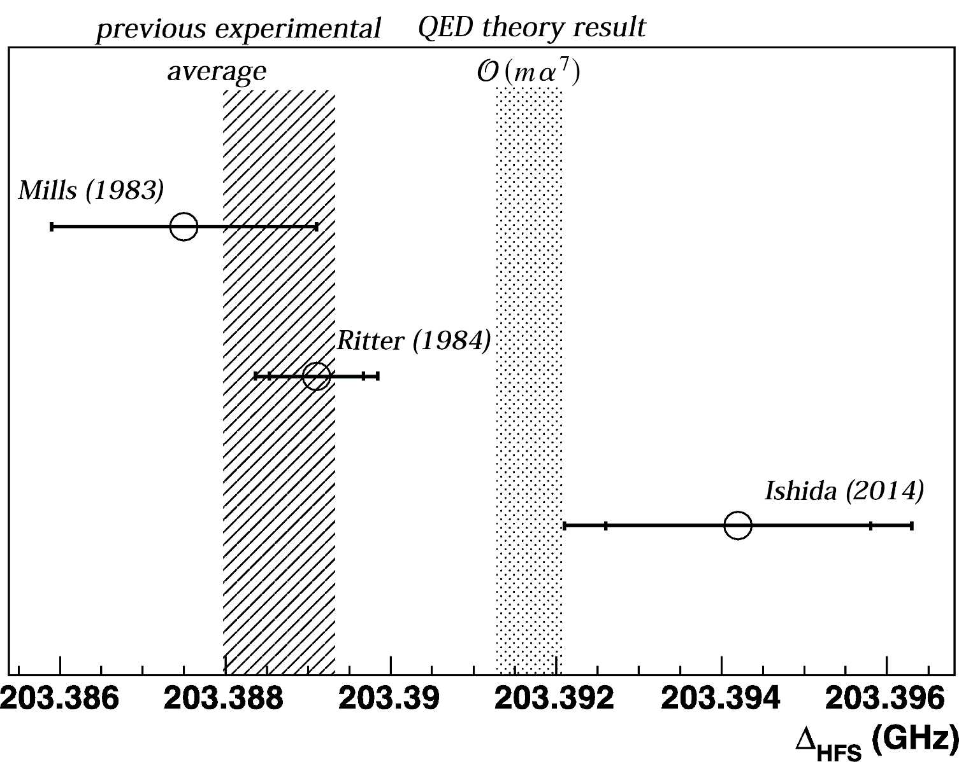
Motivation – Part 2 1S-2S HFS
Ps is purely leptonic system
(almost) free from
  QCD effects
  weak force effects
Precision test bench for
  bound state QED
Hyperfine structure
  Very precise measurements
  in 1970s and 1980s
  Almost 4 sigma discrepancy
  with most recent QED result
A. Ishida et al. New Precision Measurement of Hyperfine Splitting of Positronium. Phys. Rev. Lett. B, 734:338–344, June 2014.

Slide 27
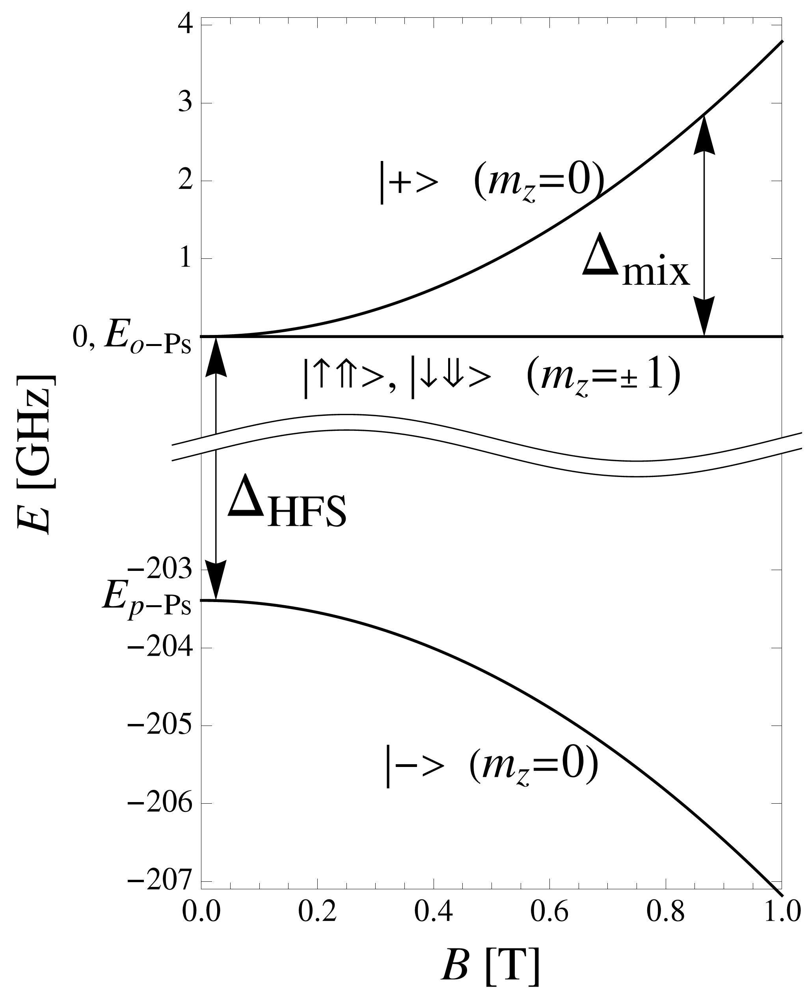
Ps HFS: Indirect measurements
3γ
2γ
In a static magnetic field:
  antiparallel spin states pick up ∆E
  magnetic quenching
3γ
2γ

Slide 28

Ps HFS: Indirect measurements
3γ
2γ
In a static magnetic field:
  antiparallel spin states pick up ∆E
  magnetic quenching
one calculates $∆_{HFS}$ from:
  $Δ_{mix}≈0.5⋅Δ_{HFS}\left(\sqrt{1+q^{2}}−1\right)$
  where: $q∝\frac{B}{Δ_{HFS}}$
3γ
2γ

Slide 29

Ps HFS: Indirect measurements
3γ
2γ
In a static magnetic field:
  antiparallel spin states pick up ∆E
  magnetic quenching
one calculates $∆_{HFS}$ from:
  $Δ_{mix}≈0.5⋅Δ_{HFS}\left(\sqrt{1+q^{2}}−1\right)$
  where: $q∝\frac{B}{Δ_{HFS}}$
  Disadvantages
  needs very high B-Fields ($\sim 1 T$)
  inhomogeneities in the fields contribute
  directly to systematic errors
3γ
2γ

Slide 30

Ps HFS: Measurements in dense gases
In dense gases
  gas acts as $e^{+}$ target
  $e^{+}$ can ionize a gas atom
  $e^{+}$ picks up the $e^{−}$ and forms Ps

Slide 31

Ps HFS: Measurements in dense gases
In dense gases
  gas acts as $e^{+}$ target
  $e^{+}$ can ionize a gas atom
  $e^{+}$ picks up the $e^{−}$ and forms Ps
Advantage: no need for a beam

Slide 32
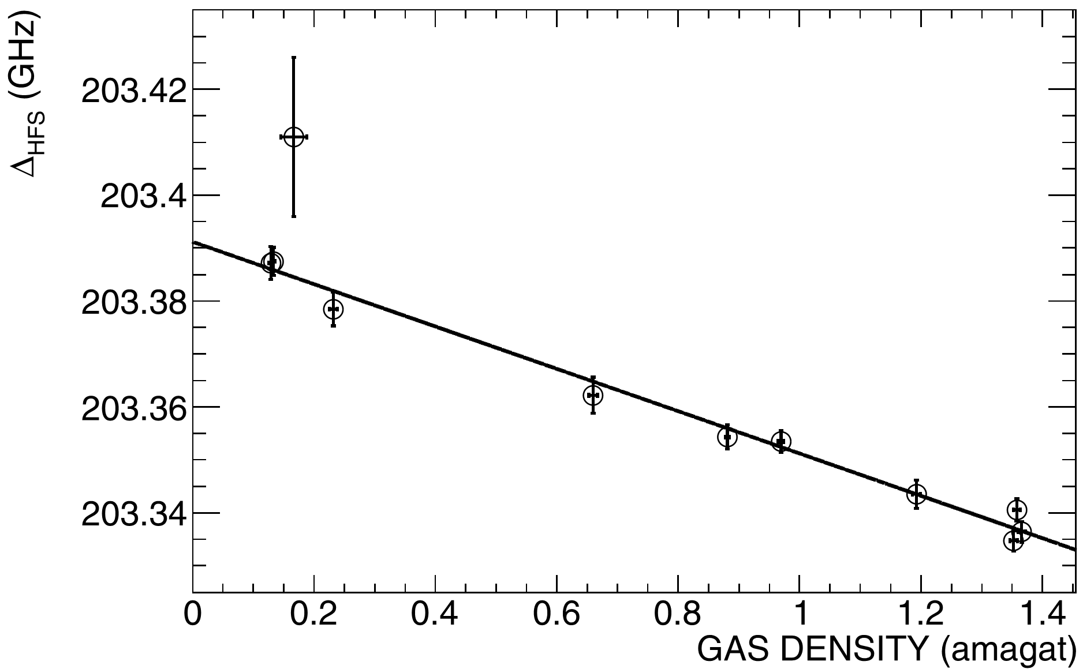

Ps HFS: Measurements in dense gases
In dense gases
  gas acts as $e^{+}$ target
  $e^{+}$ can ionize a gas atom
  $e^{+}$ picks up the $e^{−}$ and forms Ps
Advantage: no need for a beam
Disadvantages:
  E field of gas atoms $→$ Stark effect
  Needs extrapolation to vacuum
  High MW powers can strongly interfere
  with Ps production in gases
A. Ishida et al. New Precision Measurement of Hyperfine Splitting of Positronium. Phys. Rev. Lett. B, 734:338–344, June 2014.

Slide 33
Ps HFS: New technique avoiding systematic sources
Transition in vacuum
  no extrapolation necessary
  need a beam
  need different converter

Slide 34
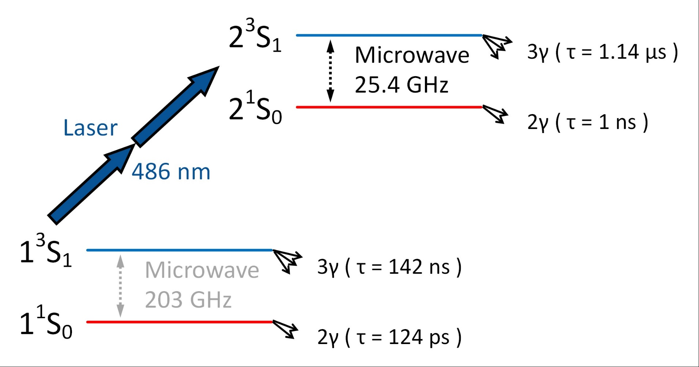
Ps HFS: New technique avoiding systematic sources
Transition in vacuum
  no extrapolation necessary
  need a beam
  need different converter
Direct transition
  doesn’t need strong B field
  no homogeneity concerns

Slide 35
Ps HFS: New technique avoiding systematic sources
Transition in vacuum
  no extrapolation necessary
  need a beam
  need different converter
Direct transition
  doesn’t need strong B field
  no homogeneity concerns
use 486nm laser
Microwave sources
  100’s mW (w/o Amp.)
  100’s W (with Amp.)

Slide 36
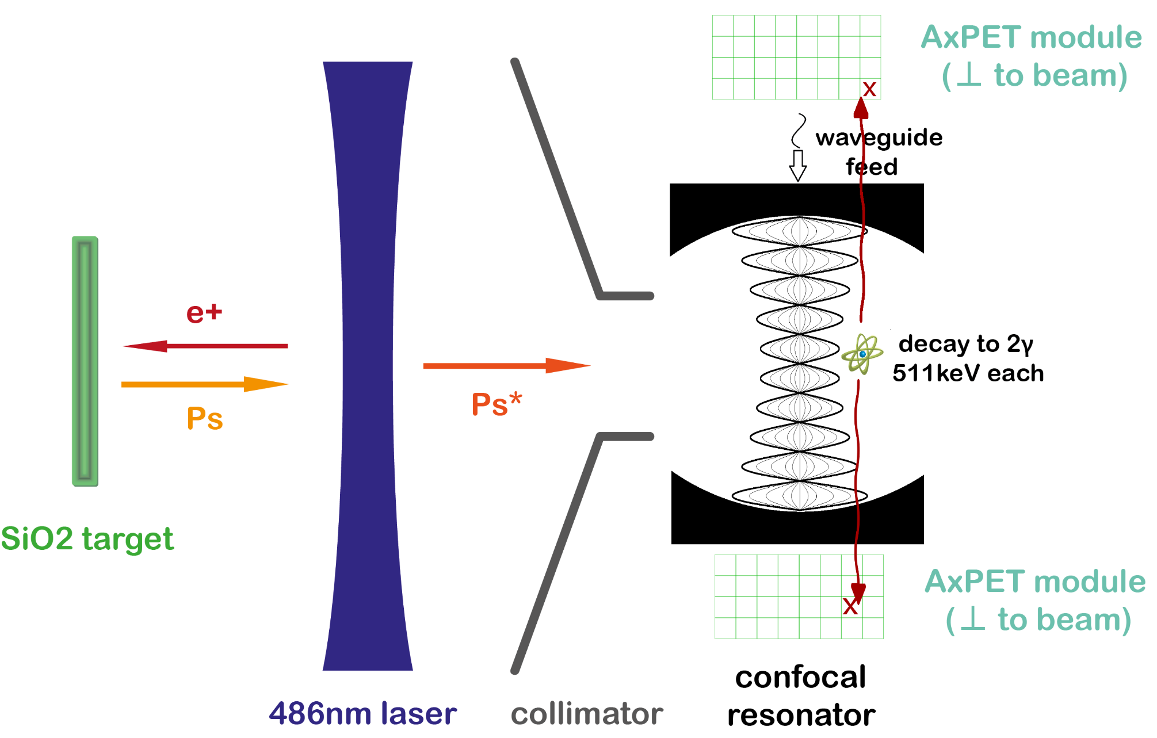
Ps HFS: Schematic overview of the experiment

Slide 37
Ps HFS: Schematic overview of the experiment

Slide 38
Ps HFS: Schematic overview of the experiment

Slide 39
Ps HFS: Schematic overview of the experiment

Slide 40
Ps HFS: Schematic overview of the experiment

Slide 41
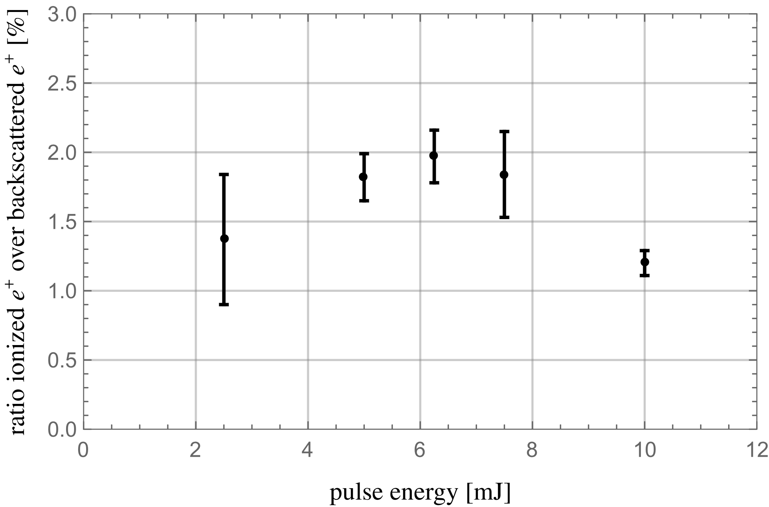
Ps HFS: Optimization of 2S surviving fraction
scan laser parameters
optimize for 2S fraction
  PI signal due to 532nm laser

Slide 42

Ps HFS: Optimization of 2S surviving fraction
scan laser parameters
optimize for 2S fraction
  PI signal due to 532nm laser
include normalization:
  $N =\frac{P_{bs}}{ε_{c}(1−P_{bs})}≈0.26$

Slide 43

Ps HFS: Optimization of 2S surviving fraction
scan laser parameters
optimize for 2S fraction
  PI signal due to 532nm laser
include normalization:
  $N =\frac{P_{bs}}{ε_{c}(1−P_{bs})}≈0.26$
Surviving 2S fraction:
  $P_{2S} ≅0.5\%$
Simulation: % level

Slide 44
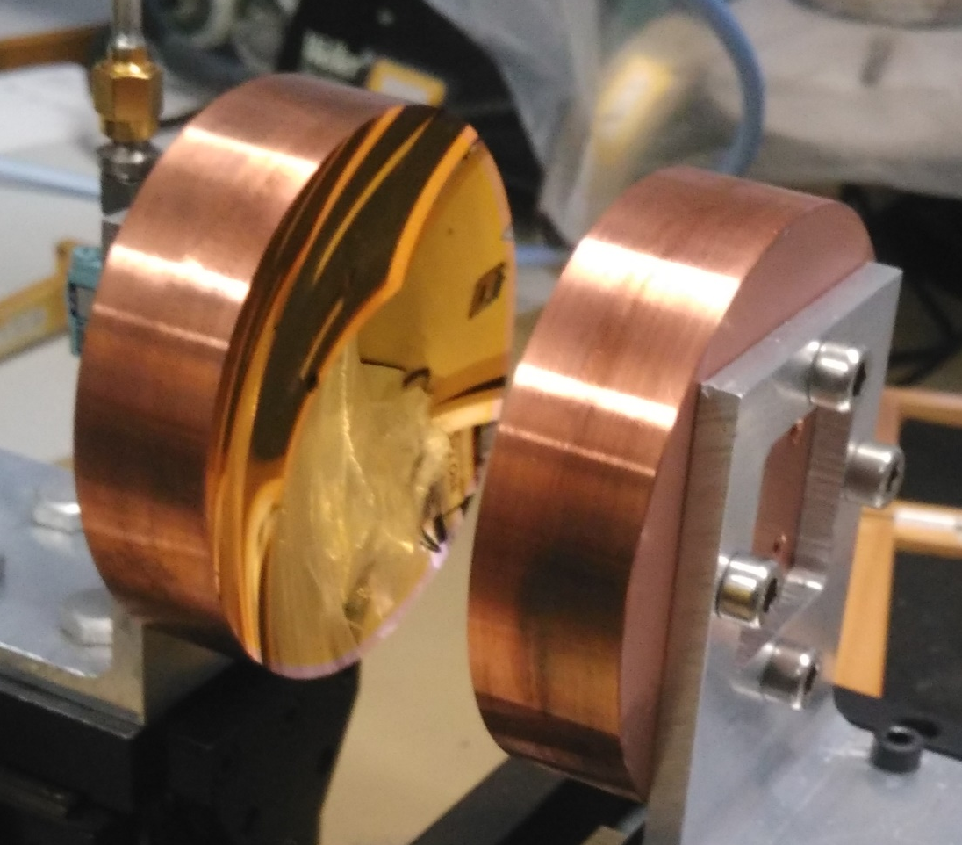
Ps HFS: Microwave system
Confocal resonator @ 25.4 GHz
  two spherical mirrors
  impedence matched coupling hole
  waveguide signal feed

Slide 45
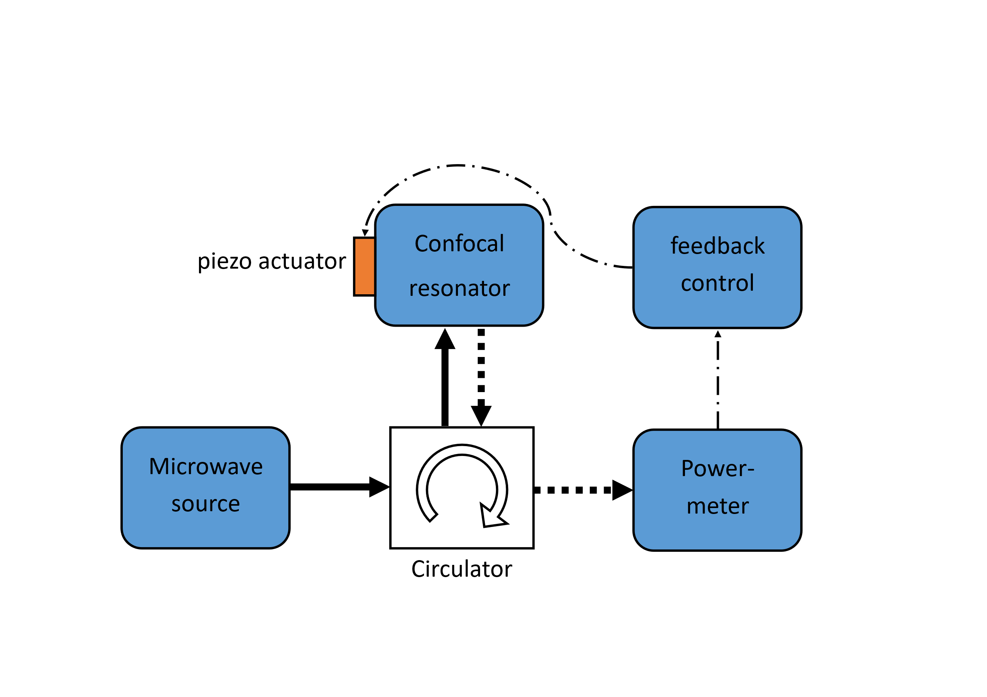
Ps HFS: Microwave system
Confocal resonator @ 25.4 GHz
  two spherical mirrors
  impedence matched coupling hole
  waveguide signal feed
Monitoring and stabilization system

Slide 46
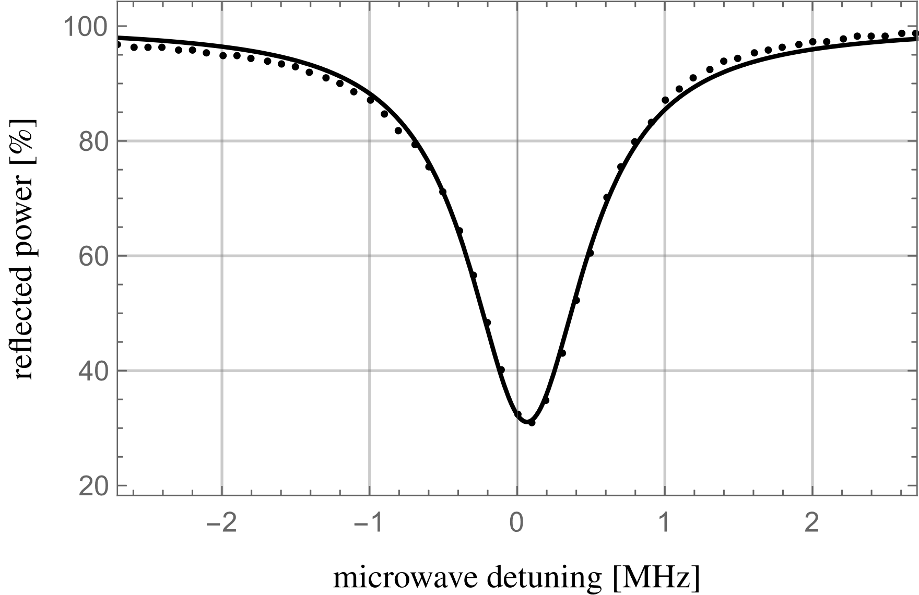

Ps HFS: Microwave system
Confocal resonator @ 25.4 GHz
  two spherical mirrors
  impedence matched coupling hole
  waveguide signal feed
Monitoring and stabilization system
Performance close to design values
  $Q≈26300$ or equivalently $Γ_{FWHM}≈1 MHz$
  Coupling efficiency $≈70\%$

Slide 47
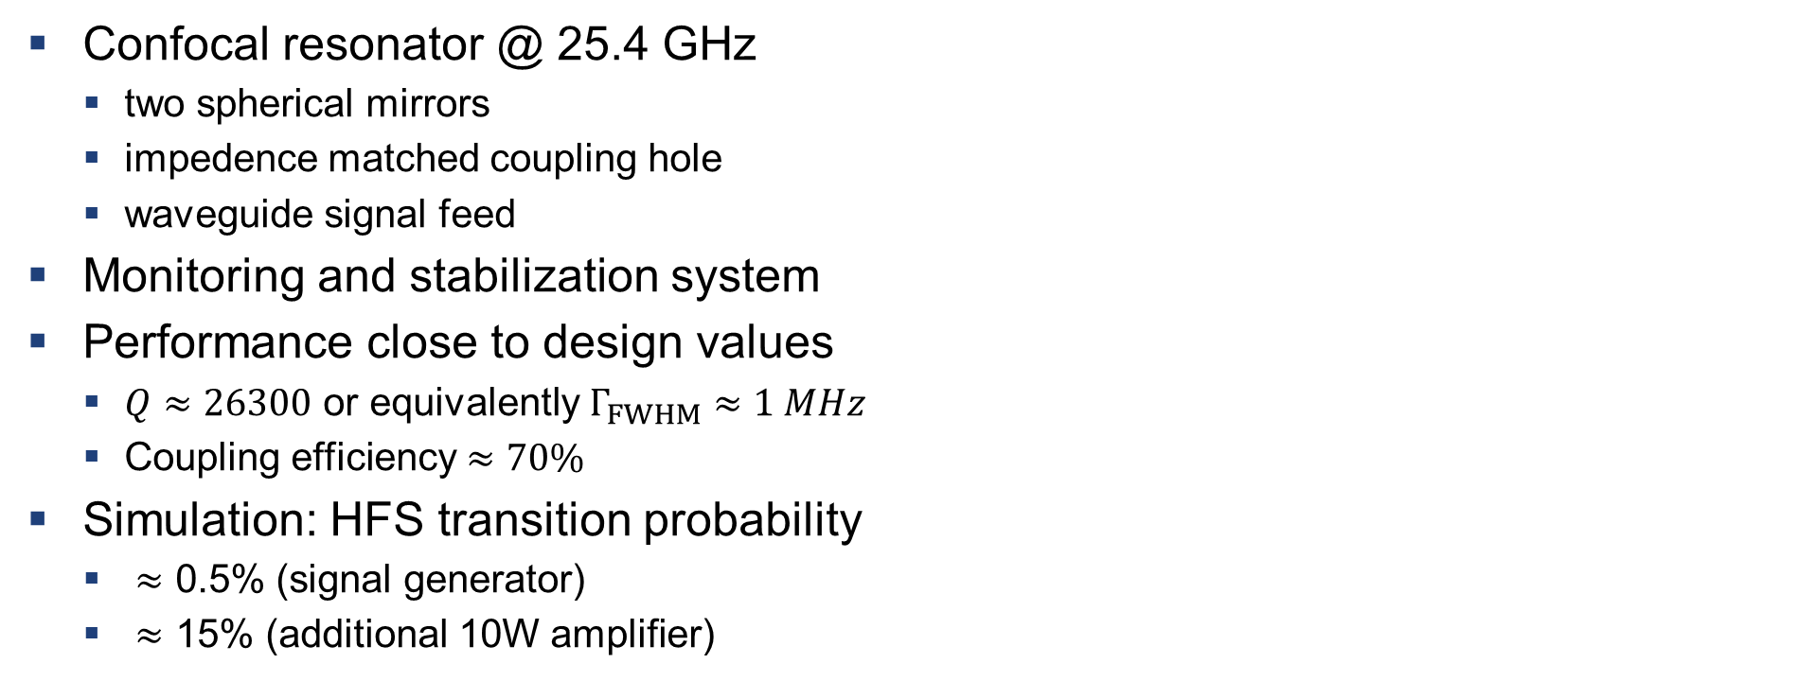
Ps HFS: Microwave system
Confocal resonator @ 25.4 GHz
  two spherical mirrors
  impedence matched coupling hole
  waveguide signal feed
Monitoring and stabilization system
Performance close to design values
  $Q≈26300$ or equivalently $Γ_{FWHM}≈1 MHz$
  Coupling efficiency $≈70\%$
Simulation: HFS transition probability
  $≈$ 0.5% (signal generator)
  $≈$ 15% (additional 10W amplifier)

Slide 48
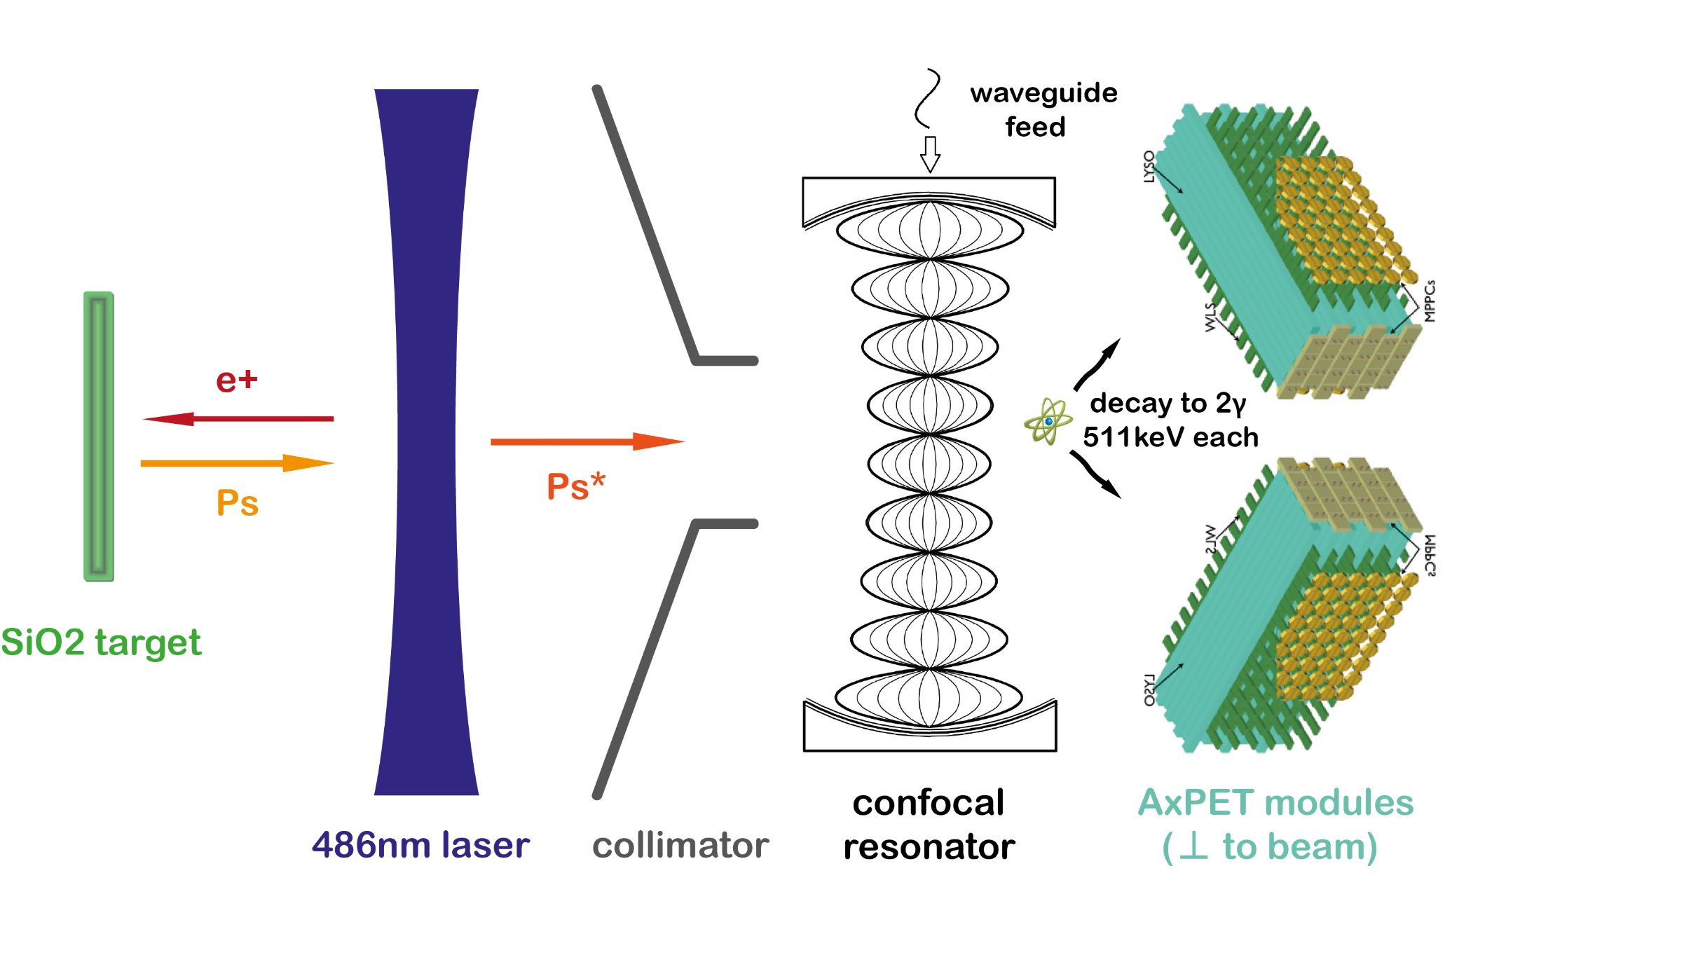
Ps HFS: Event signature
Experimental signature (pPs decay)
  2 matching back-to-back 511 keV photons
    temporal coincidence
    vertex reconstruction
    energy cut
$$E_{γ}=511 keV$$
$$m_{Ps}=1022 keV$$
$$E_{γ}=511 keV$$

Slide 49
Ps HFS: Event signature
Experimental signature (pPs decay)
  2 matching back-to-back 511 keV photons
    temporal coincidence
    vertex reconstruction
    energy cut
Dominant background (oPs decay)
$$m_{Ps}=1022 keV$$
$${∑E}_{γ}=1022 keV$$

Slide 50
Ps HFS: Event signature
Experimental signature (pPs decay)
  2 matching back-to-back 511 keV photons
    temporal coincidence
    vertex reconstruction
    energy cut
Dominant background (oPs decay)
  misidentification of 3 photon decays as 2 photon decays
    2 of the 3 photons almost colinear
$$E_{γ}≈255.5 keV$$
$$m_{Ps}=1022 keV$$
$$E_{γ}≈511 keV$$

Slide 51

Ps HFS: Event signature
Experimental signature (pPs decay)
  2 matching back-to-back 511 keV photons
    temporal coincidence
    vertex reconstruction
    energy cut
Dominant background (oPs decay)
  misidentification of 3 photon decays as 2 photon decays
    2 of the 3 photons almost colinear
    one photon very soft
$$E_{γ}≈511 keV$$
$$E_{γ}≈0 keV$$
$$m_{Ps}=1022 keV$$
$$E_{γ}≈511 keV$$

Slide 52
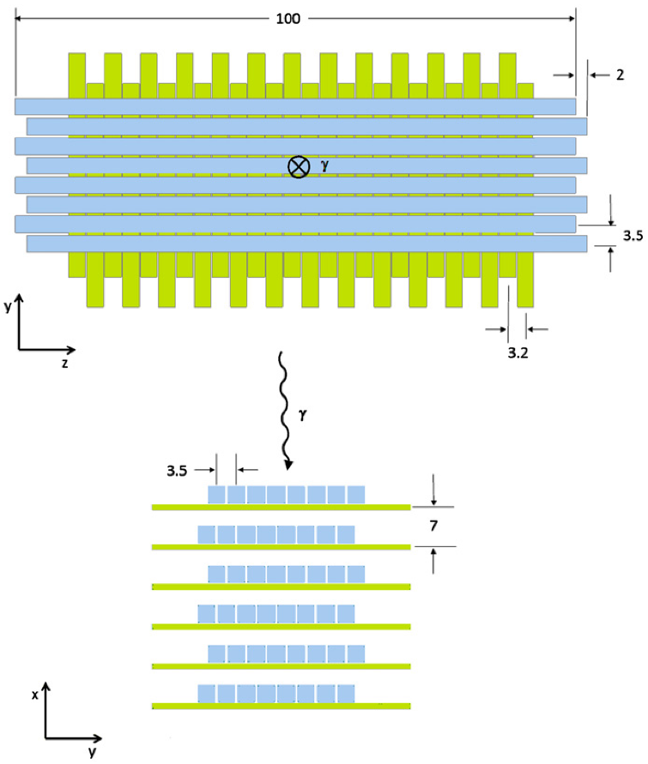
Ps HFS: Event signature
Experimental signature (pPs decay)
  2 matching back-to-back 511 keV photons
    temporal coincidence
    vertex reconstruction
    energy cut
Dominant background (oPs decay)
  misidentification of 3 photon decays as 2 photon decays
    2 of the 3 photons almost colinear
    one photon very soft
Granular detector
  good spatial, temporal, and energy resolution
Beltrame et al., The AX-PET demonstrator – Design, construction and characterization. 2011.

Slide 53

Ps HFS: Simulation results
Simulation
  rate on the order of 10⁵ e⁺/s
  25% Ps conversion efficiency
optimization for S/N
  % level detection efficiency
  S/N $≈$ 10
projected sensitivity
  ± 10 ppm (stat.)

Slide 54

Ps HFS: Simulation results
Simulation
  rate on the order of 10⁵ e⁺/s
  25% Ps conversion efficiency
optimization for S/N
  % level detection efficiency
  S/N $≈$ 10
projected sensitivity
  ± 10 ppm (stat.)
  ± 4 ppm (syst.)
A. Ishida et al. New Precision Measurement of Hyperfine Splitting of Positronium. Phys. Rev. Lett. B, 734:338–344, June 2014.

Slide 55
Ps HFS: Current status and outlook
Status
  2s excitation optimization working well
  microwave system successfully tested and up to spec
  microwave chamber being commissioned
  new detector DAQ tested and being commissioned

Slide 56
Ps HFS: Current status and outlook
Status
  2s excitation optimization working well
  microwave system successfully tested and up to spec
  microwave chamber being commissioned
  new detector DAQ tested and being commissioned
Outlook
  precision of a few ppm should be achievable → probe discrepancy with bound state QED
  more precise measurements feasible
    LN2 cooling of resonator (increase Q factor significantly)
    increase MW power (TWT amplifier)
    improved event analysis (pattern recognition, e.g. neural net)
    limited by systematic uncertainties

Slide 57

PI: Paolo Crivelli
Additional Credits: G. Wichmann, D. Cooke, A. Antognini, K. Kirch, A. Rubbia
more information:
arXiv:1805.05886

Slide 58
BACKUP SLIDES

Slide 59
CPT – Violation
CPT can be naturally broken (e.g. in string theory)
Breaks Lorentz symmetry
Can be well described at low energy scales as effective field theory:
  Standard Model Extension (SME)
  built from General Relativity and the Standard Model
  includes Lorentz- and CPT violating operators
  up to mass dimension 4 (minimal SME) and above
  coefficients have to be determined experimentally
Colladay, D., & Kostelecký, V. A. (1997). CPT violation and the standard model. Phys. Rev. D, 55(11), 6760-6774.

Slide 60
Spectroscopy and the minimal SME
Minimal SME terms can produce striking effects, e.g.
  Hydrogen sector
    time dependent shifts in hydrogen spectra (e.g. annual shifts)
    different hydrogen and anti-hydrogen spectra
  Positronium sector
    SM forbidden momentum-polarization correlations in Positronium decay
    shifts in Positronium spectrum from Lorentz-invariant values
      1s-2s transition
      hyperfine splitting
Kostelecký, V. A.; Vargas, A. J. (2015). Lorentz and CPT tests with hydrogen, antihydrogen, and related systems. Phys. Rev. D 92, 056002.
Adkins, G.S., arXiv:1007.3909.

Slide 61
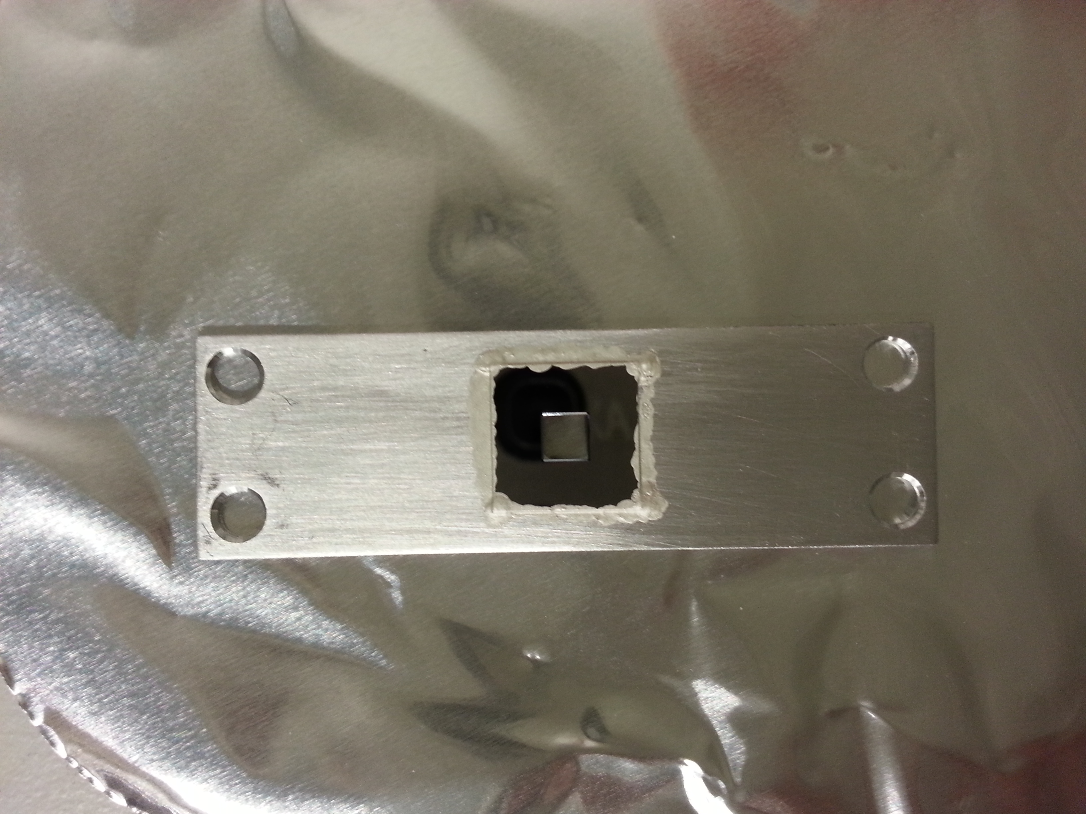
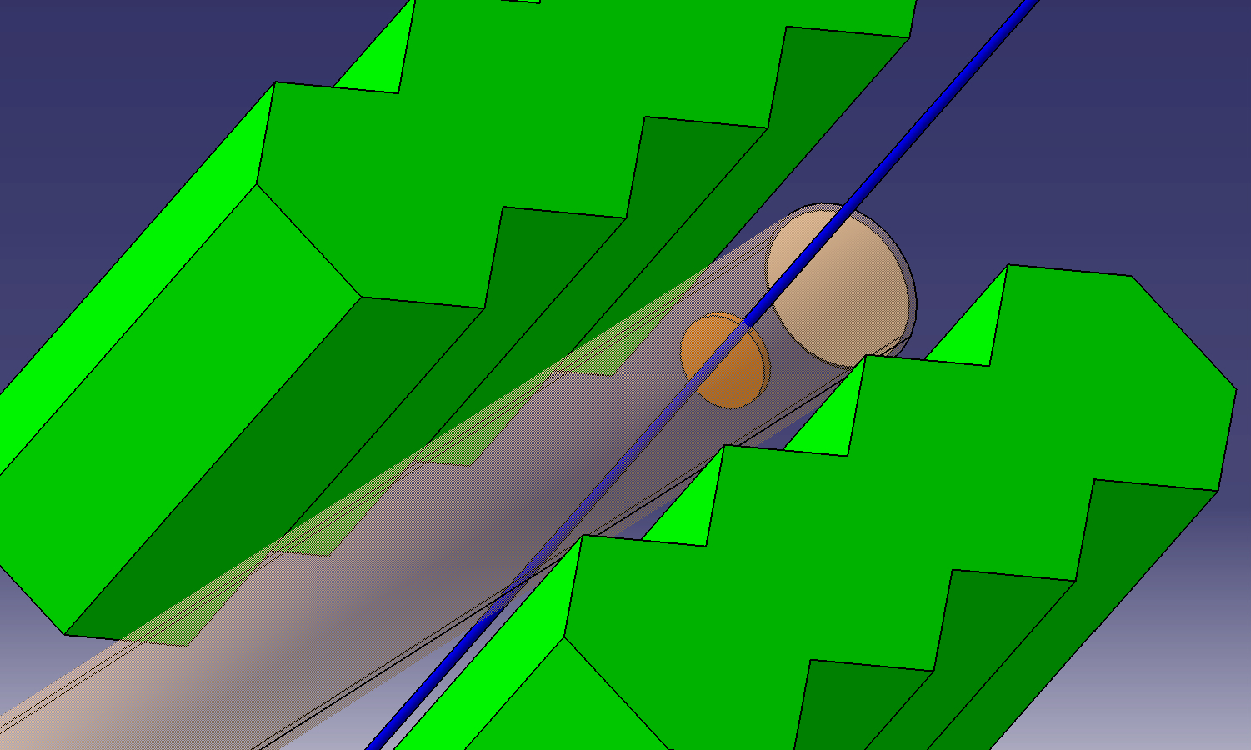
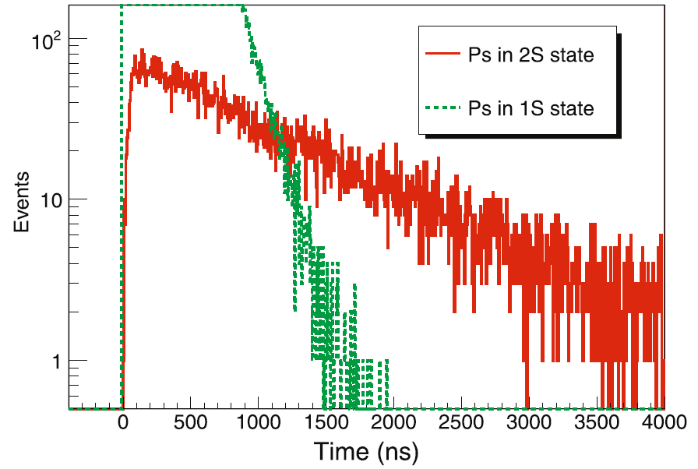

Ps 1S-2S: original detection scheme
e+ 5 keV
oPs
SiN 30 nm window 3x3 mm²
Laser (500W)
Aperture 3x3 mm²
Length 60 mm
Porous silica
Detection of annihilation photons. Lifetime of excited S states ~ n³
τ_{2S} /τ_{1S} = 8
Gamma detectors
Laser beam
142 ns (1S)
γ
Stop
Target
γ
1136 ns (2S)
Annihilation
γ
Gamma detectors
G4 simulation
Stop

Slide 62
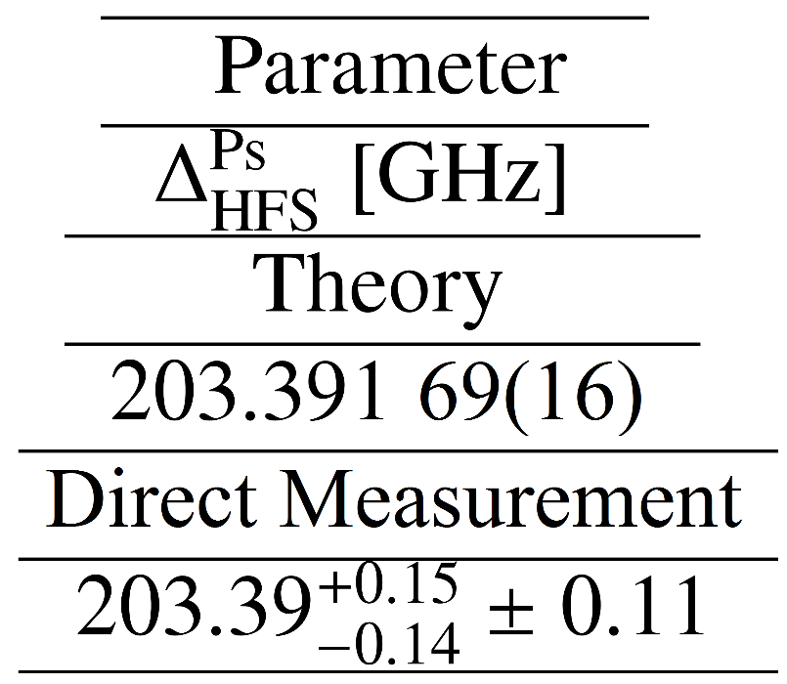
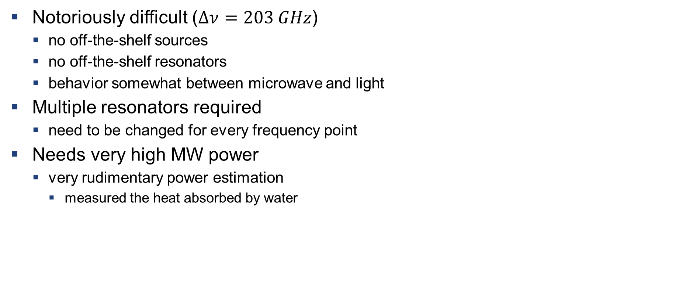
Ps HFS: Review - First direct measurement
Notoriously difficult ($Δν=203 GHz$)
  no off-the-shelf sources
  no off-the-shelf resonators
  behavior somewhat between microwave and light
Multiple resonators required
  need to be changed for every frequency point
Needs very high MW power
  very rudimentary power estimation
    measured the heat absorbed by water
A. Miyazaki et al. First millimeter-wave spectroscopy of ground-state positronium. Progress of Theoretical and Experimental Physics, 2015(1), 2015.

Slide 63
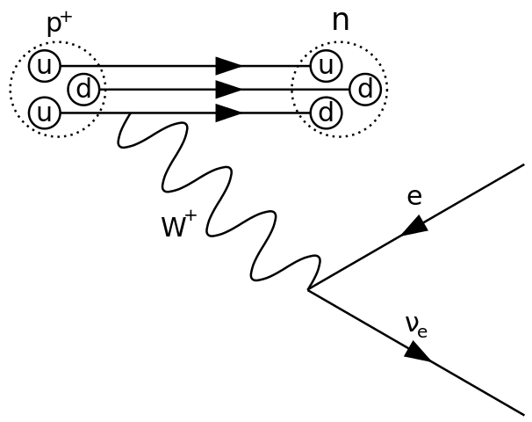
Positron production
Positrons produced in β⁺ decay of ²²Na
  $^{22}Na → ^{22}Ne^{∗}+ν_{e}+e^{+}$
    continous spectrum: 0 – 543 keV
    moderate half-life: τ_{1/2} = 2.6a
  $^{22}Ne^{∗}→ ^{22}Ne+γ$
    discrete energy: 1.27 MeV
    almost immediate process: 3.7 ps delay
    can be used to tag β⁺ decay of ²²Na
Need for moderate rate sources
  CW beam: 300 MBq
  Pulsed beam: 350 MBq

Slide 64
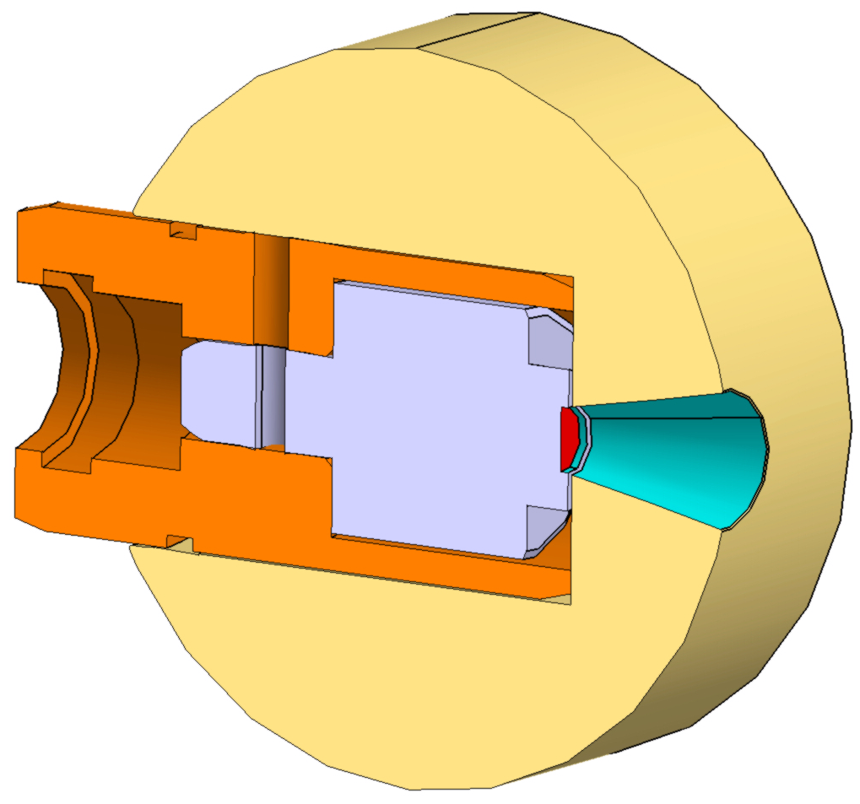
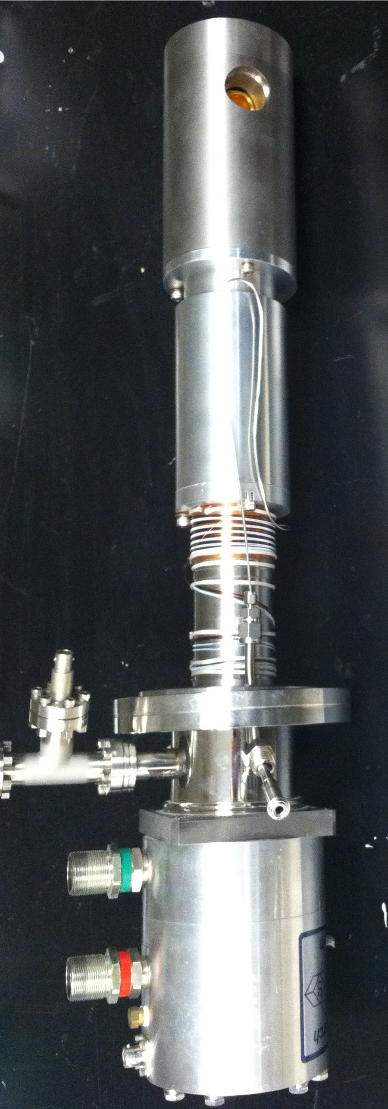
Positron moderation
Large energy spread: use moderation
Solid rare gas moderation
  4K cold head
  tungsten allow shield
  ²²Na in capsule with
  5µm titanium window
  solid neon film is grown
    e⁺ loses energy only inefficiently
    below band gap (≈20eV)
    large fraction of e⁺ is emitted
    into vacuum with epithermal energies

Slide 65
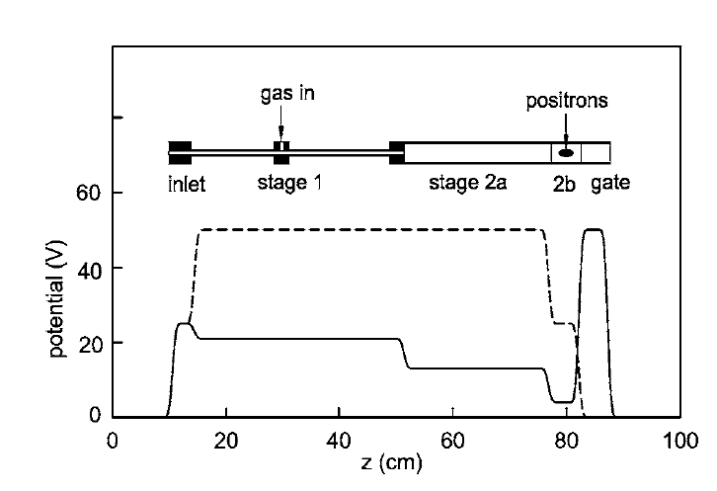
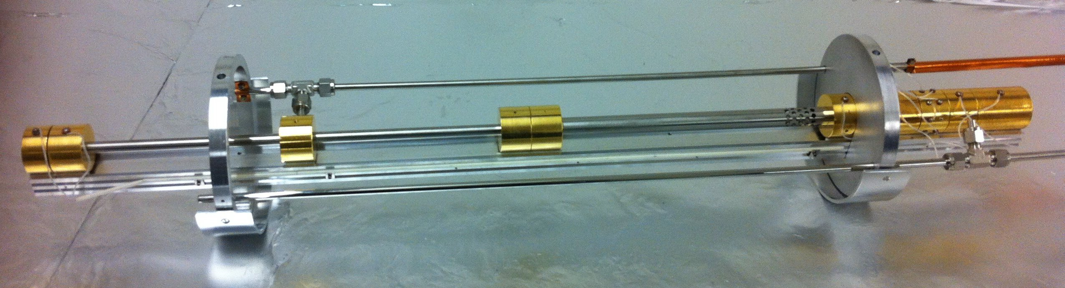
Buffer gas trap
10⁻³ mbar
10⁻⁶ mbar
e+
N₂
Positrons in few eVs
bunches (50 ns)
At 10 Hz rep rate
B-field up to 1 kG

Slide 66
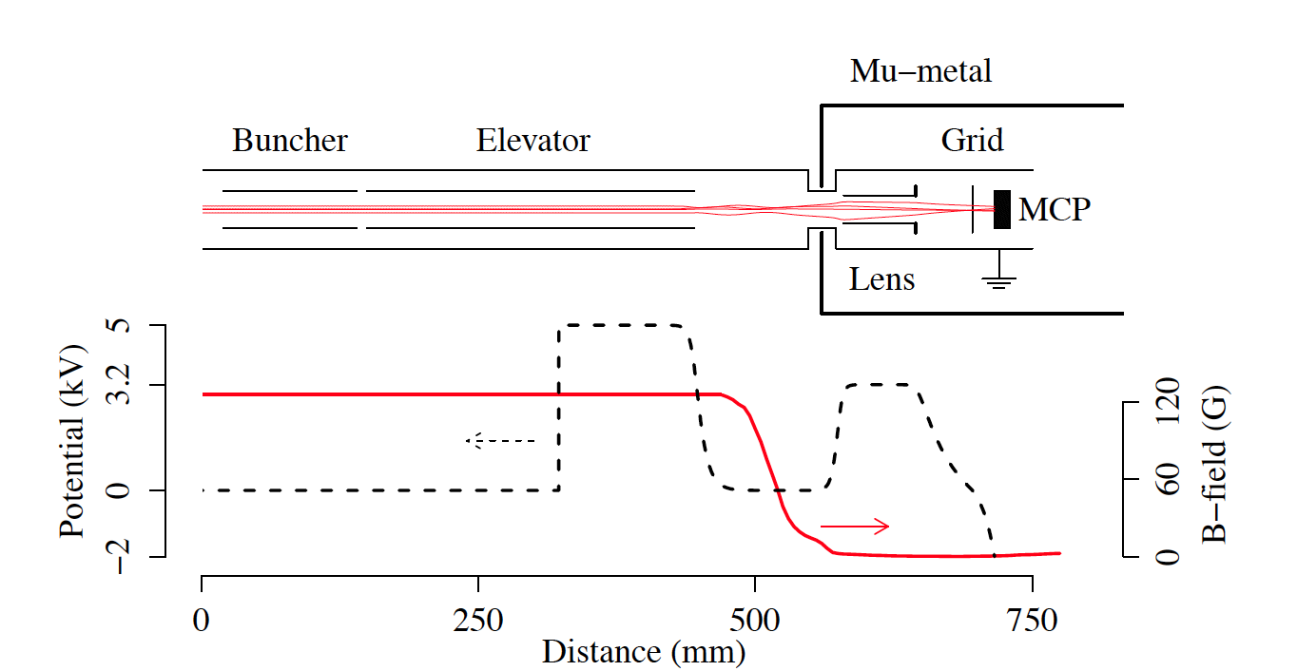
Positron bunching and extraction
Positron (7 eV) bunches from the trap
50 ns and 1 mm (σ) in 120 G
e⁺
On target (kept at ground): positron bunches of 1 ns with a beam spot of 1 mm
extracted to the field free e-m region with 90 % efficiency.
D. A. Cooke G., Barandun, S Vergani,, B Brown, A Rubbia and P Crivelli, J. Phys. B: At. Mol. Opt. Phys. 49 014001 (2016).

Slide 67
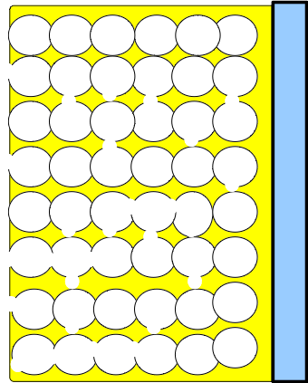

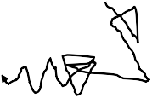
Positronium formation
Implantation in porous silica thin film
  approx. 1 µm thick, 3-4 nm pore size
  e⁺ energy of a few keV
  rapid thermalization
Diffuse and annihilate
Form Positronium by capturing e⁻
  25% pPs and 75% oPs
  diffusion to surface
  emission into vacuum
    W_{Ps} = µ_{Ps} + E_{B} - 6.8 eV < 0 eV
e⁺
Ps
e⁺
oPs
Ps
e⁺
P. Crivelli et al., Phys. Rev. A. 81, 052703 (2010).

Slide 68
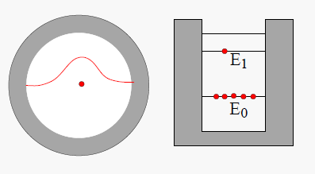
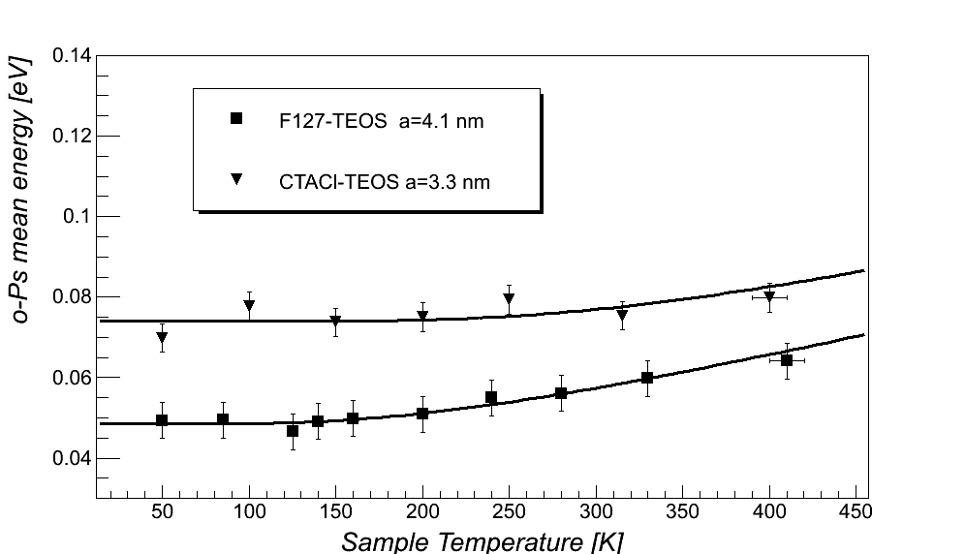
Positronium emission into vacuum
Very efficient
  ≈ 30% of incident e⁺ produce oPs into vacuum
Almost monoenergetic
  ≈ 40 meV (≈ 10⁵ m/s!)
  deBroglie wavelength of Ps:
    $λ_{Ps}= \frac{h}{\sqrt{2 m_{Ps} E_{Ps}}}≈0.9nm \sqrt{\frac{1eV}{E_{Ps}}}$
    for ≈100 meV this becomes comparable to pore size!
  particle in a box
    $E_{Ps}= \frac{h^{2}}{2 m d^{2}}≈0.8eV {\left(\frac{1nm}{d}\right)}^{2}$
P. Crivelli et al., Phys. Rev. A. 81, 052703 (2010).

