Slide 1





Exploiting highly accurate frequency ratio measurements over coherent fiber links for exploring fundamental physics problems
J. Calvert, L. De Sarlo, M. Favier, V. Cambier, C. Guo, J. Lodewyck, H. Alvarez- Martinez, Y. Le Coq, R. Le Targat, E. Cantin, D. Xu, O. Lopez, A. Amy-Klein, G. Santarelli, Ch. Chardonnet, P. –E. Pottie, N. Huntemann, C. Sanner, R. Lange, B. Lipphardt, Chr. Tamm, E. Peik, R. Schwarz, A. Al-Masoudi, S. Dörscher, Ch. Lisdat, E. Benkler, S. Koke, A. Kuhl, T. Waterholter, G. Grosche, and S. Bize
PSAS 2018, Vienna
EMPIR - OFTEN
Notes:
Talk about syrte obersatoire de paris in collaboration with PTB and LPL are the driving groups here

Slide 2
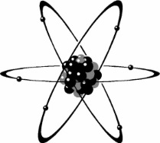
Atomic frequency standards
Local oscillator
(ultra-stable laser)
ν(t)
Output frequency
E_{e}
Correction
δ(t) = ν(t)-ν₀ → 0
hν₀ = E_{e}-E_{g}
Atomic Reference
E_{g}
Servo system
δ(t)
Atom
ν₀
Potential uses in :
  Redefining the SI second
  Geodesy
  Examining variations in fundamental constants
  Navigational improvements
Low sensitivity to external
perturbations
High stability and accuracy
Reproducible
Universal
Atomic species used in atomic clocks: Cs, Rb, Ca, Cd, Sr, Yb, Mg, Hg, Hg⁺, Al⁺, Ca⁺, Sr⁺, 2 Yb⁺
Recent review for further reading: Ludlow et al, Rev. Mod. Phys, 87, 637-701 (2015)
Notes:
Give the Hg spiel here for better for systematic shifts in constants, and Hg has few systems available

Slide 3
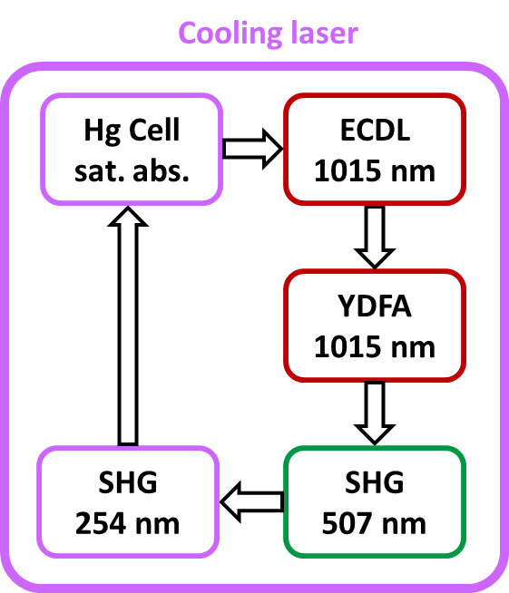
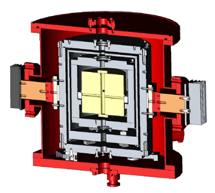
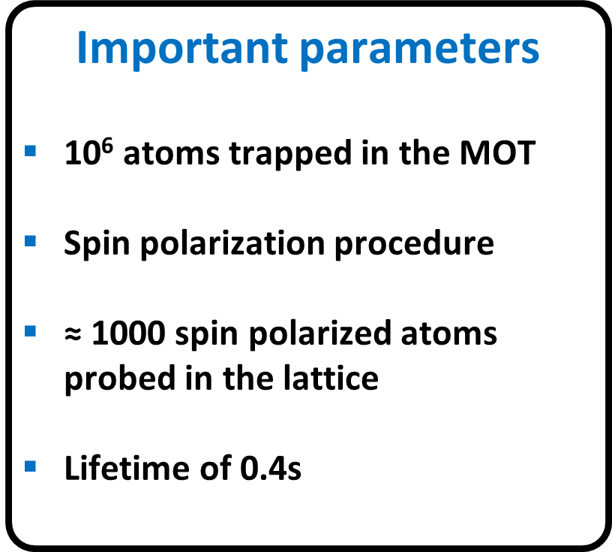
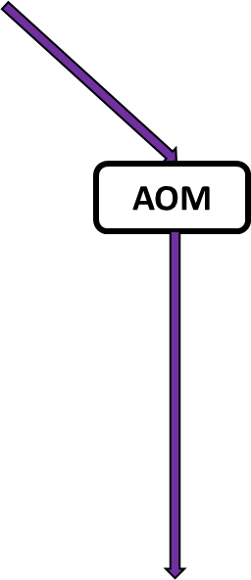
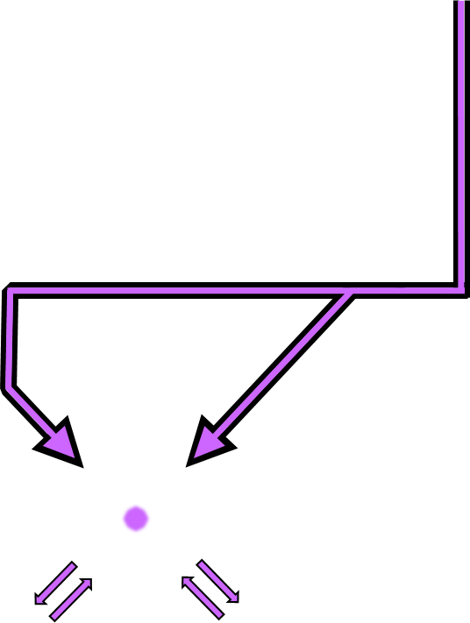
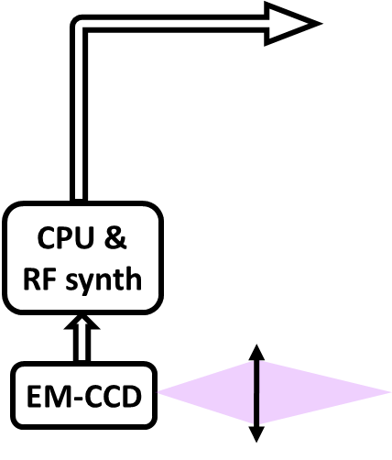
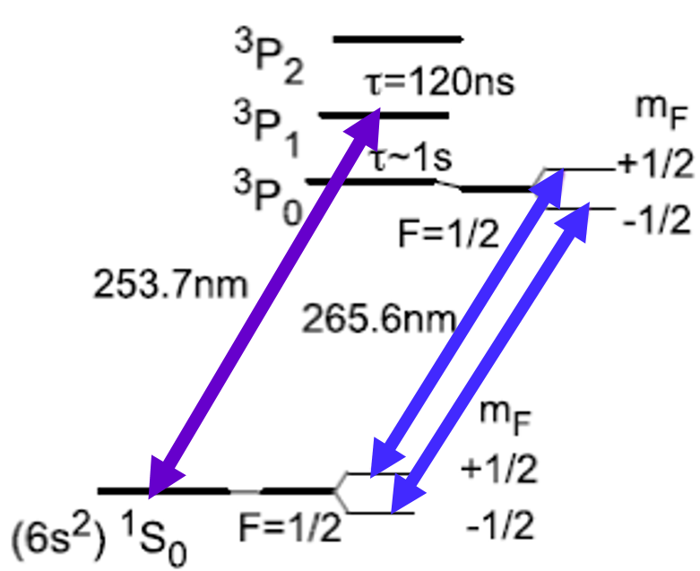
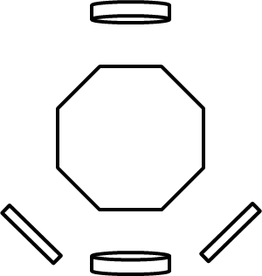
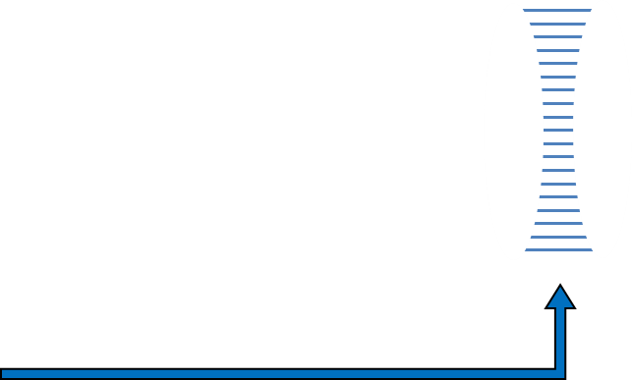
A mercury optical lattice clock
YDFA
1062 nm
Cavity enhanced SHG (ppKTP)
531nm
PDH lock
Yb fiber laser
1062 nm
Cavity enhanced SHG (BBO)
266nm
Clock laser
OFC
Custom frequency lock
Ti:Sa laser
725nm
Cavity enhanced SHG (LBO)
362nm
Trapping laser
Notes:
Start with the clock laser first, then talk about the cooling and trapping. Try to fit in the need for the lattice trap, ie confining atomic motion with a tightly confined lattice, which introduces light shift. Add arrow out of the comb to show we can connect to external systems (other clocks, fiber links, etc)

Slide 4
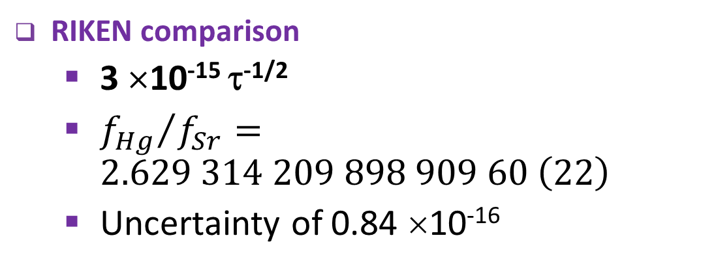
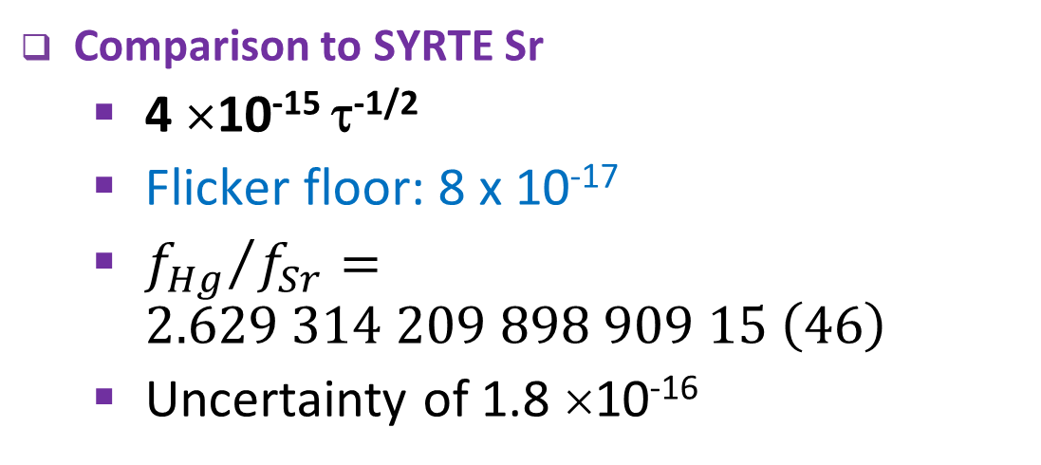
Last Hg/Sr comparison at SYRTE
Comparison to SYRTE Sr
  4 ×10⁻¹⁵ τ^{-1/2}
  Flicker floor: 8 x 10⁻¹⁷
  ${f_{Hg}}/{f_{Sr}}=2.629 314 209 898 909 15 \left(46\right)$
  Uncertainty of 1.8 ×10⁻¹⁶
New J. Phys. 18, 113002 (2016)
Hg/Sr ratios also done in Japan: Yamanaka et al, PRL, 114, 230801 (2015)
RIKEN comparison
  3 ×10⁻¹⁵ τ^{-1/2}
  ${f_{Hg}}/{f_{Sr}}=2.629 314 209 898 909 60 \left(22\right)$
  Uncertainty of 0.84 ×10⁻¹⁶
Two accurate, independent, consistent, measurements!
Notes:
Grey is raw data, blue is dedrifted (both are referenced to the FP cavity), red is self-referenced (one Zeeman peak to another).
Minimise this slide a bit, remove the first image maybe but keep the relevant information (stability, etc) measured at very high level at two places _ consider saying something about the state of the art for the entire optical freq comparison field.
Consider adding an image about how we compare Hg/Sr in house.

Slide 5
Interest in frequency ratios
Frequency and metrology purposes
- Confidence in measured values can only occur after repeated comparisons to other frequency standards.
- Frequency ratios are dimensionless so can be independently compared
- Also a great sanity check in experimental work!
Searching for variations in fundamental constants¹
- Fine structure constant α from optical frequency ratios
- Proton to electron mass ratio by comparing to hyperfine transitions, quark mass
- Test stability of electroweak and strong interactions
      Geodesy
- Clock frequencies are affected by gravity via general relativity
¹C. M. Will, Living reviews of Relativity, 17, 4 (2014)
Notes:
Need to double check why transitions are dependent upon fine structure constant again. Look at the way the variations bullet points are structured… this might require some thought and a bit of research

Slide 6
All-optical remote clock comparison
SYRTE, LPL, PTB collaboration
F. Riehle et al., Metrologia 55 188 (2018)
C Lisdat et al., Nat. Comm. 7, 12443 (2016)
Record agreement between distant clocks (4±5)×10⁻¹⁷
Link can support down to below to 10⁻¹⁹
Extended: NPL (UK) connected, INRIM (IT) in progress, other locations?
Notes:
What is the name of the network again (it doesn’t really have a name)? Really should say that this was pioneered by us and PTB for long distance fiber links to emphasize this. Also want to emphasize that we cant do these measurements without the link due to the complexity of running even a single clock. This opens up a HUGE variety of frequency standards to compare to! That means this is very new and very exciting!

Slide 7
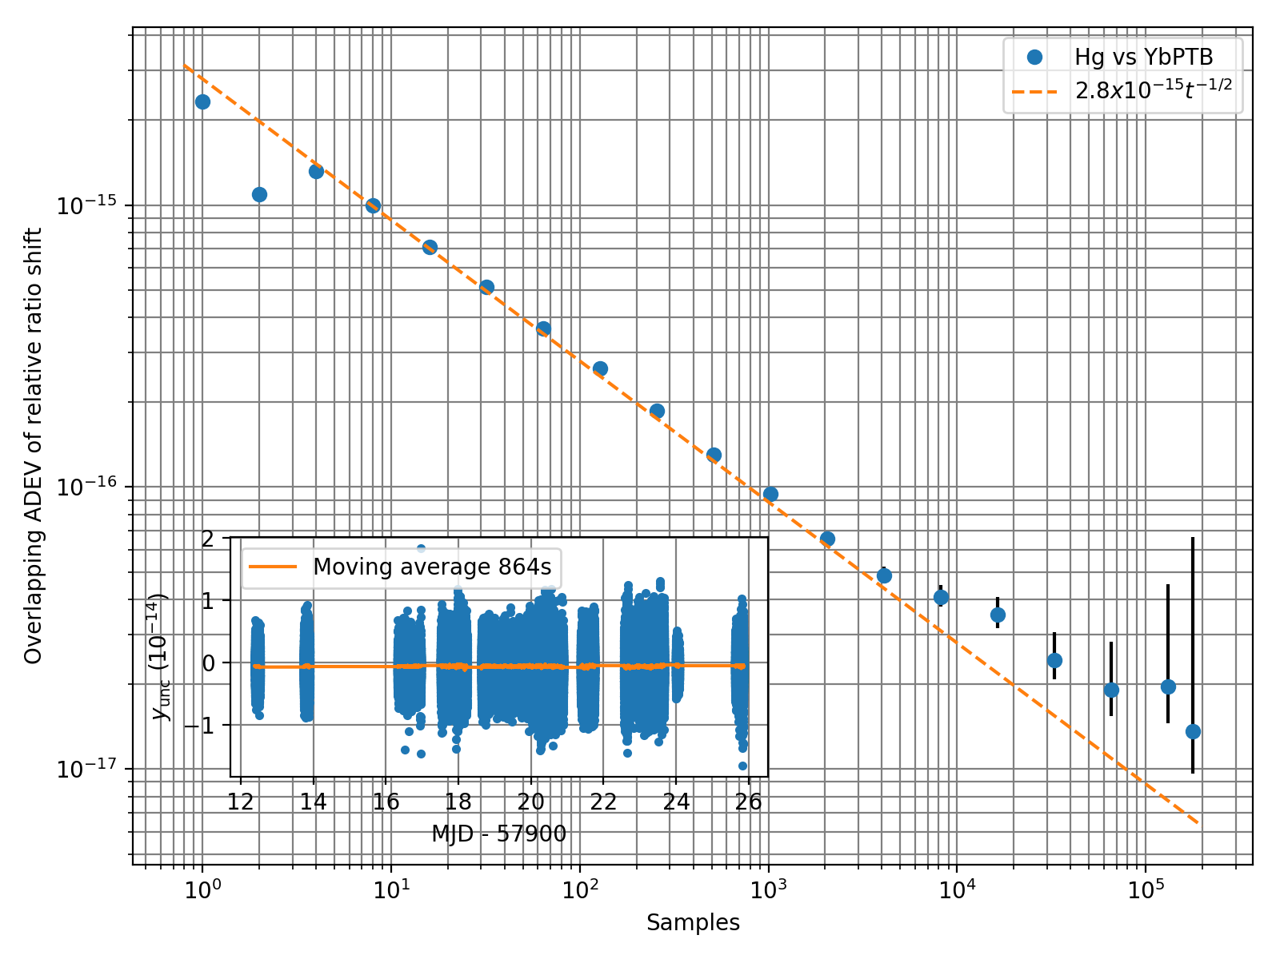
Exploiting the link! New freq ratio!
Distant comparison with Yb+ ion clock at PTB, 99h (2017):
2 x 10⁻¹⁷ resolution
First direct Hg/Yb⁺(E3) measurement

Slide 8
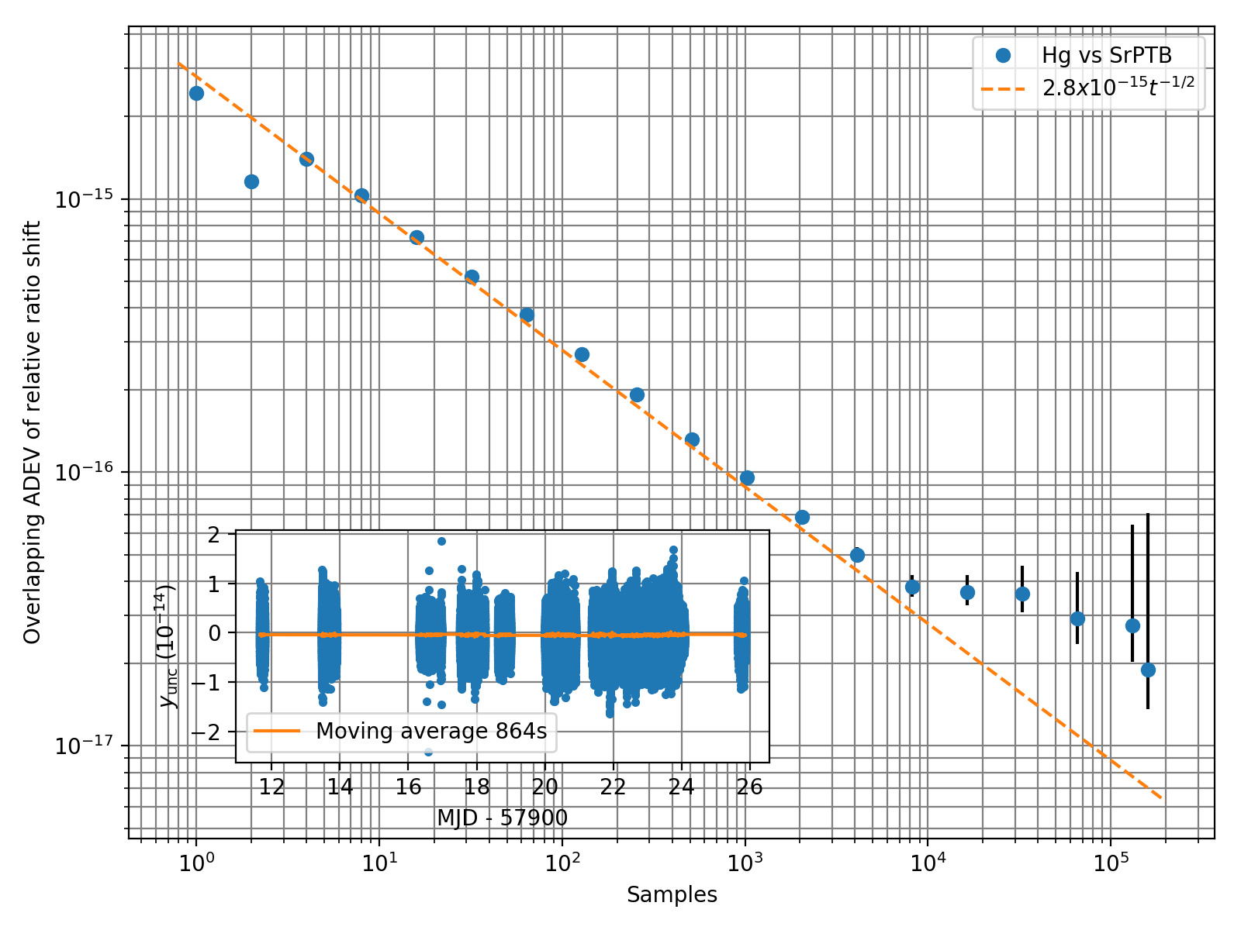
Ultimate check: frequency comparison
Distant comparison with Sr clock at PTB, 99h (2017):
Notes:
What’s our measurement limitations here? Mention that even through the link, the improvments to the Hg clock give us better results than the in house measurement shown earlier

Slide 9
Mercury uncertainty budget (2017)
Could these values be improved?
Well, certainly. Just about anything can be improved.
This is where we started.
 | Correction (10⁻¹⁷) | Uncertainty (10⁻¹⁷)
Second order Zeeman | 0.7 | 0.7
Cold collisions | -3.1 | 2.5
Background gas collisions | 0 | 2.0
Lattice light shift linear | 4 | 13.8
Lattice light shift non-linear | -6 | 4
BBR | 16.7 | 2.2
Probe light shift | 0 | 0.1
AOM chirp | 0.2 | 0.4
TOTAL | 12.3 | 14.9
Notes:
Need a quick look the second order Zeeman corrections, I think maxime did them before he wrote his thesis.
Zeeman was improved almost by an order of magnitude, uncertainty down from 4,8 to 0,7
Possibly talk about strengths of using Hg on this slide – that is, the BBR coefficients is 30 times less than Sr

Slide 10



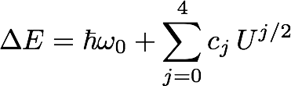
Lattice light shift
Lattice used to reduce atomic motion with dipole trapping forces
Introduces lattice light shift (LLS), a result of AC Stark effect
Can control this at the magic wavelength
See Ovsiannikov et al., PRA 93 043420 (2016), Brown et al PRL 119, 253001 (2017), Shi et al., PRA 92, 012516 (2015)
cj depend on polarisabilities and quantum state of atoms.
Notes:
Alpha is electric-dipole polarizability and beta is is the hyperpolarisability, omega_z is vibrational frequency of atoms in lattice
Have to be more forceful in emphasizing the lattice trap. Remove the wording maybe and replace with an image of the lattice in action.
Define trap depth and give our operation ranges.
Talk about the main phenomeno, that make up the cj coeefficients (hyperpolarisabilities, e2m1 mix, etc)
_actually talk about the brown reference (ie prior work done), add reference from our group which sebastien will give me

Slide 11

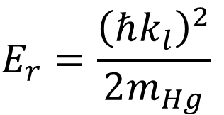
Differential measurements
Fit to:
$$E_{r}=\frac{{\left(ℏk_{l}\right)}^{2}}{2m_{Hg}}$$
Ref. depth U=101Er
~8x10-17 uncertainty!
Notes:
Delta s is lattice depth difference, alpha is the fitting constant. The reproducibility of singular points combined with the not perfect fit should be some sort of indication of the non-linear LLS terms becoming significant, the tilded points are not directly related to atomic properties as one might assume from the njp model
LATTICVE LIGHT SHIFT COMPARISON

Slide 12


Lattice light shift determination
Separate eval.
Temp. + λ0 fit
“MC” sampling
Lattice light shift (Hz)
Lattice depth (Er)
Lattice depth (Er)
Lattice depth (Er)
  Theoretical values for polarisabilities from:
  Yamanaka et al., PRL 114, 230801 (2015) & Ovsiannikov et al., PRA 93 043420 (2016)
Notes:
Rework this slide a bit in consistency with the notes i just took in my notepad (ie do not spend so long looking at the obviously crap data, say we knoz itùs crap, but went exploring the data phase space a bit)

Slide 13
Lattice lock improvements
Custom frequency lock
Lattice frequency stabilized to sub 1kHz after an hour.
Previous wavelength meter lock was accurate to 5MHz!
Ti:Sa laser
725nm
Cavity enhanced SHG (LBO)
362nm
Trapping laser
Potential for sub 10⁻¹⁸ uncertainty for the LLS!
Using differential measurements, lattice frequency uncertainty is 3x10⁻¹⁶/MHz at operational trap depth (77E_{r})
Notes:
Need to make the point that the LLS from the linear points at our trap depth to compare the actual uncertainty in the budget here.
Remove the unlocked data
Zoom in on the page 3 optical latticec control to keep people more in the loop

Slide 14
Frequency ratio determination
Using the last estimate for lattice light shift we can say that:
and
𝜈Hg/𝜈YbE3 = 1.757 572 821 468 312 73 (18) (1.0x10⁻¹⁶)
𝜈Hg/𝜈Sr = 2.629 314 209 898 908 57 (26) (1.0x10⁻¹⁶)
$$\text{Previous} \text{value}\text{:} \text{ν}\text{Hg}\text{/}\text{ν}\text{Sr}=2.629 314 209 898 909 15 \left(46\right)$$
?
?
Notes:
Emphasize the fact that this is with our estimated LLS, not a final value

Slide 15

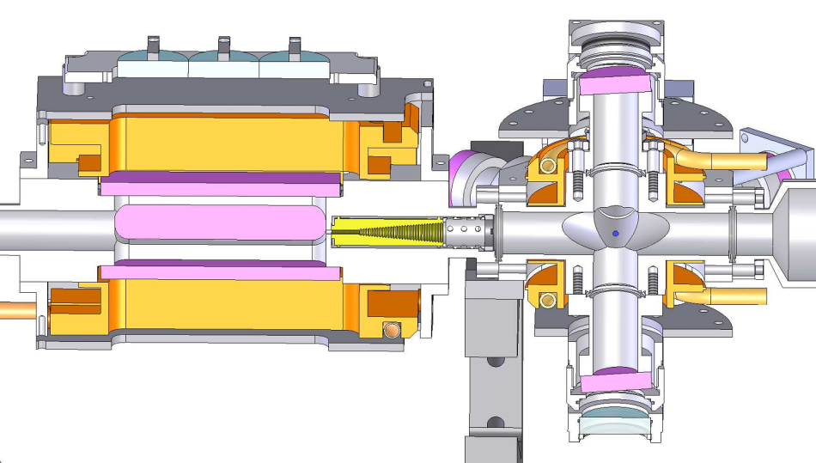
Improving statistics
Want to:
Cycle time
Increase our atom number to reduce quantum projection noise
Decrease our loading time to reduce aliasing, ie the Dick effect
Signal strength
The compromise: increase loading rate
Add 2D MOT to increase density and reduce thermal velocity of the loading Hg beam
2D-MOT
Low
conductance
section
3D-MOT
Notes:
Rief model. Trap depth is a bit weird metric as the trap isn’t conservative, but is defined via the atomic escape velocity U = 0.5*mv_esc^2
A is cross sectional area, b is a scaling factor.
Maybe remove the formula for r, talk about hitting the quantum projection noise and the Dick effect (which I will have to explain briefly)
Explain what a 2D MOT is if I have time

Slide 16
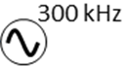

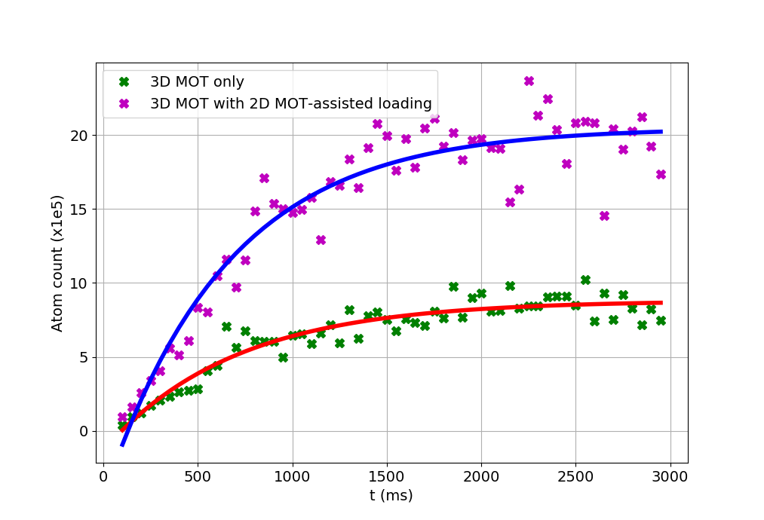
2D MOT
Lock-in amplifier
So install a second UV source locked to the first
-180MHz+Δ
AOM
AOM
ECDL
+180MHz
BBO bow-tie cavity
To 2D MOT
Saturated absorption setup
15mW
1015nm
YDFA
PPLN
AOM
30mW
254nm
To MOT
BBO bow-tie cavity
PPLN
YDFA
-180MHz+Δ
50mW
254nm
1.5W
507nm
10W
1015nm
Beat note lock
Not enough laser power to run 2D MOT and MOT at the same time
ECDL
Initial results:
DC offset
Loading time constants similar: ~675ms
Clear increase in atom count: ~2x
Room for improvement!

Slide 17
Conclusions and future direction
Continue to exploit lattice links for frequency comparisons
Make frequency comparisons with updated uncertainties and stability improvements.
Try to find a better understanding of the non-linear lattice light shift to improve characterization.
Once uncertainty improvements are made, look for fine structure constant variation!
Estimated stability improvement with new 2D MOT to mid 10⁻¹⁶ at 1s
Improved lattice shift measurements with new locking system
Take measurements for Hg hyperpolarisabilities
Probe temperature effects of non-linear LLS for Hg
Notes:
Change up order here
Make sure to conclude on the fundamental constants as well (once we have stuff running better and have a few measurements then we can start contributing to measurements for looking for alpha, etc, of course we want to be at 10-18 to do that)

Slide 18
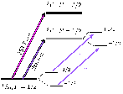
Why mercury?
Weakly sensitivity to BBR shift
  → Sr/30, Yb/15
Sensitive to fine struct. const. value
Isotope ¹⁹⁹Hg has I=1/2
  → no tensor light shift
High vapour pressure
  → no atomic oven
  → possible pre-cooling with 2D-MOT
Magic wavelength ~362 nm
Little explored in (ultra) cold regime
Singlet
Triplet
³SJ
1
¹PJ
1
546 nm
435 nm
405 nm
2
³PJ
Cooling
1
254 nm
0
¹SJ
Clock, 266nm
0
¹⁹⁹Hg
Challenge: high power UV lasers needed!

Slide 19
Outline
Atomic frequency standards
Hg optical lattice clock at syrte
Previous results (FROM SYRTE)
Talk about the fiber links and stuff (to NPL and PTB) which lets us get different freq ratios
Results from there!
Discuss how improving the accuracy for these measurements is the bomb, and how we can do that on our side.
Sensitivity to frequency shifts caused by environmental factors
              Specifically LLS, talk about these measurements
              Discuss improvements in atom number in trap and 2D MOT
              Call it a day/

Slide 20
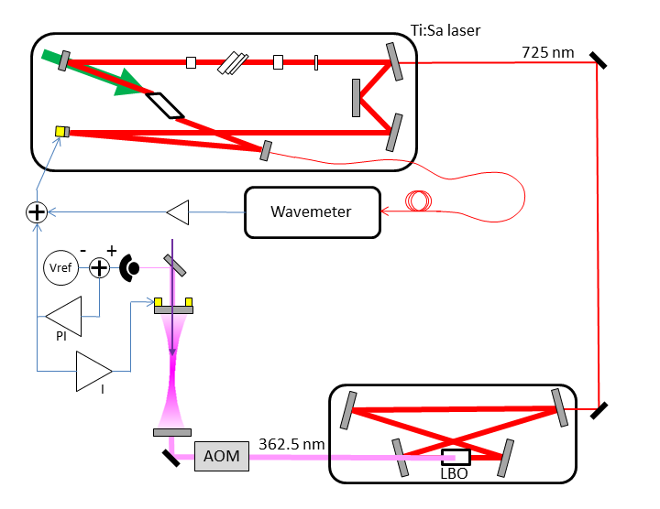

Lattice trap system
20
M-squared Ti:Sapphire
Verdi V5
Probe
Notes:
TiSa, P up to 5W
SHG LBO, up to 500mW
Buildup cavity, finesse 150 ?
Intracavity power tested up to 20 -> 150 E_R
Slow lock of Tisa to Wavemeter or comb on the magic wavelength or controlled detuning
Fast lock of laser to the cavity mode
To avoid long term drifts : lock of cavity to the laser using pzt actuator
Don’t emphasis the comb stuf but say that it is a transfer oscillator method and that you can tell more about it if interested.
Find voltage to recoil constant.
Talk up the locking how we lock the LBO as well as the cavity and with good choice of time constants we can maintain conintual operation for the orders of hours.

Slide 21
Lattice locking to comb
21
1450nm
ECDL
1450nm
Frequency comb
PI
Fiber to Comb
Coupler 90:10
Electronics
Ti:Sa
725nm
PPLN
PI
Wavemeter (5MHz accuracy)
Ti:Sa frequency
(± 100kHz)
Notes:
Maybe redo this slide to be a bit more modular, remove unneccessary lenses etc.
Find bandwidth and omega_0 for Ti:sapph comb

