Slide 1

Velkommen til mesterklasse i partikkelfysikk!
Each year more than 13.000 high school students in 60 countries come to one of about 225 nearby universities or research centres for one day in order to unravel the mysteries of particle physics.

Slide 2

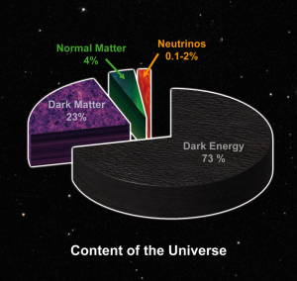
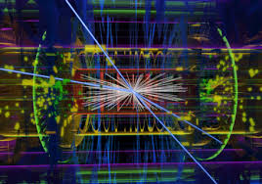




Partikkelfysikk handler om å prøve å forstå universet
Image credit: NASA
Image credit: NASA
Image credit: The ATLAS Collaboration

Slide 3
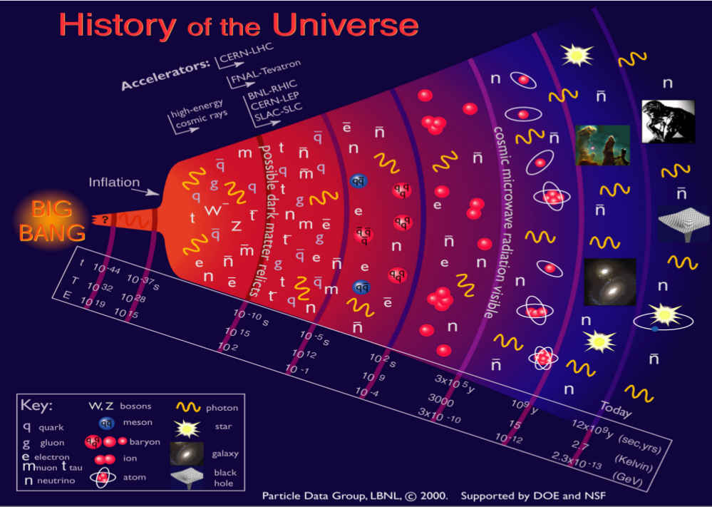

Slide 4
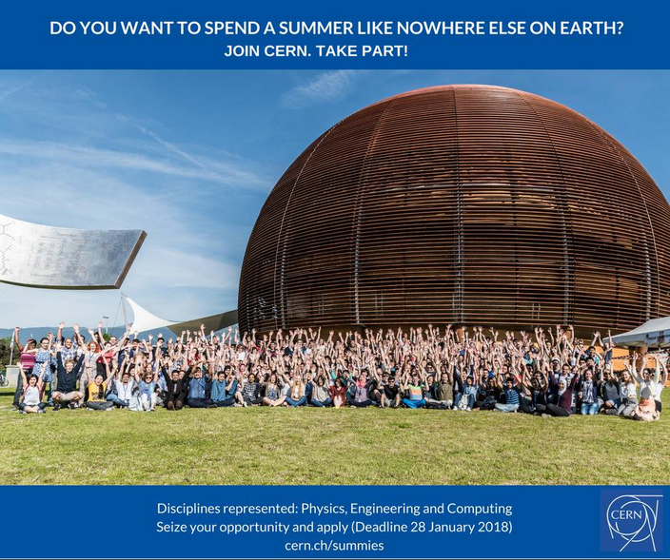
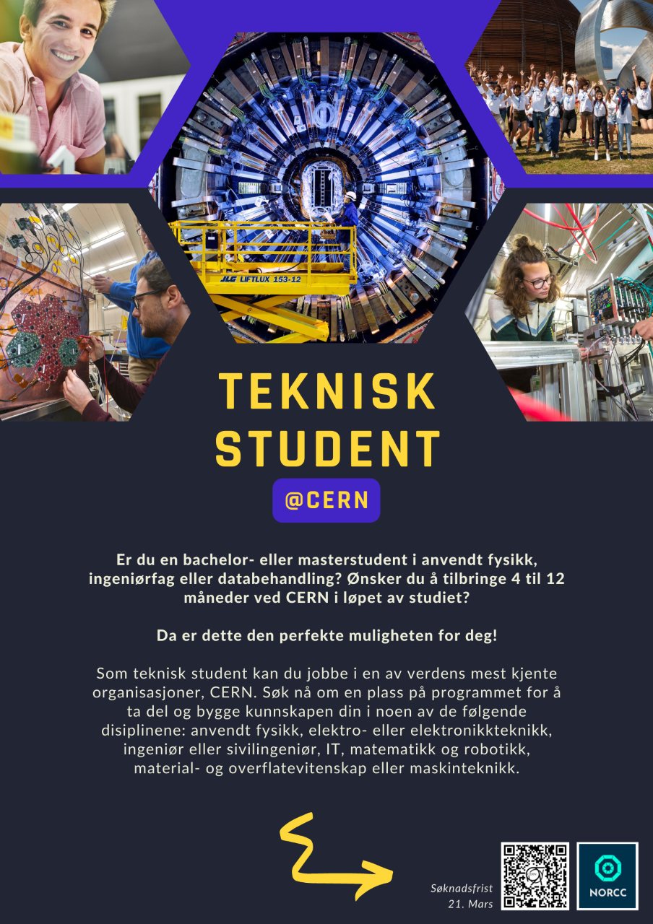
https://home.cern/students-educators/summer-student-programme

Slide 5
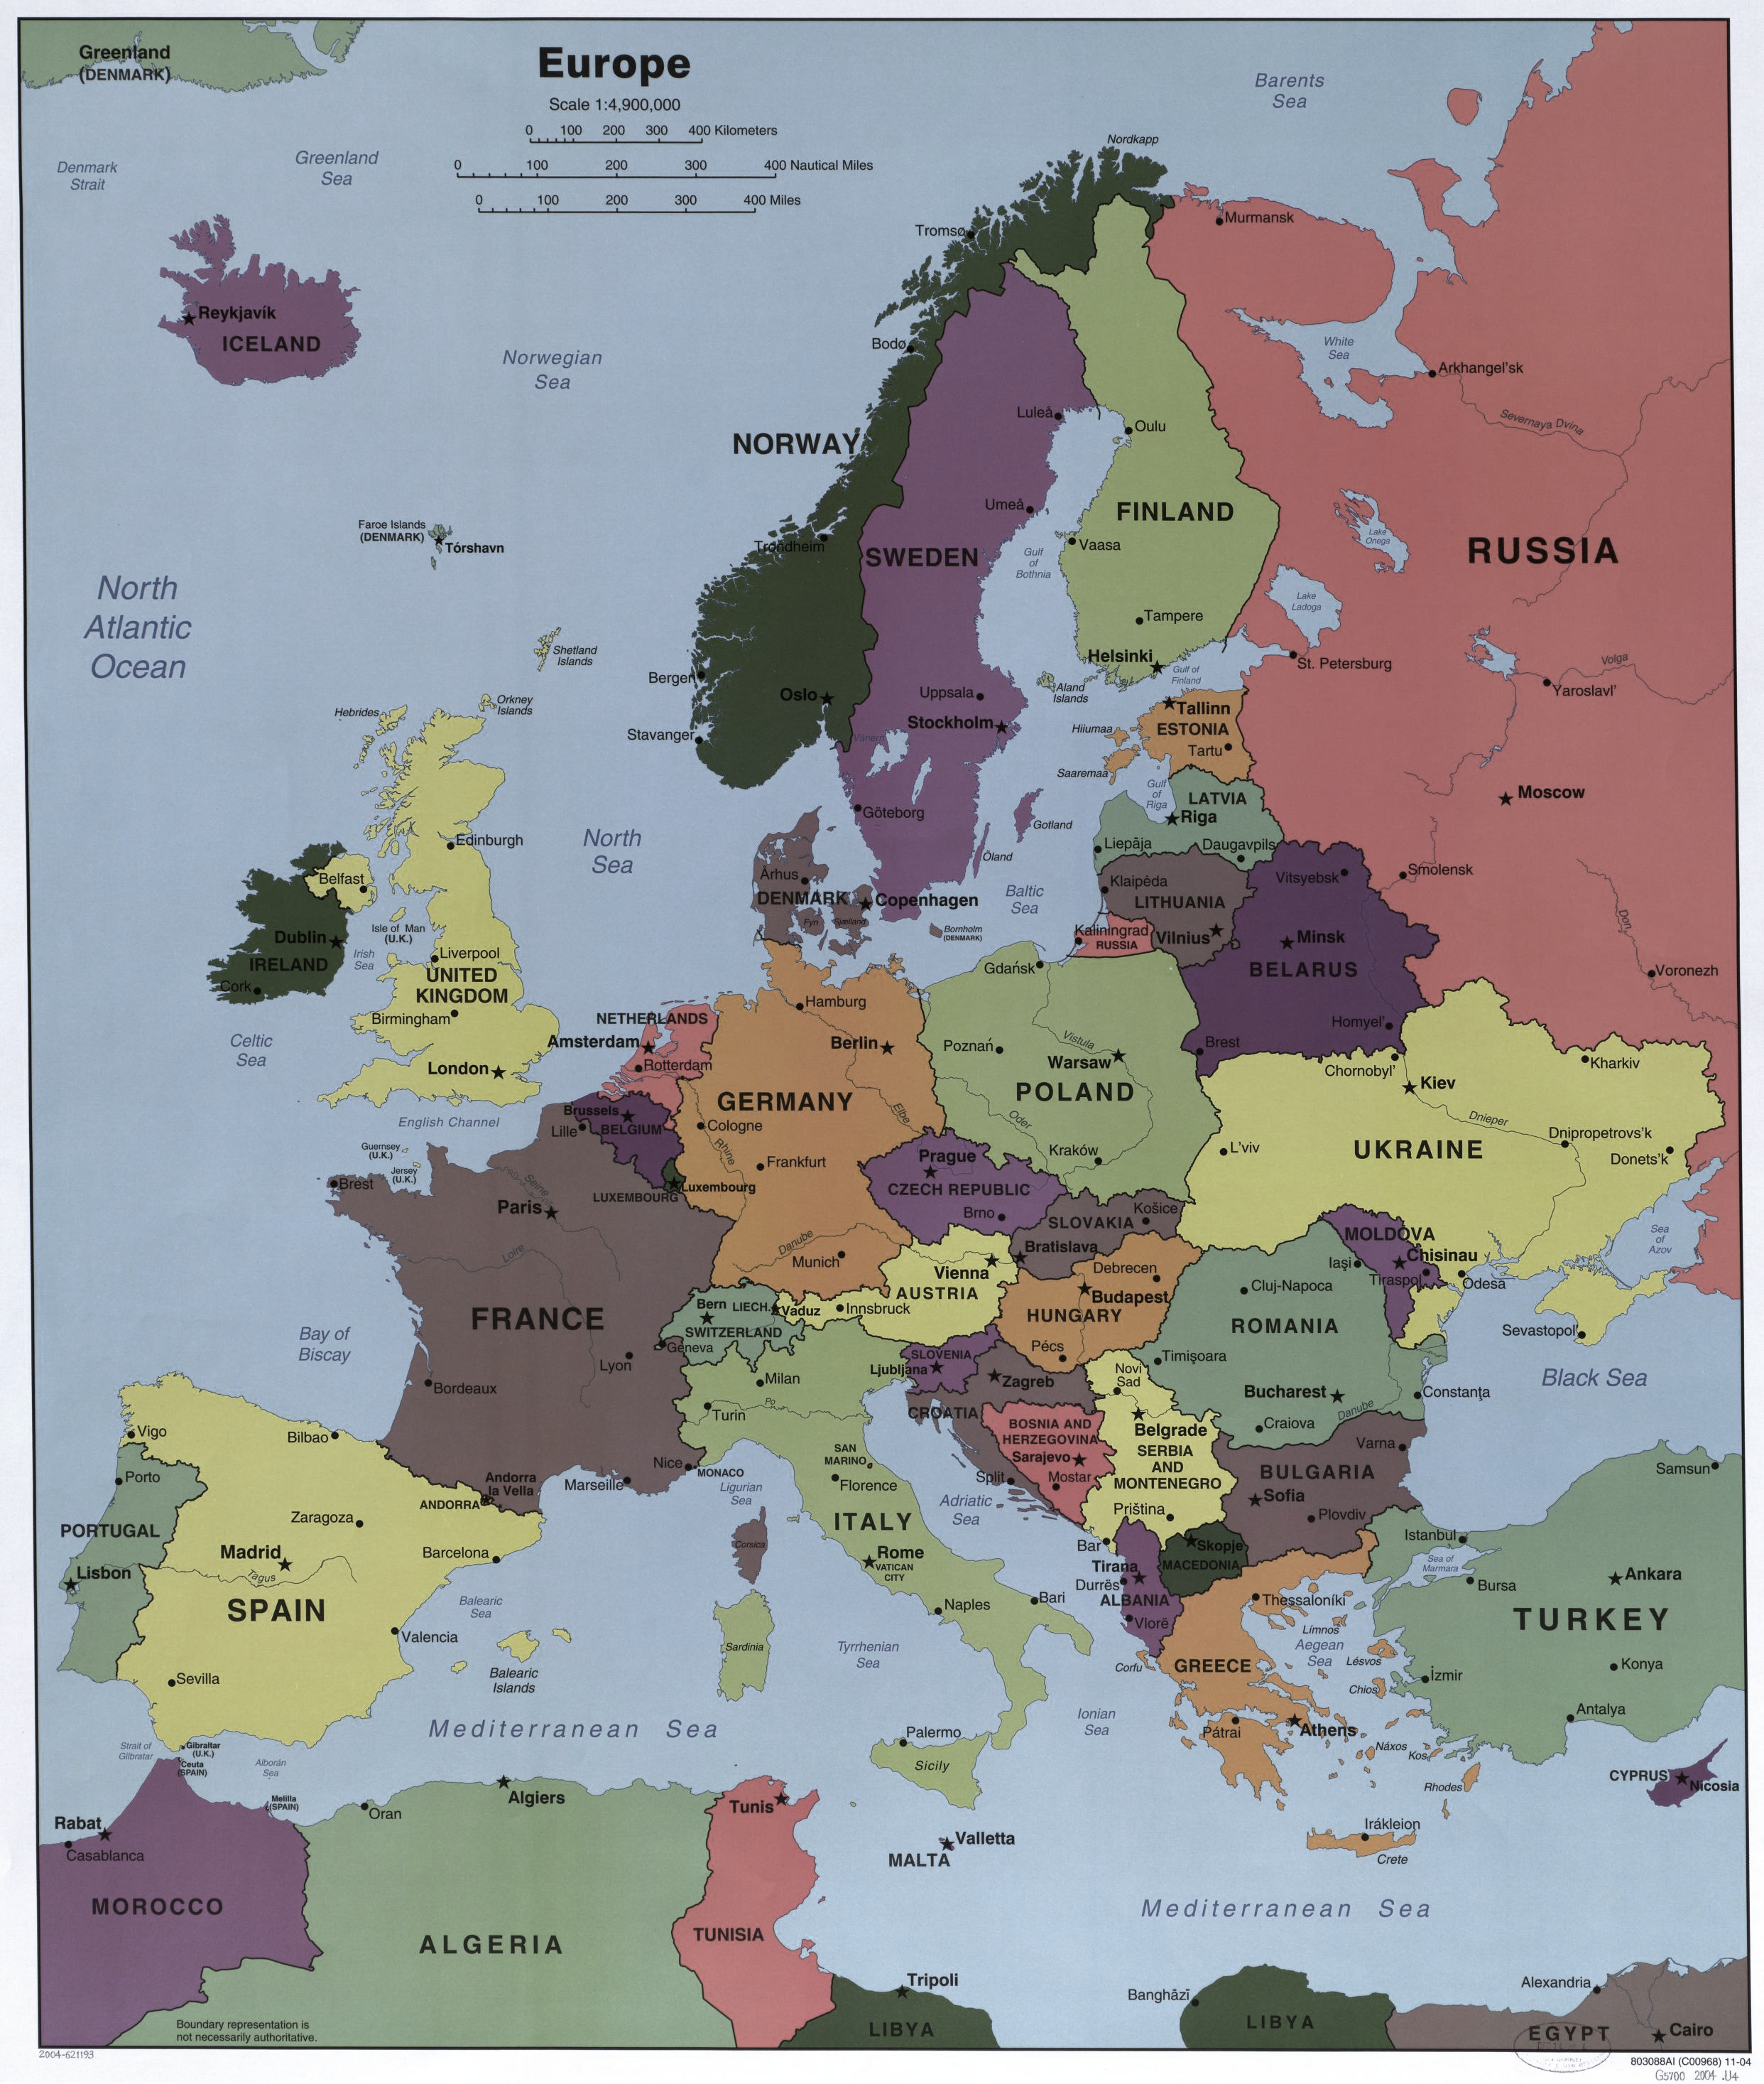
You have reserved a slot in the videoconference with CERN for one of the following institutes:
@Bergen
@Berlin
@Bologna
@Krakow
@Wuppertal

