Slide 1
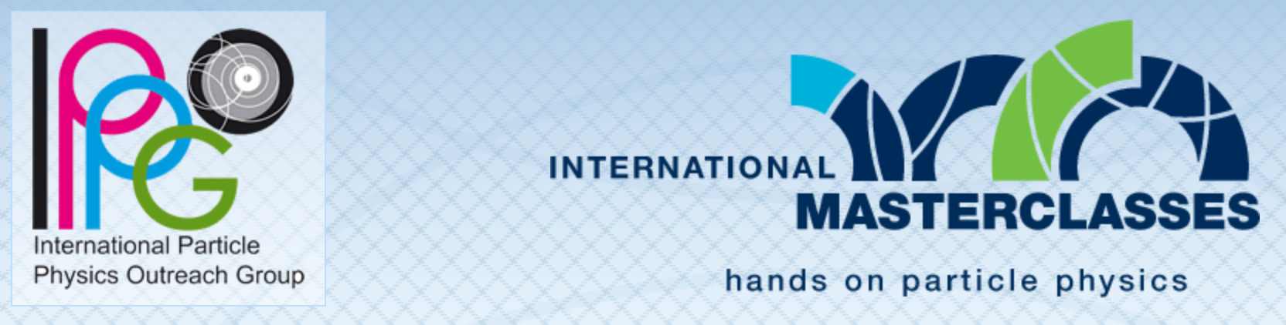
Velkommen til MasterClass i partikkelfysikk!
Each year more than 13.000 high school students in 60 countries come to one of about 225 nearby universities or research centres for one day in order to unravel the mysteries of particle physics.

Slide 2

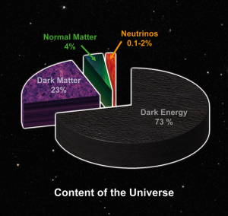
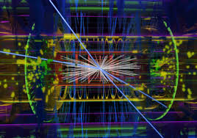




Partikkelfysikk handler om å prøve å forstå universet
Image credit: NASA
Image credit: NASA
Image credit: The ATLAS Collaboration
Therese Sjursen, MasterClass Bergen mars 2022

Slide 3
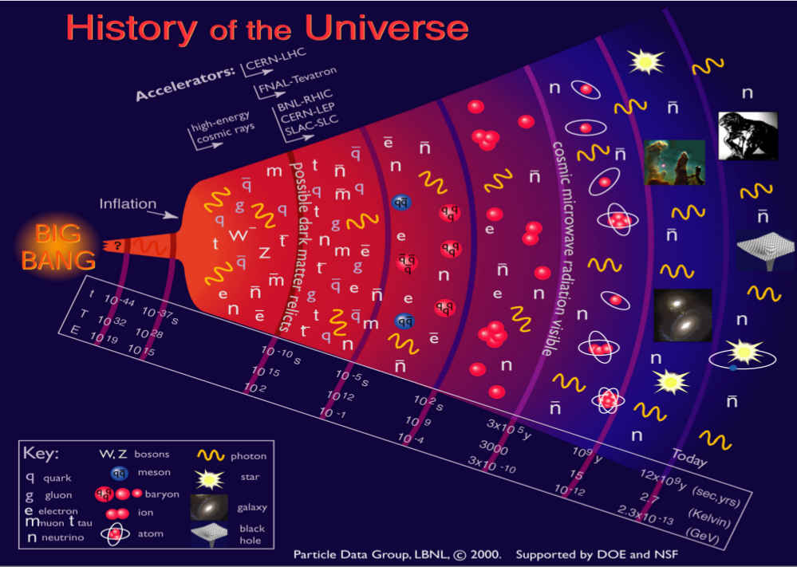

Slide 4
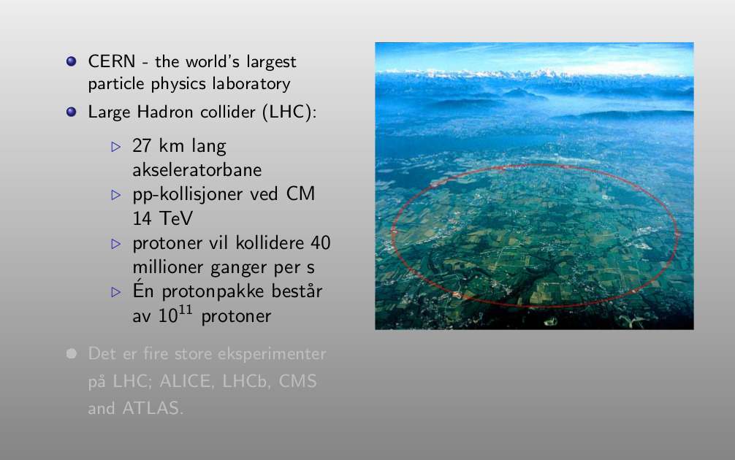

Slide 5
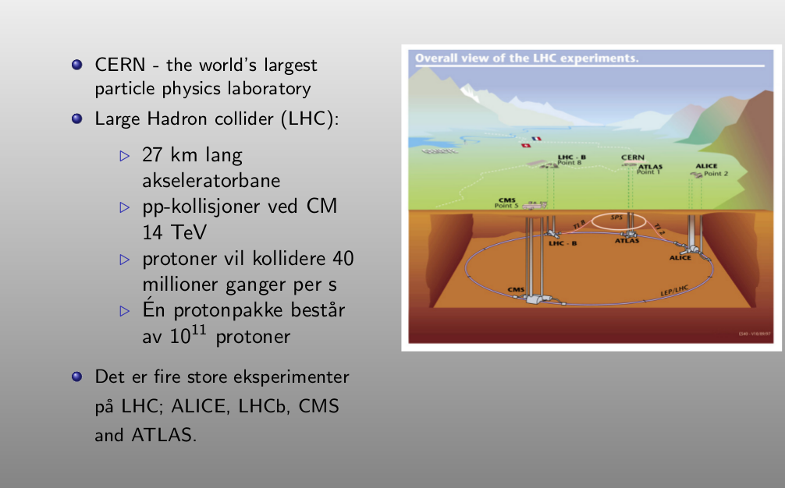

Slide 6
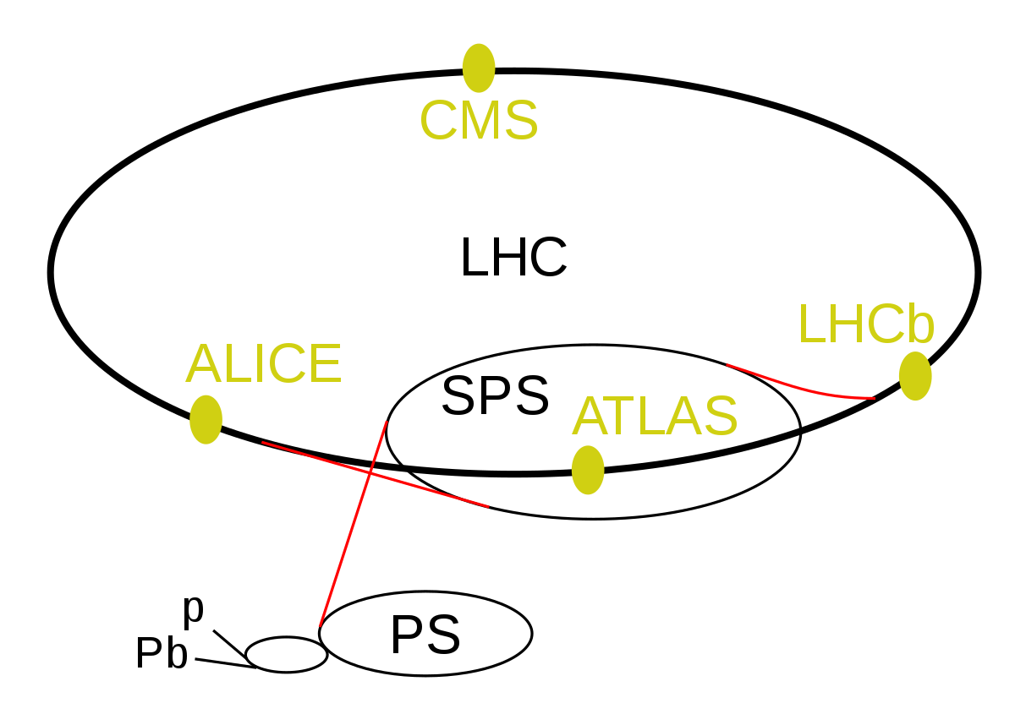
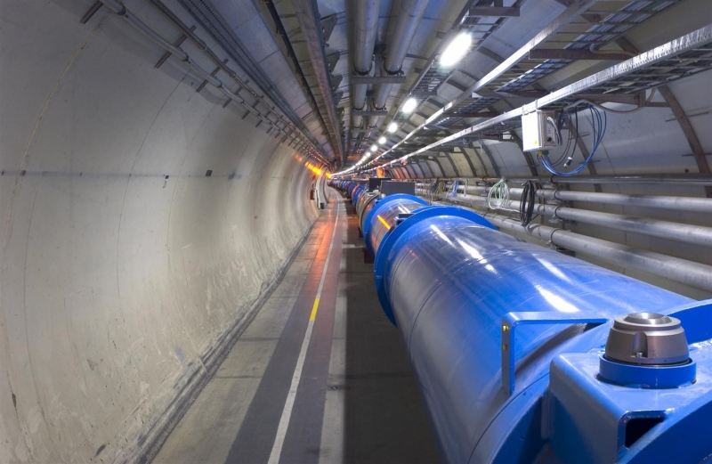

Slide 7
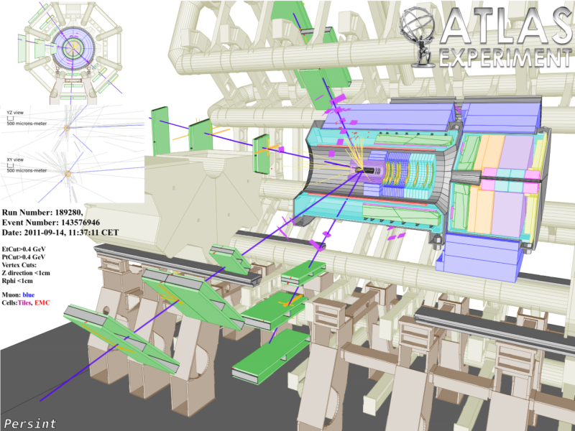
The ATLAS experiment :
  one of the largest and most complex science experiments ever built.
pp collisions -> recreate the conditions of the early universe (Big Bang)
Using Machine Learning in analysing these data sets:
  Hope to uncover “hidden insight” that may reveal the nature of Dark Matter

Slide 8
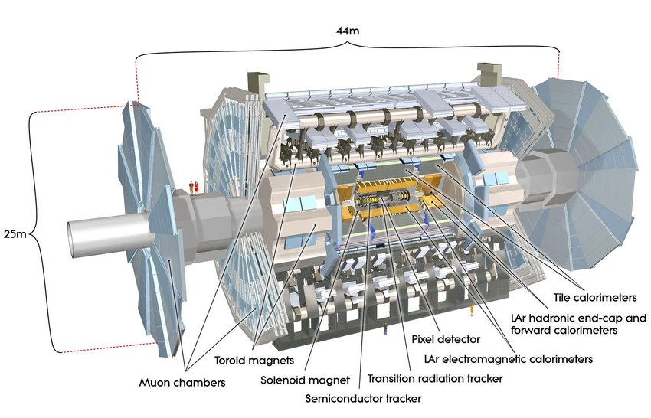

Slide 9
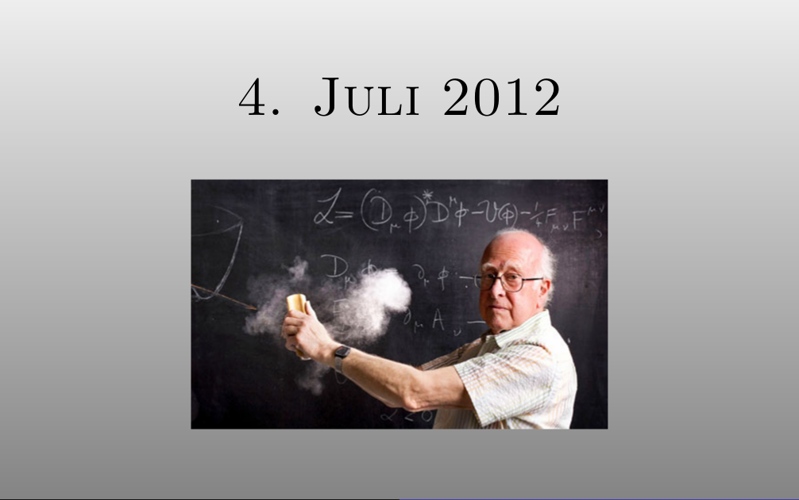

Slide 10
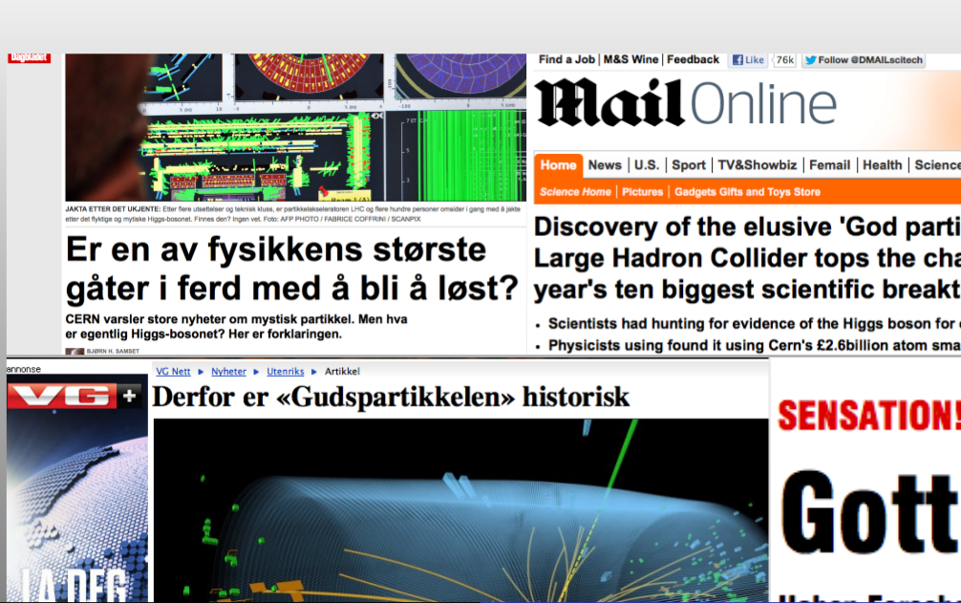

Slide 11
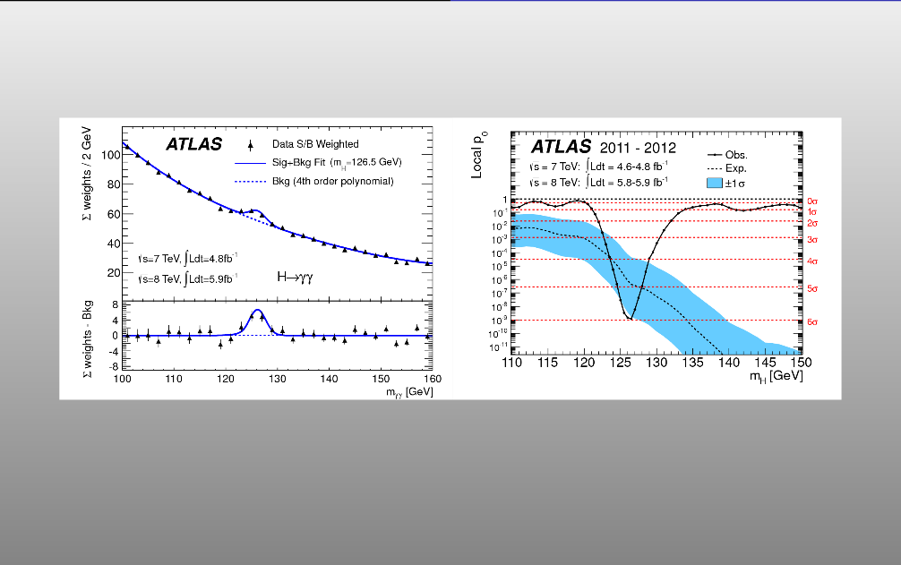

Slide 12
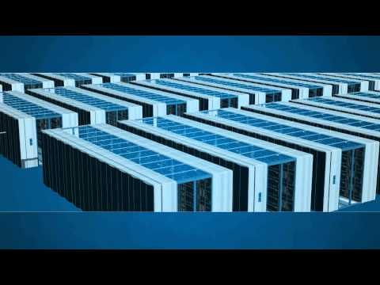
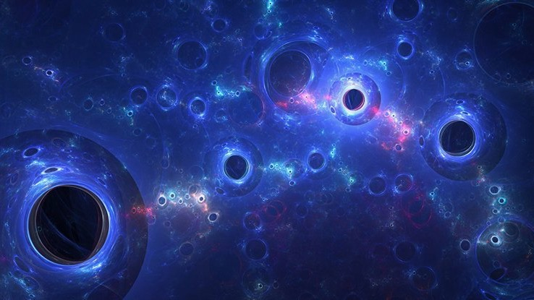
IImage: SceinceAlert.comge:

Slide 13
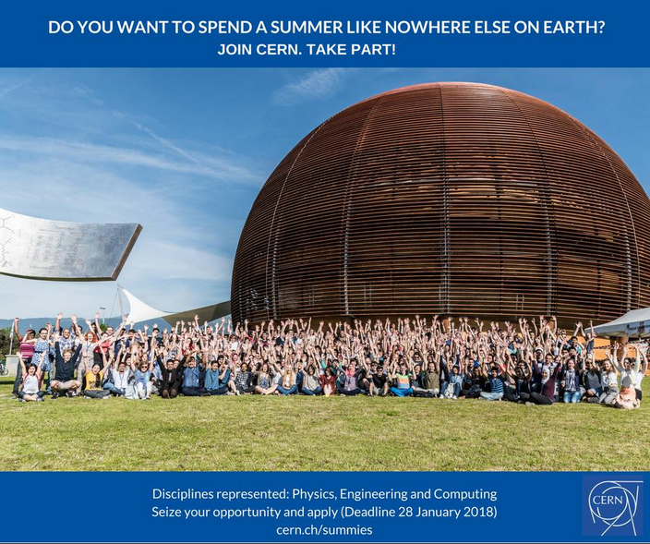
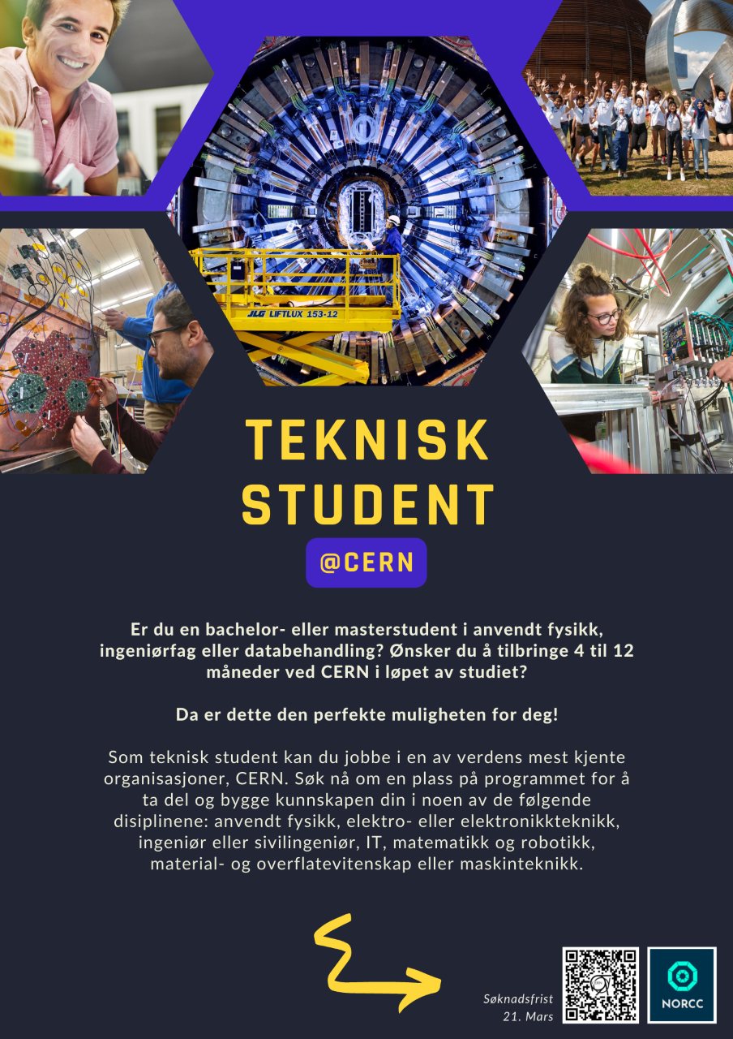
https://home.cern/students-educators/summer-student-programme

Slide 14
You have reserved a slot in the videoconference with CERN for one of the following institutes:
@Bergen
@Oxford
@Konya
@Sao Paulo

